Slide 1
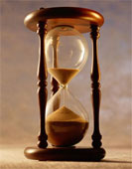
Please Stand By for John Thomas Wednesday, February 20, 2013, San Francisco, CA Global Trading Dispatch
The Webinar will begin at 12:00 pm EST

Slide 2
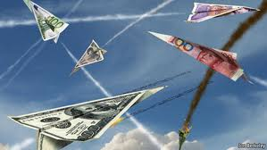
The Mad Hedge Fund Trader “Currency Wars Issue”
Diary of a Mad Hedge Fund Trader San Francisco, February 20, 2013 www.madhedgefundtrader.com

Slide 3
MHFT Global Strategy Luncheons Buy tickets at www.madhedgefundtrader.com 2013 Schedule-Upted
April 12 San Francisco April 19 Chicago July 2 New York July 8 London, England July 12 Amsterdam, Neth. July 16 Berlin, Germany July 18 Frankfurt, Germany July 25 Portofino, Italy August 9 Zermatt, Switzerland

Slide 4
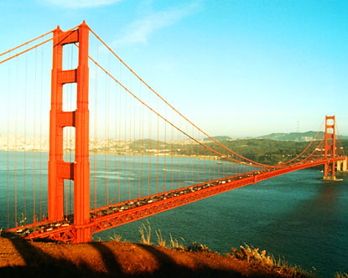
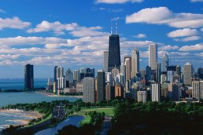
MHFT Global Strategy Luncheons Buy tickets at www.madhedgefundtrader.com
San Francisco April 12
Chicago April 19

Slide 5
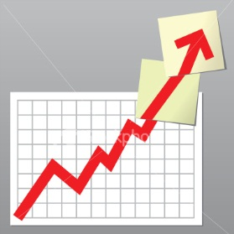
Trade Alert Performance The Hot Hand Continues
*February +8.20% *2013 YTD +25%, compared to 7.1% for the Dow, beating it by 10.7% *First 114 weeks of Trading +80% *Versus +7% for the Dow Average A 73% outperformance of the index
108 out of 155 closed trades profitable 69.7% success rate on closed trades

Slide 6
Portfolio Review-Balancing Out Longs and Shorts, Volatility collapse causing options premiums to shrink, increasing risk and reducing returns of option spread strategy Maximum return if nothing happens
Risk On
(SPY) 3/$140-$145 call spread | 30.00%
(IWM) 3/$82-$86 call spread | 20.00%
(F) 3/$11-$12 call spread | 10.00%
Risk Off
(FXY) 3/$110-$115 put spread | -20.00%
(SPY) 3/$155-$158 puts spread | -30.00%
total net position | 10.00%

Slide 7
Performance Year to Date- +25% Biggest Performance Burst Since Launch

Slide 8
Performance Since Inception-Gone Ballistic +40% Average Annualized Return

Slide 9
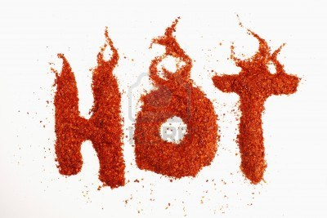
The Economy Is Red Hot
*Global synchronized recovery in play *February Empire State from -7.12 to +10.04, best since May German February ZEW 32 to 48 *Weakening currencies are stimulating economies, especially the US and Japan *Jan housing starts 890,000 vs. 300,000 low *Markets are calling Washington’s bluff *Sequestration delay from March 1 deadline could trigger another global leg up

Slide 10
Weekly Jobless Claims -27,000 plunge to 341,000 is very market positive

Slide 11
Bonds-Treading water at the lows
*Smart money is shortening duration and de-risking great reallocation into stocks is from cash, not bonds *Sending money abroad looking for non US correlated yield curves *Junk bond bubble extends 30% of new issues covenant light *$85 billion a month in bond buying is still huge support *New 10 year Treasury range is 1.80%-2.50% *Sell every substantial rally in Treasuries, corporates, and municipals

Slide 12
(TLT)

Slide 13
(TLT)-2 Year

Slide 14
Short Treasuries (TBT) See the 1:4 reverse Split—5% annual cost of carry

Slide 15
Municipal Bonds (MUB)-3% yield, Mix of AAA, AA, and A rated bonds

Slide 16
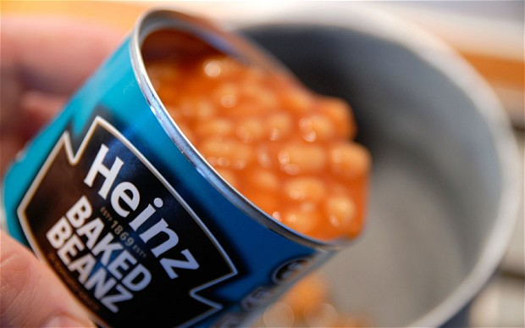
Stocks-1,600 Not Looking so “Mad”
*Drift up at multiyear highs is incredibly bullish, the dip that never comes *Took many investors frozen out of the market by the rapid market move *Speed gave individuals a big advantage
*M&A Boom is creating equity shortage, takeover at triple 2012 levels *Heinz, AA-US Air, and Comcast deal took $53 billion in stock out of market, today its Office Depot/Office Max *Earnings multiples expanding faster than fundamentals, always ends in tears. Setting up the 2013 top-don’t forget to sell “Sell in May, and go away”, Part 5

Slide 17
(SPY)- Long the 3/$140-$145 call spread Long 3/$155-$158 put spread

Slide 18
(SPX)-The 30,000 view
Fail here

Slide 19
The Next Trade March $155-$158 Bear Put Spread, Then April $158-$161 and May $161-$164
*Profits in at all price points below $155 by March 15, or 23 trading days *Profits in modestly rising, sideways, or falling market *Mitigates some downside risk *10% weighting =($0.30 X 100 X 37) = $1,110, or 1.11% for the notional $100,000 model portfolio, 100% = 11.1% a month *Could be our core trade March-August *We are closer to the top of the four year move than the bottom

Slide 20
(QQQ)-Gone to Sleep, Awaiting a rotation-Apple stopped going down, others up

Slide 21
(VIX)-Dying a slow death headed for the 9% handle

Slide 22
(AAPL)-dead in the water, putting in a bottom

Slide 23
(BAC)-Buy the Dip

Slide 24
Russell 2000 (IWM) Long the 3/$82-$86 call spread

Slide 25
Shanghai-Still on Fire

Slide 26
China (FXI)

Slide 27
Watch Japan
*Yen at 150 targets Nikkei of 20,000, up 90% *Japan’s quantitative easing is now 6 times greater than US on per capital GDP basis *20 years of policy mistakes corrected *Politicians have found a winning formula *Japanese stocks still cheap on historical basis

Slide 28
Japan Nikkei-up 30% since October

Slide 29
(DXJ)-the only way to play Japan Up 35% since October-Nikkei with hedged yen Y150 targets (DXJ) at $80, up 100%

Slide 30
Tesla (TSLA)-earnings today cash flow positive?

Slide 31
Let the Currency Wars Continue!
*Japan dodges the bullet, avoids criticism at Moscow G-20 summit *Still awaiting new BOJ governor appointment *Is the start of a multiyear run to ¥150 *Soros makes $1 billion on yen short *H1 central bank balance sheet growth: ECB - $-$300 billion US - $1 trillion Japan - $1.5 trillion, and it is 1/3 the size of the US so yen is down big, Euro stagnant to UP *These trends will continue with only minor blips

Slide 32
Long Dollar Basket (UUP)

Slide 33
Euro (FXE) Looking for a $1.38 top

Slide 34
Australian Dollar (FXA) -It’s all about China

Slide 35
Japanese Yen (FXY)-worth the chase long (FXY) 3/$110-$115 in-the-money bear put spread use any yen strength to roll over into April

Slide 36
(YCS)-break to new high

Slide 37
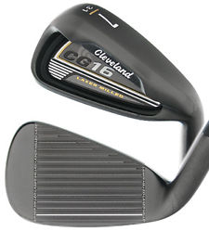
Energy-The Narrowing Wedge Targeting $100/barrel-Net net is no trade
*Acceleration of the US economy is the main driver *Spill over into China demand
*Volatility has collapsed thanks to new balance *New demand is more financial than fundamental traders-if it moves, buy it *Over $100 creates another drag on economy *Building a narrowing 4 year wedge Volatility has collapsed thanks to smaller range saw this in failure to crash in last “RISK OFF” *Natural gas stalled with warm weather

Slide 38
Crude

Slide 39
(USO)

Slide 40
Crude-Long Term-Building a Long Multi Year Wedge Economy accelerates-upside breakout, Economy slows-breakdown

Slide 41
Natural Gas

Slide 42
Copper (CU)-Demonetization risk could cap moves China growth rate may cap at 8%, not 13%, so slow grind up

Slide 43
Precious Metals-The Dog of 2013
*2012 gold demand fell -4% first fall since 2009 . Targeting $1,510/ounce *China demand flat *Big bail by major hedge funds underway Soros books big profit Paulson getting killed *QE3 monetary expansion still flat *Demand for bars and coins still up American gold eagle +47% YOY *No doubt the paper gold market (GLD) is pulling down the physical gold market

Slide 44
Gold
200 Day MA

Slide 45
Silver

Slide 46
(Platinum) (PPLT)

Slide 47
Palladium (PALL)

Slide 48
Ford Motors (F)-the bottom is in 53% move from October long the 3/$11-12 call spread

Slide 49
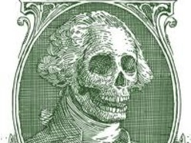
The Ags-Dead Money
*Corn down 11 consecutive days worst performance since the 1960’s *High prices are curing high prices *Awaiting next spike up or down to tell us what to do *All the action is long cotton or short coffee *Too many other things to do now

Slide 50
(CORN)

Slide 51
Soybeans (SOYB)

Slide 52
DB Commodities Index ETF (DBC)

Slide 53
Cotton (BAL)

Slide 54
Coffee (JO)

Slide 55
Real Estate -don’t touch the housing stocks-the risk/reward is terrible

Slide 56
(PHM)-

Slide 57
Trade Sheet-No Change “RISK ON” has returned big time
*Stocks- buy the dips, running to a new high *Bonds- sell rallies under a 1.90% yield *Commodities-buy dips, grinding up
*Currencies- sell yen on any rallies, buy euro on dips *Precious Metals –stand aside, wait for rebirth *Volatility-stand aside, will bounce along bottom *The ags –has gone dead, low priority *Real estate- rent, don’t buy

Slide 58
To buy strategy luncheon tickets Please Go to www.madhedgefundtrader.com Next Strategy Webinar Wednesday, March 6, 2013
Good Luck and Good Trading!

