Slide 1

Please Stand By for
John Thomas
Wednesday, December 14, 2011
Trade Alert Service
The Webinar will begin at 12:00 pm EST

Slide 2

The Mad Hedge Fund Trader
Staggering Towards the Finish Line
Diary of a Mad Hedge Fund Trader
December 14, 2011
www.madhedgefundtrader.com

Slide 3
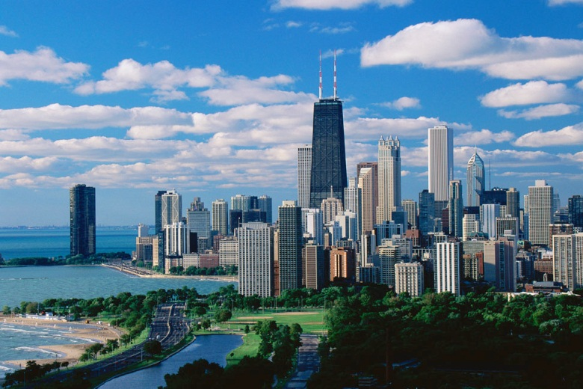

MHFT Global Strategy Luncheons
Buy tickets at www.madhedgefundtrader.com
Chicago
December 27, 2011
Beverly Hills
January 23, 2012

Slide 4
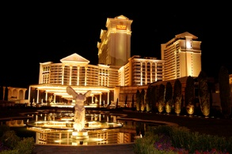
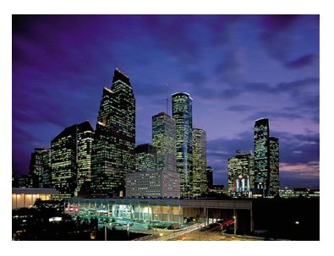
MHFT Global Strategy Luncheons
Buy tickets at www.madhedgefundtrader.com
Las Vegas
January 27, 2012
Houston
February 9, 2012

Slide 5

Trade Alert Performance
Tuesday Figures
*December MTD -1.55%
*First 54 weeks of Trading
+ 40.71%
*Versus +5.1% for the S&P500
since December, 2010 a 35.7% outperformance of the index
47 out of 56 closed trades profitable
84% success rate

Slide 6
Portfolio Review
Trade or Die
Mad Hedge Fund Trader
Trading Book
Asset Class Breakdown
Risk Adjusted Basis
current capital at risk
Risk On
bonds (TBT) | 13.60%
Risk Off
total | 13.60%

Slide 7
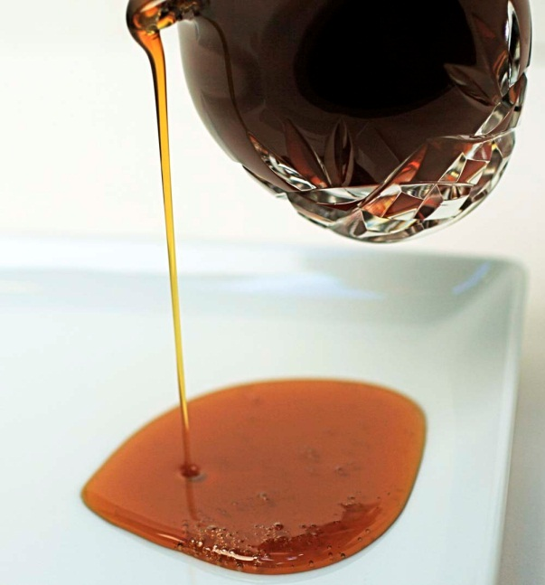
The Economy
*The positive economic data continues
*Weekly jobless claims down 23,000
381,000
*November consumer sentiment jumps from 64.1
67.7
*Europe is looking like a major drag in 2012
*Deleveraging continues at corporate
and personal level
*All consistent with a low 2.0% GDP growth rate
growing as slow as molasses

Slide 8
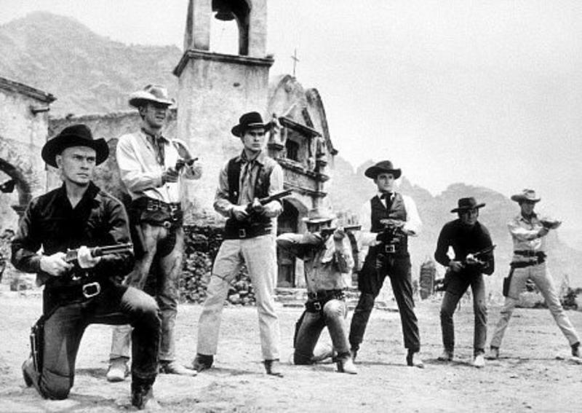
Bonds
*Did not dip at all in the last “RISK ON”
cycle
*Yields peaked at 2.10%
*Bonds are predicting deflation
and recession for 2012
*The bond vigilantes now speak Italian,
Spanish, and Greek
*For now, there is a bond shortage in the US
*Yields say the government is borrowing too little, not too much
*Target of a 1% yield on 10 year paper for 2012

Slide 9
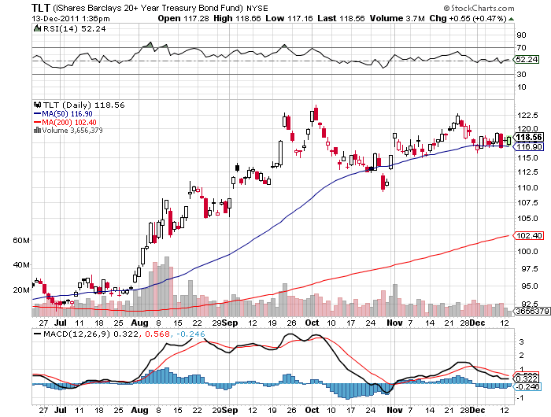
(TLT)

Slide 10
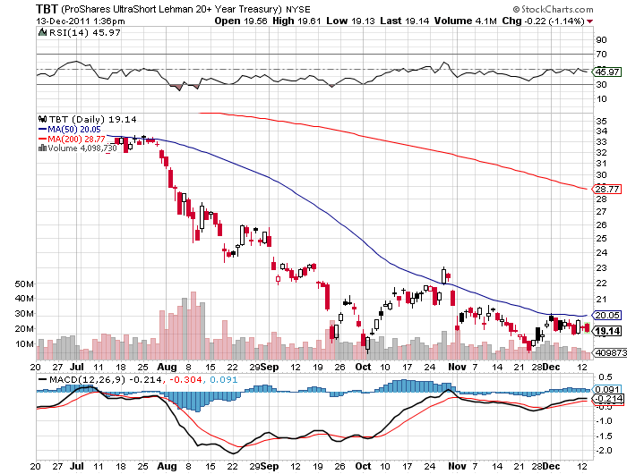
(TBT)

Slide 11
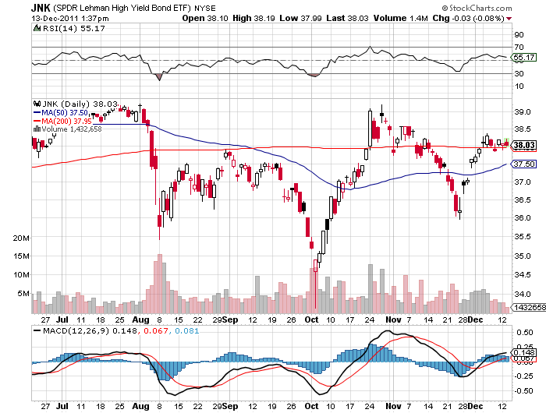
(JNK)

Slide 12

Stocks
*European buzz kill continues
*When Europe goes quiet the US rises
*The 200 day moving average wins again
*Back inside the range
*Not enough hot money in the market for a crash
*Are American large caps the new safe haven?
*S&P 500 year to date return is zero

Slide 13
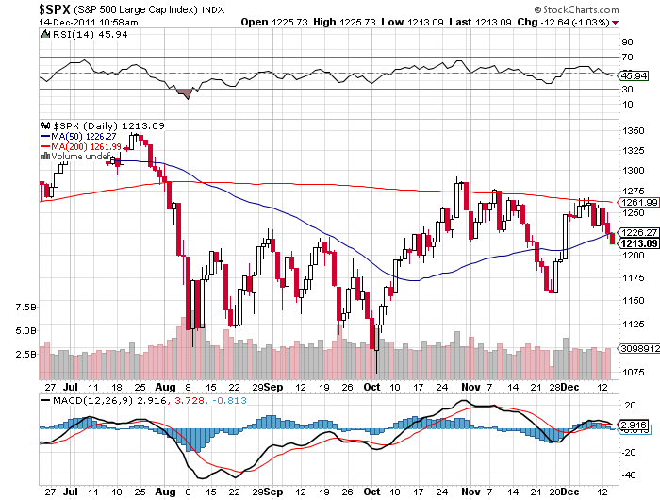
(SPY)

Slide 14
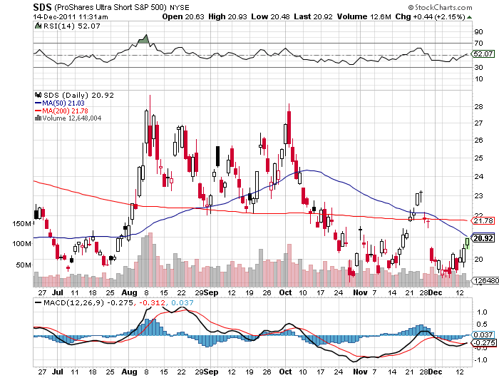
Double Short S&P 500 ETF(SDS)

Slide 15
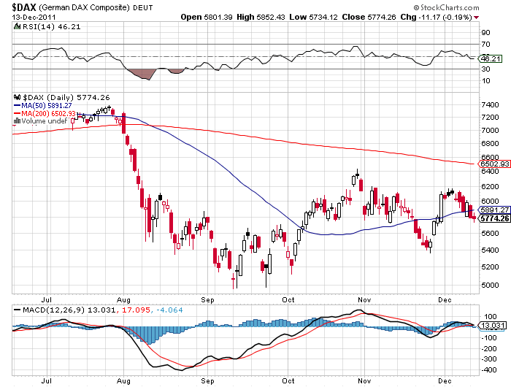
German DAX Composite(DAX)
-21.5% YTD

Slide 16
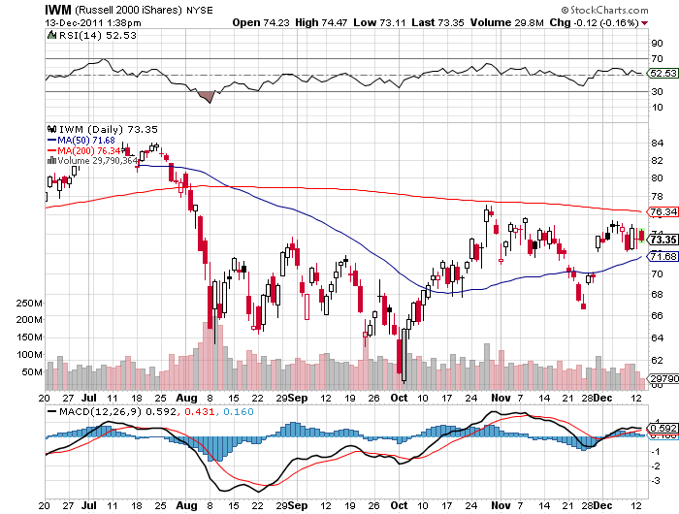
Russell 2000 (IWM)

Slide 17
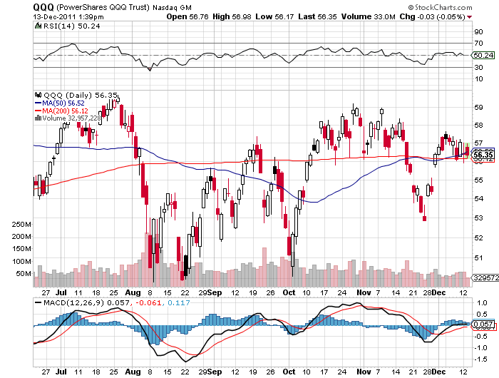
NASDAQ

Slide 18
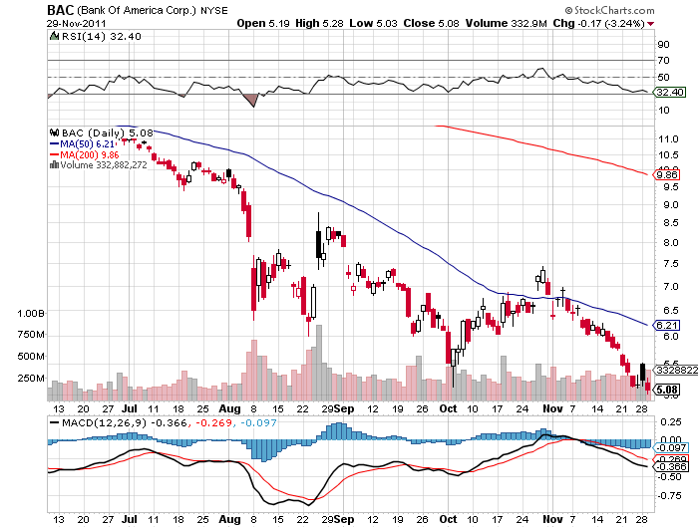
Bank of America (BAC)

Slide 19
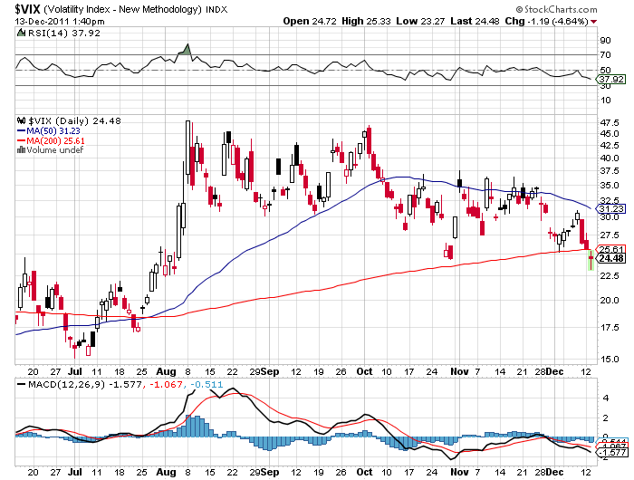
(VIX)

Slide 20

The Dollar
*Uncle Buck is now the big man on campus
*Burden of proof is on the Europeans
*Last rescue package was worth a one day rally
*“feel good” rally in the Euro came and went
*Italian bond yields still at the 7% handle
*Euro shorts at all time high
*Multi month support at $1.31 broken

Slide 21
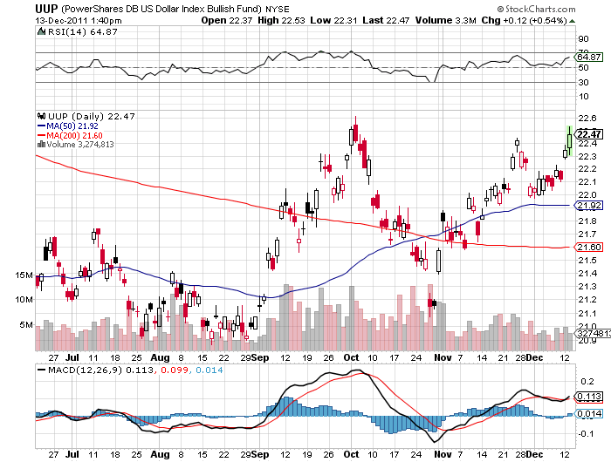
(UUP)

Slide 22
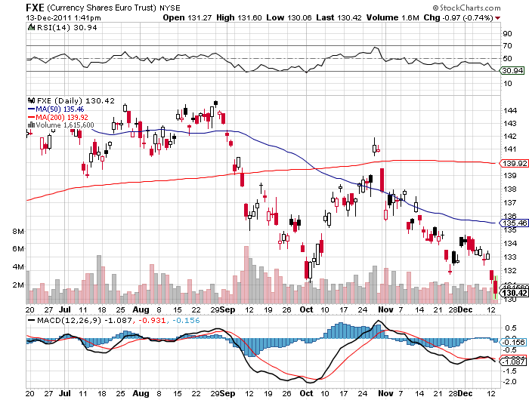
(FXE)

Slide 23
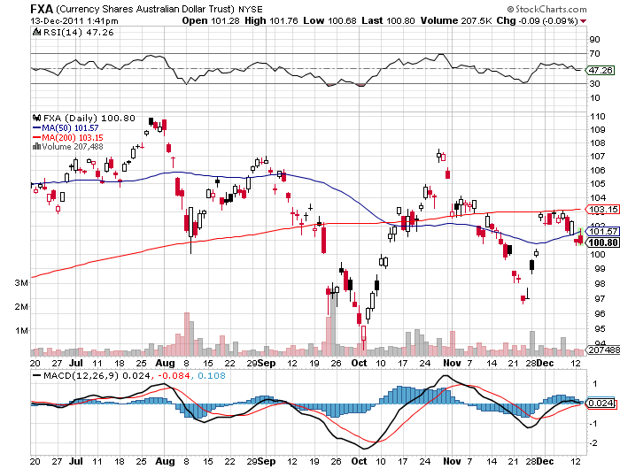
Australian Dollar (FXA)

Slide 24
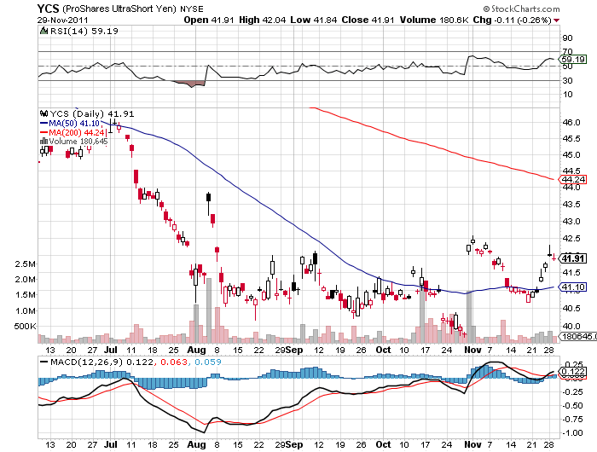
(YCS)

Slide 25
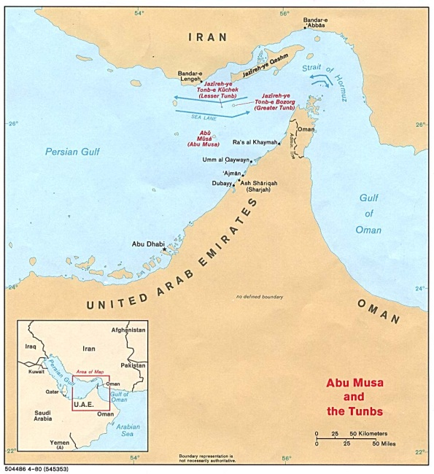
Energy
*Iran scare bumps oil up to $103
*Great shorting opportunity
*Iran will never block the straights of Hormuz
*It’s the oldest rumor in the world
*Will see $75 again in next big “RISK OFF” ROUND
*Natural gas still dead as a doorknob

Slide 26
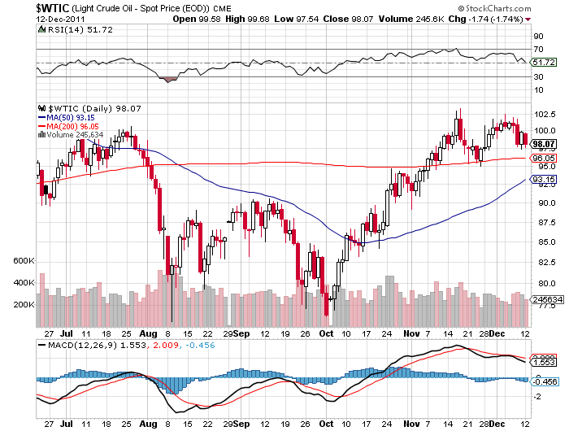
Crude

Slide 27
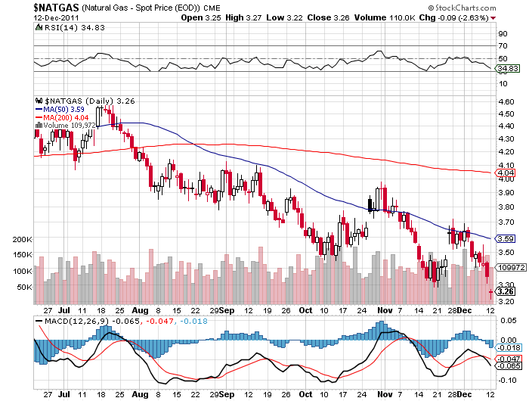
Natural Gas

Slide 28
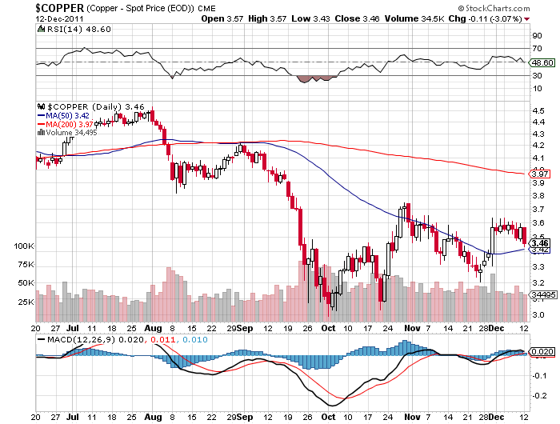
Copper

Slide 29

Precious Metals
*Gold takes a swan dive
*Massive Chinese central bank buying completely ignored
*The hot money is leaving
*New target of $1,500, and $1,000 in the
next recession
*Hedge funds harvesting profits where they can
*Big technical selling kicks in with broken support
*Silver turns to lead
*All metals are getting hit

Slide 30
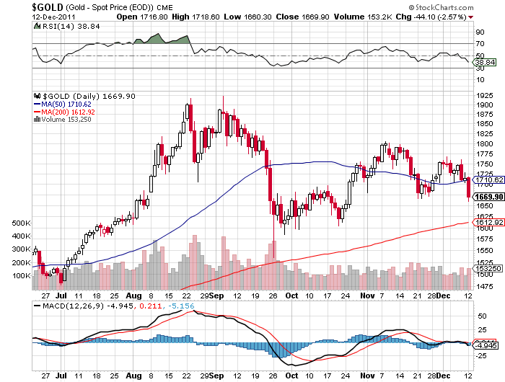
Gold

Slide 31
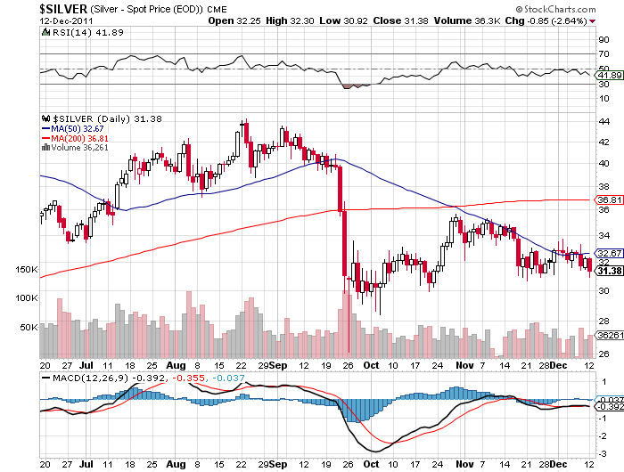
Silver

Slide 32
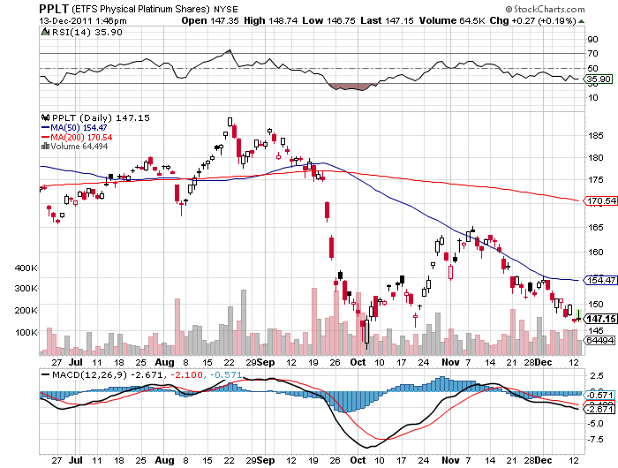
(Platinum)

Slide 33
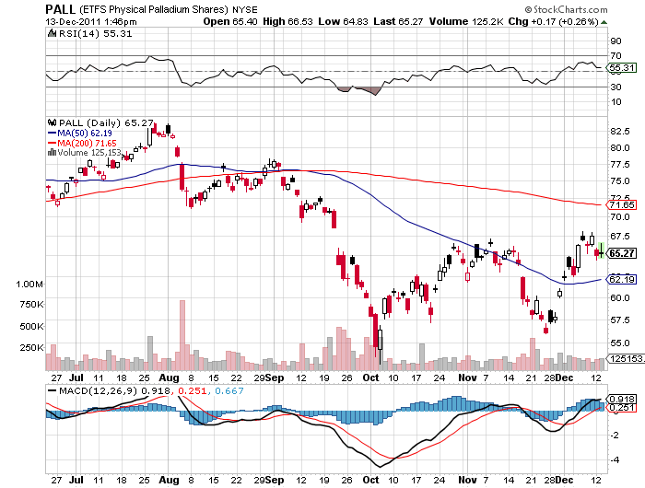
Palladium

Slide 34
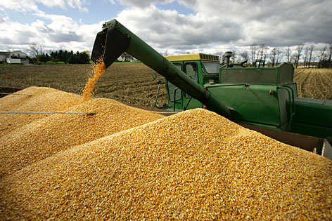
The Ags
*The season is over, no trade
*The harvest is in
*Corn is weaker, DBA is weaker
*Wait for the USDA January
crop report
*Stand aside-no trade
*Long term is a buy at these levels

Slide 35
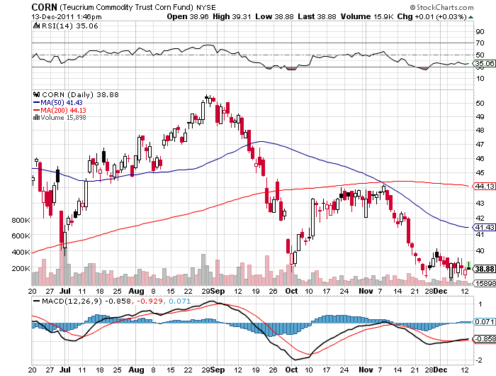
(CORN)

Slide 36
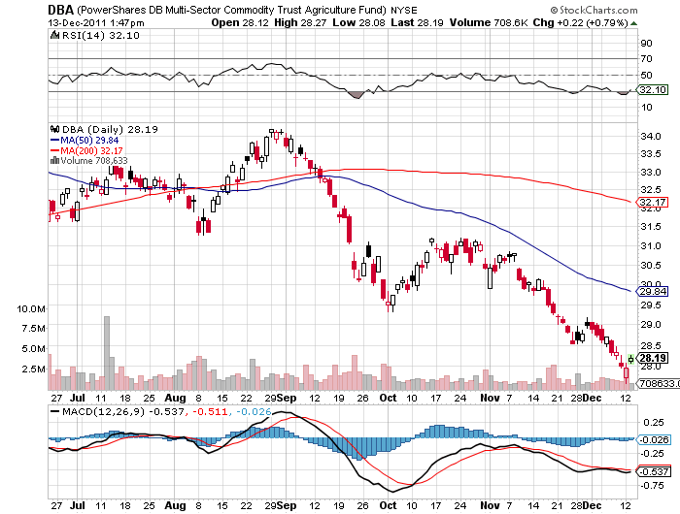
(DBA)

Slide 37
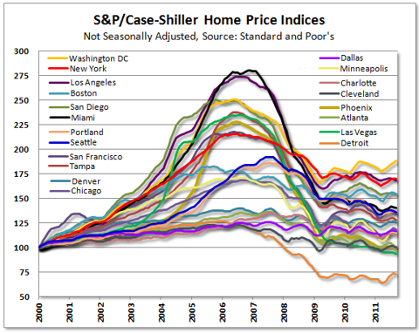
Real Estate
September

Slide 38

Trade Sheet
The bottom line: Trade or die
*Stocks-stand aside
*Bonds- bail on TBT
*Commodities- stand aside
*Currencies- sell Euro rallies from $1.33
*Precious Metals-stand aside
*Volatility-stand aside, but entering “buy” territory
*The ags – stand aside, the season is over
*Real estate-breaking to new lows
Next Webinar is on Wednesday, January 4, 2012

Slide 39

To access my research data base or buy strategy luncheon tickets Please Go to www.madhedgefundtrader.cpm

