Slide 1

Please Stand By for
John Thomas
Wednesday, November 30, 2011
Trade Alert Service
The Webinar will begin at 12:00 pm EST

Slide 2

The Mad Hedge Fund Trader
Special One Year Anniversary Issue
Diary of a Mad Hedge Fund Trader
November 30, 2011
www.madhedgefundtrader.com

Slide 3
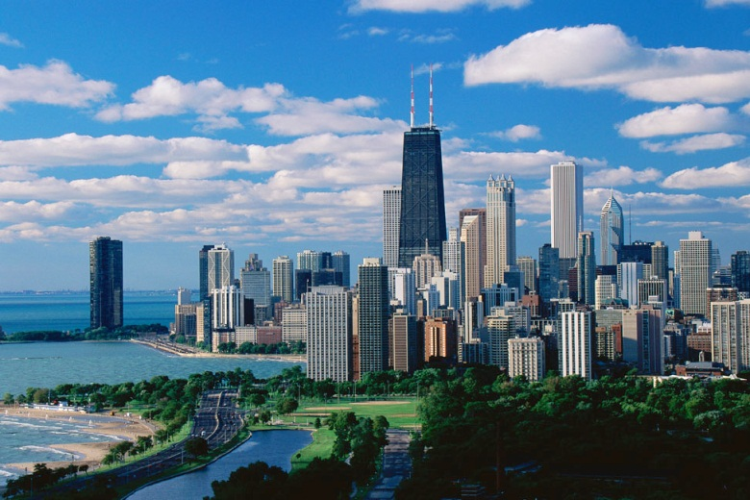

MHFT Global Strategy Luncheons
Buy tickets at www.madhedgefundtrader.com
Chicago
December 27, 2011
Beverly Hills
January 23, 2012

Slide 4

Trade Alert Performance
Tuesday Figures
*November MTD -1.55%
*First 52 weeks of Trading
+ 42.2%
*Versus +1.3% for the S&P500
since December, 2010 a 40.9% outperformance of the index
46 out of 55 closed trades profitable
82% success rate

Slide 5
One Year Performance

Slide 6
Best and Worst Trades
8/26/2011 | 9/6/2011 | FXF 10/$123 puts | long |  |  |  |  |  |  |  | 9.07%
12/7/2010 | 1/6/2011 | BAC 3/2011 $12-$14 call spread | long |  |  |  |  |  |  |  | 8.93%
10/28/2011 | 11/1/2011 | FXE 1/2012 $140 puts | long |  |  |  |  |  |  |  | 5.36%
5/5/2011 | 5/9/2011 | FXE | long |  |  |  |  |  |  |  | 5.14%
8/31/2011 | 1/9/1900 | IWM 10/2011 $71 puts | long |  |  |  |  |  |  |  | 5.02%
3/10/2011 | 5/10/2011 | TLT 6/2011 $86 puts | short |  |  |  |  |  |  |  | 4.51%
12/16/2010 | 1/24/2011 | CSCO 3/2011 $20-$22 call spread | long |  |  |  |  |  |  |  | 3.31%
1/18/2011 | 4/6/2011 | FXE 6/2011 $132-$129 put spread | long |  |  |  |  |  |  |  | -3.77%
7/25/2011 | 10/5/2011 | CAT 1/2012 $110 calls | long |  |  |  |  |  |  |  | -4.81%
7/20/2011 | 8/12/2011 | SPY 8/2011 $133 calls | long |  |  |  |  |  |  |  | -4.96%

Slide 7
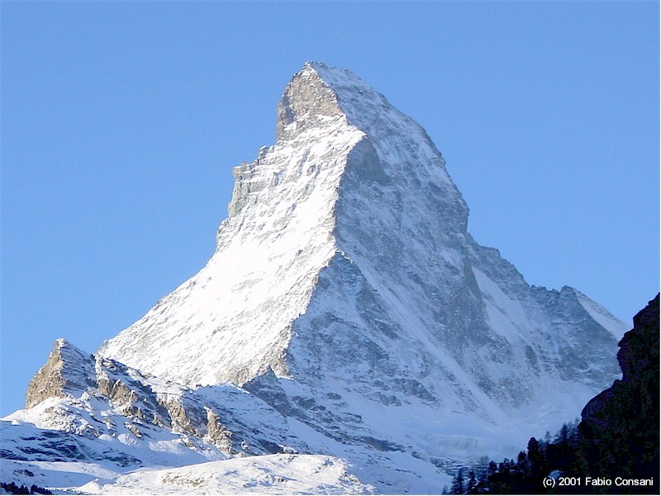
Trade of the Year! (FXF)

Slide 8
Portfolio Review
Trade or Die
Mad Hedge Fund Trader
Trading Book
Asset Class Breakdown
Risk Adjusted Basis
current capital at risk
Risk On
bonds (TBT) | 13.60%
equity (JEF) | 2.50%
silver (SLV) | 5.00%
Risk Off
euro (FXE) | -5.00%
total | 16.10%
*

Slide 9
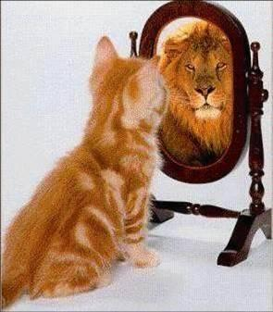
The Economy
*The positive economic data is accelerating
*Weekly jobless claims under 400,000
*Nov ADP private sector jobs 206,000, October
revised up from 110,000 to 130,000
*Chicago PMI a blistering 62.6, best since April
*Friday nonfarm payroll est. at +125,000 or more
*Consumer confidence rockets, up 40% MOM
*Europe is looking like a major drag in 2012
*Deleveraging continues at corporate
and personal level
*All consistent with a low 2.0% GDP growth rate

Slide 10
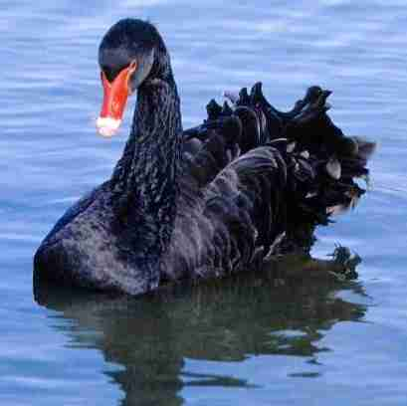
Add a Fourth Black Swan
Surprises not discounted by the market
*ECB cuts interest rate, Trichet retirement paves the way for Draghi action, there’s a new fire chief in town. Happened
*Supercommittee Surprise compromise
$4 trillion compromise from last summer is revived, Dow rallies 1,000 points by year end.
DOA
*China cuts interest rates
declares victory on inflation, says risks to economy are now on the downside, its off to the races for emerging markets. Happened today
*QE3-On the table

Slide 11

Bonds
*Are not buying this rally at all
*Market is stalled at 60 year highs
*Junk bonds gave up the October rally
*Euro bond crisis may spread to US
*For now, there is a bond shortage in the US
*Yields say the government is borrowing too little, not too much
*The bond market clearly sees a 2012 recession
*Target of a 1% yield on 10 year paper

Slide 12
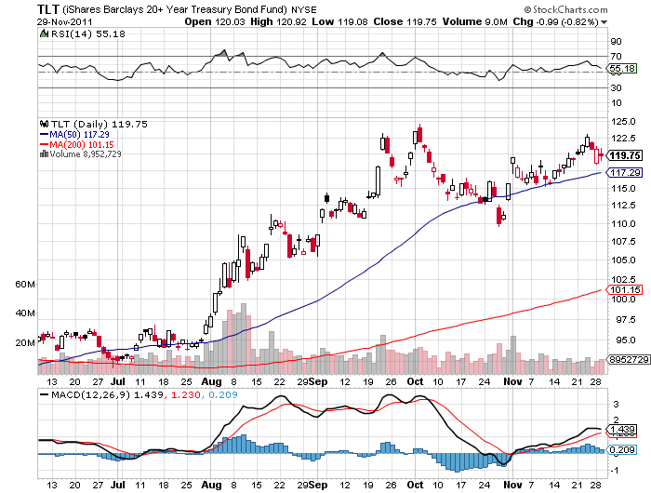
(TLT)

Slide 13
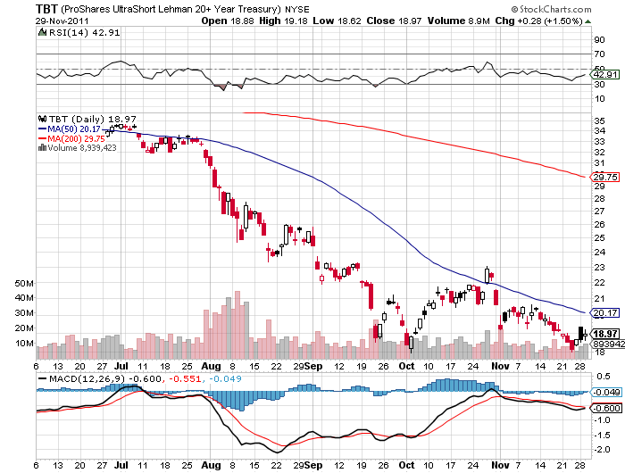
(TBT)

Slide 14
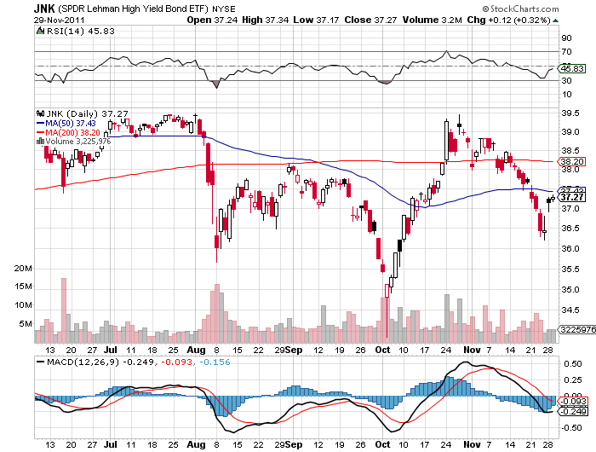
(JNK)

Slide 15
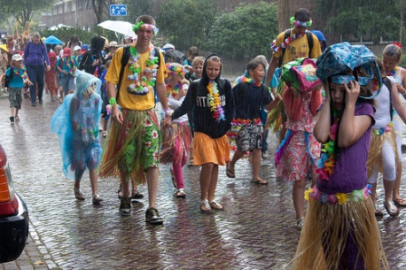
Stocks
*US keep rallying, but Europe rains on the parade
*Energy and commodities lead
*Banks will continue as major drag
*Modest year end rally in the cards
*200 day moving average at 1,266 in range
*Apple is not participating-supply chain problems
*Are American large caps the new safe haven?
*Suddenly, a zero return doesn’t look so bad

Slide 16
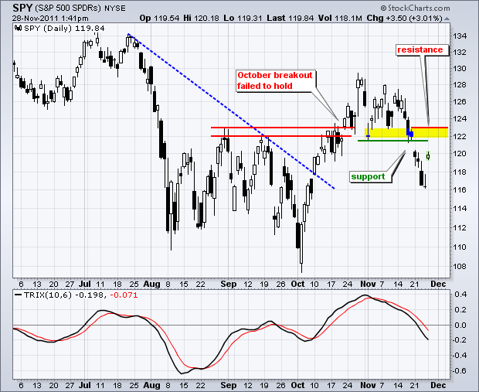
(SPY)

Slide 17
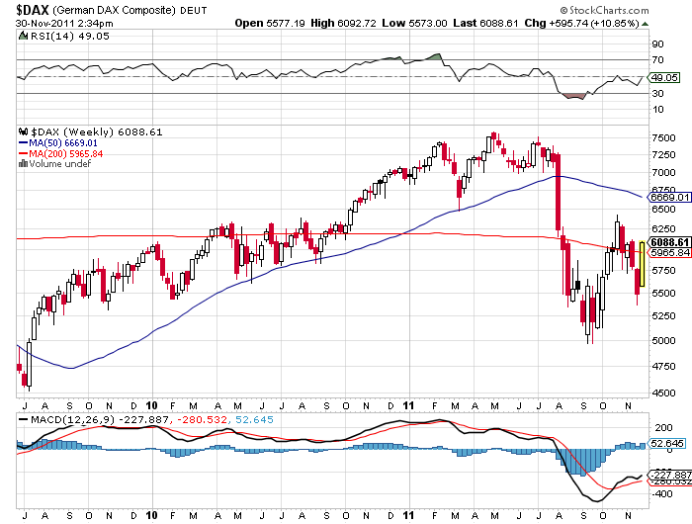
German DAX Composite(DAX)
-21.5% YTD

Slide 18
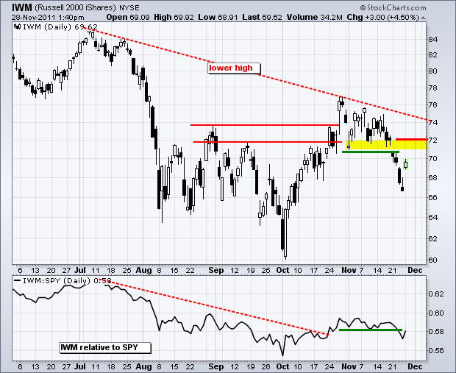
Russell 2000 (IWM)

Slide 19
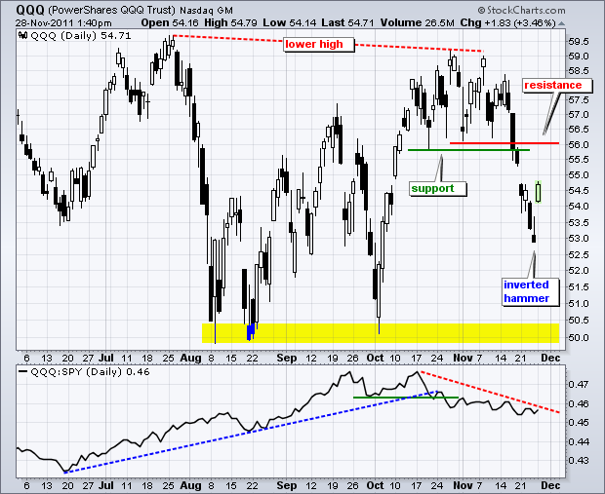
NASDAQ

Slide 20
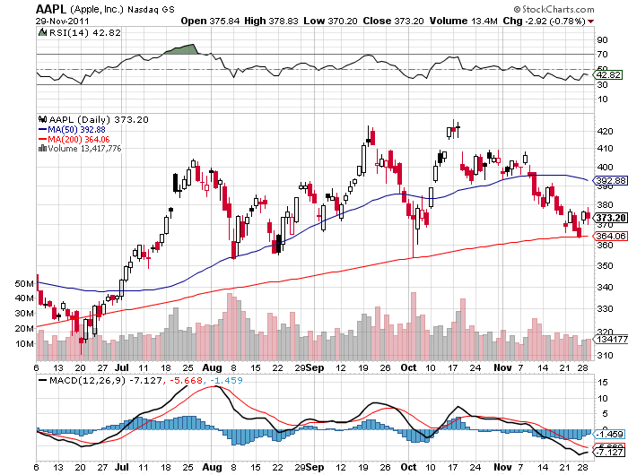
Apple (AAPL)

Slide 21
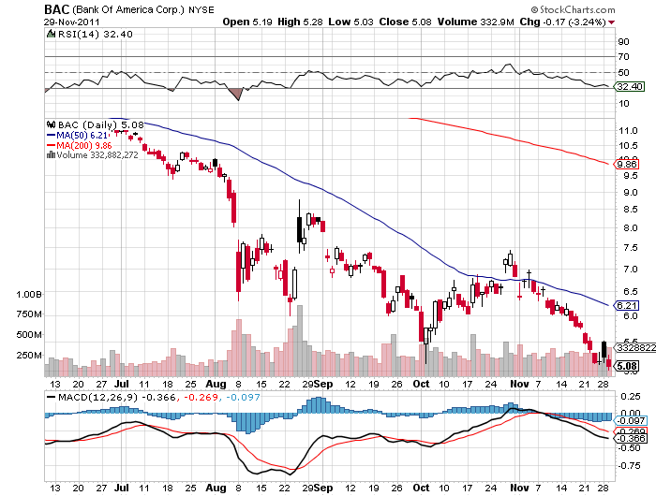
Bank of America (BAC)

Slide 22
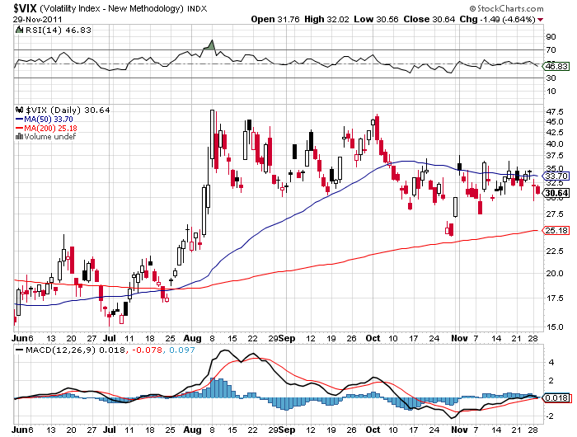
(VIX)

Slide 23
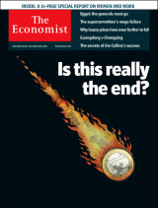
The Dollar
*Its all about the Euro
*Major international coordination effort give a
respite and a window for concrete action
*Britain sharply downgrades GDP forecast
2 million go on strike today
*Italian bond yields hit 8%
*Euro shorts at all time high, so no break of $1.31
*December 9 meeting of European leaders may trigger
“feel good” rally in the Euro
*Australian dollar strength points to more “RISK ON”

Slide 24
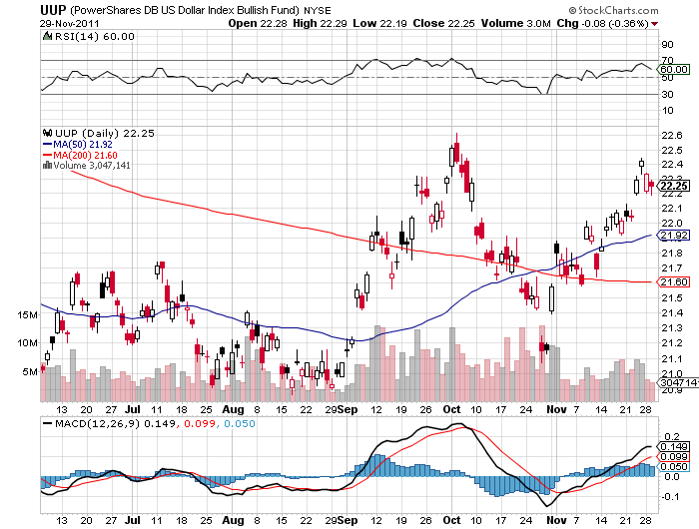
(UUP)

Slide 25
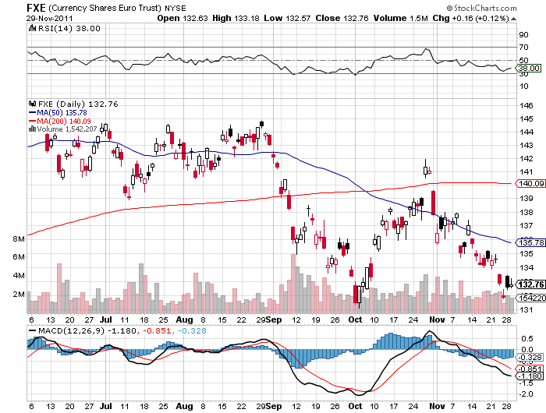
(FXE)

Slide 26
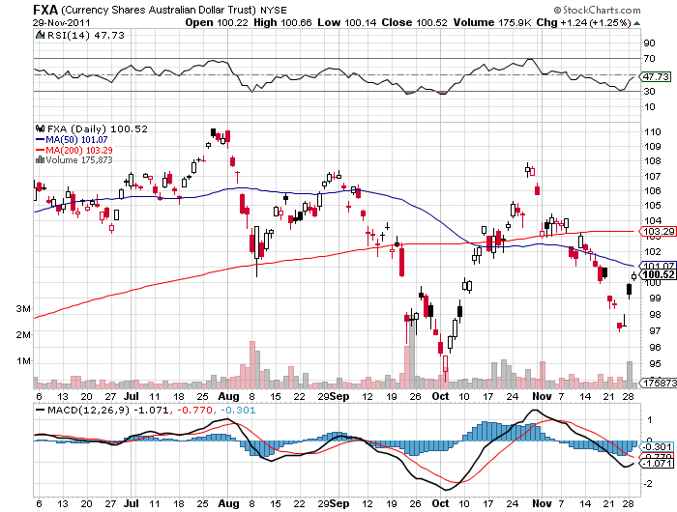
Australian Dollar (FXA)

Slide 27
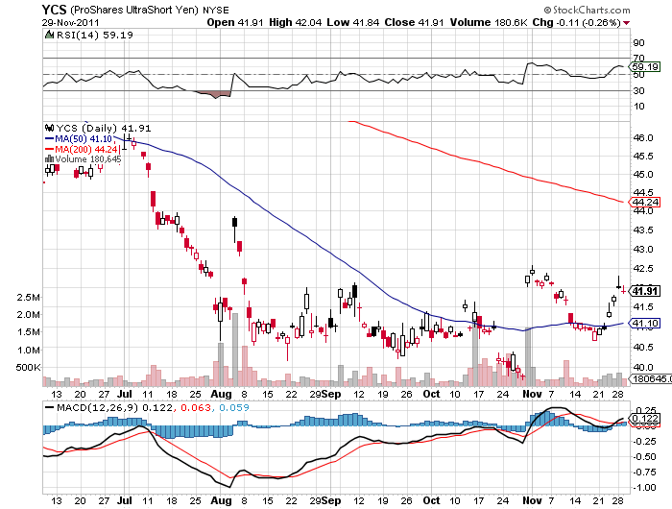
(YCS)

Slide 28
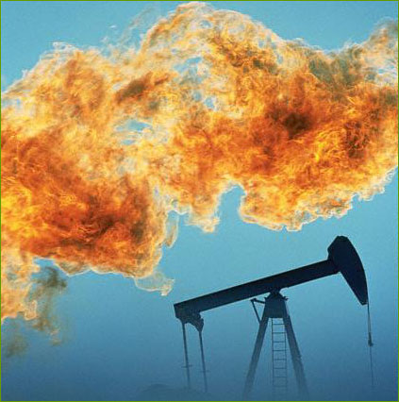
Energy
*Oil has been on fire, breaks $100
*Confirms the “RISK ON” bias
*Getting a boost from Iran
*Is leading all financial markets
*Is $120 the recession trigger for 2012?
*Natural gas still dead as a doorknob

Slide 29
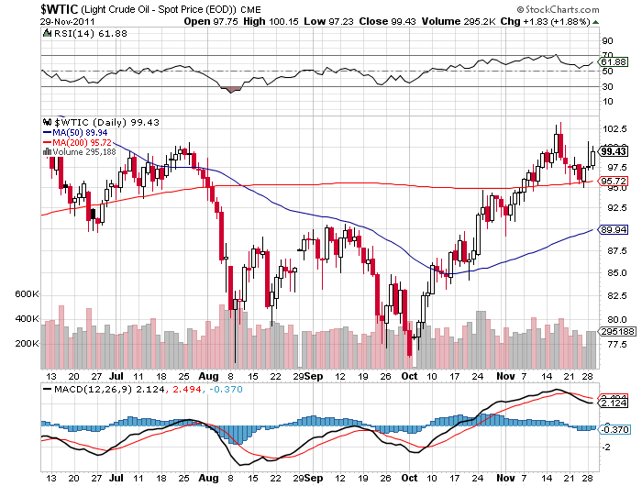
Crude

Slide 30
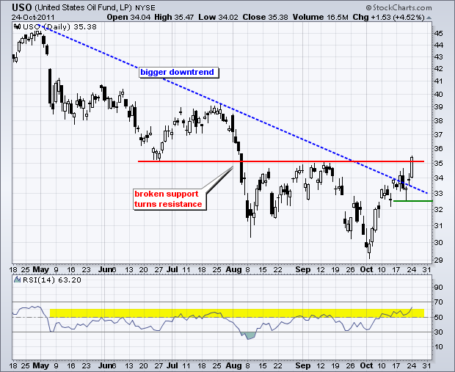
OIL

Slide 31
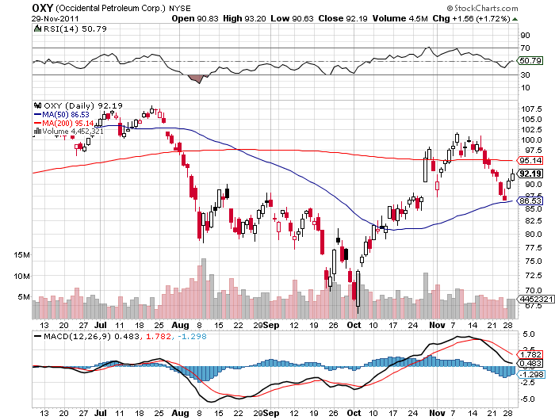
Occidental Petroleum (OXY)

Slide 32
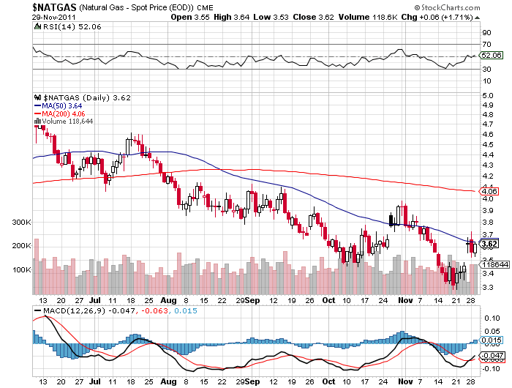
Natural Gas

Slide 33
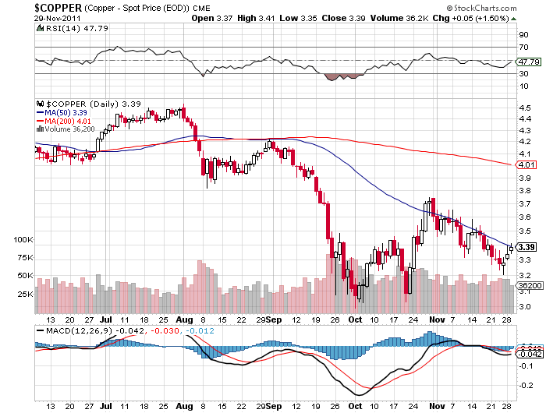
Copper

Slide 34
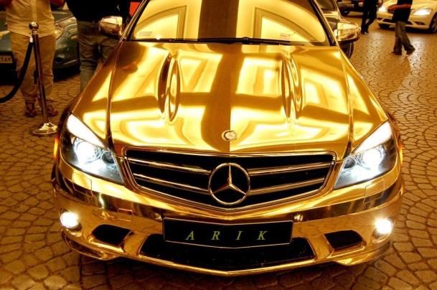
Precious Metals
*Gold is keeping a bid
*Silver has lost its momentum, bail on options within 2 weeks
*European rescue means a TARP and a quantitative easing
*Technical picture looks good
*Gold has turned into paper, so ‘RISK ON” means buy precious metals

Slide 35
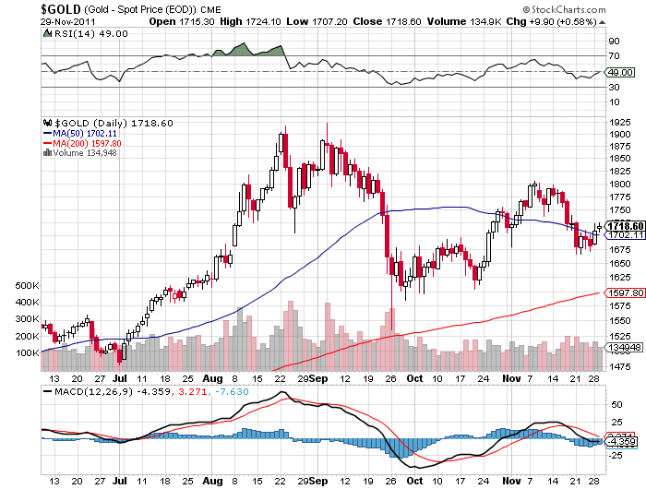
Gold

Slide 36
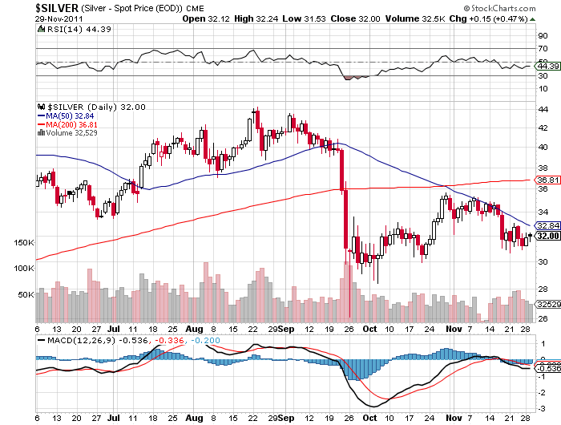
Silver

Slide 37
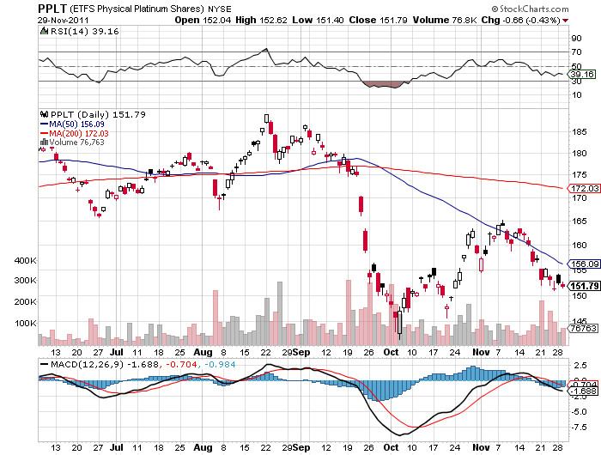
(Platinum)

Slide 38
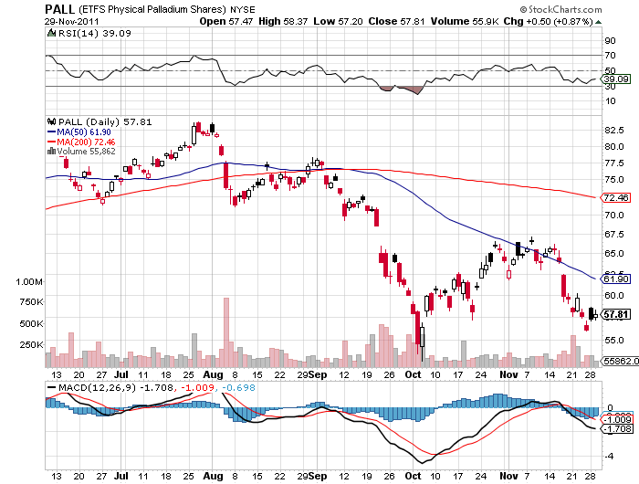
Palladium

Slide 39
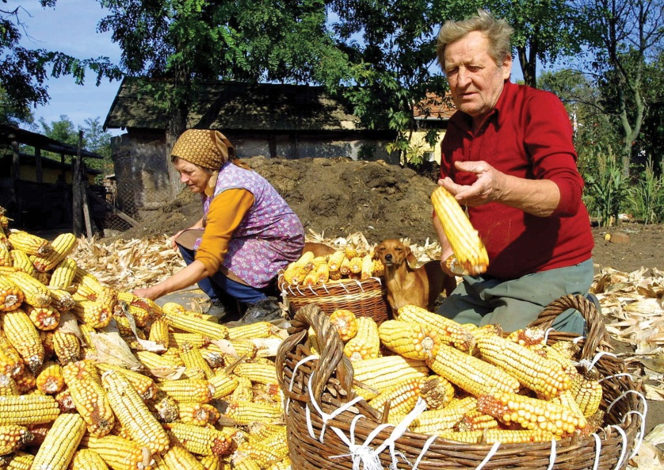
The Ags
*The season is over, no trade
*The harvest is in
*Corn is weaker, DBA is weaker
*Wait for the USDA January
crop report
*Stand aside

Slide 40
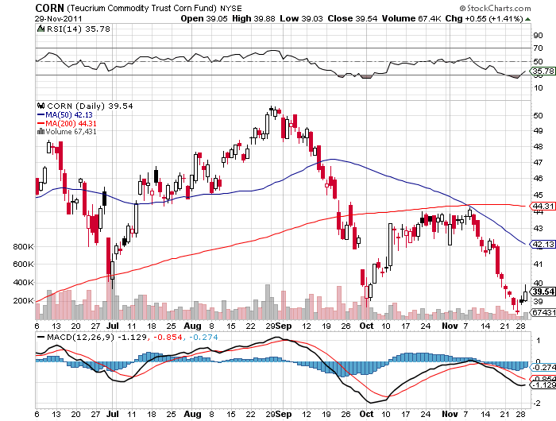
(CORN)

Slide 41
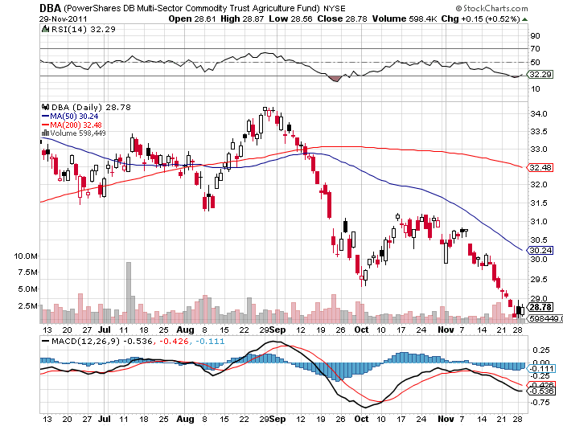
(DBA)

Slide 42
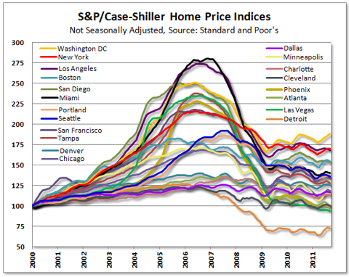
Real Estate
September

Slide 43

Trade Sheet
The bottom line: Trade or die
*Stocks-run longs for a breakout
*Bonds- stand aside, wait for 2.5% yield to sell
TBT
*Commodities- stand aside, wait for a dip
*Currencies-get ready to sell Euro rallies higher, $1.35
*Precious Metals-run silver longs
*Volatility-stand aside, year end flattening
*The ags – stand aside, the season is over
*Real estate-breaking to new lows
Next Webinar is on Wednesday, December 14

Slide 44

To access my research data base or buy strategy luncheon tickets Please Go to www.madhedgefundtrader.cpm

