Slide 1

Please Stand By for
John Thomas
Wednesday, January 18, 2012
Trade Alert Service
The Webinar will begin at 12:00 pm EST

Slide 2

The Mad Hedge Fund Trader
Welcome to Nosebleed Territory
Is Dow 12.500 = 12,500 feet?
Diary of a Mad Hedge Fund Trader
January 18, 2012
www.madhedgefundtrader.com

Slide 3

MHFT Global Strategy Luncheons
Buy tickets at www.madhedgefundtrader.com
Beverly Hills Seminar
January 23, 2012
1:30-5:00

Slide 4
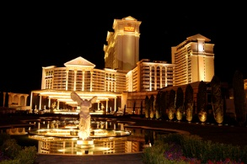
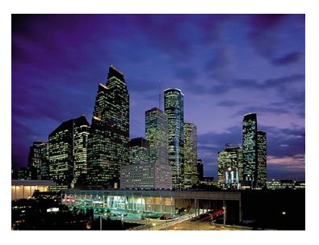
MHFT Global Strategy Luncheons
Buy tickets at www.madhedgefundtrader.com
Las Vegas
January 27, 2012
Houston
February 9, 2012

Slide 5

MHFT Global Strategy Luncheons
Buy tickets at www.madhedgefundtrader.com
2012 Schedule
January 23 Beverly Hills
January 27 Las Vegas
February 9 Houston
February 10 Orlando
April 20 San Francisco
May 3 Phoenix
June 11 Beverly Hills
June 29 Chicago
July 5 New York
July 6-13 Queen Mary II
New York to Southampton
July 16 London
July 17 Frankfurt
October 26 San Francisco
November 8 Orlando
January 3, 2013 Chicago

Slide 6

Trade Alert Performance
*January MTD +0.25%
*First 60 weeks of Trading
+ 40.42%
*Versus +3.4% for the S&P500
A 37% outperformance of the index
50 out of 59 closed trades profitable
85% success rate

Slide 7
Portfolio Review
Stay Small Until a Reversal is Confirmed
Mad Hedge Fund Trader
Trading Book
Asset Class Breakdown
Risk Adjusted Basis
current capital at risk
Risk On
Risk Off
Short Euro (EUO) | 25.00%
Short (SPY) | -2.50%
Short SPX (SDS) | -10.00%
total | 12.50%

Slide 8

The Economy-Modest Strength
*China Q4 GDP at 8.9%, kills the hard landing scenario
*German ZEW Index rockets from -54 to -22,
sharpest since 1991
*US car sales at a 13.6 million sell rate in December
scrapage is 14 million, headed for $15-16 million
*Weekly jobless claims jumped 24,000 to 399,000
clouds the picture
*NY Fed manufacturing index for January 8.19 to 13.48
*December capacity utilization 77.8% to 78.1%, 3 year high
*Nonfarm payroll took unemployment down to 8.5%, a 3 year low
*All consistent with a low 2.0% GDP growth rate

Slide 9

Bonds-no change in scenario
*Still is not buying the “RISK ON” scenario
*Ten year could go to 1.60% in the next “RISK OFF” round
*Long term charts show the uptrend is still alive
*Bonds are predicting deflation
and recession for 2012
*Waiting for the next Euro disaster
*Most narrow 2 month range in recent memory
1.80%-2.10% for ten year Treasuries
*Insights from junk

Slide 10
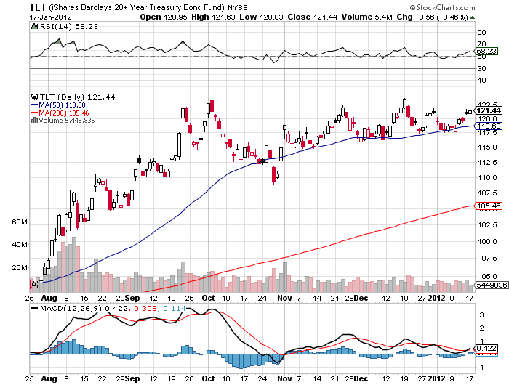
(TLT)

Slide 11
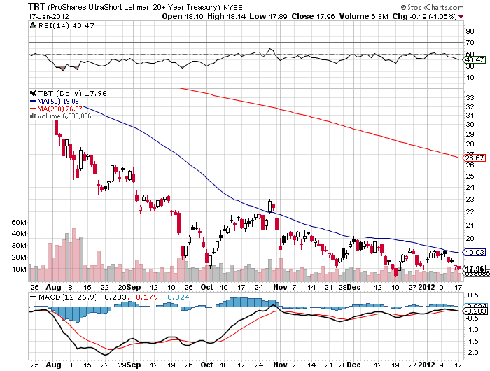
(TBT)

Slide 12
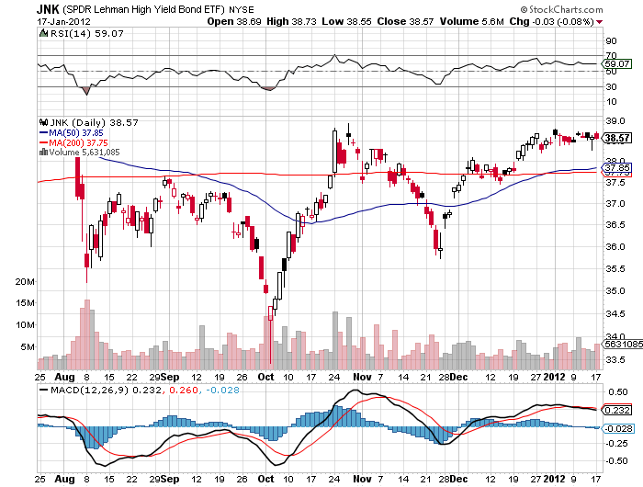
(JNK)

Slide 13
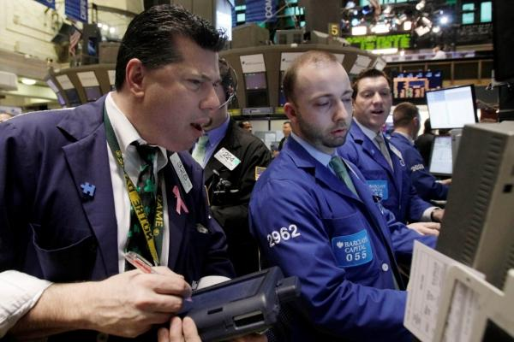
Stocks
*The low volume “melt up” continues
*We are 80% through a 300 point (SPX) move from 1,060 to 1,360
(two weeks ago was 72%)
*China soft landing news causes commodities to rip
*Still inside the range
*Value players and pension funds are making
their annual allocations, but running out of steam
*Europe’s quantitative easing is spilling over into
US stocks and bonds
*Is the “golden cross” real

Slide 14
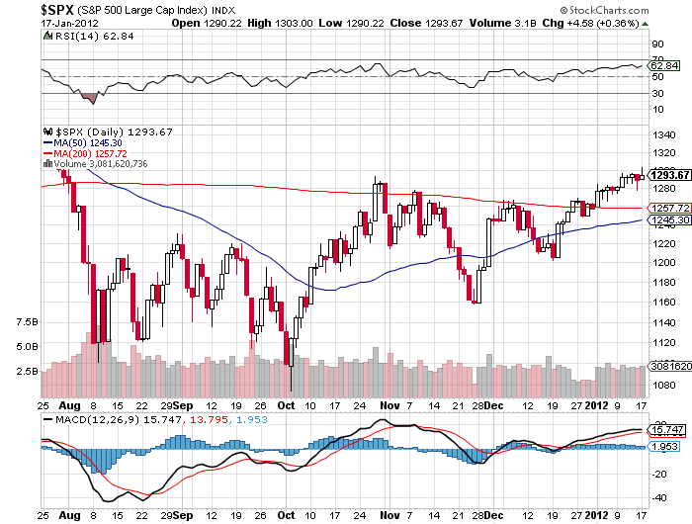
(SPY)

Slide 15
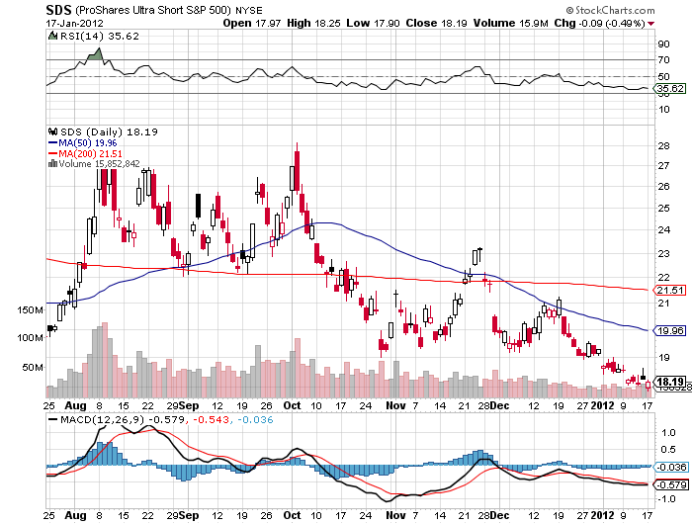
Double Short S&P 500 ETF(SDS)

Slide 16
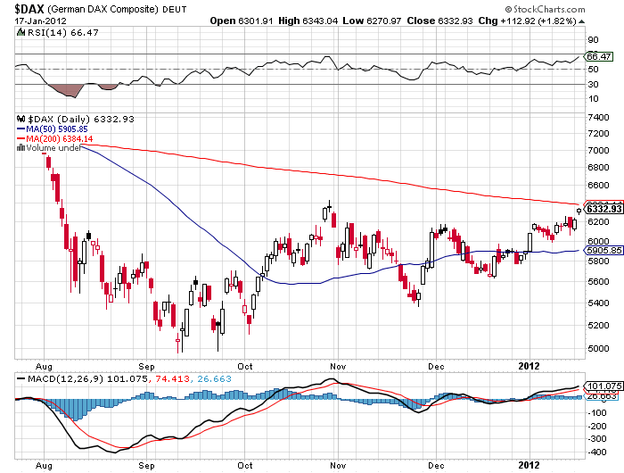
German DAX Composite(DAX)

Slide 17
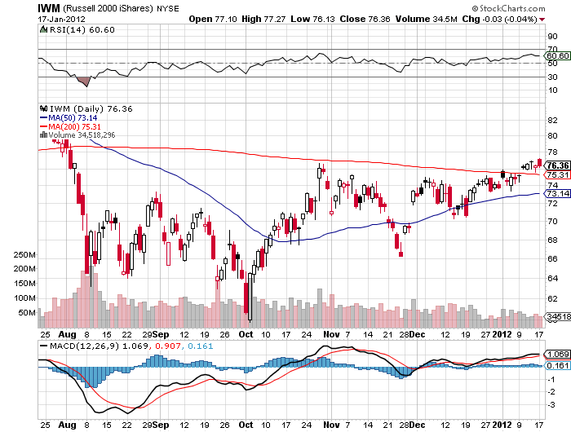
Russell 2000 (IWM)

Slide 18
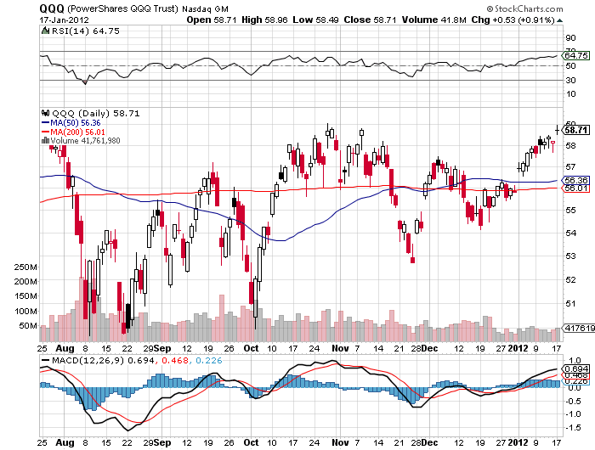
NASDAQ

Slide 19
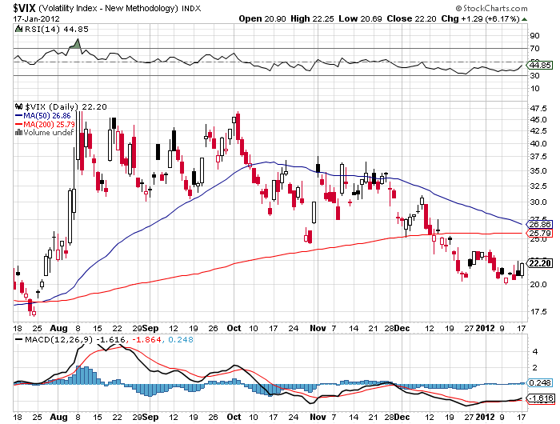
(VIX)

Slide 20
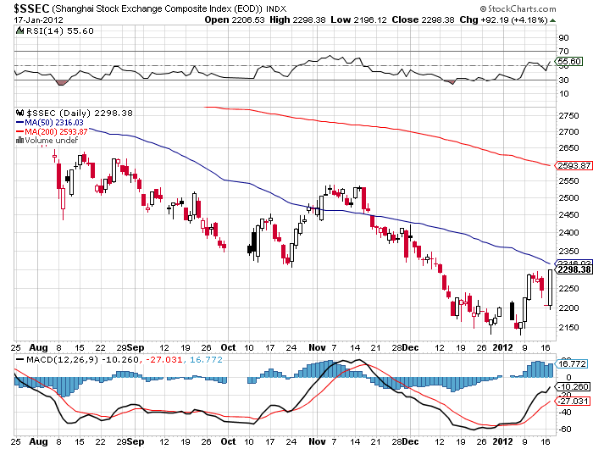
(Shanghai)

Slide 21
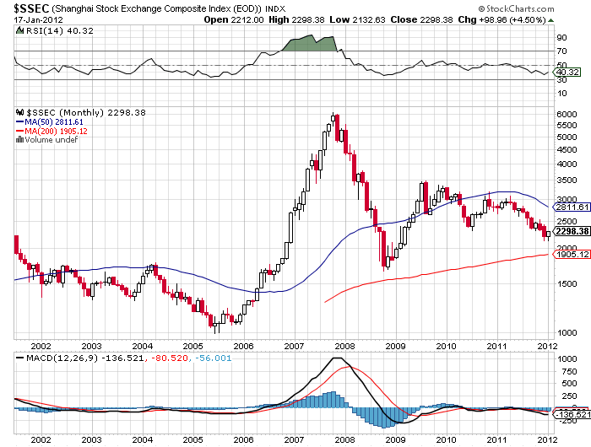
(Shanghai)-10 Year

Slide 22
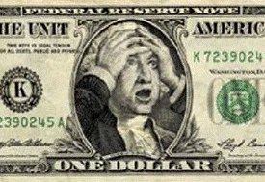
The Dollar
*Taking a rest while “RISK ON” is in vogue
*Euro shorts at all time high
*Euro downside momentum stalled as an
extreme oversold condition is worked off
*Ausie on fire on Chinese GDP number
*European bond auctions going well
*The first European downgrades are in the price,
but not the second or third

Slide 23

European 10 Year Bond Yields
*Germany 1.80%
*Spain 5.10%
*Italy 6.40%
*Portugal 14.3%
*Greece 35%

Slide 24
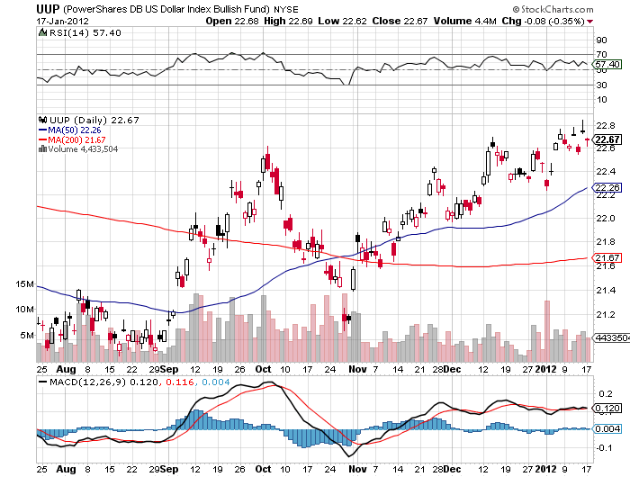
(UUP)

Slide 25
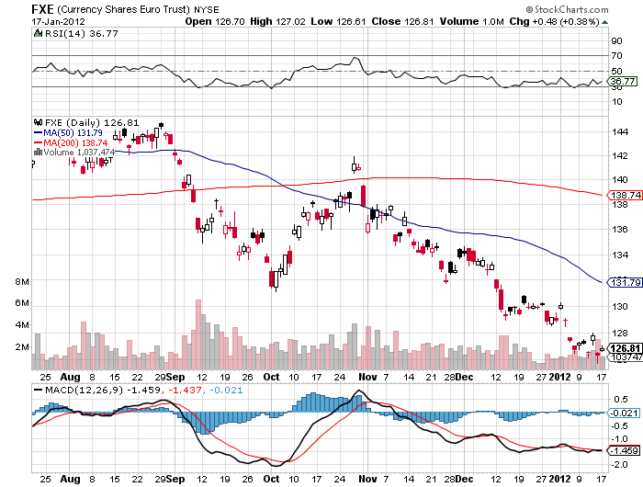
(FXE)

Slide 26
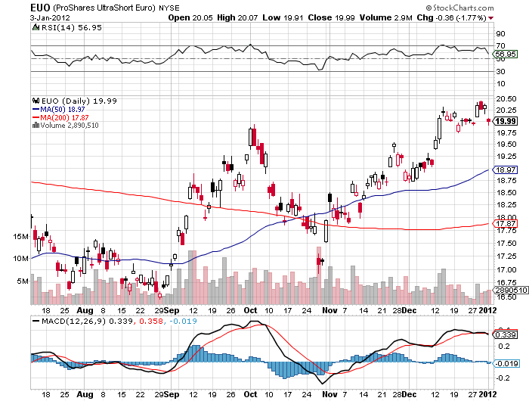
(EUO)

Slide 27
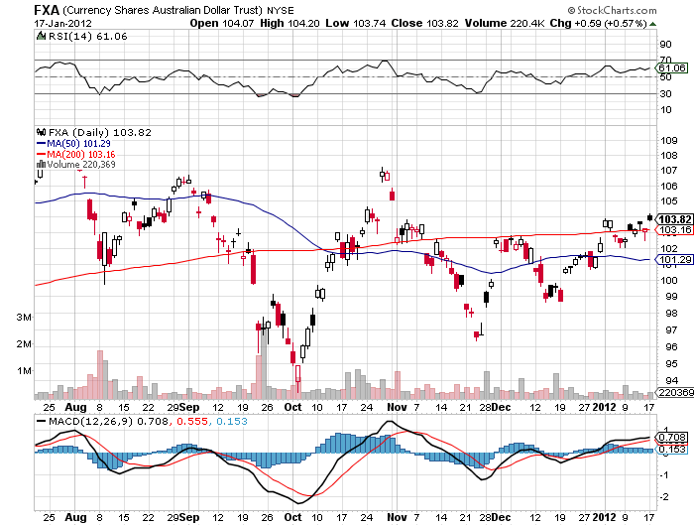
Australian Dollar (FXA)

Slide 28
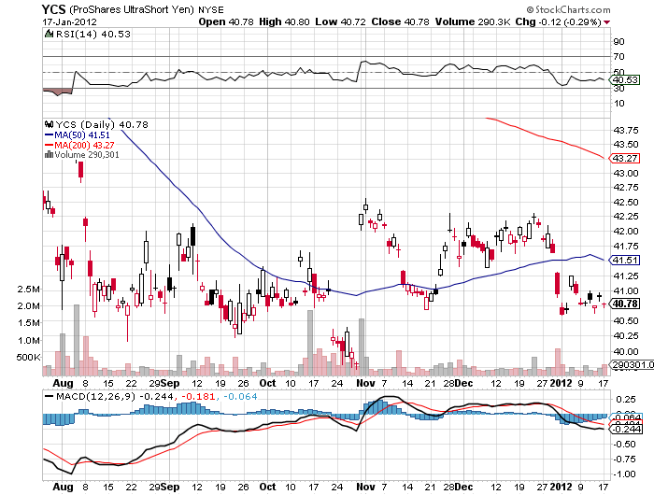
(YCS)

Slide 29

Energy
*Tug of war - Geopolitical risk versus modest economic growth
*Iran noise will be recurring this year
*Great shorting opportunity setting up over $110
*Look for a 2012 range of $75-$110
*At $110 (USO) puts start to look
very interesting
*Will see $75 again in next big “RISK OFF” ROUND
*Natural gas hits new lows-stay away

Slide 30
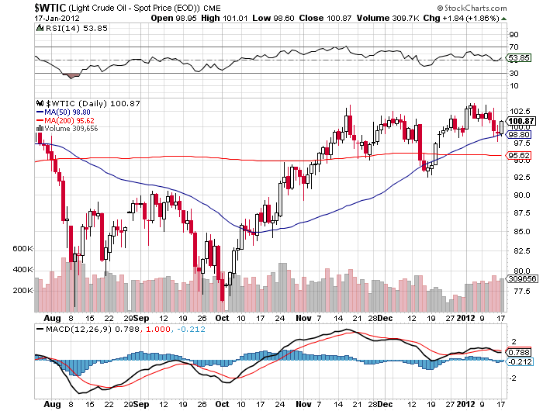
Crude

Slide 31
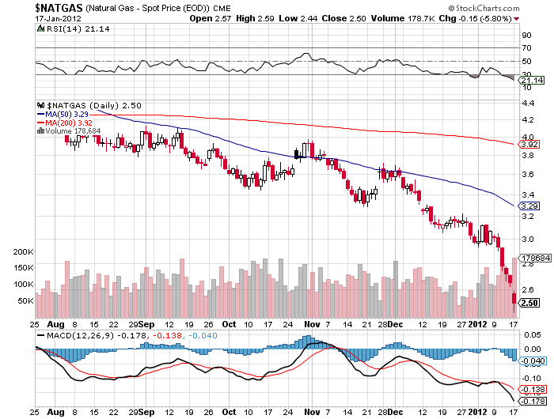
Natural Gas

Slide 32
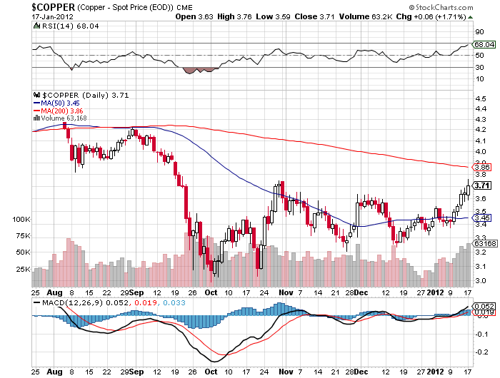
Copper

Slide 33
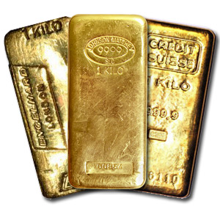
Precious Metals
*Interim low is hit
*The hot money is moving back in for a trade
*Possibly a $200 rally off lows
targeting $1,700-a shorting opportunity?
*Year end selling pressure from hedge funds
is done
*Benefiting from Euro weakness
*Modest “RISK ON” push is also helping

Slide 34
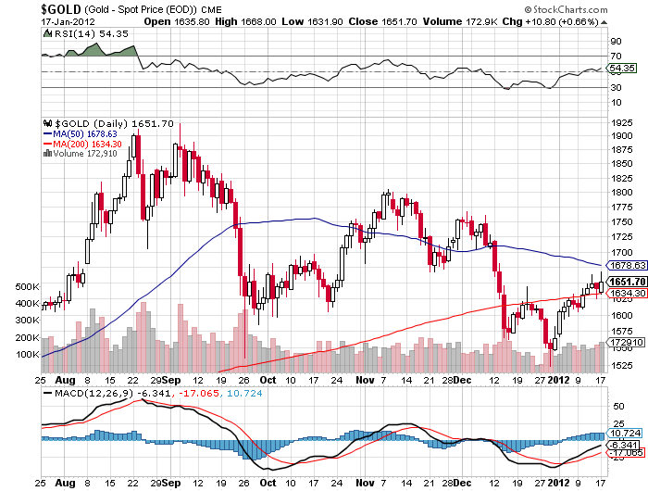
Gold

Slide 35
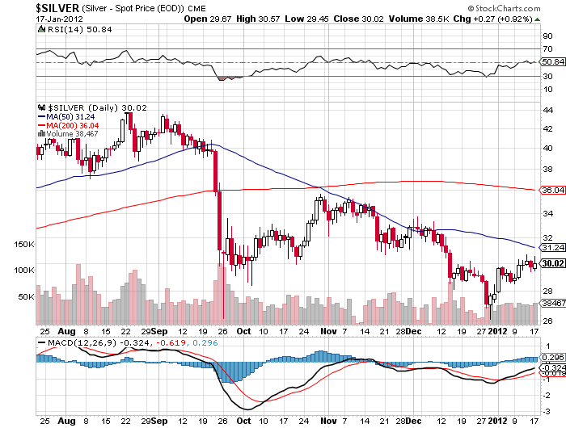
Silver

Slide 36
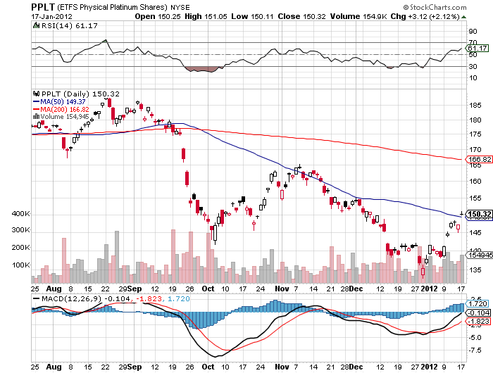
(Platinum)

Slide 37
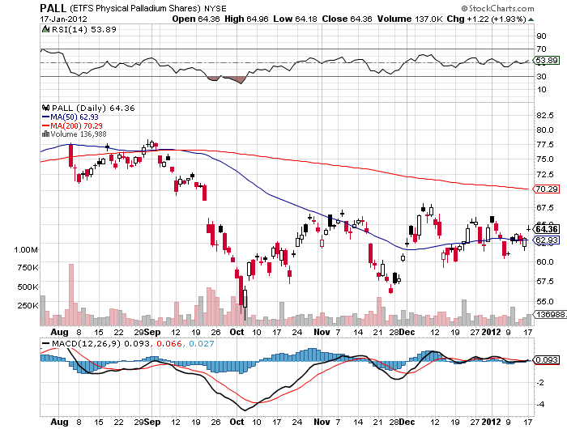
Palladium

Slide 38
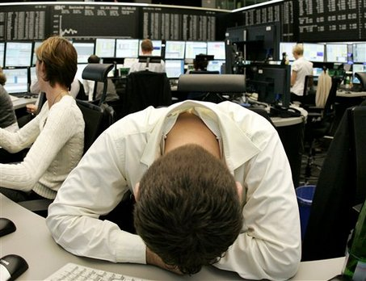
The Ags
*USDA January crop report was a disaster
*90% of traders were caught the wrong way
*Limit move down in corn
*Market has been spoiled for the
next few months
*Stand aside-no trade for now
but a nice buy is setting up
*The weather always get bad again
*Long term positive fundamentals eventually kick in

Slide 39
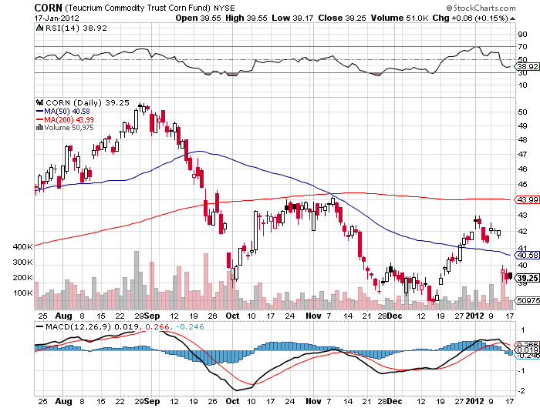
(CORN)

Slide 40
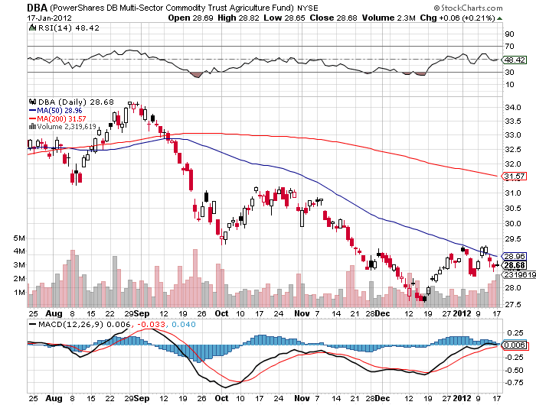
(DBA)

Slide 41
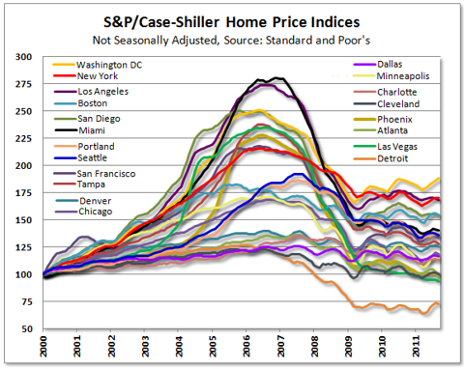
Real Estate
September

Slide 42

Trade Sheet
The bottom line: Trade or die
*Stocks-stand aside, wait to short
*Bonds- stand aside, wait for “RISK OFF”
*Commodities- stand aside-inside of range
*Currencies- sell Euro rallies from $1.30
*Precious Metals-wait for the next short to set up
*Volatility-buy under $20
*The ags – stand aside wait for a bottom
*Real estate-breaking to new lows
Next Webinar is on Wednesday, February 1, 2012

Slide 43

To access my research data base or buy strategy luncheon tickets Please Go to www.madhedgefundtrader.com

