Slide 1

Please Stand By for John Thomas Wednesday, January 4, 2012 Trade Alert Service
The Webinar will begin at 12:00 pm EST

Slide 2

The Mad Hedge Fund Trader Welcome to the New Year!
Diary of a Mad Hedge Fund Trader January 4, 2012 www.madhedgefundtrader.com

Slide 3

MHFT Global Strategy Luncheons Buy tickets at www.madhedgefundtrader.com
Beverly Hills Seminar January 23, 2012 1:30-5:00

Slide 4

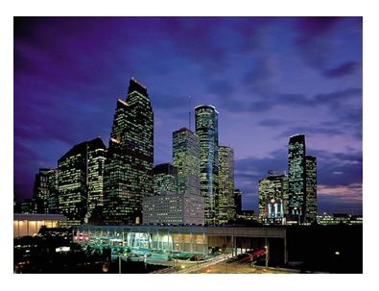
MHFT Global Strategy Luncheons Buy tickets at www.madhedgefundtrader.com
Las Vegas January 27, 2012
Houston February 9, 2012

Slide 5

Trade Alert Performance
*December final -2.08% *First 58 weeks of Trading + 40.17% *Versus +0.3% for the S&P500 A 39.9% outperformance of the index
47 out of 56 closed trades profitable 84% success rate

Slide 6

Portfolio Review Trade or Die
Mad Hedge Fund Trader
Trading Book
Asset Class Breakdown
Risk Adjusted Basis
current capital at risk
Risk On
Risk Off
total | 0.00%
*No Trade *We are in the middle of all ranges *Wait for the markets to come to you *Wait for the markets to get overbought or oversold *Maintain your discipline *Go do some research

Slide 7

The Economy
*The positive economic data continues *ISM Manufacturing Index for December from 52.7 to 53. well over expansionary 50 level *Data suggest Q4 is looking like a 3%-3.5% pop *Weekly jobless claims at 381,000 well into expansion territory *Everyone is waiting for the first European recessionary data *Friday nonfarm payroll expected to be good *All consistent with a low 2.0% GDP growth rate growing as slow as molasses

Slide 8
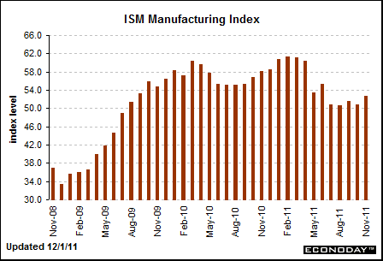
December ISM

Slide 9

Bonds
*Still is not buying the “RISK ON” scenario *Ten year could go to 1.60% in the next “RISK OFF” round *Long term charts show the uptrend is still alive *Bonds are predicting deflation and recession for 2012 *Waiting for the next Euro disaster *Junk tracking nicely with equities

Slide 10
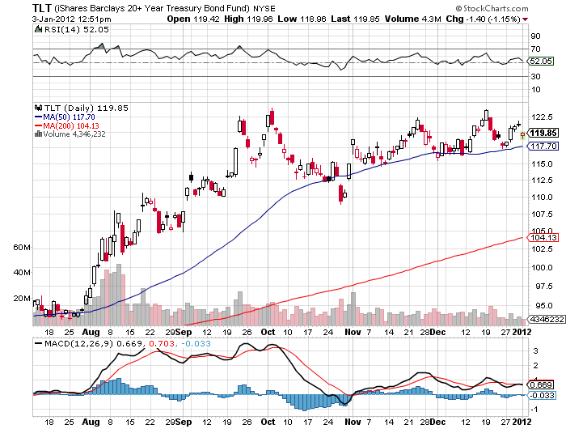
(TLT)

Slide 11
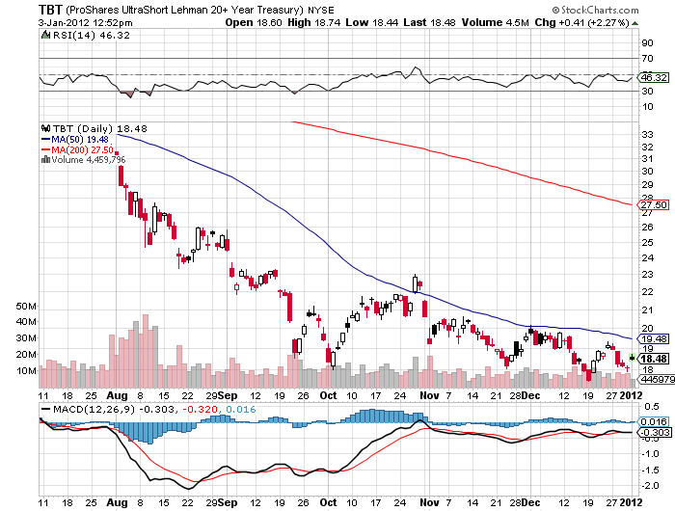
(TBT)

Slide 12
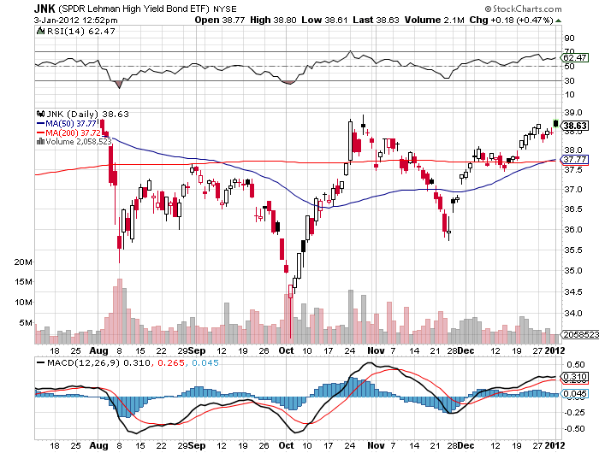
(JNK)

Slide 13

Stocks
*The low volume grind around the 200 day moving average resolved to the upside triggering a general “RISK ON” move *We are 72% through a 300 point (SPX) move from 1,060 to 1,360 *When Europe went on vacation, the US went up *Still inside the range *Value players and pension funds are making their annual allocations *High dividend multinationals leading *Technology lagging

Slide 14
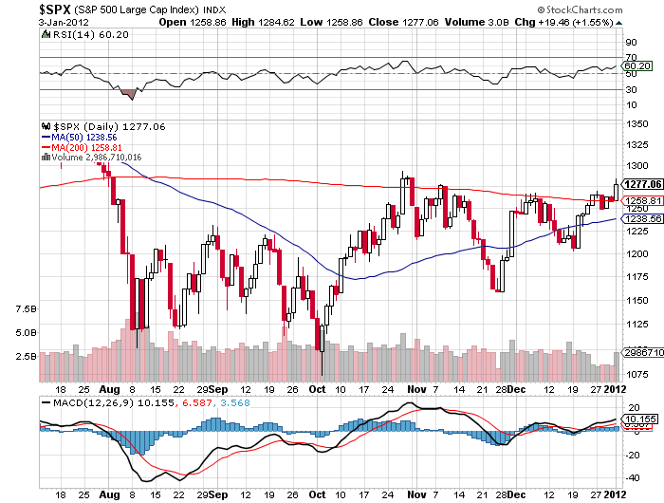
(SPY)

Slide 15
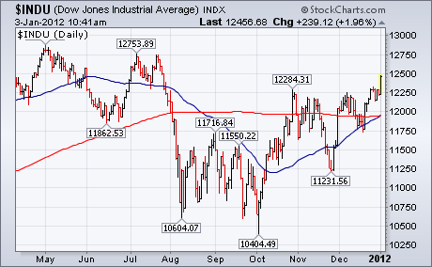
(INDU)

Slide 16
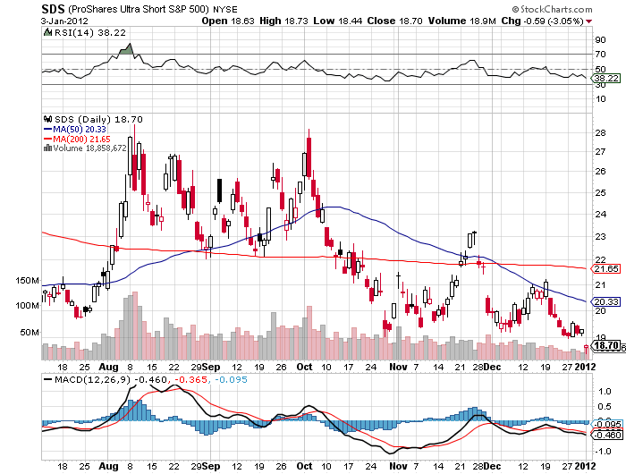
Double Short S&P 500 ETF(SDS)

Slide 17
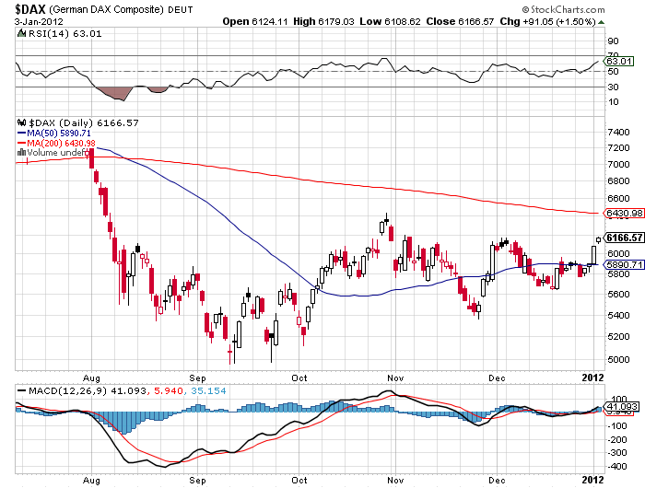
German DAX Composite(DAX) -21.5% YTD

Slide 18
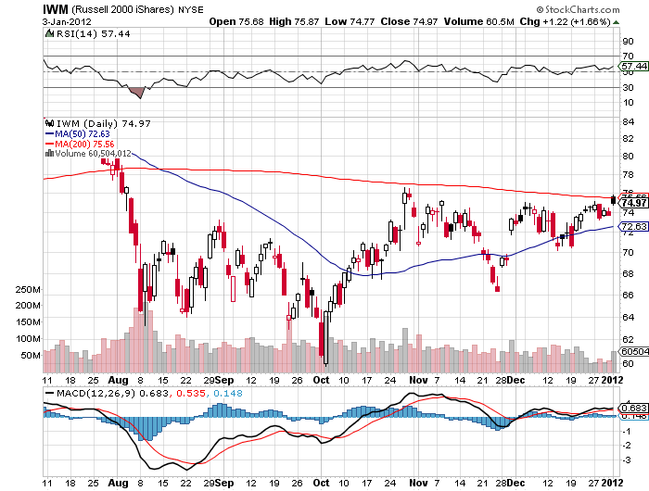
Russell 2000 (IWM)

Slide 19
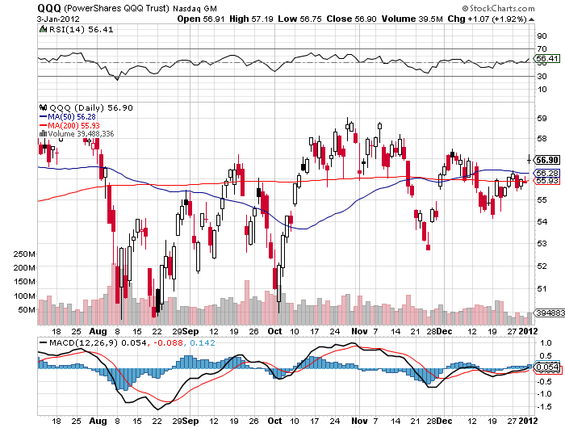
NASDAQ

Slide 20
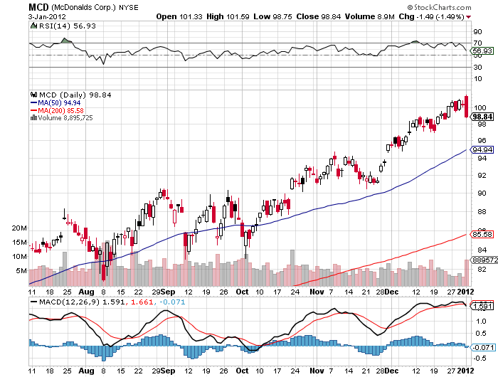
McDonalds (MCD)

Slide 21
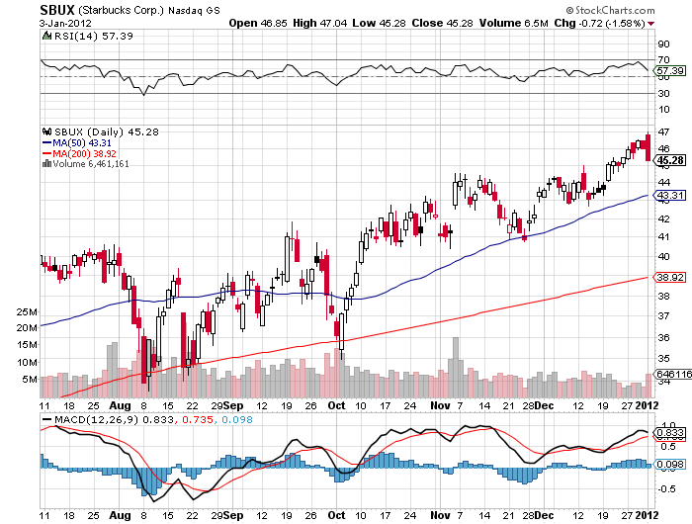
Starbucks (SBUX)

Slide 22
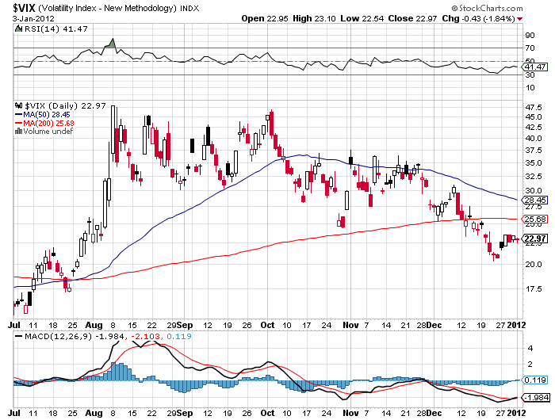
(VIX)

Slide 23
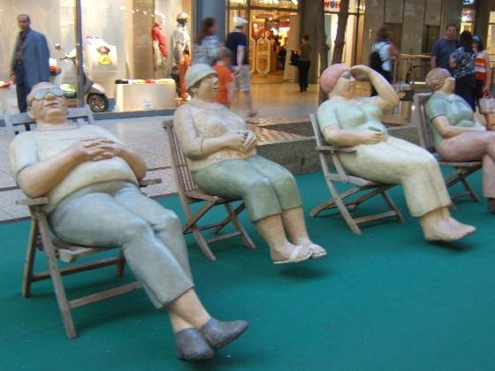
The Dollar
*Taking a rest while “RISK ON” is in vogue *Euro is drifting up on a news drought *Waiting to slam the Euro *Ausie on fire, a nice short is setting up *Italian bond yields lingering at the 7% handle *German bond auction went well *Europe has €750 billion to roll over at double the coupons *Euro shorts at all time high

Slide 24
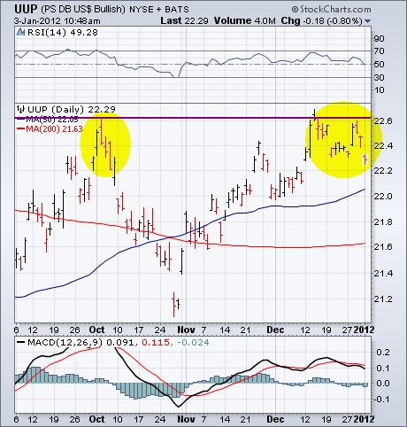
(UUP)

Slide 25
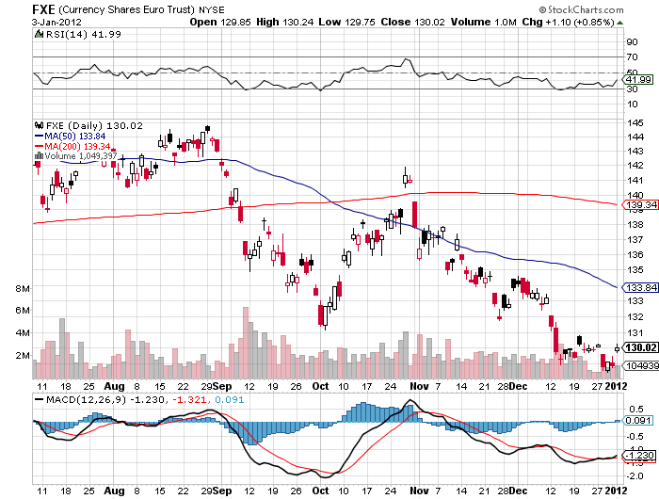
(FXE)

Slide 26
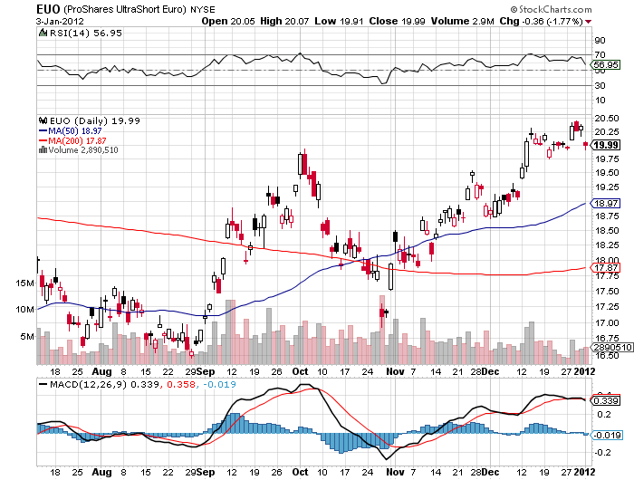
(EUO)

Slide 27
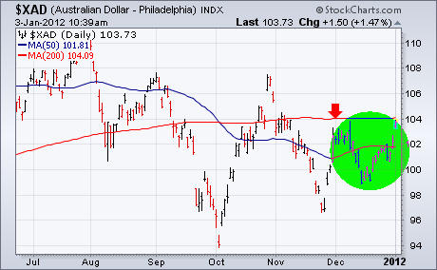
Australian Dollar ($XAD)

Slide 28
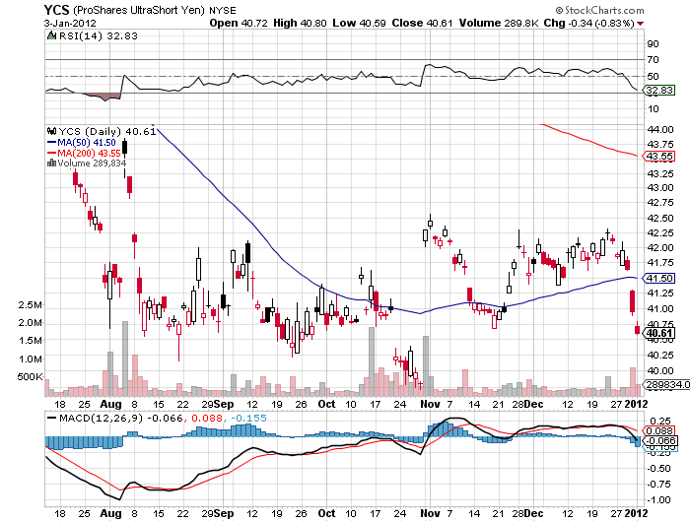
(YCS)

Slide 29
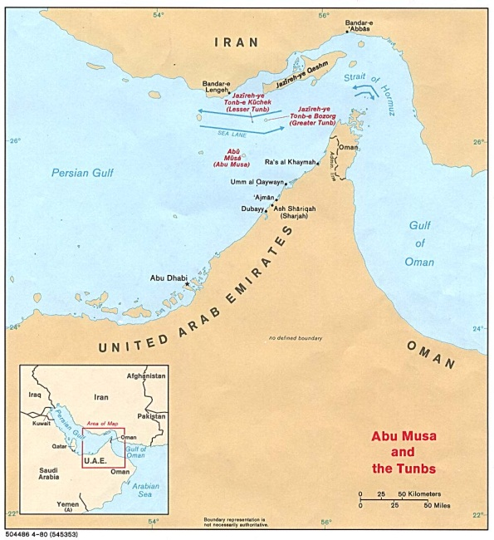
Energy
*Iran scare bumps oil up to $103 *Great shorting opportunity setting up *Look for a 2012 range of $75-$110 *At $110 USO puts start to look very interesting *Iran will never block the straights of Hormuz *China has quit buying Iranian oil, diverting ships from elsewhere *Will see $75 again in next big “RISK OFF” ROUND *Natural gas hits new lows

Slide 30
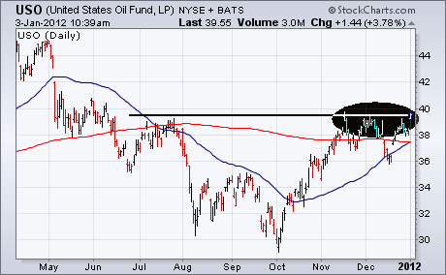
Crude

Slide 31
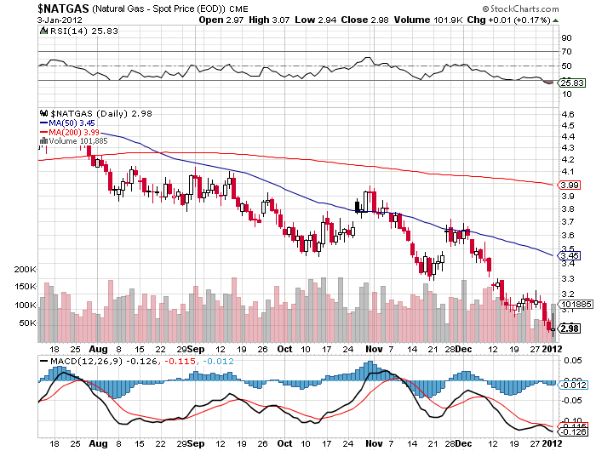
Natural Gas

Slide 32
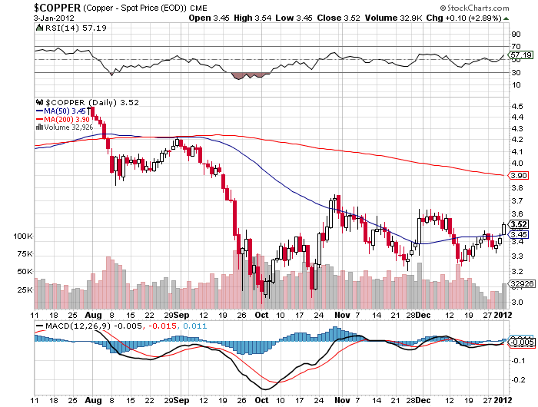
Copper

Slide 33

Precious Metals
*Interim low is hit *The hot money is moving back in for a trade *Possibly a $200 rally off lows *Year end selling pressure from hedge funds is done

Slide 34
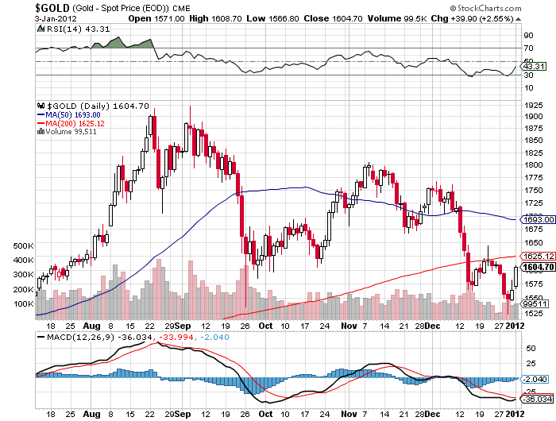
Gold

Slide 35
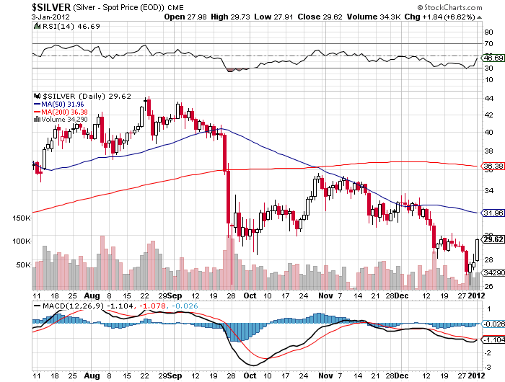
Silver

Slide 36
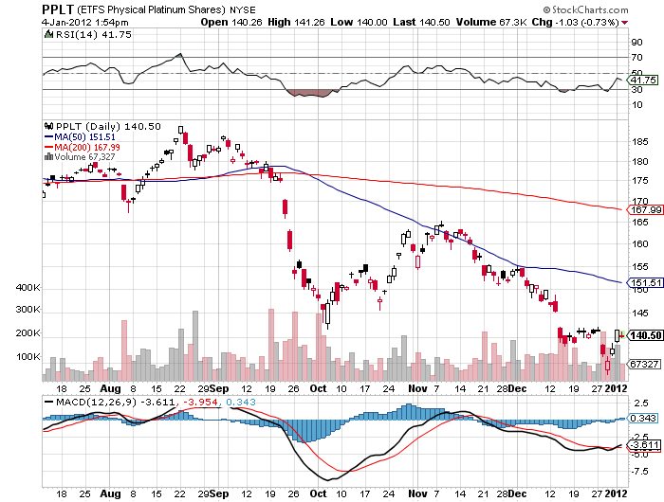
(Platinum)

Slide 37
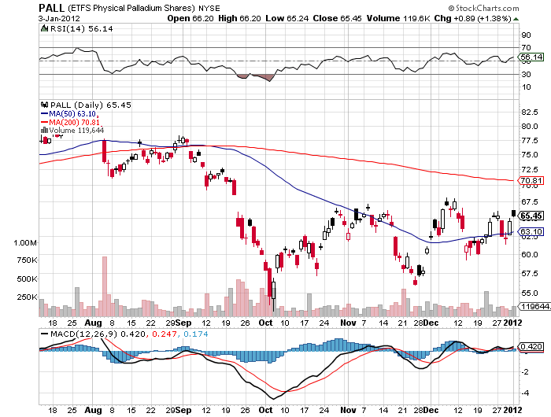
Palladium

Slide 38

The Ags
*Dry conditions in South America prompt a 10% rally *USDA crop report coming up *”RISK ON” is helping *Stand aside-no trade

Slide 39
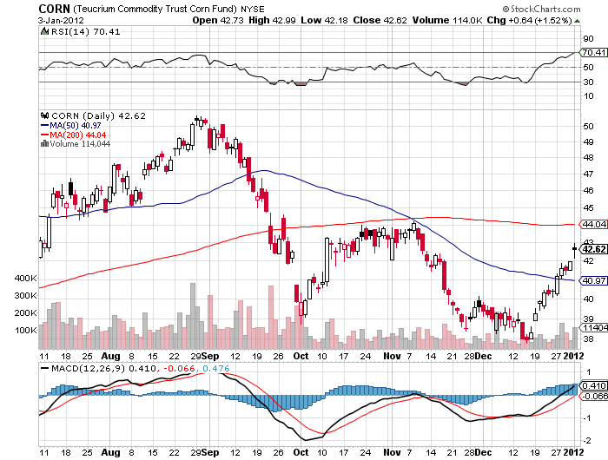
(CORN)

Slide 40
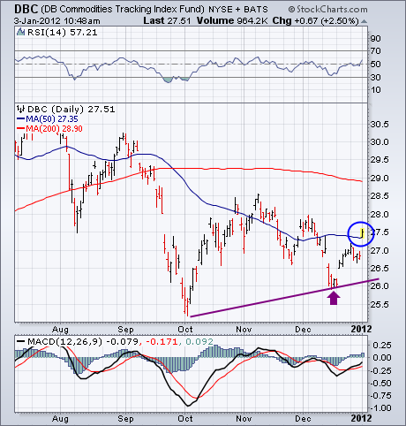
(DBA)

Slide 41
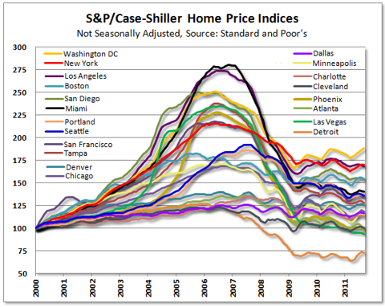
Real Estate September

Slide 42

Trade Sheet The bottom line: Trade or die
*Stocks-stand aside, wait to short *Bonds- stand aside, wait for “RISK OFF” *Commodities- stand aside-middle of range *Currencies- sell Euro rallies from $1.33 *Precious Metals-stand aside-is the move real? *Volatility-buy under $20 *The ags – stand aside-missed the pop *Real estate-breaking to new lows Next Webinar is on Wednesday, January 18, 2012

Slide 43

To access my research data base or buy strategy luncheon tickets Please Go to www.madhedgefundtrader.cpm

