Slide 1

Please Stand By for John Thomas Wednesday, February 15, 2012 Global Trading Dispatch
The Webinar will begin at 12:00 pm EST

Slide 2

The Mad Hedge Fund Trader The Grind Up Continues
Diary of a Mad Hedge Fund Trader February 15, 2012 www.madhedgefundtrader.com

Slide 3
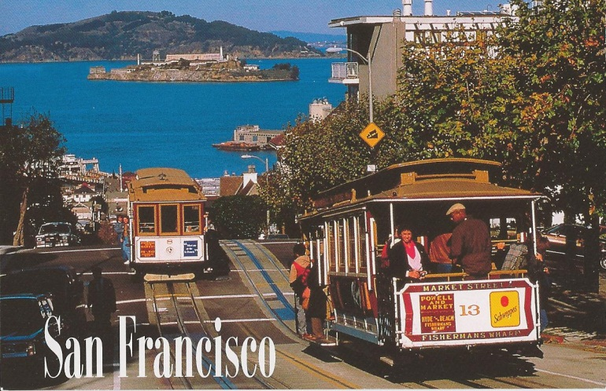

MHFT Global Strategy Luncheons Buy tickets at www.madhedgefundtrader.com
San Francisco April 20, 2012
Seminar at Sea July 11, 2012 Queen Mary 2

Slide 4

Trade Alert Performance
*February MTD +2.63% *2012 YTD +2.95% *First 64 weeks of Trading + 43.13% *Versus +4.5% for the S&P500 A 36.1% outperformance of the index
52 out of 63 closed trades profitable, users manual coming 82% success rate

Slide 5
Portfolio Review Stay Small Until a Reversal is Confirmed
Mad Hedge Fund Trader
Trading Book
Asset Class Breakdown
Risk Adjusted Basis
current capital at risk
Risk On
Risk Off
Short SPX (SDS) | -10.00%
total net position | -10.00%

Slide 6
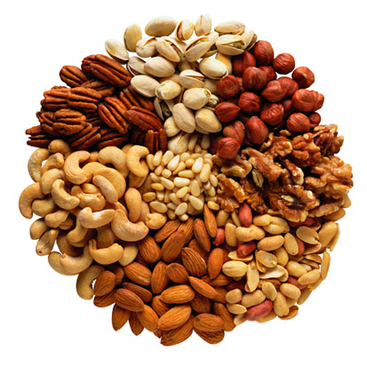
The Economy
*Economic data transitioning from strong to mixed *January Retail Sales 0.4% vs. 1% expected *Japan 2011 GDP came in at -2.3% *German ZEW economic sentiment index jumped from minus -21.6 to 5.4 *Weekly jobless claims -15,000 to 358,000 *Empire state survey 13.48 up to 19,53 in February *All consistent with a low 2.0% GDP growth rate

Slide 7
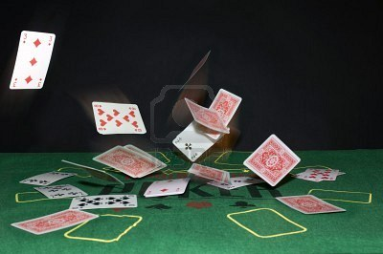
Bonds-Mixed Signals
*Still is not buying the “RISK ON” scenario *Ten year yields hit 1.79%, a new 60 year low *20 and 30 Year Treasury bonds are falling, yields rising *7-10 year bonds are rising, yields falling *Net, Net, bond investors are taking risk off the table JNK is tracking the equity market *Waiting for the next “RISK OFF” round to pop *Is this the final move?

Slide 8
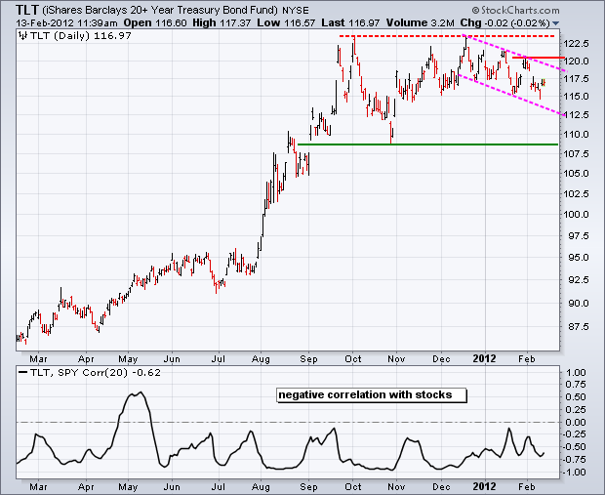
(TLT)

Slide 9
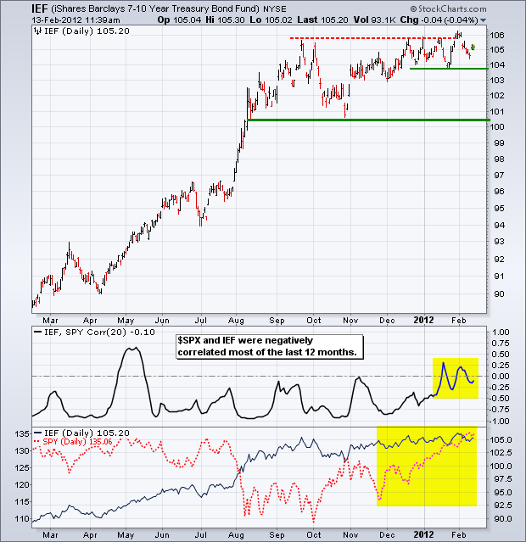
(IEF) 7-10 Year

Slide 10
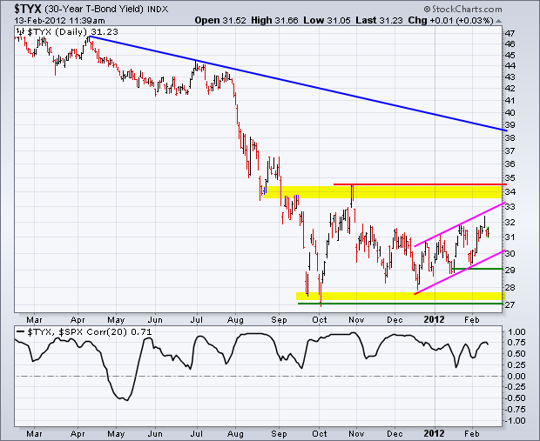
(TYX)

Slide 11
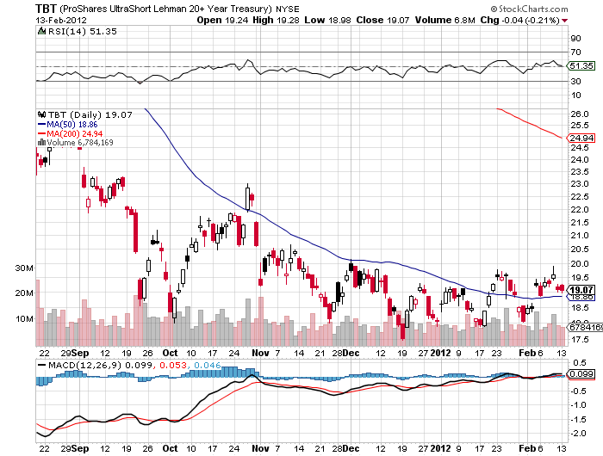
(TBT)

Slide 12
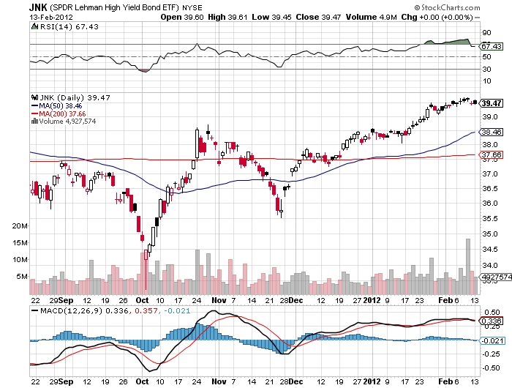
(JNK)

Slide 13

Stocks

Slide 14

Stocks
*Distilled down to a market of a single stock: Apple *We are 99% through a 300 point (SPX) move from 1,060 to 1,360 (two weeks ago was 93%), 13 to 14 multiple expansion *Global stock markets most overbought in years *Stocks are still going up marginally, while most other stocks, bonds, copper, oil, precious metals, ags, Australian and Canadian dollar *Huge amount of money trapped on the sidelines is preventing normal corrections *Europe’s, and now Japan’s quantitative easing is spilling over into US stocks and bonds *Upside risks are still greater than downside risks *Risk of a sideways correction in time, not price, then a pop *No one in the market except hedge funds and institutions, volume collapsing, Volker rule

Slide 15
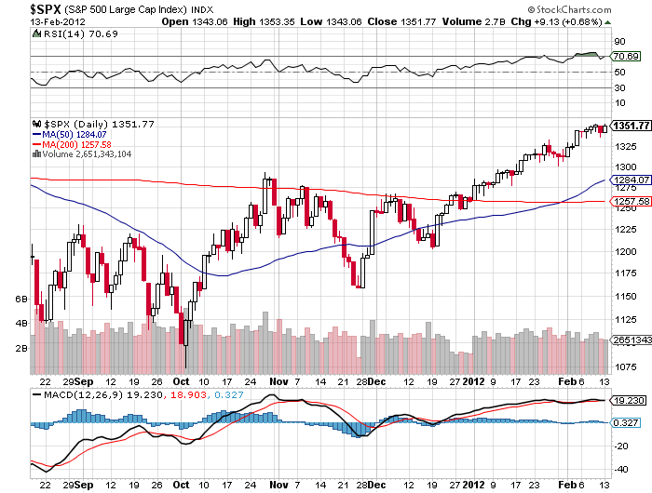
(SPY)

Slide 16
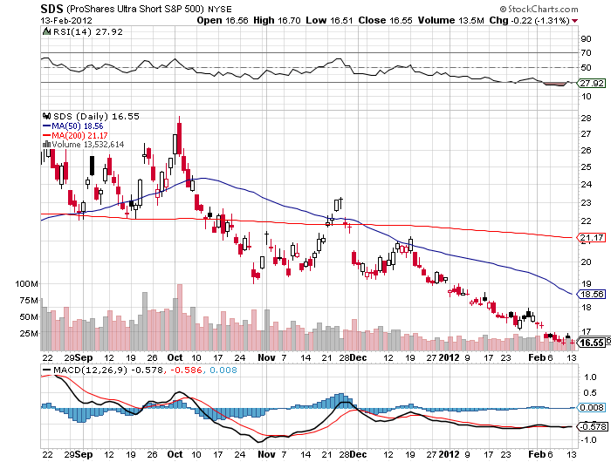
Double Short S&P 500 ETF(SDS)

Slide 17
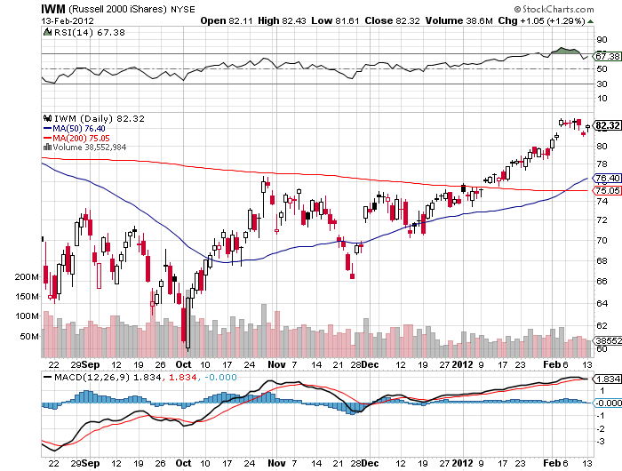
Russell 2000 (IWM)

Slide 18
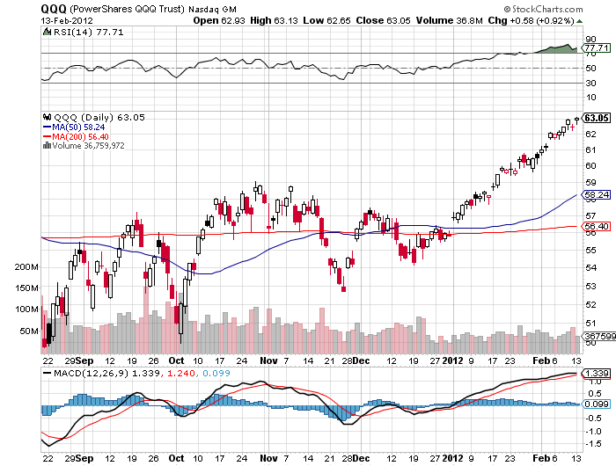
NASDAQ

Slide 19
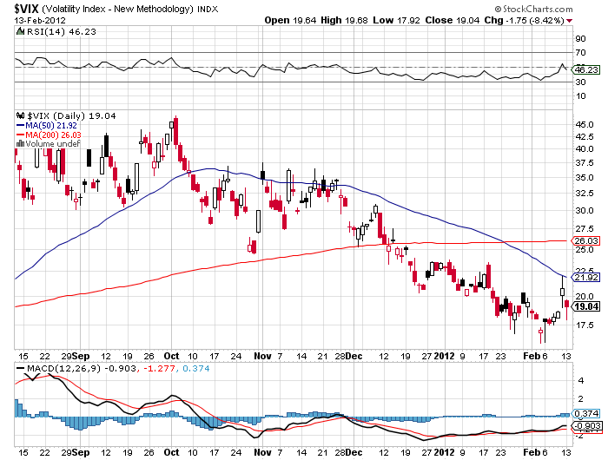
(VIX)

Slide 20
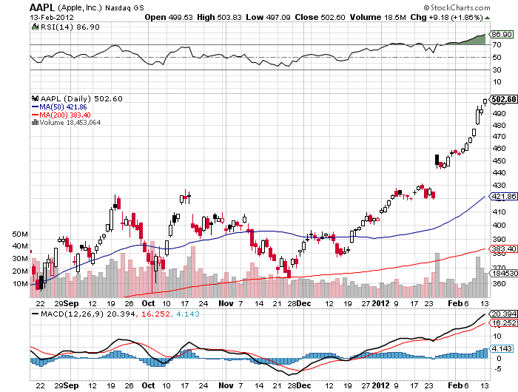
(AAPL)

Slide 21

The Dollar
*Major Breakout threatening in the yen *A 2011 -2.3% GDP forces the government to announce a more aggressive quantitative easing and 1% inflation target *Sell into the yen spike up, the low risk play is the ¥75-¥80 range, $126-$130 in the (FXY) *Made 3.18% on the short, 6.51% if you kept it, or 130% on the position Look to reestablish on next “RISK OFF” round *Euro shorts at a new all time high as hedge funds sell into the rally, possible $1.33 top *€500 billion in LTRO money in the market, maybe another €500 billion at month end *Australian dollar may be peaking here

Slide 22
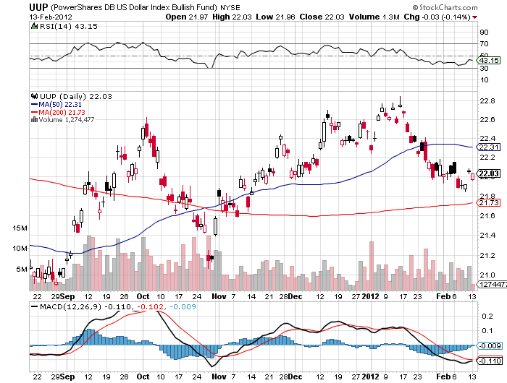
(UUP)

Slide 23
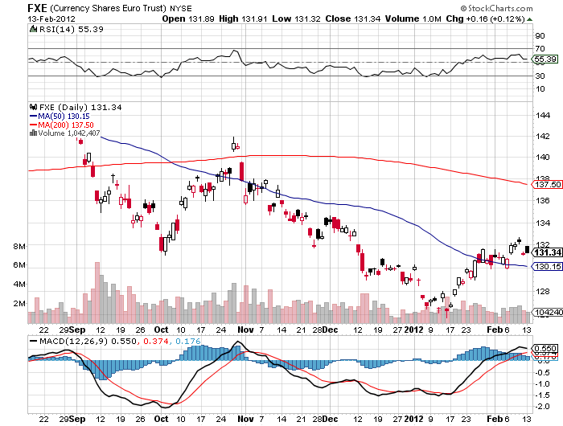
(FXE)

Slide 24
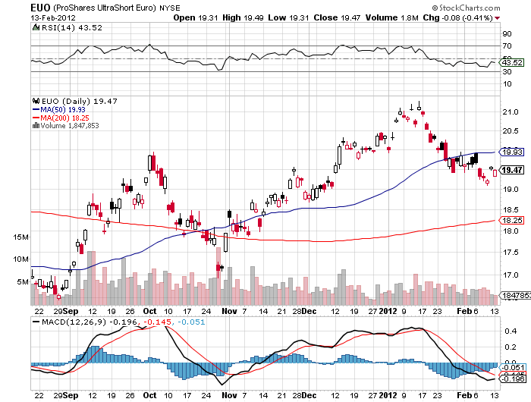
(EUO)

Slide 25
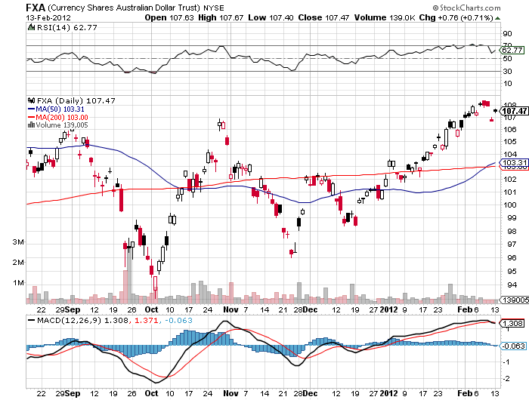
Australian Dollar (FXA)

Slide 26
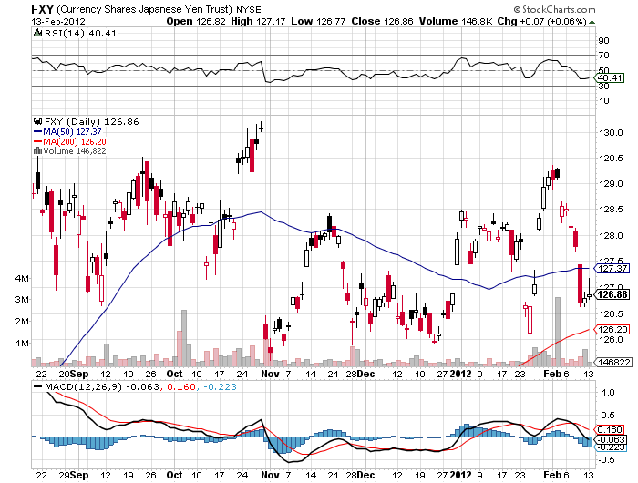
(FXY)

Slide 27
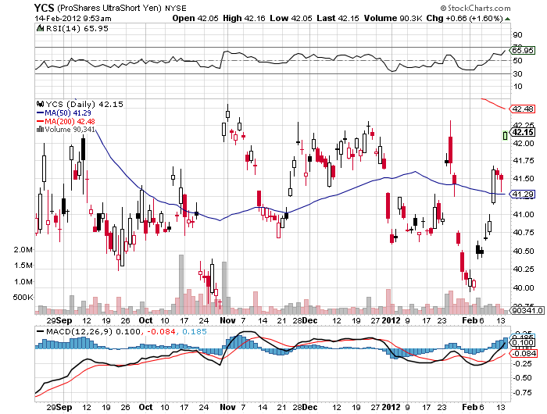
(YCS)

Slide 28
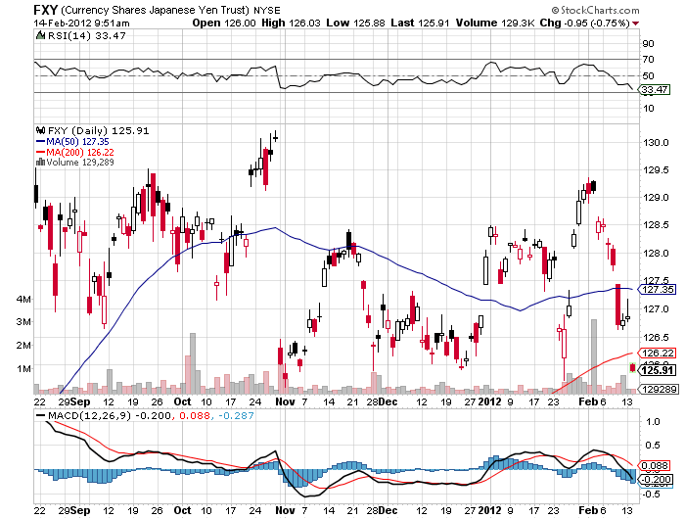
Japanese Yen (FXY)

Slide 29
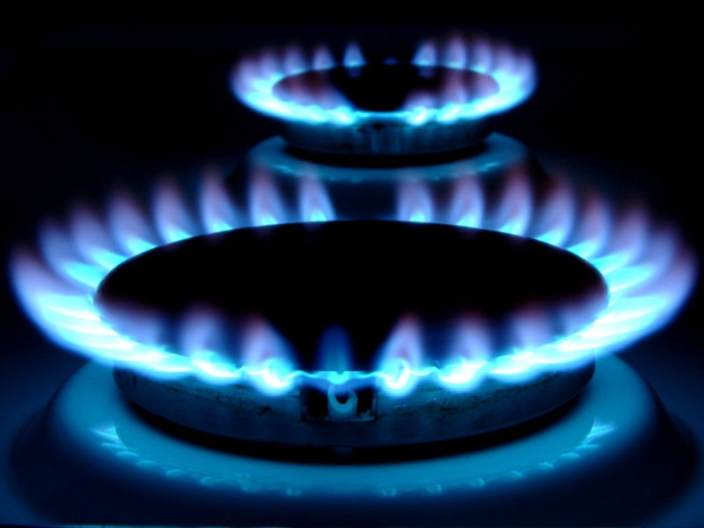
Energy
*Cooking with natural Gas, 3.77% profit on the short *Waiting to smack the next rally in Natural gas *Hold out for $3/MBTU, $6 in the (UNG) *Oil is flat lining around $100, despite Iran push *At $110 (USO) puts start to look very interesting *Will see $75 again in next big “RISK OFF” round, $50 if the Arab Spring makes it to Iran *Long term, not short term view

Slide 30
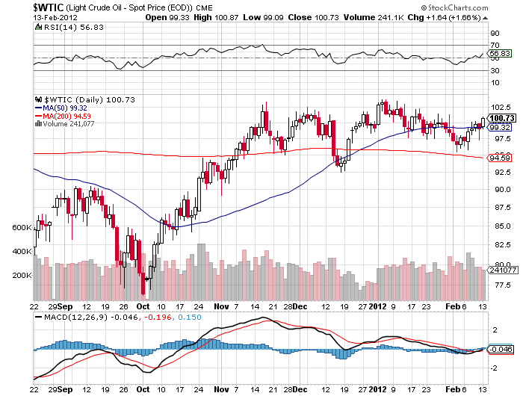
Crude

Slide 31
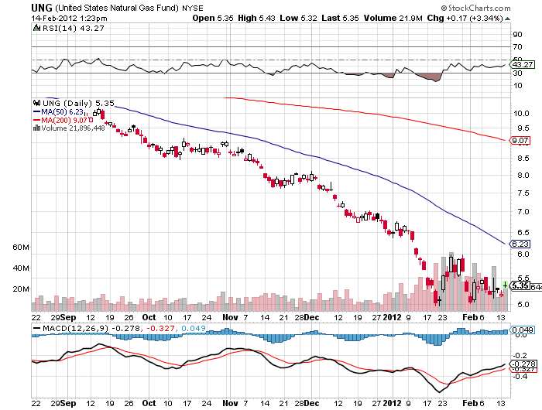
Natural Gas (UNG)

Slide 32
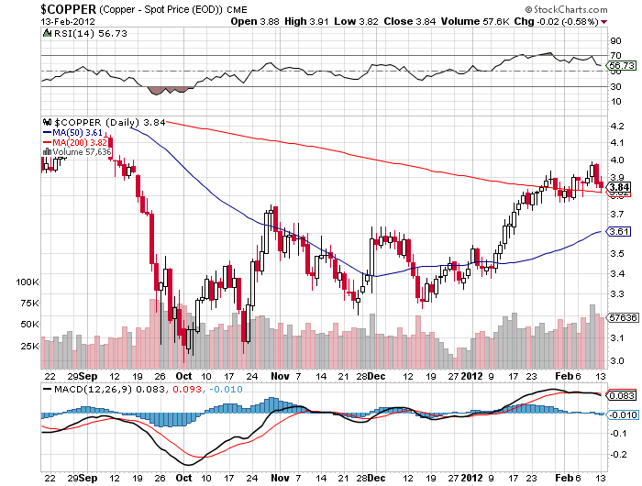
Copper

Slide 33
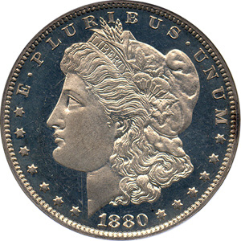
Precious Metals
*Is rolling over with other asset classes, except stocks *The hot money is moving back in for a trade *Short term overbought *The long term target is still $2,300 for gold, $100 for silver

Slide 34
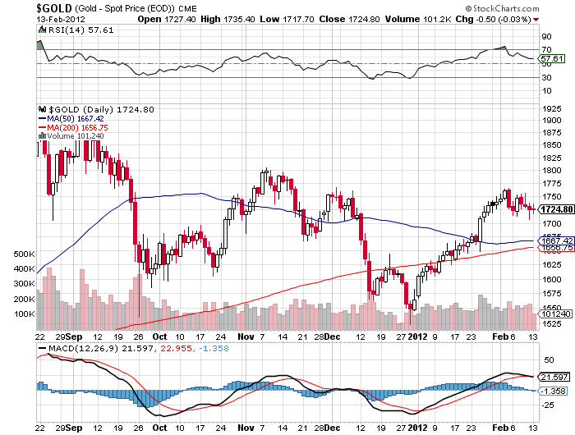
Gold

Slide 35
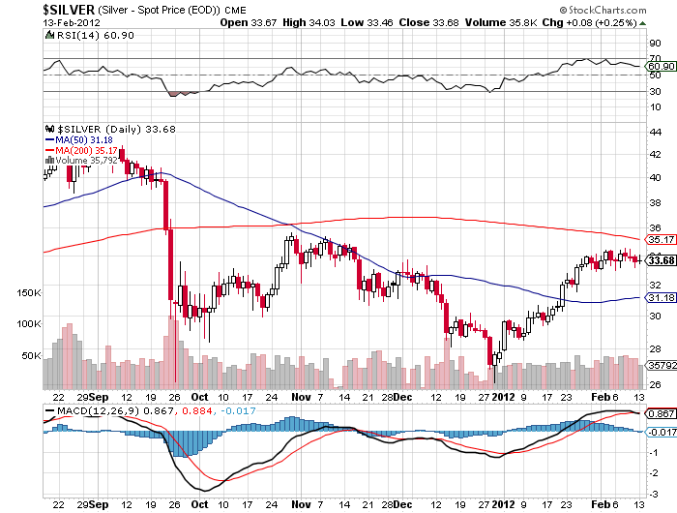
Silver

Slide 36
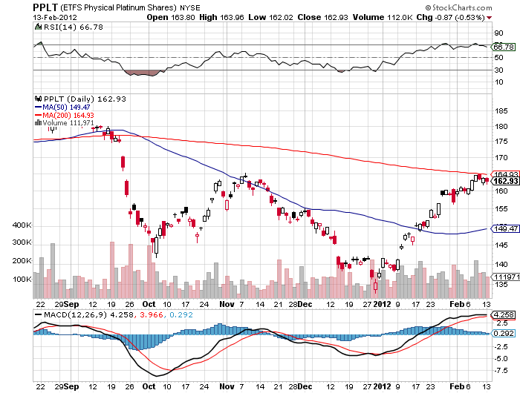
(Platinum)

Slide 37
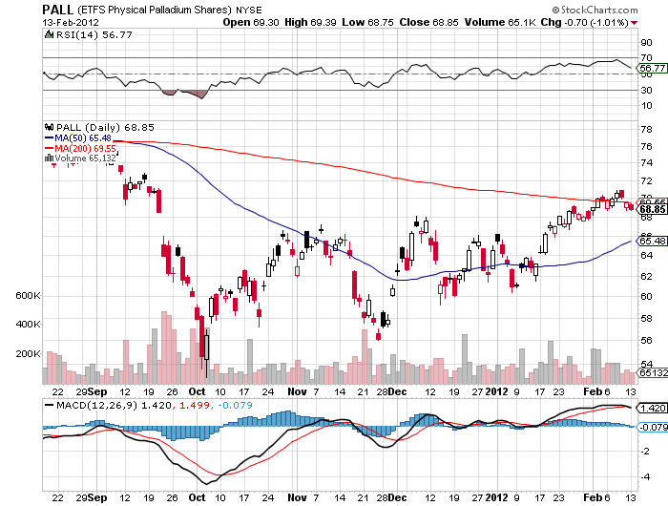
Palladium

Slide 38
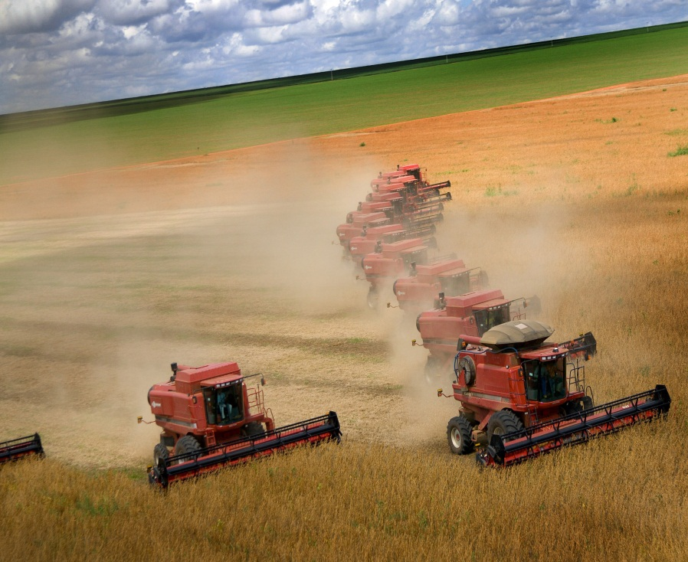
The Ags
*Out of Season *Still digesting the USDA January crop report disaster *Will be dead for a few more months *Stand aside-no trade for now but a nice buy is setting up *Long term positive fundamentals eventually kick in

Slide 39
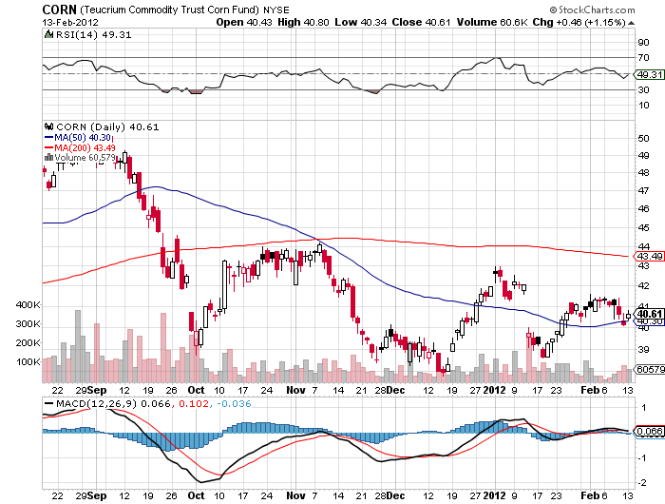
(CORN)

Slide 40
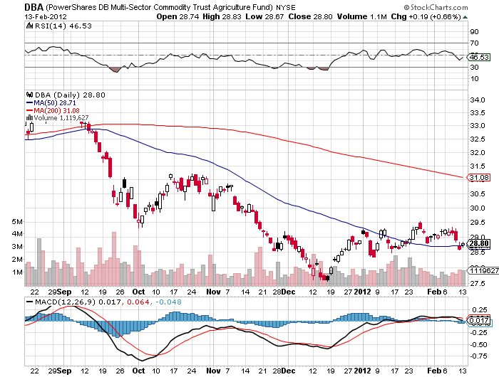
(DBA)

Slide 41
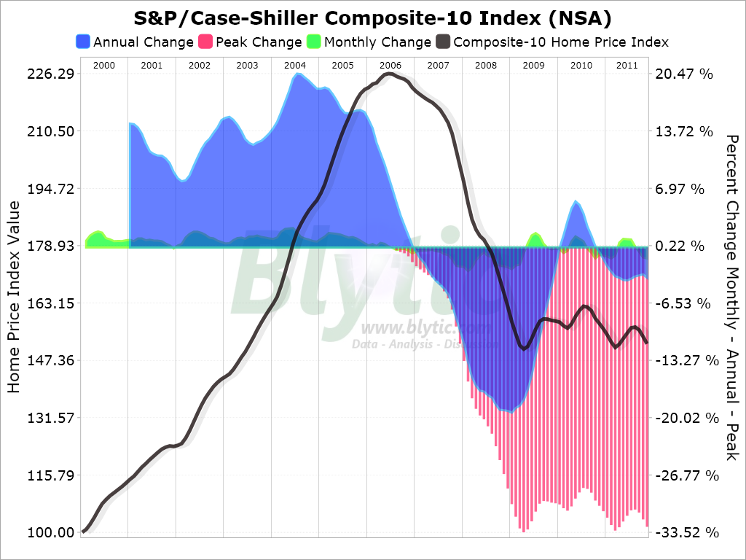
Real Estate September

Slide 42

Trade Sheet The bottom line: Trade or die
*Stocks-sell big rallies *Bonds- stand aside, buy the next dip *Commodities- sell rallies *Currencies- sell Euro and yen rallies *Precious Metals-wait for the next short to set up *Volatility-buy under $20 *The ags – stand aside wait for a bottom *Real estate-breaking to new lows Next Webinar is on Wednesday, February 29, 2012 (Sadie Hawkins Day)

Slide 43

To access my research data base or buy strategy luncheon tickets Please Go to www.madhedgefundtrader.com

