Slide 1

Please Stand By for
John Thomas
Wednesday, February 1, 2012
Global Trading Dispatch
The Webinar will begin at 12:00 pm EST

Slide 2
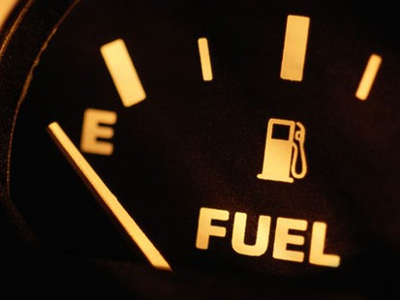
The Mad Hedge Fund Trader
Running out of Gas
Diary of a Mad Hedge Fund Trader
February 1, 2012
www.madhedgefundtrader.com

Slide 3
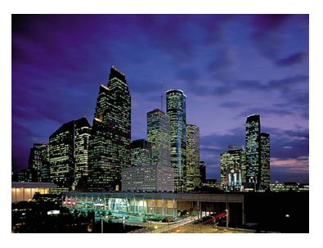
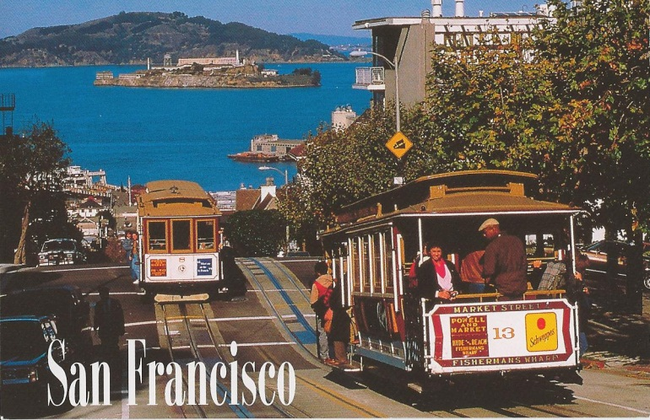
MHFT Global Strategy Luncheons
Buy tickets at www.madhedgefundtrader.com
Houston
February 9, 2012
San Francisco
April 20, 2012

Slide 4

Trade Alert Performance
*January MTD +0.32%
*2012 YTD +0.32%
*First 62 weeks of Trading
+ 40.35%
*Versus +4.5% for the S&P500
A 36.1% outperformance of the index
49 out of 61 closed trades profitable
80% success rate

Slide 5
Portfolio Review
Stay Small Until a Reversal is Confirmed
Mad Hedge Fund Trader
Trading Book
Asset Class Breakdown
Risk Adjusted Basis
current capital at risk
Risk On
short yen (FXY) | 5.00%
Risk Off
Short Euro (EUO) | 25.00%
Short (SPY) | -2.50%
Short SPX (SDS) | -10.00%
Short Nat Gas (UNG) | -5.00%
total | 12.50%

Slide 6
The Economy-Running out of Gas?
*January Chicago PMI down from 62.2 to 60.2
*January consumer confidence down from 64.5 to 61.1
*December personal income +0.5%, less than expected
*Personal Savings rate rises from 3.5% to 4.0%
*Weekly jobless claims jumped 21,000 to 377,000
clouds the picture
*Amazon earnings are terrible-consumer dying?
*Congressional Budget Office projects 2% US growth
for 2012 and 1% for 2013
*Watch the Friday January Nonfarm payroll.
Less that 200,000 will be a problem for risk assets
*All consistent with a low 2.0% GDP growth rate

Slide 7

Bonds-Yields edge down to new Territory
*Still is not buying the “RISK ON” scenario
*Ten year yields hit 1.79%, a new 60 year low
*Ten year could go to 1.60% in the next “RISK OFF” round
*Long term charts show the uptrend is still alive
*Bonds are predicting deflation
and recession for 2012
*Waiting for the next “RISK OFF” round to pop
*Is this the final move?

Slide 8
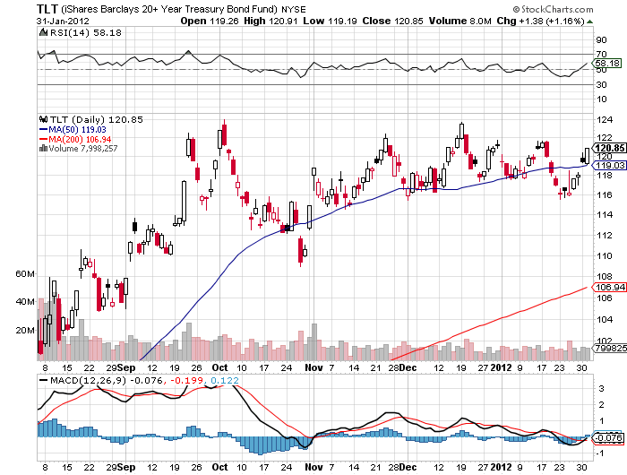
(TLT)

Slide 9
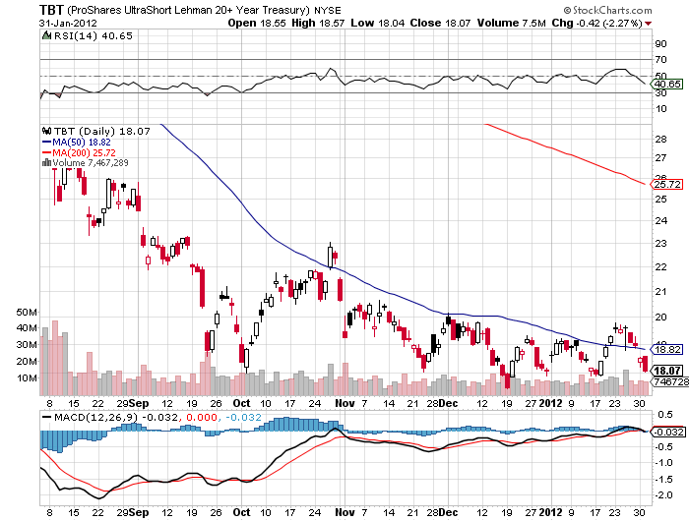
(TBT)

Slide 10
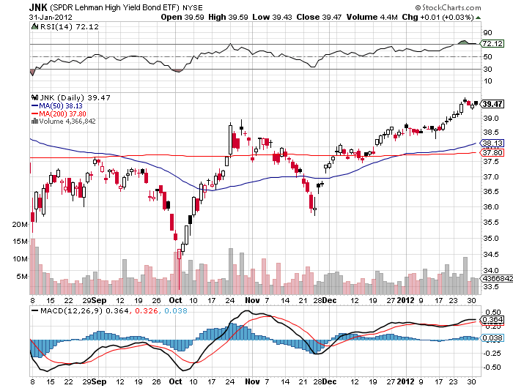
(JNK)

Slide 11
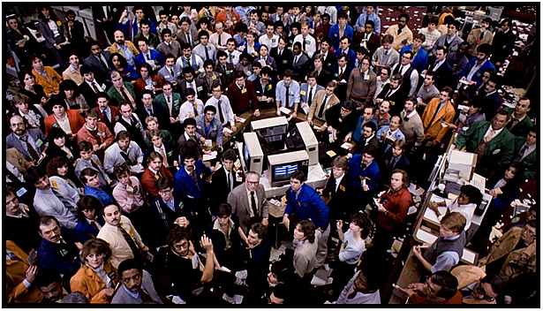
Stocks
*Best January in 15 years, up 4.6%
*We are 93% through a 300 point (SPX) move from 1,060 to 1,360
(two weeks ago was 80%)
*Global stock markets most overbought in years
*Still inside the range
*Is February the give back month?
*Value players and pension funds are making
their annual allocations, but running out of steam
*Europe’s quantitative easing is spilling over into
US stocks and bonds
*Don’t get sucked into the “golden cross”

Slide 12
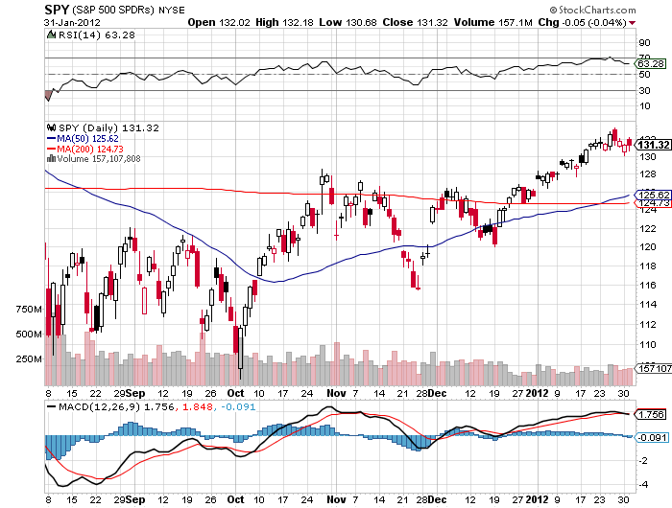
(SPY)

Slide 13
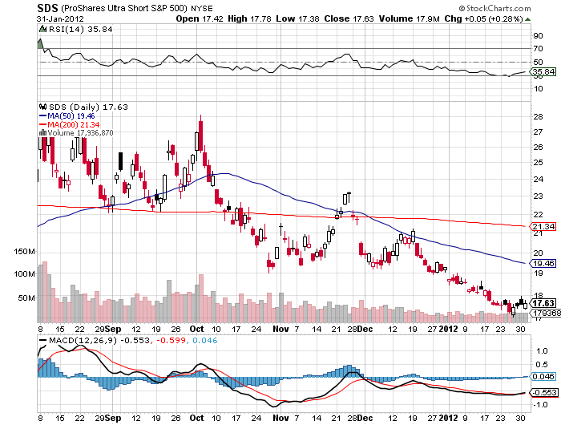
Double Short S&P 500 ETF(SDS)

Slide 14
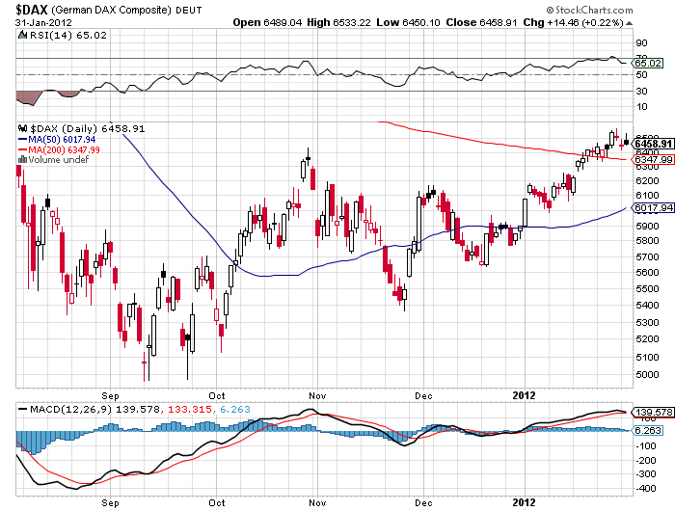
German DAX Composite(DAX)

Slide 15
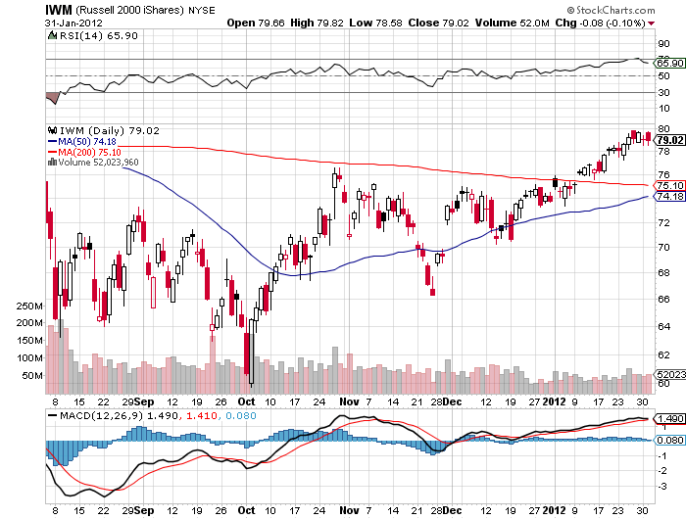
Russell 2000 (IWM)

Slide 16
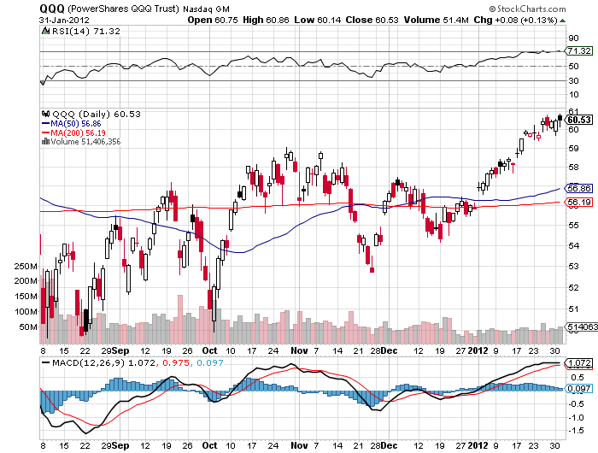
NASDAQ

Slide 17
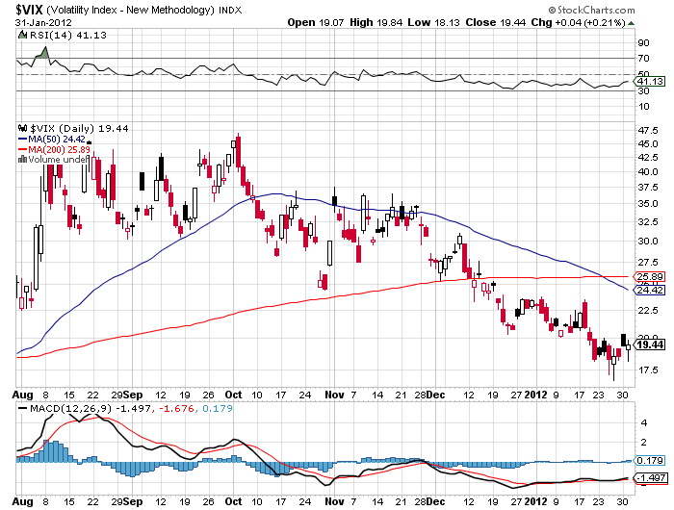
(VIX)

Slide 18
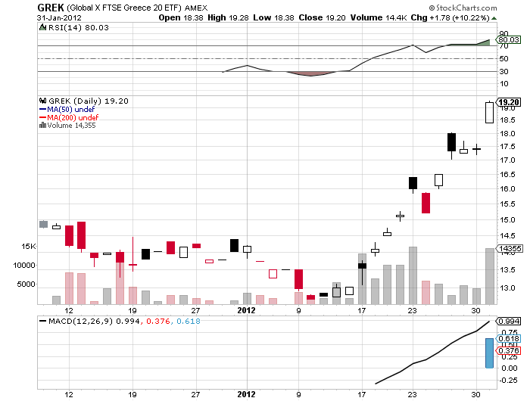
Greece (GREK)

Slide 19

The Dollar
*If “RISK OFF” is around the corner, so is a dollar rally
*Euro shorts at a new all time high as hedge funds
sell into the rally
*A six cent Euro rally on short covering
*Sell into the yen spike up, play the ¥75-¥80 range,
$126-$130 in the (FXY)
*Portuguese 10 year yields rocket from 14$ to 20%
the next chapter of the crisis?

Slide 20

European 10 Year Bond Yields
*Germany 1.80%
*Spain 5.10%
*Italy 6.40%
*Portugal 14.3%
*Greece 35%

Slide 21
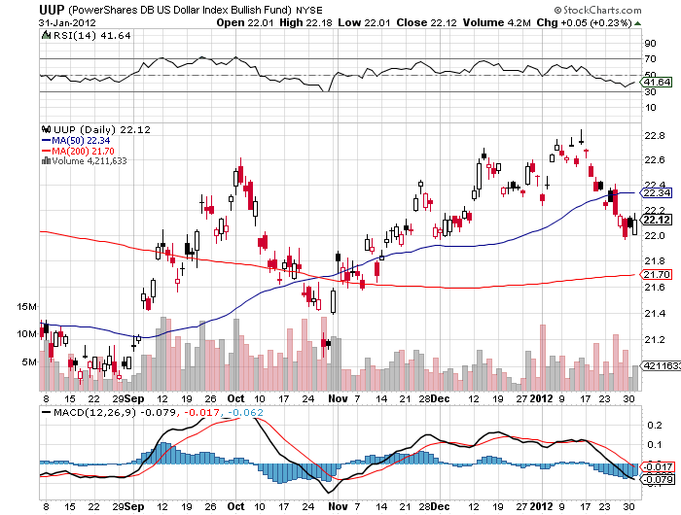
(UUP)

Slide 22
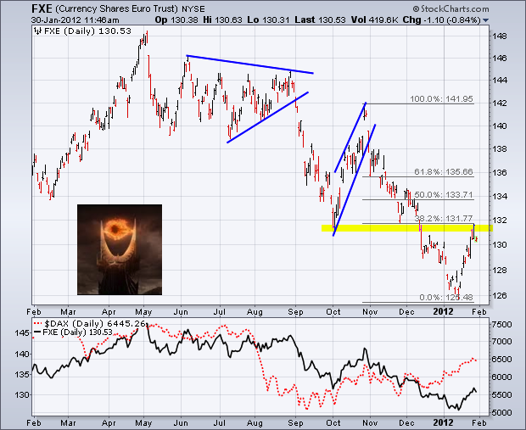
(FXE)

Slide 23
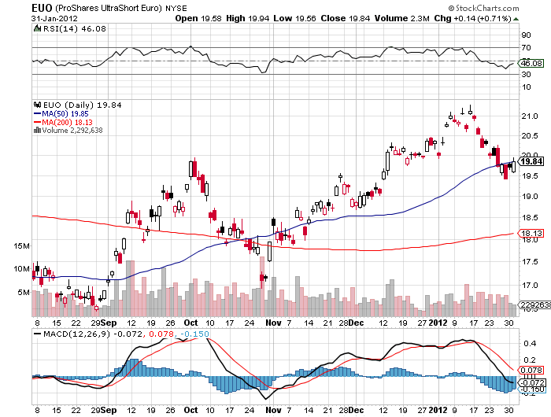
(EUO)

Slide 24
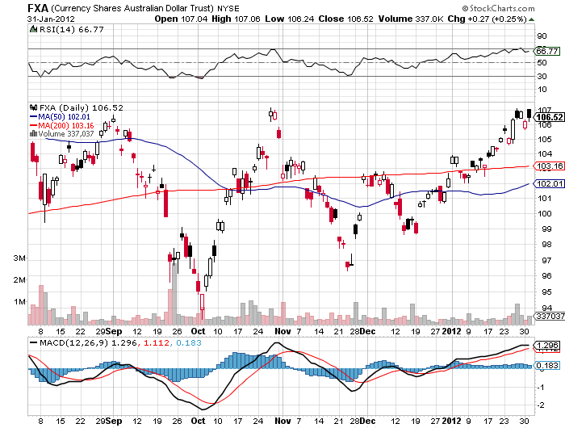
Australian Dollar (FXA)

Slide 25
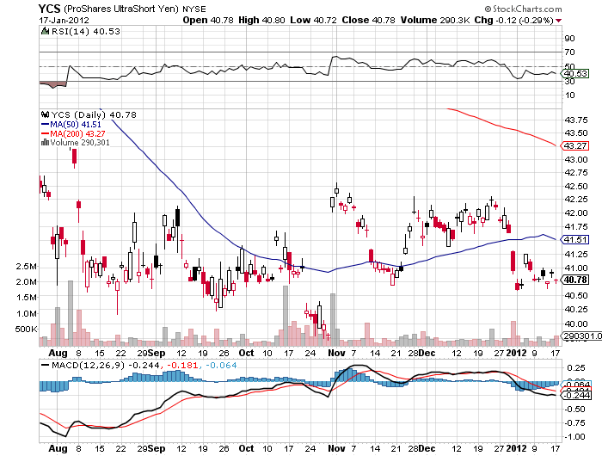
(YCS)

Slide 26
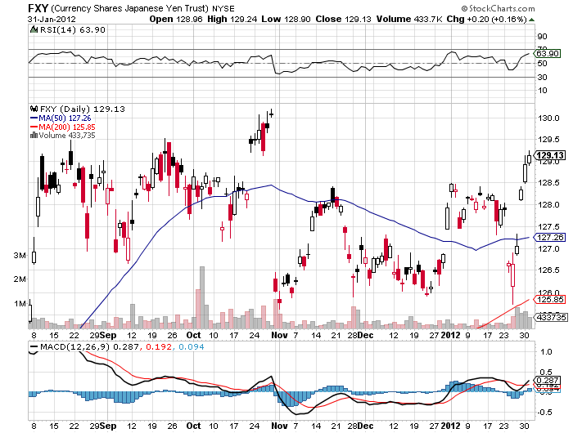
Japanese Yen (FXY)

Slide 27
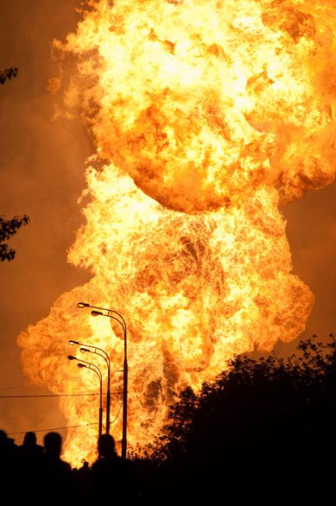
Energy
*Smack the rally in Natural gas
*One week 40% spike triggered by State of the Union
and (CHK) cutting production by half
*Remaining producers rushed to unload inventory
*Look to cover (UNG) puts when it hits $5
($1.30 in the puts) for a 100% gain
*Oil is flat lining around $100
*At $110 (USO) puts start to look
very interesting
*Will see $75 again in next big “RISK OFF” ROUND

Slide 28
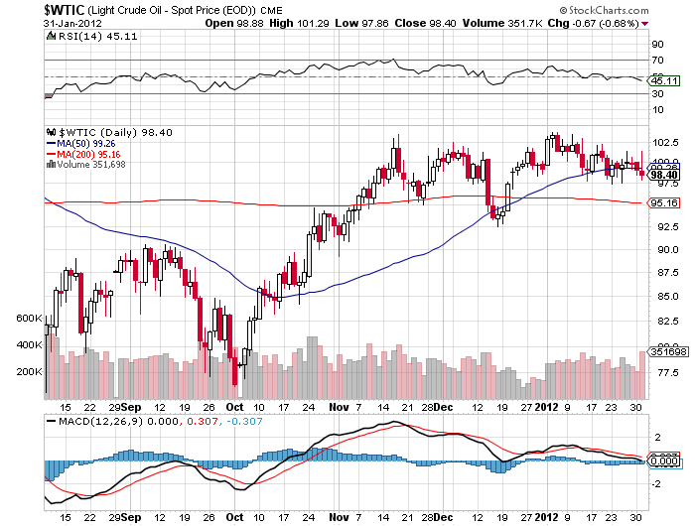
Crude

Slide 29
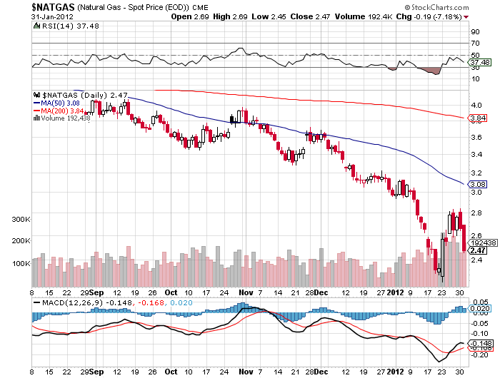
Natural Gas

Slide 30
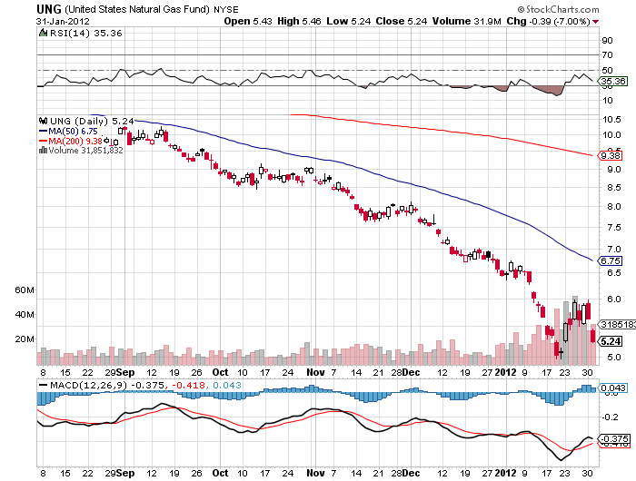
United States Natural Gas Fund (UNG)
First Home Run of the Year!

Slide 31
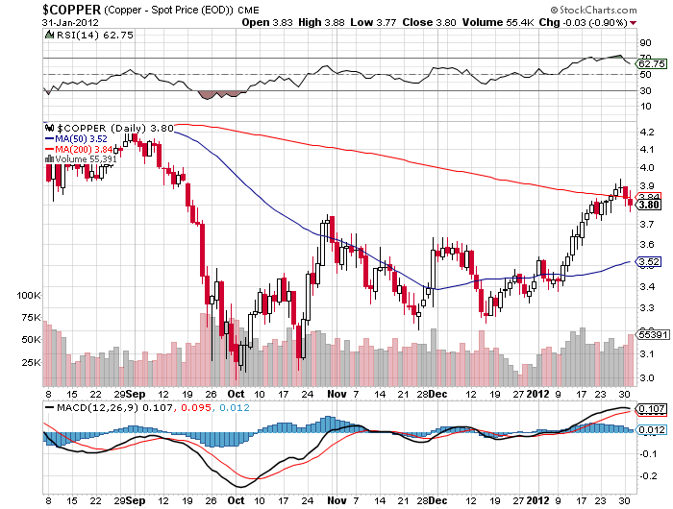
Copper

Slide 32
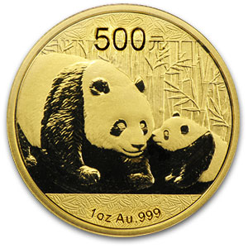
Precious Metals
*scrapage of gold is soaring, increasing supply
*The hot money is moving back in for a trade
*High prices drawing in more supply from mines
*Huge demand from China is driving prices
*Modest “RISK ON” push also helped
*Short term overbought
*The long term target is still $2,300

Slide 33
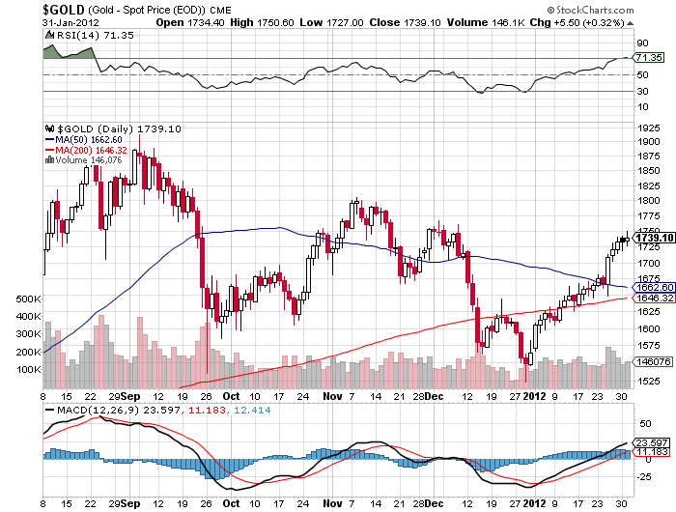
Gold

Slide 34
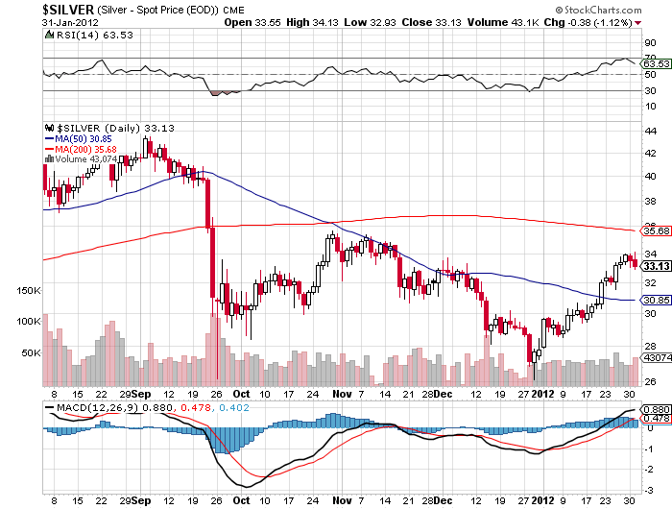
Silver

Slide 35
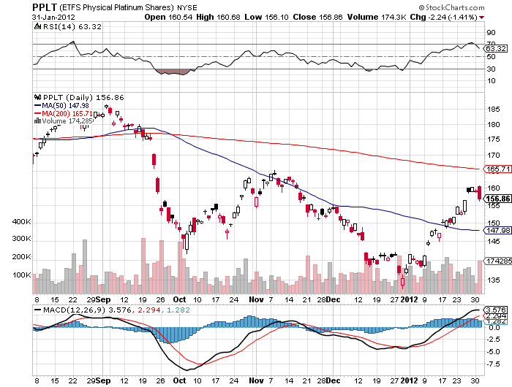
(Platinum)

Slide 36
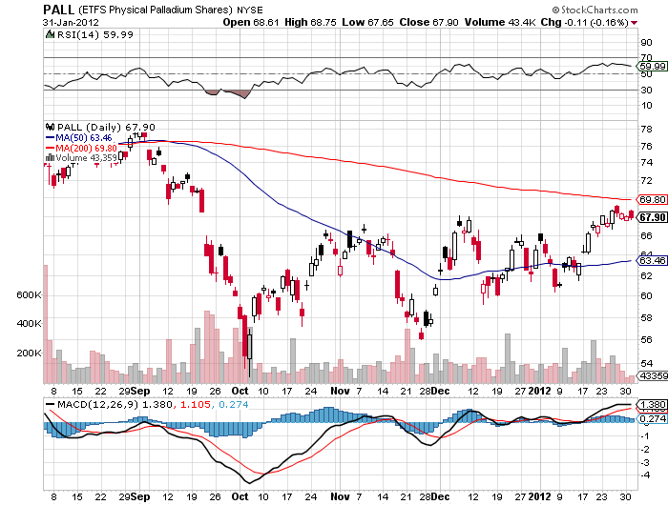
Palladium

Slide 37
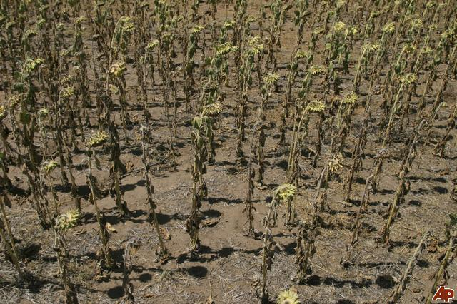
The Ags
*Still digesting the USDA January crop report disaster
*90% of traders were caught the wrong way
*Will be dead for a few more months
*Small lift in prices from the Argentina drought
*Stand aside-no trade for now
but a nice buy is setting up
*The weather always get bad again
*Long term positive fundamentals eventually kick in

Slide 38
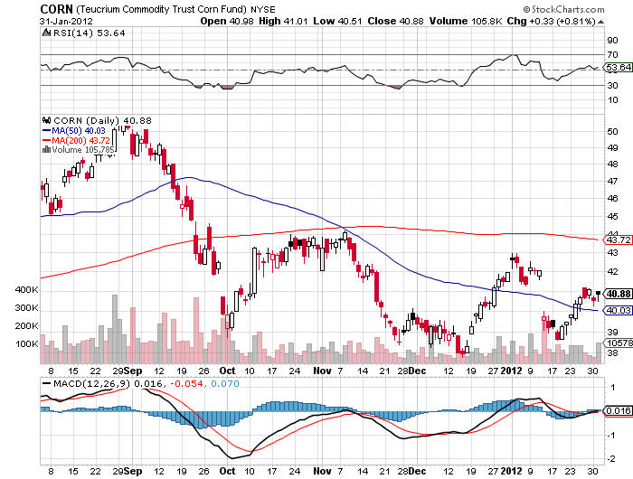
(CORN)

Slide 39
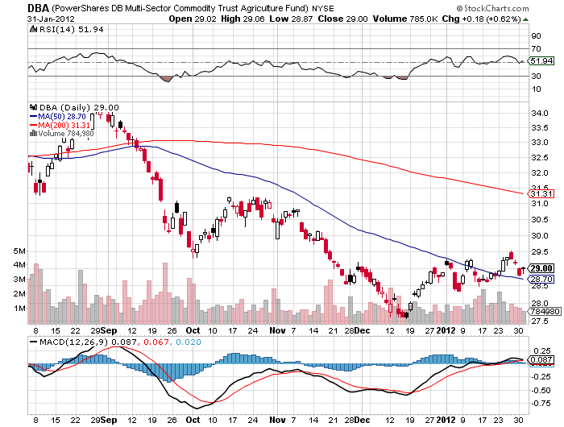
(DBA)

Slide 40
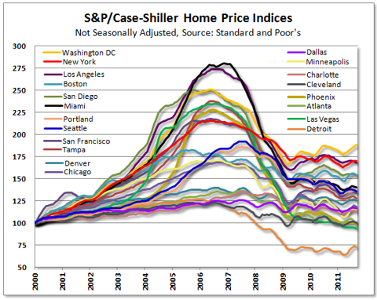
Real Estate
September

Slide 41

Trade Sheet
The bottom line: Trade or die
*Stocks-sell rallies
*Bonds- stand aside, made the move up
*Commodities- cover (UNG) short around $5
*Currencies- sell Euro and yen rallies
*Precious Metals-wait for the next short to set up
*Volatility-buy under $20
*The ags – stand aside wait for a bottom
*Real estate-breaking to new lows
Next Webinar is on Wednesday, February 15, 2012

Slide 42

To access my research data base or buy strategy luncheon tickets Please Go to www.madhedgefundtrader.com

