Slide 1
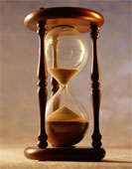
Please Stand By for
John Thomas
Wednesday, March 14, 2012
Global Trading Dispatch
The Webinar will begin at 12:00 pm EST

Slide 2
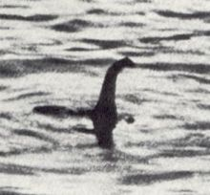
The Mad Hedge Fund Trader
Where is the 5% Correction?
Diary of a Mad Hedge Fund Trader
March 14, 2012
www.madhedgefundtrader.com

Slide 3

MHFT Global Strategy Luncheons
Buy tickets at www.madhedgefundtrader.com
2012 Schedule
April 20 San Francisco
May 3 Scottsdale
June 11 Beverly Hills
June 29 Chicago
July 5 New York
July 6-13 Queen Mary II
New York to Southampton
July 16 London
July 17 Paris
July 18 Frankfurt
July 27 Zermatt
October 26 San Francisco
November 8 Orlando
January 3, 2013 Chicago

Slide 4
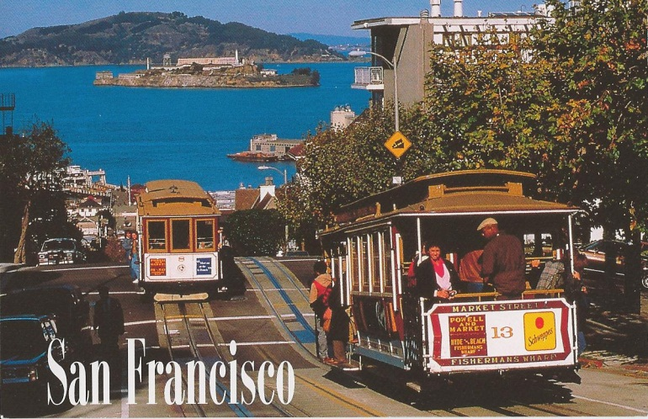

MHFT Global Strategy Luncheons
Buy tickets at www.madhedgefundtrader.com
San Francisco, CA
April 20, 2012
Scottsdale, AZ
May 3

Slide 5

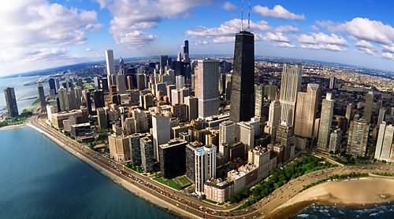
MHFT Global Strategy Luncheons
Buy tickets at www.madhedgefundtrader.com
Beverly Hills, CA
June 11
Chicago, IL
June 29

Slide 6


MHFT Global Strategy Luncheons
Buy tickets at www.madhedgefundtrader.com
New York, NY
July 5
Seminar at Sea
July 11, 2012
Queen Mary 2

Slide 7

Trade Alert Performance
*March MTD -5.96%
*2012 YTD -2.92%
*First 68 weeks of Trading
+ 37.26%
*Versus +12.5% for the S&P500
A 24.76% outperformance of the index
55 out of 68 closed trades profitable, users manual coming
81% success rate

Slide 8
Portfolio Review
Stay Small Until a Reversal is Confirmed
Mad Hedge Fund Trader
Trading Book
Asset Class Breakdown
Risk Adjusted Basis
current capital at risk
Risk On
(AAPL) call spread | 20.00%
Risk Off
Short SPX (SDS) | -20.00%
long volatility (VXX) | -20.00%
total net position | -20.00%

Slide 9
Portfolio Review
Value of a 5% correction = 9.06%
-5.96% to +3.10%
 |  |  | Model Portfolio
Wednesday, March 14, 2012 | John Thomas |  | The Mad Hedge Fund Trader
 | Asset |  | Underlying | Notional |  |  |  |  |  | YTD
Symbol | Class | Long/Short | Stop Loss | Cost | Market |  |  |  |  | Profit
(SDS) | equity | long | $15.00 | $ 18.18 | $ 16.86 |  |  |  |  | -0.73%
(SDS) | equity | long | $15.00 | $ 16.69 | $ 16.86 |  |  |  |  | 0.10%
 |  |  |  | 17.43 average
(VXX) | equity | long | $20.00 | $ 23.76 | $ 30.00 |  |  |  |  | 2.63%
(VXX) | equity | long | $20.00 | $ 24.52 | $ 30.00 |  |  |  |  | 2.23%
 |  |  |  | 24.14 average
AAPL 4/2012 $450 calls | equity | long | $0.00 | $ 97.60 | $ 30.00 |  |  |  |  | -54.08%
AAPL 4/2012 $480 calls | equity | short | $0.00 | $ 70.25 | $ - |  |  |  |  | 56.20%

Slide 10

The Economy-Markets Are Ignoring Macro Data
*Economic data transitioning from strong to mixed
*China’s rollback to 7.5% GDP growth is big, down from 13%.
*Brazil fell from 6% to 2.9% in 2011.
*February nonfarm payroll at 227,000 is half the normal rate
*No QE3 from the Federal Reserve
*April earnings will disappoint
*Feb auto sales at 15.1 million annual rate. People are buying replacements, not long term investments like houses
*Weekly jobless claims rose 8,000 to 362,000, still healthy
*All consistent with a low 2.0% GDP growth rate

Slide 11
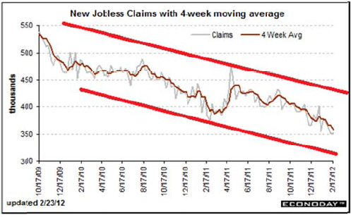
Weekly Jobless Claims

Slide 12
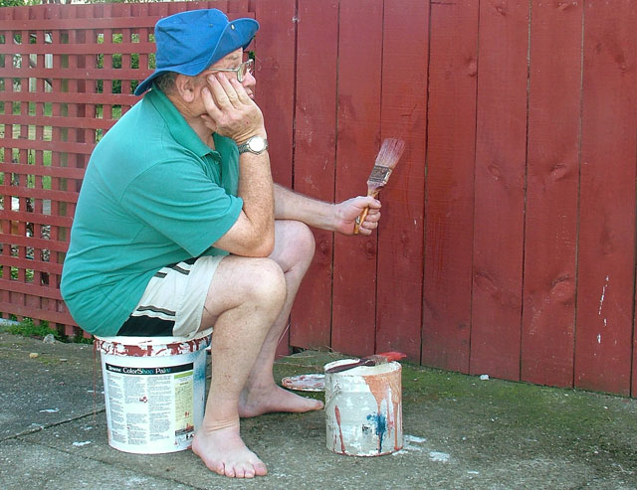
Bonds-Watching Paint Dry
*Most Interesting Chart of the week
*Still is not buying the “RISK ON” scenario
*Ten year yields threatening a breakout
from the 1.90-2.10% range?
*30 year charts breaking down
*Rising consensus that the 30 year top is this year
*Waiting for the next “RISK OFF” round to pop
*Is this the final move?

Slide 13
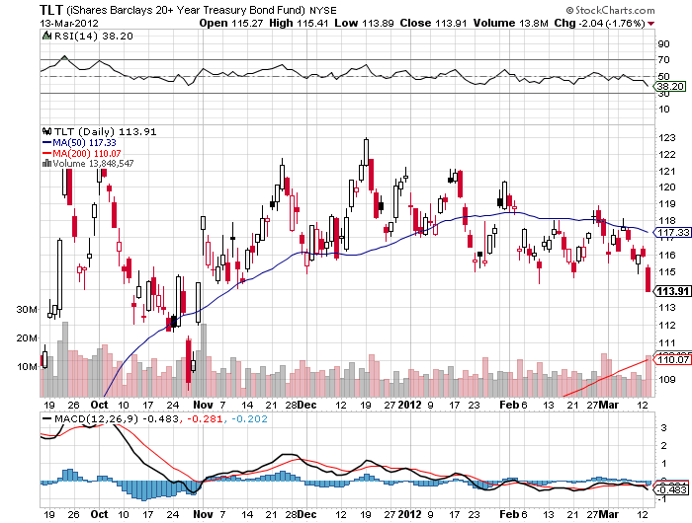
(TLT)

Slide 14
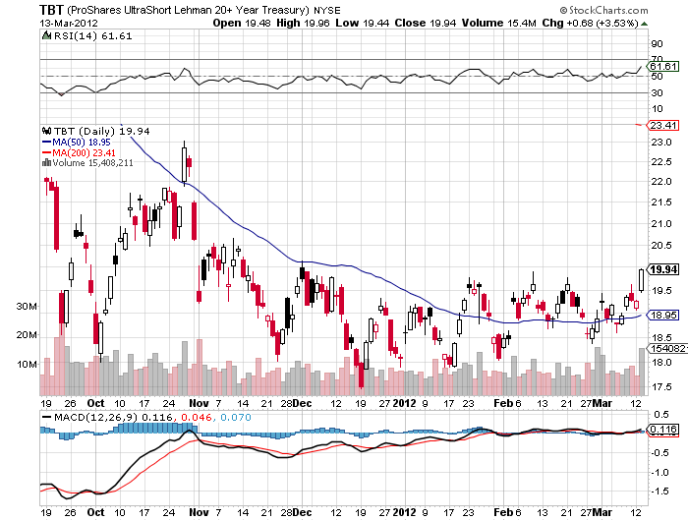
(TBT)

Slide 15
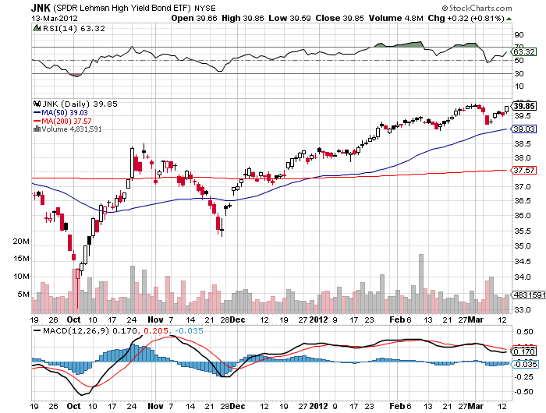
(JNK)

Slide 16

Stocks-Bring on the Rolling Top
*New High for the move, a 1,400 or 1,425 top?
*We are now at or above most 2012 targets
*Individuals, hedge funds, HF traders out of the market,
volume at the lowest of the year
*Number of rising stocks is narrowing
*Huge amount of money trapped on the sidelines
is preventing normal corrections
*End of QE or the Fed twist in June could trigger market crash
*Market internals are deteriorating rapidly,
falling volume, collapsing VIX, and insider selling
*Big push from (JPM), $12 billion buyback and
20% dividend increase

Slide 17
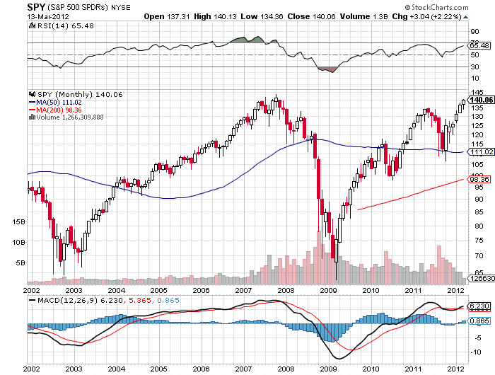
(SPY)

Slide 18
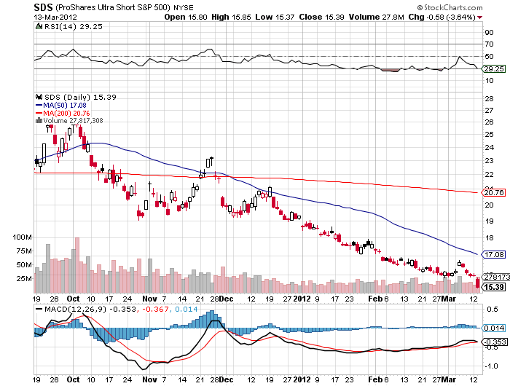
Double Short S&P 500 ETF(SDS)

Slide 19
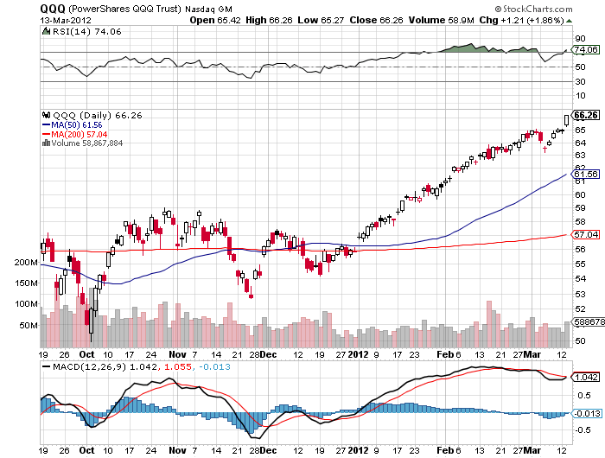
NASDAQ

Slide 20
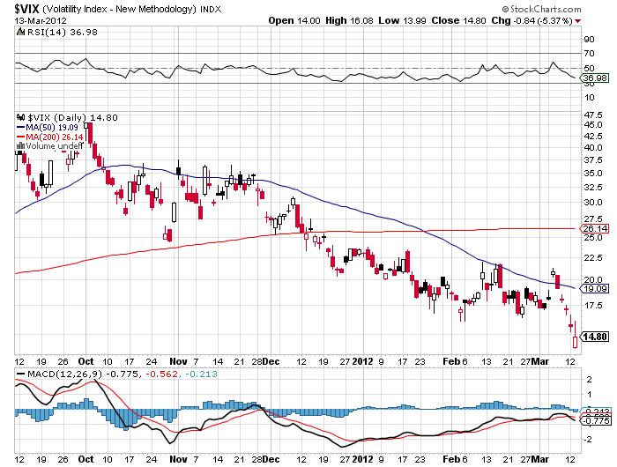
(VIX)

Slide 21
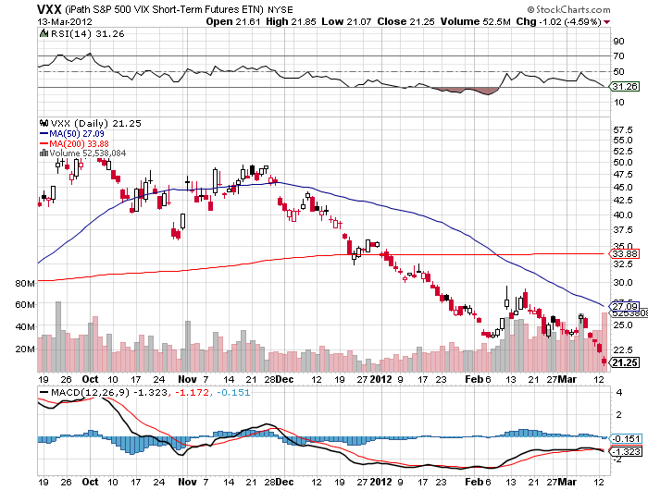
(VXX)

Slide 22
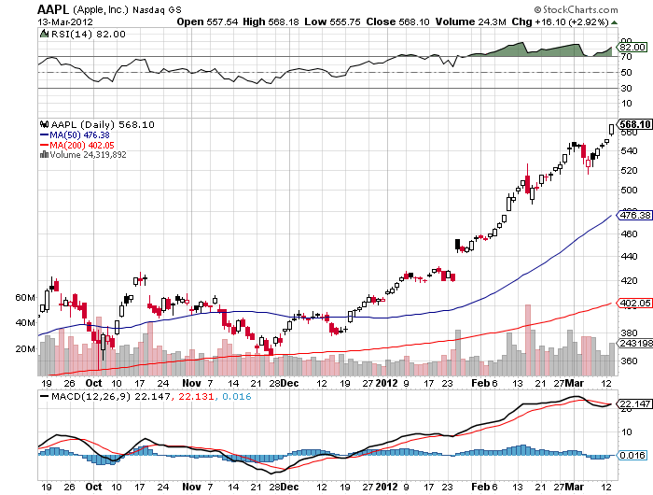
(AAPL)

Slide 23
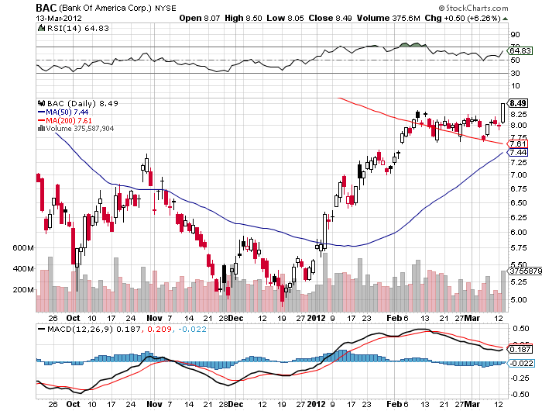
(BAC)

Slide 24
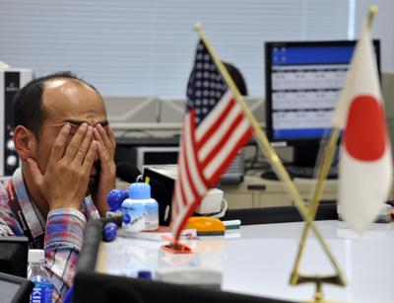
The Dollar
*The breakout is in for the yen
sell every rally for the next 20 years
*Still early days
*Next target is ¥85, then ¥90
*Look to reestablish yen short on next “RISK OFF” round
*no pullbacks of more than ¥1
*Bank of Japan stopped QE, but yen collapsed anyway.
*Ausie weak on China slowdown

Slide 25
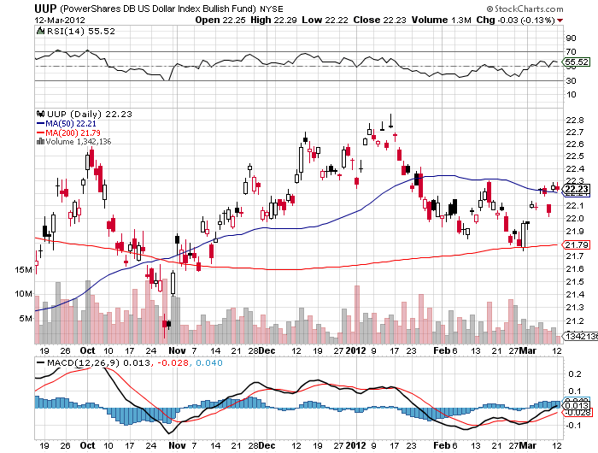
(UUP)

Slide 26
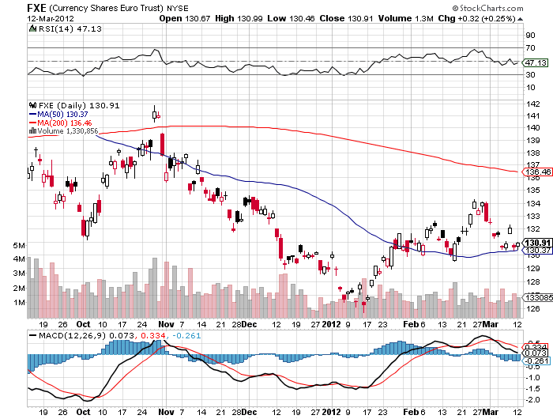
(FXE)

Slide 27
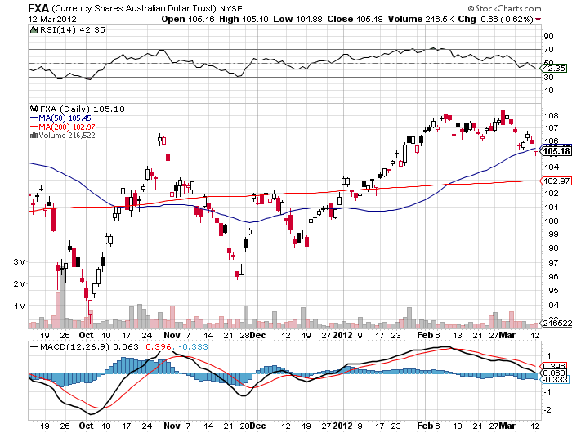
Australian Dollar (FXA)

Slide 28
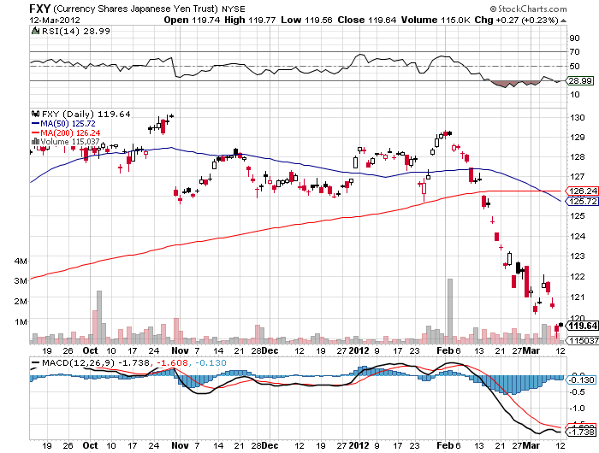
(FXY)

Slide 29
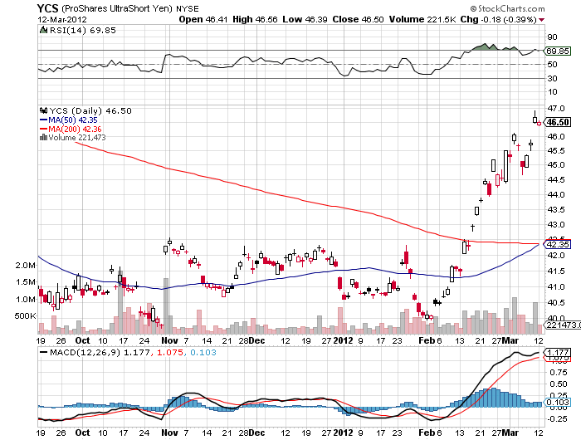
(YCS)

Slide 30
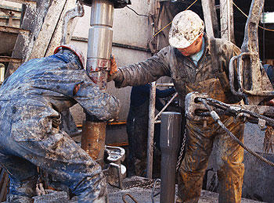
Energy
*Oil hit my $110 target
*Rising prices in a supply glut?
*Surging domestic production starting to
put a dent in prices, 3.5 million b/d by 2015
*At $110 (USO) puts start to look
very interesting
*Oil has gone quiet since the Iran election
*New lows in (UNG), wait for the next rally
*Natural gas collapse putting pressure on coal

Slide 31
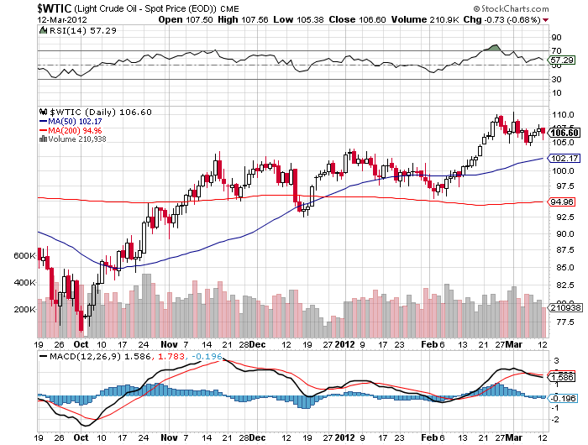
Crude

Slide 32
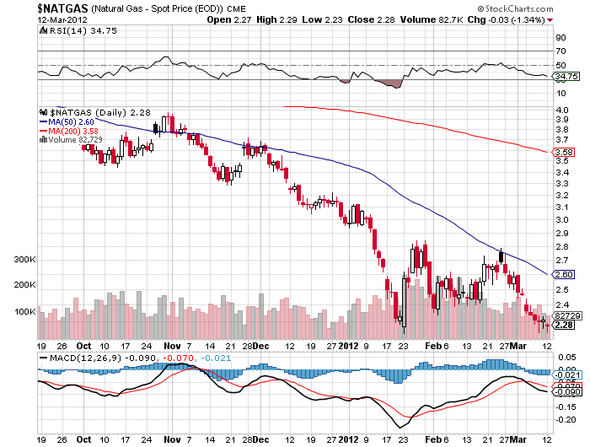
Natural Gas (UNG)

Slide 33
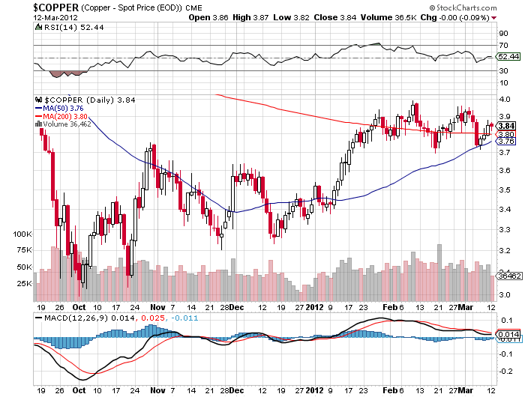
Copper

Slide 34
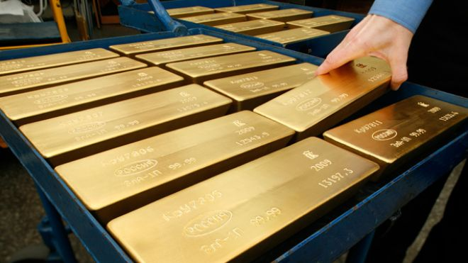
Precious Metals
*No QE means sell gold and silver
*Looking for $1,500 on the downside for gold
$25 for silver
*All of a sudden paper assets look sexy

Slide 35
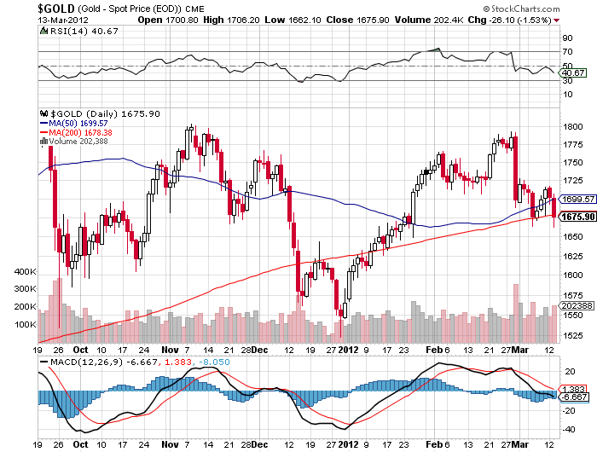
Gold

Slide 36
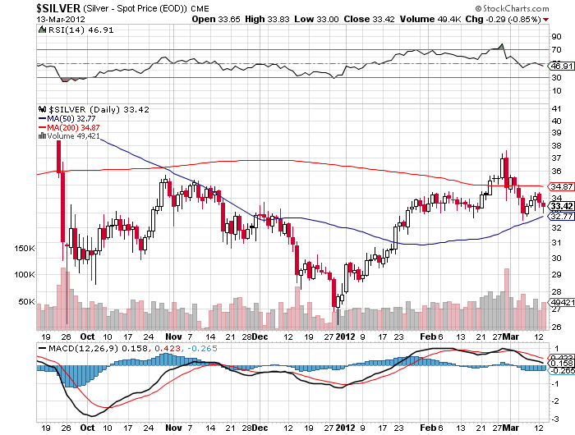
Silver

Slide 37
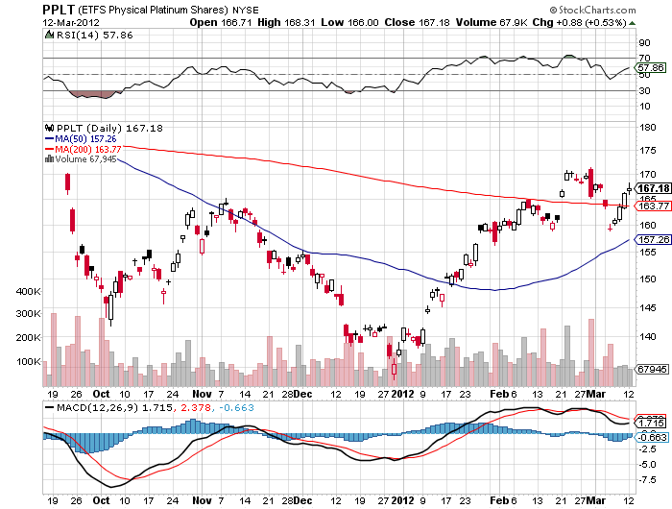
(Platinum)

Slide 38
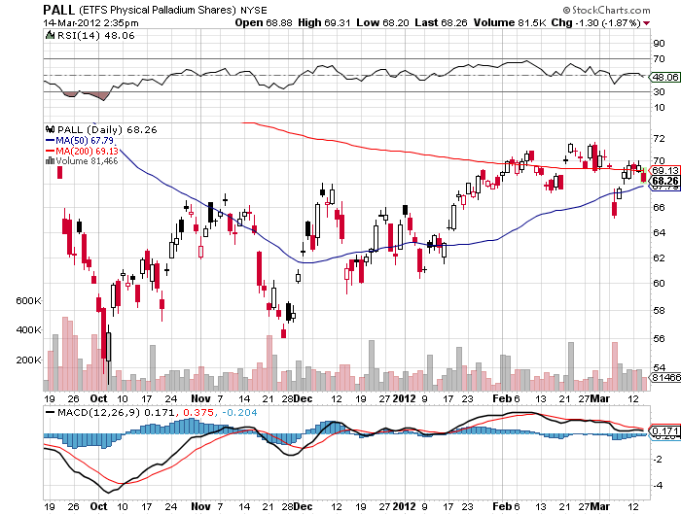
Palladium

Slide 39
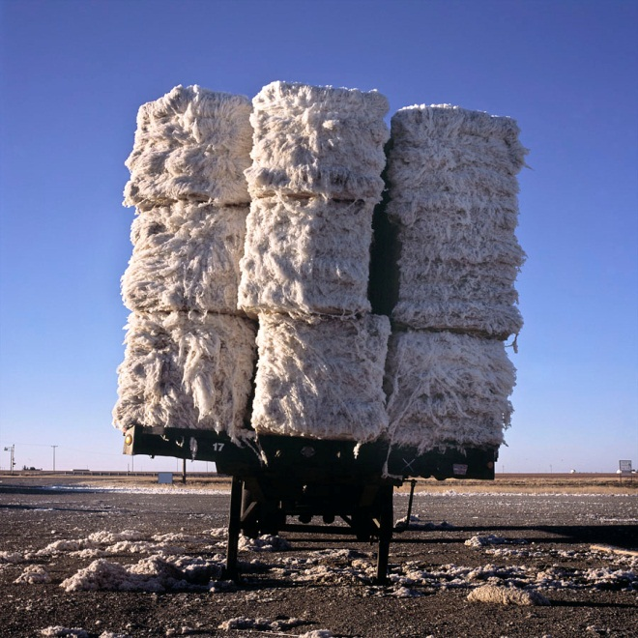
The Ags
*Showing signs of life
*India bans exports of cotton, then reverses
the next day
*Shows the surprise element in ags
*Stand aside-no trade for now
but a nice buy is setting up
*Drought in South America continues
*Long term positive fundamentals
eventually kick in
*Is a great global warming play

Slide 40
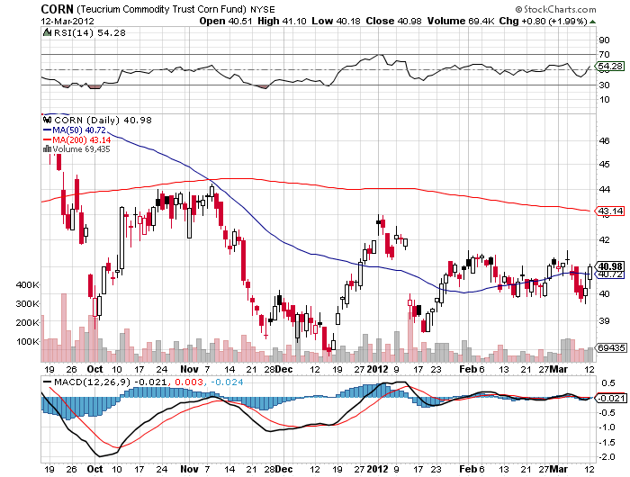
(CORN)

Slide 41
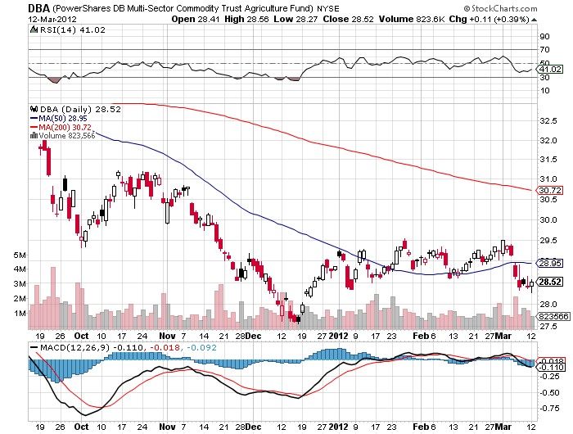
(DBA)

Slide 42
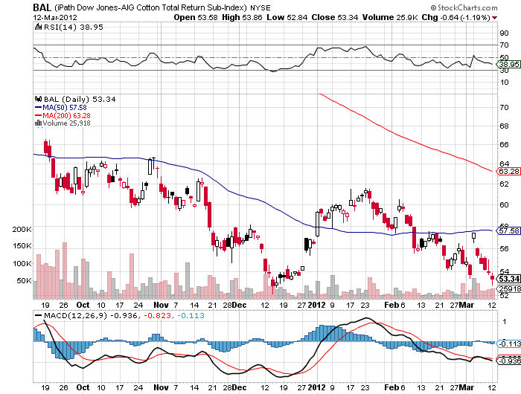
Cotton (BOL)

Slide 43
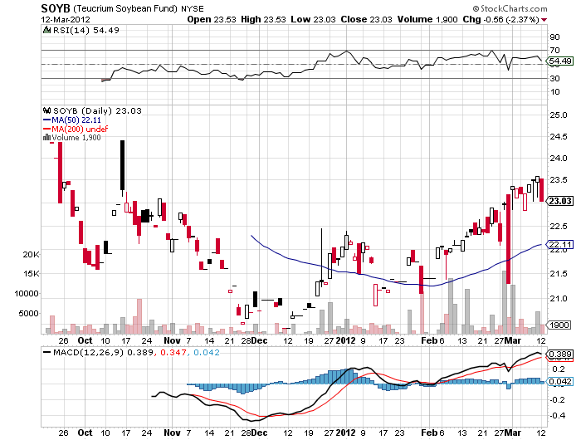
Soybeans (SOYB)

Slide 44
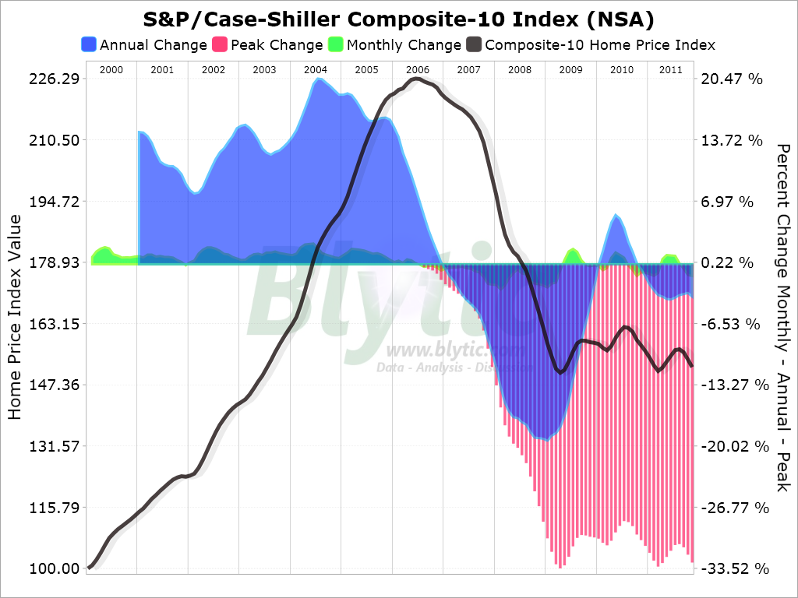
Real Estate
September

Slide 45

Trade Sheet
The bottom line: Too late to buy, too early to sell
*Stocks-wait for the 1,400 test, 1,425 now in play
*Bonds- wait for the technical breakdown (TBT)
*Commodities- sell rallies, rolling over on China
*Currencies- sell Euro and yen rallies
*Precious Metals-wait for the next short to set up
*Volatility-buy (VXX) on the dip
*The ags – stand aside wait for a bottom
*Real estate-breaking to new lows
Next Webinar is on Wednesday, March 28, 2012

Slide 46

To access my research data base or buy strategy luncheon tickets Please Go to www.madhedgefundtrader.com

