Slide 1

Please Stand By for
John Thomas
Wednesday, March 28, 2012
Global Trading Dispatch
The Webinar will begin at 12:00 pm EST

Slide 2
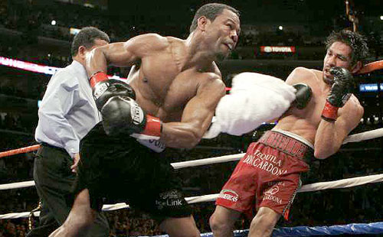
The Mad Hedge Fund Trader
Throwing in the Towel
Diary of a Mad Hedge Fund Trader
March 28, 2012
www.madhedgefundtrader.com

Slide 3

MHFT Global Strategy Luncheons
Buy tickets at www.madhedgefundtrader.com
2012 Schedule
April 20 San Francisco
May 3 Scottsdale
June 11 Beverly Hills
June 29 Chicago
July 5 New York
July 6-13 Queen Mary II
New York to Southampton
July 16 London
July 17 Paris
July 18 Frankfurt
July 27 Zermatt
October 26 San Francisco
November 8 Orlando
January 3, 2013 Chicago

Slide 4


MHFT Global Strategy Luncheons
Buy tickets at www.madhedgefundtrader.com
San Francisco, CA
April 20, 2012
Scottsdale, AZ
May 3

Slide 5

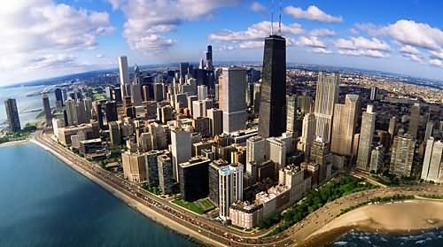
MHFT Global Strategy Luncheons
Buy tickets at www.madhedgefundtrader.com
Beverly Hills, CA
June 11
Chicago, IL
June 29

Slide 6


MHFT Global Strategy Luncheons
Buy tickets at www.madhedgefundtrader.com
New York, NY
July 5
Seminar at Sea
July 11, 2012
Queen Mary 2

Slide 7

Trade Alert Performance
*March MTD -7.64%
*2012 YTD -4.60%
*First 70 weeks of Trading
+ 35.58%
*Versus +13.28% for the S&P500
A 22.28% outperformance of the index
55 out of 68 closed trades profitable, users manual coming
80% success rate

Slide 8
Portfolio Review
Stay Small Until a Reversal is Confirmed
Risk On
(AAPL) call spread | 1.00%
(TBT) short Treasury | 10.00%
Risk Off
total net position | 11.00%

Slide 9

The Quarter from Hell
Bull market in anomalies
*All Cross market correlations broke down
stocks soared while bonds flat lined
commodities and precious metals move sideways
oil rocketed, but stocks kept rising
multiples expanded while earnings forecasts were cut
*Volume and volatility collapsed
*US econ moved sideways while Europe and China collapsed
*Winners in short yen and natural has offset by
premature shorts in equities

Slide 10
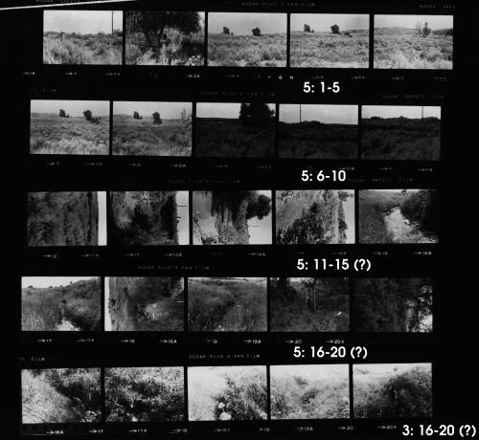
The Economy-Markets Are Ignoring Macro Data
*Economic data transitioning from strong to mixed
*The negatives are rising
*China March PMI 49.6 to 48.5, down 5 straight months,
Iron ore imports collapsing, +24% a year to +5%
*Feb Housing starts -1.1% to 717,000
*No QE3 from the Federal Reserve
*April earnings will disappoint
*March consumer sentiment 75.3 to 74.3
*Weekly jobless claims fell 5,000 to 353,000, still healthy
*All consistent with a low 2.0% GDP growth rate

Slide 11
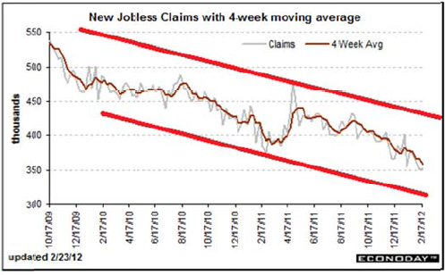
Weekly Jobless Claims

Slide 12
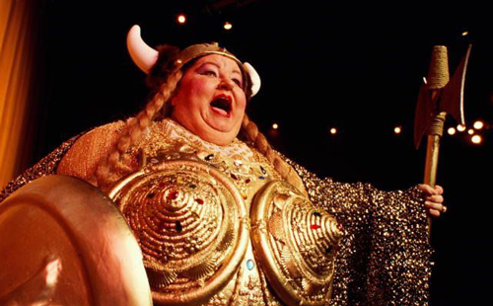
Is the Fat Lady Singing?
*Is the fat lady singing?
*The biggest trading development of the year
*Nibbling at the “RISK ON” scenario
*Ten year yield range now 2.10%-2.50%?
*30 year charts breaking down
*Waiting for the next “RISK OFF” round to pop
*Is this the final move?

Slide 13
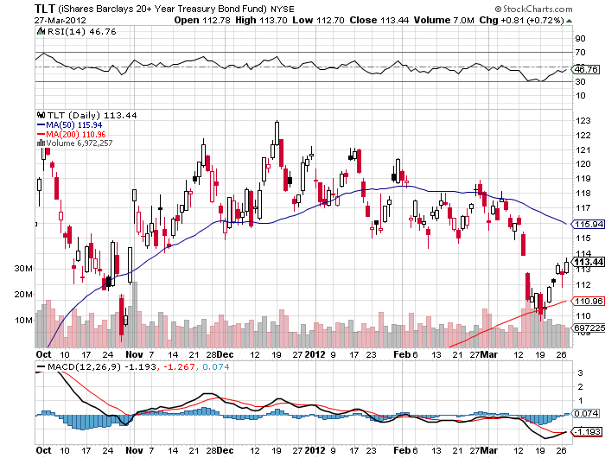
(TLT)

Slide 14
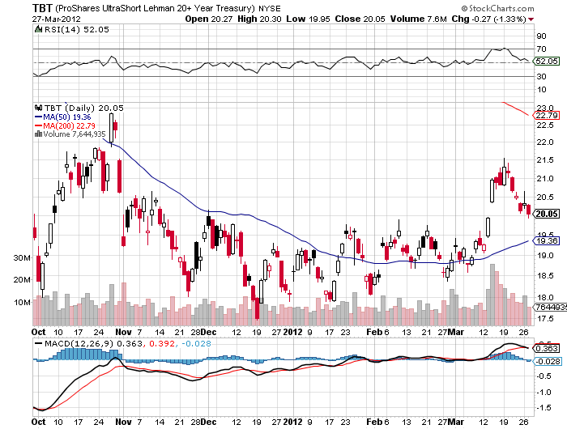
(TBT)

Slide 15
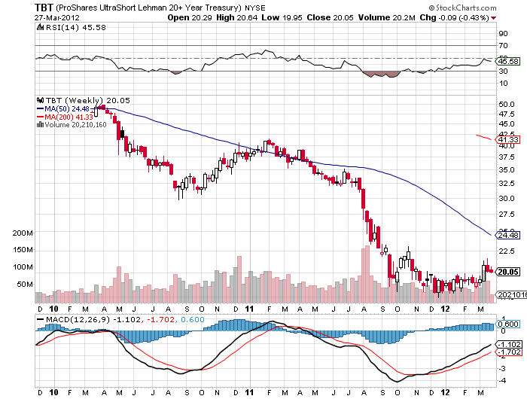
(TBT) Weekly

Slide 16
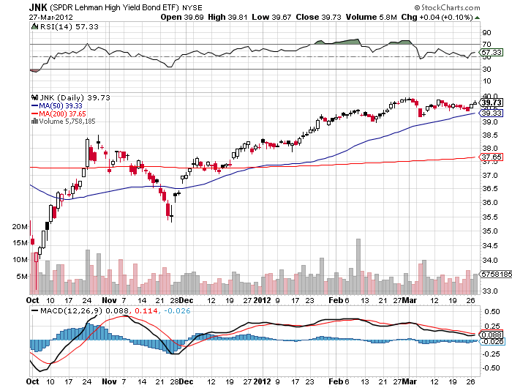
(JNK)

Slide 17

Stocks-Reaching for the Top
*New High for the move, a 1,425 or 1,450 top?
*Will Q2 bring the correction? Risk is high
*Individuals, hedge funds, HF traders out of the market,
volume at the lowest of the year
*Majority of forecasts are for a flat quarter
*Huge amount of money trapped on the sidelines
is preventing normal corrections
*End of QE or the Fed twist in June could trigger market crash
*Market internals are deteriorating rapidly,
falling volume, collapsing VIX, and insider selling

Slide 18

Stocks-Potential Tops
*March 30 quarter end
*April 20 Apple Q1 earnings
*April 29 One year anniversary of
2011 top
*SPX at 1,449 Elliot wave/momentum
top
*SPX 1,550 2007 top
Pullbacks
-140 points-1/3 of recent gain then on to new highs, econ accelerates
-400 points-double dip recession, oil over $120

Slide 19
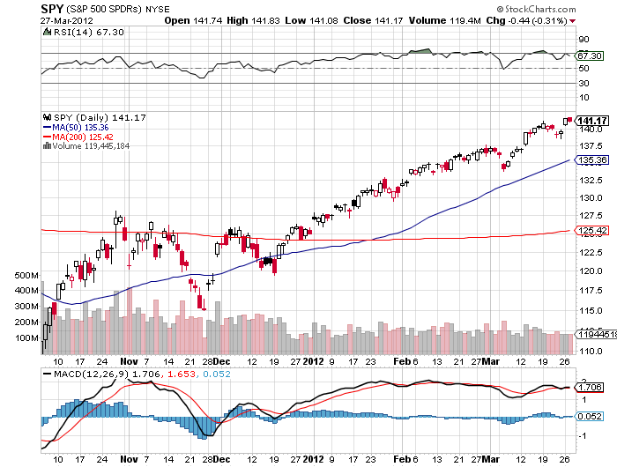
(SPY)

Slide 20
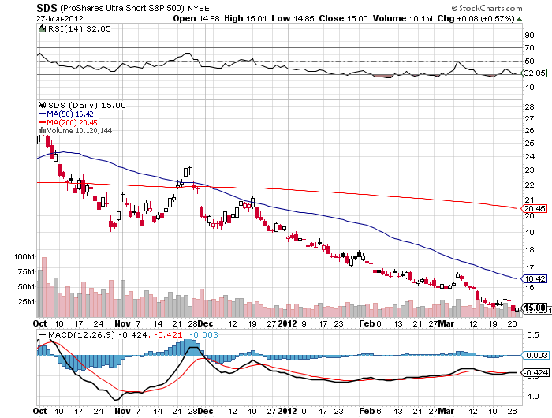
Double Short S&P 500 ETF(SDS)

Slide 21
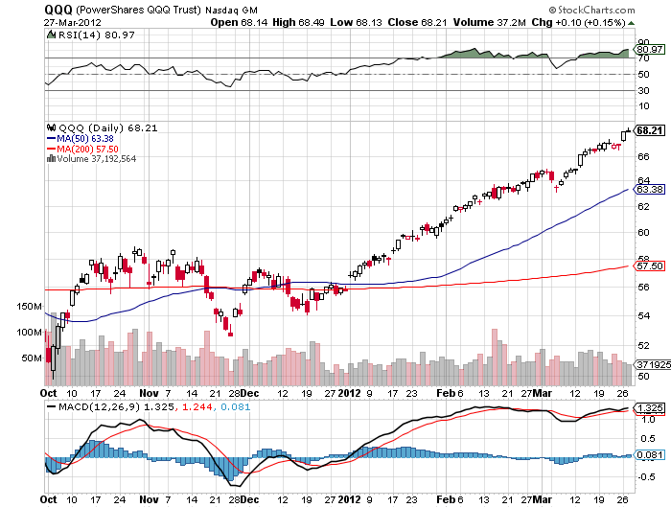
NASDAQ

Slide 22
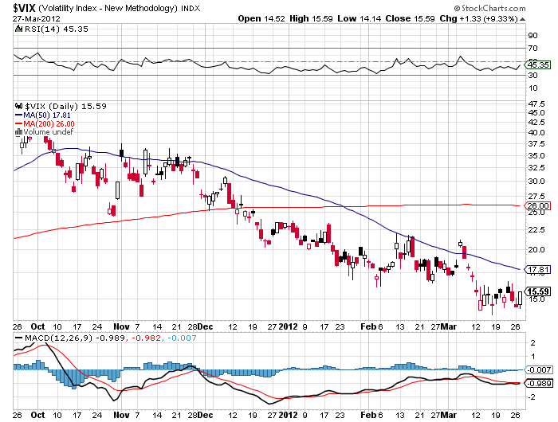
(VIX)

Slide 23
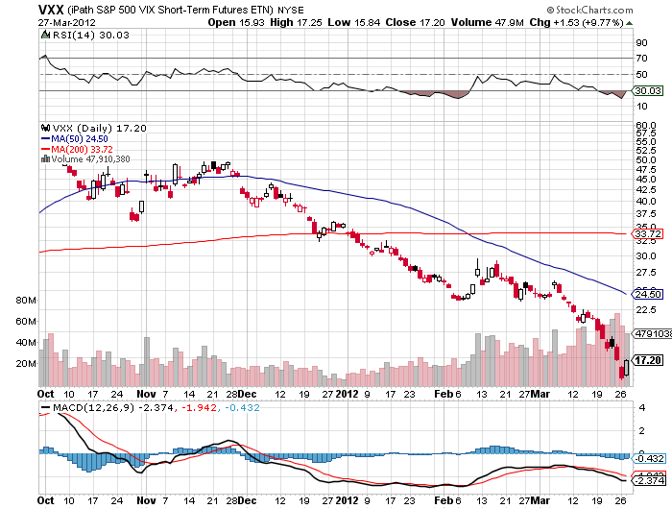
(VXX)

Slide 24
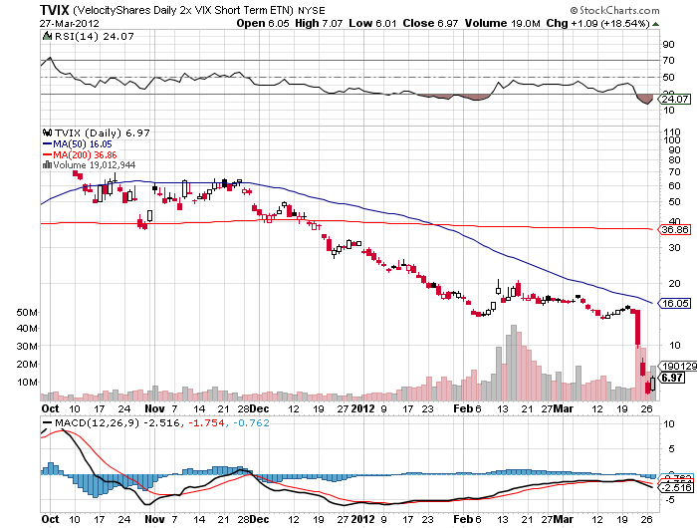
(TVIX)

Slide 25
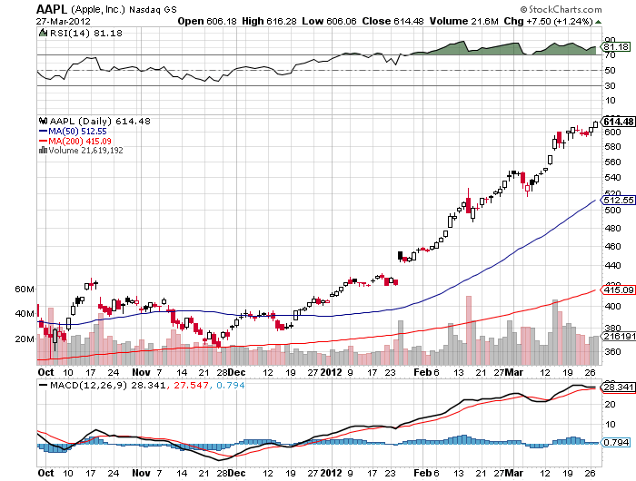
(AAPL)

Slide 26
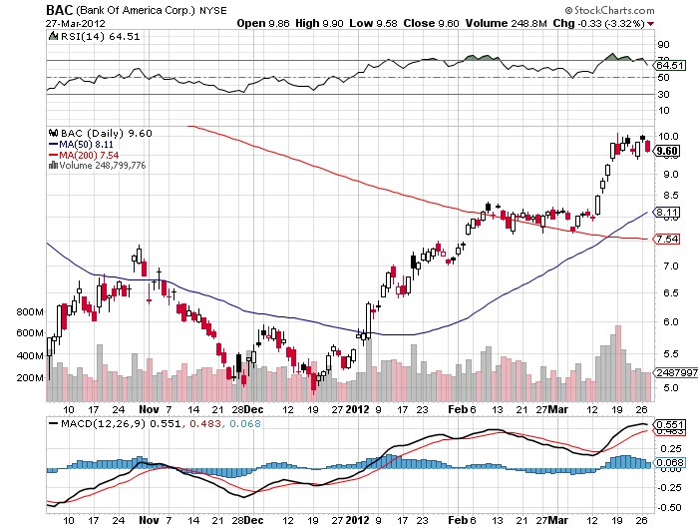
(BAC)

Slide 27

The Dollar
*The breakout is in for the yen
sell every rally for the next 20 years
*Japanese March 30 fiscal year end creating
modest yen buying and a potential entry point
*Need big US stock sell off to create meaningful
yen strength
*Next target is ¥85, then ¥90, eventually ¥150
*Look to reestablish yen short on next “RISK OFF” round
*no pullbacks of more than ¥2
*Yen is returning as the new carry currency
*Ausie weak on China slowdown

Slide 28
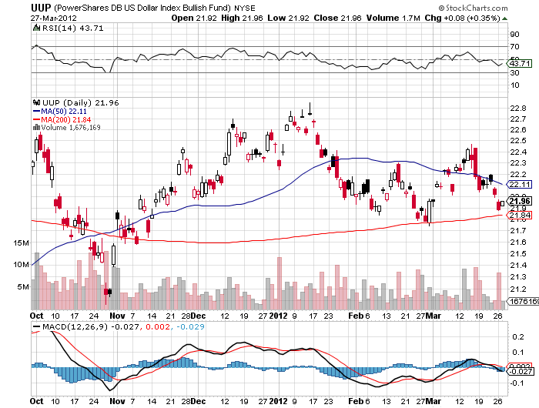
(UUP)

Slide 29
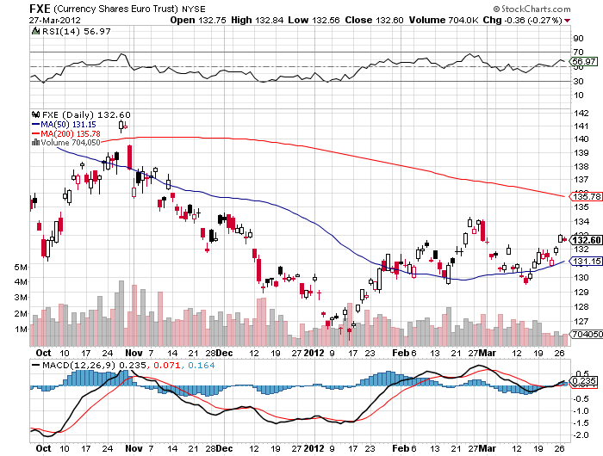
(FXE)

Slide 30
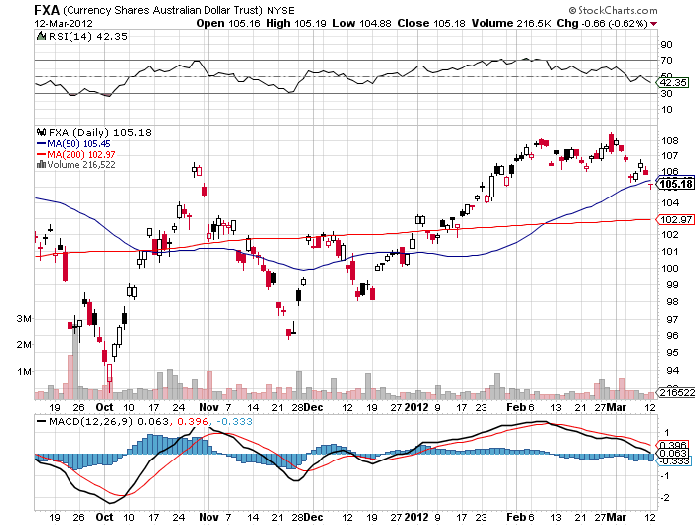
Australian Dollar (FXA)

Slide 31
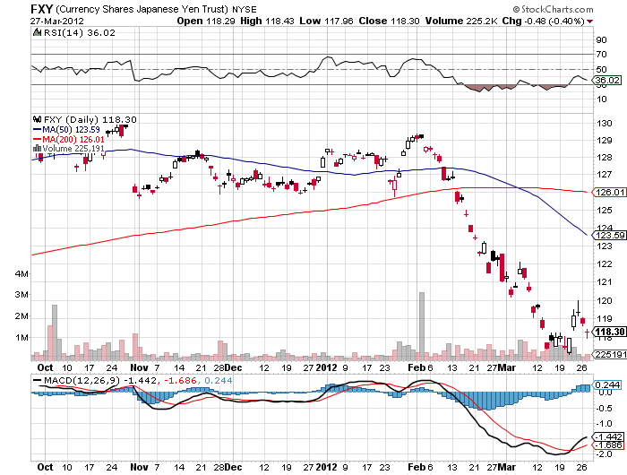
(FXY)

Slide 32
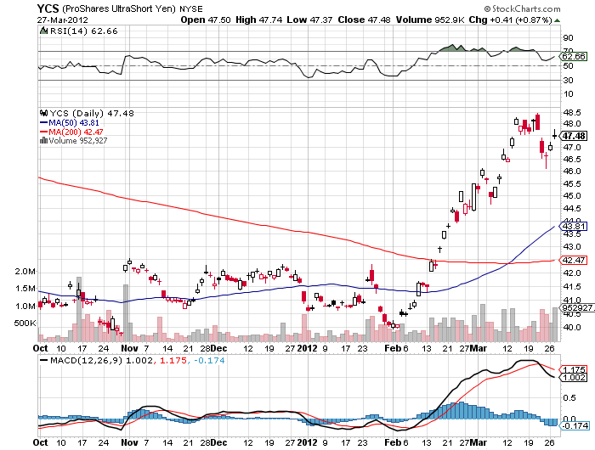
(YCS)

Slide 33

Energy
*Oil hit my $110 target
*Most difficult commodity to call now,
all headlines are random
*Recurring rumors of SPR release
*Won’t happen until we hit $120
*At $110 (USO) puts start to look
very interesting
*New lows in (UNG), wait for the next rally
Nat Gas at new 10 year low at $2.18
*Final target $1.50, too late to sell
*Natural gas collapse putting pressure on coal

Slide 34
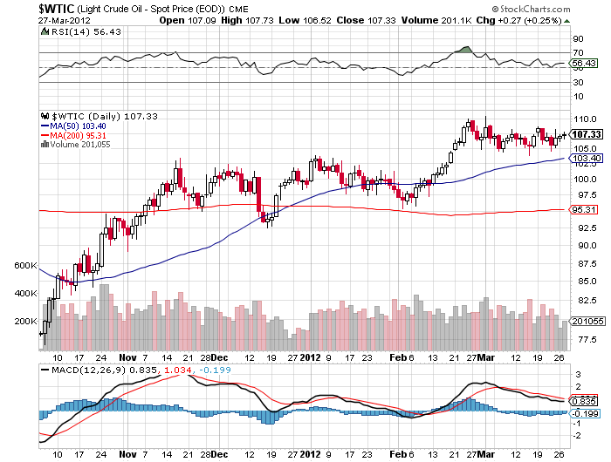
Crude

Slide 35
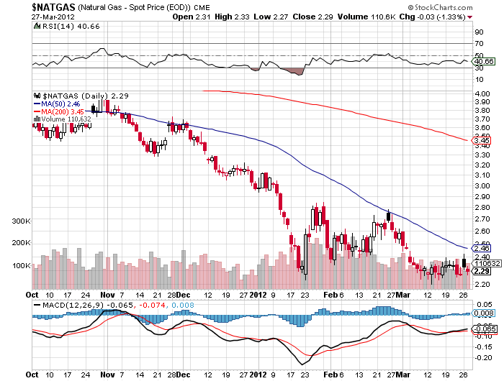
Natural Gas (UNG)

Slide 36
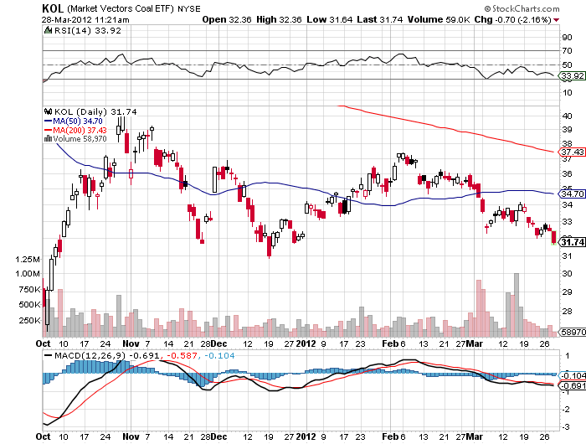
Coal (KOL)

Slide 37
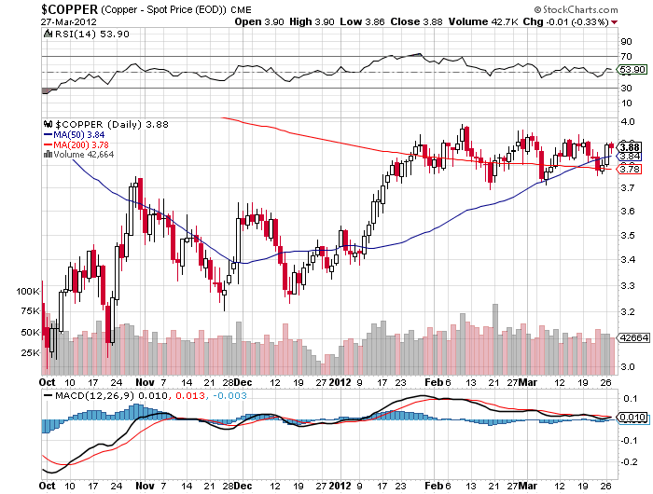
Copper

Slide 38

Precious Metals
*No QE means sell gold and silver
*Looking for $1,500 on the downside for gold
$25 for silver for the short term
*2,300 and $100 for the long term
*Panic European buying has abated
*All of a sudden paper assets look sexy

Slide 39
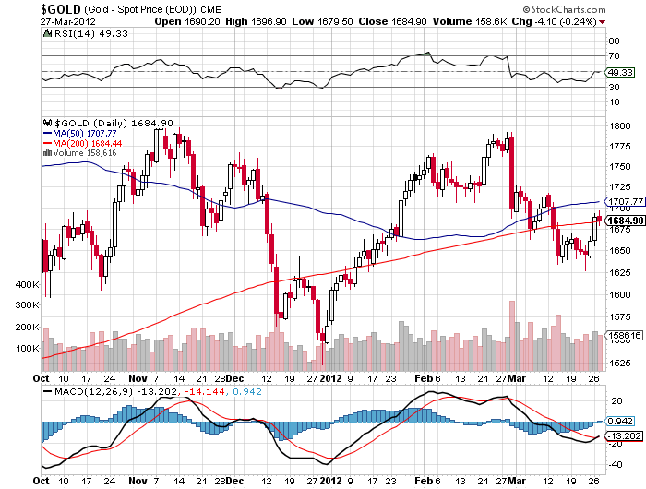
Gold

Slide 40
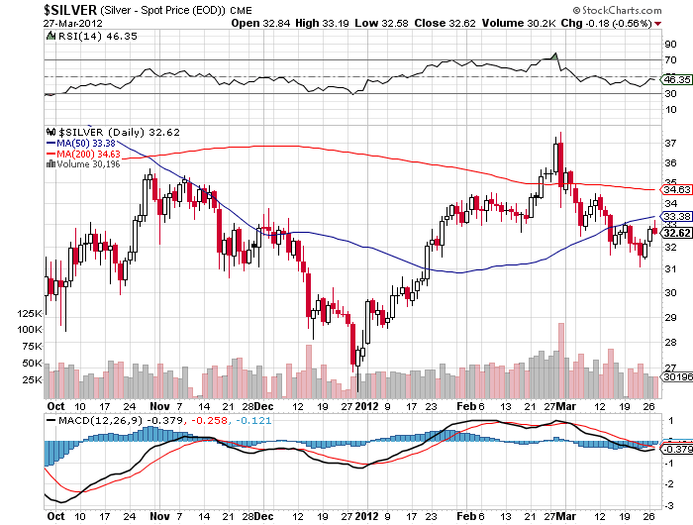
Silver

Slide 41
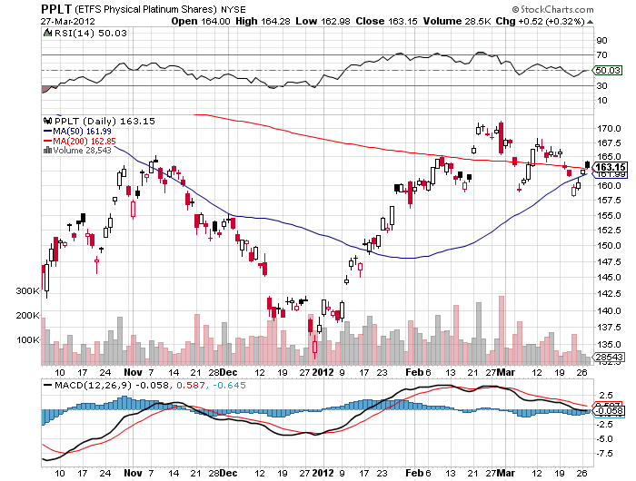
(Platinum)

Slide 42
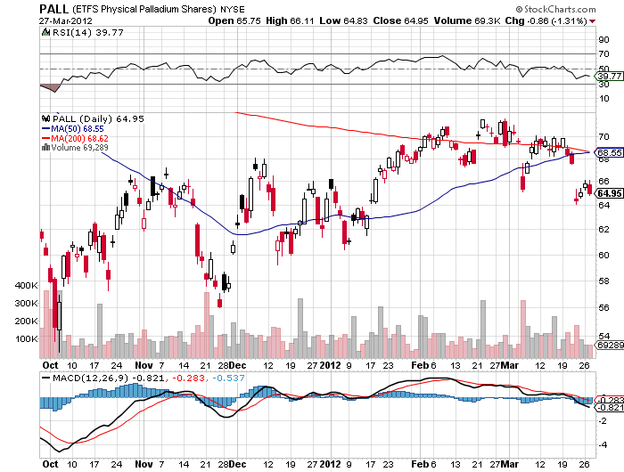
Palladium

Slide 43
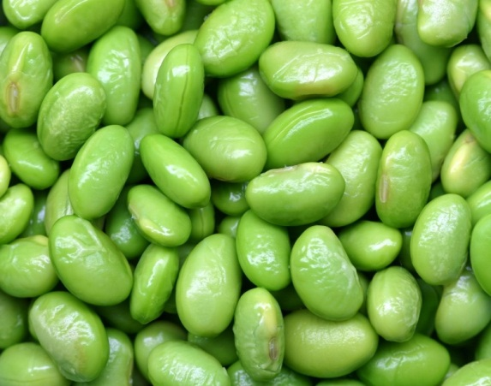
The Ags
*Showing signs of life
*Record US corn plantings this year
*At the expense of soybeans, so the price action
will be in soybeans
*Winners are ag product makers
(DBA), (POT), (MOS), (AGU)
*Drought in South America continues
*USDA planting intentions report out today
stand aside

Slide 44
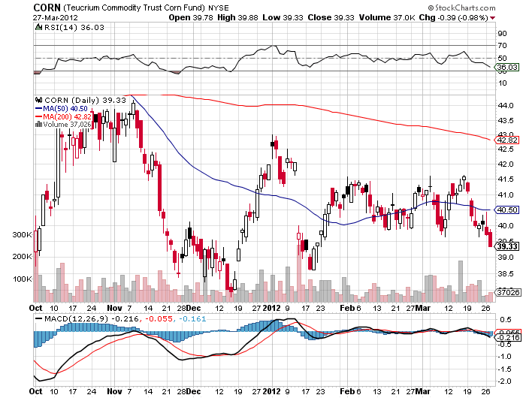
(CORN)

Slide 45
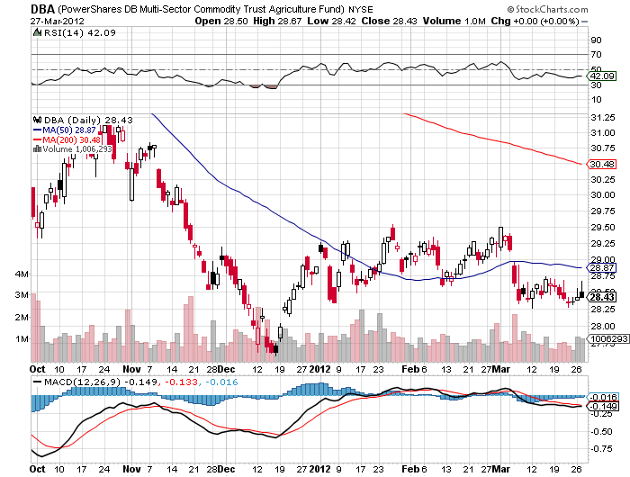
(DBA)

Slide 46
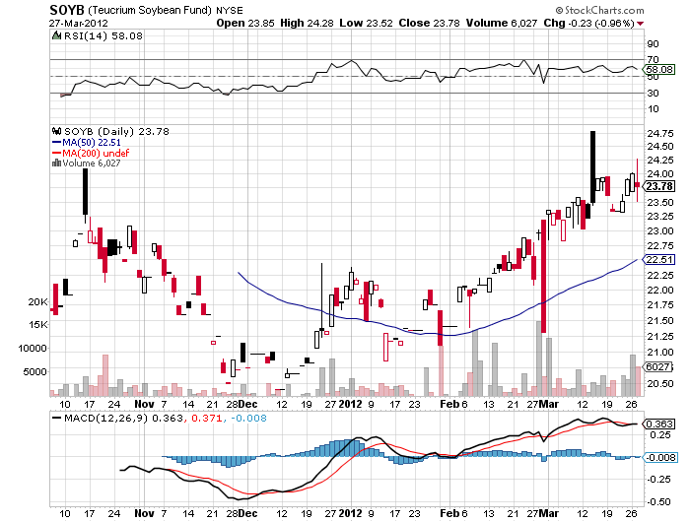
Soybeans (SOYB)

Slide 47
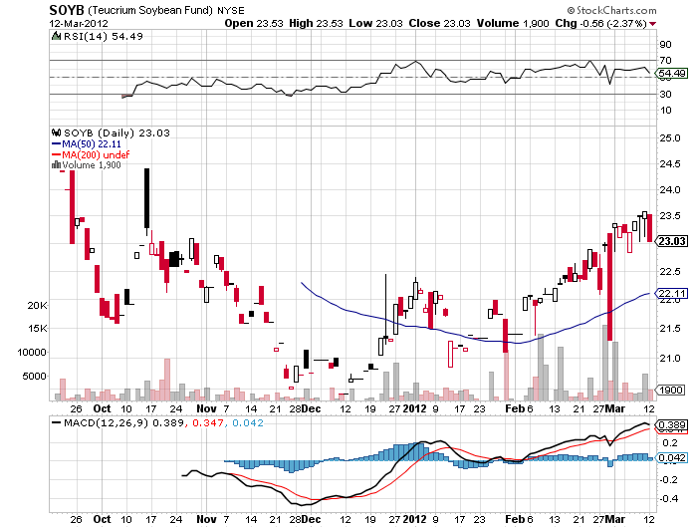
Soybeans (SOYB)

Slide 48
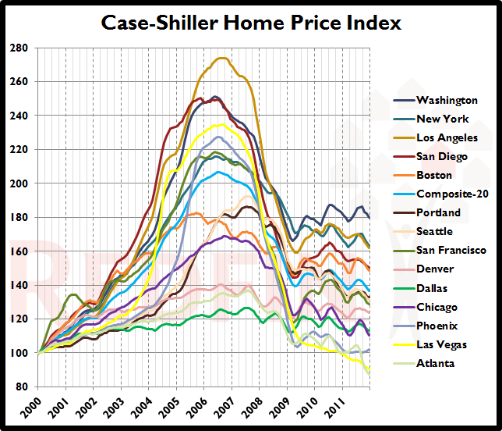
Real Estate
January, 2012

Slide 49

Trade Sheet
The bottom line: Too late to buy, too early to sell
*Stocks- 1,425 now in play, stand aside
*Bonds- buy the next big dip in the (TBT)
*Commodities- sell rallies, rolling over in China
*Currencies- sell Euro and yen rallies
*Precious Metals-wait for the next short to set up
*Volatility-stand aside until melt down ends
*The ags – buy soybeans on dips
*Real estate-breaking to new lows
Next Webinar is on Wednesday, April 11, 2012

Slide 50

To access my research data base or buy strategy luncheon tickets Please Go to www.madhedgefundtrader.com

