Slide 1

Please Stand By for John Thomas Wednesday, February 29, 2012 Global Trading Dispatch
The Webinar will begin at 12:00 pm EST

Slide 2

The Mad Hedge Fund Trader Special Sadie Hawkins Day Issue
Diary of a Mad Hedge Fund Trader February 29, 2012 www.madhedgefundtrader.com

Slide 3
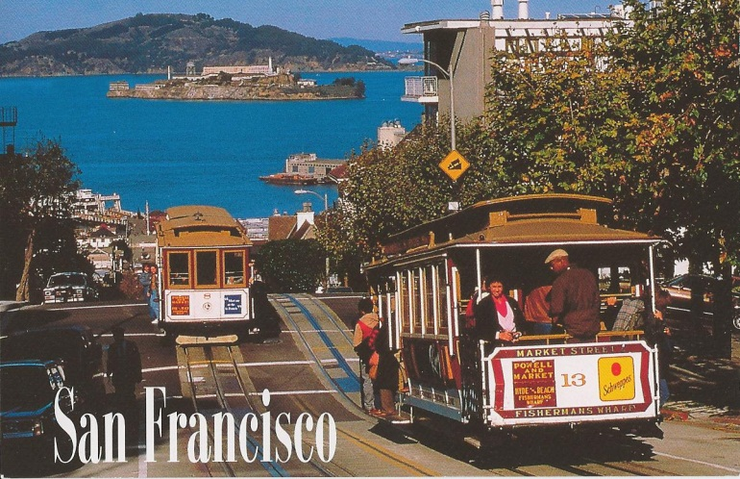

MHFT Global Strategy Luncheons Buy tickets at www.madhedgefundtrader.com
San Francisco, CA April 20, 2012
Scottsdale, AZ May 3

Slide 4


MHFT Global Strategy Luncheons Buy tickets at www.madhedgefundtrader.com
Los Angeles, CA June 11
Seminar at Sea July 11, 2012 Queen Mary 2

Slide 5

Trade Alert Performance
*February MTD +2.93% *2012 YTD +3.25% *First 66 weeks of Trading + 43.43% *Versus +9.6% for the S&P500 A 33.7% outperformance of the index
55 out of 66 closed trades profitable, users manual coming 83% success rate

Slide 6
Portfolio Review Stay Small Until a Reversal is Confirmed
Mad Hedge Fund Trader
Trading Book
Asset Class Breakdown
Risk Adjusted Basis
current capital at risk
Risk On
(MSFT) call spread | 10.00%
Risk Off
(BAC) puts | -5.00%
Short SPX (SDS) | -20.00%
total net position | -15.00%

Slide 7
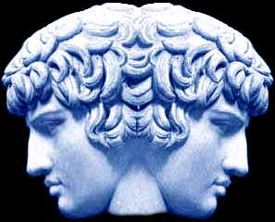
The Economy
*Economic data transitioning from strong to mixed *Dismal December Case-Shiller shows real estate still falling-but is a lagging indicator *February consumer confidence soared from 61.5 to 70.8 *Chicago February PMI 60.2 to 64.0 *European recession right on schedule, 0.5% GDP to minus -0.3% for 2012, says European Commission *Weekly jobless claims -12,000 to 367,000 *January durable goods down a huge 4% *Data pointing to a spring slowdown in earnings *All consistent with a low 2.0% GDP growth rate

Slide 8

Bonds-Mixed Signals
*Still is not buying the “RISK ON” scenario *Ten year yields trapped in the 1.90’s *February mutual fund flows show $40 billion of bond buying, $3 billion of stock buying *Rising consensus that the 30 year top is this year *Investors reaching for yield with (JNK) *Waiting for the next “RISK OFF” round to pop *Is this the final move?

Slide 9
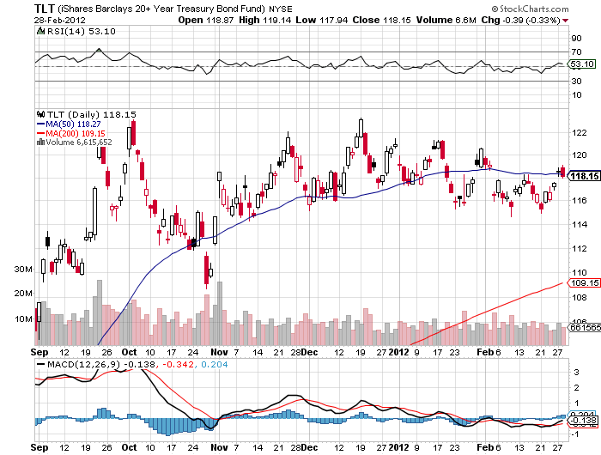
(TLT)

Slide 10
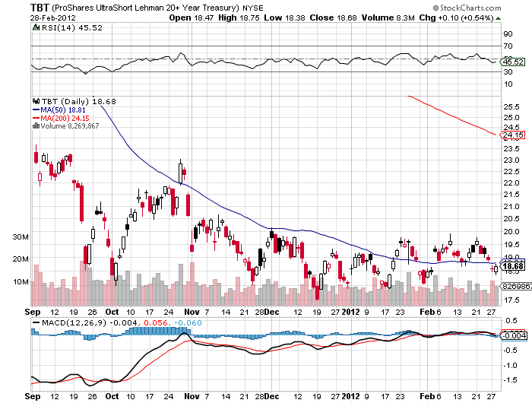
(TBT)

Slide 11
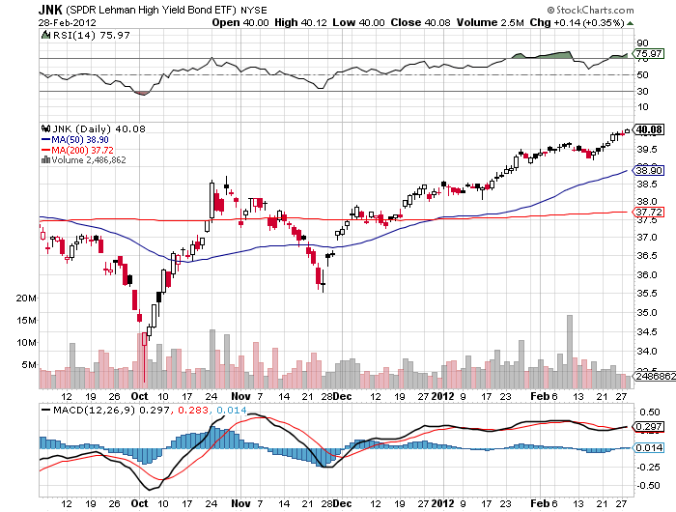
(JNK)

Slide 12

Stocks
*Distilled down to a market of a single stock: Apple, $500 billion market cap *We are 103% through a 300 point (SPX) move from 1,060 to 1,360 (two weeks ago was 99%), 13 to 14 multiple expansion *Global stock markets most overbought in years *Number of rising stocks is narrowing *Huge amount of money trapped on the sidelines is preventing normal corrections *End of QE could trigger market crash *Will March be our “RISK OFF” month?

Slide 13
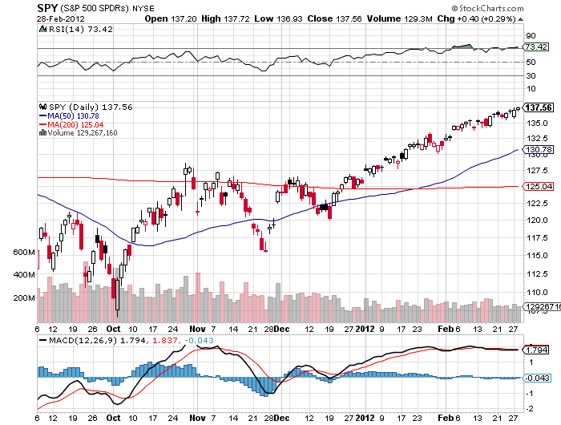
(SPY)

Slide 14
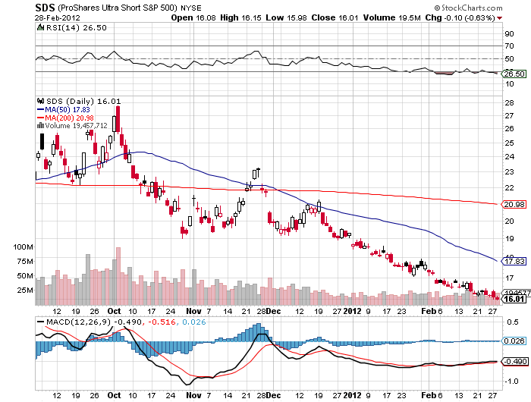
Double Short S&P 500 ETF(SDS)

Slide 15
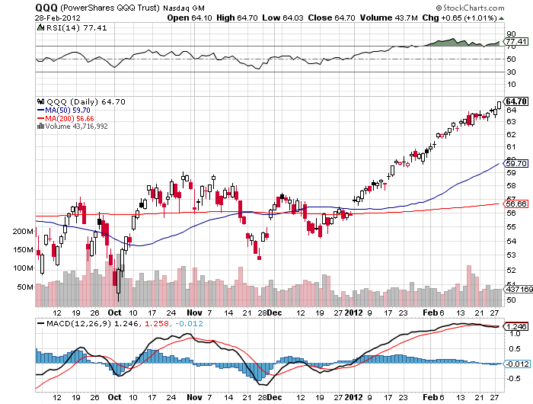
NASDAQ

Slide 16
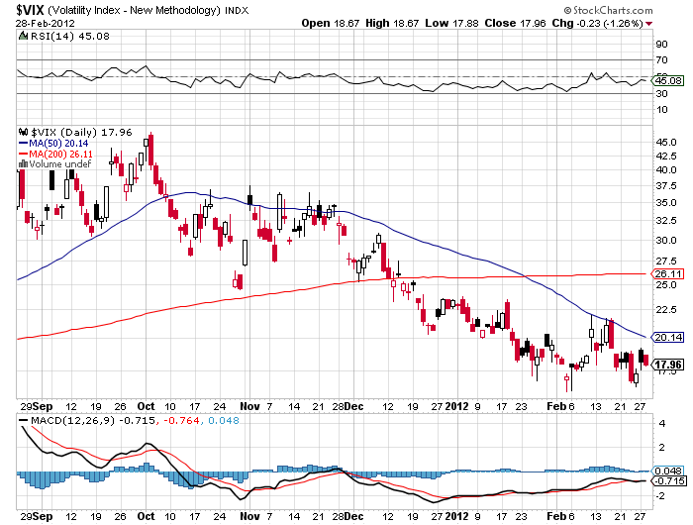
(VIX)

Slide 17
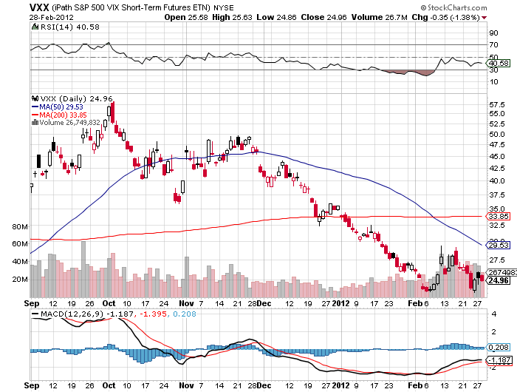
(VXX)

Slide 18
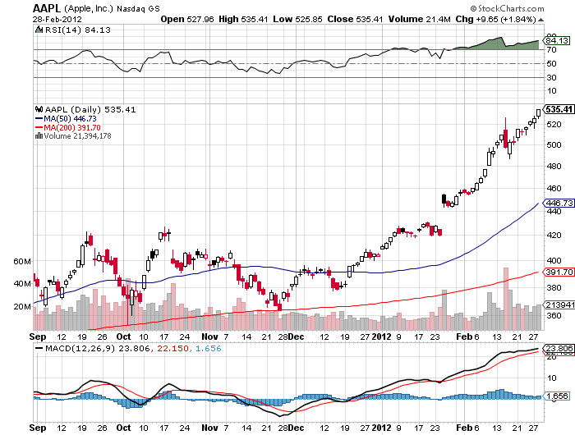
(AAPL)

Slide 19
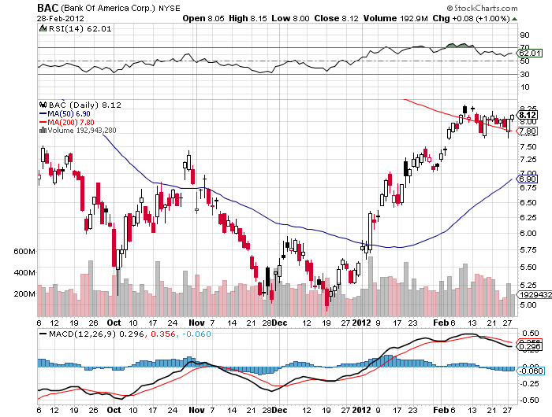
(BAC)

Slide 20

The Dollar
*The breakout is in for the yen sell every rally for the next 20 years *Japanese money printing will accelerate from here *Next target is ¥85, then ¥90 *Look to reestablish yen short on next “RISK OFF” round *LTRO €529 billion, right on expectations, may be last QE, more than half already in markets *Euro shorts have dropped by one third on short covering *Australian dollar may be peaking here

Slide 21
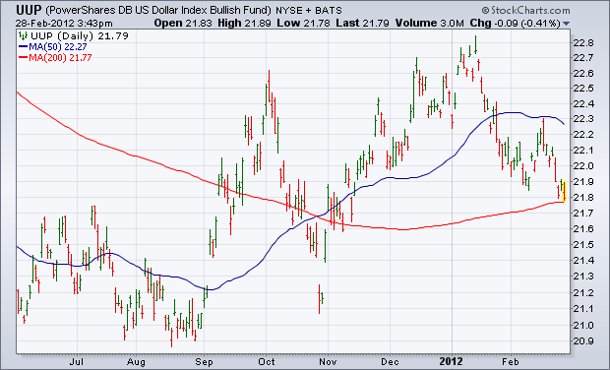
(UUP)

Slide 22
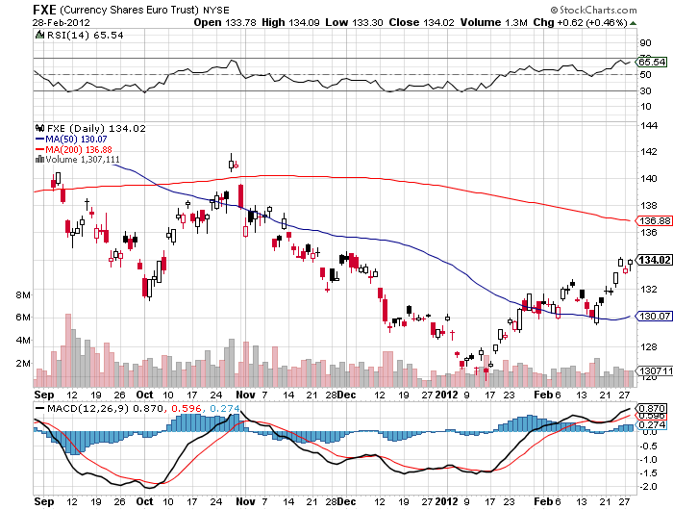
(FXE)

Slide 23
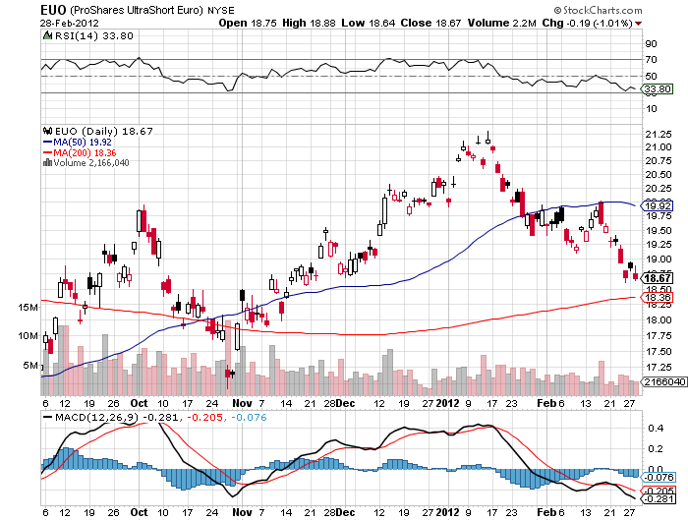
(EUO)

Slide 24
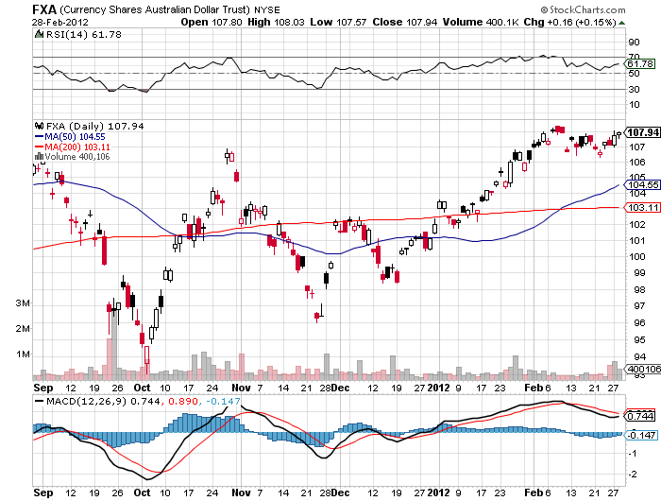
Australian Dollar (FXA)

Slide 25
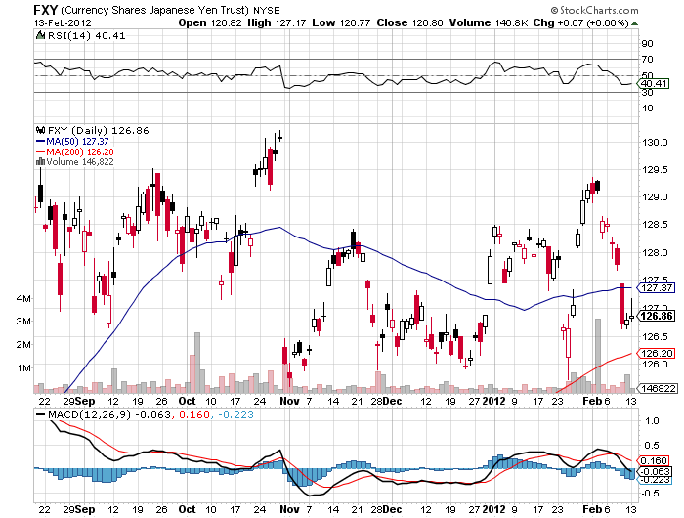
(FXY)

Slide 26
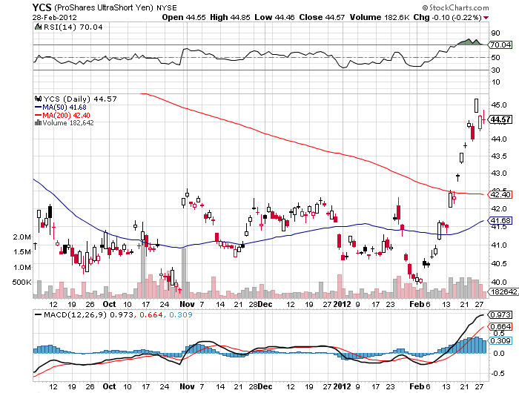
(YCS)

Slide 27
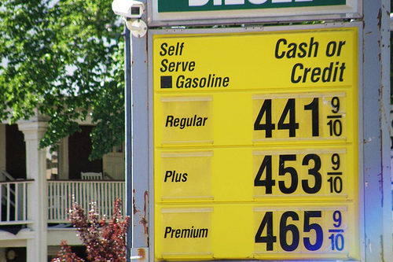
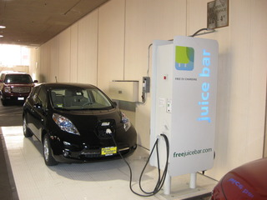
Energy
*Oil hit my $110 target *Rising prices in a supply glut? *Warmest winter in 100 years *At $110 (USO) puts start to look very interesting *A One cent rise cuts consumer spending by $1.2 billion, cuts GDP from 2% to 0.5% *A ten dollar rise wipes out all of QE *Obama releases the SPR on further strength *Hold out for $3/MBTU, $6 in the (UNG)

Slide 28
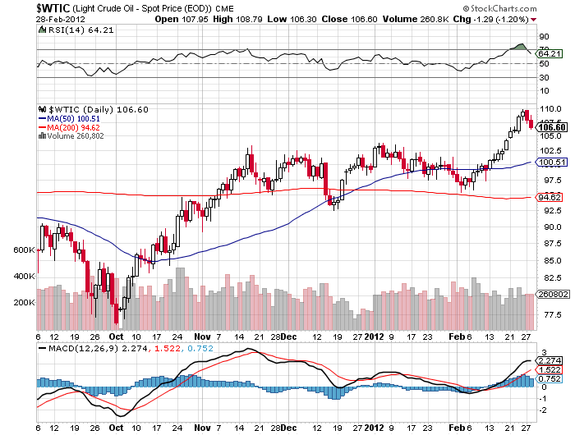
Crude

Slide 29
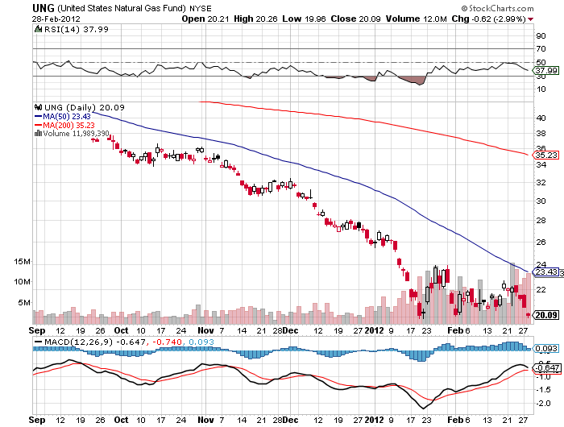
Natural Gas (UNG)

Slide 30
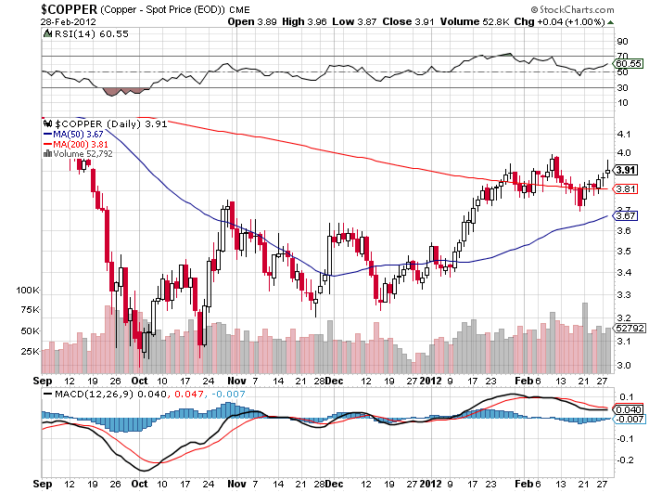
Copper

Slide 31
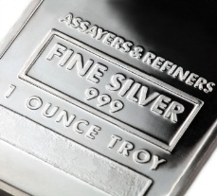
Precious Metals
*Traders rotating out of stocks and into metals *The hot money is moving back in for a trade *Short term overbought *The long term target is still $2,300 for gold, $100 for silver

Slide 32
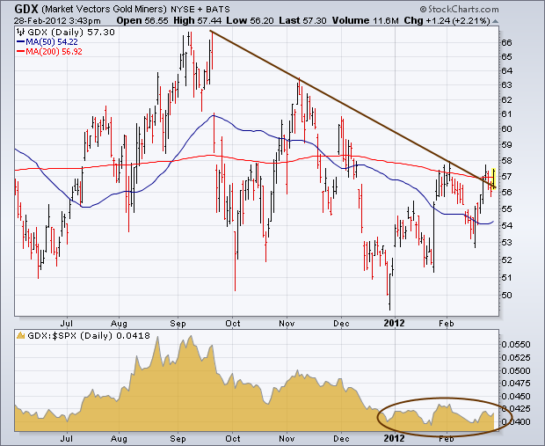
Gold

Slide 33
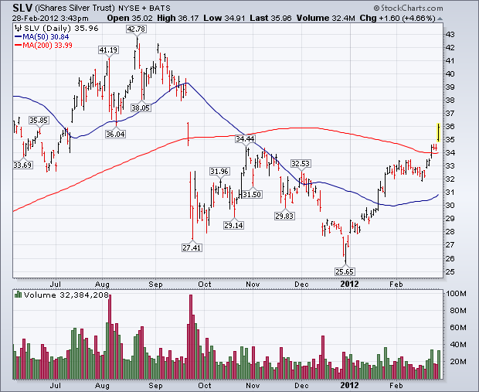
Silver

Slide 34
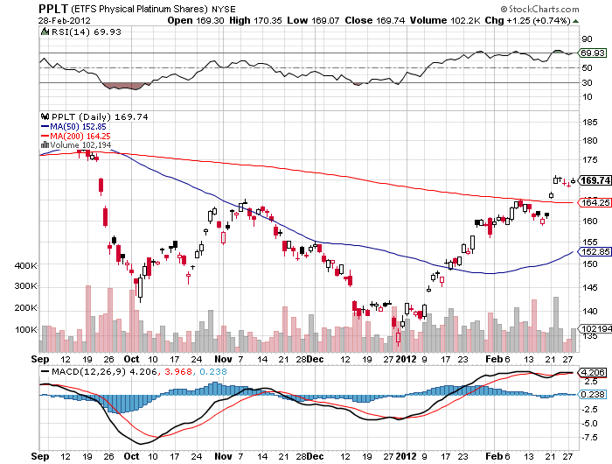
(Platinum)

Slide 35
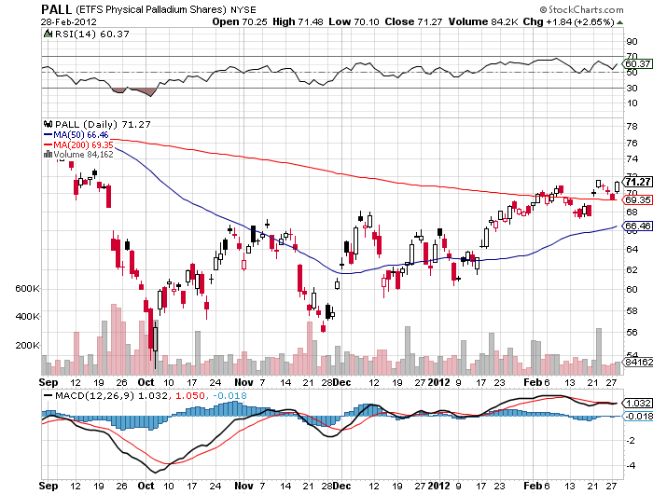
Palladium

Slide 36

The Ags
*Out of Season *Still digesting the USDA January crop report disaster *Will be dead for a few more months *Stand aside-no trade for now but a nice buy is setting up *Long term positive fundamentals eventually kick in *Major move in sugar

Slide 37
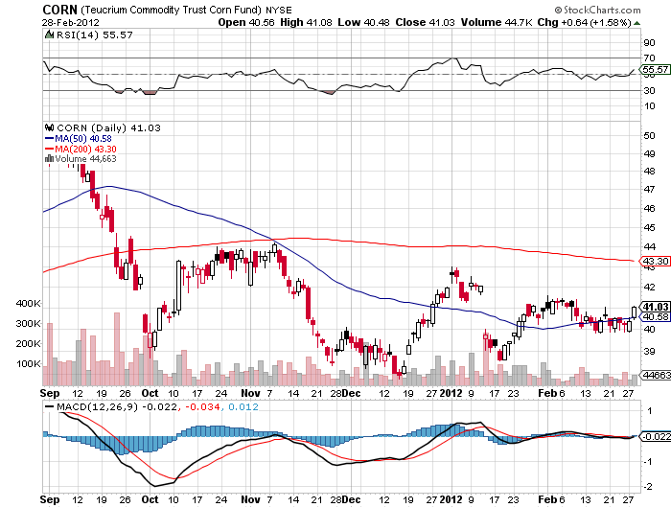
(CORN)

Slide 38
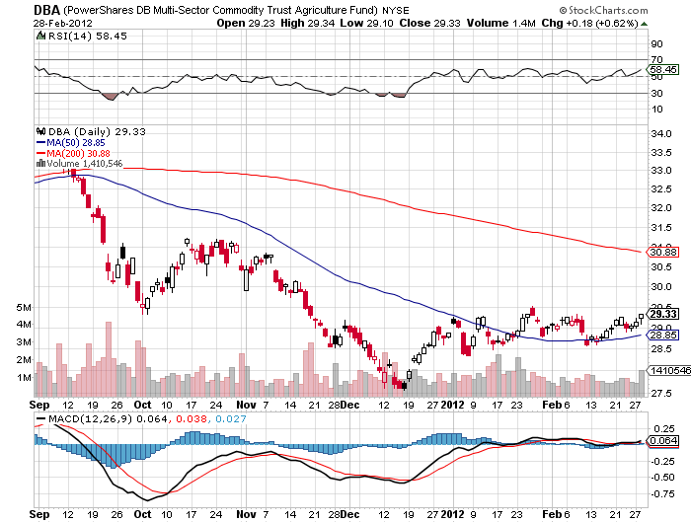
(DBA)

Slide 39
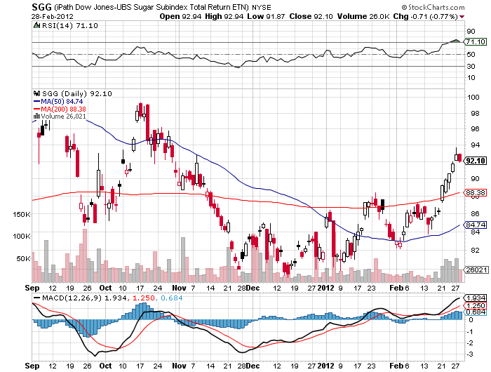
Sugar (SGG)

Slide 40
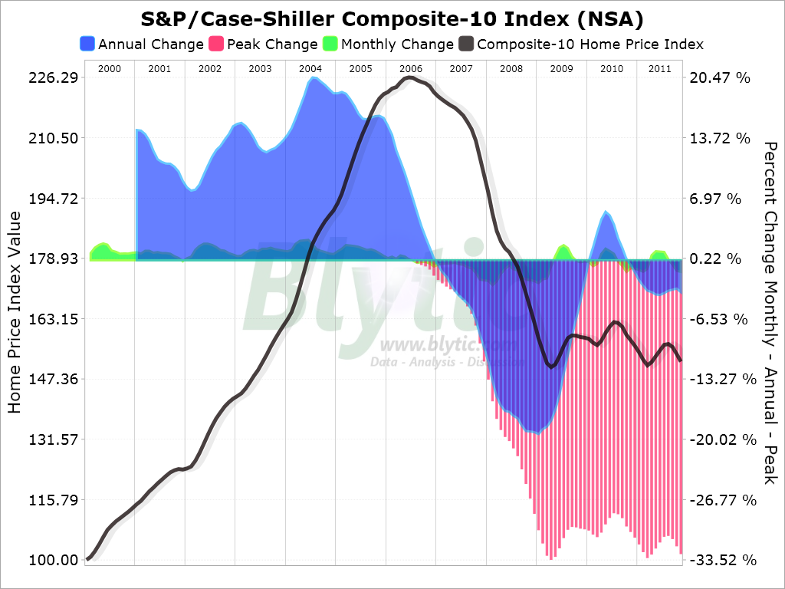
Real Estate September

Slide 41

Trade Sheet The bottom line: Trade or die
*Stocks-wait for the 1,400 test, Feb 29 month end window dress *Bonds- stand aside, buy the next dip *Commodities- sell rallies *Currencies- sell Euro and yen rallies *Precious Metals-wait for the next short to set up *Volatility-buy (VXX) under $24 *The ags – stand aside wait for a bottom *Real estate-breaking to new lows Next Webinar is on Wednesday, March 14, 2012

Slide 42

To access my research data base or buy strategy luncheon tickets Please Go to www.madhedgefundtrader.com

