Slide 1
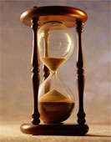
Please Stand By for
John Thomas
Wednesday, April 11, 2012
Global Trading Dispatch
The Webinar will begin at 12:00 pm EST

Slide 2

The Mad Hedge Fund Trader
“RISK OFF” Returns with a Vengeance
Diary of a Mad Hedge Fund Trader
April 11, 2012
www.madhedgefundtrader.com

Slide 3

MHFT Global Strategy Luncheons
Buy tickets at www.madhedgefundtrader.com
2012 Schedule
April 20 San Francisco
May 3 Scottsdale
June 11 Beverly Hills
June 29 Chicago
July 5 New York
July 6-13 Queen Mary II
New York to Southampton
July 16 London
July 17 Paris
July 18 Frankfurt
July 27 Zermatt
October 26 San Francisco
November 8 Orlando
January 3, 2013 Chicago

Slide 4
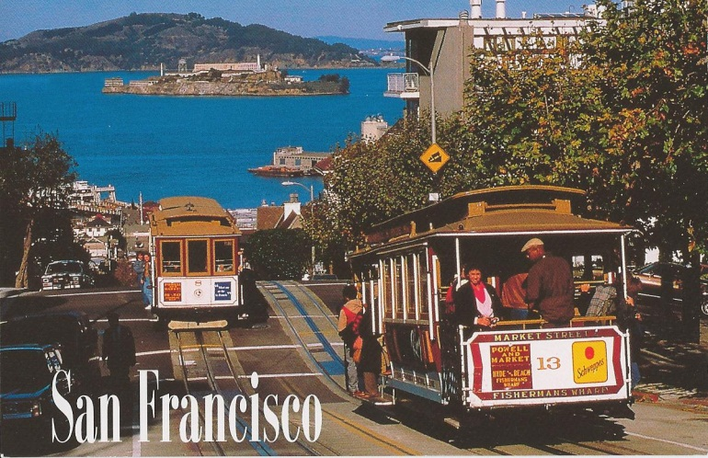

MHFT Global Strategy Luncheons
Buy tickets at www.madhedgefundtrader.com
San Francisco, CA
April 20, 2012
Scottsdale, AZ
May 3

Slide 5

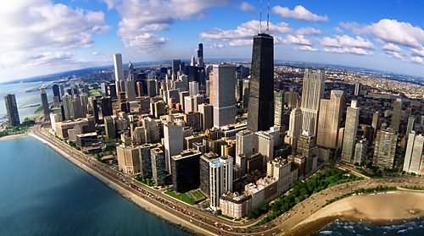
MHFT Global Strategy Luncheons
Buy tickets at www.madhedgefundtrader.com
Beverly Hills, CA
June 11
Chicago, IL
June 29

Slide 6

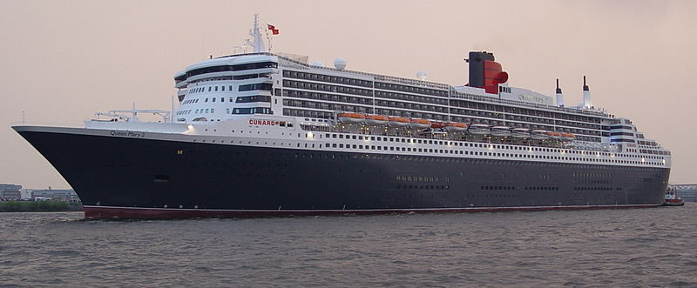
MHFT Global Strategy Luncheons
Buy tickets at www.madhedgefundtrader.com
New York, NY
July 5
Seminar at Sea
July 11, 2012
Queen Mary 2

Slide 7

Trade Alert Performance
*April MTD +2.80%
*2012 YTD -0.79%
*First 72 weeks of Trading
+ 39.39%
*Versus +15.2% for the S&P500
A 24.2% outperformance of the index
47 out of 65 closed trades profitable, users manual coming
72% success rate on closed trades

Slide 8
Portfolio Review
Stay Small Until a Reversal is Confirmed
current capital at risk
Risk On
(AAPL) call spread | 1.00%
(TBT) short Treasury | 10.00%
Risk Off
(IWM) puts | -5.00%
(PHM) puts | -5.00%
total net position | 1.00%

Slide 9

The Economy-Markets Are Ignoring Macro Data
*Economic data transitioning from mixed to weak
*The negatives are rising
*March nonfarm payroll at 120,000 a big disappointment
*March Chicago PMI down 64.0 to 62.2
*No QE3 from the Federal Reserve reaffirmed
*April earnings will disappoint, Alcoa -69% YOY
*March small business optimism drops from 94.3 to 92.5
first drop in six months
*Weekly jobless claims fell 5,000 to 357,000, still healthy
*Chinese Q1 GDP on Friday
*All consistent with a low 2.0% GDP growth rate

Slide 10
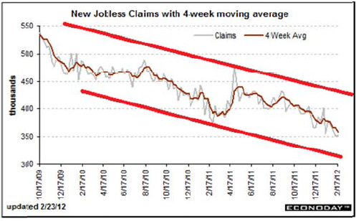
Weekly Jobless Claims
The Last Thing Bulls have to hang their hats on

Slide 11
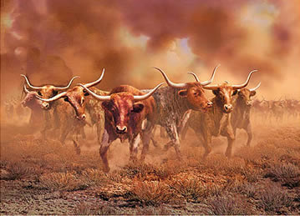
Bonds-Another False Start
*Yet another false top for bonds
*”RISK OFF” brings a bond bull stampede
*Ten year yields fall 2.50% to 1.98%
*Q1, 2012 mutual fund flows $90 billion into bonds
$3 billion into stocks
*Back into the top end range on yields,
but no upside breakout
*Hedge Treasury Short with “RISK ON” positions
and average down costs, sell again at 1.90% to
get a 2.10% average

Slide 12
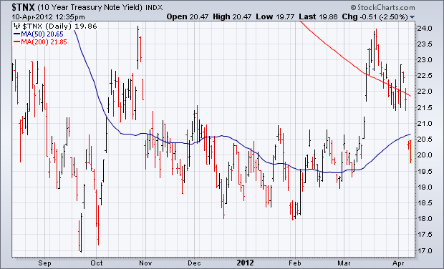
(TNX)

Slide 13
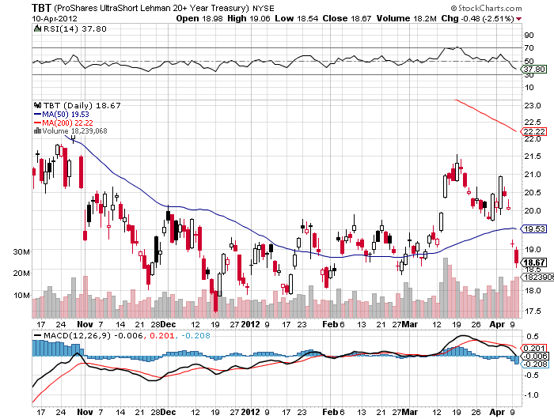
Short Treasuries (TBT)

Slide 14
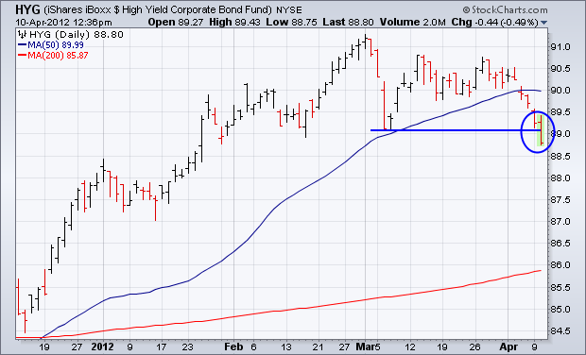
Junk Bonds (HYG)

Slide 15
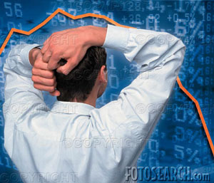
Stocks-A correction at Last
*This is not the big one
*We are 4.3% into a 5%-10% move down
*A climactic selloff coming
*Non Apple Indexes leading the downside charge
*Volume surges as individuals, hedge funds, HF traders lay on shorts
*Downside targets range from 1,325 to 1,285
*Huge amount of money trapped on the sidelines
is preventing bigger sell off, wait until next year
*The permabulls will try to take this up one more time
*The VIX spike finally comes

Slide 16

Stocks-Potential Tops
*March 30 quarter end- The Winner!
*April 20 Apple Q1 earnings
*April 29 One year anniversary of
2011 top
*SPX at 1,449 Elliot wave/momentum
top
*SPX 1,550 2007 top
Pullbacks
-140 points-1/3 of recent gain then on to new highs, econ accelerates
-400 points-double dip recession, oil over $120

Slide 17
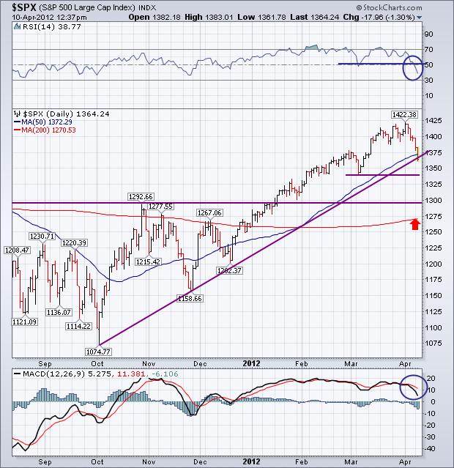
(SPY)

Slide 18
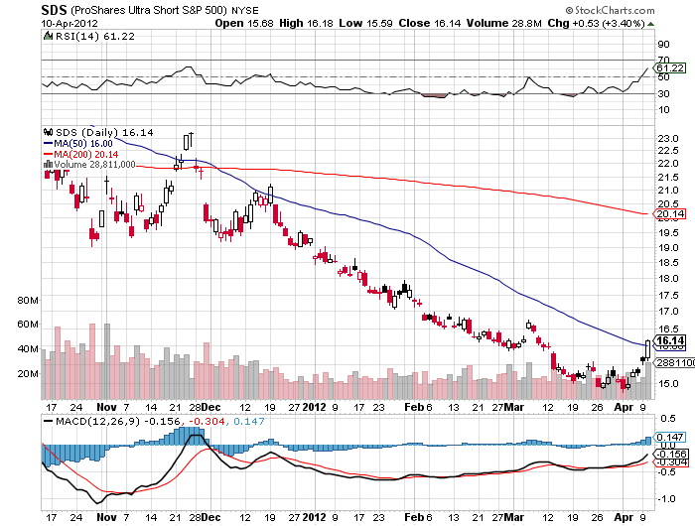
Double Short S&P 500 ETF(SDS)

Slide 19
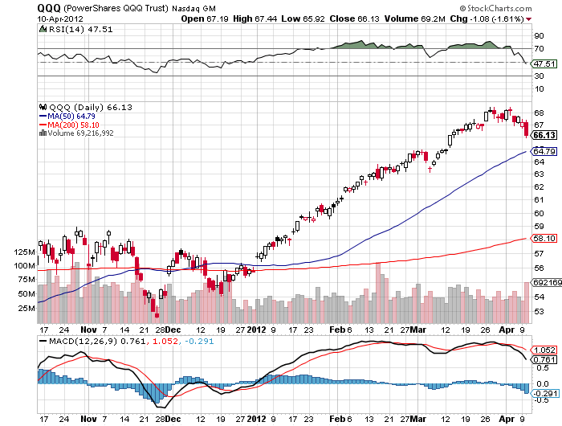
NASDAQ

Slide 20
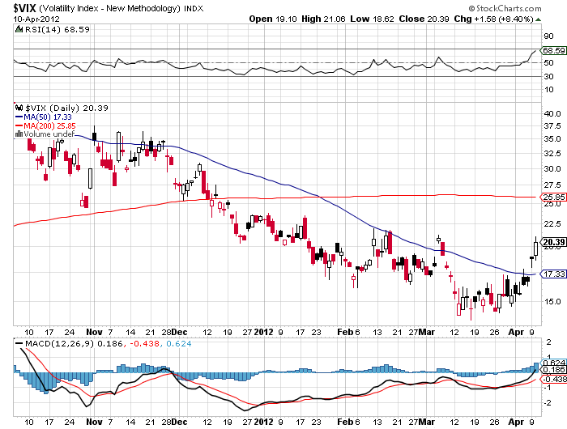
(VIX)

Slide 21
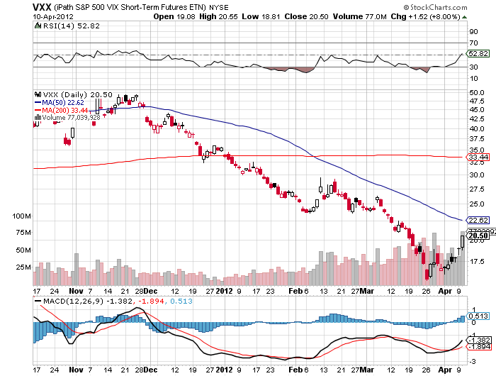
(VXX)

Slide 22
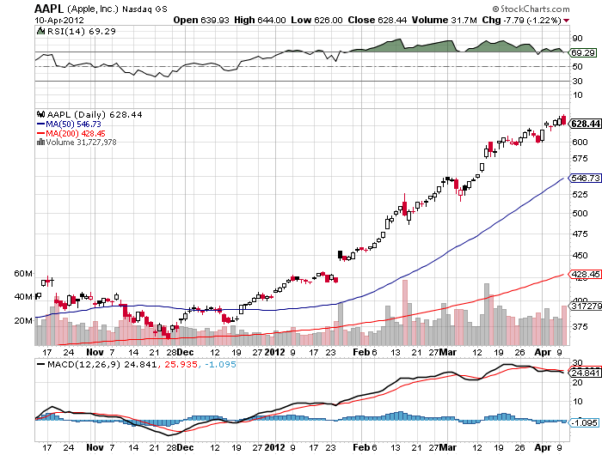
(AAPL)

Slide 23
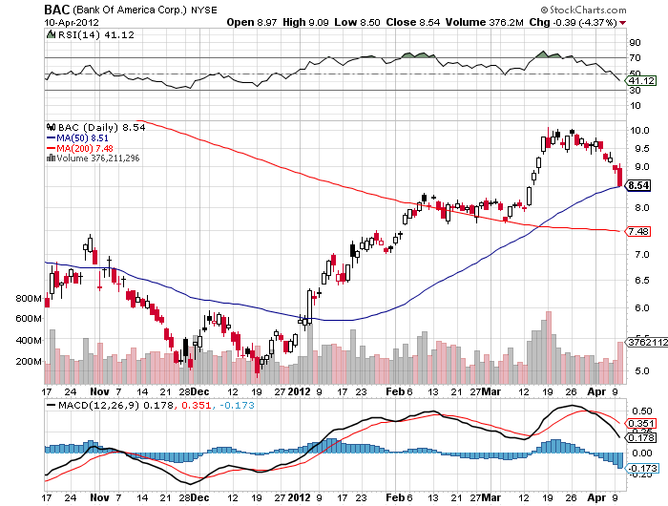
(BAC)

Slide 24
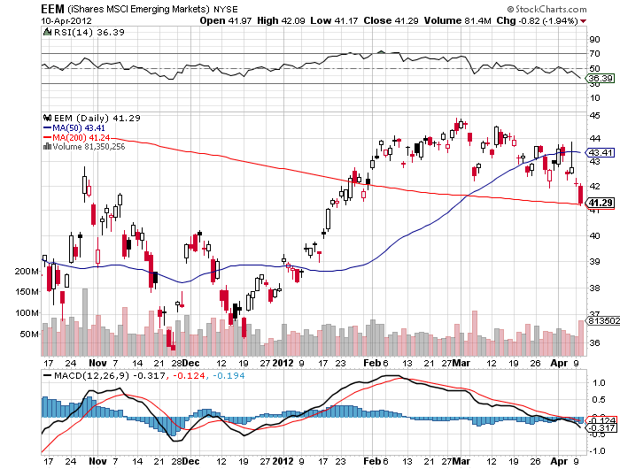
iShares MSCI EAFE Index Fund (EEM)

Slide 25
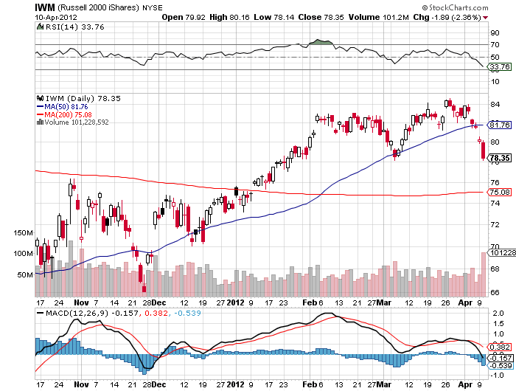
Russell 2000 (IWM) -8.3%

Slide 26
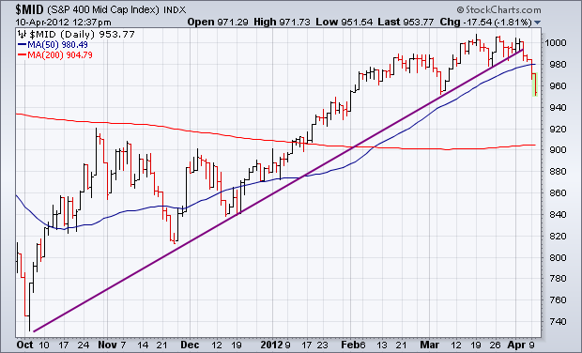
S&P 500 Mid Cap Index -6%

Slide 27
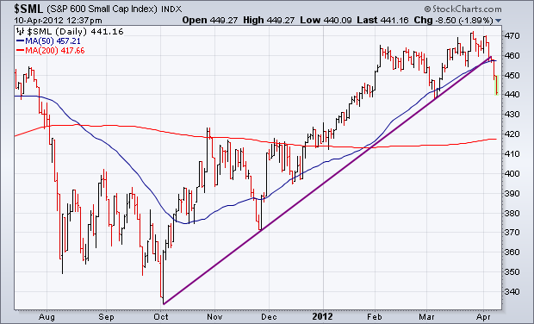
S&P 500 Small Cap Index -7.4%

Slide 28
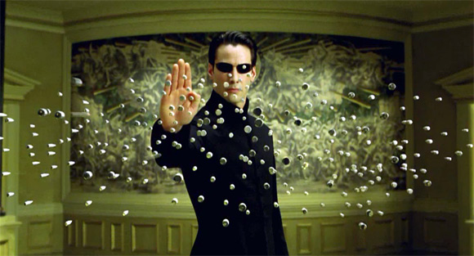
The Dollar
*Dodged the bullet on the yen
*When short term yen positions flipped from a 4 year long
to a 4.5 year short, I’m out of there
*US stock sell off created meaningful yen strength
with “RISK OFF”
*Yen has become a temporary flight to safety
currency
*look to resell in the high ¥70’s
*Ausie weaker on China slowdown
*Ausie has been a great lead currency in 2012
peaked February 28

Slide 29
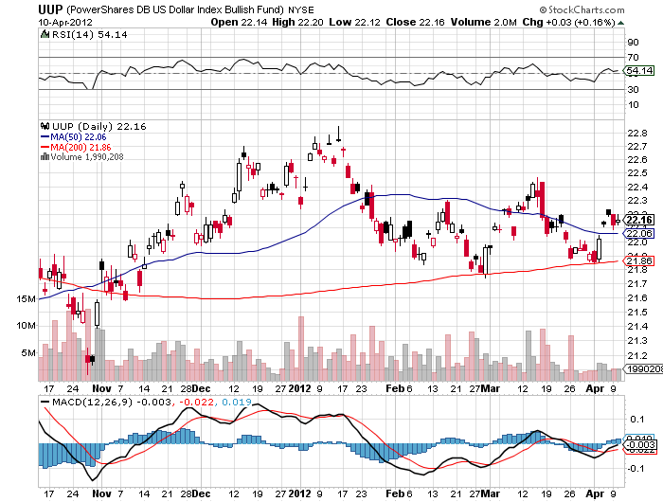
Long Dollar Basket (UUP)

Slide 30
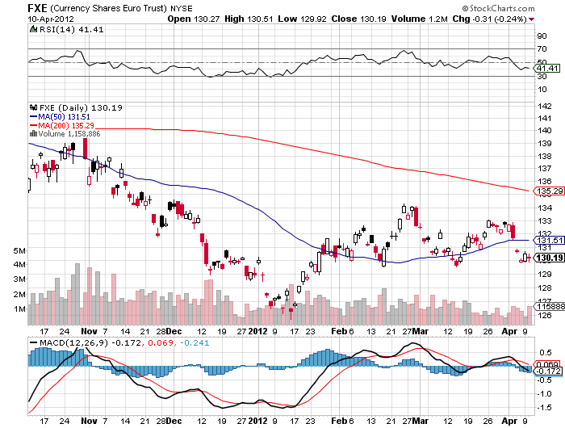
Euro (FXE)

Slide 31
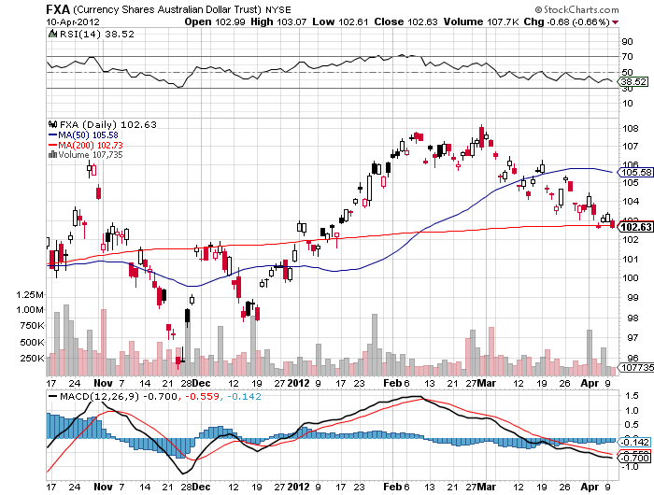
Australian Dollar (FXA)

Slide 32
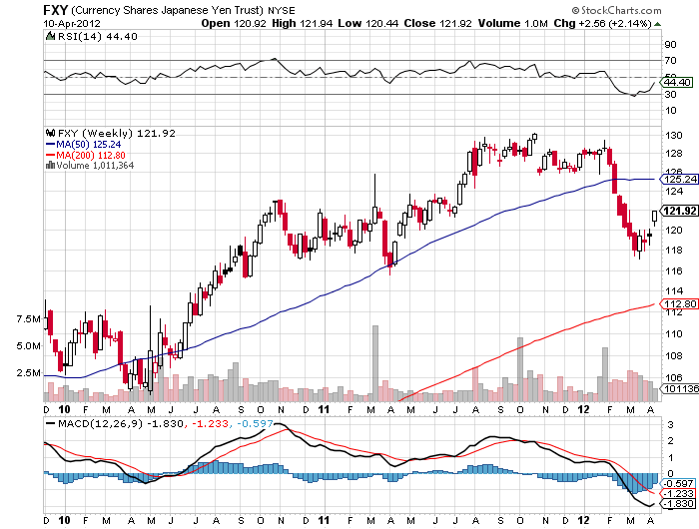
Japanese Yen (FXY)

Slide 33
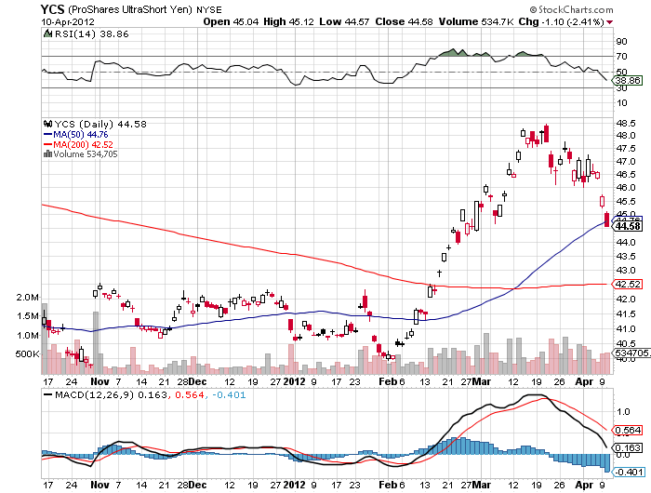
(YCS)

Slide 34
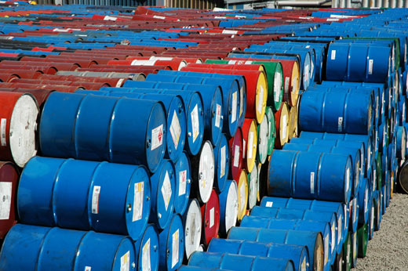
Energy
*”RISK OFF” hits oil with everything else
*Look to buy when SPX hits 1,325 or 1,275
*New lows in (UNG), wait for the next rally
Nat Gas at new 10 year low at $2.00
*Final target $1.50, too late to sell
*Natural gas collapse continues without a rally
*Crude/Nat gas ratio hits 50:1, an all time high
*Nat gas trading at 15% of crude on a BTU Basis,
no immediate conversion without massive government intervention

Slide 35
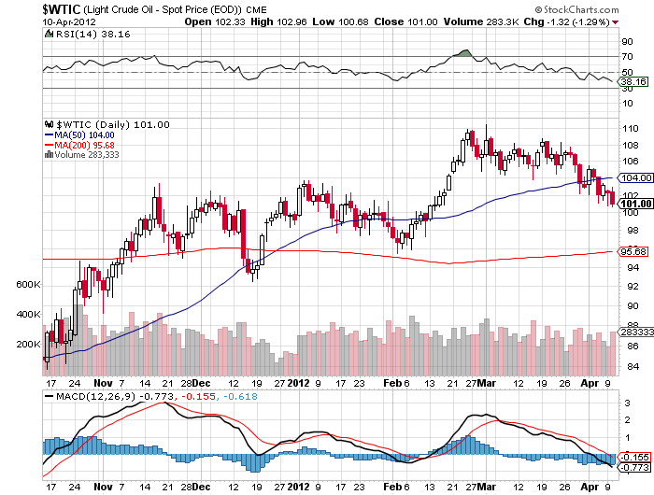
Crude

Slide 36
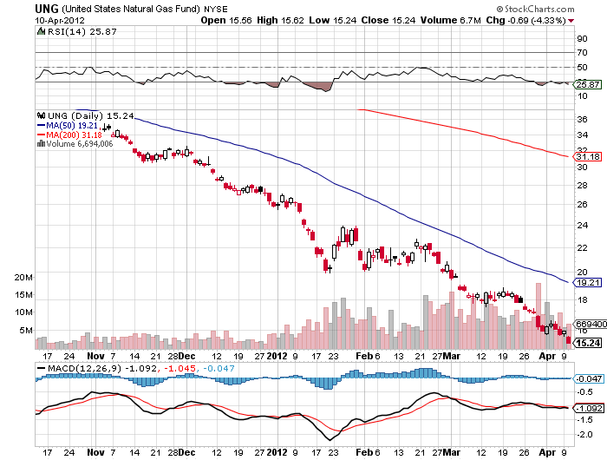
Natural Gas (UNG)

Slide 37
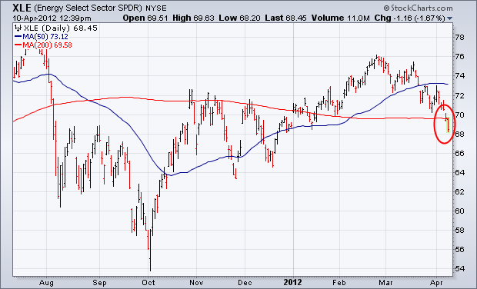
Energy Select SWPDR (XLE)

Slide 38
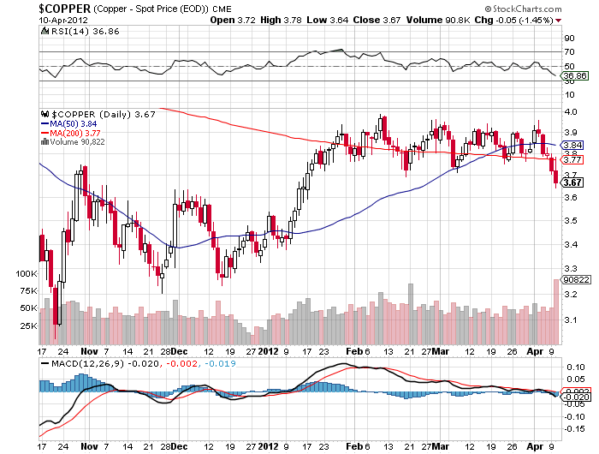
Copper (CU)

Slide 39
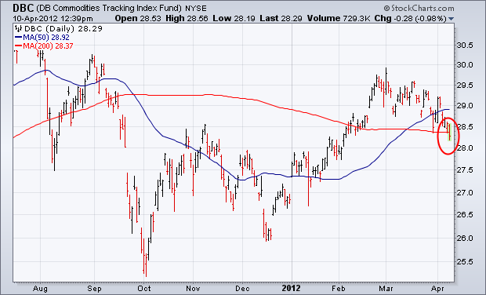
DB Commodities Index Tracking Fund (DBC)

Slide 40
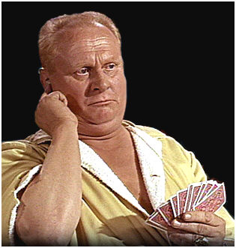
Precious Metals
*No QE means sell gold and silver
*Looking for $1,500 on the downside for gold
$25 for silver for the short term
*2,300 and $100 for the long term
*Panic European buying has abated
*Look to short gold on next serious rally,
the downtrend is still intact
*Use limited risk instruments only, like puts
*Never have an open ended short on gold

Slide 41
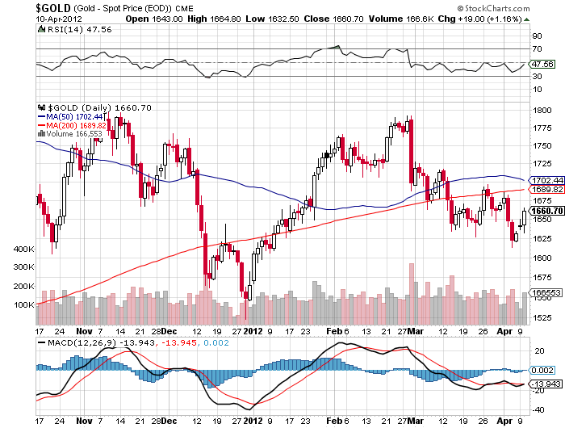
Gold

Slide 42
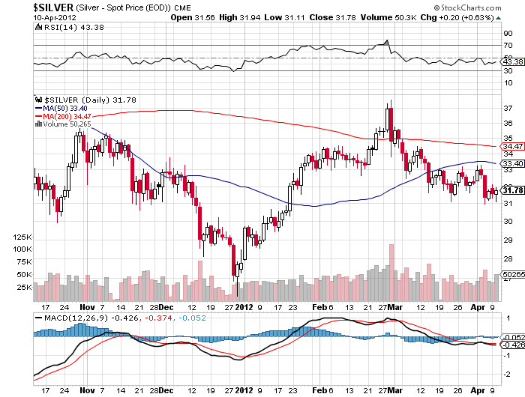
Silver

Slide 43
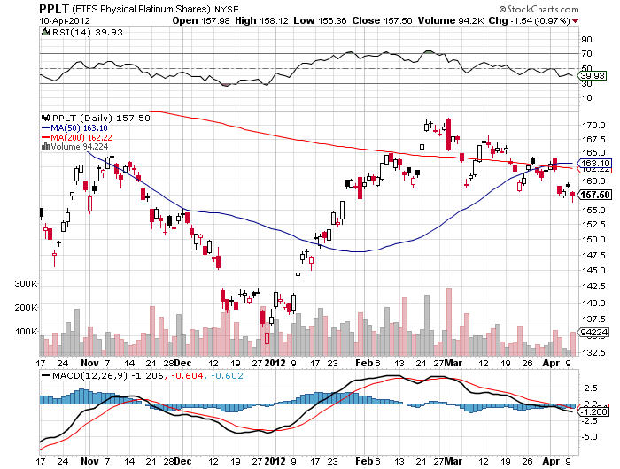
(Platinum)

Slide 44
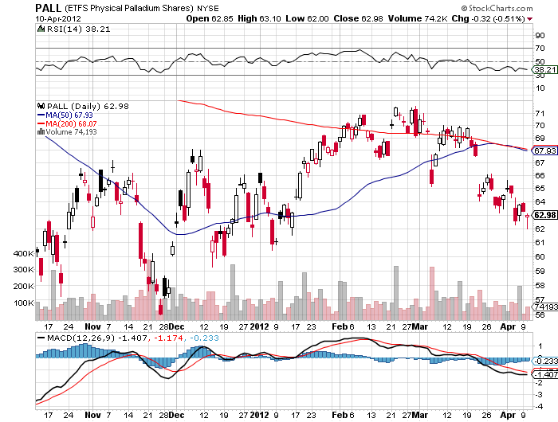
Palladium

Slide 45
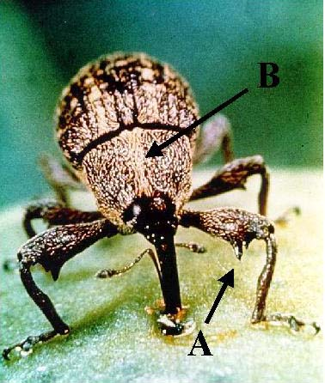
The Ags
*Caught the “RISK OFF bug
*US Corn crop to be all time high
*The price action will be in soybeans
*Drought in South America continues
*Harsh winter is cutting Russian wheat crop
*Proof that “RISK ON/RISK OFF” is still alive

Slide 46
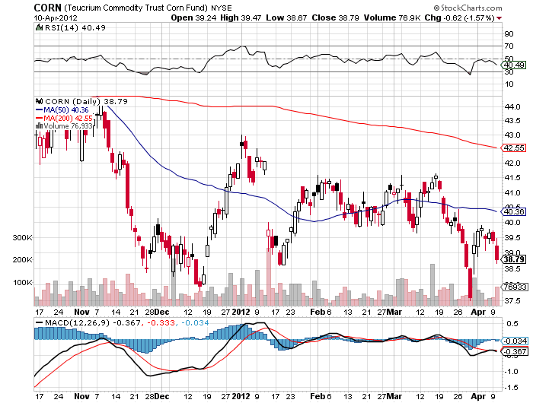
(CORN)

Slide 47
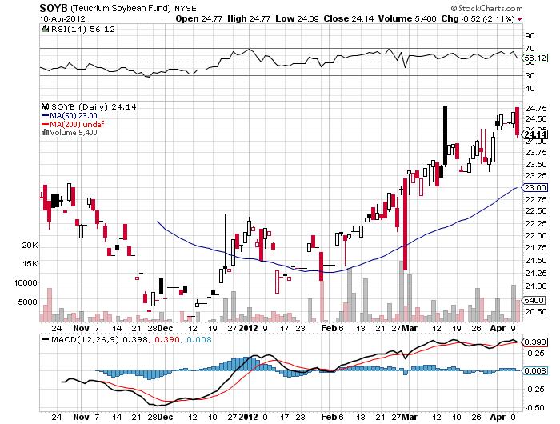
Soybeans (SOYB)

Slide 48
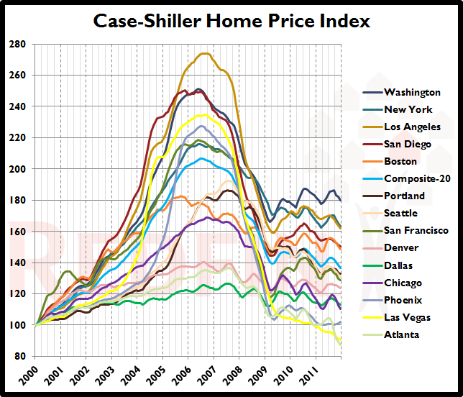
Real Estate
January, 2012

Slide 49
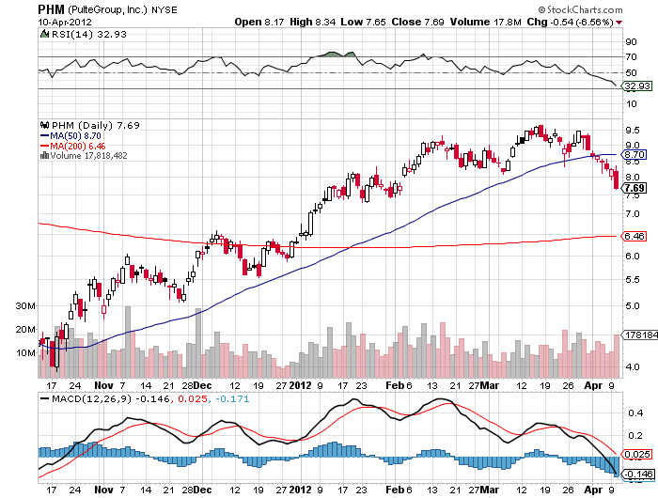
Pulte Group (PHM)

Slide 50
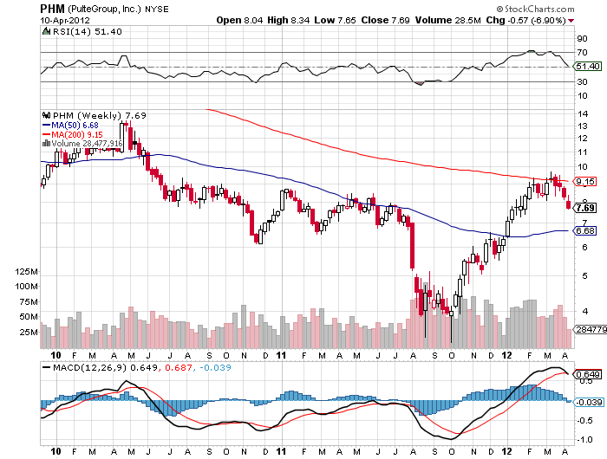
Pulte Group (PHM) Weekly

Slide 51

Trade Sheet
The bottom line: Too late to buy, too early to sell
*Stocks- sell rallies
*Bonds- stand aside, the selloff was fake
*Commodities- sell rallies, rolling over in China
*Currencies- sell Euro, stand aside yen
*Precious Metals – sell rallies in Gold
*Volatility-stand aside, missed the bounce
*The ags – stand aside
*Real estate- Sell homebuilders
Next Webinar is on Wednesday, April 25, 2012

Slide 52

To buy strategy luncheon tickets Please Go to www.madhedgefundtrader.com

