Slide 1

Please Stand By for
John Thomas
Wednesday, April 25, 2012
Global Trading Dispatch
The Webinar will begin at 12:00 pm EST

Slide 2

The Mad Hedge Fund Trader
“The Benefit of the Doubt Market”
Diary of a Mad Hedge Fund Trader
April 25, 2012
www.madhedgefundtrader.com

Slide 3

MHFT Global Strategy Luncheons
Buy tickets at www.madhedgefundtrader.com
2012 Schedule
May 3 Scottsdale
June 11 Beverly Hills
June 29 Chicago
July 5 New York
July 6-13 Queen Mary II
New York to Southampton
July 16 London
July 17 Paris
July 18 Frankfurt
July 27 Zermatt
October 26 San Francisco
November 8 Orlando
January 3, 2013 Chicago

Slide 4

MHFT Global Strategy Luncheons
Buy tickets at www.madhedgefundtrader.com
Scottsdale, AZ
May 3

Slide 5

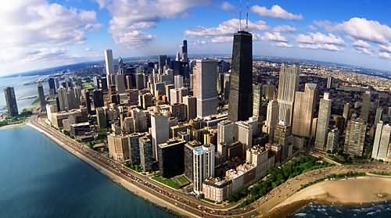
MHFT Global Strategy Luncheons
Buy tickets at www.madhedgefundtrader.com
Beverly Hills, CA
June 11
Chicago, IL
June 29

Slide 6


MHFT Global Strategy Luncheons
Buy tickets at www.madhedgefundtrader.com
New York, NY
July 5
Seminar at Sea
July 11, 2012
Queen Mary 2

Slide 7
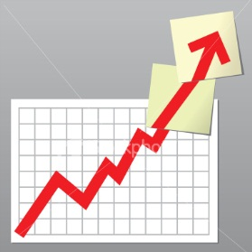
Trade Alert Performance
*April MTD -2.51%
*2012 YTD -6.10%
*First 74 weeks of Trading
+ 34.08%
*Versus +17.80% for the S&P500
A 16.3% outperformance of the index
48 out of 66 closed trades profitable, users manual coming
73% success rate on closed trades

Slide 8
Portfolio Review
Stay Small Until a Reversal is Confirmed
Risk On
(FXY) puts | 10.00%
(TBT) short Treasury | 10.00%
Risk Off
(IWM) puts | -10.00%
(PHM) puts | -5.00%
(BA) puts | -5.00%
(GLD) puts | -10.00%
(FXE) puts | -10.00%
total net position | -20.00%

Slide 9
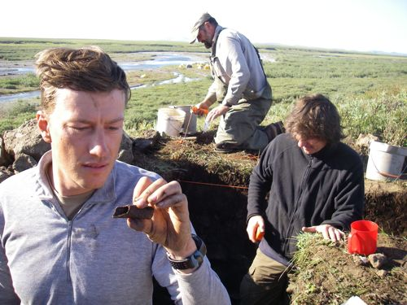
The Economy-Markets Noticed the Macro Data
*Economic data transitioning from weak to weaker
*The negatives are accelerating
*China April PMI 49.1
*Weekly jobless claims 386,000
*No QE3 from the Federal Reserve reaffirmed
*March durable goods -4.2%
*March home sales -2.6%, Case Shiller still falling
*Thursday jobless claims is crucial
*All consistent with a low 2.0% GDP growth rate

Slide 10
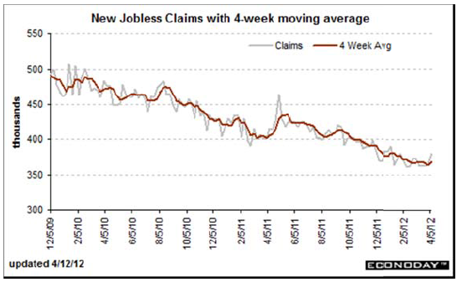
Weekly Jobless Claims
The Last Thing Bulls had to hang their hats on

Slide 11
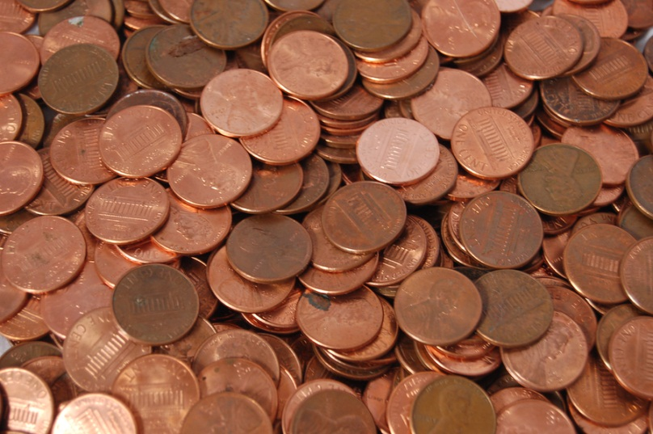
Bonds-Trading for Pennies
*Will we live forever in the $1.80%-2.10% range?
*Targeting 1.60% on the 10 year
*Is a market of pennies and nickels
*Fed will continue dissing QE3
but not rule it out
*Twist ends June 30,
Is there a replacement

Slide 12
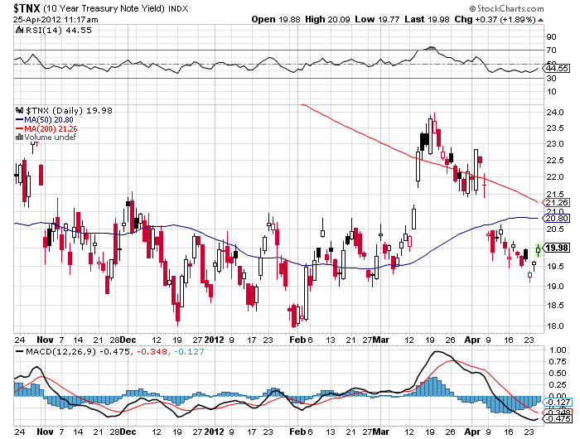
(TNX)

Slide 13
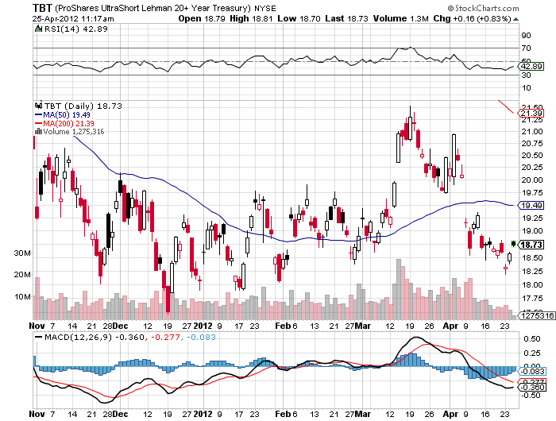
Short Treasuries (TBT)

Slide 14
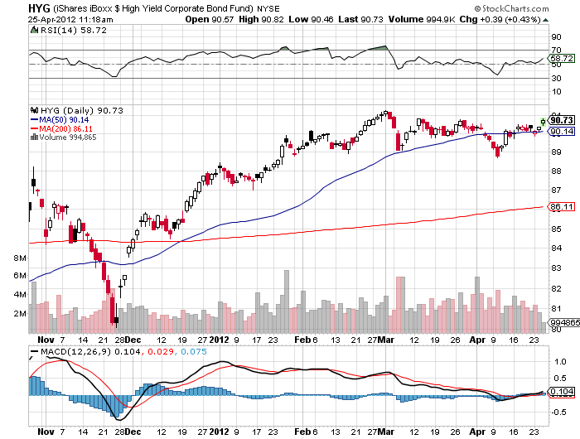
Junk Bonds (HYG)

Slide 15

Stocks-The Benefit of the Doubt Market
*This is not the big one
*We are 4.3% into a 5%-15% move down
*An ice versus fire market?
*Will the Apple bump spread to the rest of the market?
A one day pop, or a trend reversal?
*Downside targets range from 1,325 to 1,285
*Huge amount of money trapped on the sidelines
is preventing bigger sell off, wait until next year
*The VIX spike is still missing in action, is it broken?

Slide 16

Stocks-Potential Tops
*March 30 quarter end- The Winner!
*April 20 Apple Q1 earnings
*April 29 One year anniversary of
2011 top
*SPX at 1,449 Elliot wave/momentum
top
*SPX 1,550 2007 top
Pullbacks
-140 points-1/3 of recent gain then on to new highs, econ accelerates
-400 points-double dip recession, oil over $120

Slide 17
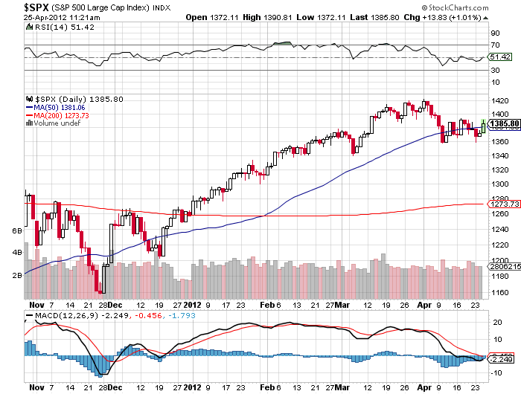
(SPY)

Slide 18
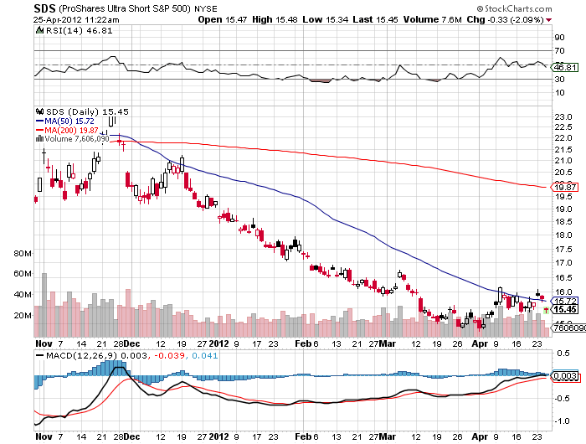
Double Short S&P 500 ETF(SDS)

Slide 19
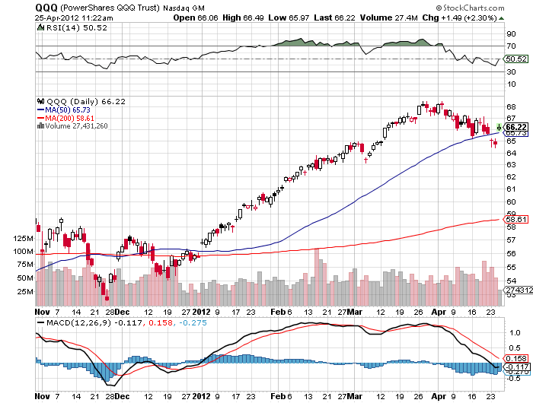
NASDAQ

Slide 20
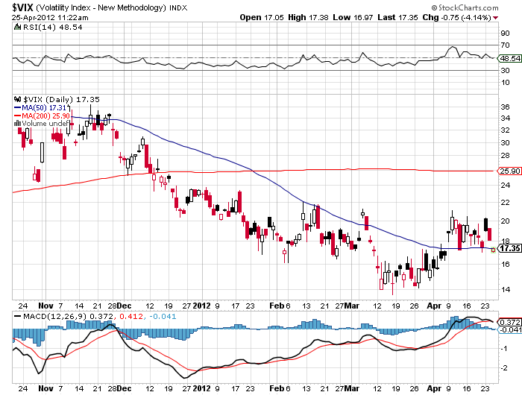
(VIX)

Slide 21
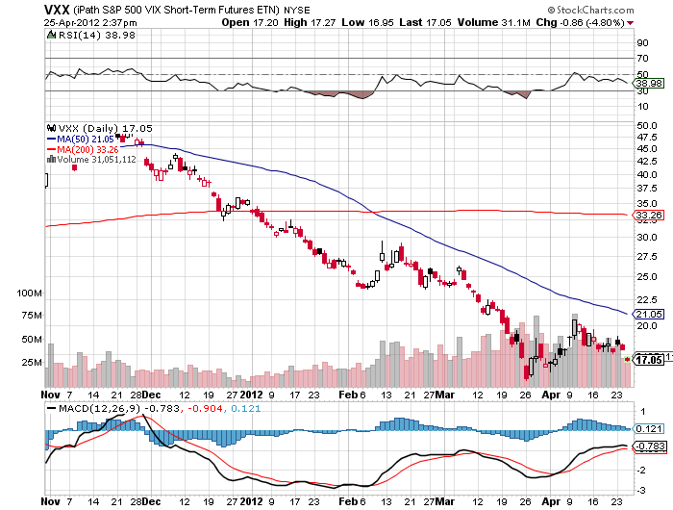
(VXX)

Slide 22
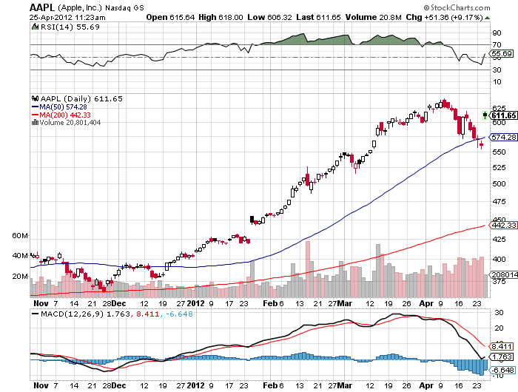
(AAPL)-
35 million iPhones vs 29 million expected, $39.2 billion revenues vs $36.8 billion expected

Slide 23
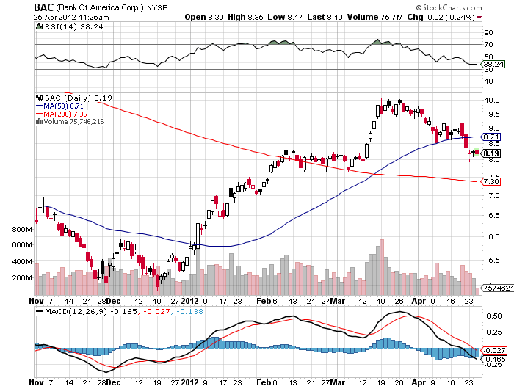
(BAC)

Slide 24
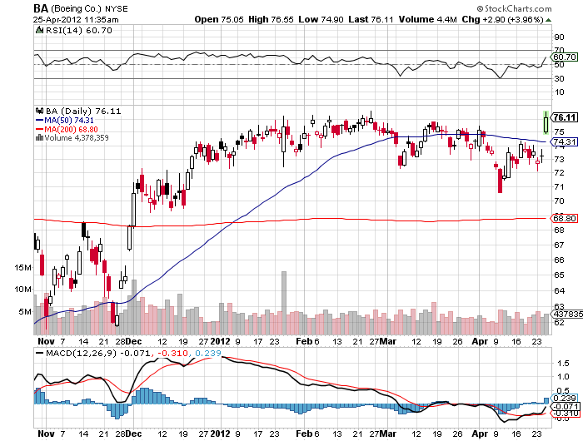
(BA) falling aircraft orders, but 2% rise in annual forecast due to reduction in litigation reserves

Slide 25
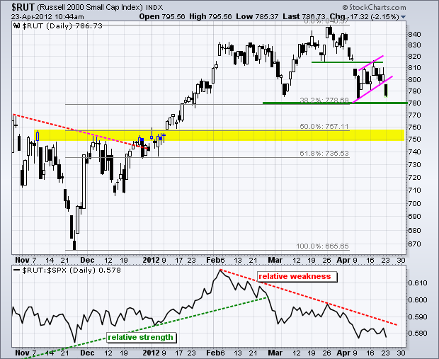
Russell 2000 (IWM)

Slide 26
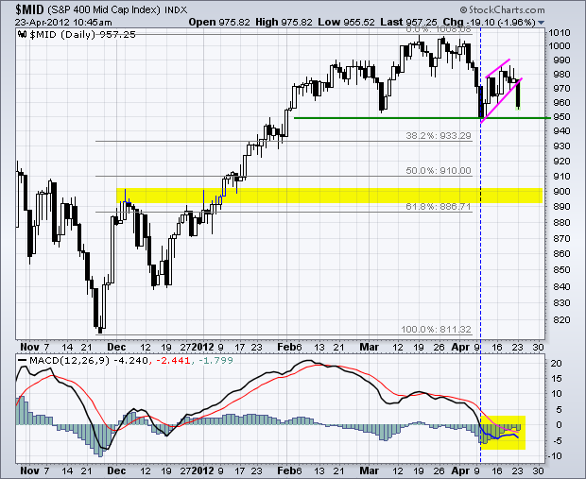
S&P 400 Mid Cap Index

Slide 27
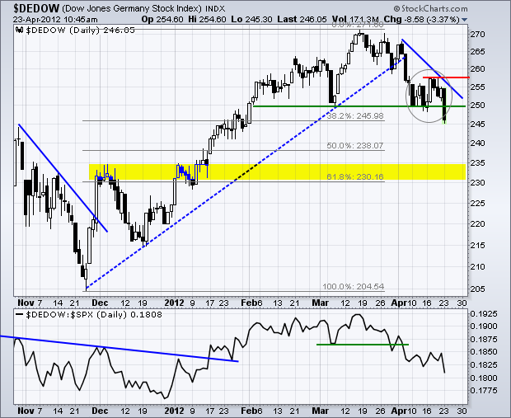
Germany

Slide 28
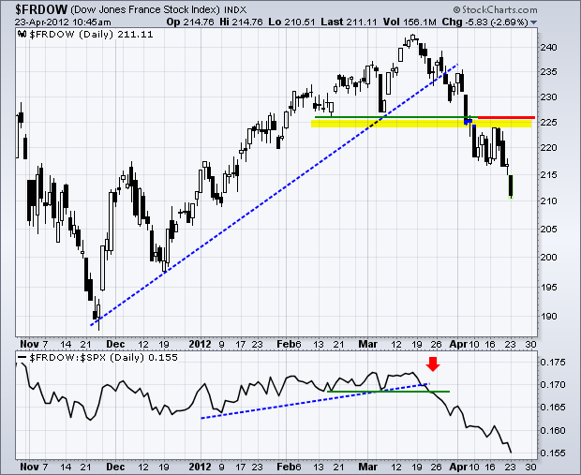
France

Slide 29

The Dollar
*US stock sell off created meaningful dollar and yen strength
with “RISK OFF”
*Yen has became a temporary flight to safety
currency
*look to resell in the high ¥70’s, when
US stocks bottom
*Socialist will in France is death for the Euro
May 6
*Break of $1.30 targets $1.26 and $1.17
*European debt crisis has just been made longer
and more severe

Slide 30
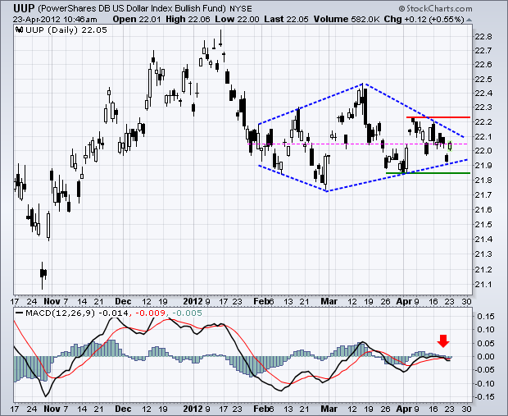
Long Dollar Basket (UUP)

Slide 31
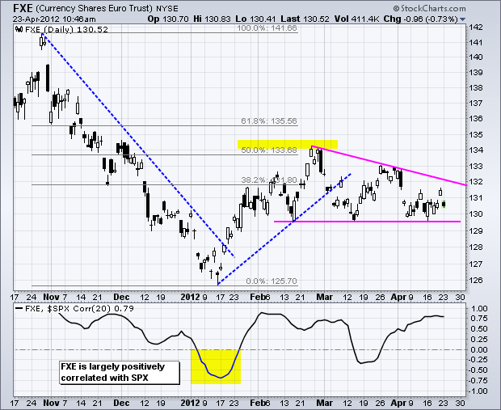
Euro (FXE)

Slide 32
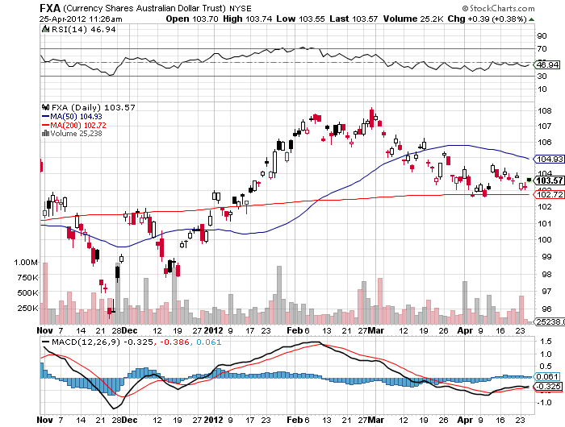
Australian Dollar (FXA)

Slide 33
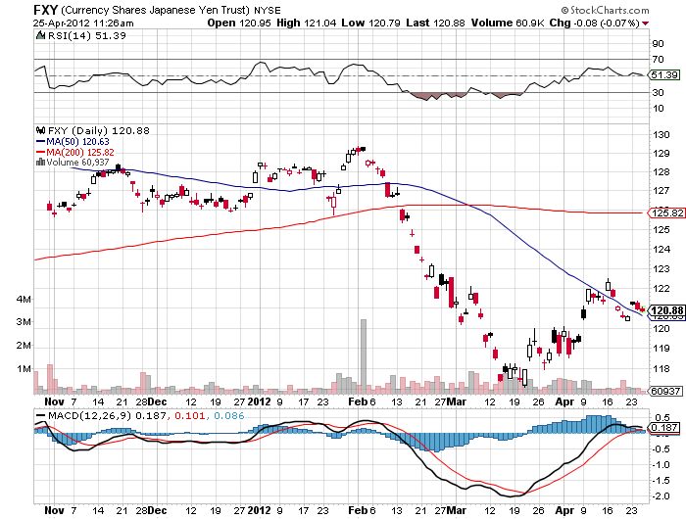
Japanese Yen (FXY)

Slide 34
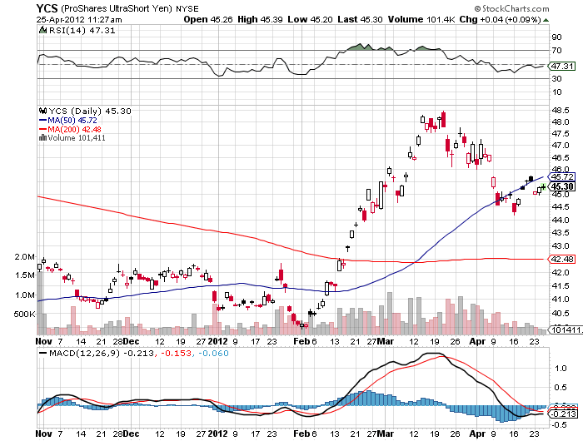
(YCS)

Slide 35
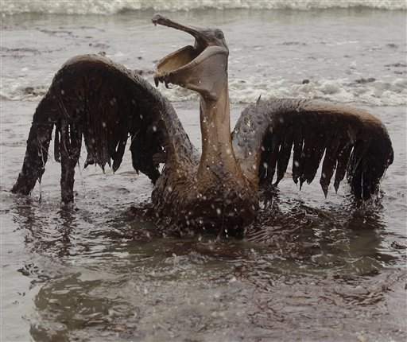
Energy
*”RISK OFF” hits oil with everything else
*Break of $100/barrel is imminent, targets $95
*Look to buy when SPX hits 1,325 or 1,275
*New lows in (UNG), wait for the next rally
Nat Gas at new 10 year low at $1.90
*Final target $1.50, too late to sell
*Natural gas collapse continues without a rally
*Crude/Nat gas ratio hits 50:1, an all time high

Slide 36
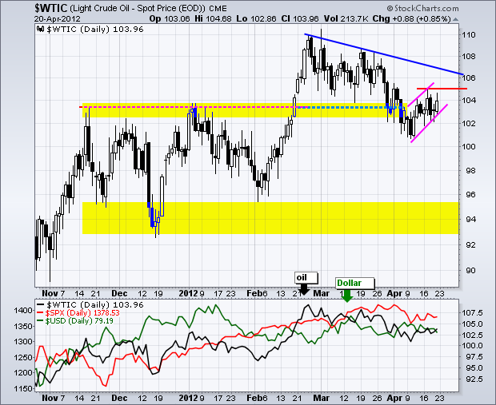
Crude

Slide 37
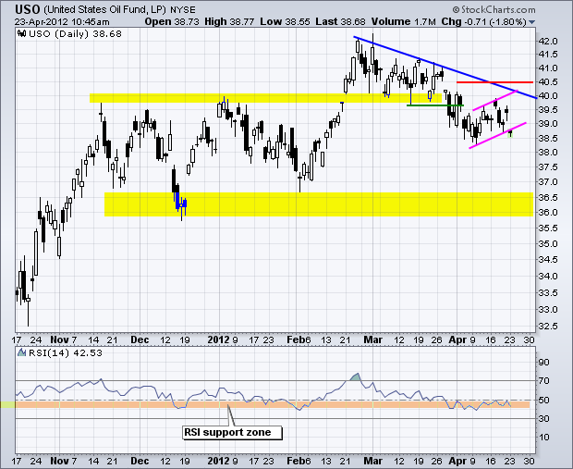
Oil (USO)

Slide 38
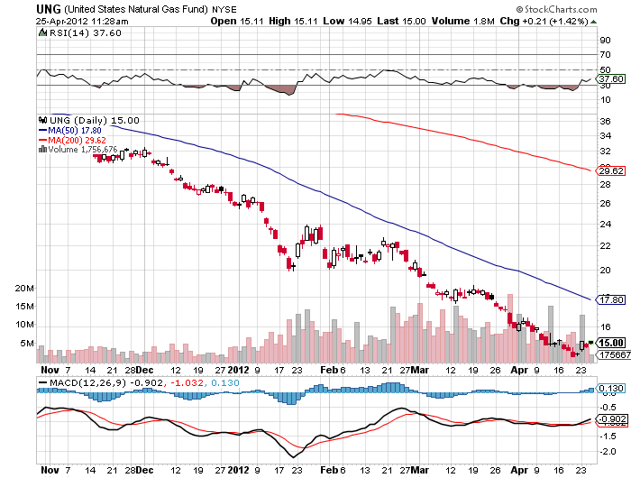
Natural Gas (UNG)

Slide 39
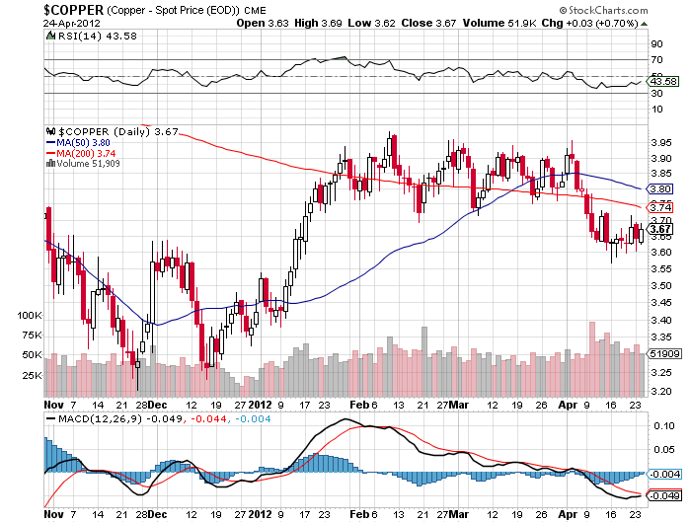
Copper (CU)

Slide 40
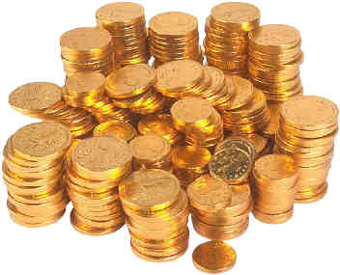
Precious Metals
*No QE means sell gold and silver
*Hedge fund selling of all metals
has accelerated
*Running my gold short, first target
$1,620, then $1,510
*Looking for $25 for silver
*Use limited risk instruments only, like puts

Slide 41
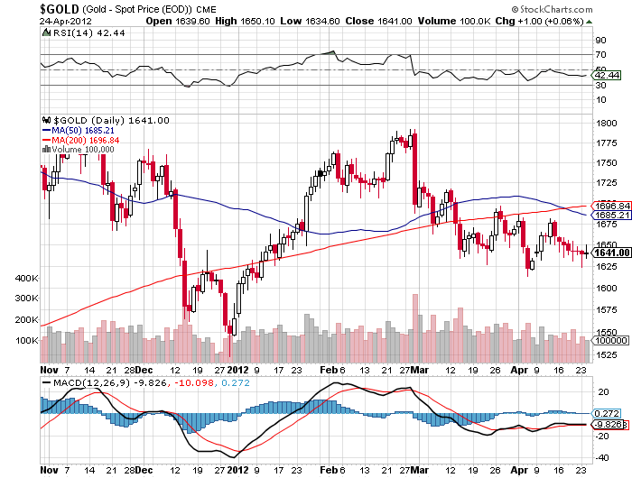
Gold

Slide 42
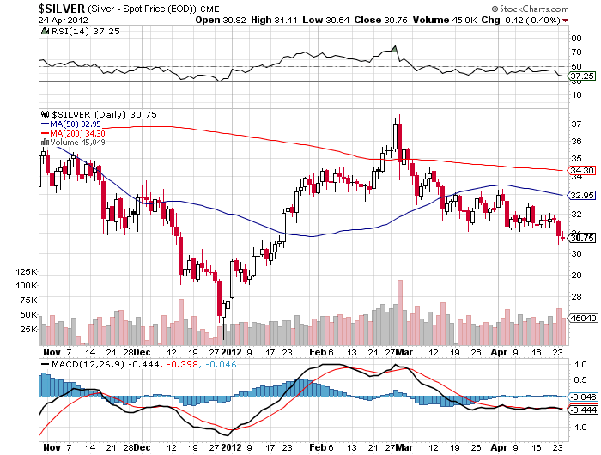
Silver

Slide 43
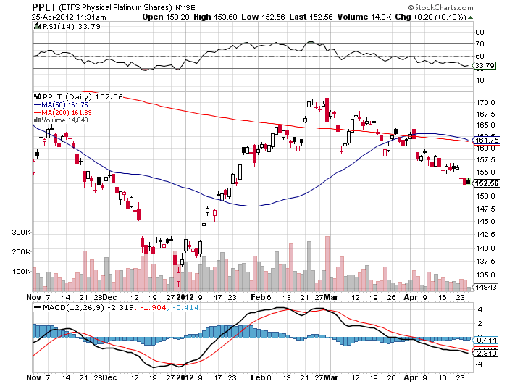
(Platinum)

Slide 44
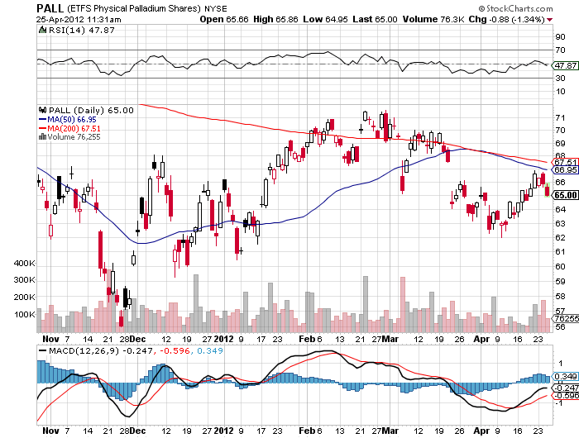
Palladium

Slide 45

The Ags
*Those huge rain storms that caused all that
damage were great for corn and wheat crops
*Soybeans fall despite major Chinese buying
*Proof that “RISK ON/RISK OFF” is still alive

Slide 46
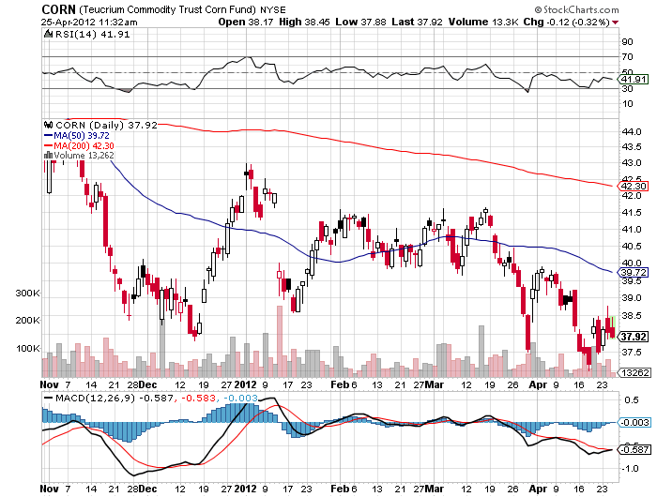
(CORN)

Slide 47
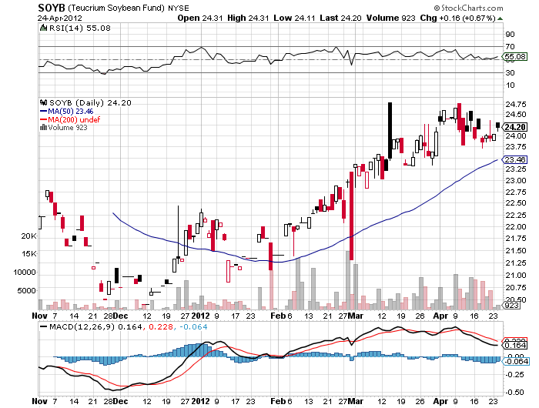
Soybeans (SOYB)

Slide 48
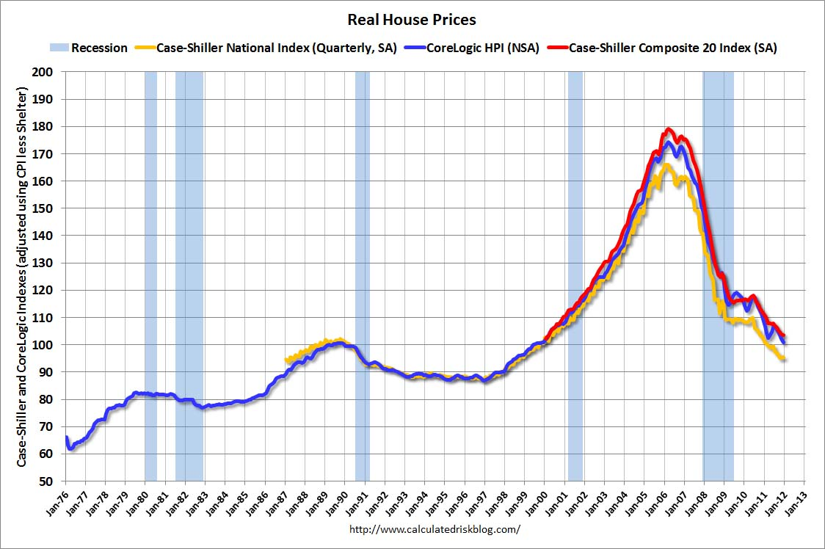
Real Estate
February, 2012

Slide 49
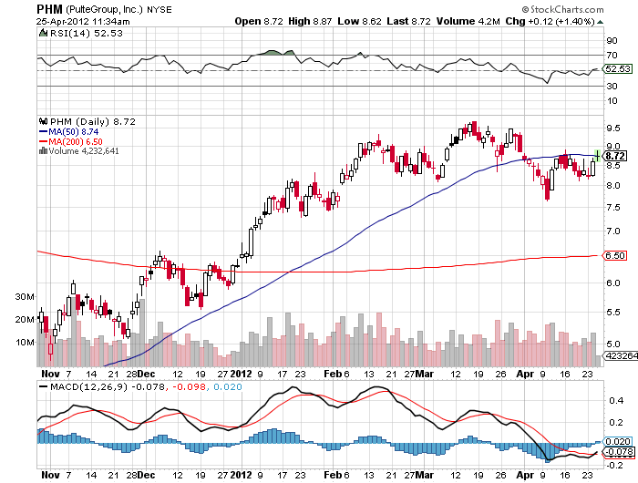
Pulte Group (PHM)

Slide 50

Trade Sheet
The bottom line: Too late to buy, too early to sell
*Stocks- sell rallies
*Bonds- stand aside, sell the next big rally
*Commodities- sell rallies, rolling over in China
*Currencies- sell Euro, sell yen
*Precious Metals – sell rallies in Gold
*Volatility-stand aside, broken
*The ags – stand aside
*Real estate- Sell homebuilders
Next Webinar is on Wednesday, May 9, 2012

Slide 51

To buy strategy luncheon tickets Please Go to www.madhedgefundtrader.com

