Slide 1

Please Stand By for John Thomas Wednesday, May 9, 2012 Global Trading Dispatch
The Webinar will begin at 12:00 pm EST

Slide 2

The Mad Hedge Fund Trader “The Wake Up Call”
Diary of a Mad Hedge Fund Trader May 9, 2012 www.madhedgefundtrader.com

Slide 3

MHFT Global Strategy Luncheons Buy tickets at www.madhedgefundtrader.com 2012 Schedule
June 11 Beverly Hills June 29 Chicago July 5 New York July 6-13 Queen Mary II New York to Southampton July 16 London July 17 Paris July 18 Frankfurt July 27 Zermatt October 26 San Francisco November 8 Orlando January 3, 2013 Chicago

Slide 4

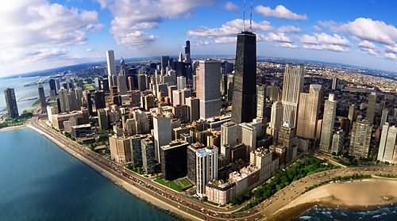
MHFT Global Strategy Luncheons Buy tickets at www.madhedgefundtrader.com
Beverly Hills, CA June 11
Chicago, IL June 29

Slide 5


MHFT Global Strategy Luncheons Buy tickets at www.madhedgefundtrader.com
New York, NY July 5
Seminar at Sea July 11, 2012 Queen Mary 2

Slide 6

Trade Alert Performance
*May MTD +7.95% *2012 YTD -18.23% *First 76 weeks of Trading + 21.65% *Versus +11.3% for the S&P500 A 10.4% outperformance of the index
48 out of 67 closed trades profitable, users manual coming 72% success rate on closed trades

Slide 7
Portfolio Review Hammering the Short Side
current capital at risk
Risk On
(FXY) Sept $121 puts | 10.00%
(TBT) short Treasury ETF | 10.00%
(FXE) short $127 puts | 20.00%
(BA) $72.50 short puts | 10.00%
(PHM) short $8 puts | 10.00%
(IWM) short $77 puts | 20.00%
Risk Off
(IWM) June $80 puts | -10.00%
(PHM) July $7 puts | -5.00%
(FXE) short May $132 calls | -20.00%
(FXY) short May $121 puts | -20.00%
(BA) Aug $70 puts | -5.00%
(FXE) $130 June puts | -10.00%
total net position | 10.00%

Slide 8

The Economy-The Wele E. Coyote Economy
*The winter pull forward was huge *Half of Q1 growth was borrowed from Q2 *April nonfarm payroll 115,000 *April ADP 119,000 private sector jobs, vs. 175,000 expected *Weekly jobless claims -27,000 to 365,000 but trend is now up *European PMI’s falling off a cliff *April New York ISM 67.4 to 61.2 *GM April car sales -8.2% *All consistent with a low 2.0% GDP growth rate

Slide 9
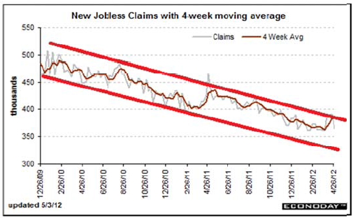
Weekly Jobless Claims The Short Term Trend is Up Break the trend line and the double dip threat is on

Slide 10

Bonds-Flight to Safety
*Will we live forever in the $1.80%-2.10% range? *Targeting 1.60% on the 10 year *Deflation still rules *Fed will continue dissing QE3 but not rule it out *Twist ends June 30, Is there a replacement? *Focus on return of capital rather than return on capital *This is what a rolling top to a 30 year bull market looks like

Slide 11
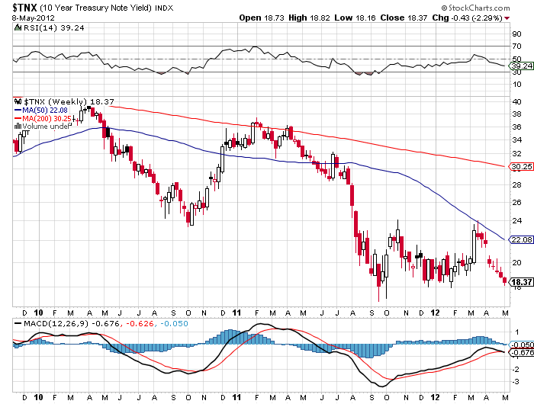
(TNX)

Slide 12
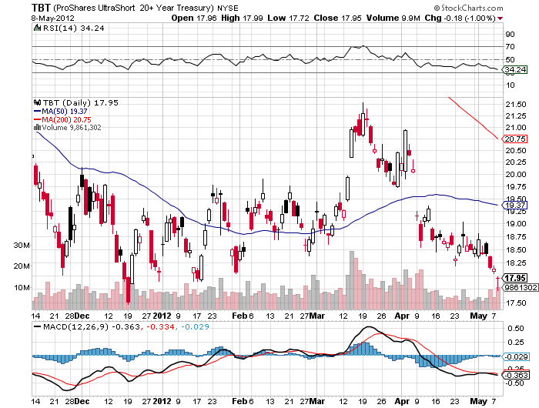
Short Treasuries (TBT)

Slide 13
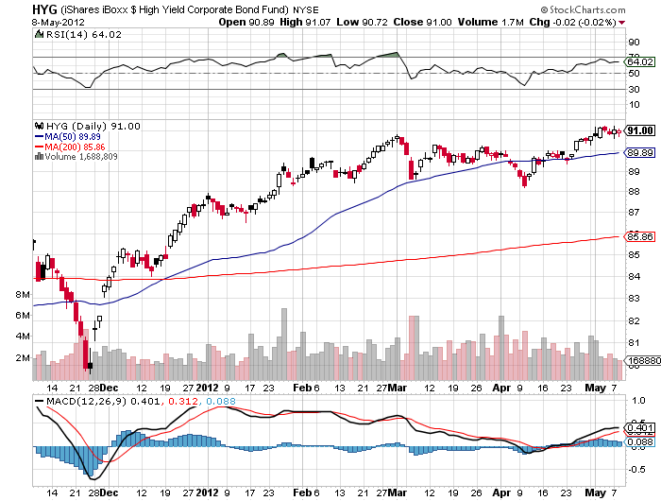
Junk Bonds (HYG)

Slide 14

Stocks-The Market Finally Sees the Macro Data
*We are 5.8% into a 5%-15% move down *Initial downside target is 1,325 (-6.9%) *Rapidly deteriorating fundamentals mean the (SPX) 200 day moving average is in play at 1,276 (-10.3%) *Earnings are over, no upside surprises for two more months *Europe has reclaimed the headlines and will be all bad *Watch for the upside breakout on (VIX) from $20 *Huge amount of money trapped on the sidelines is preventing bigger sell off, wait until next year

Slide 15
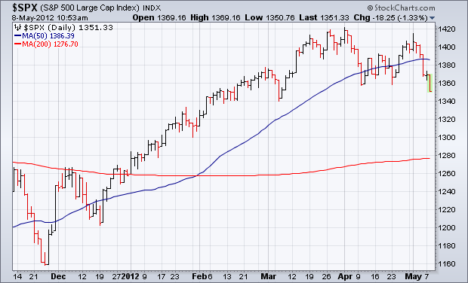
(SPY)

Slide 16
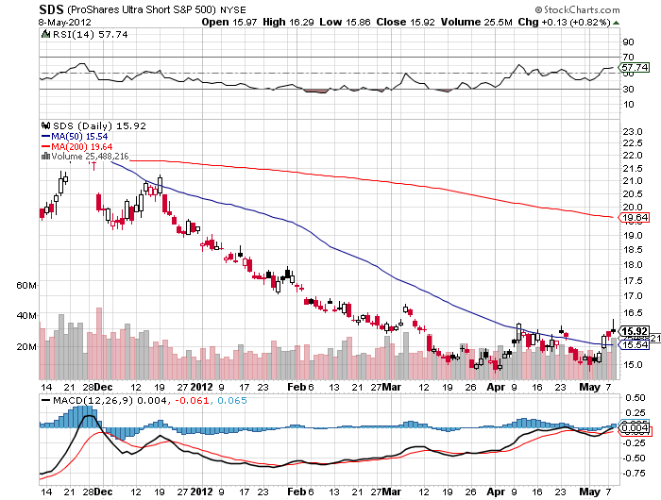
Double Short S&P 500 ETF(SDS)

Slide 17
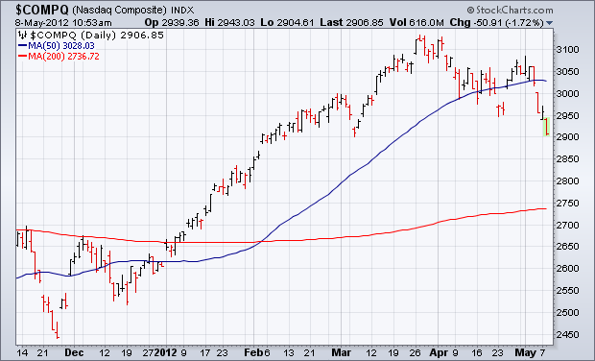
NASDAQ

Slide 18
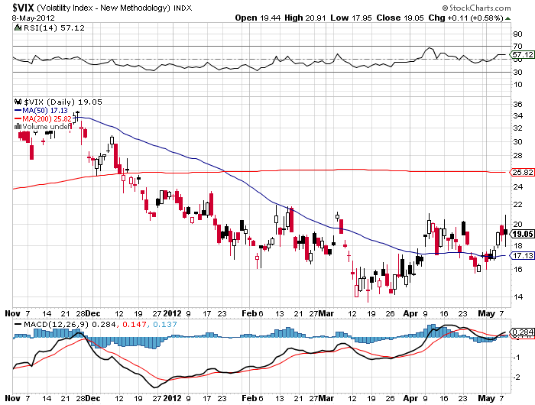
(VIX)

Slide 19
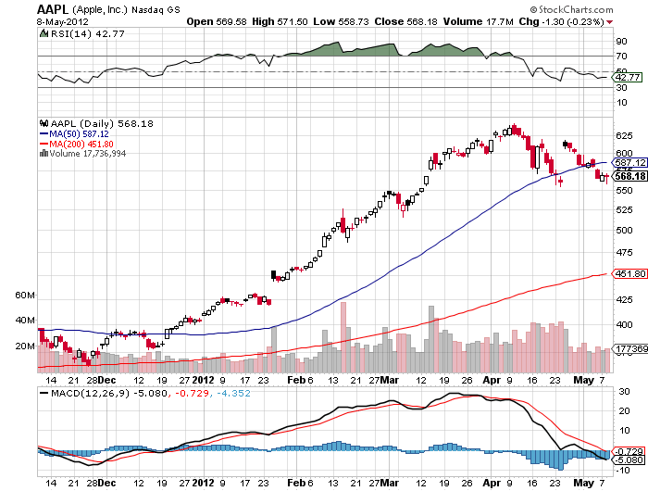
(AAPL)

Slide 20
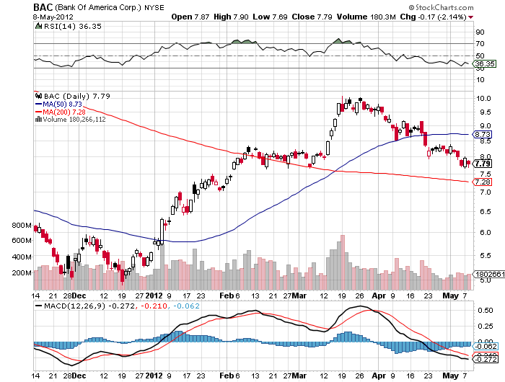
(BAC)

Slide 21
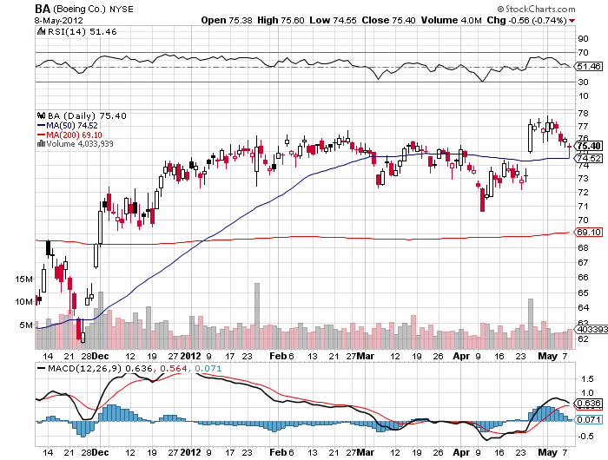
(BA) falling aircraft orders, but 2% rise in annual forecast due to reduction in litigation reserves

Slide 22
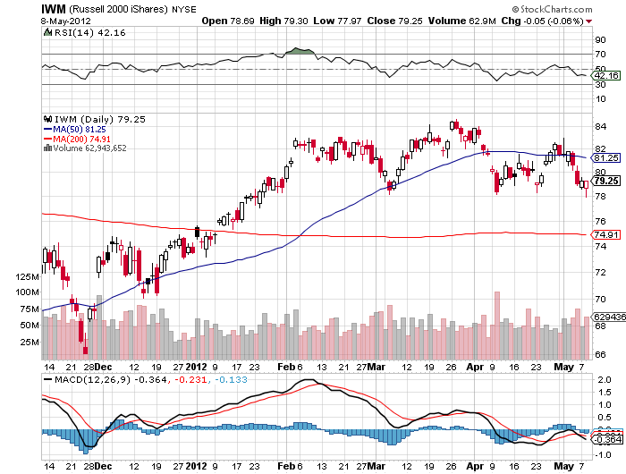
Russell 2000 (IWM)

Slide 23
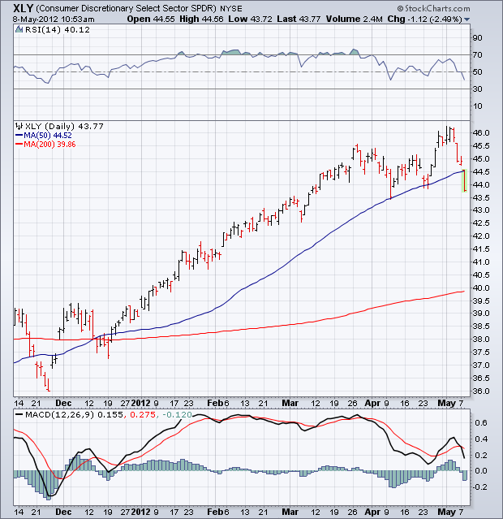
Consumer Discretionary (XLY)

Slide 24
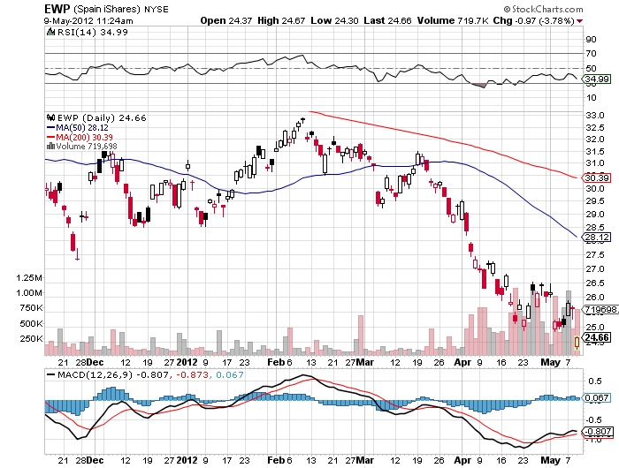
Spain ETF (EWP)

Slide 25
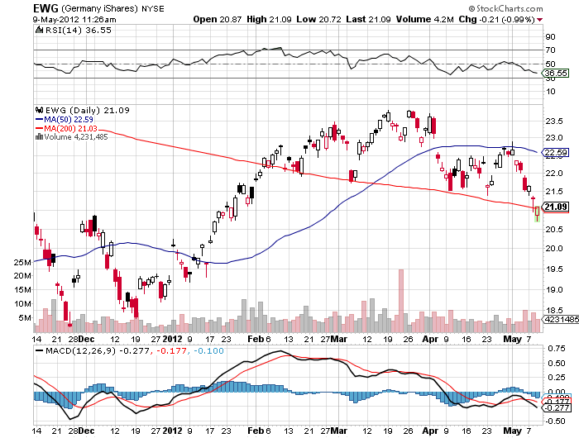
Germany ETF (EWG)

Slide 26
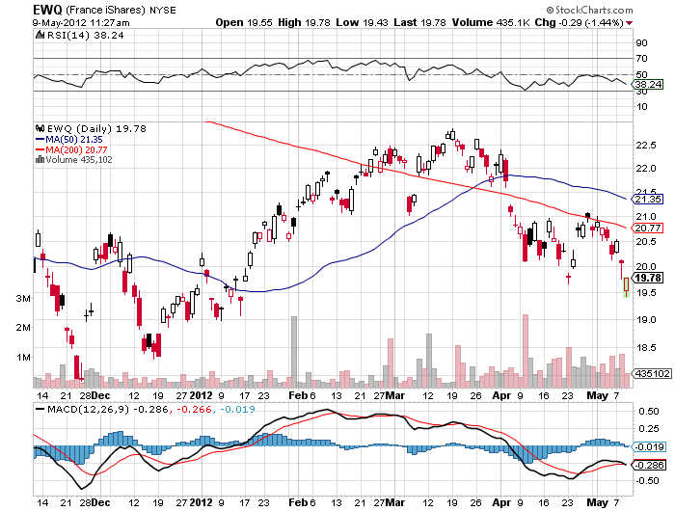
France ETF (EWQ)

Slide 27
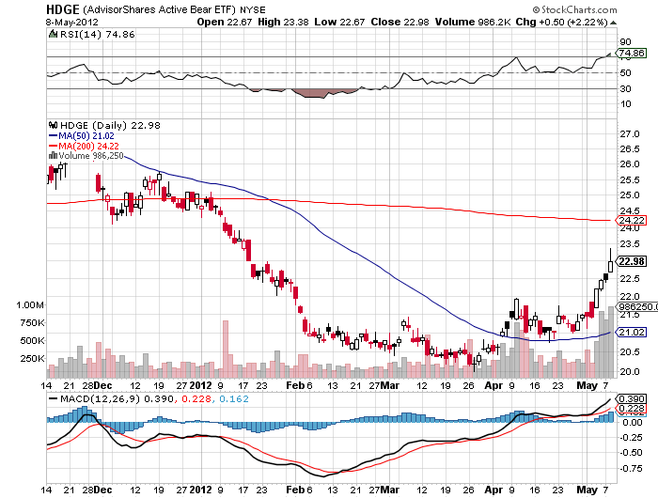
Advisor Shares Active Bear ETF (HDGE)

Slide 28
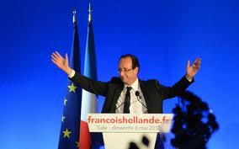
The Dollar
*Next Chapter of the European debt crisis finally break the Euro *US stock sell off created meaningful dollar and yen strength with “RISK OFF” *Yen has become a temporary flight to safety currency *Sell yen volatility, will go to sleep until weakness returns *Socialist win in France is death for the Euro May 6 *Break of $1.30 targets $1.26 and $1.17

Slide 29
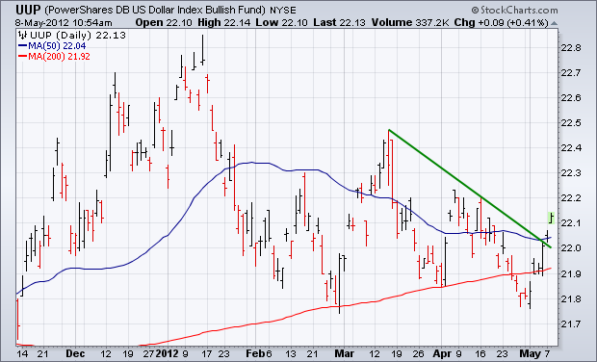
Long Dollar Basket (UUP)

Slide 30
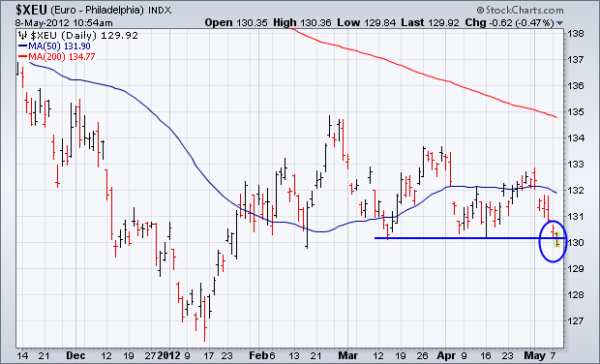
Euro (FXE)

Slide 31
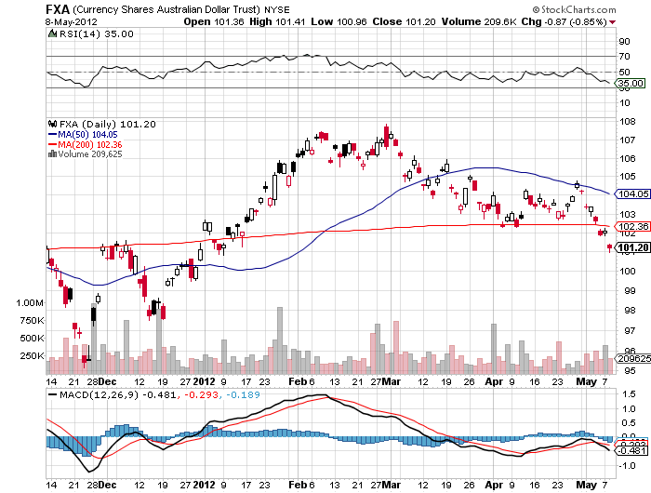
Australian Dollar (FXA)

Slide 32
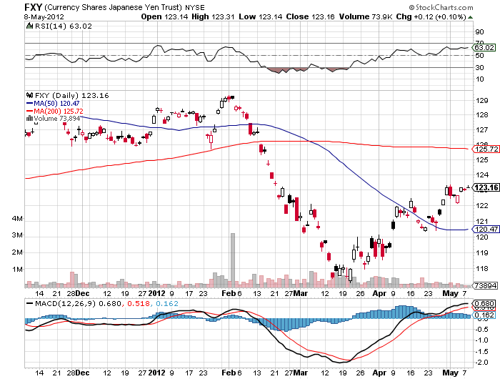
Japanese Yen (FXY)

Slide 33
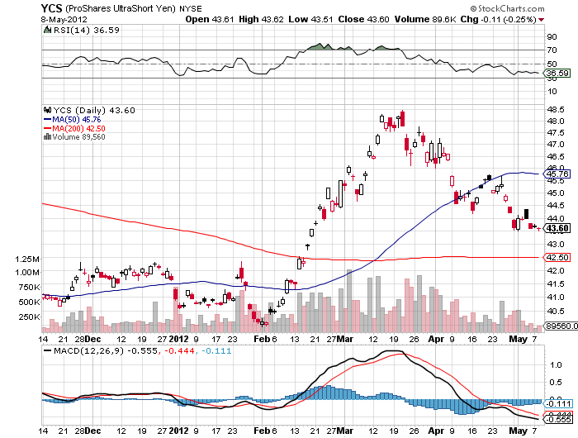
(YCS)

Slide 34
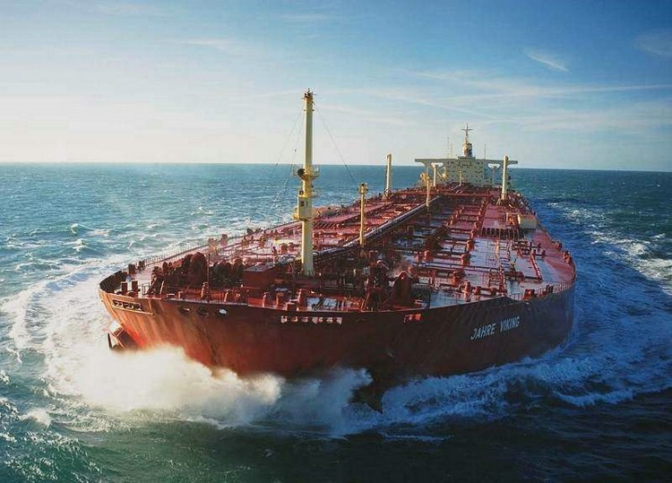
Energy
*”RISK OFF” hits oil with everything else *Break of $100/barrel targets $95 *Margin requirement increase to control “speculators” forces traders to dump positions *14 supertankers fully loaded with Iranian oil sitting in the Persian Gulf trapped by boycott *Nat Gas finally bounces *Final target $1.50, too late to sell

Slide 35
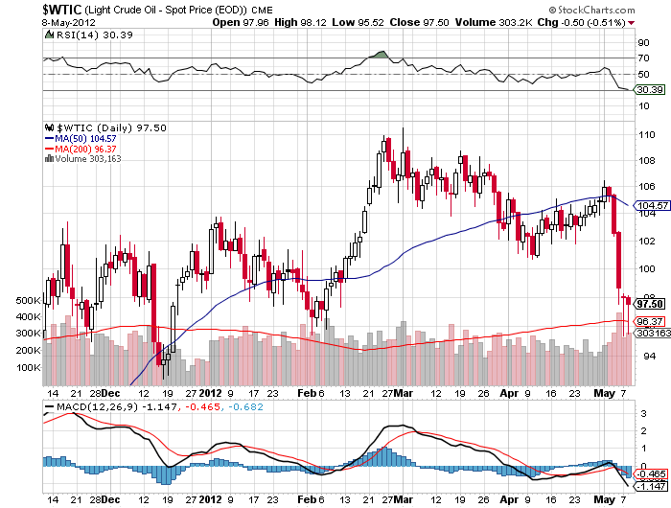
Crude

Slide 36
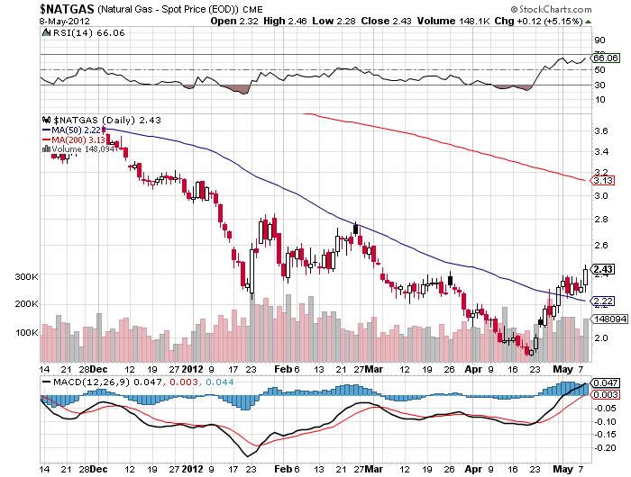
Natural Gas (UNG)

Slide 37
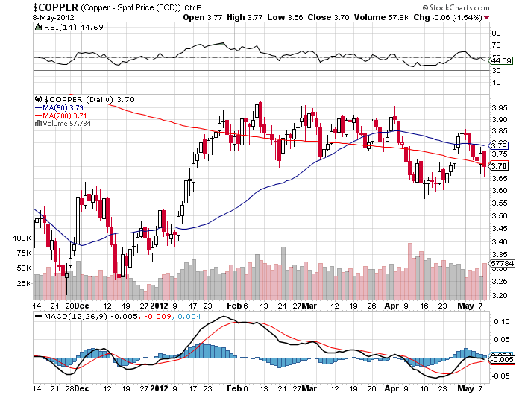
Copper (CU)

Slide 38
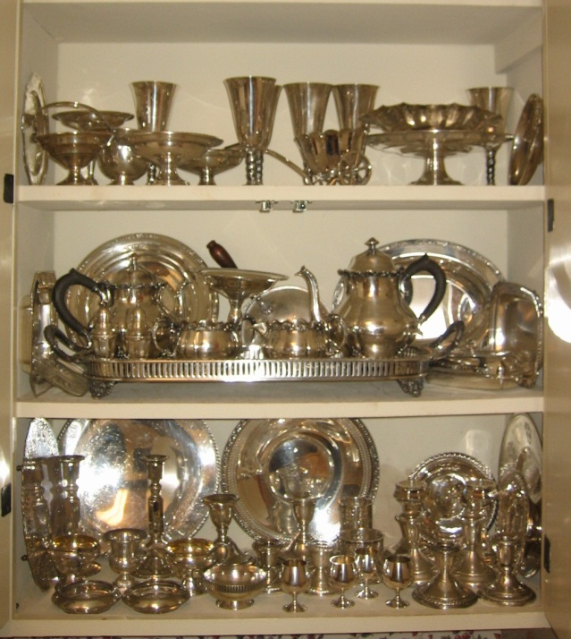
Precious Metals
*Rumors of imminent IMF gold sales to rescue Europe destroy gold on Tuesday *No QE means sell gold and silver *Silver takes the hit, but gold levitates, so I covered short too soon, 2 days before the puts doubled *Looking for $1,500 gold, $25 for silver *Use limited risk instruments only, like puts

Slide 39
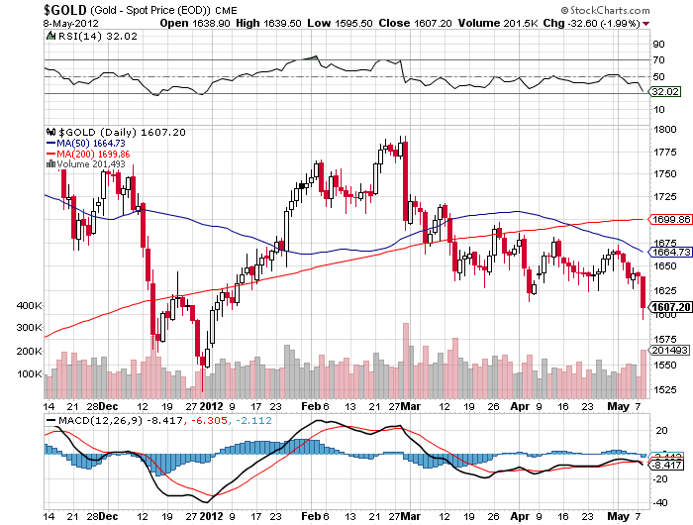
Gold

Slide 40
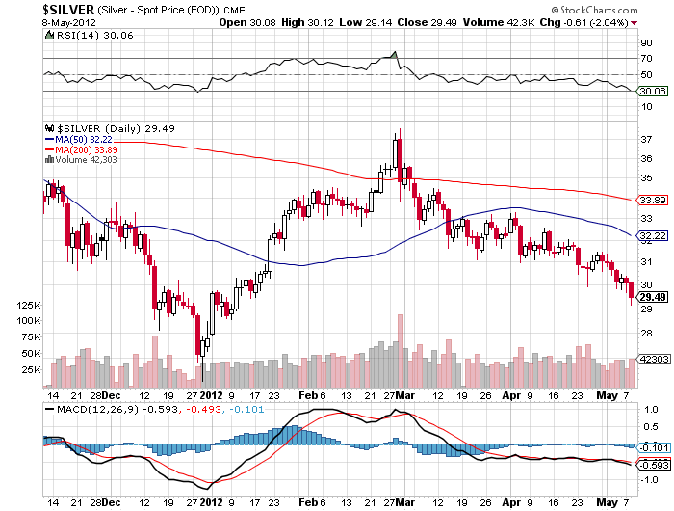
Silver

Slide 41
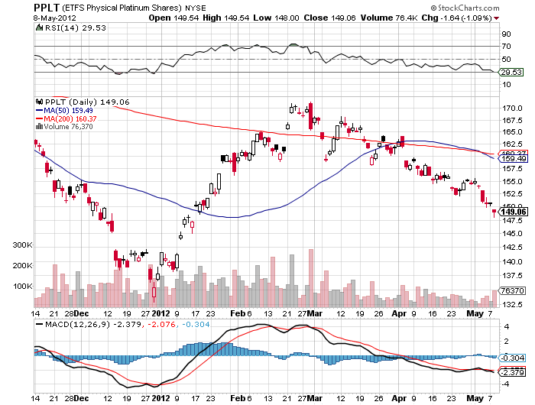
(Platinum)

Slide 42
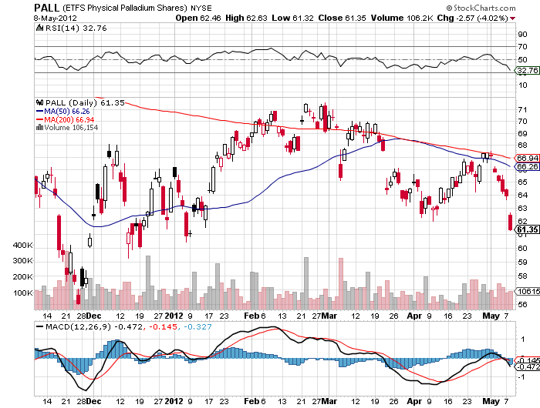
Palladium

Slide 43

The Ags
*Also took the hit on the margin increase *Several major Chinese buys have no impact prices *Market trades like the record crop forecasts will come true. *Stay away and wait for bad weather

Slide 44
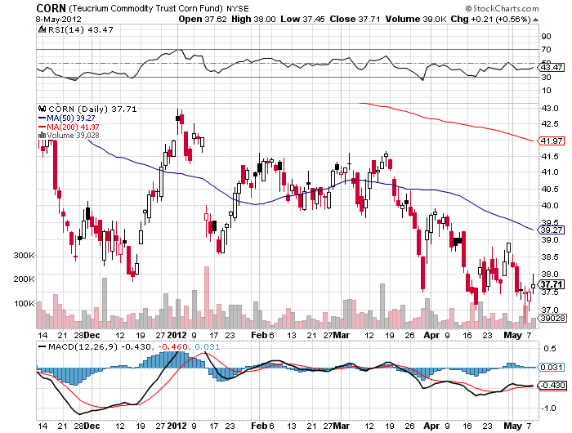
(CORN)

Slide 45
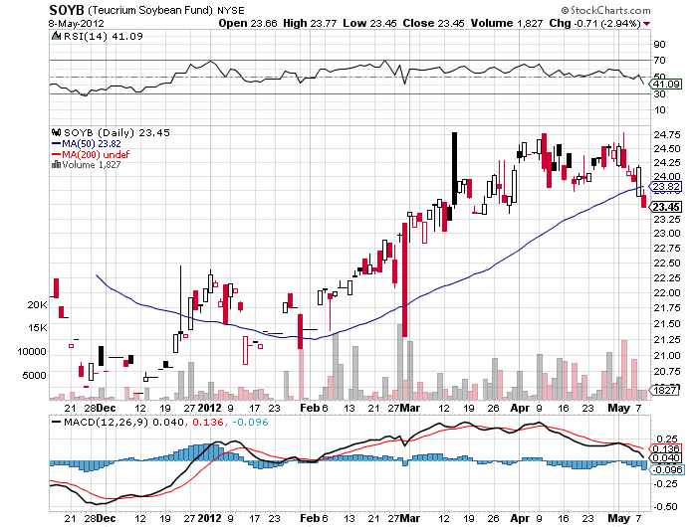
Soybeans (SOYB)

Slide 46
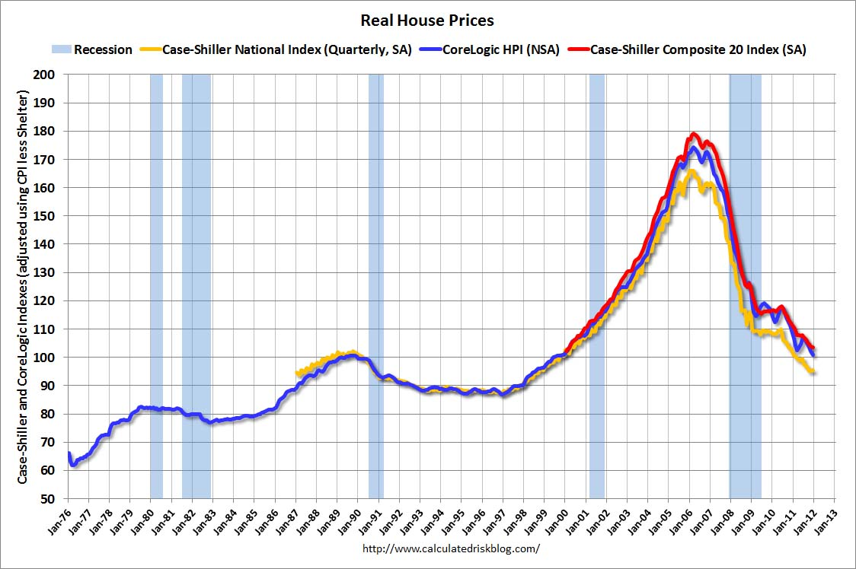
Real Estate February, 2012

Slide 47
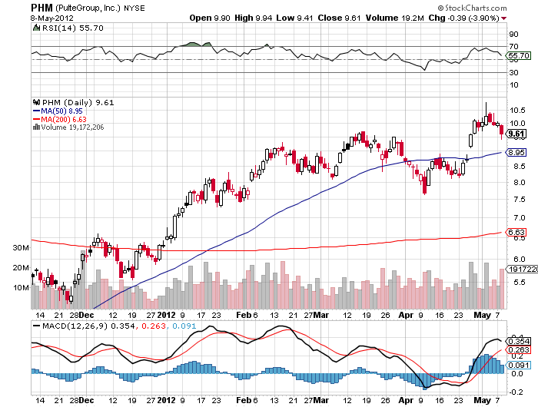
Pulte Group (PHM)

Slide 48

Trade Sheet The bottom line: Too late to buy, too early to sell
*Stocks- sell rallies *Bonds- stand aside, sell the next big rally to 1.70% *Commodities- sell rallies, especially oil and copper *Currencies- sell Euro, sell yen volatility *Precious Metals – sell rallies in Gold and silver *Volatility-stand aside *The ags – stand aside, no trade *Real estate- Sell homebuilders Next Webinar is on Wednesday, May 23, 2012

Slide 49

To buy strategy luncheon tickets Please Go to www.madhedgefundtrader.com

