Slide 1

Please Stand By for John Thomas Wednesday, May 23, 2012 Global Trading Dispatch
The Webinar will begin at 12:00 pm EST

Slide 2

The Mad Hedge Fund Trader “The Pigeons Come Home to Roost”
Diary of a Mad Hedge Fund Trader May 23, 2012 www.madhedgefundtrader.com

Slide 3

MHFT Global Strategy Luncheons Buy tickets at www.madhedgefundtrader.com 2012 Schedule
June 11 Beverly Hills June 29 Chicago July 5 New York July 6-13 Queen Mary II New York to Southampton July 16 London July 17 Paris July 18 Frankfurt July 27 Zermatt October 26 San Francisco November 8 Orlando January 3, 2013 Chicago

Slide 4

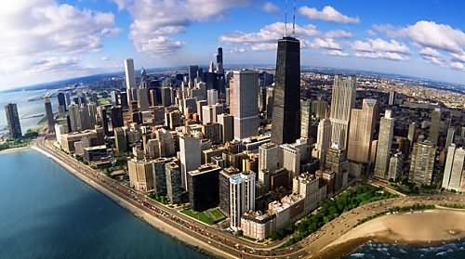
MHFT Global Strategy Luncheons Buy tickets at www.madhedgefundtrader.com
Beverly Hills, CA June 11
Chicago, IL June 29

Slide 5


MHFT Global Strategy Luncheons Buy tickets at www.madhedgefundtrader.com
New York, NY July 5
Seminar at Sea July 11, 2012 Queen Mary 2

Slide 6

Trade Alert Performance
*May MTD +24.06% *2012 YTD -2.42% *First 78 weeks of Trading + 37.7% *Versus +5.3% for the S&P500 A 32.5% outperformance of the index
59 out of 88 closed trades profitable 67% success rate on closed trades

Slide 7
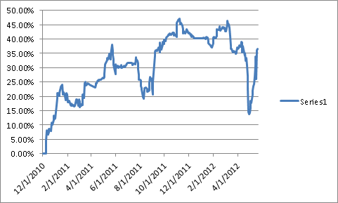
The Comeback Performance Since Inception-25% annualized rate

Slide 8
Portfolio Review Flipping to the Long Side Side
Mad Hedge Fund Trader
Trading Book
Asset Class Breakdown
Risk Adjusted Basis
current capital at risk
Risk On
(FXY) long Sept $121 puts | 10.00%
(TBT) short Treasury ETF | 10.00%
(AAPL) long call spread | 25.00%
Risk Off
no position
total net position | 45.00%

Slide 9
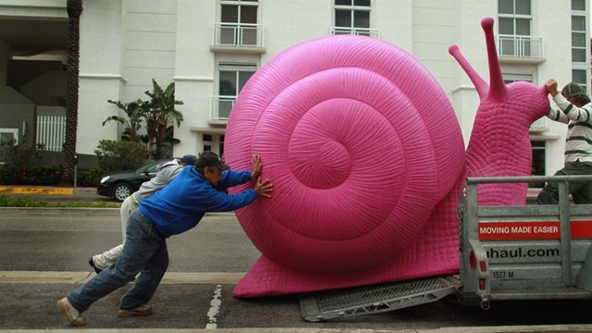
The Economy-Stagnating
*The winter pull forward was huge *Weekly jobless claims unchanged at 370,000 but trend is up *April CPI is a deflationary 0% *Spanish bond yields soar over 6.5% *German economy now slowing *April existing homes sale +3.4%, big jump in median sales price as market runs out of foreclosure inventory *April housing starts -2.6% to +2.6% *All consistent with a low 2.0% GDP growth rate

Slide 10
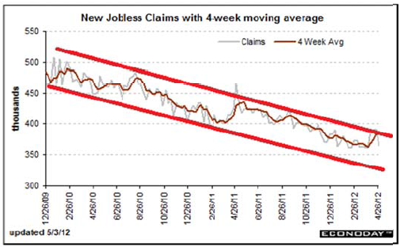
Weekly Jobless Claims The Short Term Trend is Up Break the trend line and the double dip threat is on

Slide 11
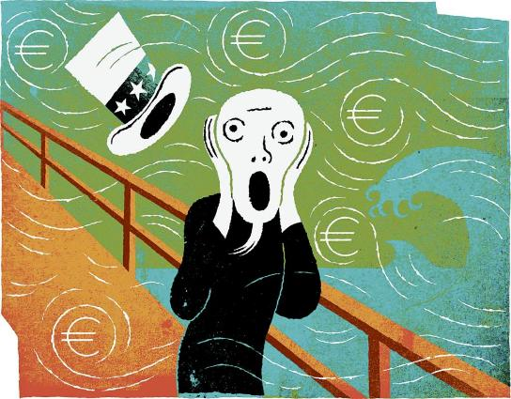
Bonds-Flight to Safety
*Yields broke the 1.80%-2.10% range *Targeting 1.60% on the 10 year in the maximum “RISK OFF” scenario *Deflation still rules *No QE3 until SPX drops below 1,100 *Twist ends June 30, then what? *Bond bid is global, Japan at 0.80%, German as 1.2% *Focus is now on return of capital rather than return on capital

Slide 12
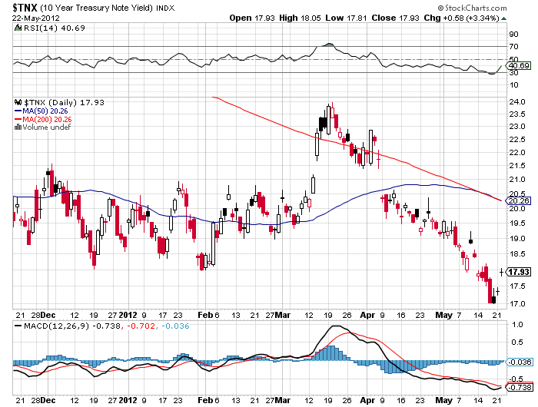
(TNX) 1.70% yield target hit

Slide 13
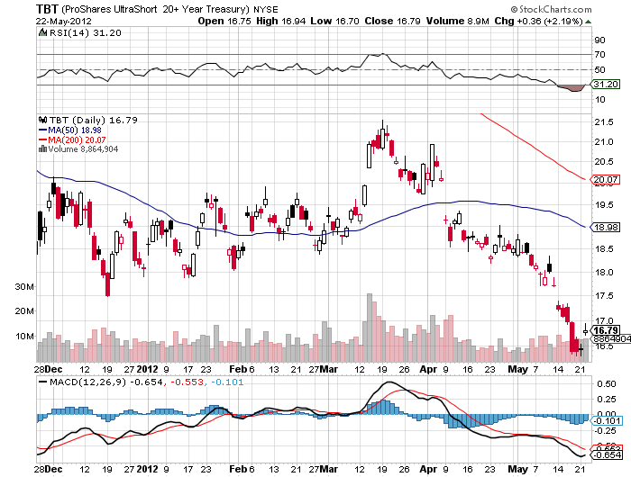
Short Treasuries (TBT)

Slide 14
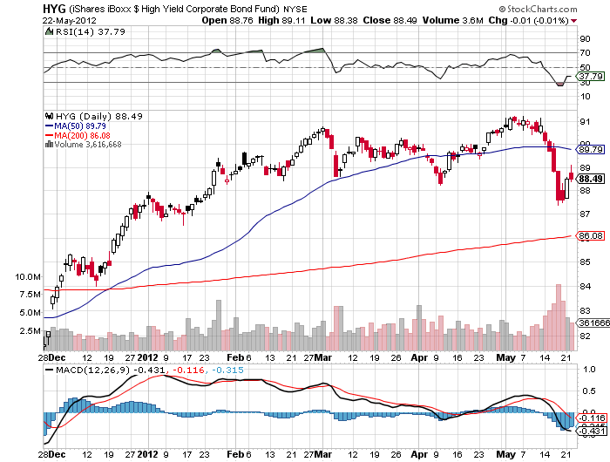
Junk Bonds (HYG)

Slide 15

Stocks-The Market Finally Sees the Macro Data
*We are 9.4% into a 5%-15% move down *Initial downside support at 1,325 (-6.9%) failed to show *The (SPX) 200 day moving average held the first time at 1,280 (-10.3%), expect more challenges *Earnings are over, no upside surprises for two more months *Europe has reclaimed the headlines and will be all bad *The Facebook flop shatter retail confidence, (MS) cut forecast days before launch, new scandal *VIX upside breakout to $26 finally shows *Unchanged on the year at (SPX) 1,250 now in play

Slide 16
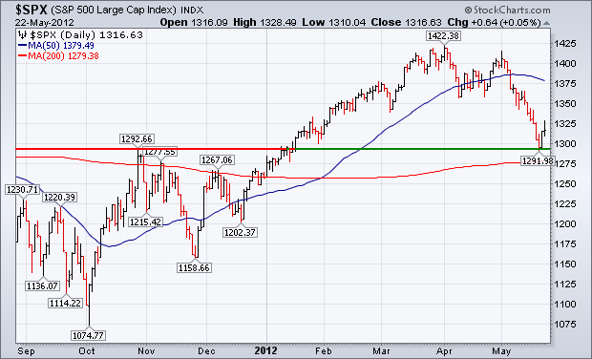
(SPX)

Slide 17
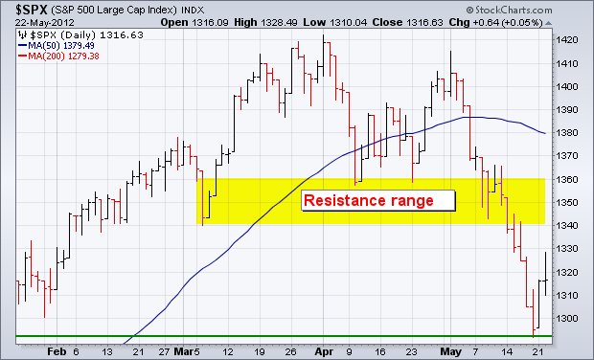
(SPX)

Slide 18
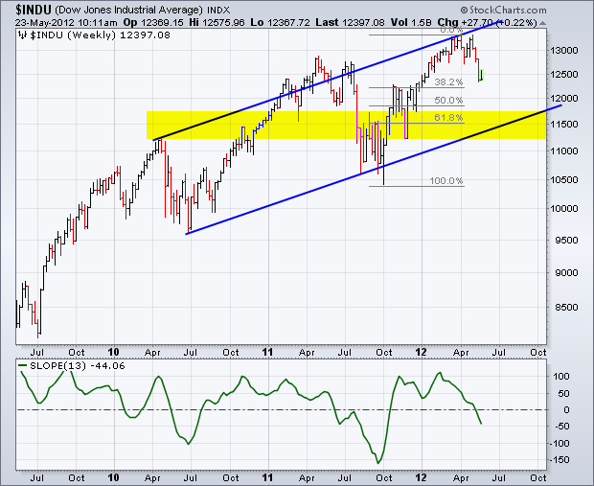
August Dow Downside Targets (INDU) down another 6%-8%

Slide 19
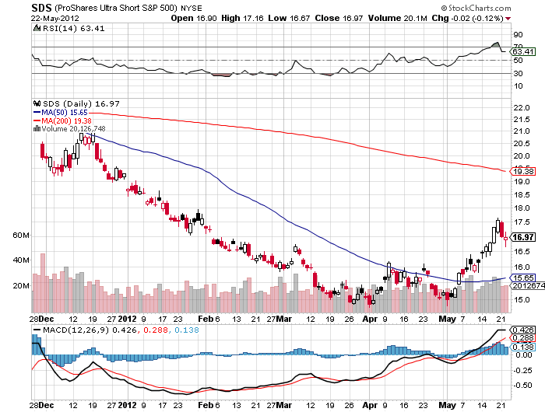
Double Short S&P 500 ETF(SDS)

Slide 20
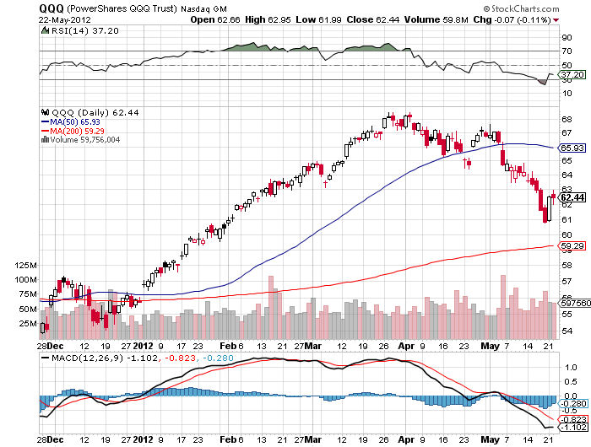
NASDAQ

Slide 21
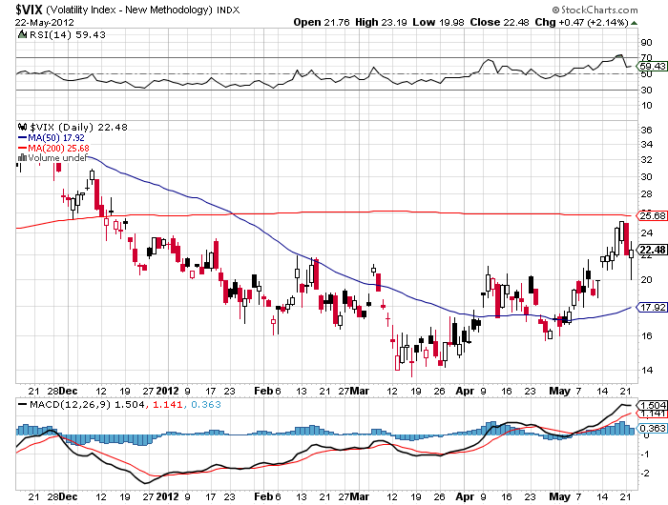
(VIX)

Slide 22
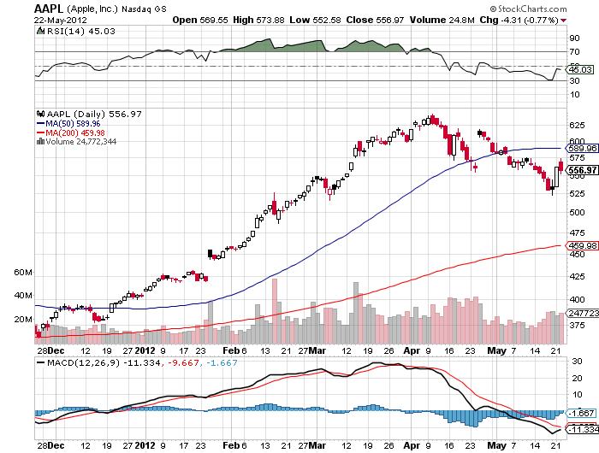
(AAPL)

Slide 23
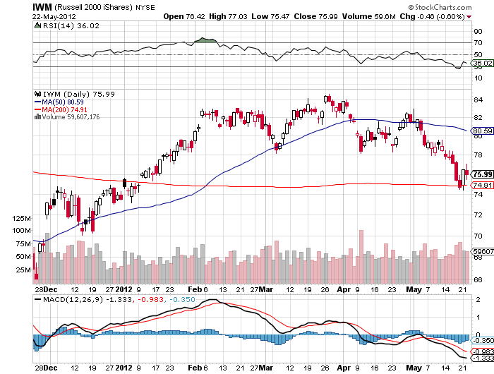
Russell 2000 (IWM)

Slide 24
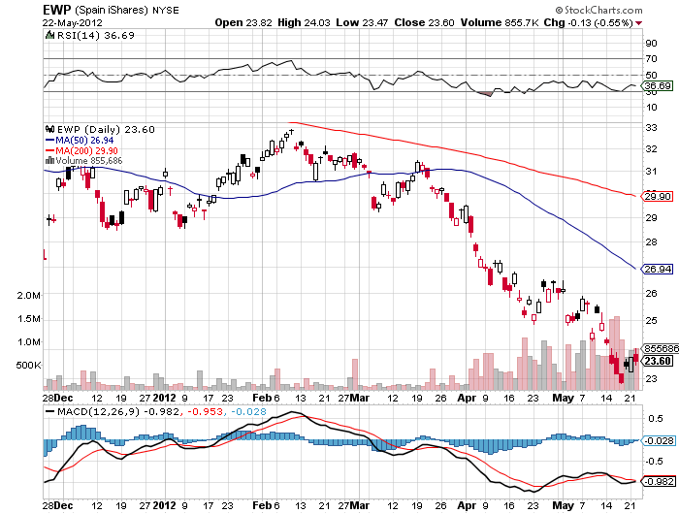
Spain ETF (EWP)

Slide 25
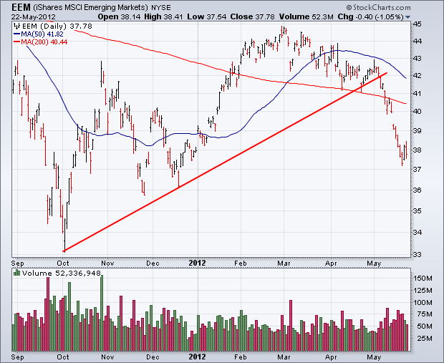
(EEM)

Slide 26
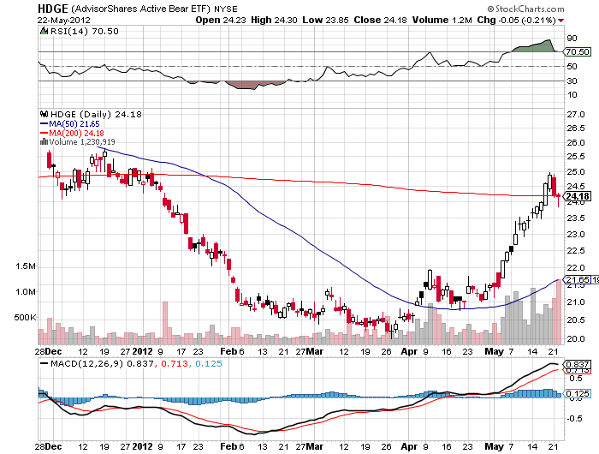
Advisor Shares Active Bear ETF (HDGE)

Slide 27
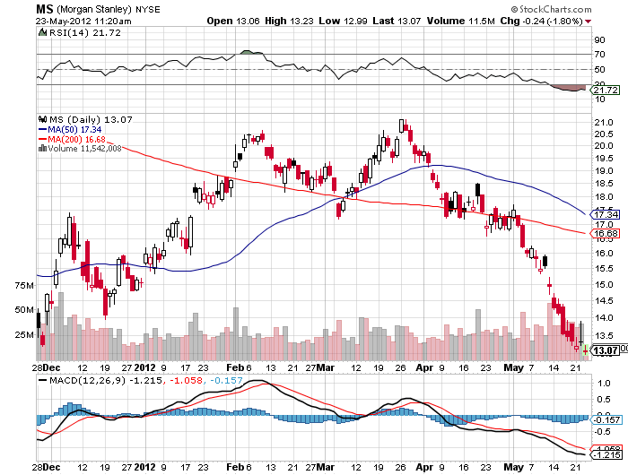
Morgan Stanley (MS) Retail (FB) loss of $6 billion, inst. advance notice of downgrades, investigations, prosecutions, hearings and fines could be a drag on the overall market for many months, pushing it to august lows

Slide 28

The Dollar
*New yearly high for Uncle Buck *Next Chapter of the European debt crisis finally broke the Euro, downside $126 target achieved, then a new 2 year low *Expect some short covering and consolidation around here *Rumors of Greek withdrawal from Euro rampant *US stock sell off created meaningful dollar and yen strength with “RISK OFF” *Fitch downgrade knocks stuffing out of yen *Watch the Ausie for global risk timing

Slide 29
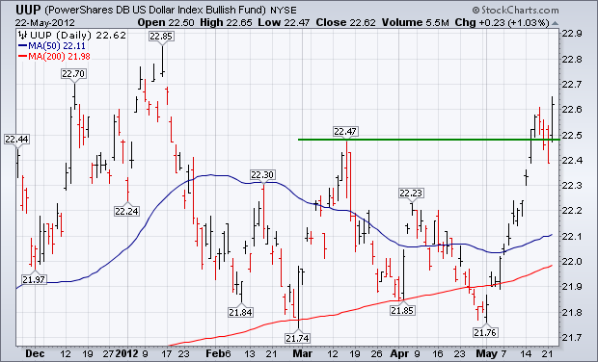
Long Dollar Basket (UUP)

Slide 30
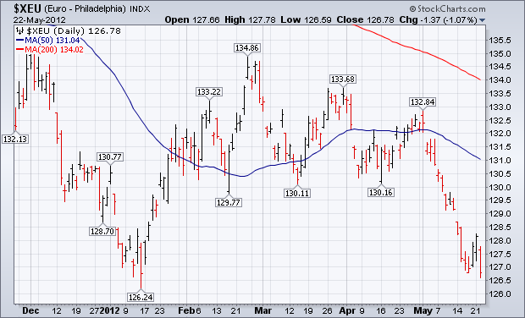
Euro (XEU)

Slide 31
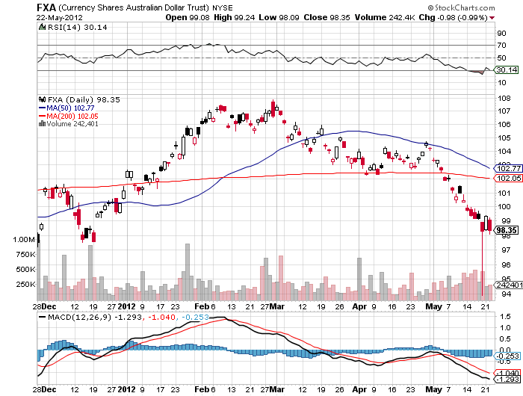
Australian Dollar (FXA)

Slide 32
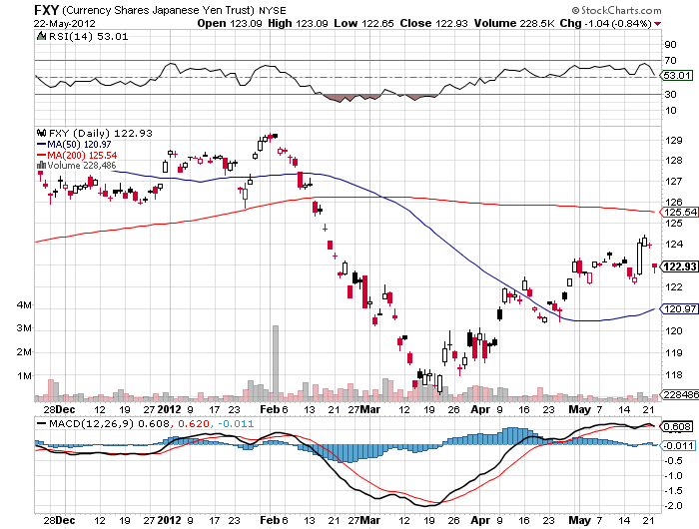
Japanese Yen (FXY)

Slide 33
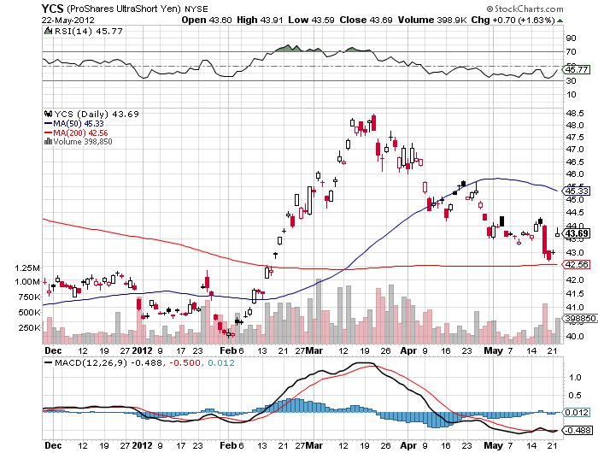
(YCS)

Slide 34
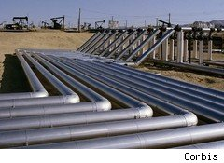
Energy
*”RISK OFF” hits oil with everything else *Supply glut decimates the market *$95 target hit, then $91 *Paying the price for the warm winter *China slowdown is accelerating downturn *Saudi boost production at US request to head off price spike on Iran embargo *Nat Gas bounce continues, sell at $3.00 the storage Armageddon is yet to come *Final target $1.50, selling opportunity setting up

Slide 35
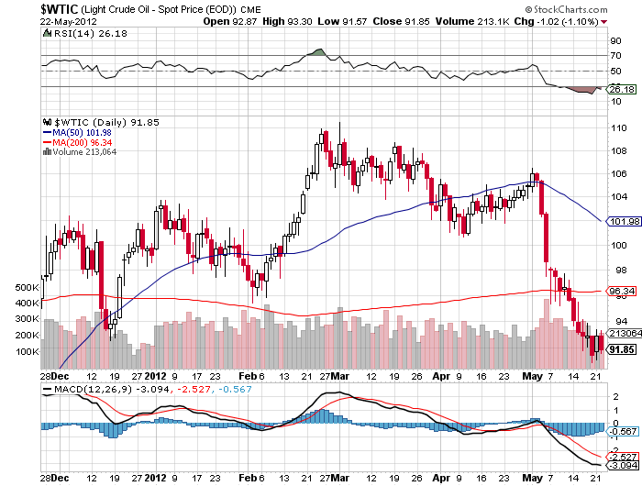
Crude

Slide 36
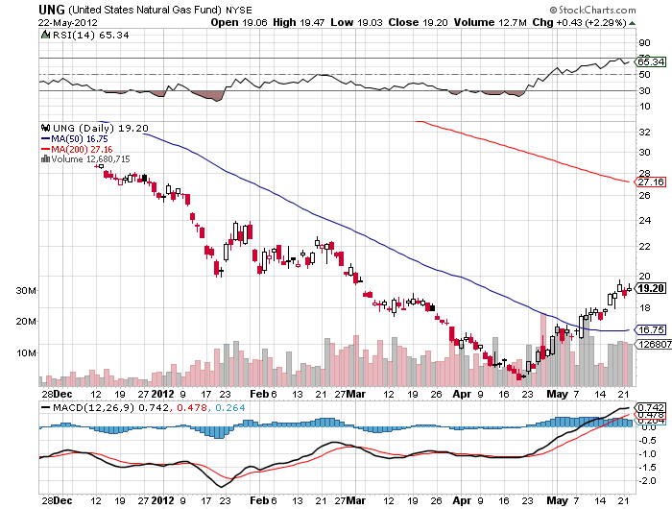
Natural Gas (UNG)

Slide 37
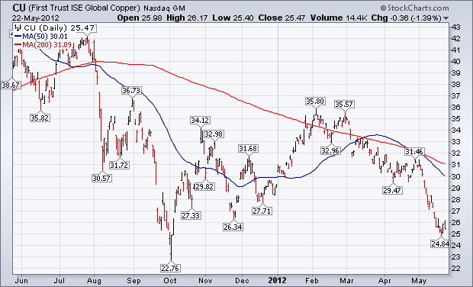
Copper (CU)

Slide 38

Precious Metals
*Strong Indian Rupee is killing short term demand, makes gold expensive for world’s largest buyer *No QE means sell gold and silver *Looking for $1,500 gold, $25 for silver *Recent move is short covering only *It’s a good time to buy a gold mine *Solid emerging market central bank buyers of gold under $1,500, especially China

Slide 39
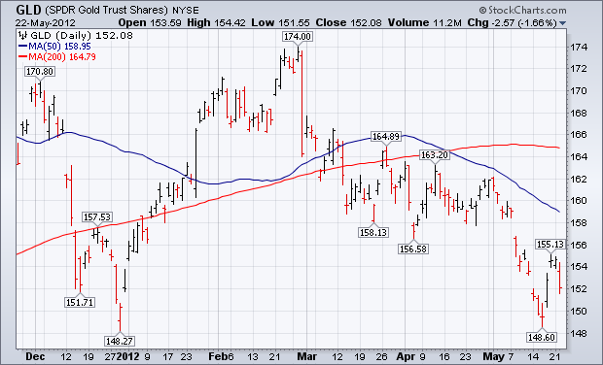
Gold

Slide 40
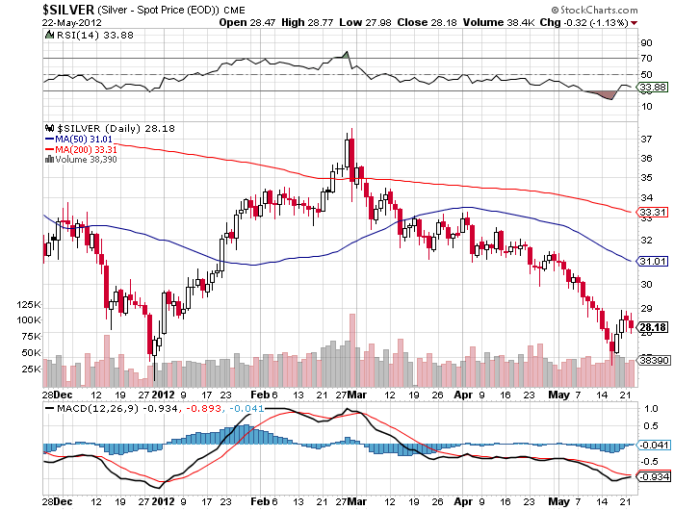
Silver

Slide 41
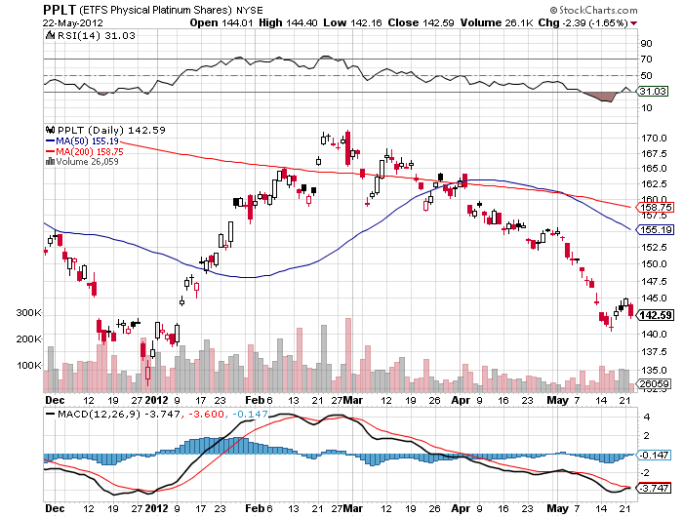
(Platinum)

Slide 42
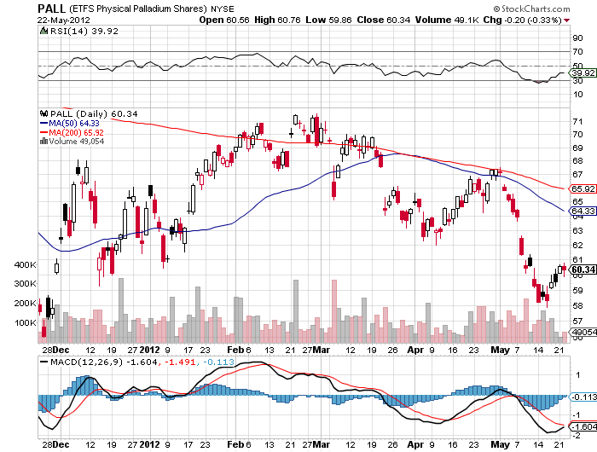
Palladium

Slide 43

The Ags
*No trade *Several major Chinese buys have no impact prices, coming in on every sell off Now Chinese are cancelling orders for many commodities, including corn, soybeans, cotton *Market trades like the record crop forecasts will come true. *Fires returning to Russia *Stay away and wait for bad weather

Slide 44
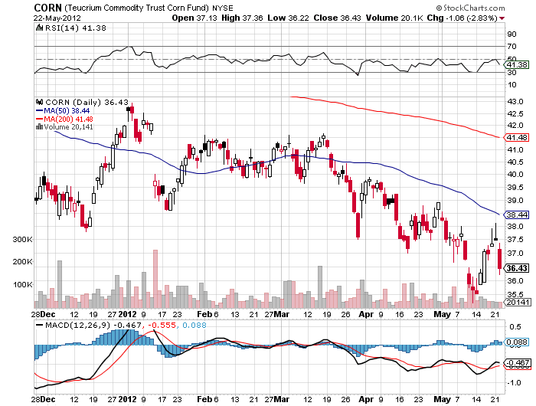
(CORN)

Slide 45
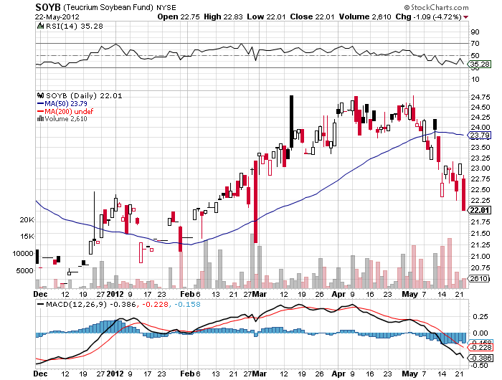
Soybeans (SOYB)

Slide 46
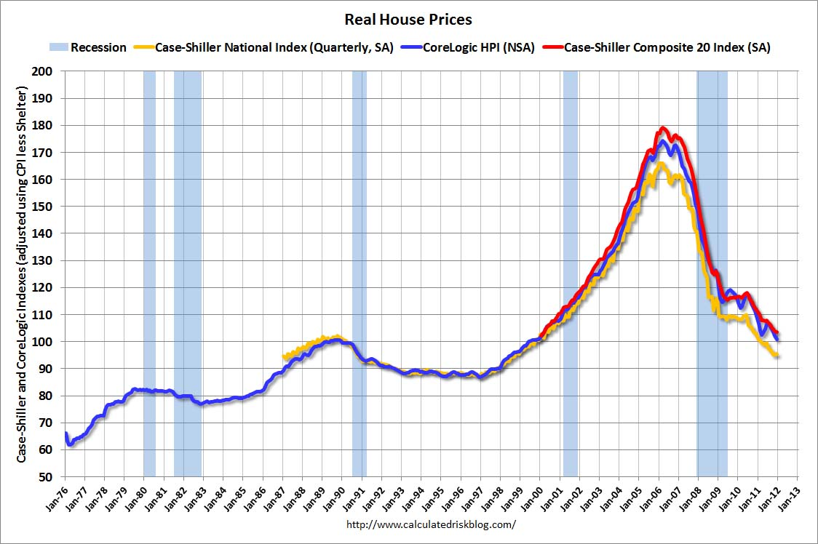
Real Estate February, 2012

Slide 47
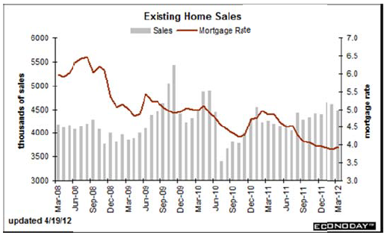
Existing Homes Sales institutional buying of SFH has created a new market, taking 60% of the market, shortage of foreclosed homes

Slide 48

Trade Sheet The bottom line: Too late to buy, too early to sell
*Stocks- sell rallies *Bonds- sell rallies from here, 1.70% hit *Commodities- sell rallies, especially oil and copper *Currencies- sell Euro, sell yen *Precious Metals – sell rallies in Gold and silver *Volatility-stand aside, too late to buy *The ags – stand aside, no trade *Real estate- rent, don’t buy Next Webinar is on Wednesday, June 6, 2012

Slide 49

To buy strategy luncheon tickets Please Go to www.madhedgefundtrader.com

