Slide 1

Please Stand By for John Thomas Wednesday, June 6, 2012 Global Trading Dispatch
The Webinar will begin at 12:00 pm EST

Slide 2

The Mad Hedge Fund Trader “Hysteria Hits”
Diary of a Mad Hedge Fund Trader June 6, 2012 www.madhedgefundtrader.com

Slide 3

MHFT Global Strategy Luncheons Buy tickets at www.madhedgefundtrader.com 2012 Schedule
June 11 Beverly Hills June 29 Chicago July 5 New York July 6-13 Queen Mary II New York to Southampton July 16 London July 17 Paris July 18 Frankfurt July 27 Zermatt October 19 Washington DC October 26 San Francisco November 8 Orlando January 3, 2013 Chicago

Slide 4

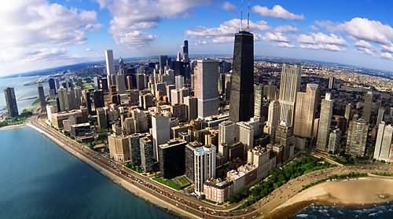
MHFT Global Strategy Luncheons Buy tickets at www.madhedgefundtrader.com
Beverly Hills, CA June 11
Chicago, IL June 29

Slide 5


MHFT Global Strategy Luncheons Buy tickets at www.madhedgefundtrader.com
New York, NY July 5
Seminar at Sea July 11, 2012 Queen Mary 2

Slide 6

Trade Alert Performance
*May Final +20.5% *June MTD +0.66% *2012 YTD -5.23% *First 80 weeks of Trading + 35.0% *Versus +2.8% for the S&P500 A 32.2% outperformance of the index
60 out of 89 closed trades profitable 67% success rate on closed trades

Slide 7
Portfolio Review Flipping to the Long Side Side
Mad Hedge Fund Trader
Trading Book
Asset Class Breakdown
Risk Adjusted Basis
current capital at risk
Risk On
(FXY) long Sept $121 puts | 10.00%
(TBT) short Treasury ETF | 10.00%
(HPQ) long call spread | 25.00%
(AAPL) long call spread | 25.00%
(JPM) long call spread | 25.00%
(TLT) short call spread | 10.00%
Risk Off
(FXY) short call spread | -10.00%
total net position | 95.00%

Slide 8

The Economy-Heading South
*We’re still paying for the pull forward *Nonfarm payroll was a disaster at 69,000 *Weekly jobless claims up10,000 to 383,000 *Q1 GPD slowed to 1.9%, now slower *Chinese slowdown is accelerating, soft to hard landing? *May Chicago PMI 56.2 to 52.7 *Pending homes sales -5.5%, -12% in the West *All consistent with a low 2.0% GDP growth rate

Slide 9
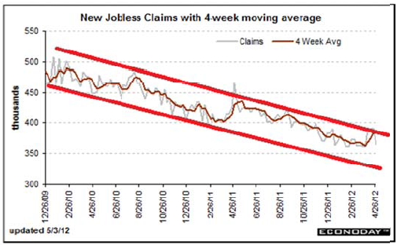
Weekly Jobless Claims The Short Term Trend is Up Break the trend line and the double dip threat is on

Slide 10

Bonds-Capitulation
*Yields broke the 1.80%-2.10% range soared to 1.42% *The final capitulation top? *Deflation still rules *No QE3 until SPX drops below 1,100 *Twist ends June 30, will it be renewed? Will the Fed shift to mortgages? *Bond bid is global, Japan at 0.80%, German as 1.2% *Bonds got it right once again, ignored the entire equity rally since October

Slide 11
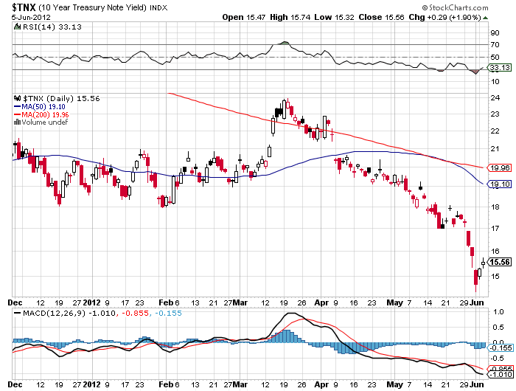
(TNX) 1.42% yield hit

Slide 12
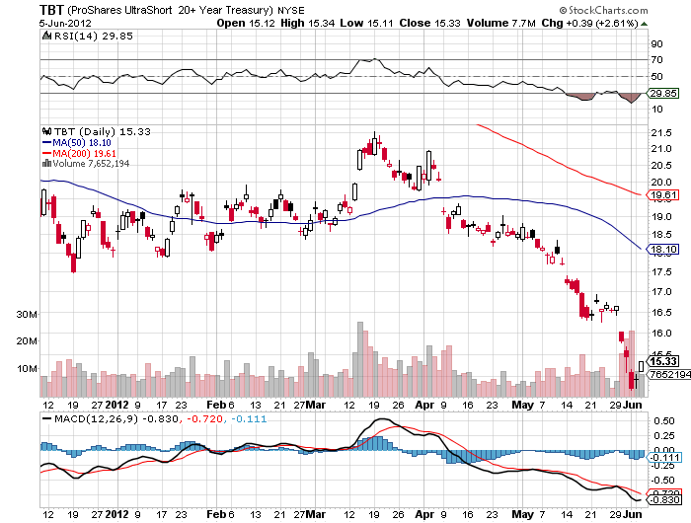
Short Treasuries (TBT)

Slide 13
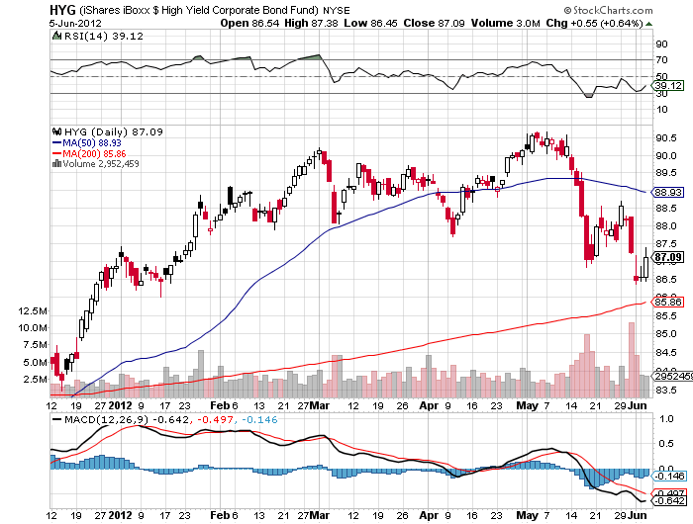
Junk Bonds (HYG)

Slide 14

Stocks-Hysteria Takes Hold
*We are 10.8% into a 5%-15% move down *This is not 2011, panic is getting overdone, May nonfarm was still a gain, not a 700,000 loss *200 day moving average broke, 1250 next stop 1200 final target *58% of S&P 500 stocks yielding more than 10 year Treasuries *Earnings downgrades are heading our way from July *All Europe driven now, expect a lot of worry, but no crash *No getting the VIX action you would expect with this move topped out at $28, huge selling at $26 *Start thinking about flipping from defensive to aggressive

Slide 15
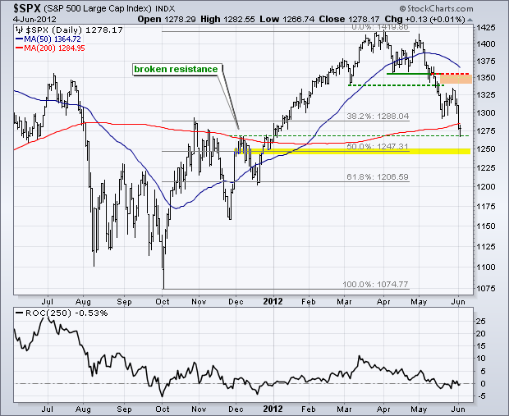
(SPX)

Slide 16
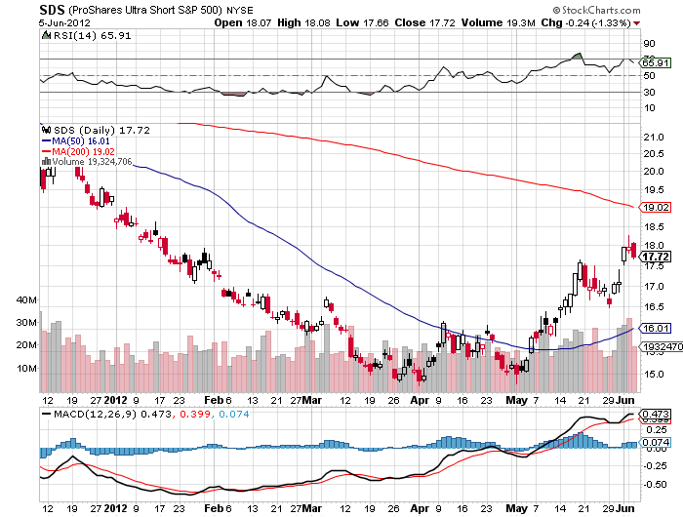
Double Short S&P 500 ETF(SDS)

Slide 17
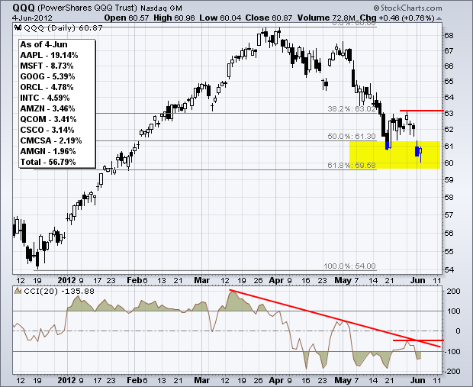
NASDAQ

Slide 18
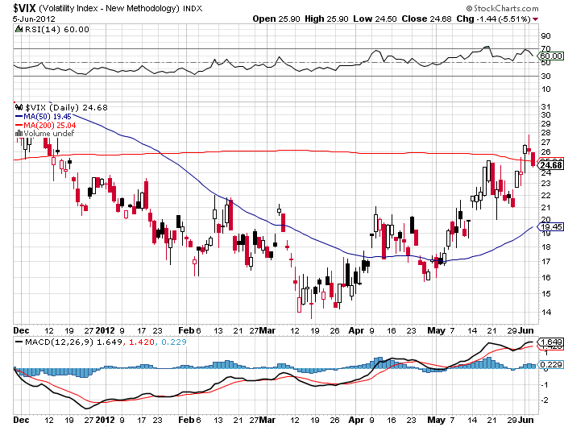
(VIX)

Slide 19
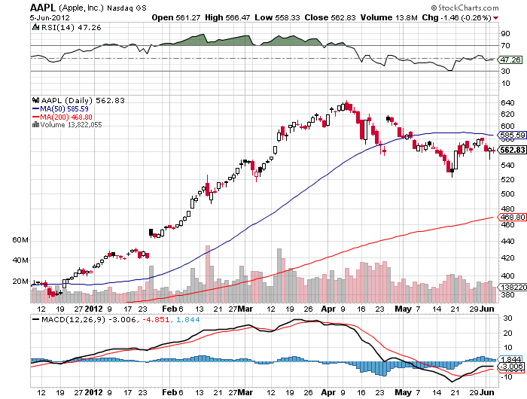
(AAPL)

Slide 20
(AAPL) The Defensive Play Deep out-of-the-money Call Spread
Cost Buy 6 X August, 2012 $400 Calls at……………. $141.20 Sell short 6 X August, 2012 $450 calls at …….$97.20 Net cost ………………………………………………………$44.00 Profit at Expiration Value at Expiration……………………………………….$50.00 Cost………………………………………………………………$44.00 Net Profit……………………………………………….………$6.00 $6.00/$44.00 = 13.6% Profitable at all points over $444 in (AAPL)

Slide 21
(AAPL) The Aggressive Play The long dated In-the-money Call Spread
Cost Buy 6 X January, 2013 $540 Calls at……………… $82.60 Sell short 6 X January, 2013 $640 calls at …...$38.00 Net cost ………………………………………………………$44.60 Profit at Expiration Value at Expiration…………………………………….$100.00 Cost……………………………………………………………$44.60 Net Profit……………………………………………….……$55.40 $55.40/$44.60 = 124.2% Profitable at all points over $584.60 in (AAPL)

Slide 22
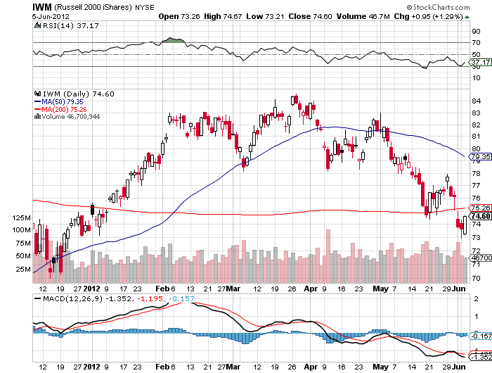
Russell 2000 (IWM)

Slide 23
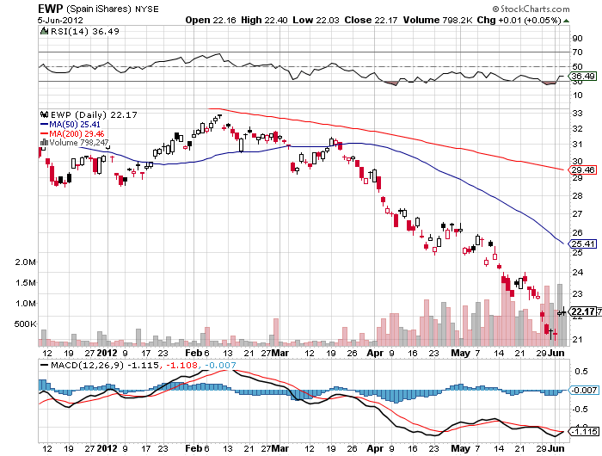
Spain ETF (EWP)

Slide 24
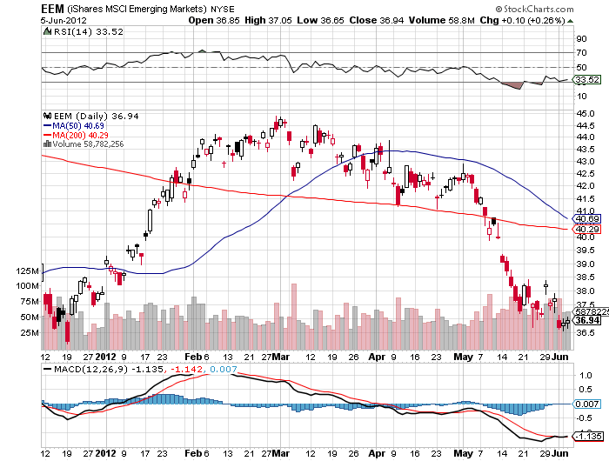
(EEM)

Slide 25
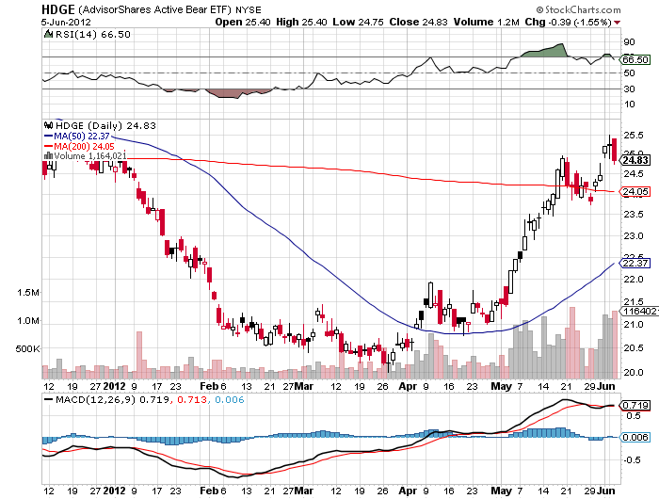
Advisor Shares Active Bear ETF (HDGE)

Slide 26
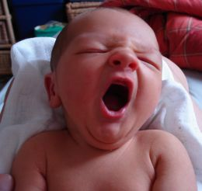
The Dollar
*Current dollar move up getting tired *Profit taking on Euro creates a short term floor at $1.22, need time to digest recent move *Fearing the next LTRO, QE3, risks are rising *US stock sell off created meaningful dollar and yen strength with “RISK OFF” *Japanese intervention on Monday lasted 5 minutes, caused 50 cent spike *Watch the Ausie for global risk timing, stabilizing above $0.97, Reserve Bank of Australia cut rates by 0.25% to 3.5%, great China slowing play

Slide 27
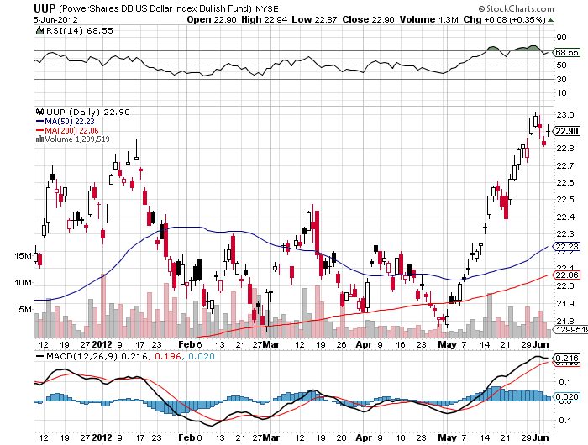
Long Dollar Basket (UUP)

Slide 28
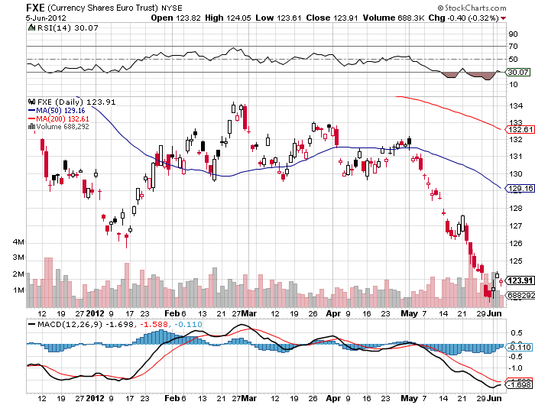
Euro (FXE)

Slide 29
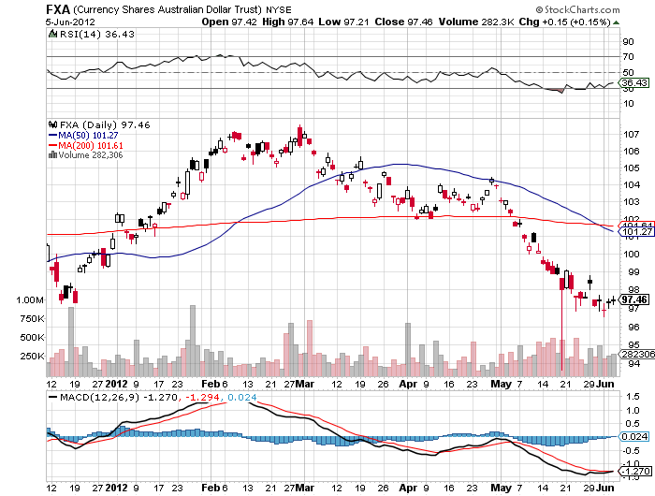
Australian Dollar (FXA)

Slide 30
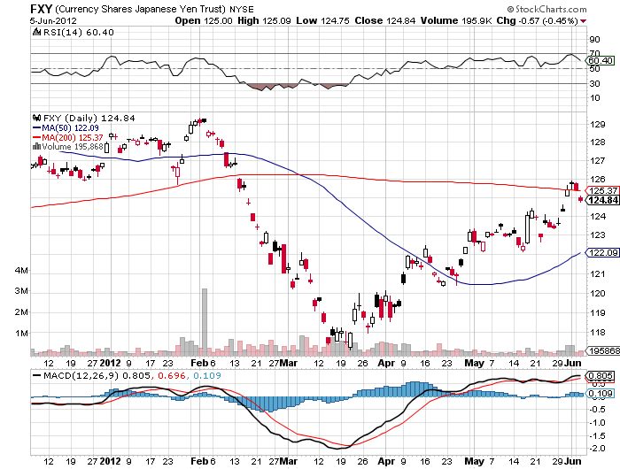
Japanese Yen (FXY)

Slide 31
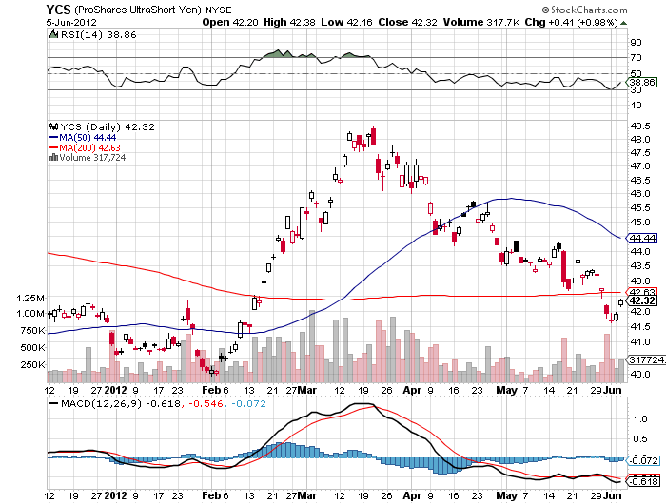
(YCS)

Slide 32
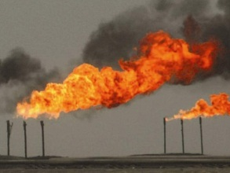
Energy
*”RISK OFF” hits oil with everything else *Supply glut decimates the market *Holding at $85, next target is $75 *Paying the price for the warm winter *China slowdown is accelerating downturn *Nat Gas gave up half of recent rally *Final target $1.50, selling opportunity setting up

Slide 33
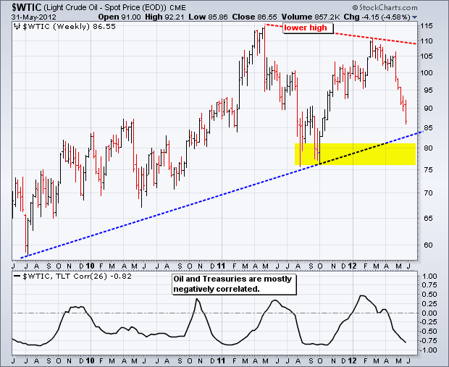
Crude

Slide 34
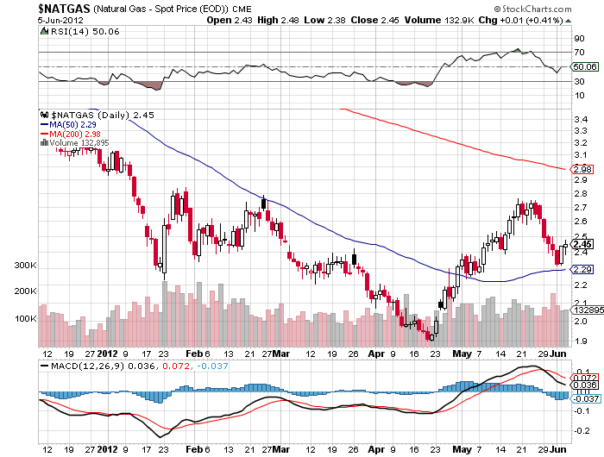
Natural Gas

Slide 35
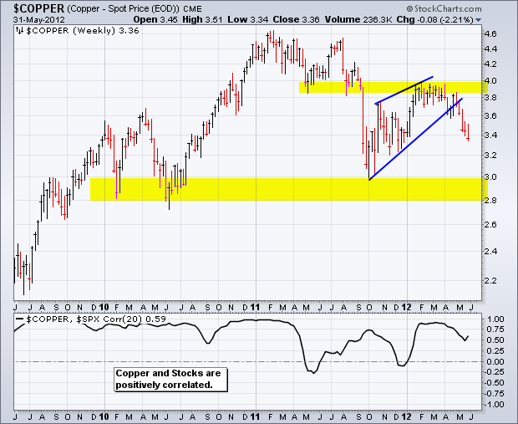
Copper (CU)

Slide 36
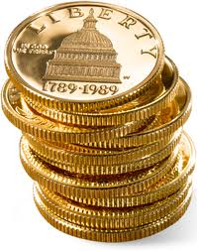
Precious Metals
*Seasonal strength kicks in during August *Increasing chance of QE means firming bid for gold and silver *$1,500 holding for gold, $26 for silver *May begin a month of base building *Asian central bank buying is putting in a floor

Slide 37
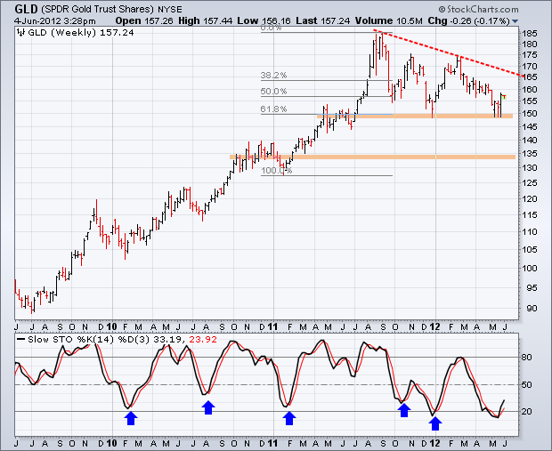
Gold

Slide 38
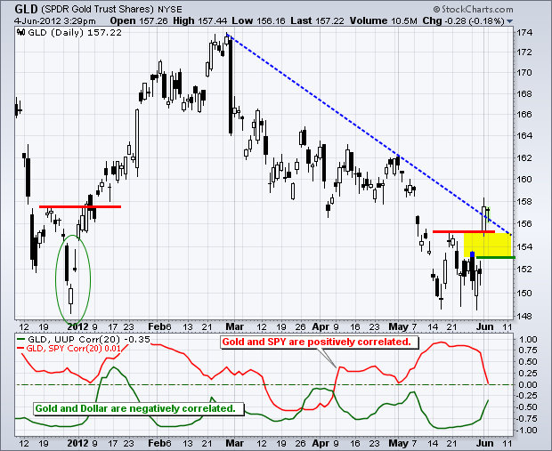
Gold

Slide 39
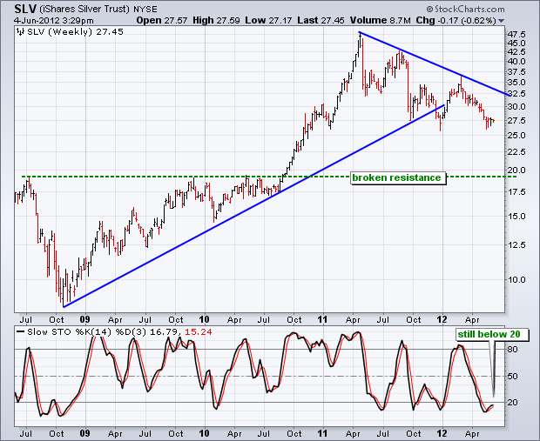
Silver

Slide 40
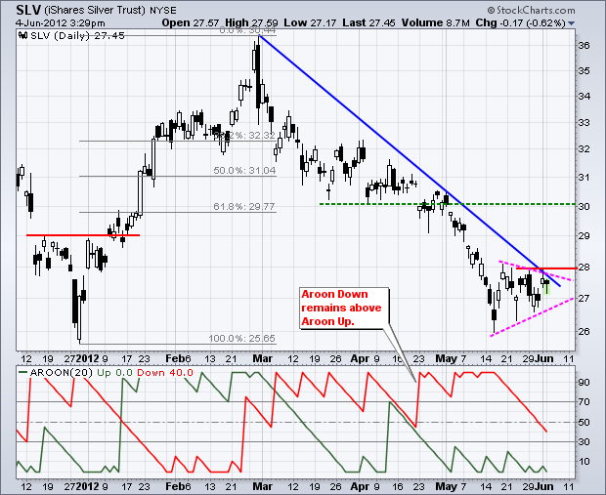
Silver

Slide 41
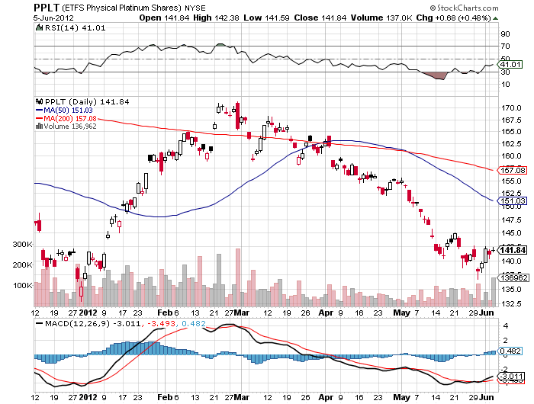
(Platinum)

Slide 42
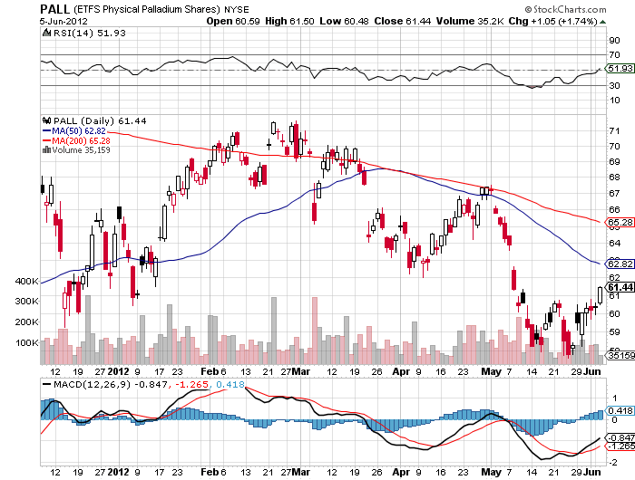
Palladium

Slide 43

The Ags
*No trade-”RISK OFF” hits grains along with everything else *Several major Chinese buys have no impact prices, coming in on every sell off *Soybeans gave up their entire 20% rally *Now Chinese are cancelling orders for many commodities, including corn, soybeans, cotton *Market trades like the record crop forecasts will come true. *Stay away and wait for bad weather

Slide 44
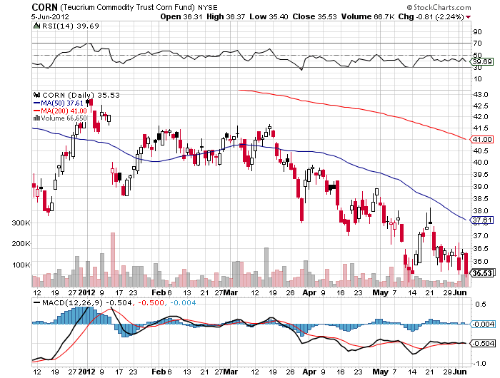
(CORN)

Slide 45
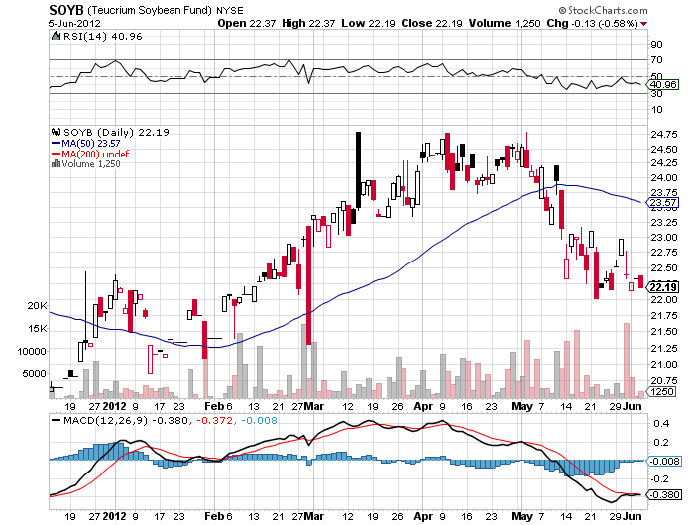
Soybeans (SOYB)

Slide 46
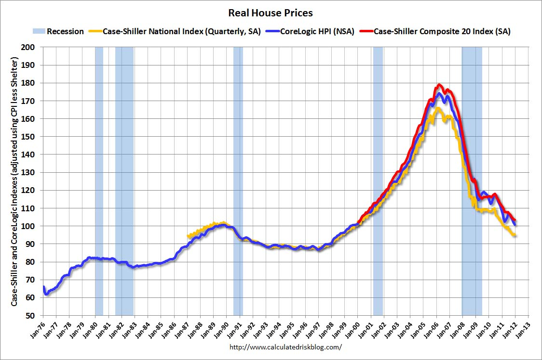
Real Estate February, 2012

Slide 47
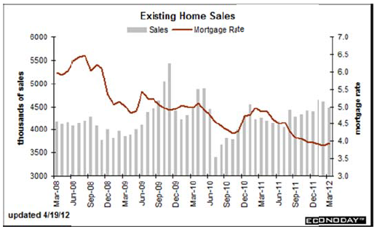
Existing Homes Sales institutional buying of SFH has created a new market, taking 60% of the market, shortage of foreclosed homes

Slide 48

Trade Sheet The bottom line: Too late to buy, too early to sell
*Stocks- sell rallies *Bonds- sell rallies from here, 1.42% hit *Commodities- sell rallies, especially oil and copper *Currencies- sell Euro, sell yen *Precious Metals – sell rallies in Gold and silver *Volatility-stand aside, too late to buy *The ags – stand aside, no trade *Real estate- rent, don’t buy Next Webinar is on Wednesday, June 20, 2012

Slide 49

To buy strategy luncheon tickets Please Go to www.madhedgefundtrader.com

