Slide 1

Please Stand By for John Thomas Wednesday, June 20, 2012 Global Trading Dispatch
The Webinar will begin at 12:00 pm EST

Slide 2

The Mad Hedge Fund Trader “All Eyes on the Fed”
Diary of a Mad Hedge Fund Trader June 20, 2012 www.madhedgefundtrader.com

Slide 3

MHFT Global Strategy Luncheons Buy tickets at www.madhedgefundtrader.com 2012 Schedule
June 11 Beverly Hills June 29 Chicago July 5 New York July 6-13 Queen Mary II New York to Southampton July 16 London July 17 Paris July 18 Frankfurt July 27 Zermatt September 28 Las Vegas? October 19 Washington DC October 26 San Francisco November 8 Orlando January 3, 2013 Chicago

Slide 4

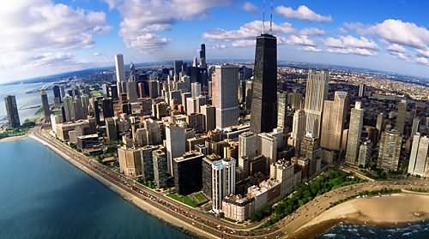
MHFT Global Strategy Luncheons Buy tickets at www.madhedgefundtrader.com
Chicago, IL June 29
New York, NY July 5

Slide 5

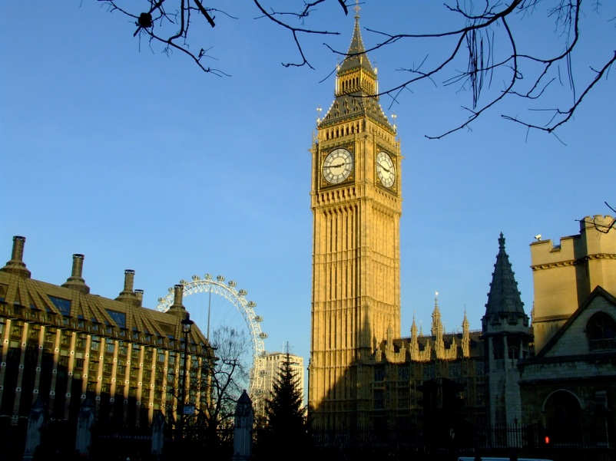
MHFT Global Strategy Luncheons Buy tickets at www.madhedgefundtrader.com
Seminar at Sea July 11, 2012 Queen Mary 2
London July 16

Slide 6
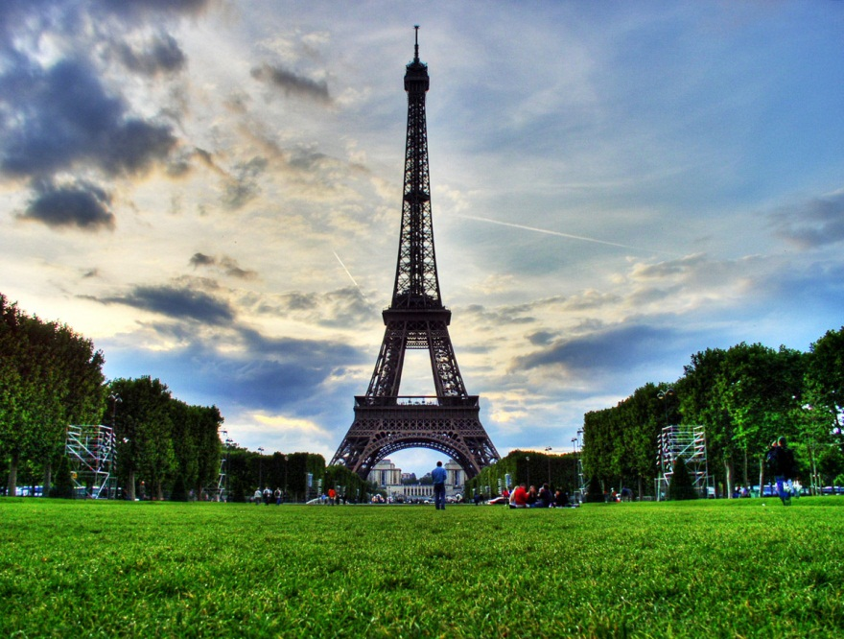
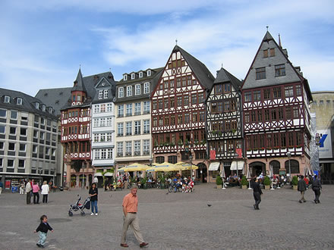
MHFT Global Strategy Luncheons Buy tickets at www.madhedgefundtrader.com
Paris July 17
Frankfurt July 18

Slide 7

Trade Alert Performance
*May Final +20.5% *June MTD +13.7% *2012 YTD +7.8% *First 82 weeks of Trading + 48.0% *Versus +8.8% for the S&P500 A 39.2% outperformance of the index
60 out of 90 closed trades profitable 66.7% success rate on closed trades

Slide 8
Portfolio Review Flipping to the Long Side Side
Mad Hedge Fund Trader
Trading Book
Asset Class Breakdown
Risk Adjusted Basis
current capital at risk
Risk On
(DIS) long call spread | 25.00%
(AAPL) long call spread | 25.00%
(JPM) long call spread | 25.00%
(FXY) July short call spread | 10.00%
Risk Off
total net position | 85.00%

Slide 9
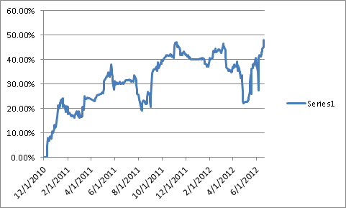
Performance Since Inception-New All Time High +30.3% Average Annualized Return

Slide 10
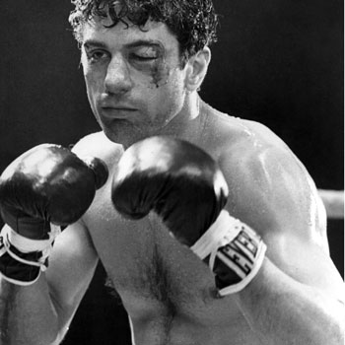
The Economy-Getting Beat Up
*May housing starts down -4.8% *Weekly jobless claims up 6,000 to 386,000 *June Empire State Index down huge, 17.09 to 2.29 *German GDP growth is slowing from 2% to 1% annual rate, June ZEW Sentiment down from +10.8 to -16.9 *May industrial production down +0.1% to -0.1% *May CPI at -0.3%, 1.7% YOY, a 3 year low *All consistent with a low 2.0% GDP growth rate, or lower

Slide 11
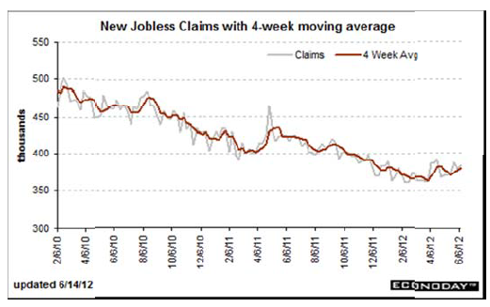
Weekly Jobless Claims The Short Term Trend is Up Break the trend line and the double dip threat is on

Slide 12

Bonds-Waiting for the Fed to Show its Hand
*Consolidating in the new range 1.40%-1.70% *Waiting for the Fed to show its hand *Deflation still rules *No QE3 until SPX drops below 1,100 *Twist ends June 30, will it be renewed? Will the Fed shift to mortgages? *Bond bid is global, Japan at 0.80%, German as 1.2% *Bonds got it right once again, ignored the entire equity rally since October

Slide 13
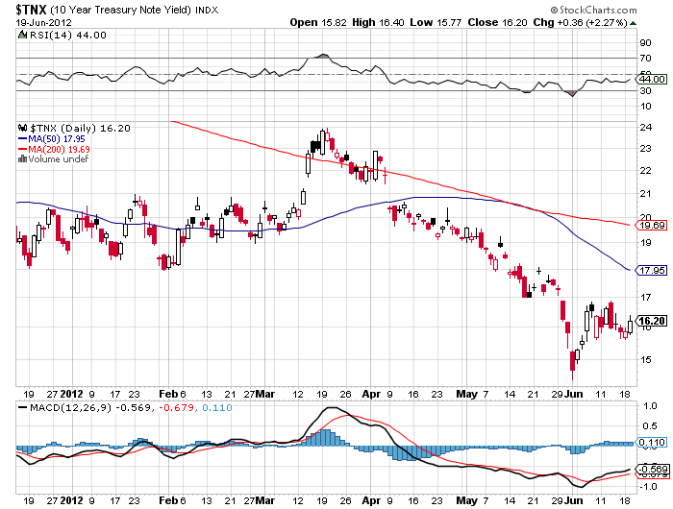
(TNX) 1.42% yield hit

Slide 14
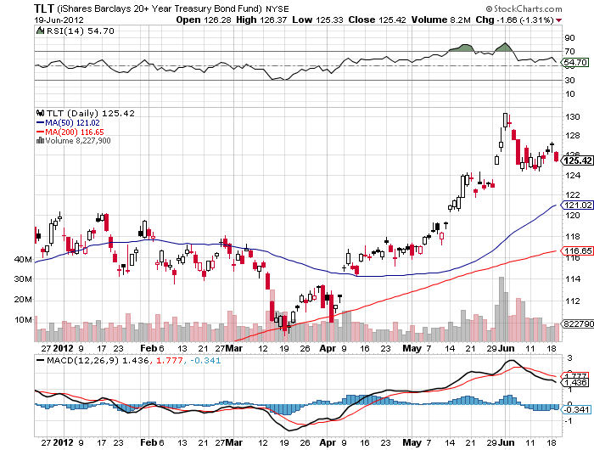
(TLT)

Slide 15
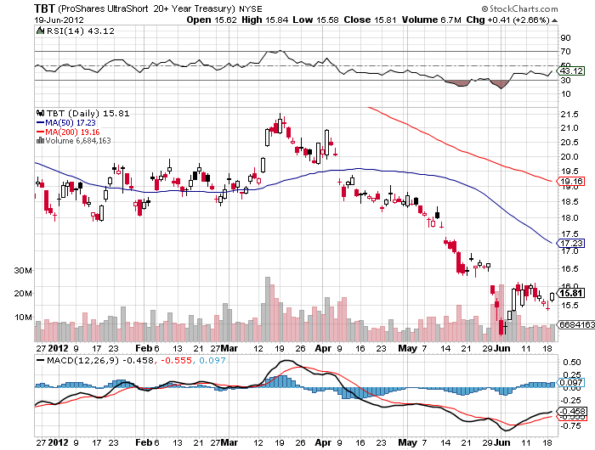
Short Treasuries (TBT)

Slide 16
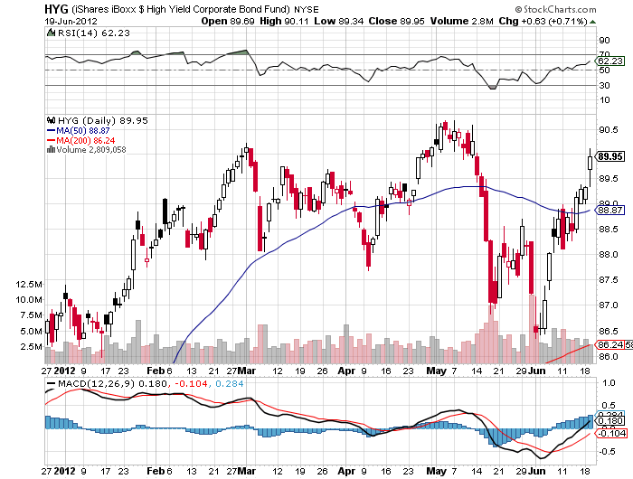
Junk Bonds (HYG)

Slide 17
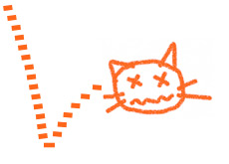
Stocks-Playing the Dead Cat Bounce
*We are 4.6% into a 5%-15% move down *Use this rally to sell, the final bottom is still ahead *50 and 200 day moving averages to the upside, points to higher *Put call ratio points to an interim bottom in early June *Rally could run into end June, end quarter *Squeezing the shorts *VIX collapse is pointing to a dead summer *Keep running low risk longs intil they reverse

Slide 18
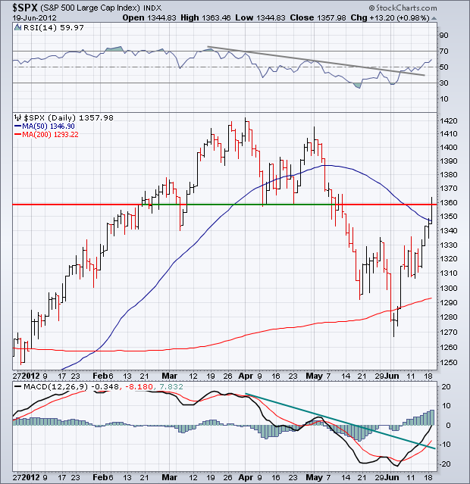
(SPX)

Slide 19
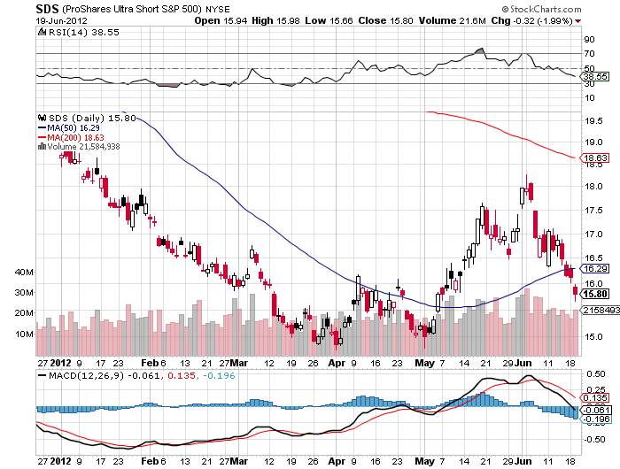
Double Short S&P 500 ETF(SDS)

Slide 20
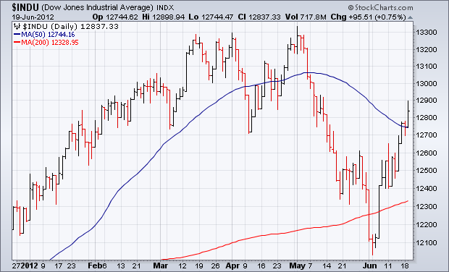
Dow

Slide 21
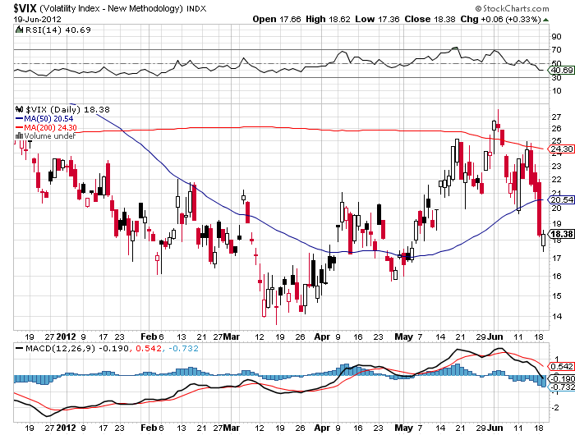
(VIX)

Slide 22
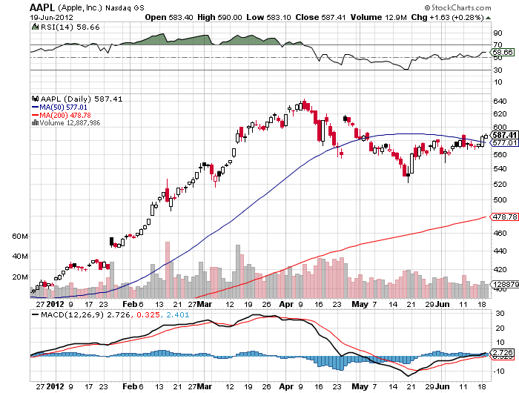
(AAPL)

Slide 23
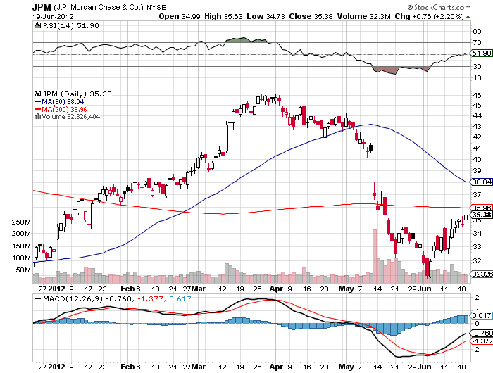
(JPM)

Slide 24
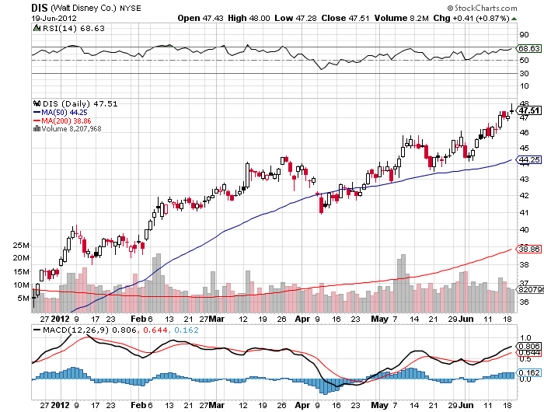
(DIS)

Slide 25
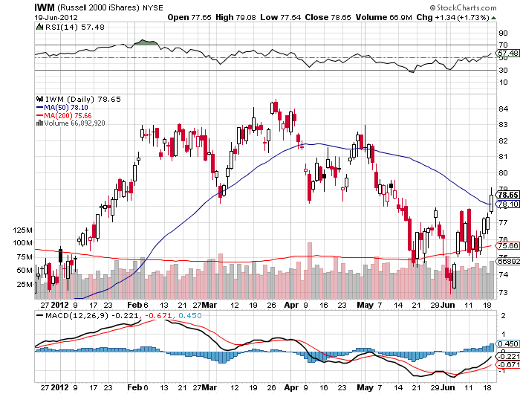
Russell 2000 (IWM)

Slide 26
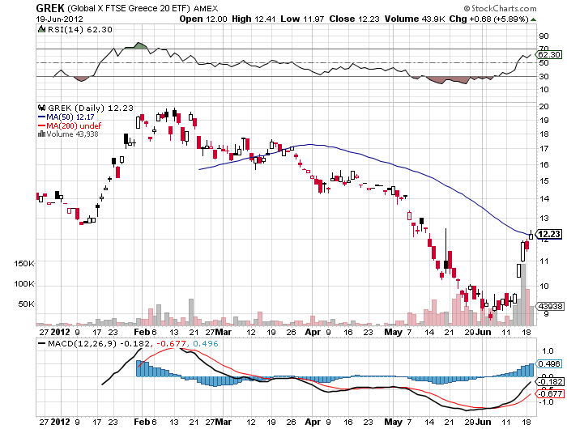
Greece ETF (GREK)

Slide 27
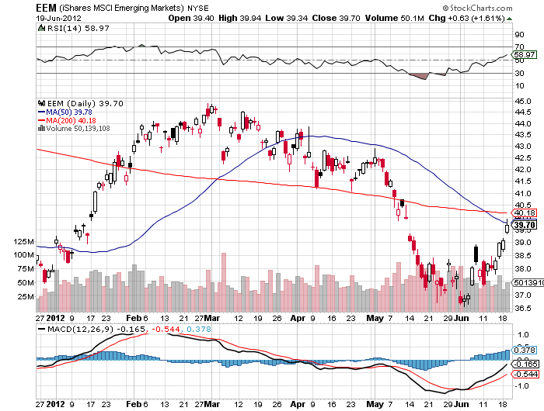
(EEM)

Slide 28
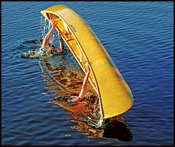
The Dollar
*Long overdue rest takes hold *Too many shorts guaranteed a “rip your face off” rally *Targeting $127.80 on next LTRO, sell again, could be in weeks, 50% retrace and 50 day MA *US stock rally created meaningful dollar weakness with “RISK ON” *Yen has gone quiet waiting for next intervention to knock it down *”RISK ON” delivers big Ausie rally, look to sell short (FXA) on next peak

Slide 29
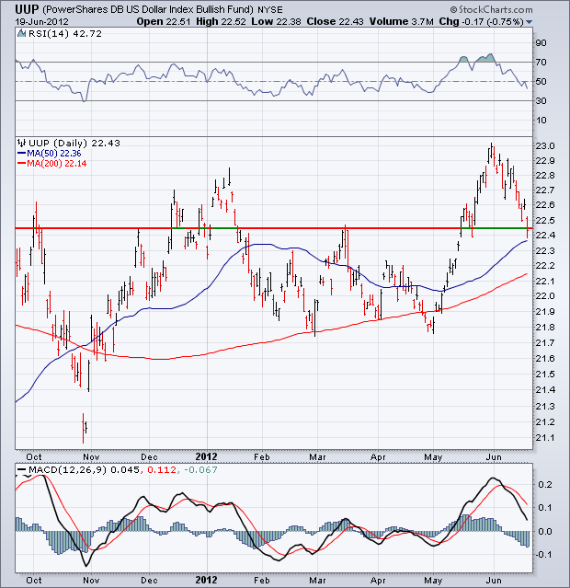
Long Dollar Basket (UUP)

Slide 30
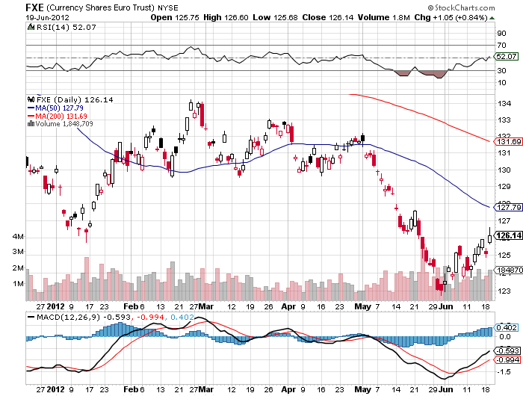
Euro (FXE)

Slide 31
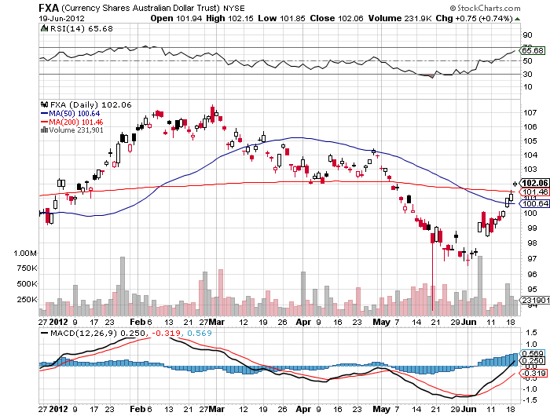
Australian Dollar (FXA)

Slide 32
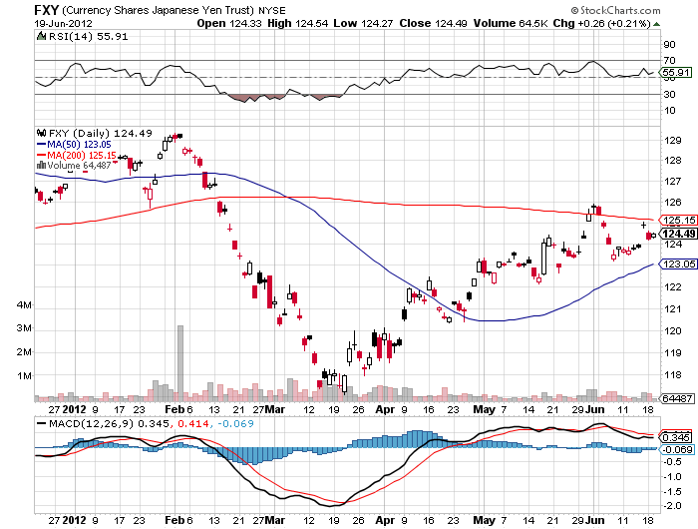
Japanese Yen (FXY)

Slide 33
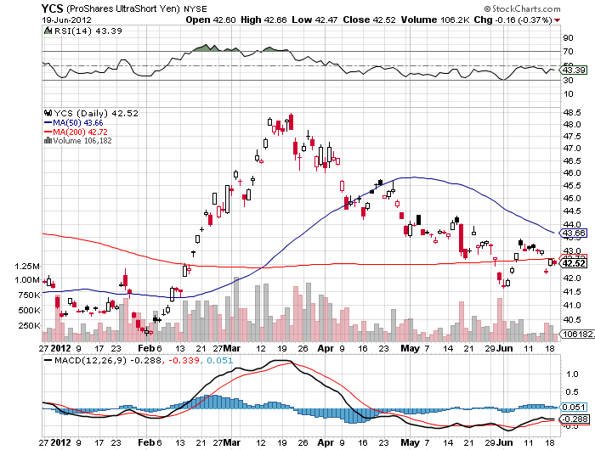
(YCS)

Slide 34
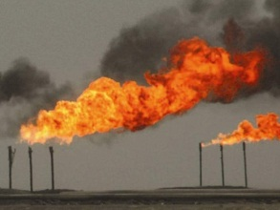
Energy
*”RISK ON” delivers $5 bounce *Supply glut decimates the market *Bounce to $85, next target is $75, via $90? *Saudis are flexing muscles, crushing minor producers with high output *Nat Gas bounced huge in supply drop

Slide 35
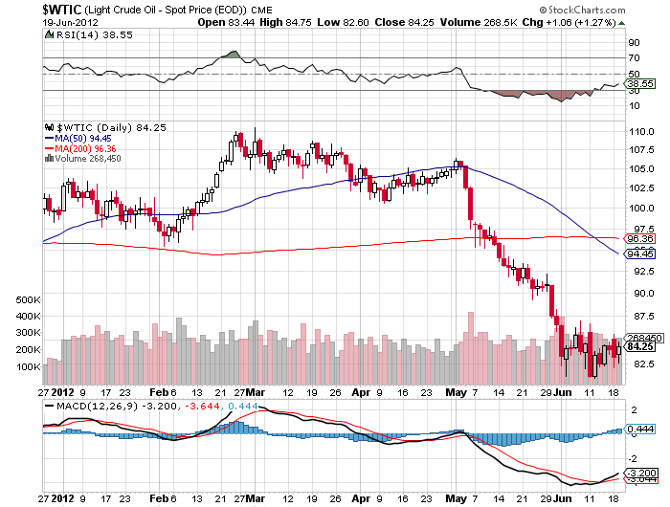
Crude

Slide 36
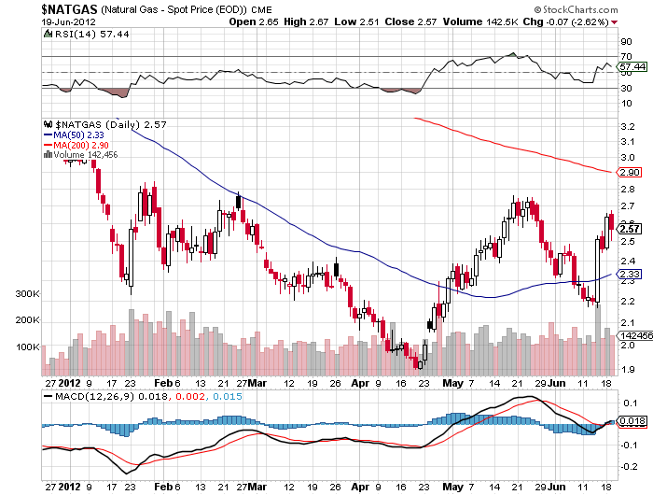
Natural Gas

Slide 37
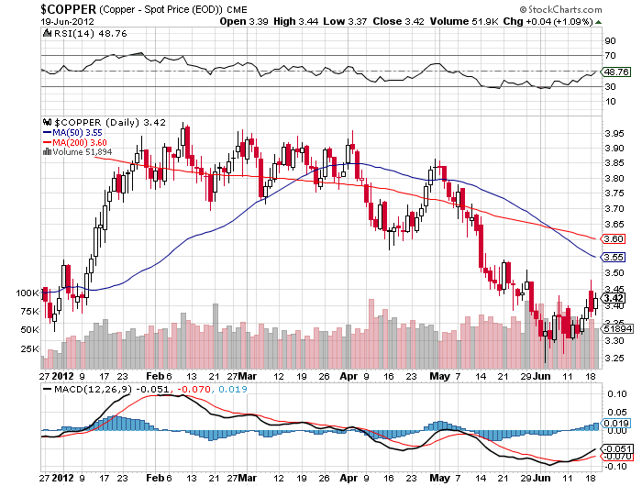
Copper (CU)

Slide 38
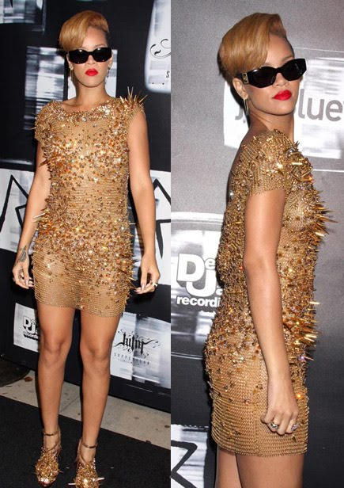
Precious Metals-Getting Interesting
*Seasonal strength kicks in during August, buy July-sell February *Increasing chance of QE means firming bid for gold and silver *Gold shares leading is very bullish leading indicator *May begin a month of base building *Asian central bank buying is putting in a floor

Slide 39
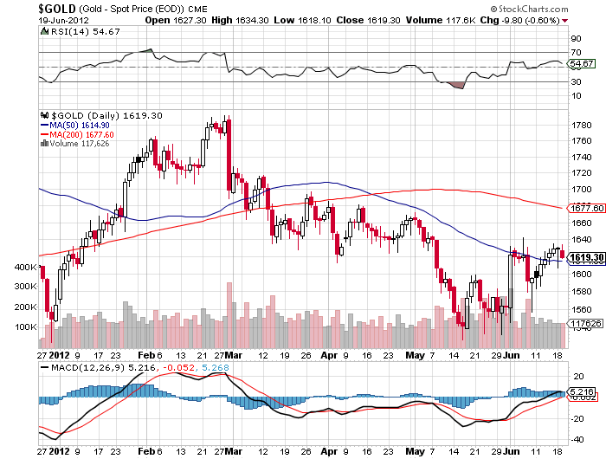
Gold

Slide 40
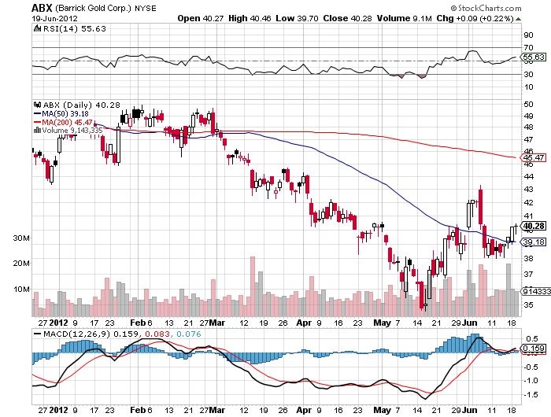
Barrick Gold (ABX)

Slide 41
Newmont Mining (NEM)

Slide 42
(GLD) The Low Risk Play Deep out-of-the-money short dated Call Spread
Cost Buy 30 X August, 2012 $140 Calls at……………. $18.25 Sell short 30 X August, 2012 $150 calls at …….$9.65 Net cost ………………………………………………………$8.60 Profit at Expiration Value at Expiration……………………………………….$10.00 Cost…………………………………………………………..…-$8.60 Net Profit……………………………………………….………$1.40 $1.40/$8.60 = 16.3% in 58 days Profitable at all points over $150 in (GLD), or $1,560 in physical gold

Slide 43
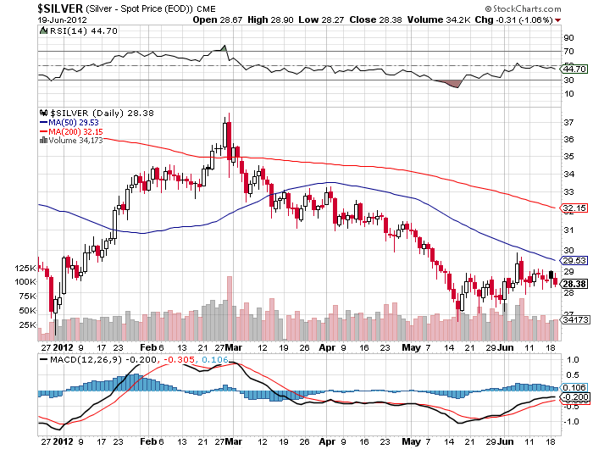
Silver

Slide 44
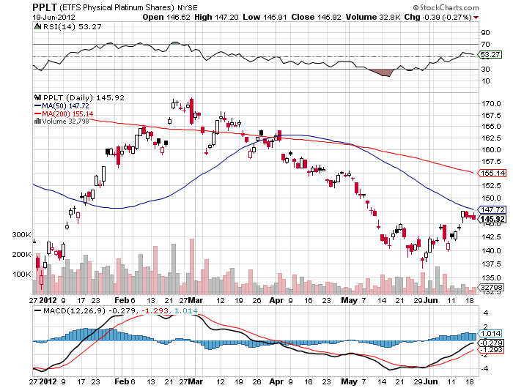
(Platinum) (PPLT)

Slide 45
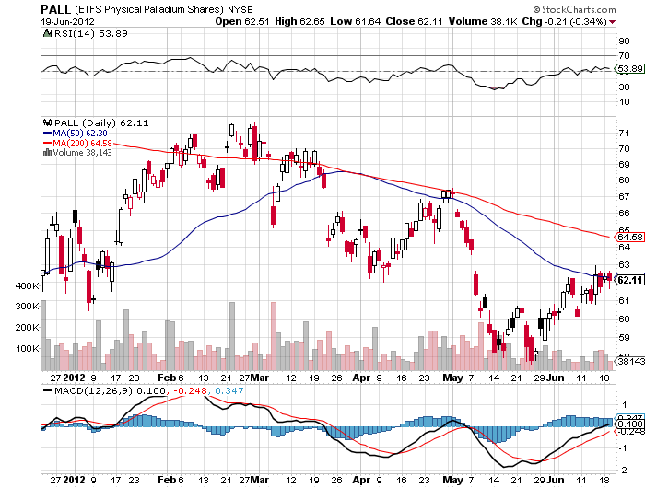
Palladium (PALL)

Slide 46
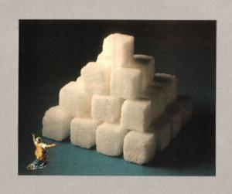
The Ags
*No trade-too many other interesting things happening *Drought hits the Midwest *US still are target for record corn and soybean crops *Drought getting more severe in Russia, cutting exports *Major bounce in sugar

Slide 47
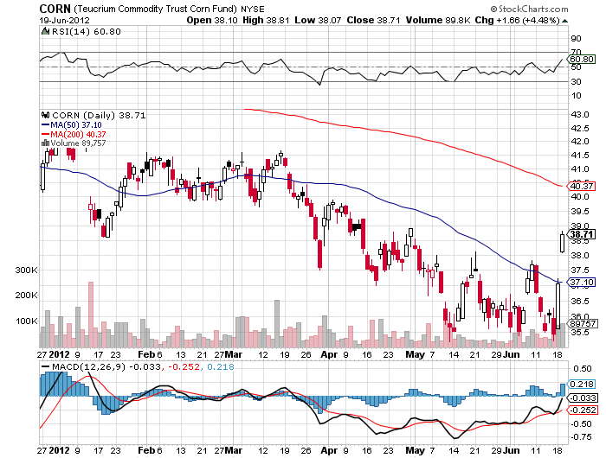
(CORN)

Slide 48
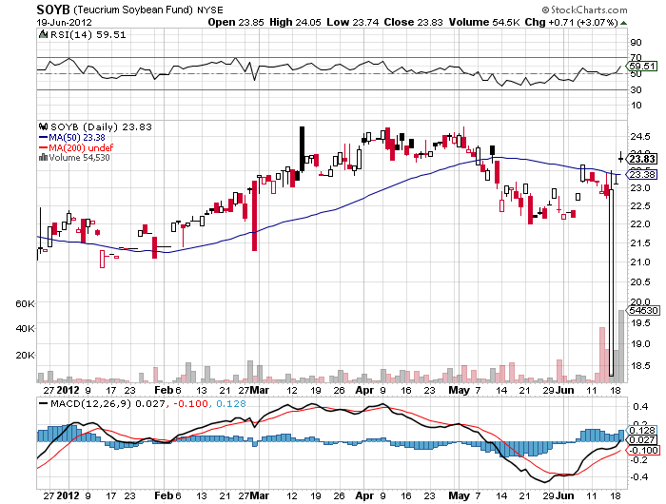
Soybeans (SOYB)

Slide 49
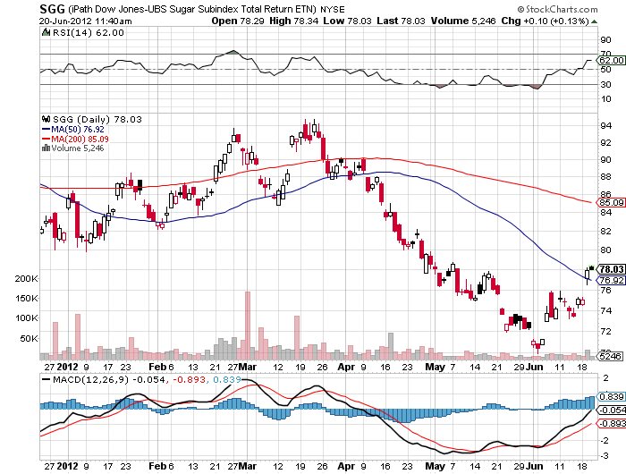
Sugar ETF (SGG)

Slide 50
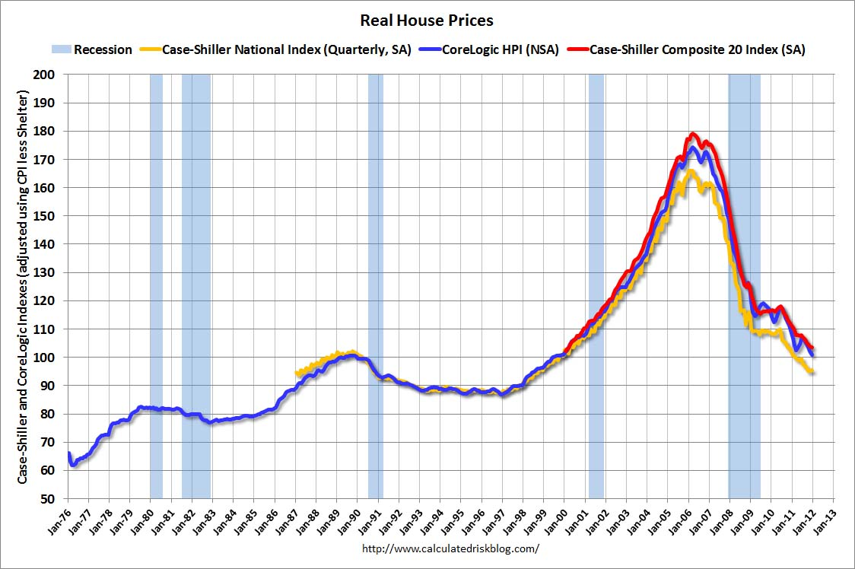
Real Estate February, 2012
Will “twist” extend to mortgage backed securities? Could take the 30 year fixed from 3.75% to 2.75%

Slide 51

Trade Sheet The bottom line: Too late to buy, too early to sell
*Stocks- sell rallies, but not here *Bonds- sell rallies from here, 1.42% hit *Commodities- sell rallies, especially oil and copper *Currencies- sell Euro, sell yen *Precious Metals – buy dips *Volatility-stand aside, dyeing into the summer *The ags – stand aside, no trade *Real estate- rent, don’t buy Next Webinar is on Tuesday, July 3, 2012 from New York City

Slide 52

To buy strategy luncheon tickets Please Go to www.madhedgefundtrader.com

