Slide 1

Please Stand By for John Thomas Wednesday, July 18, 2012, New York City Global Trading Dispatch
The Webinar will begin at 12:00 pm EST

Slide 2

The Mad Hedge Fund Trader “On Hold For the Fed”
Diary of a Mad Hedge Fund Trader New York City July 18, 2012 www.madhedgefundtrader.com

Slide 3

MHFT Global Strategy Luncheons Buy tickets at www.madhedgefundtrader.com 2012 Schedule
July 27 Zermatt September 28 Las Vegas October 19 Washington DC October 26 San Francisco November 8 Orlando January 3, 2013 Chicago

Slide 4
MHFT Global Strategy Luncheons Buy tickets at www.madhedgefundtrader.com
Zermatt, Switzerland July 27
Las Vegas September 28

Slide 5

Trade Alert Performance
*June Final +14.7% *2012 YTD +8.2% *First 84 weeks of Trading + 49.0% *Versus +8.9% for the S&P500 A 40.1% outperformance of the index
64 out of 94 closed trades profitable 68% success rate on closed trades

Slide 6

Portfolio Review Hiding on the Sidelines
Mad Hedge Fund Trader
Trading Book
Asset Class Breakdown
Risk Adjusted Basis
current capital at risk
Risk On
(FXY) July short call spread | 10.00%
(TLT) Short call spread | 10.00%
Risk Off
total net position | 20.00%

Slide 7

Performance Since Inception-New All Time High +31% Average Annualized Return

Slide 8
The Economy-Still Soggy
*June 80,000 nonfarm payroll was a killer *Weekly jobless claims down 26,000 to 350,000 *End July last chance for pre-election QE *June Japan machinery orders -14.8% *Chinese inflation falls to YOY 2.2%, a 29 month low, trade surplis rising due to collapsing imports * *All consistent with a low 1.5% GDP growth rate, or lower

Slide 9
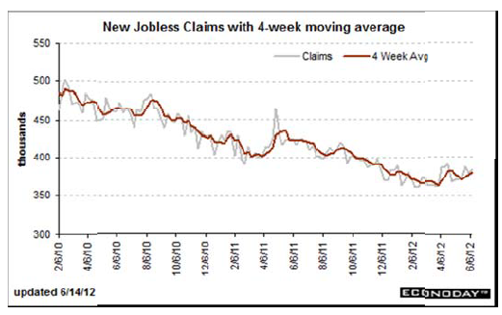
Weekly Jobless Claims The Short Term Trend is Up Break 400,000 and the double dip threat is on

Slide 10


Bonds-
*Twist was renewed until year end *Consolidating in the new range 1.40%-1.70% *No QE3 until SPX drops below 1,100 *Global bond shortage continues

Slide 11
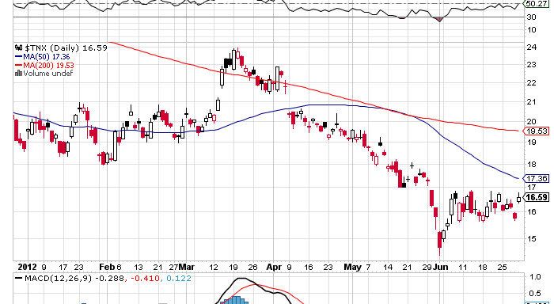
(TNX) 1.42%-1.70% Range Holding

Slide 12
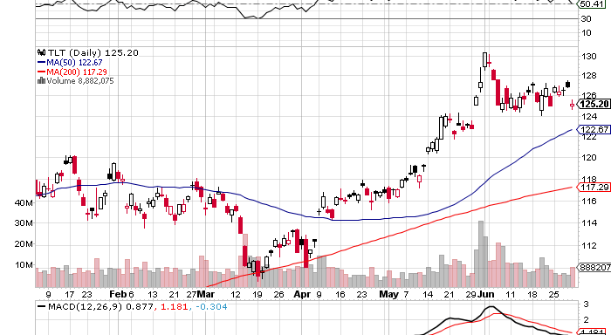
(TLT)

Slide 13
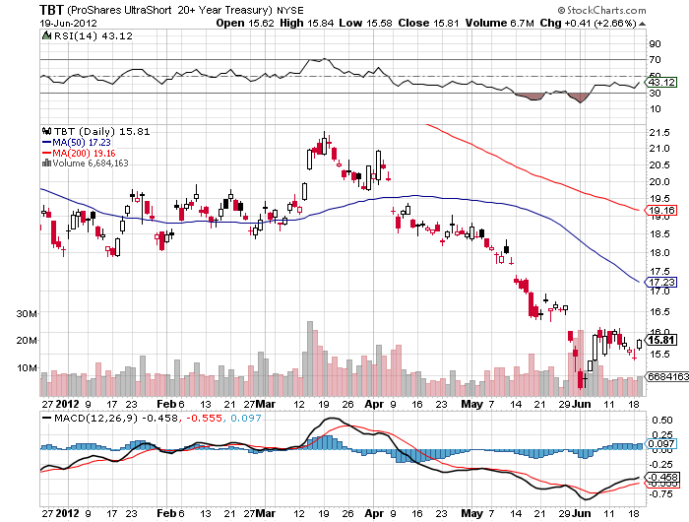
Short Treasuries (TBT)

Slide 14
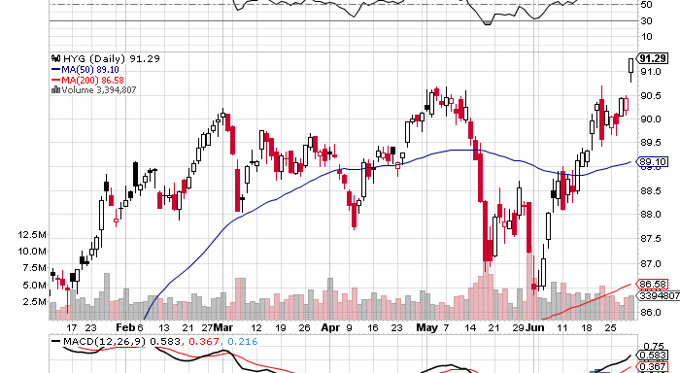
Junk Bonds (HYG)

Slide 15
Stocks-The Flat Summer is Here
*We are XX.0% into a 5%-15% move down *Use this rally to sell, but the ranges are narrowing *Trade against the rising 200 day moving average now at 1,300 *Put to call ration at 0.72/1 is turning bullish under 0.5/1 is bearish, over 0.70/1 is bullish *Watch (CAT) and (FCX) for early tells of China and equity recovery *The PFGBest and Peregrine collapse further erodes investor confidence with $200 million in customer losses *VIX collapse is pointing to a dead summer

Slide 16
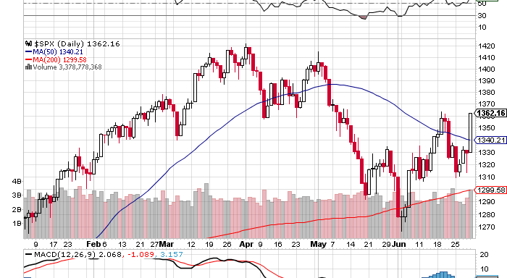
(SPX)

Slide 17
Double Short S&P 500 ETF(SDS)

Slide 18
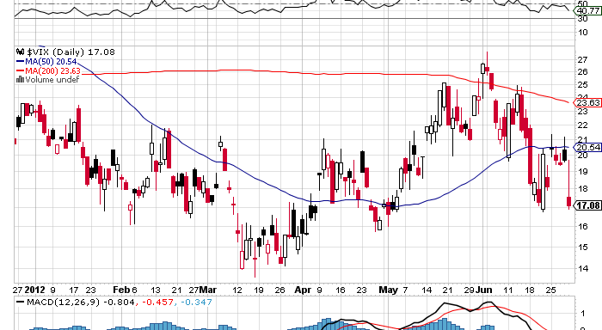
(VIX)

Slide 19
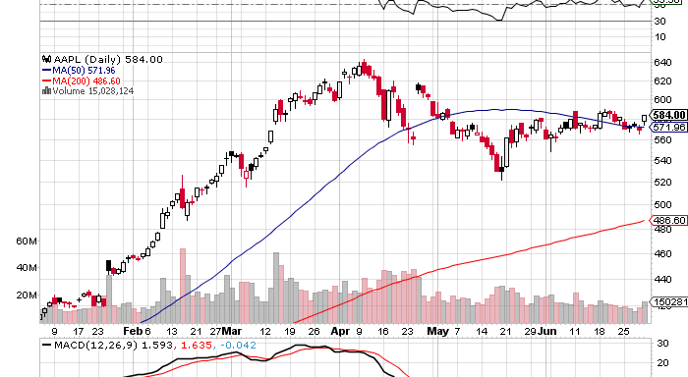
(AAPL)

Slide 20
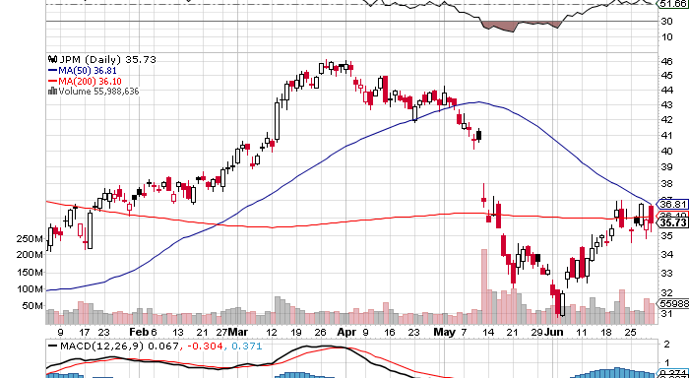
(CAT)

Slide 21
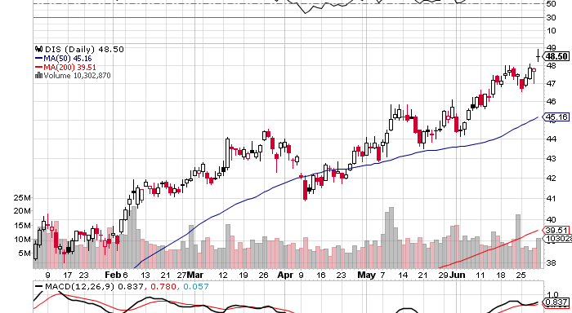
(FCX)

Slide 22
(DIS)

Slide 23
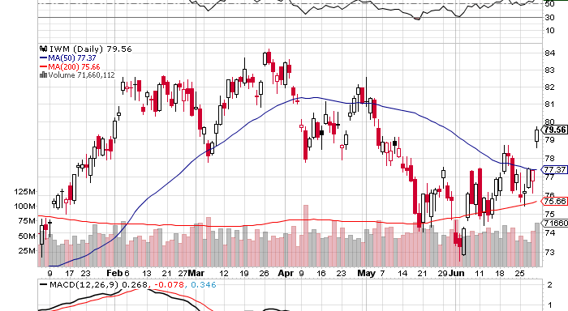
Russell 2000 (IWM)

Slide 24
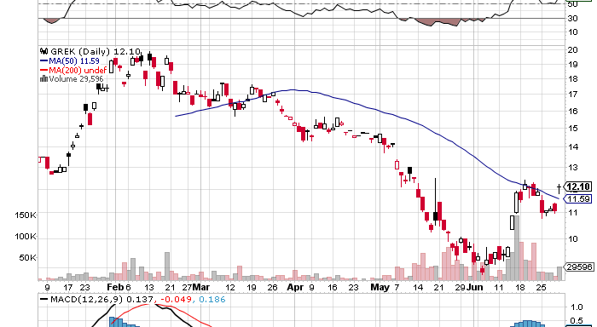
Greece ETF (GREK)

Slide 25
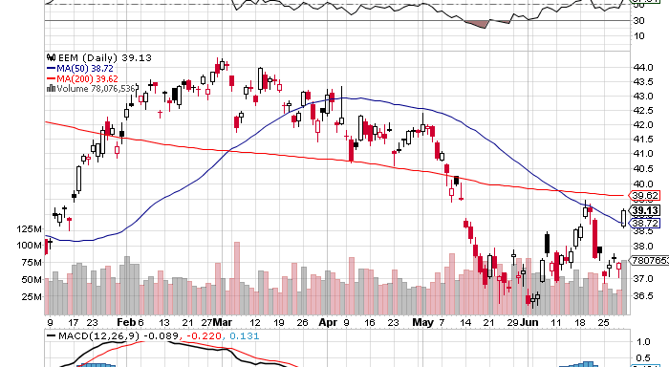
(EEM)

Slide 26
The Dollar
*ECB 0.25% rate cut triggered panic dumping of Euro *Fee good Euro rally lasted only a week *Euro peak may come with ECB interest rate cut which is imminent *No big breakouts this summer, waiting for the next Fed meeting in six weeks *Look for trading ranges to narrow *Yen is flat lining, sell OTM calls and volatility, waiting for the next QE

Slide 27
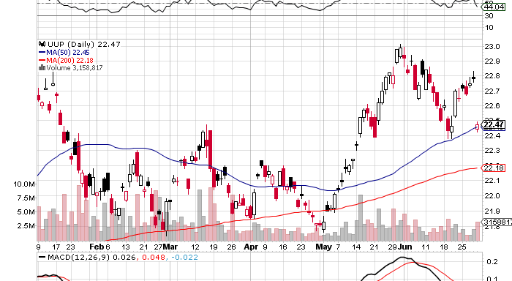
Long Dollar Basket (UUP)

Slide 28
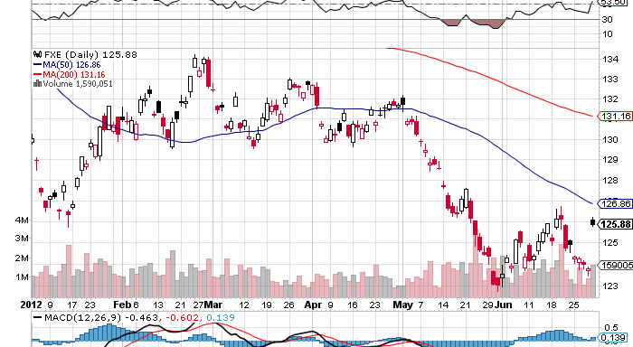
Euro (FXE)

Slide 29
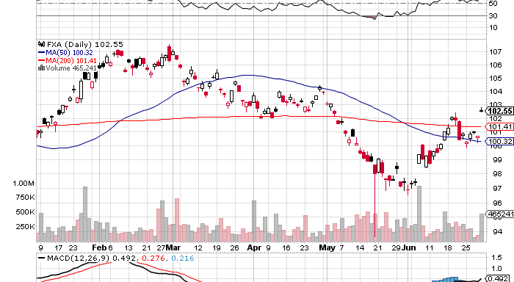
Australian Dollar (FXA)

Slide 30
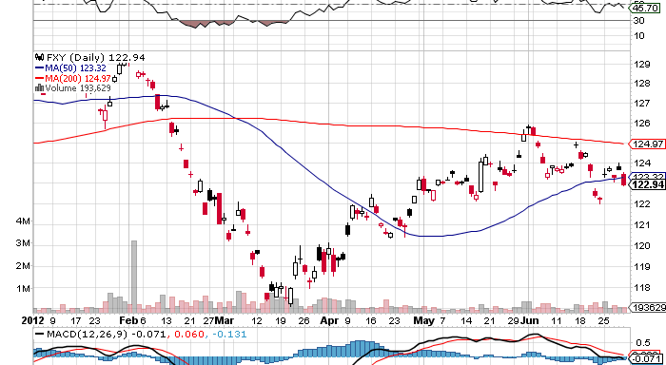
Japanese Yen (FXY)

Slide 31
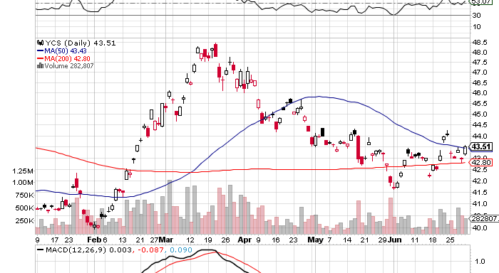
(YCS)

Slide 32
Energy
*”RISK ON” delivers $11 bounce *Norway strike takes 250,000 b/d off market *Bounce to $85, next target is $75, via $90? *Nat Gas bounced huge in supply drop, US heat wave, look to sell around $3/MM BTU, or $22 in the UNG *More US electricity is now produced from natgas than from coal for the first time in history *Patriot Coal (PCX) bankruptcy underlines coal price collapse

Slide 33
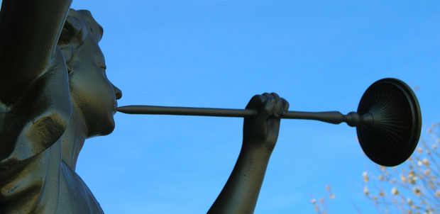
Hard Assets-Call of the Year
*All Hard Assets and their currencies peaked in February *Are now 4-8 months into bear markets *Reflecting global economic slowdown especially in China *Since they we first into the bear market, will they be the first out? *Look to make cheap buys in oil (USO), gold (GLD), silver (SLV), Copper (CU) Australian dollar (FXA), and Canadian dollar (FXC) at August lows for fall/year end rally *sell short OTM puts and take delivery or scale into ETF’s

Slide 34
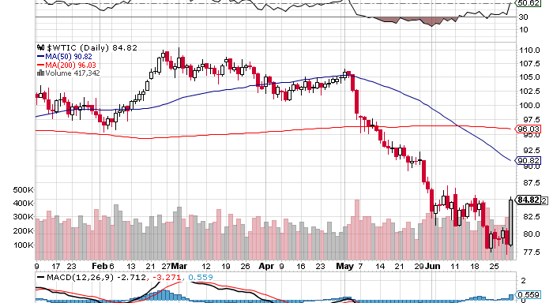
Crude

Slide 35
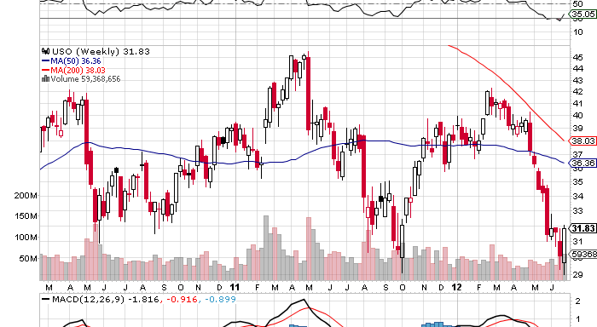
Oil (USO)

Slide 36
(USO) The Low Risk Play Naked Short Puts on Oil
Proceeds Sell short 10 X August, 2012 $28 Puts at……………. $1.00 (10 X 100 X $1.00) =………$1,000 = 1.00% return on $100,000 portfolio Profit at Expiration USO Wednesday price at $30 Take in Premium and downside (USO) cost is ($28 - $1) = $27 Oil needs to drop to $69.60 to hit (USO) $27 cost If it falls that far take delivery of USO) shares worth $25,000, or 25% of the portfolio, and keep them for fall oil bounce back to $90. If it doesn’t, keep the $1,000 in premium. Do on every dip until you get hit. Also is a good idea here on gold (GLD), silver (SLV), and copper (CU)

Slide 37
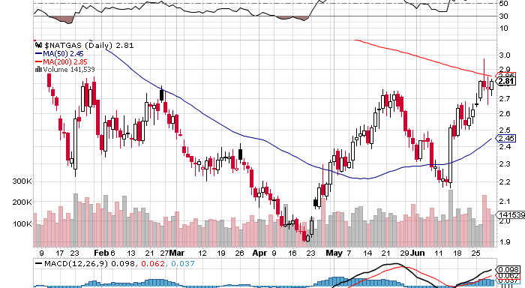
Natural Gas

Slide 38
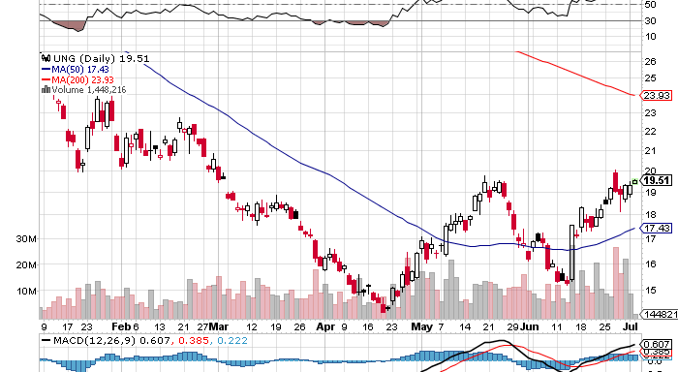
Natural Gas (UNG)

Slide 39
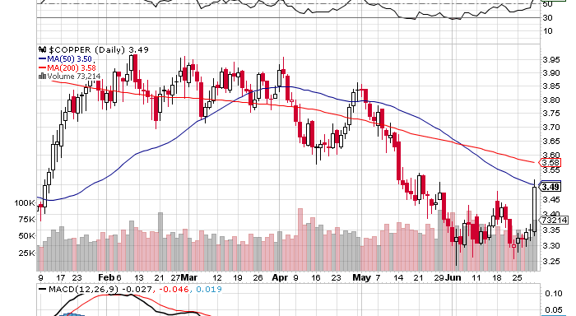
Copper (CU)

Slide 40
Precious Metals-Getting Interesting
*Seasonal strength kicks in during August, buy July-sell February *Still waiting for QE, Europe will jump before the US, will LTRO or Euro interest rate cut be the trigger? *Gold shares leading is very bullish leading indicator *May-June began months of base building *Asian central bank buying is putting in a floor

Slide 41
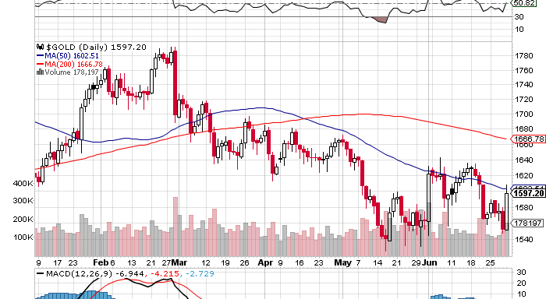
Gold

Slide 42
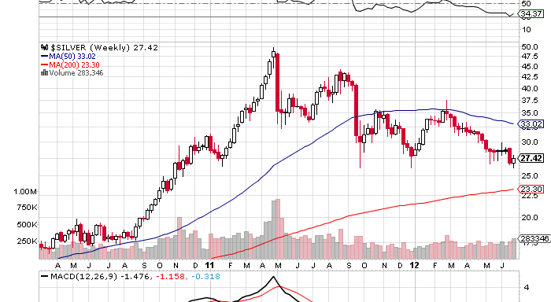
Silver

Slide 43
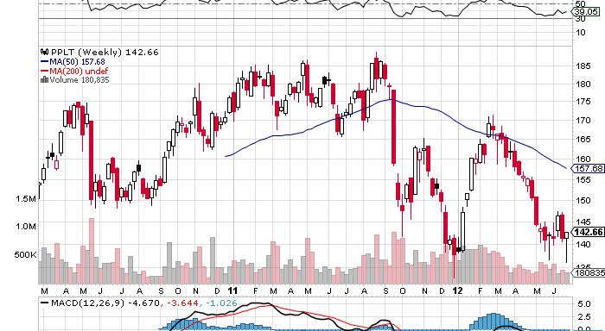
(Platinum) (PPLT)

Slide 44
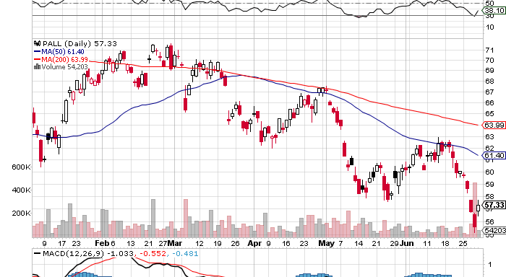
Palladium (PALL)

Slide 45
The Ags
*Global warming returns with a vengeance *Severe drought hits the Midwest *US corn and wheat yields cut back substantially *Drought getting more severe in Russia, cutting exports *Miss the pop, distracted by better trades

Slide 46
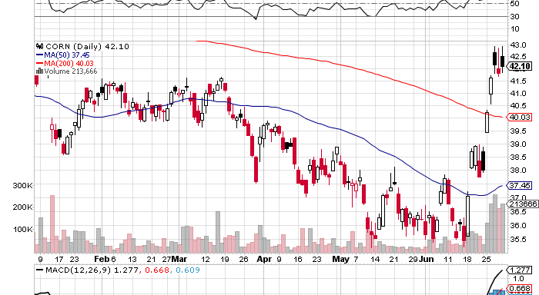
(CORN)

Slide 47
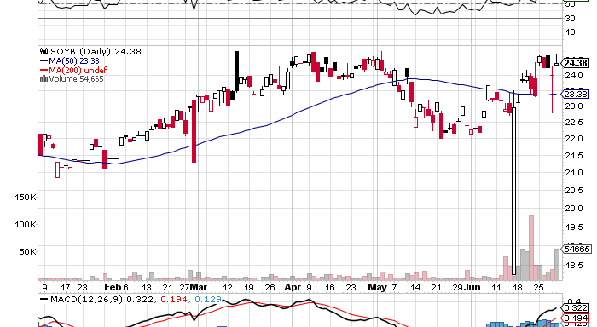
Soybeans (SOYB)

Slide 48
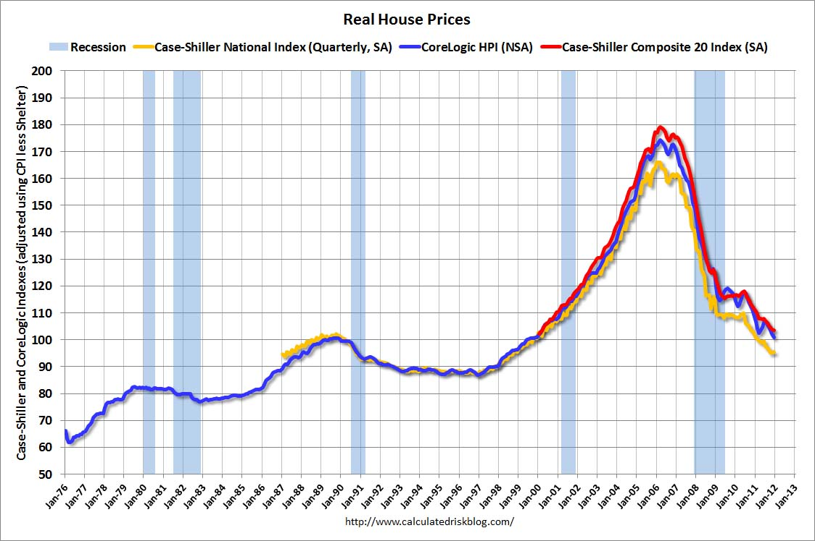
Real Estate February, 2012
Will “twist” extend to mortgage backed securities? Could take the 30 year fixed from 3.75% to 2.75%

Slide 49

Trade Sheet The bottom line: Wait for Commodities to lead the first move up
*Stocks- stand aside, wait for bigger sell off *Bonds- sell rallies through OTM Call Spreads, 1.50% or lower *Commodities- wait for bigger dip to buy *Currencies- sell Euro on rally over $1.27.8, sell yen OTM Calls *Precious Metals – Short OTM Puts *Volatility-stand aside, dying into the summer *The ags – stand aside, too late to buy *Real estate- rent, don’t buy Next Webinar is on Wednesday, August 1, 2012 12:00 noon EST from Zermatt, Switzerland

Slide 50

To buy strategy luncheon tickets Please Go to www.madhedgefundtrader.com

