Slide 1

Please Stand By for John Thomas Wednesday, July 3, 2012, New York City Global Trading Dispatch
The Webinar will begin at 12:00 pm EST

Slide 2

The Mad Hedge Fund Trader “Enter the Summer Doldrums”
Diary of a Mad Hedge Fund Trader New York City July 3, 2012 www.madhedgefundtrader.com

Slide 3

MHFT Global Strategy Luncheons Buy tickets at www.madhedgefundtrader.com 2012 Schedule
July 5 New York July 6-13 Queen Mary II New York to Southampton July 16 London July 17 Paris July 18 Frankfurt July 27 Zermatt September 28 Las Vegas October 19 Washington DC October 26 San Francisco November 8 Orlando January 3, 2013 Chicago

Slide 4

MHFT Global Strategy Luncheons Buy tickets at www.madhedgefundtrader.com
New York, NY July 5

Slide 5

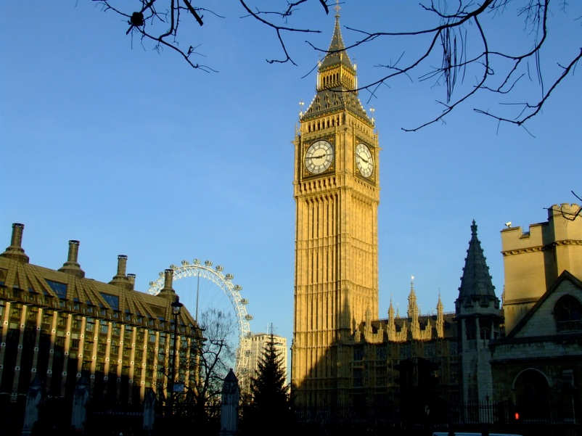
MHFT Global Strategy Luncheons Buy tickets at www.madhedgefundtrader.com
Seminar at Sea July 11, 2012 Queen Mary 2
London July 16

Slide 6

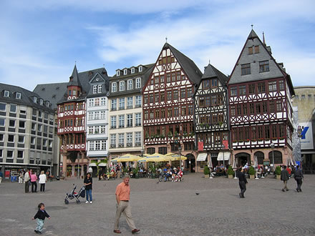
MHFT Global Strategy Luncheons Buy tickets at www.madhedgefundtrader.com
Paris July 17
Frankfurt July 18

Slide 7

Trade Alert Performance
*June Final +14.7% *2012 YTD +8.2% *First 84 weeks of Trading + 49.0% *Versus +8.9% for the S&P500 A 40.1% outperformance of the index
64 out of 94 closed trades profitable 68% success rate on closed trades

Slide 8
Portfolio Review Hiding on the Sidelines
Mad Hedge Fund Trader
Trading Book
Asset Class Breakdown
Risk Adjusted Basis
current capital at risk
Risk On
(FXY) July short call spread | 10.00%
(TLT) Short call spread | 10.00%
Risk Off
total net position | 20.00%

Slide 9
Performance Since Inception-New All Time High +31% Average Annualized Return

Slide 10

The Economy-Still Soggy
*US June PMI at 49.7, under 50 first time in 3 years *Weekly jobless claims down 6,000, but last week revised up to 392,000 *US Q1 final GDP a weaker 1.9% *June China PMI 50.4 down to 50.2 *May industrial production down +0.1% to -0.1% * German June PMI down from 45.2 to 45 *Weak Friday nonfarm payroll expected around 100,000 *All consistent with a low 1.5% GDP growth rate, or lower

Slide 11
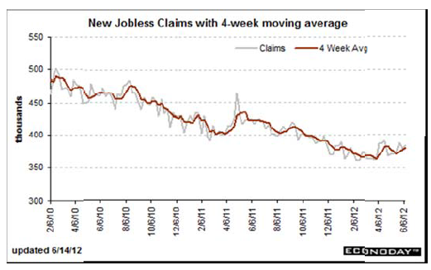
Weekly Jobless Claims The Short Term Trend is Up Break 400,000 and the double dip threat is on

Slide 12

Bonds-Fed Passed
*No QE3 Brought dramatic sell off, then stagnation *Twist was renewed until year end *Consolidating in the new range 1.40%-1.70% *Deflation still rules *No QE3 until SPX drops below 1,100 *Global bond shortage continues *Since 2007 $350 billion out of equity mutual funds, $1 trillion into bond funds

Slide 13
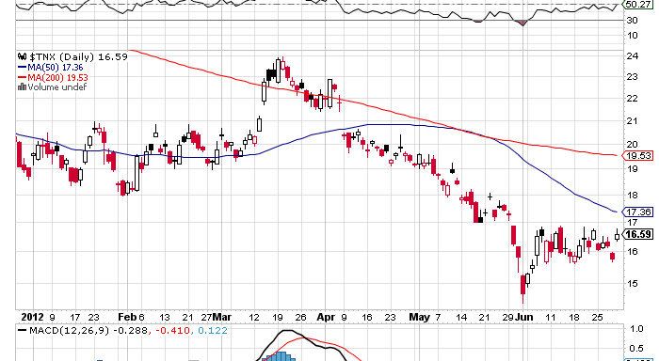
(TNX) 1.42%-1.70% Range Holding

Slide 14
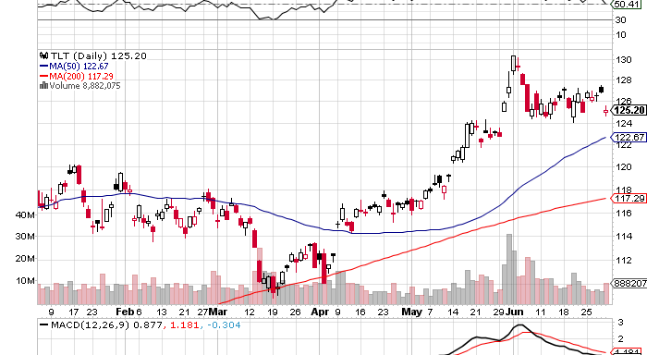
(TLT)

Slide 15
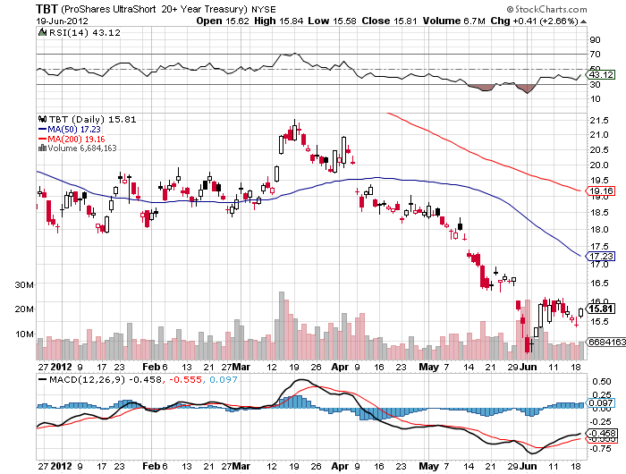
Short Treasuries (TBT)

Slide 16
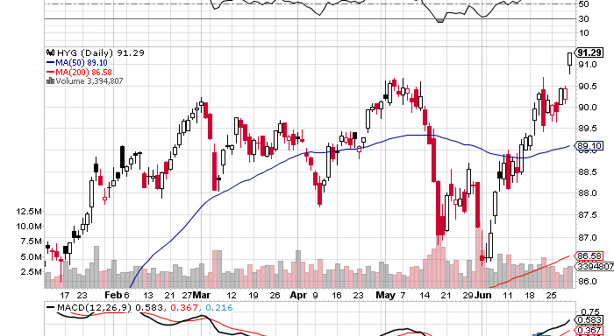
Junk Bonds (HYG)

Slide 17

Stocks-Setting Up for a Flat Summer?
*We are 4.0% into a 5%-15% move down *Use this rally to sell, but the ranges are narrowing *Trade against the rising 200 day moving average now at 1,300 *Volume is fleeing ahead of a summer shut down *Many hedge funds have quit the market *Squeezing the shorts, little new money coming into the market *VIX collapse is pointing to a dead summer

Slide 18
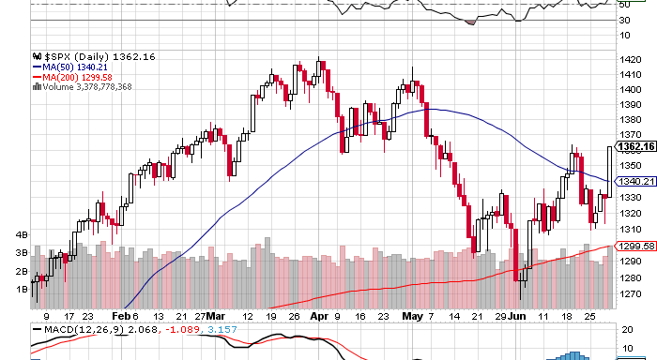
(SPX)

Slide 19
Double Short S&P 500 ETF(SDS)

Slide 20
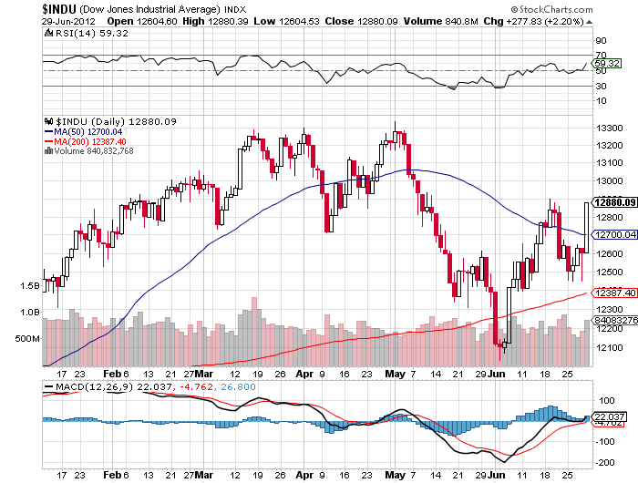
Dow

Slide 21
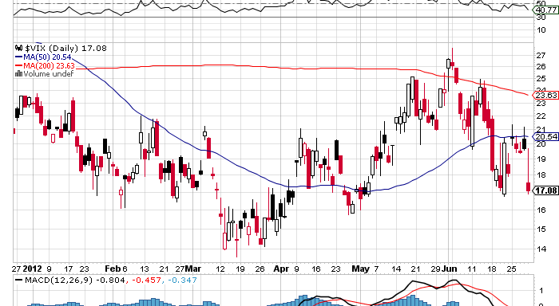
(VIX)

Slide 22
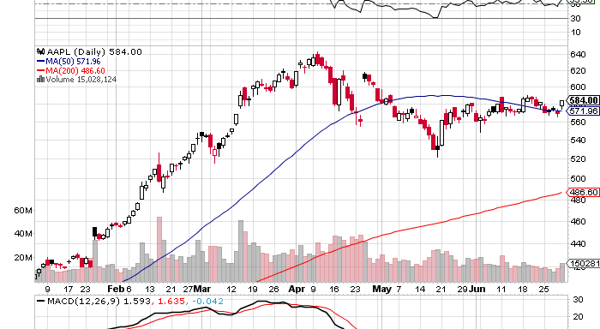
(AAPL)

Slide 23
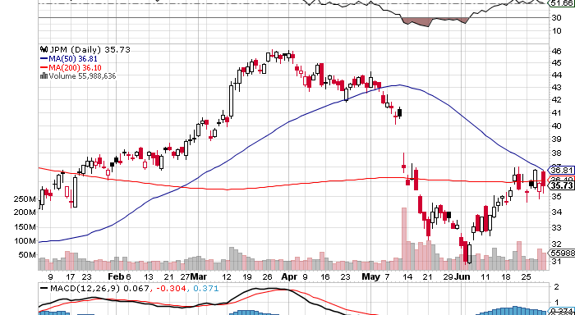
(JPM)

Slide 24
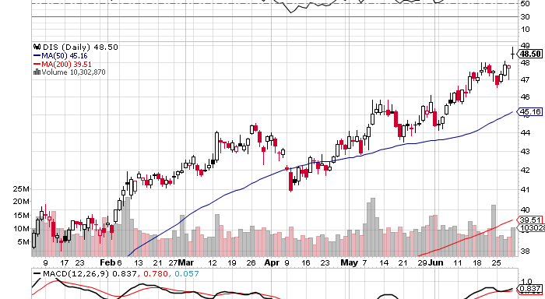
(DIS)

Slide 25
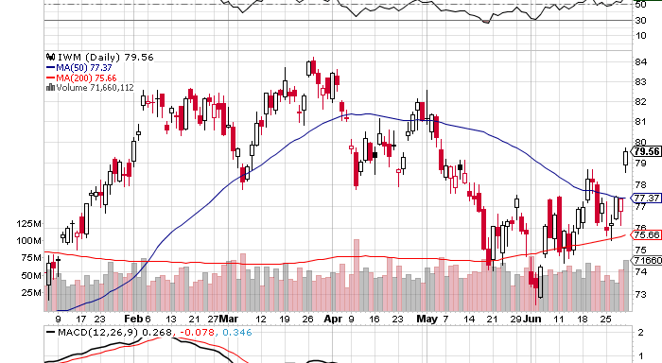
Russell 2000 (IWM)

Slide 26
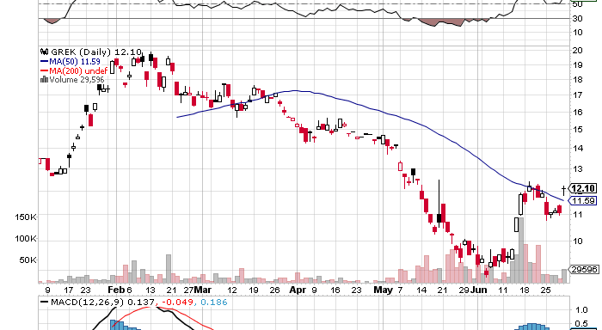
Greece ETF (GREK)

Slide 27
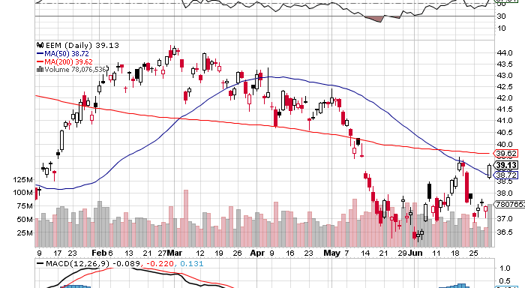
(EEM)

Slide 28
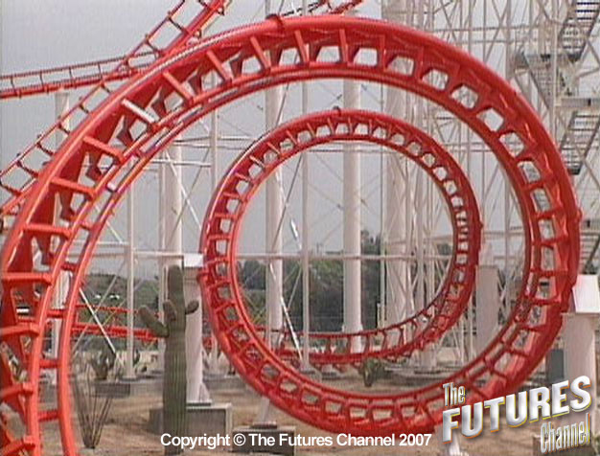
The Dollar
*Progress on European bailout was a baby step only, but triggered nice short covering gap on Euro *Euro peak may come with ECB interest rate cut which is imminent *No big breakouts this summer, waiting for the next Fed meeting in six weeks *Look for trading ranges to narrow *Targeting $127.80 for a Euro short, 50% retrace and 50 day MA *Yen is flat lining, sell OTM calls and volatility, waiting for the next QE *”RISK ON” delivers big Ausie rally, look to sell short (FXA) on next peak over $1.04

Slide 29
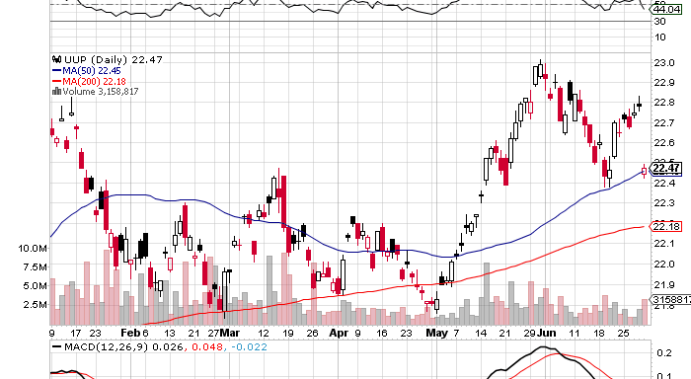
Long Dollar Basket (UUP)

Slide 30
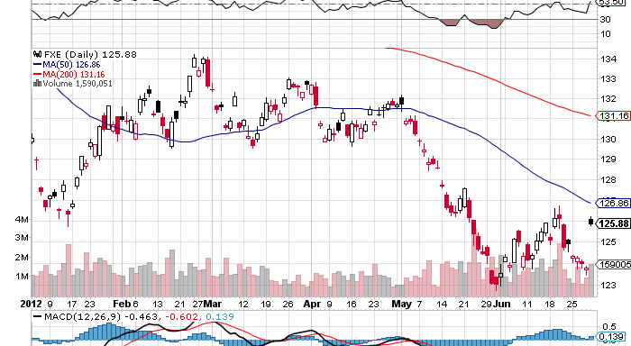
Euro (FXE)

Slide 31
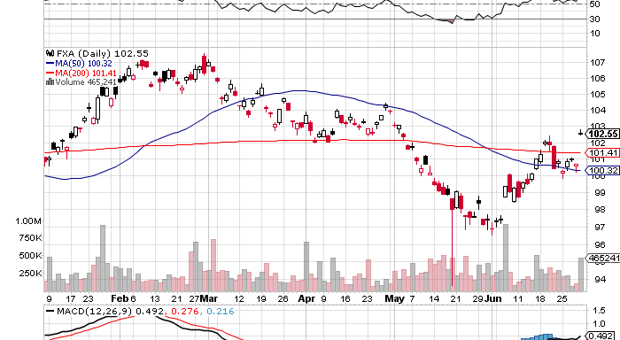
Australian Dollar (FXA)

Slide 32
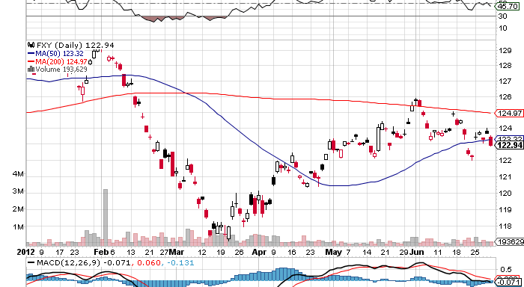
Japanese Yen (FXY)

Slide 33
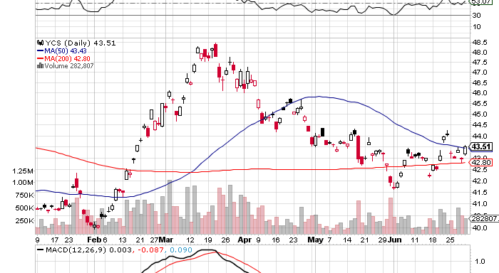
(YCS)

Slide 34
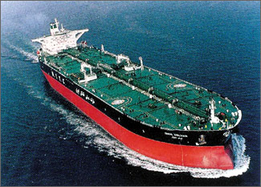
Energy
*”RISK ON” delivers $8 bounce *Supply glut decimates the market *Bounce to $85, next target is $75, via $90? *US fracking plus Saudi overproduction creating structural over supply *Nat Gas bounced huge in supply drop, US heat wave, look to sell around $3/MM BTU, or $22 in the UNG

Slide 35

Hard Assets-Call of the Year
*All Hard Assets and their currencies peaked in February *Are now 4-8 months into bear markets *Reflecting global economic slowdown especially in China *Since they we first into the bear market, will they be the first out? *Look to make cheap buys in oil (USO), gold (GLD), silver (SLV), Copper (CU) Australian dollar (FXA), and Canadian dollar (FXC) at August lows for fall/year end rally *sell short OTM puts and take delivery or scale into ETF’s

Slide 36
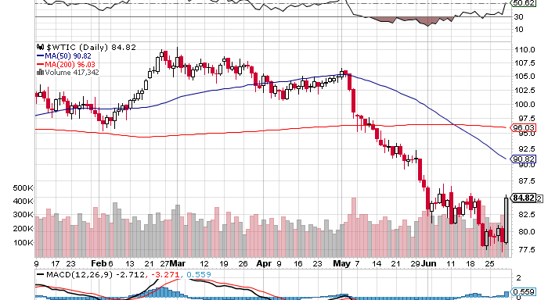
Crude

Slide 37
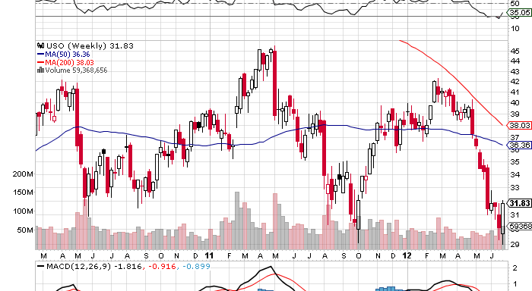
Oil (USO)

Slide 38
(USO) The Low Risk Play Naked Short Puts on Oil
Proceeds Sell short 10 X August, 2012 $28 Puts at……………. $1.00 (10 X 100 X $1.00) =………$1,000 = 1.00% return on $100,000 portfolio Profit at Expiration USO Wednesday price at $30 Take in Premium and downside (USO) cost is ($28 - $1) = $27 Oil needs to drop to $69.60 to hit (USO) $27 cost If it falls that far take delivery of USO) shares worth $25,000, or 25% of the portfolio, and keep them for fall oil bounce back to $90. If it doesn’t, keep the $1,000 in premium. Do on every dip until you get hit. Also is a good idea here on gold (GLD), silver (SLV), and copper (CU)

Slide 39
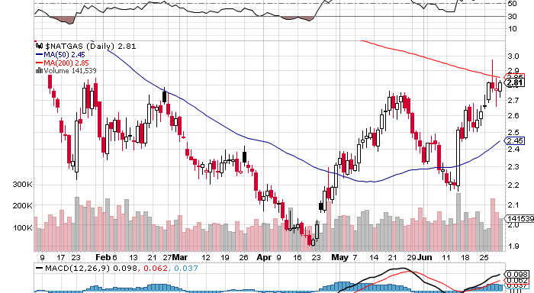
Natural Gas

Slide 40
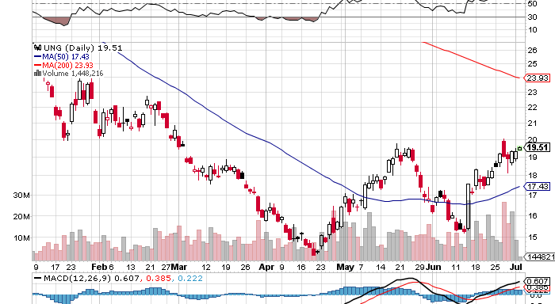
Natural Gas (UNG)

Slide 41
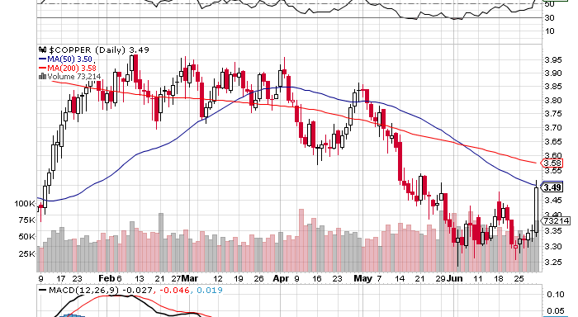
Copper (CU)

Slide 42

Precious Metals-Getting Interesting
*Seasonal strength kicks in during August, buy July-sell February *Still waiting for QE, Europe will jump before the US, will LTRO or Euro interest rate cut be the trigger? *Gold shares leading is very bullish leading indicator *May-June began months of base building *Asian central bank buying is putting in a floor

Slide 43
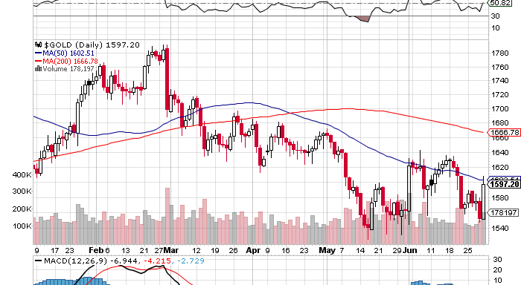
Gold

Slide 44
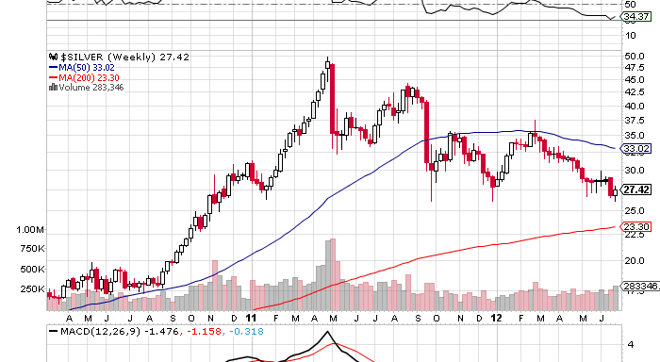
Silver

Slide 45
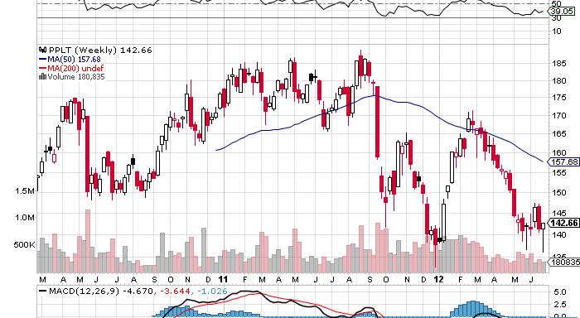
(Platinum) (PPLT)

Slide 46
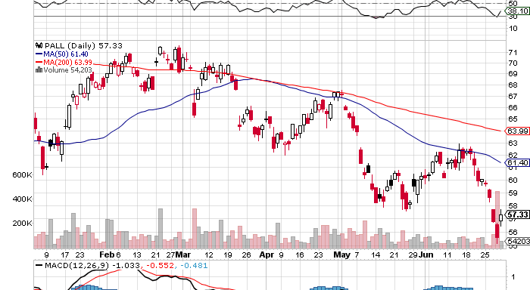
Palladium (PALL)

Slide 47

The Ags
*Global warming returns with a vengeance *Severe drought hits the Midwest *US corn and wheat yields cut back substantially *Drought getting more severe in Russia, cutting exports *Miss the pop, distracted by better trades

Slide 48
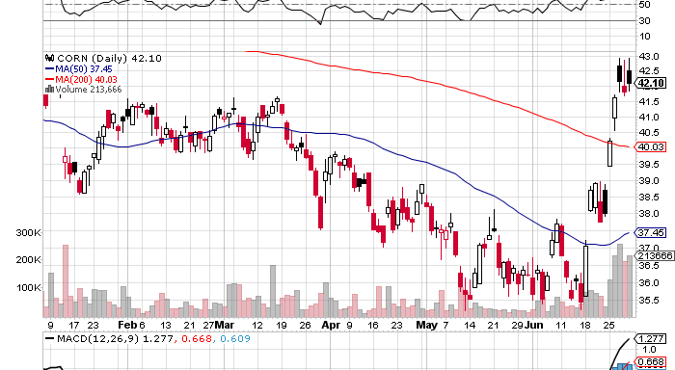
(CORN)

Slide 49
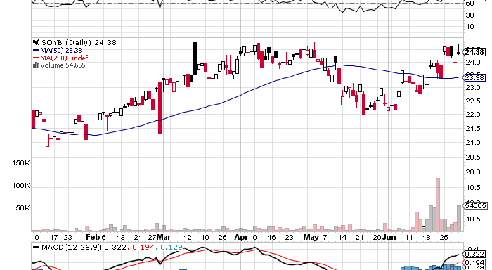
Soybeans (SOYB)

Slide 50
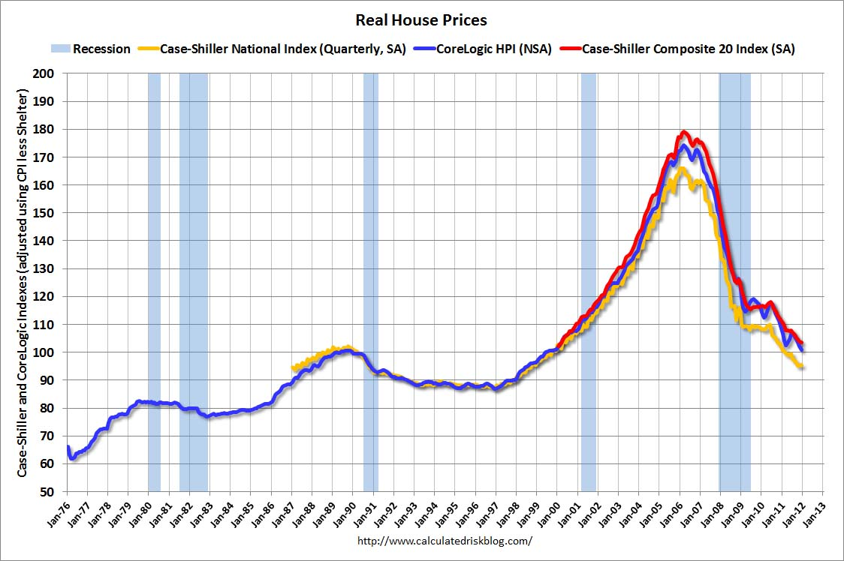
Real Estate February, 2012
Will “twist” extend to mortgage backed securities? Could take the 30 year fixed from 3.75% to 2.75%

Slide 51

Trade Sheet The bottom line: Wait for Commodities to lead the first move up
*Stocks- stand aside, wait for bigger sell off *Bonds- sell rallies through OTM Call Spreads, 1.50% or lower *Commodities- wait for bigger dip to buy *Currencies- sell Euro on rally over $1.27.8, sell yen OTM Calls *Precious Metals – Short OTM Puts *Volatility-stand aside, dying into the summer *The ags – stand aside, too late to buy *Real estate- rent, don’t buy Next Webinar is on Tuesday, July 18, 2012 12:00 noon EST from Frankfurt, Germany

Slide 52

To buy strategy luncheon tickets Please Go to www.madhedgefundtrader.com

