Slide 1

Please Stand By for
John Thomas
Wednesday, August 1, 2012, Zermatt, Switzerland
Global Trading Dispatch
The Webinar will begin at 12:00 pm EST

Slide 2

The Mad Hedge Fund Trader
“Mr. Mario Strikes Back”
Diary of a Mad Hedge Fund Trader
Zermatt, Switzerland, 2012
www.madhedgefundtrader.com

Slide 3

MHFT Global Strategy Luncheons
Buy tickets at www.madhedgefundtrader.com
2012 Schedule
September 28 Las Vegas
October 19 Washington DC
October 26 San Francisco
November 8 Orlando
January 3, 2013 Chicago

Slide 4
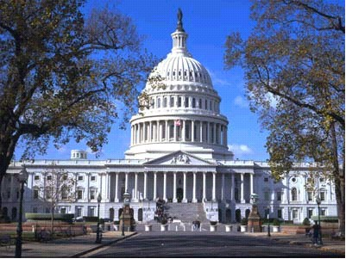
MHFT Global Strategy Luncheons
Buy tickets at www.madhedgefundtrader.com
Las Vegas
September 28
Washington, DC
October 19

Slide 5
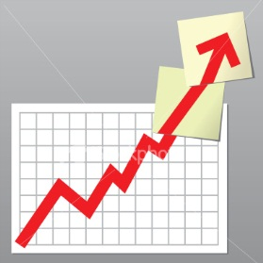
Trade Alert Performance
*July MTD +1.80%
*2012 YTD +10.0%
*First 88 weeks of Trading
+ 50.1%
*Versus +10.8% for the S&P500
A 39.3% outperformance of the index
66 out of 96 closed trades profitable
69% success rate on closed trades

Slide 6
Portfolio Review
Dipping a Toe Back in the Water
Mad Hedge Fund Trader
Trading Book
Asset Class Breakdown
Risk Adjusted Basis
current capital at risk
Risk On
Short (FXY) Call Spread | 15.00%
Risk Off
Long (SPY) $138 puts | -5.00%
total net position | 10.00%

Slide 7
Performance Since Inception-New All Time High
+30.8% Average Annualized Return

Slide 8

The Economy-Still Bad News
*June existing home sales fell 5.4%, up only 4.5% YOY
inventories down 25%, prices up 8%
*Weekly jobless claims down 35,000
to 353,000
*HSBC’s private China July PMI
48.2 to 49.5, but still negative,
Government PMI 50.2 to 50.1
*UK GDP -0.7% in Q2, 3rd quarter of recession
*US June new home sales 350,000, 20k less than expected
*US June durable goods +1.6%, but down 1.1%
without aircraft
*All consistent with a low 1.5% GDP growth rate,
or lower

Slide 9
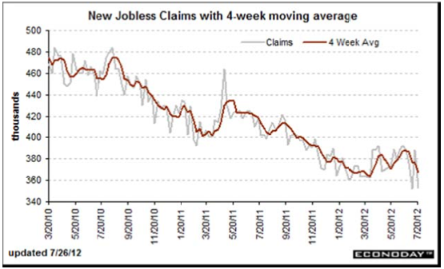
Weekly Jobless Claims
The Short Term Trend is Up
Break 400,000 and the double dip threat is on
New Detroit is muddling data creating volatiltiy
4 week moving average at 367,000

Slide 10
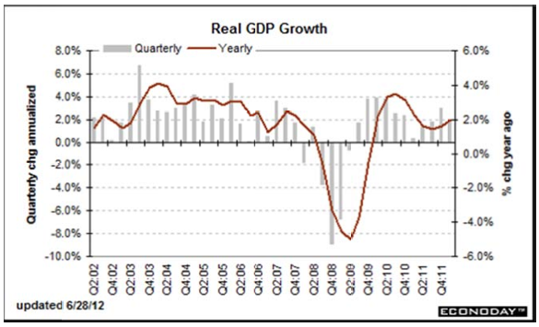
US Quarterly GDP

Slide 11

Bonds-Still in the New Range
*Consolidating in the new range 1.40%-1.70%
*Fed failure to QE3 will send it back to
top of range in prices, 1.40% in yields
*No QE3 until SPX drops below 1,100
*Global bond shortage continues
*Double top in the (TLT) at $131?
*Sold the $136-$141 call Spread
at a 1.15% yield on the 10 year, took
quick profit

Slide 12
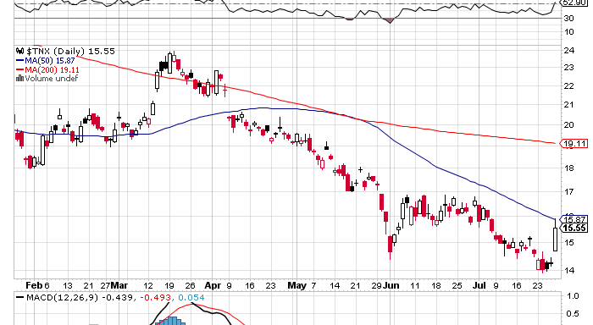
(TNX) 1.40%-1.70% Range Holding

Slide 13
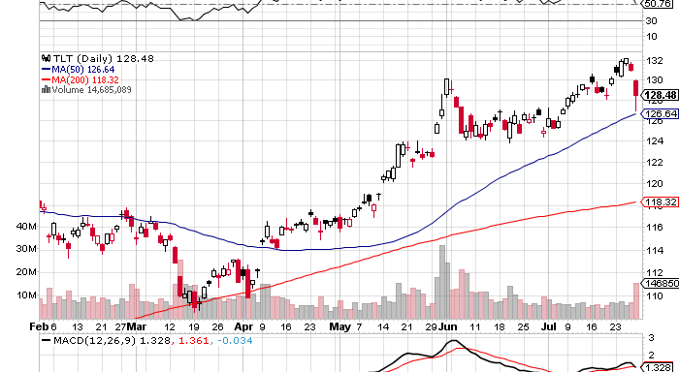
(TLT)

Slide 14
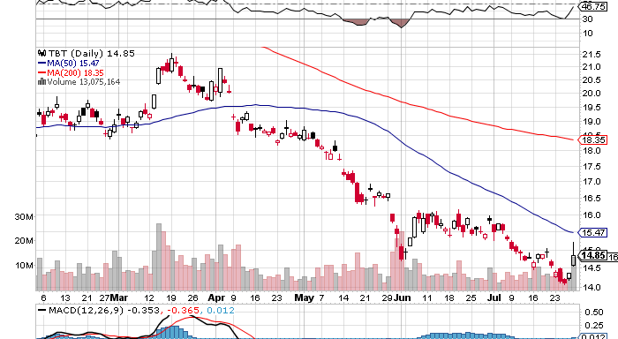
Short Treasuries (TBT)

Slide 15
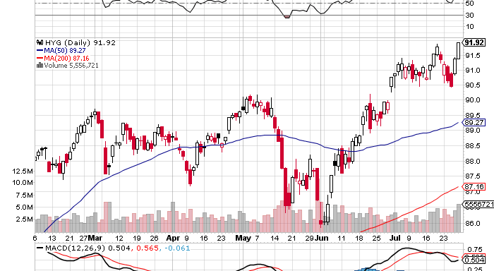
Junk Bonds (HYG)

Slide 16
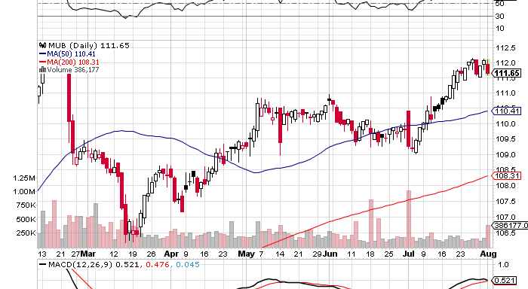
Municipal Bonds (MUB)-3% yield,
Mix of AAA, AA, and A rated bonds

Slide 17
Short the August (TLT) $136-$141 Call Spread
Sell Short the August $136 Call at……….$0.51
Buy the August $141 Call at…………………$0.12
Net credit…………………………………………….$0.39
38 contracts for a 15% weighting in the model $100,000 portfolio
(38 X $0.39 X 100) = $1,482 = 1.48% 3 week return
Profitable with the (TLT) at all points below $136.39,
or the 10 year treasury above a 1.15% yield

Slide 18

Stocks-Mr. Mario Strikes
*New high for the year in range
*Use this rally to sell
*Hedge Fund short covering has been huge
*Could give it all back if Bernanke disappoints
with no QE3
*Buy the August Low wherever it is for the
presidential election rally
*VIX collapse is pointing to a dead summer
*Buy puts, write covered calls, sell Out-of-the-Money calls,
sell long side positions for trading profits

Slide 19
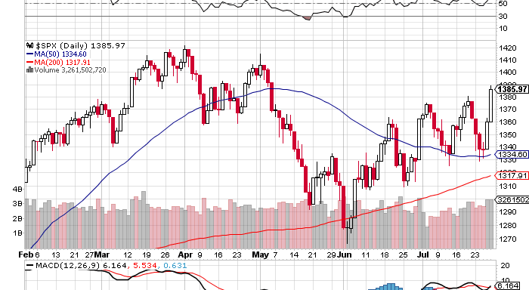
(SPY)

Slide 20
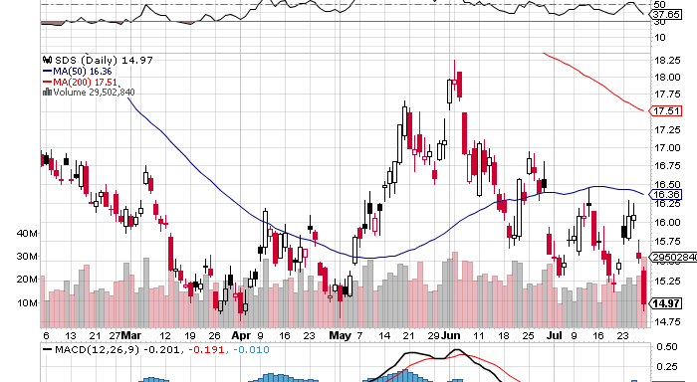
Double Short S&P 500 ETF(SDS)

Slide 21
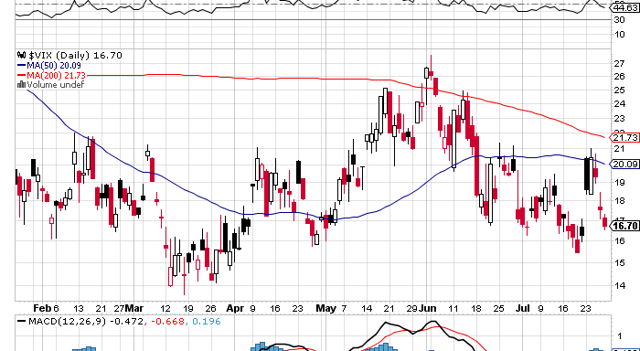
(VIX)

Slide 22
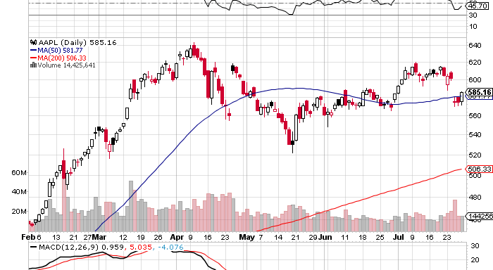
(AAPL)

Slide 23
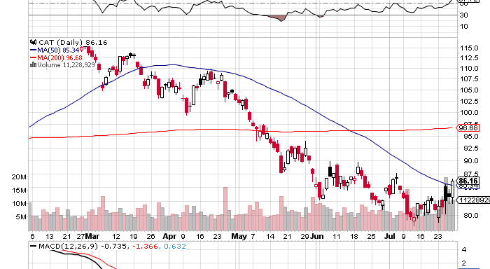
(CAT)

Slide 24
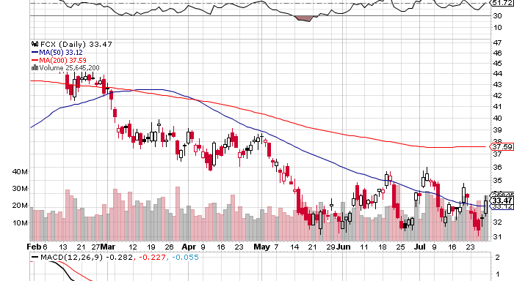
(FCX)

Slide 25
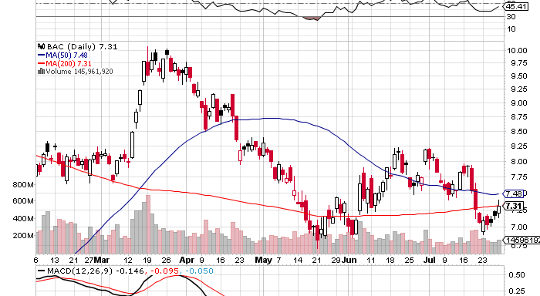
(BAC)

Slide 26
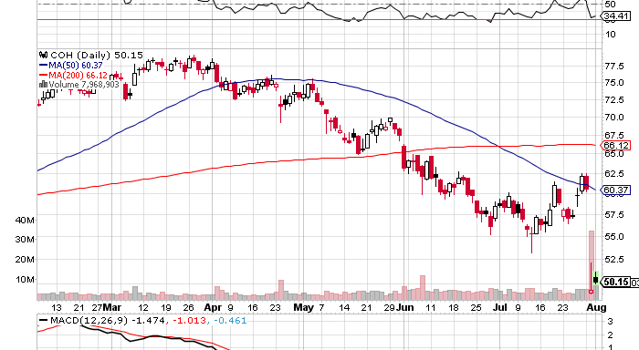
(COH)
Today’s collapse does not bode well for any risk assets

Slide 27
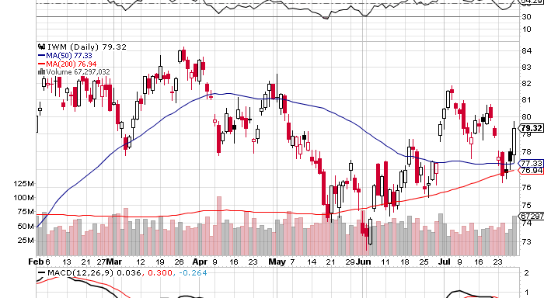
Russell 2000 (IWM)

Slide 28
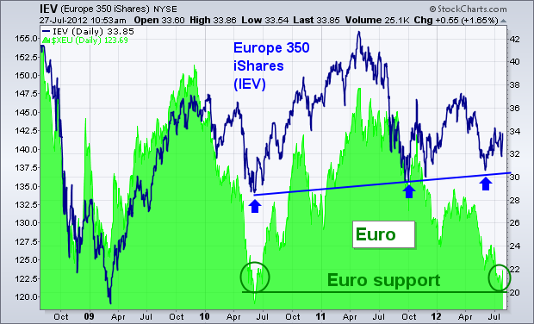
Euro vs. European stock market correlation

Slide 29
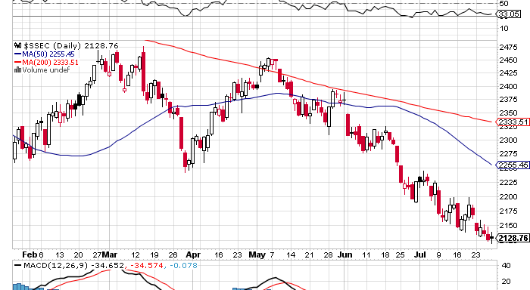
Shanghai

Slide 30

The Dollar
*Euro makes a new 2012 low at $1.20
*ECB president Mario Draghi says the ECB
will “do whatever it takes to preserve Euro”
triggers 3 cent rally
*Yen is stagnating at double top, sell OTM calls and volatility,
sold $127-$130 call spread again in August
*Japanese finance minister says will take “decisive action”
on monetary policy
*Ausie is surprisingly strong,
watch out for anomalies, is a “stay away” signal

Slide 31
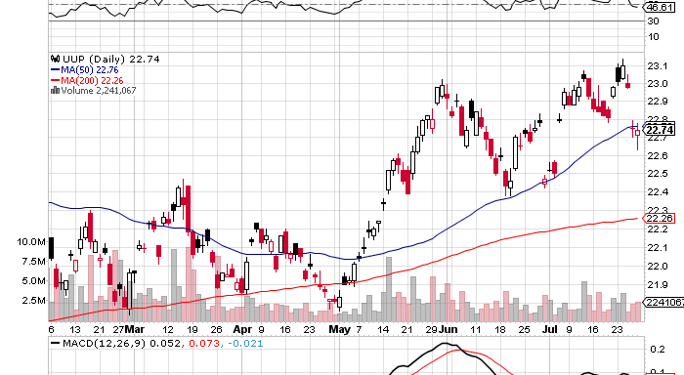
Long Dollar Basket (UUP)

Slide 32
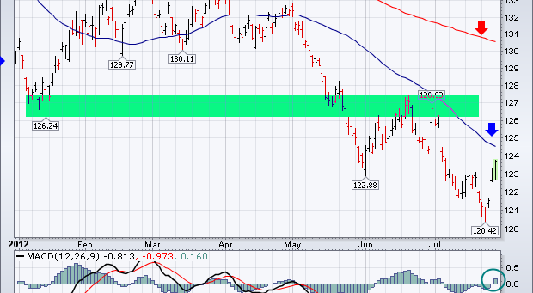
Euro (FXE)

Slide 33
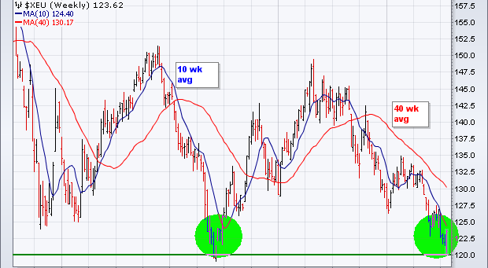
Long Term Euro (FXE)

Slide 34
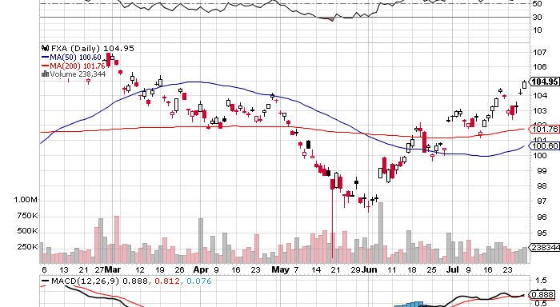
Australian Dollar (FXA)

Slide 35
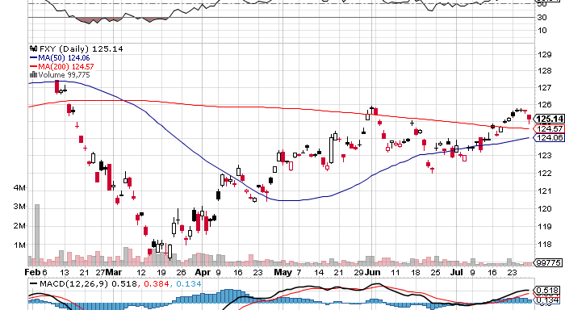
Japanese Yen (FXY)

Slide 36
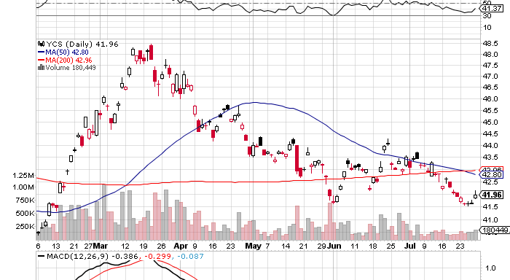
(YCS)

Slide 37
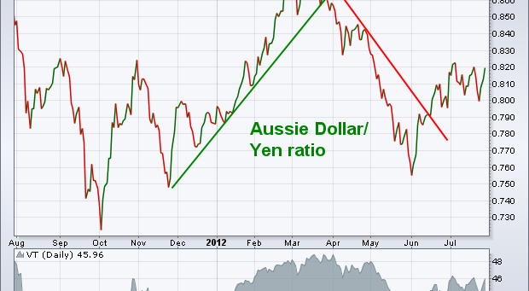
Ausie/Yen Cross
While yen is stagnant against US dollar, it is breaking down again Ausie and gold

Slide 38
Trade of the Week
Short the August (FXY) $127-$130 Call Spread
Sell Short the August $127 Call at……….$0.40
Buy the August $130 Call at…………………$0.05
Net credit…………………………………………….$0.40
45 contracts for a 15% weighting in the model $100,000 portfolio
(45 X $0.40 X 100) = $1,575 = 1.56% 3 week return
Profitable with the (FXY) at all points below $127.40,
or the Japanese yen at ¥77.00 in the cash market

Slide 39

Energy
*Emirates pipeline now open, reduces
closure of Straights of Hormuz threat
*Bounce to $87, next target is $75, via $93?
*Oil is a demand problem
*Nat Gas lowest weekly storage injection in 18 years,
US heat wave causing power demand to surge,
look to sell around $3/MM BTU,or $22 in the UNG
*Since 2008 change in electricity generation
coal 48% to 33%, natural gas 25% to 31%, nuclear 20% to 19%*

Slide 40
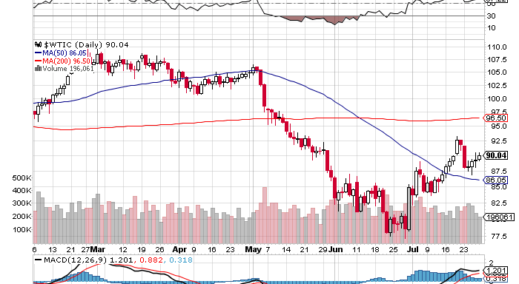
Crude

Slide 41
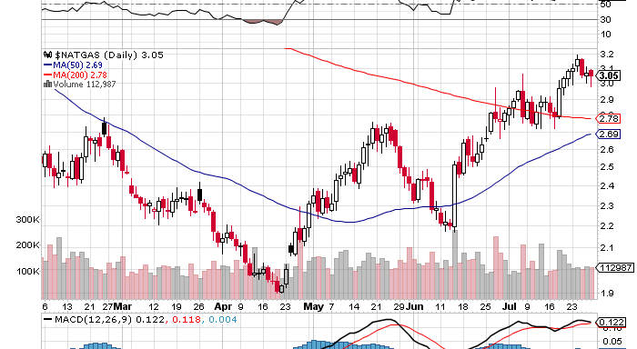
Natural Gas

Slide 42
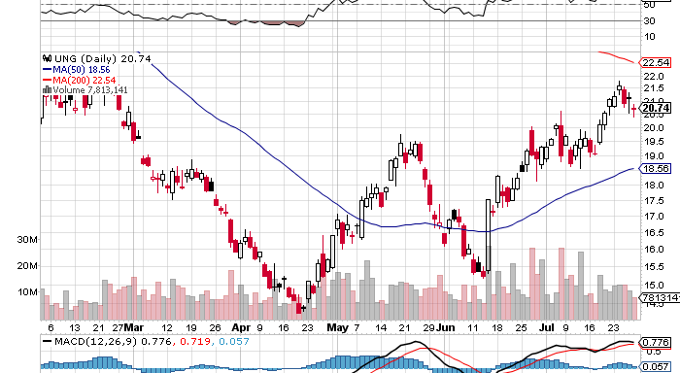
Natural Gas (UNG)

Slide 43
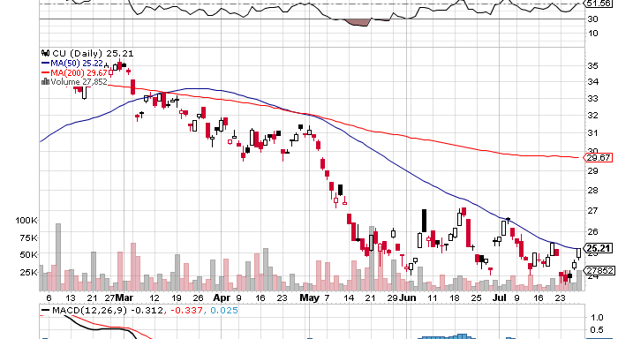
Copper (CU)

Slide 44

Precious Metals-Getting Interesting
*Seasonal strength kicks in during August,
buy July-sell February
*Gold rallies $70 on Euro QE threat
*Gold bottom looking better by the day
*May-July began months of base building
*Watch out for Bernanke disappointment
on QE3
*It all shows how sensitive the metals are to QE,
which are really a QE Call

Slide 45
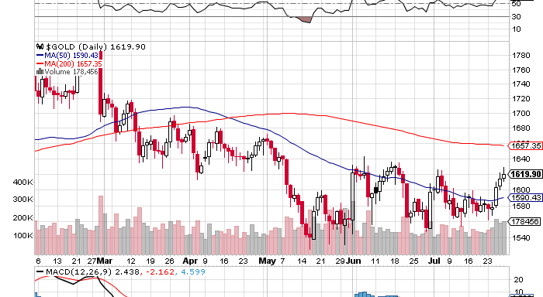
Gold

Slide 46
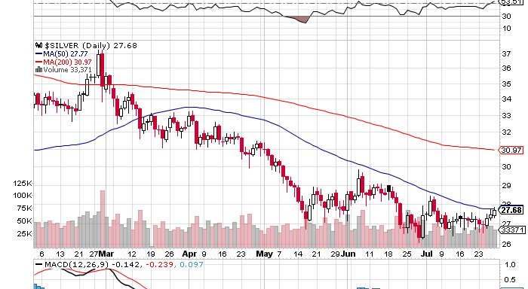
Silver

Slide 47
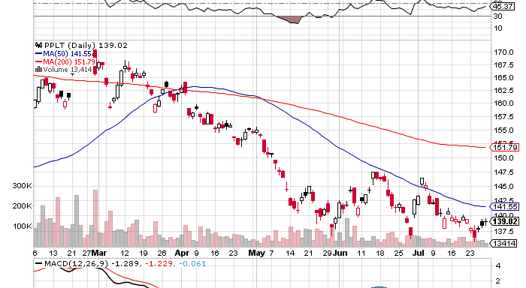
(Platinum) (PPLT)

Slide 48
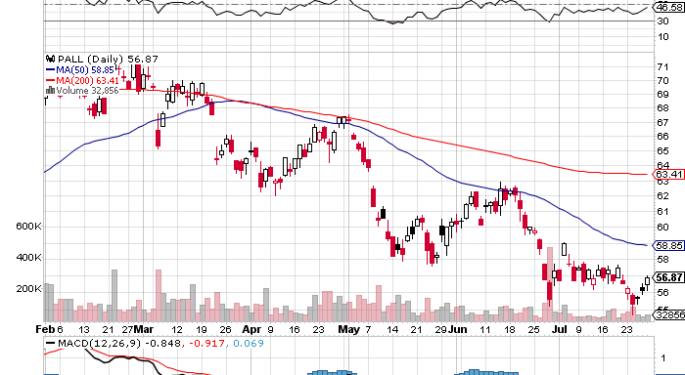
Palladium (PALL)

Slide 49
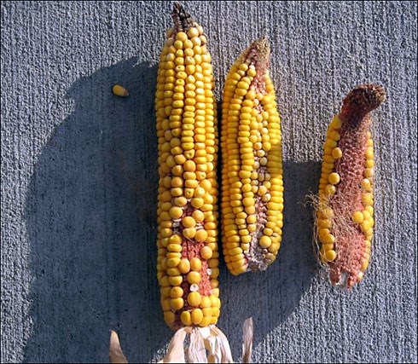
The Ags
*Worst drought in 50 years hits the Midwest
*US corn and wheat yields slashed, from 14.7 million
bushels to high 11 million bushels range, down 20%
*Corn up 50%
*No amount of rain can save the corn crop now
because much of it is dead
*Farmers are now plowing
under dead corn crops and planting wheat
*Number of people who believe in global warming
has risen from 50% to 70% this year

Slide 50
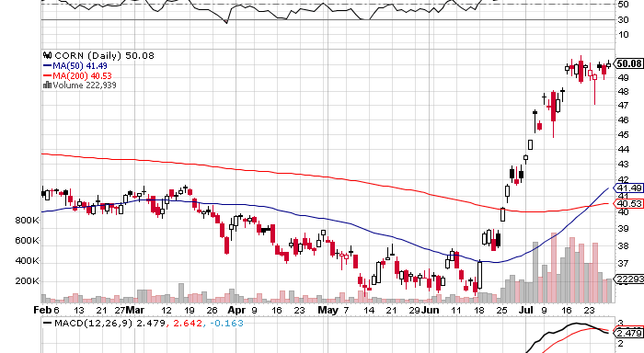
(CORN)

Slide 51
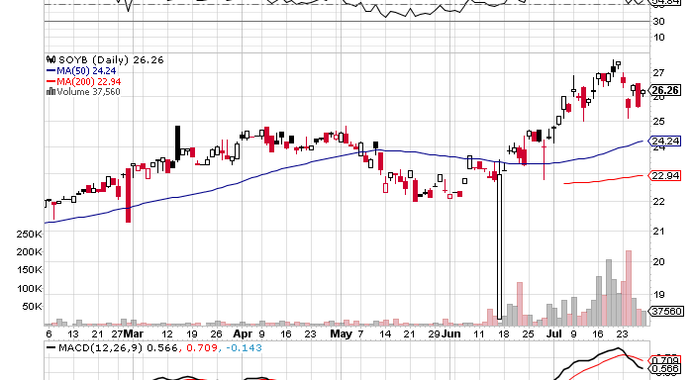
Soybeans (SOYB)

Slide 52
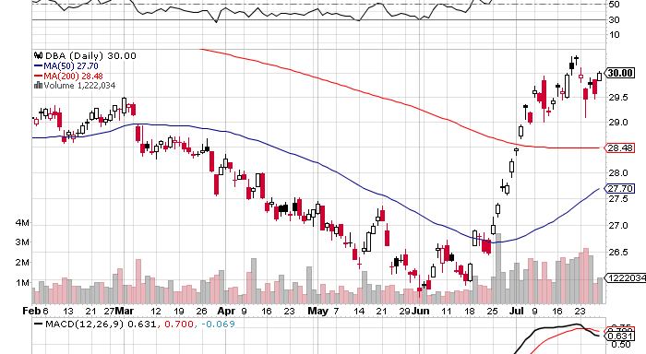
Ag ETF (DBA)

Slide 53
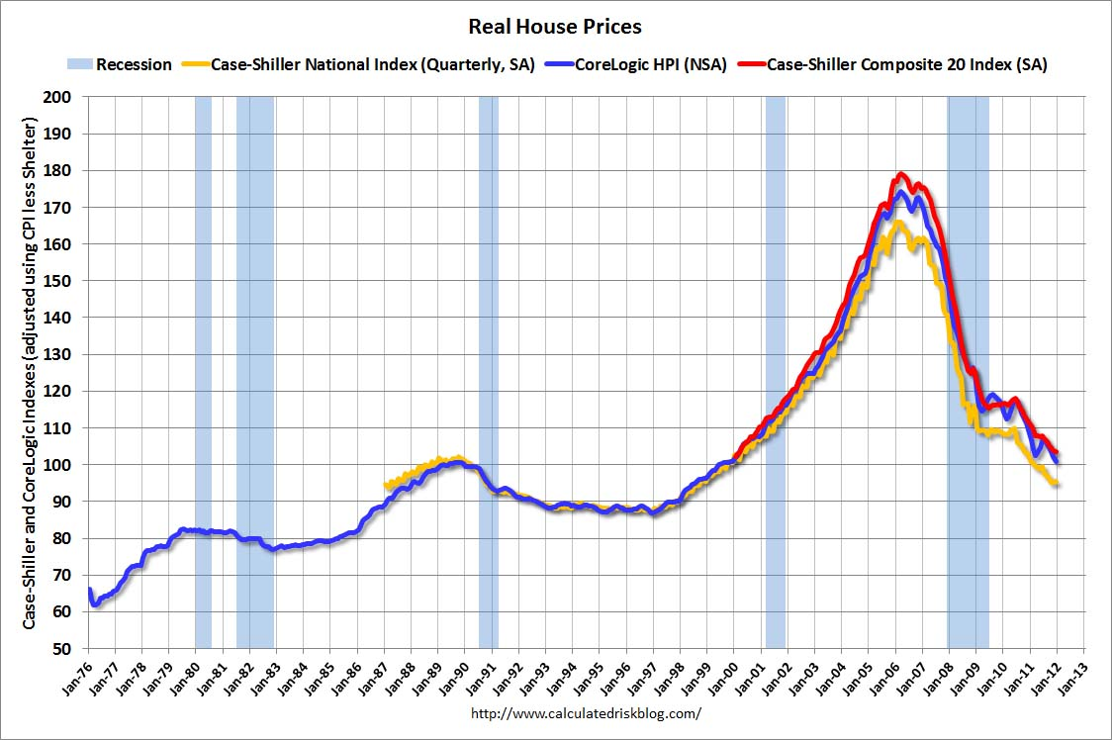
Real Estate
February, 2012
Will “twist” extend to mortgage backed securities?
Could take the 30 year fixed from 3.75% to 2.75%

Slide 54
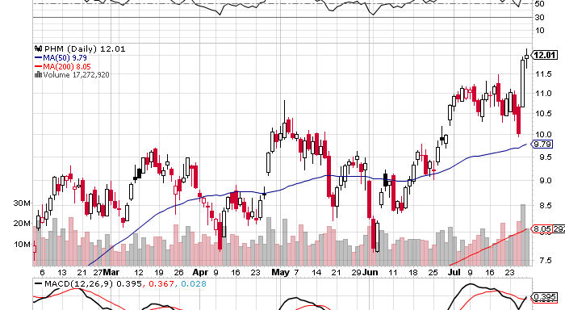
(PHM)
Why you use limited risk instruments with stop losses

Slide 55

Trade Sheet
The bottom line: Wait for Commodities to lead the first move up
*Stocks- sell the rally, there will be no QE3
*Bonds- sell rallies through OTM Call Spreads, 1.15% or lower
*Commodities- stand aside, wait for bigger dip to buy
*Currencies- Euro stand aside, too low to sell, sell yen OTM Calls
*Precious Metals – buy next dip, the fall rally has begun
*Volatility-stand aside, dying the summer heat
*The ags – stand aside, too late to buy
*Real estate- rent, don’t buy
Next Webinar is on Wednesday, August 15, 2012
12:00 noon EST from San Francisco, California

Slide 56

To buy strategy luncheon tickets Please Go to www.madhedgefundtrader.com

