Slide 1

Please Stand By for
John Thomas
Wednesday, August 15, 2012, San Francisco, CA
Global Trading Dispatch
The Webinar will begin at 12:00 pm EST

Slide 2
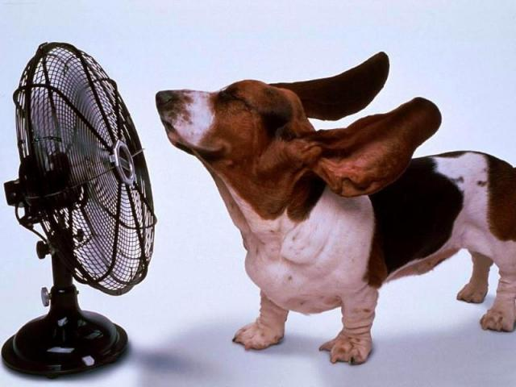
The Mad Hedge Fund Trader
“The Dog Days of Summer”
Diary of a Mad Hedge Fund Trader
San Francisco, CA August 15, 2012
www.madhedgefundtrader.com

Slide 3

MHFT Global Strategy Luncheons
Buy tickets at www.madhedgefundtrader.com
2012 Schedule
September 28 Las Vegas
October 19 Washington DC
October 26 San Francisco
November 8 Orlando
January 3, 2013 Chicago

Slide 4
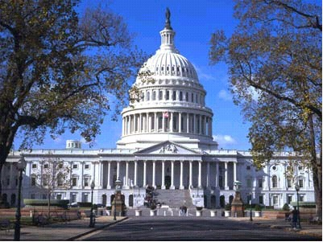
MHFT Global Strategy Luncheons
Buy tickets at www.madhedgefundtrader.com
Las Vegas
September 28
Washington, DC
October 19

Slide 5

Trade Alert Performance
New All Time High!
*August MTD +0.36%
*2012 YTD +10.11%
*10 consecutive profitable closing trades,
or every trade for 3 months
*First 90 weeks of Trading
+ 50.3%
*Versus +12.4% for the S&P500
A 38% outperformance of the index
67 out of 97 closed trades profitable
69% success rate on closed trades

Slide 6
Portfolio Review
Dipping a Toe Back in the Water
Mad Hedge Fund Trader
Trading Book
Asset Class Breakdown
Risk Adjusted Basis
current capital at risk
Risk On
Short (FXY) Call Spread | 15.00%
Risk Off
Long (SPY) $132-$138 put spread | -3.20%
Short 9/(SPY) Call spread | -5.00%
total net position | 6.80%

Slide 7
Performance Since Inception-New All Time High
+30.2% Average Annualized Return

Slide 8

The Economy-Going Downhill
*July retail sales +0.8% after 3 down months
*Weekly jobless claims down -6,000
to 361,000
*Europe a growing drag
Q2 GDP -0.2%, Germany 0.3%
*Japan Q2 GDP down from 5.5% to 1.4%
*July China exports to Europe -16%
*US July import prices -3.2% YOY
*All consistent with a low 1.5% GDP growth rate,
or lower

Slide 9
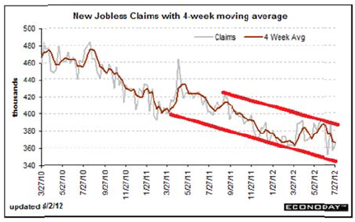
Weekly Jobless Claims
The Short Term Trend is Up
Break 400,000 and the double dip threat is on
4 week moving average at 368,250

Slide 10
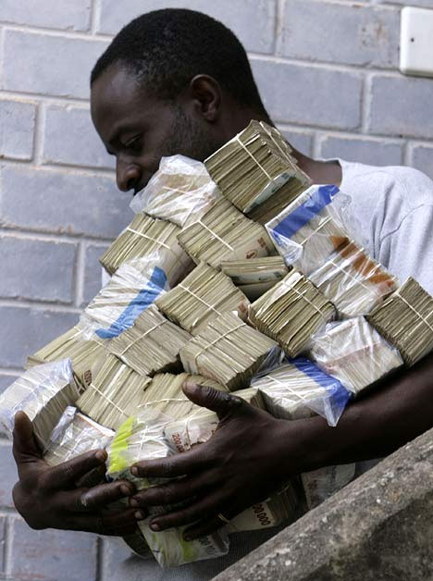
QE or no QE?
*August 26 Jackson Hole meeting of central
bankers will be a big nothing
*No Fed QE3 in September, especially if the
September 7 nonfarm payroll is strong
*ECB has no choice but to do another big LTRO,
€500 billion – €1 trillion
*Euro liquidity won’t flow over here, but optimism will, supporting asset prices
*Means the safety net under the markets is still
in place.
*Could get a disappointment sell off in September if Fed fails to act, but downside no more than (SPX) 1,300
Short (SPX) puts with reckless abandon

Slide 11
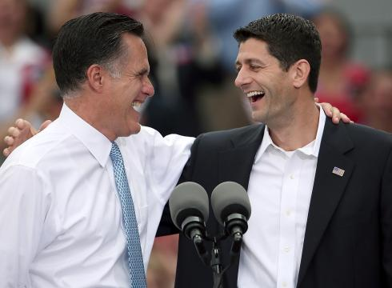
The Election is Over-Obama Won
*Romney moved to the far right when he didn’t need to
*Paul Ryan will turn the election into a referendum on Medicare
*States with oldest populations are Florida (29), Pennsylvania (20), and Iowa (6).
*He should have picked a moderate to capture the middle, independents, and undecideds
*By patronizing the right, he isn’t attracting new votes
*Is the second time that the Republicans blew an election on a running mate pick
*Make all investment assumptions based on a second Obama term-is market positive, more QE3, QE4, QE5, Bernanke is replaced with a clone

Slide 12
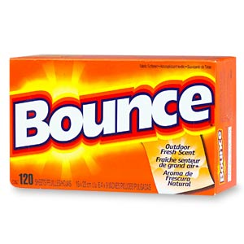
Bonds-Yields Bounce Big
*Breaking in the new range 1.40%-1.70%
*If the double top is in it will be the biggest development of the decade
*Heavy issuance in thin market take yields to 1.79%,
a 3 month high
*Fed failure to do QE3 will send it back to
top of range in prices, 1.40% in yields
*Big Rallies in Spanish and Italian bonds
*Double top in the (TLT) at $132?
*Covered short in the $136-$141 call Spread
too soon for a small profit
Watch for next “RISK OFF” round to take yields
back to 1.40%

Slide 13
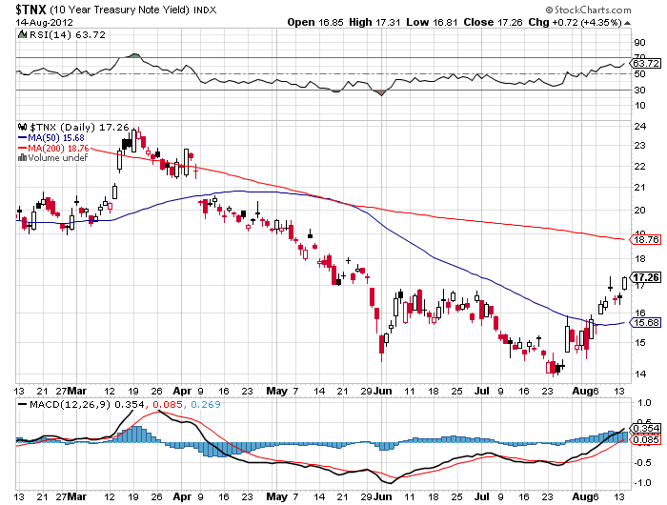
(TNX) 1.40%-1.70% Range Holding

Slide 14
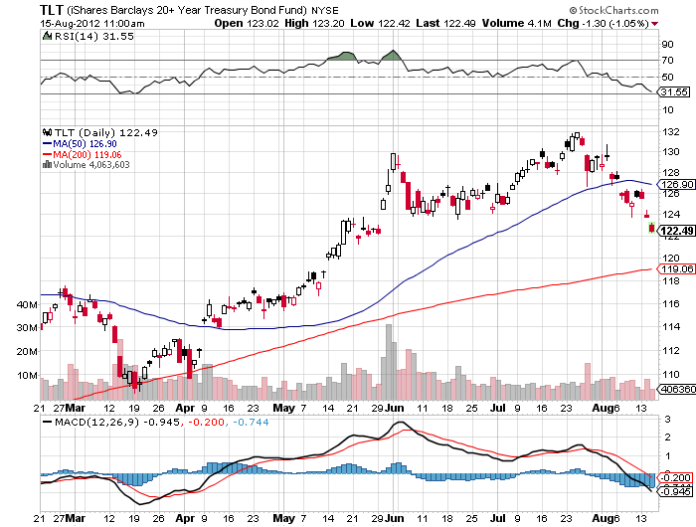
(TLT)

Slide 15
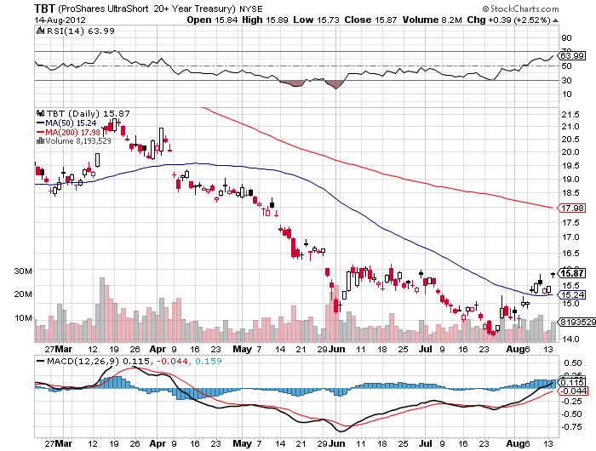
Short Treasuries (TBT)

Slide 16
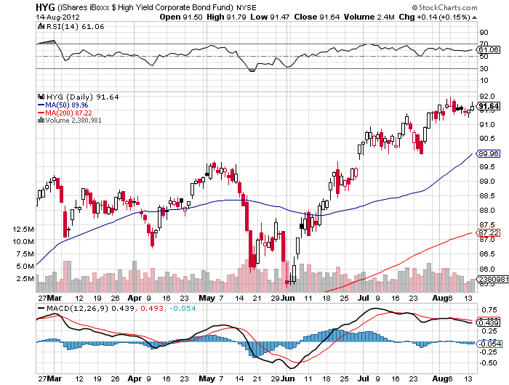
Junk Bonds (HYG)

Slide 17
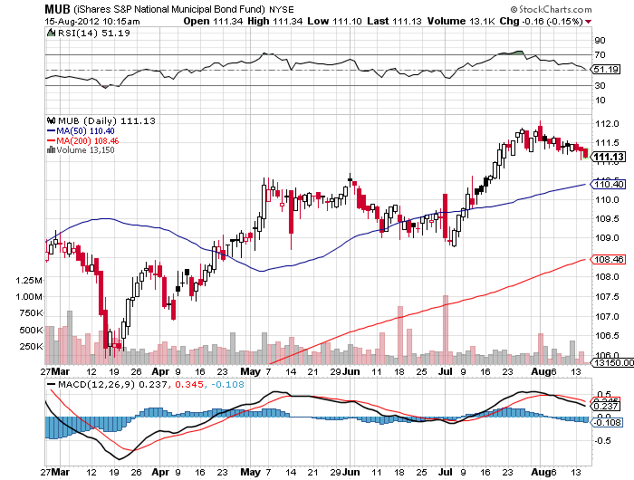
Municipal Bonds (MUB)-3% yield,
Mix of AAA, AA, and A rated bonds

Slide 18
Covered the short August (TLT) $136-$141 Call Spread
Covered the short in the August $136 Call at……….$0.22
Sold the August $141 Call at………………………..………$0.06
Net cost……………………………………………..……………….$0.16
38 contracts for a 15% weighting in the model $100,000 portfolio
Profit: $0.39-$0.16 = $0.23
(38 X $0.23 X 100) = $874 = 0.87% return
Profitable with the (TLT) at all points below $136.39,
or the 10 year treasury above a 1.15% yield
(TLT) now at $123

Slide 19

Stocks-Floating up on no Volume
*New high for the year in range
*Use this rally to sell
*Bond sell off is supporting equities
*Hedge Fund short covering has been huge
*Could give it all back if Bernanke disappoints
with no QE3
*Buy the August Low wherever it is for the
presidential election rally
*VIX collapse is pointing to a dead summer
*Buy puts, write covered calls, sell Out-of-the-Money calls,
sell long side positions for trading profits

Slide 20
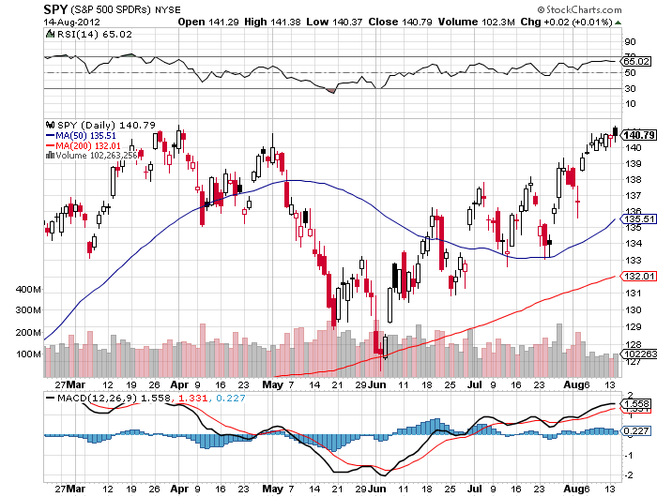
(SPY)

Slide 21
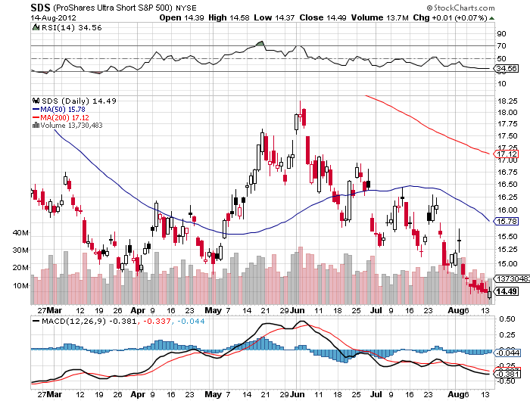
Double Short S&P 500 ETF(SDS)

Slide 22
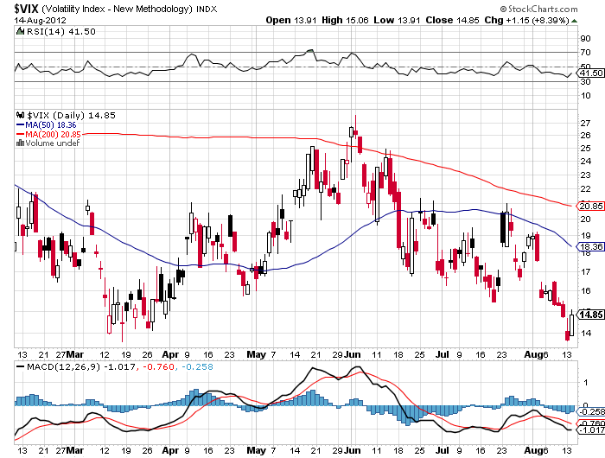
(VIX)-Yikes! new 5 year low

Slide 23
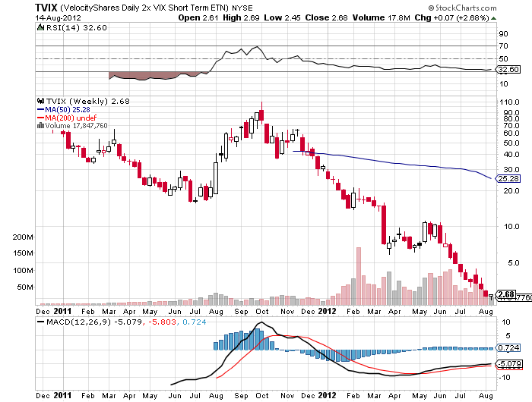
(TVIX)-why you never buy 3X ETF’s

Slide 24
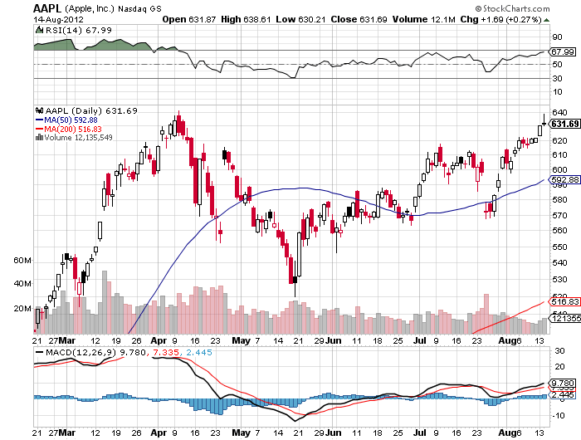
(AAPL)-run at new high into iPhone 5 launch

Slide 25
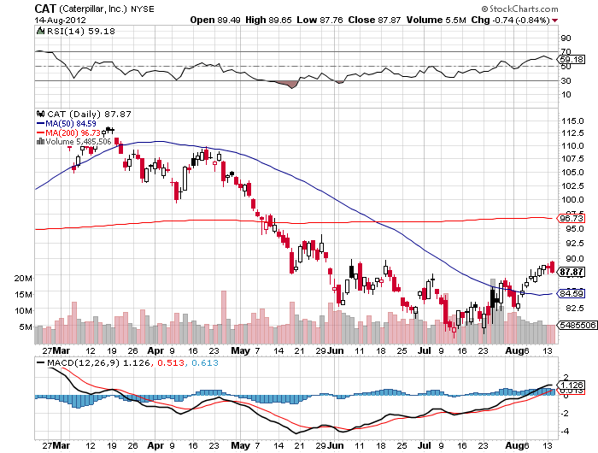
(CAT)

Slide 26
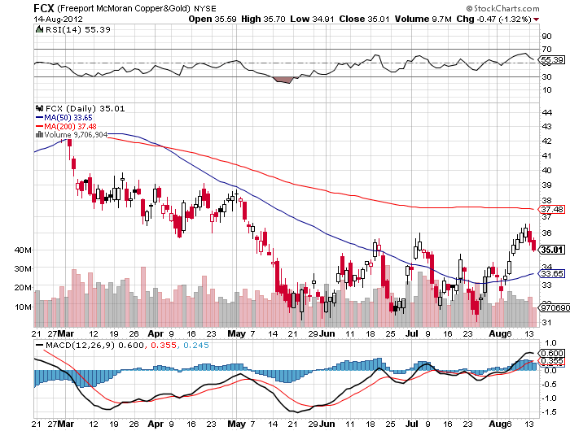
(FCX)

Slide 27
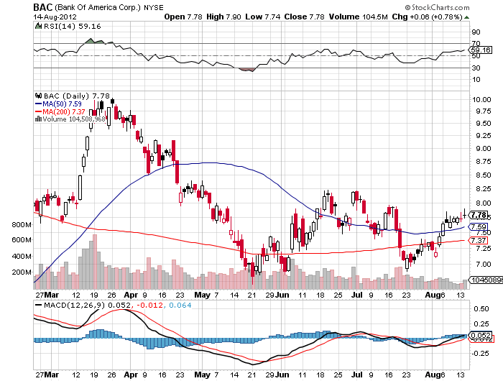
(BAC)

Slide 28
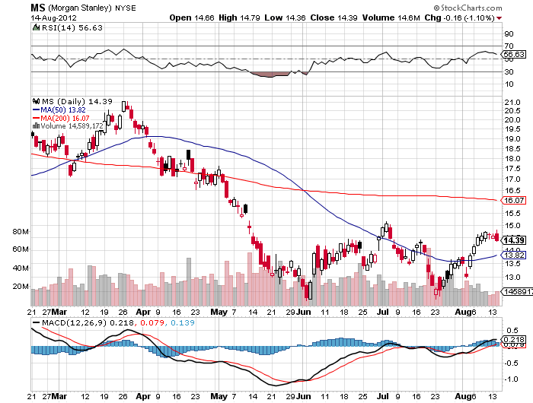
(MS)-Good Short candidate

Slide 29
Buy the October, 2012 (MS) $13-$15 Put Spread
Buy the October (MS) $15 Put at……………..….$1.23
Sell Short the October $13 Call at…………………$0.43
Net cost……………………………………………………….$0.80
60 contracts for a 5% weighting in the model $100,000 portfolio
Maximum Potential Profit = (60 X $1.20 X 100) = $7,200 = 7.20%
Profitable with the (MS) at all points below $14.20,

Slide 30
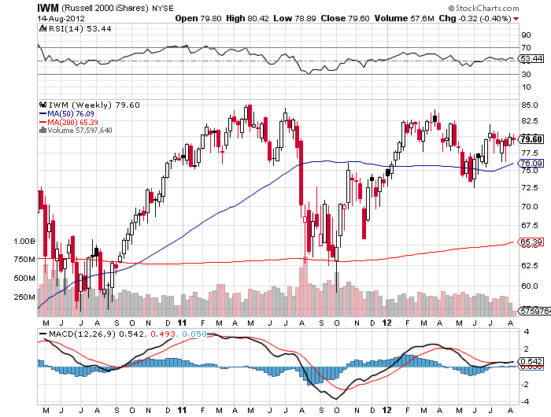
Russell 2000 (IWM)

Slide 31
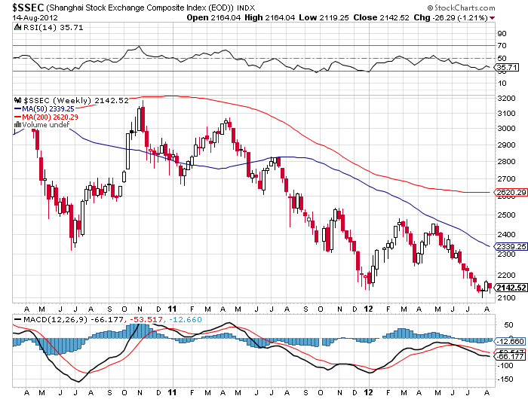
Shanghai

Slide 32
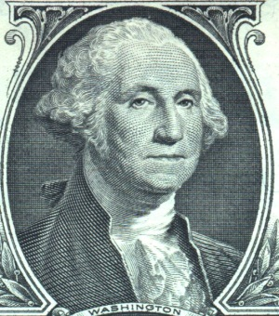
The Dollar
*Euro rallies with “RISK ON”
*European vacation is probably a bigger factor
*Euro bond rally is supporting the Euro rally
*More rumors of QE in Japan
*Yen is stagnating at double top, sell OTM calls and volatility,
sold $127-$130 call spread again in August,
will repeat for September
*Ausie is surprisingly strong,
watch out for anomalies, is a “stay away” signal
get ready to short with “RISK OFF”

Slide 33
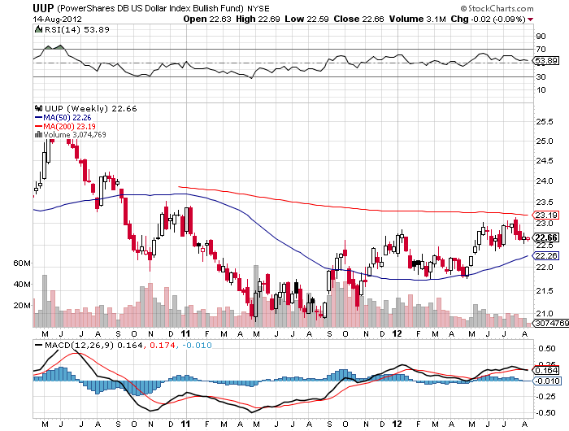
Long Dollar Basket (UUP)

Slide 34
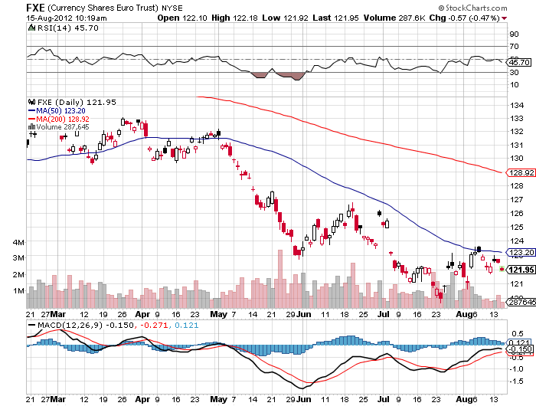
Euro (FXE)-2 year double bottom setting up?

Slide 35
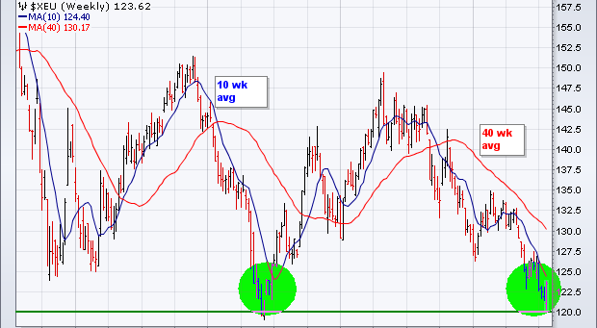
Long Term Euro (FXE)

Slide 36
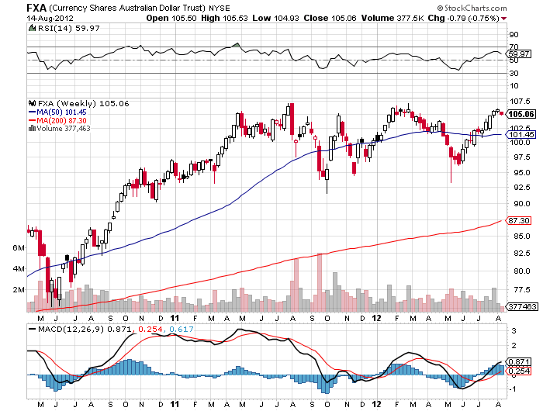
Australian Dollar (FXA)

Slide 37
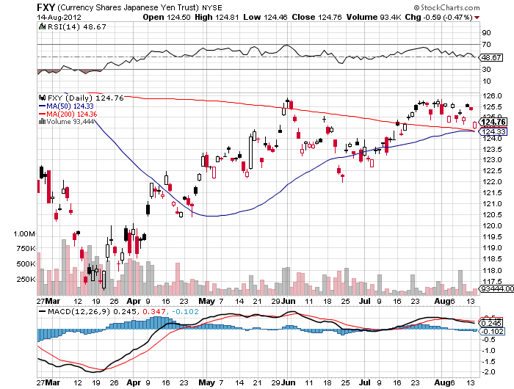
Japanese Yen (FXY)

Slide 38
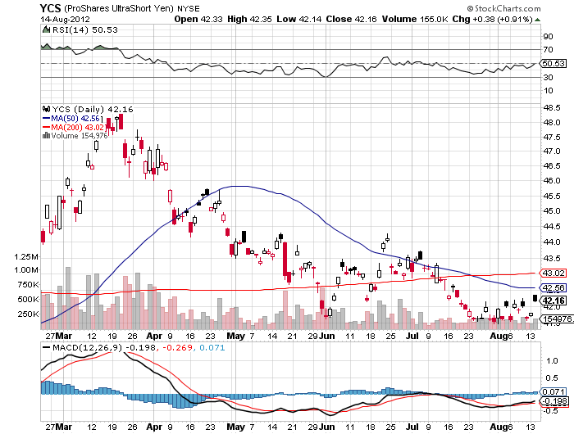
(YCS)

Slide 39
Short the September, 2012 (FXY) $127-$130 Call Spread
Sell Short the August $127 Call at……….$0.30
Buy the August $130 Call at…………………$0.05
Net credit…………………………………………….$0.25
45 contracts for a 15% weighting in the model $100,000 portfolio
(45 X $0.25 X 100) = $1,125 = 1.12% 4 week return
Profitable with the (FXY) at all points below $127.25,
or the Japanese yen at ¥77.00 in the cash market

Slide 40
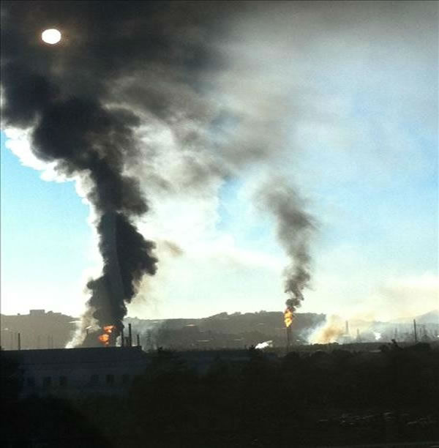
Energy
*Beholden to QE3, as with other assets
*QE3 in September gives you $100 West Texas
No QE3 and we revisit $77
*Oil is a demand problem, demand in
Europe is collapsing
*Iran sanctions are biting, Standard Chartered
scandal will accelerate fall, could unleash
3 million barrels a day on market after government falls
*Nat Gas down big. It finally rained
*California’s Chevron fire boosting gasoline prices in the west

Slide 41
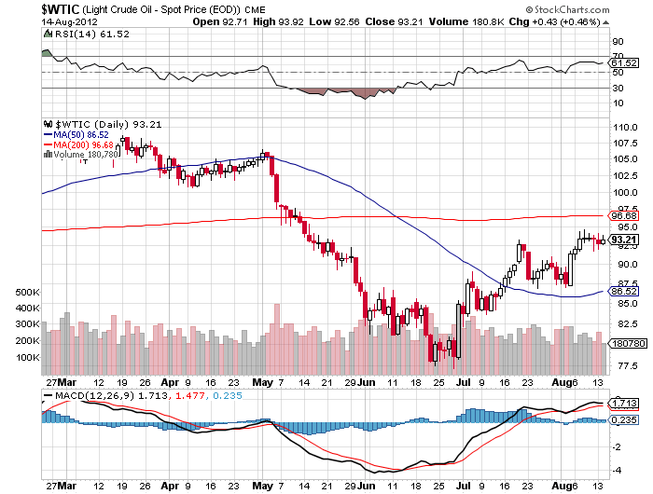
Crude-waiting for QE3

Slide 42
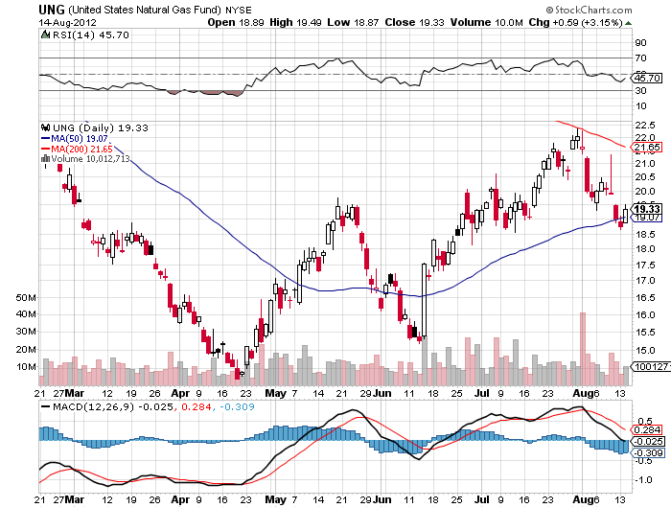
Natural Gas-It finally rained

Slide 43
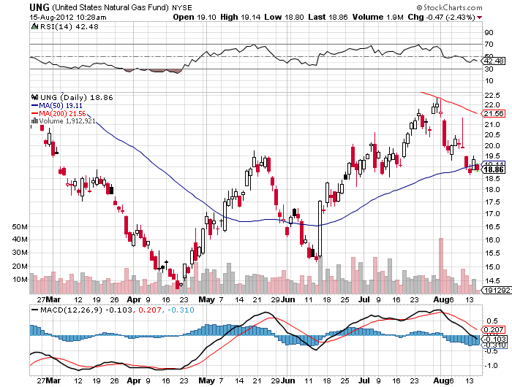
Natural Gas (UNG)

Slide 44
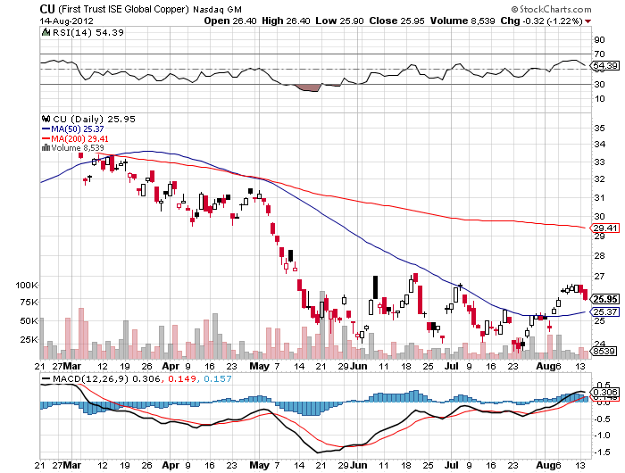
Copper (CU)-leading the downturn

Slide 45
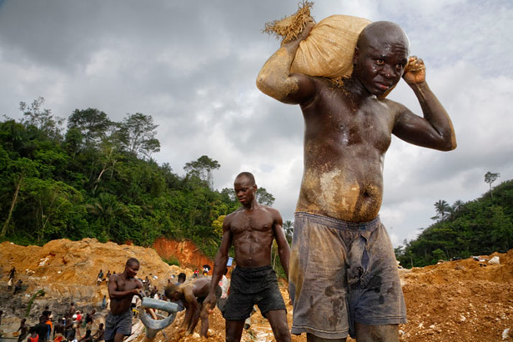
Precious Metals-
*Seasonal strength kicks in during
August,buy July-sell February
*Gold bottom is looking stronger
every day
*If US doesn’t do QE, then Europe will.
Gold positive
*Big hedge funds adding to long positions
*It all shows how sensitive the metals are to QE,
which are really a QE Call

Slide 46
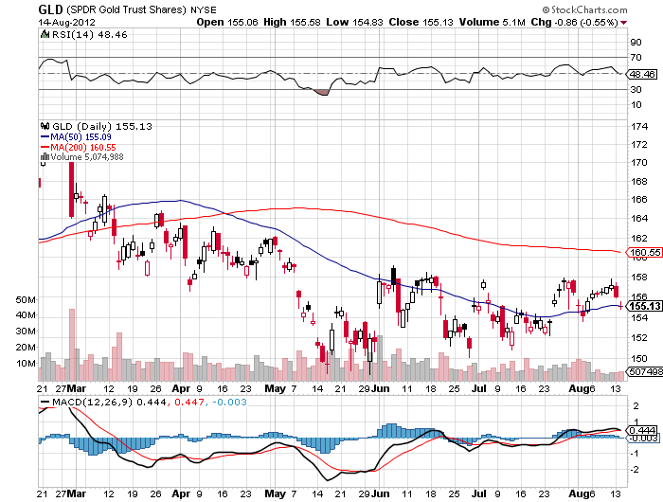
Gold

Slide 47
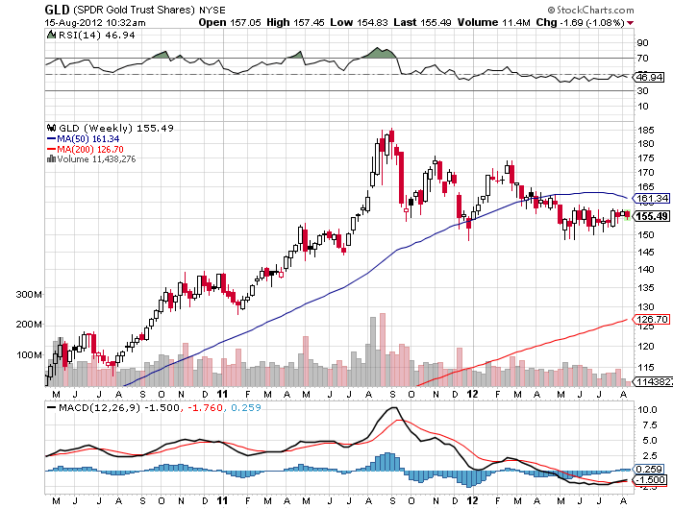
Gold

Slide 48
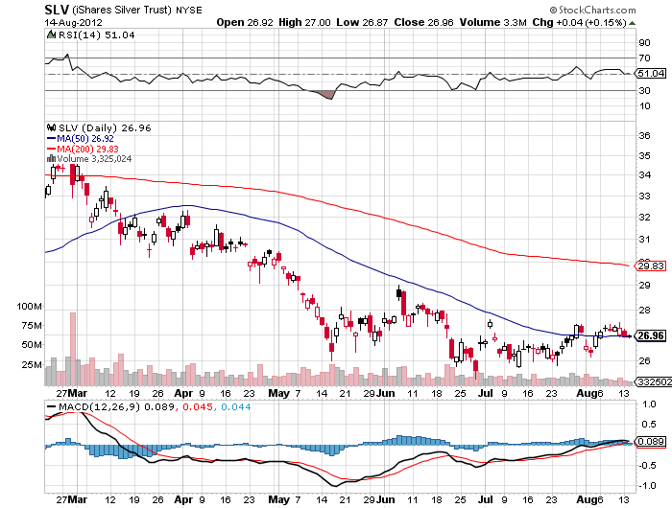
Silver

Slide 49
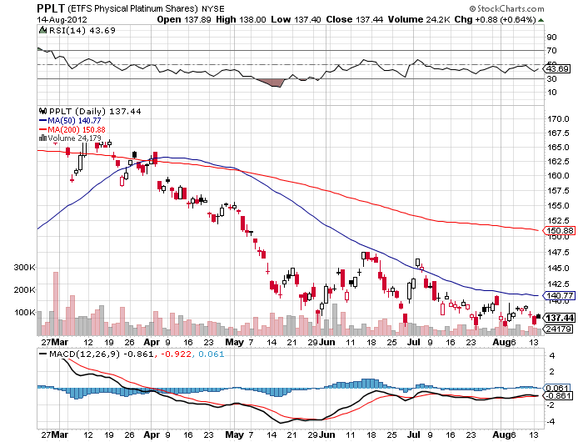
(Platinum) (PPLT)

Slide 50
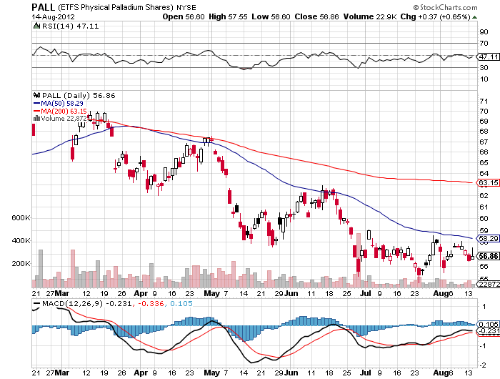
Palladium (PALL)

Slide 51
Buy the September, 2012 (GLD) $155-$158 Call Spread
Buy the September, 2012 (GLD) $155 Call at……….$3.00
Sell short the September, 2012 $158 Call at…………$1.75
Net cost…………………………………..………………………….$1.25
40 contracts for a 5% weighting in the model $100,000 portfolio
Maximum Profit (40 X $1.75 X 100) = $7,000 = 7.00% return,
or 140% gain on a 1.8% move up in gold
Profitable with the (GLD) at all points above $156.25,
(GLD) now at $155.13

Slide 52
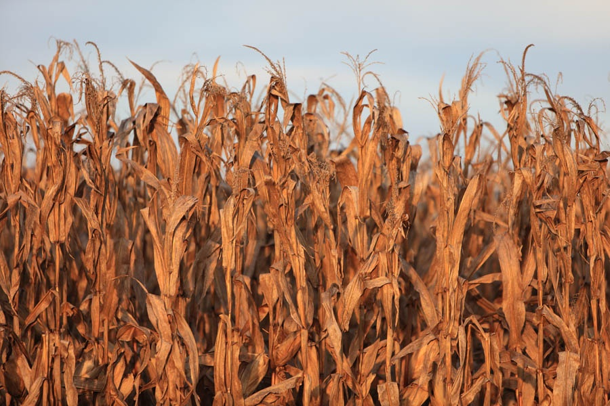
The Ags
*Worst drought in 50 years hits the Midwest
*US corn and wheat yields slashed, from 14.7 million
bushels to only 10.8 million, down 27%
*Corn stagnates at high prices as some rain appears
*China has lost 10% of its corn crop to the
army worm catepillar
*UN asked the US to stop ethanol program, which burns
40% of US corn, pushes up prices globally
*Ethanol will end after this election
*Beef prices collapsing as farmers slaughter herds
because they can’t afford feed

Slide 53
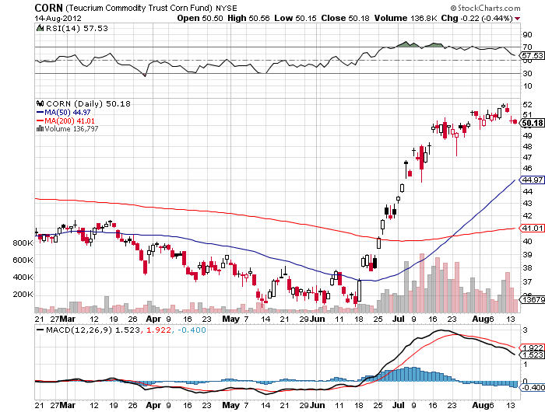
(CORN)

Slide 54
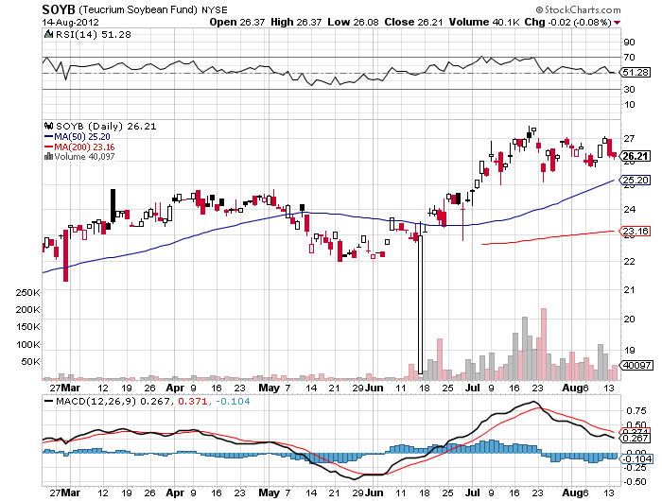
Soybeans (SOYB)

Slide 55
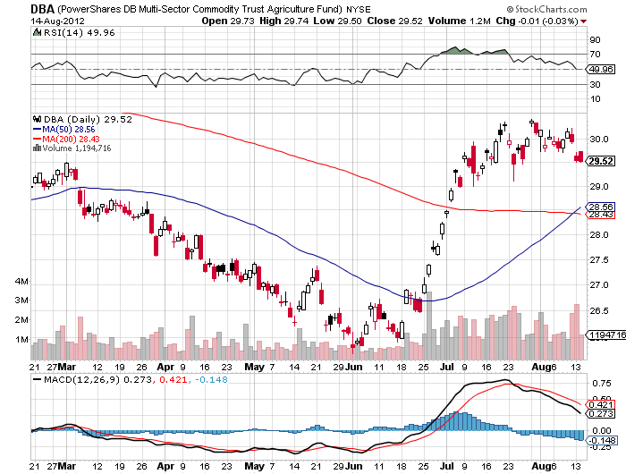
Ag ETF (DBA)

Slide 56
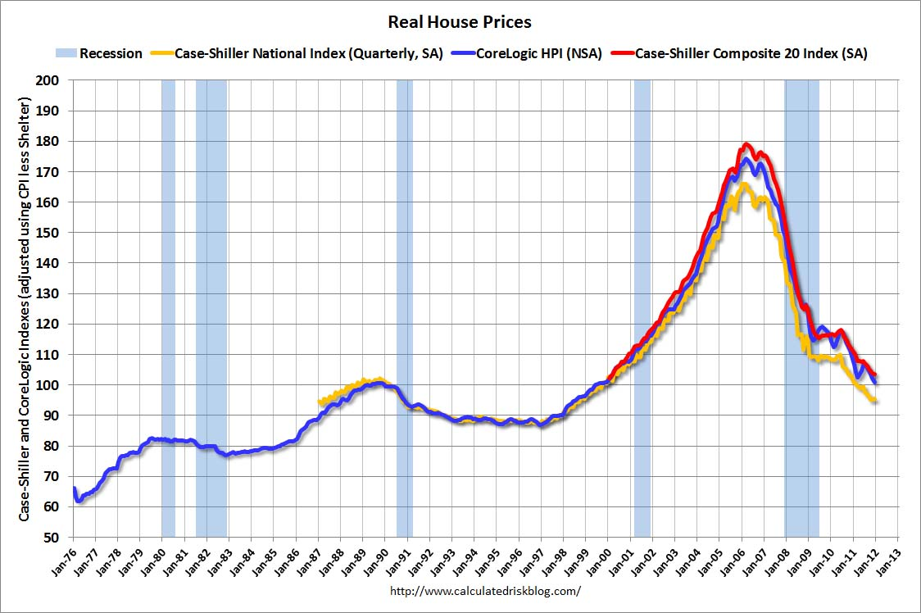
Real Estate
February, 2012
Will “twist” extend to mortgage backed securities?
Could take the 30 year fixed from 3.75% to 2.75%

Slide 57
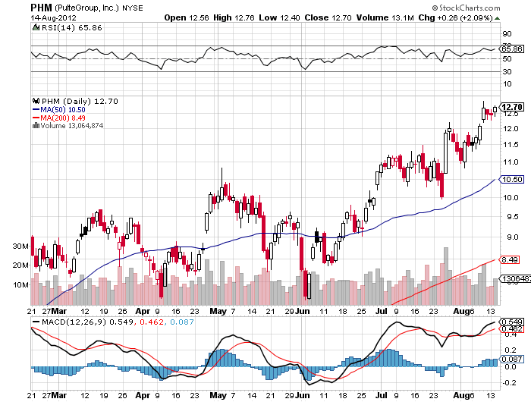
(PHM)
The John Thomas is an idiot stock

Slide 58

Trade Sheet
The bottom line: Wait for Commodities to lead the first move up
*Stocks- sell the rally, there will be no QE3
*Bonds- buy dips over a 1.70% yield
*Commodities- trading sell setting up in oil, copper
*Currencies- Euro stand aside, too low to sell, sell yen OTM Calls
*Precious Metals – buy next dip, the fall rally has begun
*Volatility-stand aside, dying the summer heat
*The ags – stand aside, too late to buy
*Real estate- rent, don’t buy
Next Webinar is on Wednesday, August 29, 2012
12:00 noon EST from San Francisco, California

Slide 59

To buy strategy luncheon tickets Please Go to www.madhedgefundtrader.com

