Slide 1

Please Stand By for
John Thomas
Wednesday, August 29, 2012, San Francisco, CA
Global Trading Dispatch
The Webinar will begin at 12:00 pm EST

Slide 2
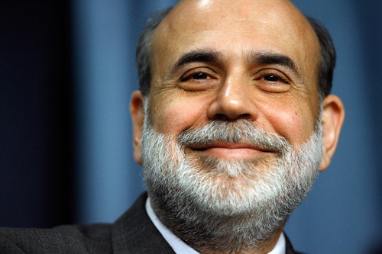
The Mad Hedge Fund Trader
“Don’t Get Jackson Holed!”
Diary of a Mad Hedge Fund Trader
San Francisco, CA August 29, 2012
www.madhedgefundtrader.com

Slide 3

MHFT Global Strategy Luncheons
Buy tickets at www.madhedgefundtrader.com
2012 Schedule
September 28 Las Vegas
October 19 Washington DC
October 26 San Francisco
November 8 Orlando
January 3, 2013 Chicago

Slide 4
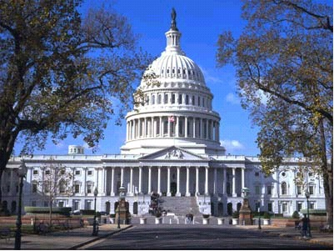
MHFT Global Strategy Luncheons
Buy tickets at www.madhedgefundtrader.com
Las Vegas
September 28
Washington, DC
October 19

Slide 5

Trade Alert Performance
New All Time High!
*August MTD +4.60%
*2012 YTD +14.35%, Beating the
Dow by 7.2%
*14 consecutive profitable closing trades,
or every trade for 3 months
*First 92 weeks of Trading + 54.5%
*Versus +13% for the S&P500
A 41.5% outperformance of the index
69 out of 99 closed trades profitable
69% success rate on closed trades

Slide 6
Portfolio Review
Dipping a Toe Back in the Water
Mad Hedge Fund Trader
Trading Book
Asset Class Breakdown
Risk Adjusted Basis
current capital at risk
Risk On
Long (GLD) call spreads | 30.00%
Short Sept (FXY) Call Spread | 15.00%
Long (YCS) | 10.00%
Long Sept (AAPL) Call Spread | 35.00%
Risk Off
Long (SPY) $138 put | -3.20%
Short Sept (SPY) Call spread | -5.00%
long Oct (MS) $15-$13 Put Spread | -5.00%
total net position | 76.80%

Slide 7
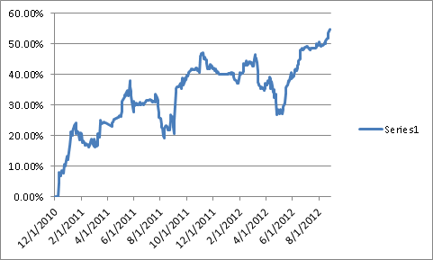
Performance Since Inception-New All Time High
+31.1% Average Annualized Return

Slide 8

The Economy-Still Slowing
*CBO says -0.5% GDP in 2012 if US falls over fiscal cliff
*Weekly jobless claims up +4,000 to 372,000
*July existing homes sales +2.3%, new homes sales +3.6%
*Japan exports down -8.1% YOY, to Europe down -25%,
government downgrades outlook for the economy
*Chinese HSBC July PMI 49.3 to 47.8, clearly accelerating
into recession territory
*Eurozone July PMI in recessionary 45.3
*August consumer confidence down
a huge 65.4 to 60.6
*US revised Q2 GDP disappoints at 1.7%
*All consistent with a low 1.5% GDP growth rate,
or lower

Slide 9
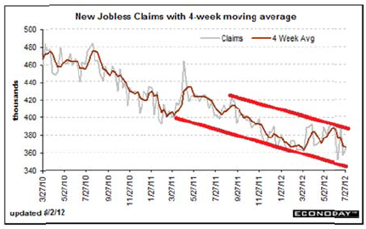
Weekly Jobless Claims
The Short Term Trend is Up
Break 400,000 and the double dip threat is on
4 week moving average at 368,250

Slide 10
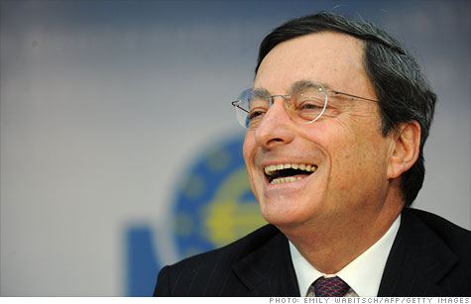
Bonds-Recover Half Their Draghi Loss
Mr. Mario has the last laugh-took profits on short (TLT) put spread
*Yields plunge back down from 1.90% to 1.63%,
the 1.40% - 1.90% range holds, could be our
range for years
*On pins and needles waiting for the Fed move,
or lack there of
*No Fed move means bonds rocket to new highs
*Huge action for yield starved investors in Junk
*Big Rallies in Spanish and Italian bonds
*Covered short in the $111-$116 put spread
for a good 75 basis point profit in 8 days
Watch for next “RISK OFF” round to take yields
back to 1.40%

Slide 11
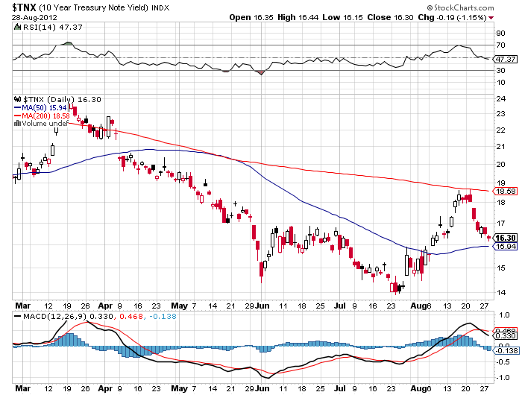
(TNX) 1.40%-1.70% Range Holding

Slide 12
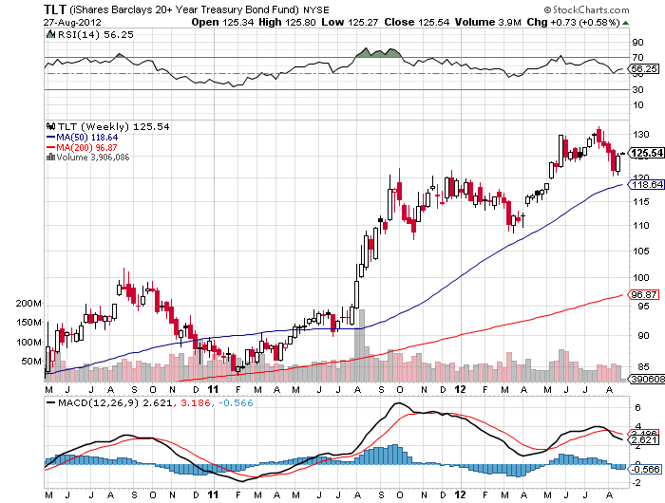
(TLT)

Slide 13
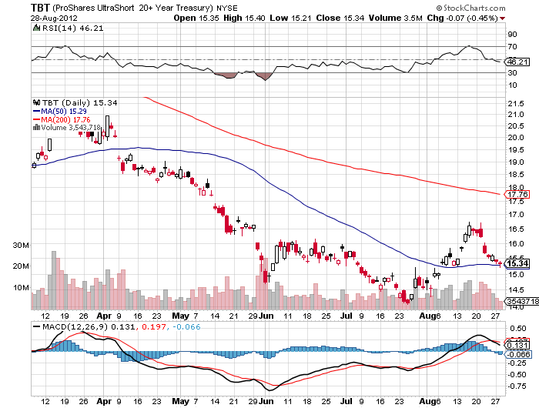
Short Treasuries (TBT)

Slide 14
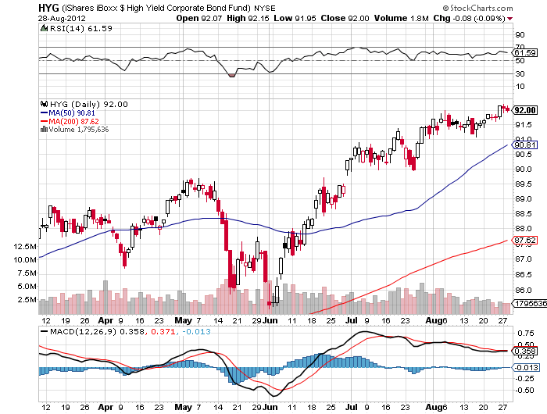
Junk Bonds (HYG)

Slide 15
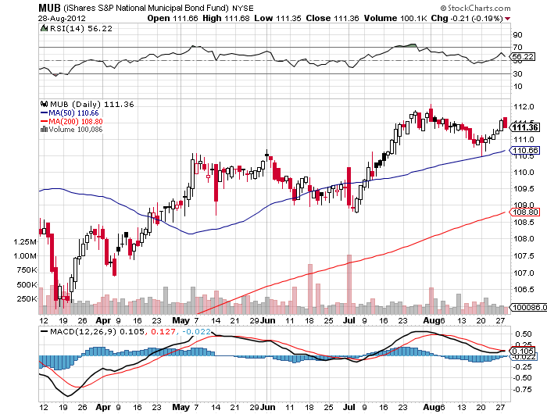
Municipal Bonds (MUB)-3% yield,
Mix of AAA, AA, and A rated bonds

Slide 16
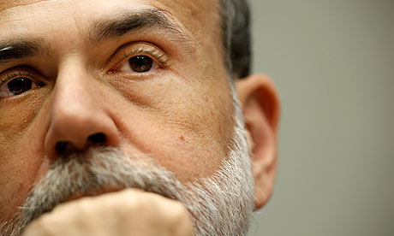
Stocks-The Selloff is coming, but how big?
Long (SPY) puts, (MS) put spread
*It’s all up to Uncle Ben-
Jackson Hole speech will refer to “using all available tools”
but no more
Fed failure to deliver QE3 on September 12-13
will cause a market selloff
*Use this rally to sell
traders hoping for a 10% fall
3%-6% fall is more likely – unlikely to take the market
down big before the election, that’s what VIX thinks
*August was the flatest month in history,
with a 40 point range in the (SPX)
*Deep in the money call spreads have been the perfect
strategy for the past four months, modest long
plus short volatility
*Sudden VIX upturn is hinting at volatility rise in September

Slide 17
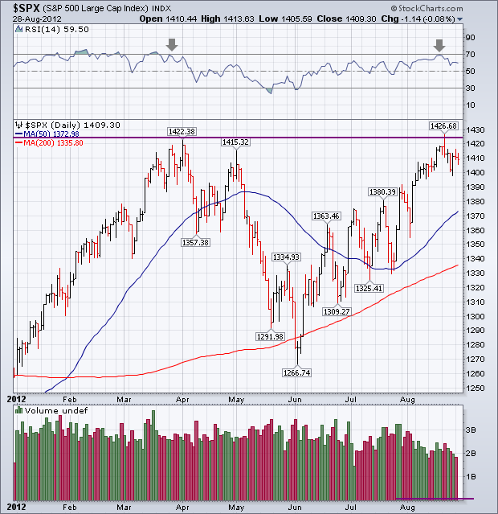
(SPY)

Slide 18
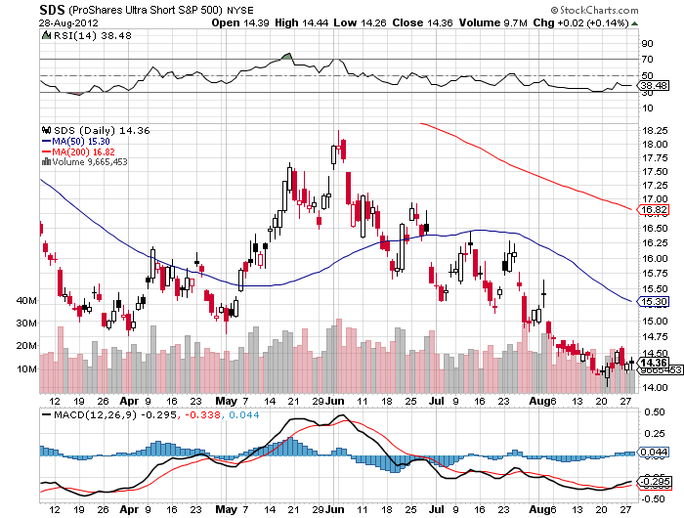
Double Short S&P 500 ETF(SDS)

Slide 19
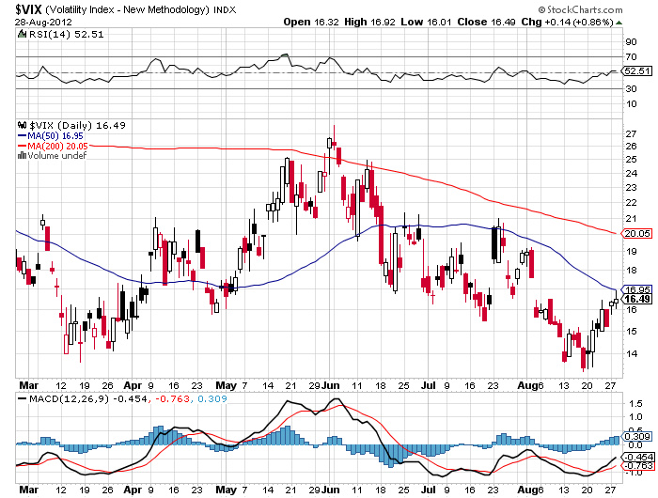
(VIX)-Warming up for a big market drop in September?

Slide 20
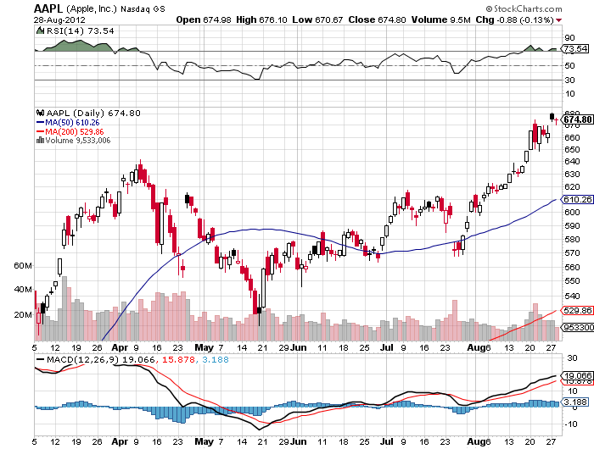
(AAPL)-The Samsung $1 billion win

Slide 21
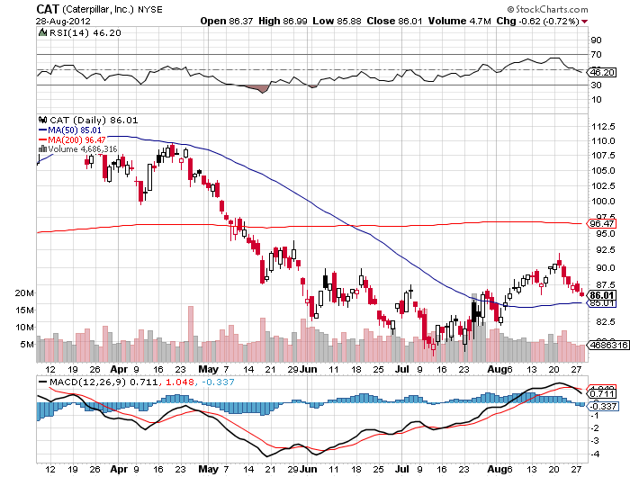
(CAT)

Slide 22
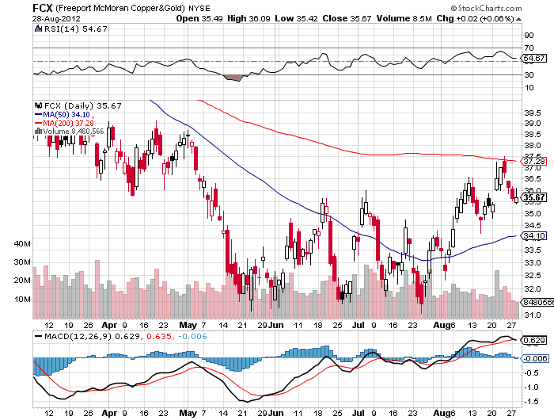
(FCX)

Slide 23
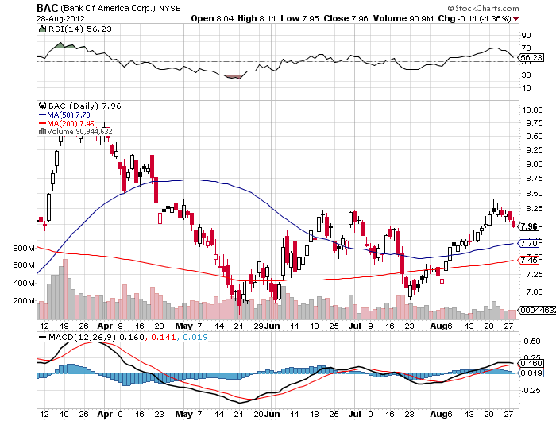
(BAC)

Slide 24
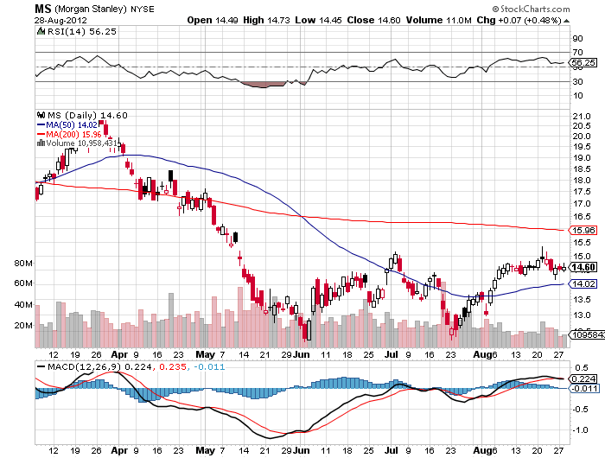
(MS)-Good Short candidate

Slide 25
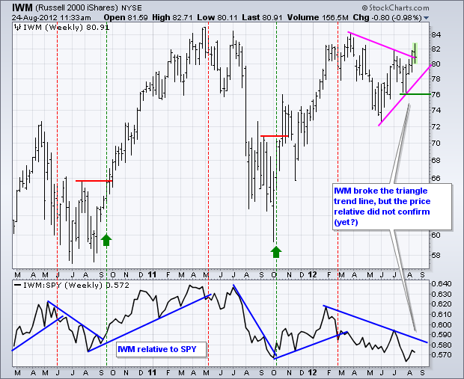
Russell 2000 (IWM)

Slide 26
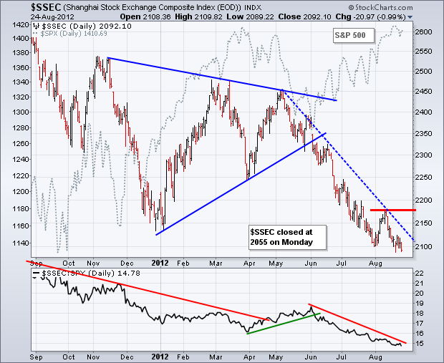
Shanghai

Slide 27
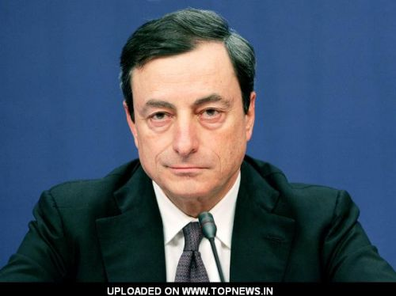
The Dollar
Short OTM Yen Call Spreads
*Euro rallies with “RISK ON”
*ECB bond yield target now a big factor
*Mario Draghi is attempting to orchestrate a
Euro short squeeze, lots of talk, no action
*Euro double bottom on long term charts
providing big support
*Break $1.26 and $1.2950 is the final target
*Yen is stagnating at double top, sell OTM calls
and volatility,
sold $127-$130 call spread for September,
added some (YCS) for a longer term view
*Ausie rolled over on China weakness, I missed the top,
look to short on next rally

Slide 28
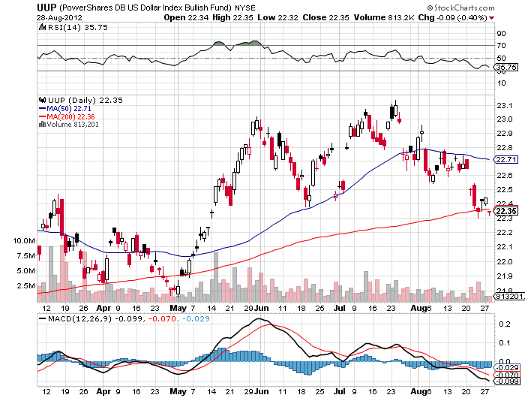
Long Dollar Basket (UUP)

Slide 29
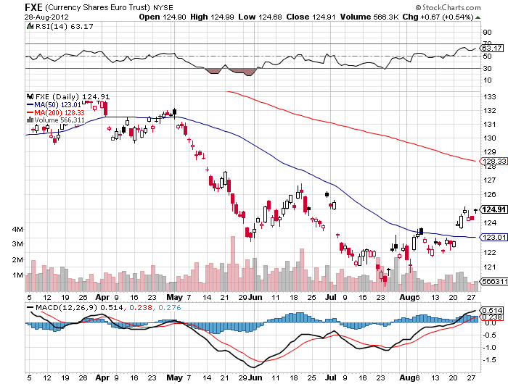
Euro (FXE)-2 year double bottom setting up?

Slide 30
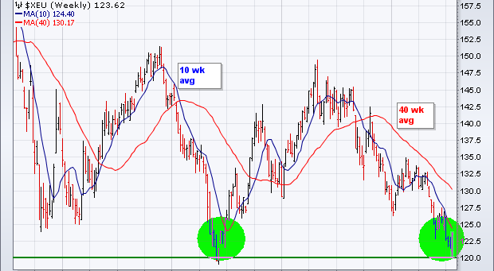
Long Term Euro (FXE)

Slide 31
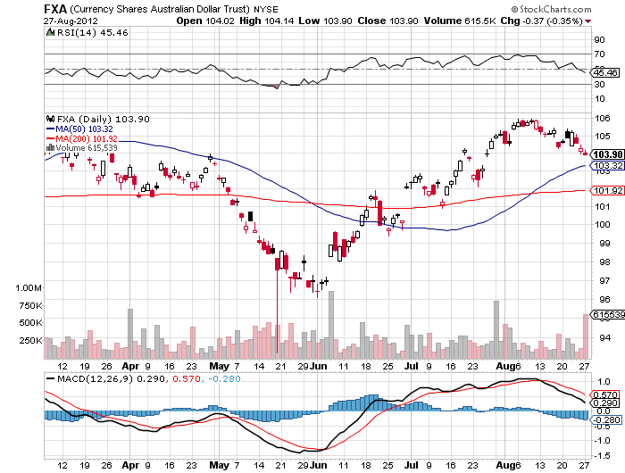
Australian Dollar (FXA)

Slide 32
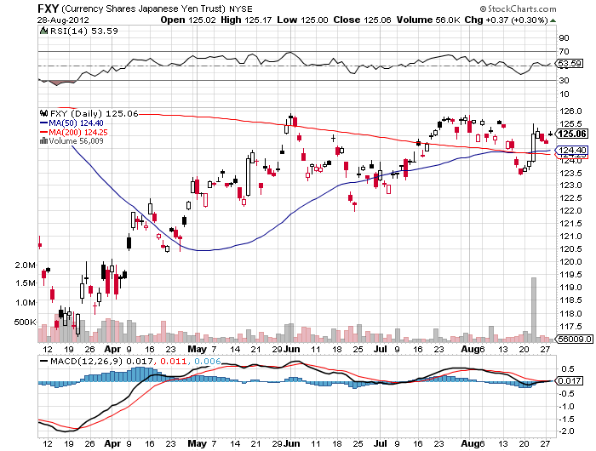
Japanese Yen (FXY)

Slide 33
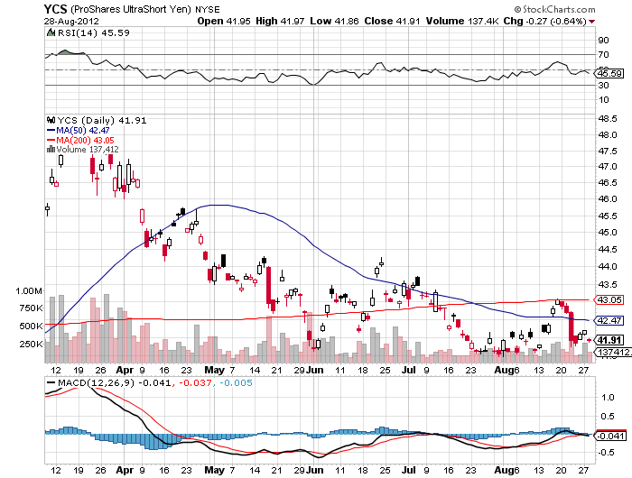
(YCS)

Slide 34
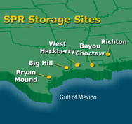
Energy
*Price supports are fourfold
prospect of continued quantitative easing
continued instability in the Middle East
Iran sanctions keeping 3 million barrels/day off the market
rumors of release from the Strategic Petroleum Reserve
to cap prices
*Hurricane Isaac providing additional short term boost
*High oil prices are close to demolishing what growth we have
*Fundamental demand for oil is weakening dramatically
in the face of a weakening global economy
*Iranian troops are now in Syria helping Assad
*Oversupply still the driving factor for natural gas

Slide 35
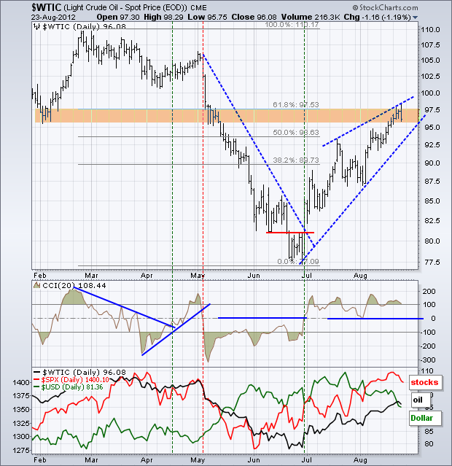
Crude-waiting for QE3

Slide 36
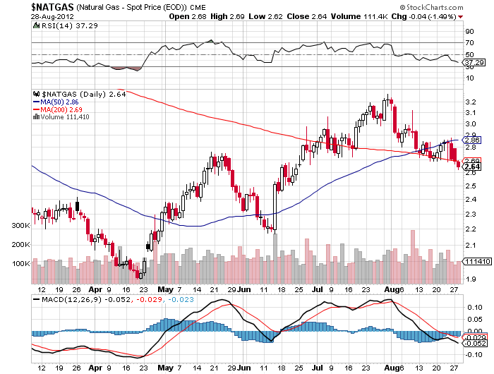
Natural Gas-It finally rained

Slide 37
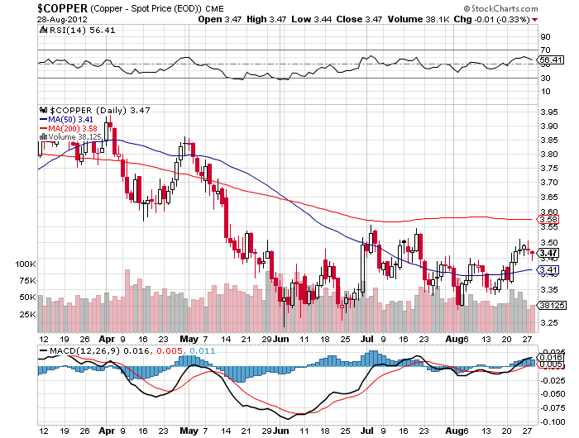
Copper (CU)-leading the downturn

Slide 38
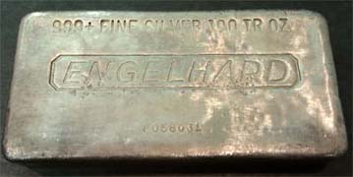
Precious Metals-The Bull Market as Returned long in the money call spreads
*Seasonal strength continuing on schedule
*If US doesn’t do QE, then Europe will.
Gold positive
If Fed disappoints at September 12-13 meeting expect a brief gold selloff before long term fundamentals reassert
*Gold next stop $1,700
*Silver Wheaton breakout tells of
more to come
*Will Paulson overhang cap gains at yearend?

Slide 39
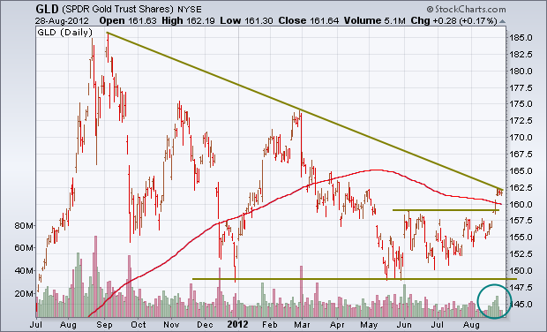
Gold

Slide 40
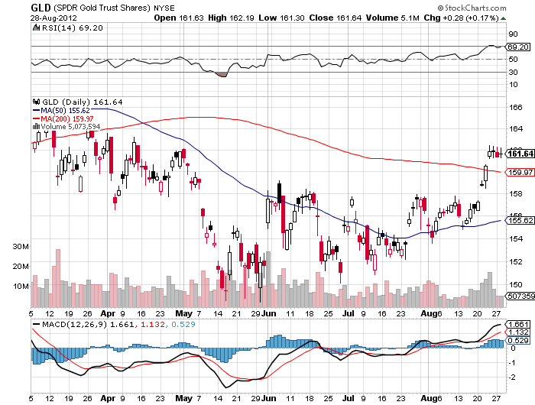
Gold

Slide 41
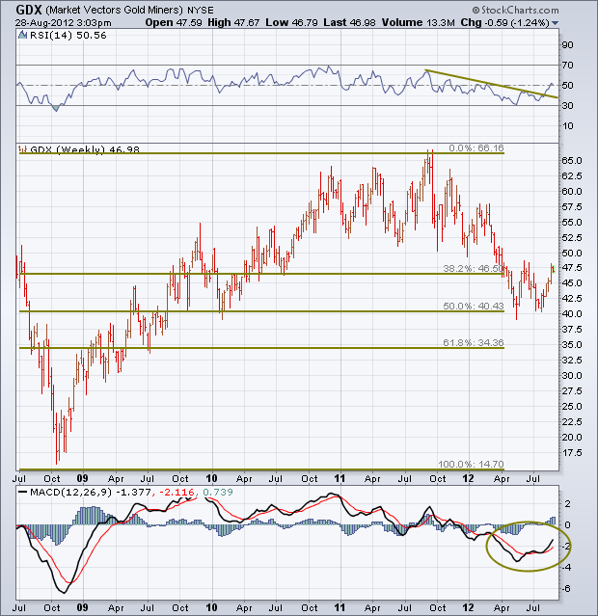
Gold Miners ETFF (GDX)

Slide 42
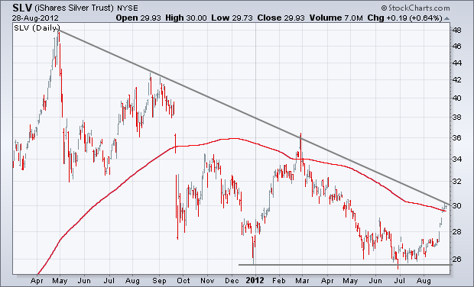
Silver

Slide 43
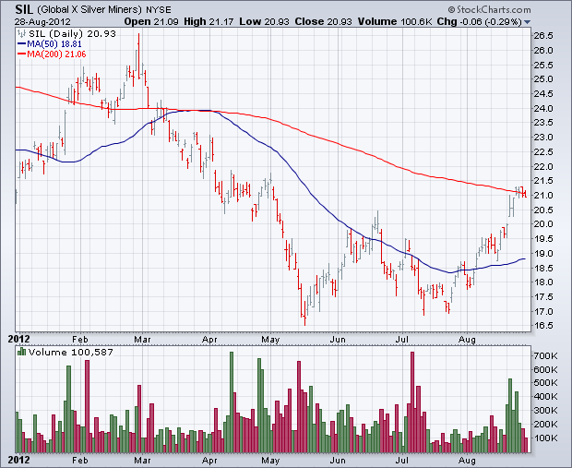
Silver Miners (SIL)

Slide 44
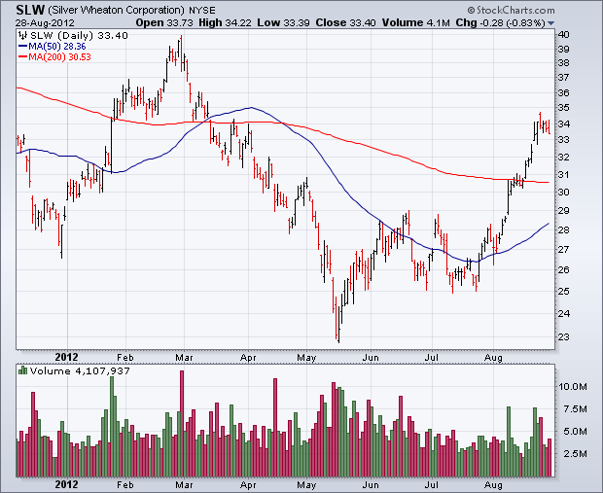
Silver Wheaton (SLW)

Slide 45
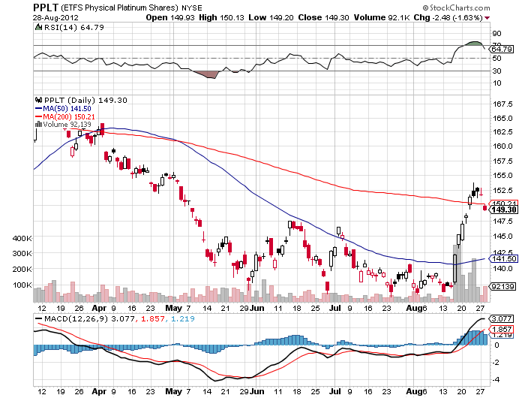
(Platinum) (PPLT)

Slide 46
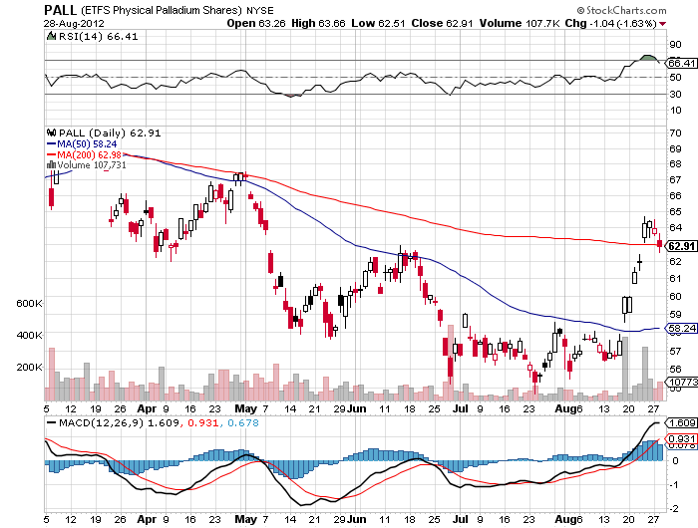
Palladium (PALL)

Slide 47
Buy the September, 2012 (GLD) $155-$158 Call Spread
Buy the September, 2012 (GLD) $155 Call at……….$7.40
Sell short the September, 2012 $158 Call at…………$5.00
Net cost…………………………………..………………………….$2.40
45 contracts for a 10% weighting in the model $100,000 portfolio
Maximum Profit (45 X $0.60 X 100) = $2,700 = 2.7% return,
or 25% gain on a move up, sideways, or less than 2.2%
down in gold over the next 15 trading days
Profitable with the (GLD) at all points above $157.40,
(GLD) now at $160.80
Even though gold has gone down since Friday, this position is nearly unchanged, thanks to time decay

Slide 48
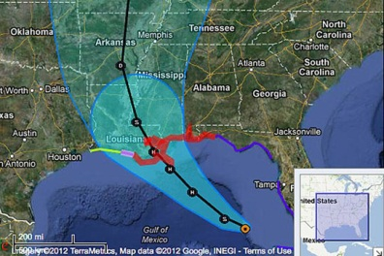
The Ags
*Hurricane Isaac gives respite to the draught
*Despite worst draught in 50 years, farm incomes
hit all time highs at $122.2 billion, up 4%
*Least hit areas see incomes up 39% as in
North Dakota and California
*$30 billion in crop insurance claims expected this year
*Ag still gets $11 billion in subsidies,
key in an election year

Slide 49
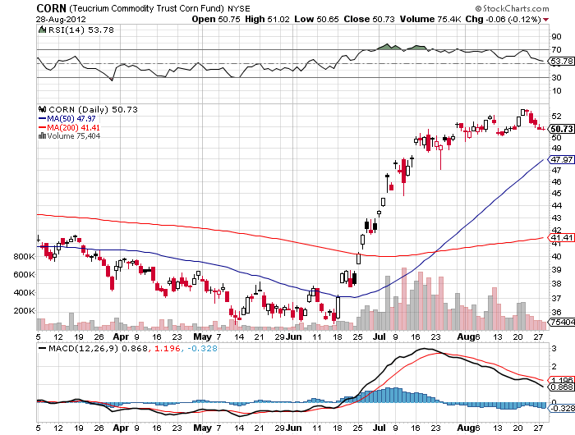
(CORN)

Slide 50
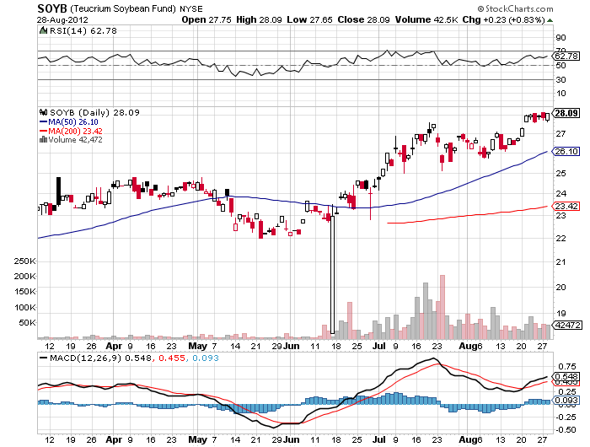
Soybeans (SOYB)

Slide 51
Ag ETF (DBA)

Slide 52
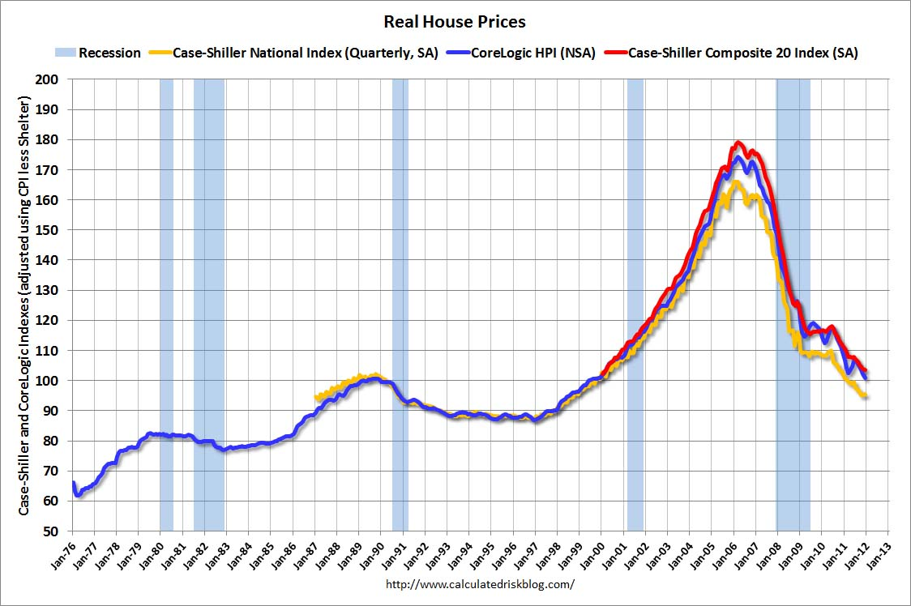
Real Estate
February, 2012
Will “twist” extend to mortgage backed securities?
Could take the 30 year fixed from 3.75% to 2.75%

Slide 53

Trade Sheet
The bottom line: Wait for Commodities to lead the first move up
*Stocks- sell the rally, there will be no QE3
*Bonds- buy dips over a 1.70% yield
*Commodities- trading sell setting up in oil, copper
*Currencies- Euro stand aside, too low to sell, sell yen OTM Calls
*Precious Metals – run your longs, the fall rally has begun
*Volatility-stand aside, dying the summer heat
*The ags – stand aside, too late to buy
*Real estate- rent, don’t buy
Next Webinar is on Wednesday, September 12
12:00 noon EST from San Francisco, California

Slide 54

To buy strategy luncheon tickets Please Go to www.madhedgefundtrader.com

