Slide 1

Please Stand By for
John Thomas
Wednesday, September 12, 2012, San Francisco, CA
Global Trading Dispatch
The Webinar will begin at 12:00 pm EST

Slide 2
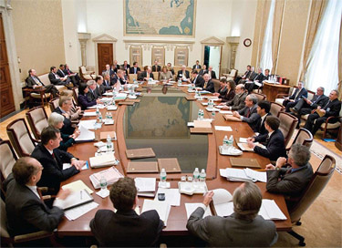
The Mad Hedge Fund Trader
“So What’s It to Be?”
Diary of a Mad Hedge Fund Trader
San Francisco, September, 2012
www.madhedgefundtrader.com

Slide 3

MHFT Global Strategy Luncheons
Buy tickets at www.madhedgefundtrader.com
2012 Schedule
September 28 Las Vegas
October 19 Washington DC
October 26 San Francisco
November 7 Houston
November 8 Orlando
January 3, 2013 Chicago

Slide 4
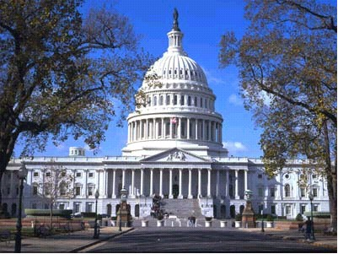
MHFT Global Strategy Luncheons
Buy tickets at www.madhedgefundtrader.com
Las Vegas
September 28
Washington, DC
October 19

Slide 5

Trade Alert Performance
New All Time High!
*September MTD +7.25%
*2012 YTD +23.5%, Beating the
Dow by 8.2%
*26 consecutive profitable closing trades,
or every trade for 5 months
*First 94 weeks of Trading + 63.7%
*Versus +21.6% for the Dow Average
A 42.1% outperformance of the index
85 out of 118 closed trades profitable
72% success rate on closed trades

Slide 6
Portfolio Review
Cutting Risk Ahead of the Fed Meeting
Mad Hedge Fund Trader
Trading Book
Asset Class Breakdown
Risk Adjusted Basis
current capital at risk
Risk On
Long (YCS) | 10.00%
Risk Off
Long (SPY) $137 Put | -5.00%
long Oct (MS) $15 Put | -5.00%
Short (FXA) Oct $105-108 call spread | -10.00%
total net position | -10.00%

Slide 7
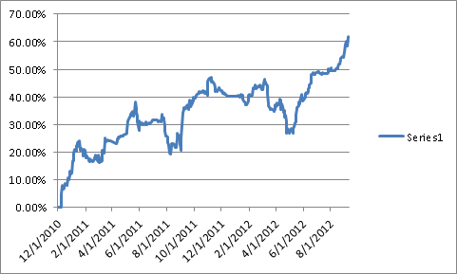
Performance Since Inception-New All Time High
+33.8% Average Annualized Return

Slide 8

The Economy-bad is still good
*Surprise reflationary budget from China
how bad are things really?
*Weekly jobless claims up +4,000 to 372,000
U-6 rate at 14.7%
*Weekly jobless claims down 12,000 to 365,000
*August nonfarm payroll 96,000, vs. 125,000 expected
*Australian Q2 GDP 1.4% to 0.6%
*US August ISM 49.8 to 49.6
down 3 months in a row
*iPhone 5 launch could add 0.3% to Q$ US GDP
*All consistent with a low 1.5% GDP growth rate,
or lower

Slide 9
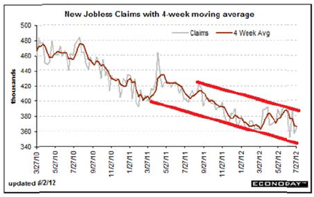
Weekly Jobless Claims
The Short Term Trend is Up
Break 400,000 and the double dip threat is on
4 week moving average at 368,250

Slide 10
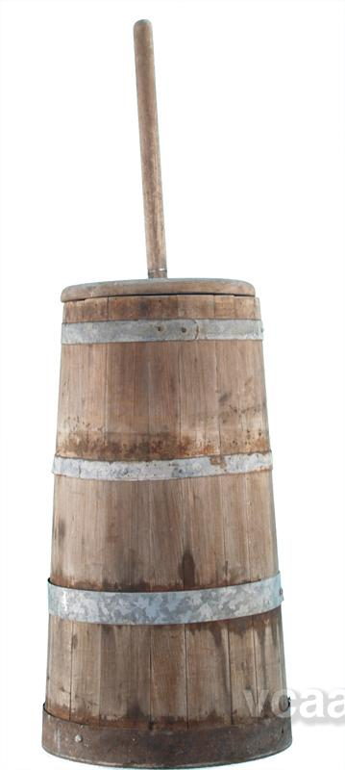
Bonds-Churning at the top
*the 1.40% - 1.90% range holds, could be our
range for years
*On pins and needles waiting for the Fed move,
or lack there of
*No Fed move means bonds rocket to new highs
*Huge action for yield starved investors in Junk
*Big Rallies in Spanish and Italian bonds
*Covered short in the $137-$137call spread
for a good 200 basis point profit in 2 days
Watch for next “RISK OFF” round to take yields
back to 1.40%

Slide 11
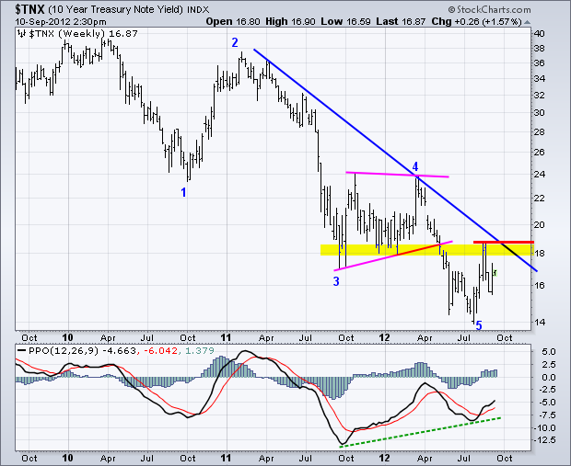
(TNX) 1.40%-1.70% Range Holding

Slide 12
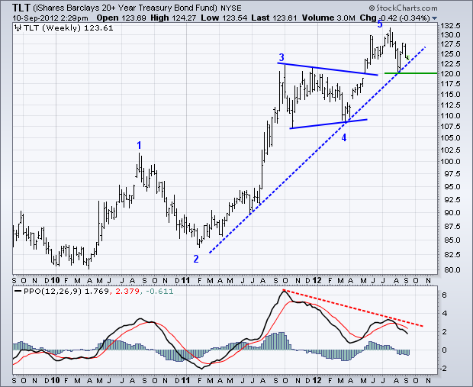
(TLT)

Slide 13
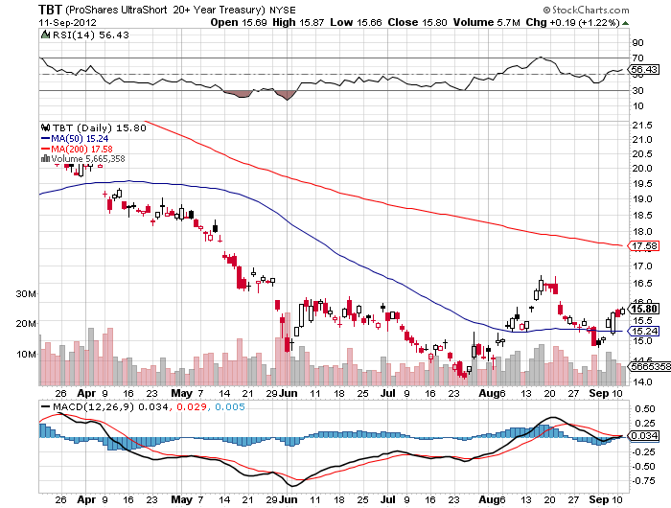
Short Treasuries (TBT)

Slide 14
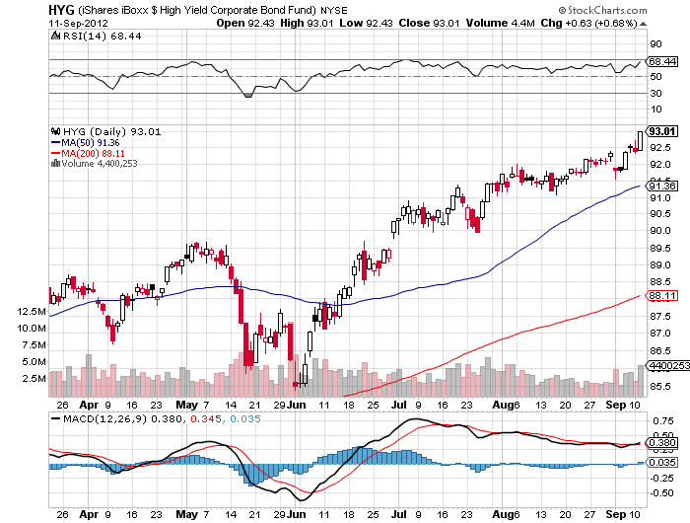
Junk Bonds (HYG)

Slide 15
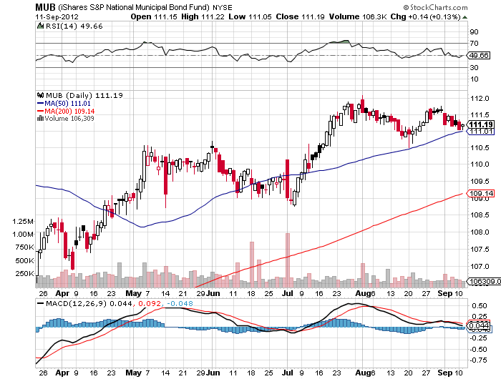
Municipal Bonds (MUB)-3% yield,
Mix of AAA, AA, and A rated bonds

Slide 16

Stocks-The Selloff is coming, but how big?
Long (SPY) puts, (MS) puts
*It’s all up to Uncle Ben-
Fed failure to deliver QE3 on September 12-13
will cause a market selloff, but not much
*Use this rally to sell
traders hoping for a 10% fall
3%-6% fall is more likely – unlikely to take the market
*Sudden VIX upturn is hinting at volatility
rise in September
*I dramatically shrunk book going into the decision
covered all short puts, running small long puts
*Financials and commodities catch up giving market new life
*Last rally before 2013 recession?

Slide 17
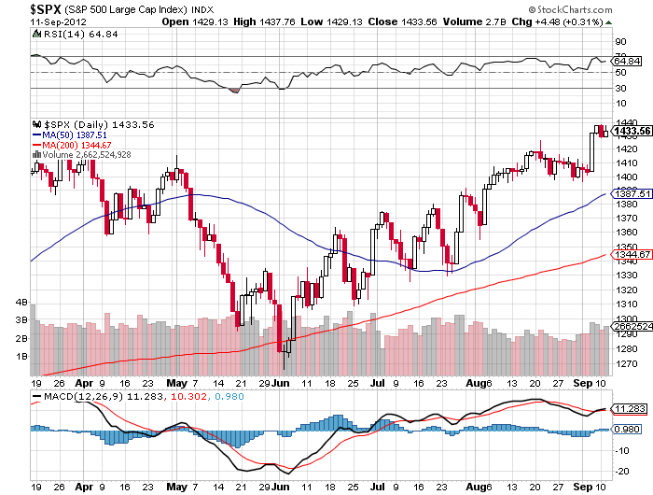
(SPY)

Slide 18
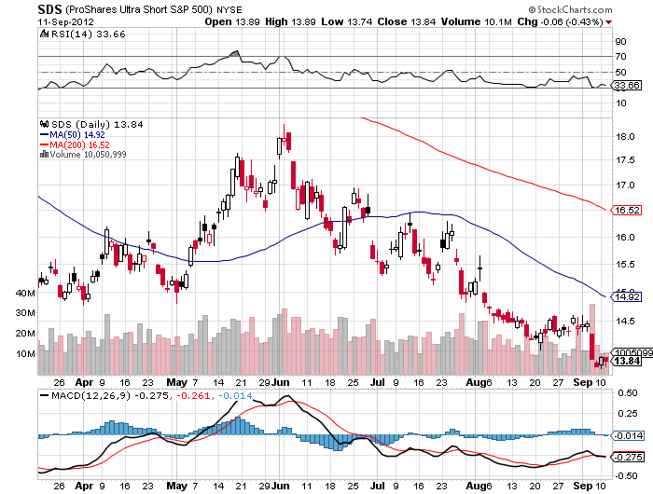
Double Short S&P 500 ETF(SDS)

Slide 19
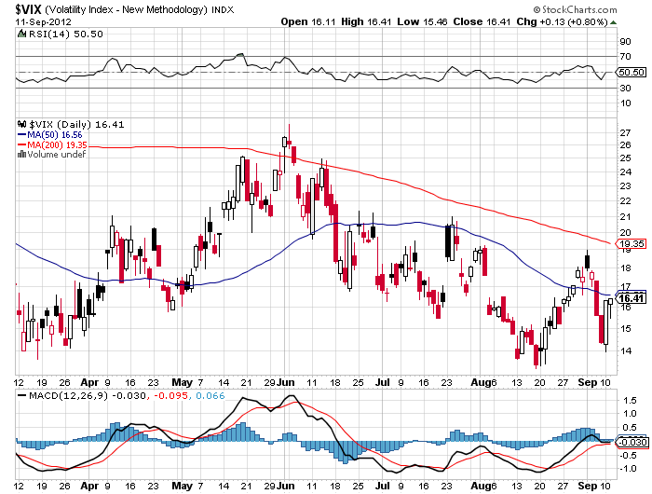
(VIX)-Warming up for a big market drop in September?

Slide 20
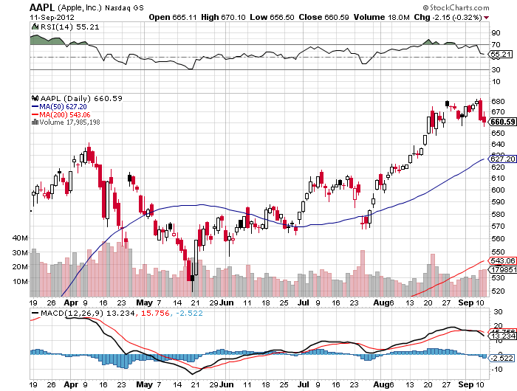
(AAPL)-5 million iPhone 5 sales this weekend buy the next dip

Slide 21
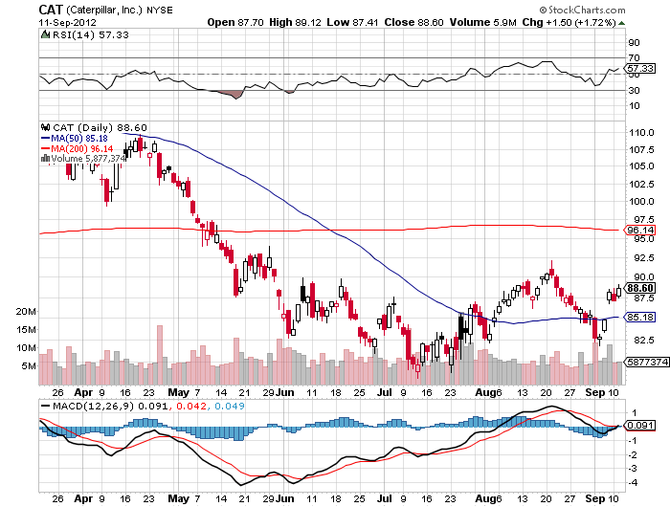
(CAT)-the China bounce

Slide 22
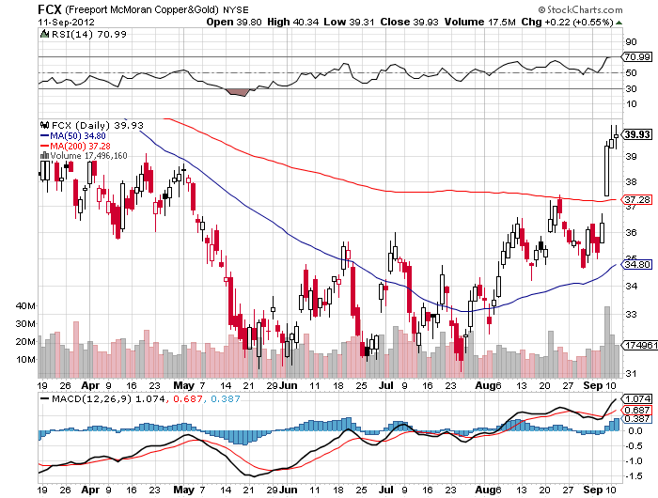
(FCX) Another China bounce

Slide 23
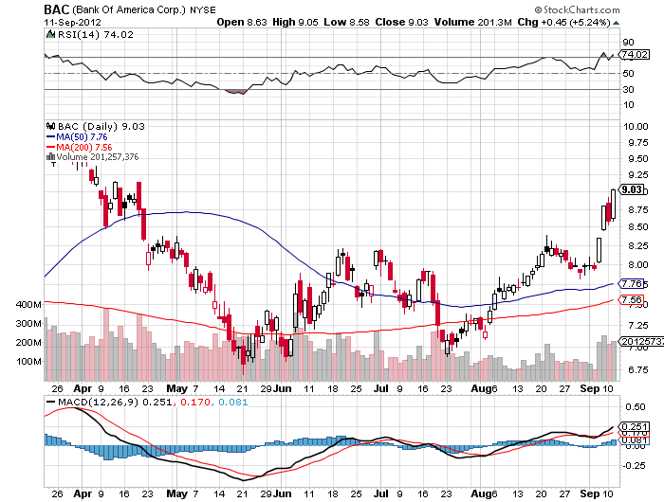
(BAC)-What is going on?

Slide 24
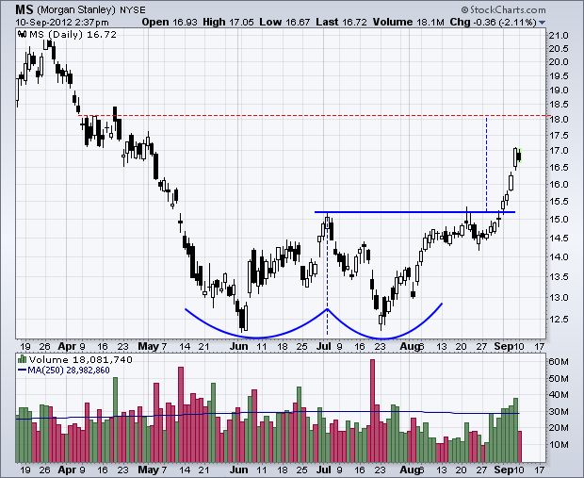
(MS)-Ouch!

Slide 25
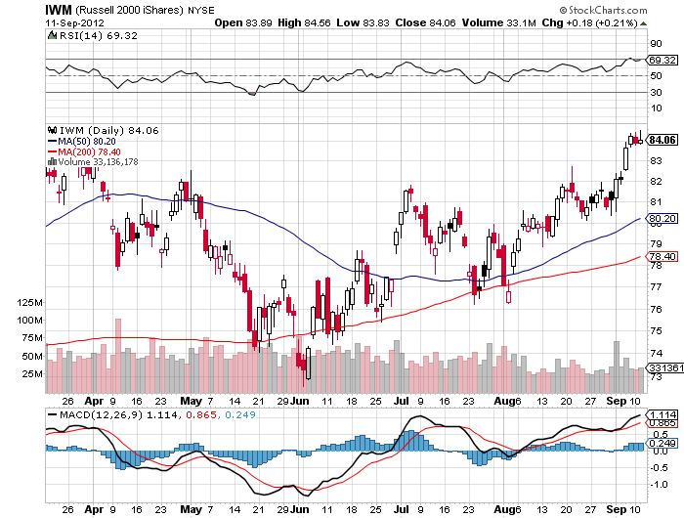
Russell 2000 (IWM)

Slide 26
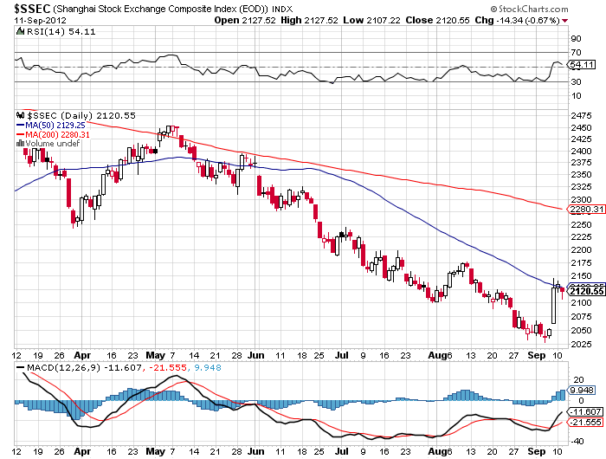
Shanghai-Is it Real?
Wait for the double bottom

Slide 27

My Post Fed Shopping List
Stocks to buy on the dip
November, December, January Deep in-the-money Calls Spreads
Apple (AAPL)
Google (GOOG)
Disney (DIS)
JP Morgan (JPM)
Boeing (BA)

Slide 28

The Dollar
Pressing dollar longs
*German Supreme Court votes for Euro bail out
*Euro shorts getting killed
*Wait for net long in Euro before going short
*Euro double bottom on long term charts
providing big support
*Break $1.26 and $1.2950 is the final target
*Yen is still stagnating, getting a weak dollar push
covered $127-$130 call spread for September, for a loss
to trim risk ahead of Fed meeting
added some (YCS) for a longer term view
*Ausie bounce on China reflation budget
does it stop here? Approaching stop loss

Slide 29
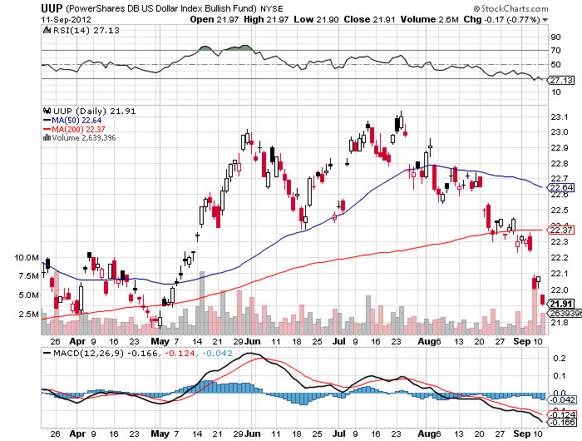
Long Dollar Basket (UUP)
Close to the May bottom

Slide 30
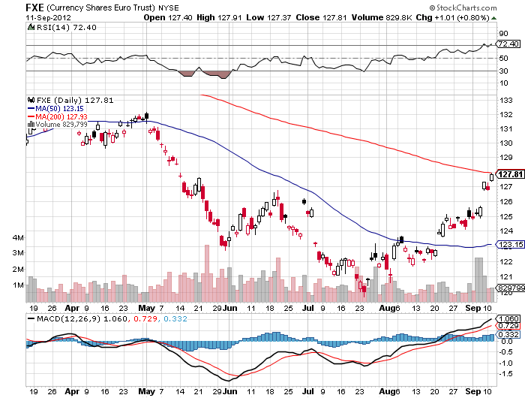
Euro (FXE)-2 year double bottom setting up?

Slide 31
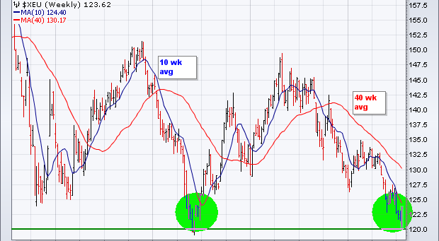
Long Term Euro (FXE)

Slide 32
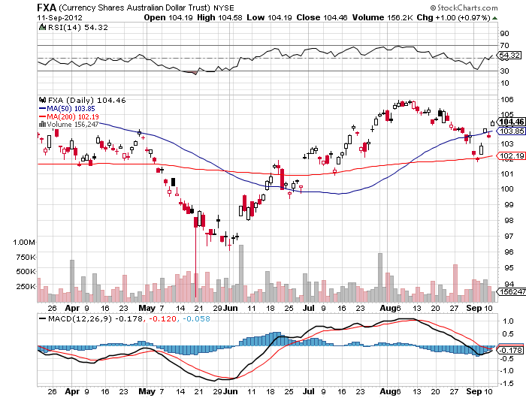
Australian Dollar (FXA)
Pressing the Shorts

Slide 33
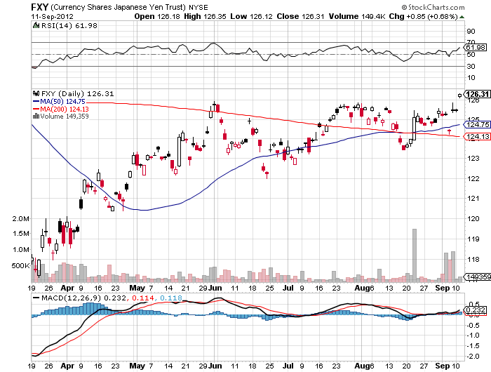
Japanese Yen (FXY)
Stopped Out

Slide 34
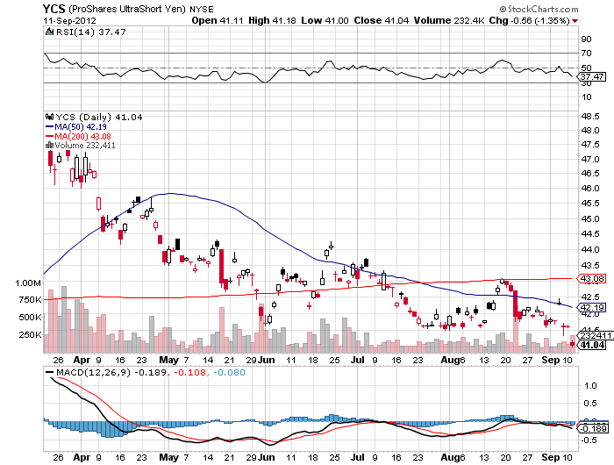
(YCS)
Running a long-double up opportunity

Slide 35

Energy
*Israelis still rattling Iran’s cage
*Waiting for Ben like everyone else
*High oil prices are close to demolishing
what growth we have
*Fundamental demand for oil is weakening
dramatically in the face of a
weakening global economy
*Oversupply still the driving factor for natural gas

Slide 36
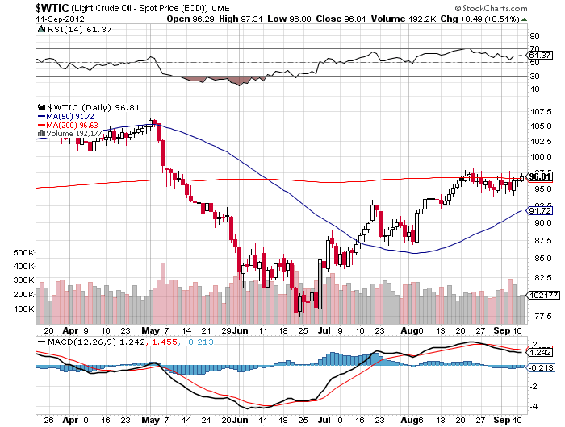
Crude-waiting for QE3

Slide 37
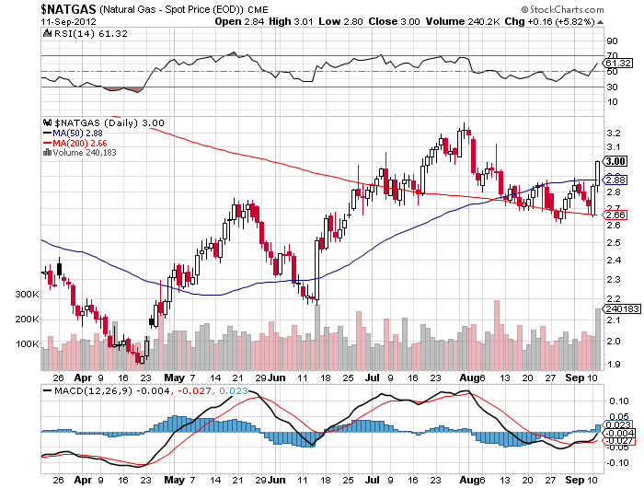
Natural Gas-Signs of life

Slide 38
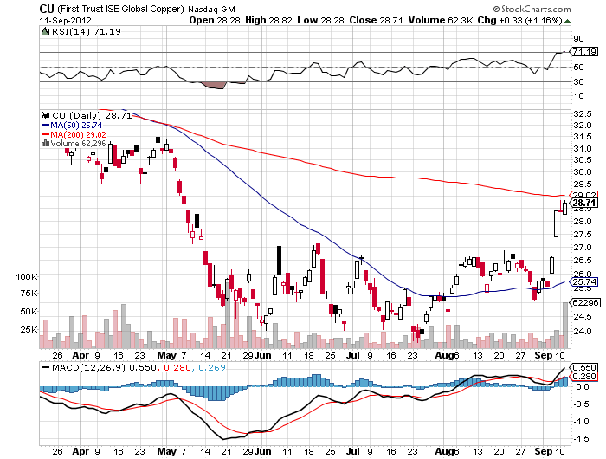
Copper (CU)-China bounce

Slide 39

Precious Metals-My Favorite Asset Class stepped out ahead of Fed to buy lower
*Seasonal strength continuing on schedule
will run until February
*If US doesn’t do QE, then Europe will.
Gold positive
If Fed disappoints at September 12-13 meeting expect a brief gold selloff before long term fundamentals reassert
*Taking a run at $1,922
*Where is the silver volatility
economic demand vs. central bank demand
*Emerging market central bank buying is continuing

Slide 40
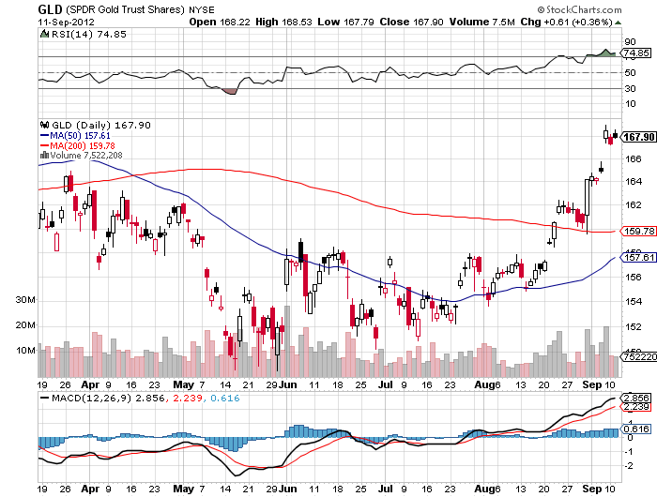
Gold

Slide 41
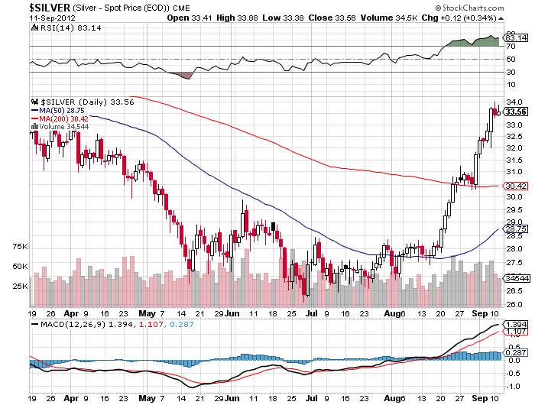
Silver

Slide 42
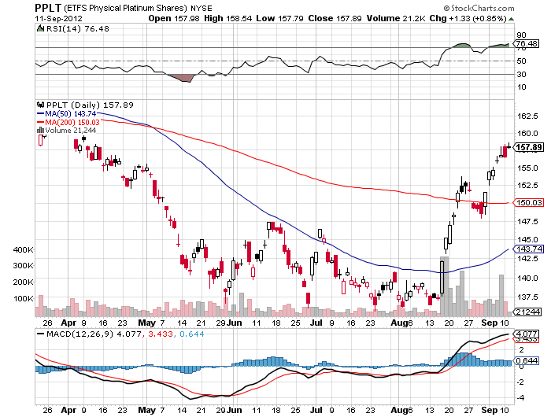
(Platinum) (PPLT)

Slide 43
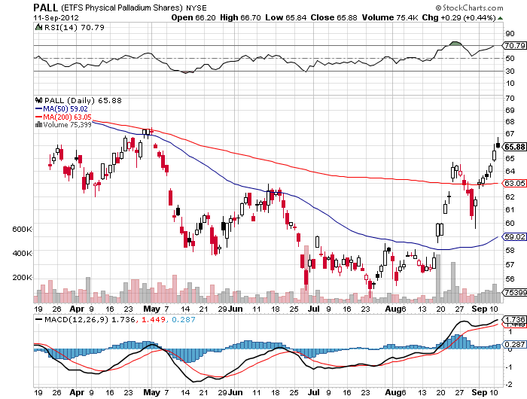
Palladium (PALL)

Slide 44
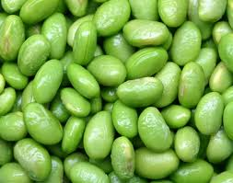
The Ags
*USDA crop report on Friday
*Charts showing signs of topping

Slide 45
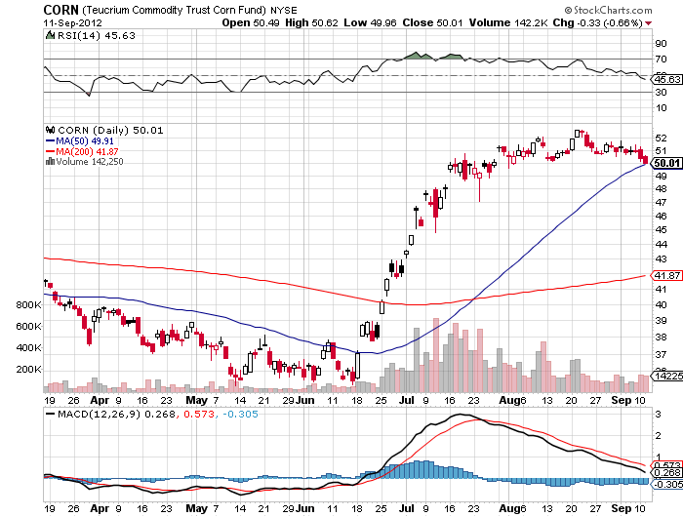
(CORN)

Slide 46
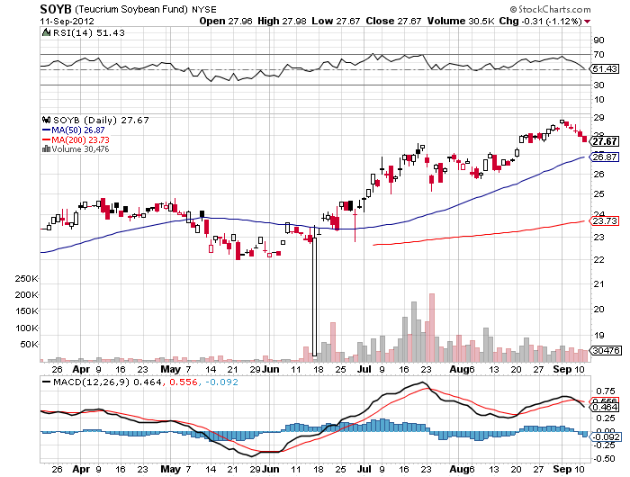
Soybeans (SOYB)

Slide 47
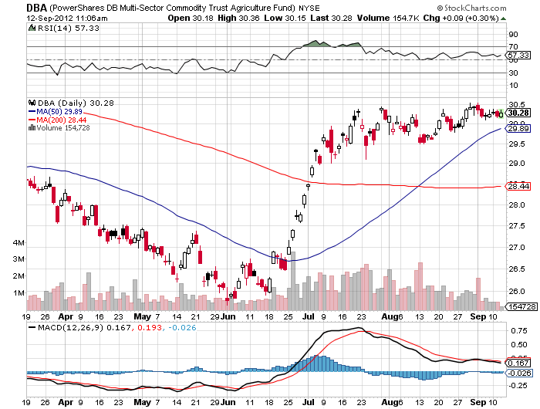
Ag ETF (DBA)

Slide 48
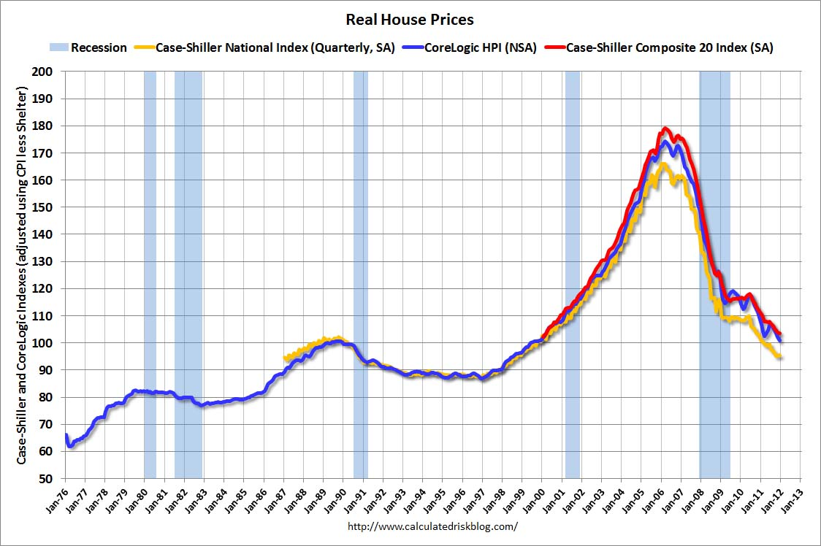
Real Estate
February, 2012
Will “twist” extend to mortgage backed securities?
Could take the 30 year fixed from 3.75% to 2.75%

Slide 49
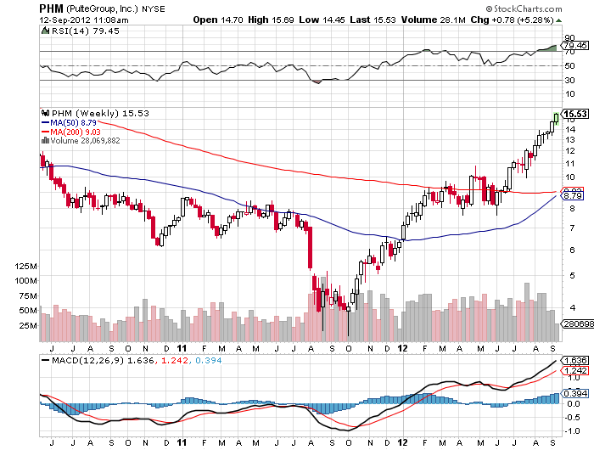
Pulte Homes (PHM)

Slide 50

Trade Sheet
The bottom line: Wait for the Fed
*Stocks- sell the rally, there will be no QE3
*Bonds- buy dips over a 1.80% yield
*Commodities- trading sell setting up in oil, copper
*Currencies- Euro stand aside, too early to sell, sell yen OTM Calls
sell short Aussie
*Precious Metals – buy the dips, the fall rally has begun
*Volatility-stand aside
*The ags – stand aside, too late to buy
*Real estate- rent, don’t buy
Next Webinar is on Wednesday, September 24
12:00 noon EST from San Francisco, California

Slide 51

To buy strategy luncheon tickets Please Go to www.madhedgefundtrader.com

