Slide 1

Please Stand By for
John Thomas
Wednesday, September 24, 2012, San Francisco, CA
Global Trading Dispatch
The Webinar will begin at 12:00 pm EST

Slide 2

The Mad Hedge Fund Trader
“Doing the Backflip”
Diary of a Mad Hedge Fund Trader
San Francisco, September, 2012
www.madhedgefundtrader.com

Slide 3

MHFT Global Strategy Luncheons
Buy tickets at www.madhedgefundtrader.com
2012 Schedule
September 28 Las Vegas
October 19 Washington DC
October 26 San Francisco
November 7 Houston
November 8 Orlando
January 3, 2013 Chicago

Slide 4
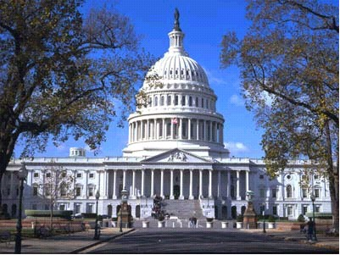
MHFT Global Strategy Luncheons
Buy tickets at www.madhedgefundtrader.com
Las Vegas
September 28
Washington, DC
October 19

Slide 5

Trade Alert Performance
New All Time High!
*September MTD +1.58%
*2012 YTD +17.8%, Beating the
Dow by 7.9%
*First 96 weeks of Trading + 58%
*Versus +17% for the Dow Average
A 41% outperformance of the index
86 out of 122 closed trades profitable
70.5% success rate on closed trades

Slide 6
Portfolio Review
The QE3 Trading Book
Mad Hedge Fund Trader
Trading Book
Asset Class Breakdown
Risk Adjusted Basis
current capital at risk
Risk On
(GLD) $157-$162 Calls Spread | 30.00%
(AAPL) $620-$650 Call spread | 30.00%
(GOOG) $650-$680 Call spread | 10.00%
(SLV) $28-$31 call spread | 10.00%
Risk Off
(USO) $32.50-$35 Put spread | -5.00%
total net position | 75.00%

Slide 7
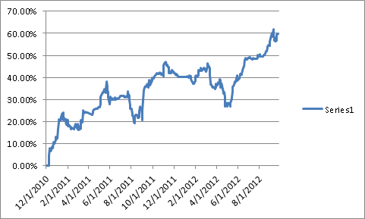
Performance Since Inception-New All Time High
+31.6% Average Annualized Return

Slide 8

The Economy-bad data still coming through
*August Housing starts +2.3% annualized,
750,000 annual rate
*August existing home sales +7.8%
*Case-Shiller real estate data is turning positive
*US August industrial production 0.6% to 1.2%
*August capacity utilization 79.3% down to 78.2%
*Weekly jobless claims up -3,000 to 382,000
*German ZEW index 18.2 down to 12.6
*All consistent with a low 1.5% GDP growth rate,
or lower

Slide 9
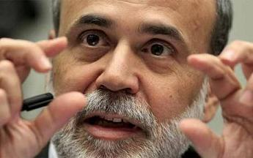
What scared Bernanke into QE3?
*The move was not justified by the economic data
*Wants a belt and suspenders approach to
higher economic growth. Overkill?
*A guaranty of higher inflation,
but not until the 2020’s
*With only one year to go, does Ben want
to go out with a bang?
*Raises the floor under asset prices, but doesn’t
boost them much higher either, augurs for markets
that chop sidways
*Is why we have deep in the money call spreads instead
of outright long stock, at-the-money calls, or
out-of-the-money calls
*The big winners of monetary debasement are gold and silver

Slide 10
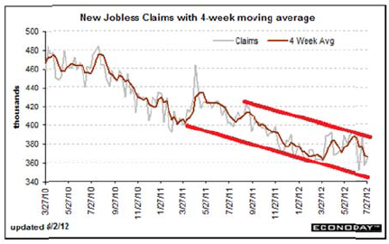
Weekly Jobless Claims
The Short Term Trend is Up
Break 400,000 and the double dip threat is on
4 week moving average at 368,250

Slide 11

Bonds-Still churning at the top
*the 1.40% - 1.90% range holds, could be our
range for years
*Look to sell spread spreads outside these ranges
*Is the final top in?
*$40 billion a month in MBS buying
scares investors out of Treasuries
*Record junk issuance continues
*More European scares kill rally there

Slide 12
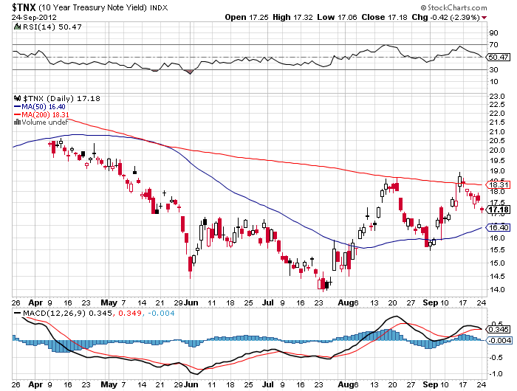
(TNX) 1.40%-1.70% Range Holding

Slide 13
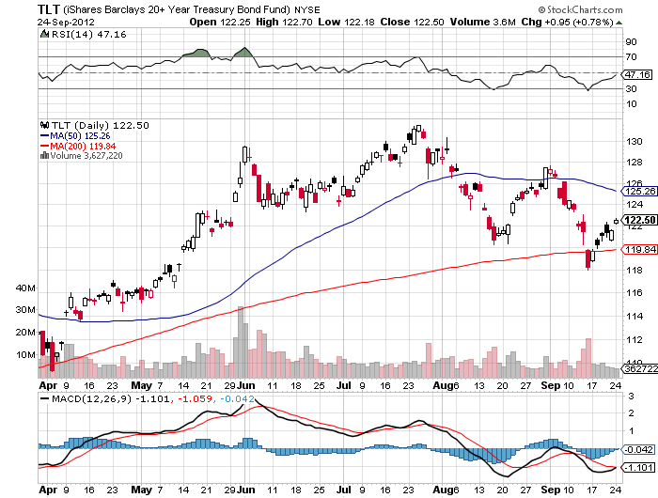
(TLT)

Slide 14
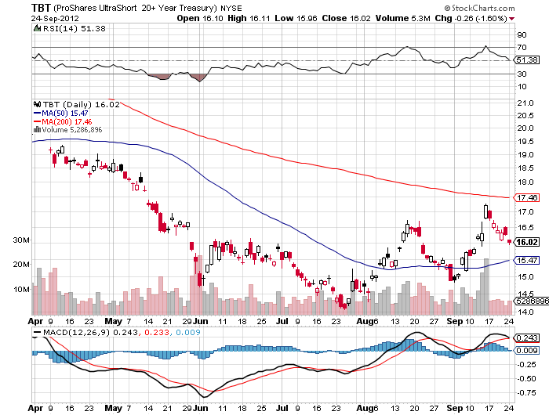
Short Treasuries (TBT)

Slide 15
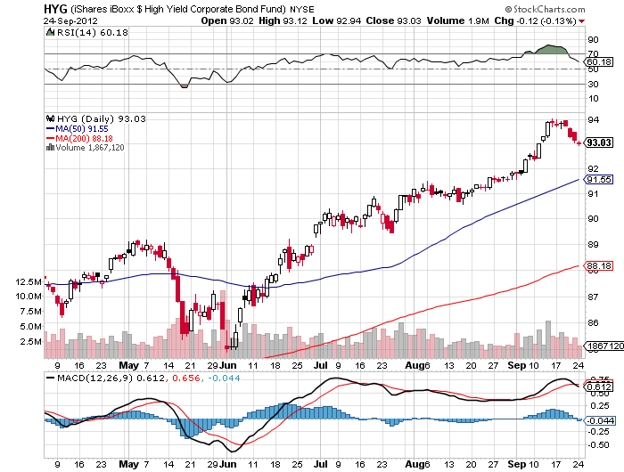
Junk Bonds (HYG)

Slide 16
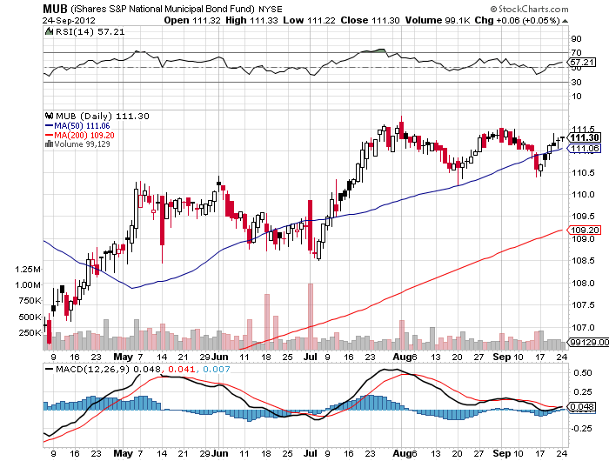
Municipal Bonds (MUB)-3% yield,
Mix of AAA, AA, and A rated bonds

Slide 17
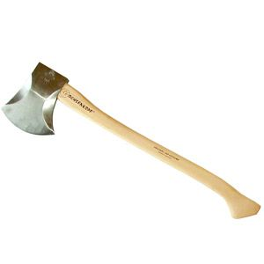
Stocks-The chop sideways scenario is looking good
*QE3 raises the floor below stocks, but they won’t
rise much either
*Instead of a Dow 10,000 floor, it is more
like 12,000, the June low
*Any substantial sell off will be met my more
aggressive Fed action
*VIX could enter a long sleep here of range
trading at the bottom
*I dramatically shrunk book going into the decision
covered all short puts, running small long puts,
was the right thing to do
*Last rally before 2013 recession?

Slide 18
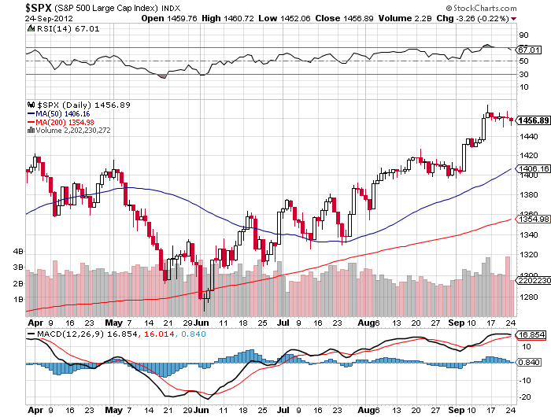
(SPY)-the bottom is in, but the top also?

Slide 19
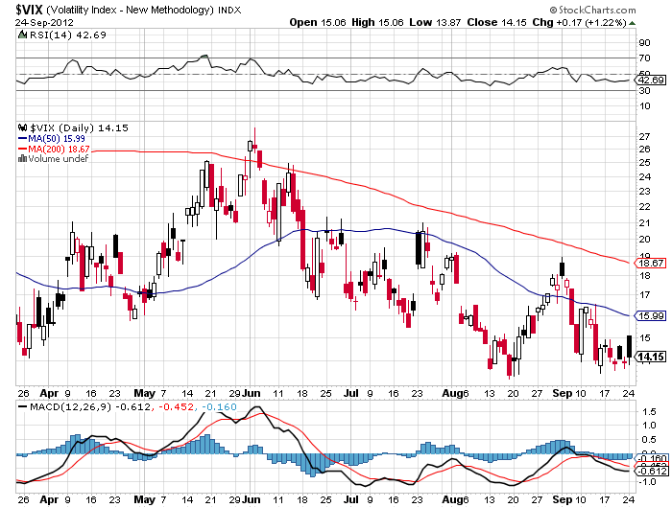
(VIX)-Going to sleep

Slide 20
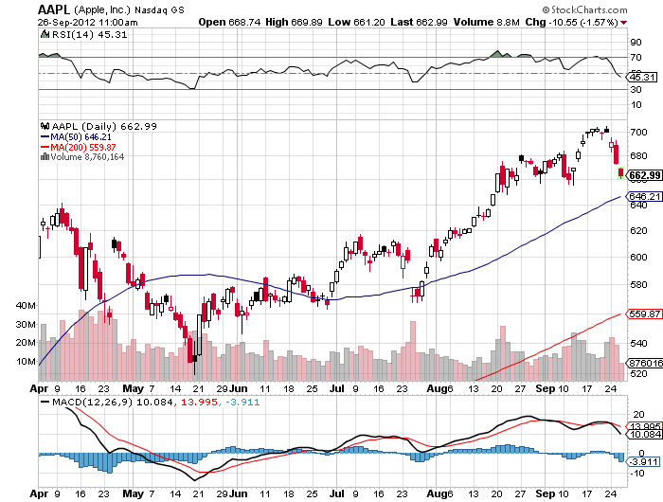
(AAPL)-Long the $620-$650 Call spread buy this dip

Slide 21
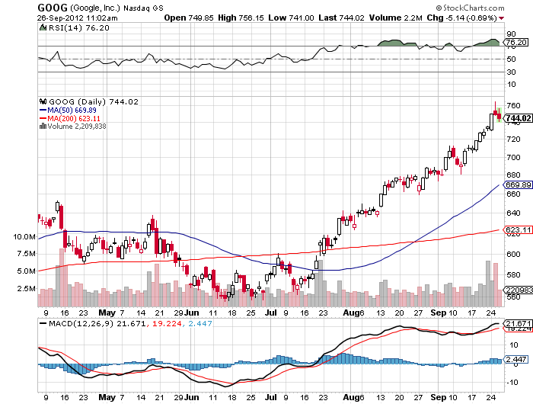
(GOOG)-
Long the December $650-$680 Call Spread

Slide 22
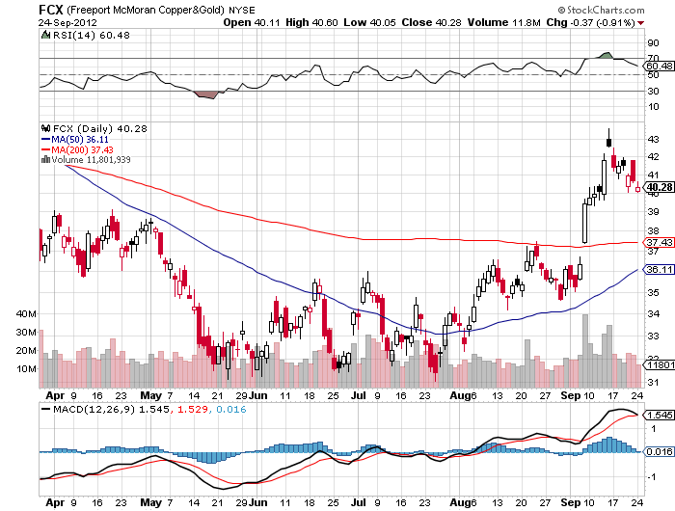
(FCX) No follow through on the China bounce

Slide 23
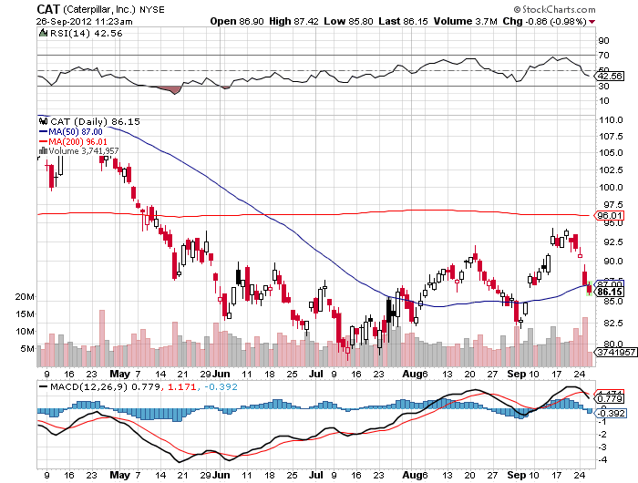
(CAT)-the short I missed

Slide 24
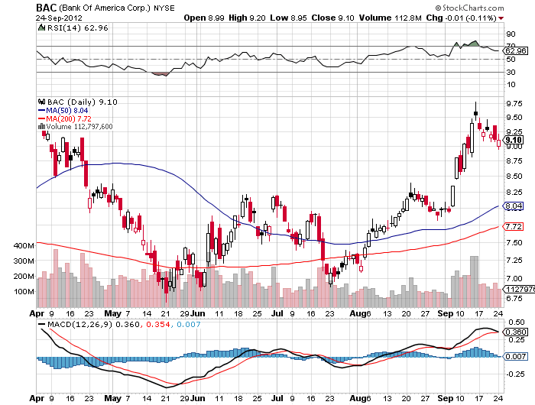
(BAC)-What is going on?

Slide 25
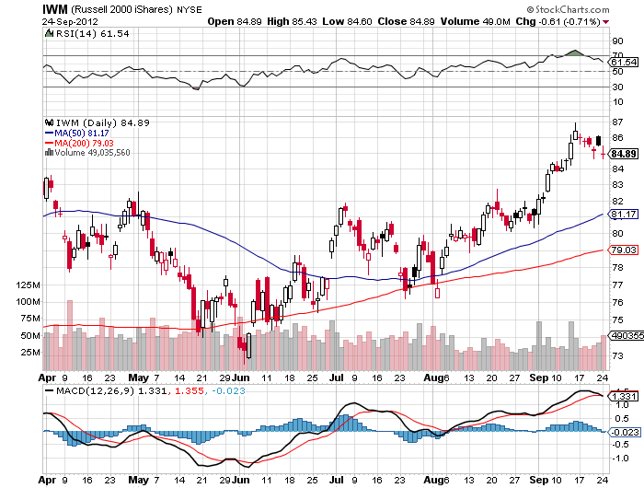
Russell 2000 (IWM)

Slide 26
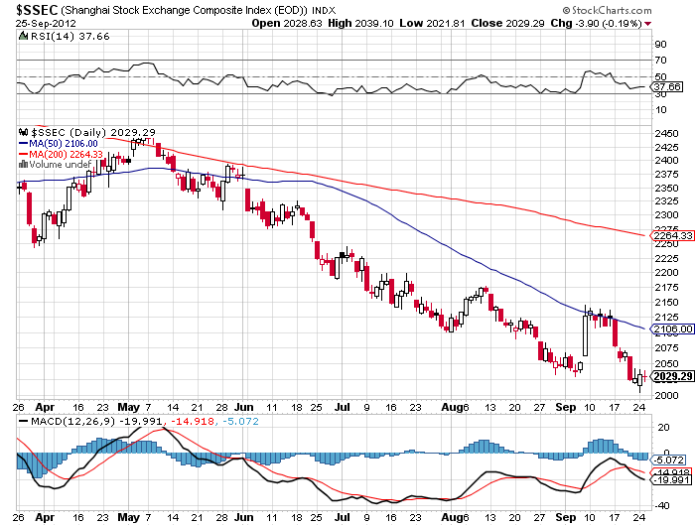
Shanghai-Is it Real?
Wait for the double bottom

Slide 27

My Post Fed Shopping List
Stocks to buy on the dip
November, December, January Deep in-the-money Calls Spreads
Apple (AAPL)
Google (GOOG)
Disney (DIS)
JP Morgan (JPM)
Boeing (BA)

Slide 28

The Dollar
Pressing dollar longs
*QE3 is hugely dollar negative
*Euro is rolling over again
*Missed the Euro short at $1.32
*Yen is still stagnating, getting
a weak dollar push
*Ausie rolled over once again on
weak China market
*The competitive devaluation is on,
the race to the bottom

Slide 29
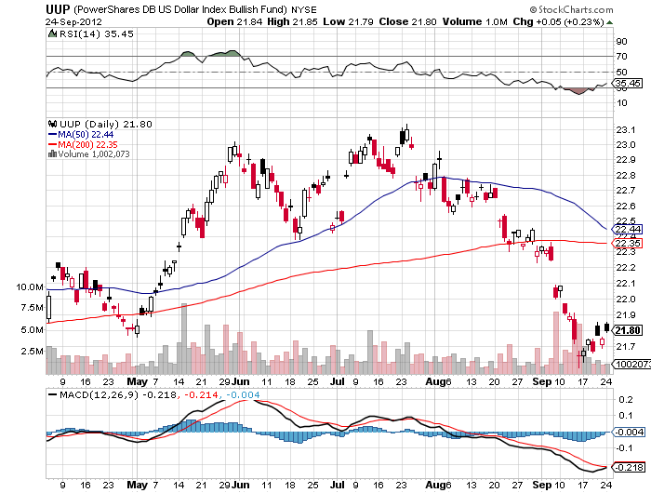
Long Dollar Basket (UUP)
Close to the May bottom

Slide 30
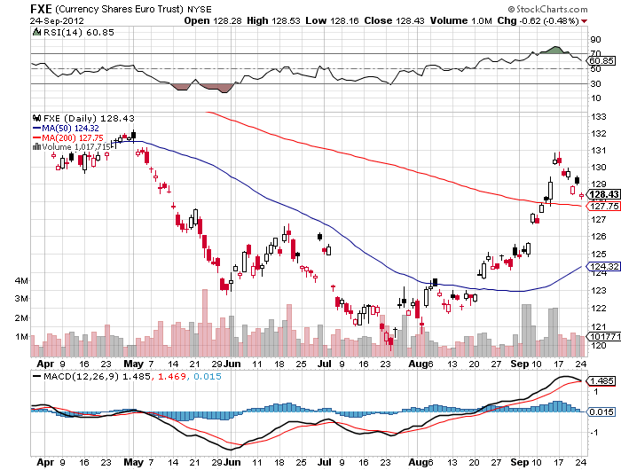
Euro (FXE)

Slide 31
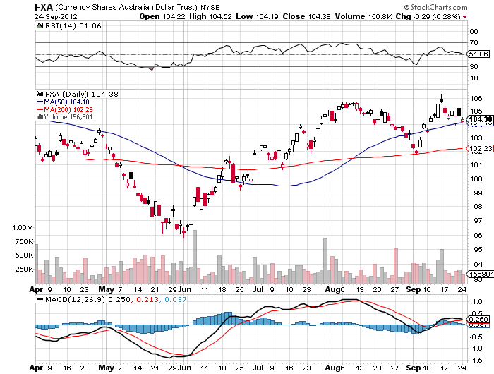
Australian Dollar (FXA)
Heartbreak Alert!
$105-$108 September call spread expired out of the money!

Slide 32
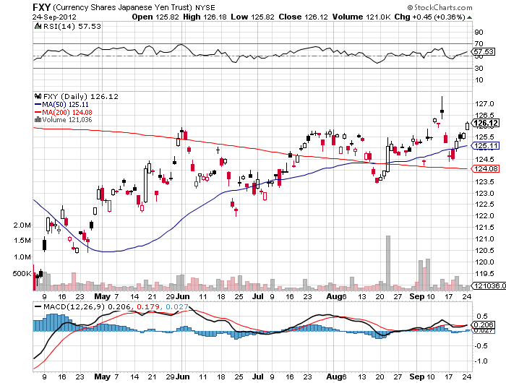
Japanese Yen (FXY)
Heartbreak Alert!
$126-$130 September call spread expired out of the money!

Slide 33
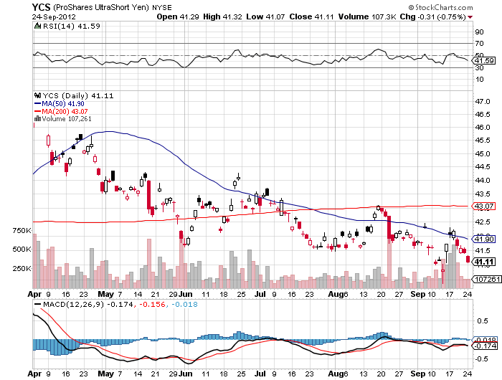
(YCS)
Bailed at the Top

Slide 34
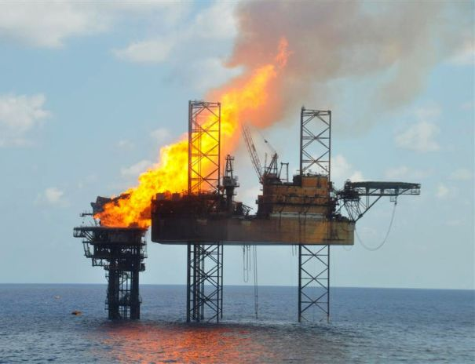
Energy
*The surprise sell off after QE3,
down 10% in six sessions
*Oversupply is overwhelming demand
*Slowing China is a big factor
*Saudi production ramp into yearend
for political reasons
*Iraq, Canada, and Norway are
ramping up production
*New US production comes online daily
*A stealth parabolic leap in conservation?
*Oversupply still the driving factor for natural gas

Slide 35
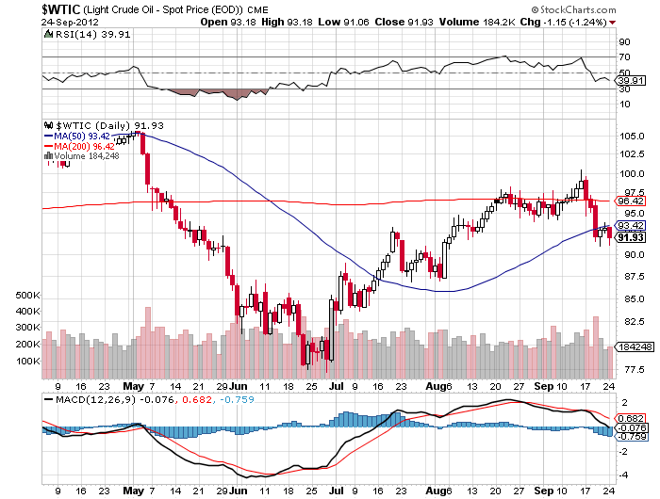
Crude-waiting for QE3

Slide 36
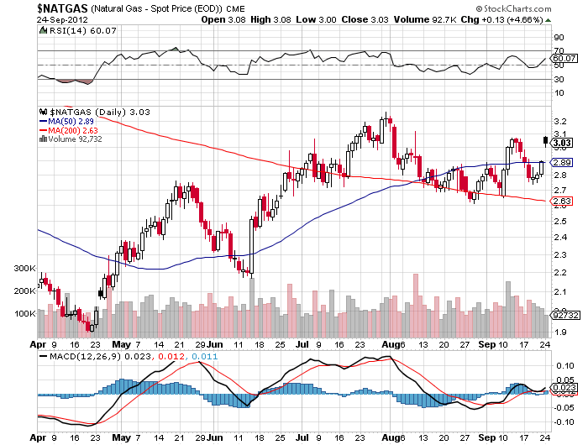
Natural Gas

Slide 37
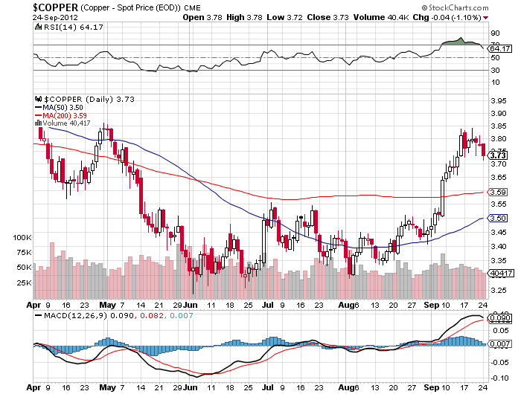
Copper (CU)-China bounce

Slide 38
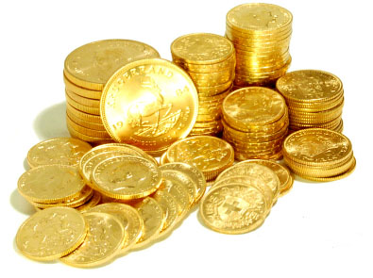
Precious Metals-My Favorite Asset Class
The Big winner from QE3
*Seasonal strength continuing on schedule
will run until February
*US, Europe, and China all doing
simultaneous QE or-is hugely gold positive
*Taking a run at $1,922, $2,300 in 2013?
*Where is the silver volatility
economic demand vs. central bank demand
*Emerging market central bank buying is continuing

Slide 39
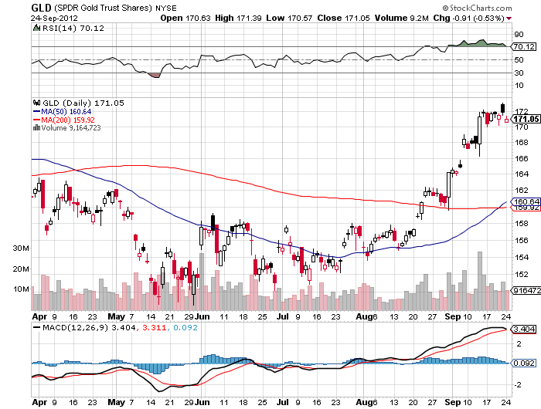
Gold-long the December $157-$162 call spread

Slide 40
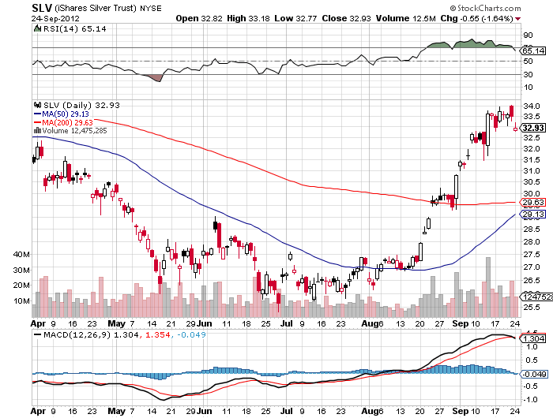
Silver-long the December $28-31 call spread

Slide 41
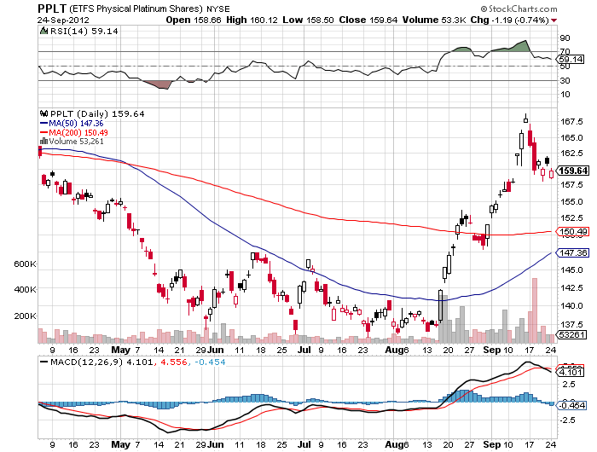
(Platinum) (PPLT)

Slide 42
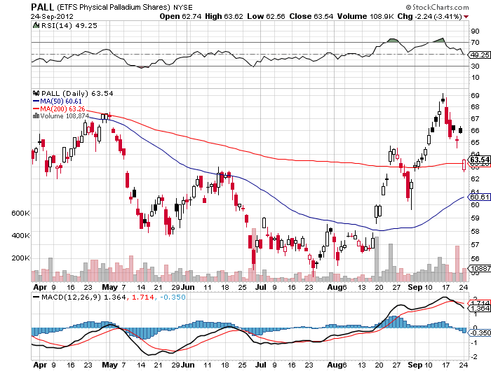
Palladium (PALL)

Slide 43
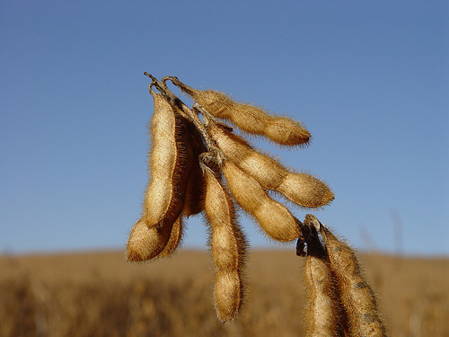
The Ags
*Charts are clearly rolling over
*Soybeans led the upswing,
now leading downturn
*Trade is out of season
*Dead money for now, no trade

Slide 44
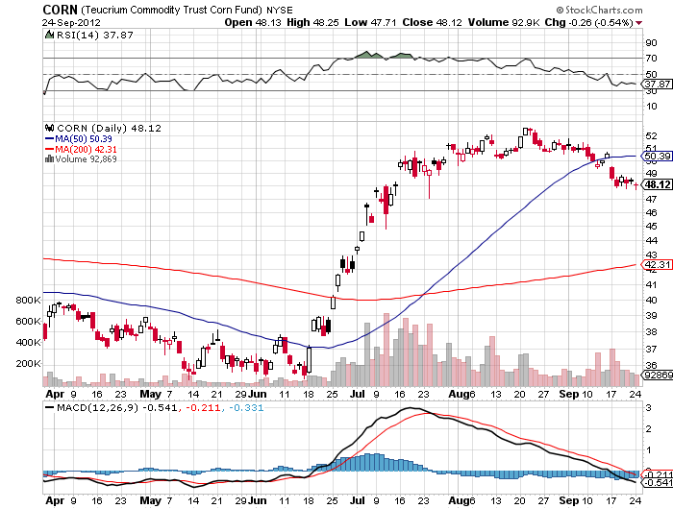
(CORN)

Slide 45
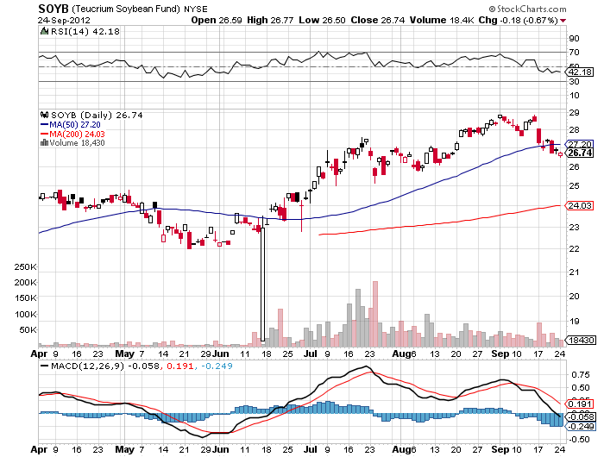
Soybeans (SOYB)

Slide 46
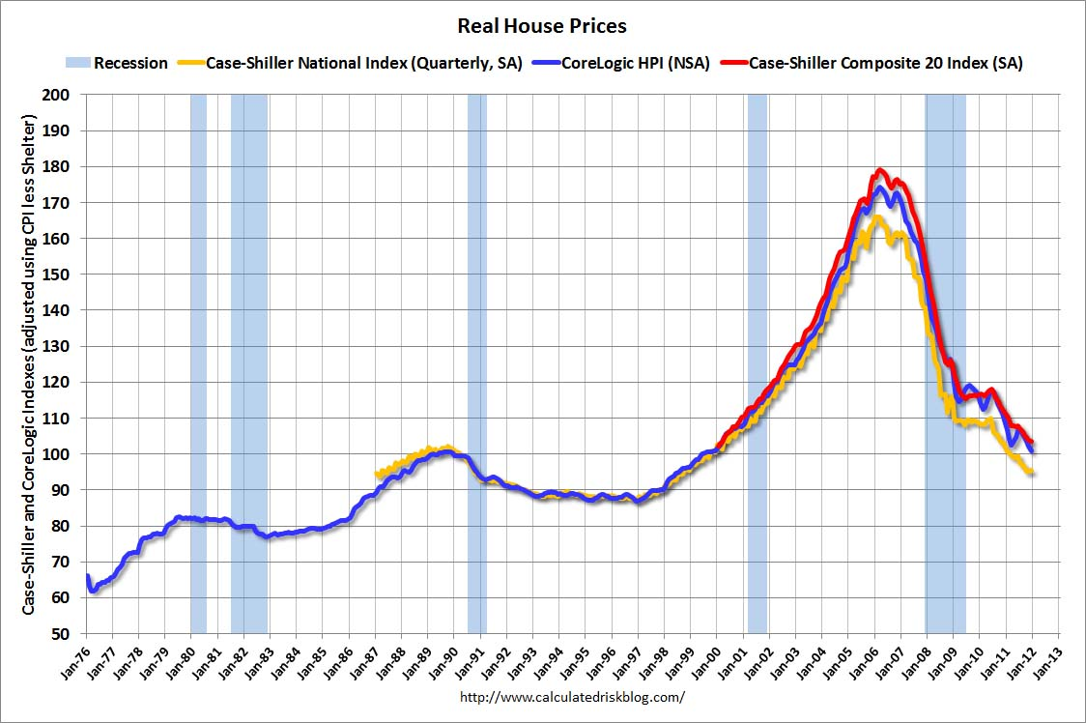
Real Estate
No longer a drag, but a modest positive
Rally will end when recession hits in 2013
“Twist” was extended to mortgage backed securities.
The 30 year fixed has plunged from 3.75% to 3.40%, lower to come

Slide 47
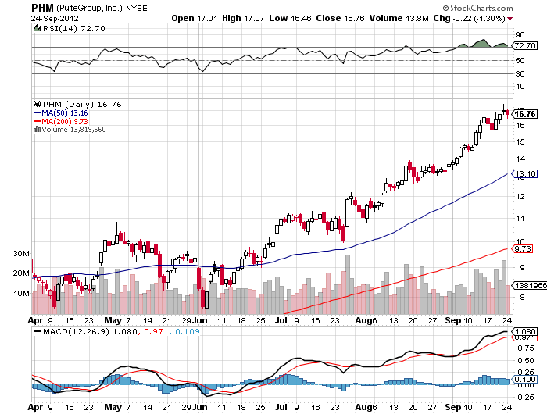
Pulte Homes (PHM)

Slide 48

Trade Sheet
The bottom line: Wait for the Fed
*Stocks- buy the dips, but trade, QE3has arrived
*Bonds- sell rallies over a 1.50% yield
*Commodities-short oil, stand aside related China commodities
*Currencies- Euro stand aside, too late to sell
*Precious Metals – buy the dips aggressively, loves QE3
*Volatility-stand aside, will bounce along bottom
*The ags – stand aside, has gone dead
*Real estate- rent, don’t buy
Next Webinar is on Wednesday, October 10
12:00 noon EST from San Francisco, California

Slide 49

To buy strategy luncheon tickets Please Go to www.madhedgefundtrader.com

