Slide 1
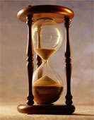
Please Stand By for John Thomas Wednesday, October 24, 2012, San Francisco, CA Global Trading Dispatch
The Webinar will begin at 12:00 pm EST

Slide 2

The Mad Hedge Fund Trader “Waiting for the Election”
Diary of a Mad Hedge Fund Trader San Francisco, October 24, 2012 www.madhedgefundtrader.com

Slide 3

MHFT Global Strategy Luncheons Buy tickets at www.madhedgefundtrader.com 2012 Schedule
October 26 San Francisco November 7 Houston November 8 Orlando January 4, 2013 Chicago

Slide 4

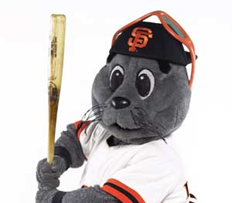
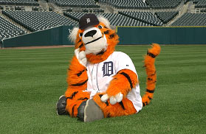
The 2012 World Series! San Francisco Giants vs. Detroit Tigers

Slide 5
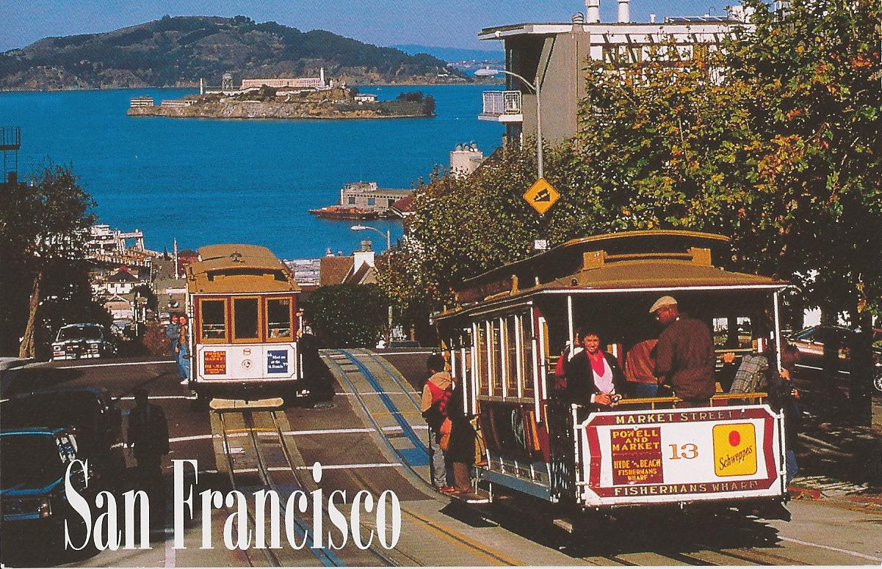
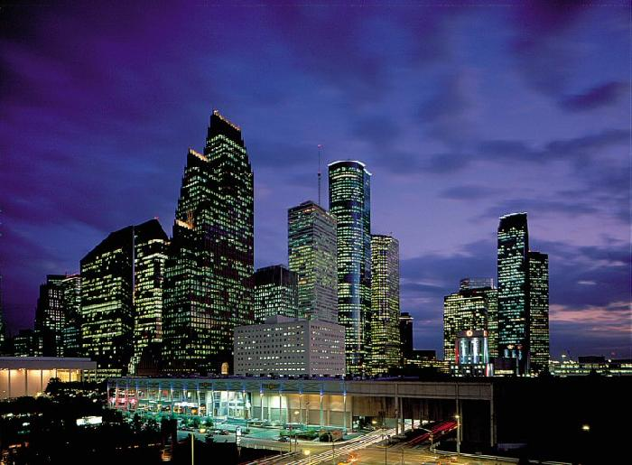
MHFT Global Strategy Luncheons Buy tickets at www.madhedgefundtrader.com
San Francisco October 26
Houston, Texas November 7

Slide 6

Trade Alert Performance Churning under All Time High
*October MTD -2.4% *2012 YTD +18.5%, compared to 7% for the Dow, beating it by 11.5% *First 100 weeks of Trading +60% *Versus +10.8% for the Dow Average A 49% outperformance of the index
90 out of 131 closed trades profitable 68.7% success rate on closed trades

Slide 7
Portfolio Review-Cutting risk before the election
Mad Hedge Fund Trader
Trading Book
Asset Class Breakdown
Risk Adjusted Basis
current capital at risk
Risk On
(FXY) $124-$127 Put Spread | 10.00%
(GLD) $160-$165 Calls Spread | 10.00%
(AAPL) $525-$575 call spread | 10.00%
Risk Off
(CORN) $50-$55 put spread | -10.00%
total net position | 20.00%

Slide 8
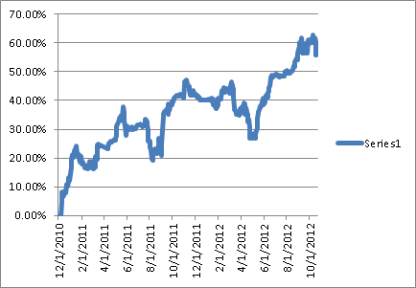
Performance Since Inception-New All Time High +33.1% Average Annualized Return

Slide 9
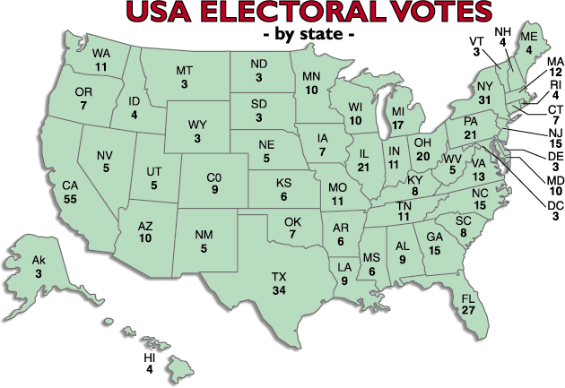
US Electoral College House of Representatives-435 + Senate-100 + District of Columbia-3 = 538

Slide 10
Electoral College as of October 24, 2012 270 Votes Needed to Win
Battleground | Votes | Romney | Obama | Obama
State |  |  |  | Poll
 |  |  |  | Lead
Colorado | 9 | 9 |  | 3
Florida | 27 | 27 |  | -1
Iowa | 7 | 7 |  | 1
Nevada | 5 | 5 |  | 2
North Carolina | 15 | 15 |  | -2
Ohio | 20 |  | 20 | 5
Pennsylvania | 21 |  | 21 | 5
Virginia | 13 | 13 |  | -1
Wisconsin | 10 | 6 |  | 3
Safe States |  | 164 | 247
Total | 127 | 246 | 288

Slide 11

The Economy-Still weak fundamentals
*Q3 earnings coming in below expectations -2% YOY vs. 0% YOY *Weekly jobless claims up +50,000 to 390,000, is meaningless due to statistical aberrations *September housing starts up a huge 35% YOY, off a very low base, still 1/3 peak 2007 starts *September retail sales up a flat 1.0% *China Q3 GDP at 7.4%, vs 7.6% in Q2 and an official target of 8.0% *HSBC China flash PMI up to 49.1, a 3 month high *September CPI a low 2.0%, no sign of inflation *October Empire State -6.6% *All consistent with a low 1.5% GDP growth rate, or lower

Slide 12
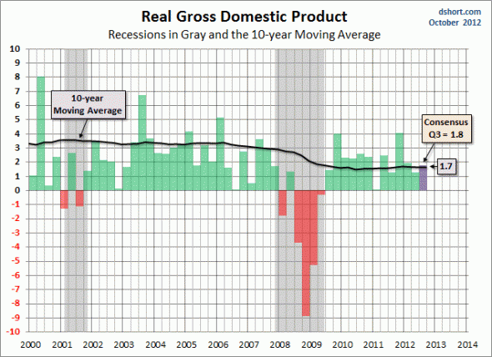
US Quarterly GDP Q3 Advanced Look out on Friday

Slide 13
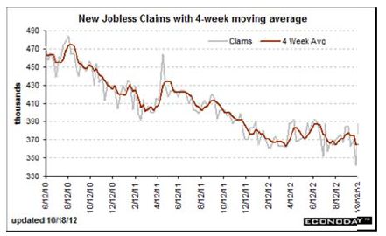
Weekly Jobless Claims Trapped in a Sideways Range Break 400,000 and the recession threat is on to 50,000 gain is bogus

Slide 14

Bonds-Directionless
*Bonds and stocks never sell off at the same time, is the pre election flight from risk *the 1.40% - 1.90% range holds, could be our range for years *Look to sell spread spreads outside these ranges *Is the final top in? *$40 billion a month in MBS buying is still on the menu *QE3 will work eventually

Slide 15
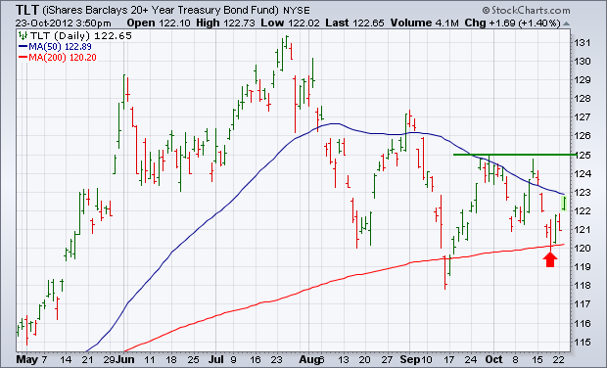
(TLT)

Slide 16
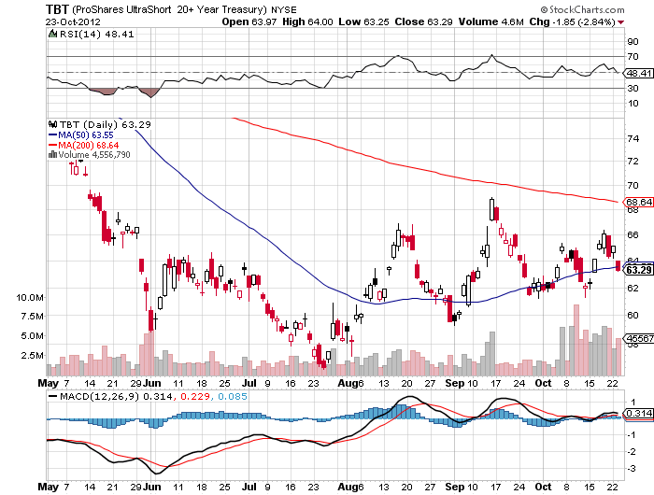
Short Treasuries (TBT) See the 1:4 reverse Split

Slide 17
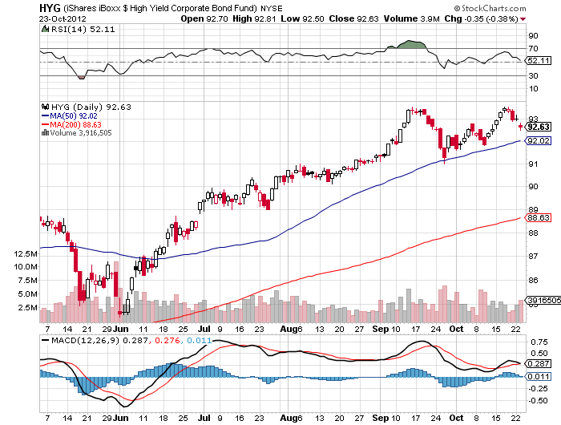
Junk Bonds (HYG)

Slide 18
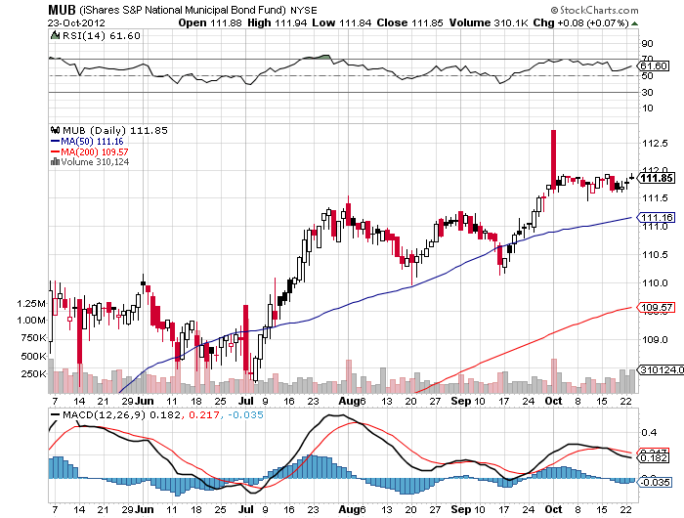
Municipal Bonds (MUB)-3% yield, Mix of AAA, AA, and A rated bonds

Slide 19
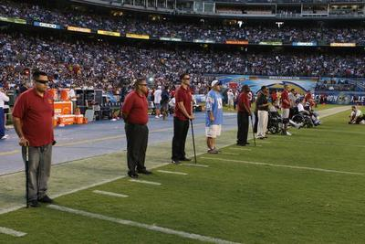
Stocks-rushing for the sidelines
*Its all about the election now *Tightening polls mean a certain Obama win is now a maybe Obama win, bad for risk assets *QE3 raises the floor below stocks, so they won’t crash *75% of companies failing to meet already low earnings expectations *”Fiscal Cliff” has jumped back on the table *Investors are running for the sidelines *No win by anyone, as in 2000, would be a disaster for the market

Slide 20
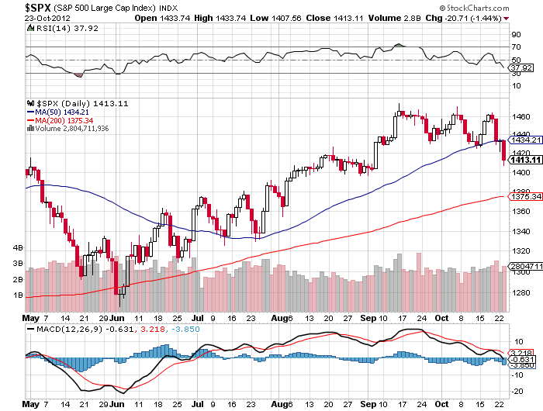
(SPX)-Did we just get a triple top? Or a head and shoulders top? 200 day MA target at 1,365, down 48 points?

Slide 21
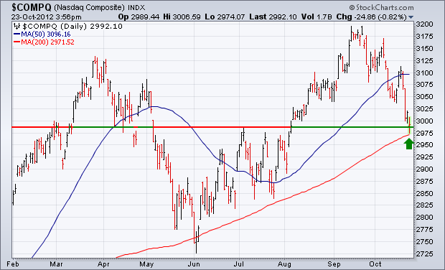
(QQQ)-NASDAQ

Slide 22
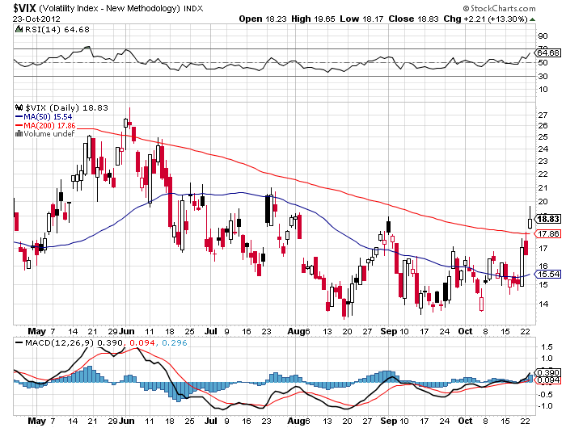
(VIX)-Wake up call

Slide 23
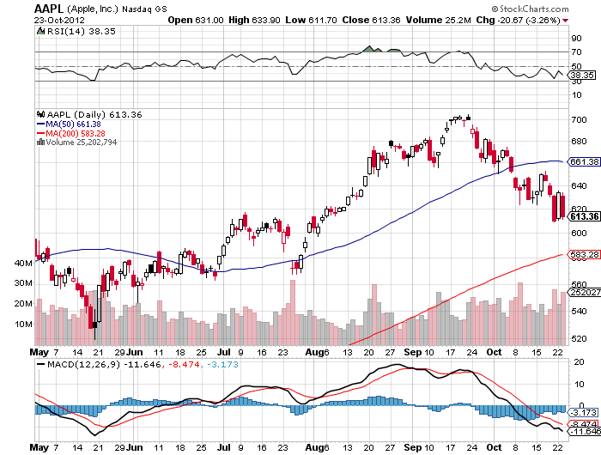
(AAPL)-Long the 1/$525-575 Call spread buy this dip

Slide 24
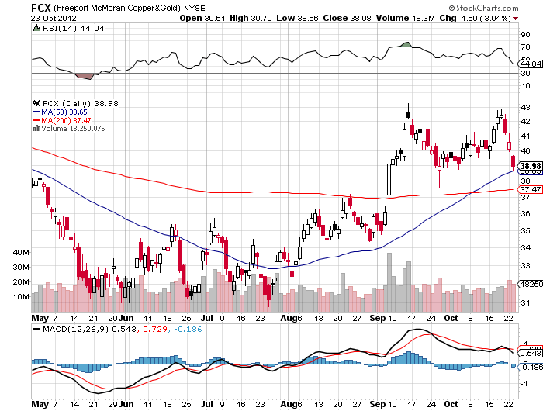
(FCX)

Slide 25
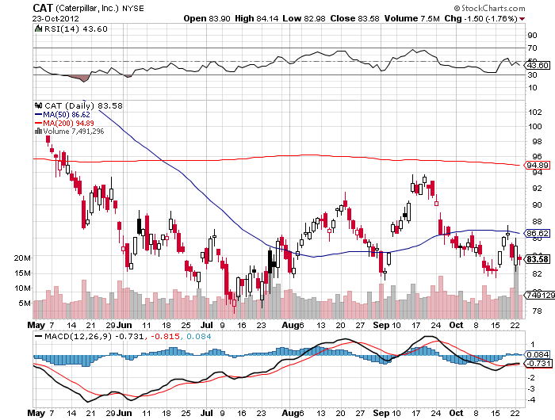
(CAT)

Slide 26
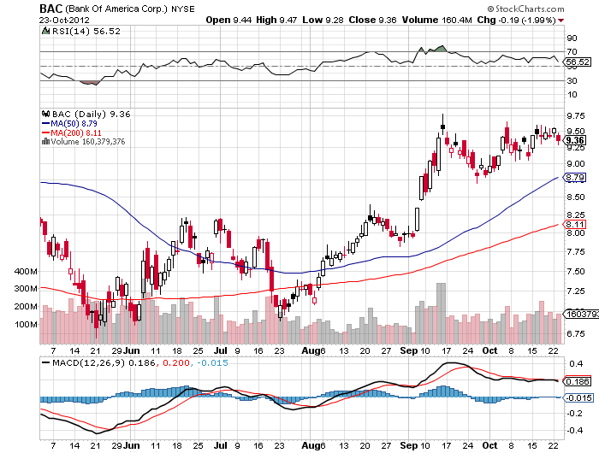
(BAC)-augurs for double top scenario

Slide 27
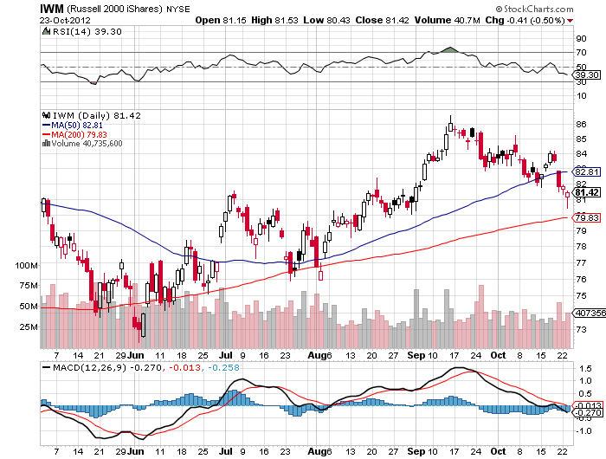
Russell 2000 (IWM)

Slide 28
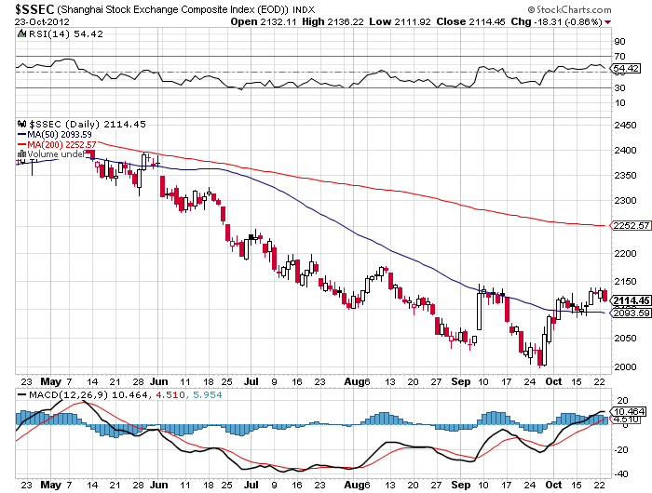
Shanghai-Not yet for the double bottom

Slide 29
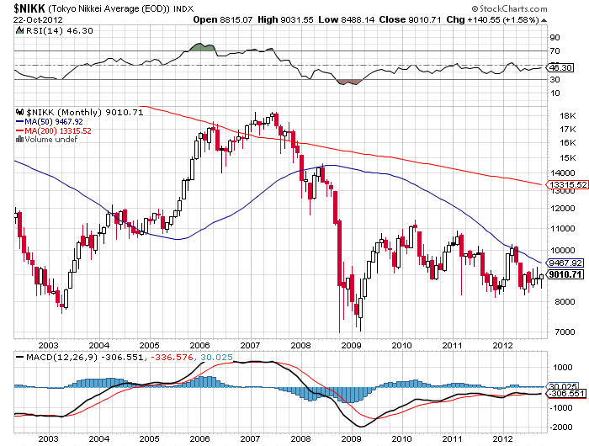
Japan-a world of hurt

Slide 30

My Post Election Shopping List Stocks to buy on the dip November, December, January Deep in-the-money Calls Spreads
Apple (AAPL) Google (GOOG) Disney (DIS) JP Morgan (JPM) Boeing (BA) Merck (MRK)

Slide 31

The Dollar
*QE3 is hugely dollar negative *Romney favors a strong dollar policy which is bad for everything else except Treasuries *Missed the Euro short at $1.32, still levitating on bail out hopes *European bonds markets have gone quiet, supporting the euro *China cold war is hurting the Japanese economy, knocking the knees out from under the yen, breaking 200 day moving average

Slide 32
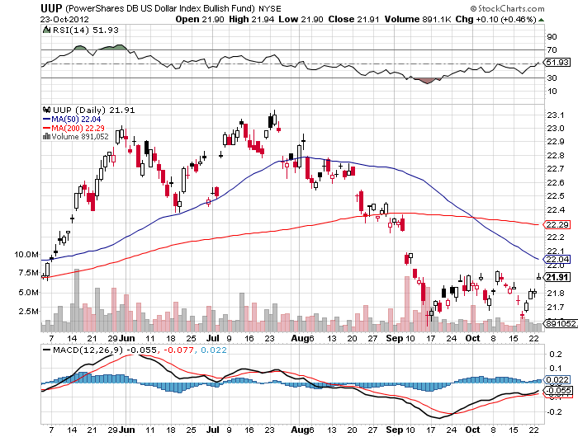
Long Dollar Basket (UUP) May bottom is holding

Slide 33
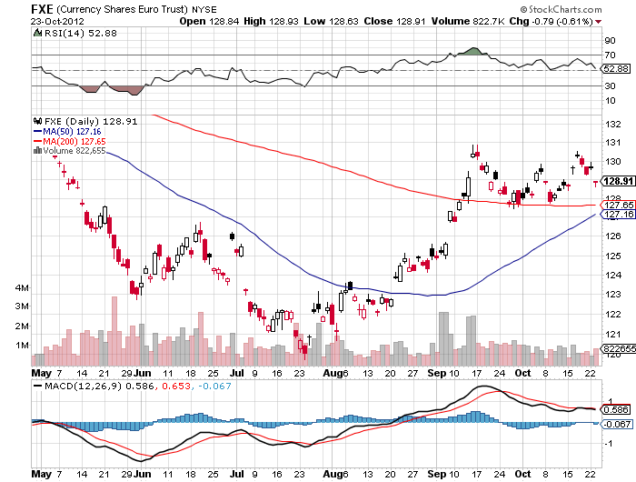
Euro (FXE) putting in a top?

Slide 34
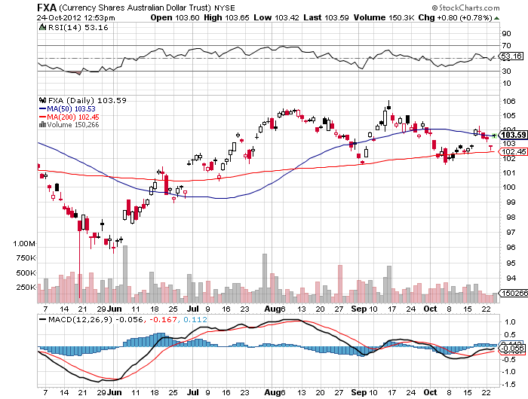
Australian Dollar (FXA)

Slide 35
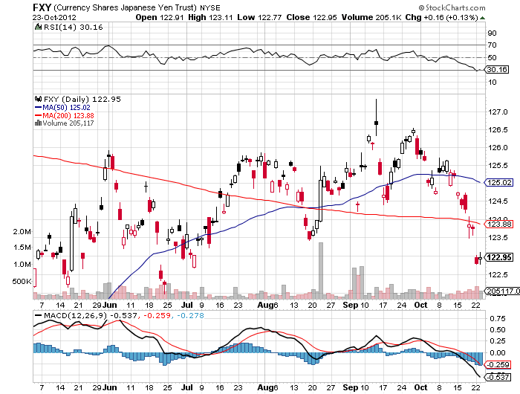
Japanese Yen (FXY) Long $124-$127 November bear put spread 14 days to run
200 Day MA

Slide 36
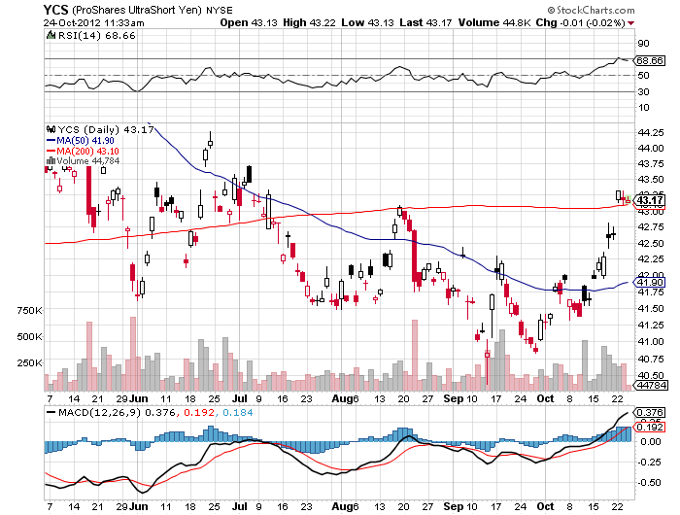
(YCS)
200 Day MA

Slide 37

Energy-sell oil rallies with (USO) put spreads
*Geopoliticals can’t overwhelm weakening demand *Go short on every way rumor, Israeli intelligence told me they will wait until next summer to see if Iran sanctions work *Slowing China is a big factor, oil demand grew 8%/year from 2000 to 2011, growing at 2% in 2012 *Futures structure says that prices are headed lower *Natural gas has stalled at a peak.

Slide 38
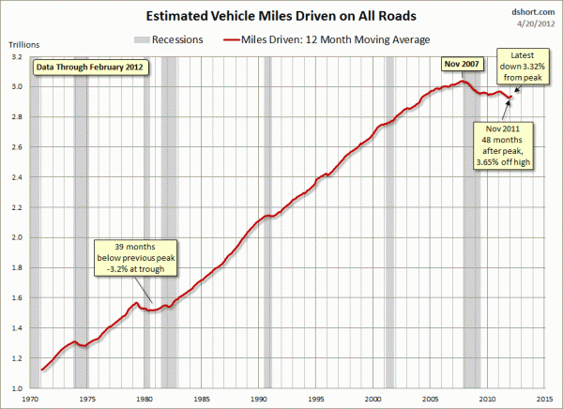
Miles Driven have Fallen for 5 years fewer miles driven and better mileage per car bad for oil total miles down to 1998 level today
1998 level

Slide 39
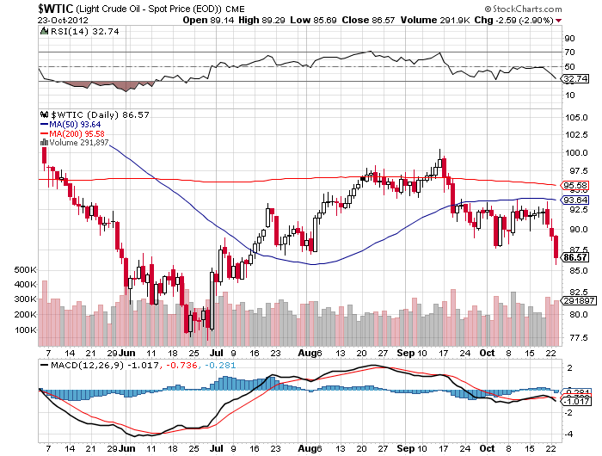
Crude-trading like death

Slide 40
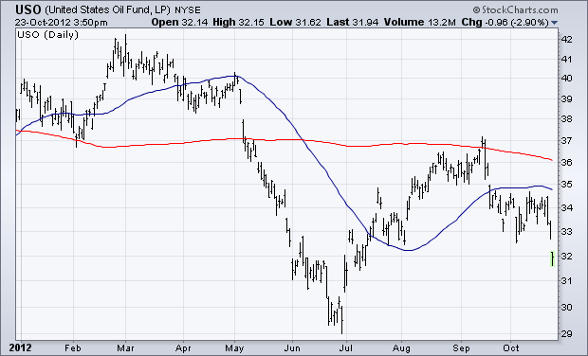
(USO)

Slide 41
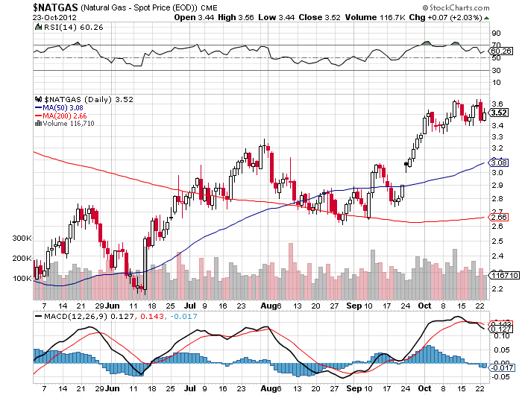
Natural Gas

Slide 42
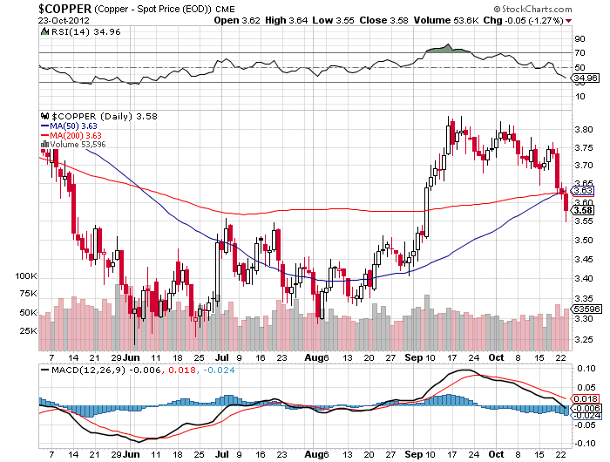
Copper (CU)-China bounce

Slide 43

Precious Metals-Run longs in small limited risk positions Long (GLD) 12/$160-$165 Bull call spread
*”RISK OFF” hits the precious metals big time *Traders selling big winners going into year end *Investors want to see the monetary expansion before buying it, may take months *Rumors of European gold sales to collateralize future sovereign bond issues, not true, 400 ton a year treaty limitation *Romney bump in polls is triggering profit taking in precious metals. No Obama means no Bernanke means no QE *May resume upside when Obama win is in the bag *Downside: 2 more weeks of pain

Slide 44
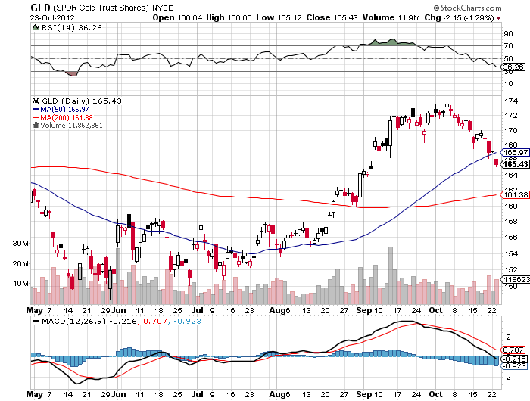
Gold-cut positions by 75% long the December $160-$165 call spread Is $1,614 the downside target, down $40 more?
200 Day MA

Slide 45
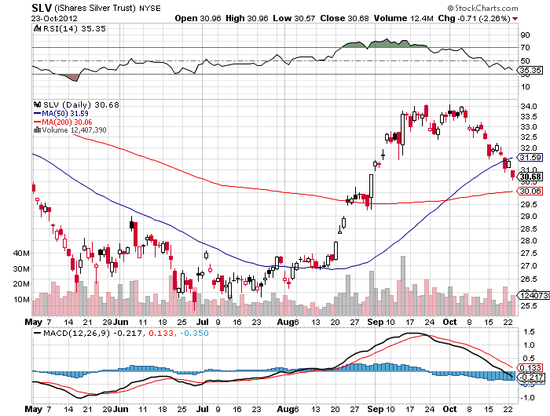
Silver-don’t own the high beta metal unless you’re sure

Slide 46
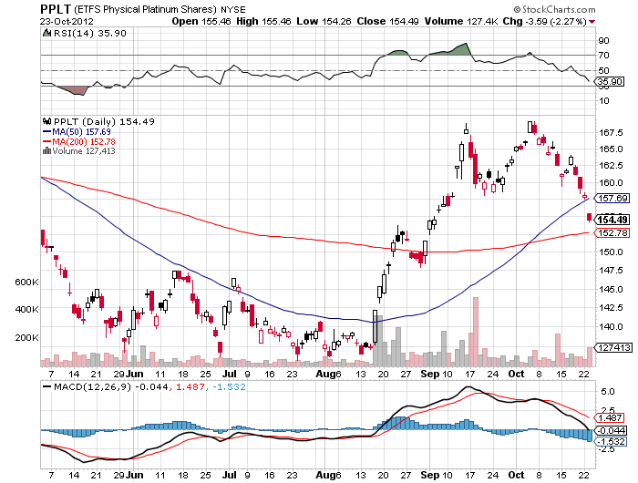
(Platinum) (PPLT)- Ouch!

Slide 47
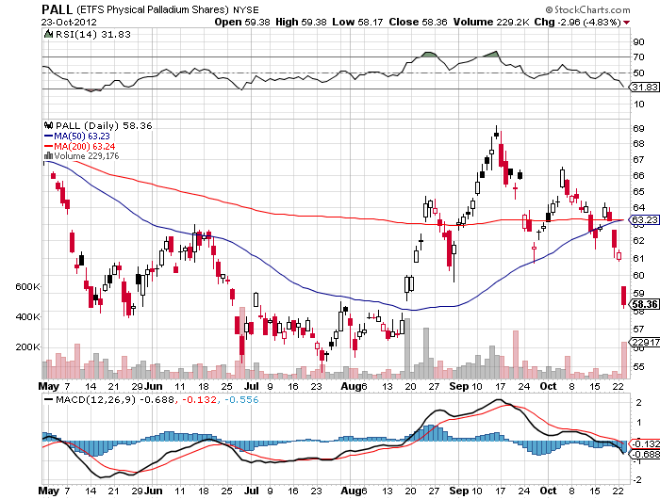
Palladium (PALL)-double ouch!

Slide 48

The Ags long the (CORN) 11/$50-$55 bear put spread
*Charts are clearly rolling over *Trade is out of season *No Major Dept. of Agriculture reports due *87% of corn crop is in, so any surprises will be small *Is a short term trade only, off in 14 days

Slide 49
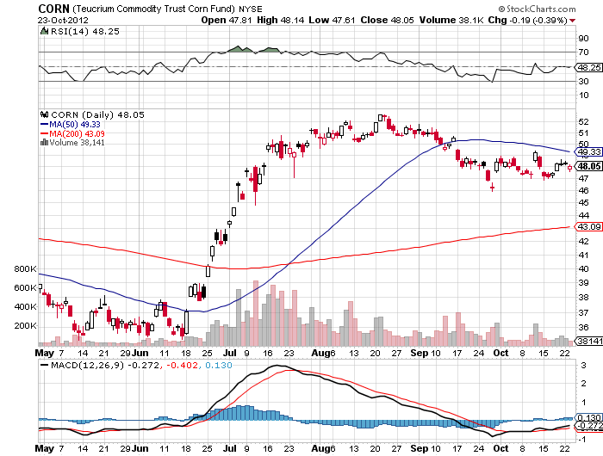
(CORN)

Slide 50
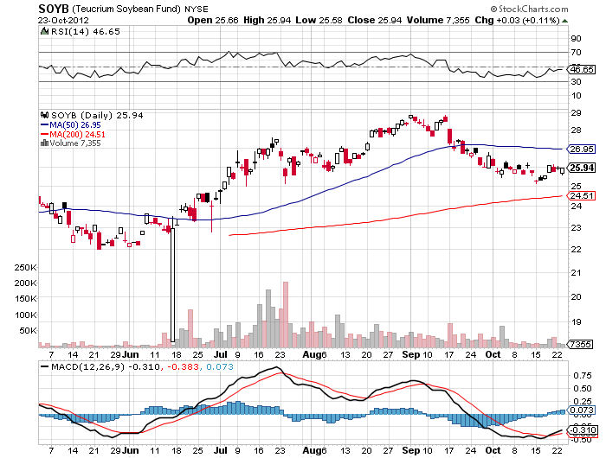
Soybeans (SOYB)

Slide 51
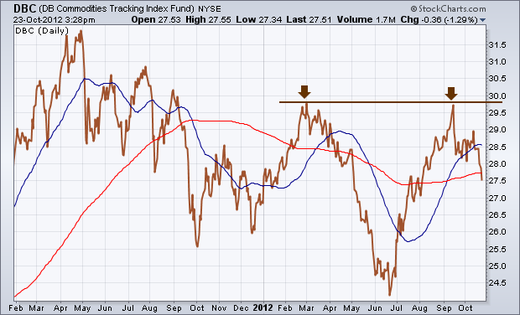
DB Commodities Index ETF (DBC)

Slide 52
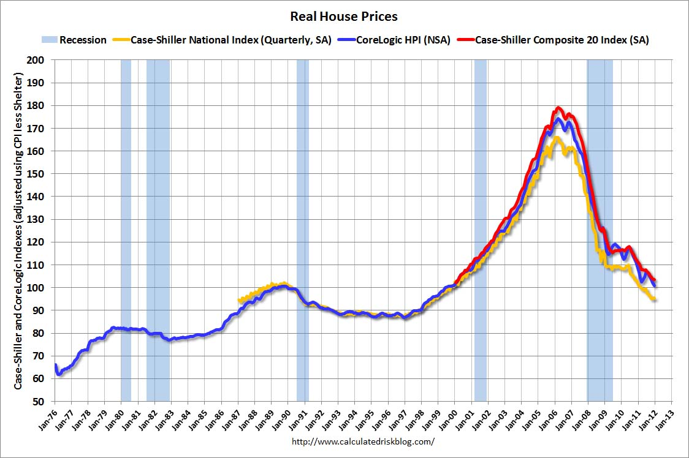
Real Estate No longer a drag, but a modest positive Rally will end when recession hits in 2013
“Twist” was extended to mortgage backed securities. The 30 year fixed has plunged from 3.75% to 3.40%, lower to come

Slide 53

Trade Sheet The bottom line: Wait for the Fed
*Stocks- stand aside, wait for correction to finish *Bonds- sell rallies under a 1.50% yield, buy under 1.90% *Commodities-stand aside, sell next oil and copper rallies *Currencies- sell yen on breakout through ¥80 *Precious Metals – buy the big dips *Volatility-stand aside, don’t chase, will bounce along bottom *The ags –has gone dead, sell OTM Calls and spreads *Real estate- rent, don’t buy Next Webinar is on Wednesday, November 14 12:00 noon EST

Slide 54

To buy strategy luncheon tickets Please Go to www.madhedgefundtrader.com

