Slide 1
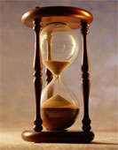
Please Stand By for John Thomas Wednesday, November 14, 2012, San Francisco, CA Global Trading Dispatch
The Webinar will begin at 12:00 pm EST

Slide 2
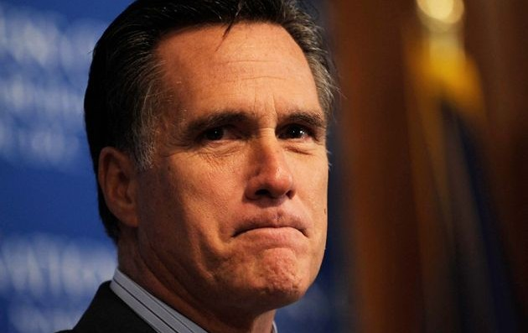
The Mad Hedge Fund Trader “The Romney Shock”
Diary of a Mad Hedge Fund Trader San Francisco, November 14, 2012 www.madhedgefundtrader.com

Slide 3
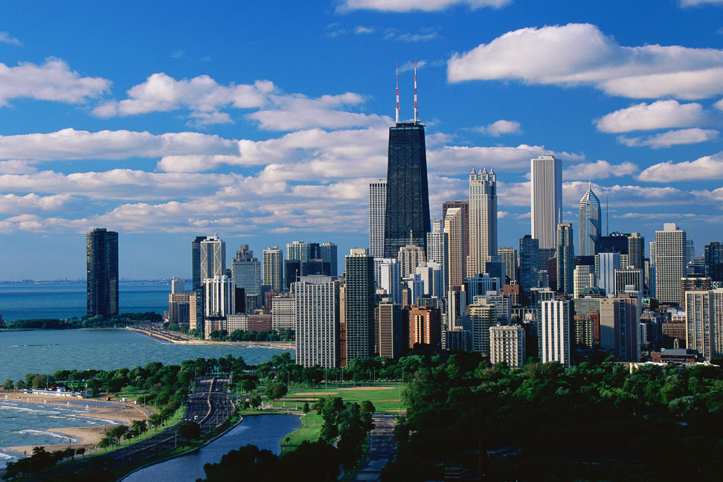
MHFT Global Strategy Luncheons Buy tickets at www.madhedgefundtrader.com
Chicago Friday, January 4, 2013

Slide 4

Trade Alert Performance Churning under All Time High
*November MTD -5.5% *2012 YTD +12.3%, compared to 7% for the Dow, beating it by 11.5% *First 100 weeks of Trading +52.5% *Versus +4.1% for the Dow Average A 48.4% outperformance of the index
91 out of 133 closed trades profitable 68.4% success rate on closed trades

Slide 5
Portfolio Review-Cutting risk before the election
Mad Hedge Fund Trader
Trading Book
Asset Class Breakdown
Risk Adjusted Basis
current capital at risk
Risk On
(GOOG) $600-$650 call spread | 10.00%
(SPY) $131-$136 Call Spread | 20.00%
(IWM) $76-$80 Call Spread | 10.00%
(AAPL) $525-$575 call spread | 10.00%
Risk Off
(FXE) $126-$131 put spread | -5.00%
(FXY) $119-$124 put spread | -5.00%
(FXY) $124-$127 Put Spread | -10.00%
total net position | 30.00%

Slide 6
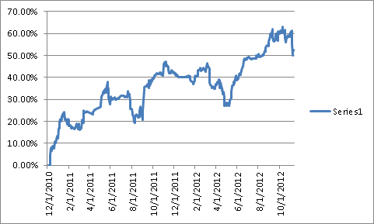
Performance Since Inception-New All Time High +25% Average Annualized Return

Slide 7
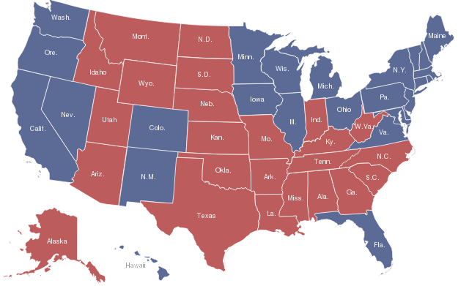
US Electoral College House of Representatives-435 + Senate-100 + District of Columbia-3 = 538 Obama wins 332 to 206

Slide 8
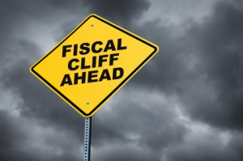
The Economy-Still weak fundamentals
*US first look Q3 GDP 2%, up from Q2 1.3% *Weekly jobless claims up -8,000 to 355,000, is positive *Japan Q3 GDP -0.9%, -3.5% YOY *US October retail sales -0.3%-hurricane Sandy effect *US October PPI a very weak -0.2%, 2.2% YOY *HSBC private China PMI 49.5 to 50.2 over 50 for the first time in months *Will fiscal cliff cause a Q4 slowdown? *All consistent with a low 1.5% GDP growth rate, or lower

Slide 9
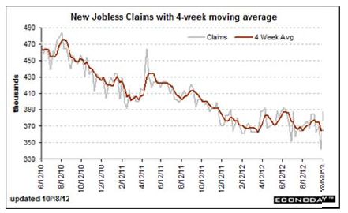
Weekly Jobless Claims Trapped in a Sideways Range Break 400,000 and the recession threat is on to 50,000 gain is bogus

Slide 10
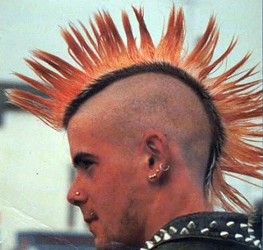
Bonds-Get ready to sell the spike
*Moved to top end of a narrow range *the 1.40% - 1.90% range holds, could be our range for years *Look to sell spread spreads outside these ranges *Muni bonds rocket on fiscal cliff *$40 billion a month in MBS buying is still on the menu *QE3 will work eventually, will be felt in the 30 year fixed rate home loan the most, now at 3.25%

Slide 11
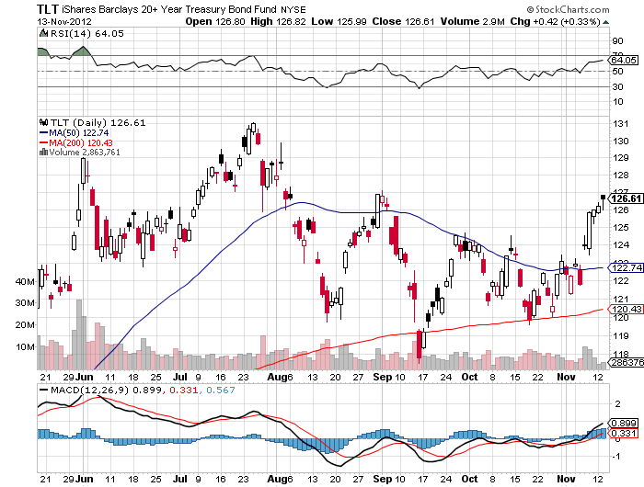
(TLT)

Slide 12
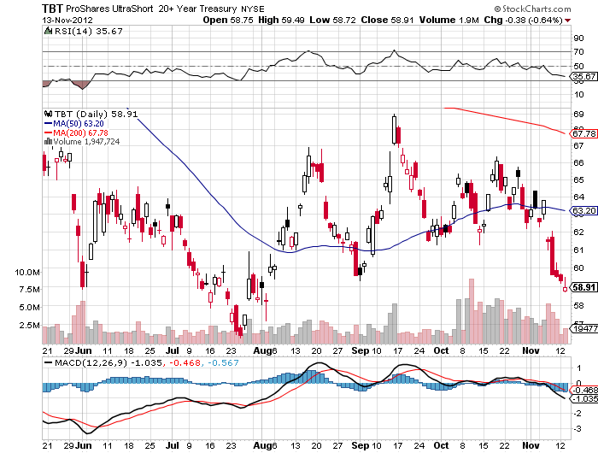
Short Treasuries (TBT) See the 1:4 reverse Split

Slide 13
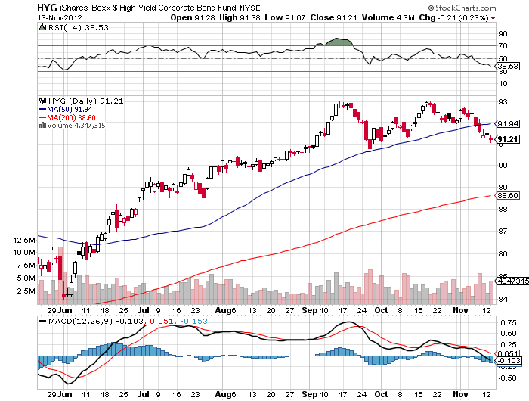
Junk Bonds (HYG)-pointing to a bottom in the stock market?

Slide 14
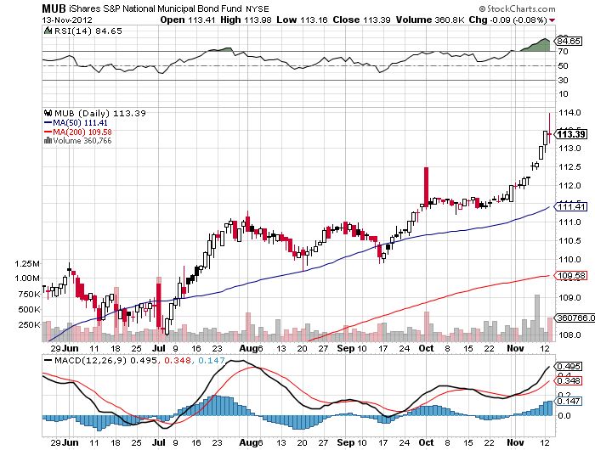
Municipal Bonds (MUB)-3% yield, Mix of AAA, AA, and A rated bonds

Slide 15
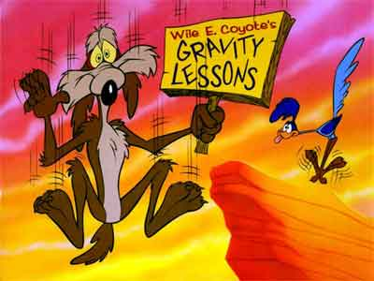
Stocks-waiting for the fiscal cliff
*Romney shock sends market spilling *Higher capital gains taxes are now a certainty is accelerating selling in 2012 *I underestimated the number of people convinced Romney would win *Created kneejerk selling of Romney positions *No fiscal cliff resolution is in the price, resolution isn’t. Next big move is up *QE3 raises the floor below stocks, so they won’t crash *Markets could chop sideways until fiscal cliff resolved as traders await resolution

Slide 16
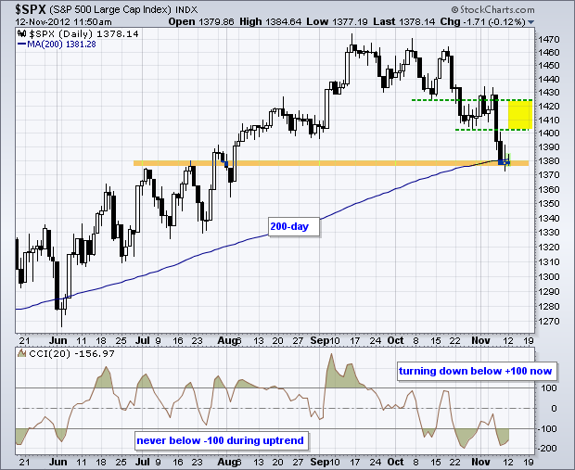
(SPX)-Did we just get a triple top? Or a head and shoulders top? 200 day MA target at 1,365, down 48 points? Long the (SPY) $131-$136 call spread

Slide 17
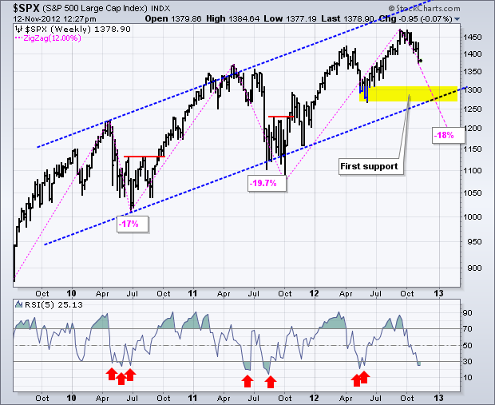
(SPX)-the worst case scenario major long term trend support at 1,280 But RSI says the bottom is here, now
RSI Bottom

Slide 18
SPY Downside Hedge
Trade Alert - (SPY) Buy the SPDR S&P 500 (SPY) December, 2012 $137 Puts at $2.02 or best Opening Trade 11-14-2012 – 9:30 AM EST expiration date: 12-21-2013 Portfolio weighting: 2.8% Number of Contracts = 10 contracts Buy 10 December, 2012 (SPY) $137 Calls at……………$2.82 total cost: $2,820

Slide 19
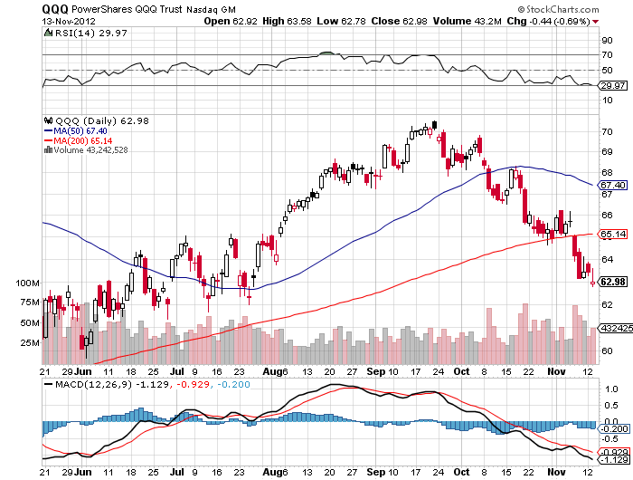
(QQQ)-NASDAQ running out of downside

Slide 20
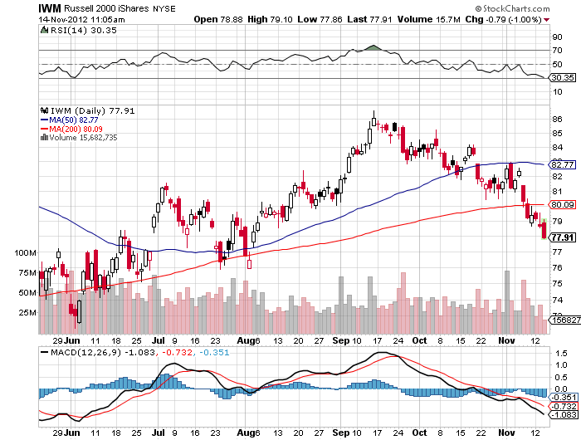
(IWM)- long the 1/$76/$80 bull call spread

Slide 21
(IWM)-downside hedge
Buy the iShares Russell 2000 Index ETF (IWM) December, 2012 $78 puts at $2.20 or best Opening Trade 11-14-2012 – 9:30 AM EST expiration date: 1-18-2013 Portfolio weighting: 1.8% Number of Contracts = 8 contracts Buy 8 December, 2012 (IWM) $78 Calls at……………$2.20 total cost: $1,760

Slide 22
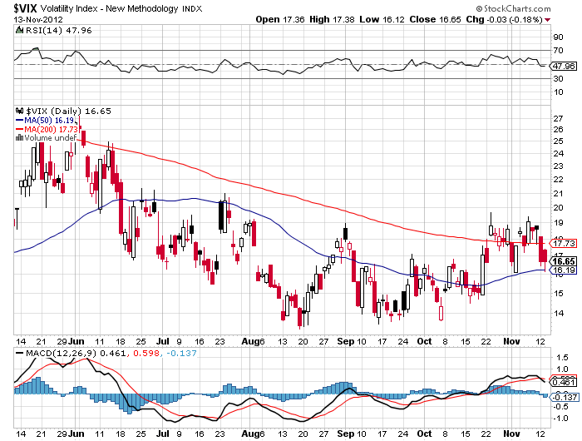
(VIX)-not buying the meltdown scenario

Slide 23
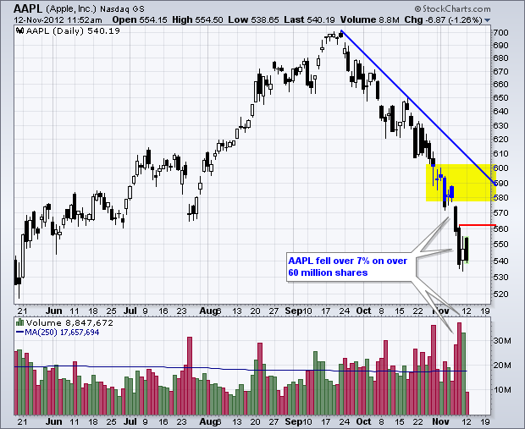
(AAPL)-Long the 1/$525-575 Call spread the capitulation is in buy this dip

Slide 24
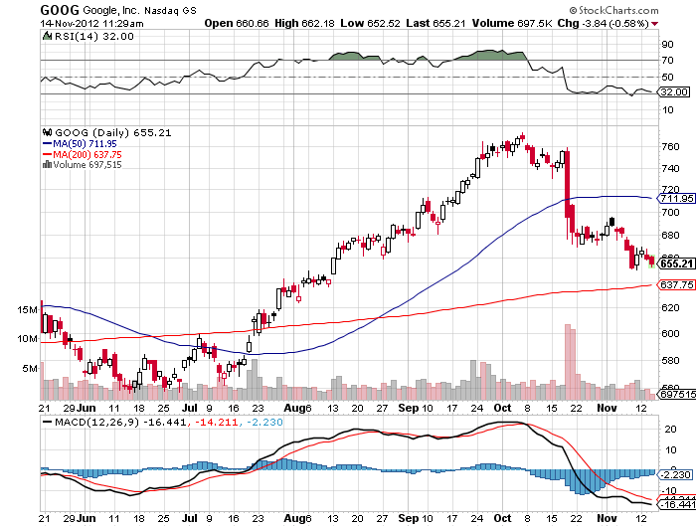
(GOOG) Long the 1/$600/$650 call spread

Slide 25
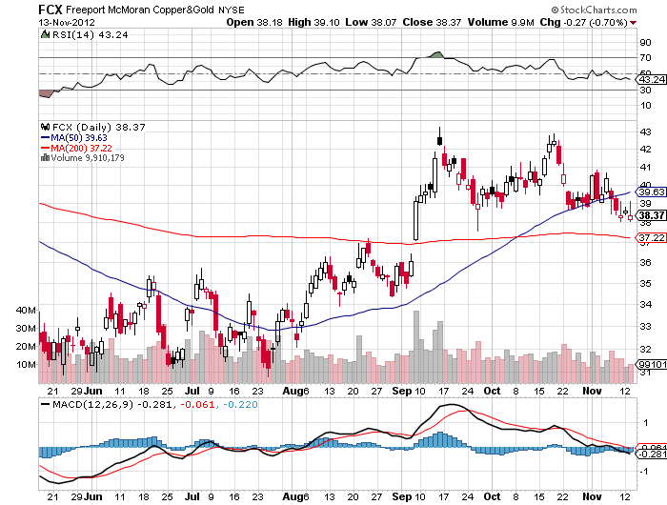
(FCX)-the support must hold

Slide 26
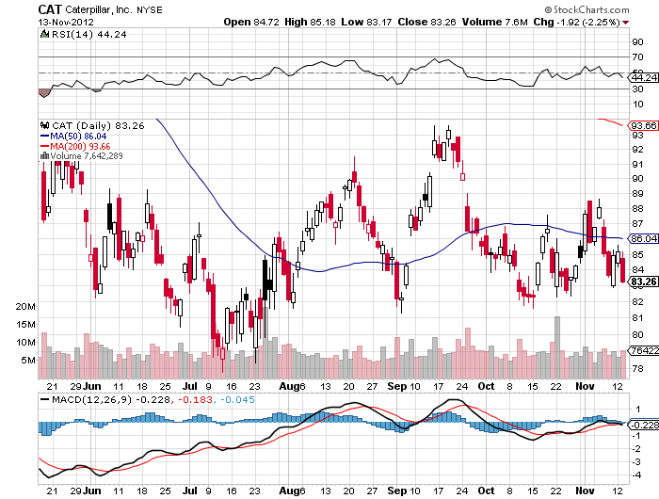
(CAT)-bottom of the range

Slide 27
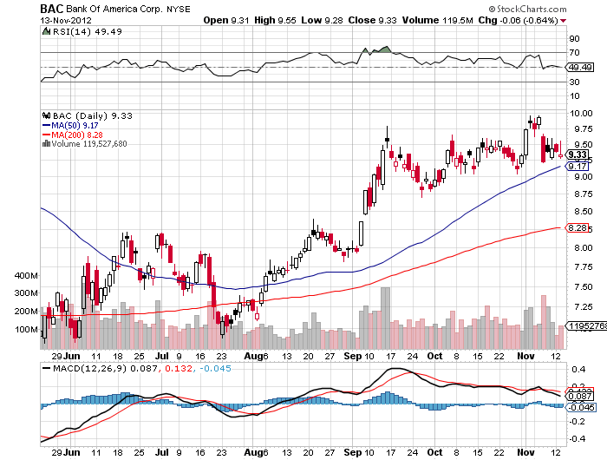
(BAC)-holding its own, a big outperformer since September

Slide 28
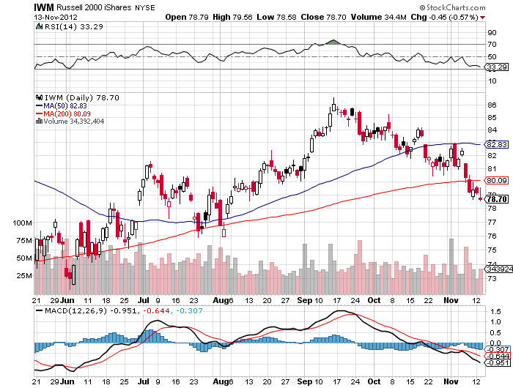
Russell 2000 (IWM)

Slide 29
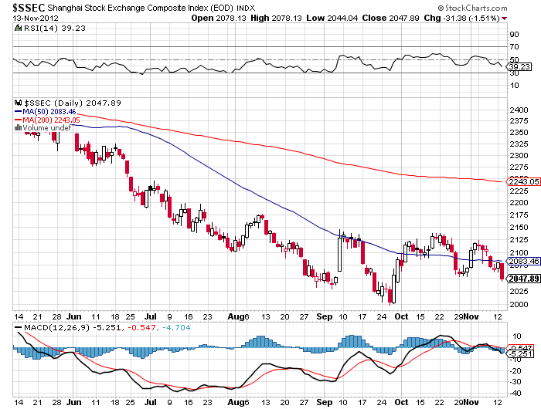
Shanghai-still looking for a bottom

Slide 30

My Post Election Shopping List Stocks to buy on the dip January Deep in-the-money Calls Spreads
Apple (AAPL) Google (GOOG) Disney (DIS) JP Morgan (JPM) Boeing (BA) Merck (MRK)

Slide 31

The Dollar-flight to safety
*”RISK OFF” brings major dollar rally *Euro and Yen hedges worked big time, rescued our performance *Headlines from Europe hammering the Euro *Euro hit $1.26 target, next target is $1.22 *Japan prime minister Noda calls elections triggers overnight yen collapse, 200 day moving average break is holding *Chinese yuan hits new 19 year high

Slide 32
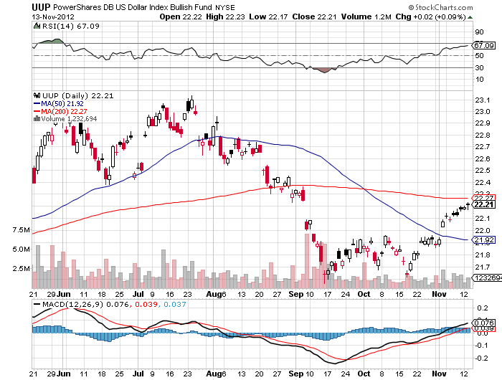
Long Dollar Basket (UUP) Major trend reversal is in

Slide 33
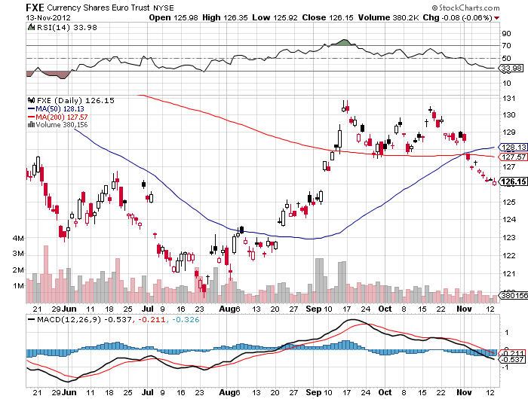
Euro (FXE) the breakdown is complete long the 1/$126-$131 bear put spread

Slide 34
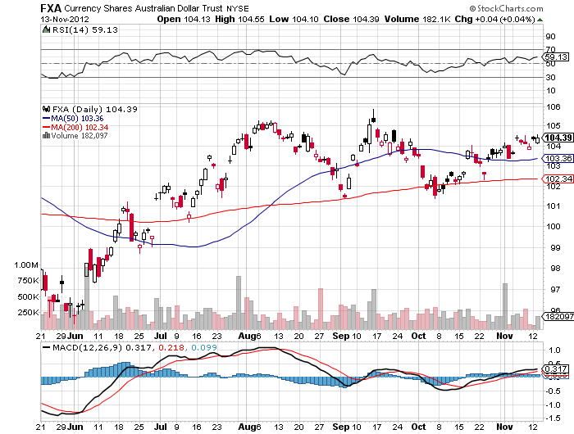
Australian Dollar (FXA)

Slide 35
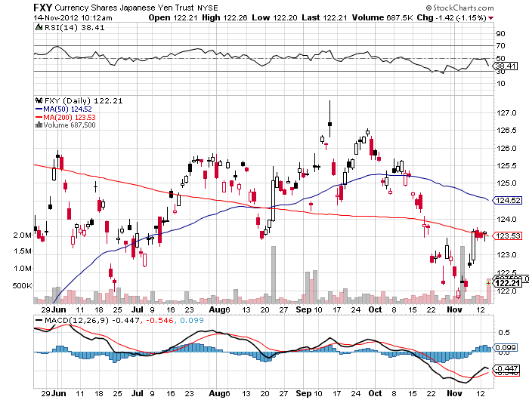
Japanese Yen (FXY) Long $124-$127 November bear put spread-expires Friday long 1/$119-$124 bear put spread
200 Day MA

Slide 36
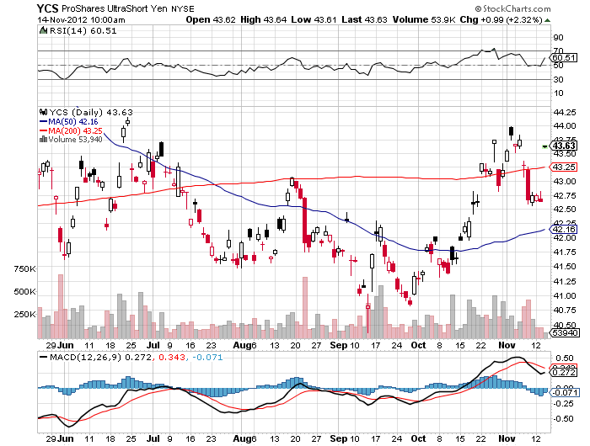
(YCS)
200 Day MA

Slide 37
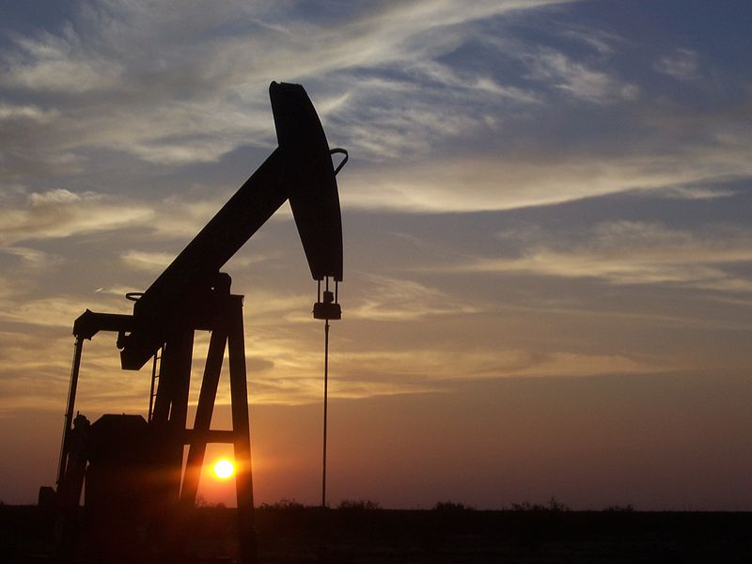
Energy-sell oil rallies with (USO) put spreads
*IEA report says US energy independence by 2030, US out produces Saudi Arabia by 2020 *Go short on every way rumor, *Futures structure says that prices are headed lower *Natural gas hits a one year high.

Slide 38
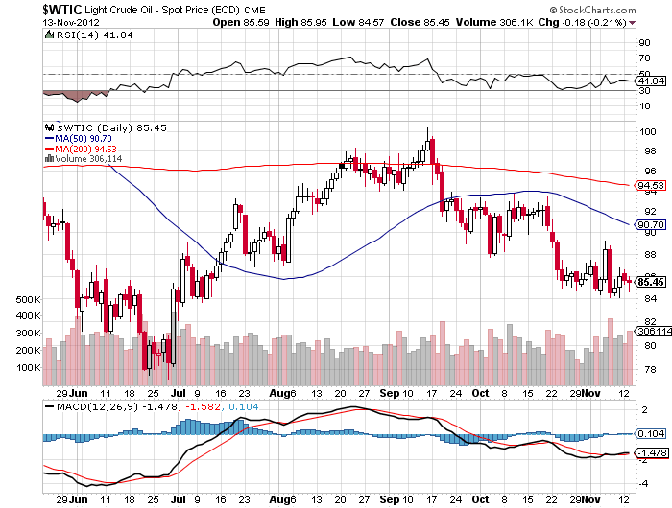
Crude-trading like death

Slide 39
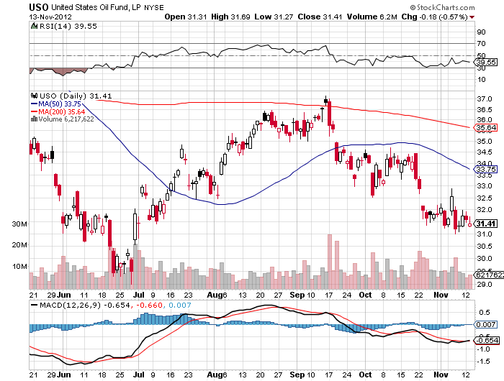
(USO)

Slide 40
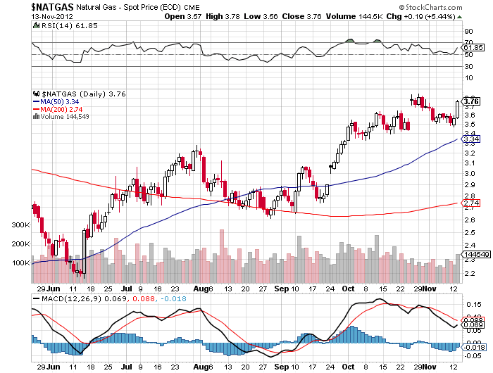
Natural Gas

Slide 41
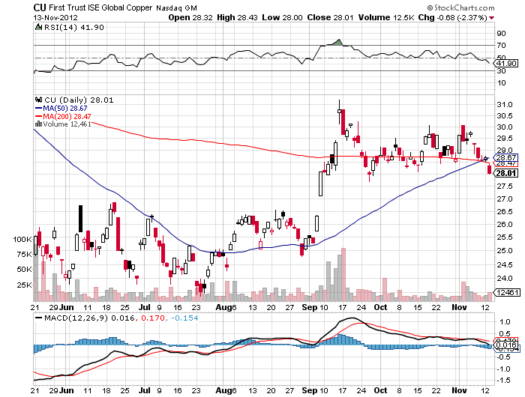
Copper (CU)-China bounce

Slide 42
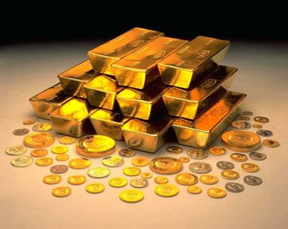
Precious Metals-Run longs in small limited risk positions
*Gold has flipped from a “RISK ON” asset to a “RISK OFF” one *Expectation of rise on monetary base from QE3 fueling move *Investors want to see the monetary expansion before buying it, may take months *Emerging market central bank buying helping *Market started discounting a Romney loss early November *Bull move resumed upside when Obama win was in the bag

Slide 43
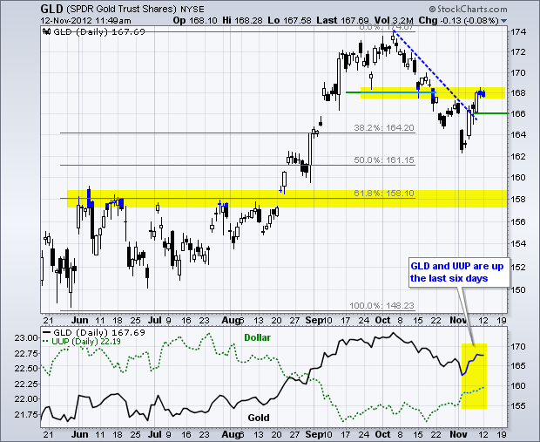
Gold-cut positions by 75%
200 Day MA

Slide 44
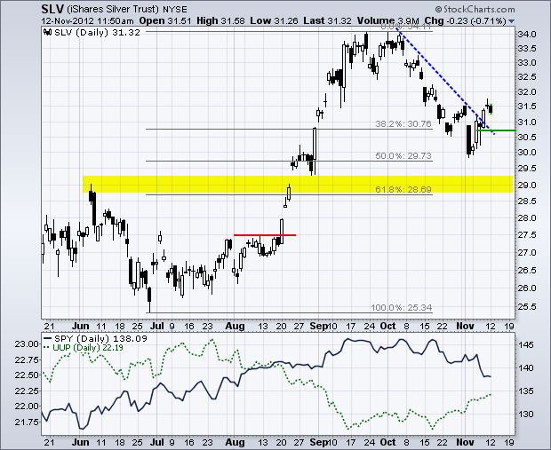
Silver

Slide 45
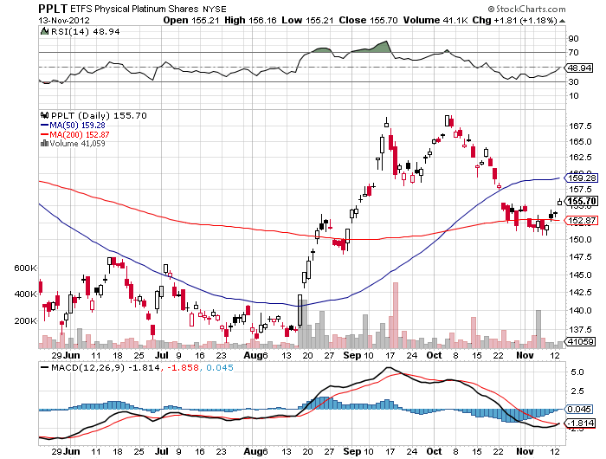
(Platinum) (PPLT)- Ouch!

Slide 46
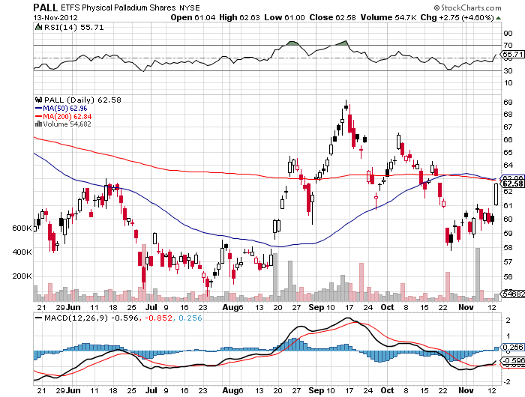
Palladium (PALL)-double ouch!

Slide 47
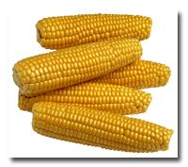
The Ags the (CORN) 11/$50-$55 bear put spread-expires Friday
*Charts are clearly rolling over *Trade is out of season *No Major Dept. of Agriculture reports due

Slide 48
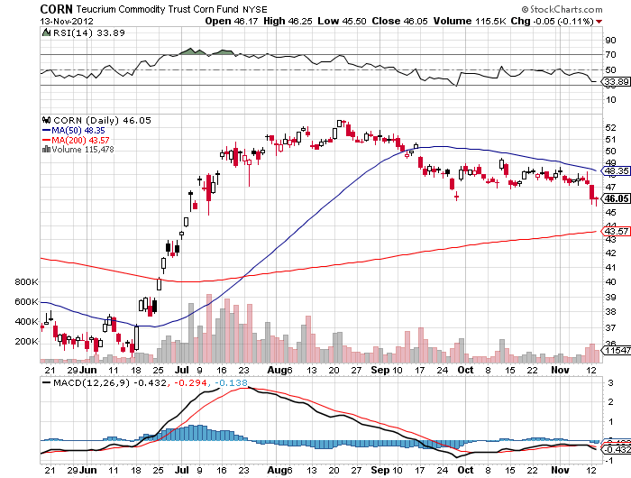
(CORN)

Slide 49
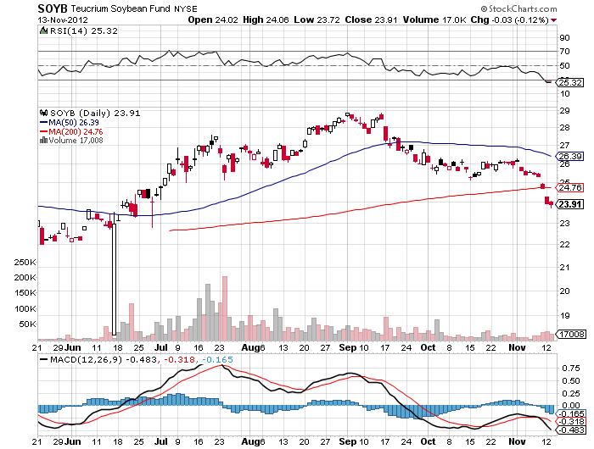
Soybeans (SOYB)

Slide 50
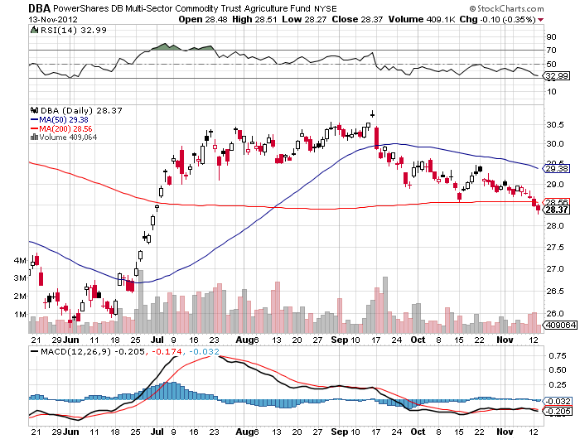
DB Commodities Index ETF (DBC)

Slide 51
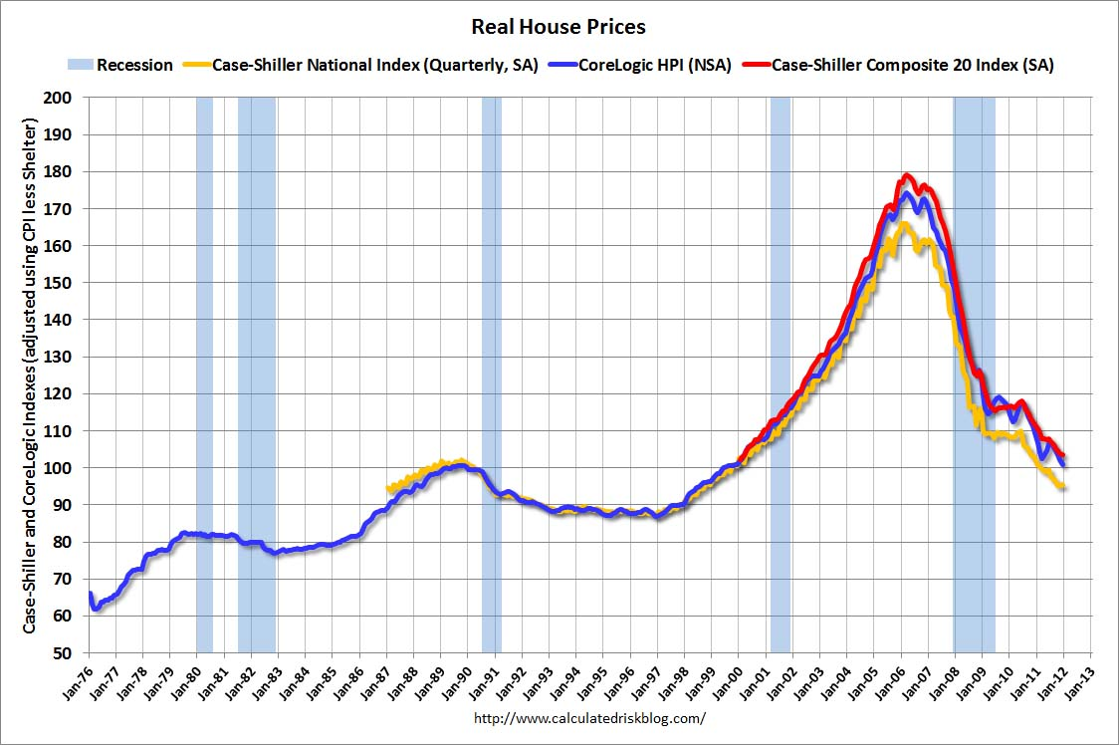
Real Estate No longer a drag, but a modest positive Rally will end when recession hits in 2013
“Twist” was extended to mortgage backed securities. The 30 year fixed has plunged from 3.75% to 3.40%, lower to come

Slide 52

Trade Sheet The bottom line: Wait for the Fed
*Stocks- stand aside, wait for correction to finish *Bonds- sell rallies under a 1.50% yield, buy under 1.90% *Commodities-stand aside, sell next oil and copper rallies *Currencies- sell yen on breakout through ¥80 *Precious Metals – buy the big dips *Volatility-stand aside, don’t chase, will bounce along bottom *The ags –has gone dead, sell OTM Calls and spreads *Real estate- rent, don’t buy Next Webinar is on Wednesday, November 28 12:00 noon EST

Slide 53

To buy strategy luncheon tickets Please Go to www.madhedgefundtrader.com

