Slide 1
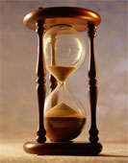
Please Stand By for John Thomas Wednesday, November 28, 2012, San Francisco, CA Global Trading Dispatch
The Webinar will begin at 12:00 pm EST

Slide 2
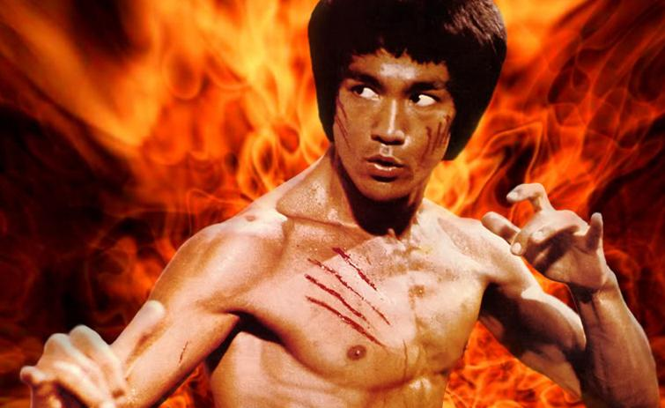
The Mad Hedge Fund Trader “Here Comes the Chop”
Diary of a Mad Hedge Fund Trader San Francisco, November 28, 2012 www.madhedgefundtrader.com

Slide 3

MHFT Global Strategy Luncheons Buy tickets at www.madhedgefundtrader.com 2012 Schedule
January 4, 2013 Chicago

Slide 4
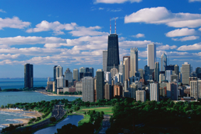
MHFT Global Strategy Luncheons Buy tickets at www.madhedgefundtrader.com
Chicago, January 4, 2013

Slide 5

Trade Alert Performance Churning under All Time High
*November MTD -0.45% *2012 YTD +17.4%, compared to 5% for the Dow, beating it by 12% *First 102 weeks of Trading +57.6% *Versus +5% for the Dow Average A 53% outperformance of the index
93 out of 134 closed trades profitable 69.4% success rate on closed trades

Slide 6
Portfolio Review-Cutting risk before the election
Mad Hedge Fund Trader
Trading Book
Asset Class Breakdown
Risk Adjusted Basis
current capital at risk
Risk On
(GOOG) $600-$650 call spread | 10.00%
(SPY) $131-$136 Call Spread | 20.00%
(IWM) $76-$80 Call Spread | 10.00%
(AAPL) $525-$575 call spread | 10.00%
Risk Off
(FXE) $126-$131 put spread | -5.00%
(FXY) $119-$124 put spread | -5.00%
(USO) $29-$32 put spread | -5.00%
(SPY) $137 puts | -24.00%
(IWM) $78 puts | -10.00%
total net position | 1.00%

Slide 7
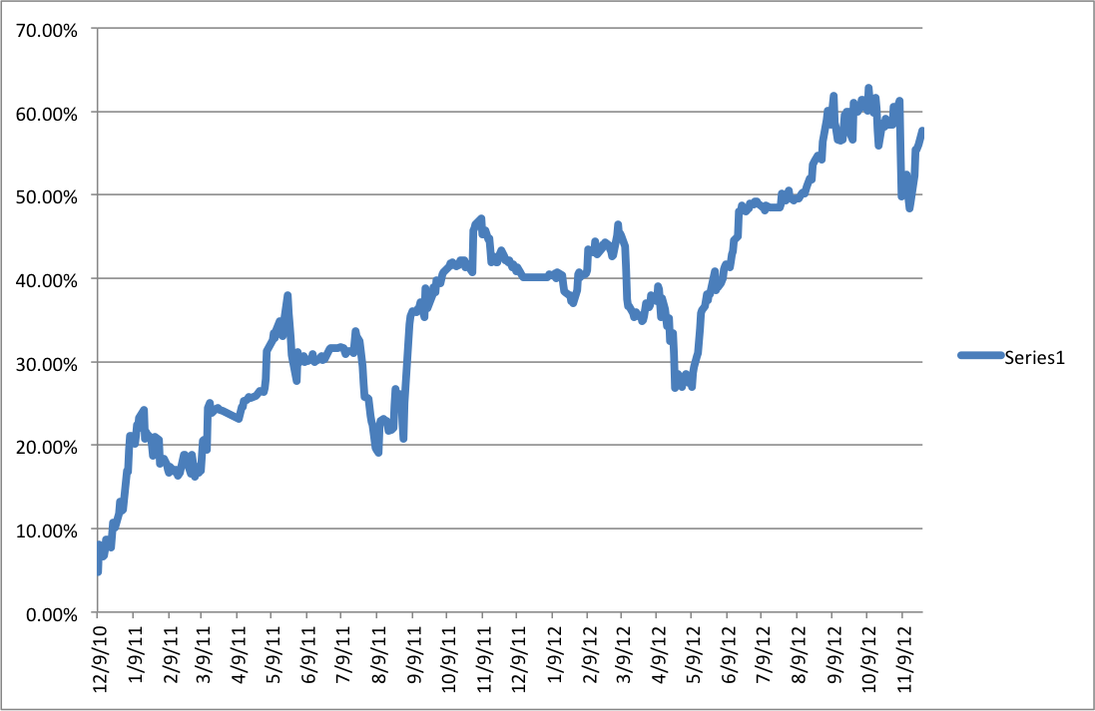
Performance Since Inception-New All Time High +33.1% Average Annualized Return

Slide 8
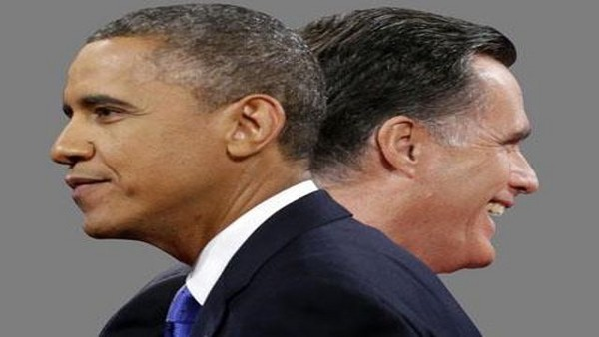
The Economy-A Post Election Pop?
*German Q3 GDP a very weak 0.2%, Q4 will be negative *Weekly jobless claims up +41,000 to 410,000, 18 month high is meaningless due to Sandy aberrations *China HSBC private PMI 50.4, over 50 *October US housing starts +3.6% to 894,000, a 4 year high, still 1/3 peak levels *University of Michigan Consumer November Confidence Survey 73.1 to 73.7 *November Richmond Fed Survey -7 to +9 *Black Friday and Cyber Monday sales huge (WMT) *Will US Q3 GDP come in at a hot 2.8%? *All consistent with a low long term 1.5% GDP growth rate, or lower

Slide 9
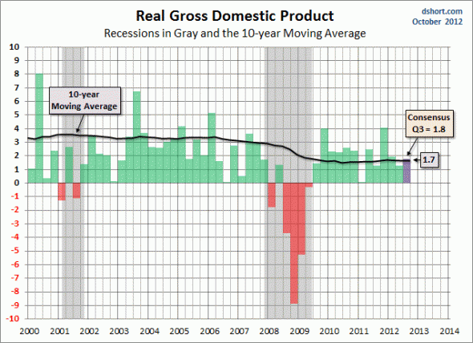
US Quarterly GDP Q3 Advanced Look out on Friday

Slide 10
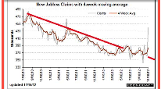
Weekly Jobless Claims Data has become useless, thanks to Sandy Flying on instruments without a radar calling for a recession or not?

Slide 11

Bonds-Gone to Sleep
*Fiscal Cliff offsets QE3 *the 1.40% - 1.90% range holds, could be our range for years *Look to sell spread spreads outside these ranges *$40 billion a month in MBS buying is still on the menu *QE3 is kicking in *Only the muni bond market is rocketing

Slide 12
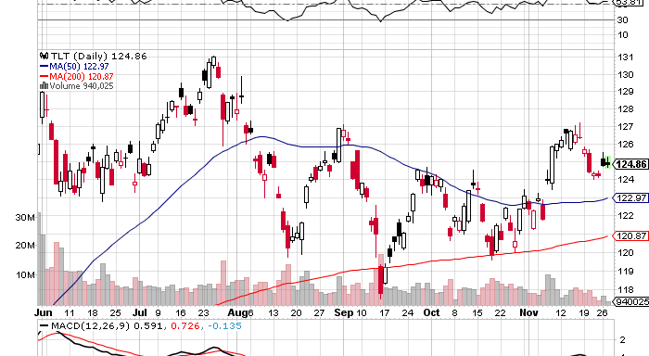
(TLT)

Slide 13
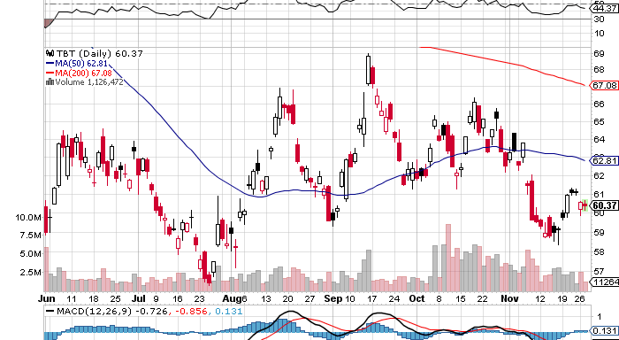
Short Treasuries (TBT) See the 1:4 reverse Split

Slide 14
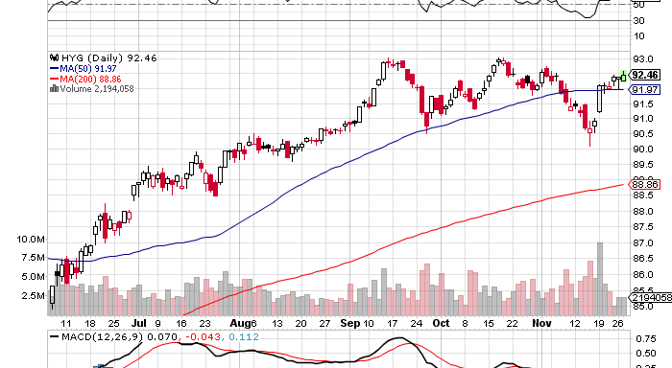
Junk Bonds (HYG)

Slide 15
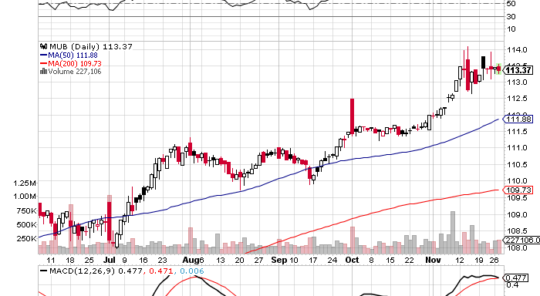
Municipal Bonds (MUB)-3% yield, Mix of AAA, AA, and A rated bonds

Slide 16
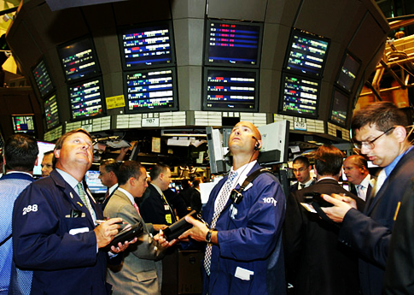
Stocks-Fiscal Cliff mania
*Take a view, don’t trade every headline, or you’ll go broke *Tax loss selling is done, buy high yielders once more *The fiscal cliff resolution is approaching *Apple leads the rebound, leads “non-pc” tech *”RISK ON” returns means the yearend rally has started *Going for non-global exposure with the Russell 2000 (IWM)

Slide 17
Fiscal Cliff Resolution
*Cap all deductions at $50,000, raises about $1 trillion a year *Raise capital gains tax from 15% to 20% *Raise social security retirement age from 66 to 70 over 30 years *Means test social security, earning over $250,000 a year means no $22,000 a year benefit *Treat dividend and interest income as ordinary income?

Slide 18
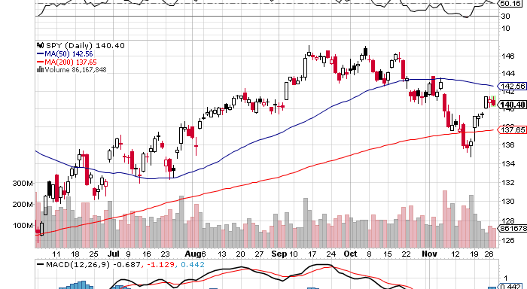
(SPY)-Bouncing hard off the 200 day Long the 1/$131-$136 call spread

Slide 19
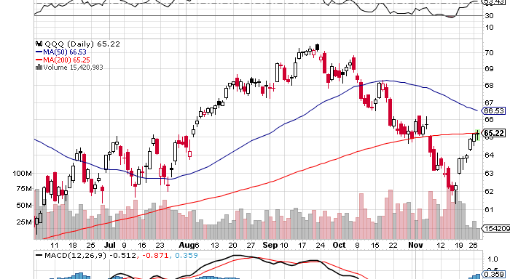
(QQQ)-NASDAQ leading the upside charge they were never going to rest for long

Slide 20
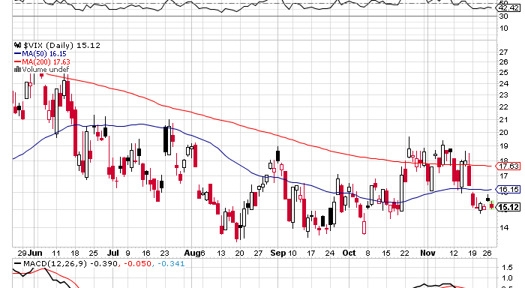
(VIX)-the “Tell” worked

Slide 21
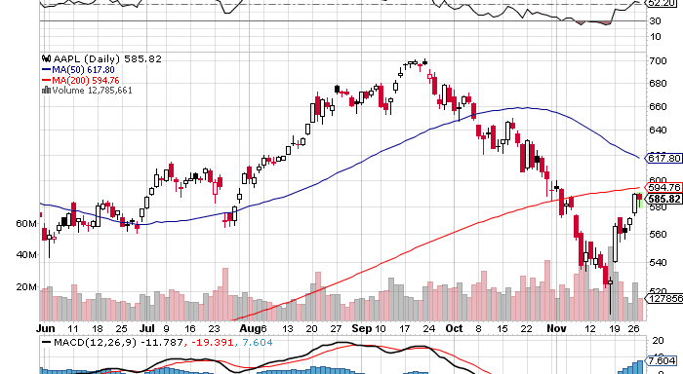
(AAPL)-Long the 1/$525-575 Call spread Long the 1/$450-500 Call spread

Slide 22
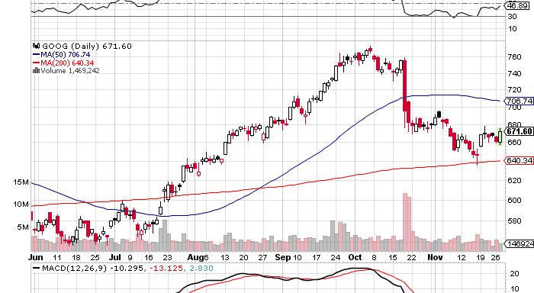
(GOOG)-the basing looks good, takeover rumors proved false long the 1/$600-$650 call spread

Slide 23
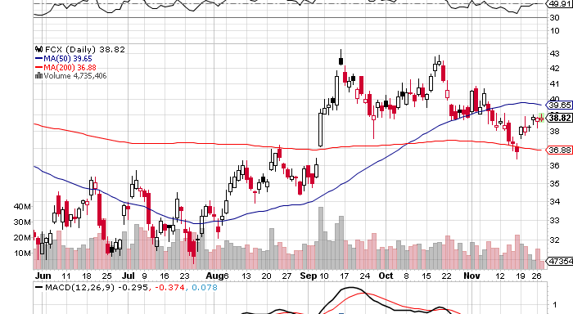
(FCX)-China plays still dead in the water

Slide 24
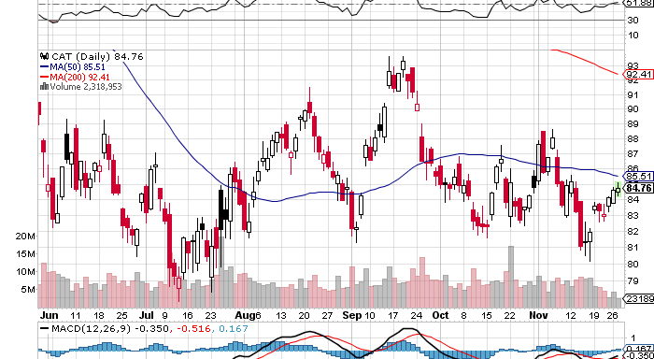
(CAT)

Slide 25
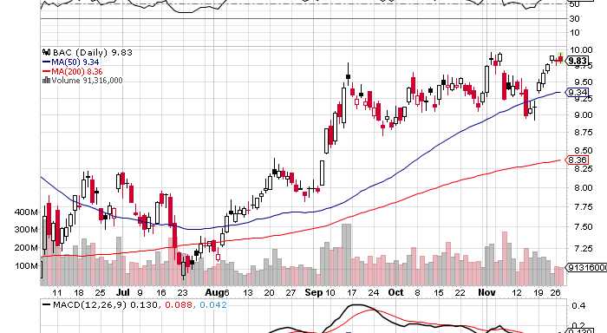
(BAC)-augurs for double top scenario

Slide 26
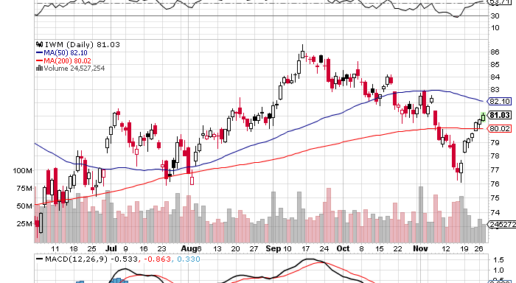
Russell 2000 (IWM) Long the $76-$80 call spread Long equities ex Europe and Asia exposure

Slide 27
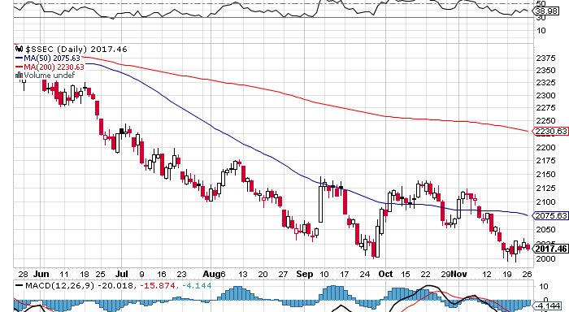
Shanghai-Is this the double bottom?

Slide 28
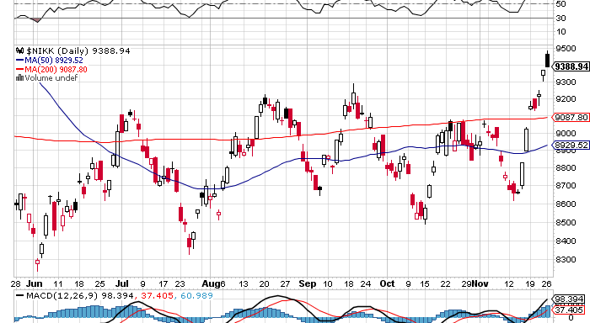
Japan-loves the weak yen

Slide 29

My Post Election Shopping List Stocks to buy on the dip November, December, January Deep in-the-money Calls Spreads
Apple (AAPL) Google (GOOG) Disney (DIS) JP Morgan (JPM) Boeing (BA) Merck (MRK)

Slide 30

The Dollar
*Big “RISK ON” move hurt the dollar *Yen collapse is dominating the markets *Consolidating now, but could run to ¥85 by the December 14 election *Is the start of a multiyear run to $150 *Buy the rumor, sell the news on the Greek bailout with the euro *Greek deal finally done, cuts debt to GDP from 175% in 2016 to 110% in 2022, interest forgiven, maturities extended, is really a default *Euro correlation with stocks make it a great hedge, buy the next dip to $1.26

Slide 31
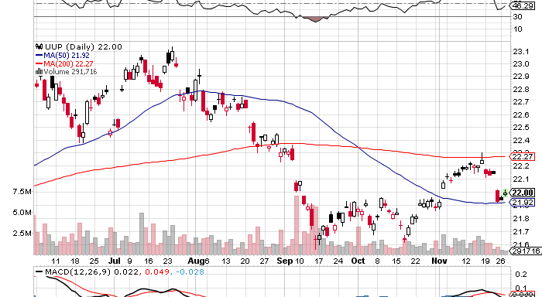
Long Dollar Basket (UUP) May bottom is holding

Slide 32
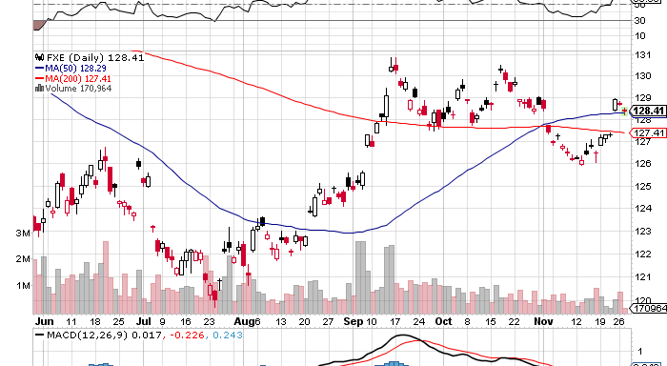
Euro (FXE) putting in a top?

Slide 33
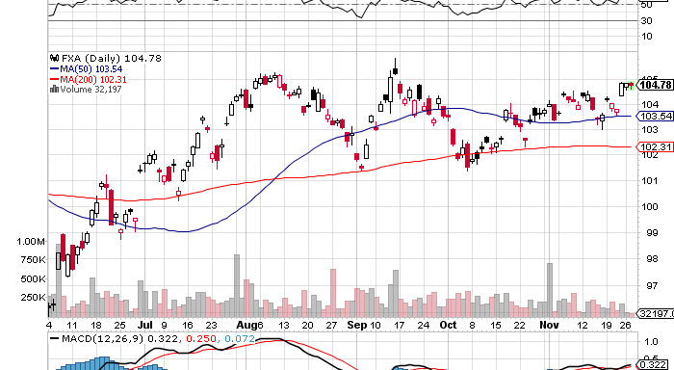
Australian Dollar (FXA)

Slide 34
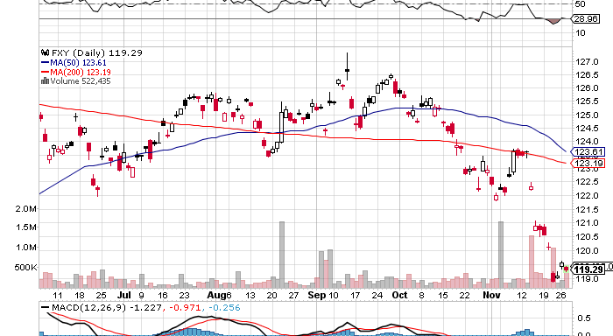
Japanese Yen (FXY) Long $124-$127 November bear put spread 14 days to run
200 Day MA

Slide 35
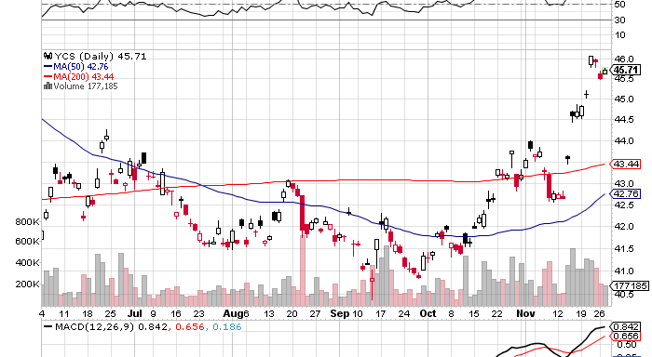
(YCS)
200 Day MA

Slide 36

Energy-sell oil rallies with (USO) put spreads LONG THE (USO) 1/$32-$29 PUT SPREAD
*Geopoliticals can’t overwhelm weakening demand *Go short on every way rumor, Israeli intelligence told me they will wait until next summer to see if Iran sanctions work *API inventory figures show big oversupply *Kazakhstan, Somalia, Yemen, and Syria all offline, Iran down 1 million b/d and the price still can’t go up *Futures structure says that prices are headed lower *First good “RISK OFF” DAY, AND OIL FALLS $3 *Natural gas has stalled at a peak.

Slide 37
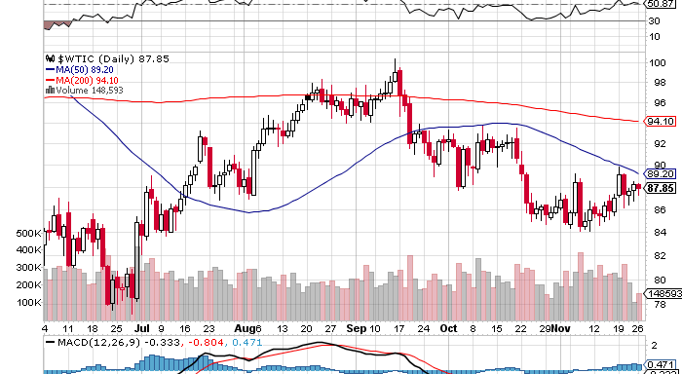
Crude-sell those rallies

Slide 38
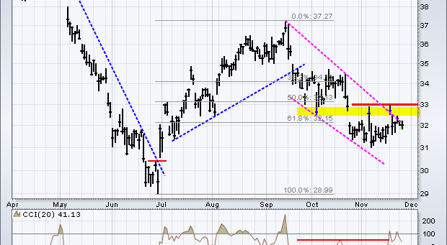
(USO)

Slide 39
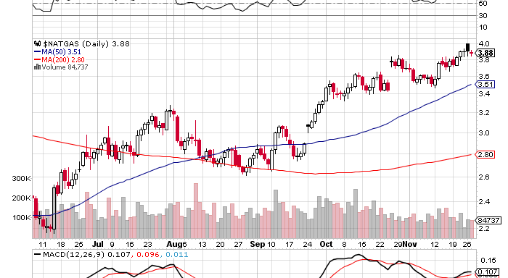
Natural Gas

Slide 40
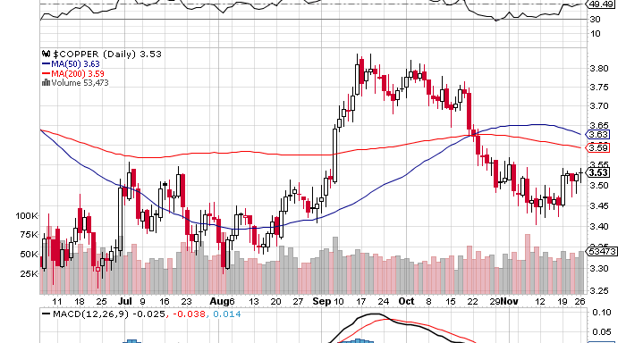
Copper (CU)-no China bounce

Slide 41
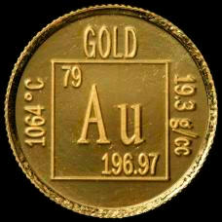
Precious Metals-Run longs in small limited risk positions
*”RISK ON” is great for gold *Year end profit taking is done *QE3 monetary expansion has started *Turkey gold sales to buy oil from Iran made October low *Obama win accelerated current rally *Taking a run at the highs across all metals

Slide 42
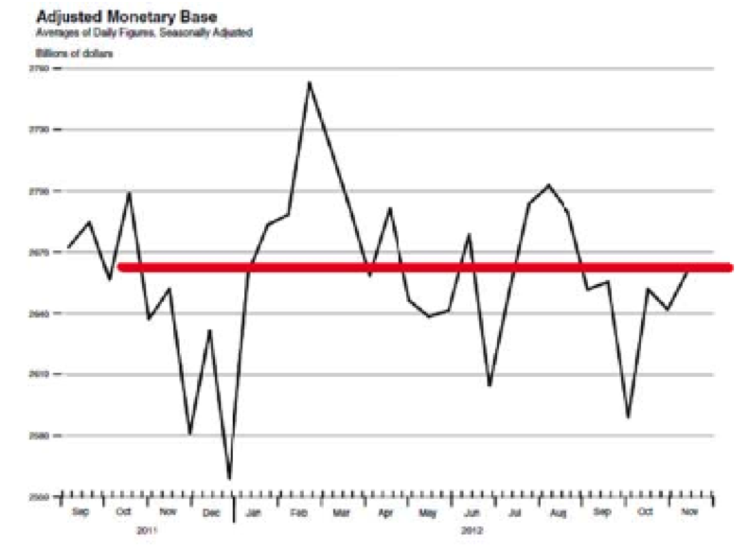
Adjusted Monetary Base tells the whole story on precious metals-delayed MBS settlement has delayed QE3
September Gold Peak at $1,798
October Gold Trough $1,665

Slide 43
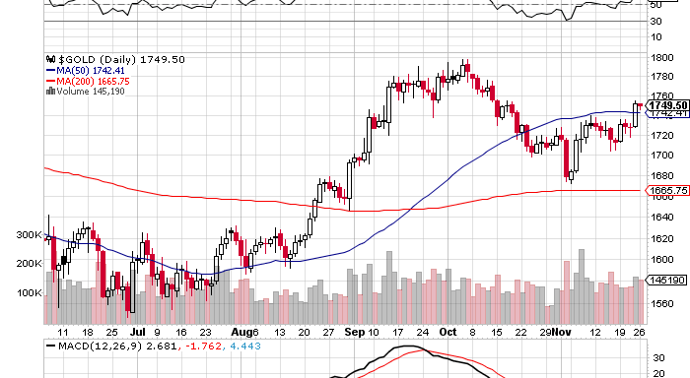
Gold-the 200 day MA held now taking a run at the highs
200 Day MA

Slide 44
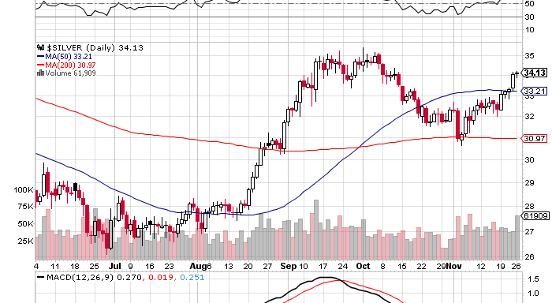
Silver-don’t own the high beta metal unless you’re sure

Slide 45
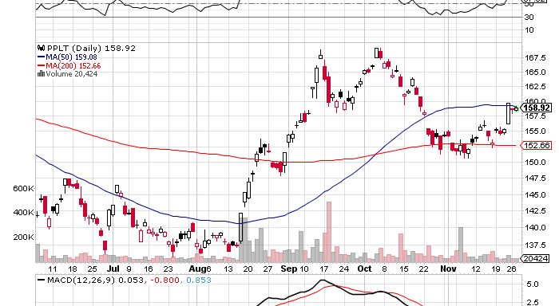
(Platinum) (PPLT)- Ouch!

Slide 46
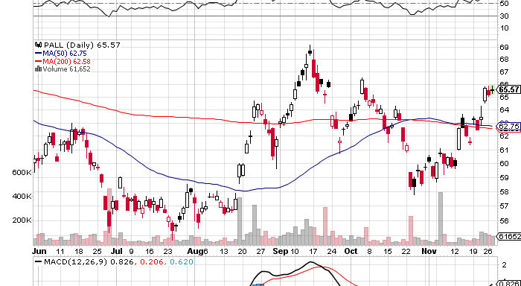
Palladium (PALL)

Slide 47

The Ags long the (CORN) 11/$50-$55 bear put spread
*Dead as a doorknob, Trade is out of season *USDA says winter wheat crop is 33% “good/excellent”, all time low *No Major Dept. of Agriculture reports due for rest of 2012 *Low Mississippi River levels causing transport problems *Still long term bullish, draught continues in Australia, Brazil, and Ukraine *Awaiting next spike up or down to tell us what to do

Slide 48
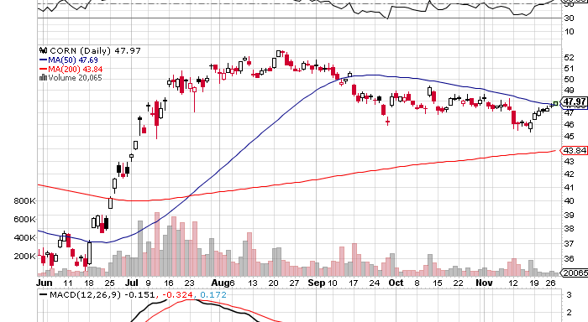
(CORN)

Slide 49
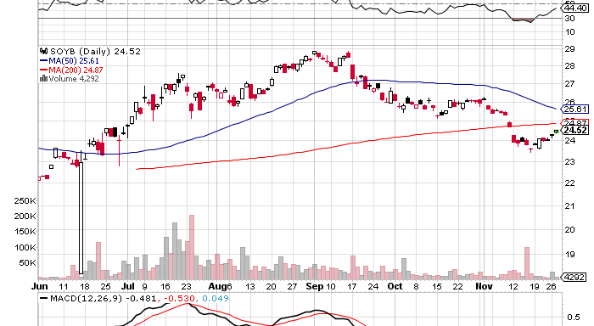
Soybeans (SOYB)

Slide 50
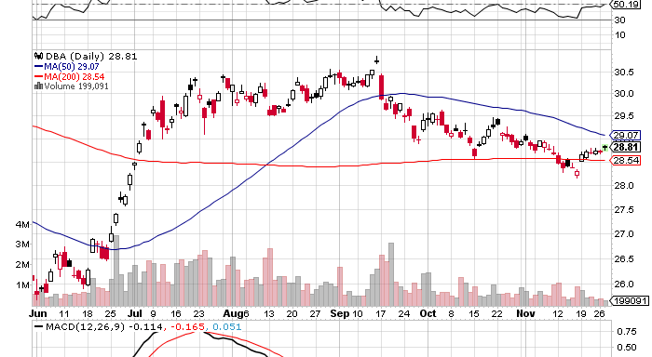
DB Commodities Index ETF (DBC)

Slide 51
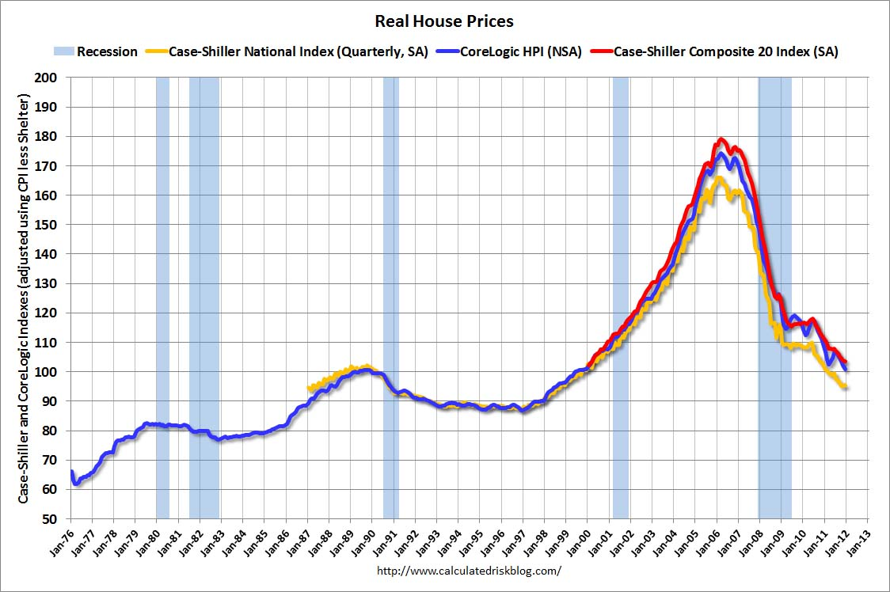
Real Estate No longer a drag, but a modest positive Rally will end when recession hits in 2013
Case-Shiller is up 6 months in a row on a 3 month lag, new starts at 4 year high, but Killing or capping the mortgage interest deduction will kill the housing recovery in 2013

Slide 52

Trade Sheet “RISK ON” has returned
*Stocks- buy the dips, the yearend rally is on *Bonds- sell rallies under a 1.50% yield, buy under 1.90% *Commodities-stand aside, sell next oil and copper rallies *Currencies- sell yen on breakout through ¥80 *Precious Metals – buy the big dips *Volatility-stand aside, don’t chase, will bounce along bottom *The ags –has gone dead, sell OTM Calls and spreads *Real estate- rent, don’t buy Next Webinar is on Wednesday, December 12 12:00 noon EST last webinar of the year

Slide 53

To buy strategy luncheon tickets Please Go to www.madhedgefundtrader.com

