Slide 1
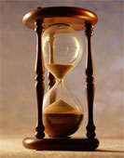
Please Stand By for John Thomas Wednesday, December 12, 2012, San Francisco, CA Global Trading Dispatch
The Webinar will begin at 12:00 pm EST

Slide 2

The Mad Hedge Fund Trader “Looking Across the Valley”
Diary of a Mad Hedge Fund Trader San Francisco, December 12, 2012 www.madhedgefundtrader.com

Slide 3

MHFT Global Strategy Luncheons Buy tickets at www.madhedgefundtrader.com 2012 Schedule
January 4, 2013 Chicago

Slide 4
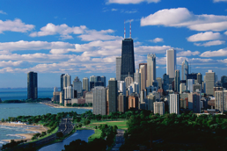
MHFT Global Strategy Luncheons Buy tickets at www.madhedgefundtrader.com
Chicago, January 4, 2013

Slide 5

Trade Alert Performance Churning under All Time High
*December MTD +0.82% *2012 YTD +18.8%, compared to 8.3% for the Dow, beating it by 10.5% *First 104 weeks of Trading +59% *Versus +8.3% for the Dow Average A 51% outperformance of the index
93 out of 137 closed trades profitable 68% success rate on closed trades

Slide 6
Portfolio Review-Cutting risk before the election
Asset Class Breakdown
Risk Adjusted Basis
current capital at risk
Risk On
(TLT) $127-$132 put spread | 10.00%
(GOOG) $600-$650 call spread | 10.00%
(GLD) $157-$162 call spread | 10.00%
(SPY) $131-$136 Call Spread | 20.00%
(IWM) $76-$80 Call Spread | 10.00%
(AAPL) $525-$575 call spread | 20.00%
Risk Off
(FXE) $126-$131 put spread | -5.00%
(FXY) $119-$124 put spread | -5.00%
(TLT) $117-$122 put spread | 10.00%
total net position | 80.00%

Slide 7
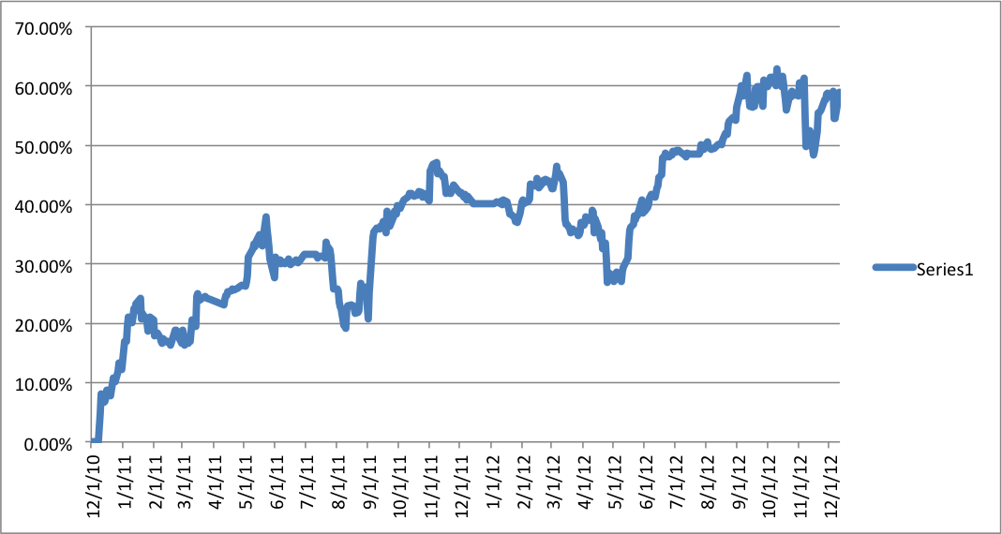
Performance Since Inception-New All Time High +29.5% Average Annualized Return

Slide 8
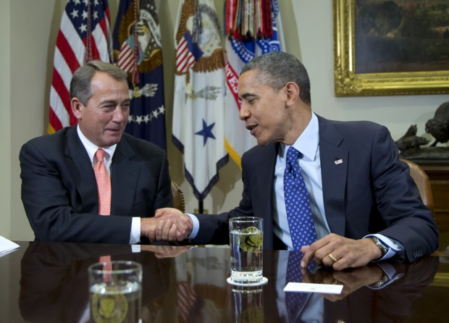
The Economy-A New Post Election Confidence?
*November nonfarm payroll a huge upside surprise at +146,000 *Weekly jobless claims up -25,000 to 370,000, may be real, the Dandy pop is done *October construction spending +1.4% *Official China November PMI 50.2 to 50.6 *Fiscal Cliff resolution will give the economy a short term confidence boost, but a long term 1.5% annual drag. *Fed renewal of QE3 a big plus *Will US Q4 GDP come in at a hot 3%? *Still looking at a low long term 1.5% GDP growth rate

Slide 9
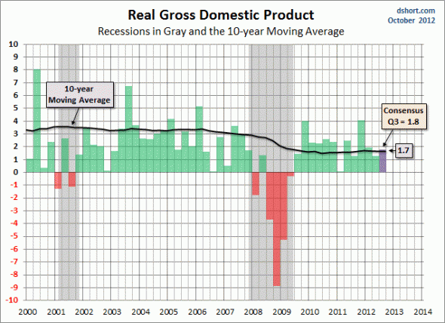
US Quarterly GDP Moving to the upper end of a ten year range

Slide 10
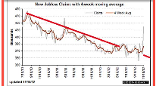
Weekly Jobless Claims Recent statistical aberrations may be done the 25,000 drop may be real

Slide 11
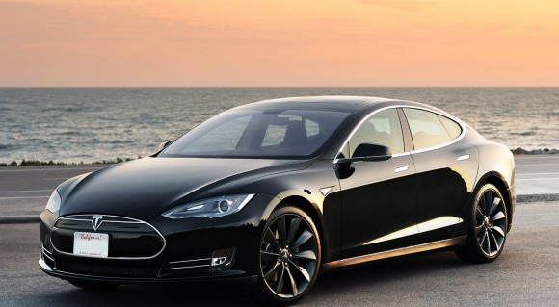
My Own Personal Economic Stimulus 300 mile range for $110,000

Slide 12
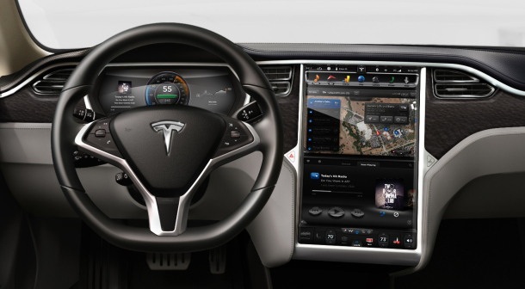
Tesla S-1 Performance

Slide 13
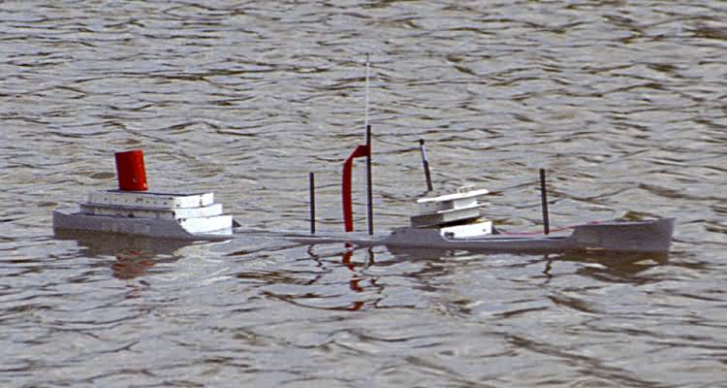
Bonds-Dead in the Water long (TLT) December, 2012 $117-$122 bull call spread long (TLT) December, 2012 $127-$132 bear put spread
*Fiscal Cliff offsets QE3 *the 1.40% - 1.90% range holds, could be our range for years *Short volatility is the play here, shorted dated to expire before fiscal cliff resolution *$40 billion a month in MBS buying is still on the menu *Fed QE3 extension decision today, happy to go for overkill

Slide 14
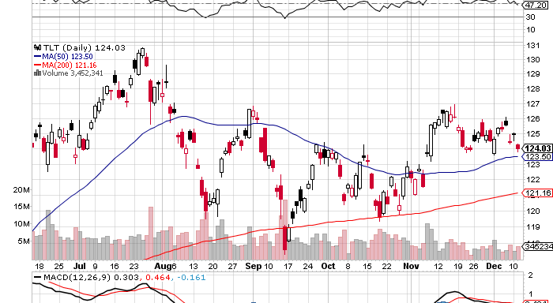
(TLT)

Slide 15
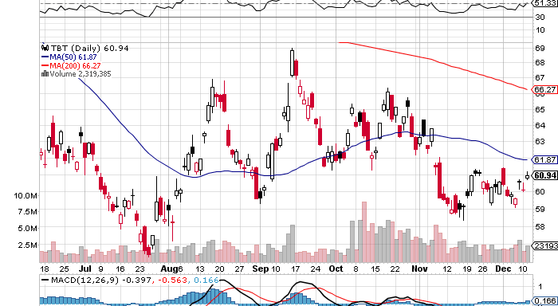
Short Treasuries (TBT) See the 1:4 reverse Split

Slide 16
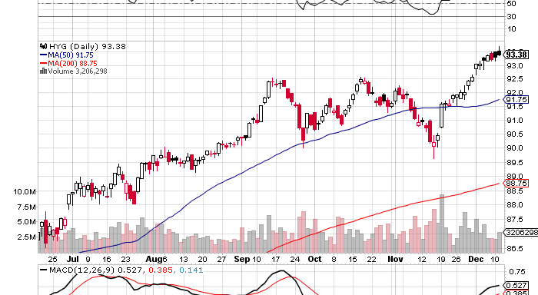
Junk Bonds (HYG)

Slide 17
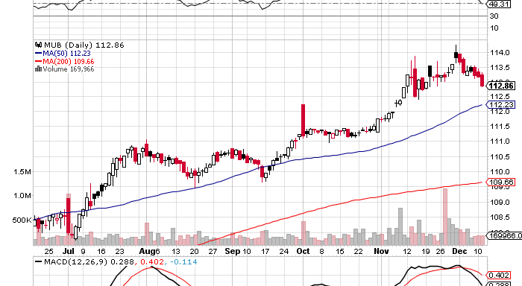
Municipal Bonds (MUB)-3% yield, Mix of AAA, AA, and A rated bonds

Slide 18

Stocks-Looking across the valley
*Expect a big resolution rally to come, Looking across the valley,
But how much is already in the price?
*Tax loss selling is done, buy high yielders once more *The fiscal cliff resolution is approaching *Next comes the New Year reallocation
trade out of bonds into stocks
*”RISK ON” returns means the yearend rally continues *A few more special dividends to go, then watch out!

Slide 19
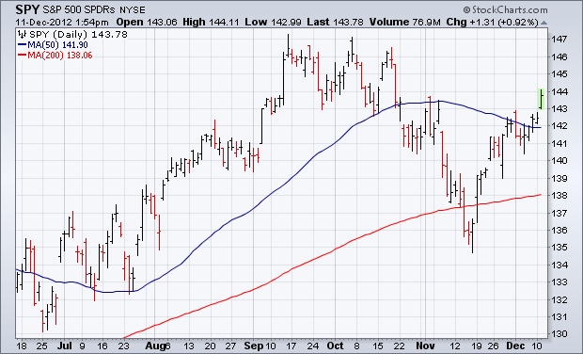
(SPY)-Bouncing hard off the 200 day Long the 1/$131-$136 call spread

Slide 20
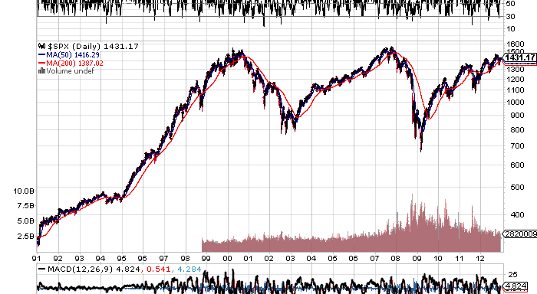
(SPX)-The 30,000 view

Slide 21
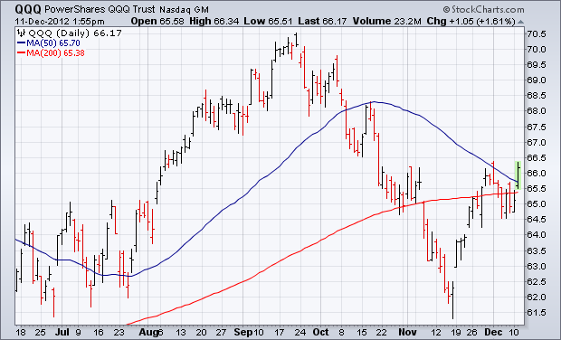
(QQQ)-NASDAQ leading the upside charge they were never going to rest for long

Slide 22
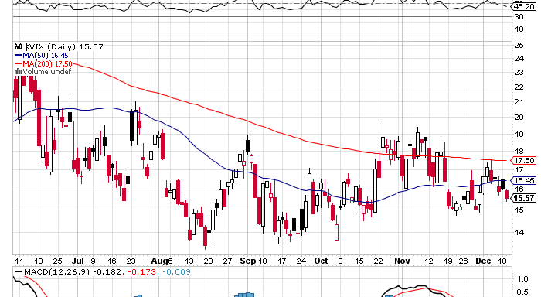
(VIX)-the “Tell” worked

Slide 23
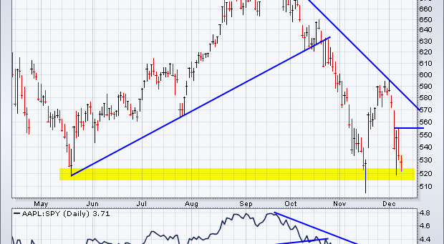
(AAPL)-Long the 1/$525-575 Call spread Long the 1/$450-500 Call spread

Slide 24
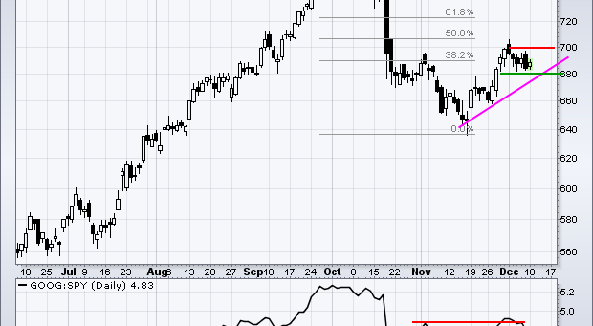
(GOOG)-the basing was real, long the 1/$600-$650 call spread

Slide 25
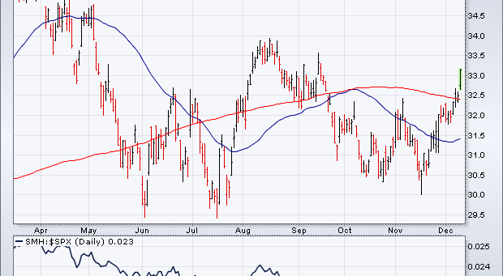
(SMH)-

Slide 26
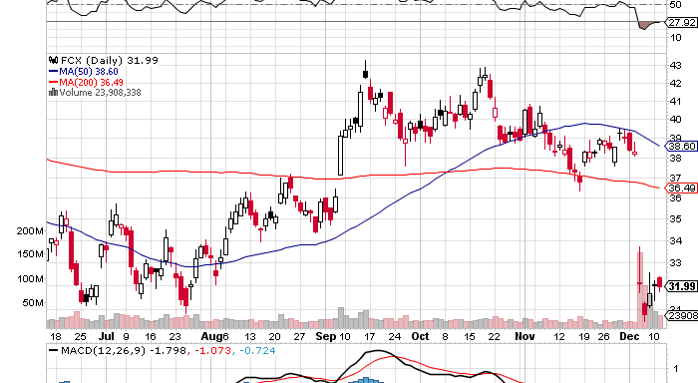
(FCX)-China plays still dead in the water

Slide 27
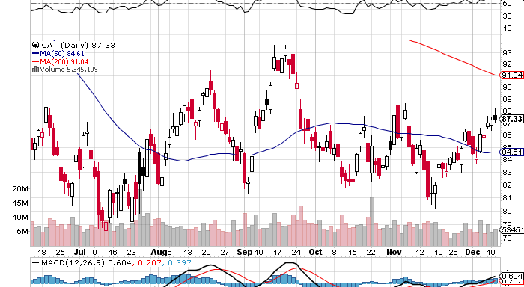
(CAT)

Slide 28
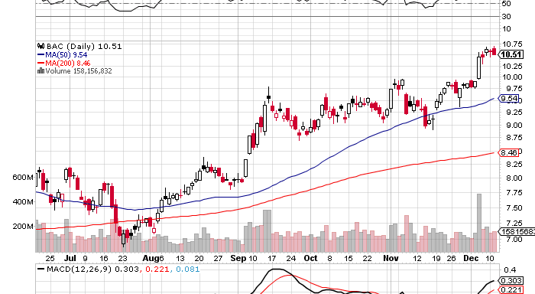
(BAC)-augurs for double top scenario

Slide 29
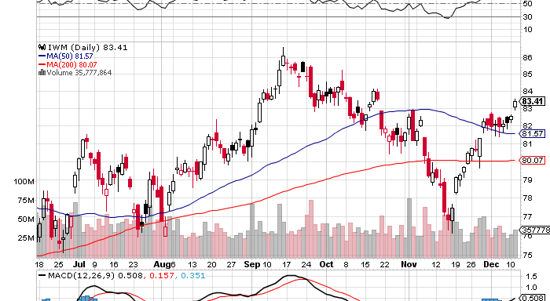
Russell 2000 (IWM) Long the $76-$80 call spread Long equities ex Europe and Asia exposure

Slide 30
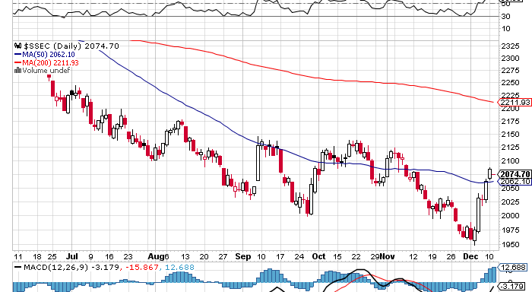
Shanghai-Is this the double bottom?

Slide 31
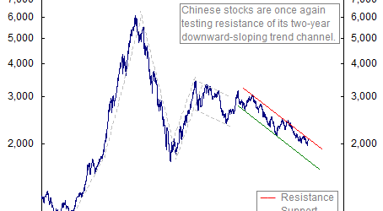
Shanghai-12 Year

Slide 32
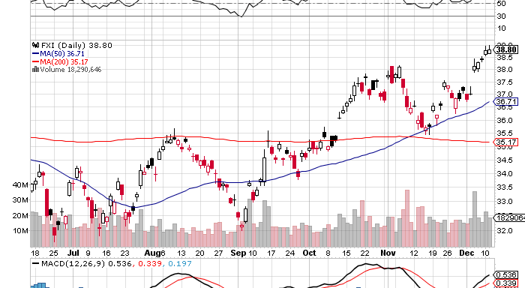
China (FXI)

Slide 33

My Post Election Shopping List Stocks to buy on the dip November, December, January Deep in-the-money Calls Spreads
Apple (AAPL) Google (GOOG) Disney (DIS) JP Morgan (JPM) Boeing (BA) Merck (MRK) Freeport (FCX)

Slide 34
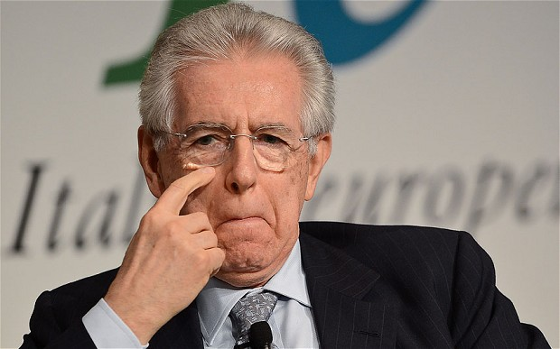
The Dollar -Waiting for the next yen leg down
*Yen collapse is dominating the markets Japanese election on Sunday, sell the news on gap down? *Consolidating now, but could run to ¥84 by yearend *Is the start of a multiyear run to ¥150 *Italian election surprise should weaken
the Euro, but “RISK ON” is holding it up *Keeping my Euro short as a hedge
Against an aggressive long portfolio,
Gave back 3%

Slide 35
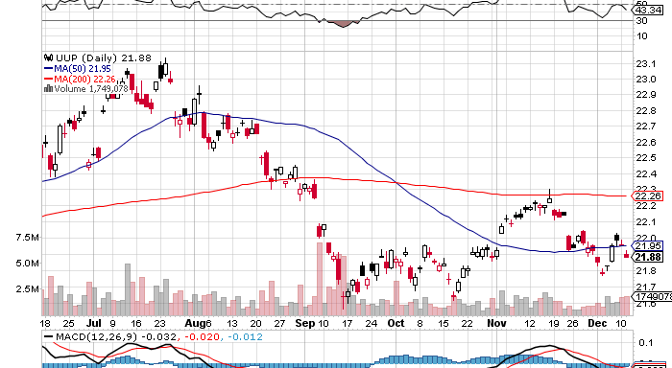
Long Dollar Basket (UUP) May bottom is holding

Slide 36
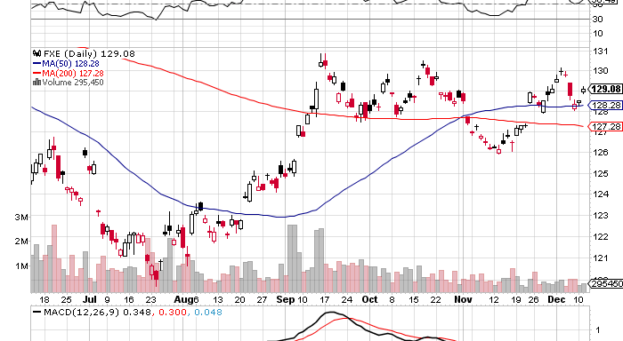
Euro (FXE) putting in a top?

Slide 37
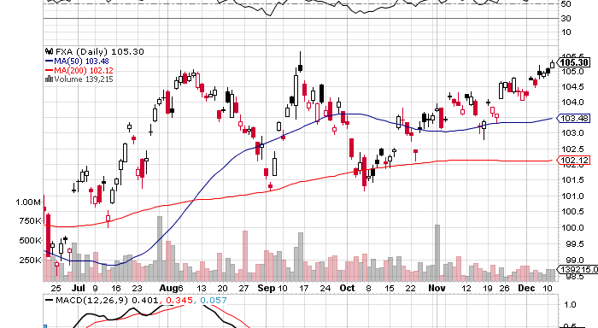
Australian Dollar (FXA) Reserve Bank rate cut -It’s all about China

Slide 38
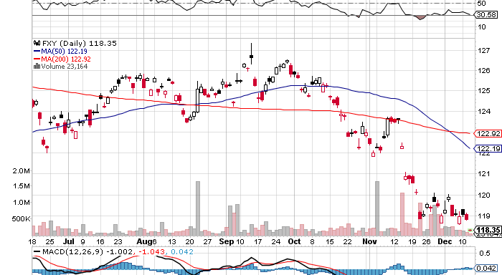
Japanese Yen (FXY) (FXY) January, 2013 $119-$124 in-the-money bear put spread 7 days to run-break to new low
200 Day MA

Slide 39
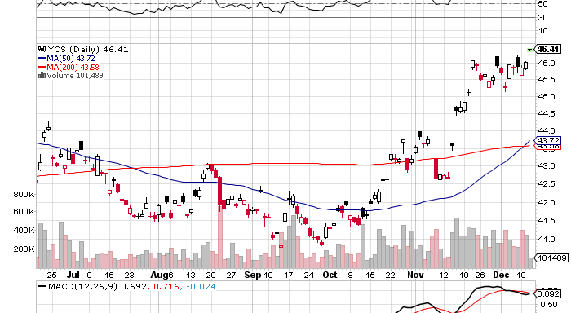
(YCS)-break to new high
200 Day MA

Slide 40
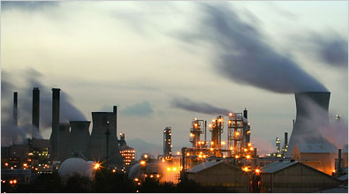
Energy-the range is narrowing
*A ‘RISK ON” push offsets deteriorating fundamental demand *Market has gone quiet ahead of This week’s OPEC meeting,
Quotas kept at 30 million b/d vs. 87 million b/d demand
Cheating is pervasive
*Surprise upturn in China demand November 5.68 million barrels imports
Is six month high *Stand aside, waiting for next pop *Futures structure has suddenly improved, contango is shrinking *Natural gas selloff triggered by
Warm weather, yearend profit taking

Slide 41
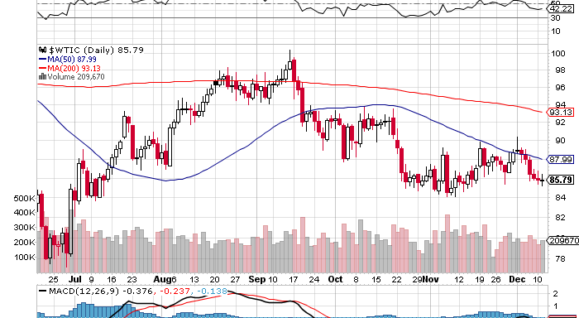
Crude

Slide 42
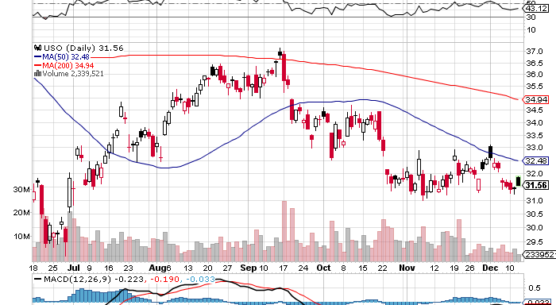
(USO)

Slide 43
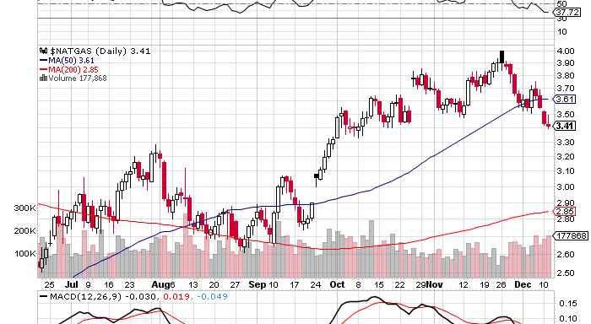
Natural Gas

Slide 44
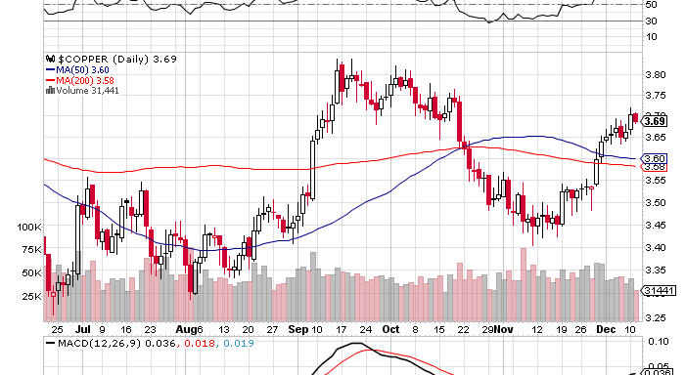
Copper (CU)-no China bounce

Slide 45
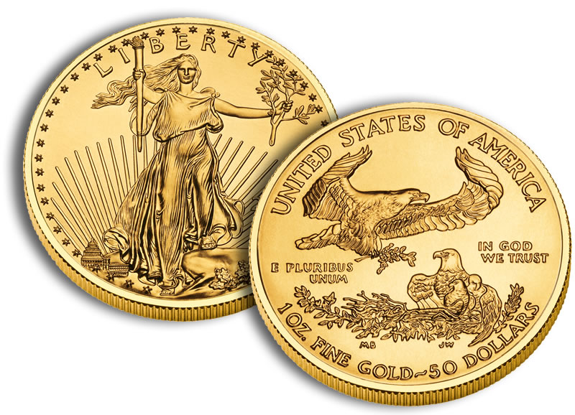
Precious Metals-Run longs in small limited risk positions long (GLD) January, 2013 $157-$162 Call Spread
*”RISK ON” is great for gold *Year end profit taking is done *QE3 monetary expansion has started *Taking a run at the highs across all metals *Obama win sparked panic buying
Of American gold eagle coins

Slide 46
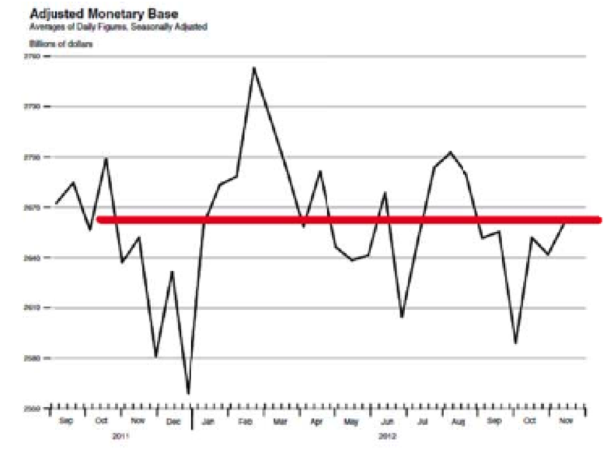
Adjusted Monetary Base tells the whole story on precious metals-delayed MBS settlement has delayed QE3
September Gold Peak at $1,798
October Gold Trough $1,665

Slide 47
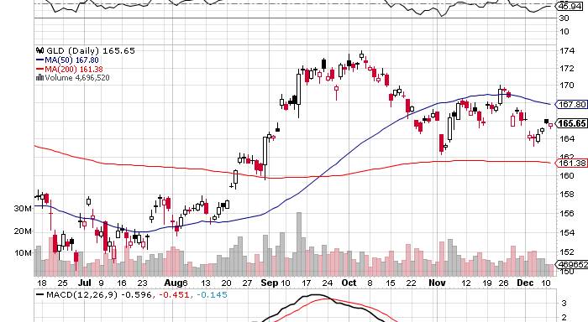
Gold (GLD) January, 2013 $157-$162 Call Spread
200 Day MA

Slide 48
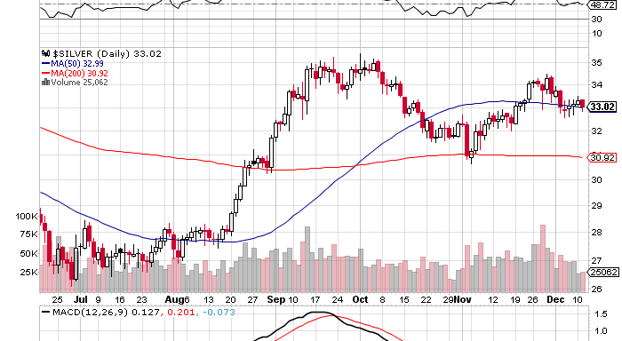
Silver

Slide 49
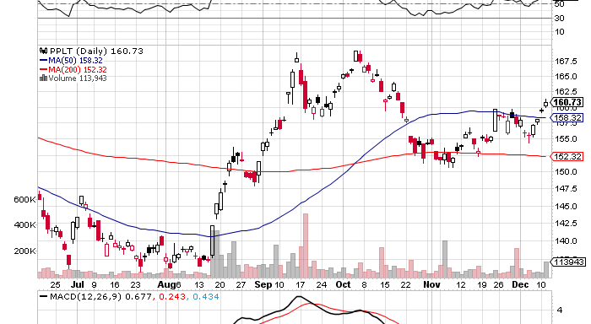
(Platinum) (PPLT)

Slide 50
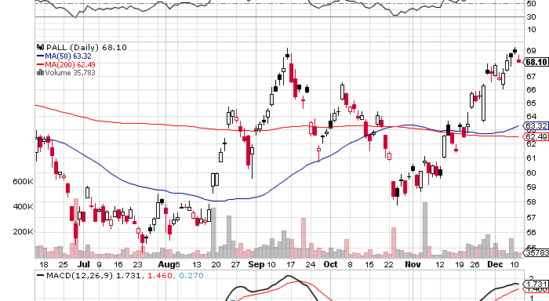
Palladium (PALL)

Slide 51

The Ags long the (CORN) 11/$50-$55 bear put spread
*Dead as a doorknob, Trade is out of season *Still long term bullish, draught continues in Australia, Brazil, and Ukraine *Kansas is in third year of draught
*Most forecasts for 2013 are positive *Awaiting next spike up or down to tell us what to do

Slide 52
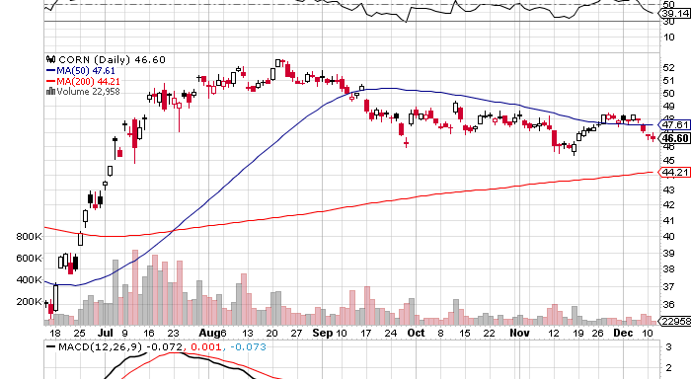
(CORN)

Slide 53
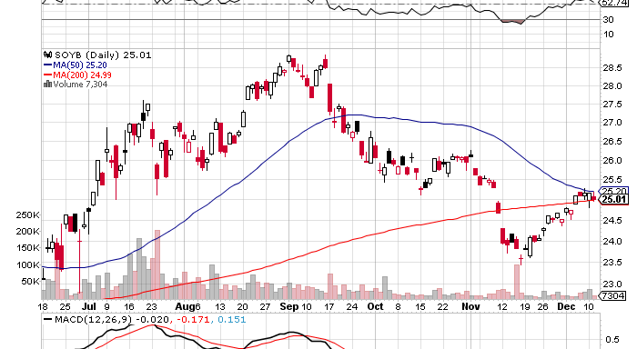
Soybeans (SOYB)

Slide 54
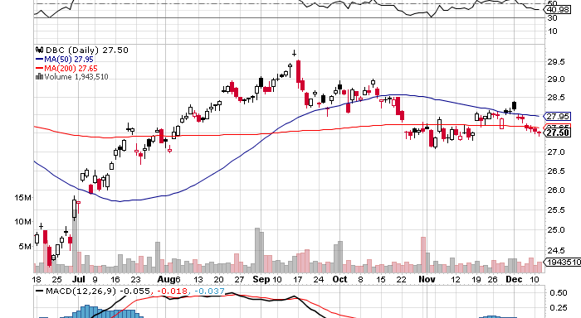
DB Commodities Index ETF (DBC)

Slide 55
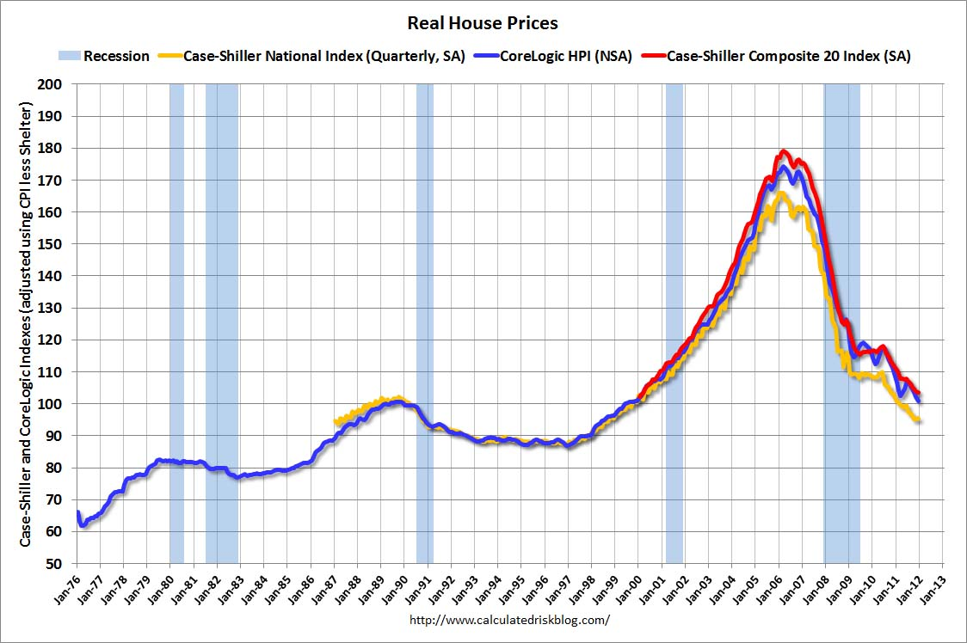
Real Estate No longer a drag, but a modest positive Rally will end when recession hits in 2013
Case-Shiller is up 6 months in a row on a 3 month lag, new starts at 4 year high, but Killing or capping the mortgage interest deduction will kill the housing recovery in 2013

Slide 56

Trade Sheet “RISK ON” has returned
*Stocks- buy the dips, the yearend rally is on *Bonds- sell rallies under a 1.50% yield, buy under 1.90% *Commodities-stand aside, don’t chase here
*Currencies- sell yen on rallies *Precious Metals – buy the big dips *Volatility-stand aside, don’t chase, will bounce along bottom *The ags –has gone dead, sell OTM Calls and spreads *Real estate- rent, don’t buy Next Webinar is on Wednesday, January 9, 2013 12:00 noon EST last webinar of the year

Slide 57

To buy strategy luncheon tickets Please Go to www.madhedgefundtrader.com

