Slide 1

Please Stand By for John Thomas Wednesday, January 9, 2013, San Francisco, CA Global Trading Dispatch
The Webinar will begin at 12:00 pm EST

Slide 2

The Mad Hedge Fund Trader “A Ton of Good News”
Diary of a Mad Hedge Fund Trader San Francisco, January 9, 2013 www.madhedgefundtrader.com

Slide 3

MHFT Global Strategy Luncheons Buy tickets at www.madhedgefundtrader.com
Chicago, April 19, 2013

Slide 4

Trade Alert Performance Churning under All Time High
*2012 total return of 14.78% *2013 YTD +7.09%, compared to 1.9% for the Dow, beating it by 5.19% *First 108 weeks of Trading +62.1% *Versus +6.9% for the Dow Average A 55% outperformance of the index
93 out of 137 closed trades profitable 68% success rate on closed trades

Slide 5
Performance Since Inception-New All Time High +31% Average Annualized Return

Slide 6
Portfolio Review-Cutting risk before the election
Mad Hedge Fund Trader
Trading Book
Asset Class Breakdown
Risk Adjusted Basis
current capital at risk
Risk On
(AIG) $32-$35 call spread | 10.00%
(IWM) $79-$84 call spread | 20.00%
(SPY) $135-$140 call spread | 30.00%
(SPY) $137-$142 call spread | 10.00%
(FCX) $30-$33 long call spread | 10.00%
(AAPL) $525-$575 long call spread | 10.00%
(AAPL) $450-$500 long call spread | 10.00%
Risk Off
(AAPL) $575-$650 short call spread | -20.00%
total net position | 80.00%

Slide 7

A Ton of Good News Is About to Hit the Markets
*A post election growth spurt for the economy is underway, from a 1.5% annual rate to 3.5% *Fed is offering ultra low rates until the jobless rate falls below 6.5%, could take 5 years (overcompensating for no Congressional action) *Housing recovery is accelerating *Auto recovery is accelerating *Hurricane Sandy reconstruction adds 0.5% to GDP, iPhone 5, 0.3%, Obamacare scale up 1.0% *All the markets needed to unleash was a fiscal cliff resolution

Slide 8

The Fiscal Cliff Resolution
*Creates a net drag on GDP growth of 1.5%
*Tax rates go up from 35% to 39.6% on income over $450,000 and spending is cut. *The sleeper will be on your Schedule “A” *Any further entitlement reform cuts spending more, such as raising retirement age from 66 to 67.

Slide 9

Foreign Economies
*Are transitioning from a headwind to a tailwind *China reaccelerates from 7% to 9% (transitioning from an export oriented to domestic economy) *Recovery spreads to the rest of Asia *Emerging market ETF’s could be the big performers of 2013 (EWT), (EWY), (TF), (IDX), (VNM), (EWH) *Europe year end recovery may be the real kicker here (US spill over LTRO’s, bond market recovery, progress towards new constitution)

Slide 10
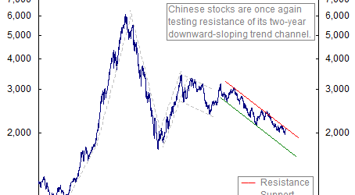
Shanghai-12 Year

Slide 11

Look for an “M” Shaped Year
*Growth spurt takes us up in Q1 *Growth Scare takes us down in Q2 & Q3 Will be another “sell in May and go away” year, (SPX) drops 10%-20% *Look for a strong finish in Q4 As China and Europe come back on line, and the health care industry gears up for Obamacare

Slide 12

Stocks
*S&P 500 earnings rise from $100 to $105/share Rising profits with flat sales through technology improvements *Multiples rise from 14X to 15.2X
Justified by low interest rates *Takes (SPX) to 1,600, top of the 13 year channel *Look for a summer dip to 1,300 *Year end rally back towards highs

Slide 13

Sectors
*Technology- (AAPL), (GOOG), (ORCL) *Financials-(JPM), (WFC), (AIG) *Commodities-(FXC), (CAT) *Autos-(F), (TM) *Consumer cyclicals-(EBAY), (WSM)

Slide 14
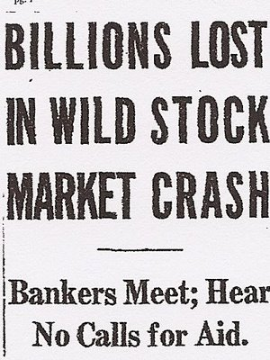
The Great Recession of 2013
*Fiscal cliff resolution negative effects start to kick in during Q2, higher withholding taxes, less government spending *The next leg of the European crisis hits
*Demographic headwind prevents economy from breaking out to the upside, continues until 2022 *May not be a real recession at all, but just a growth recession

Slide 15
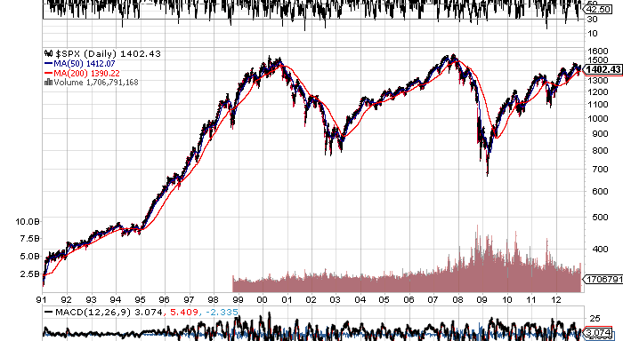
(SPX) 1990-2012 Can’t break out on 2% growth

Slide 16

Bonds The Peak is in
*Reallocation out of bonds into stocks will be the big trade of 2013 *Treasuries hit their 60 year peak in August, 2012 ten year yield of 1.38% *Negative real returns across every maturity range
*Don’t look for a crash, but a grind down with Ben Bernanke buying $85 billion a month of bonds
*Inflation returns with a vengeance in the 2020’s (see financial system in 2030 piece)

Slide 17
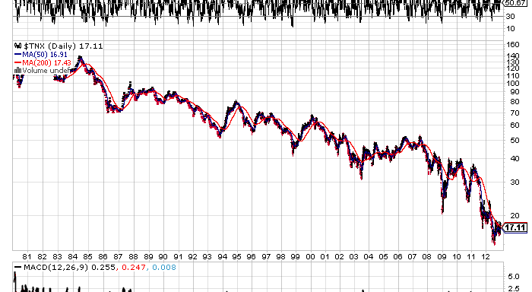
10 Year Treasury Yields 1980-2012 Yielding 1.70%

Slide 18
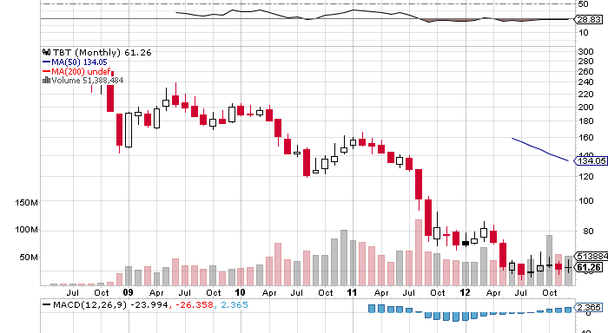
(TBT)- Double Inverse Treasury ETF effective yield –negative 5%

Slide 19
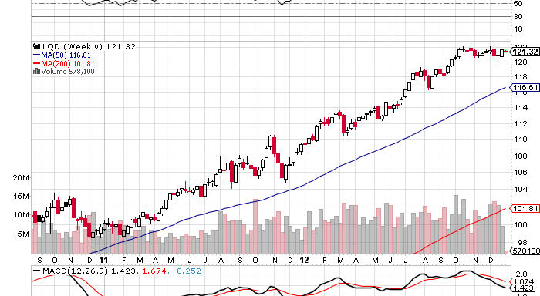
(LQD)-3.8%

Slide 20
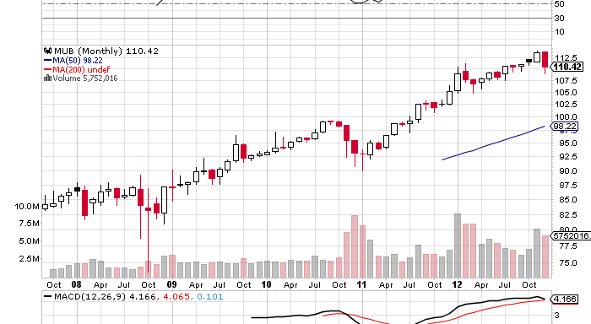
Municipal Bonds-2.9% yield

Slide 21
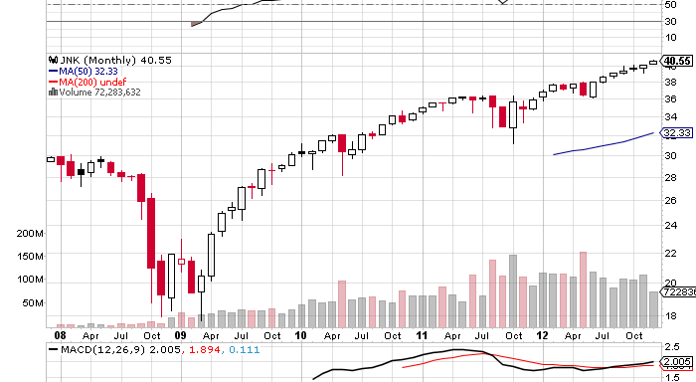
Junk Bonds (JNK) will continue to track with equity markets as investors reach for yield, now under 6%

Slide 22
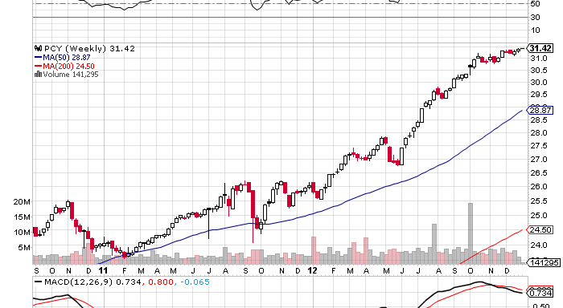
(PCY) Sovereign Debt-4.7% yield

Slide 23
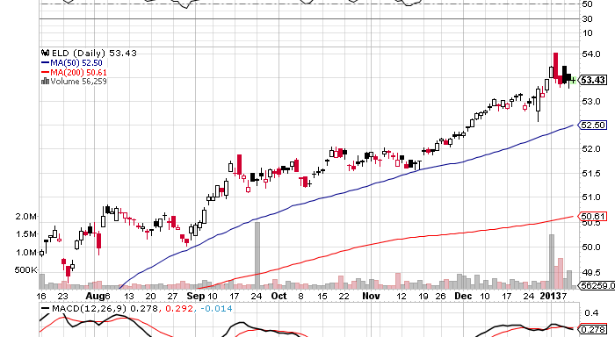
Wisdom Tree Emerging Market Local Debt Fund (ELD)

Slide 24

Foreign Exchange
*Weak dollar Q1, Q4, Strong dollar Q2, Q3 most aggressive central bank creates the weakest currency *Weak yen will be the big trade beginning of a multiyear, possible multi decade plunge *Euro stagnates in a range supported by weak QE *Commodity based Ausie and Canadian dollars are strong supported by China demand

Slide 25
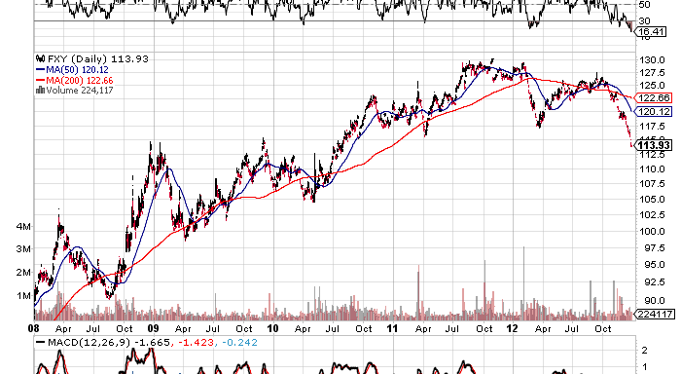
Japanese Yen 1980-2012

Slide 26
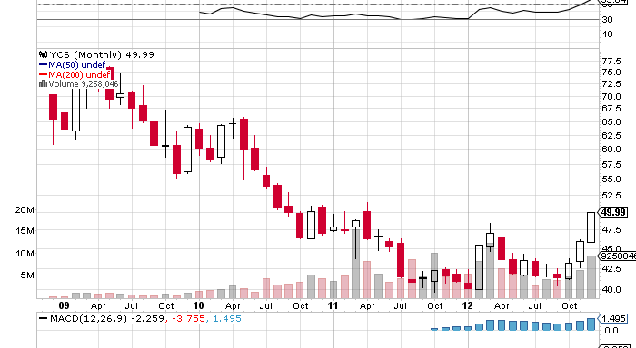
(YCS) Double Inverse Yen ETF

Slide 27
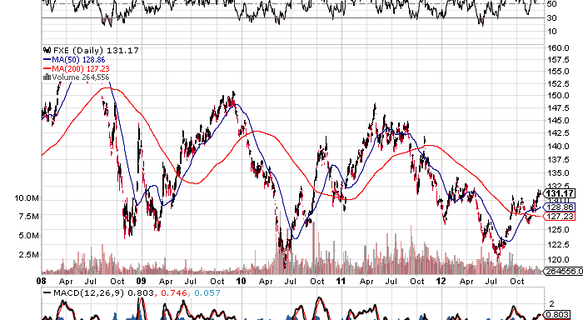
Euro

Slide 28
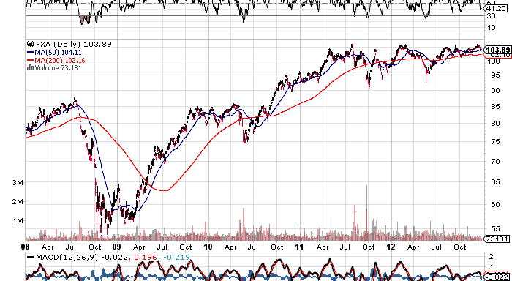
Australian Dollar

Slide 29
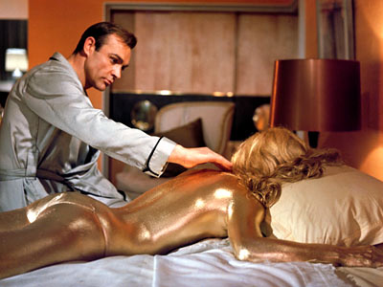
Precious Metals
*Long term bull market intact, but may stagnate while other assets are in “RISK ON” mode *QE3 and QE4 have not translated into growth of the monetary base essential for higher precious metals prices (because money is targeted at the mortgage market) *Who needs an insurance policy if we are going to live forever? *Emerging market central bank buying underpins gold at $1,500

Slide 30
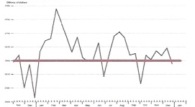
Adjusted Monetary Base tells the whole story on precious metals-delayed MBS settlement has delayed QE3
September Gold Peak $1,789
October Gold Trough $1,665

Slide 31
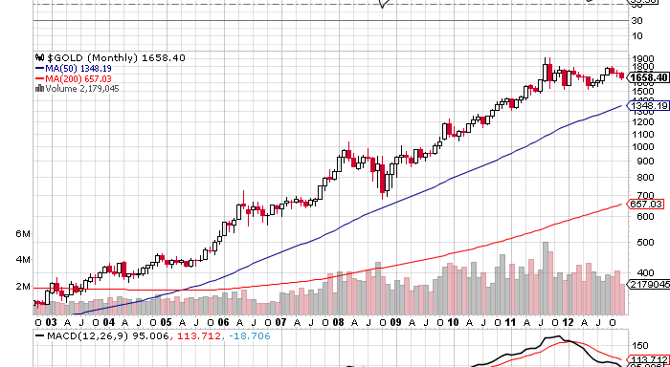
Gold

Slide 32
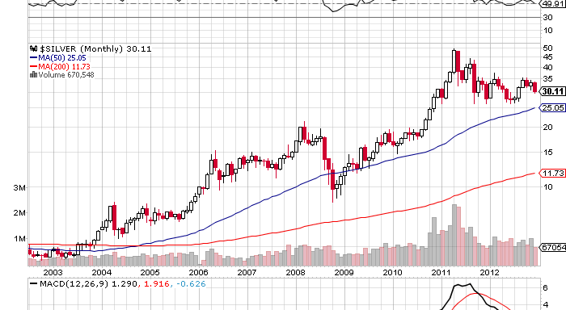
Silver

Slide 33
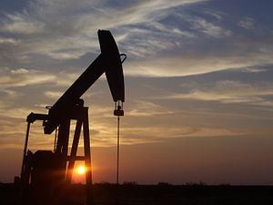
Energy
*US energy independence will become the dominant factor in the market over the next five years *Chinese recovery creates a new boost for prices *May see a rough balance of new American supply against new Chinese demand that keeps oil in a $80-$105 range *Natural gas conversions is finally putting that market in balance at $3-$4 MMBTU (coal power drops from 50% to 36% of US power supply)

Slide 34
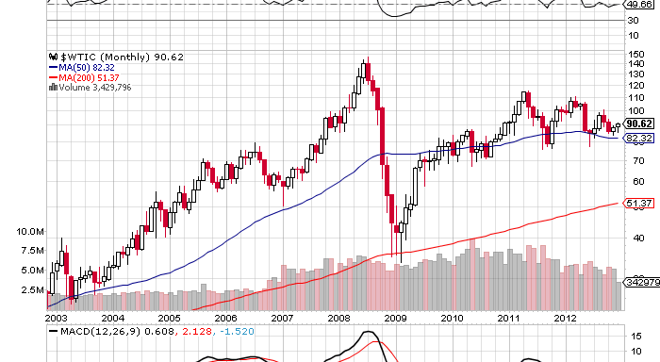
West Texas Crude

Slide 35
Natural Gas

Slide 36
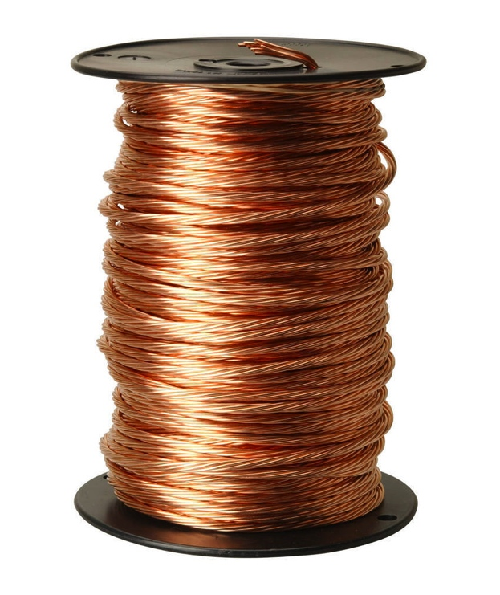
Commodities
*Its all about China *Modest Chinese recovery puts floor under base metals *Add a US housing recovery and prices go up *Add a European recovery and they go ballistic (it takes five years to bring on new supply)

Slide 37
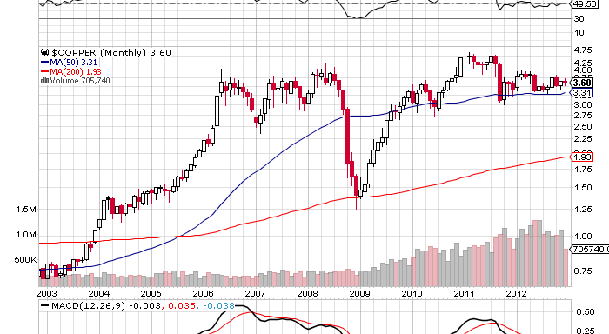
Copper

Slide 38

Agricultural Products
*Long term play on population expansion 7 billion to 9 billion by 2050 half of increase is in food importing nations *Rising emerging market standards of living *Does global warming return? *Use any winter weakness to pick up positions for another summer draught

Slide 39
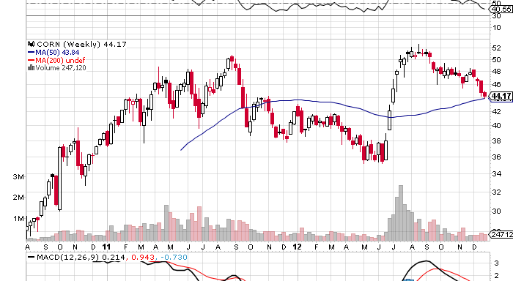
Corn

Slide 40
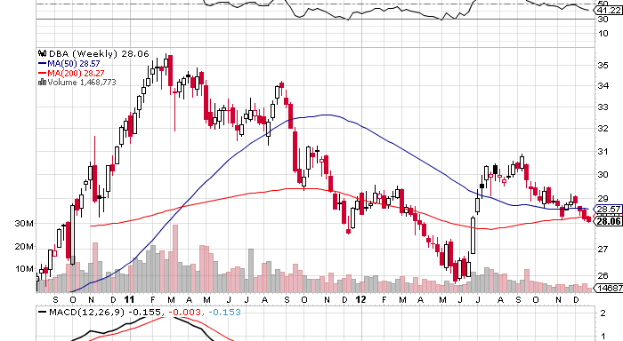
DBA

Slide 41

The 2013 Portfolio
*Stocks-buy the dips, especially in high beta emerging markets *Bonds-sell rallies in Treasuries, corporates, muni’s, buy junk and emerging market debt *Commodities-buy the dips on China recovery
*Currencies-sell yen on rallies, buy Ausie on dips *Precious Metals–buy the big dips, but don’t chase *Volatility-stand aside, will bounce along bottom *The Ags–buy dips on long term global food shortage *Real estate-buy commercial and apartment REIT’s, single family homes bounce along bottom for 5 more years

Slide 42

To buy strategy luncheon tickets Please Go to www.madhedgefundtrader.com Next Strategy Webinar Wednesday, January 23,2013
Good Luck and Good Trading!

