Slide 1

Please Stand By for
John Thomas
Wednesday, January 23, 2013, San Francisco, CA
Global Trading Dispatch
The Webinar will begin at 12:00 pm EST

Slide 2

The Mad Hedge Fund Trader
“The Crisis is Cancelled”
Diary of a Mad Hedge Fund Trader
San Francisco, January 23, 2013
www.madhedgefundtrader.com

Slide 3

MHFT Global Strategy Luncheons
Buy tickets at www.madhedgefundtrader.com
2013 Schedule
April 12 San Francisco
April 19 Chicago
June 27 New York
July 1 London
July 4 Amsterdam
July 8 Berlin
July 9 Frankfurt
July 18 Zermatt

Slide 4
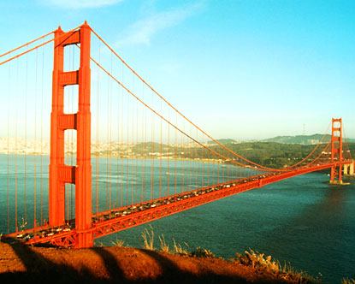
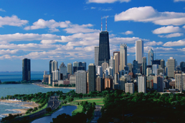
MHFT Global Strategy Luncheons
Buy tickets at www.madhedgefundtrader.com
San Francisco
April 12
Chicago
April 19

Slide 5
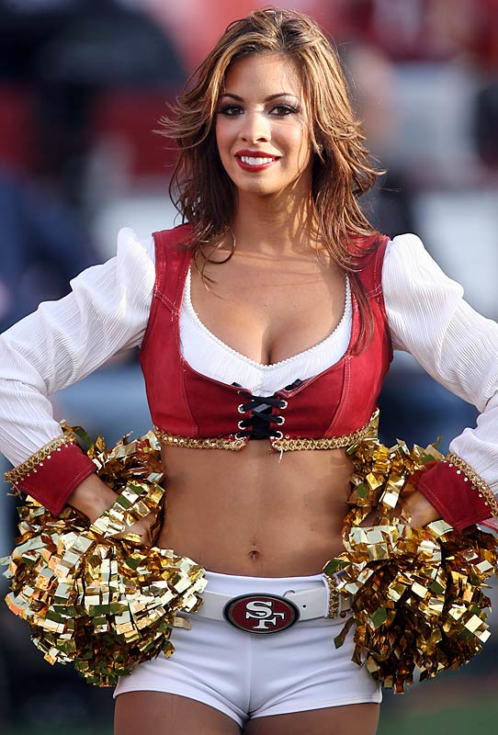

Go Niners!
Will San Francisco win both the World Series and the Super Bowl this season?

Slide 6

Trade Alert Performance
Hottest new year start in many years
*January MTD +10.92%
*2013 YTD +10.92%, compared to 8.3%
for the Dow, beating it by 10.5%
*First 110 weeks of Trading +66%
*Versus +12% for the Dow Average
A 54% outperformance of the index
99 out of 147 closed trades profitable
68% success rate on closed trades

Slide 7
Portfolio Review-Cutting risk before the election add more (SPY) longs? Reenter (TLT) short?
Mad Hedge Fund Trader
Trading Book
Asset Class Breakdown
Risk Adjusted Basis
current capital at risk
Risk On
(AIG) $32-$35 call spread | 10.00%
(IWM) $79-$84 call spread | 20.00%
(SPY) $135-$140 call spread | 30.00%
(SPY) $137-$142 call spread | 10.00%
(FCX) $30-$33 long call spread | 10.00%
Risk Off
(FXY) $113-$118 put spread | -10.00%
(FXY) $112-$117 put spread | -10.00%
total net position | 60.00%

Slide 8
Performance Since Inception-New All Time High!!
+33% Average Annualized Return

Slide 9
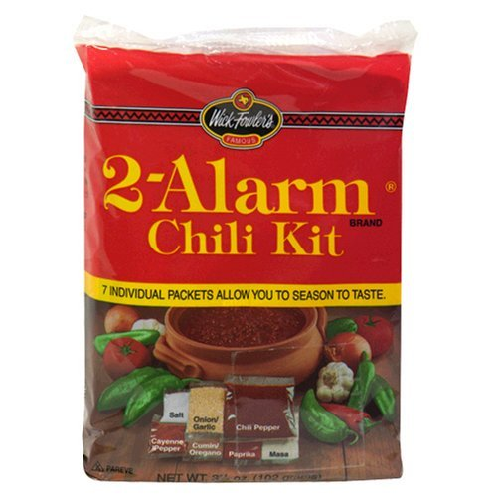
The Economy Is Red Hot
*Car Industry accelerating from 15 to 16 million units
*Existing home sales 2012 +9%
*ZEW Jan current conditions 5.7 to 7.1
*Dec CPI unchanged, 1.7% YOY
*December retail sales +0.5%
*World Bank cut global growth forecast
from 3.0% to 2.4%

Slide 10
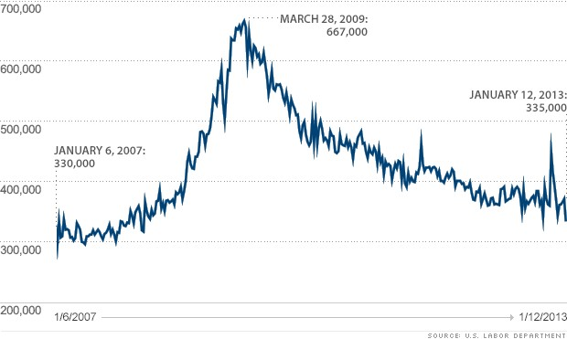
Weekly Jobless Claims
37,000 drop to 335,000 is a new 5 year low the trend is your friend-growth acceleration on track

Slide 11
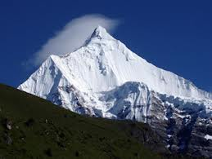
Bonds-Putting in the top the 60 year bull market is over
Negative returns in 2013
*Bond to stock reallocation is the big trade of 2013
*Fiscal Cliff never happened
*the 1.40% - 1.90% range can’t last,
next is a 1.90%-2.50% range
*Short volatility is the play here,
shorted dated to expire before fiscal
cliff resolution
*$85 billion a month in bond buying
is still on the menu
*Sell every 3-5 point rally

Slide 12
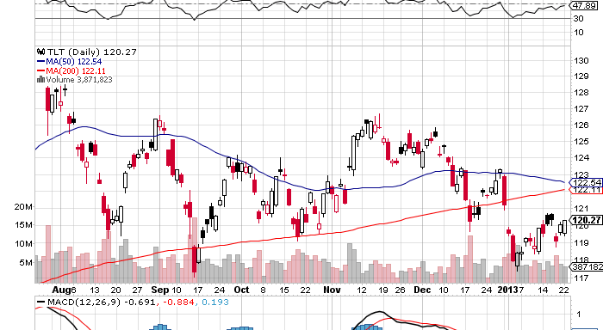
(TLT)

Slide 13
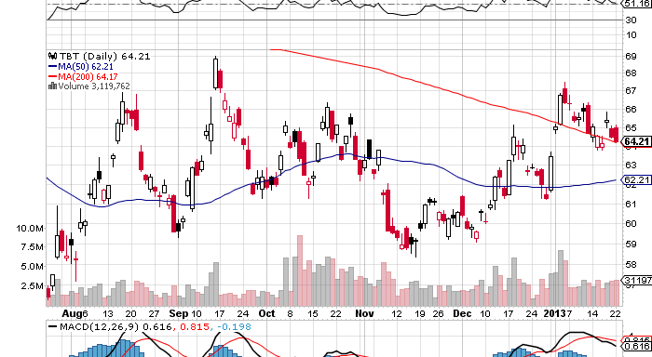
Short Treasuries (TBT)
See the 1:4 reverse Split

Slide 14
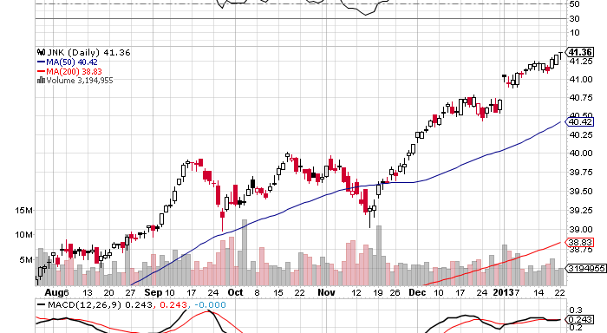
Junk Bonds (HYG)

Slide 15
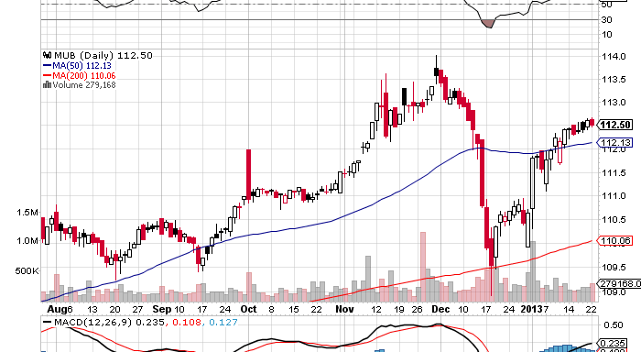
Municipal Bonds (MUB)-3% yield,
Mix of AAA, AA, and A rated bonds

Slide 16

Stocks-Running to all time highs
1,600 here we come
*The New Year rally arrived on schedule,
cancellation of debt ceiling crisis takes cap off market
*Biggest equity fund inflows in 10 years
*Hedge funds running biggest long in a year
*Bond/equity reallocation has only just started
*Q4, 2012 earnings better than expected
*Setting up the 2013 top
“Sell in May, and go away”, Part 5

Slide 17
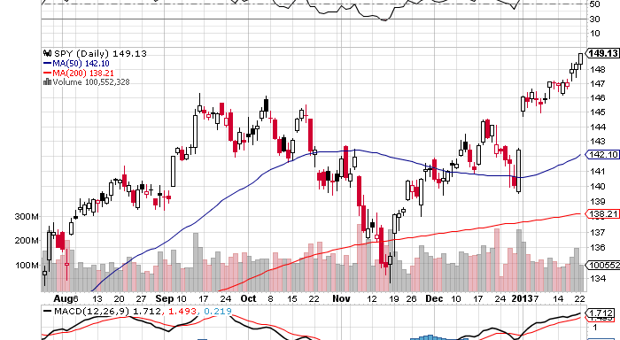
(SPY)-
Long the 1/$135-$140 call spread
Long the 1/$137-$142 call spread

Slide 18
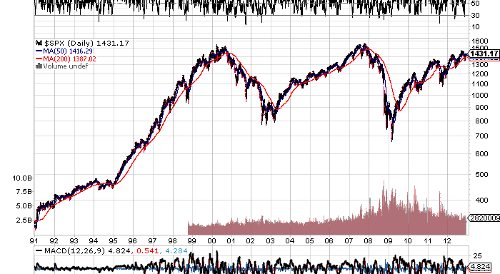
(SPX)-The 30,000 view
Fail
here

Slide 19
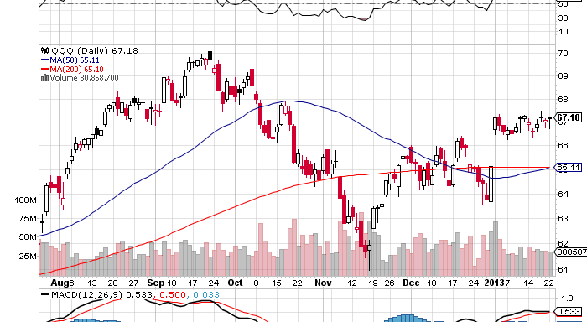
(QQQ)-NASDAQ leading the upside charge they were never going to rest for long

Slide 20
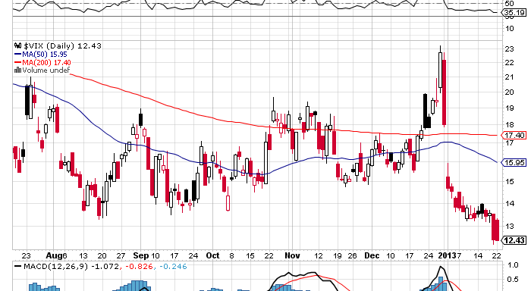
(VIX)-Dying a slow death headed for the 9% handle

Slide 21
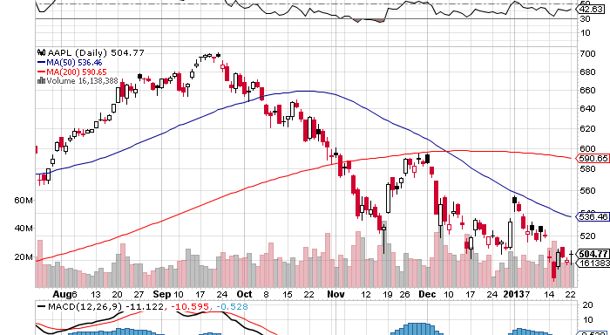
(AAPL)-The Final Insult
January expiration dead on $500-earnings today

Slide 22
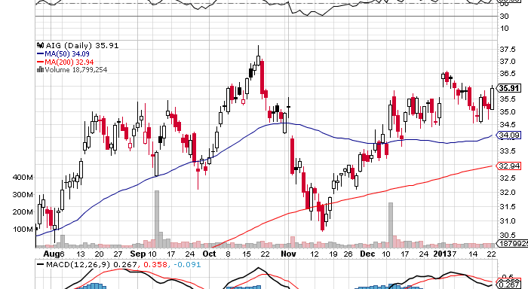
(AIG)-long the 2/$32-$35 call spread
Riding on Travelers (TRV) Coattail

Slide 23
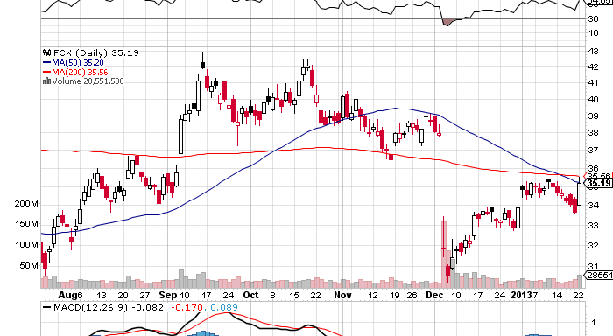
(FCX)-long 2/$30-$33 call spread the China play kicks in, earnings upside blowout

Slide 24
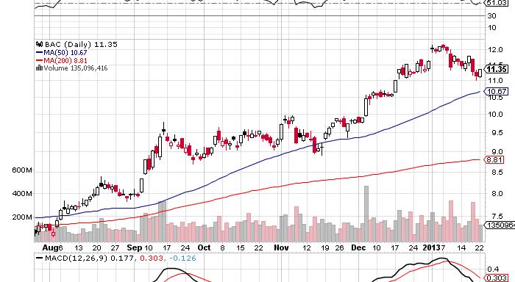
(BAC)-led the charge watch for sector rotation into laggard could be great dogs of the Dow year (RIM)

Slide 25
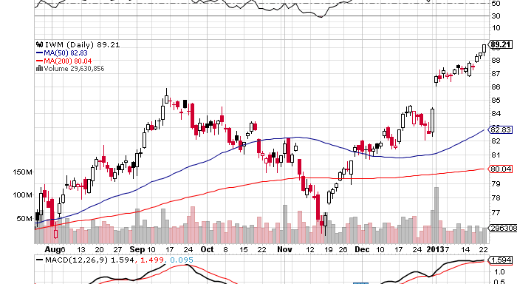
Russell 2000 (IWM)
Long the 2/$79-$84 call spread

Slide 26
Shanghai-China reacceleration to 8% growth

Slide 27
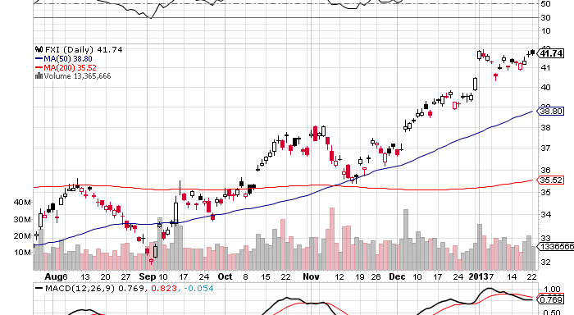
China (FXI)

Slide 28
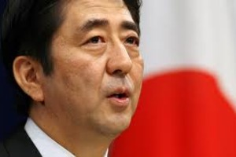
The Dollar-Short Yen is the trade of the year
My New Favorite Prime Minister
*Yen collapse is dominating the markets
sharpest currency move in 20 years,
¥76 to ¥90
*Shinzo Abe is pedal to the metal on
weakening the yen
*Consolidating now for a ¥90 breakout
*Is the start of a multiyear run to ¥150
*Yen shorts at all time high
*Could get bulk of 2013 move in Q1
*Britain to hold election on EC membership

Slide 29
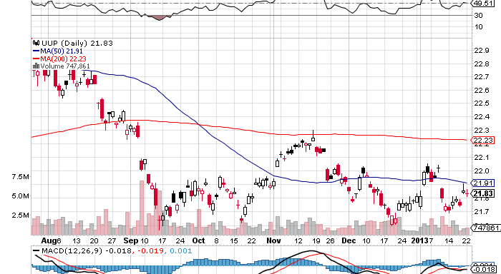
Long Dollar Basket (UUP)

Slide 30
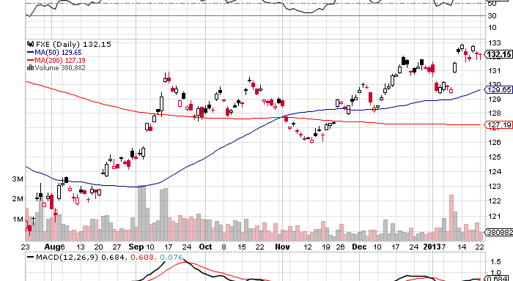
Euro (FXE)
Looking for a $1.38 top

Slide 31
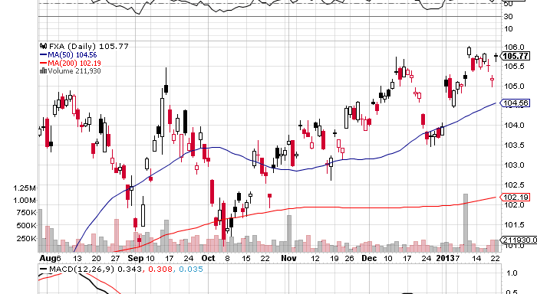
Australian Dollar (FXA)
-It’s all about China

Slide 32
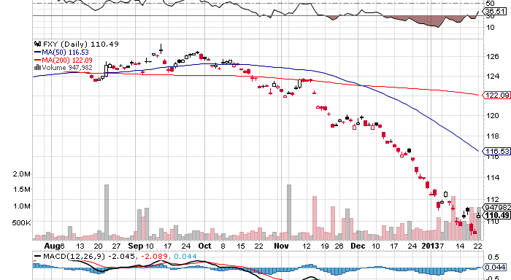
Japanese Yen (FXY)-worth the chase
(FXY) 2/$113-$118 in-the-money bear put spread
(FXY) 2/$113-$118 in-the-money bear put spread
200 Day
MA

Slide 33
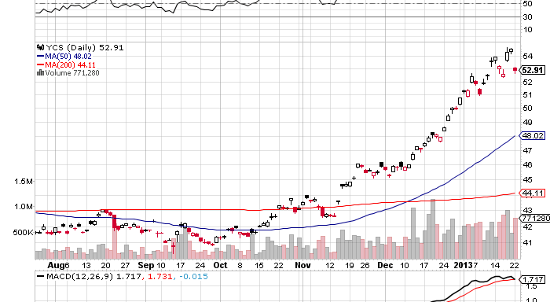
(YCS)-break to new high
200
Day MA

Slide 34
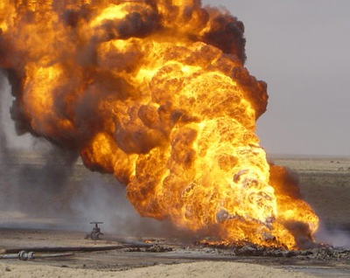
Energy-Riding along with global “RISK ON”
Targeting $100/barrel
*Acceleration of the US economy is the main driver
*Spill over into China demand
*Algeria terrorist attack was the icing on the cake
*Saudi Arabia cuts production by 500,000 b/d
to offset US gains
*Futures structure has suddenly improved,
contango is shrinking, backwardation is widening
*US energy boom continues, production up
779,000 to 6.5 million barrels, 900,000 barrels
in 2013 expected
*Natural gas stalled with warm weather

Slide 35
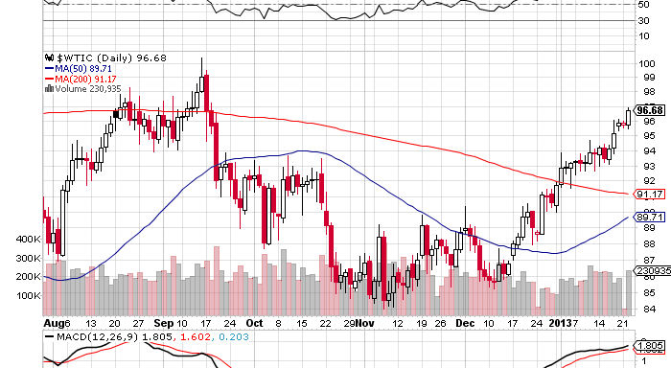
Crude

Slide 36
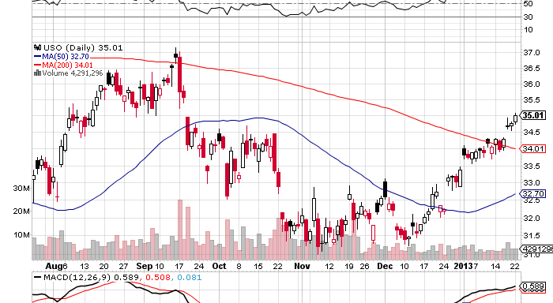
(USO)

Slide 37
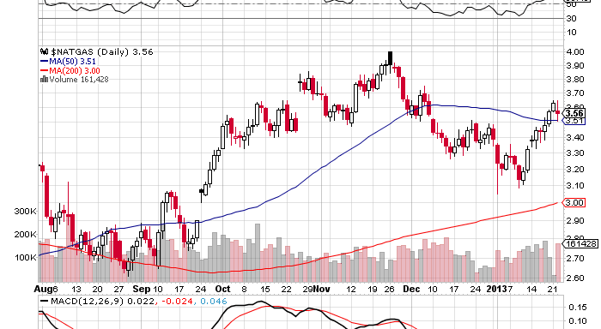
Natural Gas

Slide 38
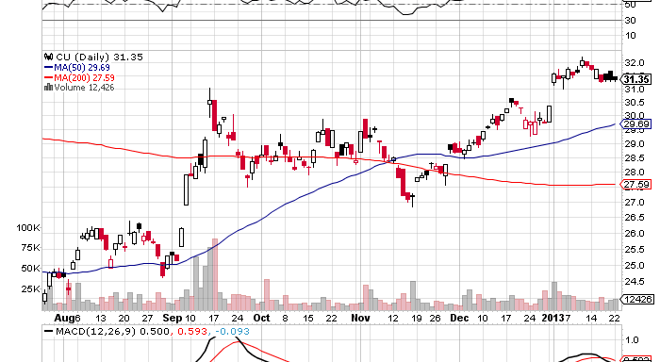
Copper (CU)-China bounce kicks in

Slide 39
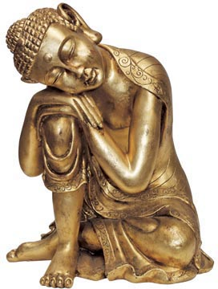
Precious Metals-Gone to sleep
*”RISK ON” is not working for gold
*Year end profit taking is done
*QE3 monetary expansion still flat
*Who needs life insurance if you are going to live forever?
*Chatter about the Bundesbank taking its gold
back from the Fed amounts to nothing
*All the action is in the industrial metals of
platinum and palladium, driven by car
industry forecasts rising from
15 million to 16 million

Slide 40
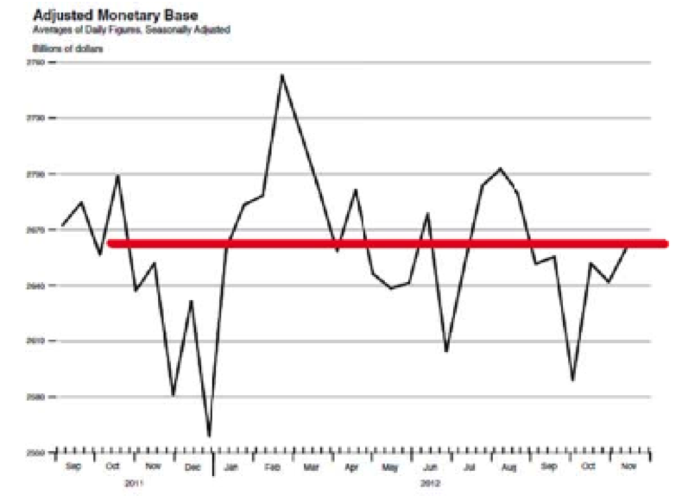
Adjusted Monetary Base tells the whole story on precious metals-delayed MBS settlement has delayed QE3
September Gold
Peak at $1,798
October Gold Trough
$1,665

Slide 41
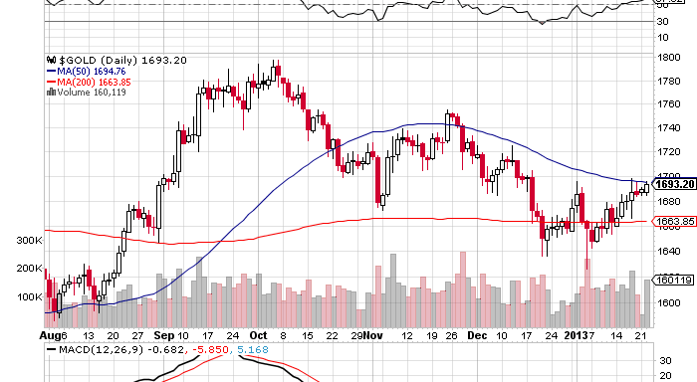
Gold
200
Day MA

Slide 42
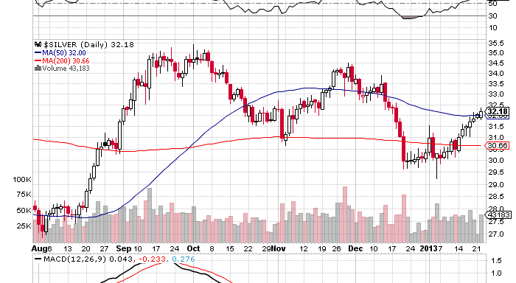
Silver

Slide 43
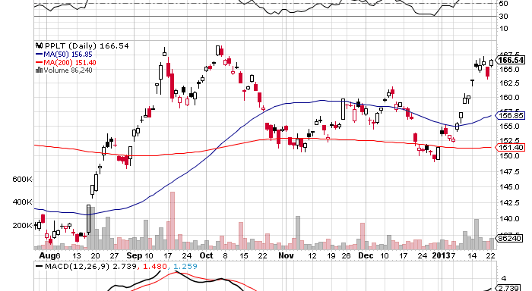
(Platinum) (PPLT)

Slide 44
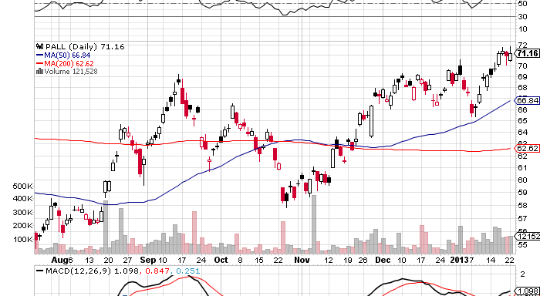
Palladium (PALL)

Slide 45
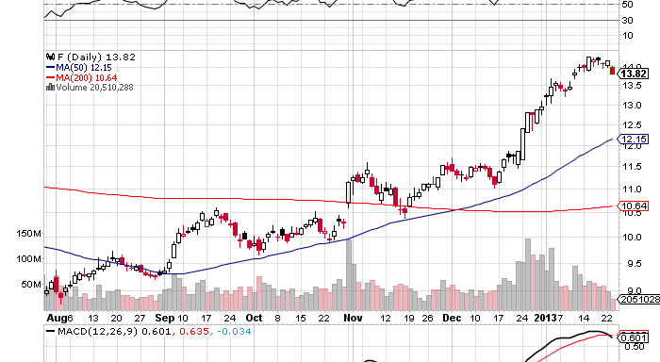
Ford Motors (F)

Slide 46
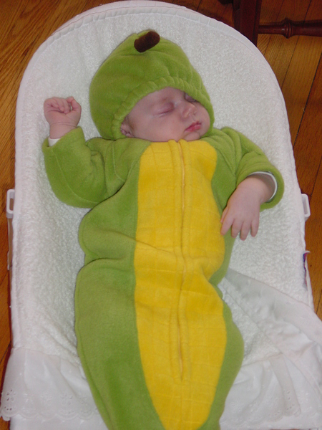
The Ags
*Finally got the spike on a USDA report
*Still long term bullish, draught continues in
Australia, Brazil, and Ukraine
*Most forecasts for 2013 are positive
*Awaiting next spike
up or down to tell us what to do
*Too many other things to do now

Slide 47
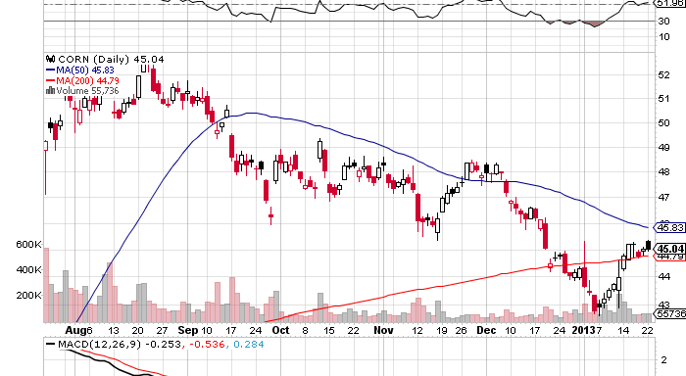
(CORN)

Slide 48
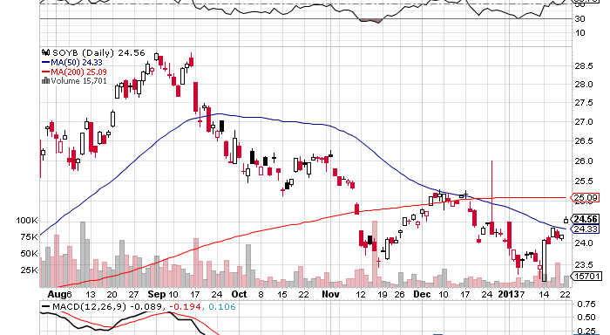
Soybeans (SOYB)

Slide 49
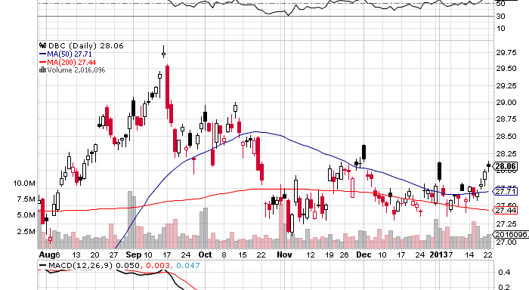
DB Commodities Index ETF (DBC)

Slide 50
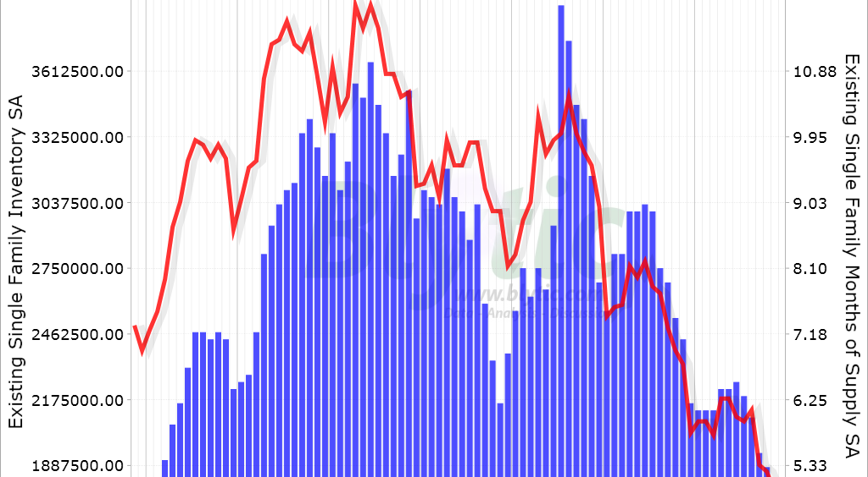
Real Estate
What I missed-California is hot, and is 25% of US housing value
Inventories at 11 lows

Slide 51

Trade Sheet
“RISK ON” has returned big time
*Stocks- buy the dips, the New Year rally is on
*Bonds- sell rallies under a 1.70% yield
*Commodities-stand aside, don’t chase here
*Currencies- sell yen on any rallies
*Precious Metals –stand aside, wait for rebirth
*Volatility-stand aside, will bounce along bottom
*The ags –has gone dead, low priority
*Real estate- rent, don’t buy

Slide 52
To buy strategy luncheon tickets Please Go to www.madhedgefundtrader.com
Next Strategy Webinar Wednesday, February 6, 2013
Good Luck and Good Trading!

