Slide 1

The Mad Hedge Fund Trader
“Who Tipped Over the Punch Bowl”
San Francisco,CA
June 26, 2013
www.madhedgefundtrader.com

Slide 2

MHFT Global Strategy Luncheons
Buy tickets at www.madhedgefundtrader.com
2013 Schedule
July 2 New York
July 8 London, England
July 12 Amsterdam, Neth.
July 16 Berlin, Germany
July 19 Frankfurt, Germany
July 25 Portofino, Italy
August 1 Mykonos, Greece
August 9 Zermatt, Switzerland

Slide 3

MHFT Global Strategy Luncheons
Buy tickets at www.madhedgefundtrader.com
New York
July 2
London
July 8

Slide 4
MHFT Global Strategy Luncheons
Buy tickets at www.madhedgefundtrader.com
Amsterdam
July 12
Berlin
July 16

Slide 5
MHFT Global Strategy Luncheons
Buy tickets at www.madhedgefundtrader.com
Frankfurt
July 19
Portofino
July 25

Slide 6
MHFT Global Strategy Luncheons
Buy tickets at www.madhedgefundtrader.com
Mykonos
August 1
Zermatt
August 9

Slide 7

Trade Alert Performance
Beating the Entire Market
*2013 YTD +35.04%, compared to 13%
for the Dow, beating it by 22%
*June -0.66%
*First 124 weeks of Trading +90.1%
*Versus +20% for the Dow Average
A 70% outperformance of the index, a 3.5X
136 out of 192 closed trades profitable
70.8% success rate on closed trades

Slide 8
Portfolio Review-Running small net long
Market Risk is Now Very -High-keep positions small
Markets are Looking for their summer range,
Lots of volatility within range to be defined
Mad Hedge Fund Trader
Trading Book
Asset Class Breakdown
Risk Adjusted Basis
current capital at risk
Risk On
(FXY) 7/$105-$108 put spread | 10.00%
Risk Off
total net position | 10.00%

Slide 9
Performance Year to Date +35.04%
Taking another run at 40%

Slide 10
Performance Since Inception
+35% Average Annualized Return

Slide 11

Strategy Outlook
*Too late to sell, too early to buy
*At the top of a 13 year range in stocks,
60 year top in bonds
*Markets have been living off of an accommodative Fed
for 5 years
*Rate hike at long end, not short end, not enough
to kill the bull market
*Economy doesn’t justify more than 12% correction
to bottom of uptrend, so buy the bigger dip
*Expect Fed to pull back from taper talk

Slide 12
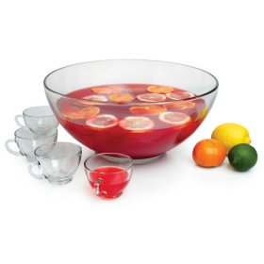
When Does the Punch Bowl Really End?
End of Quantitative Easing Could Trigger the Next Recession
*Fed target of 6.5% headline
unemployment is big
a roustabout, nurse, or construction worker
*Fed wants to see 6 months
of nonfarm payrolls over 200k
*Market least suspects a self
sustaining recovery;
therefore, we may get it

Slide 13

The Jim Parker View
The Mad Day Trader-Goes on sale on Monday, July 1
$1,000 for the upgrade on a one year renewal
Technical Set Up of the week
*Buy
sell into stock rally
on quarter end mark up
wait for break down or bounce on metals
*Sell Short
sell Aussie (FXA) on 400 BP rally
sell oil at $96.15, (USO) at $34
Yen? (FXY) $99.30-$102 range

Slide 14

The Goldilocks Economy Continues
Not too hot, not too cold
*Global synchronized recovery in play
with the US leading the way
*Q4 acceleration from a 2% to 3%
GDP growth rate
*Housing and energy booms are spilling into
the rest of the economy
*Autos running at 16 million annual rate
*Technology is booming
*Next comes Obamacare - +0.5% GDP,
2 million jobs

Slide 15

The Bull Case for the Economy
Is Goldilocks Here to Stay?
*Stock market wealth effect kicking in
*June consumer confidence 74.3 to 81.4
*June Richmond Fed Index -2 to +8
*May durable goods +3.6%
*Q1 GDP downgraded from 2.4% to 1.8%
*Debt ceiling, sequestration, and budget crisis fail to have impact
*Reindustrialization of America becoming a factor, birth of “onshoring”
*Market continues up for rest of 2013 with no more than a 12% dips to 1,490

Slide 16

Reality Hits the Markets
End of the One Way Mrket
* China GDP slowdown from 8.0% to 7%, on the way to 6%
*China rate spike to 28% warns of
same in the US
*Sell emerging markets and currencies
first, take the money home to US dollar
*Has the Great Rotation started
from bonds to stocks?
*Sharpest Treasury bond market selloff since 1962

Slide 17
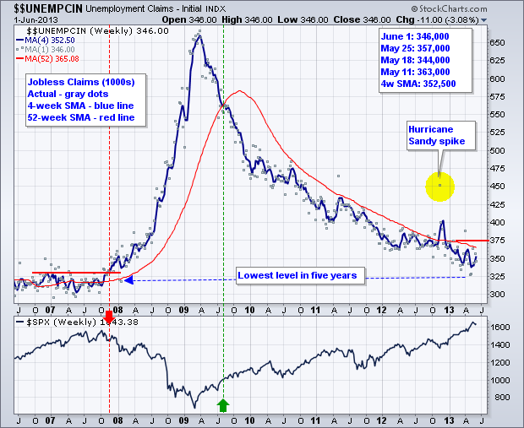
Weekly Jobless Claims
+18,000 fall to 354,000 Downtrend still in place

Slide 18
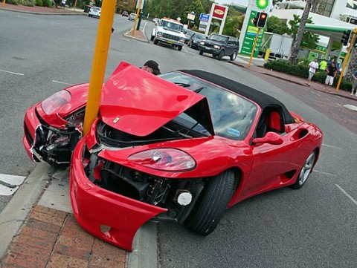
Bonds-Crash at Last!
The collapse everyone predicted, but no one was prepared for
*Sharpest bond market selloff since 1962, ten year yield hits 2.66%
*Completely skipped the 1.90%-2.50% range, moved straight to a 2.40%-2.90% range
*Great Rotation talks resume, but this time the evidence is there
*Bond mutual fund sales biggest in history
*Selling in “Reach for Yield” bonds,
like (MUB),(LQD), (JNK), (HYG), accelerates
*Stand aside, market too volatile to trade
*The “Big One” is still years off (6%),
just playing the new 1.90%-2.50% range

Slide 19
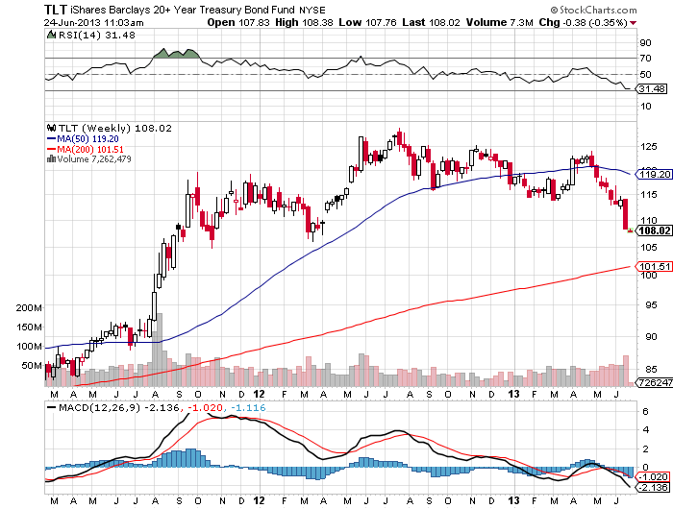
(TLT) – 20 year + Treasury ETF

Slide 20
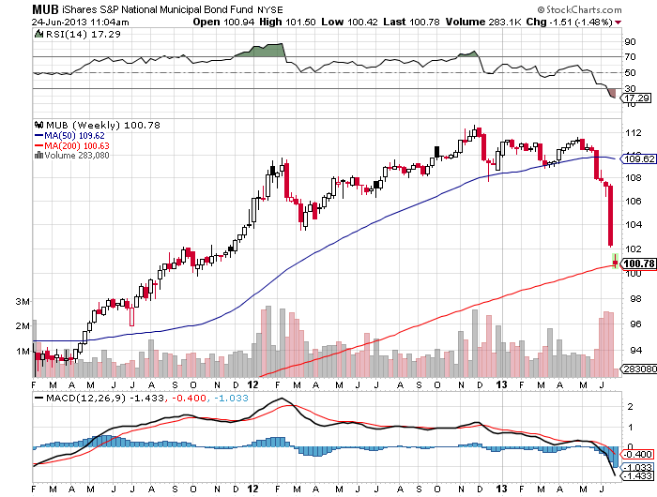
Municipal Bonds (MUB)-3% yield,
Mix of AAA, AA, and A rated bonds

Slide 21
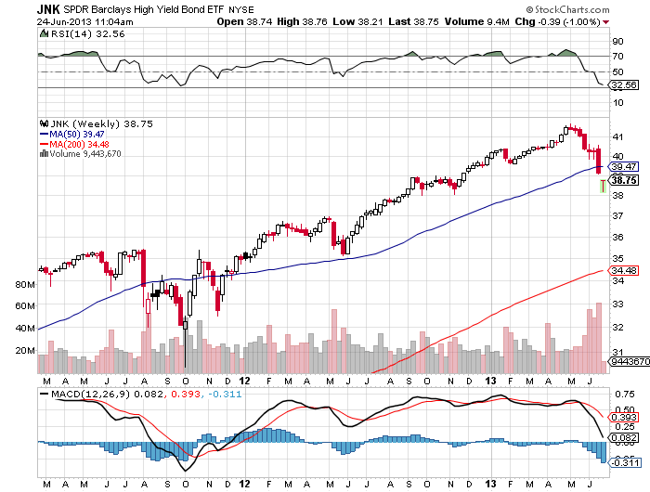
(JNK)-Cruising for a bruising

Slide 22
Stocks-Who Tipped Over the Punch Bowl?
*Multiple expansion is the major feature of 2013
*Too many investors trapped out of the market
trying to buy the dip, so dips are small
*Rising despite multiple headlines risks
*At 15.5 X earnings stock are dead in the
middle of their historic 9-22 valuation range
*Reversion to the mean can be a bitch
*When to dust settles, the world will pour back into US equities
*Only Ben Bernanke can spoil the party

Slide 23
US Corporate Profit Margins

Slide 24
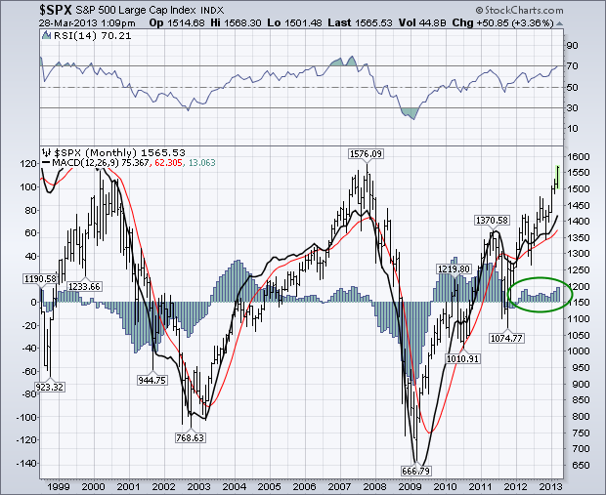
(SPX)-The 30,000 view
Here comes the six month churn
Fail
Here

Slide 25
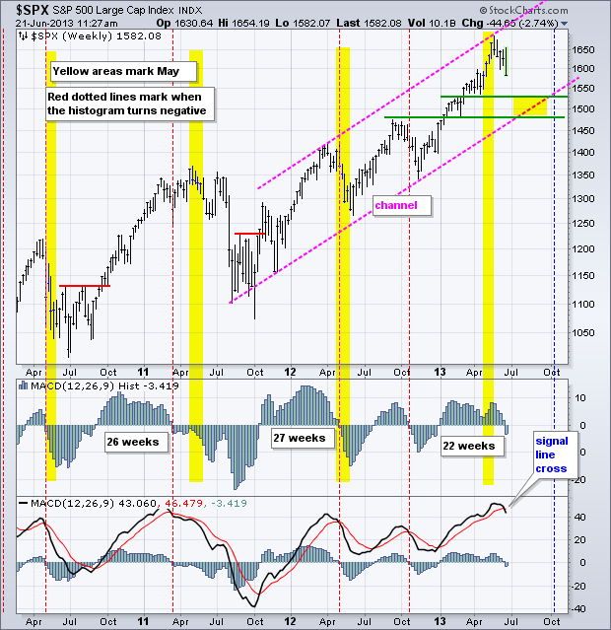
S&P 500 (SPX)-Targets 1,490-1,530

Slide 26
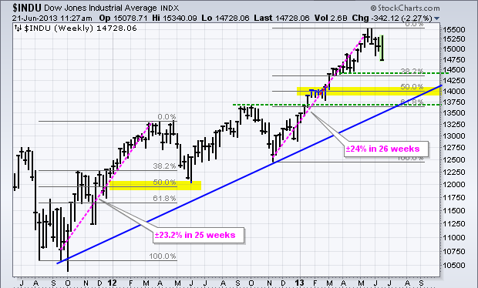
Dow Average (INDU)-Targets 14,000

Slide 27
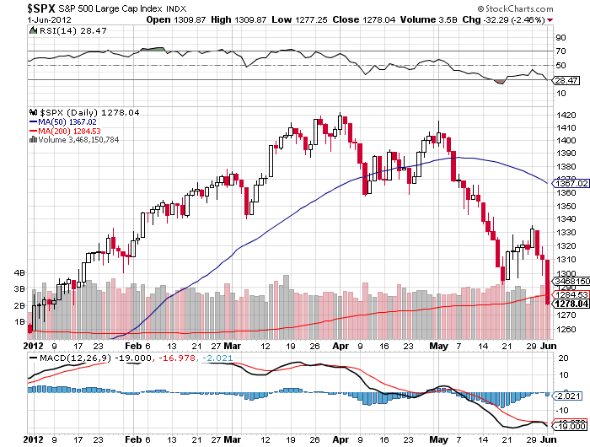
Trading Market Tops-(SPX) H1, 2012
Long Put spreads
and
Call Spreads
Long Puts
and
Put Spreads
Long Call
Spreads
Volatility
Collapses

Slide 28
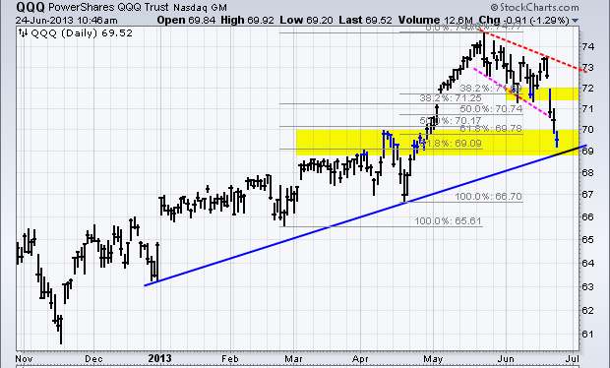
(QQQ)

Slide 29
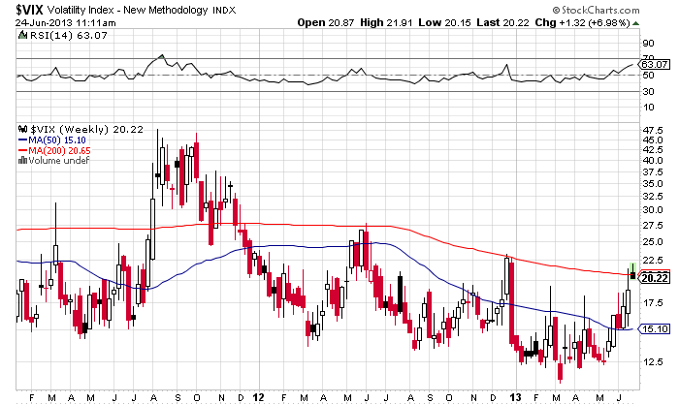
(VIX)-Coming back to life

Slide 30
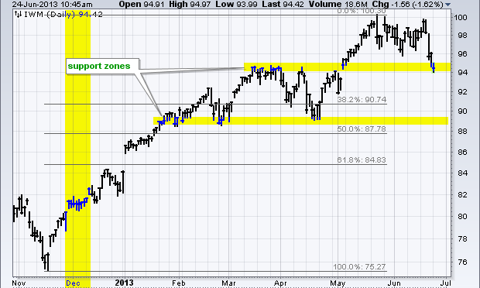
Russell 2000 (IWM)

Slide 31
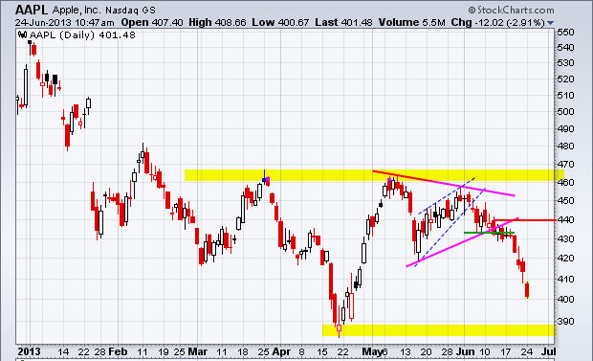
Apple (AAPL)-Looking for a double bottom

Slide 32
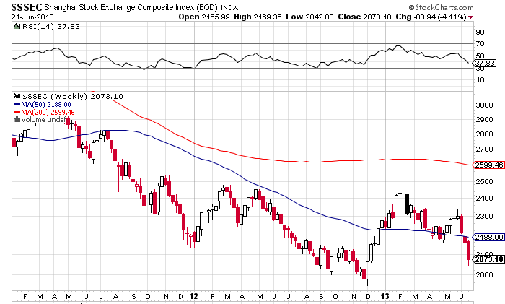
Shanghai-Still Trending Down
Taking commodities and oil with it, real estate clamp down fuel to fire
While we’re speeding up, their slowing down

Slide 33
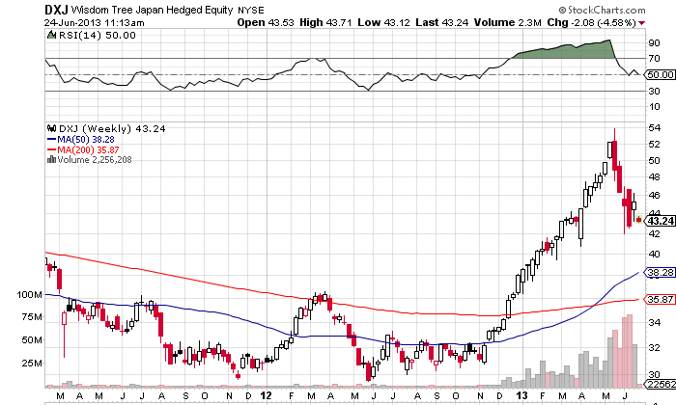
(DXJ)-the only way to play Japan
-Nikkei with hedged yen
Assets rise from $300 million to $7 billion in Q4, Q1

Slide 34
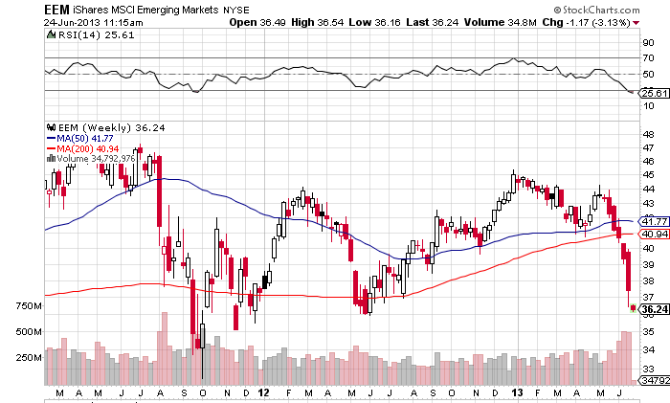
Emerging Markets-Take it on the nose

Slide 35
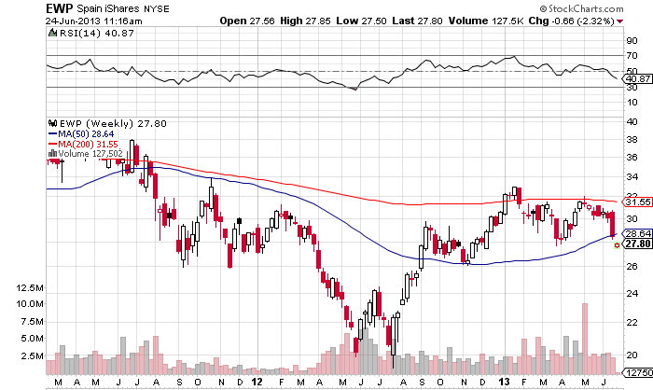
Spain-The high beta play in Europe

Slide 36

Dollar-The new flight to safety currency
*Foreign capital pouring into US from Asia, Europe,
and Cyprus
*Dollar outflows falling from US
energy boom
*Japan determined to devalue their way
to prosperity
*Continental chaos sucks the life
out of the Euro
*Weak China data has cut the knees out from under the Australian and Canadian dollars

Slide 37
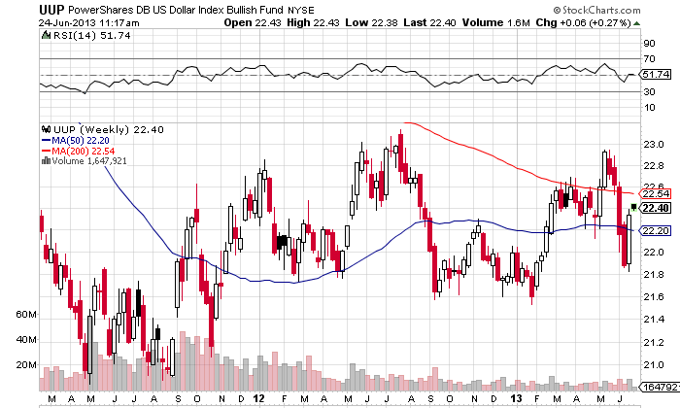
Long Dollar Basket (UUP)

Slide 38
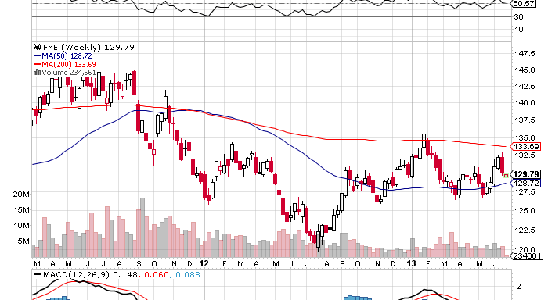
Euro (FXE)-One of the great mysteries
Looking for a $1.20 bottom

Slide 39
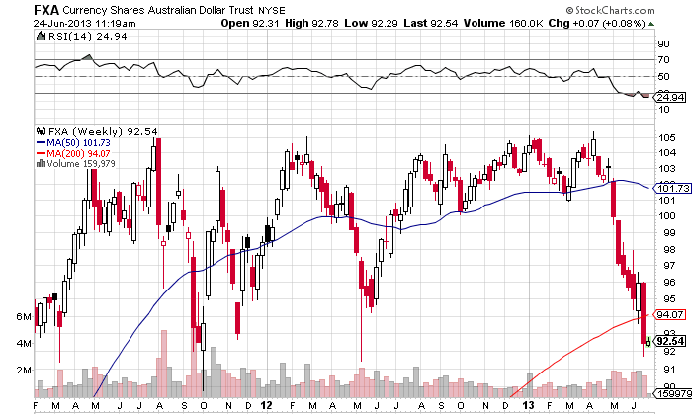
Australian Dollar (FXA)
Stalled by China and the Commodities Collapse

Slide 40
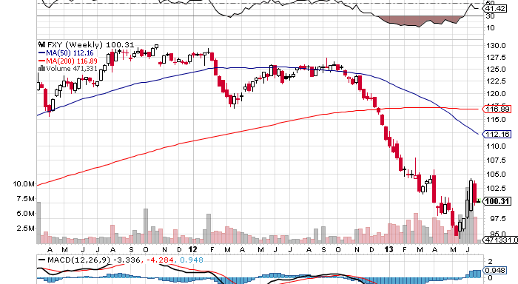
Japanese Yen (FXY)-Headed for the high 80’s or ¥110 in the cash market

Slide 41
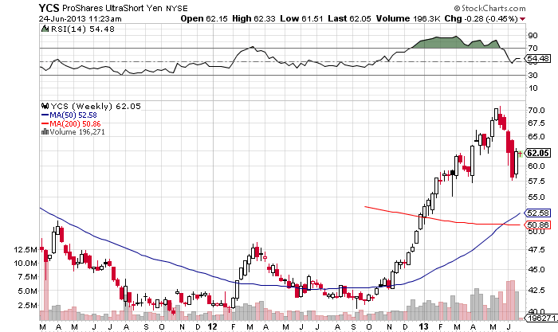
(YCS)-For Non Options Players
200% Short Yen ETF

Slide 42

Energy-Saudi America Here We Come
*US energy independence in 3 years- CA + ND = Saudi imports
*No oil crash, supported by China demand
*Volatility has collapsed
thanks to new balance
*US import dependence falls from
60% to 32% since 2005, 0 by 2016
*Huge job creator, 3 million already,
5 million by 2015
*New finds + conservation + alternatives + mileage improvements
+ building designs all leveraging each other, capping gasoline demand

Slide 43
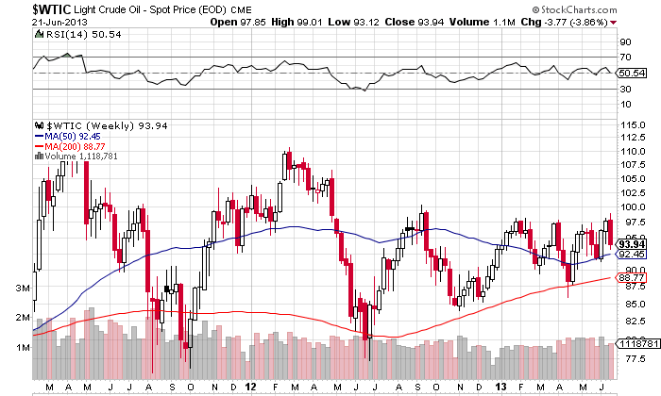
Crude

Slide 44
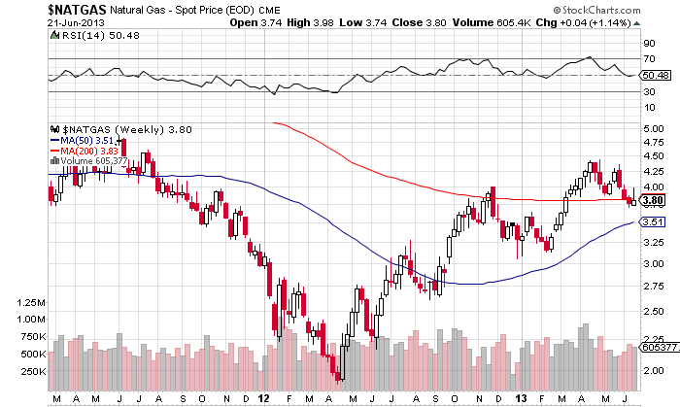
Natural Gas

Slide 45
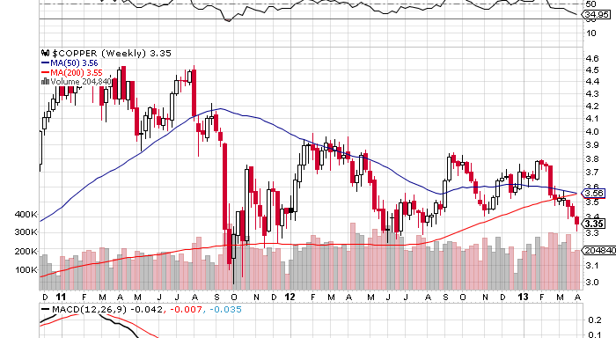
Copper (CU)-Ouch! Inventories double YOY on China drag

Slide 46
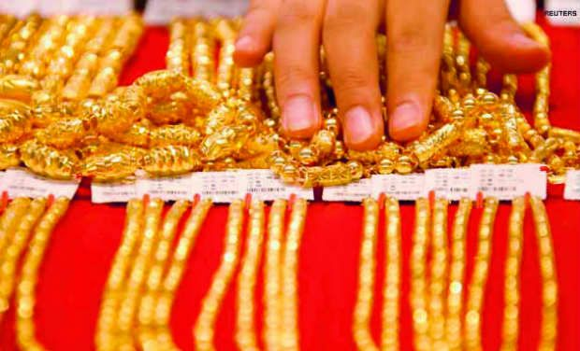
Precious Metals-Look but don’t touch
*If gold can’t rally when a country blows up, then when? After Cyprus, then what?
*As long as stocks rally, paper rules
and hard assets suffer
*Capitulation sell off below $1,300
kicked in big time
*Who needs inflation hedge during deflation?
*Paper gold (GLD) is selling off, while physical gold and coins is held

Slide 47
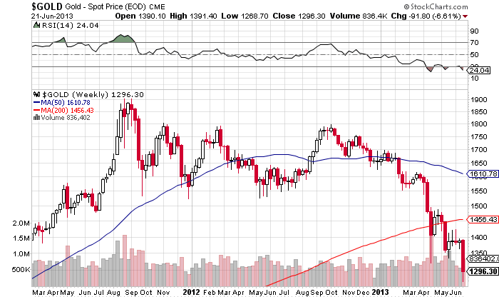
Gold

Slide 48
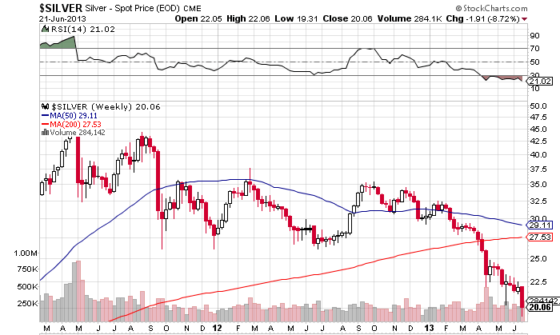
Silver

Slide 49

Agriculture
The Global Warming/Emerging Market Trade
*The world is making people faster than the food to feed them
*Global population rises from 7 to 9 billion by 2050
*Half of the increase is in countries that can’t
feed themselves (Middle East)
*Food stocks at 40 year lows
*Ethanol will fall victim to budget crisis,
freeing up 40% of US corn supply
*Look for entry points to play the
summer drought
*Buy foodstuffs, fertilizer, equipment makers, and the (DBA)

Slide 50
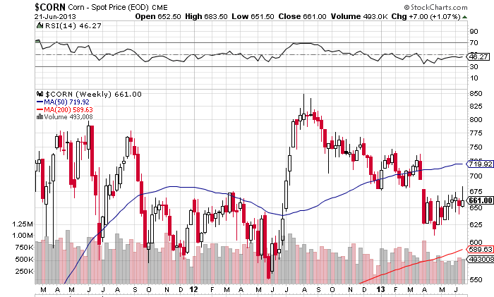
(CORN)

Slide 51
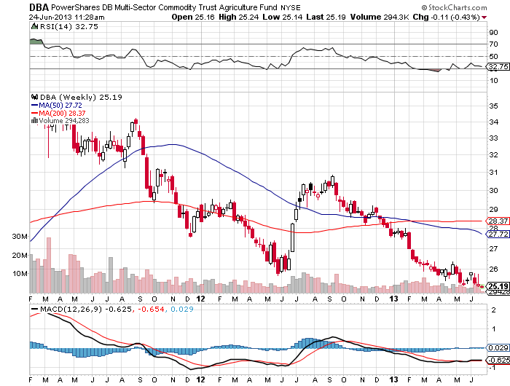
DB Commodities Index ETF (DBC)

Slide 52

Real Estate-the boom continues
(BAC), (HD)
*April S&P Case Shiller up 2.5% as housing shortage emerges, biggest monthly gain in 12 year history, +12% YOY
*Multiplier effect into rest of
the economy is huge
*New monthly housing starts 300,000 to
1 million in 3 years
*May new home sales +2.1%
May new home price +10.3%, 32% in CA
*Interest rates won’t drag on the
market until mortgages hit 4%
*$82 billion in foreign real estate investment in the US YOY

Slide 53
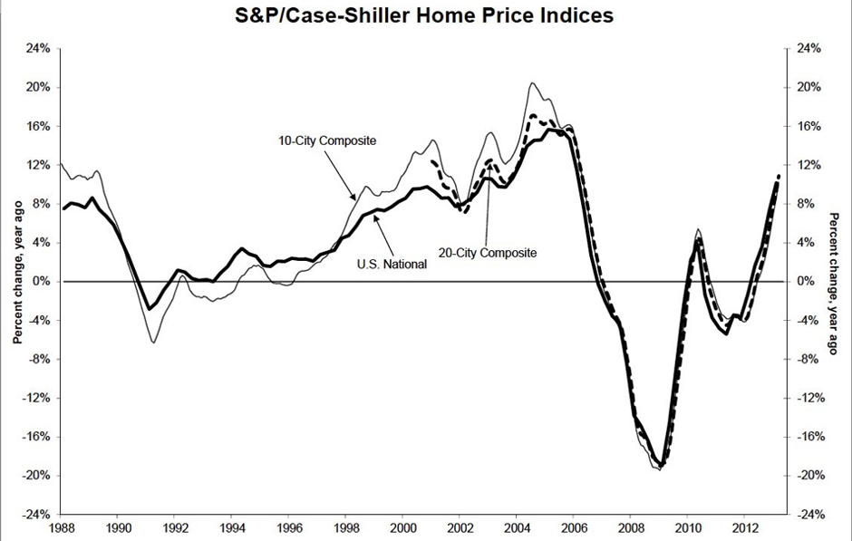
March S&P Case –Shiller
Back to 2003 prices and collateral

Slide 54
(ITB)-US Home Construction Dow Sub index

Slide 55

Trade Sheet-No Change
“RISK ON” Good Until Proven Guilty
*Stocks- buy the big dips, running to a new yearend high
*Bonds- stand aside, too volatile to trade
*Commodities-stand aside until global sell off ends
*Currencies- sell yen on any rallies
*Precious Metals –stand aside, wait for rebirth
*Volatility-stand aside, will bounce along bottom
*The Ags –buy dips for global warming play
*Real estate- too late to touch

Slide 56
To buy strategy luncheon tickets Please Go to www.madhedgefundtrader.com
Next Strategy Webinar Wednesday, July 17, 2013
Pre recorded in Berlin, Germany and link sent to you
Good Luck and Good Trading!

