Slide 1
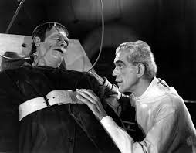
The Mad Hedge Fund Trader
“It Lives!”
Zermatt, Switzerland
August 7, 2013
www.madhedgefundtrader.com

Slide 2
MHFT Global Strategy Luncheons
Buy tickets at www.madhedgefundtrader.com
Zermatt
August 9

Slide 3

Hello from the Italian Riviera

Slide 4
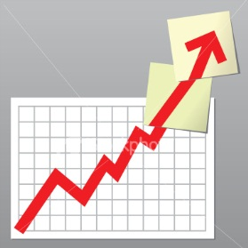
Trade Alert Performance
Staying On Top
*2013 YTD +36.76%, compared to 14.5%
for the Dow, beating it by 22.3%
*July +1.19%
*First 124 weeks of Trading +91.6%
*Versus +26% for the Dow Average
A 66% outperformance of the index
137 out of 193 closed trades profitable
70.6% success rate on closed trades

Slide 5
Portfolio Review-Running small net long
Market Risk is Now -High-keep positions small
Too late to buy
Mad Hedge Fund Trader
Trading Book
Asset Class Breakdown
Risk Adjusted Basis
current capital at risk
Risk On
(GLD) 8/$106-$110 call spread | 10.00%
(FXE) 9/$133-$135 put spread | 10.00%
Risk Off
total net position | 20.00%

Slide 6
Performance Year to Date +37.08%
Taking another run at 40%

Slide 7
Performance Since Inception
+35.7% Average Annualized Return

Slide 8

Hello from Portofino, Italy

Slide 9

Strategy Outlook
*Too late to buy for this cycle
*We never got the 12% correction, only 7.1%
*Fed does a 180 on taper talk
*In Boston, Ben Bernanke hints that quantitative
easing to continue until 2014, as I expected
*Half the market thought it would end in September,
therefore the rally
*So it’s off to the races once more with risk assets
*You will get another chance to buy down 5%

Slide 10

The Jim Parker View
The Mad Day Trader-On sale for a $1,000 upgrade
Summer market still prevails
Technical Set Up of the week
*Buy -little is attractive up here
Tesla (TSLA) on a dip to $118, final target is $170
*Sell Short
bonds on big rallies of a point or more
Chinese yuan (CYB) on rallies

Slide 11
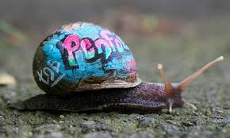
The Economy-More Slow Motion
*July nonfarm payroll comes in at 169,000 far below expectations
*US Q2 GDP revised down from from 1.8% to 1.78%,
Q1 revised down drastically
*Fed downgrades economy from
“moderate”to “modest”, QE to continue
*Big LDP win in July 21 Japanese election
promises major reforms to come
*China July HSBC PMI falls 48.2 to 47.7, 11 month low
*Green shoots in Europe? Unemployment falls
*The bottom line is more money for
US equities on the dips

Slide 12
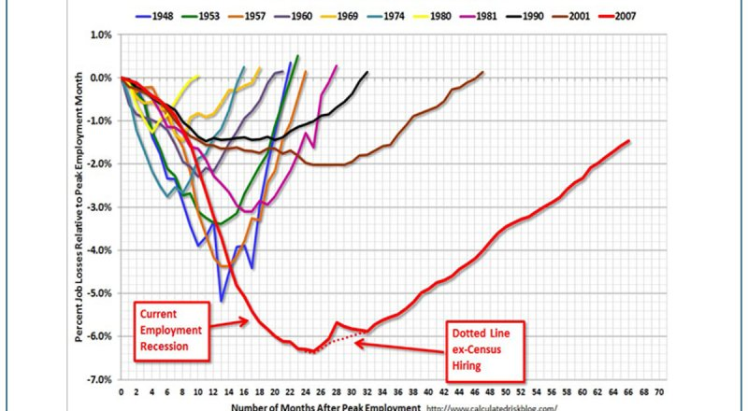

Slide 13
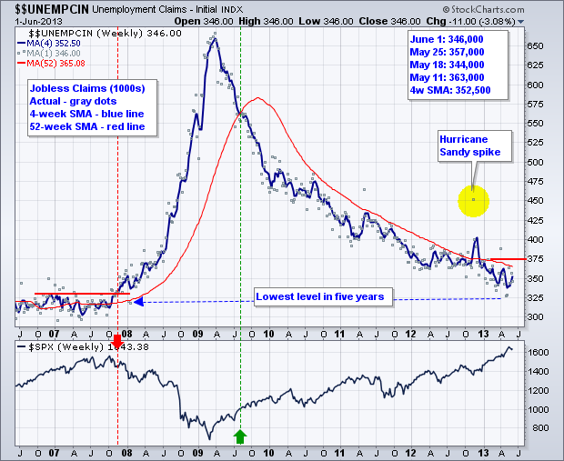
Weekly Jobless Claims
+16,000 jump to 360,000 Downtrend still in place

Slide 14

Bonds-QE Lives!
*$85 billion a month in Fed bond buying continues for foreseeable future on Fed downgrade of economy
*Bonds probing new lows in prices,
new highs in yields
*Sell the rallies, buy (TBT) on dips
*Continued commodity collapse shows
that inflation is not on the radar

Slide 15
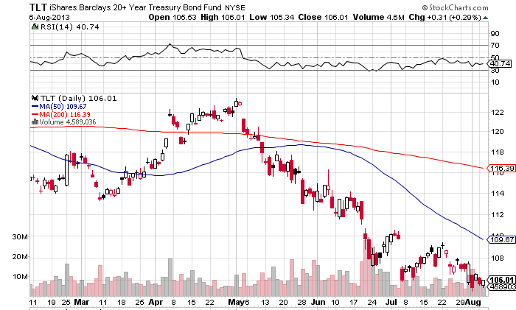
Ten Year Treasuries (TLT)

Slide 16
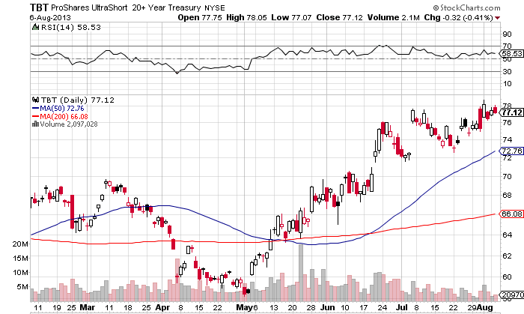
2X Short Treasuries (TBT)

Slide 17
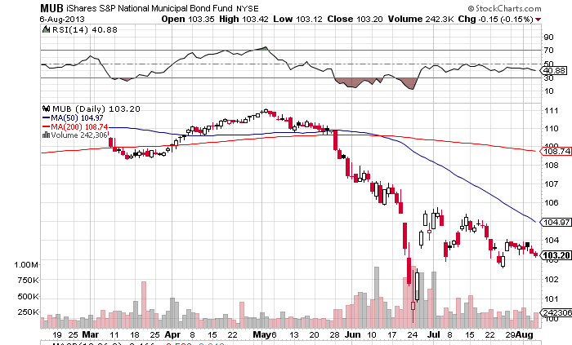
Municipal Bonds (MUB)-3% yield,
Mix of AAA, AA, and A rated bonds

Slide 18
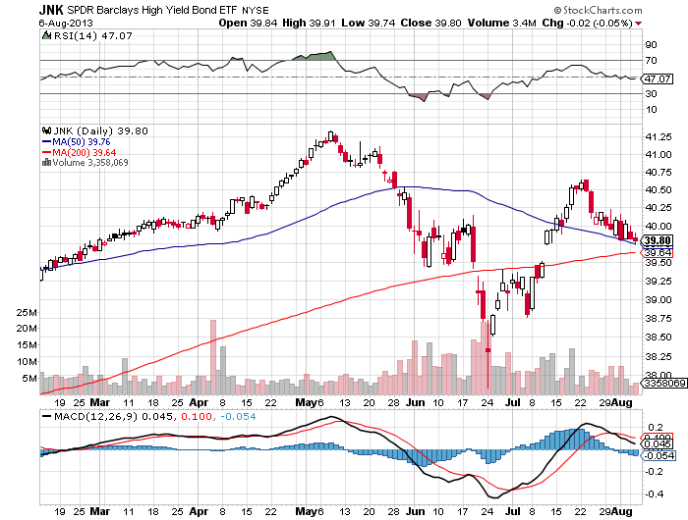
(JNK)-Cruising for a bruising

Slide 19

Checking in from Cinqueterre

Slide 20

Stocks-Nosebleed Territory Again
*Bernanke comments send indexes to new highs, but volume stalling during summer slowdown
*To see market strength like this during a period of historic seasonal weakness suggests the bull market could continue for the rest of the year.
*Apply rally takes NASDAQ to new
highs for year, provides new leadership
*As long as market is in the middle of its
9-22 PE valuation range, buy every 5% dip
*Buy every hint the tapering is coming

Slide 21
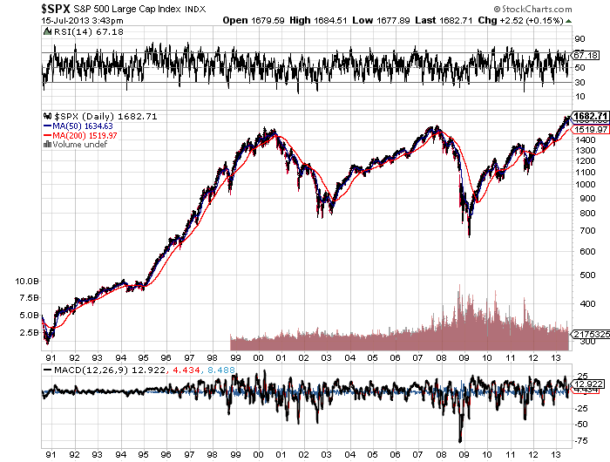
(SPX)-The 30,000 view
Here comes the six month churn
Fail
Here

Slide 22
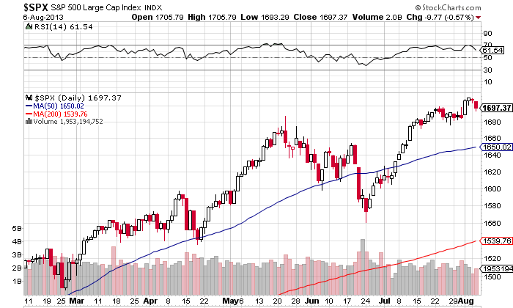
S&P 500 (SPX)-New Highs Again

Slide 23
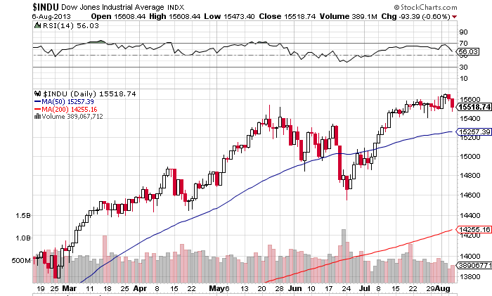
Dow Average (INDU)-Targets 16,000

Slide 24
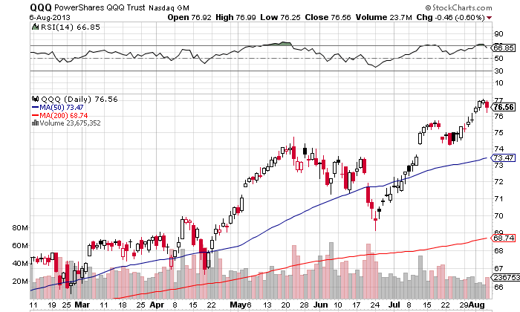
NASDAQ (QQQ)

Slide 25
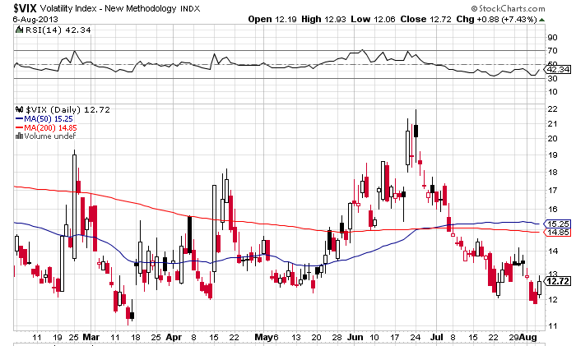
(VIX)-Back to the Graveyard
The spike for the year is in

Slide 26
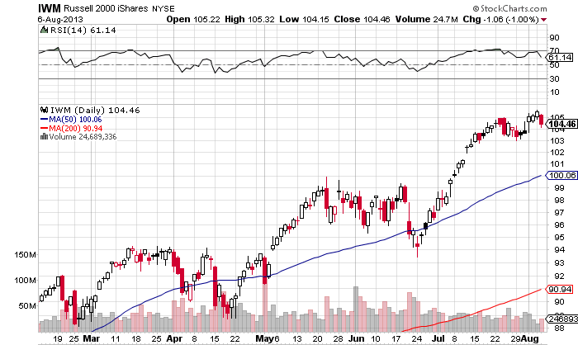
Russell 2000 (IWM)-Leads the Upturn

Slide 27
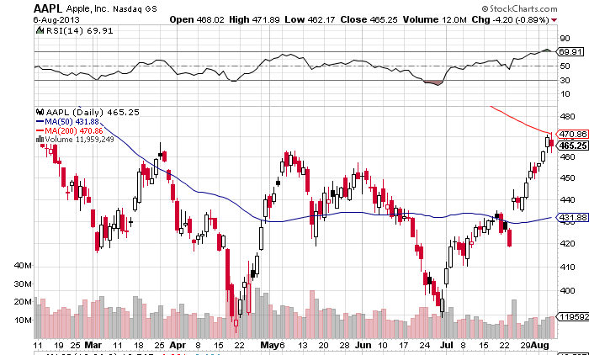
Apple (AAPL)-Off to the races

Slide 28
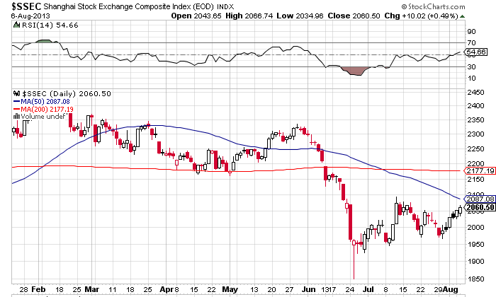
Shanghai-Barely a pulse

Slide 29
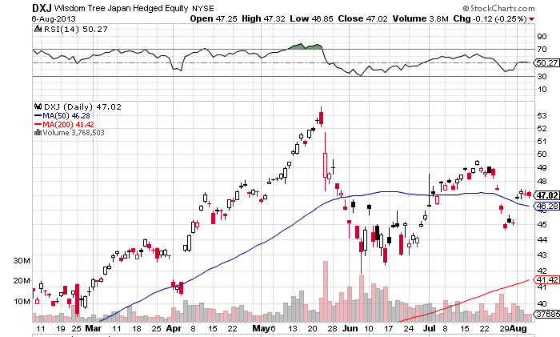
(DXJ)-the only way to play Japan
-Nikkei with hedged yen

Slide 30
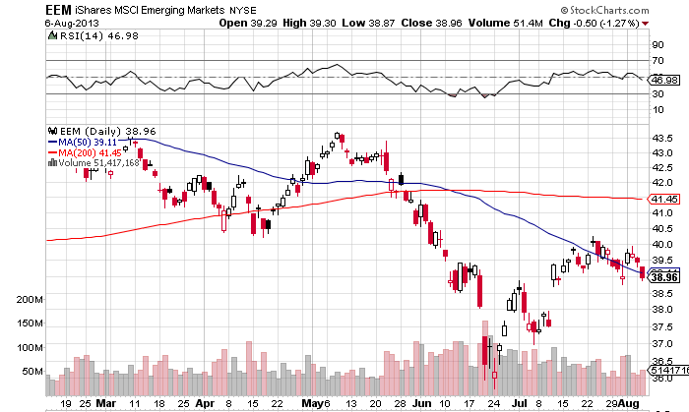
Emerging Markets-Dragged Down by Strong dollar and weak China and commodities

Slide 31

The Mykonos Strategy Lunch

Slide 32
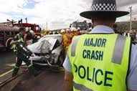
Dollar-The Australian Ambush
*Bernanke speaks again, no more tapering
*Big LDP win in July 21 Japanese election,
keep selling major yen rallies
*Green shoots in Europe give Euro some
stability
*BOJ governor Kuroda say economy so strong
that tax rises are possible, yen soars 2%
*Aussie crashes on governor Stevens comments,
his it has more to fall and there is room for means,
signals Australia’s entry into the currency “race to the bottom”
*Long term strong US dollar trend still in place

Slide 33
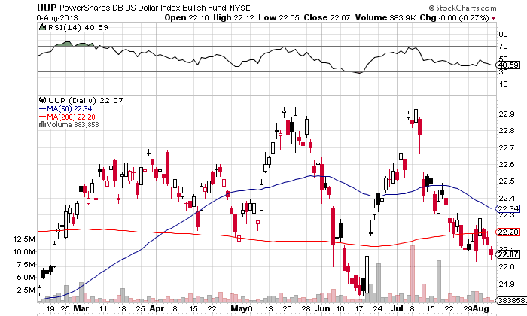
Long Dollar Basket (UUP)-
Bottom end of the range

Slide 34
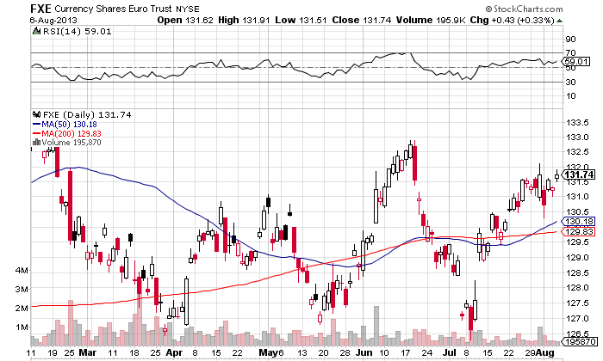
Euro (FXE)-Top end of Range, shorting territory

Slide 35
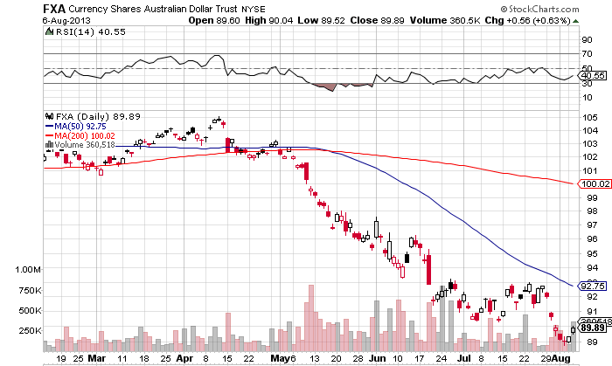
Australian Dollar (FXA)
Ambushed by the Reserve Bank of Australia interest rates at all time low

Slide 36
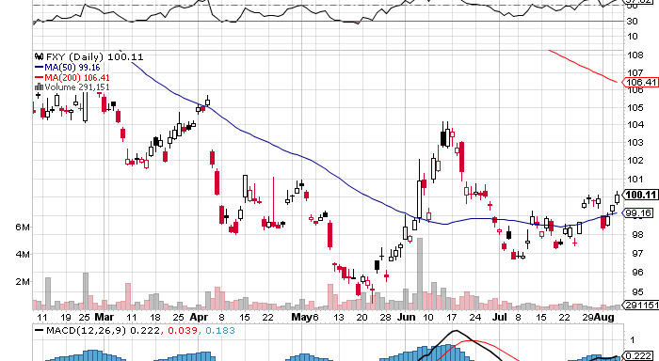
Japanese Yen (FXY)-Still stalled at ¥100

Slide 37
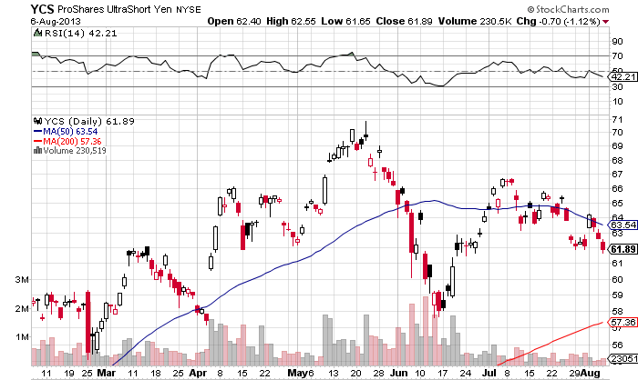
(YCS)-For Non Options Players
200% Short Yen ETF-head and shoulders top risk

Slide 38

Hello from Greece

Slide 39

Energy-Sell the Breakout, it can’t last
*Saudi Prince bin Talal says US fracking major threat to Saudi incomes
*Brent moves to discount to West Texas for first time in 3 years as US fracking supplies flood Europe, and refining capacity rises,
*WTI should be an $11 discount to reflect transportation costs
*Use the Egypt spike to go short
*With Chicago at 65 degrees, natgas is
getting destroyed
*London copper inventories at all
time highs, as China moves to
more service oriented economy

Slide 40
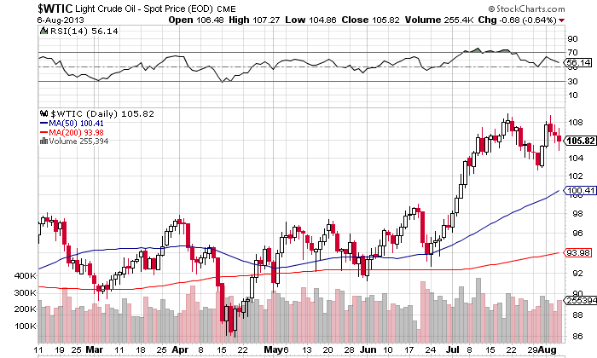
Crude-Double top in place, sell the rallies

Slide 41
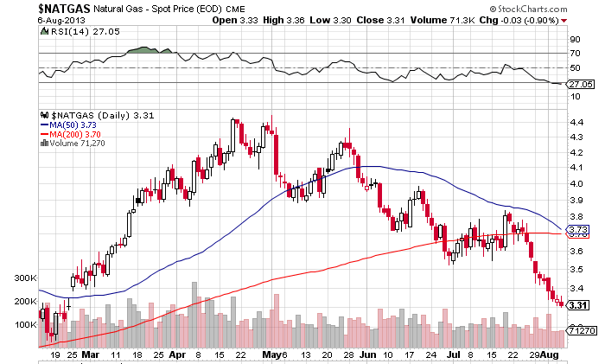
Natural Gas-Killed by a Cool summer

Slide 42
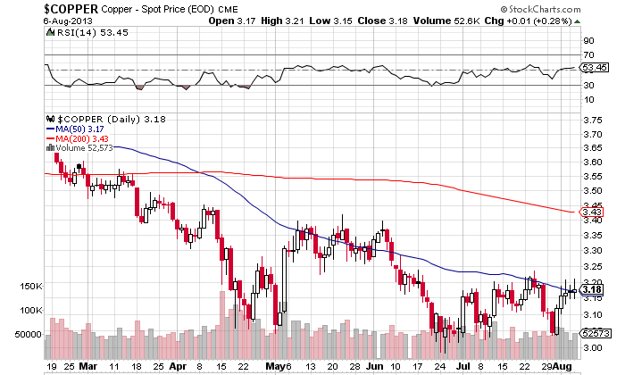
Copper (CU)-trying to bottom

Slide 43

Mykonos Old Port

Slide 44
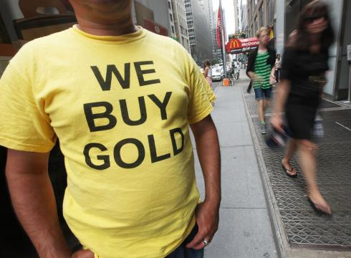
Precious Metals-Signs of Life
*Abe election win in Japan, sends gold soaring, as more global QE good for gold
*Bernanke comments on no tapering also gold positive
*Gold miners (GDX) outperforming
metal for the first time in 8 years
*Big hedge funds switching out of gold and
into gold miners
*Industry hedging at all time low

Slide 45
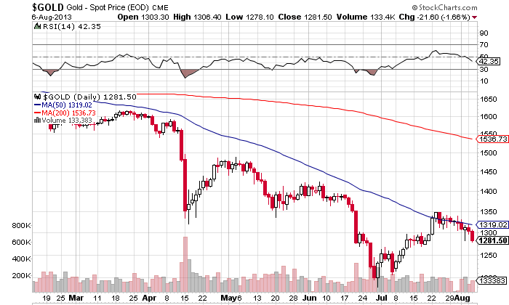
Gold-retesting the lows

Slide 46
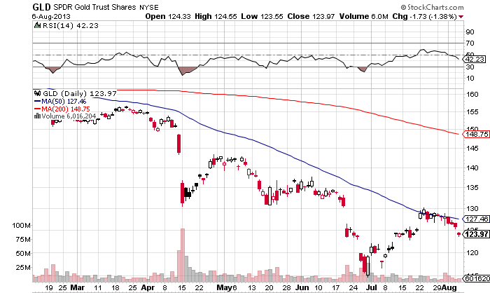
Gold (GLD)
Long the 8/$106-$110 Call Spread-expires in 7 trading days

Slide 47
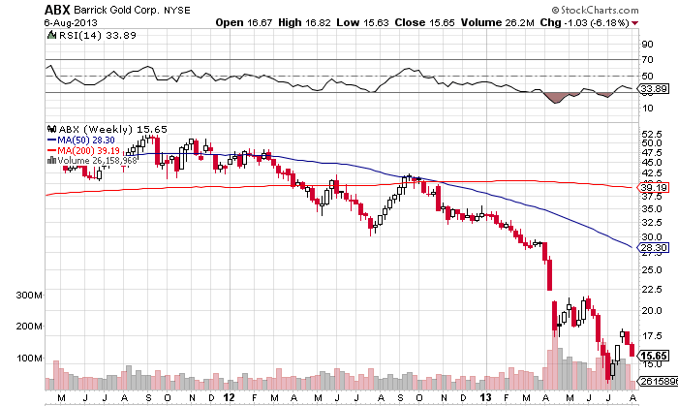
Barrack Gold (ABX)-weekly
75% dividend cut on huge reported losses

Slide 48
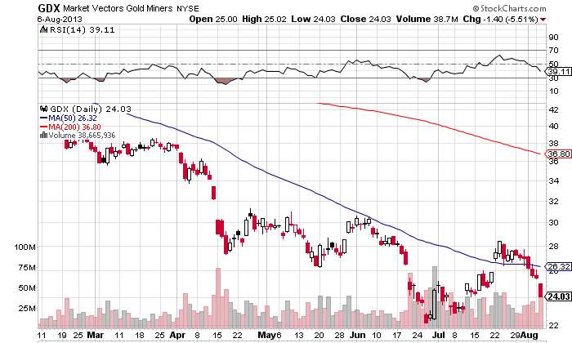
Market Vectors Gold Miners ETF- (GDX)

Slide 49
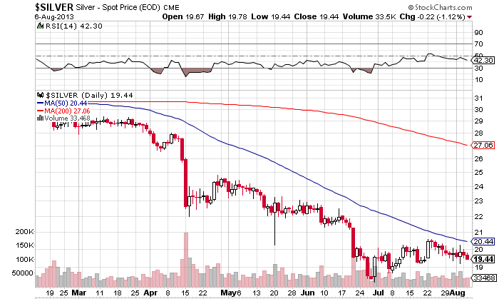
Silver

Slide 50

Back in Italy at Lake Como

Slide 51
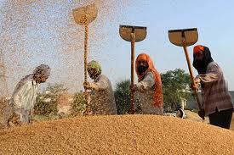
Agriculture-Break Down to New Lows
*More rain and moderate temps create perfect growing
*Setting up for the biggest grain crop of all time
*63% of corn crop “good/excellent” and trending up,
vs long term average of 58%
*Potash cartel collapse puts
more downward pressure
on ags
*No bottom yet in ags

Slide 52
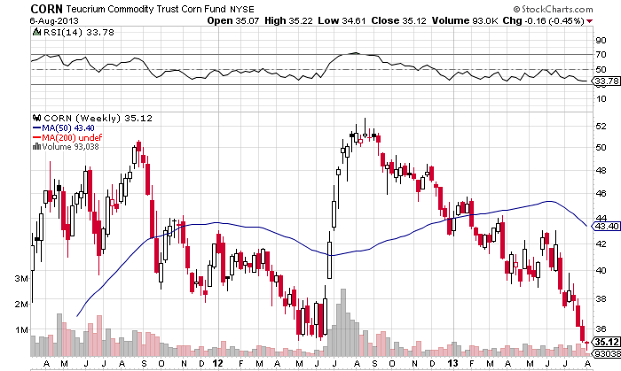
(CORN)-still trying to bottom

Slide 53
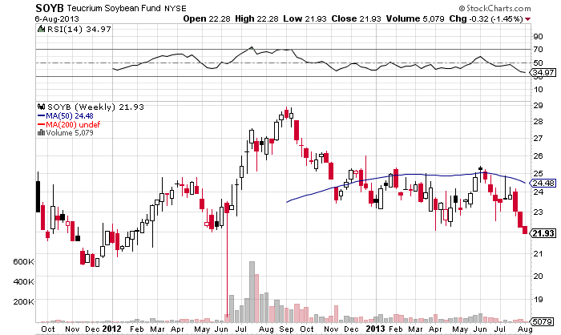
Soybeans (SOYB)-lookout below

Slide 54
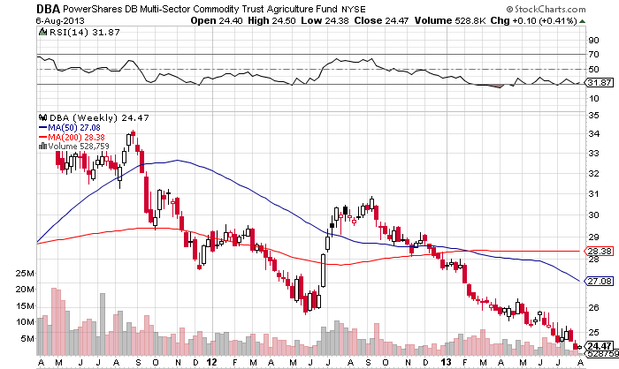
DB Commodities Index ETF (DBC)
More new lows

Slide 55

Real Estate-the boom continues
(BAC), (HD)
* May Case Shiller +12.2% YOY, highest since May, 2006, although slowing slightly,
San Francisco leads with +24.5%
*June existing home sales -1.2% to 5.08 million
*June new home sales +8.3% to 497,000,
most since May, 2008
*30 year loans up full percent from May
lows to 4.58%, up 28%,
*No impact on 30% of buyers who pay cash

Slide 56
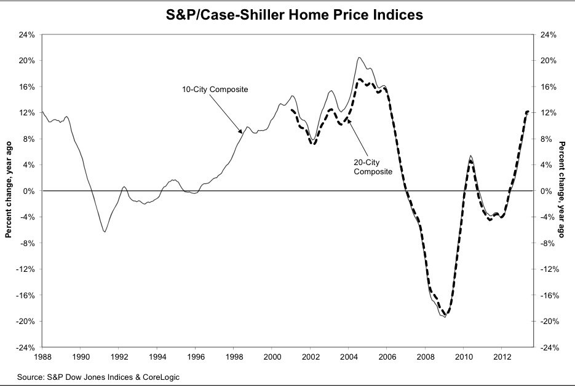
May S&P/Case–Shiller Home Price Index

Slide 57
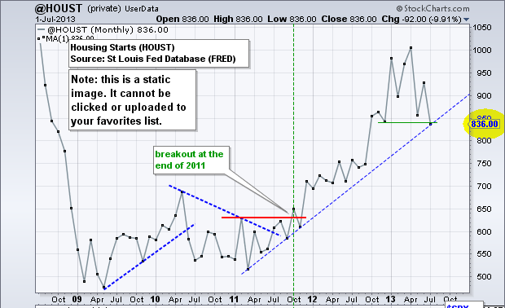
July Housing Starts

Slide 58
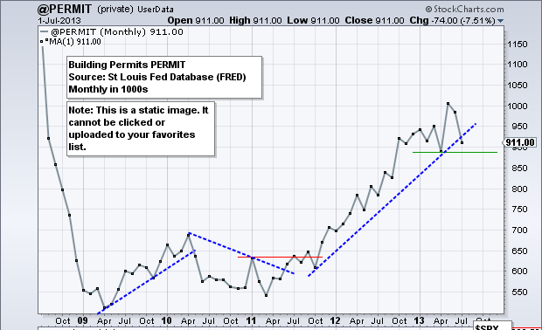
Housing Permits July

Slide 59
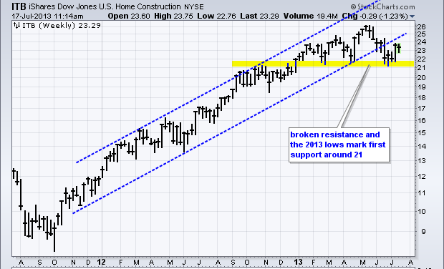
(ITB)-US Home Construction Dow Sub index

Slide 60
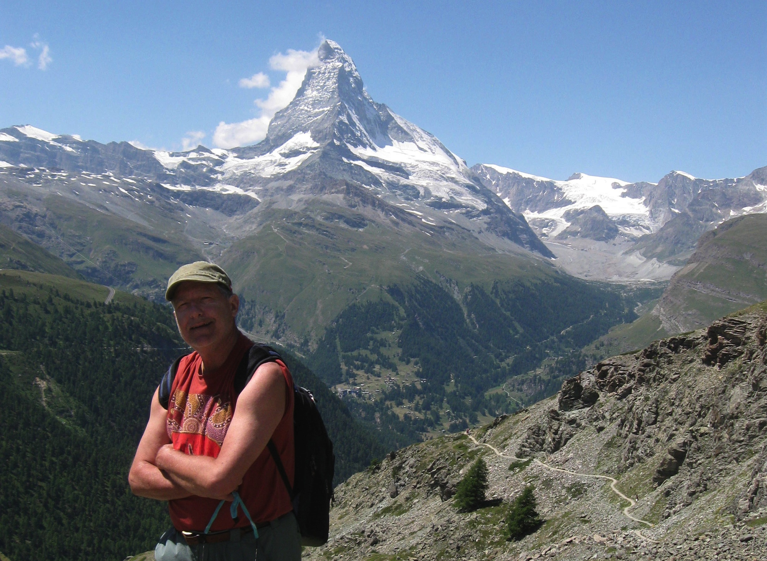
Hello from Zermatt

Slide 61

Trade Sheet-No Change
“RISK ON” Good Until Proven Guilty
*Stocks- buy the big dips, running to a new yearend high
*Bonds- sell the big rallies
*Commodities-stand aside until global sell off ends
*Currencies- sell yen and Aussie on any rallies
*Precious Metals –buy dips to $1,100
*Volatility-stand aside, will bounce along bottom
*The Ags –stay away
*Real estate- too late to touch

Slide 62
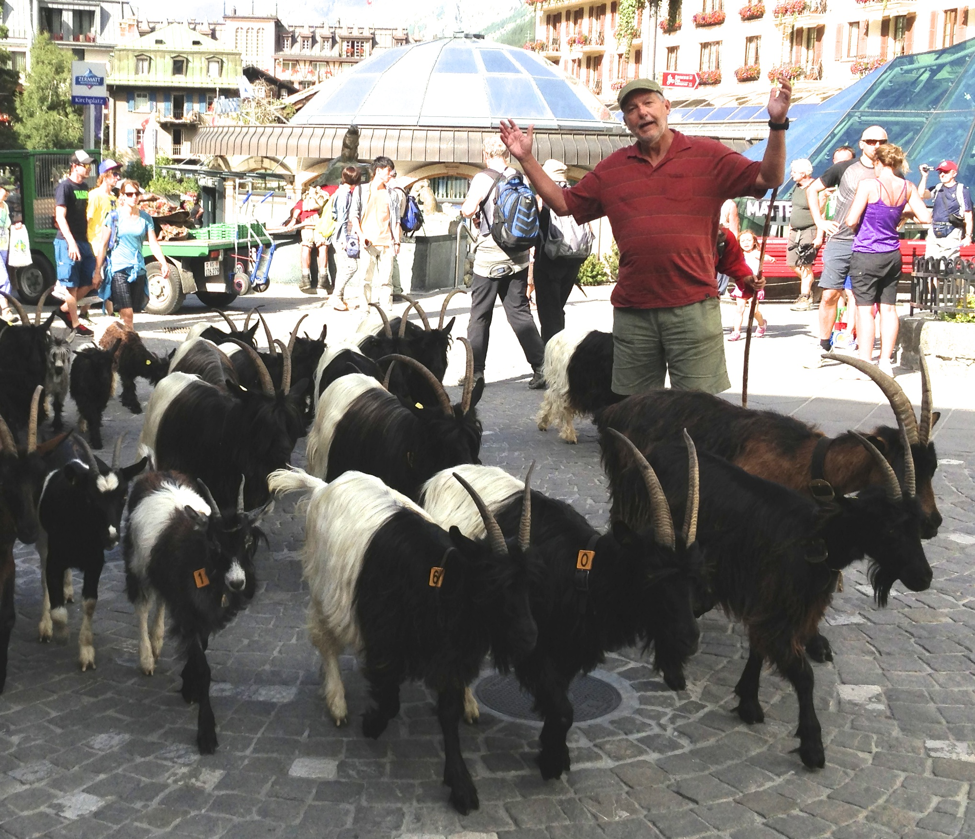
In This Business, Everyone is a hero or a Goat

Slide 63

To buy strategy luncheon tickets Please Go to www.madhedgefundtrader.com
Next Strategy Webinar 12:00 EST Wednesday, August 28, 2013
Live from San Francisco
Good Luck and Good Trading!

