Slide 1

The Mad Hedge Fund Trader
“A Symphony of ‘BUY’ Signals”
With John Thomas
from San Francisco, CA
October 22, 2014
www.madhedgefundtrader.com
Notes:
*

Slide 2

Go Giants!

Slide 3
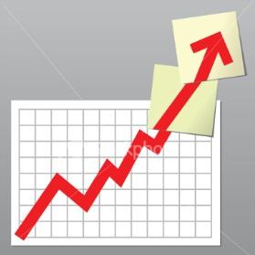
Trade Alert Performance
Still Another New All Time High!
*January Final +3.05%, *July Final +4.18%
*February Final +6.41%, *August Final 5.86%
*March Final -2.52% *September Final 5.01%
*April Final +3.32% *October MTD 8.39%
*May Final +4.61%
*June Final +4.24%
2014 YTD +43%, versus 0% for the Dow,
an outperformance of 43%, survived the crash!
*First 187 weeks of Trading +165.4%!

Slide 4
Paid Subscriber Trailing 12 Month Return +69%

Slide 5
46 Months Since Inception
Averaged annualized +43%

Slide 6
Portfolio Review-Pedal to the Metal!
Making a Fortune on a Neutral Book bought at the crash lows, then sold into the rally to cut risk
Positioned for a big sideways move for two weeks
Risk On
(TBT) short Treasury ETF | 20.00%
(BAC) 11/$15-$16 call spread | 10.00%
Risk Off
(FXE) 11/$127-$129 put spread | -10.00%
(FXE) 11/$128-$130 put spread | -10.00%
(SPY) 11/$197-$202 short call spread | -10.00%
total net position | 0.00%

Slide 7

Strategy Outlook-Risk Back On
*Cheap oil has just given the US a new $1.1 trillion stimulus package, bigger than the one in 2009, energy savings is $12,000 a year
*That means it is ”RISK ON” for the next 6 months, but it may take a month to launch, digesting the havoc of the past month
*Commodities, oil, gold, silver, base metals, food, and foreign currencies still dead in the water
*Dollar churning until another run at new highs
*All Assets classes corrected in unison, will
rebound in unison, thanks to hedge fund dominance
*All other issues are just noise (Ebola, ISIL,
Ukraine)

Slide 8

The Jim Parker View
The Mad Day Trader-On sale for a $1,500 upgrade
Technical Set Up of the week-Watch European financials for the lead
Buy
*(LNG), (HCA), (TWX), biotech on dips
*Gold if it holds $1,240
*Mexico (EWW)
Sell Short
*Aussie (FXA)
*Oil on rallies to $82.40, Brent is the driver
*If (FXE) closes under $125.10 its going to $123
Avoid
* Chicago in the winter

Slide 9

The Global Economy- Fortress America
*Europe grinds to a halt, French CPI -0.4% MOM, German October ZEW -3.6 to 3.3, worst in 2 years, ECB to accelerate QE in a couple of days
*China does a surprise $32 billion injection into regional banks to invigorate the economy, Q3 growth slows to 7.3%, a 5 year low
*Bank of England says rates to stay lower for longer
*Plunging gasoline prices amount to
a global tax cut for all just ahead
of Christmas
*US macro data is holding up well

Slide 10
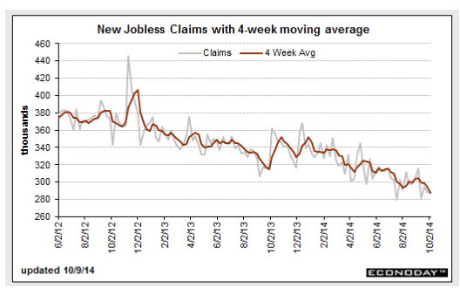
Weekly Jobless Claims - The trend is your Friend
-4,000 to 284,000, new 14 year lows!

Slide 11

Bonds-Now the Top is Really In!
*The ten year Treasury ran from 2.30% to 1.86% to 2.22% in just two days!
*This is the final month of the Fed’s tapers quantitative easing, but interest rates rises not until late 2015 0r 2016
*ECB promises to accelerate QE to head off crisis
*Switch out of bonds into stocks about to become major factor
*Watch junk bonds (JNK) as the new
canary in the coal mine for global
risk taking

Slide 12
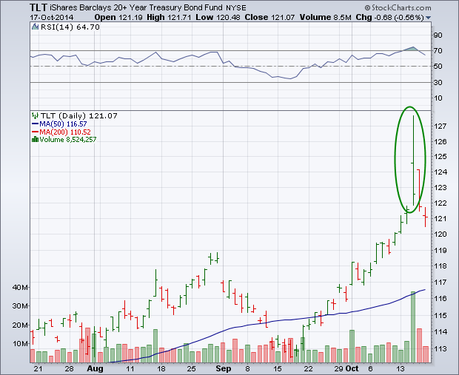
Ten Year Treasuries (TLT) 2.20%
Classic Blow Off Top
Stopped out of the the 11/$122-$125 vertical bear put spread

Slide 13
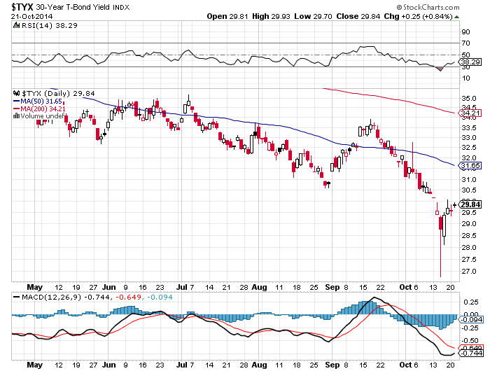
30 Year Treasury Yield ($TYX)-Yield 2.84%

Slide 14
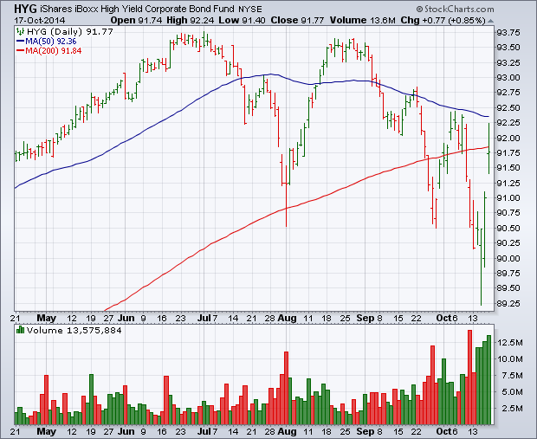
Junk Bonds (HYG) 5.81% Yield
The New Lead Contract-A Classic High Volume Spike Bottom

Slide 15
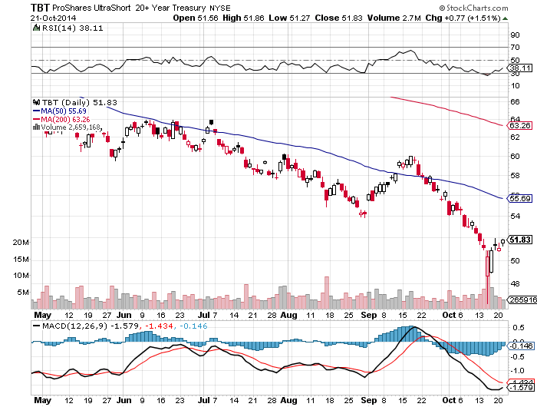
2X Short Treasuries (TBT) long 20% position-I Was Early

Slide 16
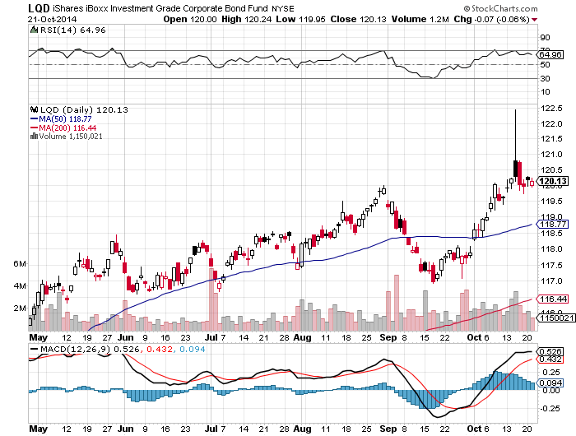
Investment Grade Corporate Bonds (LQD)
3.54% Yield

Slide 17
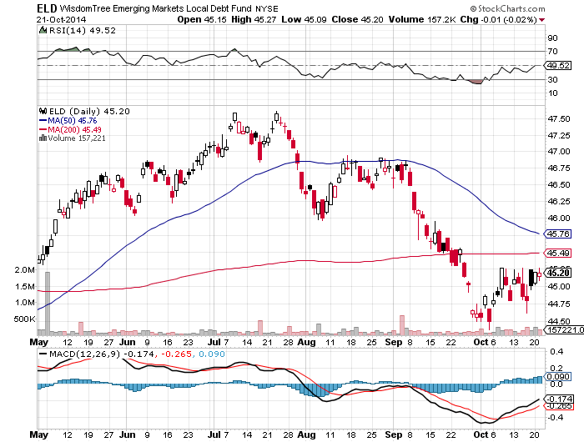
Emerging Market Debt (ELD) 3.56% Yield

Slide 18
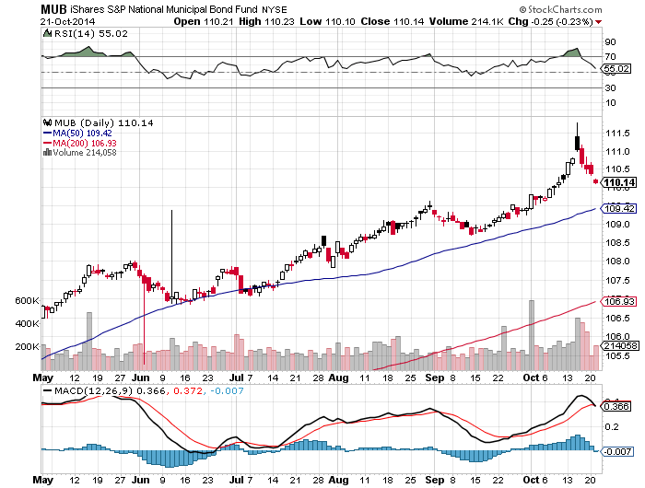
Municipal Bonds (MUB)-2.88% yield, Mix of AAA, AA, and A rated bonds

Slide 19
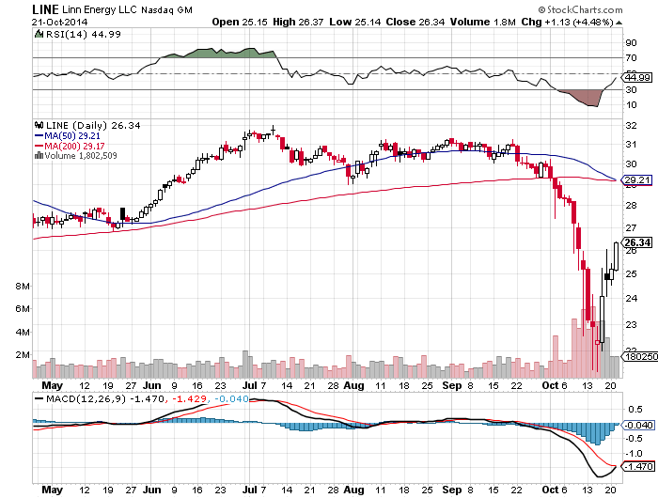
MLP’s (LINE) 11.70% Yield-Smashed by Oil

Slide 20
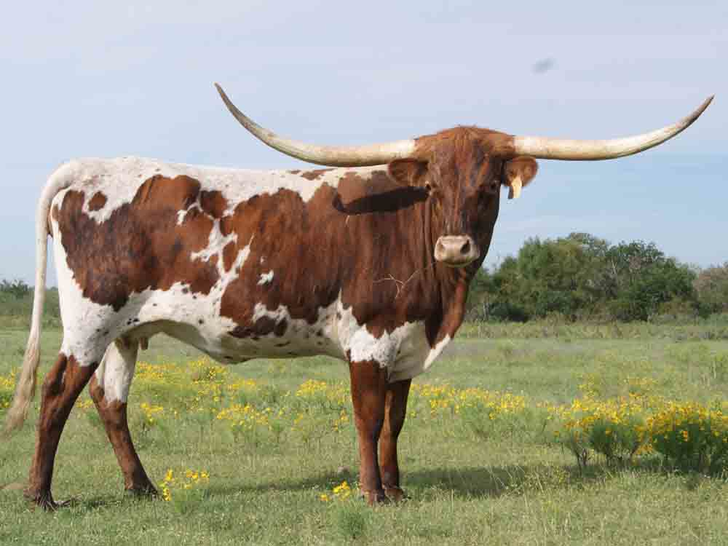
Stocks-The Bull Lives!
*The bottom is in, don’t waste your time guessing
*Earnings season is looking good, 63% of companies beating forecasts
*Apple knocks the cover off the ball
*Watch for the sector rotation, airlines, technology, retailers, and financials to lead
*Yearend rally coming, but not yet, wait
for market to get its bearings
*(SPY) could add 10% by yearend from
the August low, regardless of geopolitics
*Volatility peaked at 30%, grind down from here

Slide 21
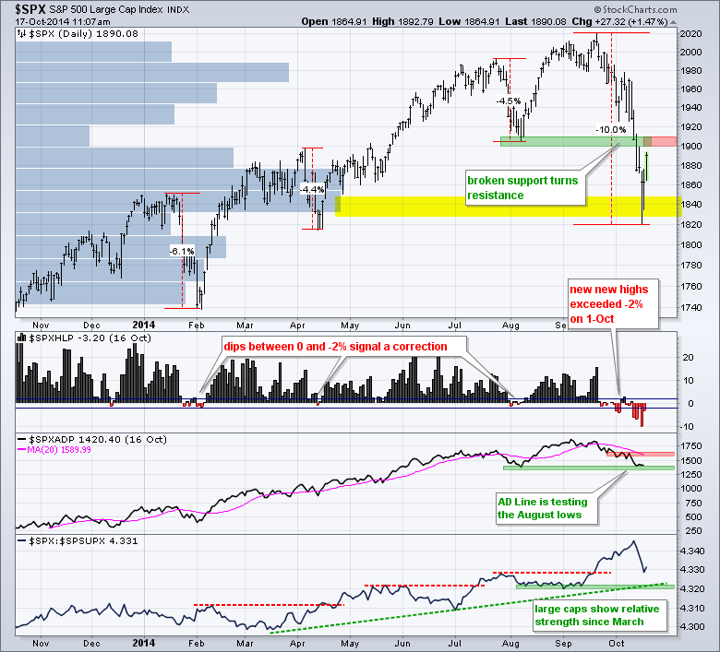
S&P 500
Long 11/$168-$173 vertical bull call spread
Short 2X 10/$202-$205 vertical bear put spread Expired at Max Profit short $197-$202 call spread

Slide 22
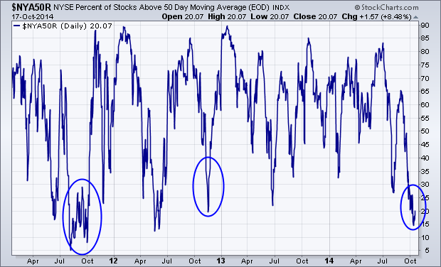
Percent of Stocks Above 50 Day Moving Average
At 3 Year Low-Take out 2008 spike, and is at a 20 year low

Slide 23
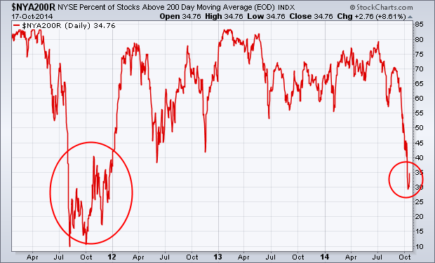
Percent of Stocks Above 200 Day Moving Average
At 3 Year Low

Slide 24
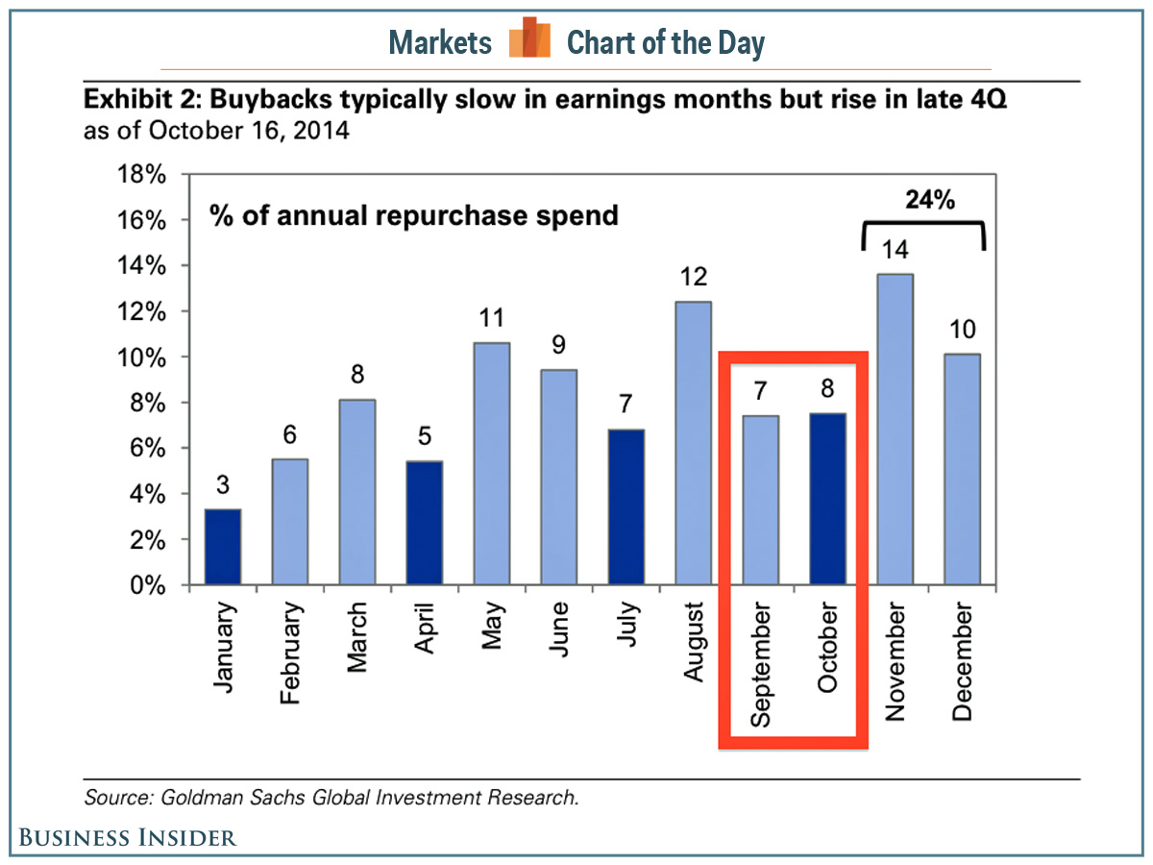

Slide 25
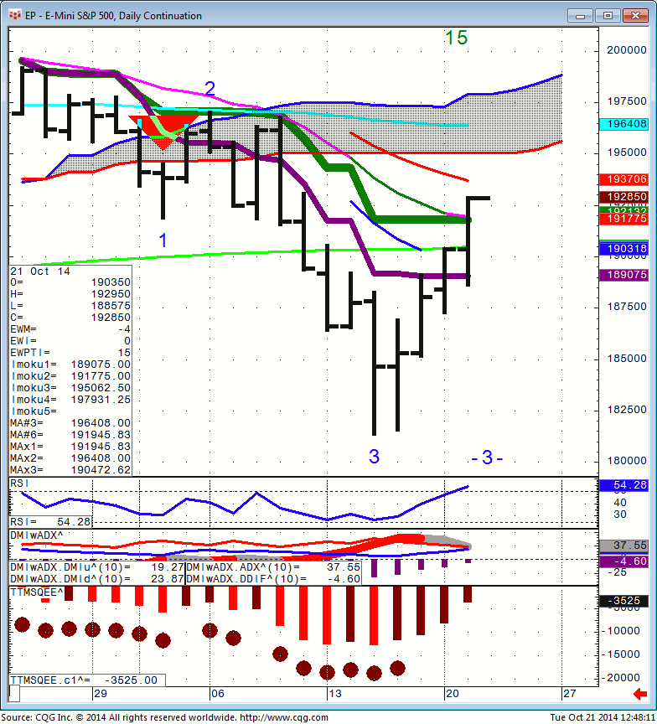
S&P 500 (SPX)

Slide 26
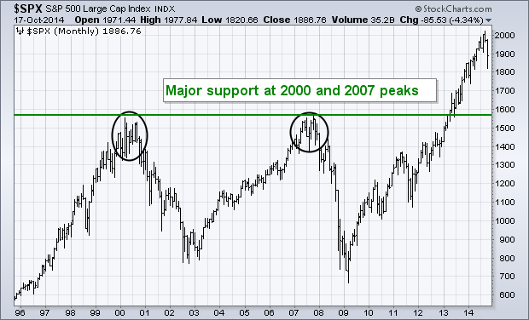
If I’m Wrong, Here’s the Next Bear Market
Downside Target at $1,570

Slide 27
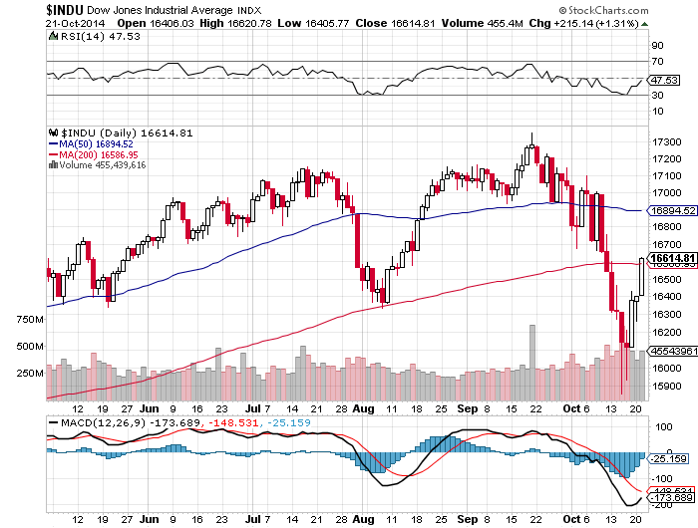
Dow Average-Targeting 200 day moving average

Slide 28
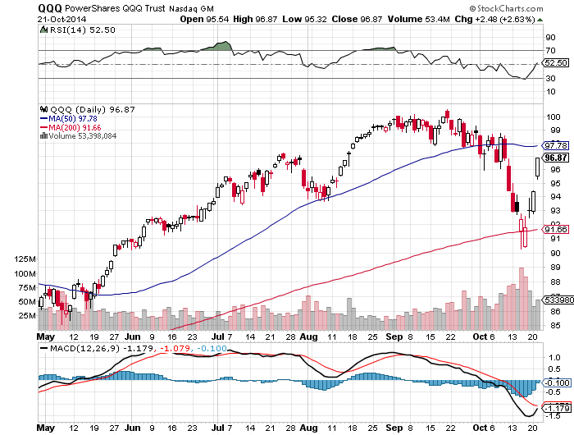
NASDAQ (QQQ)-Back to the Top of The Range

Slide 29
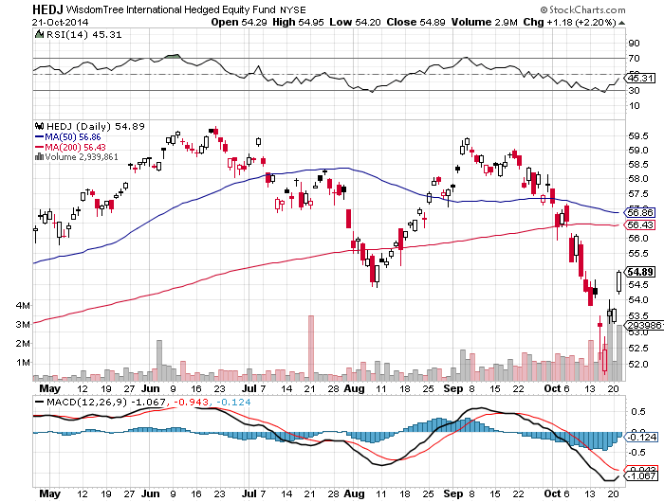
Europe Hedged Equity (HEDJ)-Back to the 200 day

Slide 30
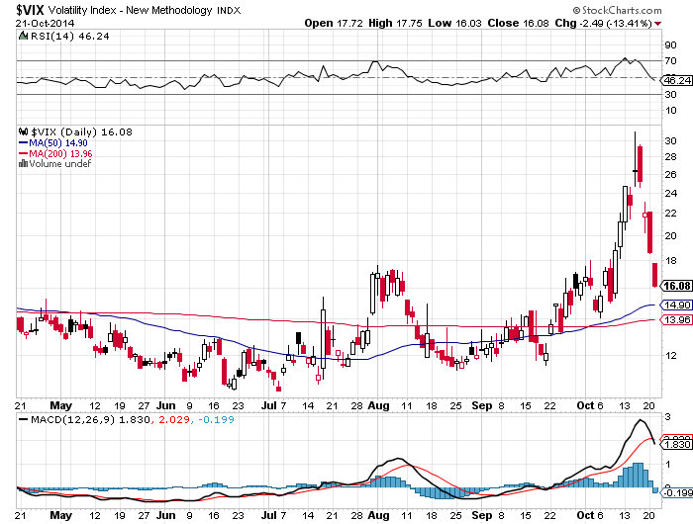
(VIX)-Yikes! The Top is In

Slide 31
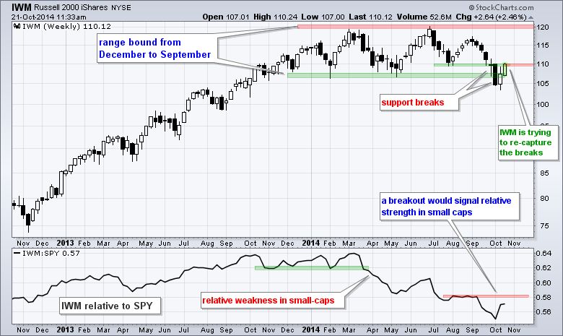
Russell 2000 (IWM)-A Classic High Volume Spike Volume

Slide 32
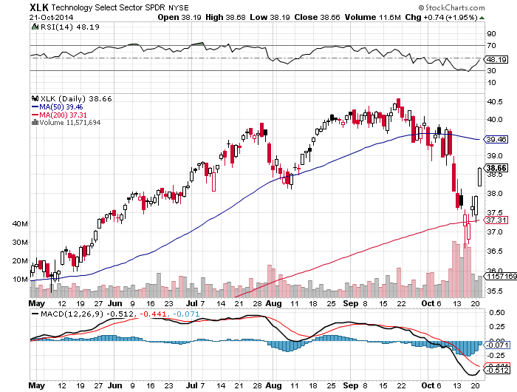
Technology Sector SPDR (XLK), (ROM)
Back to the 50 Day

Slide 33
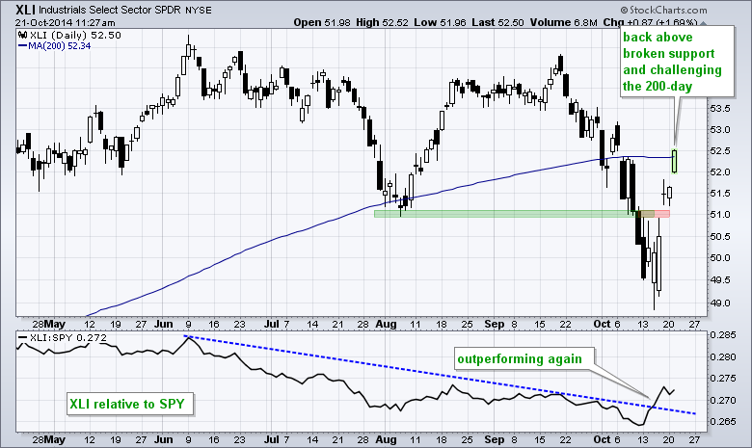
Industrials Sector SPDR (XLI)

Slide 34
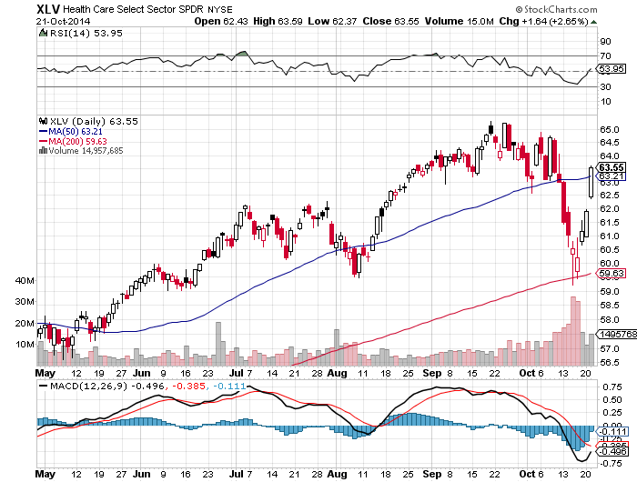
Health Care Sector SPDR (XLV), (RXL)

Slide 35
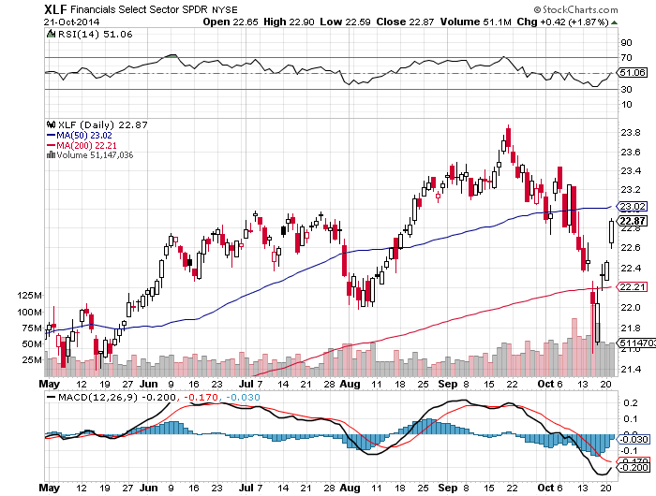
Financial Select SPDR (XLF)
Back to the 50 Day

Slide 36
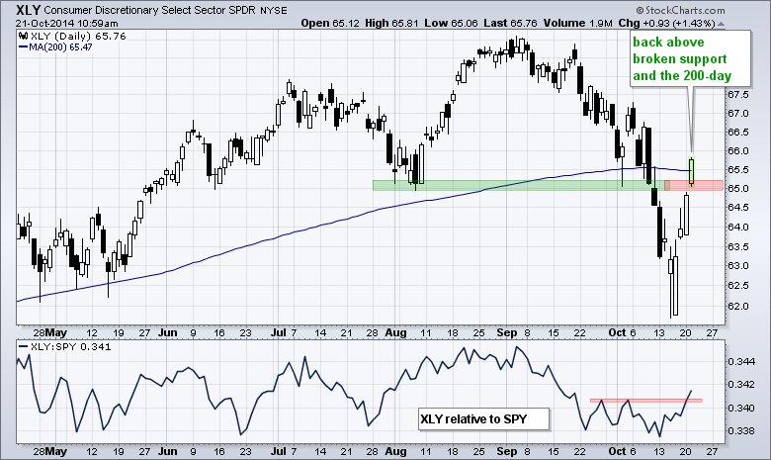
Consumer Discretionary SPDR (XLY)

Slide 37
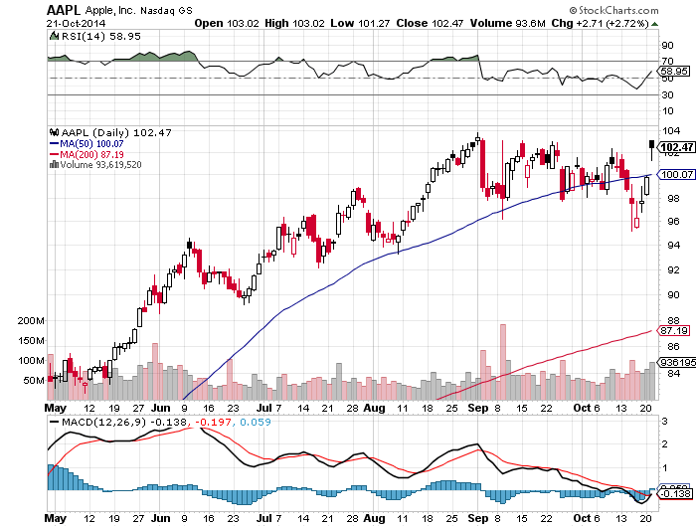
Apple (AAPL) –Blow Out Q3 Earnings
Will Bring a New High Shortly, running to $110 by New Year
In and Out of the 11/$87.50-$92.50 vertical bull call spread

Slide 38
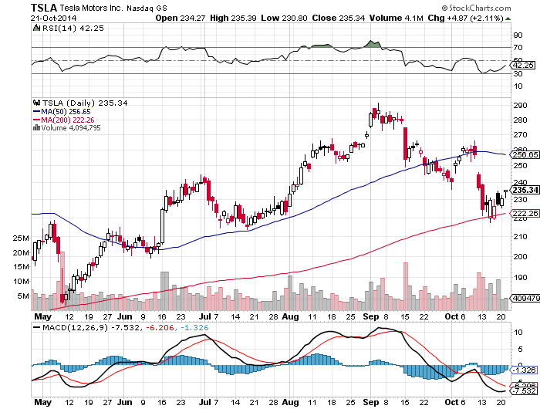
Tesla (TSLA) – stopped out of the 11/$200-$220 vertical bull call spread for a loss

Slide 39
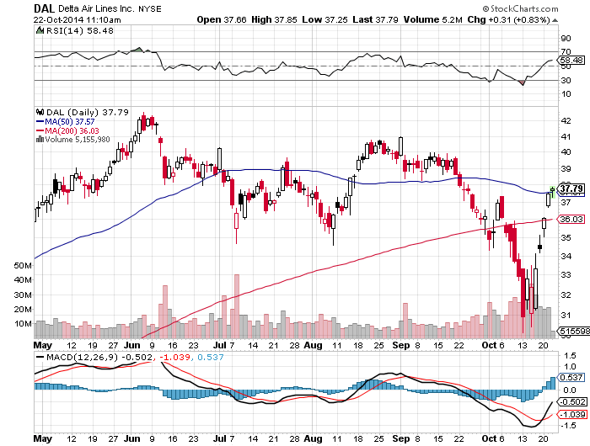
Delta Airlines (DAL)
In and Out of the 11/$25-$27 vertical bull call spread for a profit

Slide 40
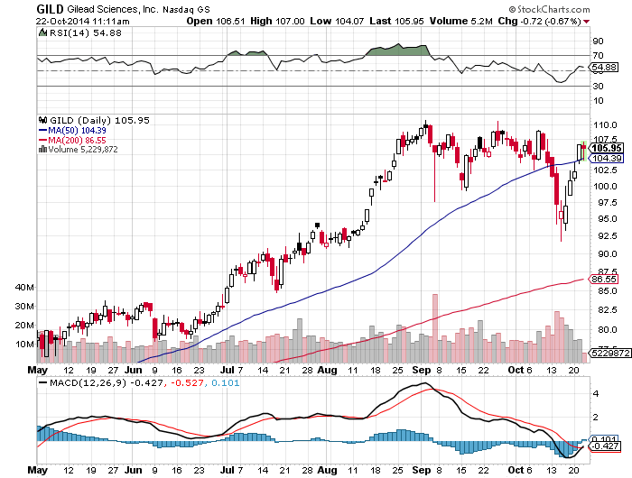
Gilead Sciences (GILD)
In and Out of the 11/$80-$85 vertical bull call spread for a profit

Slide 41
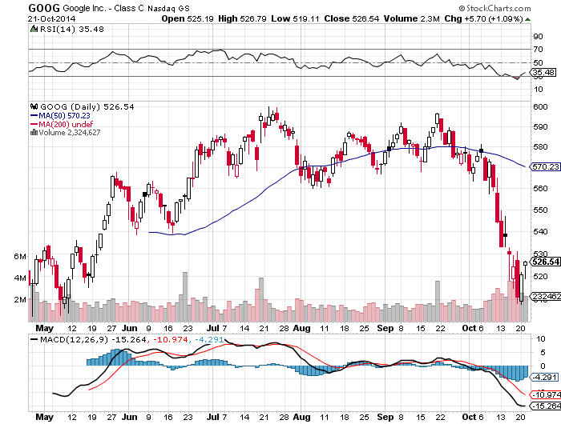
Google (GOOGL)-Earnings Disappoint
Great Entry Point for the Long Term

Slide 42
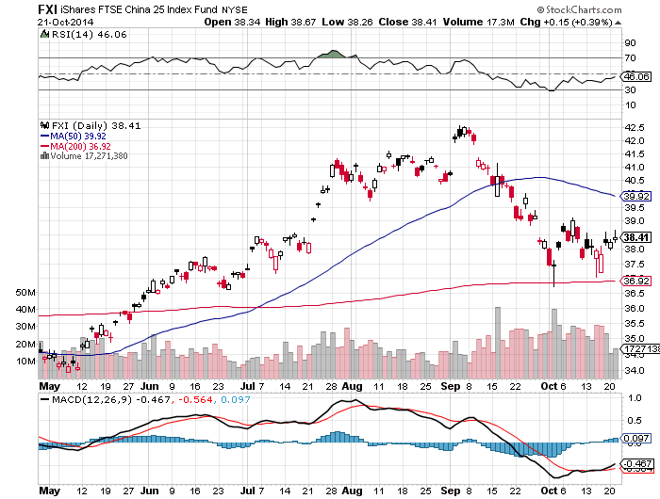
China (FXI)-In Case You Missed It the First Time

Slide 43
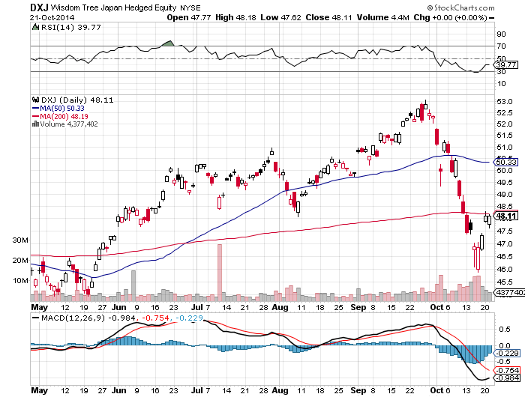
Japan (DXJ)-
Strong Yen Plus Collapsing Markets Kill It

Slide 44
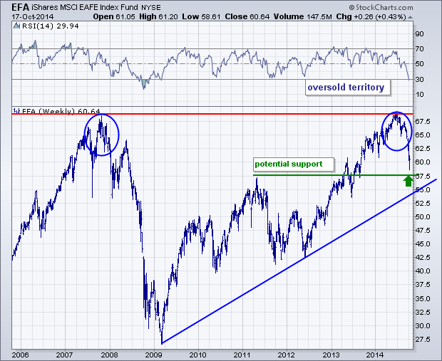
Emerging Markets (EFA)-
Approaching Long Term Trend Support

Slide 45
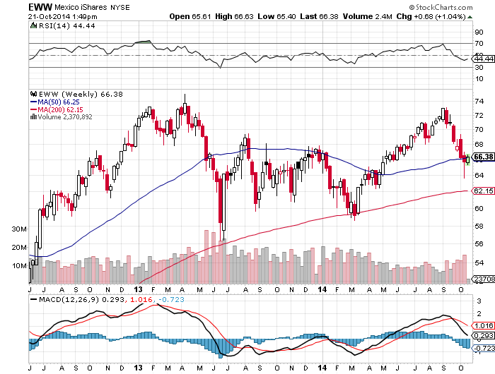
Mexico (EWW)-An Oil Play

Slide 46
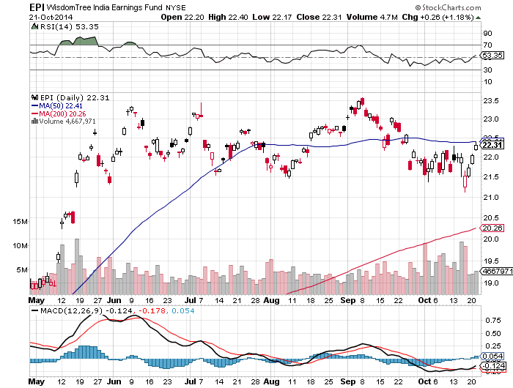
India (EPI) – Still Grinding Up on EEM Strength

Slide 47

Foreign Currencies-Running Home
*A Rush by traders to reduce all position finally brings a dollar correction
*Is only a temporary move, a pullback from extreme overbought conditions
*Banks are refusing to accept Euro deposits, or are charging interest,
ECB “considering buying corporate securities
for the first time, have no other choice as there
are no Euro Treasury bonds, mimicking Fed QE
*Is Germany changing its position on monetary easing?
If so, it’s huge
*Japanese yen spikes up on short covering
*Commodity collapse killing the Aussie

Slide 48
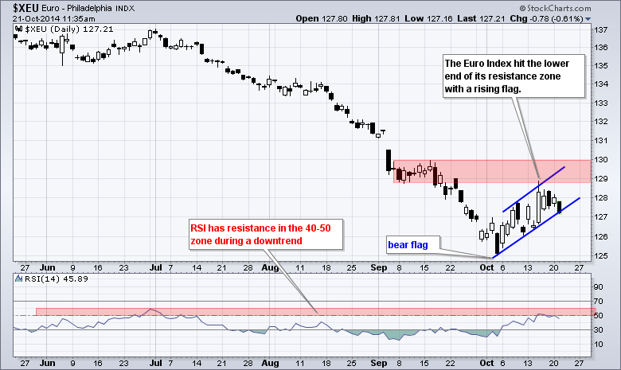
Euro (FXE)-The Freefall is On
Long the 11/$127-$129 vertical bear put spread
Long the 11/$128-$130 vertical bear put spread
(FXE) is 2 points lower than the cash market

Slide 49
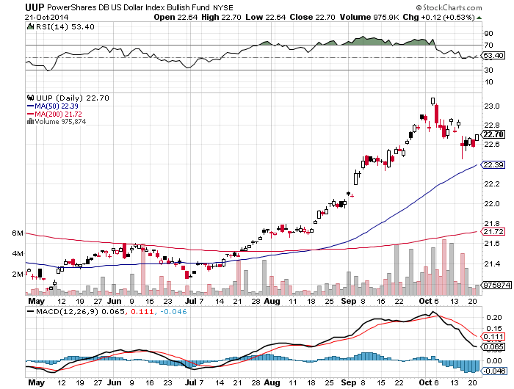
Long Dollar Index (UUP)
The Pause That Refreshes, But just the beginning of the bull market

Slide 50
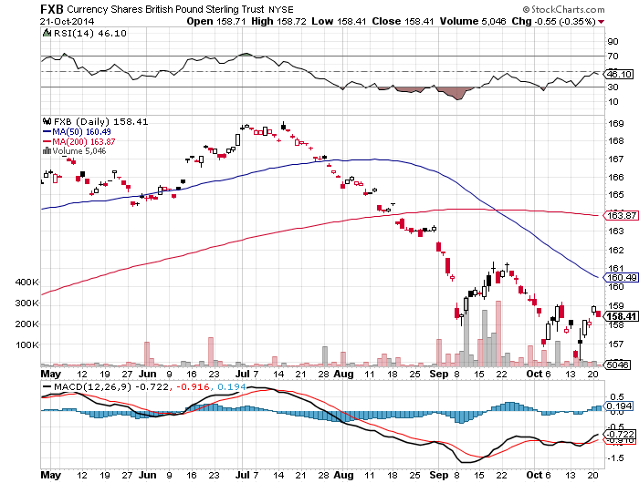
British Pound (FXB)-
Not Much of a Dead Cat Bounce

Slide 51
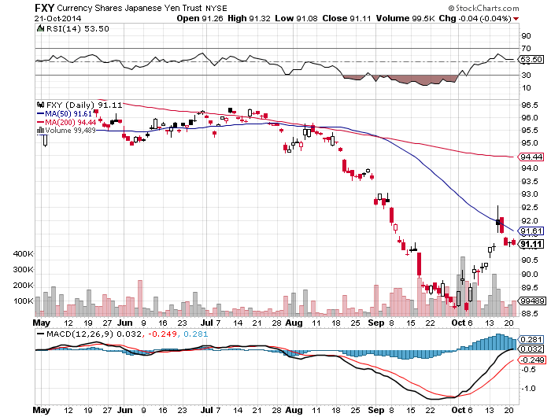
Japanese Yen (FXY)-
A New Entry Point on the short side

Slide 52
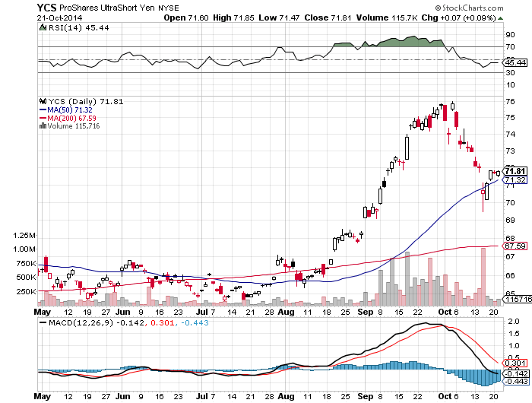
Short Japanese Yen ETF (YCS)

Slide 53
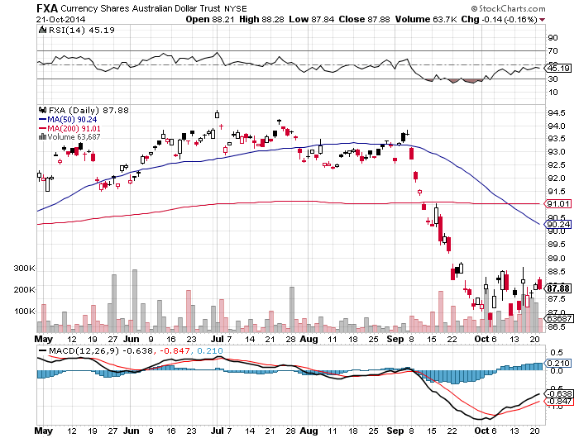
Australian Dollar (FXA) –

Slide 54
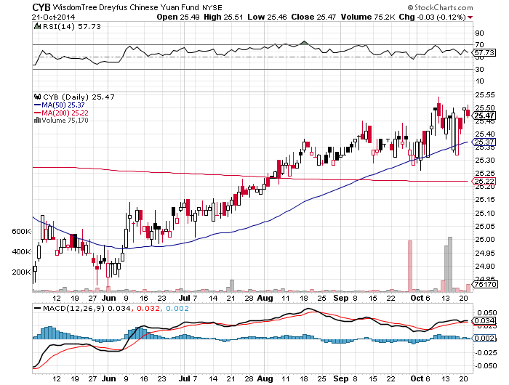
Chinese Yuan (CYB)-Immune to Trouble

Slide 55
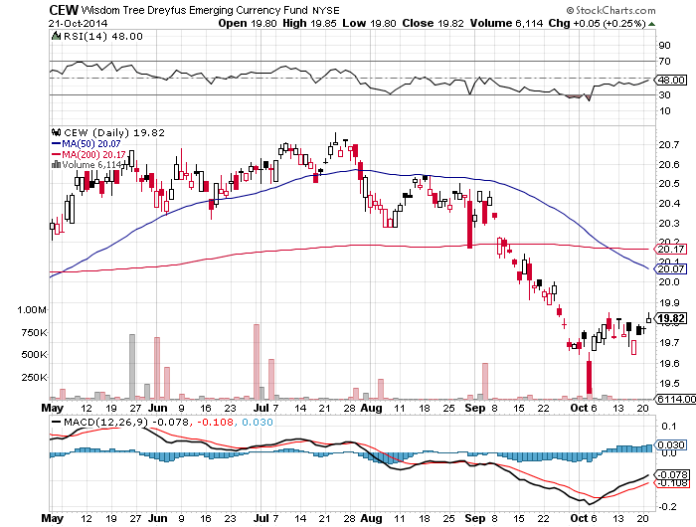
Emerging Market Currencies (CEW)

Slide 56

Energy-Collapse!
*Saudi Arabia says it can handle $80 a barrel oil and keep it there for a year, are they trying to crush Iran, Russia, US fracking, or all of the above
*Near record increase in US storage of 10.2 million barrels in one week
*Expect political instability in high cost countries, like Venezuela, Nigeria, and any offshore (RIG)
*Euro slowdown prompts IEA to cut 2014 demand increase from 900,000 barrels/day to 700,000.
*Gasoline price 50 cent drop puts $50 billion in the pockets of consumers ahead of Christmas
*At $80/barrel, the oil futures market suddenly
flipped from contango to backwardation, is
price positive
*Even if oil goes to $75, it will be back to $100
by sometime next year on Chinese demand

Slide 57
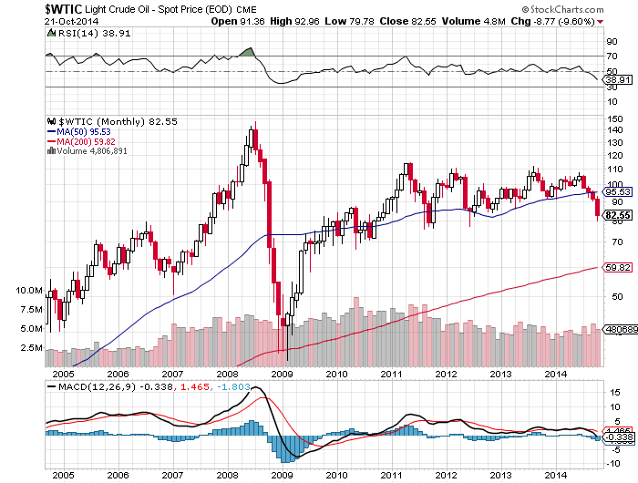
Oil
Back to Multi Year $77.50-$112.50 Range

Slide 58
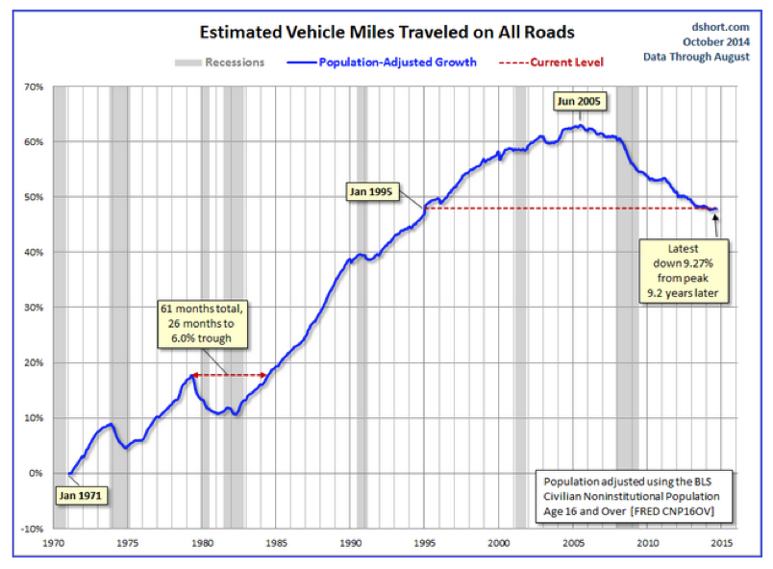

Slide 59
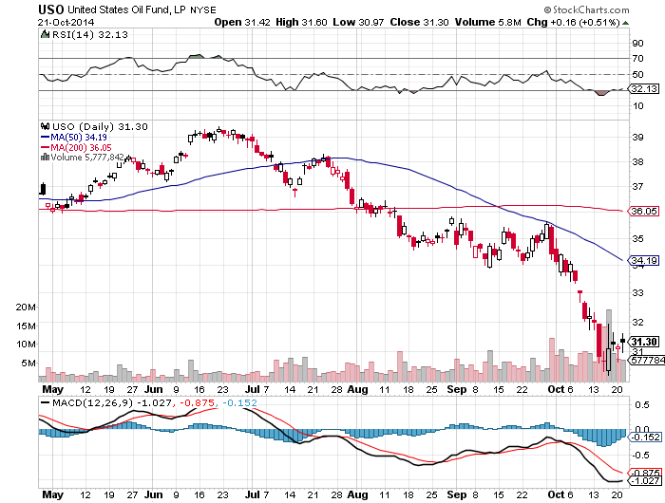
United States Oil Fund (USO)

Slide 60
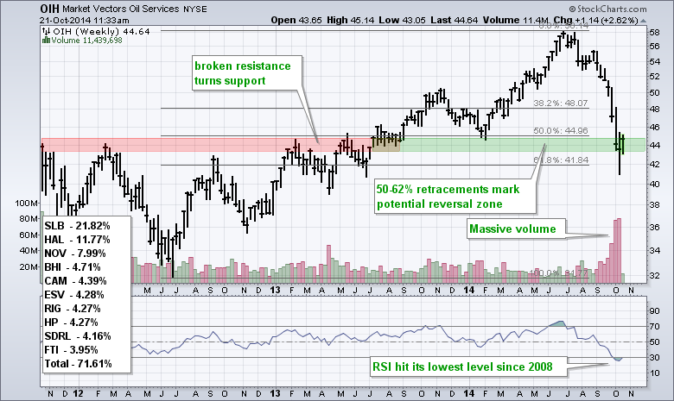
Oil Services ETF (OIH)
The selling climax is in

Slide 61
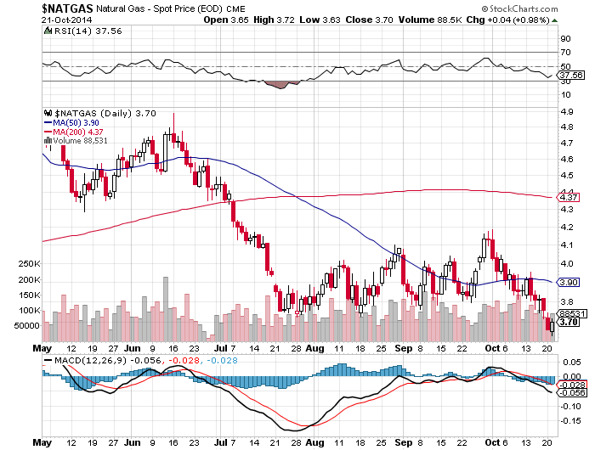
Natural Gas (UNG)-Breakdown!

Slide 62

Copper-Bottom of the Range

Slide 63

Freeport McMoRan (FCX)

Slide 64

Precious Metals-Breakdown!
*Where’s the flight to safety bid?
*Indian Diwali season starts tomorrow and continues to October 27, market a peak in gold demand
*Indian gold imports doubled in September YOY
*Stand aside and wait for the next
bull market, too many other better
things to do
*Leave gold for the conspiracy theorists

Slide 65

Gold-Plunging Interest Rates Crushing Prices

Slide 66

Barrack Gold (ABX)

Slide 67

Market Vectors Gold Miners ETF- (GDX)

Slide 68

Silver (SLV) – Where’s the Rally?

Slide 69

Silver Miners (SIL)

Slide 70

Agriculture
*Weather still perfect, prices falling, Corn targeting 15 billion bushels, the largest in history
*Combines are running 24/7 to bring the crop in, running behind schedule, only 30% of corn brought in, compared to 38% a year ago
*Huge crop means of shortage of dryers for wet grain
*Excess grain overflowing silos, is piled up under tarps, or left out in the open
*Hopes that the draught in Brazil puts a
floor under prices, shortages of drinking
in Sao Paolo

Slide 71

(CORN) – Is This the Final Low?

Slide 72

(SOYB)-Not Much of a Rally

Slide 73

Ag Commodities ETF (DBA)

Slide 74

Real Estate-An Autumn Revival?
*Price gains are slowing dramatically nationally.
September existing home sales +2.4% to 5.17 million units
*Only San Francisco, Miami, and Las Vegas are still showing double digit YOY gains
*September housing starts 1.07 million, up 6.3%
*September permits also strong

Slide 75

May S&P/Case–Shiller Home Price Index
+14% YOY down to +6.7%

Slide 76

US Home Construction Index (ITB)
Not responding to ultra low interest rates at all!

Slide 77

Trade Sheet
So What Do We Do About All This?
*Stocks- buy the dips, with technology and health care leading,
we’re running to new highs
*Bonds- sell rallies across all fixed income, the end is here
*Commodities-stand aside until global economy recovers
*Currencies- sell every Euro rally forever, and the yen too
*Precious Metals –stand aside until the $1,000 bottom is in
*Volatility-stand aside, the peak is in
*The Ags –stand aside until next season
*Real estate- stand aside, the dead cat
bounce is done

Slide 78

Next Strategy Webinar
12:00 Wednesday,
November 5, 2014
Live from Lake Tahoe, Nevada
Good Luck and Good Trading!
Notes:
*

