Slide 1

The Mad Hedge Fund Trader “Getting Tired”
With John Thomas from San Francisco, CA November 19, 2014 www.madhedgefundtrader.com
Notes:
*

Slide 2
Portfolio Review Running a Small Low Risk Book at the Top of a Massive Move Adding to longs on small Dips
World is Getting Better
Risk On
(TBT) short Treasury ETF | 10.00%
(BAC) 11/$15-$16 call spread | 10.00%
(SPY) 11/$179-$183 call spread | 10.00%
(BAC) 12/$15-$16 call spread | 10.00%
World is Getting Worse
Risk Off
total net position | 40.00%

Slide 3
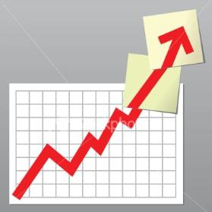
Trade Alert Performance Still Another New All Time High!
*January Final +3.05%, *July Final +4.18%
*February Final +6.41%, *August Final 5.86%
*March Final -2.52% *September Final 5.01%
*April Final +3.32% *October Final 6.69%
*May Final +4.61% * November MTD 1.19%
*June Final +4.24%
2014 YTD +42.40%, versus 6% for the Dow, October was the best month of the year! survived the crash!
*First 206 weeks of Trading +165%!

Slide 4
Paid Subscriber Trailing 12 Month Return +68%

Slide 5
47 Months Since Inception Averaged annualized +42%

Slide 6

Strategy Outlook-Risk Back On
*Surprise Japanese recession could cool “RISK ON” short term, paints a bleaker future for the yen *Look for a slow grind in stocks leading into a year end rally, volatility to stay low *Commodities, oil, gold, silver, base metals, and foreign currencies to remain unloved *The bond top is in, but prices to grind sideways for the indefinite future *Midterm election result raises the prospect of more confrontation and headline risk for the markets *The grains finally showing signs of a bottom due to transportation crisis

Slide 7

The Jim Parker View The Mad Day Trader-On sale for a $1,500 upgrade
Technical Set Up of the week-
Buy *Vix low looking good at $14
Sell Short
*If (AAPL) can’t hold $113.85, bail on all longs *If Aussie can’t hold here it will break 4 cents could signal broader “RISK OFF” move
Avoid
* Currencies, too extended

Slide 8

The Global Economy- Still a US Story
*US GDP ramping up to a 4% growth rate in 2015, increase in hours worked is the same as adding 400,000 jobs to the October nonfarm payroll *November preliminary Consumer Sentiment up a red hot 89.4, best since 2007 as cheap gas fills consumer pockets *US JOLTS survey of unfilled jobs up a strong 20% YOY, age 25-34 employment accelerating *Japan posts second consecutive negative GDP quarter, down 1.8%, is now officially in recession *Gasoline still falling nationally, is a huge surprise stimulus/tax cut, positive impacts to still wildly underestimated by investors *China now running the biggest budget deficits in history to float the economy

Slide 9
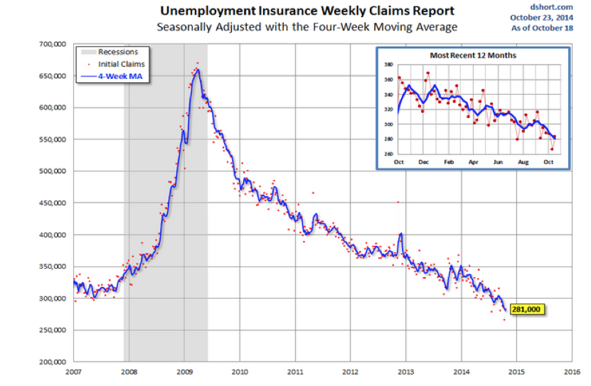
Weekly Jobless Claims - The trend is your Friend +12,000 to 290,000, still hugging 14 year lows!

Slide 10

Bonds-Falling Asleep
*Bonds have entered a long sideway range to build a base prior to launching the next jump up in yields, is good for the (TBT) *Quantitative easing is over in the US, but is reborn in Japan and the US, German bond yields fall below 0.80%! *Look for the ten year Treasury yield to break to a new 2.30%-2.60% range and then stay there for a long time *Take profits on (TBT) when the ten year yield hits 2.60% *Deflation is a growing factor in US GDP, dragged down by energy costs *Fed not to raise interest rates until 2016.

Slide 11
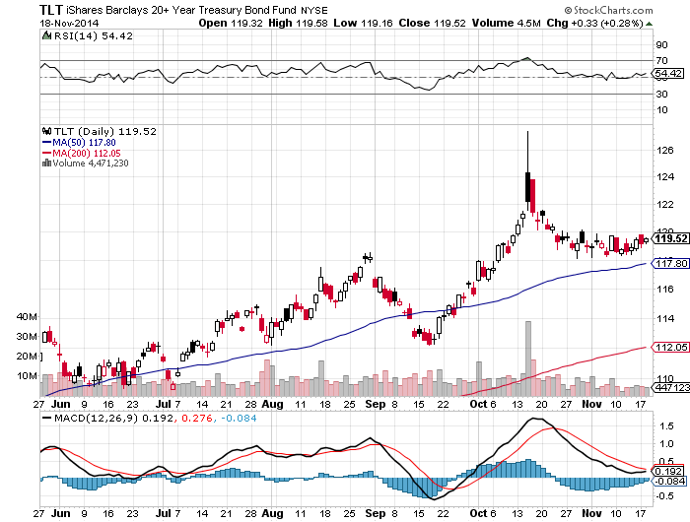
Ten Year Treasuries (TLT) 2.31% One Month of Incredible Flat Line

Slide 12
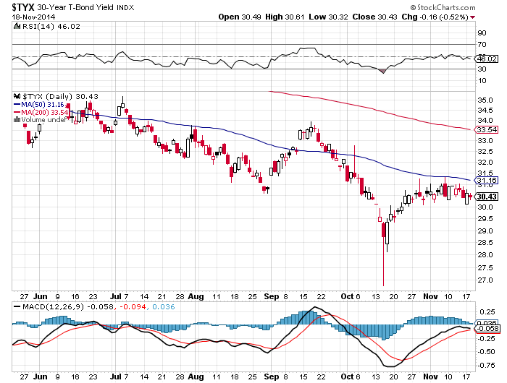
30 Year Treasury Yield ($TYX)-Yield 2.84% Ditto Here

Slide 13
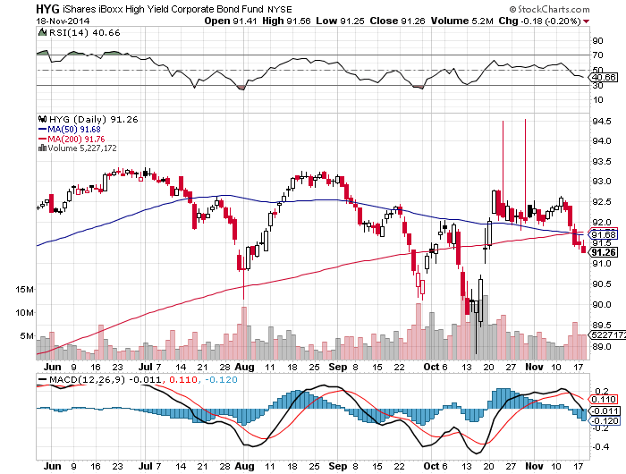
Junk Bonds (HYG) 5.31% Yield The New Lead Contract

Slide 14
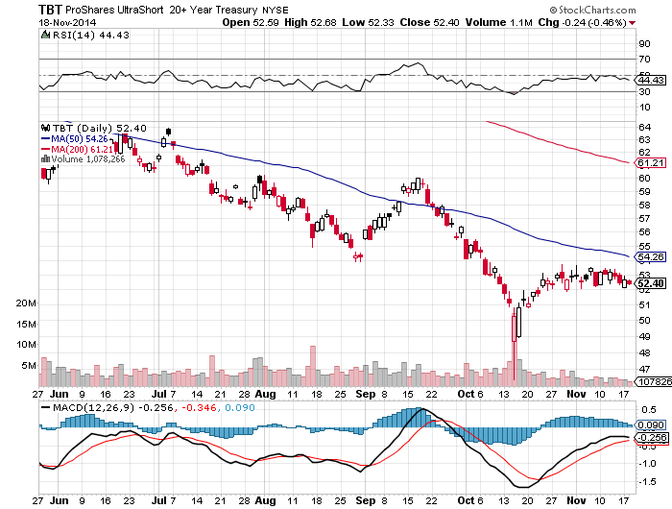
2X Short Treasuries (TBT) 10% long position-Cost of Carry 45 basis points a month-Avoid options

Slide 15
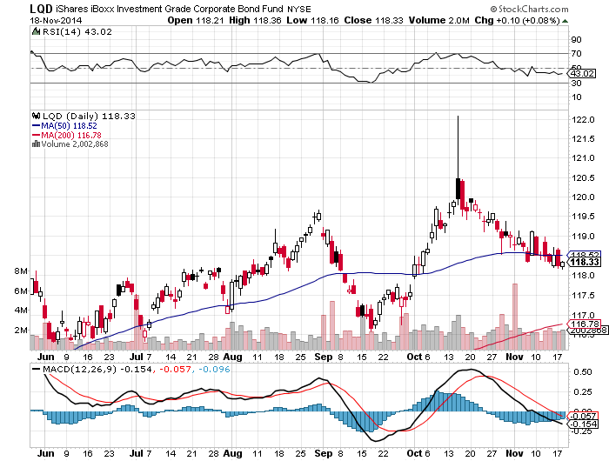
Investment Grade Corporate Bonds (LQD) 3.40% Yield

Slide 16
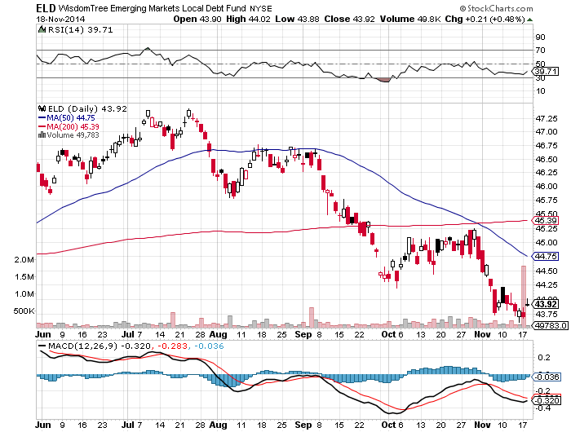
Emerging Market Debt (ELD) 4.92% Yield

Slide 17
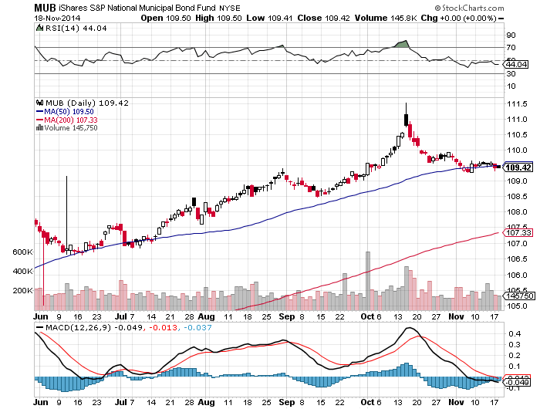
Municipal Bonds (MUB)-2.61% yield, Mix of AAA, AA, and A rated bonds

Slide 18
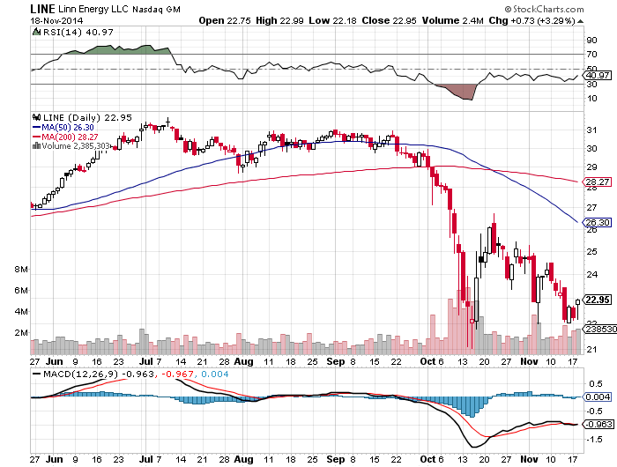
MLP’s (LINE) 12.64% Yield-Smashed by Oil

Slide 19

Stocks-Getting Tired
*The rally was so fast, most managers were left behind *Now dealing with the same problem we have faced for most of the year: do we buy at the market top? *US corporate profits looking to gain another 10% in 2015
*Flat bond market gives us flat financials *Maybe another 60 points in (SPX) to 2,100 by yearend *Volatility peaked at 33%, a stunning return to 11%, and then a flat line

Slide 20
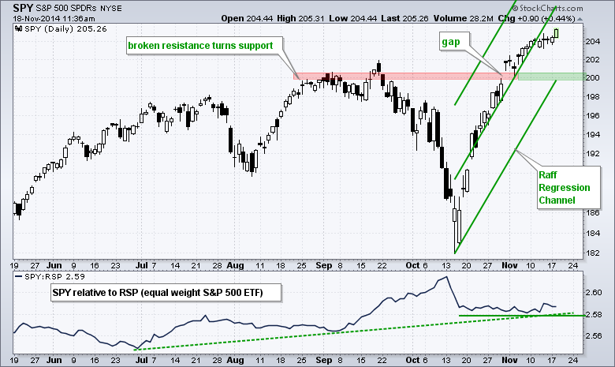
S&P 500 Long 11/$179-$183 vertical bull call spread stopped out of short $197-$202 call spread

Slide 21
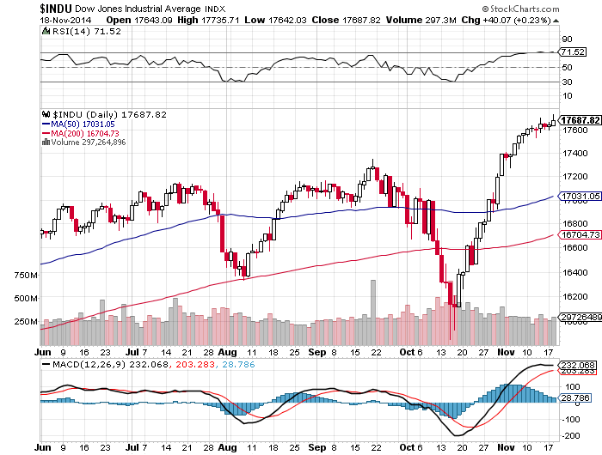
Dow Average-

Slide 22
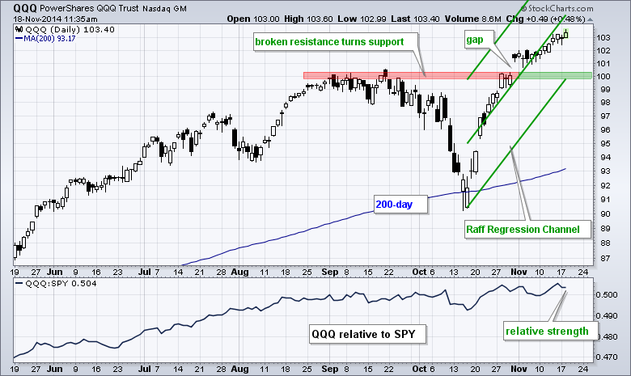
NASDAQ (QQQ)-

Slide 23
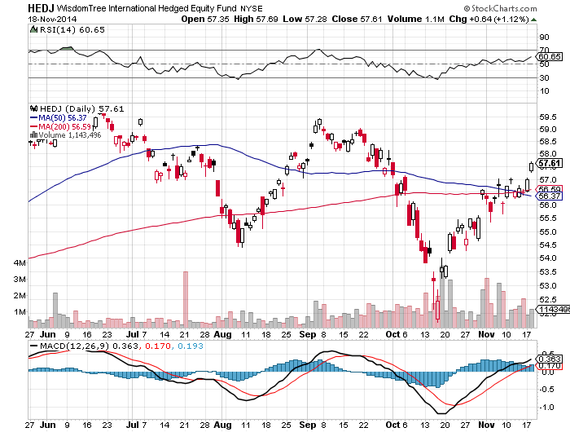
Europe Hedged Equity (HEDJ)-

Slide 24
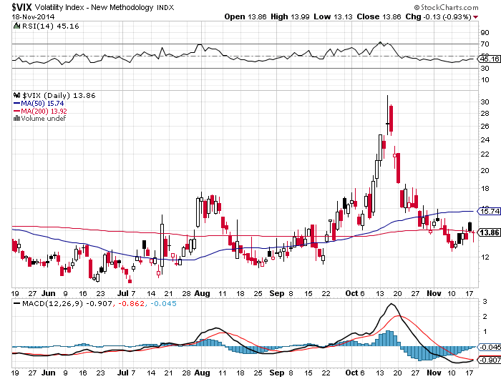
(VIX)-Is saying no 10% correction for 3 years!

Slide 25
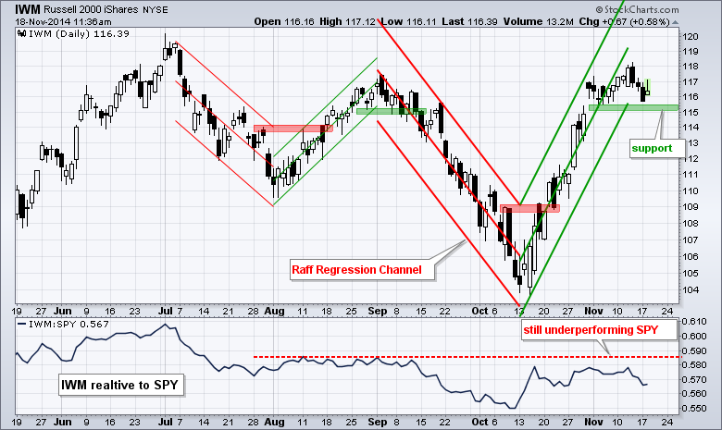
Russell 2000 (IWM)-Breaking the Downtrend

Slide 26
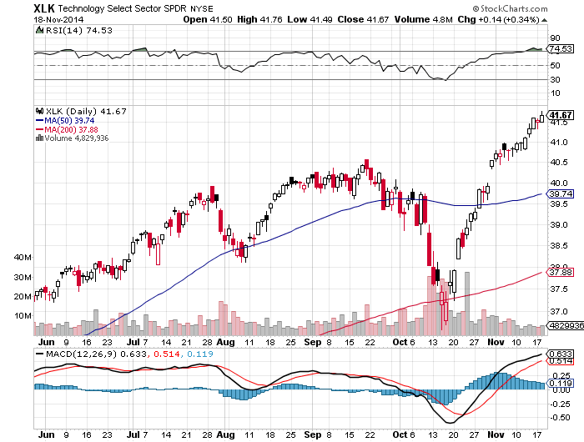
Technology Sector SPDR (XLK), (ROM)

Slide 27
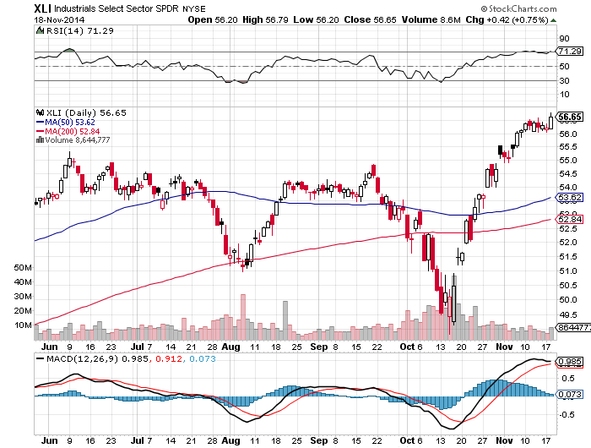
Industrials Sector SPDR (XLI)

Slide 28
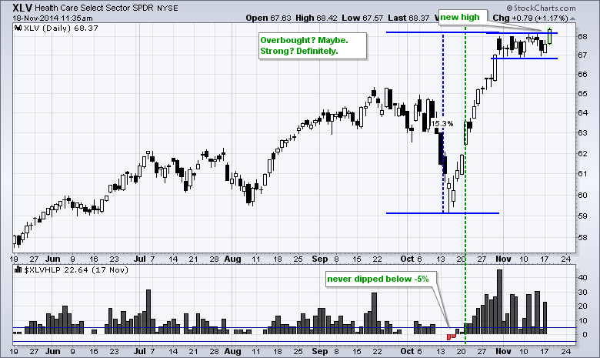
Health Care Sector SPDR (XLV), (RXL)

Slide 29
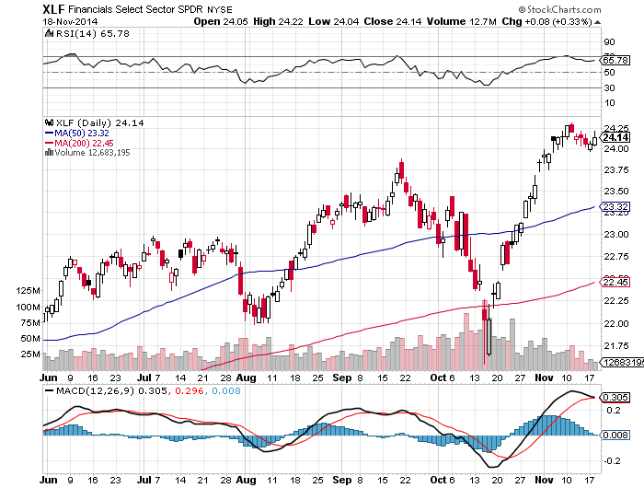
Financial Select SPDR (XLF)

Slide 30
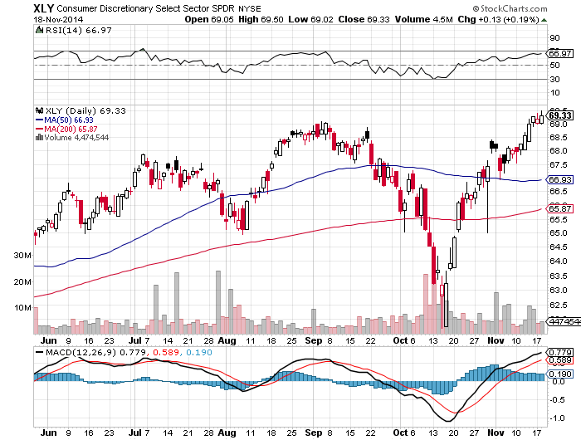
Consumer Discretionary SPDR (XLY)

Slide 31
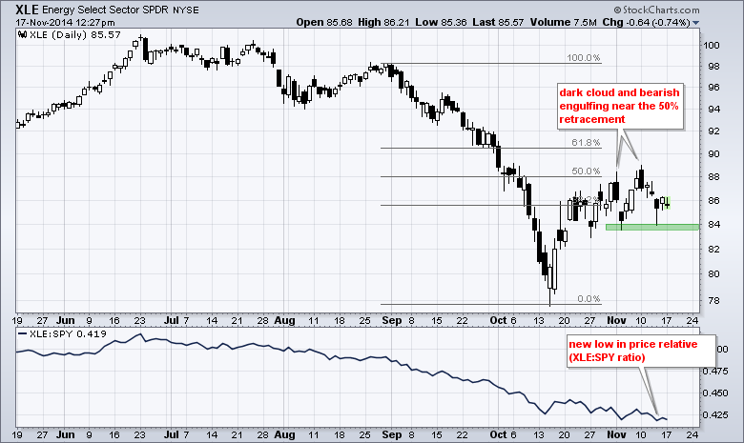
Energy Select Sector ETF SPDR (XLE)

Slide 32
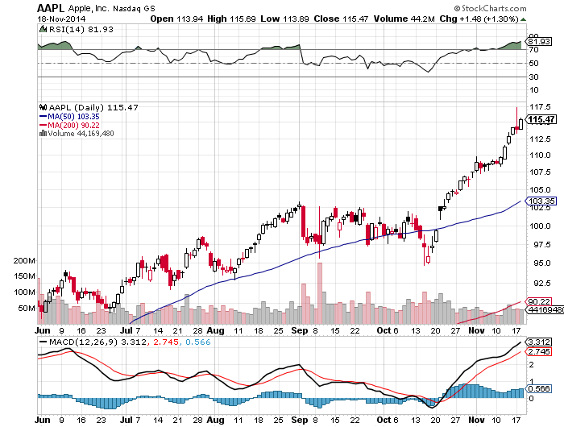
Apple (AAPL) – Getting Overheated

Slide 33
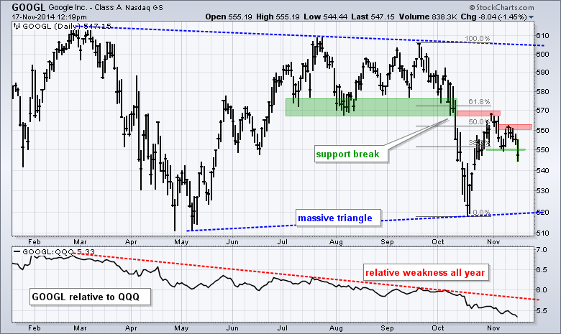
Google (GOOGL)- Relaunch Postponed

Slide 34
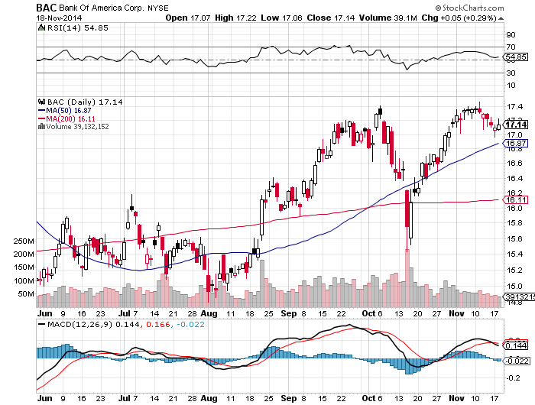
Bank of America (BAC)- long the 11/$15-$16 vertical bull call spread-run to expiration on Friday long the 12/$15-$16 vertical bull call spread will do well as long as 10 year Treasury bonds hold 2.30%

Slide 35
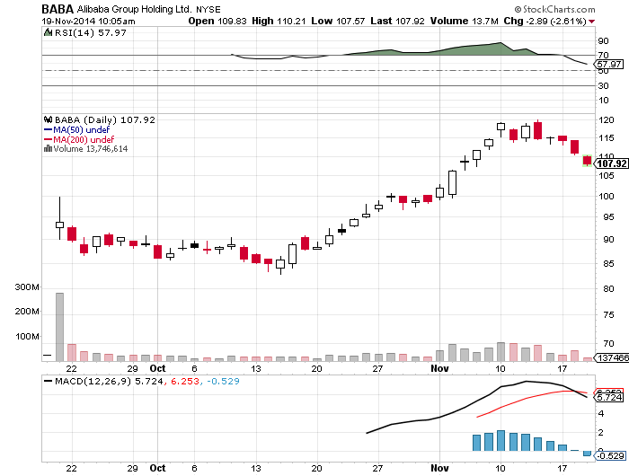
Alibaba(BABA)- stopped out of the 12/100-$105 call spread a round of profit taking hits before the yearend rally

Slide 36
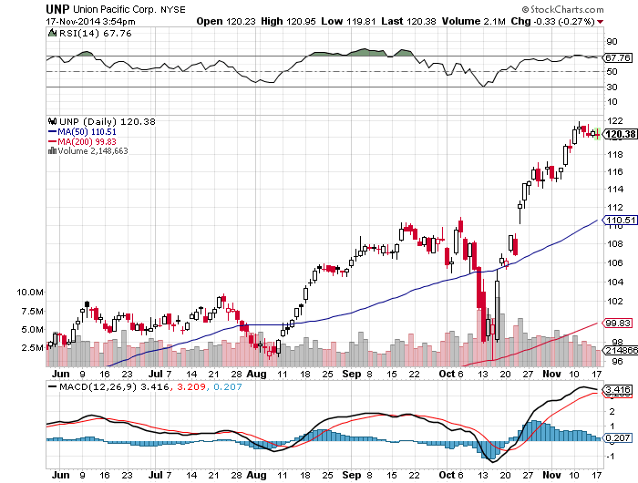
Union Pacific Railroad (UUP)- If the Keystone Pipeline is Approved, dump all your railroads!

Slide 37
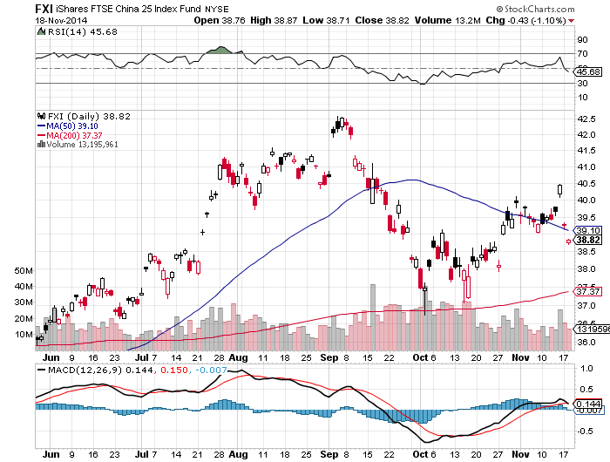
China (FXI)-

Slide 38
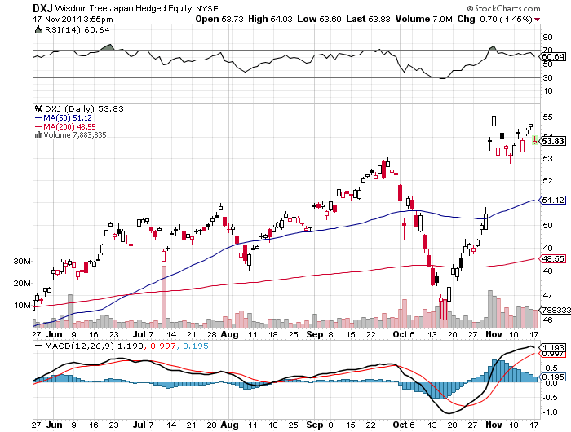
Japan (DXJ)-Hedged Japan Equity Second Recessionary Quarter will cap gains for the time being

Slide 39
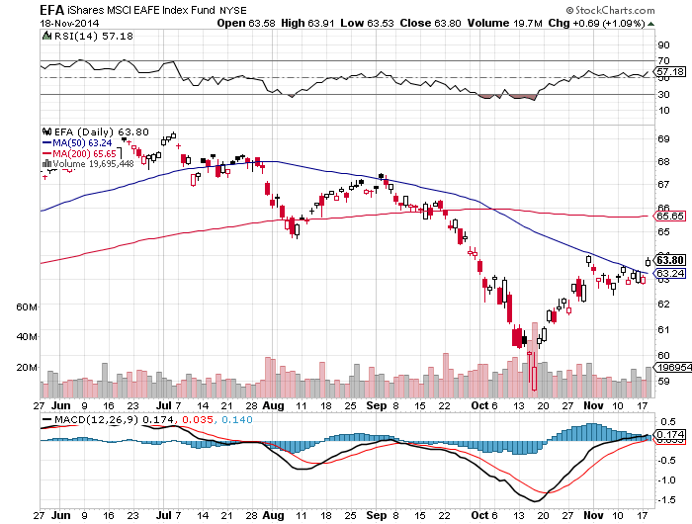
Emerging Markets (EFA)-

Slide 40
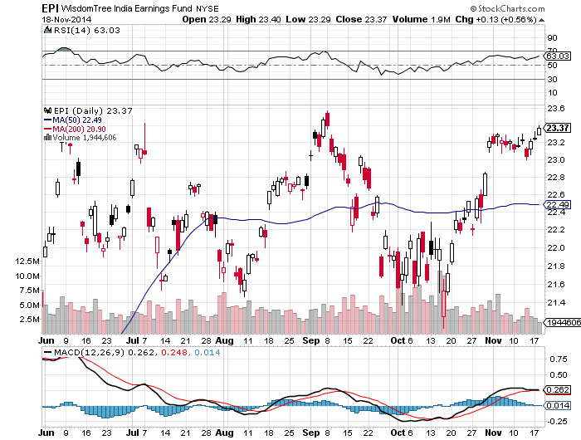
India (EPI) –

Slide 41
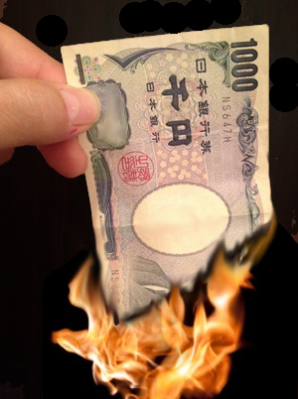
Foreign Currencies-It’s All About the Yen
*Japan is now in recession, to postpone hike in consumption tax from 8% to 10%. Snap elections in the works. Yen still falls. *Only solution is for Japan to accelerate the collapse of the yen *Now we know why the BOJ was so aggressive with its “shock and awe” QE a month ago *Australian and Canadian dollars still dragged down my the commodities cycle

Slide 42
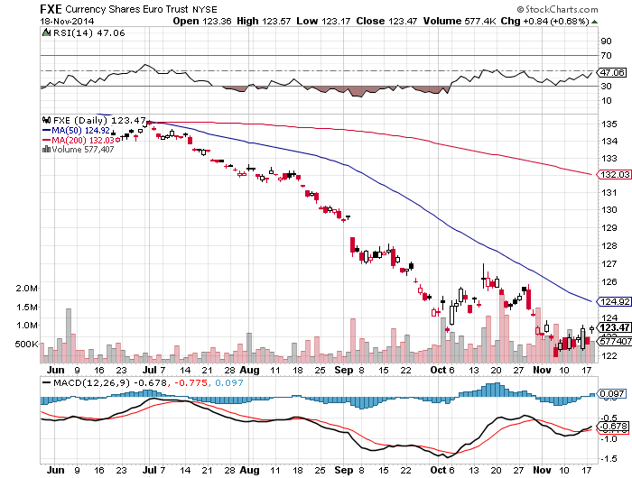
Euro (FXE)- Taking a rest on yearend profit taking

Slide 43
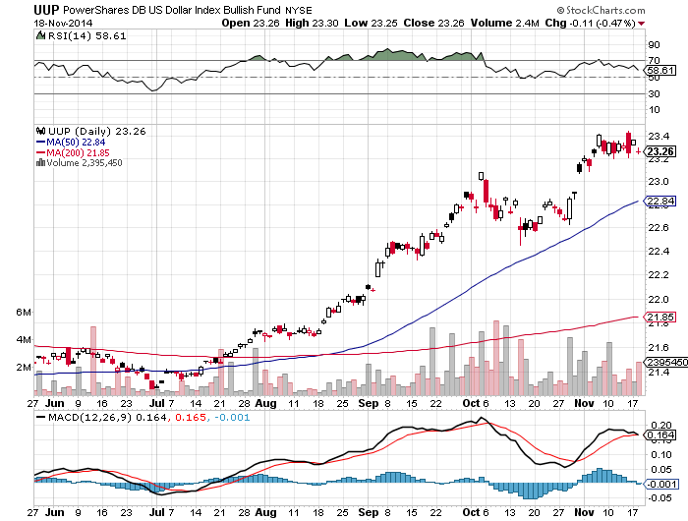
Long Dollar Index (UUP)

Slide 44
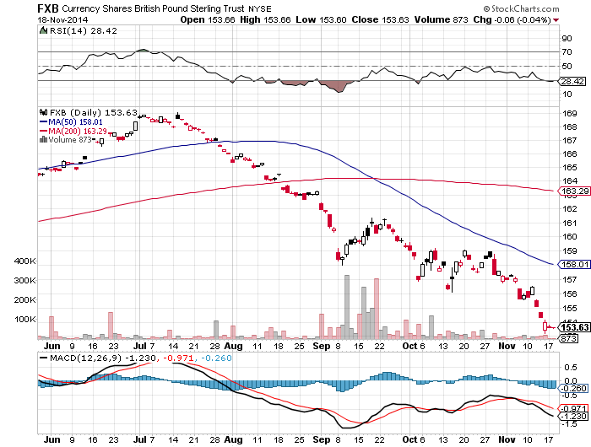
British Pound (FXB)-

Slide 45
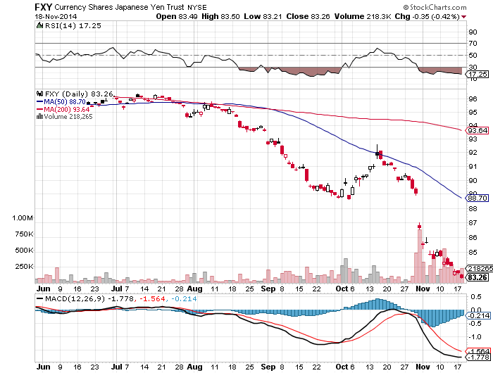
Japanese Yen (FXY)- No Friends

Slide 46
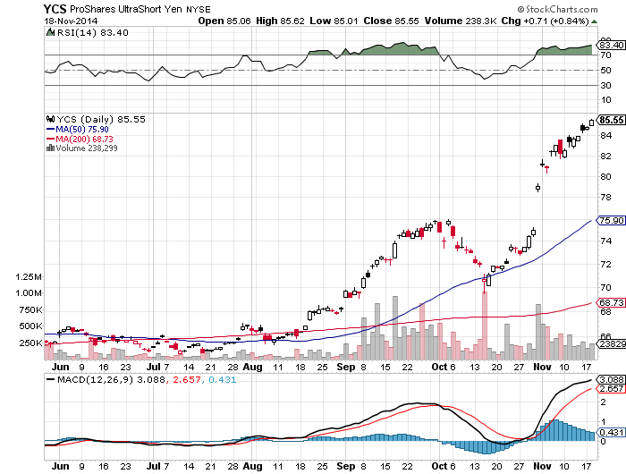
Short Japanese Yen ETF (YCS)

Slide 47
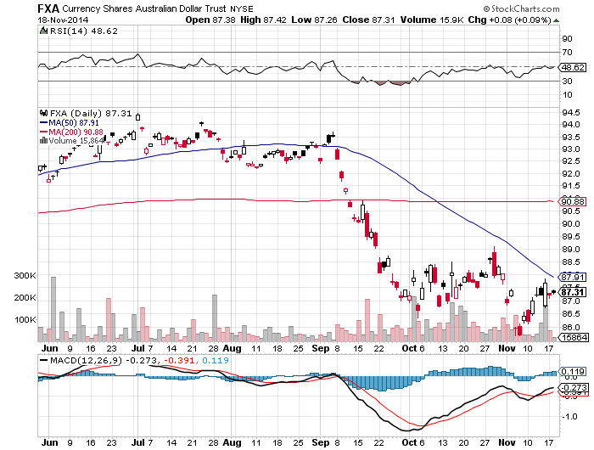
Australian Dollar (FXA) –Missing the Volatility

Slide 48
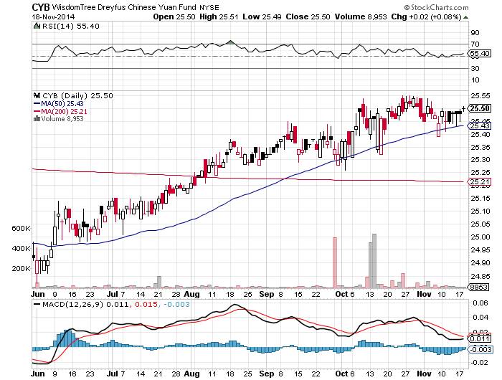
Chinese Yuan (CYB)-

Slide 49
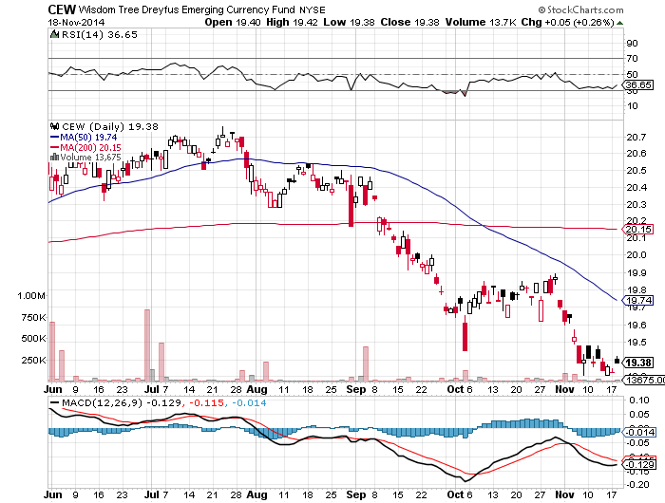
Emerging Market Currencies (CEW) Dragged down by commodities and rising US interest rates

Slide 50

Energy-Looking for a Bottom
*Prices will look for new lows until November 27 Vienna OPEC meeting *Likely they will probably agree to cuts on paper, but not carry them out *Weaker nations will most likely increase production to offset falling prices *Hand on to MLP’s, yields will protect you from volatility over time

Slide 51
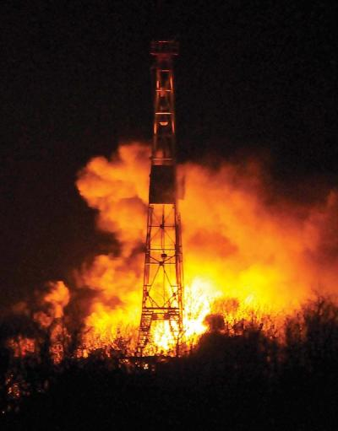
Oil Breakeven Cost per Barrel by Source Who’s in the Driver’s Seat?
* $160 Venezuela balances its budget * Iran balances its budget *$115 Iraq balances its budget *$100 New fields for Canadian tar sands *$90 Saudi Arabia balances its budget *$80 Breakeven cost for deepwater exploration in Norway, Angola, Brazil, and the UK *$60 US shale median breakeven

Slide 52
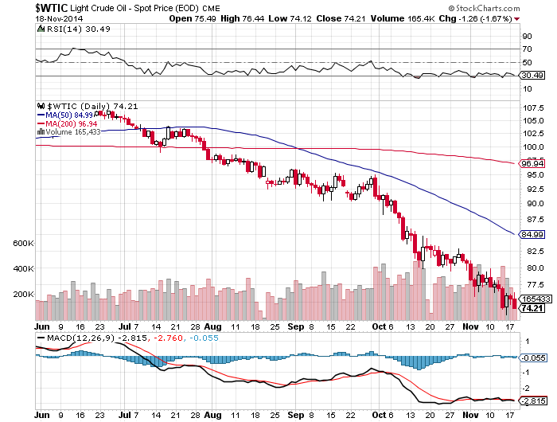
Oil

Slide 53
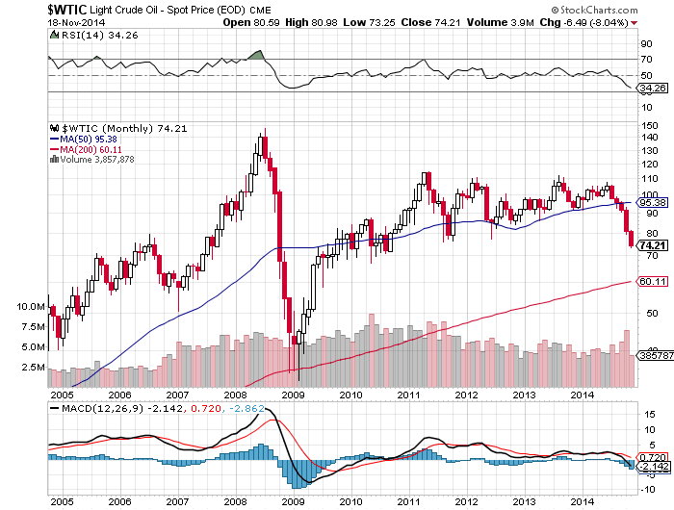
Oil 10 Years-Approaching 5 year support at $70

Slide 54
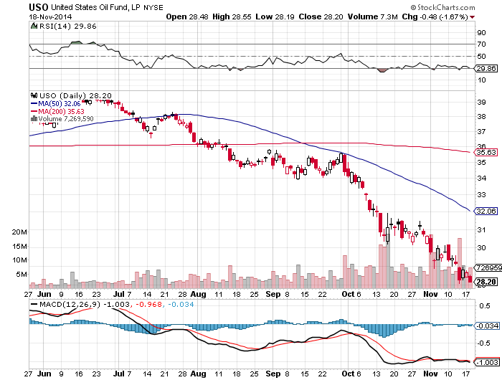
United States Oil Fund (USO)

Slide 55
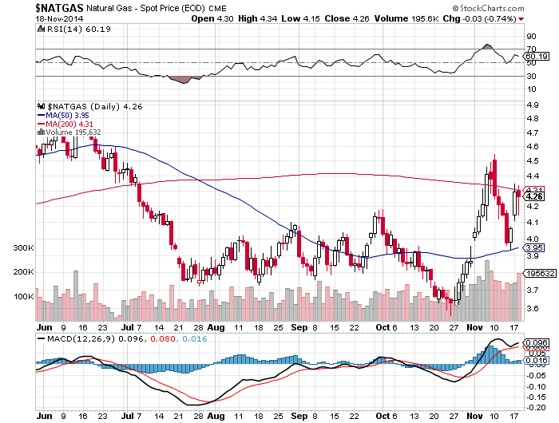
Natural Gas (UNG)-

Slide 56
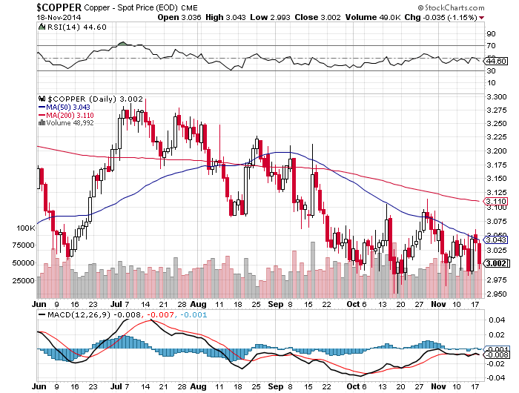
Copper-

Slide 57
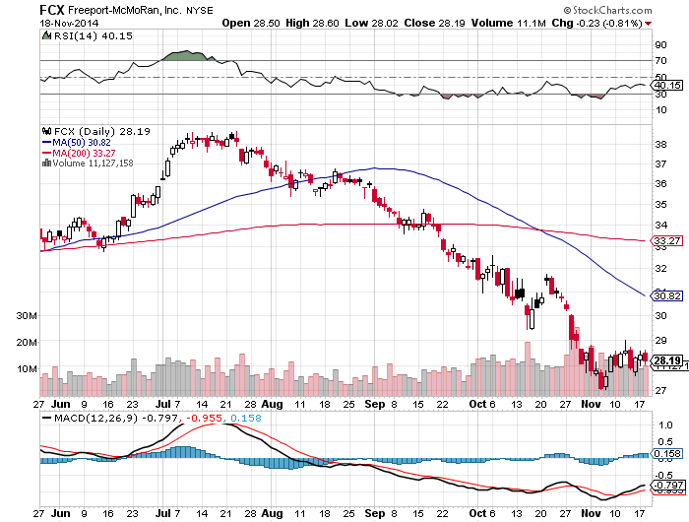
Freeport McMoRan (FCX)

Slide 58

Precious Metals-A Bear Market Rally
*Trading statistics show physical demand outstripping paper demand by a large margin, coin buying/ETF selling as price falls *Global QE is terrible news for all precious metals *Referendum on Swiss national gold ownership next week, has only 38% support, is a no issue *Still targeting $1,000

Slide 59
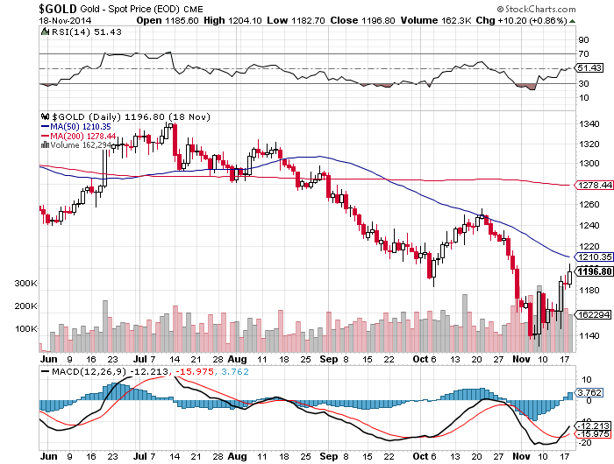
Gold-Another Bear Market Rally

Slide 60
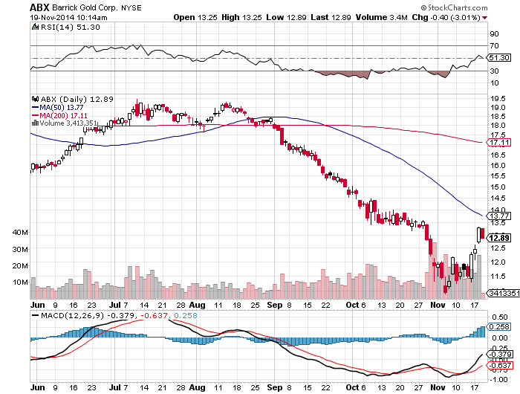
Barrick Gold (ABX)

Slide 61
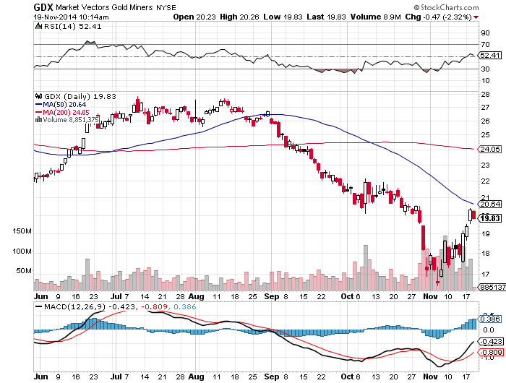
Market Vectors Gold Miners ETF- (GDX) No Friends

Slide 62

Silver (SLV)

Slide 63

Silver Miners (SIL)

Slide 64

Agriculture
*Almost all the crops were harvested before the winter weather hit *Low prices stimulating ethanol demand, putting a floor under prices for corn *Strong dollar a problem for grains in the international markets *Shipping problems for the huge crop are still bedeviling sellers, with rail car and barge problems Sanctions on Russian and Ukrainian wheat also helping *Focus on 2015, but it will be another record crop without extreme weather

Slide 65

(CORN) –

Slide 66

(SOYB)-Not Much of a Rally

Slide 67

Ag Commodities ETF (DBA)

Slide 68

Real Estate-Mixed Data
*November homebuilder confidence jumps 4 points to 58, an upside surprise, up everywhere except the Midwest *October housing starts -2.8% to a 1.008 million unit annualized rate, permits up 4.8% *Foreclosures rising again as banks accelerate processing, 123,000 in October, up 15% MOM and a four year high *Mortgage volumes falling, despite record low interest rates *Institutional investors who bought at the bottom starting to exit market

Slide 69

May S&P/Case–Shiller Home Price Index +14% YOY down to +5.1%

Slide 70

US Home Construction Index (ITB)

Slide 71

Trade Sheet So What Do We Do About All This?
*Stocks- buy the dips, with Financials, technology and health care leading, we’re running to new highs *Bonds- sell rallies across all fixed income, the end is here *Commodities-stand aside until global economy recovers *Currencies- sell every Euro rally forever, and the yen too *Precious Metals –stand aside until the $1,000 bottom is in *Volatility-stand aside, the peak is in *The Ags –stand aside until next season *Real estate- stand aside, the dead cat bounce is done

Slide 72

To buy strategy luncheon tickets Please go to: www.madhedgefundtrader.com Next Strategy Webinar 12:00 Wednesday, December 3, 2014 Live from San Francisco, CA Last webinar of the year!
Good Luck and Good Trading!
Notes:
*

