Slide 1

The Mad Hedge Fund Trader “It’s All About Oil”
With John Thomas from San Francisco, CA December 17, 2014 www.madhedgefundtrader.com
Notes:
*

Slide 2
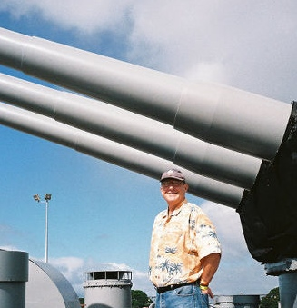
MHFT Global Strategy Luncheons Buy tickets at www.madhedgefundtrader.com
Chicago December 23, 2014
Honolulu, Hawaii April 3, 2015

Slide 3
Portfolio Review Running a Small Low Risk Book at the Top of a Massive Move Adding to longs on small Dips-80% Cash as of Friday
current capital at risk
World is Getting Better
Risk On
(TBT) short Treasury ETF | 10.00%
(BAC) 12/$15-$16 call spread | 10.00%
(LINN) units | 10.00%
World is Getting Worse
Risk Off
 | 0%
total net position | 30.00%

Slide 4
Trade Alert Performance Four Year Anniversary!
*January Final +3.05%, *July Final +4.18%
*February Final +6.41%, *August Final 5.86%
*March Final -2.52% *September Final 5.01%
*April Final +3.32% *October Final 6.69%
*May Final +4.61% * November -1.26%
*June Final +4.24% *December MTD -6.07%-Ouch!!
2014 YTD +33.9%, versus 3% for the Dow
*First 208 weeks of Trading +156.4%!

Slide 5
Paid Subscriber Trailing 12 Month Return +42%

Slide 6
48 Months Since Inception Averaged annualized +39.1%

Slide 7

Strategy Outlook-The Oil Black Swan
*Super weak oil cancels the Christmas rally, prompts global “RISK OFF” and profit taking *Oil fell so fast that it is creating global systemic risks and uncertainty *Heightened disinflation fears spills over to other commodities, and a monster bond market rally *Smaller demand for oil prompted by low oil prices ignites a big profit taking move in the yen (FXY) and the Euro (FXE) *No flight to safety bid for precious metals *Grains in winter hibernation

Slide 8

The Jim Parker View The Mad Day Trader-On sale for a $1,500 upgrade
Technical Set Up of the week-Chase the Winners!
Buy *Maybe Buy after oil futures expiration on Thursday *(QQQ) for another bounce
Sell Short
*Aussie under $82, Euro under $123.20 *Bonds (TLT) after Thursday, don’t hurry
Avoid
*Risk, gold, silver are untradable

Slide 9

The Global Economy-Divergence is the Name of the Game US is Accelerating, Rest of the World is Slowing Down
*Gasoline still falling nationally, is a huge surprise $430 billion stimulus/tax cut, could add 1% to US GDP in 2015, giving us our 4% year *December US Consumer sentiment makes huge jump from 89.5 to 93.5, Deflation accelerating, CPI falling off a cliff, -0.3% in November *Russian economic collapse happening so fast that it is creating global systemic risks *November China imports flip from +4.6% to -6.7% more stimulus to come? *Housing still asleep, but will revive next year on US growth pop *Auto sales going through the roof *Abe election win gives Japan more ammo to stimulate the economy

Slide 10
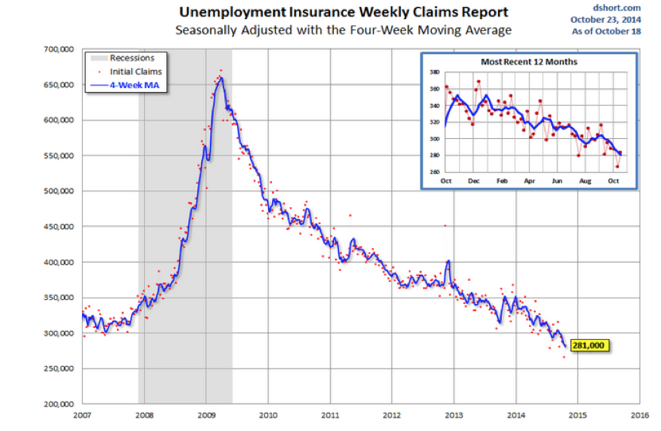
Weekly Jobless Claims - The trend is your Friend -3,000 to 294,000, still hugging 14 year lows!

Slide 11
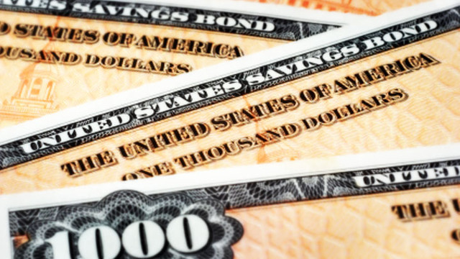
Bonds-New Highs
*Treasury bonds hit new highs on “RISK OFF” flight to safety and disinflationary fears, taking 10 year yields to 2.03% *Quantitative easing is over in the US, but is reborn in Japan and the US, German bond yields fall below 0.70%, 0.40% in Japan! * (TBT) hits new all time low at $45 *Sell off in junk bonds accelerates as energy issues weigh down index, is 18% of the junk universe *Fed not to raise interest rates until 2016, reinforced by oil crash

Slide 12
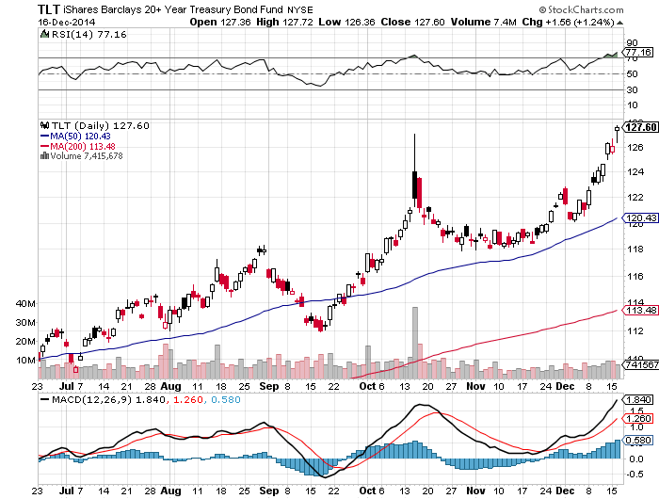
Ten Year Treasuries (TLT) 2.06% A marginal new high

Slide 13
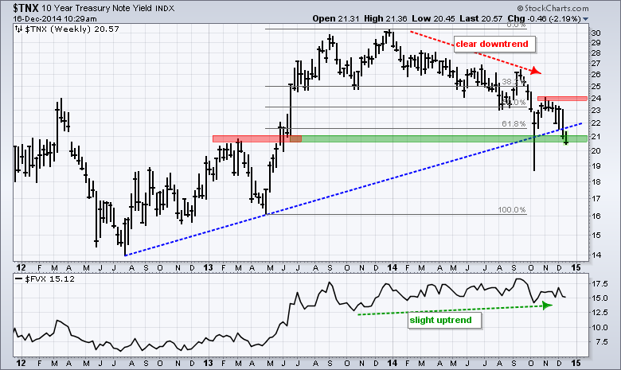
Ten Year Treasuries ($TNX) 2.06%

Slide 14
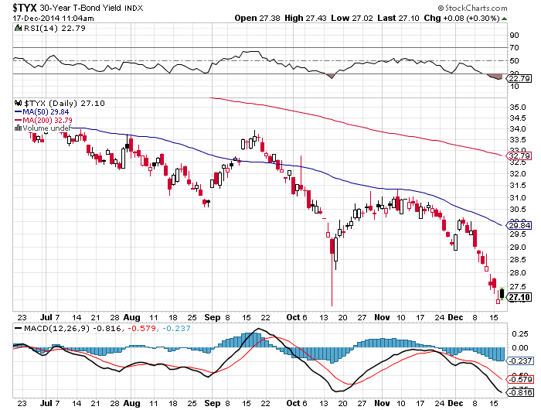
30 Year Treasury Yield ($TYX)-Yield 2.71% Ditto Here

Slide 15
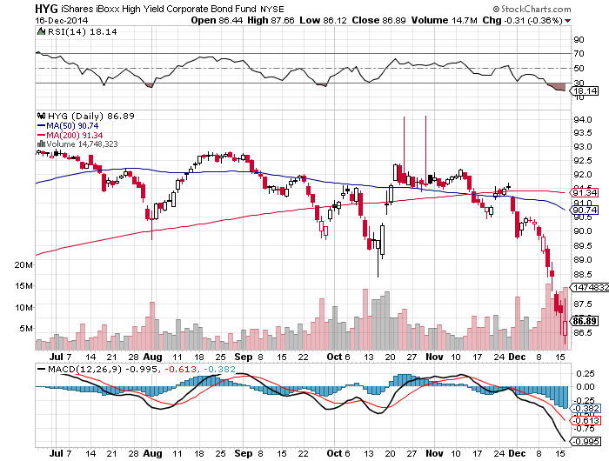
Junk Bonds (HYG) 5.91% Yield The New Lead Contract

Slide 16
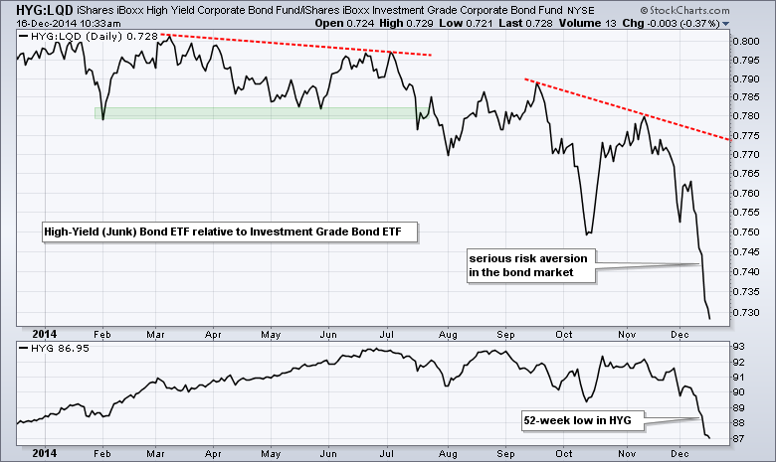
Junk Bonds/Corporates (HYG)/(LQD)

Slide 17
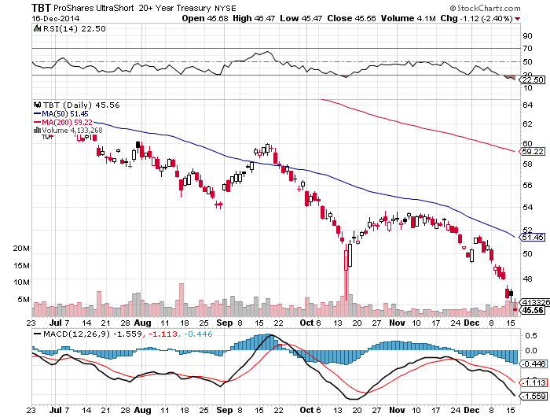
2X Short Treasuries (TBT) 10% long position-Cost of Carry 45 basis points a month-Avoid options

Slide 18
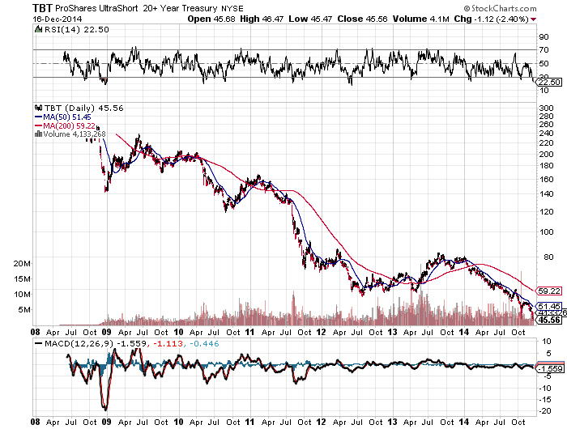
2X Short Treasuries (TBT) New All Time Low-Thank Goodness for Small Positions!

Slide 19
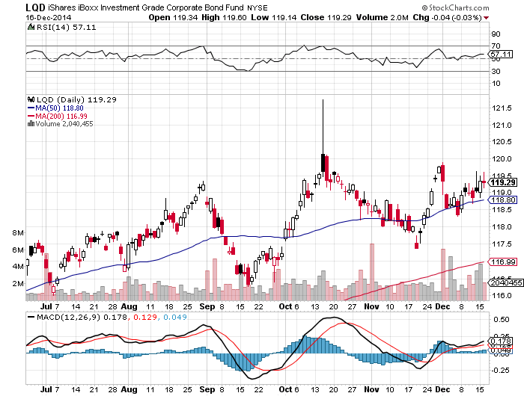
Investment Grade Corporate Bonds (LQD) 3.42% Yield

Slide 20
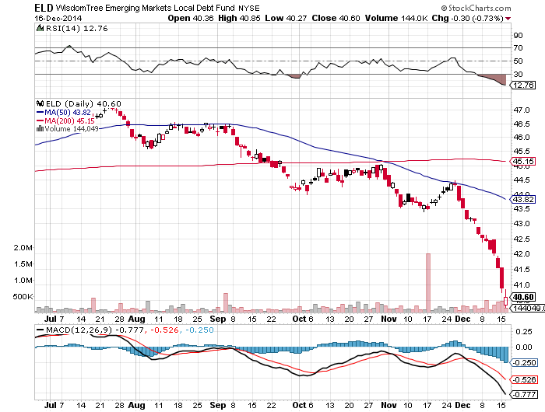
Emerging Market Debt (ELD) 5.19% Yield

Slide 21
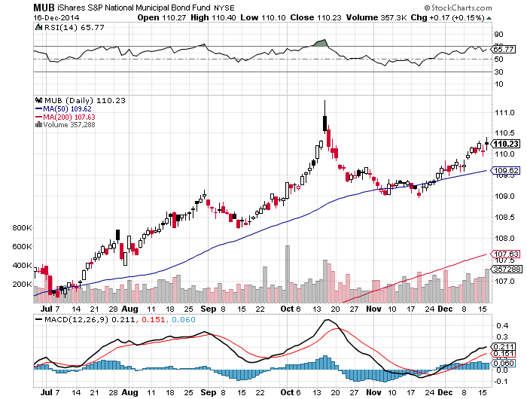
Municipal Bonds (MUB)-2.65% yield, Mix of AAA, AA, and A rated bonds

Slide 22
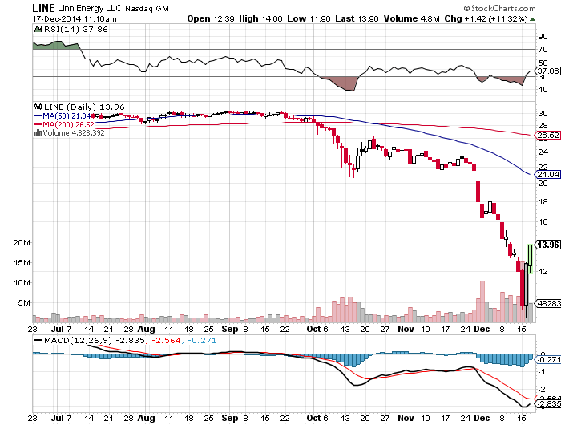
MLP’s (LINE) 20.74% Yield-Capitulation Sell Off long a 10% Position

Slide 23

Stocks-The Oil Black Swan Hits
*All shares are now effectively trading like they are oil shares *This is creating a great entry point for 2015 for the best non oil sectors, like financials, technology, health care, and solar *December dump is extremely rare, is exacerbated by year end liquidity fall off *US corporate profits looking to gain another 10% in 2015, or more thanks to oil *Just missed my 2,100 yearend target *Long term investors now bottom fishing energy names, buying large, safe names with big balance sheets

Slide 24
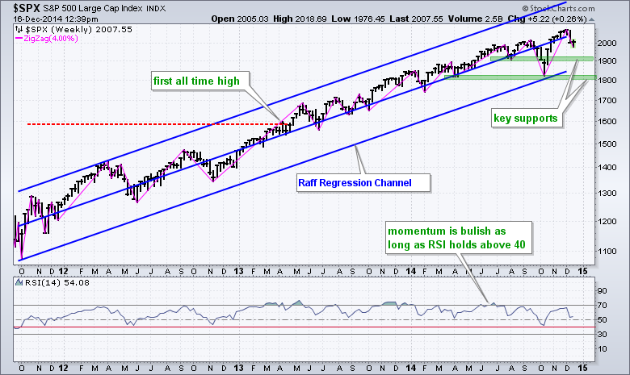
S&P 500-Targeting 1,900?

Slide 25
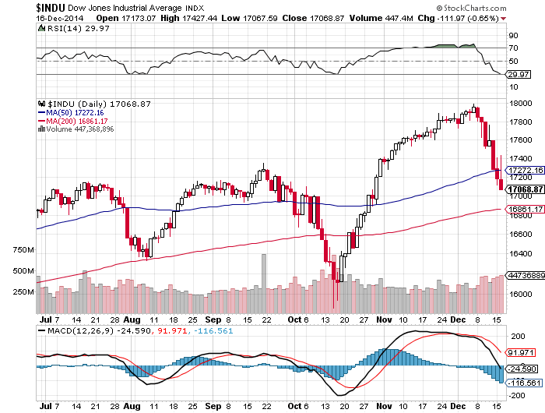
Dow Average-Targeting 16,800?

Slide 26
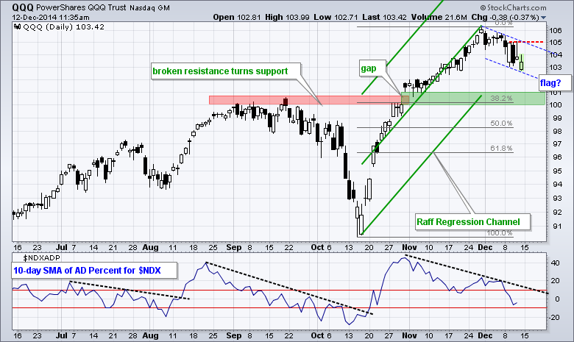
NASDAQ (QQQ)-

Slide 27
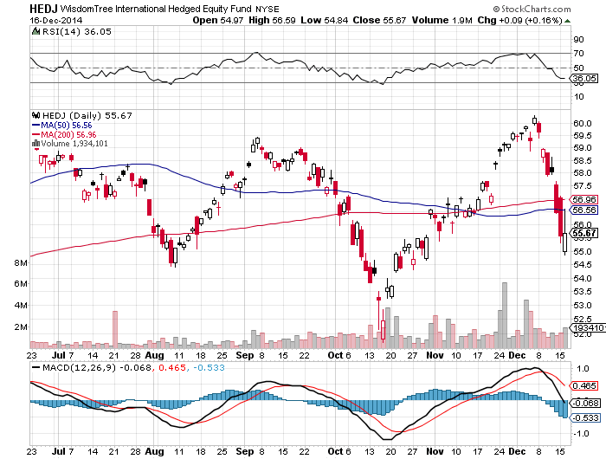
Europe Hedged Equity (HEDJ)-Demolished by Russia

Slide 28
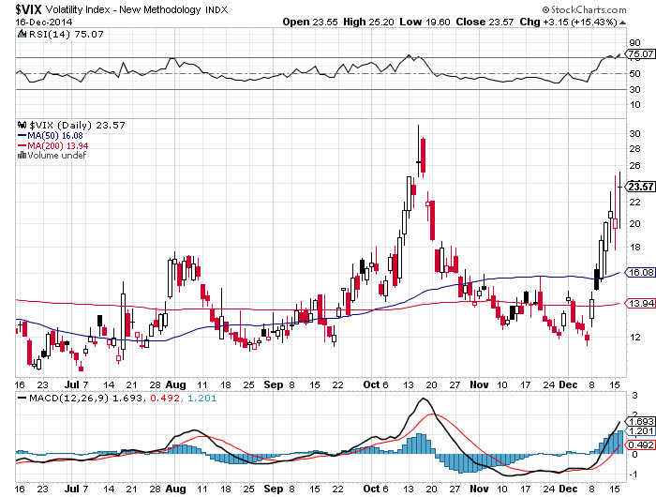
(VIX)-Setting up a double top

Slide 29
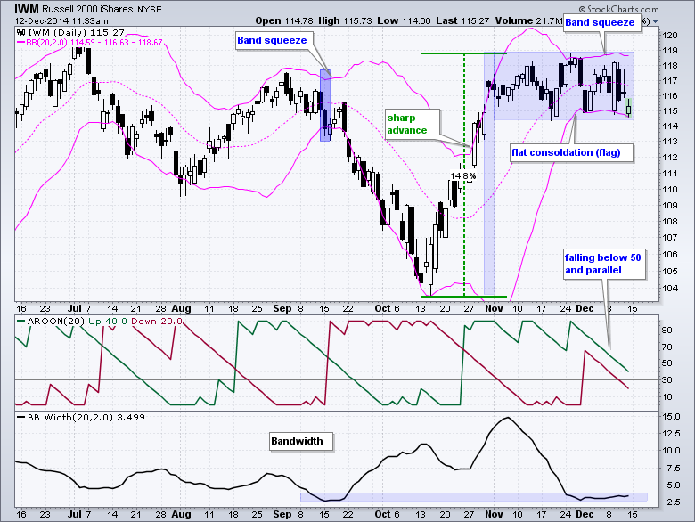
Russell 2000 (IWM)-Poised for a Breakout

Slide 30
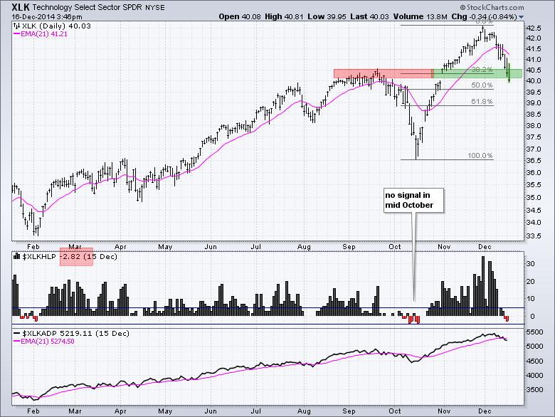
Technology Sector SPDR (XLK), (ROM)

Slide 31
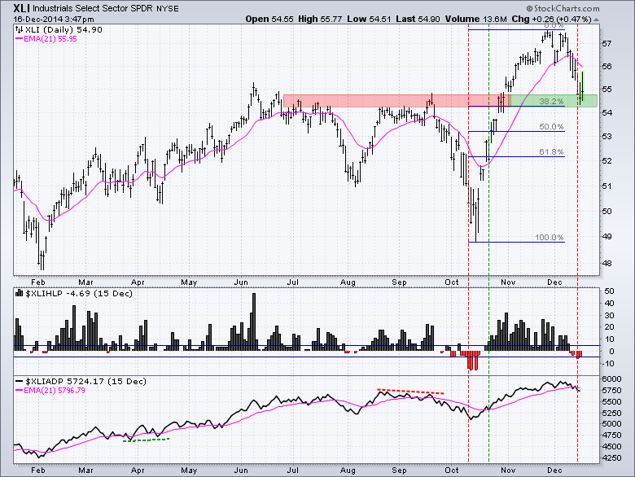
Industrials Sector SPDR (XLI)

Slide 32
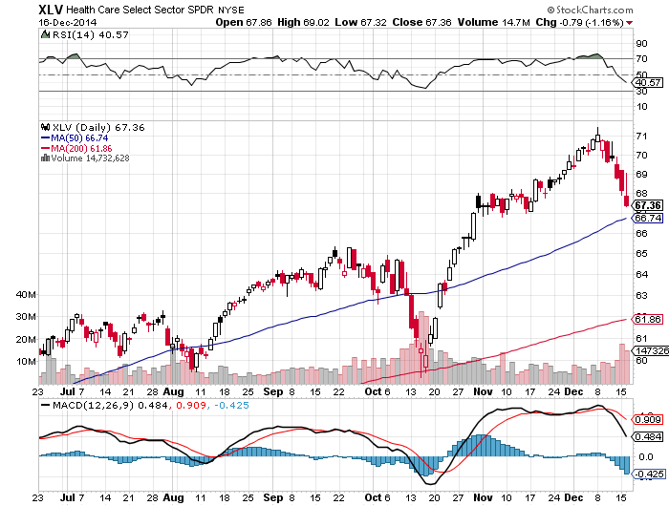
Health Care Sector SPDR (XLV), (RXL)

Slide 33
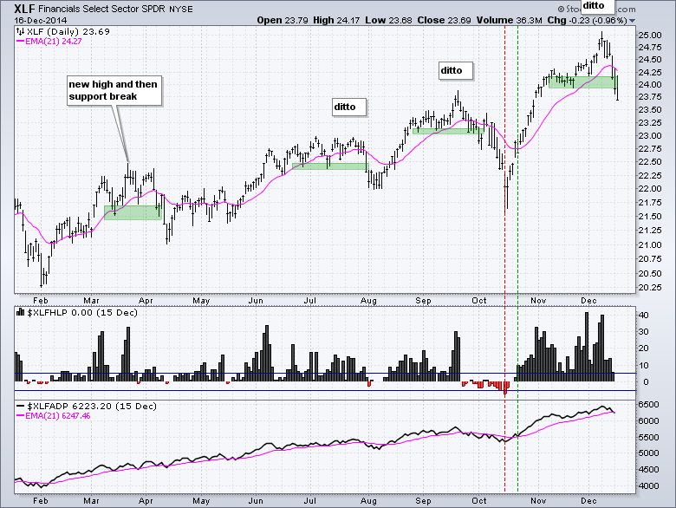
Financial Select SPDR (XLF)-Buy the Dip, bond selloff to follow

Slide 34
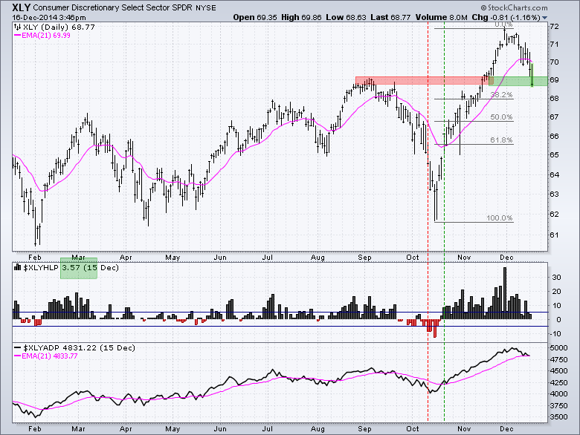
Consumer Discretionary SPDR (XLY)

Slide 35
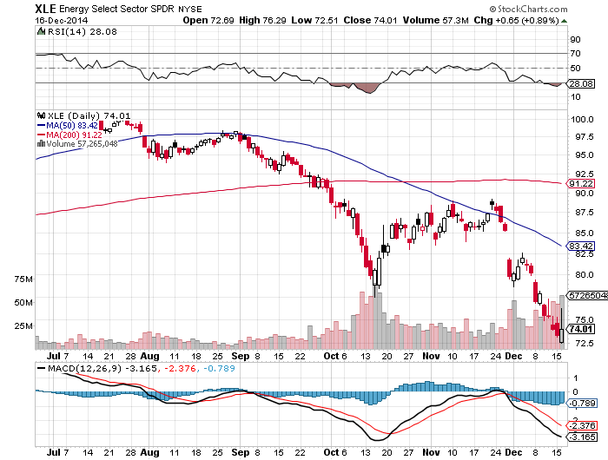
Energy Select Sector ETF SPDR (XLE)

Slide 36
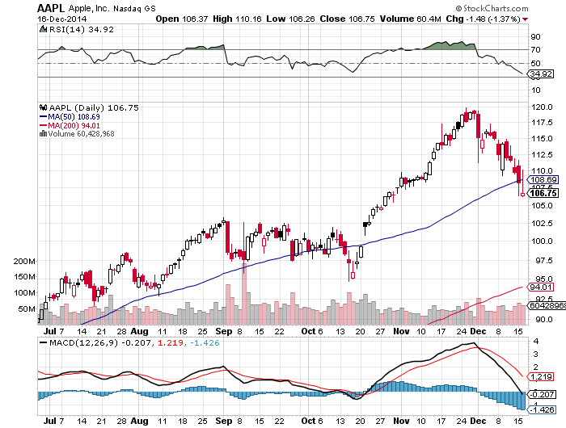
Apple (AAPL) –

Slide 37
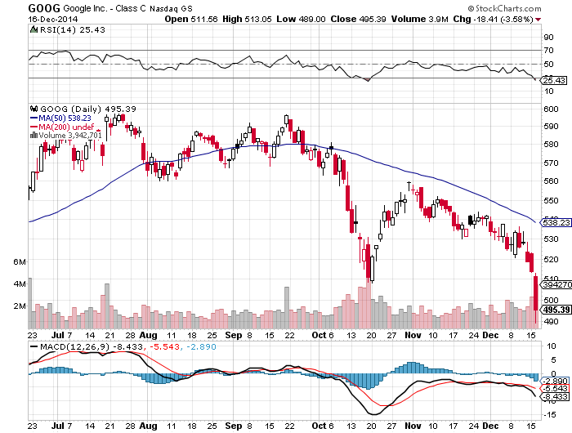
Google (GOOGL)- Relaunch Postponed

Slide 38
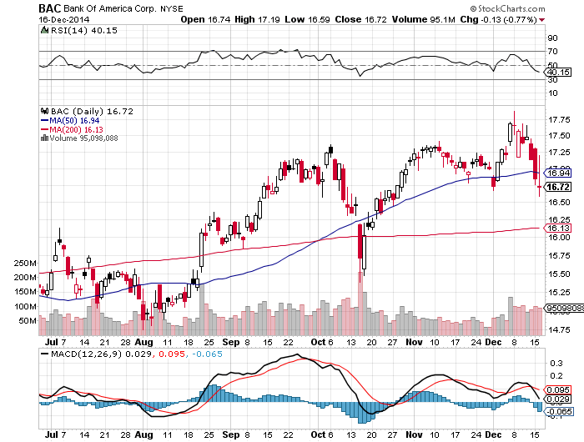
Bank of America (BAC)- long the 12/$15-$16 vertical bull call spread-2 weeks to expiration

Slide 39
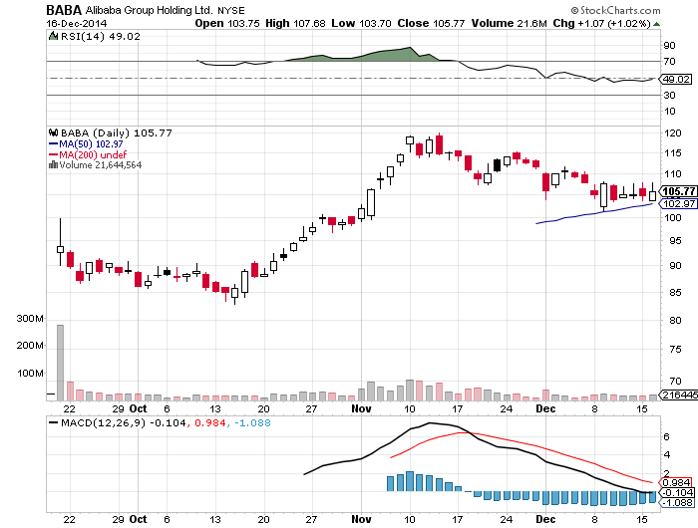
Alibaba (BABA)- stopped out of the 12/100-$105 call spread

Slide 40
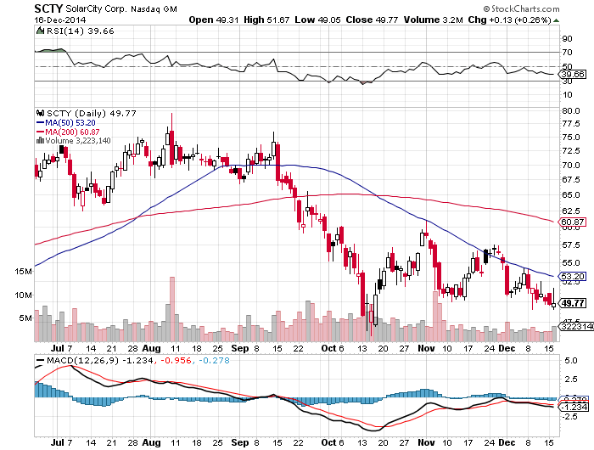
Solar City (SCTY)- stopped out of the 12/$47.50-$52.50 vertical bull call spread

Slide 41
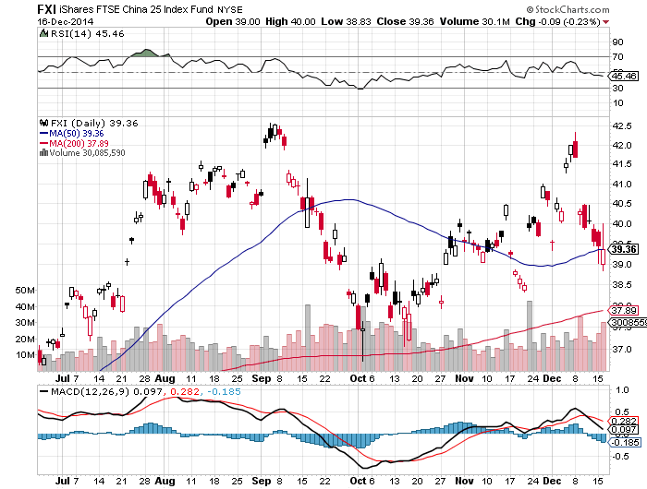
China (FXI)-

Slide 42
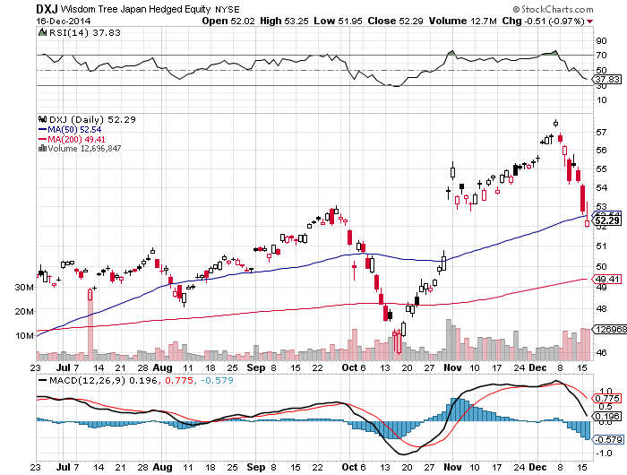
Japan (DXJ)-Hedged Japan Equity No positive election impact

Slide 43
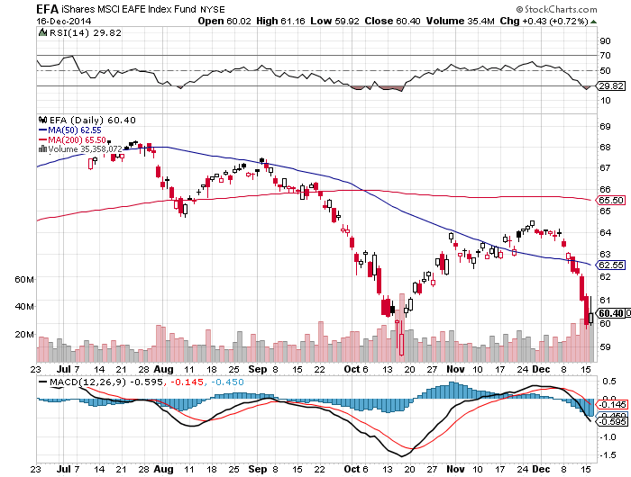
Emerging Markets (EFA)- Biggest Beneficiaries of Cheap Oil-Go figure

Slide 44
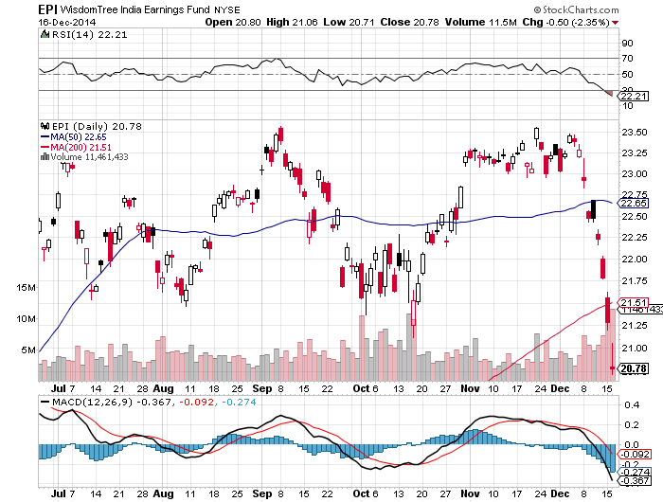
India (EPI) –Biggest Beneficiary of Cheap Oil

Slide 45
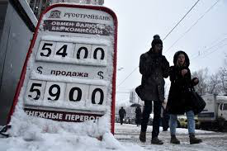
Foreign Currencies- ”RISK OFF” Means Take Profits on All Shorts
*Mario Draghi’s confusing comments triggers short covering spike in the Euro *Abe Japanese election win very yen negative long term *Aussie hits new four year low on collapsing commodities and weaker growth, iron ore meltdown *Russian Ruble collapse is having a global contagion risk, debt defaults for European banks iPhone 6 from $547 to $856 *Emerging currencies in free fall

Slide 46
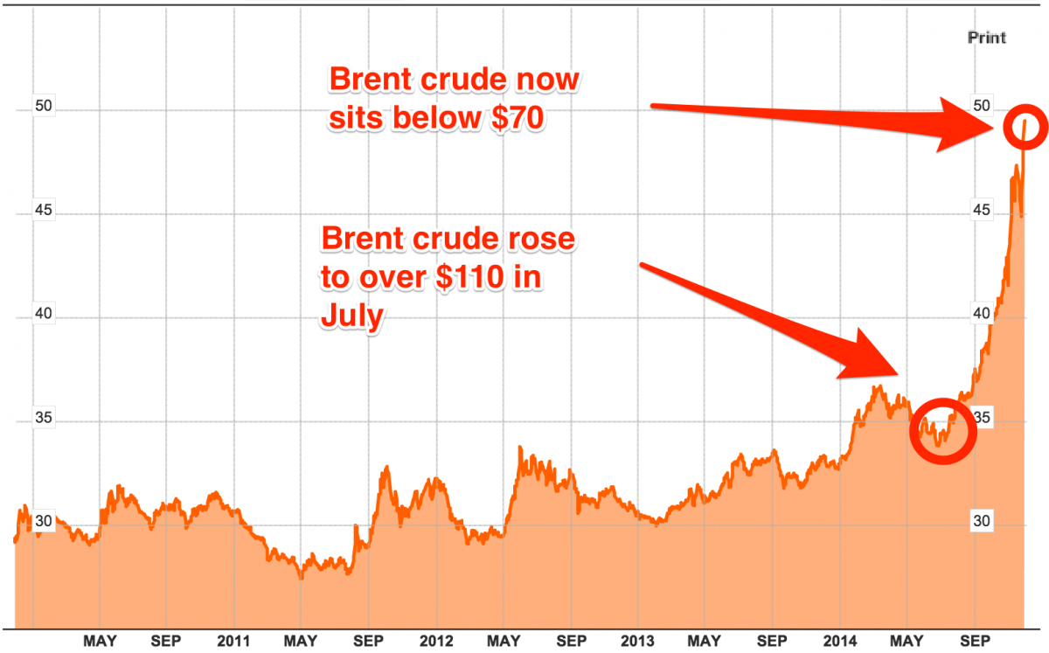
Russian Rubles to the US Dollar-Now at 70!

Slide 47
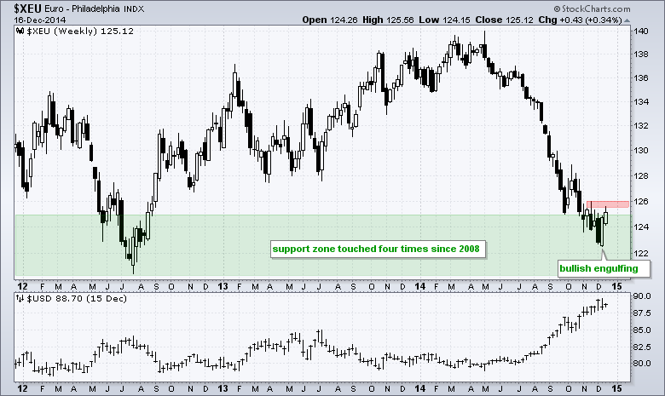
Euro ($XEU)- Taking a rest on yearend profit taking

Slide 48
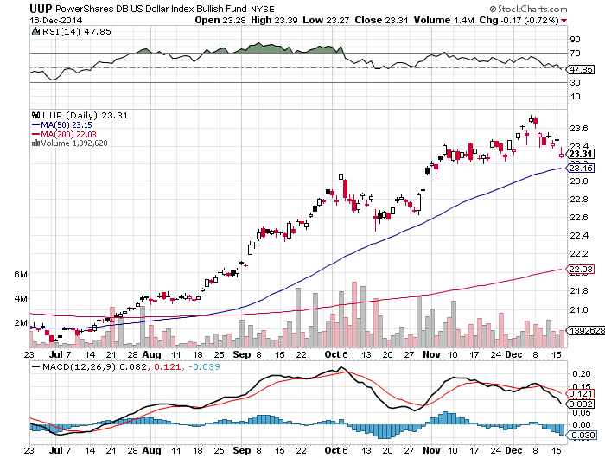
Long Dollar Index (UUP) New Four Year High!

Slide 49
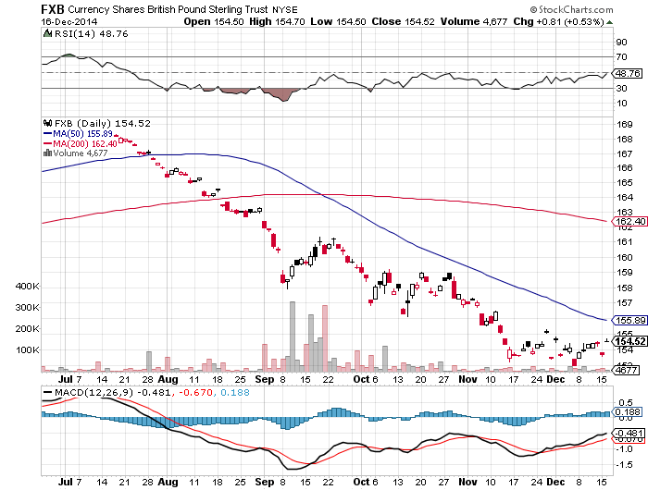
British Pound (FXB)-

Slide 50
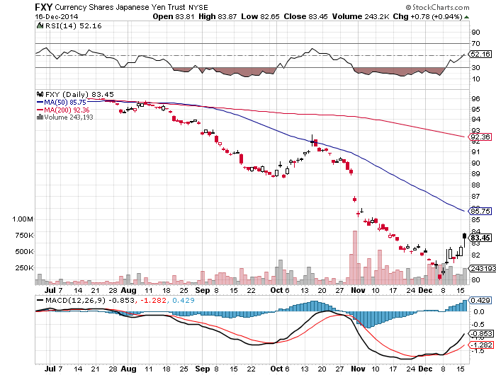
Japanese Yen (FXY)- Global ‘RISK OFF” Means cover yen shorts

Slide 51
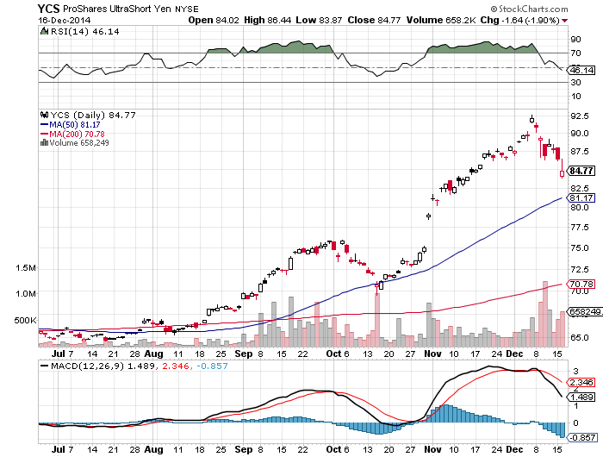
Short Japanese Yen ETF (YCS)

Slide 52
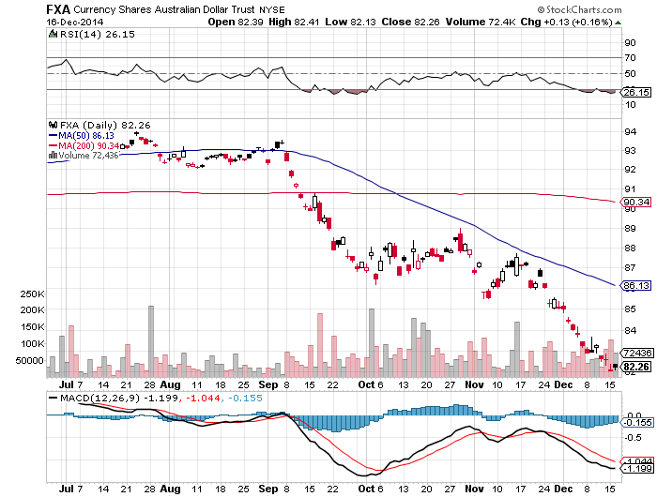
Australian Dollar (FXA) –New Four Year Low

Slide 53
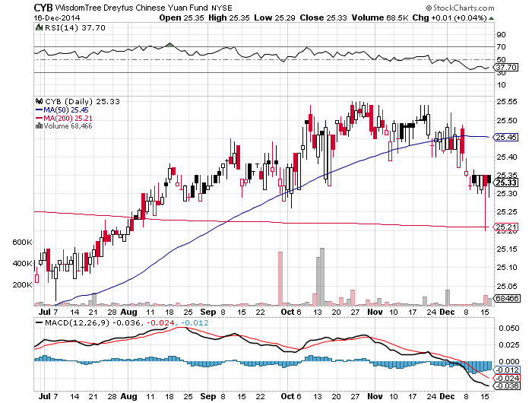
Chinese Yuan- (CYB)

Slide 54
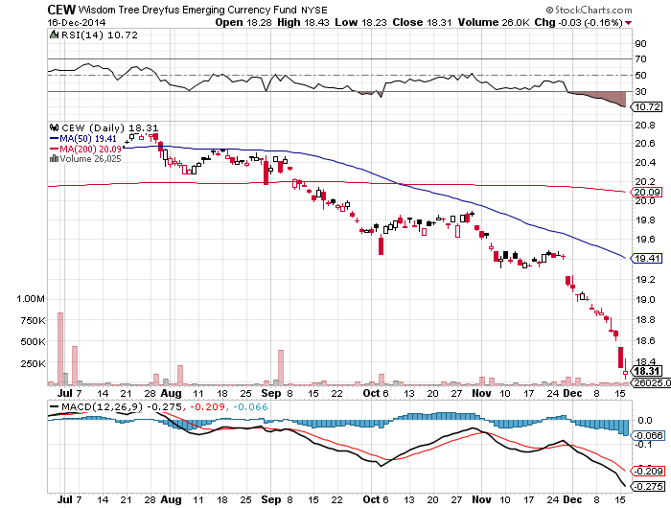
Emerging Market Currencies (CEW) Dragged down by commodities collapse

Slide 55
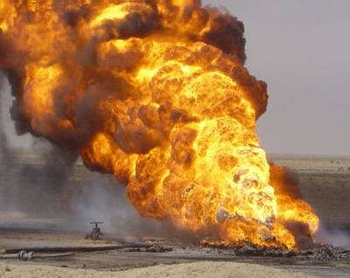
Energy-Crash!
*Bottom is here, or close *Futures term structure turning from hugely negative to mildly positive. *Watch for oil to fall, but stocks to stay flat or rise, a great turning indicator *Expect financial crisis in Russia, Venezuela, Nigeria, and trouble in Canada, it could take years for all the bodies to rise to the surface *Long term players moving in to scoop up MLP’s for double digit yields *Don’t expect a rapid bounce back, winding down 15 years of leverage accumulation

Slide 56
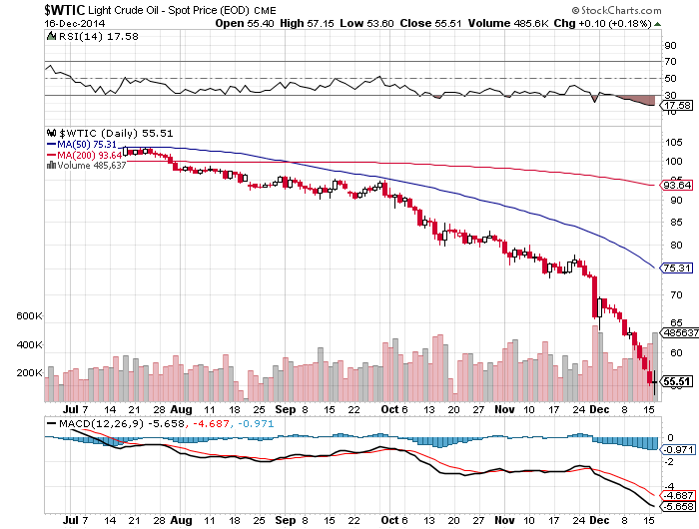
Oil-Trying to Find a Bottom

Slide 57
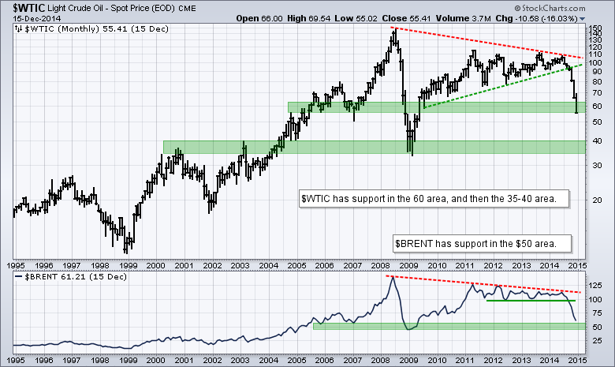
Oil-Trying to Find a Bottom

Slide 58
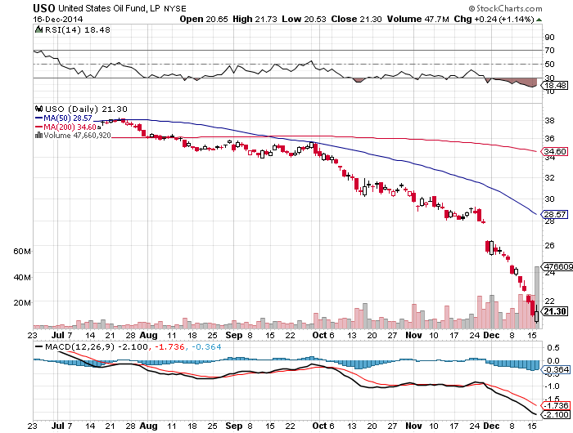
United States Oil Fund (USO)

Slide 59
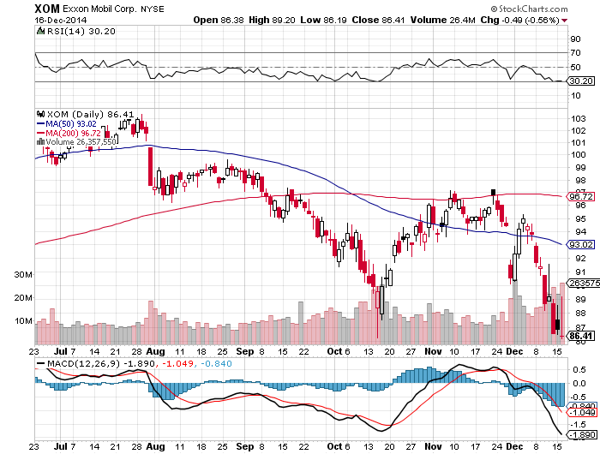
Exxon (XOM)

Slide 60

Occidental Petroleum (OXY)

Slide 61

Conoco Phillips (COP)

Slide 62

Natural Gas (UNG)-

Slide 63

Copper-

Slide 64

Freeport McMoRan (FCX)-New Lows

Slide 65

Precious Metals-A Bear Market Rally
*Oil crash prompting fears of Russian panic selling of gold to meet budget shortfall and head off a debt default *No demand for metals in a disinflationary world *Still targeting $1,000 *For coin collecting only

Slide 66

Gold-Another Bear Market Rally Gone

Slide 67

Barrick Gold (ABX)-New Lows

Slide 68

Market Vectors Gold Miners ETF- (GDX) No Friends

Slide 69

Silver (SLV)-New 5 Year Lows

Slide 70

Silver Miners (SIL)

Slide 71

Agriculture
*Transportation crisis is providing support under market *Collapse of Russian Ruble gives the huge price advantage in international markets *Strong dollar hurting US sellers, will get worse *Volatility has gone out of the market, look elsewhere for better trades *Focus on 2015, but it will be another record crop without extreme weather

Slide 72

(CORN) –

Slide 73

(SOYB)-Not Much of a Rally

Slide 74

Ag Commodities ETF (DBA)

Slide 75

Real Estate-Looking Soft, But Better Next Year
*Home Prices to be Flat to slightly higher in 2015 *High prices, lack of credit freezing out buyers, shrinking volumes *Millennials boycotting the housing market, but may be forced in by rising rents *November new housing starts down -1.6% to 1.028 million *Ultra low mortgage rates could bring a jump in new construction by 14% in 2015, giving another leg up for the economy *Rising wages could finally give real estate the spur it needs.

Slide 76

May S&P/Case–Shiller Home Price Index +14% YOY down to +4.9%, Still Slowing

Slide 77

US Home Construction Index (ITB)

Slide 78

Trade Sheet So What Do We Do About All This?
*Stocks- buy the dips, with Financials, technology and health care leading, we’re running to new highs *Bonds- sell rallies across all fixed income, the end is here *Commodities-stand aside until global economy recovers *Currencies- sell every Euro rally forever, and the yen too *Precious Metals –stand aside until the $1,000 bottom is in *Volatility-is peaking, get ready to sell *The Ags –stand aside until next season *Real estate- stand aside, the dead cat bounce is done

Slide 79

To buy strategy luncheon tickets Please go to: www.madhedgefundtrader.com Next Strategy Webinar 12:00 Wednesday, January 7, 2015 Live from San Francisco, CA Last webinar of the year!
Good Luck and Good Trading!
Notes:
*

