Slide 1

Mad Day Trader
Bill Davis
Webinar – June 17, 2015

Slide 2
How to Read Short
Term Market Swings
Using the VIX

Slide 3
From yesterday’s update …
I would watch the VIX and where it opens.
If it opens above 15.63, expect further down movement.
The next level to watch is 16.41.
If the VIX stalls there and heads down, expect the markets to head up.
VIX: Key levels are 15.63 and 12.50
Above 15.63 is 16.41.
Below 15.63 is 14.85

Slide 4
Let’s look at where the VIX failed … and how to trade it …

Slide 5
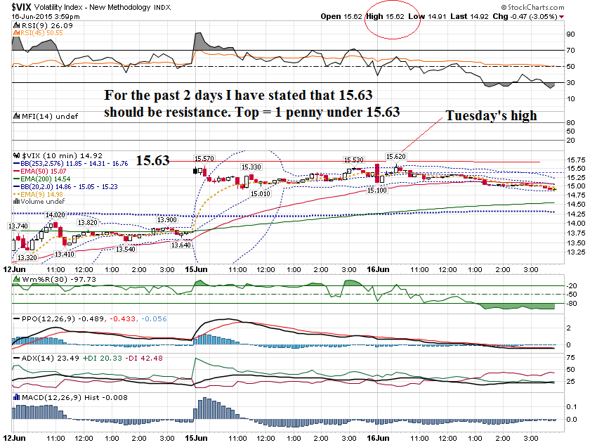

Slide 6
From yesterday’s update …
“With the FOMC announcement tomorrow, profits should be booked quickly on any intra day trades”

Slide 7
Go to a shorter term chart after the
VIX failed at 15.63 and trade off the shorter chart.

Slide 8
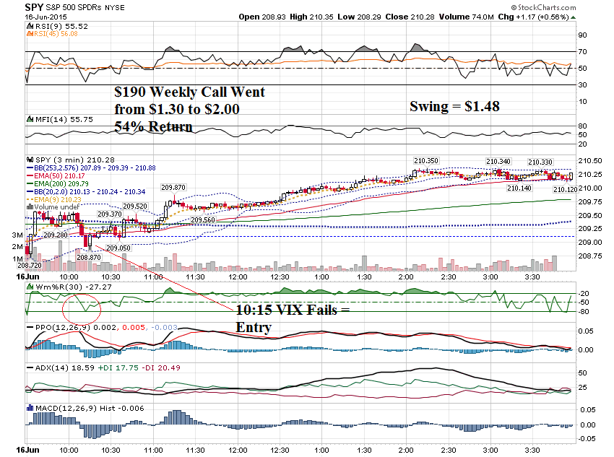

Slide 9
Let’s look at some charts from some prior days, using this same analysis

Slide 10
Charts from
Friday June 12, 2015

Slide 11
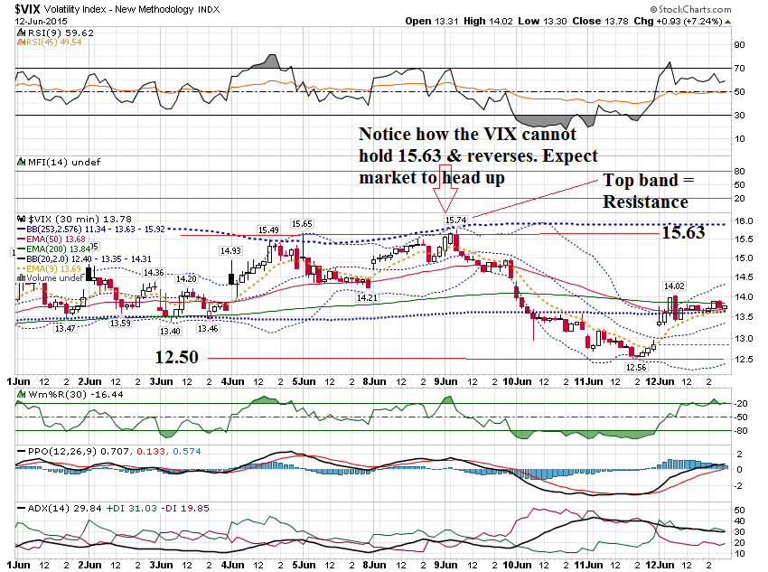

Slide 12
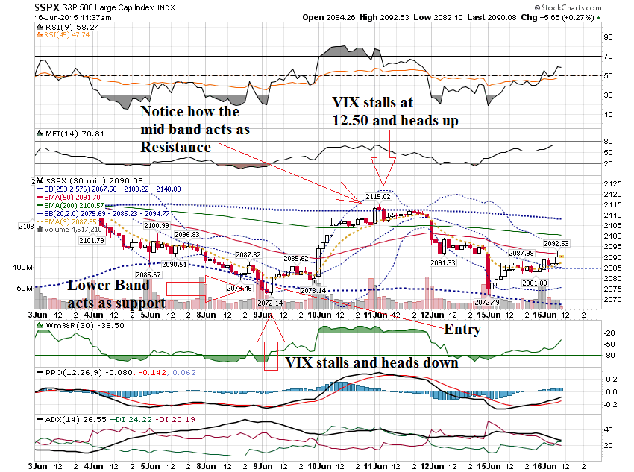

Slide 13
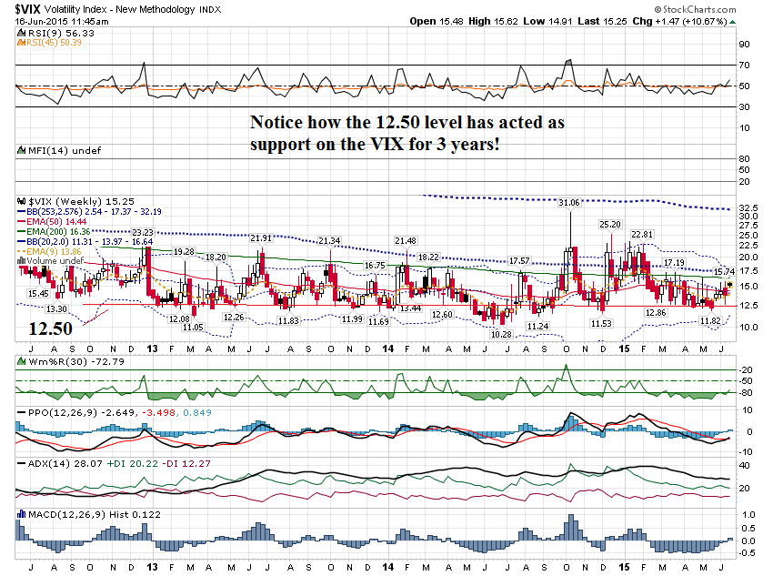

Slide 14
Charts from
February 17, 2015

Slide 15
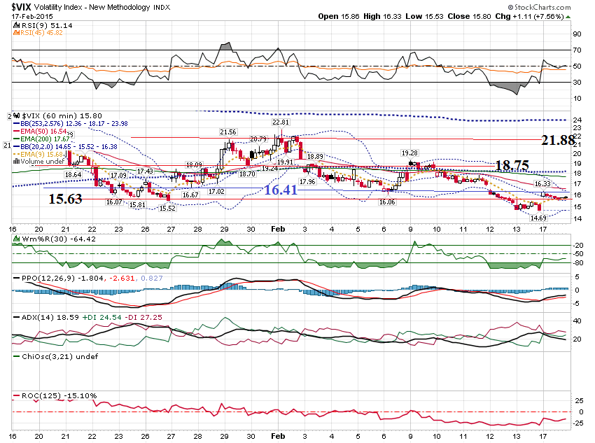

Slide 16
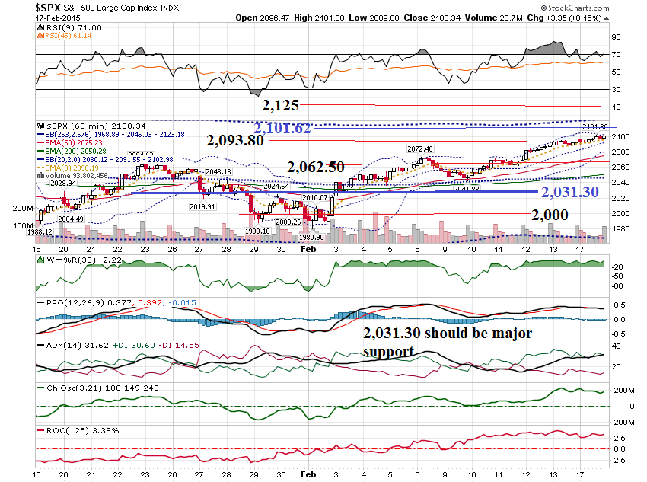

Slide 17
Charts from
January 7, 2015

Slide 18
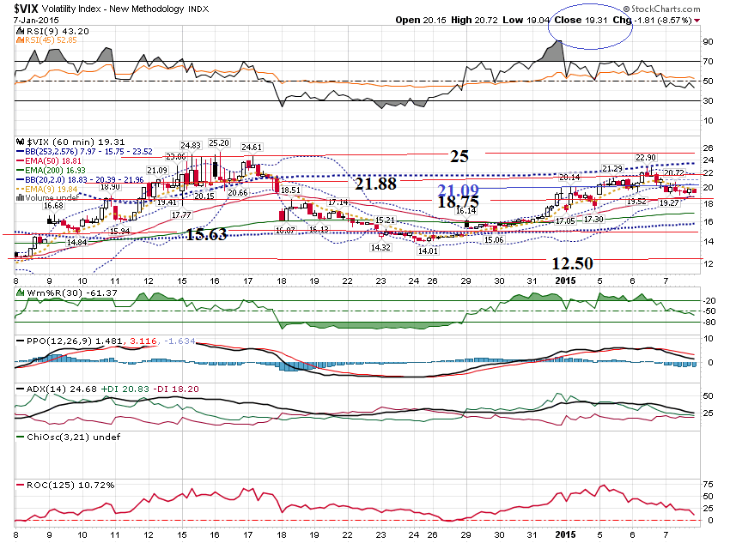

Slide 19
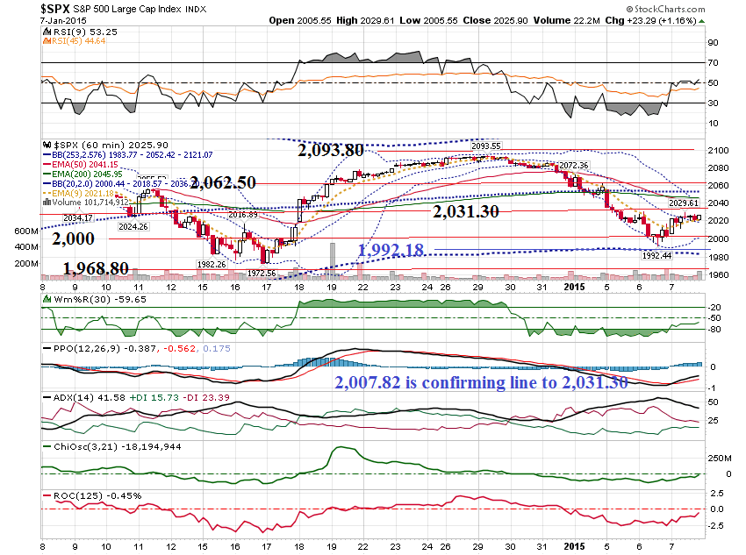

Slide 20
I like trading these swings on Friday, when the option leverage using weeklies is the greatest.

Slide 21
Examples from
Last Friday …

Slide 22
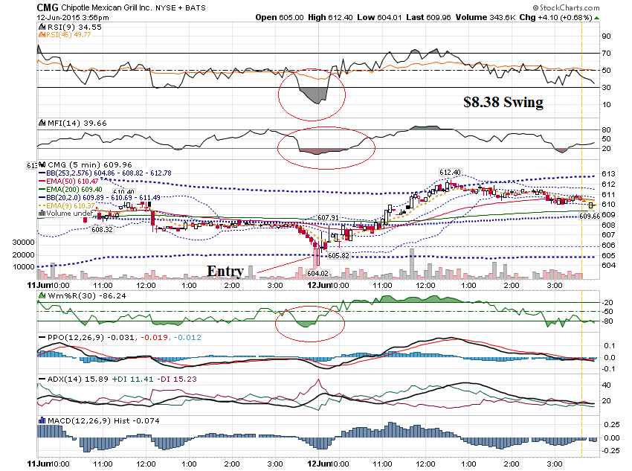

Slide 23
CMG $605 Calls
Prev Close: 2.93
Open: 3.10
Bid: 4.40
Ask: 6.90
Strike: 605.00
Expire Date: 12-Jun-15
Day's Range: 2.47 - 7.00
Contract Range: N/A - N/A
Volume: 194
Open Interest: 194

Slide 24
CMG $607.50 Calls
Prev Close: 1.80
Open: 1.01
Bid: 2.35
Ask: 3.20
Strike: 607.50
Expire Date: 12-Jun-15
Day's Range: 1.01 - 4.60
Contract Range: N/A - N/A
Volume: 746
Open Interest: 67

Slide 25
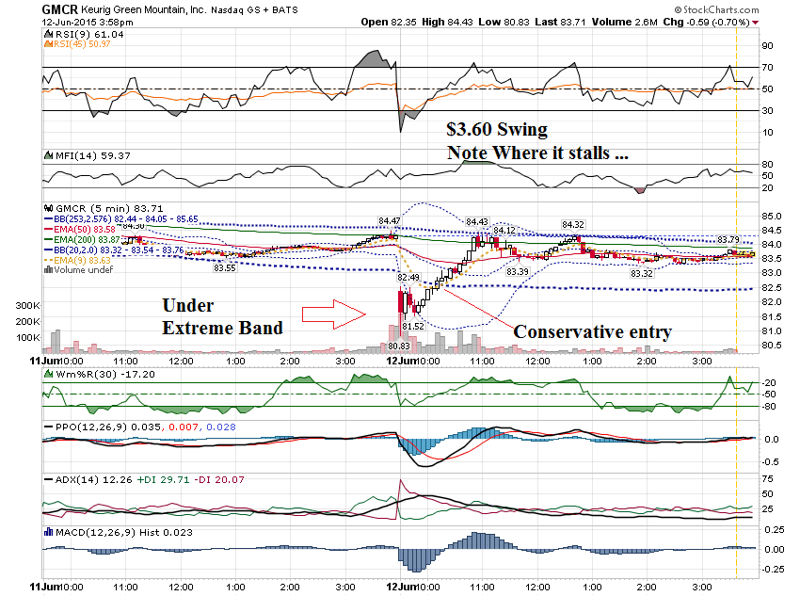

Slide 26
GMCR $81 Call
Prev Close: 3.40
Open: 0.75
Bid: 0.95
Ask: 3.50
Strike: 81.00
Expire Date: 12-Jun-15
Day's Range: 0.75 - 2.80
Contract Range: N/A - N/A
Volume: 15
Open Interest: 16

Slide 27
GMCR $83 Call
Prev Close: 1.55
Open: 0.18
Bid: 0.65
Ask: 0.86
Strike: 83.00
Expire Date: 12-Jun-15
Day's Range: 0.18 - 1.09
Contract Range: N/A - N/A
Volume: 264

Slide 28
If you were on John
Thomas’s webinar last week, you heard me say you should stay on the sidelines on NFLX.
Here is why …

Slide 29
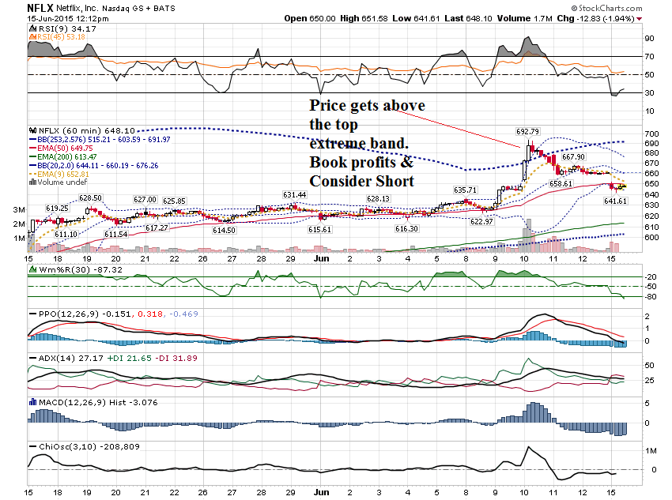

Slide 30
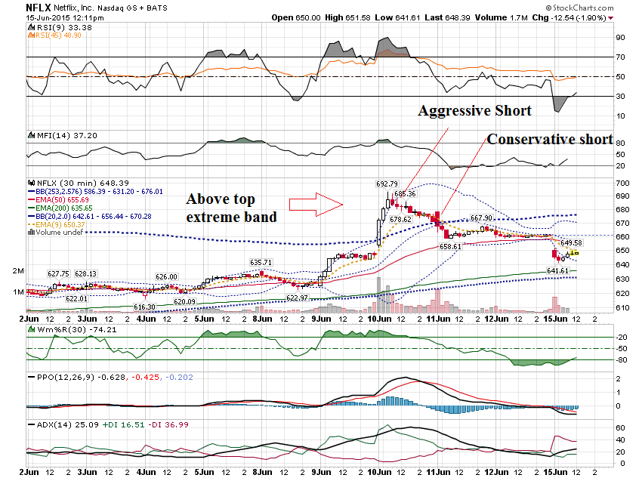

Slide 31
Let’s apply this to another stock that is really overbought …
ZOES

Slide 32
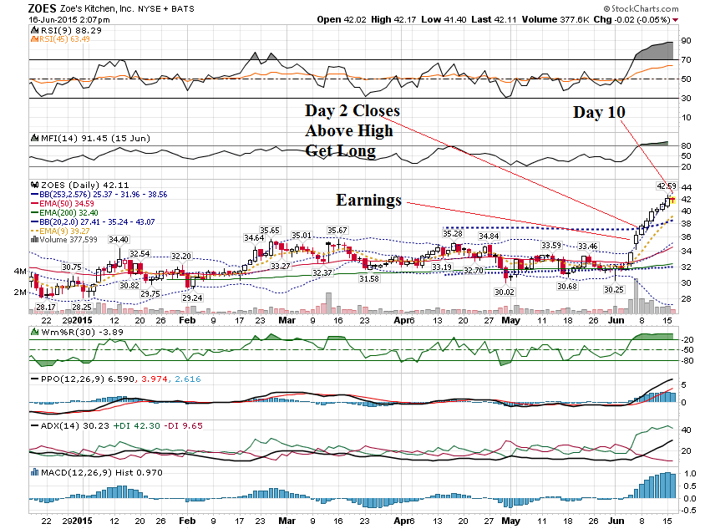

Slide 33
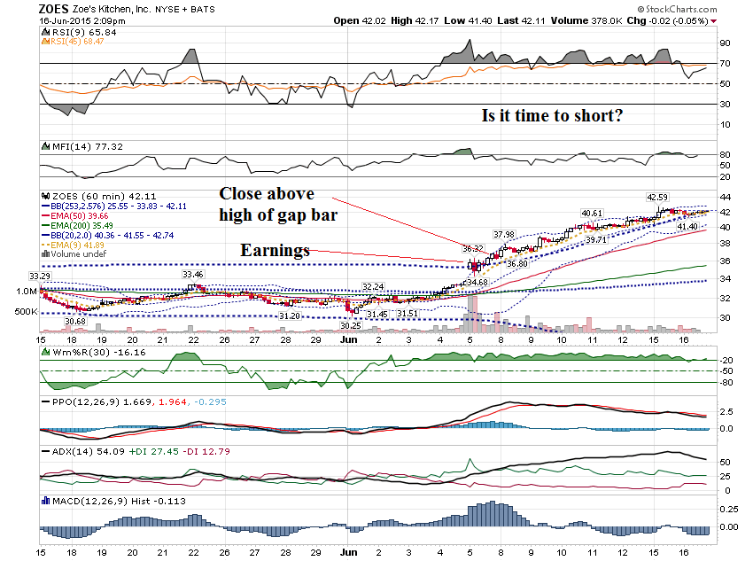

Slide 34
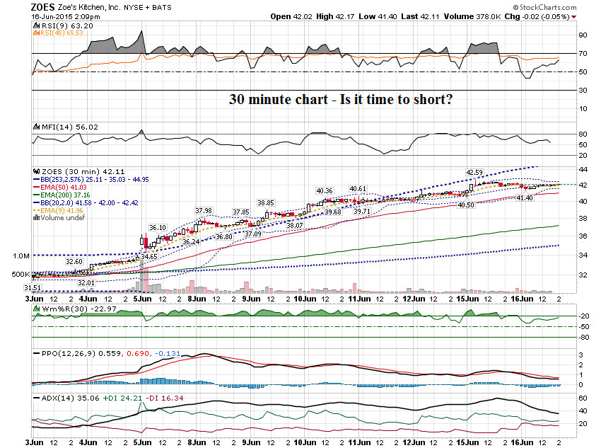

Slide 35
Had a question about cyber security stocks …
CYBR, BLOX & FEYE
( I like PANW)

Slide 36
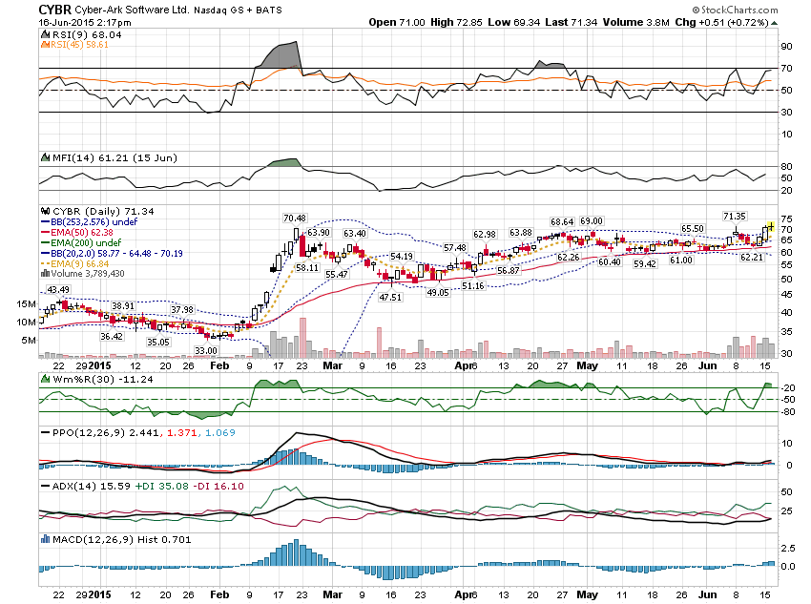

Slide 37
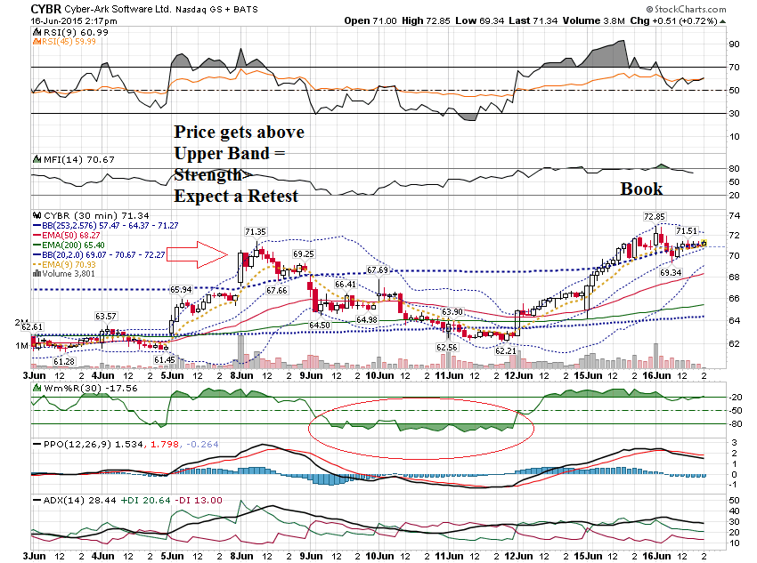

Slide 38
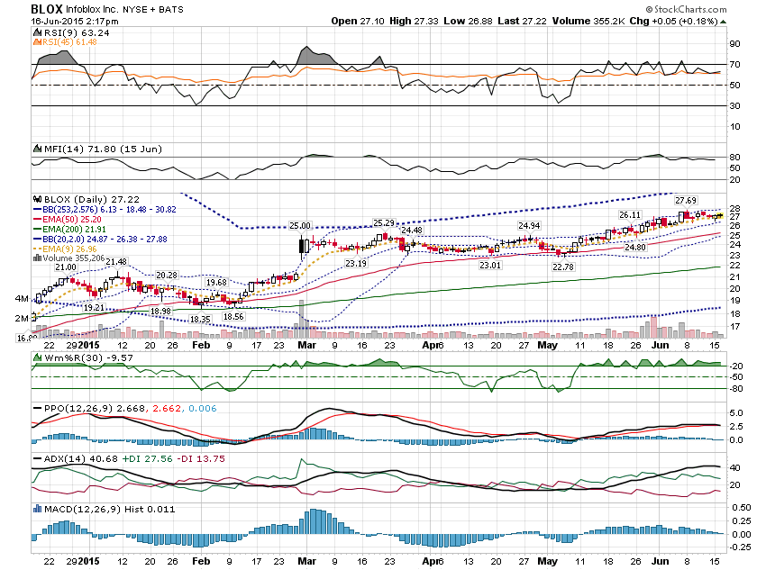

Slide 39
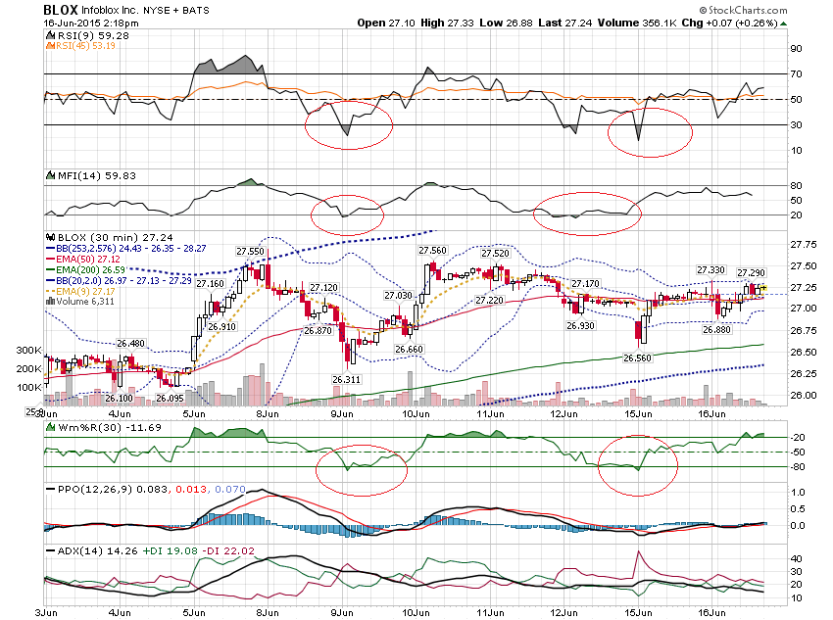

Slide 40
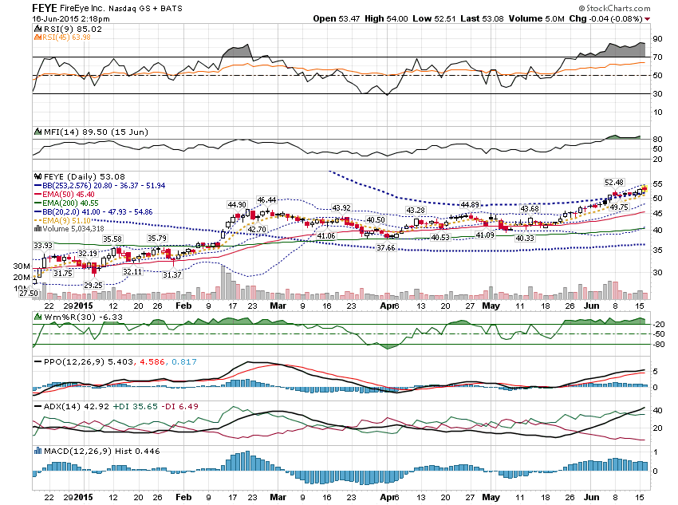

Slide 41
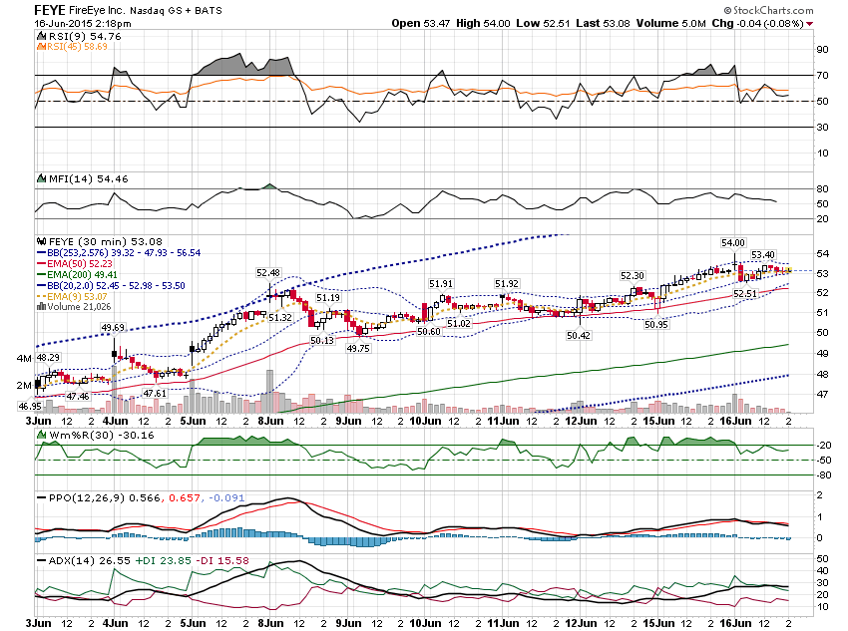

Slide 42
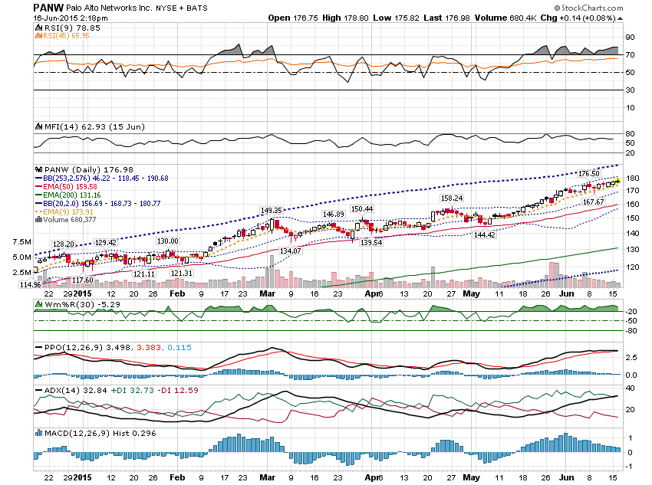

Slide 43
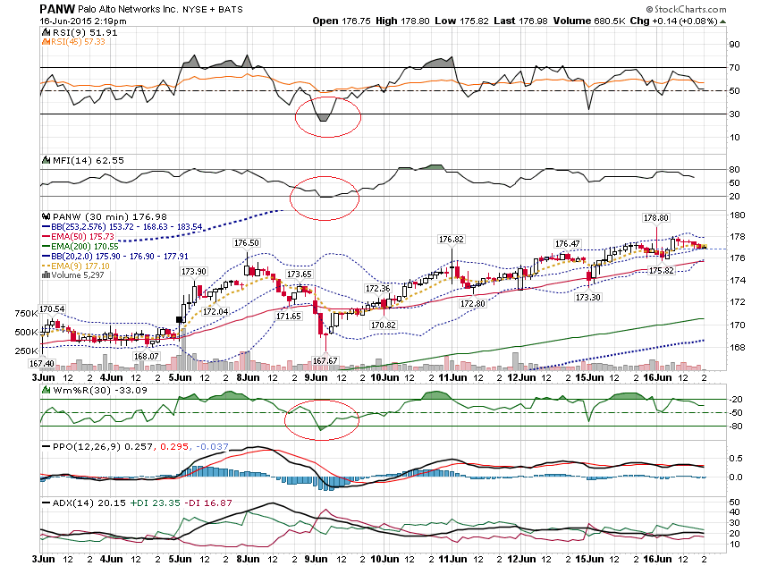

Slide 44
Stocks that gap can be great stocks to trade after earnings … especially if they report Thursday after the close & have weekly options.

Slide 45
Would you like to see the Granddaddy of all post earnings move?

Slide 46
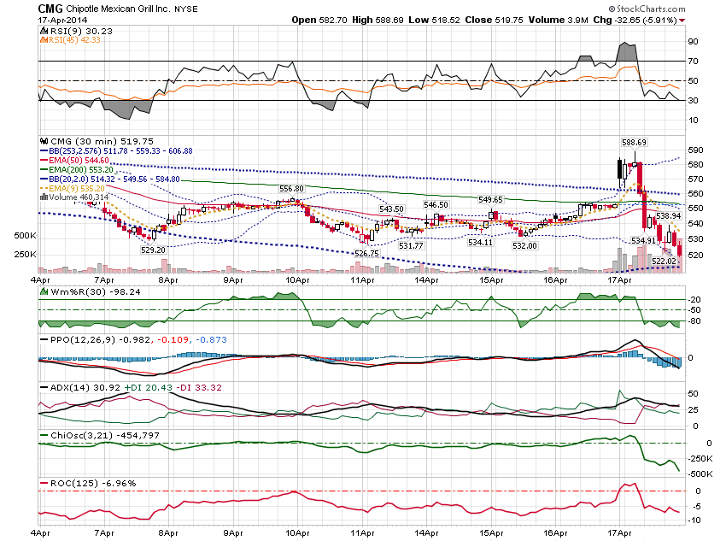

Slide 47
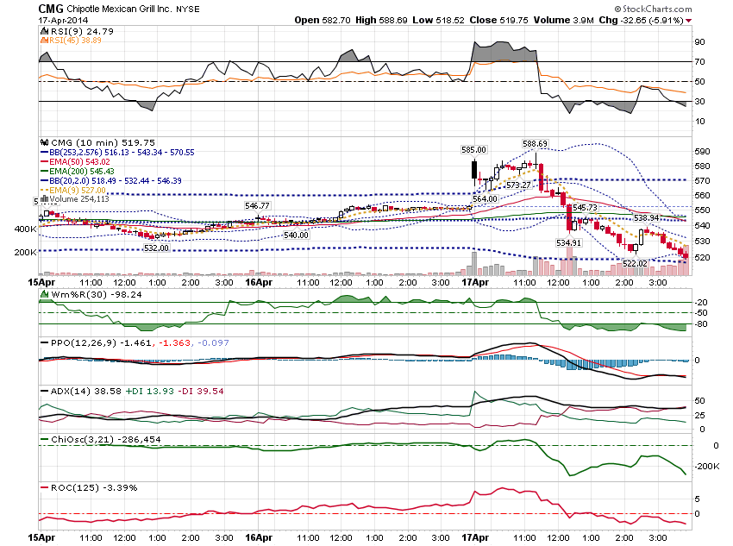

Slide 48
Let’s look at some options on that day ….

Slide 49
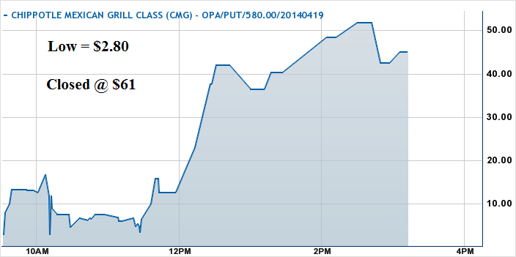

Slide 50
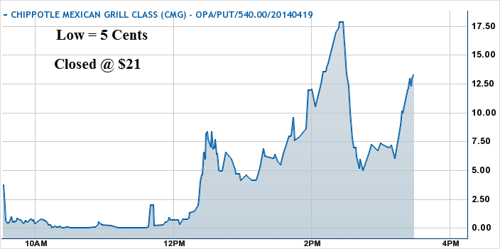
420% return in 1 day!
Did you think this is possible?

Slide 51
On the next webinar,
I will show a 100 to 1 return overnight. I will also share the set up that preceded the move!

Slide 52
Thanks for watching!
Bill Davis
Mad Day Trader
June 17, 2015 davismdt@gmail.com

