Slide 1

Mad Day Trader
Bill Davis
Webinar – July 29, 2015

Slide 2
I want to continue the discussion on integrating the VIX with the
Market turning points.

Slide 3
As I said in yesterday’s daily update, I mentioned how on John’s Webinar last week that the market was at an inflection point.

Slide 4
Today, I want to show you what that means and the implications.
John’s webinar was on
Wednesday July 22, 2015.
Today I want to show why I said that.

Slide 5
Let’s look at some charts of the S & P 500 and the VIX

Slide 6
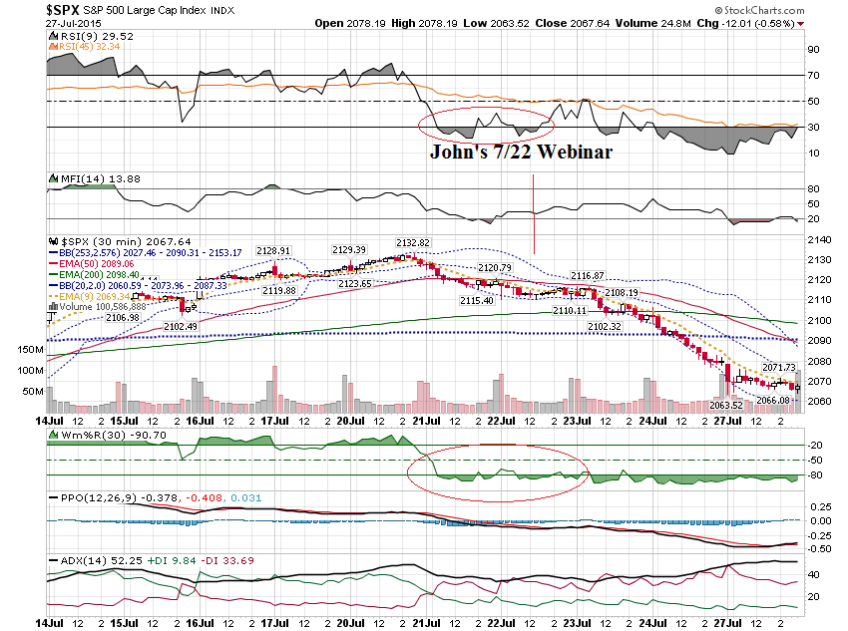

Slide 7
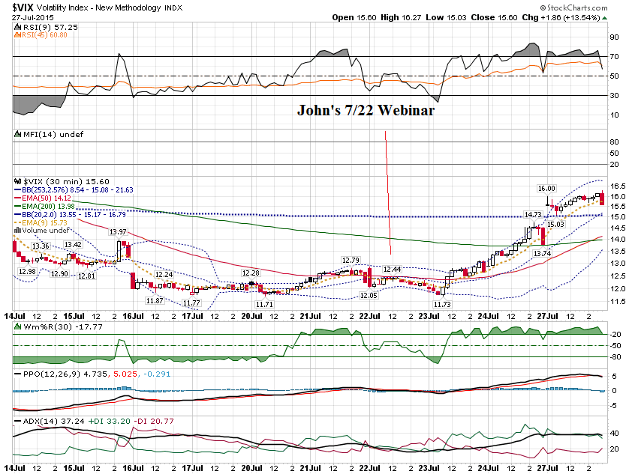

Slide 8
Now let’s look at these charts with the resistance levels.

Slide 9
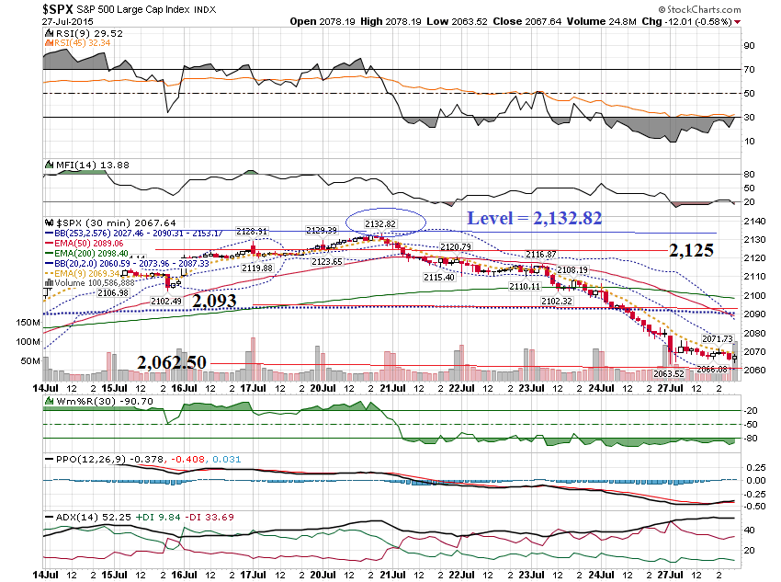

Slide 10
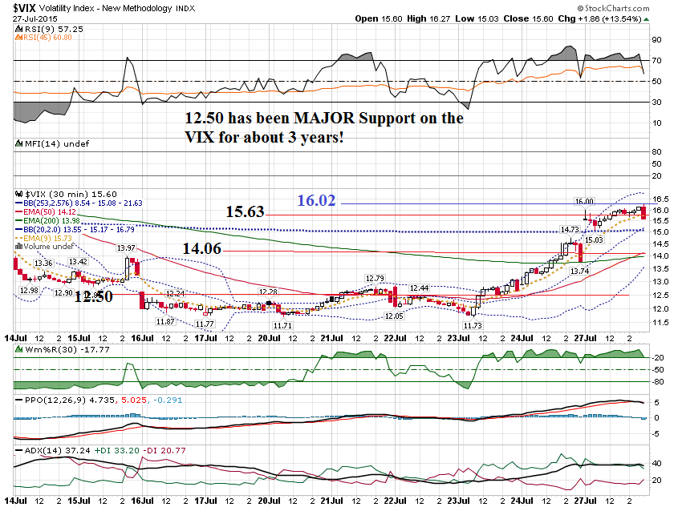

Slide 11
Let’s scope down to a
10 minute chart of the VIX …

Slide 12
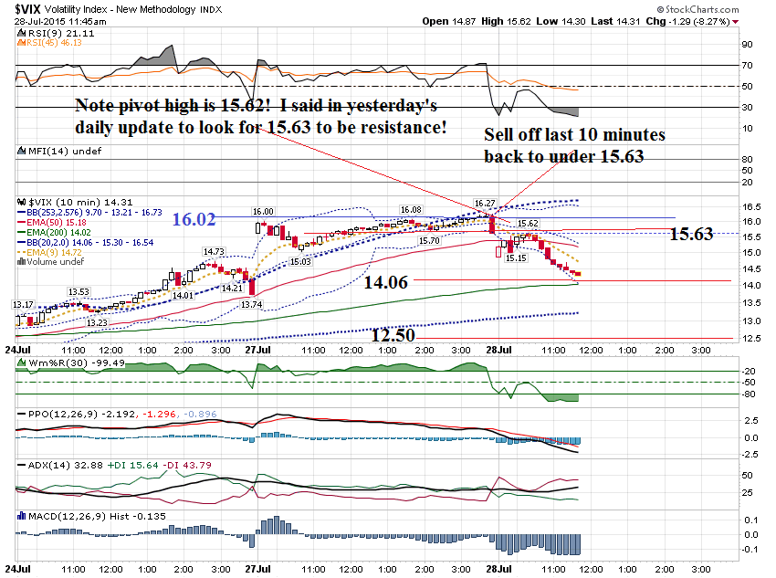

Slide 13
You still apply your basic technical tools to the VIX.
The main ones I use are moving averages and the
Extreme Bollinger Bands.

Slide 14
The % move on the VIX will NOT correlate to the same % move on the markets!

Slide 15
The only thing the VIX is telling you is if the market will reverse and when you can expect a reversal.
It does this by reversing off a resistance level.

Slide 16
Because we are in earnings season and there have been a number of outstanding moves,
I would like to discuss how to look at a company reporting.

Slide 17
This was prompted by a member asking me my thoughts on trading AMZN BEFORE earnings came out.

Slide 18
You may have seen some of the incredible moves off earnings this quarter …
GOOGL – Up $97.84
CMG – Up $52.75
ILMN – Down $20.05
SNDK – Up $9.52
AMZN – Up $47.24
And I could go on …

Slide 19
The market makers know that traders will straddle or strangle options BEFORE earnings so they inflate the Implied
Volatility, making the options more expensive.

Slide 20
If you have ever bought calls before earnings and watched the stock go up, but lost money on your calls you know what I mean.
This is because of the inflated option prices.

Slide 21
Typically, after the earnings announcement, the
Implied Volatility will return to normal. This is called the Volatility Crush.

Slide 22
The one thing we can do is estimate the move that the market makers expect.

Slide 23
We do this by adding up the cost of the At the Money Call and the At the Money Put.
I will use BIDU as an example.
BIDU reported Monday after the close.

Slide 24
BIDU
Close Monday 7/27/15 @ $197.68
$197.50 call closed @ $9.60
$197.50 put closed @ $9.50
Total = $19.10
Projected move = 9.66%

Slide 25
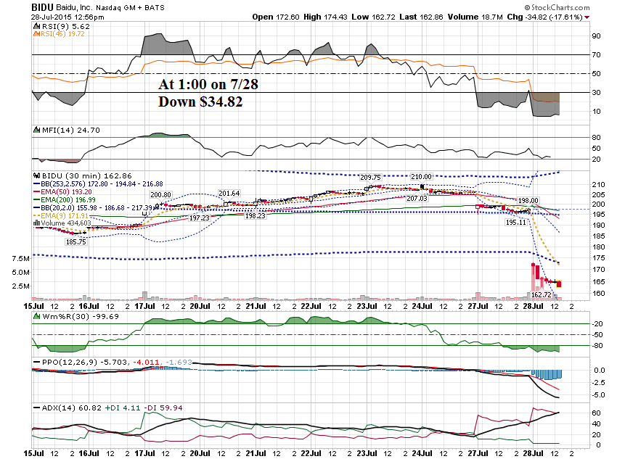

Slide 26
BIDU ATM Straddle
$197.50 Call - $9.60
$197.50 Put - $9.50
$19.10
After Earnings;
$197.50 Call - $.02
$197.50 Put - $33.00
Profit = $13.90 or 73% overnight

Slide 27
BIDU moved almost 75% more than what the market makers projected, so the straddle made money.
But if BIDU moved only what the market makers projected, this deal would have lost money!

Slide 28
Here is what I like to do.
Take the projected move and add a 50% cushion.
So, 1.50% of $19 = $28.50

Slide 29
Then I price out a spread above and below the closing price and add the 50% cushion.

Slide 30
$197.50 + 28.50 = $226
$197.50 – 28.50 = $169
Then price out spreads using the 150 cushion.

Slide 31
Call Spread:
Sell the $225 Call @ $1.80
Buy the $230 Call @ $.92
Net credit of .88 per contract or 17.6 % max value

Slide 32
Put Spread:
Sell the $170 Put @ $.82
Buy the $165 Put for $.50
Net Credit = $.32 or
6.4% max value.

Slide 33
The first question you have to ask yourself is this.
Would you have done the put side?
The call side paid 17.6% and the put side paid 6.4%!

Slide 34
There was one technical condition that had me biased to BIDU selling off.
Can you guess what that was?

Slide 35
The prior day BIDU
Gapped Down.

Slide 36
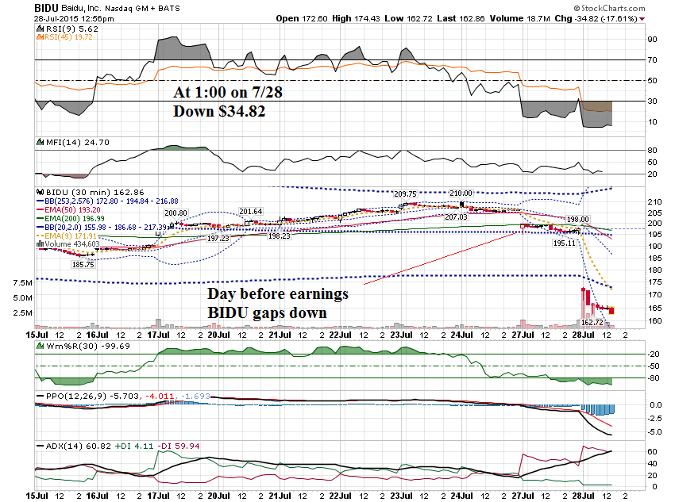

Slide 37
Let’s apply the same analysis to a company that reported last night … BWLD

Slide 38
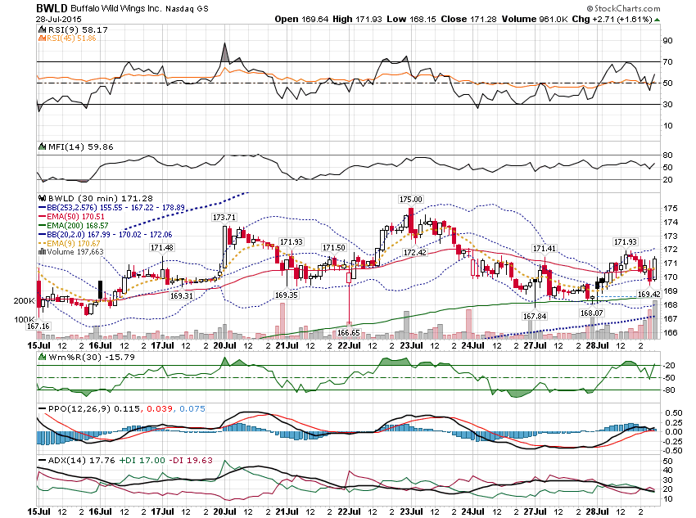

Slide 39
BWLD Closed on 7/28 @ $171.28
$170 Call @ $9.36
$170 Put @ $8.10
Total = $17.46
17.46/171.28 = 10.2% Projected

Slide 40
$17.50 x 1.50 = $26
$195 C @ $1.57
$200 C @ $ .99
Net Credit = $.58
11.6% Return
$145 P @ $1.08
$140 P @ $.60
Net Credit = $.48
9.6% Return

Slide 41
Let’s look at BWLD Today …

Slide 42
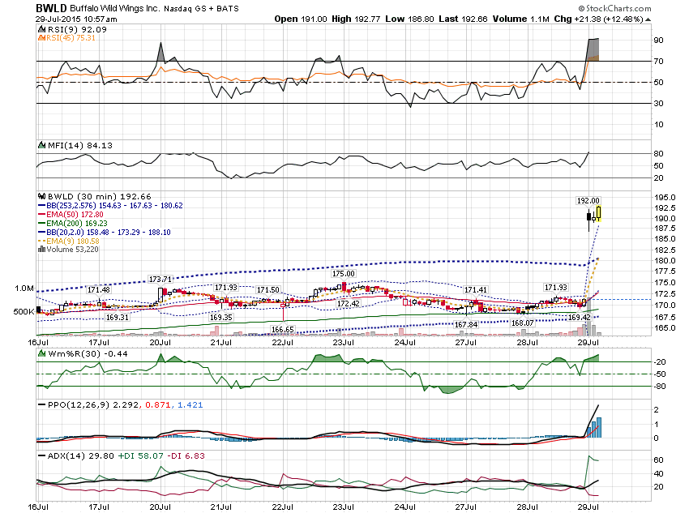

Slide 43
BWLD Project Move = $17.46
Move today = $21.38 or 12.48%
Exceeded Projection by $3.92

Slide 44
$170 Call @ $9.36 $21.10
$170 Put @ $8.10 .30
Total = $17.46 $21.40
Profit = $3.94 or 22.5%
With a move that exceeded the projection by 12.5%

Slide 45
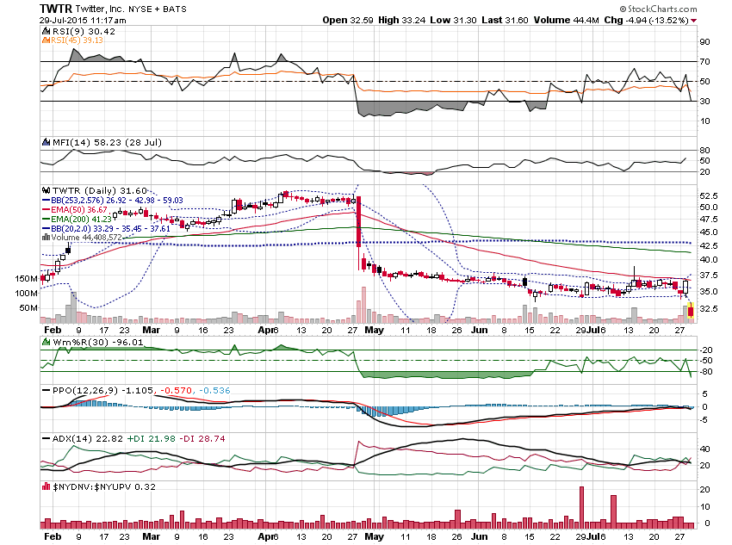

Slide 46
If you trade intra day, you want to look at companies that have made big gaps off earnings … especially on Fridays when the leverage is the greatest!

Slide 47
Stocks that make a big gap moves off earnings are great candidates for shorter term trading!
The more strikes it cross the better!

Slide 48
Let’s use AMZN as an example.
AMZN reported on Thursday
July 23rd after the close and gapped up almost $100.

Slide 49
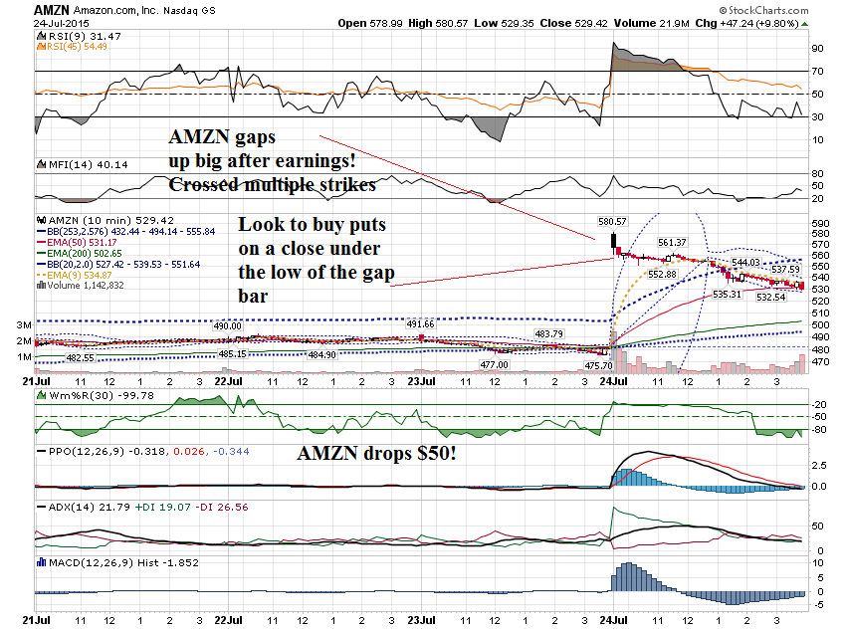

Slide 50
To help time your entry, you can scope down to a shorter timeframe.

Slide 51
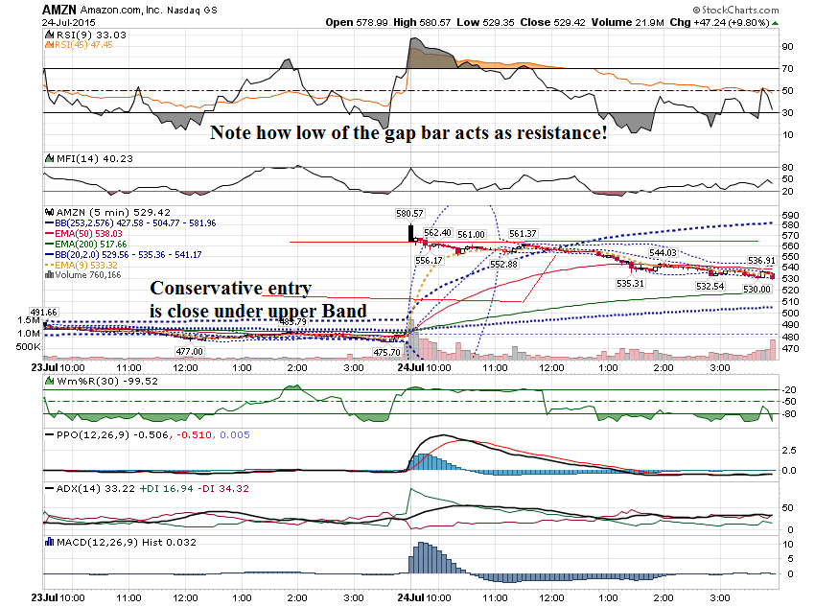

Slide 52
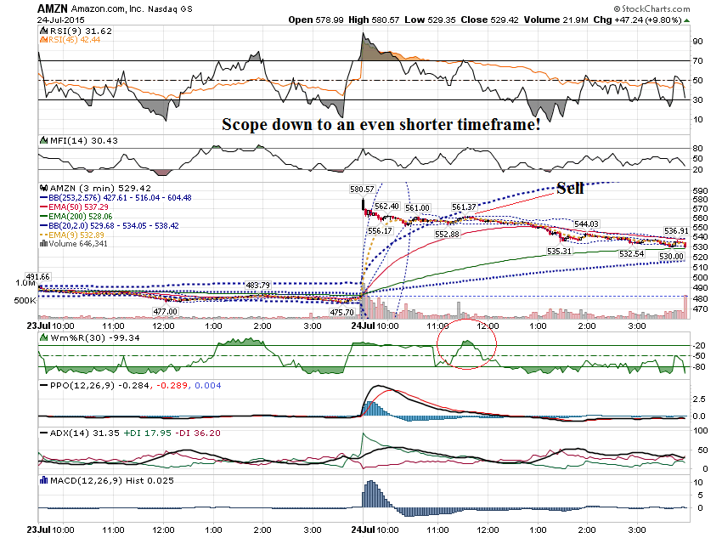

Slide 53
You can always trade using a straddle or strangle!

Slide 54
Thanks for watching!
Bill Davis
Mad Day Trader
July 29, 2015 davismdt@gmail.com

