Slide 1

Mad Day Trader
Bill Davis
Webinar – July 8, 2015

Slide 2
I want to discuss the selling climax and then
I want to continue the discuss of how to integrate the levels with the market.

Slide 3
I define a Selling Climax or capitulation day, when the down to up Volume on the NYSE is great than
9 to 1.

Slide 4
By measuring the selling volume versus the buying volume, we can determine if shares are moving form weak hand to strong hands.

Slide 5
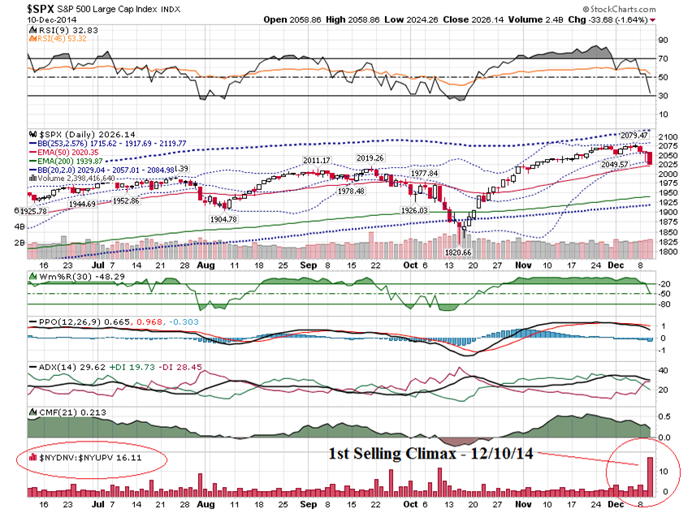

Slide 6
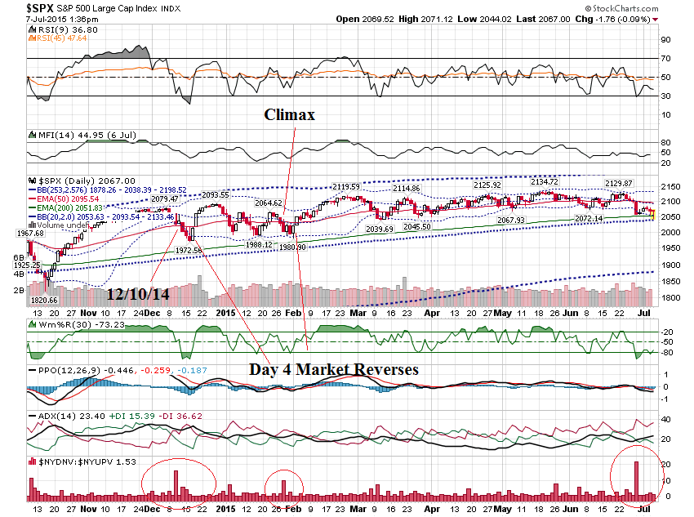

Slide 7
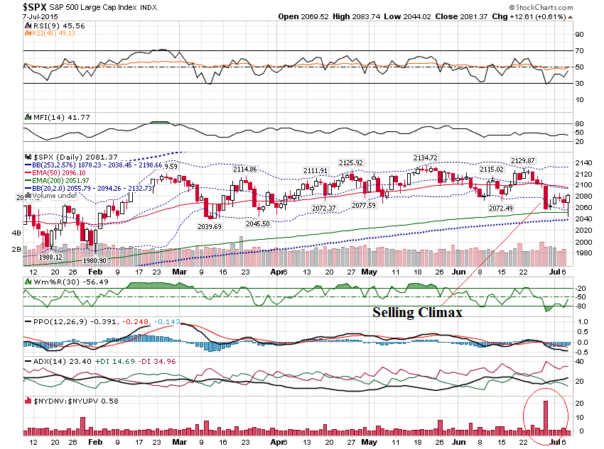

Slide 8
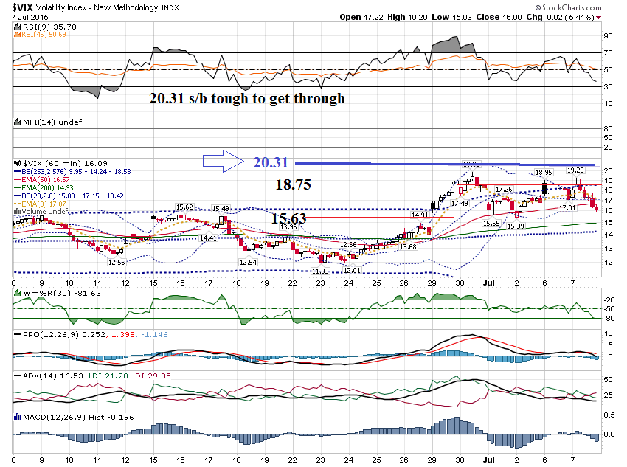

Slide 9
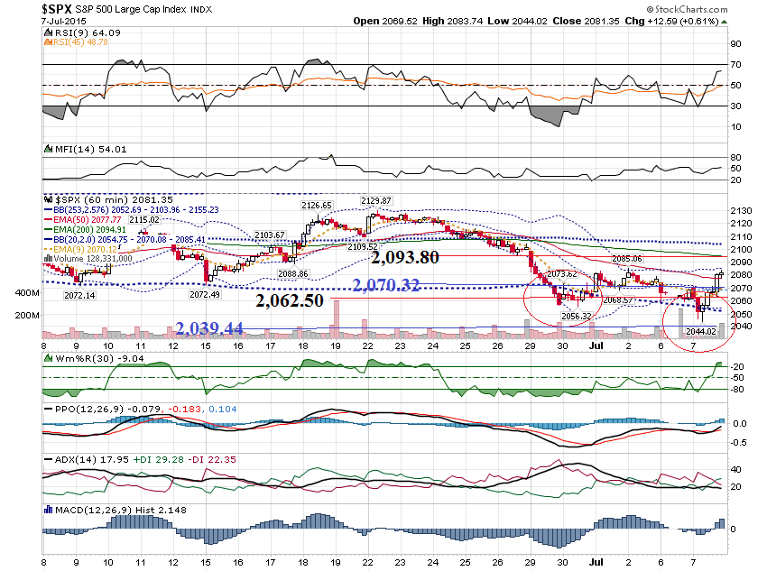

Slide 10
Friday Trade Set Up

Slide 11
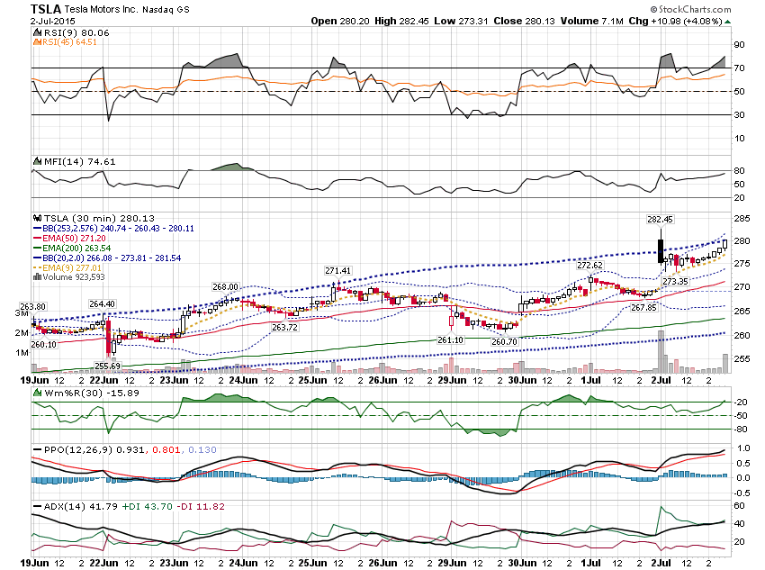

Slide 12
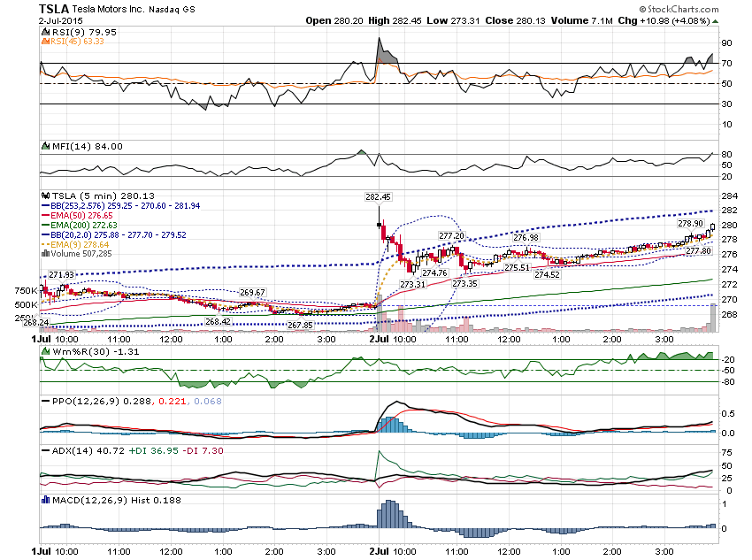

Slide 13
Notice how TSLA gapped up on a day before a
Holiday that was rather lackluster.
Let me show you how you could enter for a late day trade.

Slide 14
Scale down to a shorter timeframe, like a
2 or 3 minute chart and look to buy when it gets oversold.

Slide 15
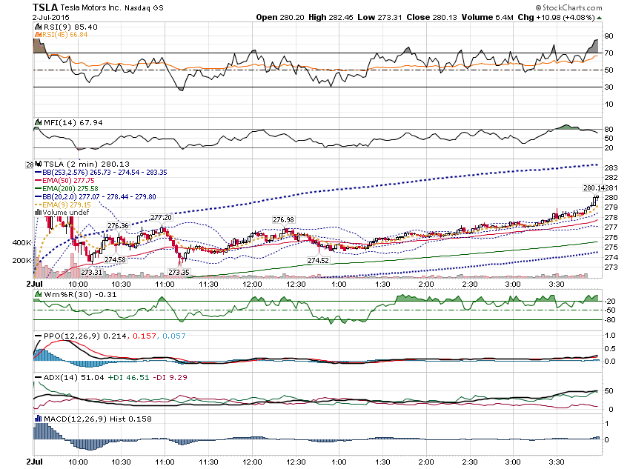

Slide 16
Here is the result of entering off the 2 minute chart.

Slide 17
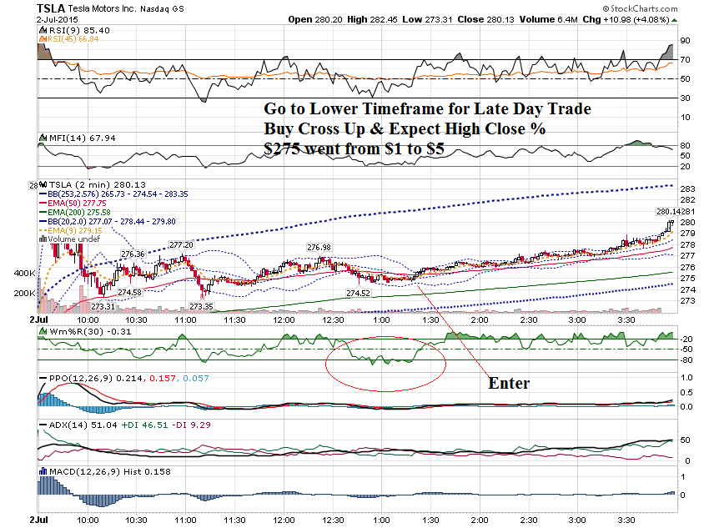

Slide 18
You can apply this same strategy to the trending stocks I share in the daily updates.

Slide 19
Here are 4 examples from the daily update list. 2 bullish and 2 bearish.

Slide 20
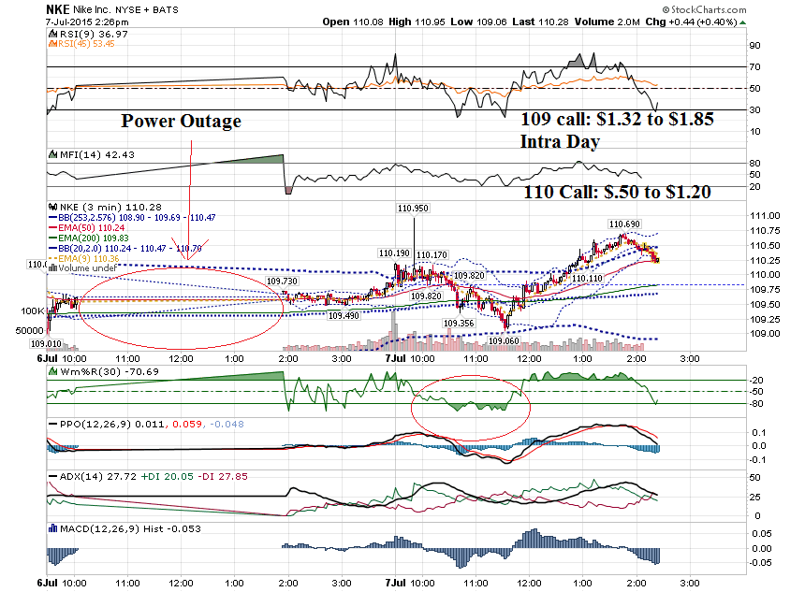

Slide 21
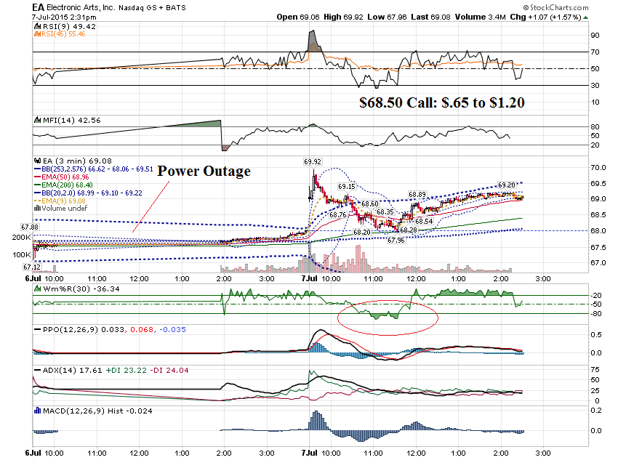

Slide 22
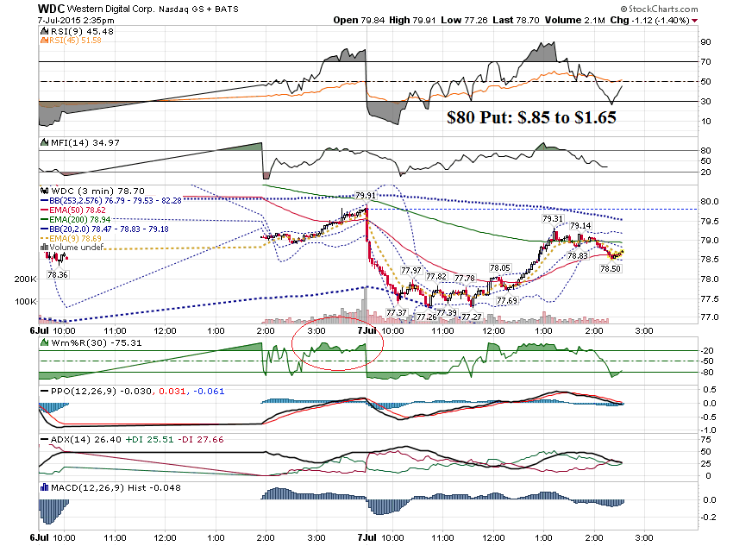

Slide 23
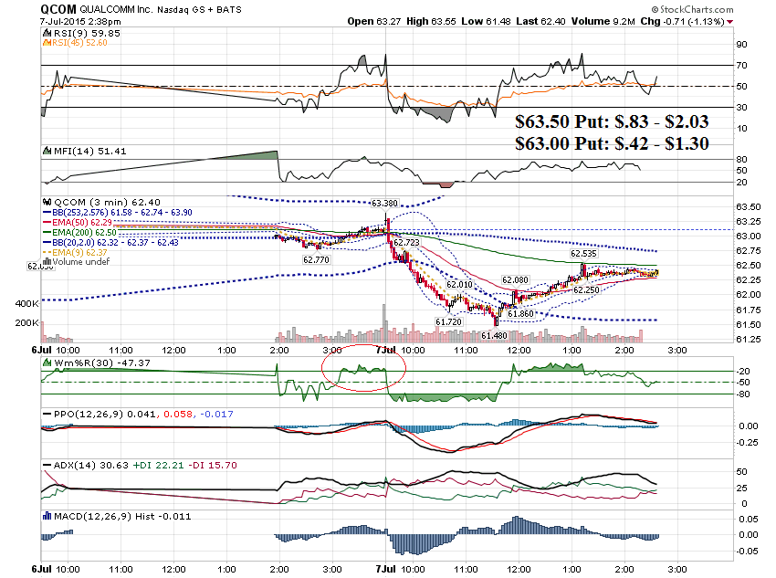

Slide 24
Shorter Term
Swings using the VIX

Slide 25
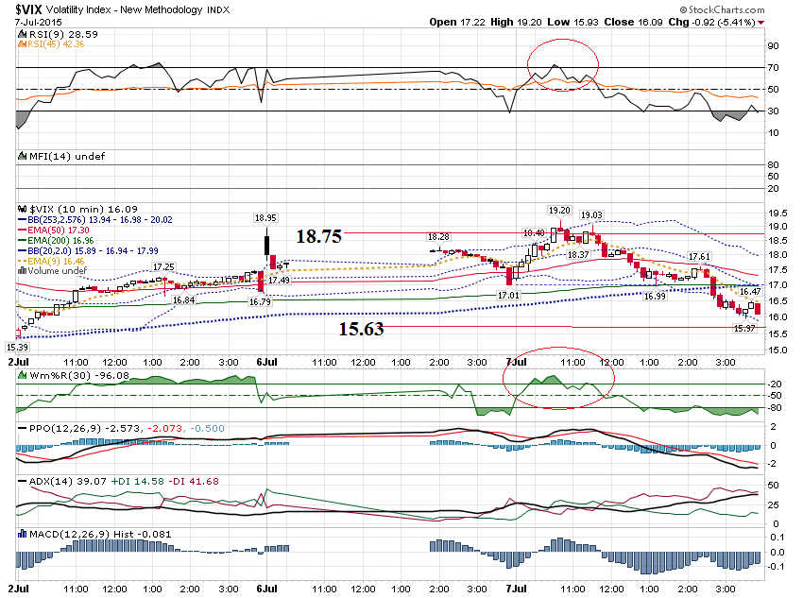

Slide 26
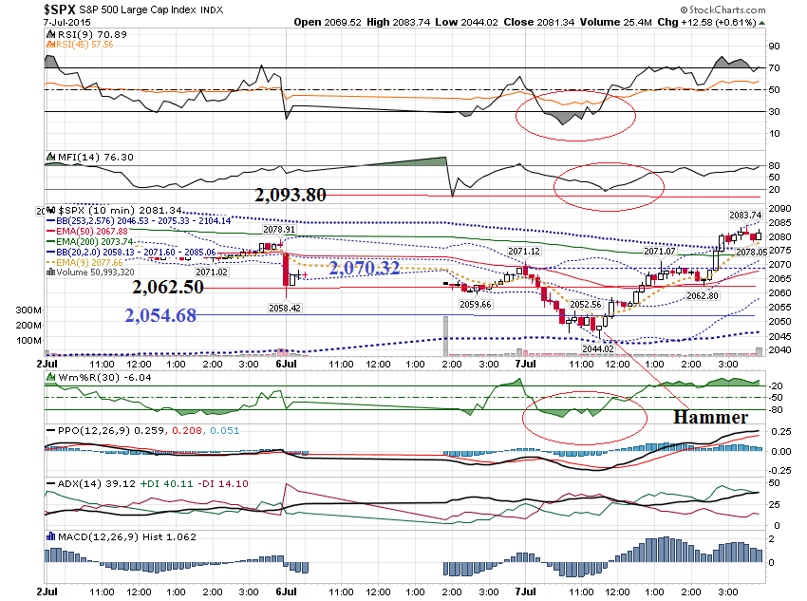

Slide 27
Thanks for watching!
Bill Davis
Mad Day Trader
July 8, 2015 davismdt@gmail.com

