Slide 1
Mad Day Trader
Bill Davis
Webinar – August 19, 2015

Slide 2
I want to continue the discussion of integrating the price levels from the daily updates and how to relate them to the market.

Slide 3
I will demonstrate using recent price action on the VIX & the S & P 500.

Slide 4
The VIX will apply to all major markets, including the Dow, NASD and the S & P 500.

Slide 5
For trading purposes, using the DIA, the QQQ or the SPY will work. I generally prefer the SPY, but the QQQ maybe better suited to you.

Slide 6
As way of demonstration, On Tuesday around midday, here is a comparison of the at the money options for all three major markets: DIA $175.74 - $175.50 Call-$.78 $176 Call- $$.46 QQQ $111.34 - $111 Call - $.73 $111.50 Call - $.44 SPY $210.42 - $210 Call - $1.09 $210.50 Call - $.78

Slide 7
All three instruments have options in 50 cent increments.

Slide 8
Let’s compare the Average True Range (ATR) for the three markets: SPY $1.97 DIA $1.71 QQQ $1.37

Slide 9
As you can see from the prior slide, the SPY has an ATR $.26 greater than the DIA and $.60 greater then the QQQ. This mean is has a greater chance to cross multiple strike prices in 1 day!

Slide 10
Let’s see how we can apply this using the VIX & SPX levels … I will show a 30 minute chart of the VIX and the S & P with their levels.

Slide 11
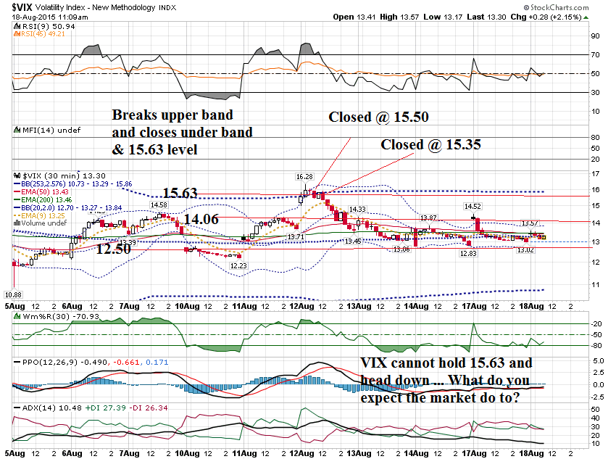

Slide 12
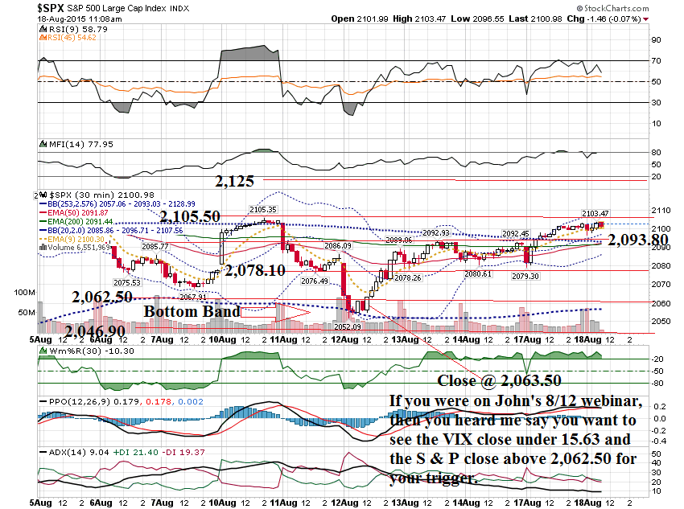

Slide 13
Another way to scalp trade using this is to scale down to a shorter timeframe, like a 10 minute or 5 minute chart and BUY the oversold conditions off that timeframe.

Slide 14
Here is a 10 minute chart during this timeframe …

Slide 15
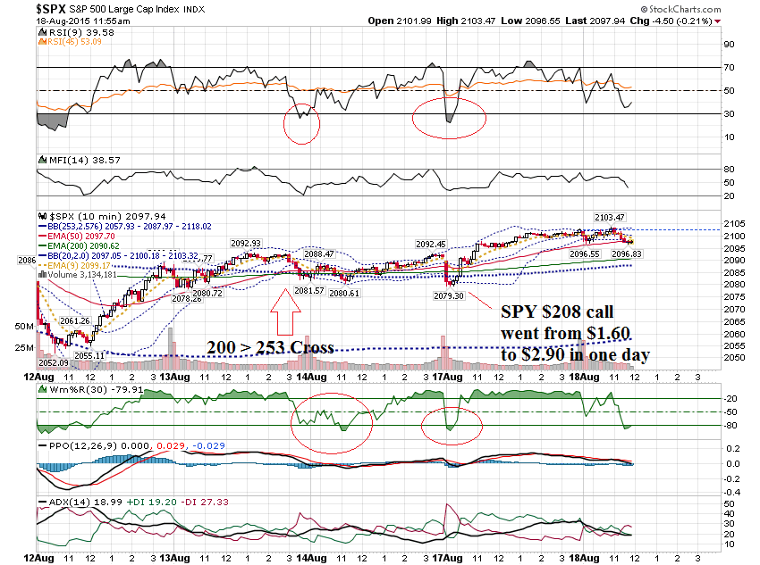

Slide 16
I will show how you can use the levels and scale down even further for intra day trading using yesterday as an example.

Slide 17
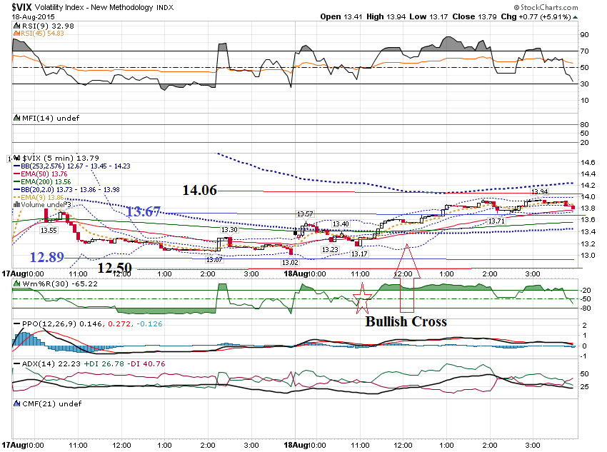

Slide 18
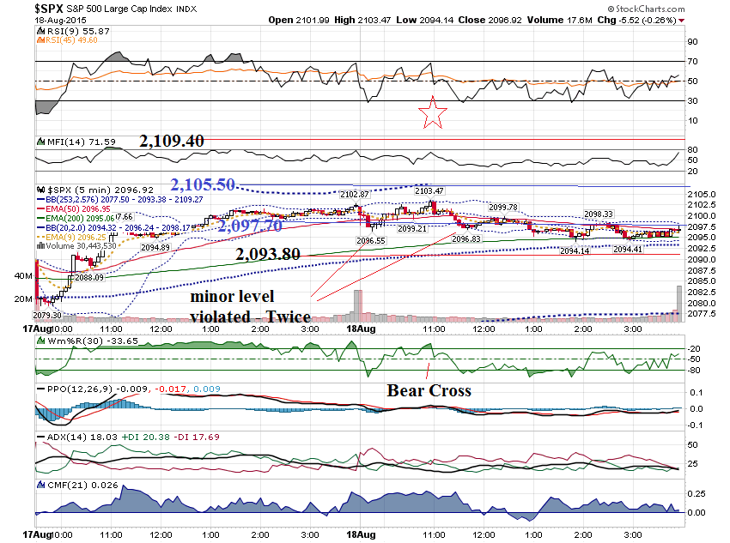

Slide 19
Today I would like to share one other pattern that can be highly effective. It uses the extreme bollinger bands.

Slide 20
The extreme Bollinger Bands use a 253 day setting, with a 2.576 setting.

Slide 21
This setting replicates approximately one year’s worth of price data, and should include 99% of the data set.

Slide 22
There is a 1% chance that price should exceed the top or bottom band.

Slide 23
I interpret this to mean that it is a highly unusual event when the top or bottom extreme band is violated.

Slide 24
One of the best patterns for short term trading, is when the 60 minute chart is in an uptrend and the price gets under the lower band on the 10 minute chart.

Slide 25
Let me show you a few examples …

Slide 26
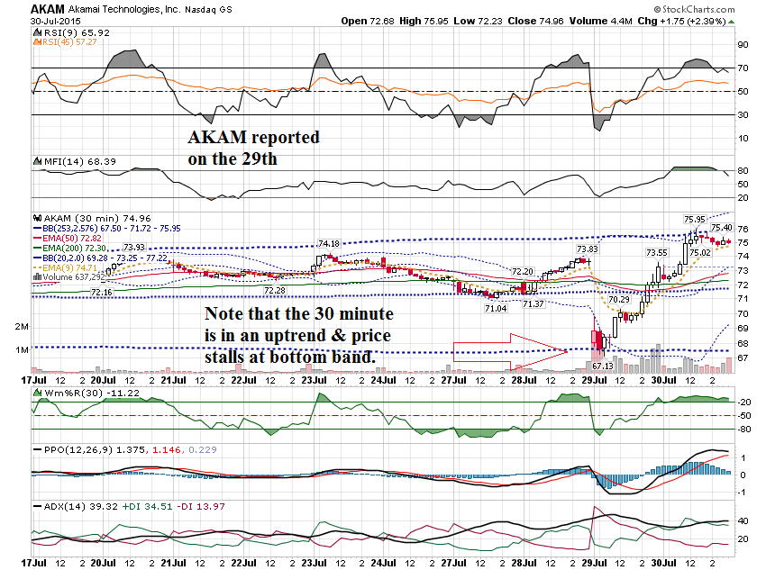

Slide 27
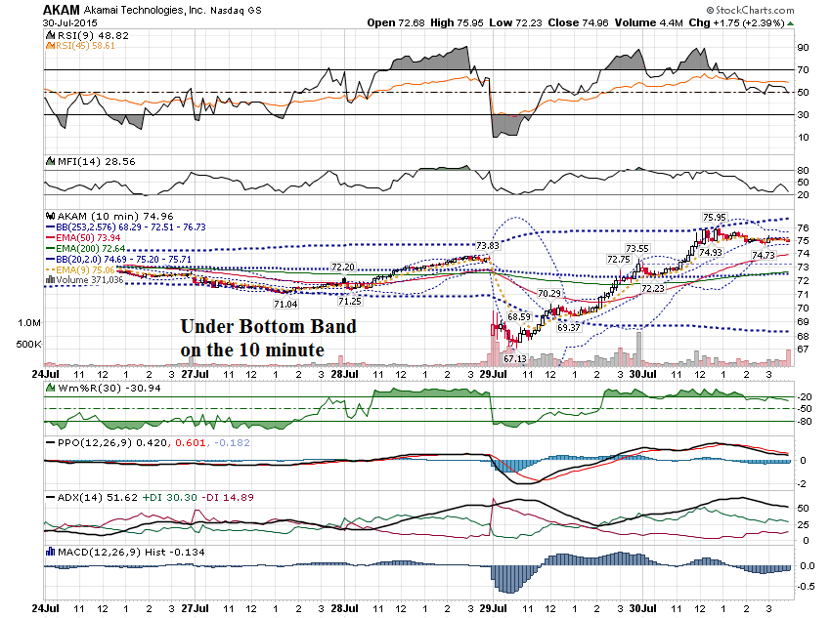

Slide 28
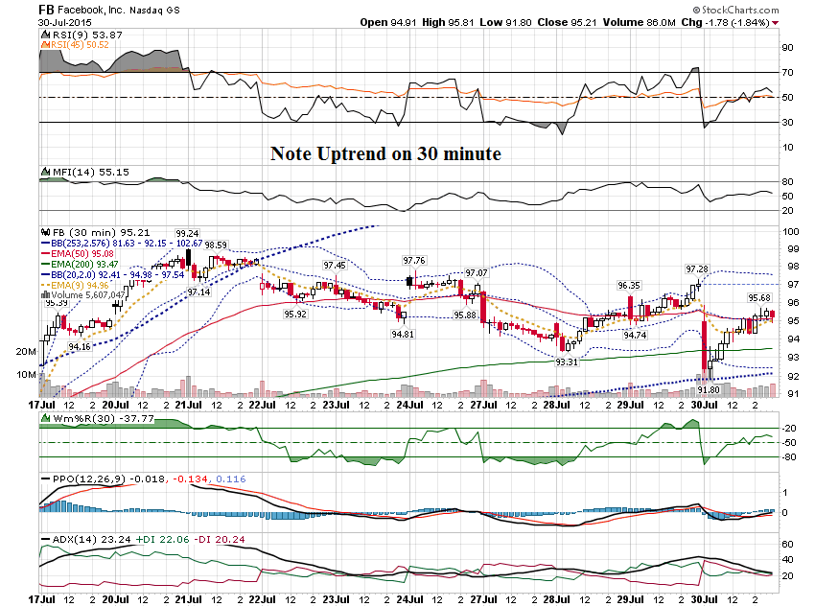

Slide 29
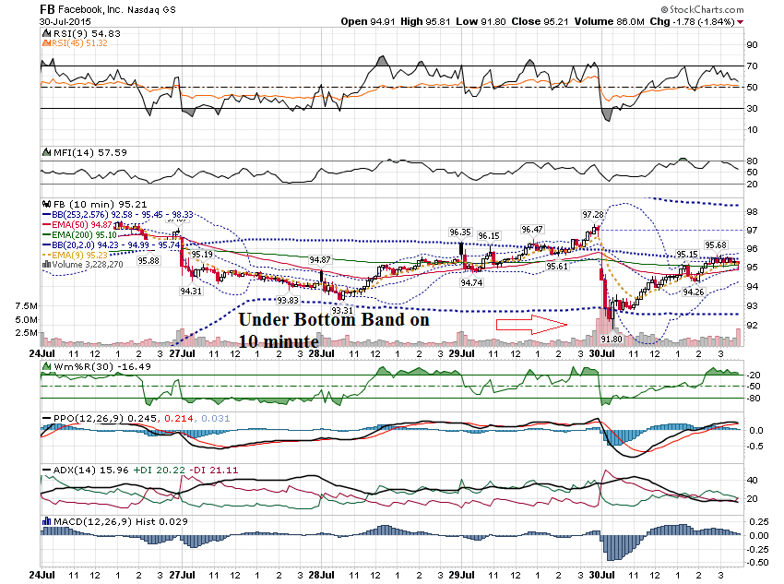

Slide 30
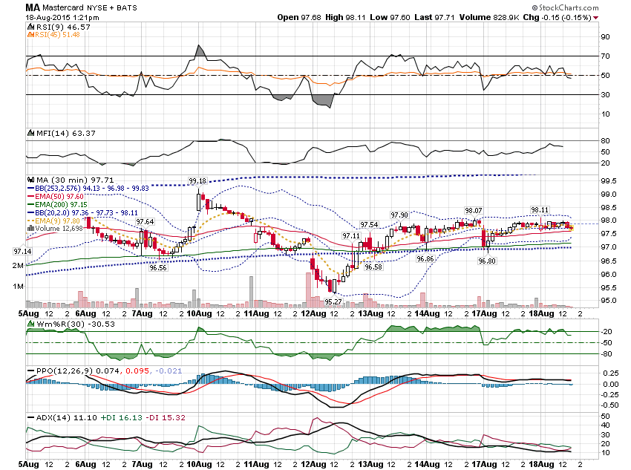

Slide 31
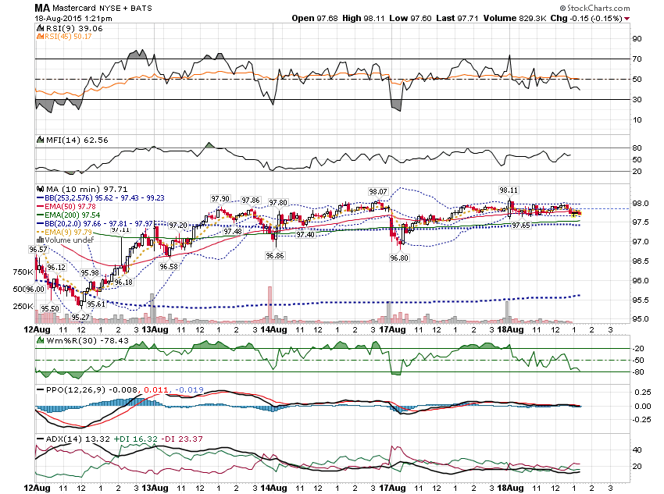

Slide 32
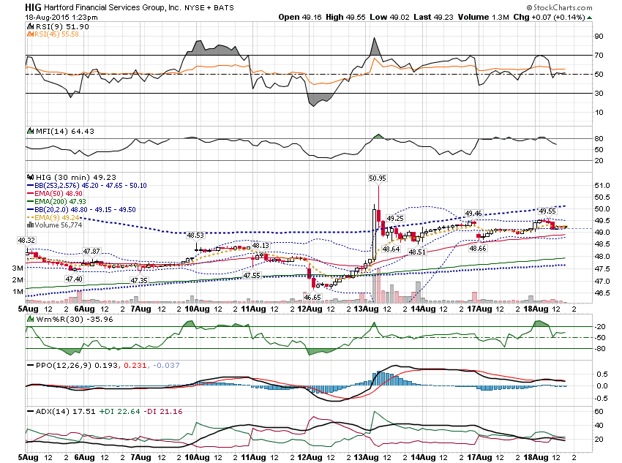

Slide 33
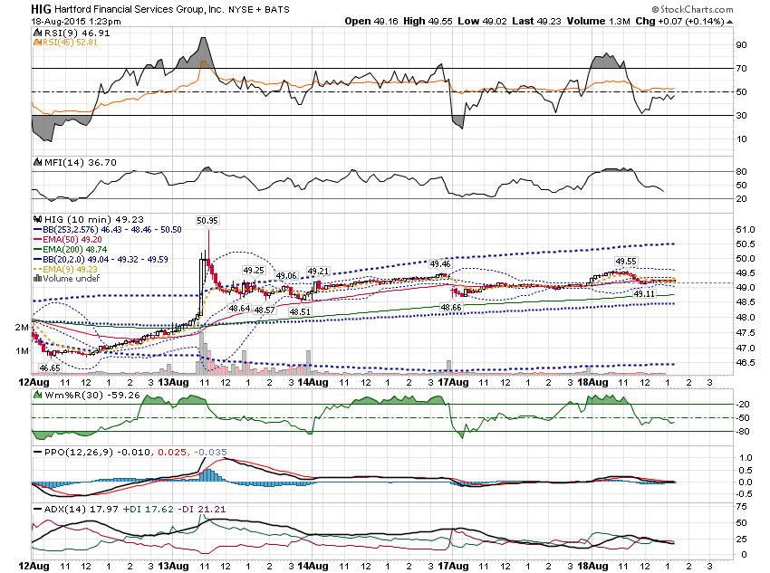

Slide 34
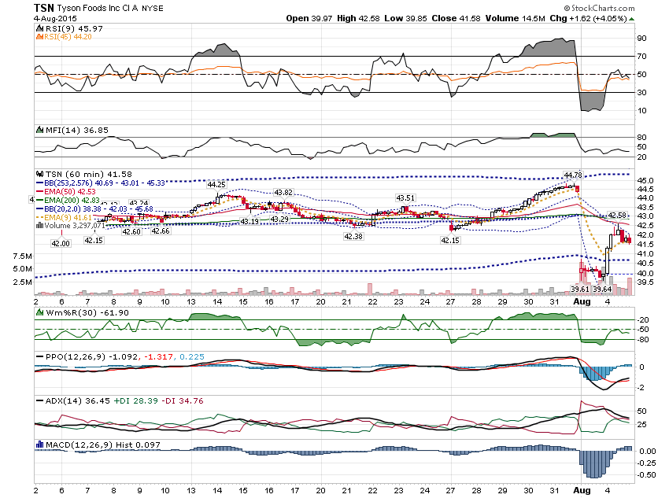

Slide 35
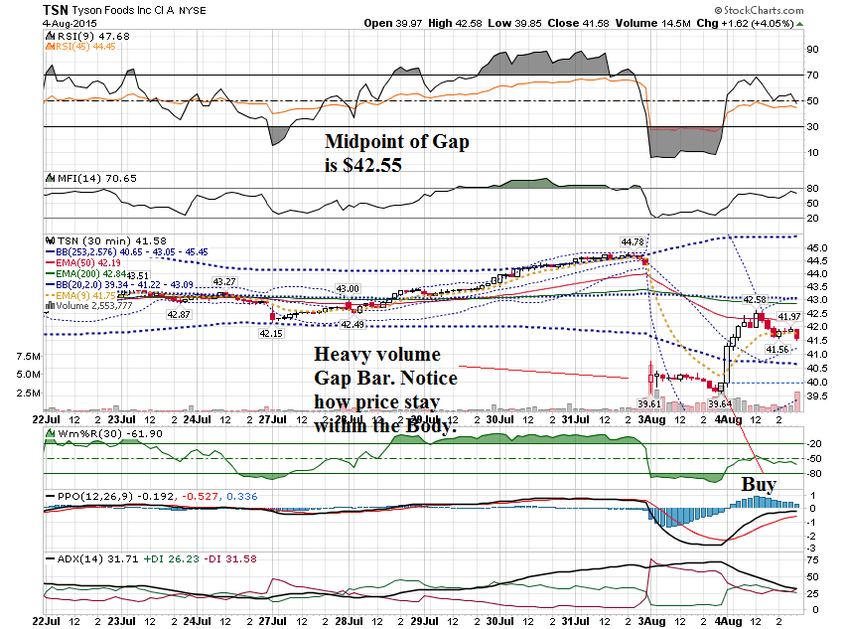

Slide 36
Thanks for watching! Bill Davis Mad Day Trader August 19, 2015 davismdt@gmail.com

