Slide 1
Mad Day Trader
Bill Davis
Webinar – September 16, 2015

Slide 2
Trading at the Extremes Using the Extreme Bollinger Bands to your advantage!

Slide 3
This is not a black box System! Using the bollinger bands with the suggested settings is simply a tool. However, it is a tool that I feel gives you an instant understanding of whether a stock is overbought or oversold.

Slide 4
Then it sets up expectations based on what price has been able to achieve.

Slide 5
The settings I suggest are this: 253 Days with a 2.576 standard deviation Just plug those settings into your charting package.

Slide 6
The 253 day setting represents about a year of trading on a daily chart. The 2.576 setting should encompass 99.9% of all the price action.

Slide 7
By definition, if price can get above or below the upper or lower band, it is an unusual event.

Slide 8
In general, you should be looking to cover a long position above the upper bands. Initiating a long position ABOVE the top band should generally be avoided.

Slide 9
In general, you should be thinking of covering a short position when price breaks under the lower Band. Initiating a short position BELOW the bottom band should generally be avoided.

Slide 10
There are 3 patterns I look at: 1) Price gets above the top band 2) Price hovers at the midband 3) Price gets under the lower band

Slide 11
Price gets above the Upper Band. I consider a stock or market that gets above the upper band as an unusual event. And my expectation is that price will make a run back to the Upper Band … at some point.

Slide 12
I will show examples on various timeframes of the pattern.

Slide 13
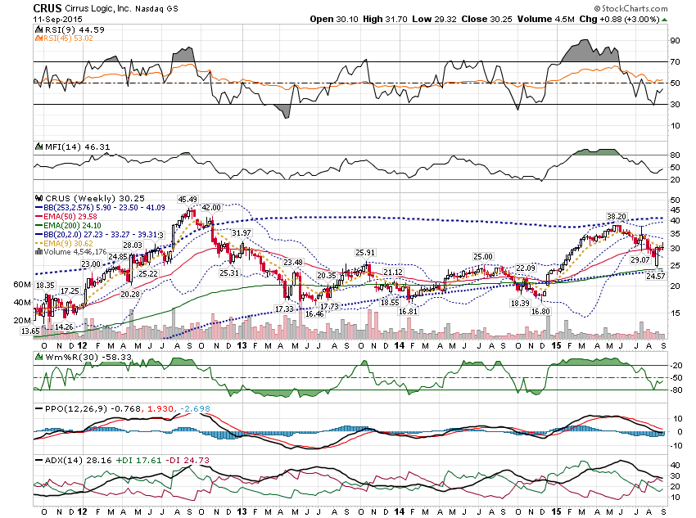

Slide 14
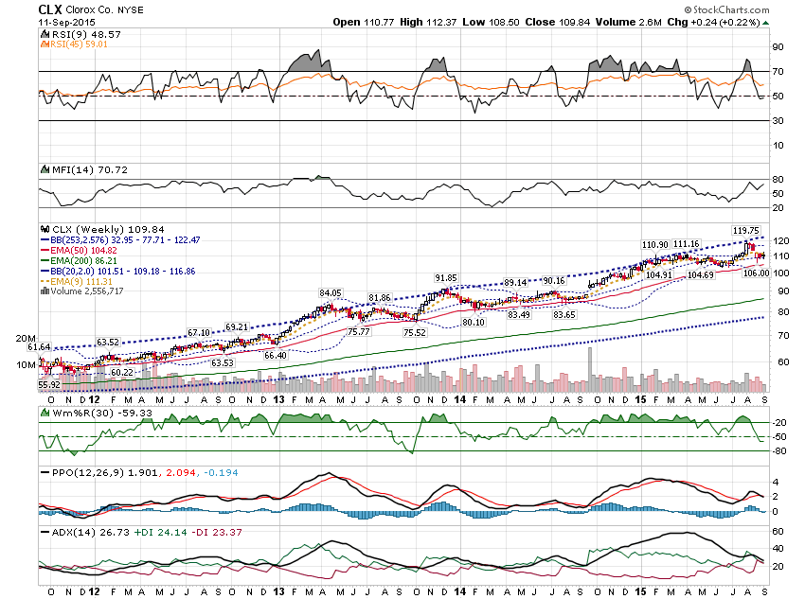

Slide 15
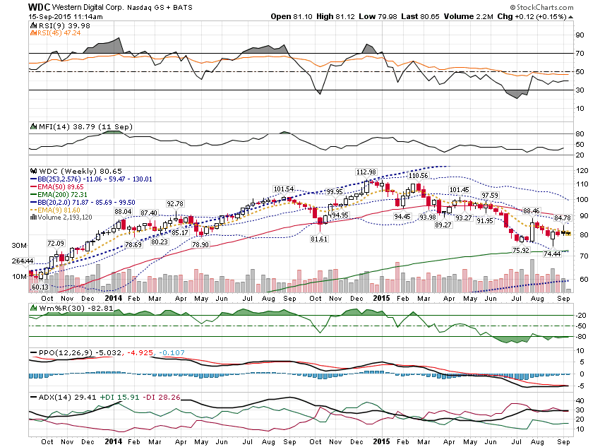

Slide 16
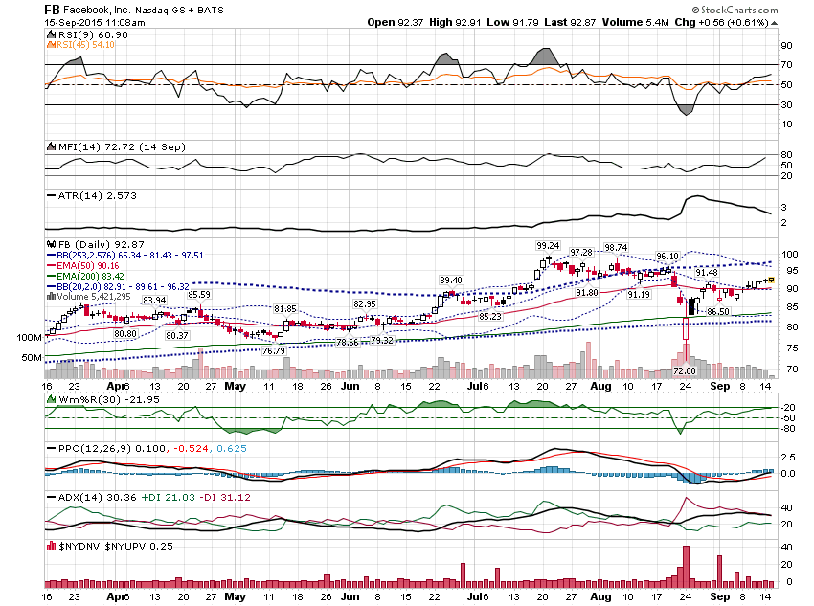

Slide 17
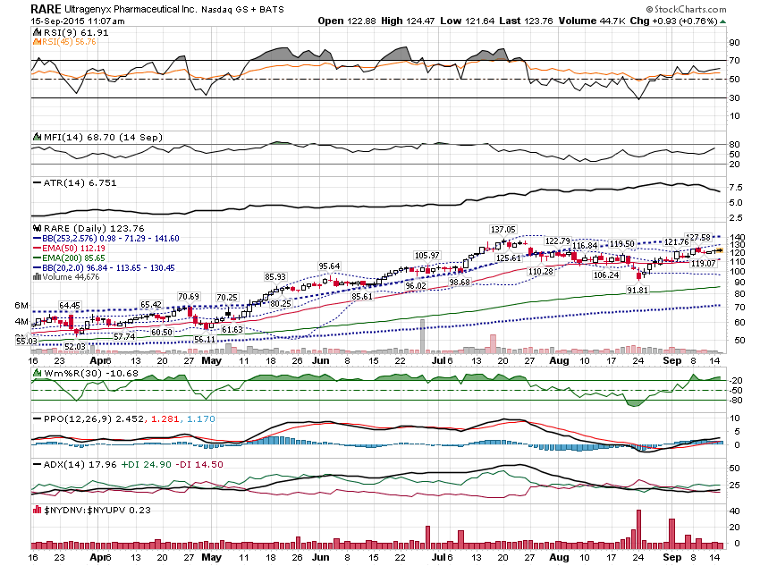

Slide 18
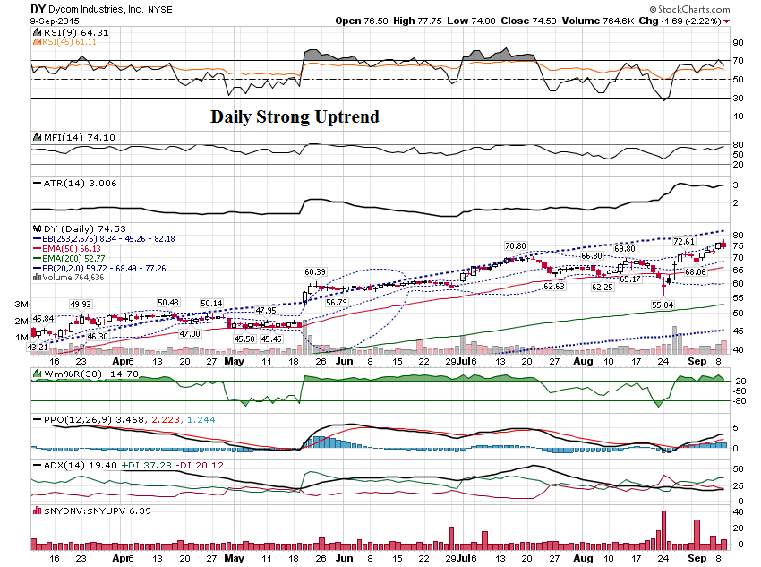

Slide 19
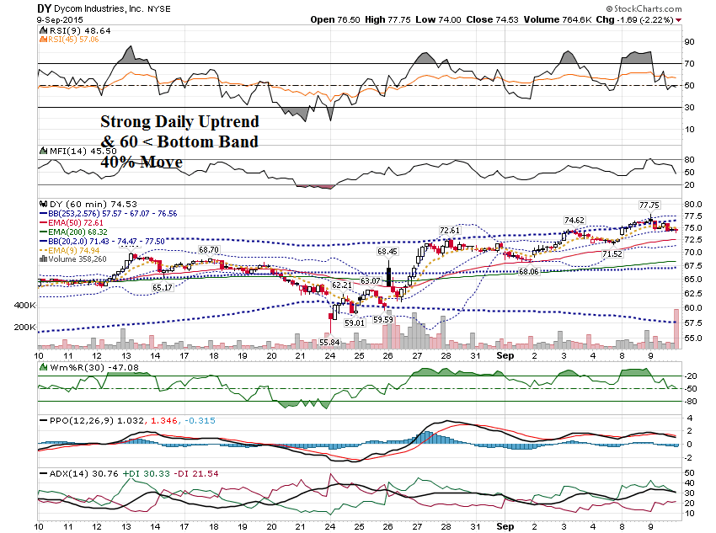

Slide 20
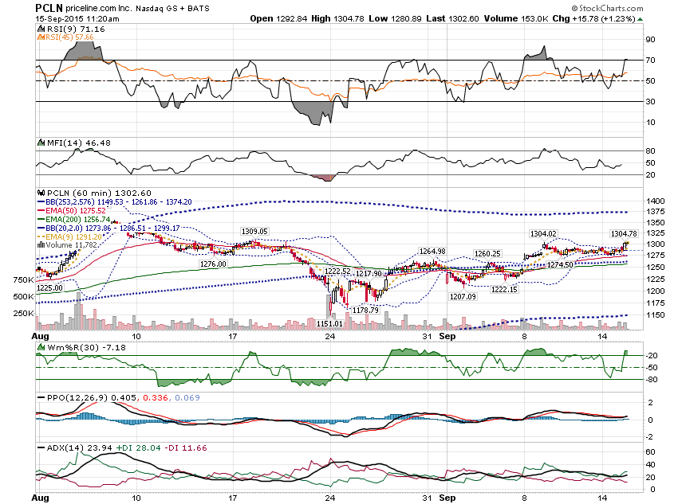

Slide 21
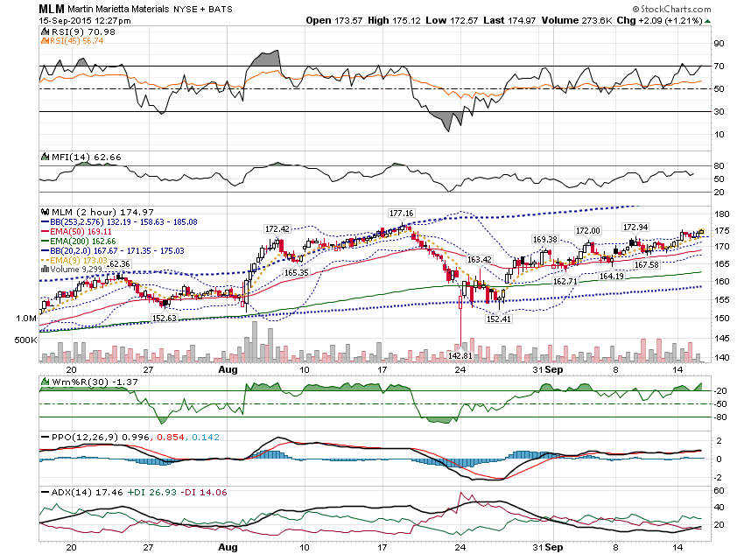

Slide 22
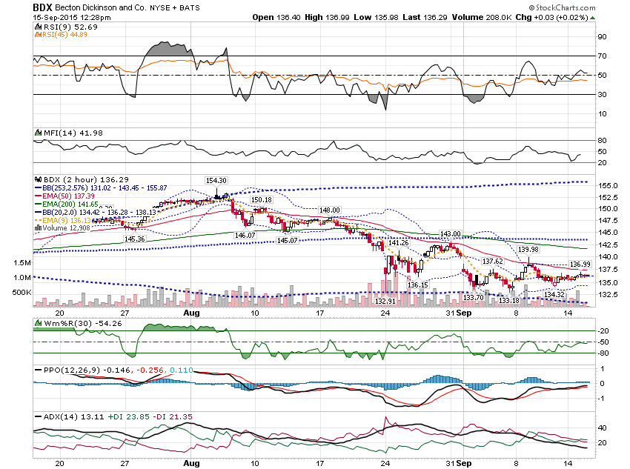

Slide 23
Oftentimes, you will see price hover around the mid band deciding which way to move.

Slide 24
This can result in a decent size move once the stock breaks out or breaks down. The Mid Band will act as support or resistance.

Slide 25
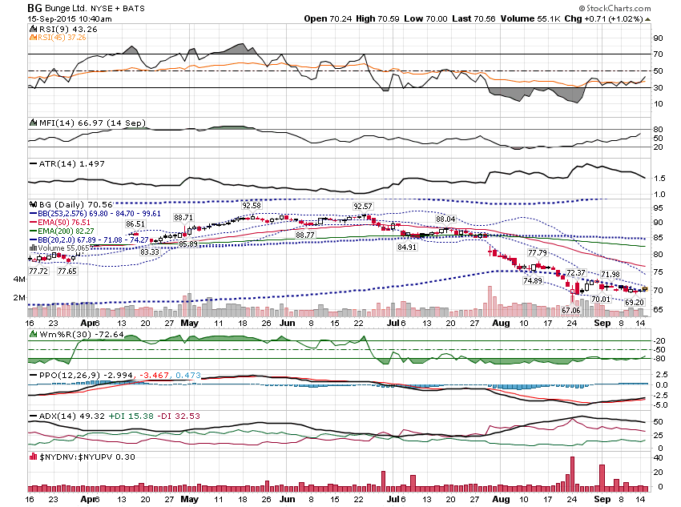

Slide 26
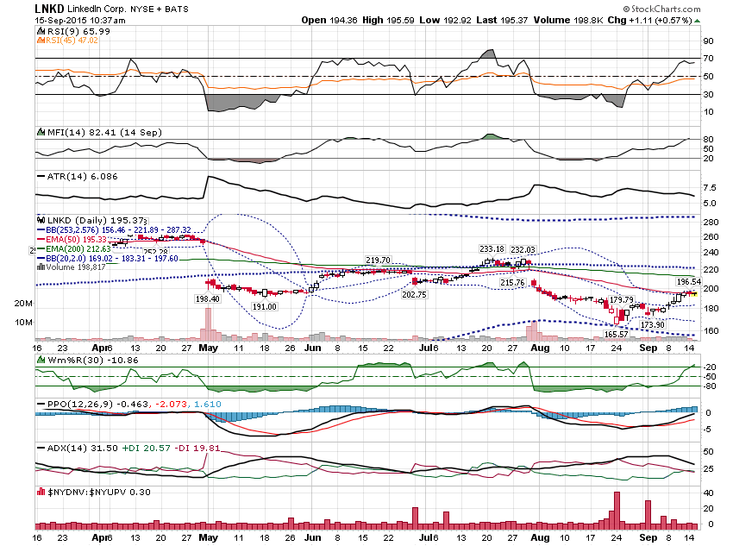

Slide 27
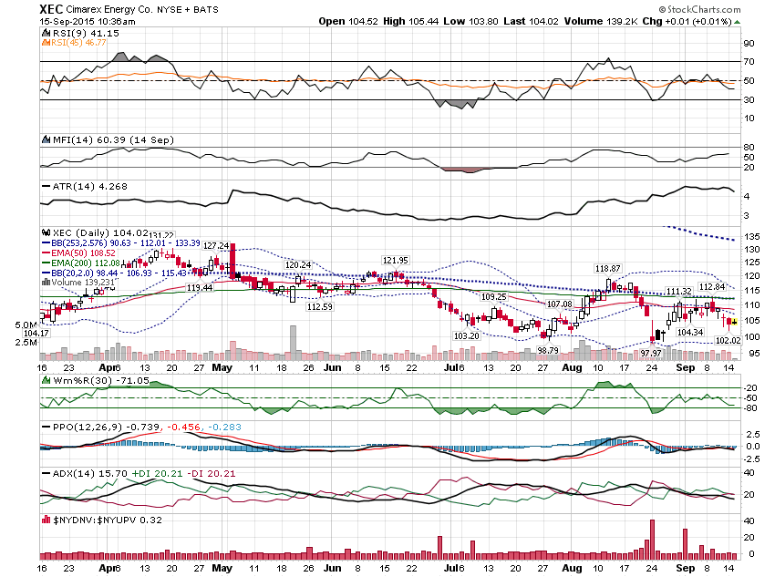

Slide 28
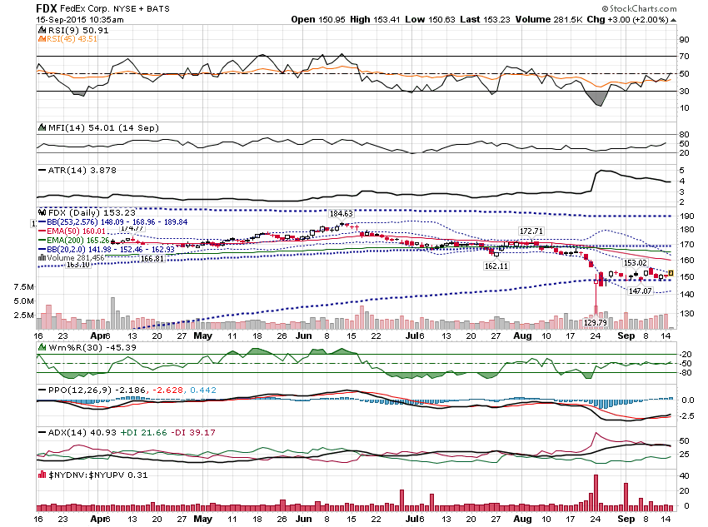

Slide 29
When price gets under the Lower Extreme Bollinger Band on a lower timeframe, and the higher timeframe is in an uptrend, you generally want to buy.

Slide 30
If price can get above the Upper Extreme Bollinger Band, you generally want to buy the pullback.

Slide 31
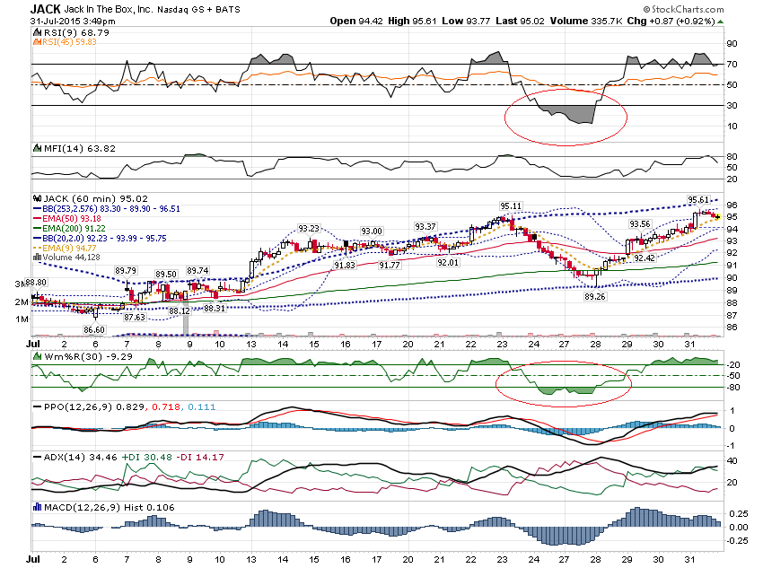

Slide 32
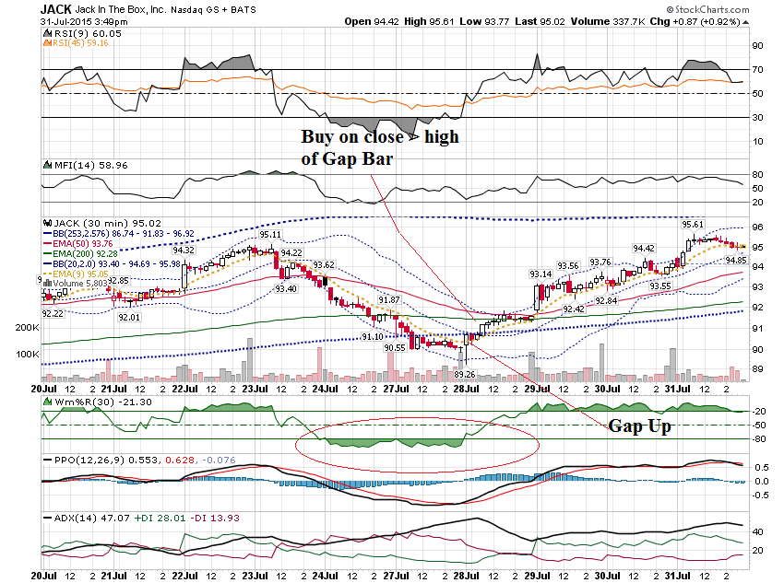

Slide 33
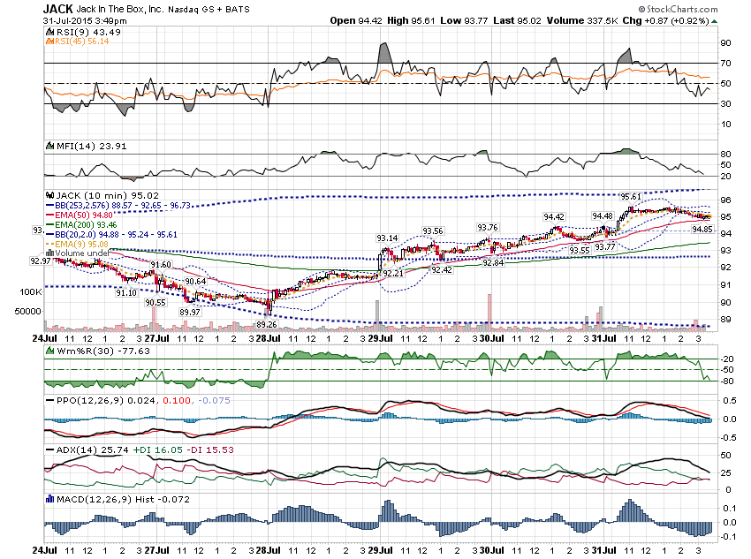

Slide 34
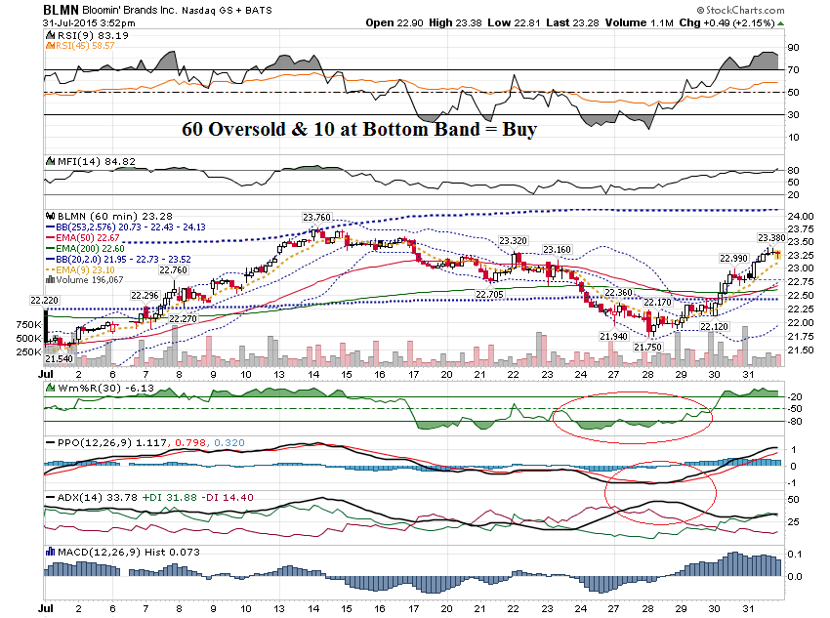

Slide 35
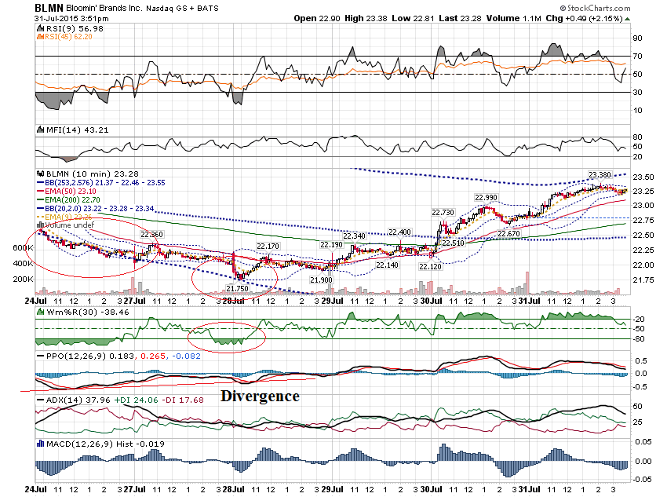

Slide 36
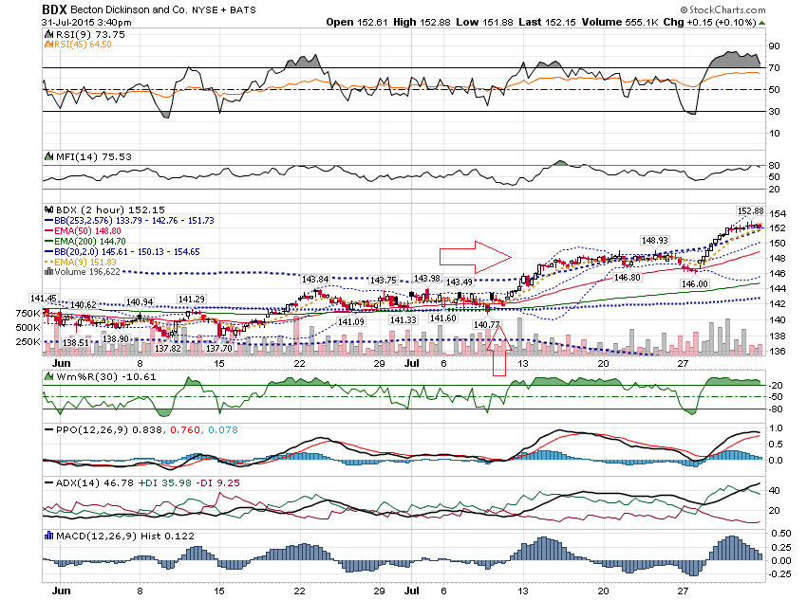

Slide 37
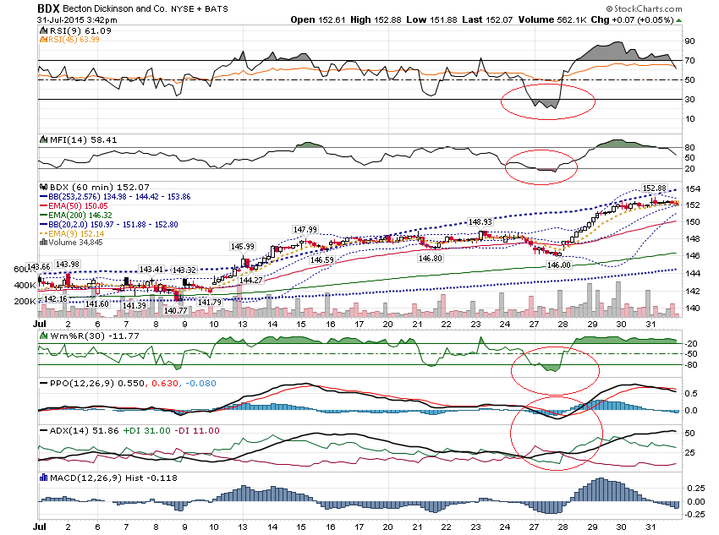

Slide 38
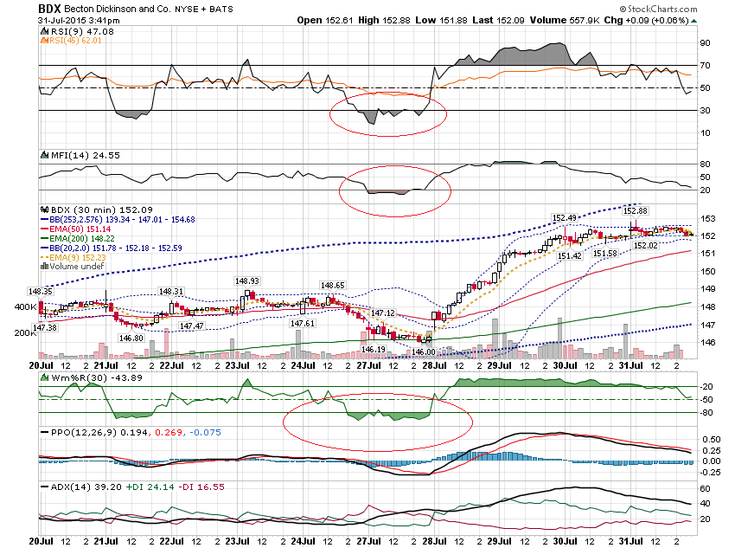

Slide 39
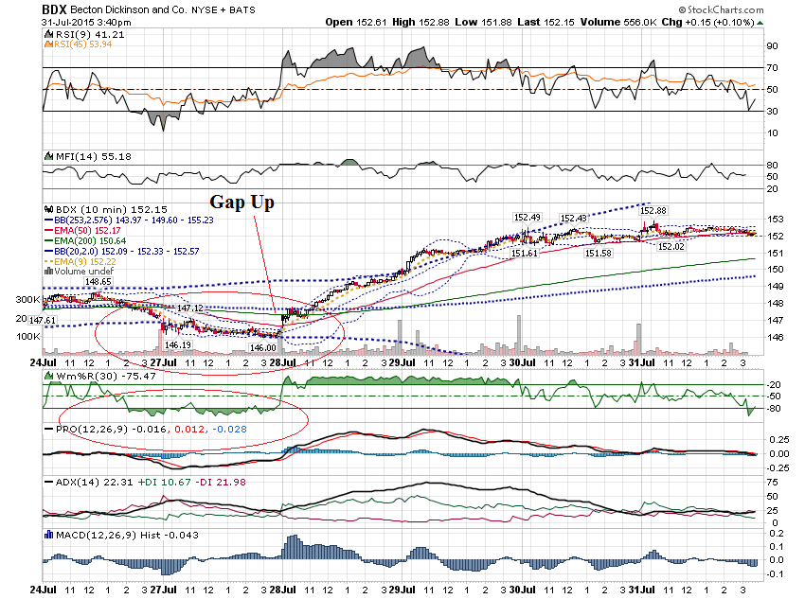

Slide 40
Generally, you want to sell when price gets above the Upper Band on the Lower Timeframe, when the higher timeframe is in a downtrend.

Slide 41
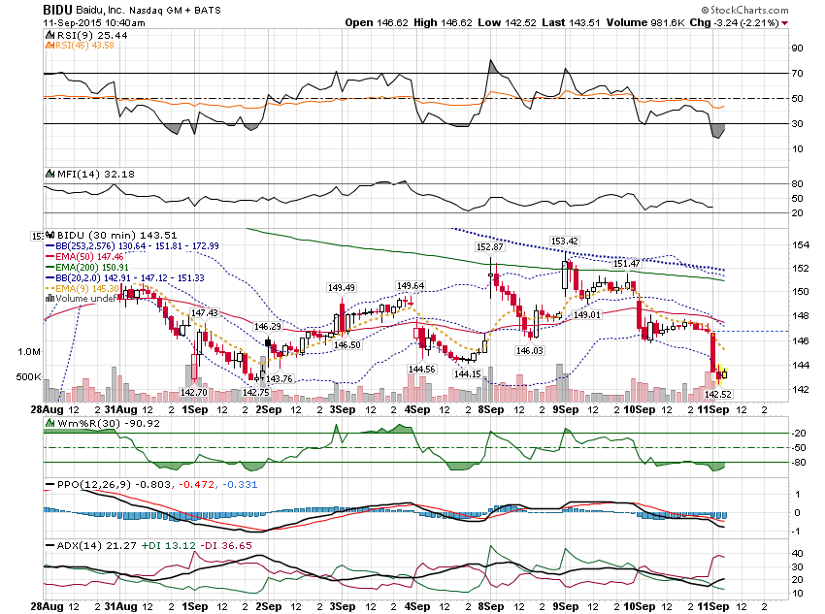

Slide 42
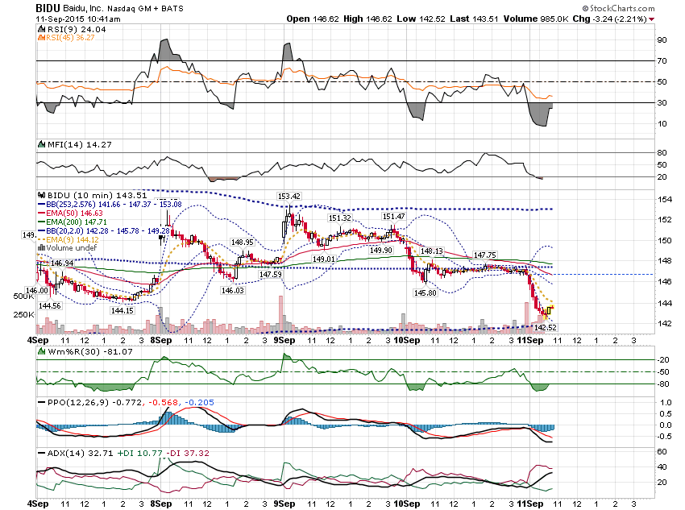

Slide 43
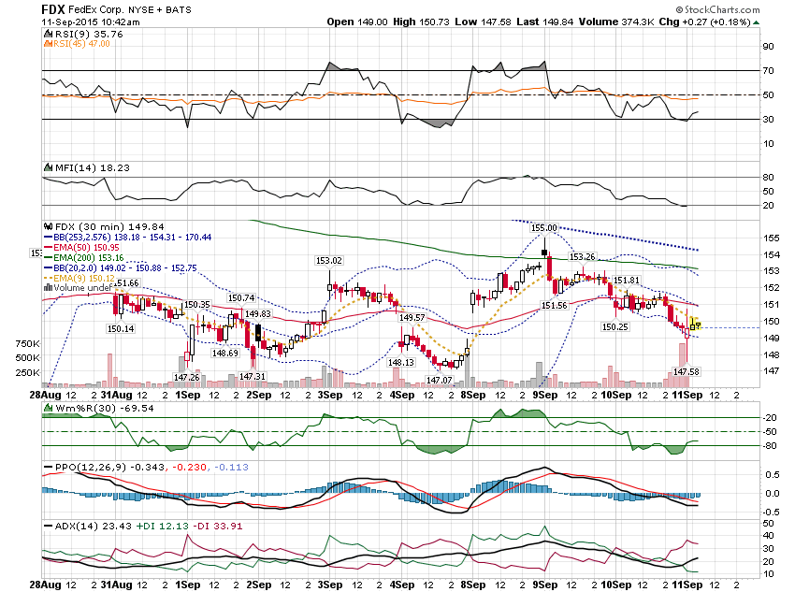

Slide 44
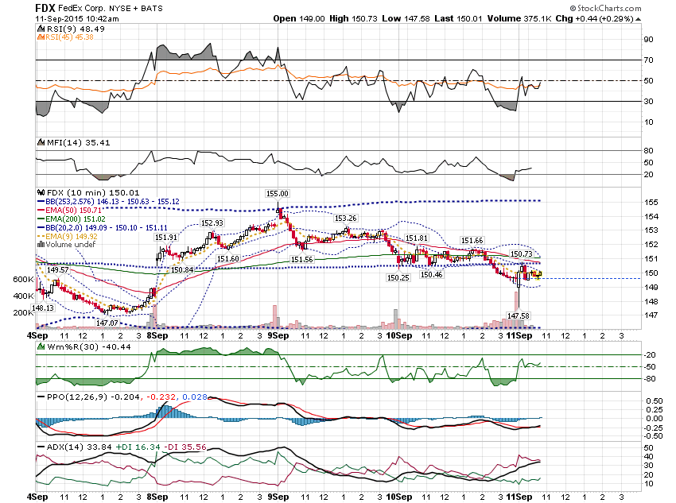

Slide 45
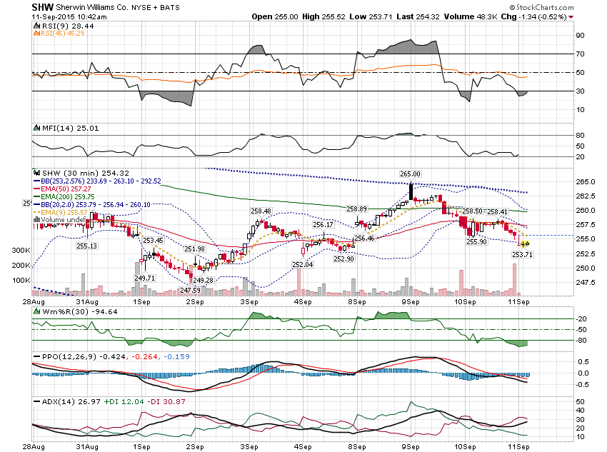

Slide 46
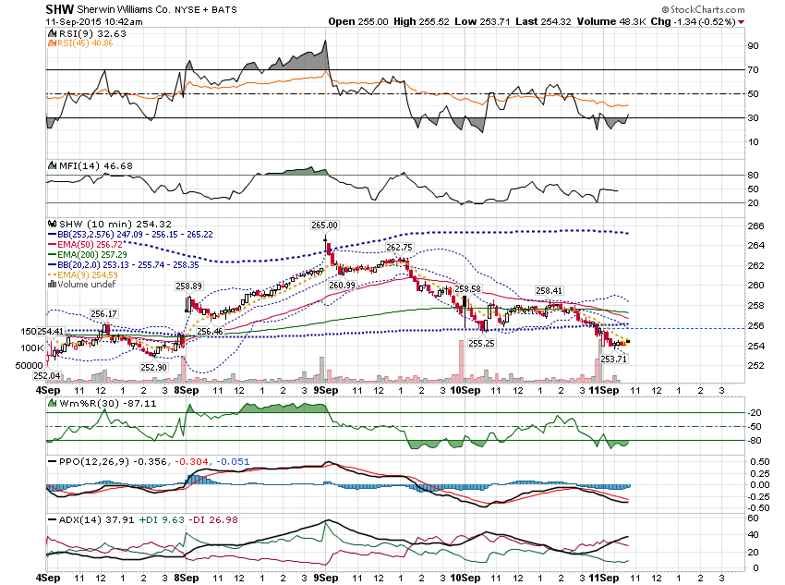

Slide 47
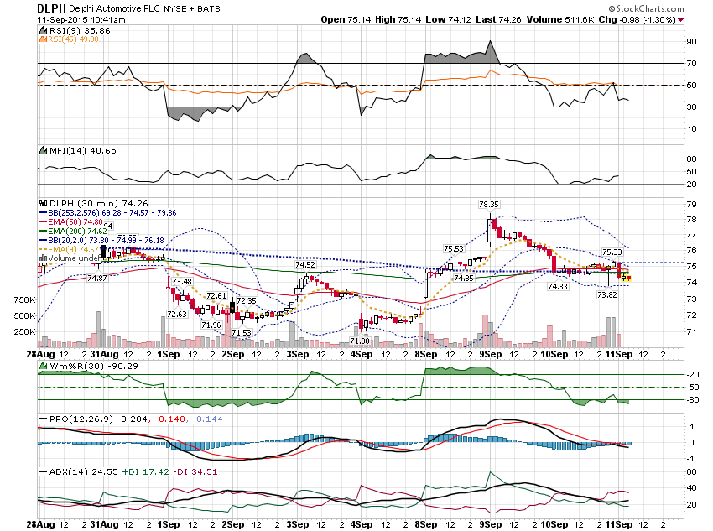

Slide 48
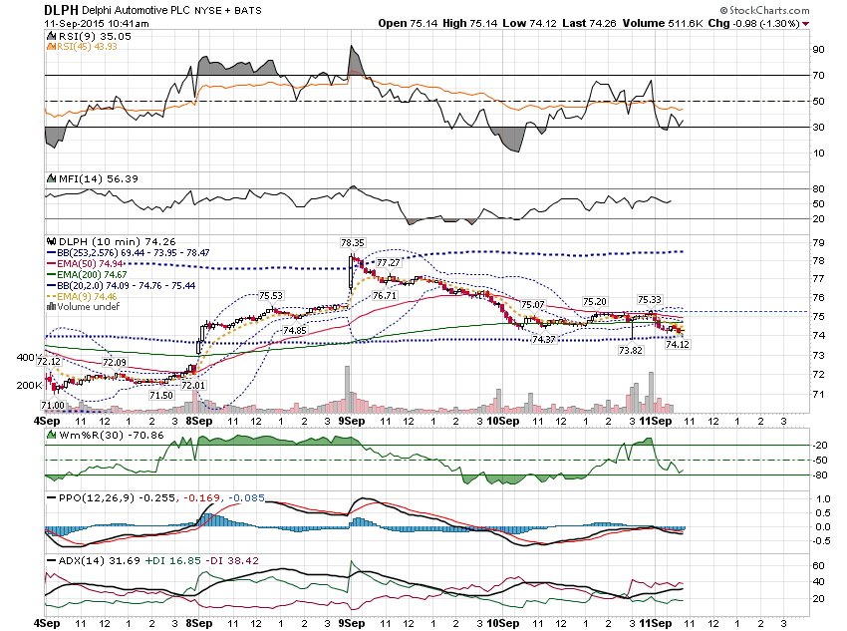

Slide 49
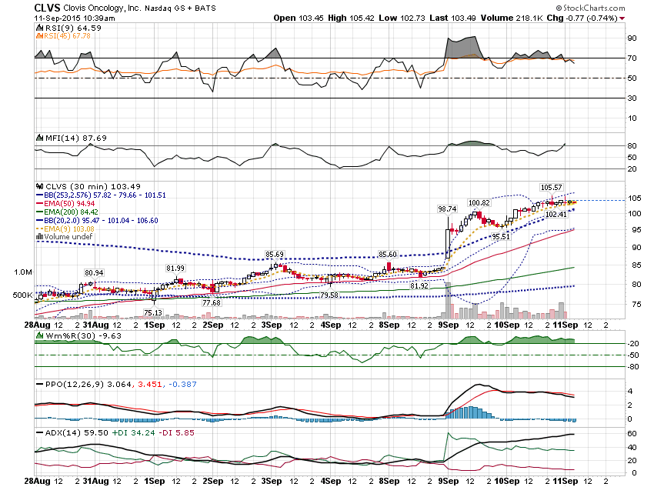

Slide 50
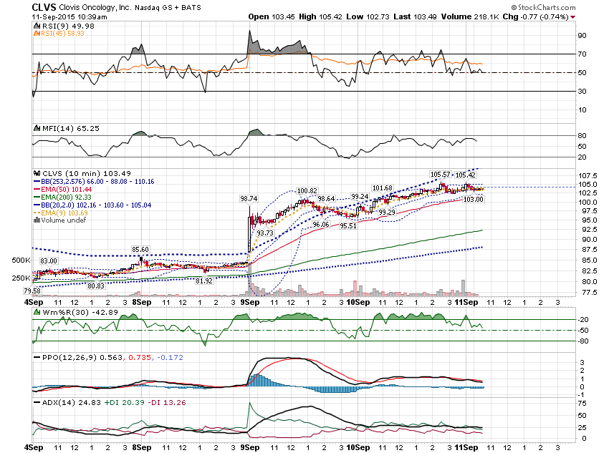

Slide 51
Thanks for watching! Bill Davis Mad Day Trader September 16, 2015 davismdt@gmail.com

