Slide 1
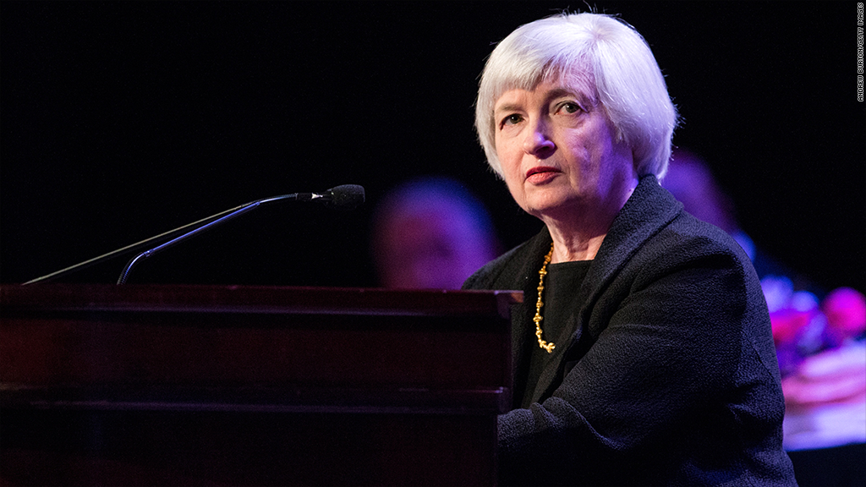
The Mad Hedge Fund Trader “It’s All About Janet”
With John Thomas from San Francisco, September 9, 2015 www.madhedgefundtrader.com
Notes:
*

Slide 2

Trade Alert Performance New All Time High!
*January +0.53% Final *July +6.42% Final *February +7.73% Final *August +1.27% Final *March +3.00% Final *September 3.29% MTD *April +6.62% Final *May +5.15% Final *June +3.68% Final *2015 Year to Date +35.52% compared to -7% for the Dow Average *Trailing 1 year return +35.40%, +188.33% since inception
*Average annualized return of 39.58%

Slide 3
Portfolio Review Run a small book in crash conditions a very wide short strangle
Mad Hedge Fund Trader
Trading Book
Asset Class Breakdown
Risk Adjusted Basis
current capital at risk
Risk On
World is Getting Better
none | 0.00%
Risk Off
World is Getting Worse
(SPY) 9/$204-$207 put spread | -10.00%
total net position | -10.00%
Expiration P&L 35.86%

Slide 4
Paid Subscriber Trailing 12 Month Audited Return +35.40% - The Comeback Kid!

Slide 5
57 Months Since Inception Daily Audited Performance Averaged annualized return +39.58%

Slide 6
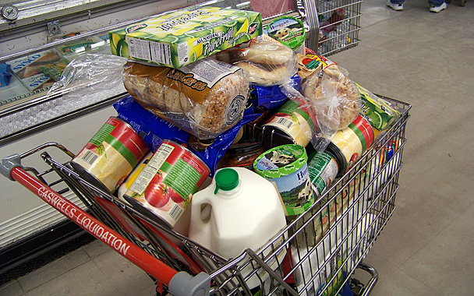
10 Stocks to Buy at the Bottom
Lennar Homes (LEN) $53.45 Home Depot (HD) $116.16 Walt Disney (DIS) $98.84 General Motors (GM) $29.60 Tesla (TSLA) $230.77 Apple (AAPL) $105.76 Solar City (SCTY) $40.99 Gilead Sciences (GILD) $105.33 Wisdom Tree Japan Hedged Equity (DXJ) $52.01 Wisdom Tree Europe Hedged Equity (HEDJ) $56.95

Slide 7

Strategy Outlook-Setting Up the “BUY”
*The bottom in stocks may be in, but expect a retest, and another flash crash, thanks to structurally poor liquidity *Huge short covering rally in oil to $48, but oil producer hedging smashed it back down to $45, entering seasonal weakness *Bond market gets a flight to safety bid, will hold until Fed Sept 17 decision *If no rate rise, then we have 3.7% economic growth, full unemployment, and zero inflation for the first time in history, therefore buy stocks on the big dips *Profit taking on King dollar returns, long term bull market intact *Gold stalls again at the bottom

Slide 8
The China Syndrome
*From the “Gang of Four” to the “Gang Who Couldn’t Shoot Straight” *Government manipulation of stock market fails, will drag on rest of the economy, the market that refuses to take orders *220 traders arrested for short selling, $200 billion spent to support stocks *Ham handed efforts have become a wellspring of global volatility, will continue for months until proof that the main economy isn’t damaged

Slide 9
The Bill Davis View
Picks of the Week
Buys:
QIHU 360 Techmology Co. Ltd. (QIHU) $46.50 Target to $56
(If it breaks under $43.75, buy is invalidated)
Biogen, Inc. (BIIB) $289 Target to $367
CF Industries Holding, Inc. (CF) $53 Target to $62
Electronic Arts,Inc. (EA) $66 Target to $70
Ralph Lauren Corp (RL) $112 Target to $125
FedEx Corp (FDX) $150 Target to $175
Biogen Inc (BIIB) $298 Target to $367
Sells:
TripAdvisor, Inc. (TRIP) $74 Target to $56
Wynn Resorts (WYNN) $75 Target to $50
Linkedin Corp (LNKD) $187 Target to $162
Bunge Ltd. (BG) $72 Target to $62

Slide 10

The Global Economy-US Engine of Growth
*Tepid August nonfarm payroll at 173,000, but average august revisions are 90,000, next month’s revisions to 263,000 on October 2 will spark big stock rally *Q2 GDP revised up to a blockbuster 3.7%, July personal incomes up +0.4%, spending up +0.3% *The US is now the sole engine of growth, with Europe, China, and Japan still weak *China cuts GDP forecast from 7.4% to 7.33% growth, but the real number is probably 3% *Next to come is a “RISK ON” global synchronized growth

Slide 11
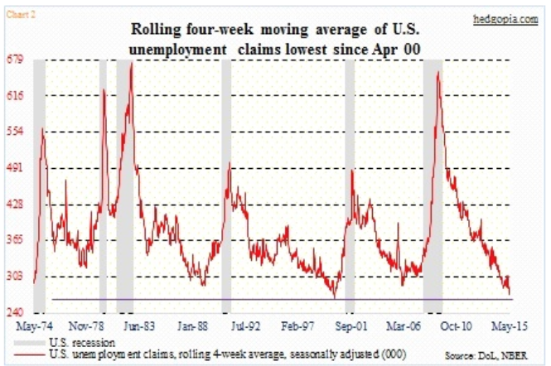
Weekly Jobless Claims – Another Run at the Lows 4,000 to 277,000, NEW 42 YEAR LOW! headed for Full Unemployment at 5%-Global Recovery a Driver

Slide 12
Bonds-It’s All About Janet
*All eyes now on Fed, expect a narrow range until September 17 *China sells $100 billion of $1 trillion in US Treasury bond holdings to support its stock markets, produces a snore instead of a crash, and no move in rates *Crash eliminates any chance of a Fed rate rise in September, even though the economic data say otherwise *173,000 nonfarm payroll and 5.1% unemployment rate puts a cap on any bond price rises, floor under yields *The China crash has slowed things down, with IMF and World begging for a rate hike delay, is basis for the recent 11 point rally *Junk bonds get slaughtered, touching October, 2014 low, becoming a “BUY” Target

Slide 13
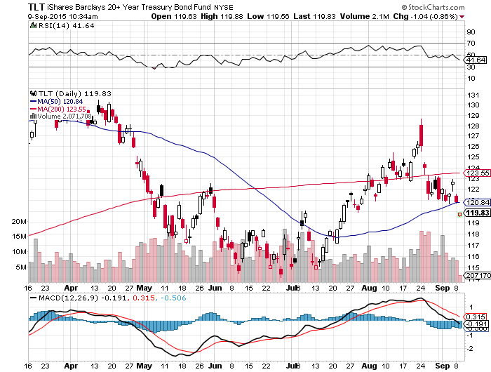
Ten Year Treasuries (TLT) 2.25% The down trend is in place! Sell Rallies!

Slide 14
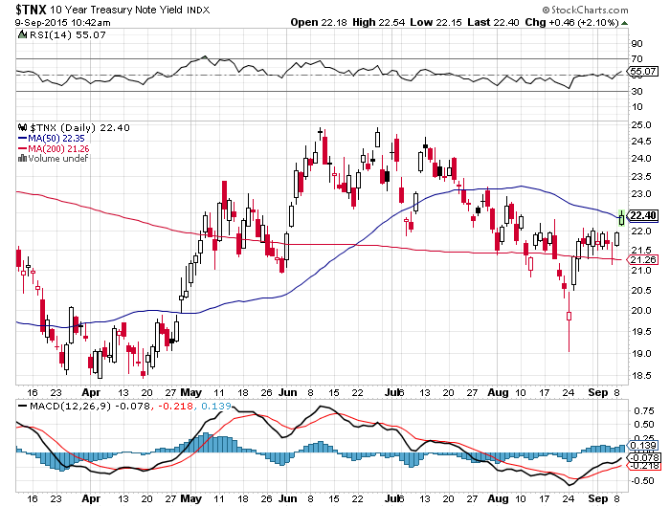
Ten Year Treasury Yield ($TNX) 2.25% 1.95% Support Holds

Slide 15
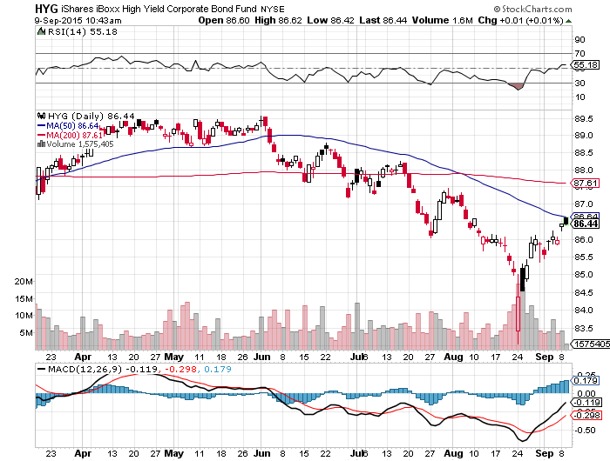
Junk Bonds (HYG) 6.44% Yield Big Hedge Funds lining up to short

Slide 16
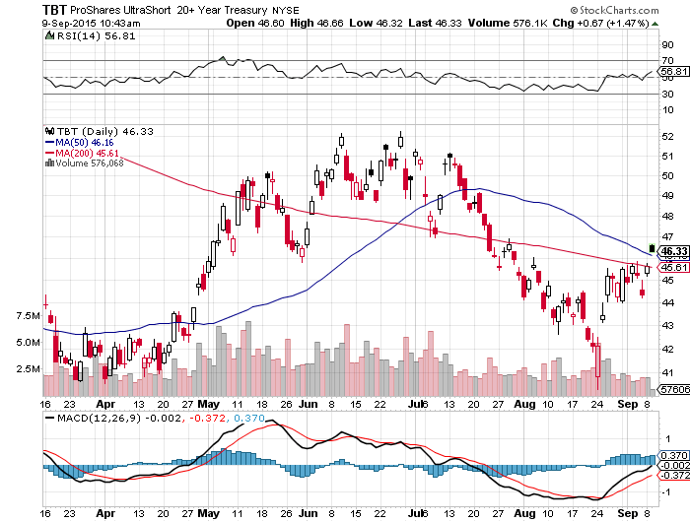
2X Short Treasuries (TBT)- Second Half Big Trade? Buy at the Dip, $41 will hold

Slide 17
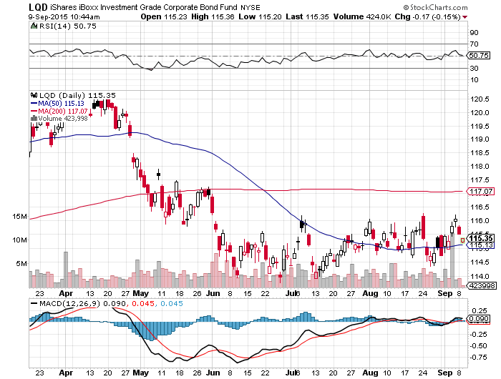
Investment Grade Corporate Bonds (LQD) 4.27% Yield

Slide 18
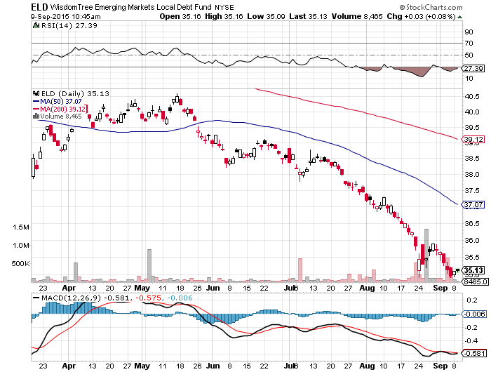
Emerging Market Debt (ELD) 5.50% Yield- Big hedge funds lining up to sell-Identical chart to junk bonds

Slide 19
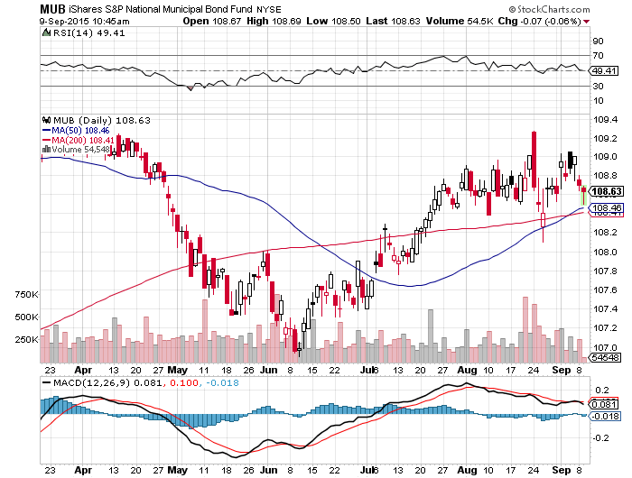
Municipal Bonds (MUB)-1.74% yield Mix of AAA, AA, and A rated bonds- another Puerto Rico Crisis looming

Slide 20

Stocks-Living on a Roller Coaster
*Retest of the October 2014 $1,820 coming with another possible 1,000 point flash crash, buy every big volatility dip and sell every rally *Watch the stocks that bounced back the fastest, they will lead in next rally, (HD), (DIS), (AAPL), (GE), (SCTY), (NFLX) *Crash was exaggerated by the exodus of market makers from the business, especially the banks, creating a structural liquidity shortage and high volatility *Stocks have gone from fairly valued to cheap in a week, multiple falls from 17.5 to 15 X 2015 earnings, and 13.5 X 2016 earnings. 10% down and those numbers are 13.5X and 12X, 2009 levels that bring in buyers in droves *October 2 August payroll revisions to 263,000 could trigger fall rally *China is the wild card, but we are approaching the end of this crash

Slide 21
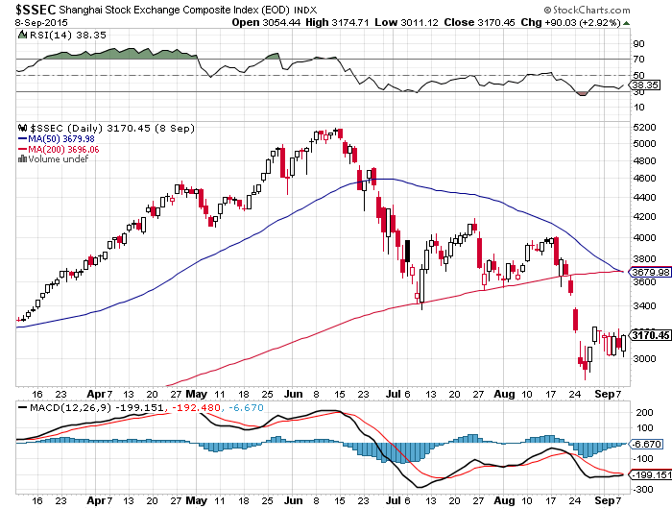
Shanghai ($SSEC)-The Bad Boy

Slide 22
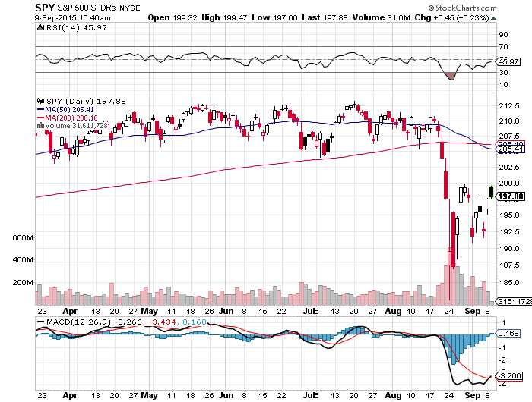
S&P 500-200 Day MA in Play at $206.10 Old support becomes resistance long the 9/$204-$207 vertical bear put spread-7 trading days to expiration

Slide 23
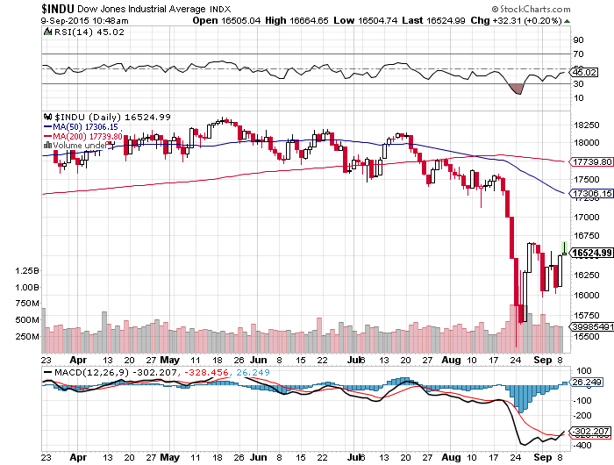
Dow Average-Boring!, Down -7% on the year! 200-day MA break! The Death Cross That Worked

Slide 24
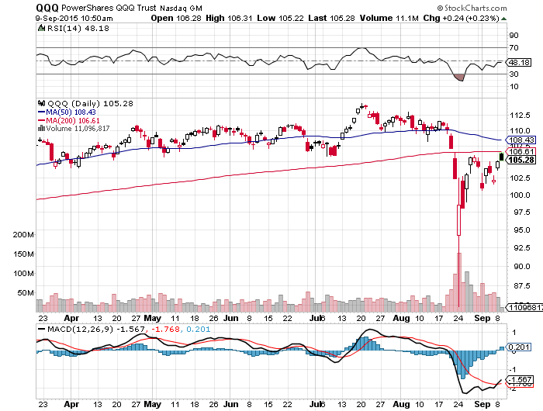
NASDAQ (QQQ)-The new leadership

Slide 25
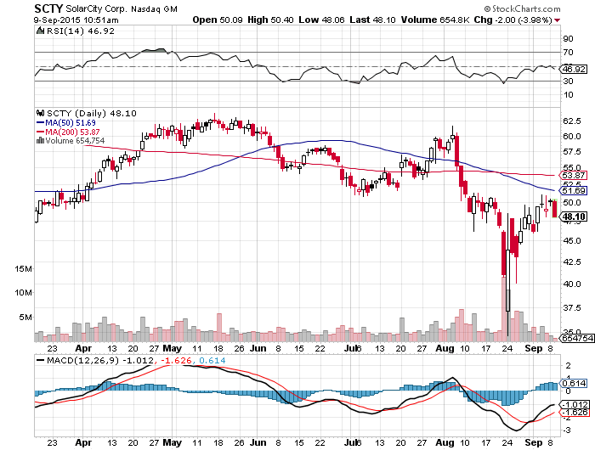
Solar City (SCTY)-Elon Musk engineers another short squeeze, Buys $50 million of stock

Slide 26
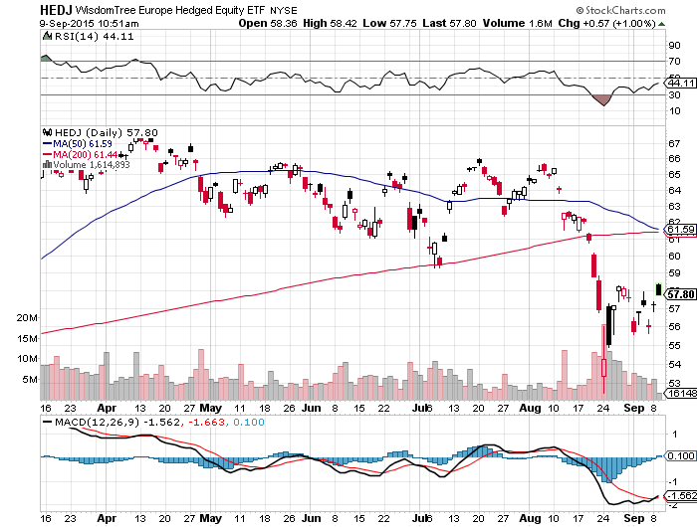
Europe Hedged Equity (HEDJ)-Greek bounce

Slide 27
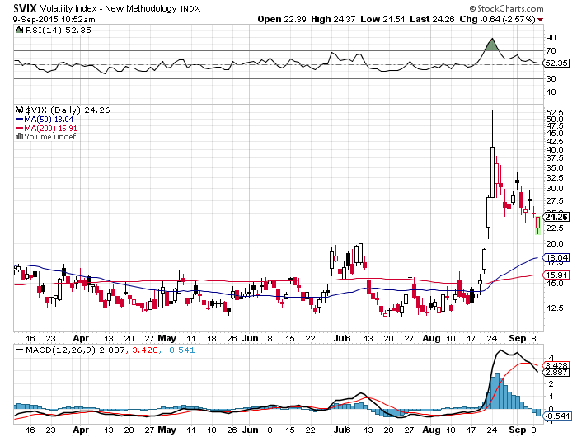
(VIX)-Four Year High!

Slide 28
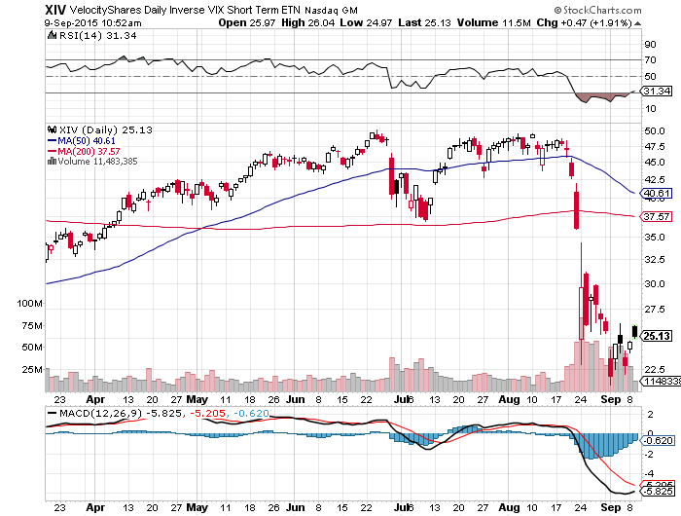
(XIV)-Velocity Shares Daily Inverse VIX Short Term ETN buy on next market selloff and VIX spike

Slide 29
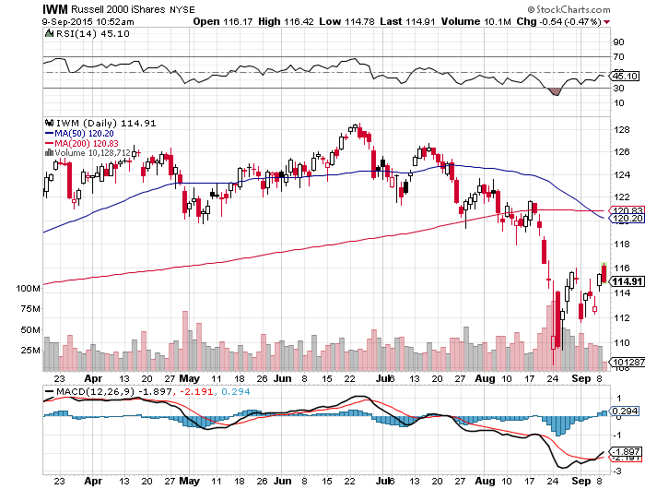
Russell 2000 (IWM)-The Weak Link most affected by rising rates-Great leading indicator

Slide 30
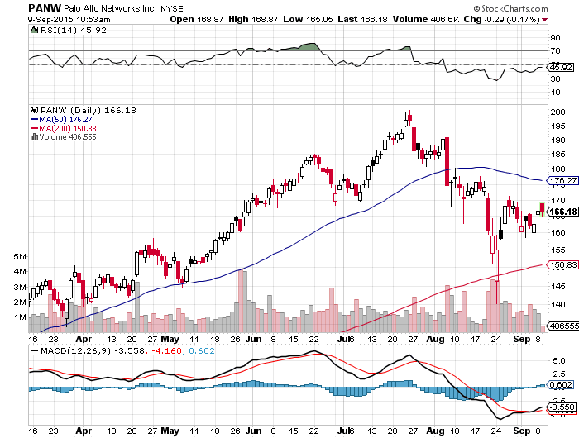
Palo Alto Networks (PANW)- New Uptrend

Slide 31
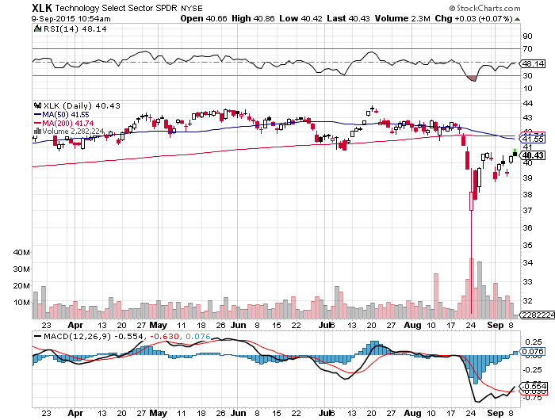
Technology Sector SPDR (XLK), (ROM) (AAPL), (MSFT), (VZ), (T), (FB), (IBM)

Slide 32
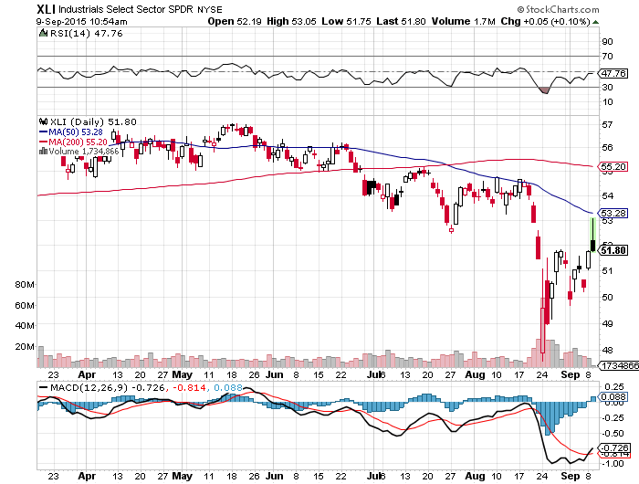
Industrials Sector SPDR (XLI)-Dow Mainstay (GE), (MMM), (UNP), (UTX), (BA), (HON)

Slide 33
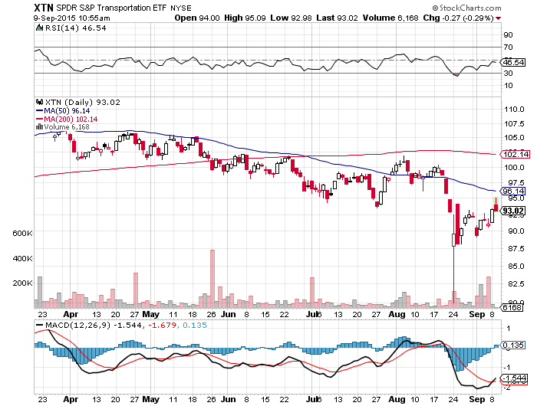
Transports Sector SPDR (XTN)- Another Dow Mainstay (ALGT), (ALK), (JBLU), (LUV), (CHRW), (DAL),

Slide 34
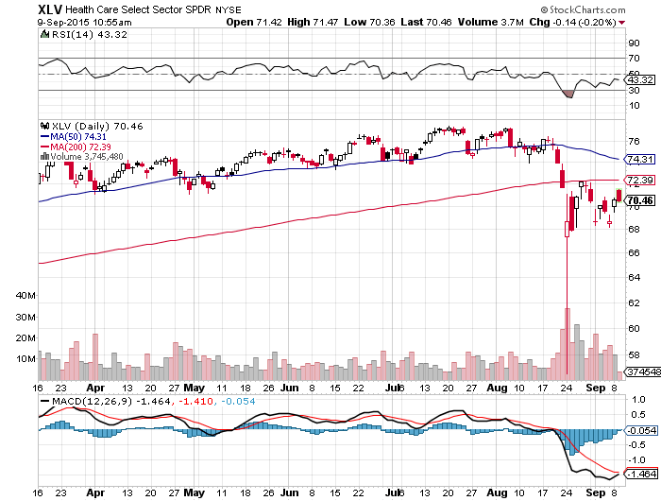
Health Care Sector SPDR (XLV), (RXL) (JNJ), (PFE), (MRK), (GILD), (ACT), (AMGN)

Slide 35
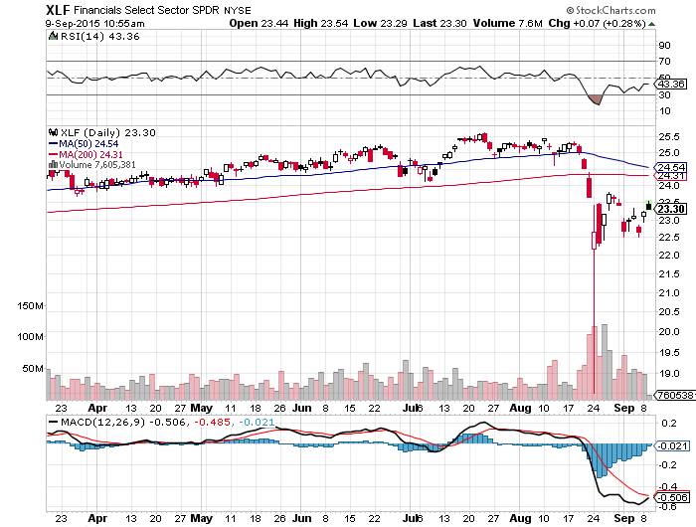
Financial Select SPDR (XLF)- Party Postponed (BLK/B), (WFC), (JPM), (BAC), (C), (GS)

Slide 36
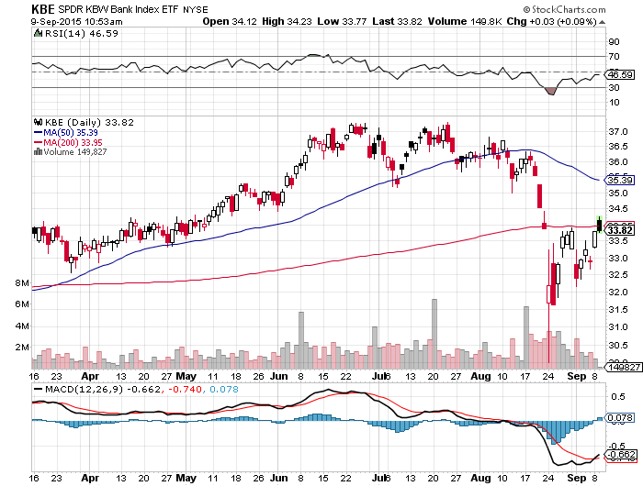
Regional Bank Basket (KBE)-The Fix on the Fed is In (MTG), (RDN), (SIVB), (CFG), (CFR), (BXS)

Slide 37
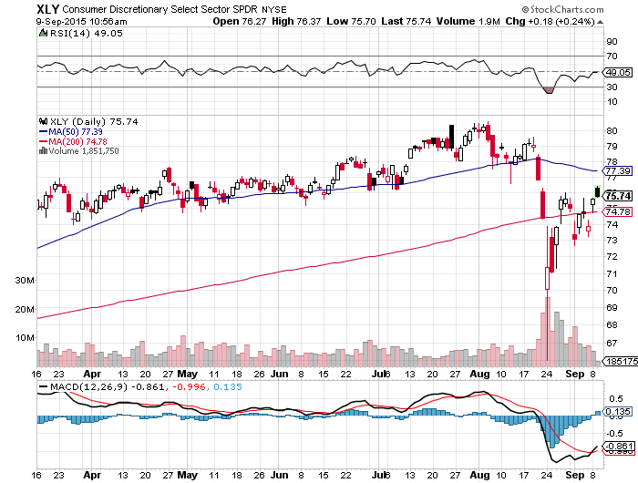
Consumer Discretionary SPDR (XLY) (DIS), (AMZN), (HD), (CMCSA), (MCD), (SBUX)

Slide 38
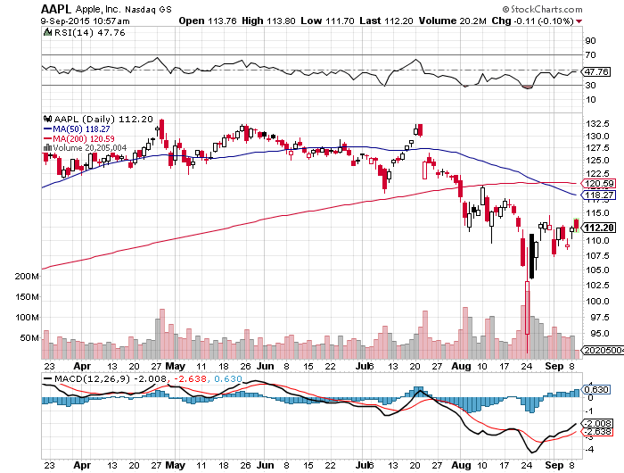
Apple (AAPL) –Announcement Day waiting for the next real catalyst-the iPhone 7

Slide 39
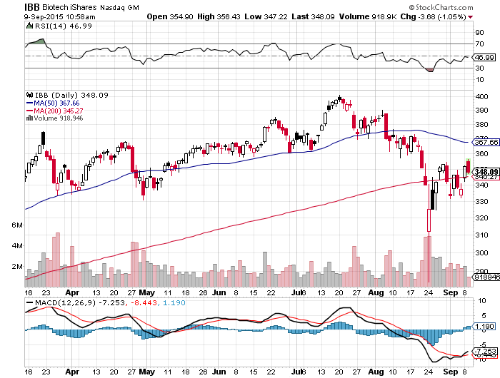
Biotech iShares (IBB)-The Uptrend has begun

Slide 40
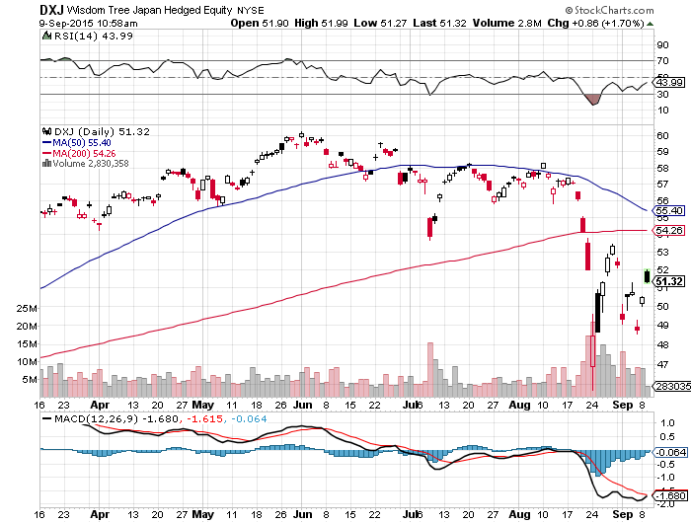
Japan (DXJ)-Hedged Japan Equity took profits on 20% weighting-Love That Stimulus! 10% in 2 Days

Slide 41
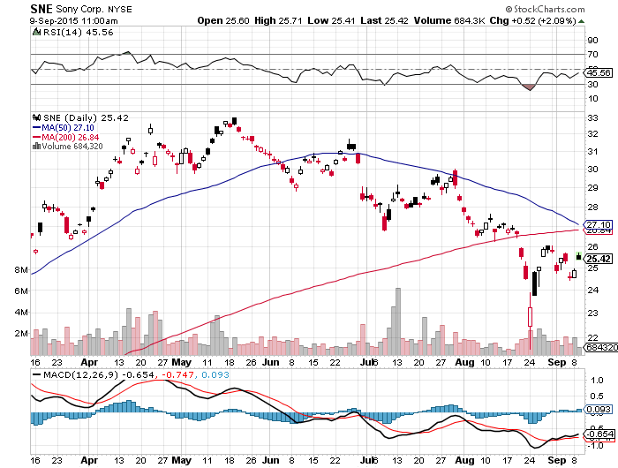
Sony (SNE)-Buy Territory

Slide 42
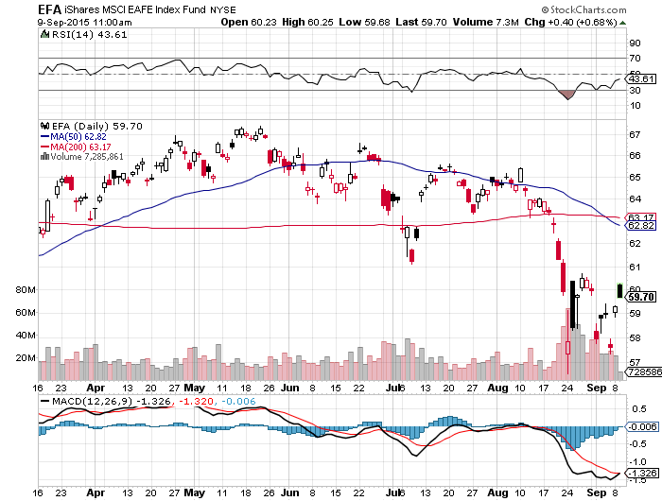
Emerging Markets (EFA)- another big short sellers target

Slide 43
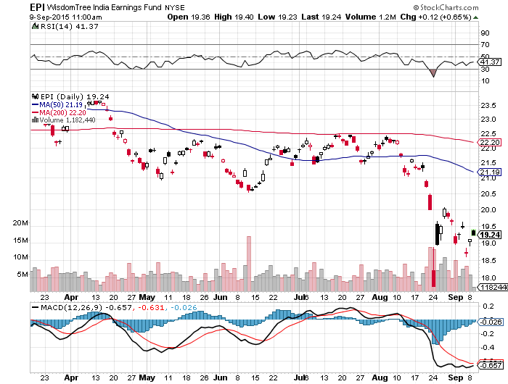
India (EPI)-Buy it Here

Slide 44

Foreign Currencies-Long Term Trends Reasserting
*Global panic brings dollar profit taking as traders dump all interest rate rise plays, no chance of September Fed rate rise, if they do rise, it will bring another crash, is all bad for the dollar *Will create another great long dollar entry point *Europe to expand asset purchases, is very pro dollar *China devaluation reaches nearly 5% to boost economy and exports, slaughtering (CYB) *Euro gives back its spike *Yen spike goes to on stimulus

Slide 45
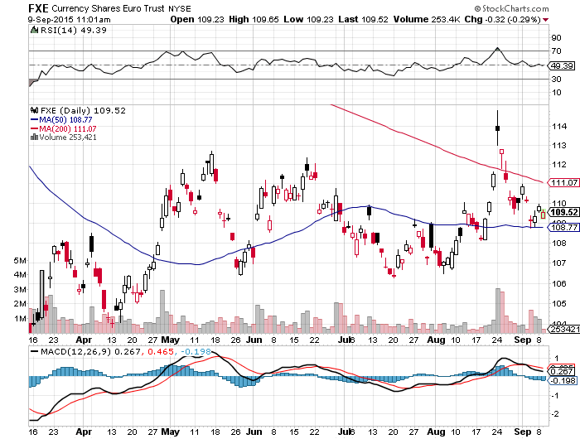
Euro ($XEU), (FXE), (EUO)-Playing Both Asides Post Greece Hangover

Slide 46
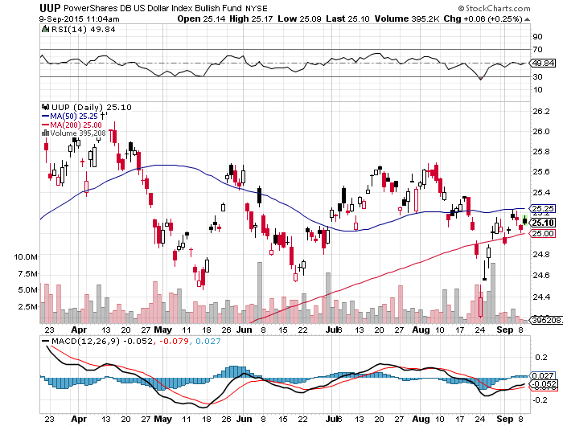
Long Dollar Index (UUP)-

Slide 47
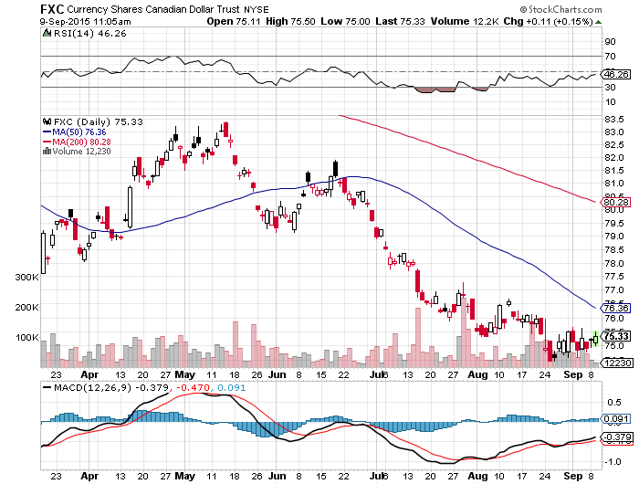
Canadian Dollar (FXC)-Commodity Collapse

Slide 48
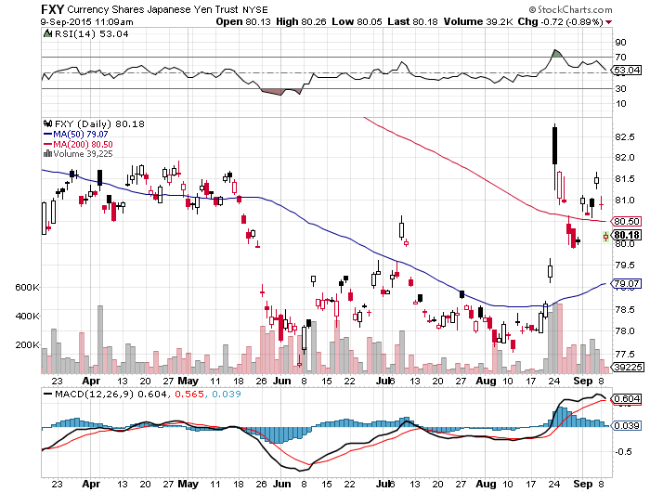
Japanese Yen (FXY)-

Slide 49
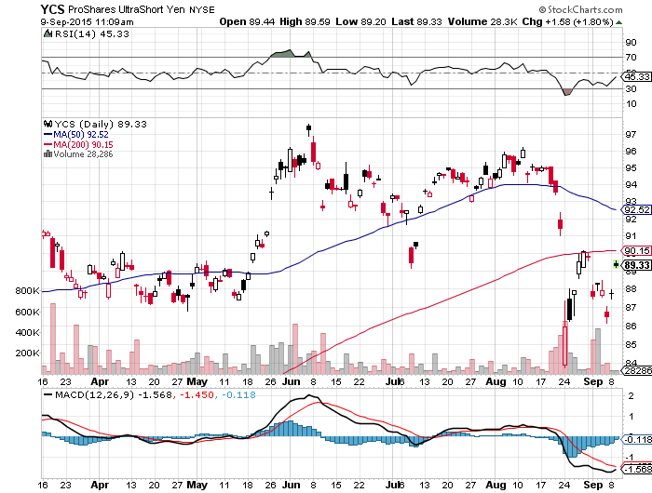
Short Japanese Yen ETF (YCS)

Slide 50
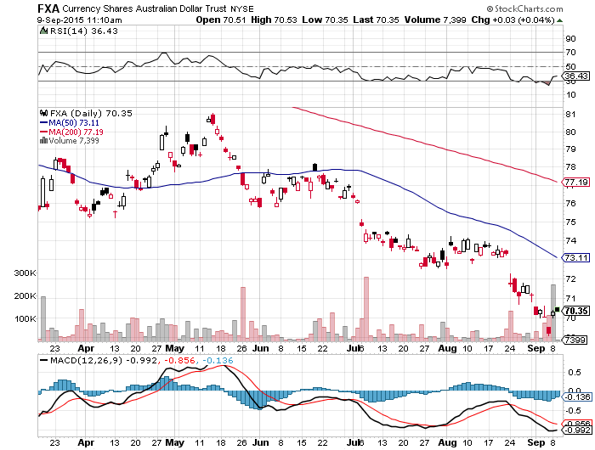
Australian Dollar (FXA) –Commodity Disaster

Slide 51
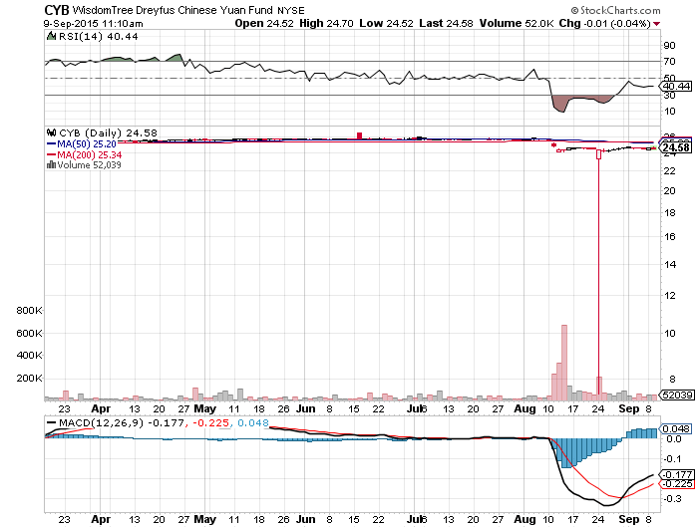
Chinese Yuan- (CYB)-4% Devaluation

Slide 52
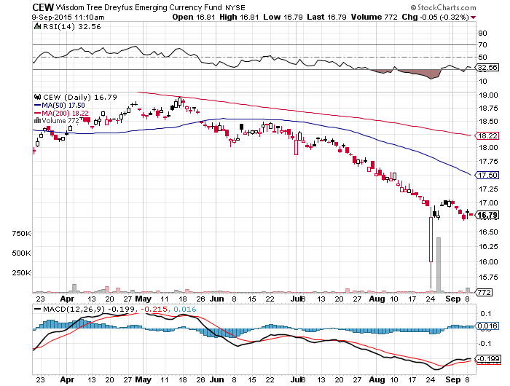
Emerging Market Currencies (CEW) another hedge fund short target and flash crash

Slide 53
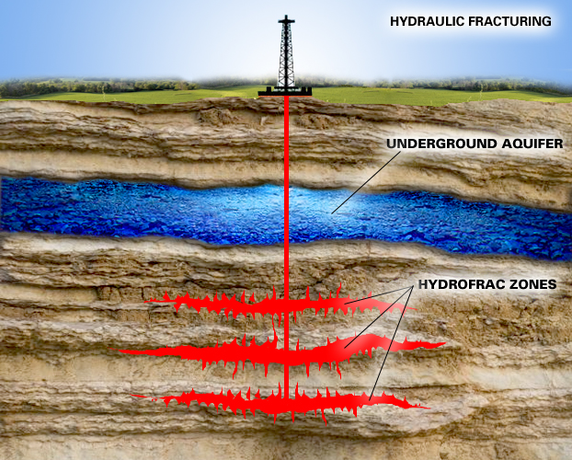
Energy-Lower for Longer
*The oil markets are now moving from seasonal strength to weakness, should bring the final bottom, US rigs fall -13 to 662 *Another bottoming signal will be an outbreak of takeover by big companies of small companies *Dividends dropping like flies throughout the energy space, cut by half or all? *$100 billion in commodity ETF redemptions in 4 years is a huge drag *Commodity futures ETF net exposure at all time low *Shale net debt rises from $80 billion to $161 billion 2010-2015 *2015 H1 shale losses reach $30 billion, leading to a bankruptcy wave *Buy this final washout

Slide 54
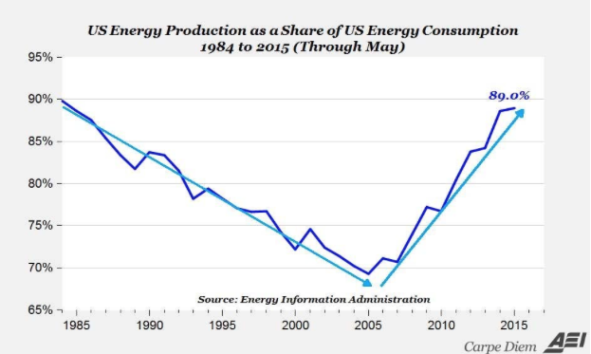

Slide 55
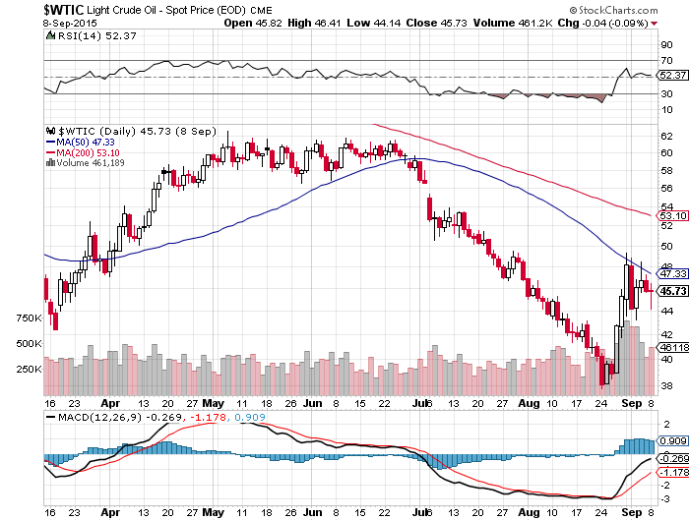
Oil-May Be a Q4 Story

Slide 56
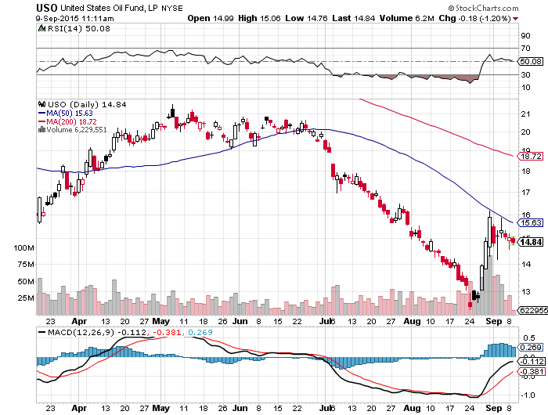
United States Oil Fund (USO)

Slide 57
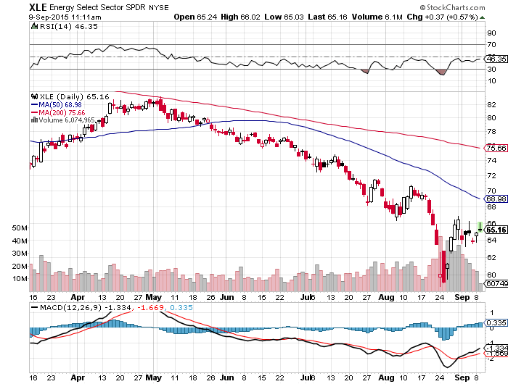
Energy Select Sector SPDR (XLE) (XOM), (CVX), (SLB), (KMI), (EOG), (COP) stocks lead oil turnaround by 6 months

Slide 58
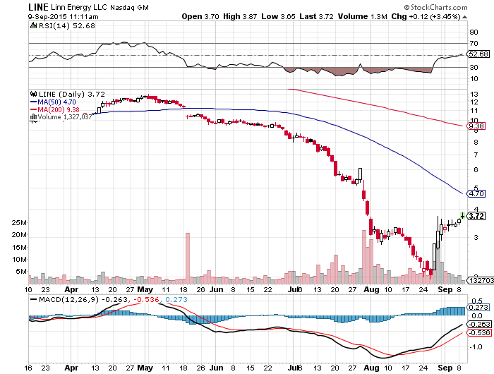
MLP’s (LINE)-Dividend Suspended! Shares fall to option value

Slide 59
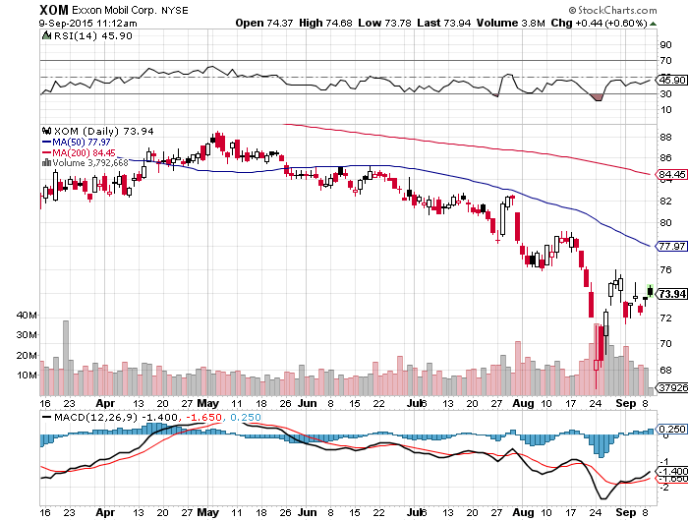
Exxon (XOM)-A Perfect Storm Oil Crashes, then the Stock Market Crashes

Slide 60
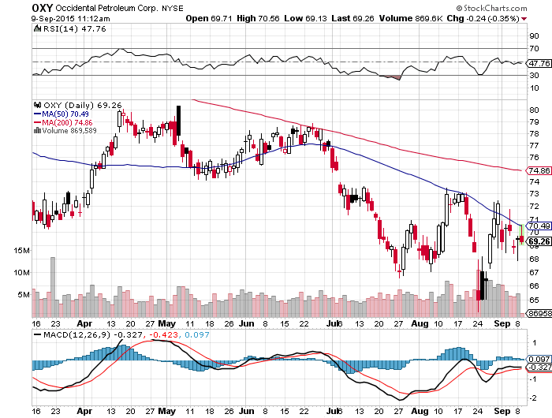
Occidental Petroleum (OXY)-

Slide 61
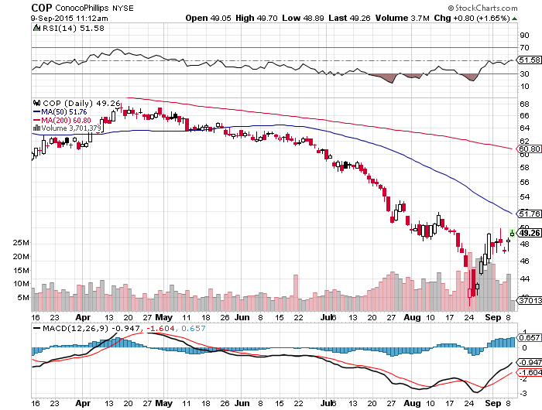
Conoco Phillips (COP)-

Slide 62

Natural Gas (UNG)-Bouncing along a bottom

Slide 63

Copper-Commodity Collapse

Slide 64

Freeport McMoRan (FCX)-New Lows

Slide 65

$100 Billion of Commodity ETF Redemptions in 4 Years

Slide 66

Precious Metals-Don’t Chase Here!
*Shanghai Gold Exchange net sales hit 302 tonnes in August, a new all time high, as metal is dumped to meet margin calls *CTA gold futures net position reaches a short for the first time in history *Poor monsoon could weaken Indian buying, world’s largest buyer *As Fed interest rate rise looms, the fundamental picture for gold goes from bad to worse

Slide 67

Gold (GLD)- Finally, A Flight to Safety

Slide 68

Market Vectors Gold Miners ETF- (GDX)

Slide 69

Silver (SLV)-

Slide 70

Silver Miners (SIL)

Slide 71

Palladium (PALL)

Slide 72
Agriculture-New Lows!
*Return of fine weather in the Midwest ends the rally, new lows in reach *Floods in Texas finally end *Extreme drought conditions continue in California, bringing back the water wars *No trade here, dragged down by the global commodity bust *Pass for now, bigger fish to fry elsewhere, US stocks much more interesting

Slide 73

(CORN) –Back to the Bottom

Slide 74

(WEAT)-

Slide 75

Ag Commodities ETF (DBA)-New Lows!

Slide 76
Real Estate-Gaining Speed
*New housing starts hot eight year high, up +13% YOY, but still 25% below long term average *Multi family strong, making up for apartments not built during the crash *June Case Shiller up +5% YOY *Homebuilders to lead stock for rest of 2015 *Predicted rush to buy homes to beat the fed interest rate hike is unfolding *Spillover occurring into the existing home market, pushing Case Shiller data upward

Slide 77

June S&P/Case–Shiller Home Price Index +5.0% YOY, Denver, San Francisco, Dallas

Slide 78

US Home Construction Index (ITB) (DHI), (LEN), (PHM), (TOL), (NVR)

Slide 79

Trade Sheet So What Do We Do About All This?
*Stocks- buy the dips *Bonds-the top is in, sell rallies, buy (TBT) *Commodities-stand aside, buy the next oil down leg *Currencies- Sell short the Yen and Euro on rallies *Precious Metals –stand aside, wait for new low *Volatility-sell short spikes through (XIV) *The Ags –wait for new lows *Real estate-buy the homebuilders LT

Slide 80

To buy strategy luncheon tickets Please go to: www.madhedgefundtrader.com Next Strategy Webinar 12:00 EST Wednesday, September 23, 2015 San Francisco, California USA!
Good Luck and Good Trading!
Notes:
*

