Slide 1

The Mad Hedge Fund Trader
“Thank You Janet”
With John Thomas
from San Francisco, September 23, 2015
www.madhedgefundtrader.com
Notes:
*

Slide 2

Trade Alert Performance
New All Time High!
*January +0.53% Final *July +6.42% Final
*February +7.73% Final *August +1.27% Final
*March +3.00% Final *September 6.72% MTD
*April +6.62% Final
*May +5.15% Final
*June +3.68% Final
*2015 Year to Date +38.95%
compared to -8.5% for the Dow Average
*Trailing 1 year return +38.90%, +191.76% since inception,
*Average annualized return of 40.58%

Slide 3
Portfolio Review
Staying very small and very nimble
current capital at risk
Risk On
World is Getting Better
none
Risk Off
World is Getting Worse
(SPY) 10/$203-$206 put spread | -10.00%
total net position | -10.00%
Expiration P&L
40.63%

Slide 4
Paid Subscriber Trailing 12 Month
Audited Return +38.90%-
The Comeback Kid!

Slide 5
57 Months Since Inception
Daily Audited Performance
Averaged annualized return +40.58%

Slide 6
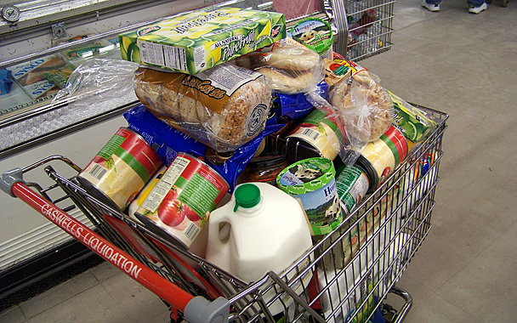
10 Stocks to Buy at the Bottom
Lennar Homes (LEN) $53.45
Home Depot (HD) $116.16
Walt Disney (DIS) $98.84
General Motors (GM) $29.60
Tesla (TSLA) $230.77
Apple (AAPL) $105.76
Solar City (SCTY) $40.99
Gilead Sciences (GILD) $105.33
Wisdom Tree Japan Hedged Equity (DXJ) $52.01
Wisdom Tree Europe Hedged Equity (HEDJ) $56.95

Slide 7

Strategy Outlook-Setting Up the “BUY”
*No Fed action shocks markets, will bring 3 more months of volatility and uncertainty. Kaching!!
*The bottom in stocks may be in, but expect a retest, and another flash crash, thanks to structurally poor liquidity, learning to live with VIX in the $20’s
*Oil trapped in wide $44-$48 range, entering seasonal weakness
*Bond market gets a respite from Fed decision
to hold rates
*Profit taking on King dollar returns after Fed, but
returns to long term bull market quickly
*Gold stalls again at the bottom

Slide 8
The Bill Davis View
Picks of the Week
Buys:
Facebook (FB) $91 Target to $100
Apple (AAPL) $112.50 Target to $118
(If it breaks under $112.50, do not initiate)
Aetna (AET) $120 Target to $140
(Buy on breakout)
Alkermes (ALKS) $65 Target to $74
Dycom (DY) $78.50 Target to $85
Sells:
Jazz Pharmaceuticals (JAZZ) $162 Target to $148
Wynn Resorts (WYNN) $72 Target to $60
Western Digital (WDC) $80 Target to $70
Biogen (BIIB) $312 Target to $280
F5 Networks (FFIV) $117 Target to $108

Slide 9

The Global Economy-Confused
*Fed inaction extends a safety net to emerging nations, but markets don’t buy it
*OECD revises us 2015 growth up from 2% to 2.4%, Europe down from 3.1% to 3.0% on China weakness
*US consumer spending booming at 4.5%, if you add services, about 65% of US economy
*The US is now the sole engine of growth,
with Europe, China, and Japan still weak
*China still the big unknown, more GDP
downgrades coming, PMI drops to 47
*Next to come is a “RISK ON” global
synchronized growth

Slide 10
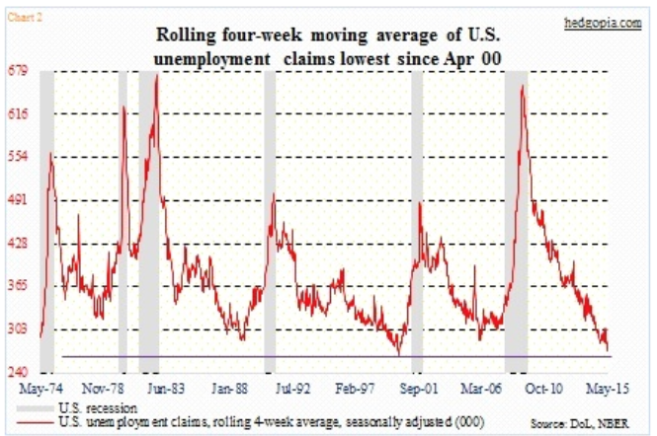
Weekly Jobless Claims – Another Run at the Lows
-11,000 to 264,000, NEW 42 YEAR LOW! headed for Full Unemployment at 5%-Global Recovery a Driver

Slide 11

Bonds-Execution Stayed
*Fed non move gives the bond market a new lease on life
*Driver was fears of a strong dollar and emerging market crash importing more deflation to the US
*Junk bonds are not buying it, probing new lows
*Big flight to safety going on in muni bonds
*266,000 print in weekly jobless claims show the pressure on the Fed to move is rising
*The long term play here is a short,
but not yet
*Watch the (TBT)

Slide 12
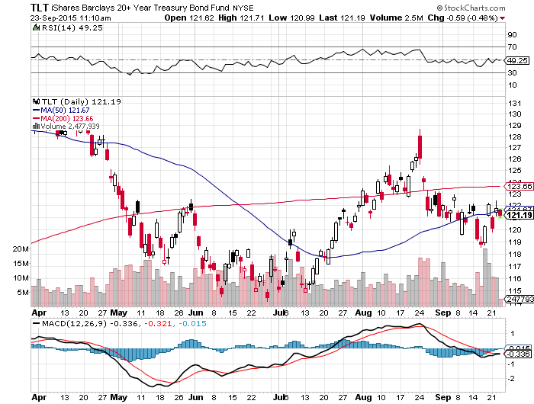
Ten Year Treasuries (TLT) 2.16%
The down trend is in place! Sell Rallies!

Slide 13
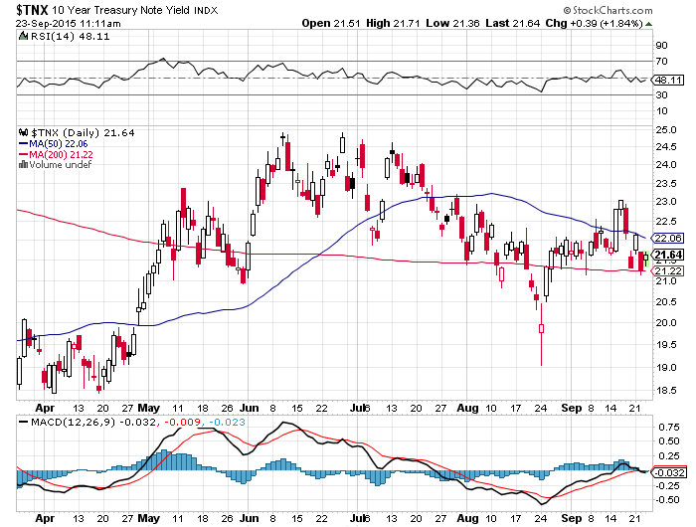
Ten Year Treasury Yield ($TNX) 2.16%
1.95% Support Holds

Slide 14
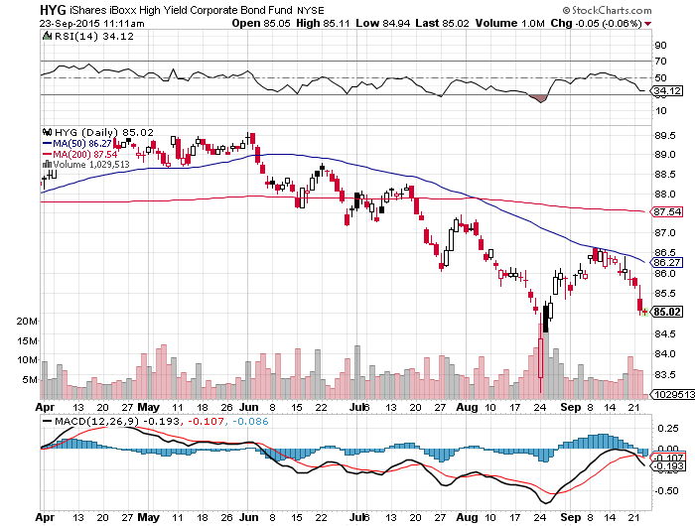
Junk Bonds (HYG) 6.44% Yield
Big Hedge Funds lining up to short

Slide 15
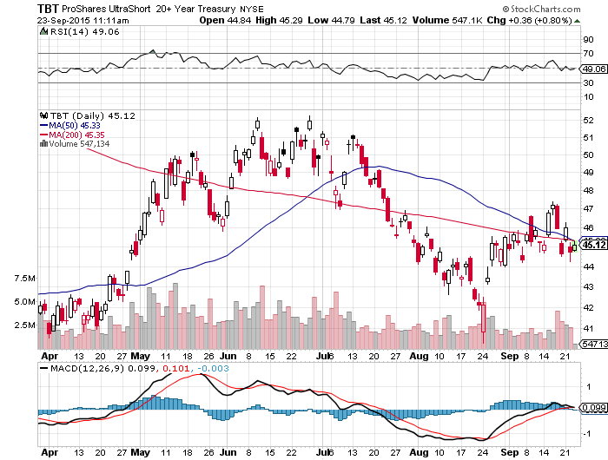
2X Short Treasuries (TBT)-Second Half Big Trade?
Buy at the Dip, $41 will hold

Slide 16
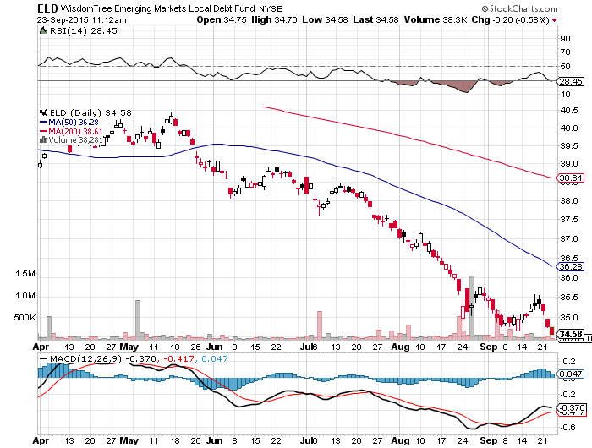
Emerging Market Debt (ELD) 5.50% Yield-
Big hedge funds lining up to sell-Identical chart to junk bonds

Slide 17
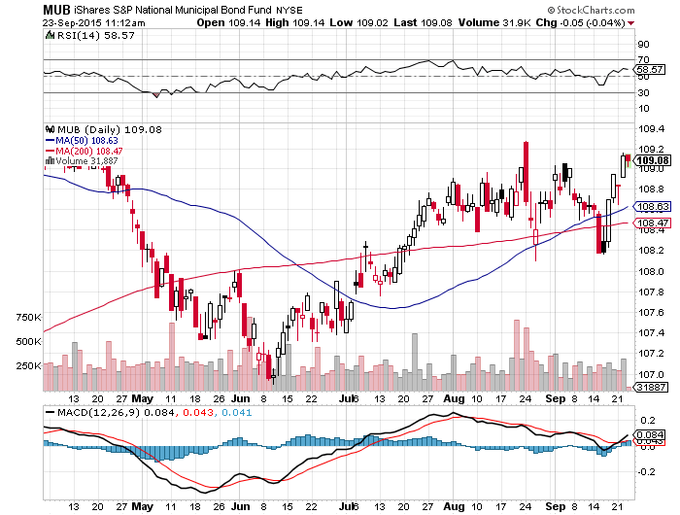
Municipal Bonds (MUB)-1.74% yield
Mix of AAA, AA, and A rated bonds
-another Puerto Rico Crisis looming

Slide 18

Stocks-Bracing for an October Crash
*Retest of the October 2014 $1,820 coming with another possible 1,000 point flash crash, buy every big volatility dip and sell every rally
*Watch the stocks that bounced back the fastest, they will lead in next rally, (HD), (DIS), (AAPL), (GE), (SCTY)
*Stocks are now in the third quarter of a gross revenue recession, Q3-3.3%, Q4 -1.4%
*15 X 2015 earnings, and 13.5 X 2016 earnings will limit any downside.
*Volkswagen scandal puts Europe in the tank
*October 2 August payroll revisions to
263,000 could trigger fall rally
*Work on your shopping lists, a chance to get
in at a multiyear low is approaching

Slide 19
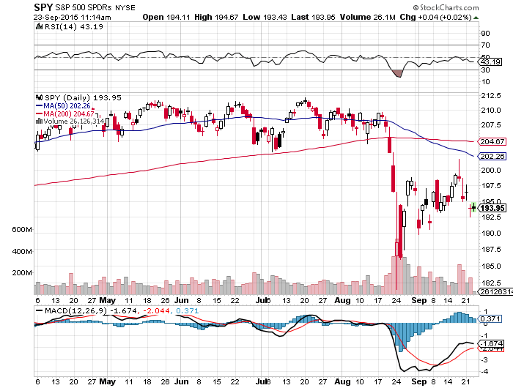
S&P 500-200 Day MA in Play at $206.10
Old support becomes resistance long the 10/$203-$206 vertical bear put spread-17 days to expiration

Slide 20
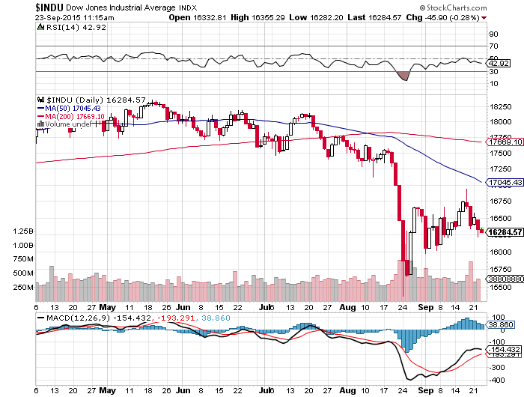
Dow Average-Boring!, Down -7% on the year!
200-day MA break! The Death Cross That Worked

Slide 21
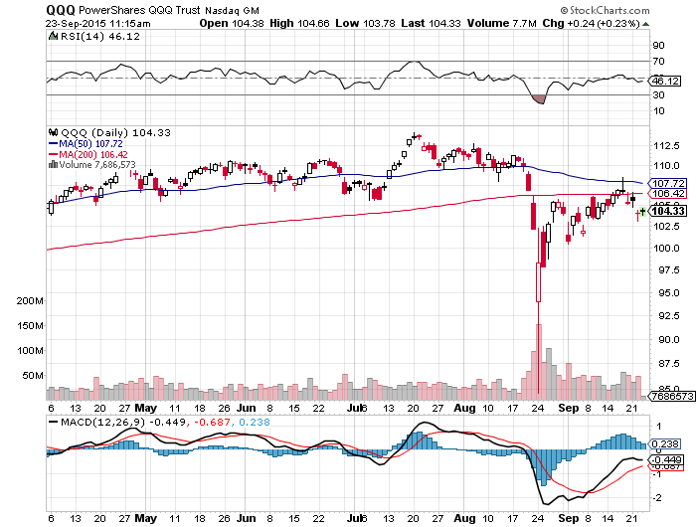
NASDAQ (QQQ)-

Slide 22
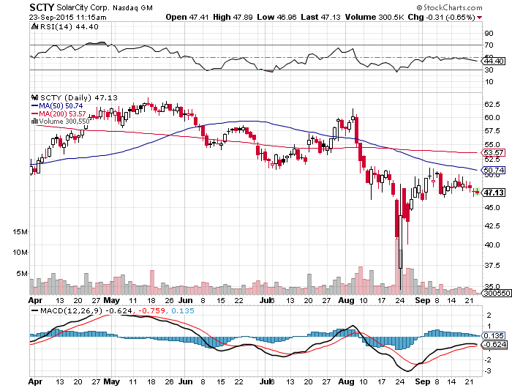
Solar City (SCTY)-Still a Slave to Oil

Slide 23
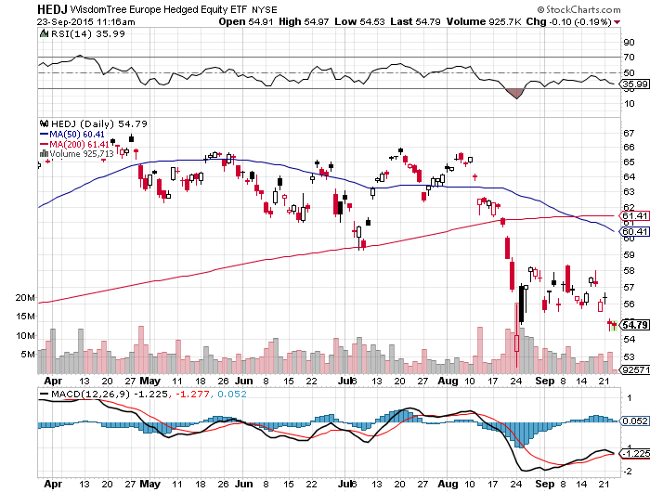
Europe Hedged Equity (HEDJ)-Greek bounce

Slide 24
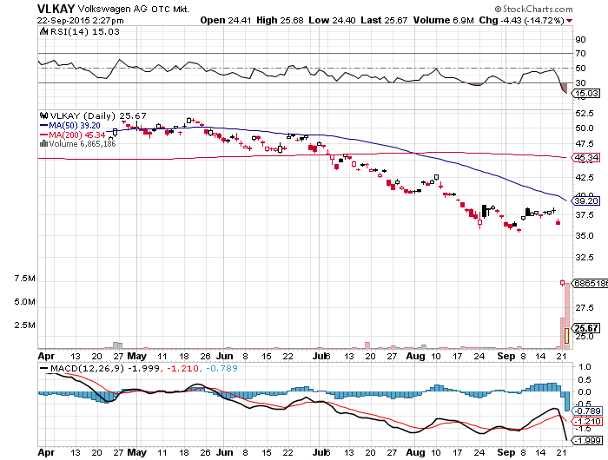
Volkswagen (VLKAY)-Stock of the Week down 37% in 2 days on fake emissions data scandal

Slide 25
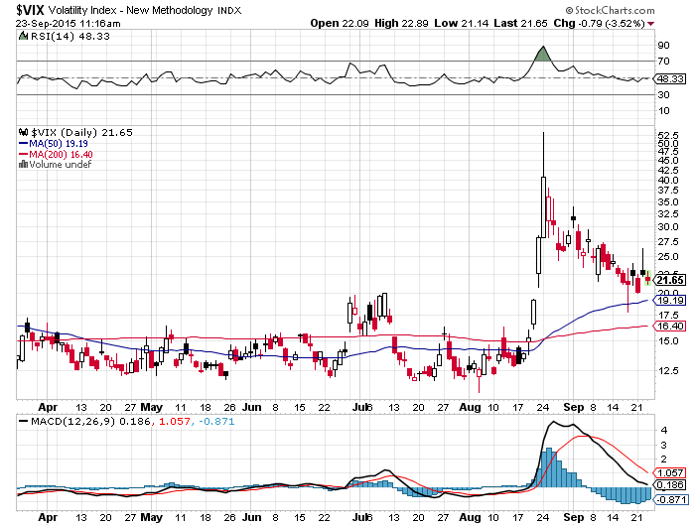
(VIX)-Bleeding Off From Four Year High!

Slide 26
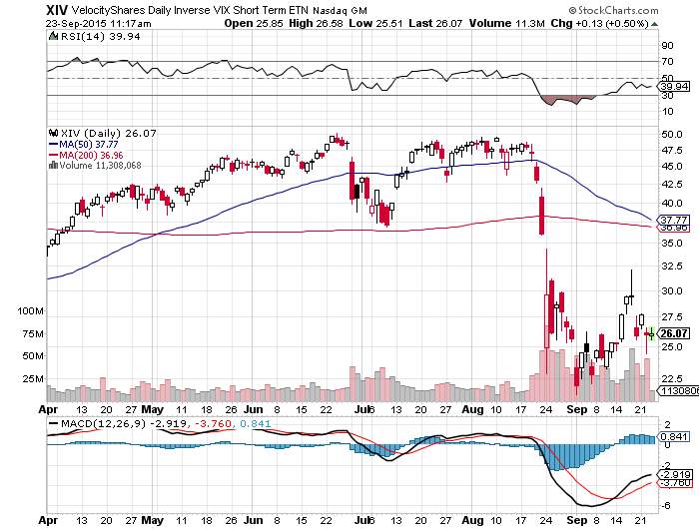
(XIV)-Velocity Shares Daily Inverse VIX Short Term ETN buy on next market selloff and VIX spike

Slide 27
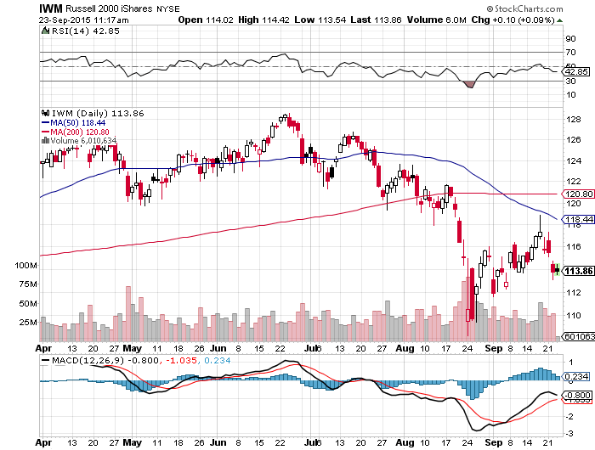
Russell 2000 (IWM)-The Weak Link most affected by rising rates-Great leading indicator

Slide 28
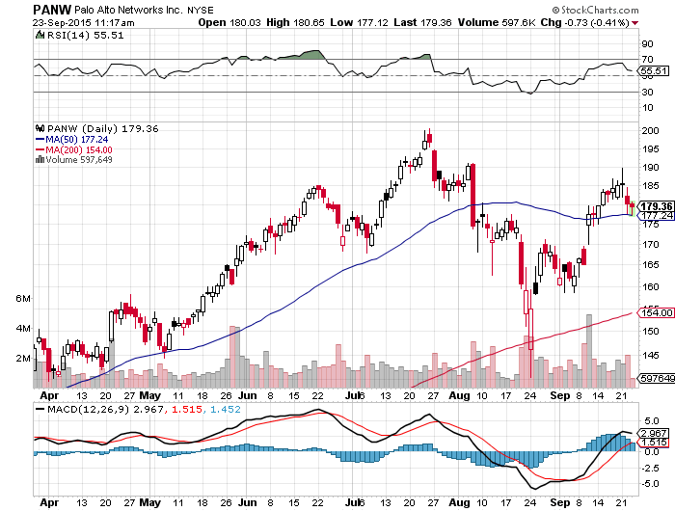
Palo Alto Networks (PANW)-
New Uptrend

Slide 29
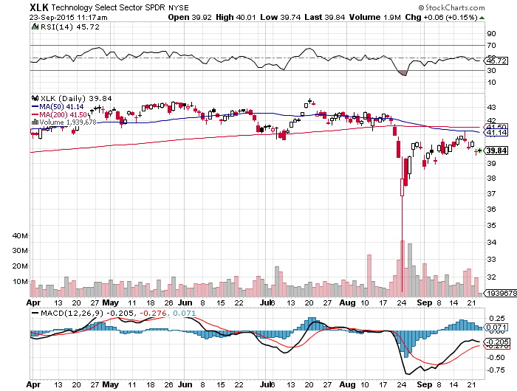
Technology Sector SPDR (XLK), (ROM)
(AAPL), (MSFT), (VZ), (T), (FB), (IBM)

Slide 30
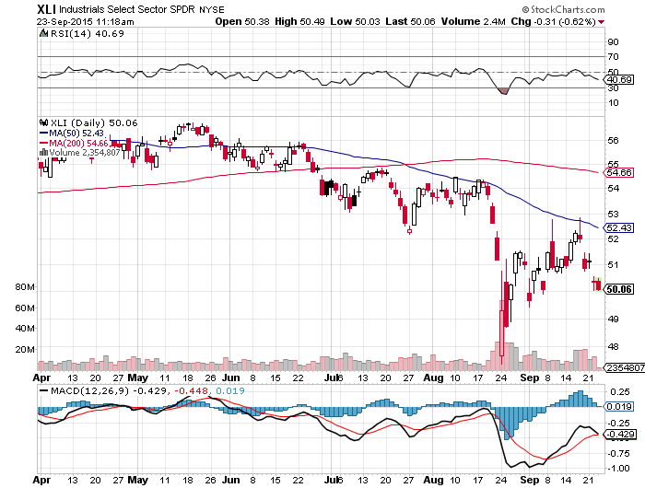
Industrials Sector SPDR (XLI)-Dow Mainstay
(GE), (MMM), (UNP), (UTX), (BA), (HON)

Slide 31
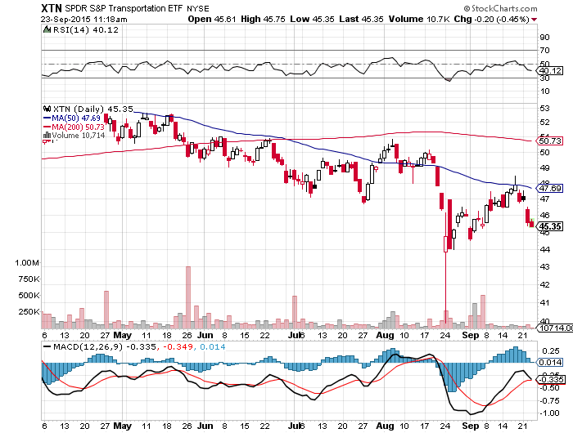
Transports Sector SPDR (XTN)-Another Dow Mainstay
(ALGT), (ALK), (JBLU), (LUV), (CHRW), (DAL),

Slide 32
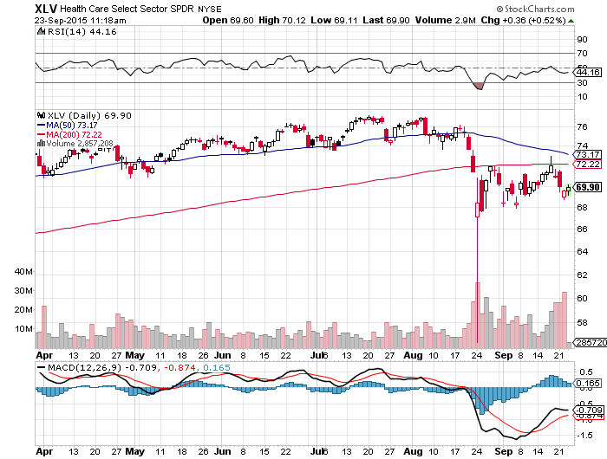
Health Care Sector SPDR (XLV), (RXL)
(JNJ), (PFE), (MRK), (GILD), (ACT), (AMGN)

Slide 33
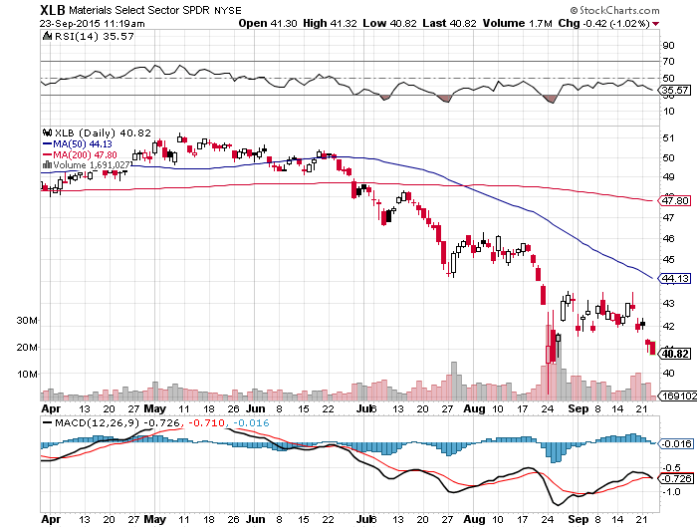
Financial Select SPDR (XLF)-
Party Postponed
(BLK/B), (WFC), (JPM), (BAC), (C), (GS)

Slide 34
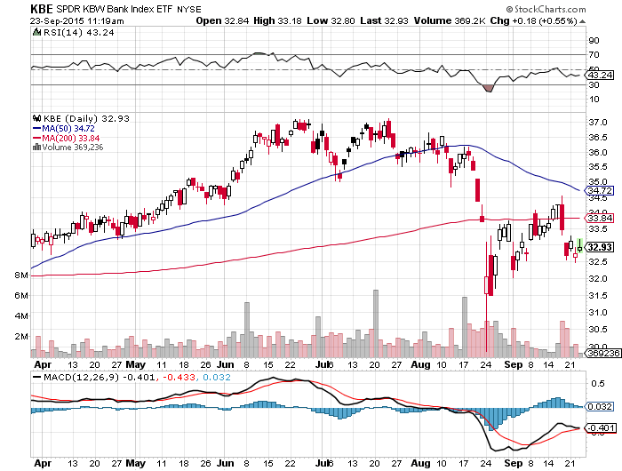
Regional Bank Basket (KBE)-The Fix Disappoints
(MTG), (RDN), (SIVB), (CFG), (CFR), (BXS)

Slide 35
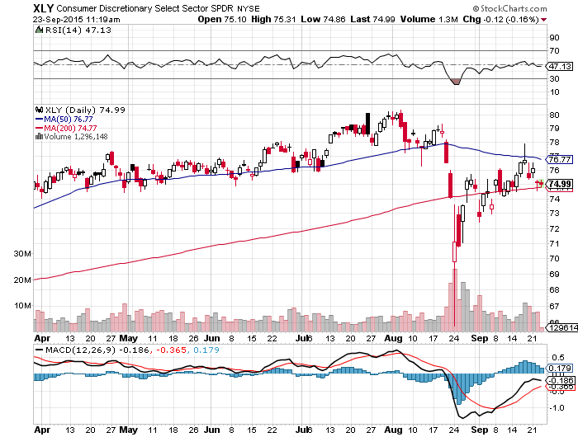
Consumer Discretionary SPDR (XLY)
(DIS), (AMZN), (HD), (CMCSA), (MCD), (SBUX)

Slide 36
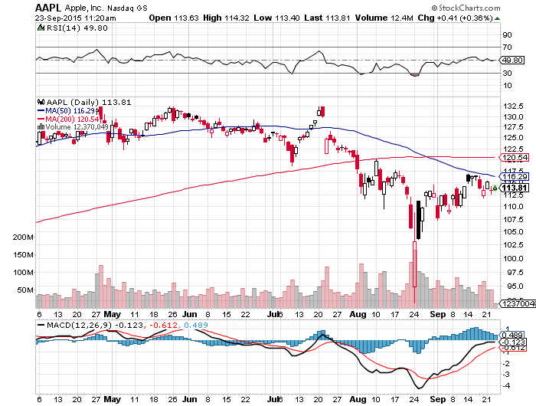
Apple (AAPL) –Announcement Day waiting for the next real catalyst-the iPhone 7

Slide 37
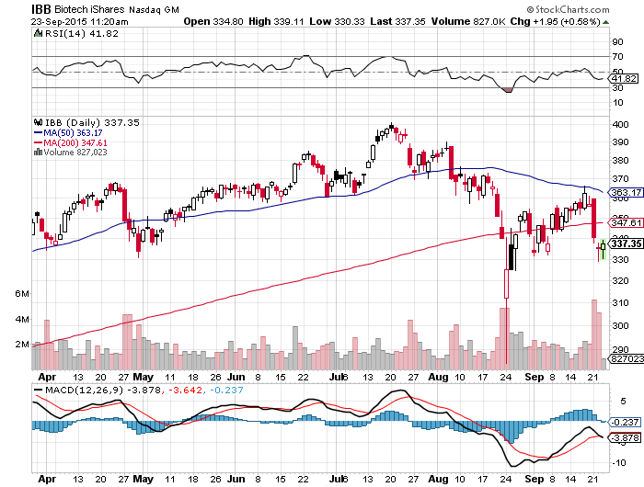
Biotech iShares (IBB)-The Hillary Hit
Government open bidding on drug buys and imports

Slide 38
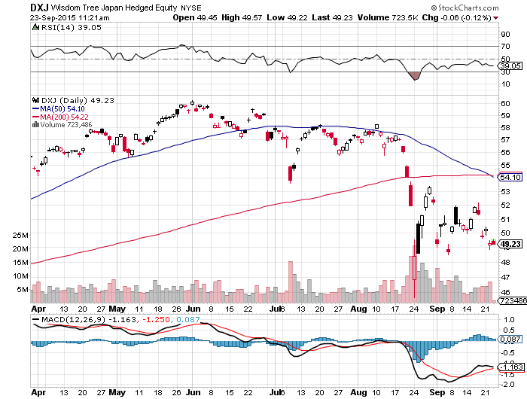
Japan (DXJ)-Hedged Japan Equity took profits on 20% weighting-Love That Stimulus! 10% in 2 Days

Slide 39
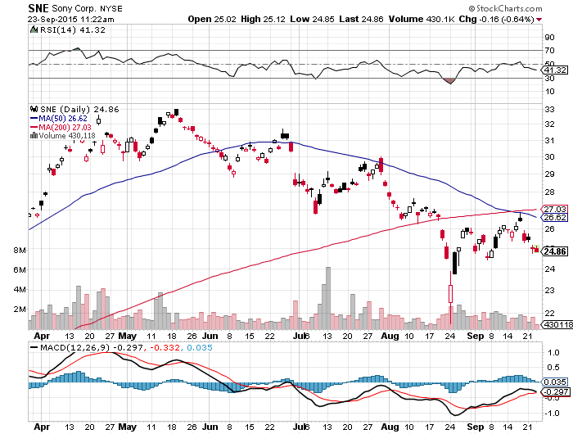
Sony (SNE)-Buy Territory

Slide 40
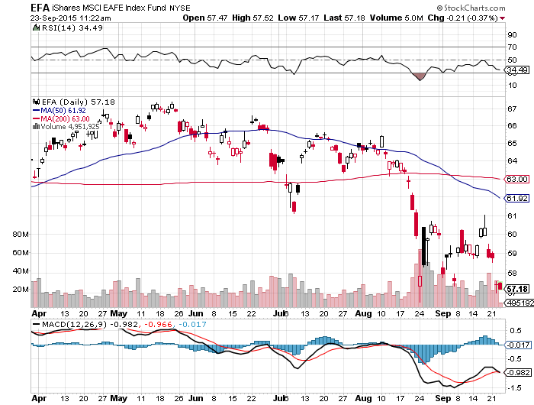
Emerging Markets (EFA)-
Still a No Go

Slide 41
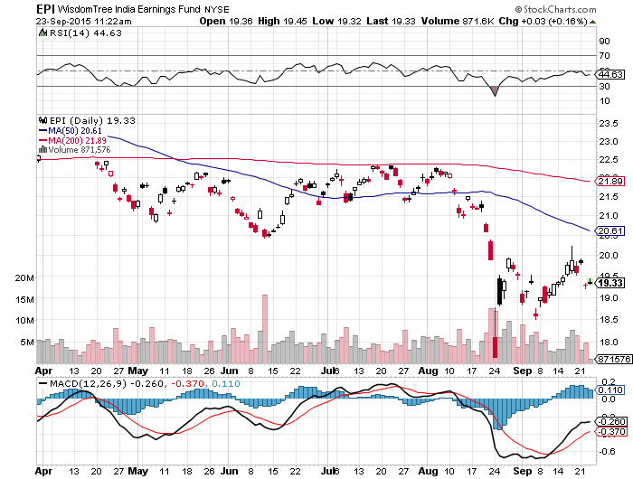
India (EPI)-Buy it Here

Slide 42

Foreign Currencies-Long Term Trends Reasserting
*No interest rate rise from the Fed triggers immediate profit taking in the dollar, but the bull market reasserted in just a couple of days latter
*Created another great long dollar entry point
*Refugee crisis is diverting European attention away from the economy,
400,000 new immigrants?
*China Yuan stabilizes, government is supporting
it at current level
*Euro gives back its spike
*Yen moves into another wedge pattern
awaiting a downside breakout

Slide 43
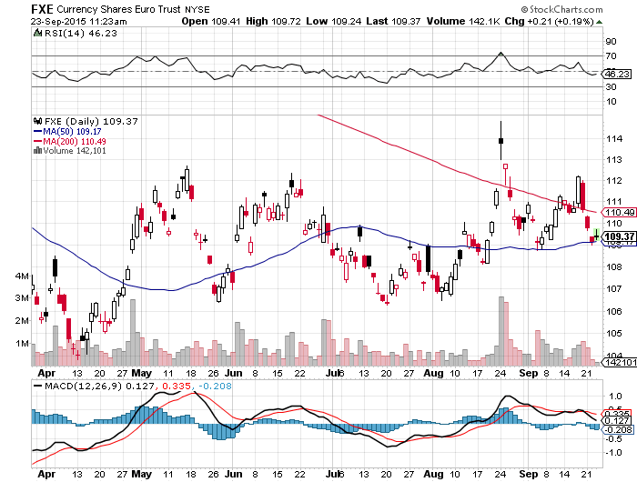
Euro ($XEU), (FXE), (EUO)-Playing Both Asides

Slide 44
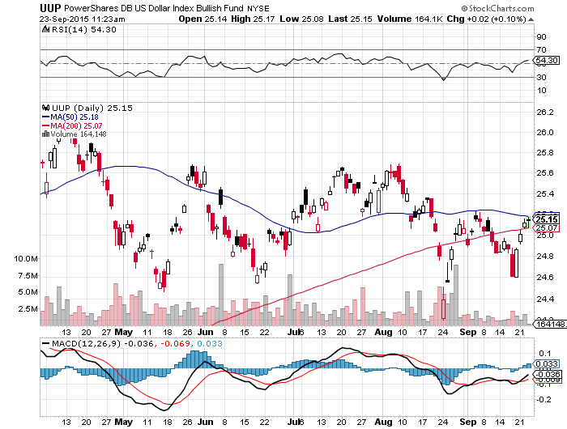
Long Dollar Index (UUP)-

Slide 45
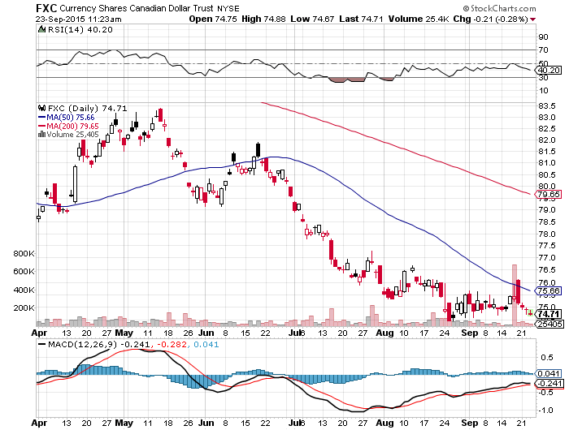
Canadian Dollar (FXC)-Commodity Collapse

Slide 46
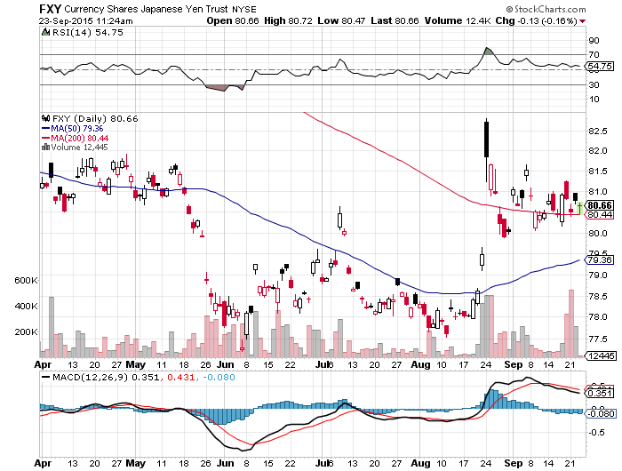
Japanese Yen (FXY)-

Slide 47
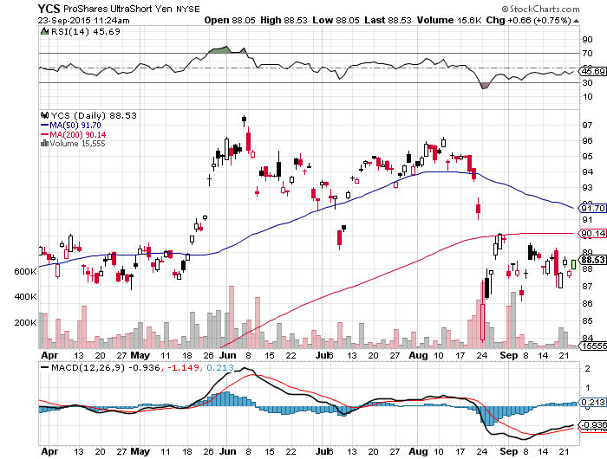
Short Japanese Yen ETF (YCS)

Slide 48
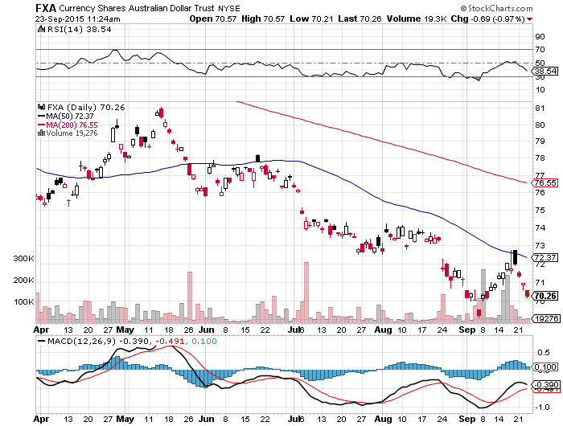
Australian Dollar (FXA) –Commodity Disaster

Slide 49
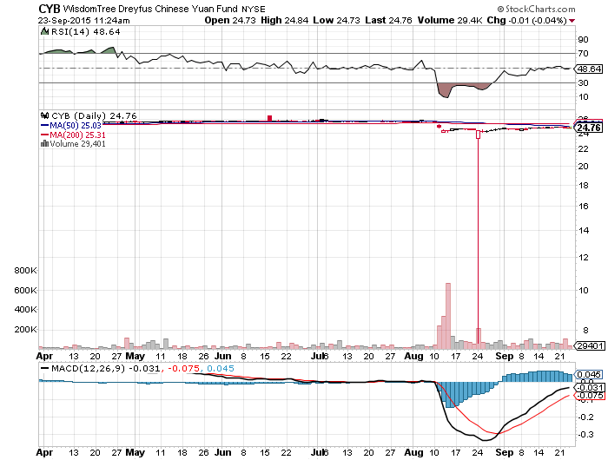
Chinese Yuan- (CYB)-4% Devaluation

Slide 50
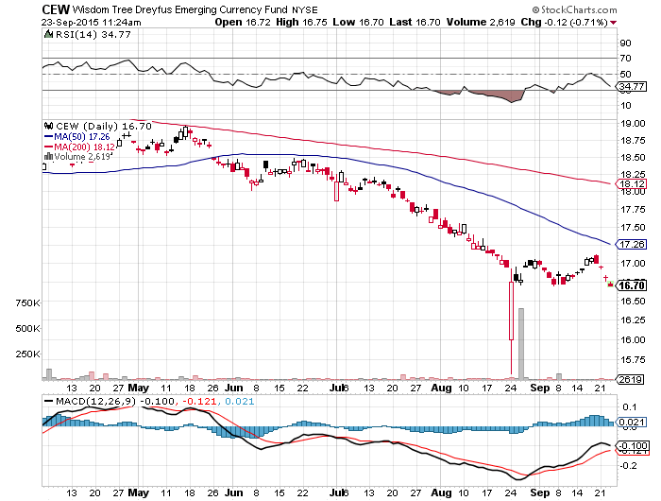
Emerging Market Currencies (CEW) another hedge fund short target and flash crash

Slide 51
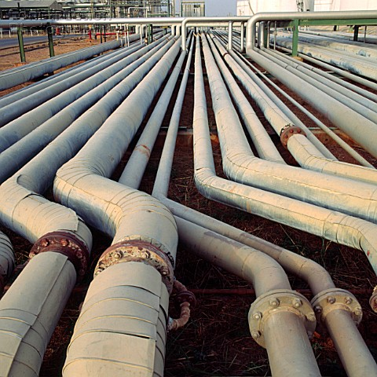
Energy-Chaos
*The oil markets are now moving from seasonal strength to weakness, should bring the final bottom, speculators now play from the long side
*Wild trading within wide range means nobody has a clue what is happening
*Goldman Sachs downgrades oil target to a potential $20/barrel
*Dividends dropping like flies throughout the energy space, cut by half or all?
*Oil deflation was a major factor in Fed decision
to hold
*Many traders abandoning an untradable
market, worsening liquidity
*Buy this final washout

Slide 52
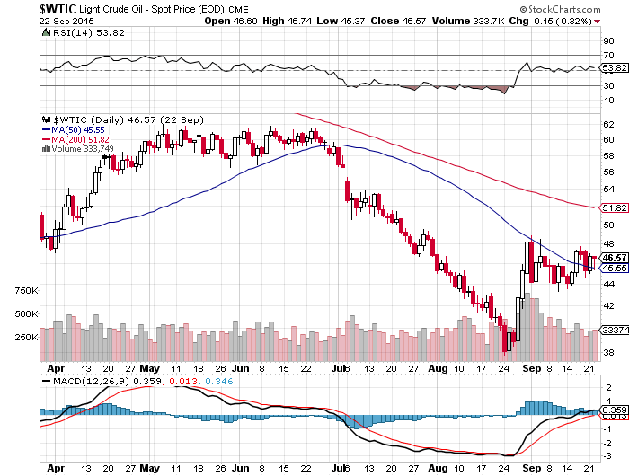
Oil-May Be a Q4 Story

Slide 53
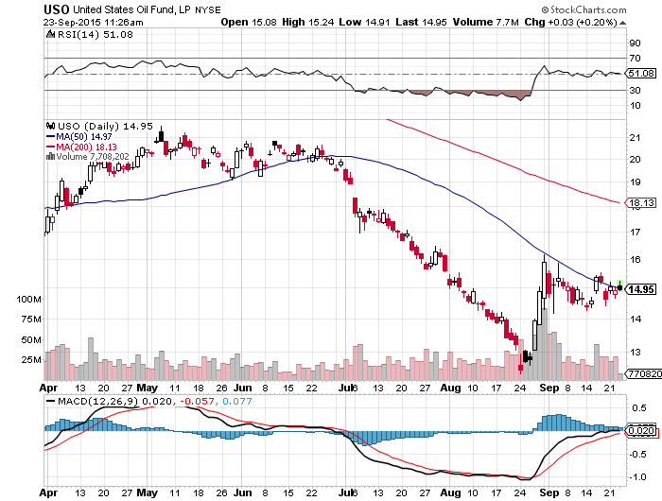
United States Oil Fund (USO)

Slide 54
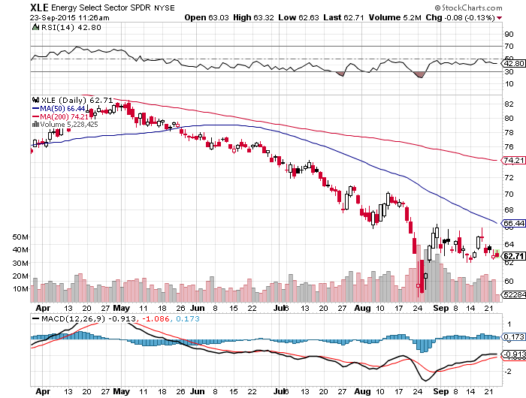
Energy Select Sector SPDR (XLE)
(XOM), (CVX), (SLB), (KMI), (EOG), (COP) stocks lead oil turnaround by 6 months

Slide 55
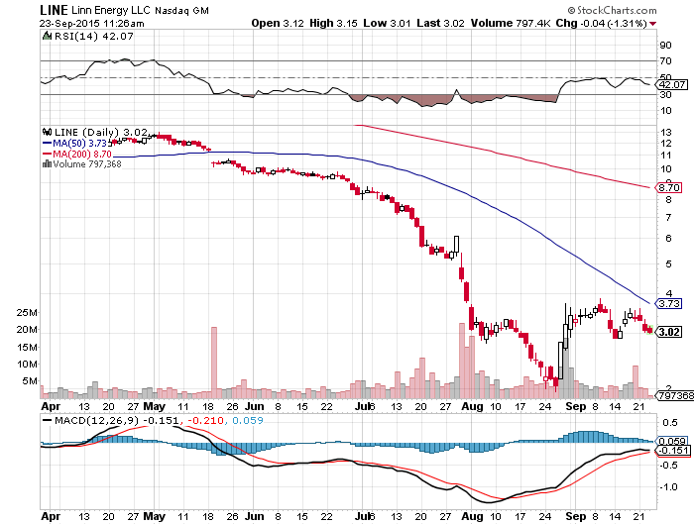
MLP’s (LINE)-Dividend Suspended!
Shares fall to option value

Slide 56
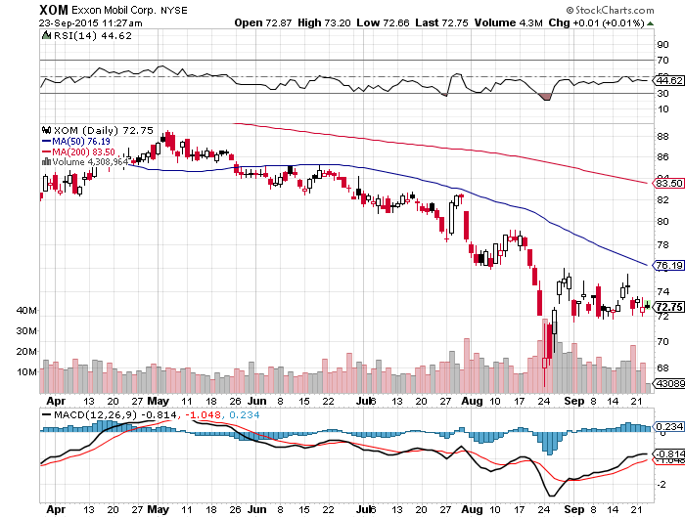
Exxon (XOM)-A Perfect Storm
Oil Crashes, then the Stock Market Crashes

Slide 57
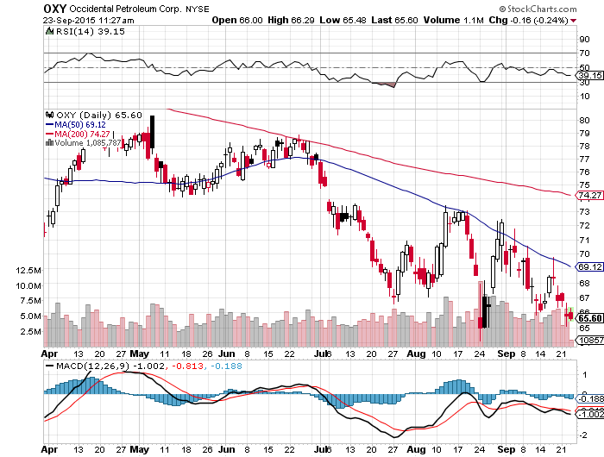
Occidental Petroleum (OXY)-

Slide 58
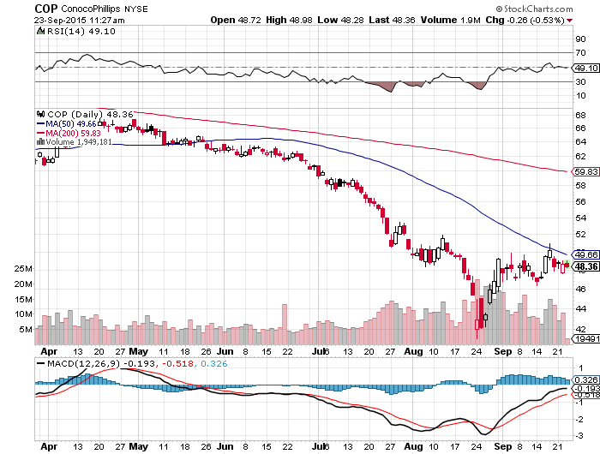
Conoco Phillips (COP)-

Slide 59
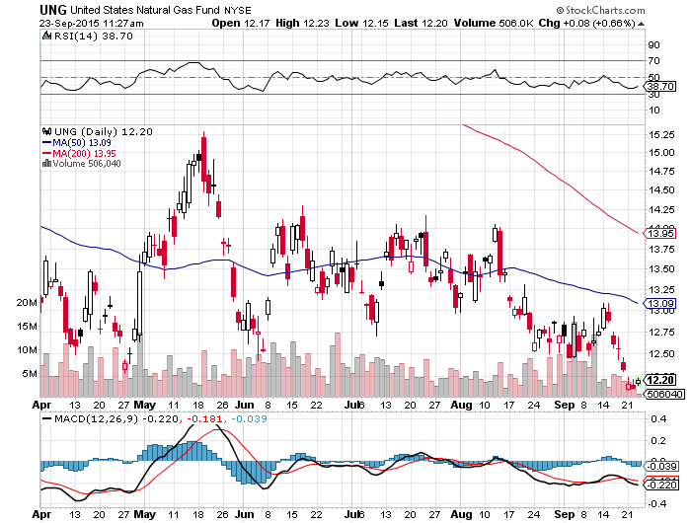
Natural Gas (UNG)-Bouncing along a bottom

Slide 60
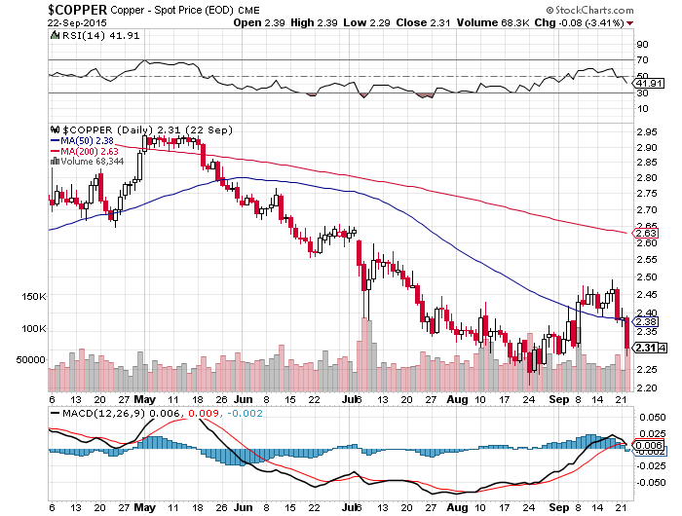
Copper-Commodity Collapse

Slide 61
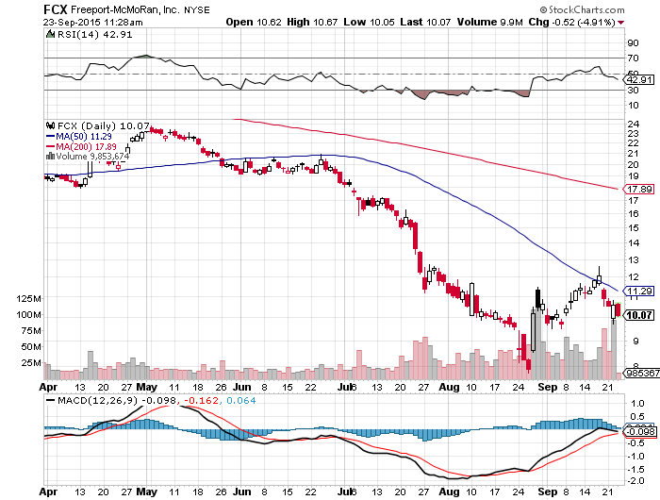
Freeport McMoRan (FCX)-New Lows

Slide 62

Precious Metals-Dead in the water
*Fed inaction postpones the pain for gold, but not for long
*CTA gold futures net position reaches a short for the first time in history
*Focus is on other asset classes and price action in precious metals goes dead
*Stay away, better fish to fly elsewhere

Slide 63

Gold (GLD)- Finally, A Flight to Safety

Slide 64

Market Vectors Gold Miners ETF- (GDX)

Slide 65

Silver (SLV)-

Slide 66

Silver Miners (SIL)

Slide 67

Palladium (PALL)

Slide 68

Agriculture-Dead Cat Bounce
*Bad weather in Midwest finally arrives
*USDA revises down corn crop from 13.686 to 15.585 billion bushels, -4%, triggering short covering rally
*Still the third largest crop in history, but reductions may continue into October and November
*Extreme drought conditions continue in California, another 100 square miles lost to fires over the weekend
*No trade here, dragged down by the
global commodity bust
*Pass for now, bigger fish
to fry elsewhere, US stocks
much more interesting

Slide 69

(CORN) –Back to the Bottom

Slide 70

(WEAT)-

Slide 71

Ag Commodities ETF (DBA)-New Lows!

Slide 72

Real Estate-Still on Fire
*August single home starts a ten year high 699,000 units
*Big disappointment on August existing home sales, down -4.8%
*Inventories of existing homes for sale down 1.7% YOY, shortage of homes hurting sales figures and raising prices
*32% are first time homebuyers, better than recent 30%, but a far cry from the traditional 40% level.
*Distress sales fall to only 7% well
off 35% Great Recession peak
*Homebuilders to lead stock for rest of 2015
*Predicted rush to buy homes to beat
the fed interest rate hike is unfolding

Slide 73

June S&P/Case–Shiller Home Price Index
+5.0% YOY, Denver, San Francisco, Dallas

Slide 74

US Home Construction Index (ITB)
(DHI), (LEN), (PHM), (TOL), (NVR)

Slide 75

Trade Sheet
So What Do We Do About All This?
*Stocks- buy the big dips in best names only
*Bonds-the top is in, sell rallies, buy (TBT)
*Commodities-stand aside, buy the next oil down leg
*Currencies- Sell short the Yen and Euro on rallies
*Precious Metals –stand aside, wait for new low
*Volatility-sell short spikes through (XIV)
*The Ags –wait for new lows
*Real estate-buy the homebuilders LT

Slide 76

To buy strategy luncheon tickets
Please go to: www.madhedgefundtrader.com
Next Strategy Webinar
12:00 EST Wednesday,
October 7, 2015
San Francisco, California
USA!
Good Luck and Good Trading!
Notes:
*

