Slide 1
Mad Day Trader
Bill Davis
Webinar – October 14, 2015

Slide 2
There was enough interest in the corporate buybacks, that I will add a PDF to the members area every month.

Slide 3
I am going to show some examples of buyback activity and the resulting stock price movement. But, I want to caution that just because a company announces a buyback does not mean it is a automatic signal to buy.

Slide 4
Having said that, it is nice to know if a company is reducing their outstanding shares. Let’s look at a few from this year.

Slide 5
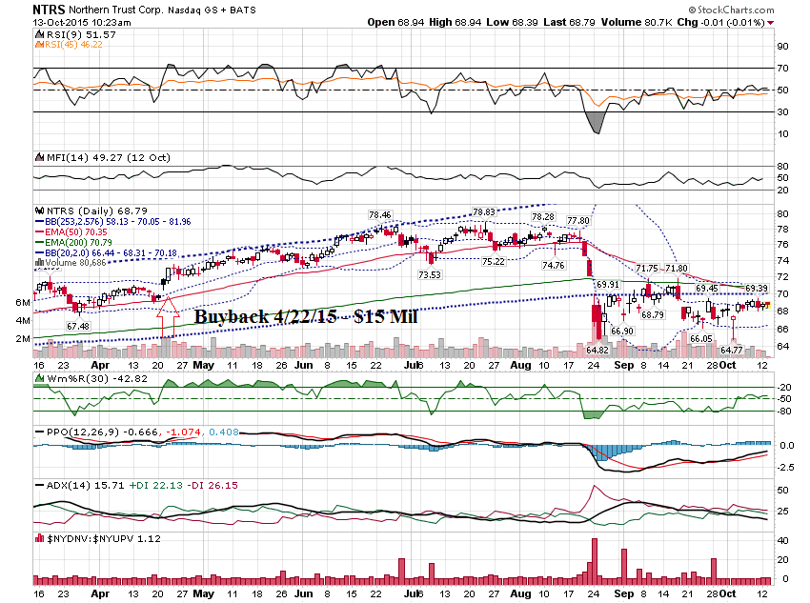

Slide 6
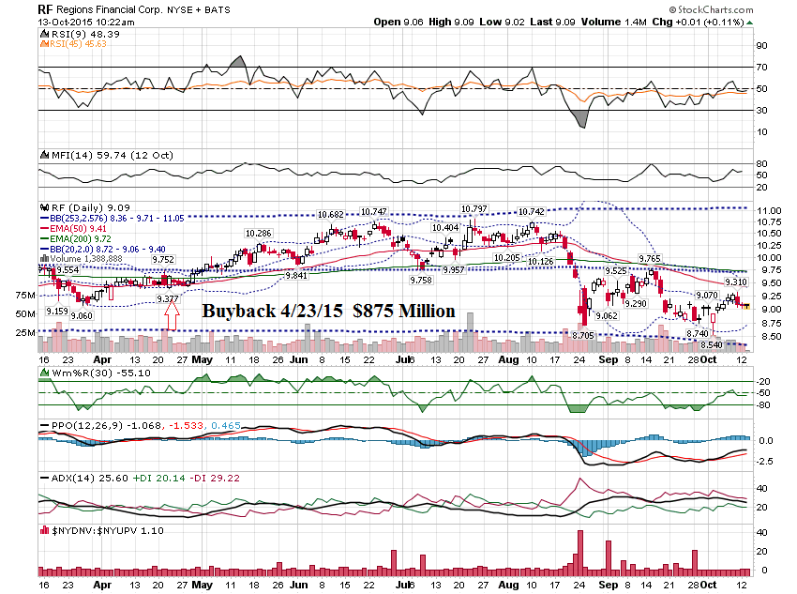

Slide 7
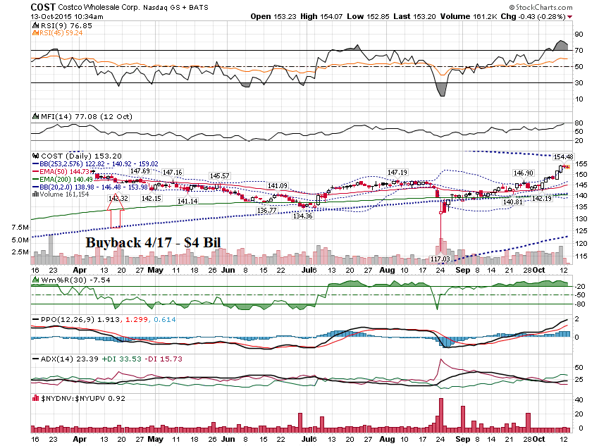

Slide 8
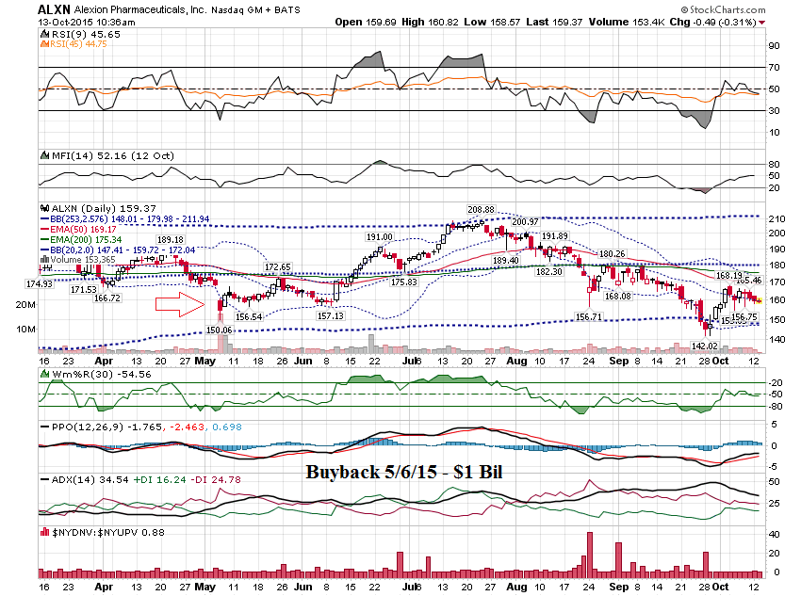

Slide 9
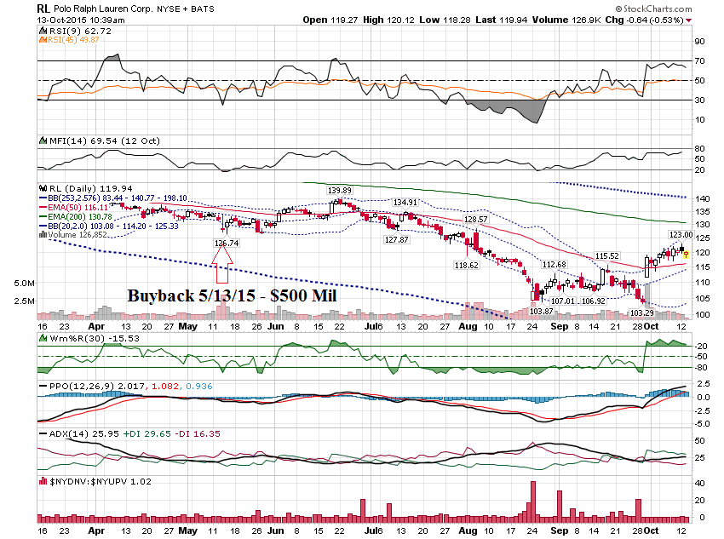

Slide 10
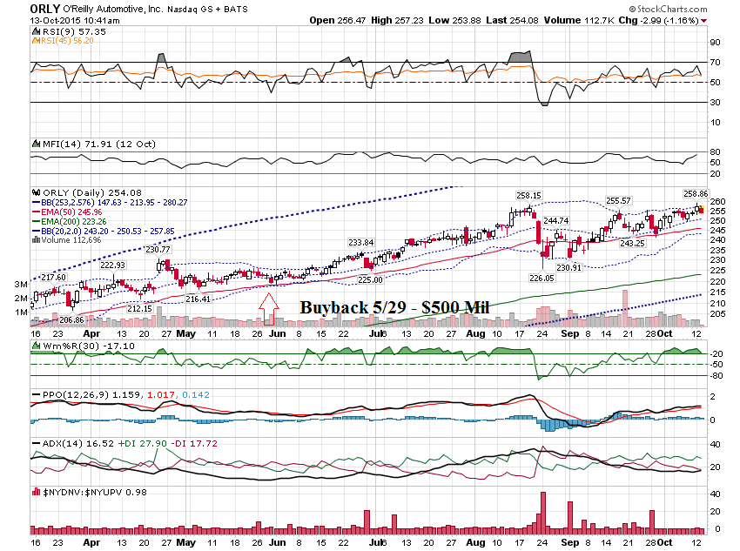

Slide 11
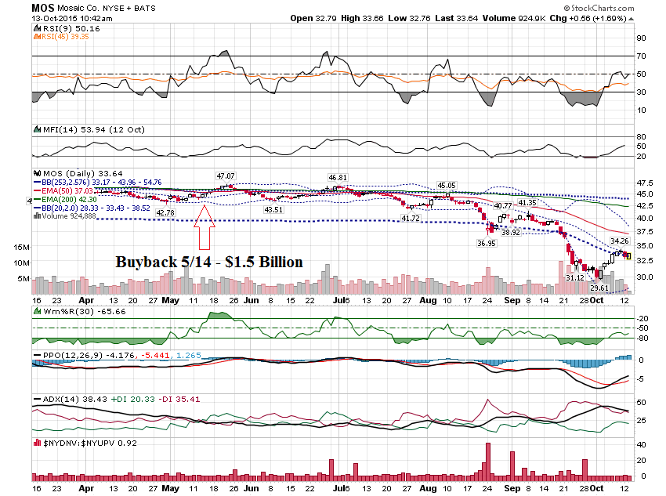

Slide 12
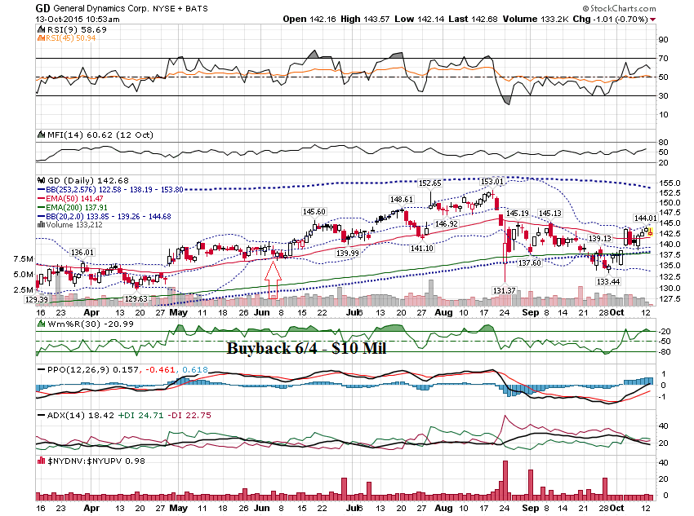

Slide 13
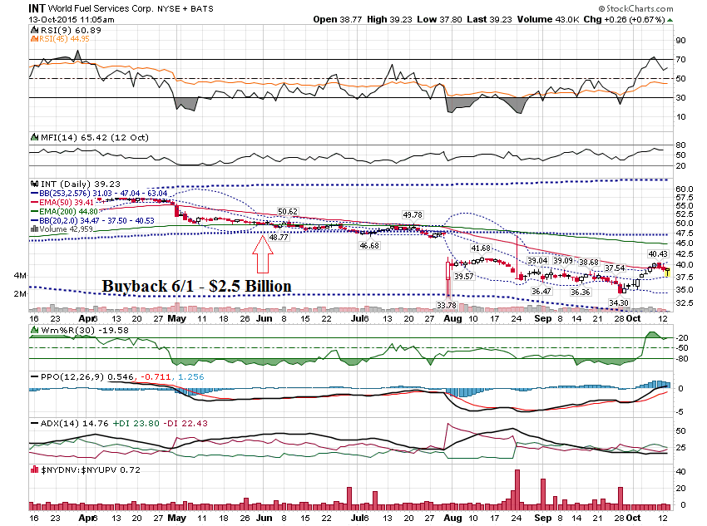

Slide 14
Here are some companies that announced buybacks last year. Price action is depicting using weekly charts.

Slide 15
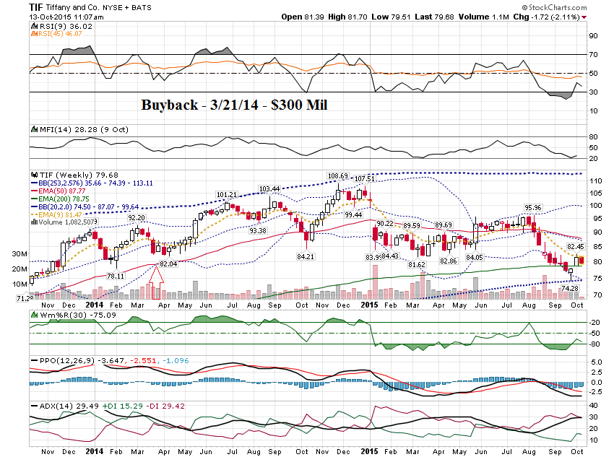

Slide 16
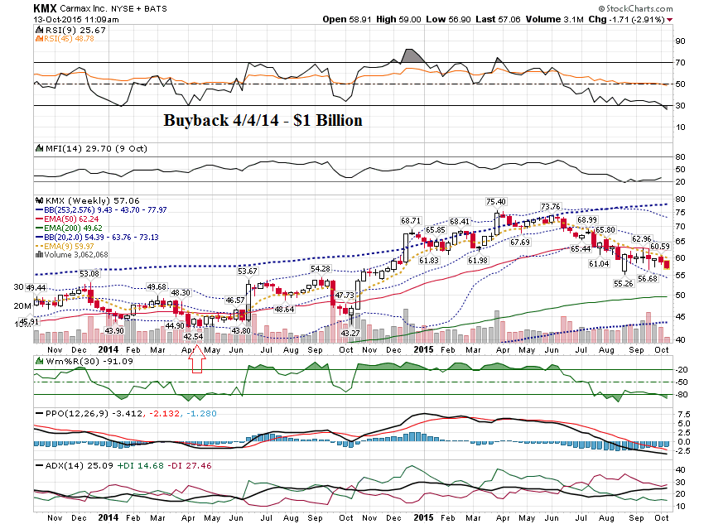

Slide 17
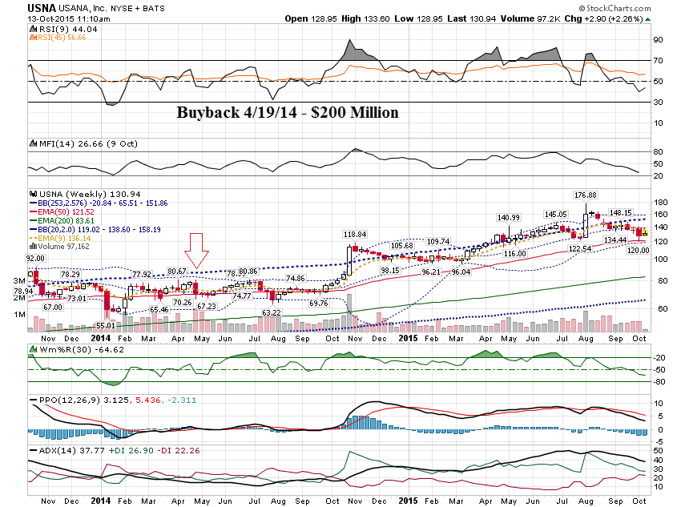

Slide 18
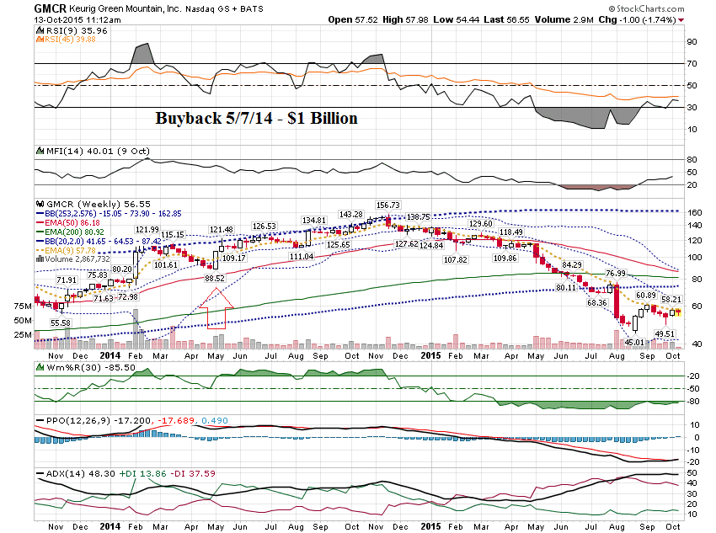

Slide 19
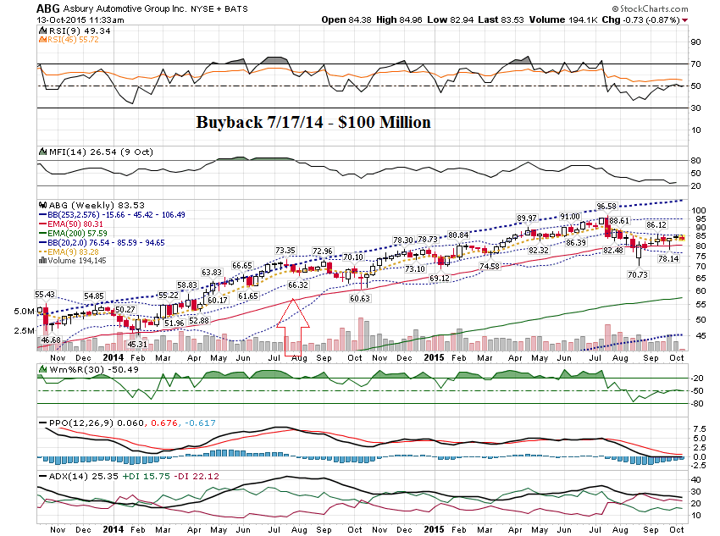

Slide 20
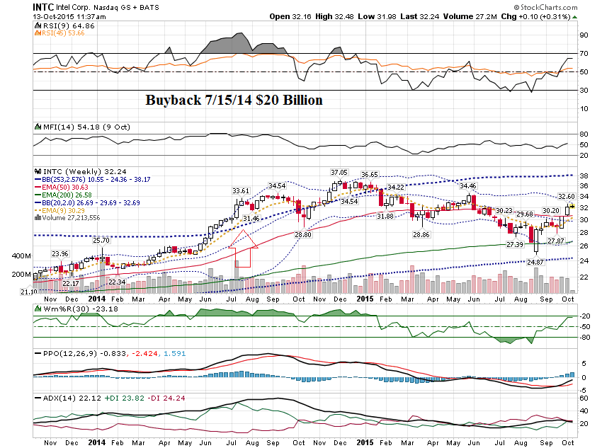

Slide 21
As you can see, following stocks that announce buybacks can be profitable. But, you still need to trade off a technical set up and take profits where appropriate.

Slide 22
Let’s move on to the support & resistance levels.

Slide 23
The first thing to do is to determine the trends on short timeframes.

Slide 24
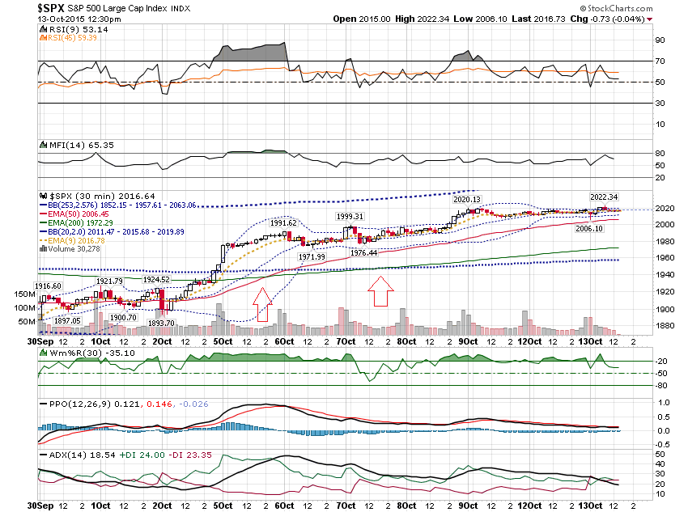

Slide 25
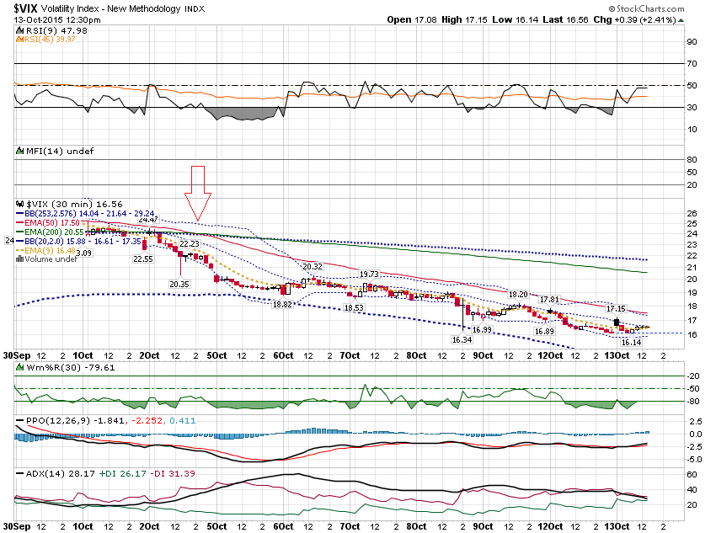

Slide 26
Now let’s look at the charts with the relevant support & resistance levels.

Slide 27
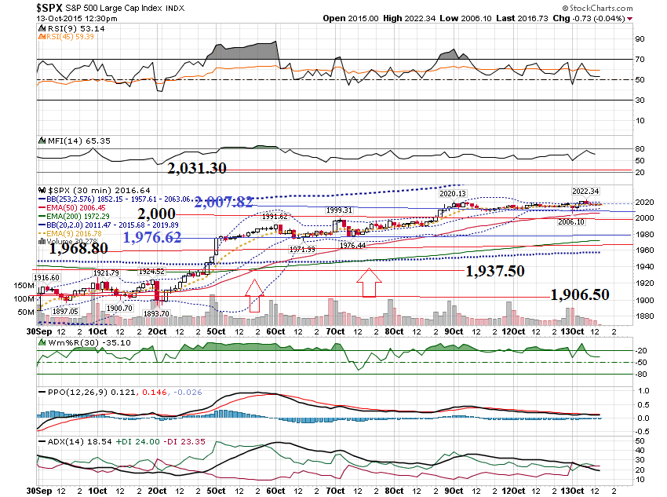

Slide 28
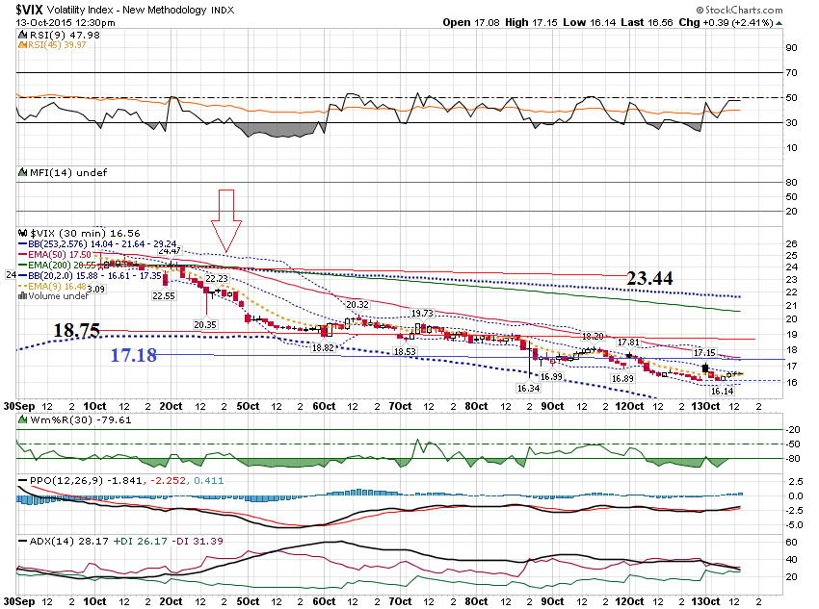

Slide 29
Let’s shorten this down to see how you could use this for an intra day trade.

Slide 30
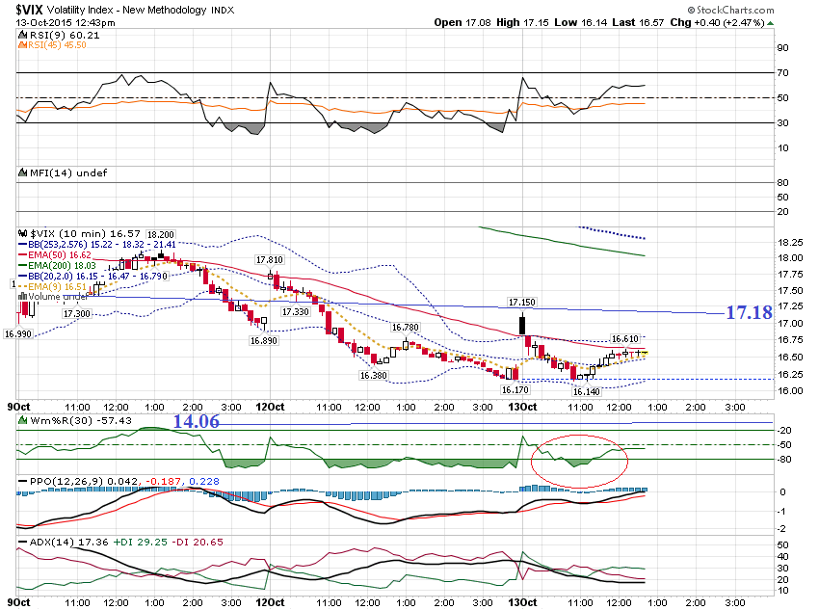

Slide 31
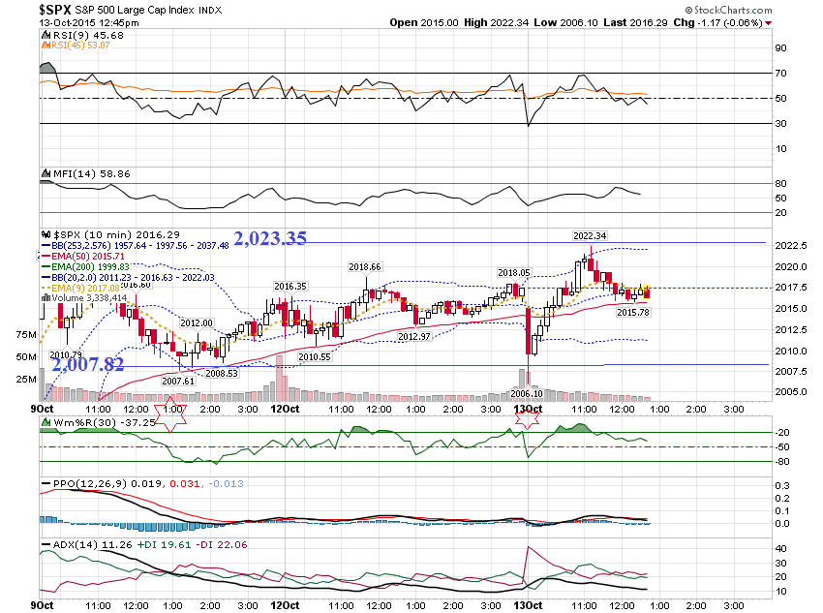

Slide 32
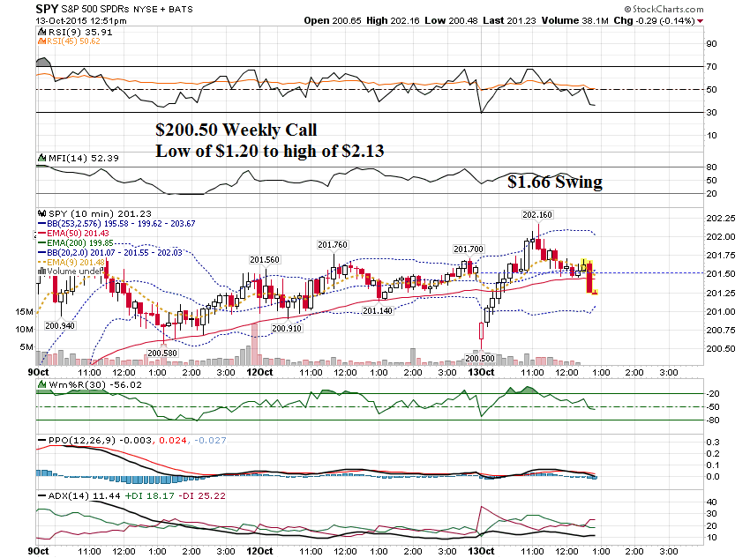

Slide 33
The final topic I want to discuss is the use of the extreme bollinger bands. Generally, you expect certain price expectations when they are violated. And when hold as support (or resistance).

Slide 34
Today I want took at a bottoming formation and what to expect.

Slide 35
I like to look at the price action in multiple timeframes. I will check the daily, a 2 hour chart and a 1 hour chart.

Slide 36
Generally, if the higher timeframe is in an uptrend, and price gets under the lower band on the lower timeframe, it is a buy!

Slide 37
Let’s look at an example …

Slide 38
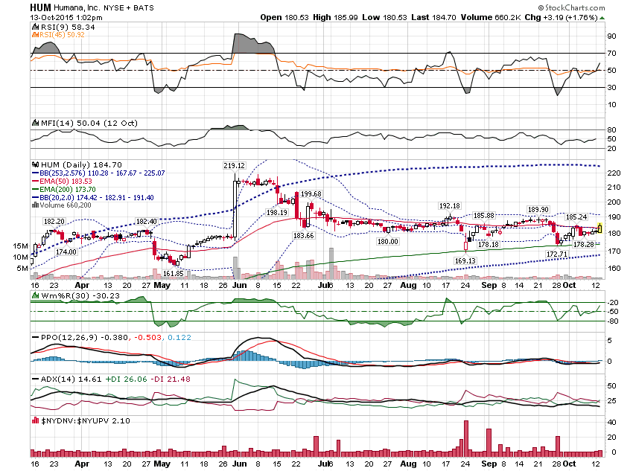

Slide 39
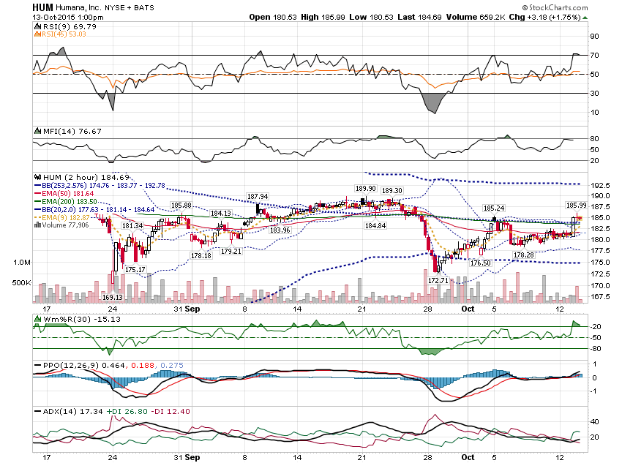

Slide 40
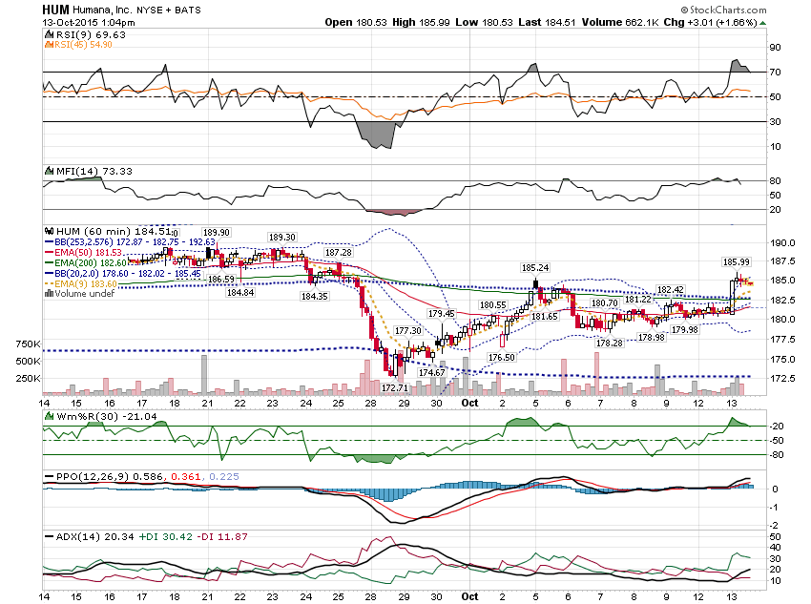

Slide 41
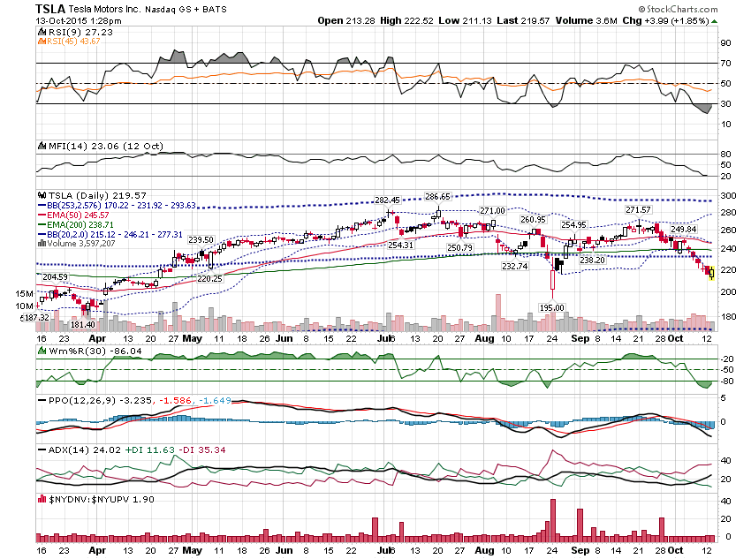

Slide 42
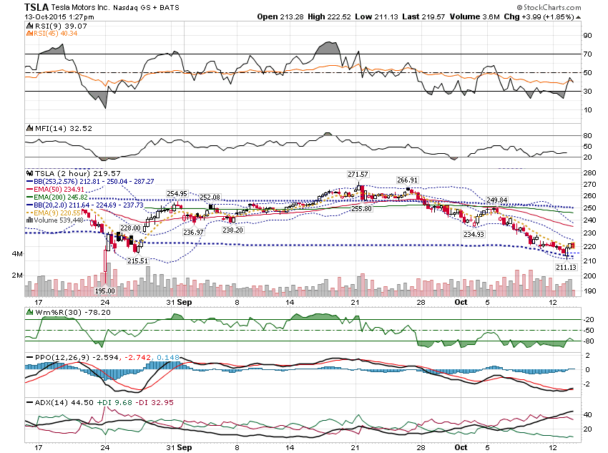

Slide 43
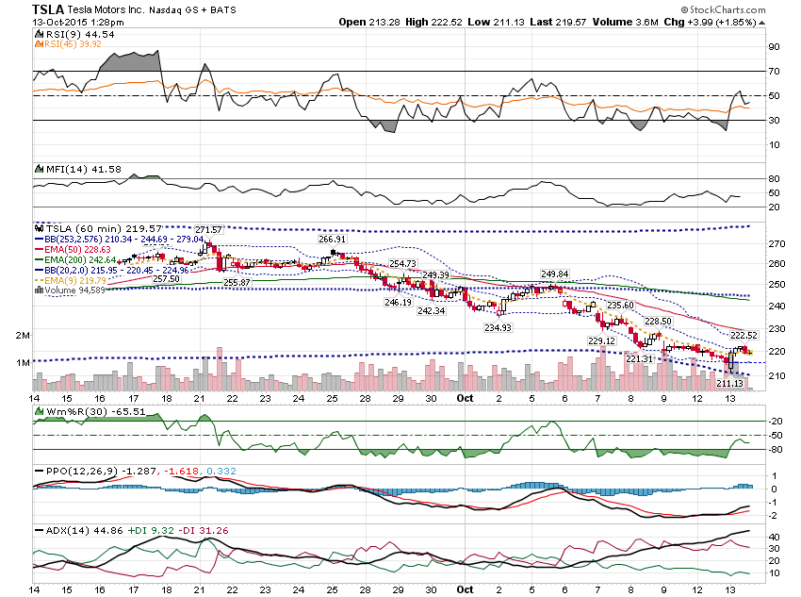

Slide 44
Here is an example of the daily & 2 hour in uptrends & the 60 minute under the lower band.

Slide 45
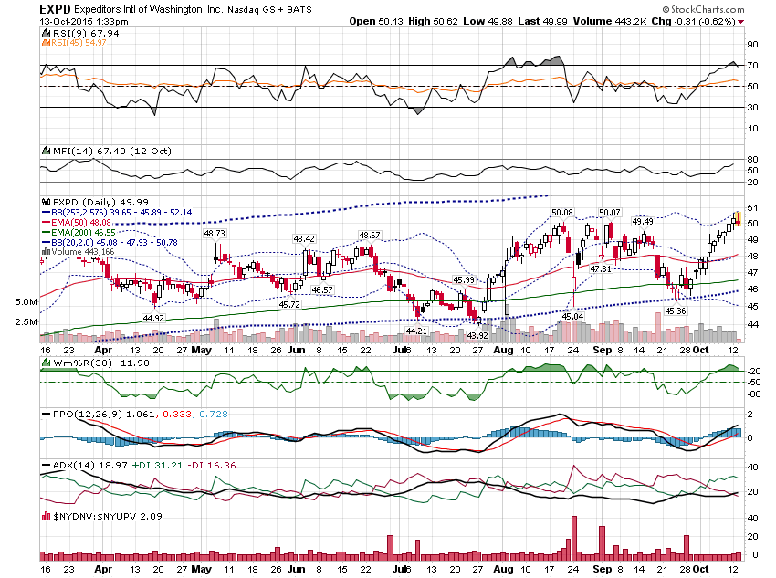

Slide 46
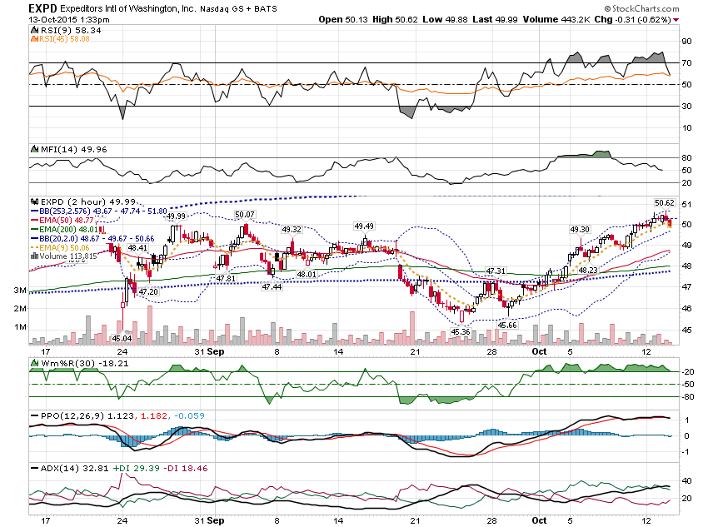

Slide 47
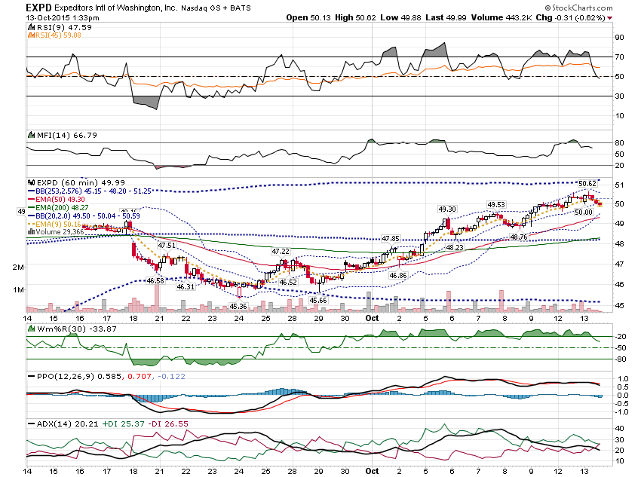

Slide 48
Let’s look at one final example with the Daily under the bottom band.

Slide 49
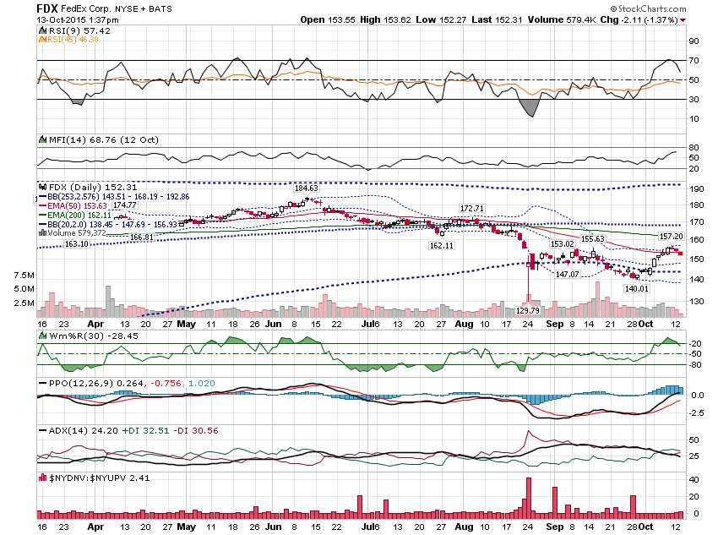

Slide 50
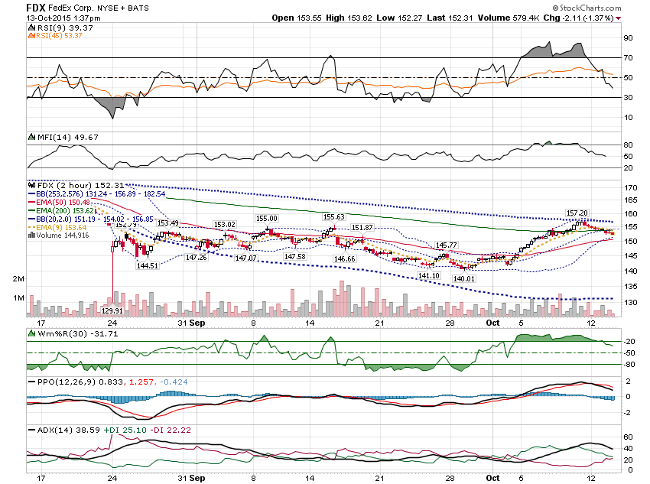

Slide 51
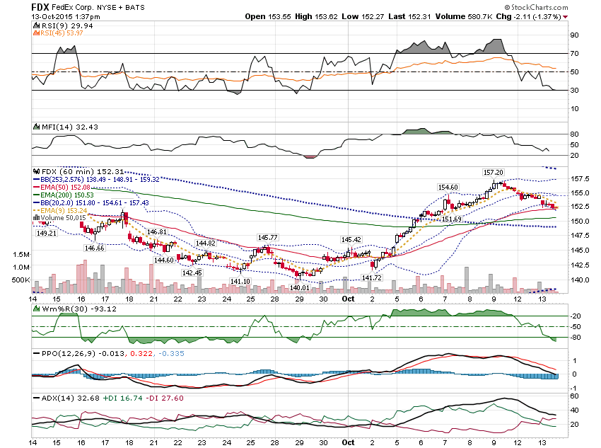

Slide 52
Thanks for watching! Bill Davis Mad Day Trader October 14, 2015 davismdt@gmail.com

