Slide 1
Mad Day Trader
Bill Davis
Webinar – October 5, 2015

Slide 2
I want to review the major markets as a follow up to the special report I wrote in August. It can be found here: http://www.madhedgefundtrader.com/wp-content/uploads/2015/08/Major-Market-Outlook-August-2015.pdf

Slide 3
In that report, I mentioned that the major markets where all trading at extremes. I also argued that the Biotech sector (IBB) was in a bubble.

Slide 4
Today closes out the 3rd quarter of 2015 and I will show monthly charts for September which exclude today’s action. (Close enough for review)

Slide 5
Let’s look at the major indexes …

Slide 6
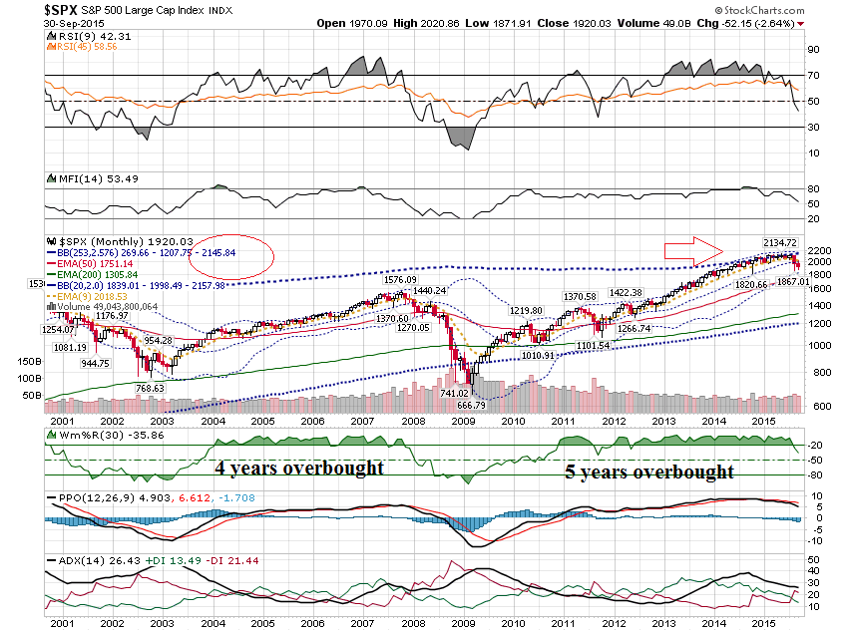

Slide 7
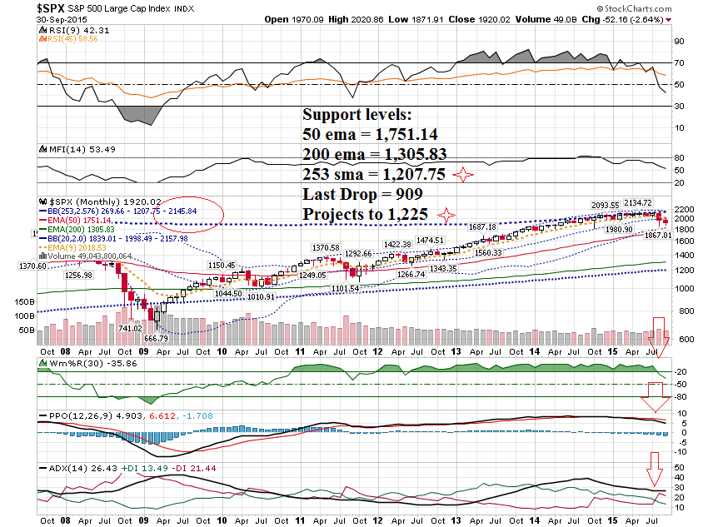

Slide 8
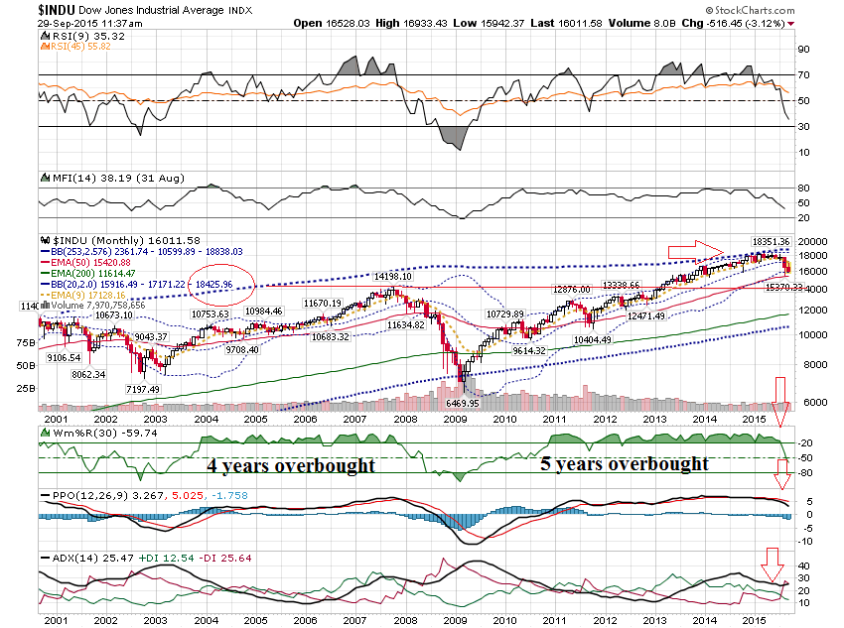

Slide 9
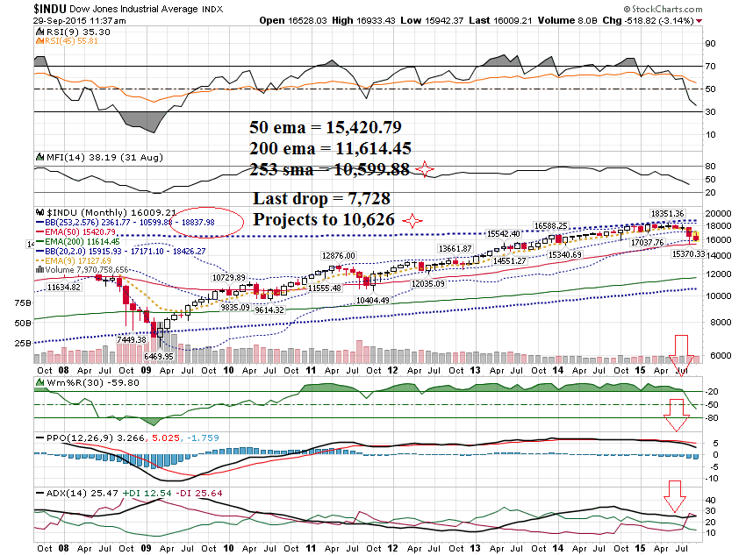

Slide 10
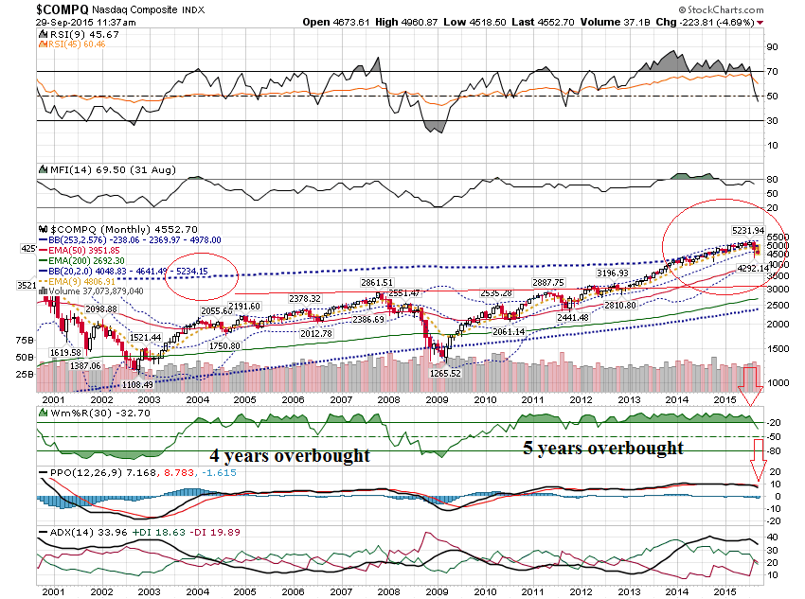

Slide 11
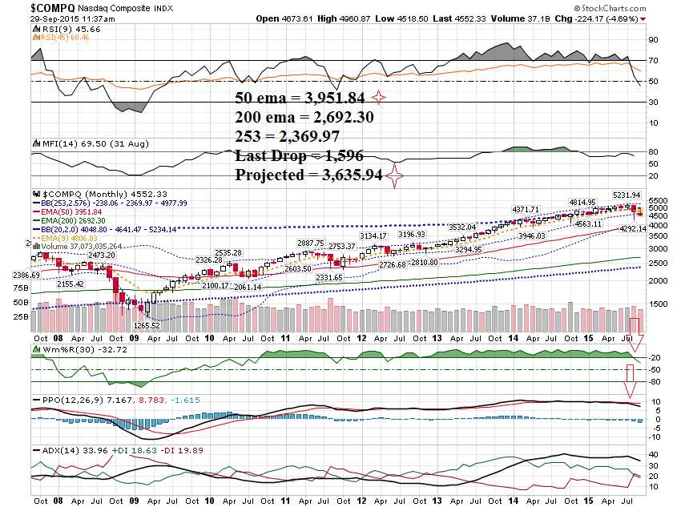

Slide 12
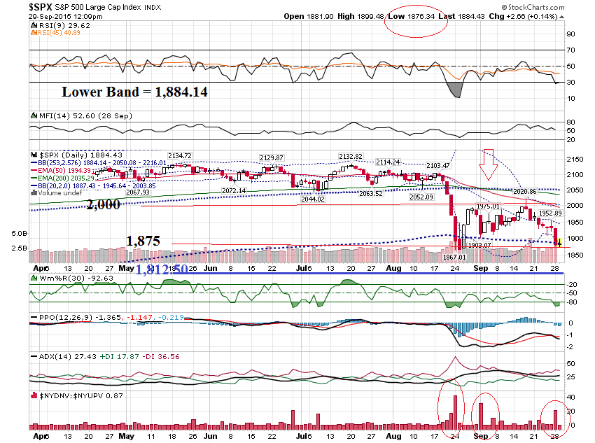

Slide 13
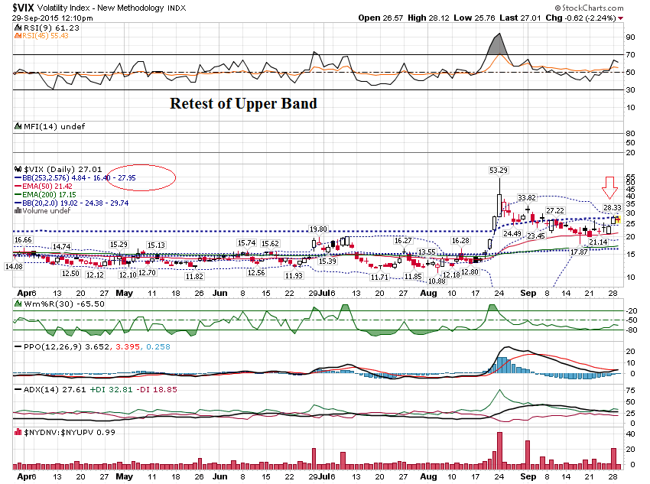

Slide 14
"Credit Suisse: There's a Growing Threat of a Major Top in the S&P 500" Yahoo Finance - September 28, 2015

Slide 15
In the August Special Report, I mentioned that the Biotech Sector was in a bubble. Let’s take a look at a few of their charts.

Slide 16
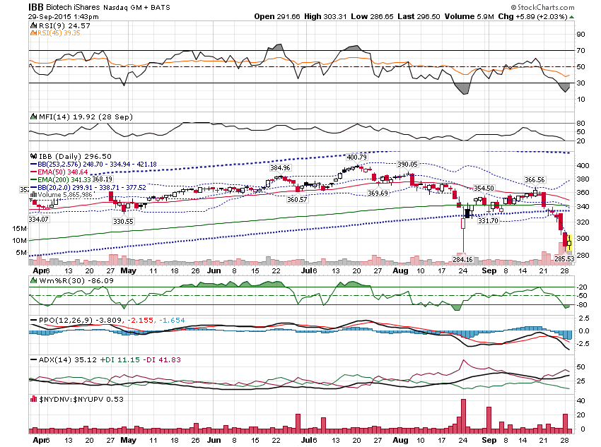

Slide 17
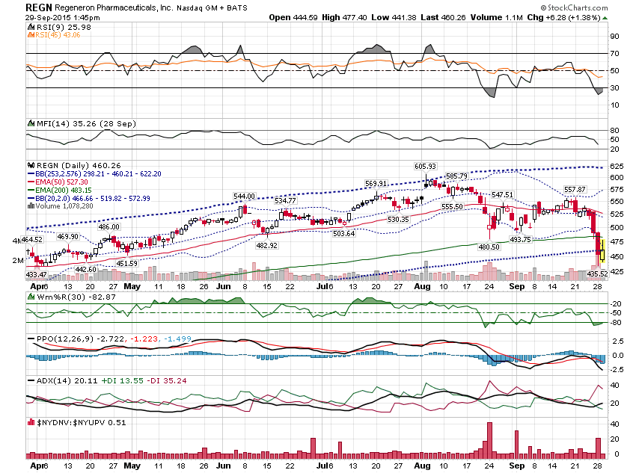

Slide 18
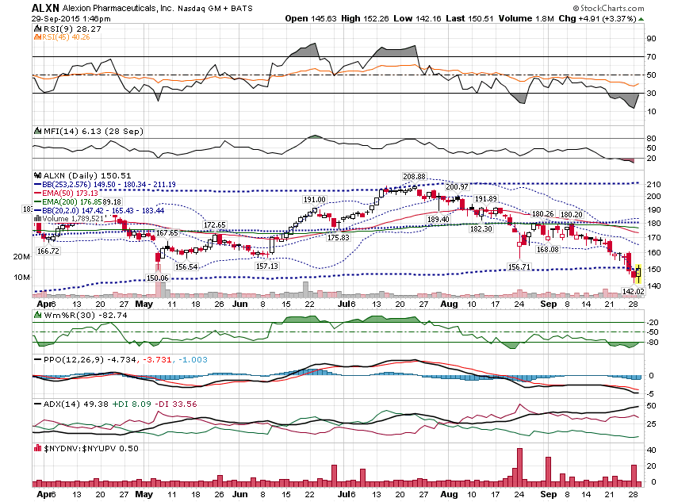

Slide 19
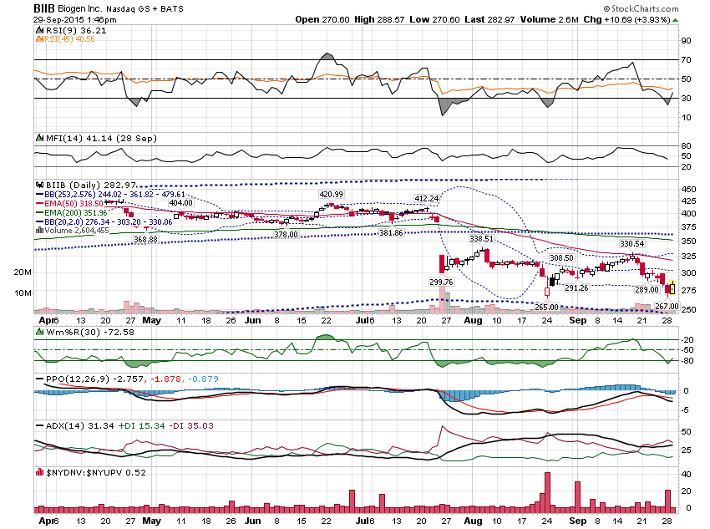

Slide 20
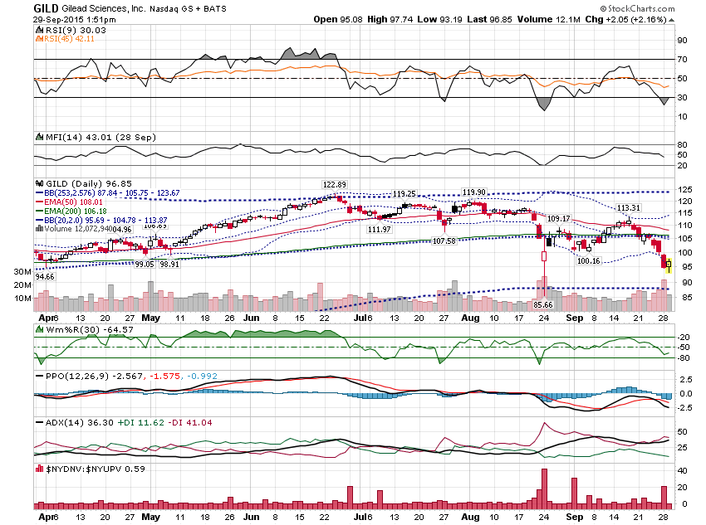

Slide 21
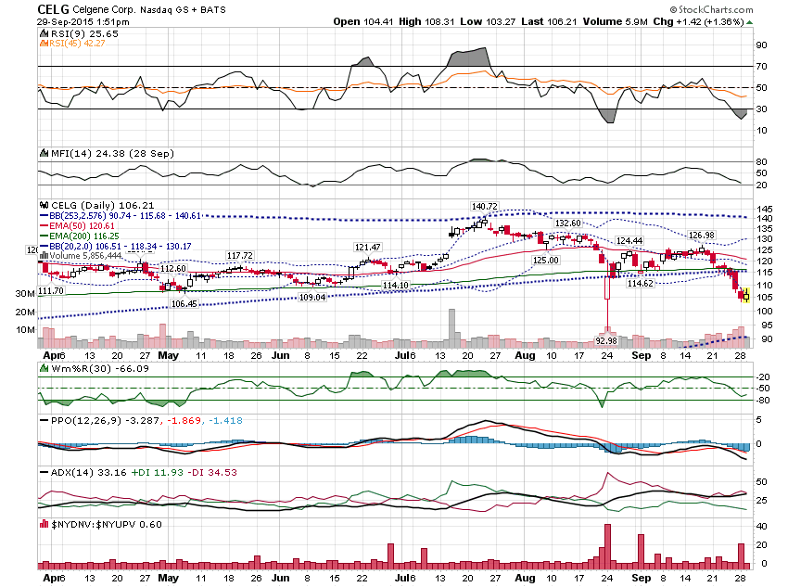

Slide 22
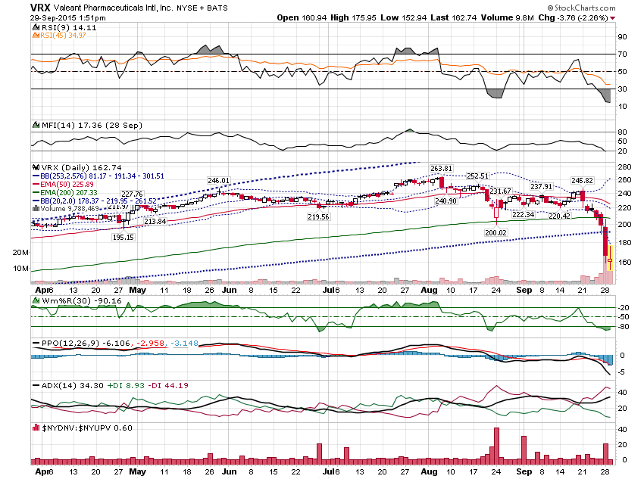

Slide 23
So, what do we do in a market like this?

Slide 24
Certainly, you want to trade smaller and take profits quickly. Built up cash and work on your watchlist.

Slide 25
You can also consider trading off a shorter timeframe, if you have the time availability, using thee leverage of weekly options … especially on a Friday.

Slide 26
Before I show that, I mentioned I would show the move that VNR made in the last 10 minutes on expiration day ….

Slide 27
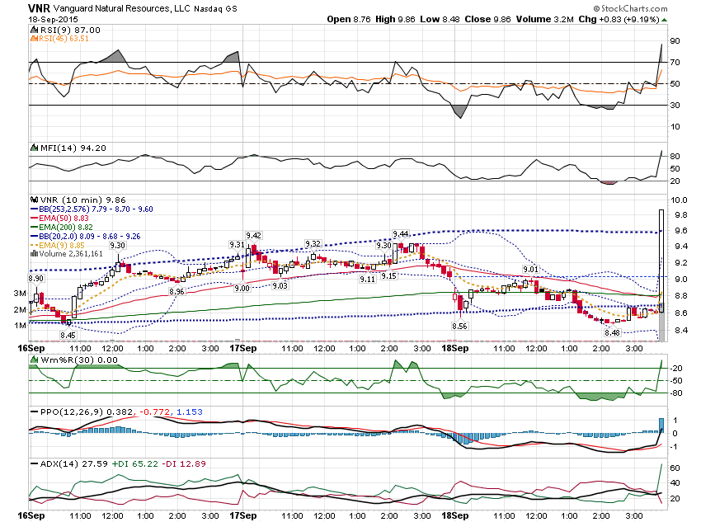

Slide 28
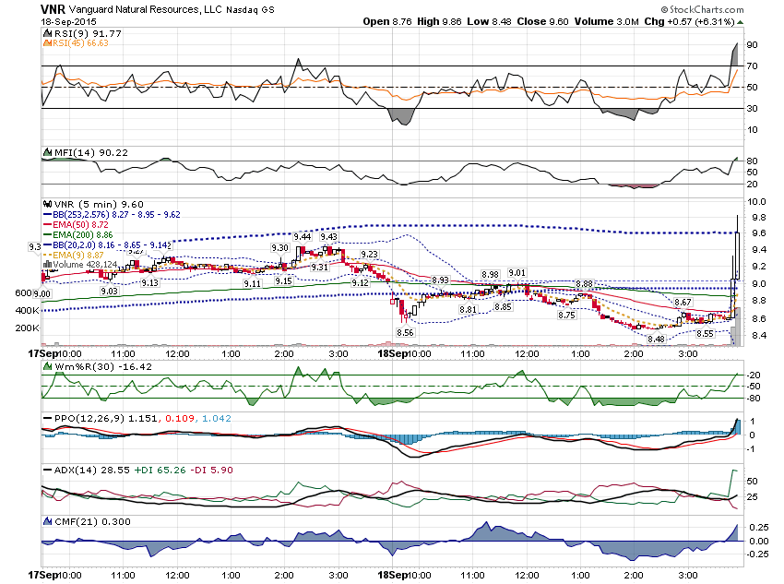

Slide 29
What I like to do is to look for stocks where multiple timeframes are in agreement and then look to enter off a 10 minute overbought or oversold condition.

Slide 30
For example, the 60 minute, 30 minute and 10 minute charts are in uptrends and you buy off an oversold condition off the 10 minute.

Slide 31
Or the 60 minute, 30 minute, and 10 minute are in downtrends and you Sell an overbought condition off the 10 minute.

Slide 32
Let’s look at some examples from last Friday’s weekly expiration day …

Slide 33
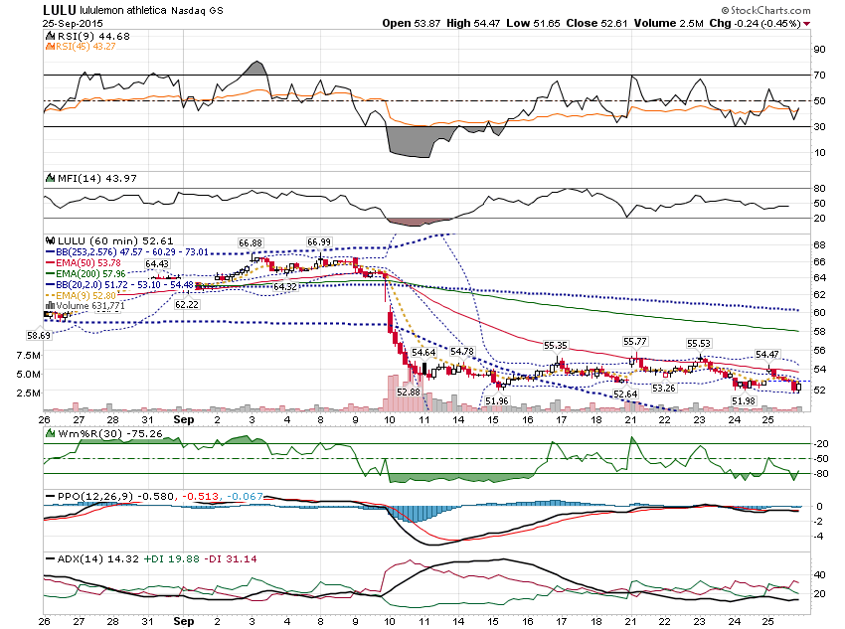

Slide 34
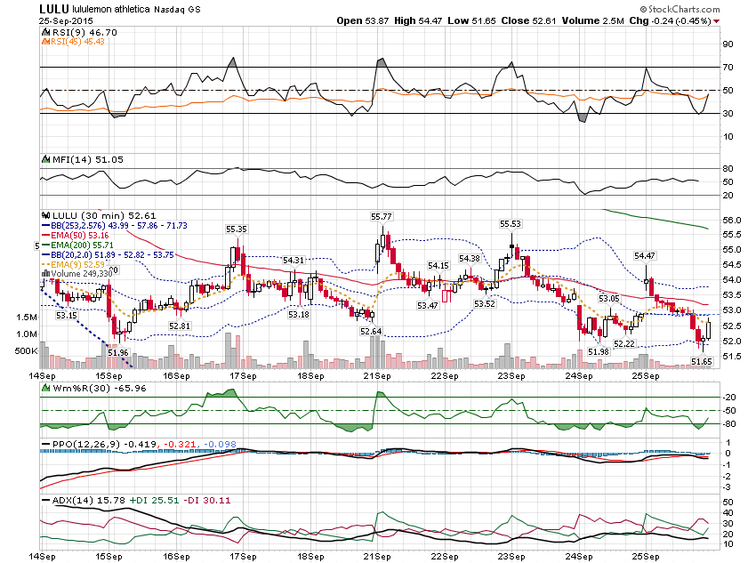

Slide 35
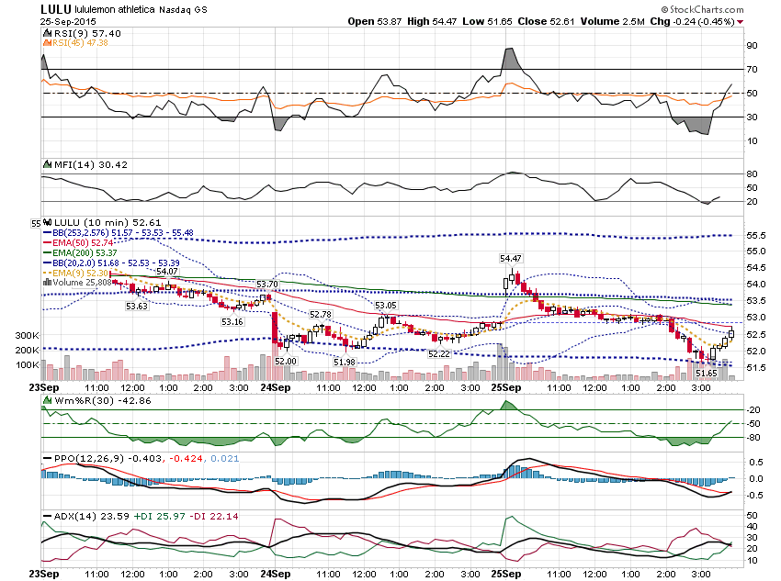

Slide 36
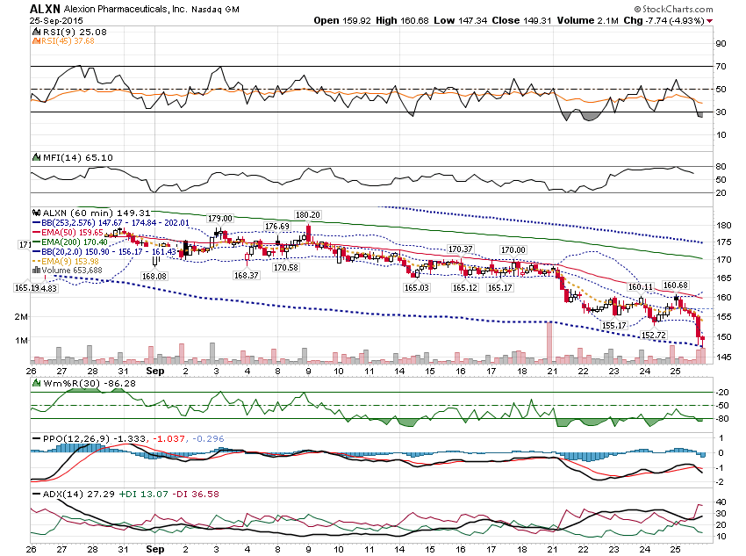

Slide 37
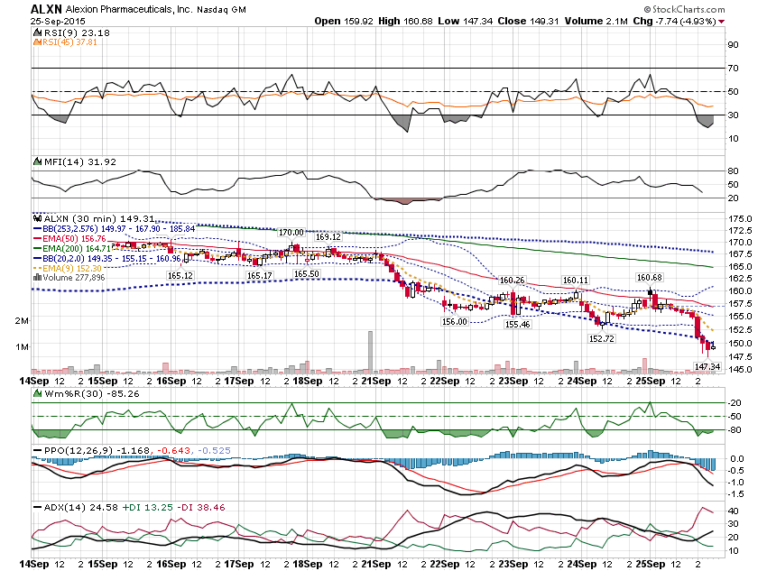

Slide 38
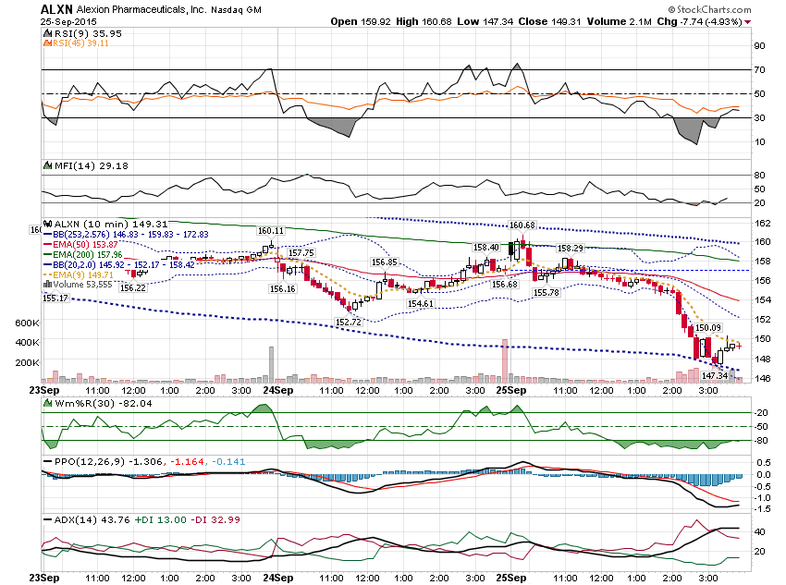

Slide 39
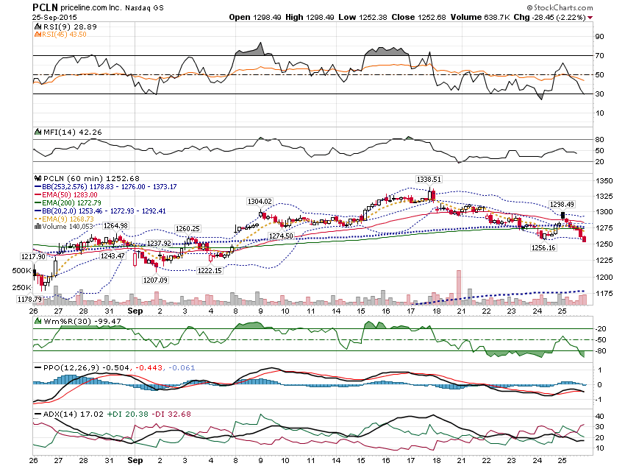

Slide 40
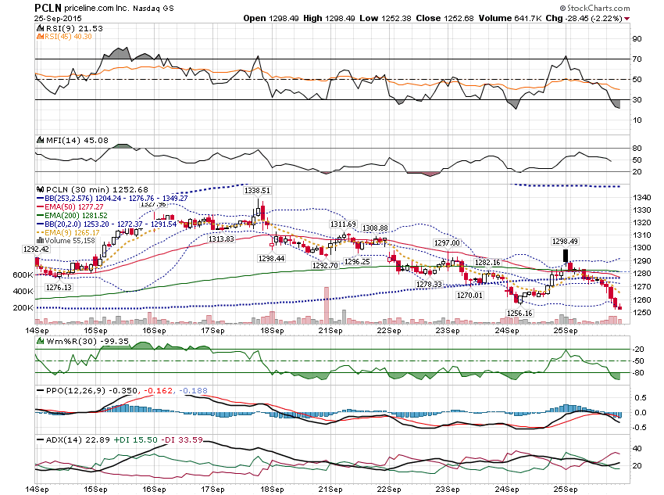

Slide 41
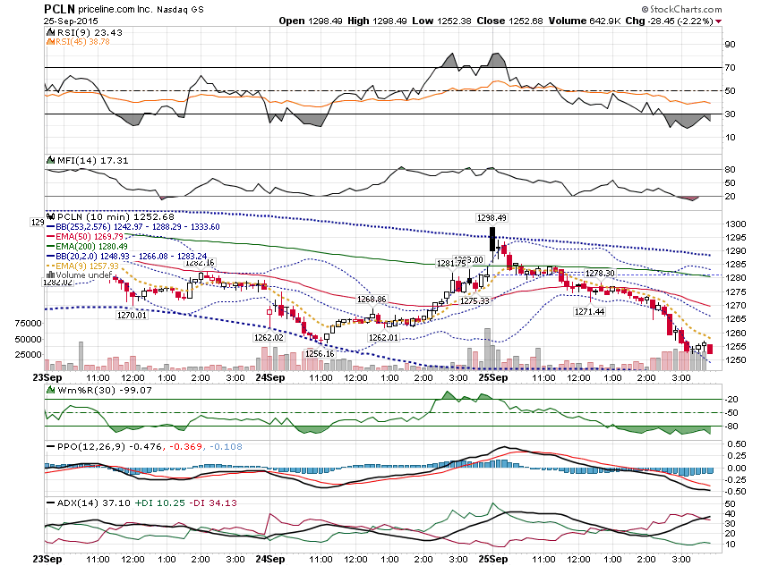

Slide 42
PCLN weekly $1,270 put $1.50 to $18 Intraday

Slide 43
Let’s look at 3 markets from last Friday – 10/2

Slide 44
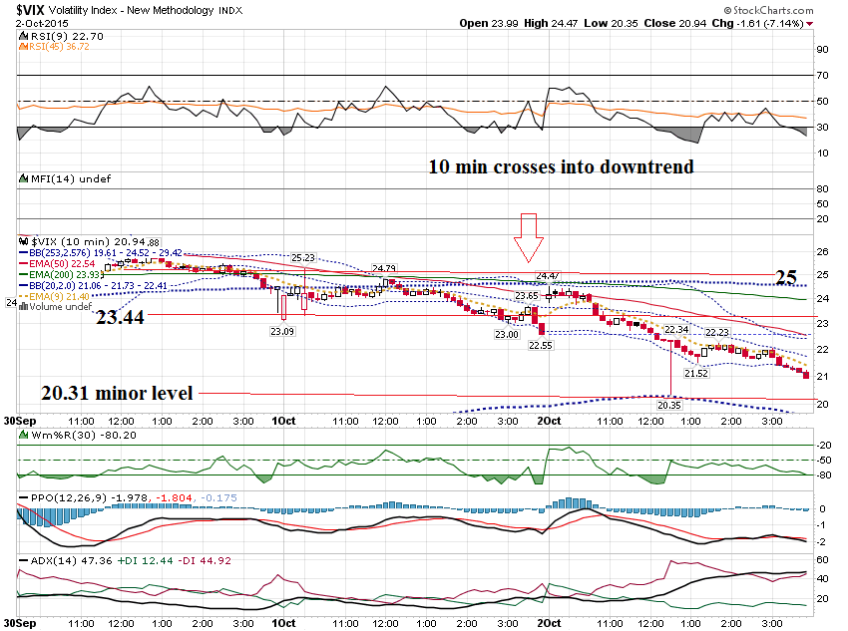

Slide 45
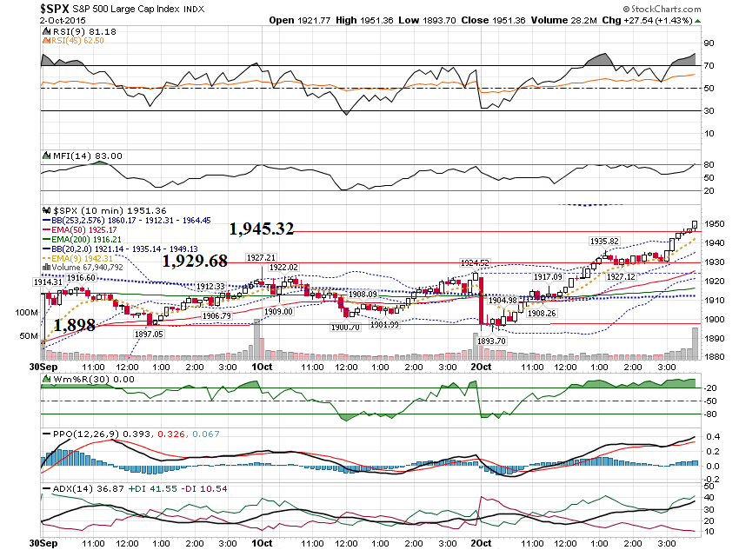

Slide 46
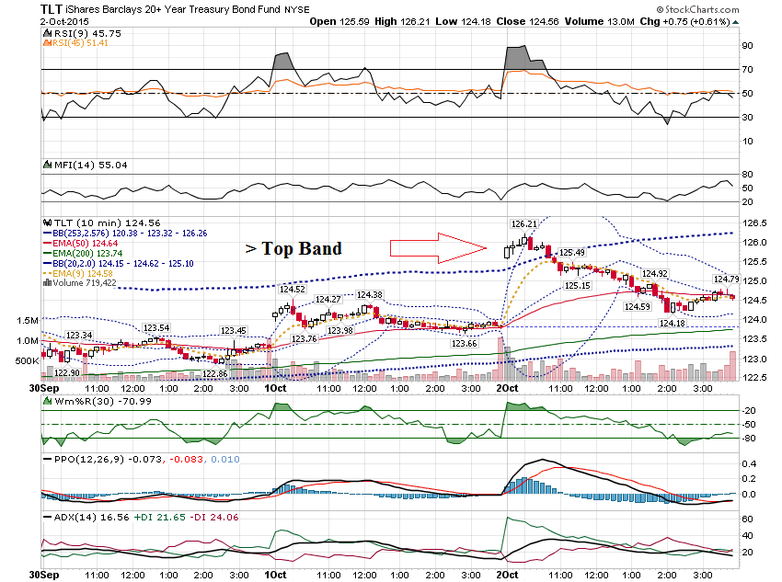

Slide 47
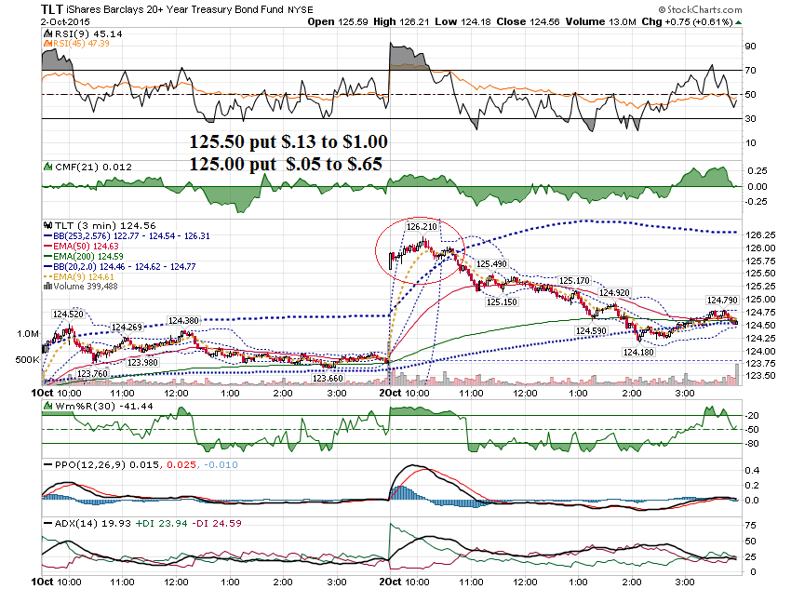

Slide 48
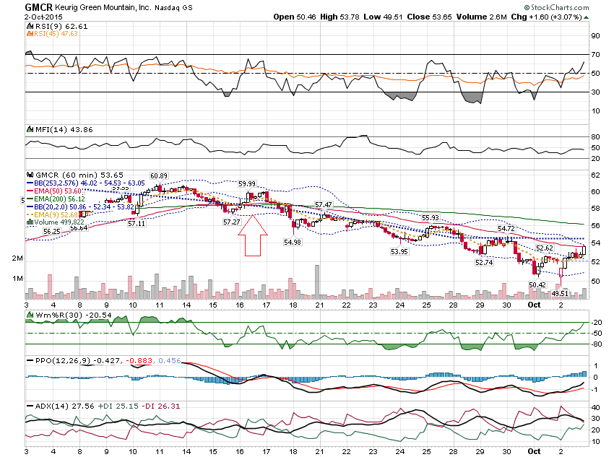

Slide 49
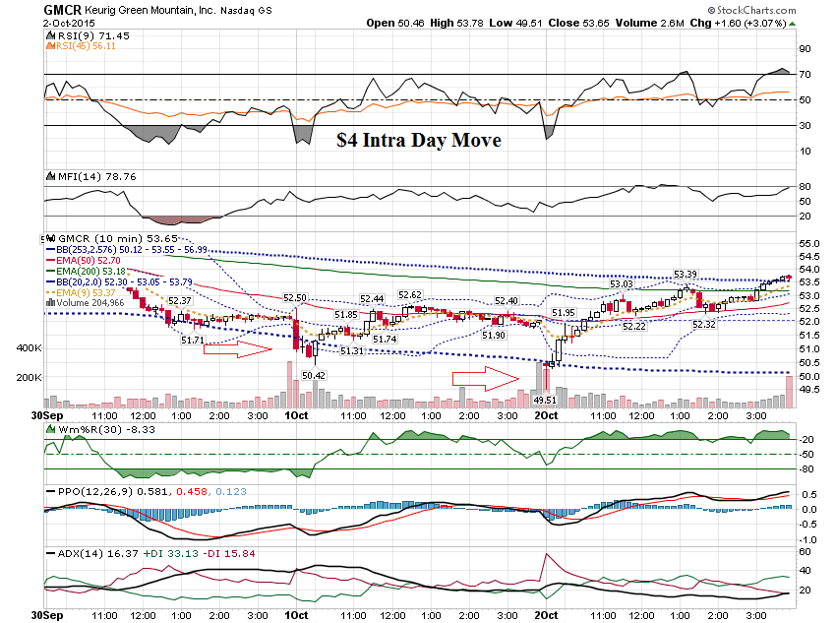

Slide 50
Thanks for watching! Bill Davis Mad Day Trader October 5, 2015 davismdt@gmail.com

