Slide 1
Mad Day Trader
Bill Davis
Webinar – October 28, 2015

Slide 2
Because we are in Earnings Season, I want to discuss trading around earnings. But before I do, I want to show the price action on the S & P the day after our last webinar.

Slide 3
On the last webinar, I discussed how we should be looking for the VIX to reverse off the major 18.75 level. And that would be the clue to get long the markets.

Slide 4
Let’s start with the VIX ….

Slide 5
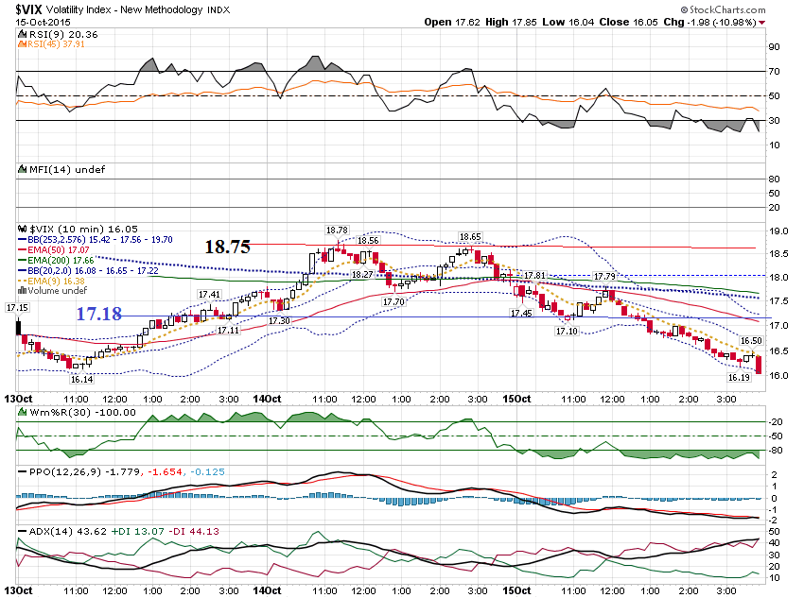

Slide 6
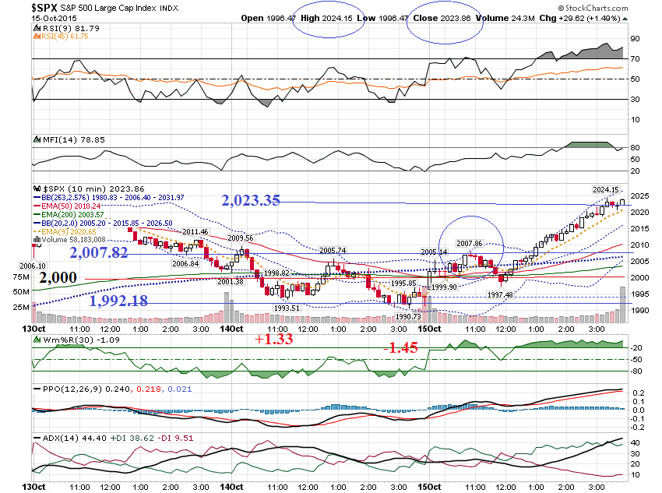

Slide 7
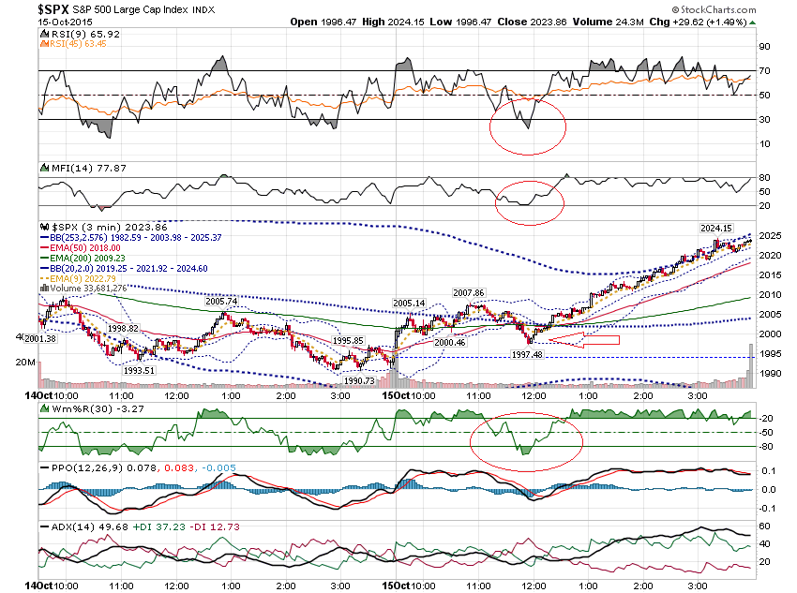

Slide 8
Let’s move onto to earnings. I want to show how I estimate the expected move and then show a few set ups after earnings.

Slide 9
Apple reports after the close on Tuesday October 27 (yesterday). Let me show you how to project the expected move.

Slide 10
As I am creating this, Apple is trading at $116.25. I want to price out the at the money straddle.

Slide 11
Apple $116.25 Oct 30th-$116 call - $3.70 -73.6-IV Oct 30th - $116 Put - $3.65 – 78.5-IV Total Cost = $7.35 Projected Move = 6.3% (7.36 / 116.25)

Slide 12
Apple has to move over $7.35 for a straddle to make money. If it doesn’t, you will lose on both sides.

Slide 13
Note that the IV is over 78% for the front week options. The IV for the Nov 6th options are under 55%. The prices are inflated for the earnings event!

Slide 14
Let’s add a 50% cushion to the projected move & price out spreads. 7.35 X 1.50 = $11

Slide 15
Apple Call Spread $116 + 11 = $127 $127 Call = $.53 $131 Call = .23 Net Credit = $.30 30 / 400 = 7.5% Return

Slide 16
Apple Put Spread $116 – 11 = $105 $105 Put = $1.08 $101 Put = .57 Net Credit = $.51 51 / 400 = 12.75 Return

Slide 17
You could actually move the puts strikes lower and get a bigger cushion.

Slide 18
Let’s see how much Apple actually moved off their earnings.

Slide 19
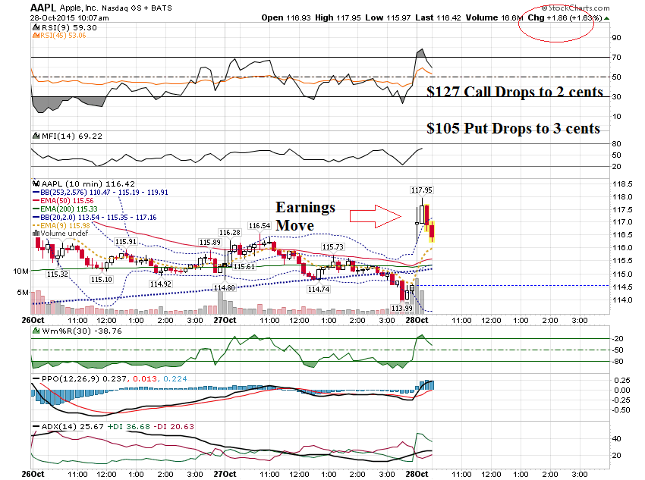

Slide 20
Let’s look at one more company reporting last night, AKAM, trading at $75.45

Slide 21
AKAM $75.45 Oct 30th-$75.50 call - $3.10 -98.6-IV Oct 30th - $75.50 Put - $2.90 -94.2-IV Total Cost = $6.00 Projected Move = 7.95% (6 / 75.45)

Slide 22
AKAM-$75.45 Add 50% ($6 + $3) to the projected move and the range becomes … Upper end - $84.45 Lower end - $66.45

Slide 23
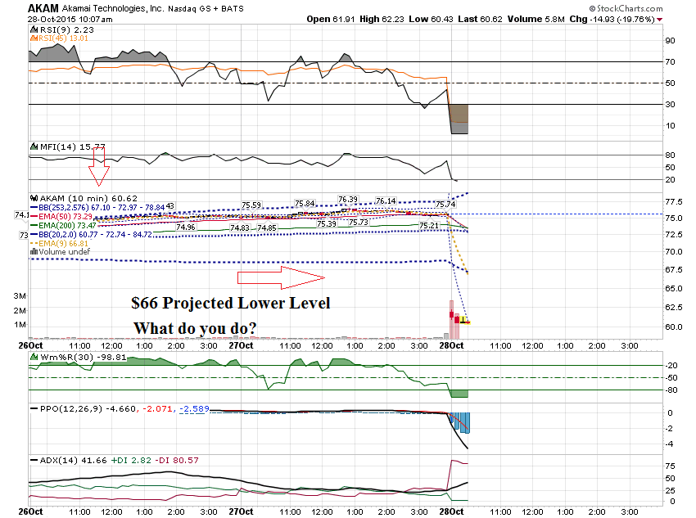

Slide 24
Let’s look at some sticks that reported earnings and what they did AFTER their earnings.

Slide 25
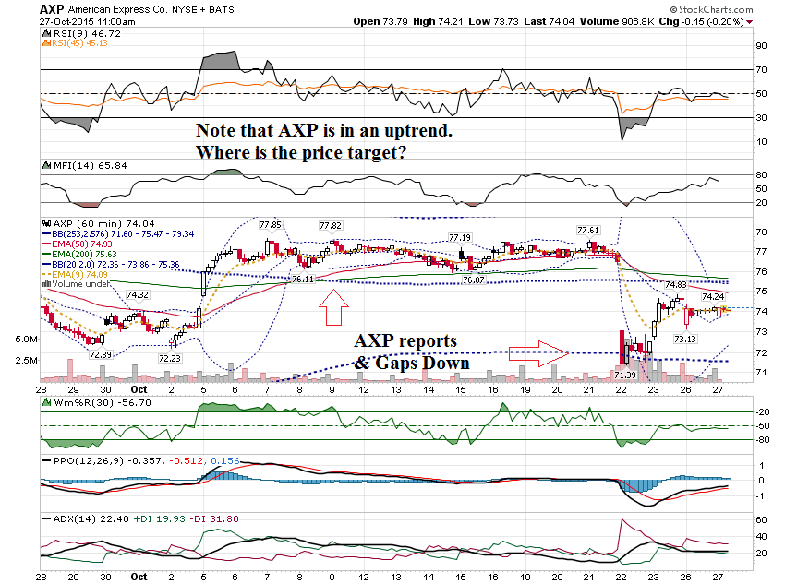

Slide 26
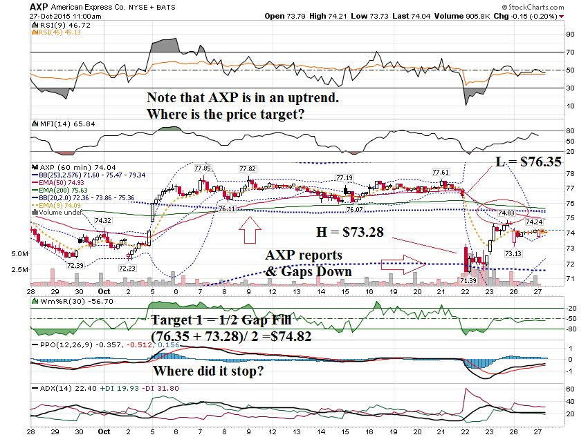

Slide 27
AXP Oct 30th-$73 call Went from $.40 to $1.85

Slide 28
I wanted to show this stock from the day of our last webinar.

Slide 29
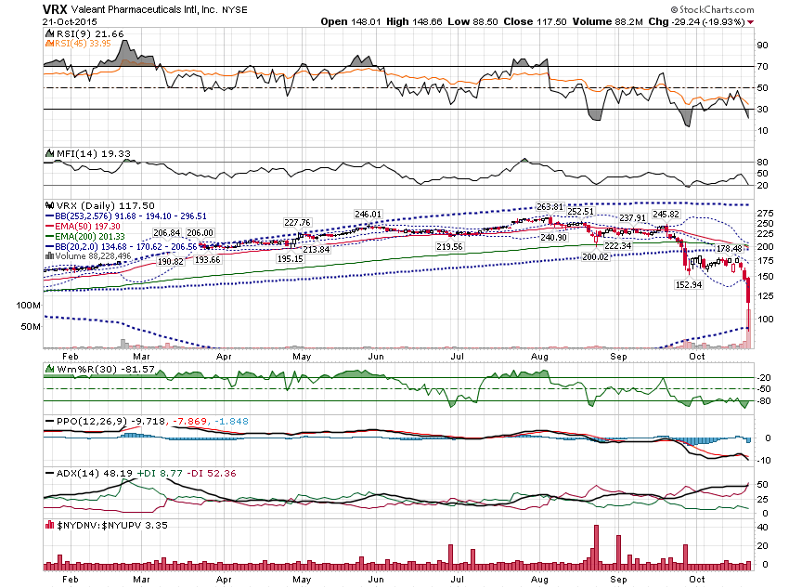

Slide 30
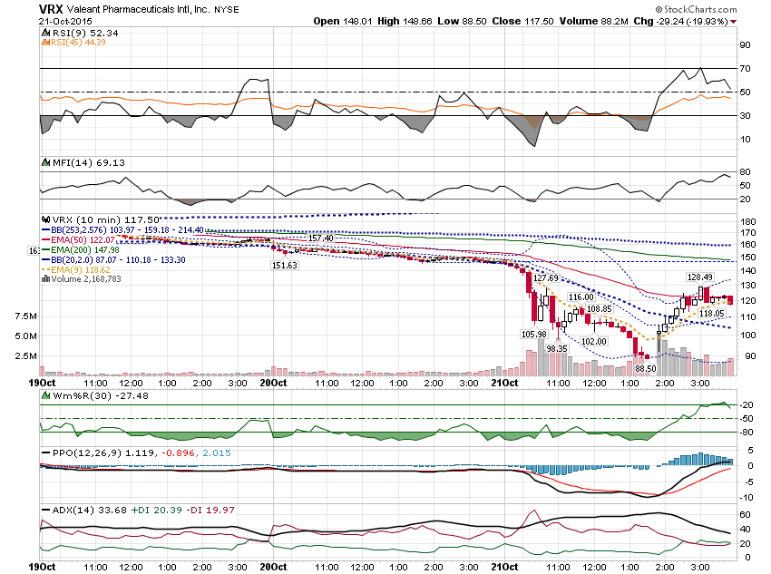

Slide 31
Let’s look at a few more post earnings moves …

Slide 32
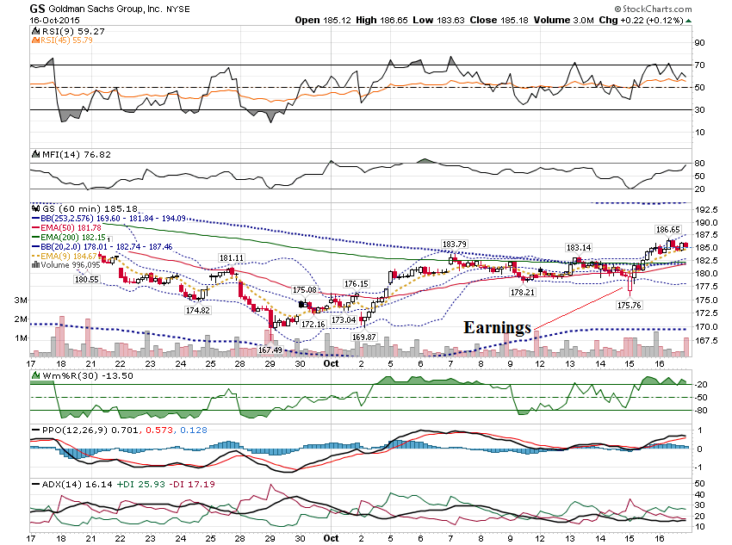

Slide 33
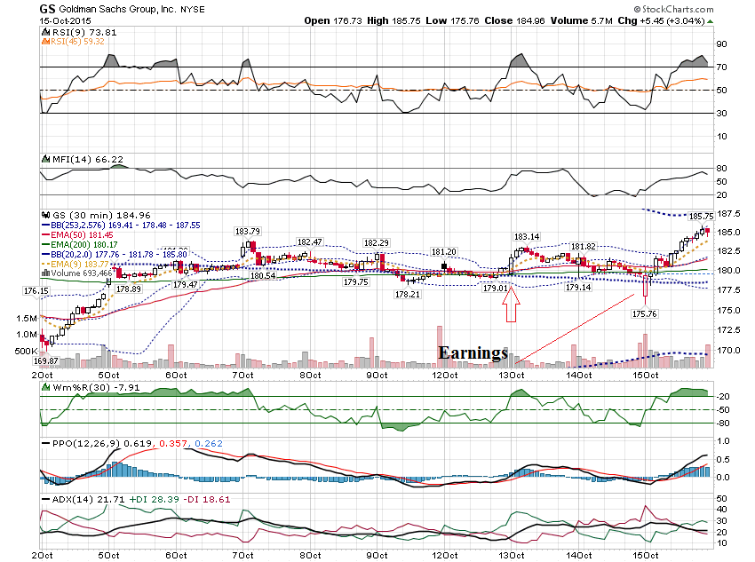

Slide 34
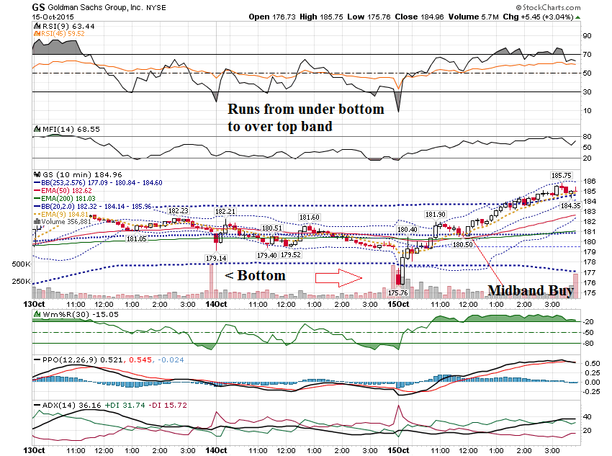

Slide 35
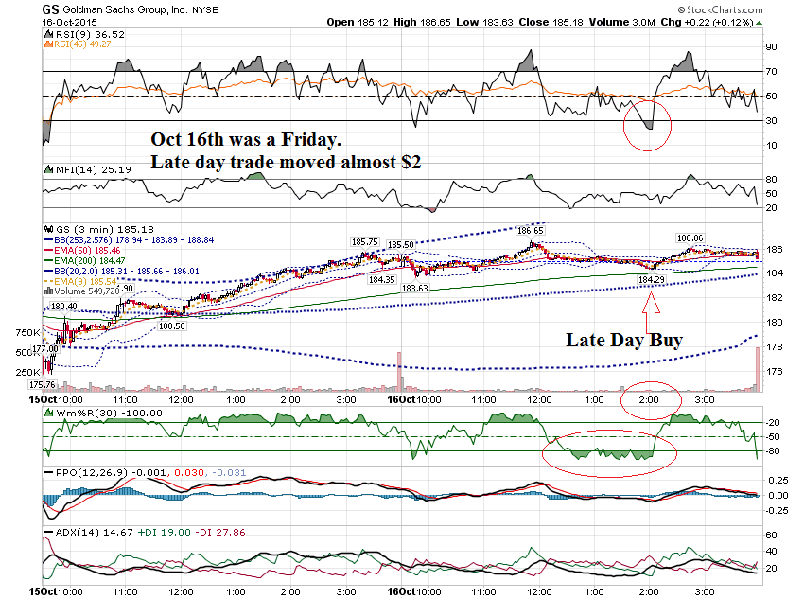

Slide 36
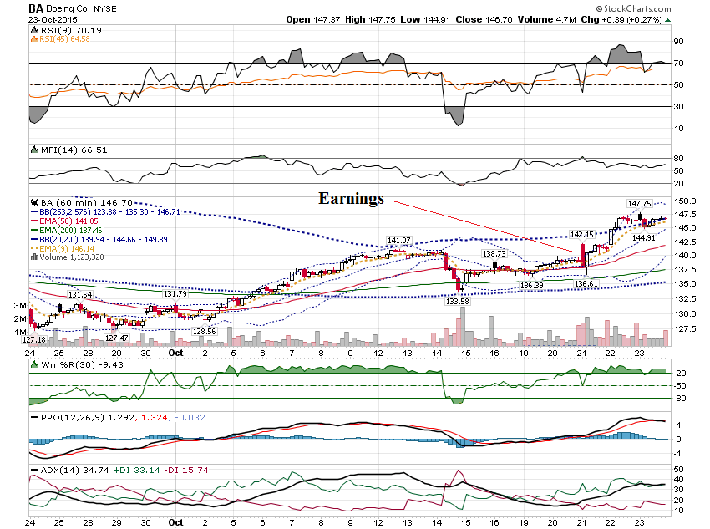

Slide 37
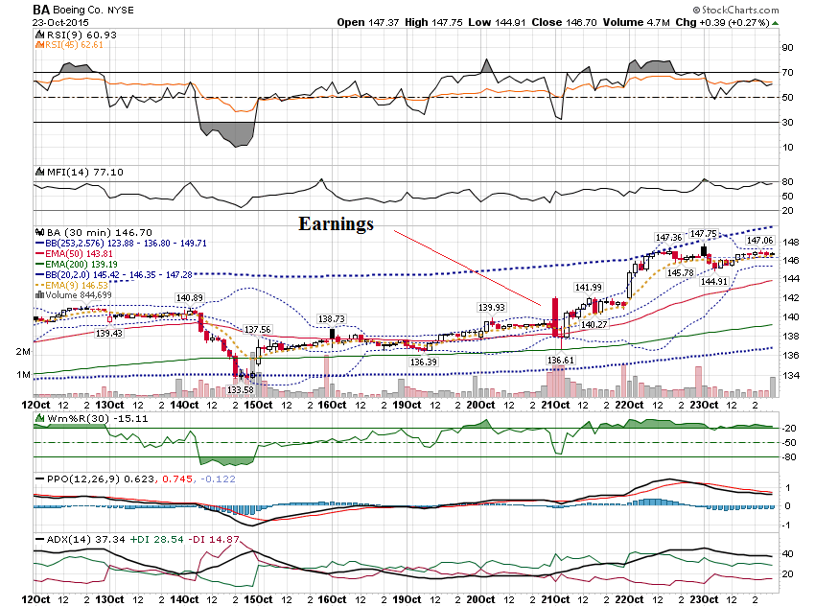

Slide 38
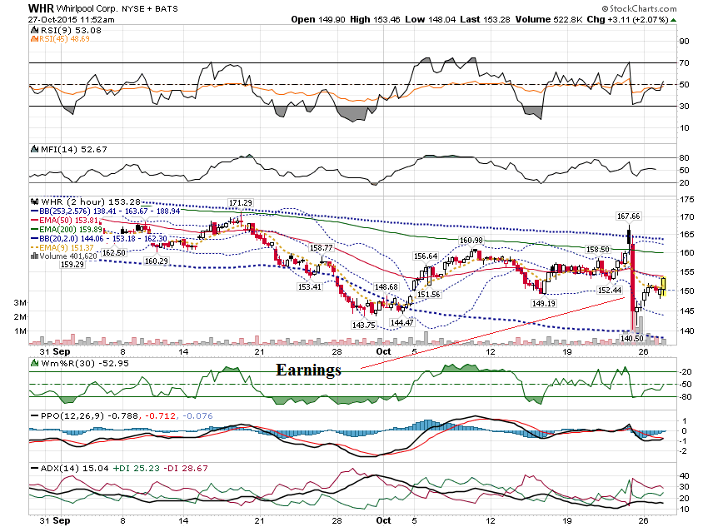

Slide 39
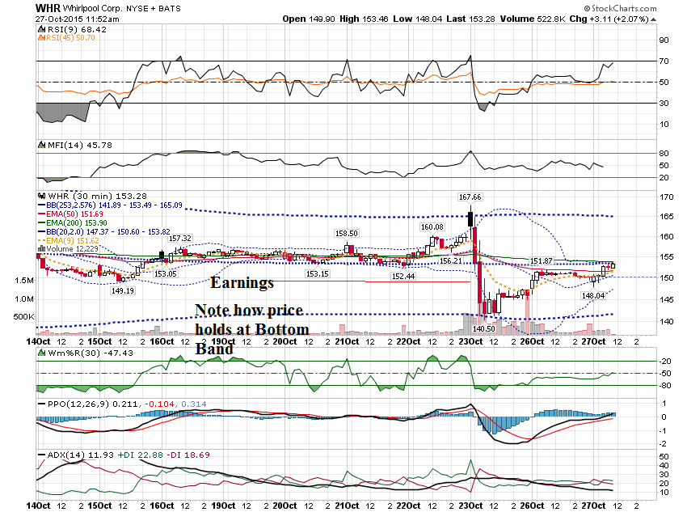

Slide 40
Do you want to see the Godfather of all Post Earnings Moves?

Slide 41
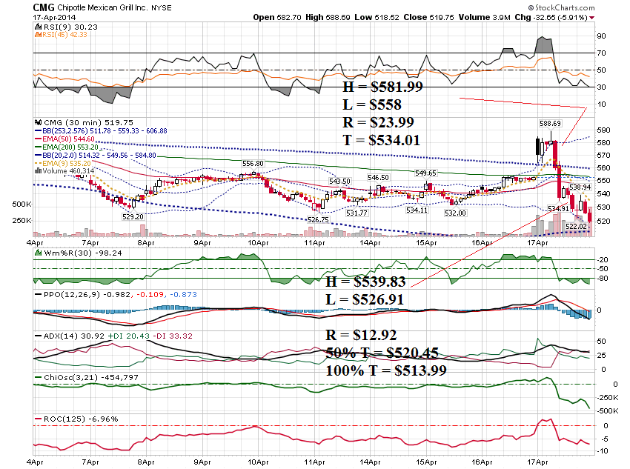

Slide 42
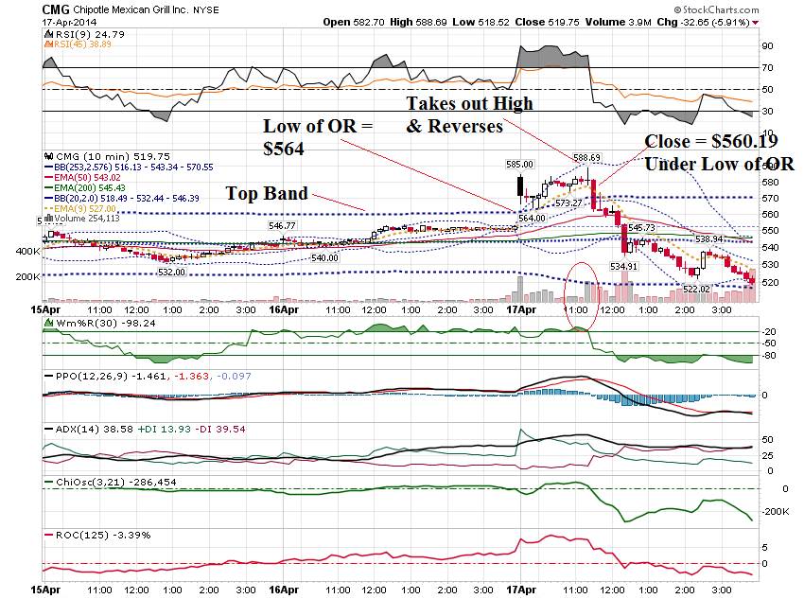

Slide 43
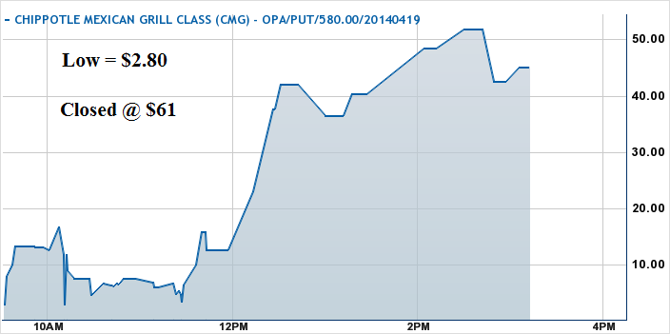

Slide 44
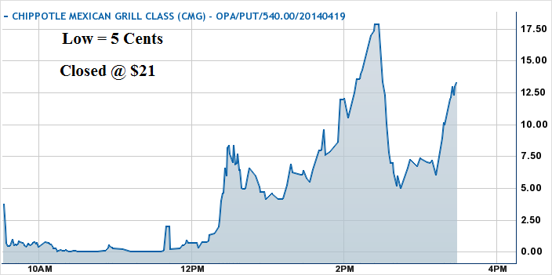

Slide 45
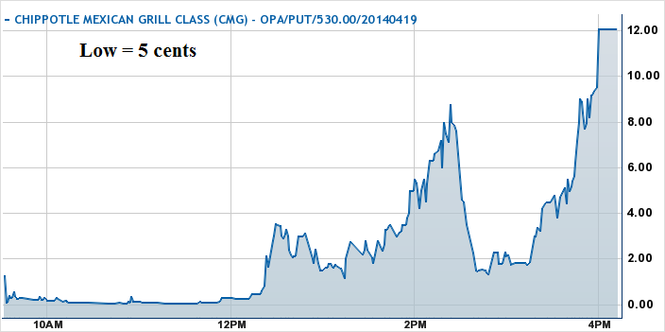

Slide 46
Thanks for watching! Bill Davis Mad Day Trader October 28, 2015 davismdt@gmail.com

