Slide 1
Mad Day Trader
Bill Davis
Webinar – November 11, 2015

Slide 2
On the last webinar, I showed stocks that had gapped down off their earnings and said that we would look at stocks that had gapped up on the next webinar.

Slide 3
But, before I do that, I want to show a few charts of the S & P and the VIX and some charts of Priceline.

Slide 4
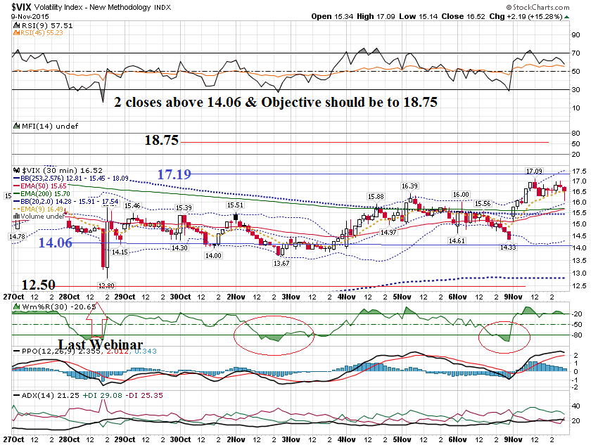

Slide 5
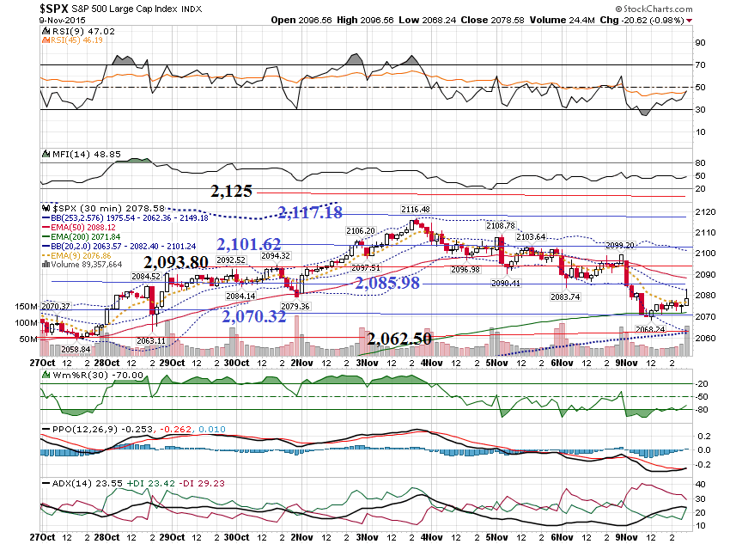

Slide 6
Watch how the VIX reacts against resistance and use as your trigger to enter. I will tend to use a 10 minute chart earlier in the week.

Slide 7
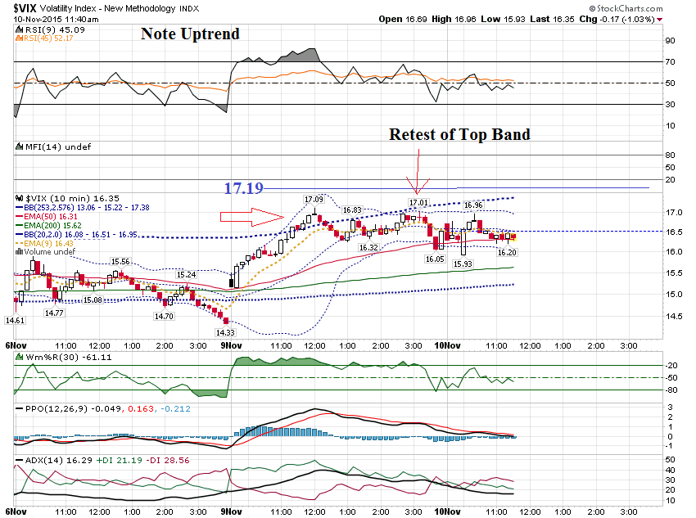

Slide 8
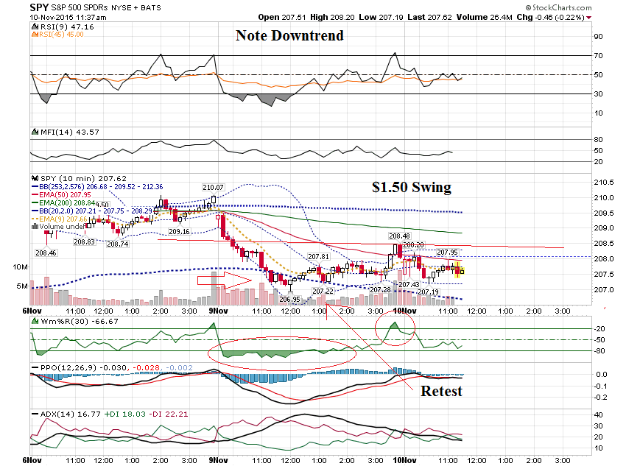

Slide 9
For trading on Friday’s, I will scale down to a 3 minute chart and take signals off the 3 minute, as long as the trend on the 3 minute agrees with the trend on the 10 minute.

Slide 10
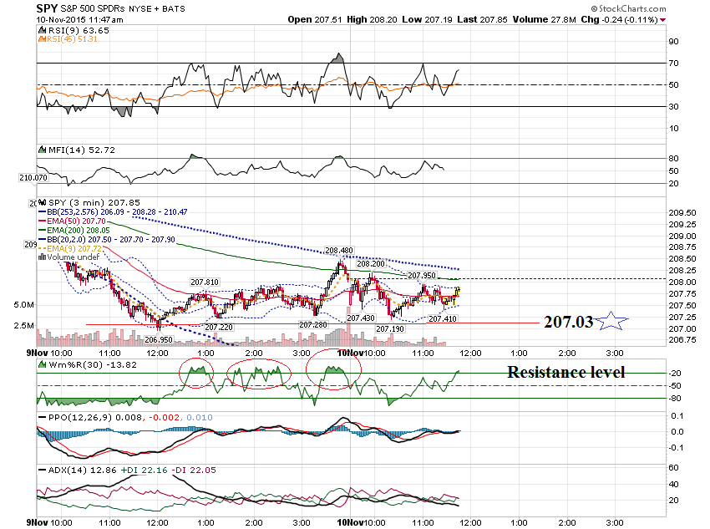

Slide 11
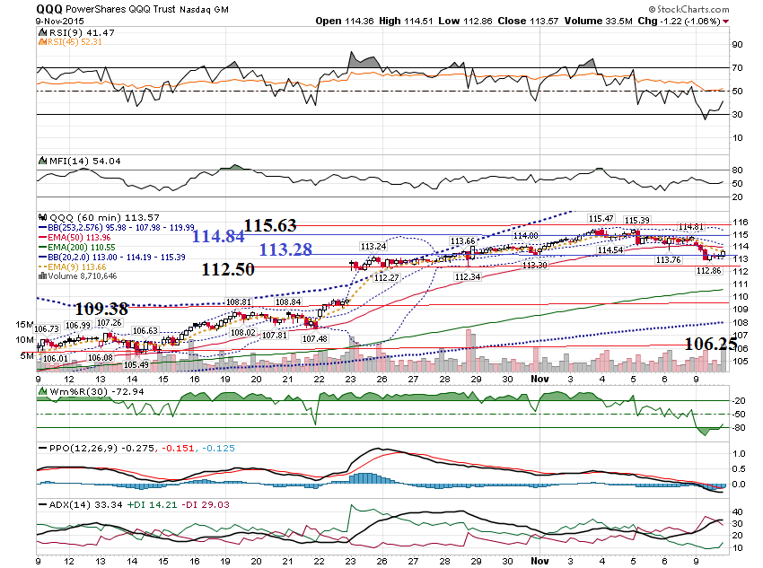

Slide 12
Before I share some charts of stocks announcing earnings, I want to show some charts of Priceline

Slide 13
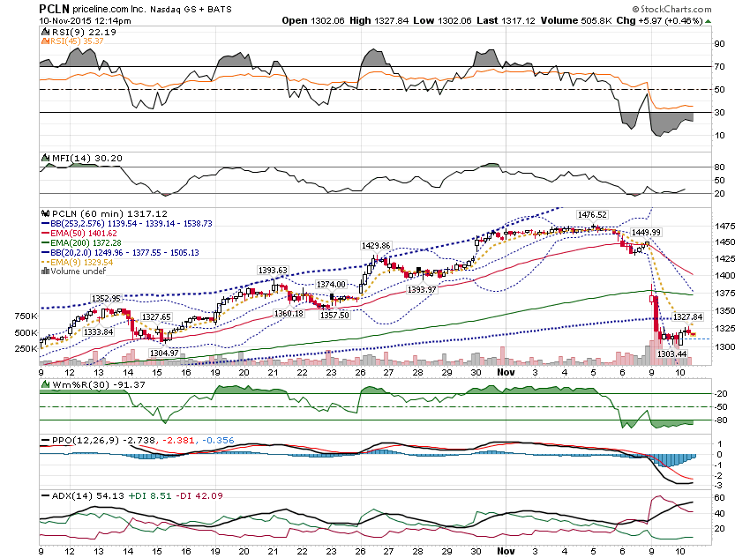

Slide 14
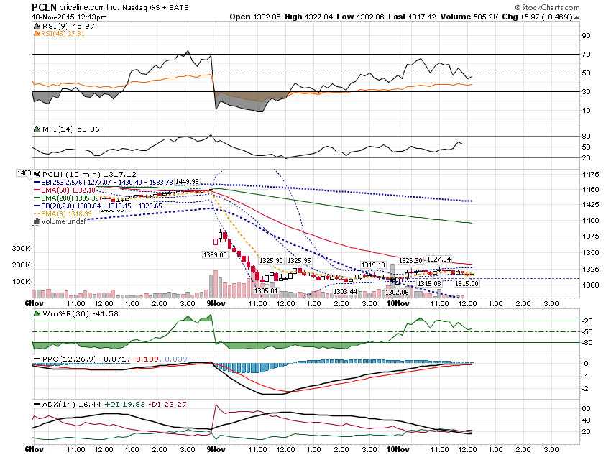

Slide 15
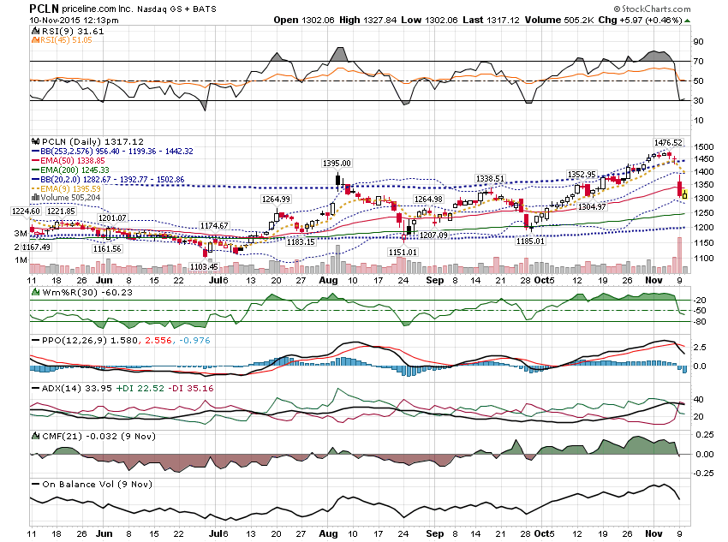

Slide 16
Before I show some Bullish Gaps, I want to show some deals from the last webinar.

Slide 17
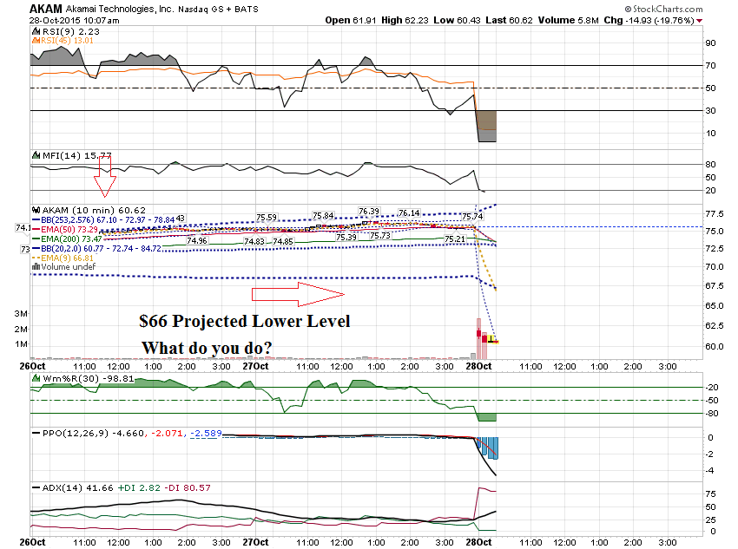

Slide 18
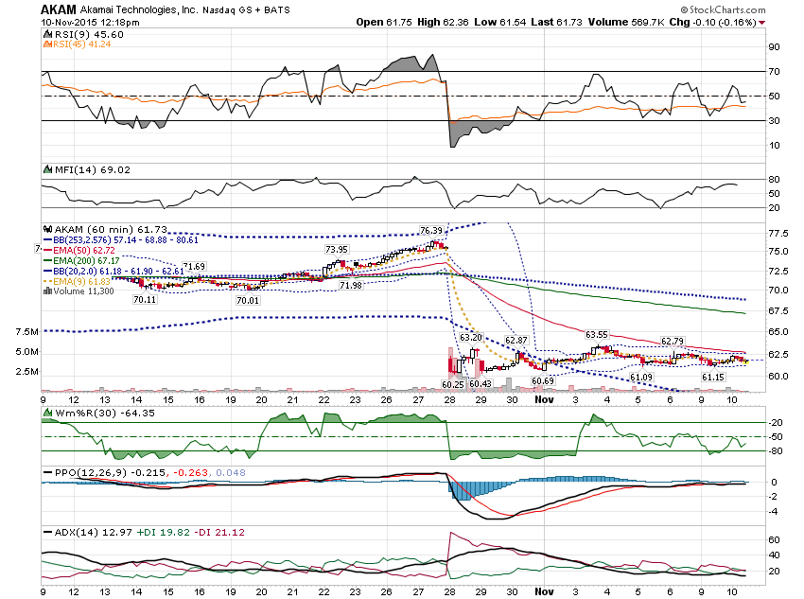

Slide 19
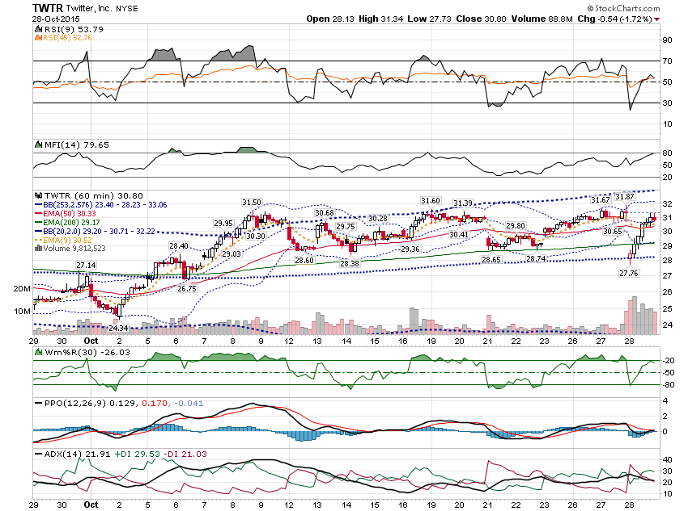

Slide 20
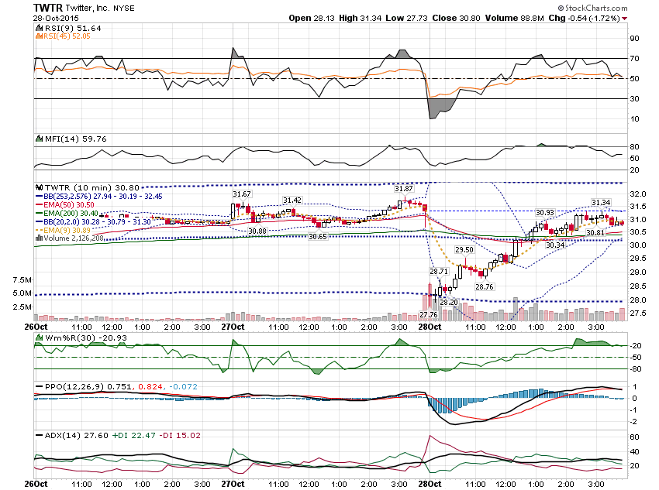

Slide 21
Let’s look at some Bullish earnings Gaps …

Slide 22
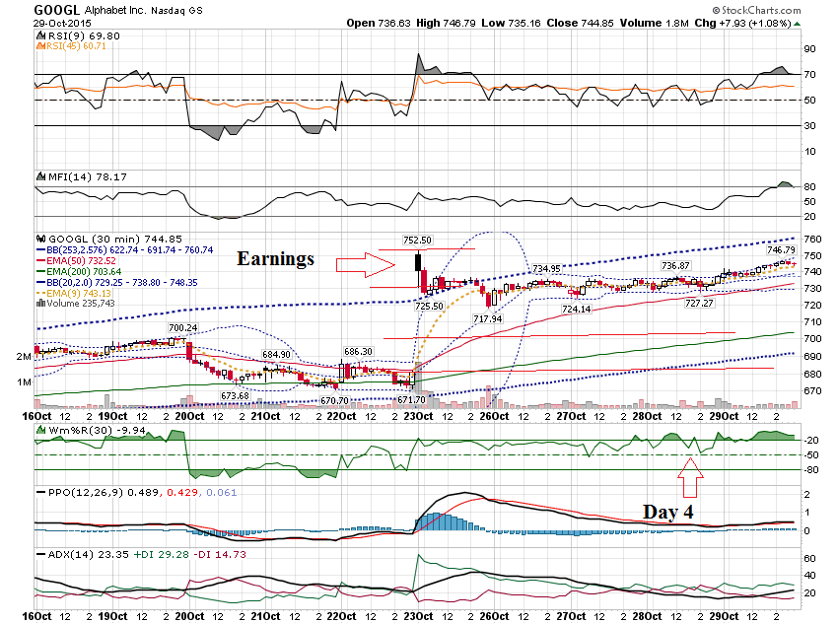

Slide 23
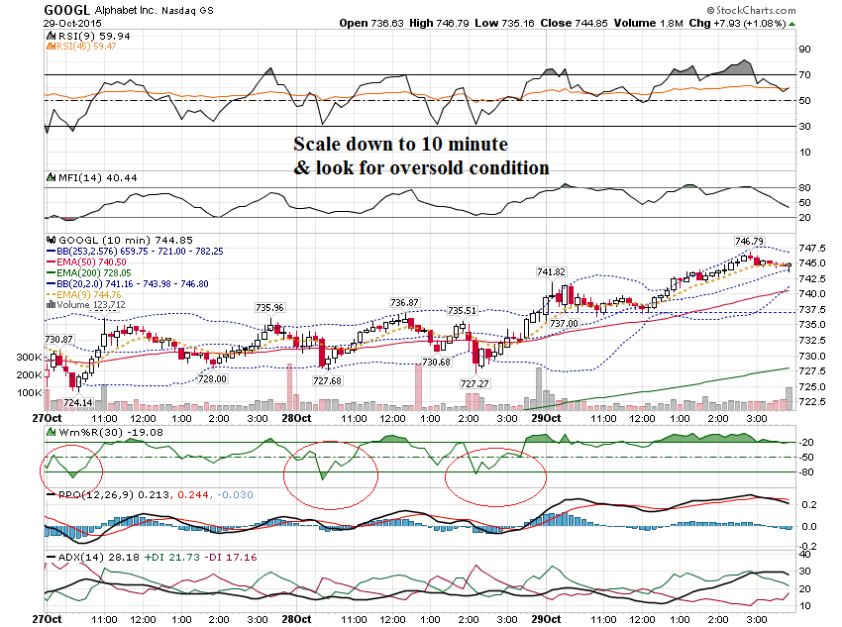

Slide 24
GOOGL $727.50 Calls Thursday October 29, 2015 Prev Close: 11.00 Open: 11.10 Bid: 16.80 Ask: 18.10 Strike: 727.50 Expire Date: 30-Oct-15 Day's Range: 11.10 - 17.90 Contract Range: N/A - N/A Volume: 14 Open Interest: 130

Slide 25
GOOGL $732.50 Calls Thursday October 29, 2015 Prev Close: 6.60 Open: 8.35 Bid: 12.10 Ask: 13.30 Strike: 732.50 Expire Date: 30-Oct-15 Day's Range: 7.38 - 14.13 Contract Range: N/A - N/A Volume: 29 Open Interest: 189

Slide 26
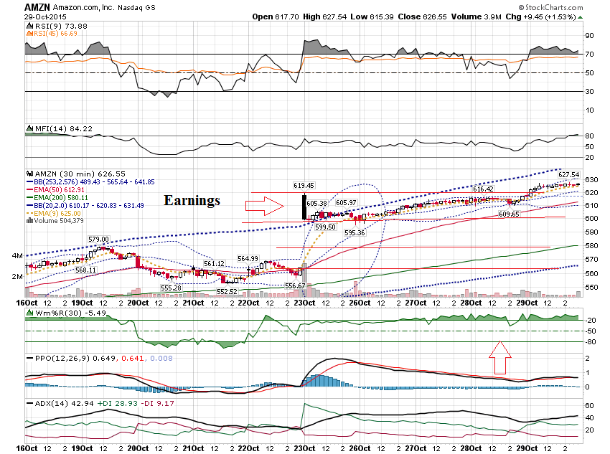

Slide 27
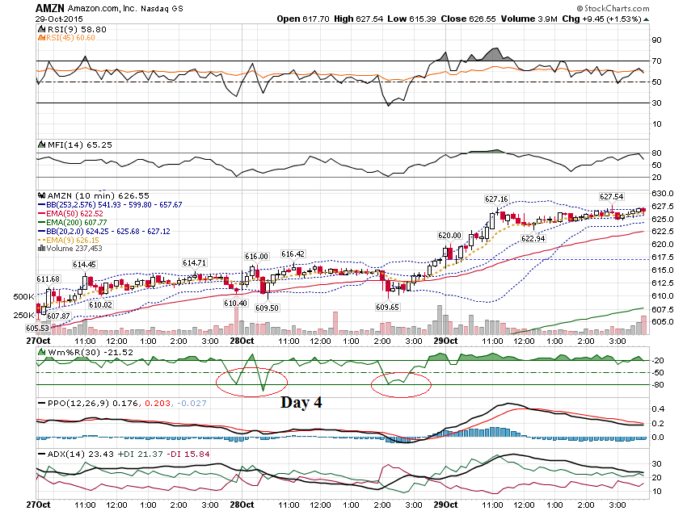

Slide 28
AMZN $610 Call Thursday Oct 29, 2015 Prev Close: 8.85 Open: 8.61 Bid: 16.10 Ask: 16.90 Strike: 610.00 Expire Date: 30-Oct-15 Day's Range: 7.70 - 17.24 Contract Range: N/A - N/A Volume: 639 Open Interest: 1,923

Slide 29
AMZN $615 Call Thursday Oct 29, 2015 Prev Close: 5.30 Open: 5.00 Bid: 11.40 Ask: 12.25 Strike: 615.00 Expire Date: 30-Oct-15 Day's Range: 4.30 - 12.60 Contract Range: N/A - N/A Volume: 936 Open Interest: 842

Slide 30
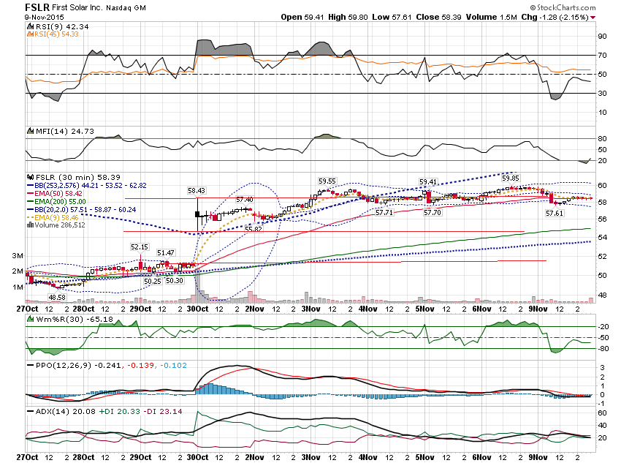

Slide 31
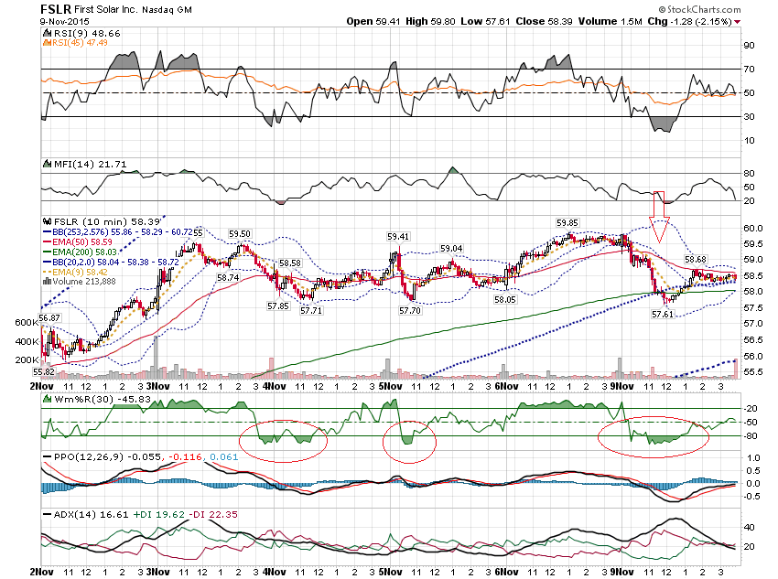

Slide 32
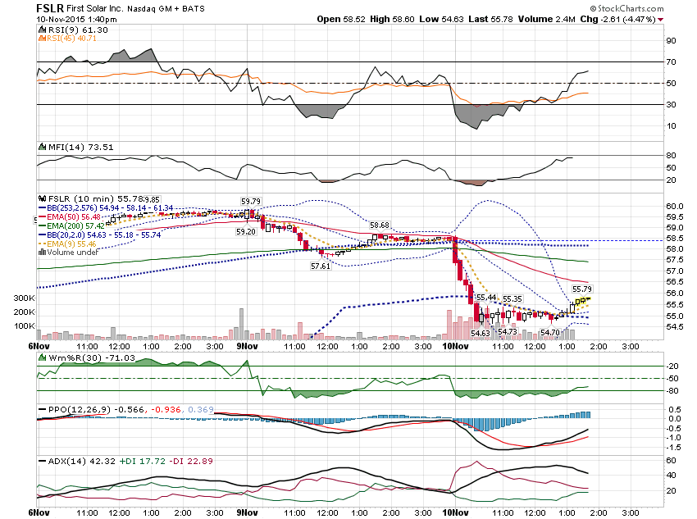

Slide 33
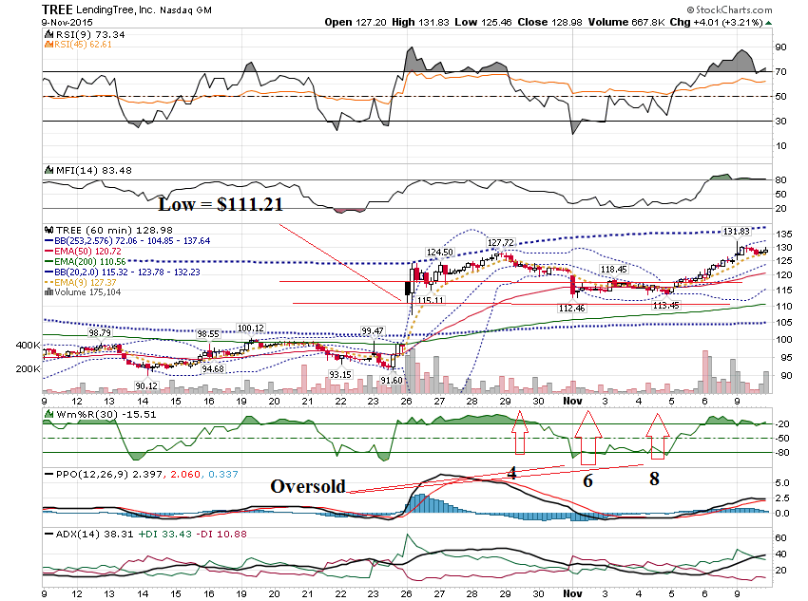

Slide 34
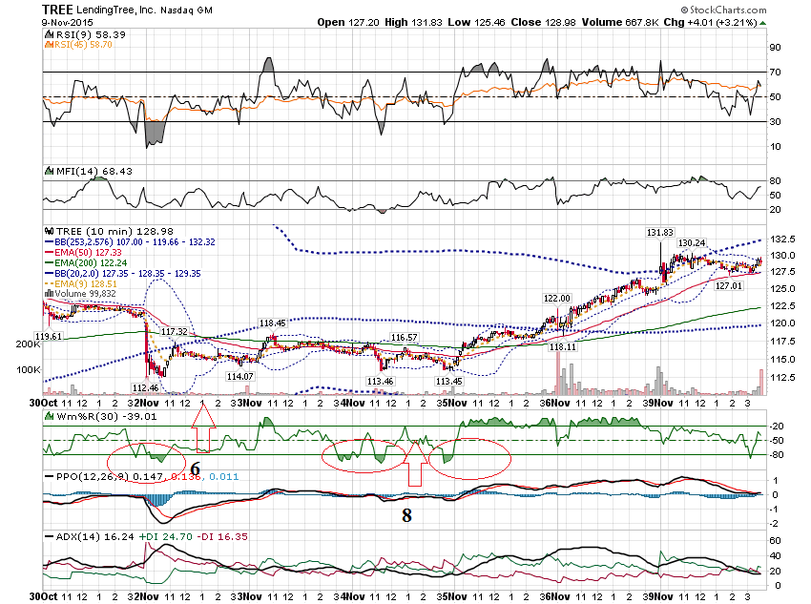

Slide 35
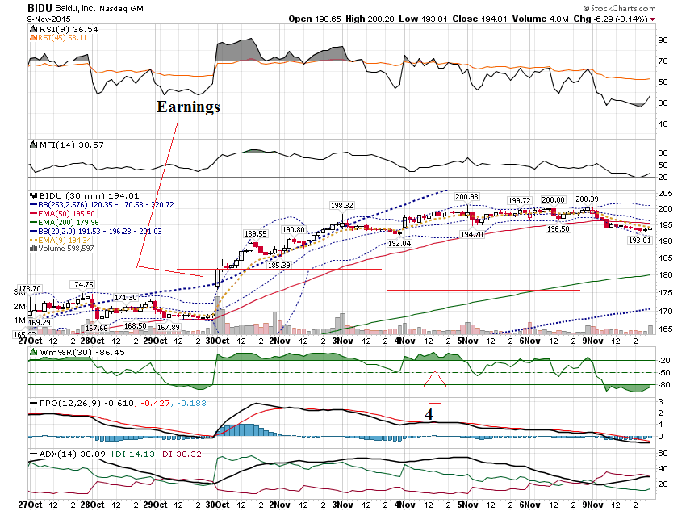

Slide 36
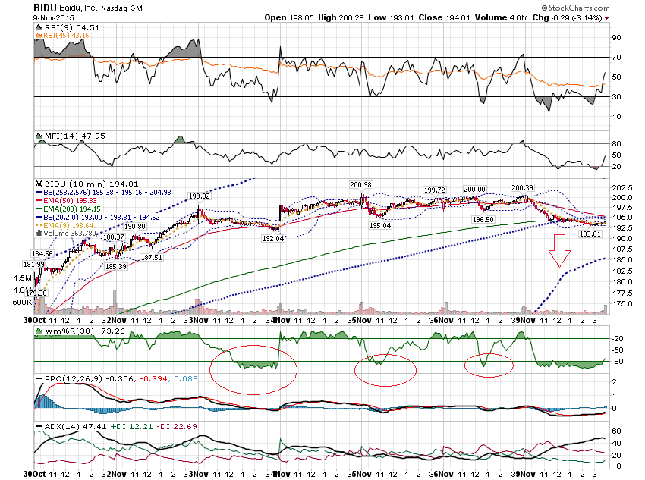

Slide 37
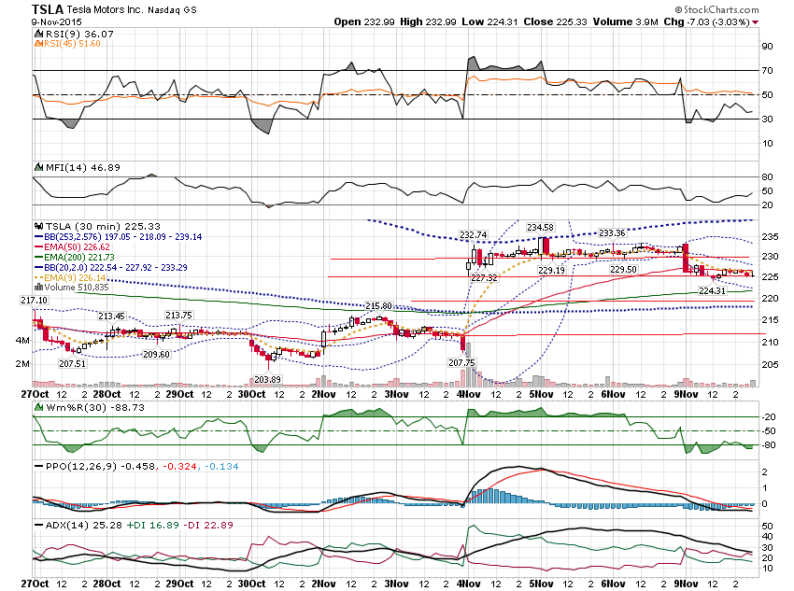

Slide 38
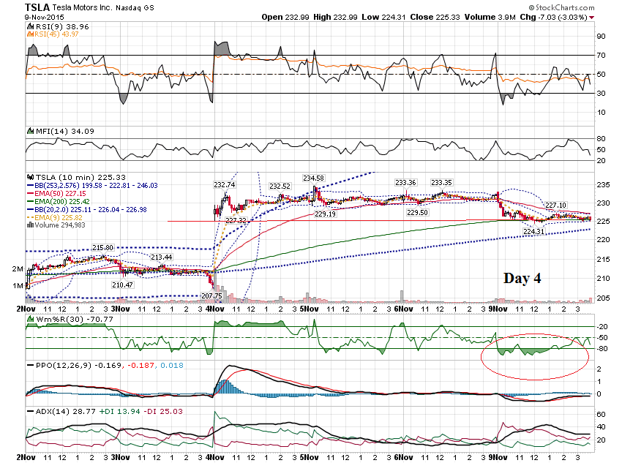

Slide 39
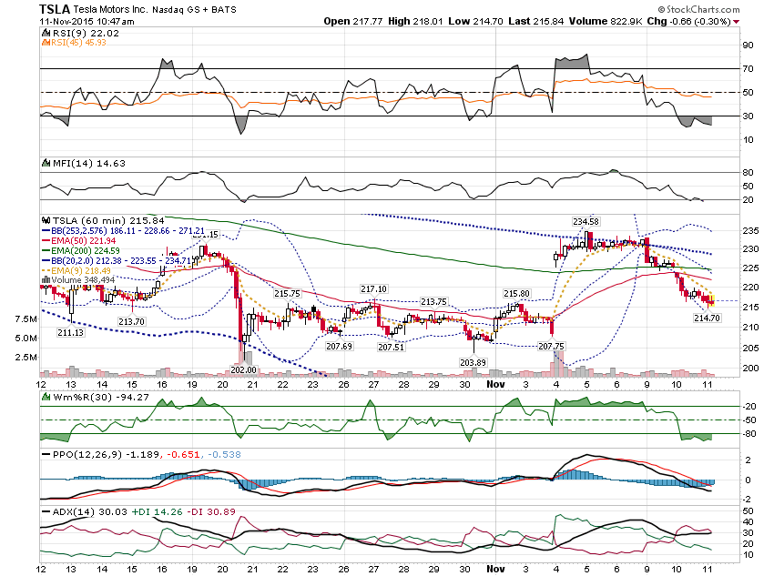

Slide 40
Thanks for watching! Bill Davis Mad Day Trader November 11, 2015 davismdt@gmail.com

