Slide 1

Mad Day Trader
Bill Davis
Webinar – November 25, 2015

Slide 2
This week I would like to review some charts from Friday and then take a look at few set ups based on the extreme
Bollinger Bands.

Slide 3
I would like to start with a trade that a member shared on Friday using the QQQ.

Slide 4
He traded the $114.50 calls on the QQQ that expired last
Friday and he was kind enough to share his trades.

Slide 5
I would like to review his trades in an attempt to help you if you do trade on a Friday.
I do want to thank him for sharing what he did!

Slide 6
“I don't know how much detail you require but basicly I was oriented to a long position with the weekly that was expiring at the end of the day. I used the 114.50 strike.
On a 10 lot position I started scaling in with
1/10th of the position during the 10:10 bar for 21cents. The position was only profitable for a few short minutes.”

Slide 7
Let’s start by looking at the 60 minute chart for the QQQ.

Slide 8
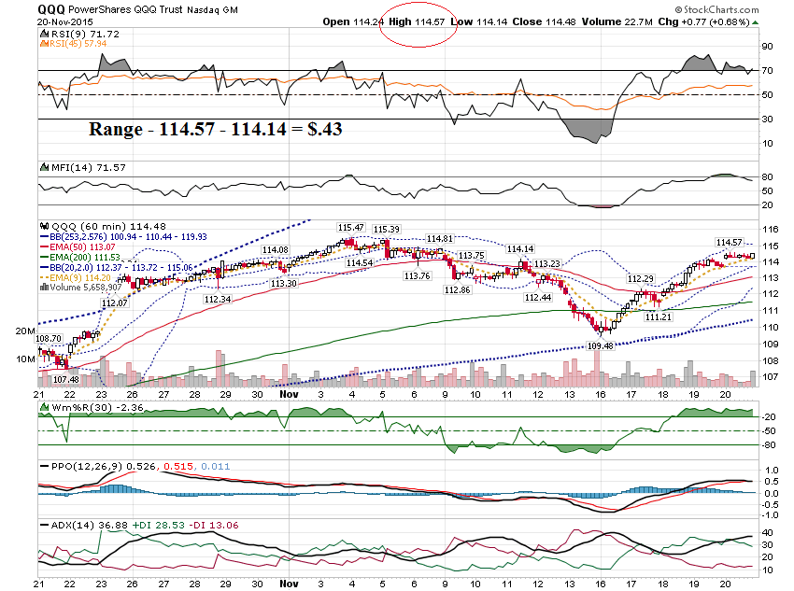

Slide 9
Let’s scale to a
30 minute chart.

Slide 10
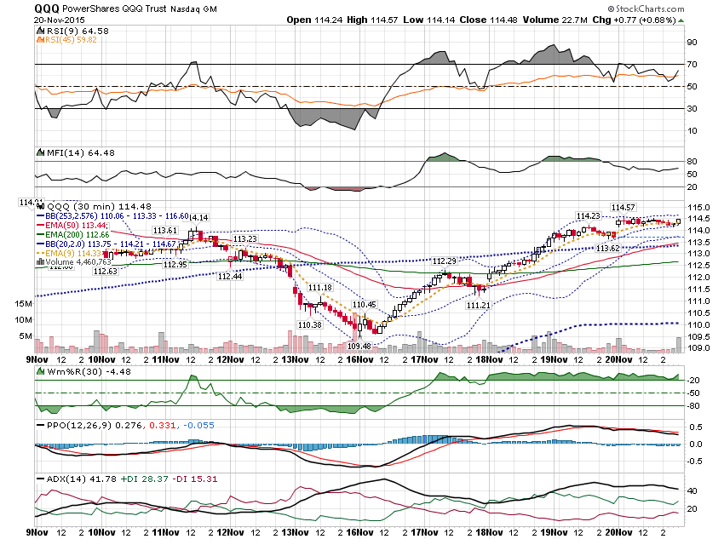

Slide 11
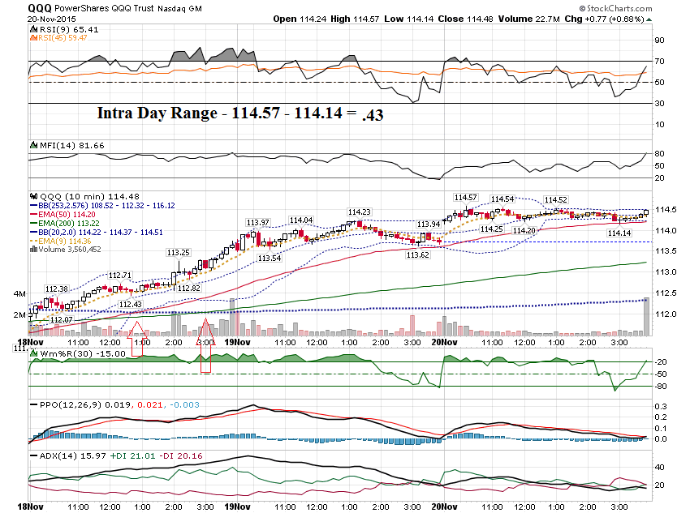

Slide 12
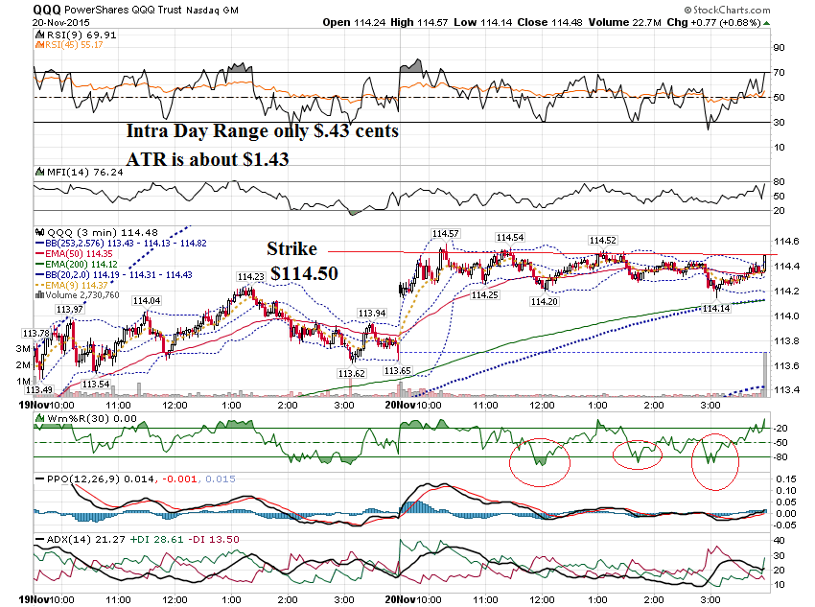

Slide 13
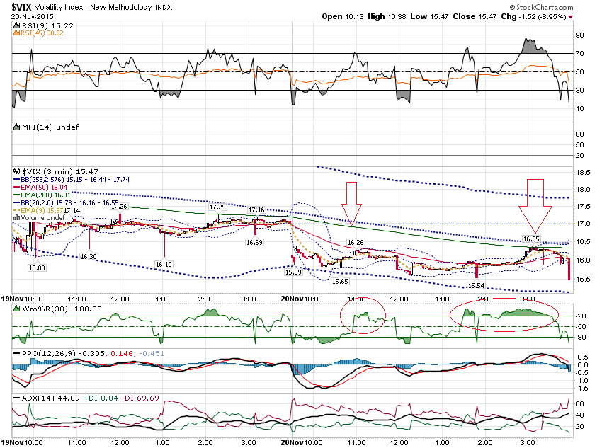

Slide 14
“I kept adding to the position during the pullbacks so that by 12:00 EST my average fill cost on the full position was 10.888 cents.
I sold the position in 3 stages from about
12:55 till 1:05. for 15 and 16 cents. After costs I had approx.
33% return on capital at risk.”

Slide 15
Couple of general comments.
The QQQ had an ATR of
$1.38 and the daily range was only $.43. Had the
QQQ moved the ATR, his position could have been worth over $1,000, with an investment of only about $100.

Slide 16
He wisely pulled out the trade and was flat by around 1:00 EST.
By 2:00 EST, time premium erodes quickly.

Slide 17
Once the 2:00 EST hits, rapid premium decay sets in.

Slide 18
Final comment …

Slide 19
“I added to the position during the pullbacks because the VIX actually declined during that same period. and board leaders like AMZN, GOOGl, and NFLX seemed to be staying bid.
I sold the positions because the index was approaching the level that it had already stalled at twice and I was afraid of accelerating time decay.
Hopefully that makes sense.
If not let me know.”

Slide 21
Let’s look at some intra day charts from Monday.

Slide 22
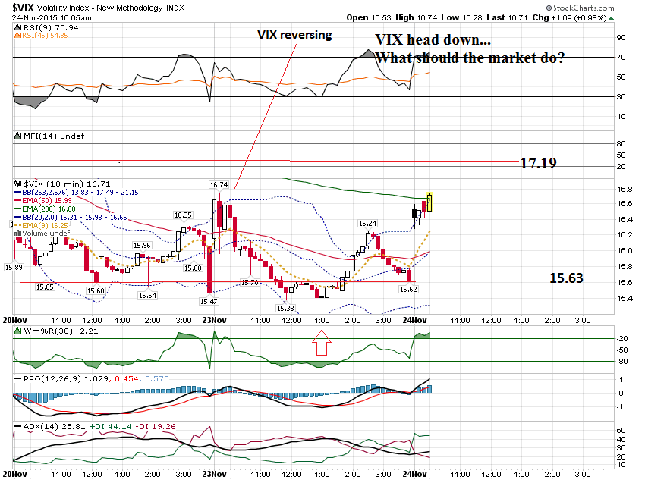

Slide 23
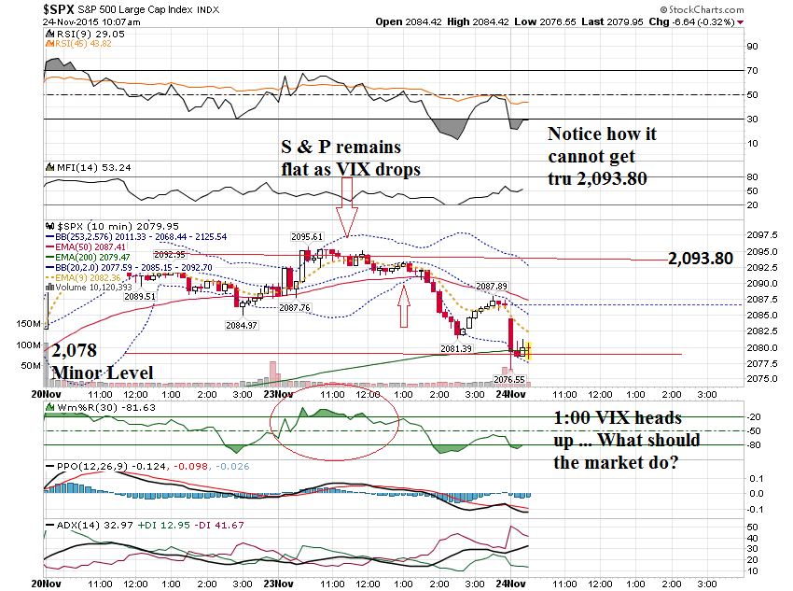

Slide 24
Let’s look at the same charts from yesterday,
Tuesday November 24th

Slide 25
From Tuesday’s DailyUpdate …
“Resistance should be at
17.19 and 18.75.”
“Look for support at 2,085 and 2,070. And also at the minor support level of 2,078.”

Slide 26
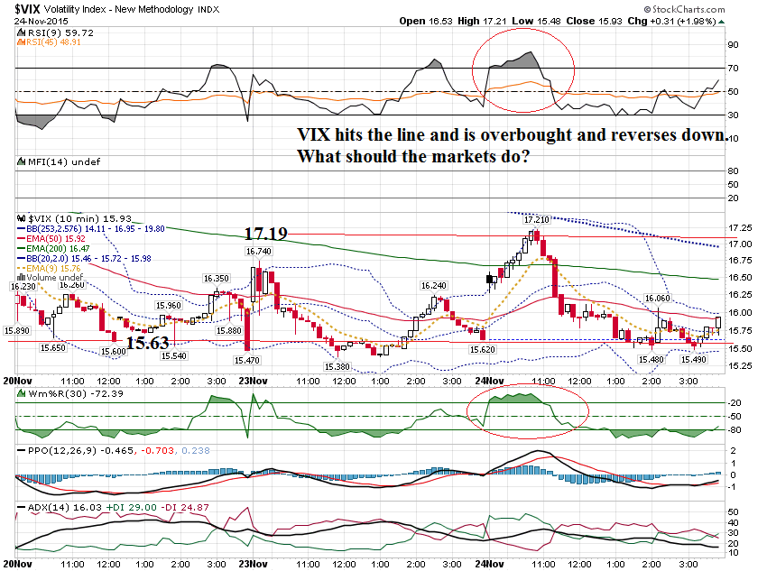

Slide 27
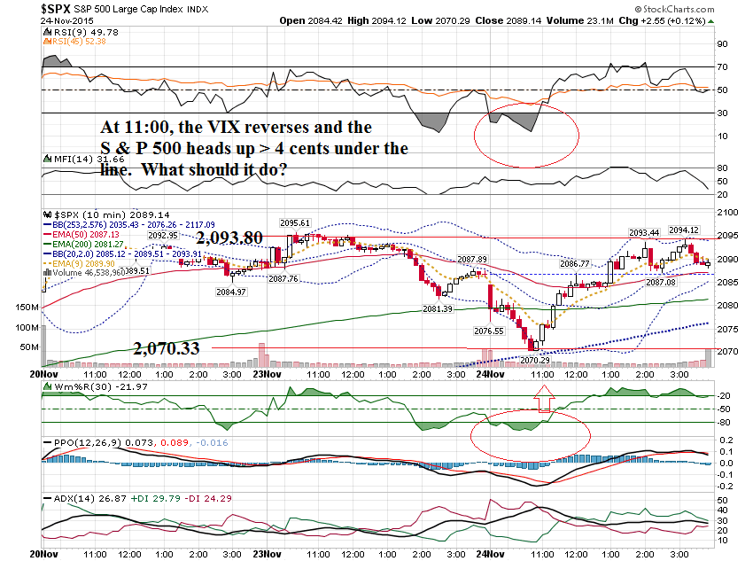

Slide 28
SPY $207.50 Weekly Call
Prev Close: 2.06
Open: 1.24
Bid: N/A
Ask: N/A
Strike: 207.50
Expire Date: 27-Nov-15
Day's Range: 0.99 - 2.52
Contract Range: N/A - N/A
Volume: 9,034
Open Interest: 7,555

Slide 29
Had a question about
ASNA & X and stop loss & money management.
“Looking at the charts, there are clear moments we should have gone out in my opinion. For the moment my lossing are far bigger than my gains and that's no the way I like to trade!”

Slide 30
Let me first start by saying if you feel you should get out … get out!
Let’s start with ASNA

Slide 31
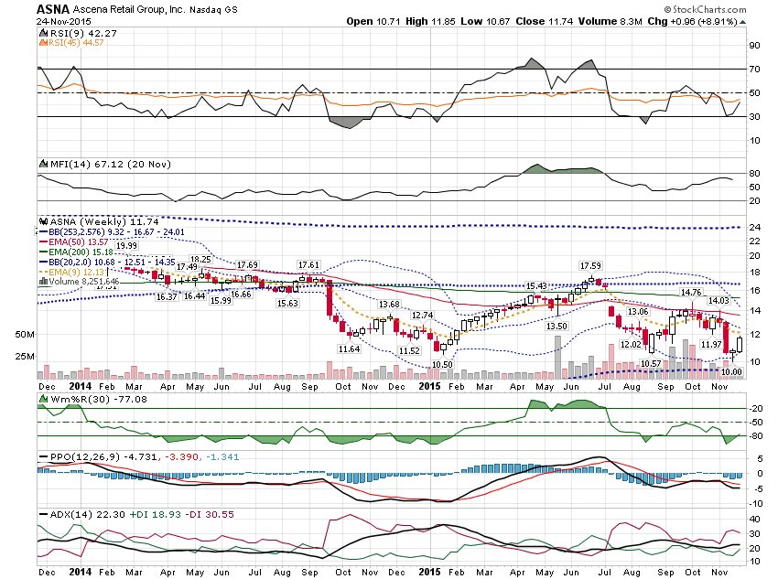

Slide 32
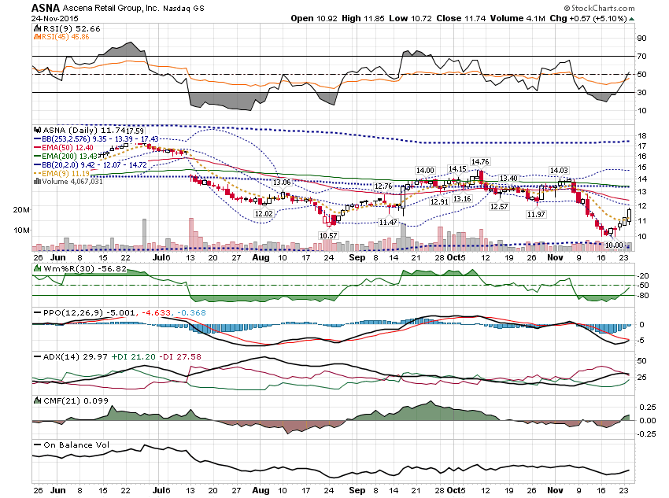

Slide 33
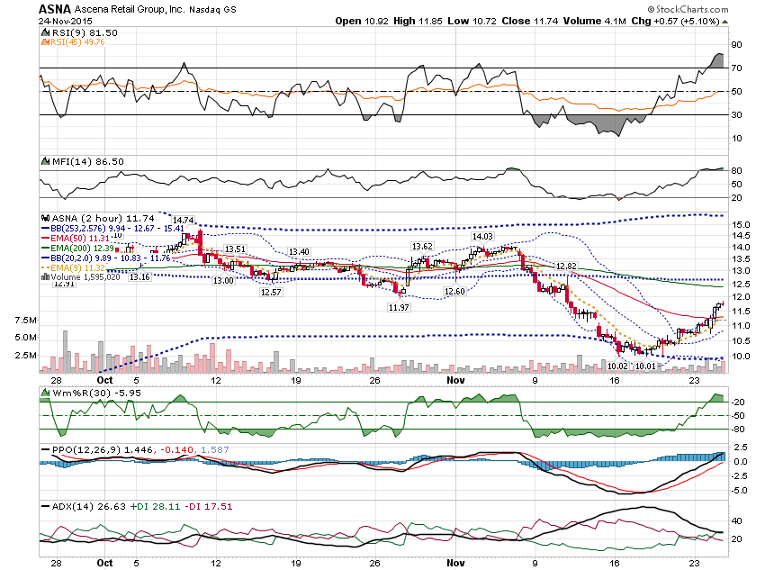

Slide 34
Let’s look at X …

Slide 35
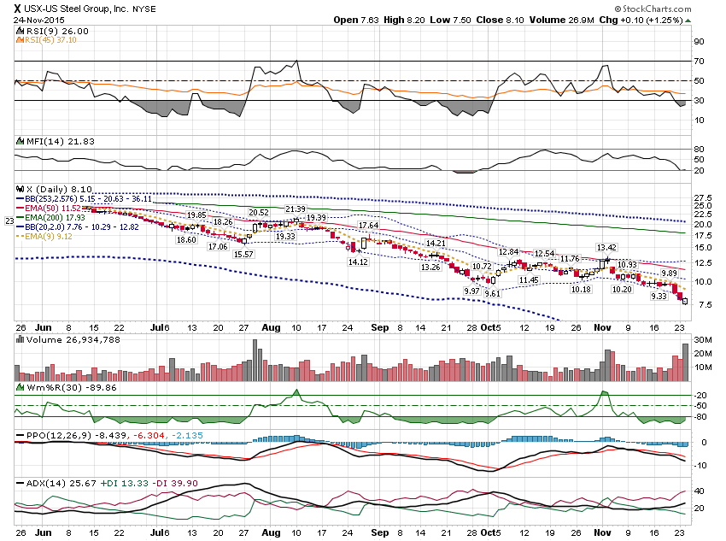

Slide 36
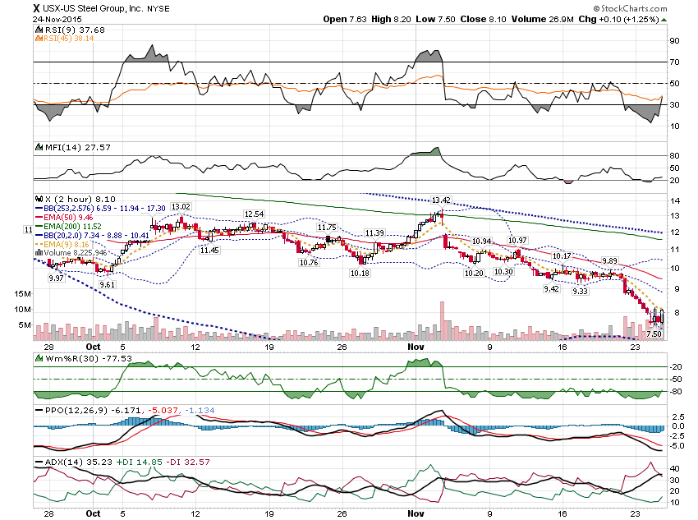

Slide 37
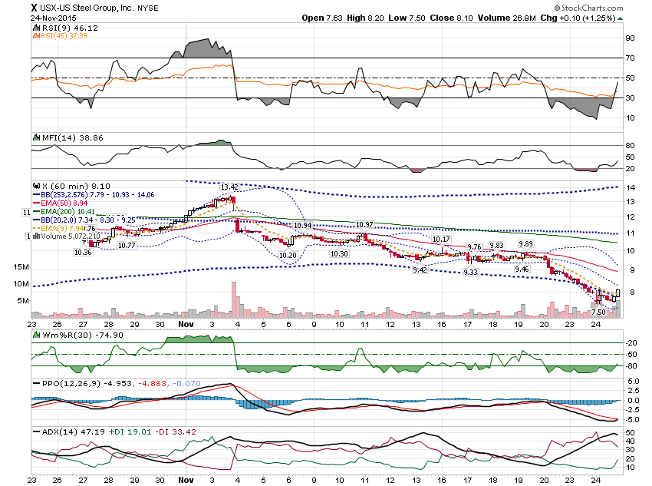

Slide 38
Bottom Band Pattern
VRX

Slide 39
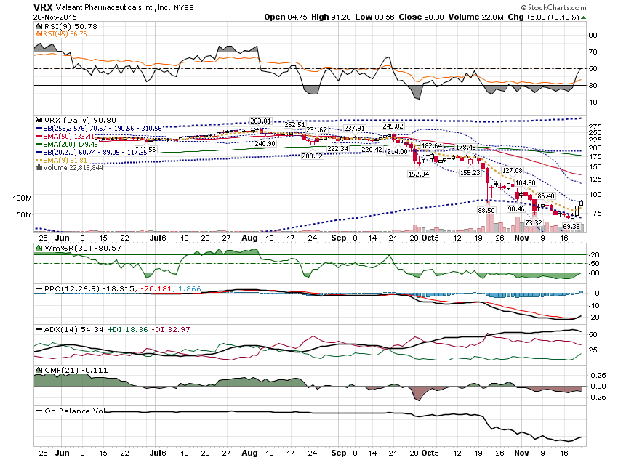

Slide 40
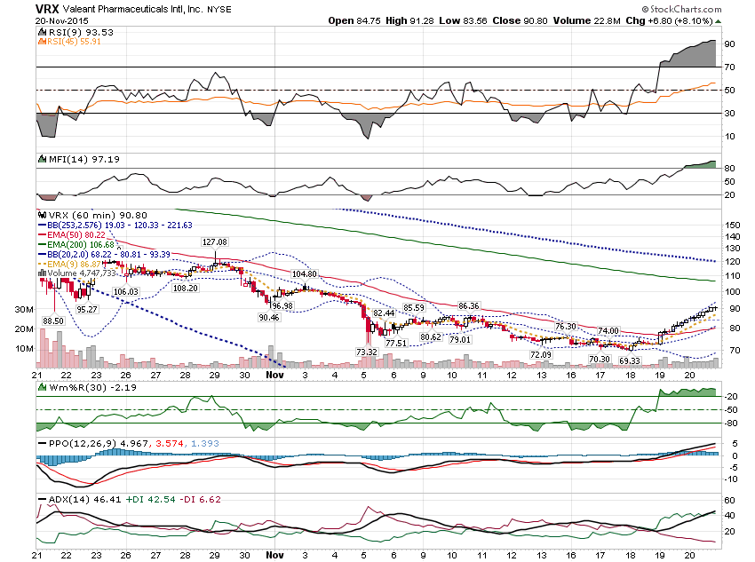

Slide 41
VRX $72.50 Calls
$1.26 to $18.20
$75 calls
$.75 to $14.60

Slide 42
I wanted to show one other move from last week … CMG

Slide 43
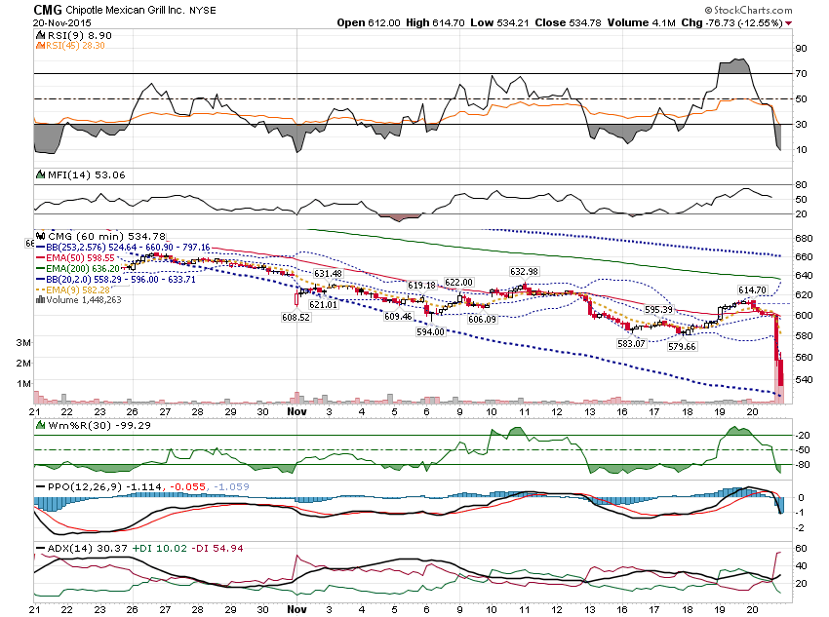

Slide 44
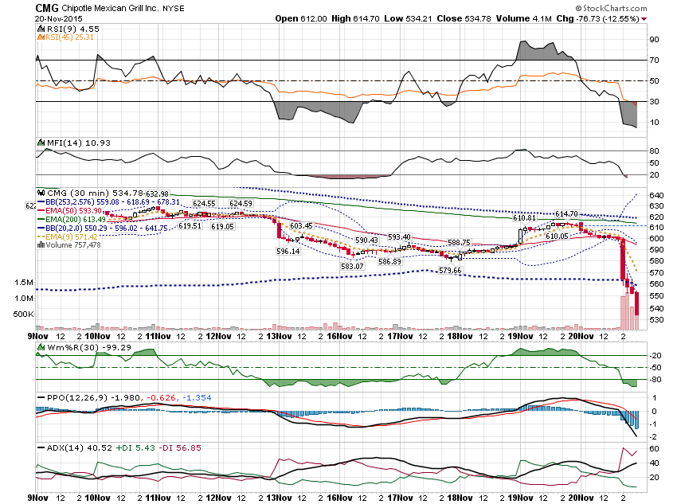

Slide 45
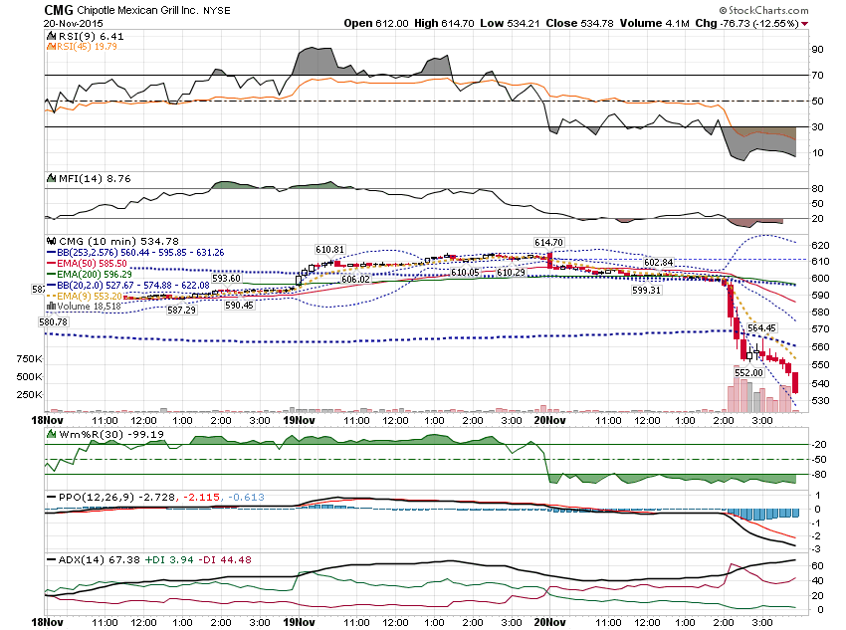

Slide 46
CMG $592.50 Weekly Put
Prev Close: 0.30
Open: 0.50
Bid: 37.60
Ask: 40.90
Strike: 592.50
Expire Date: 20-Nov-15
Day's Range: 0.05 - 57.50
Contract Range: N/A - N/A
Volume: 520
Open Interest: 294

Slide 47
$595 Weekly Put
Prev Close: 0.55
Open: 0.41
Bid: 39.80
Ask: 42.80
Strike: 595.00
Expire Date: 20-Nov-15
Day's Range: 0.20 - 60.00
Contract Range: N/A - N/A
Volume: 506
Open Interest: 348

Slide 48
$600 Weekly Put
Prev Close: 0.78
Open: 0.90
Bid: 48.40
Ask: 52.30
Strike: 600.00
Expire Date: 20-Nov-15
Day's Range: 0.64 - 65.00
Contract Range: N/A - N/A
Volume: 910
Open Interest: 735

Slide 49
Thanks for watching!
Bill Davis
Mad Day Trader
November 25, 2015 davismdt@gmail.com

