Slide 1

The Mad Hedge Fund Trader
“The Bull Market is Back!”
With John Thomas
from San Francisco, NV, November 4, 2015
www.madhedgefundtrader.com
Notes:
*

Slide 2

Trade Alert Performance
*January +0.53% Final *July +6.42% Final
*February +7.73% Final *August +1.27% Final
*March +3.00% Final *September +11.99% Final
*April +6.62% Final *October Final -6.19%
*May +5.15% Final *November MTD 0.81%
*June +3.68% Final
*2015 Year to Date +38.84%
compared to -0.3% for the Dow Average
*Trailing 1 year return +35.41%, +191.65% since inception,
*Average annualized return of 39.11%

Slide 3
Portfolio Review
Staying very small and very nimble
Mad Hedge Fund Trader
Model Trading Book
Asset Class Breakdown
Risk Adjusted Basis
current capital at risk
Risk On
World is Getting Better
(TLT) 11/$125-$128 put spread | 10.00%
(FXY) 12/$82-$84 put spread | 10.00%
Risk Off
World is Getting Worse
None
total net position | 20.00%
Expiration P&L
39.73% YTD

Slide 4
Paid Subscriber Trailing 12 Month Audited Return +35.41%

Slide 5
59 Months Since Inception
Daily Audited Performance
Averaged annualized return +39.11%

Slide 6

Strategy Outlook-The 3 Month Year
*Global wave of QE points to “RISK ON”
*Melt up in stocks brings new all time highs within reach as underperforming managers chase performance to make a year in 3 months
*Kiss bonds goodbye as they head towards 2015 lows, high in yields
*Oil trapped in wide $44-$48 range, entering seasonal
weakness, stocks are saying this is the bottom
*New focus in December Fed rate hike breathes new
life into the US dollar, demolishes bonds
*Gold rally dies another death on Fed rate rise hopes
*Ags clearly discounting major damage from
an el nino, which is growing in severity by the day

Slide 7
The Bill Davis View
Picks of the Week
Buys:
Facebook (FB) $102 Target to $108
Salesforce.com (CRM) $78 Target to $83
Baidu, Inc. (BIDU) $177 Target to $197
First Solar Inc (FSLR) $53 Target to $60
LendingTree, Inc (TREE) $105 Target to $135
Expedia, Inc (EXPE) $131 Target to $140
Sells:
SolarCity Corp (SCTY) $35 Target to $26
Buffalo Wild Wings (BWLD) $170 Target to $150
Akami Tech. (AKAM) $69 Target to $60
Int Business Mach (IBM) $145 Target to $135

Slide 8

The Global Economy-Another Round of Global QE
*ECB’s Draghi talks down Euro, threatens deposit rate cut
*Bank of China cuts rates 25 basis points
*US Q3 GDP estimates being consistently revised downward, Q3 initial comes in at a weak 1.5%, down from last read of 3.9%, housing (+6.1%) consumer spending (+3.2%) and capital investment (+5.3%) were hot, but inventories are a (-1.4%) drag
*US car production at a new all time high of an 18.2 million annual rate, Us Jeep sales up 33% YOY, cashing in on reviving economy and cheap gas
*China October PMI at 48.3, down
8 months in a row
*Next to come is a “RISK ON” global
synchronized growth in 2016

Slide 9
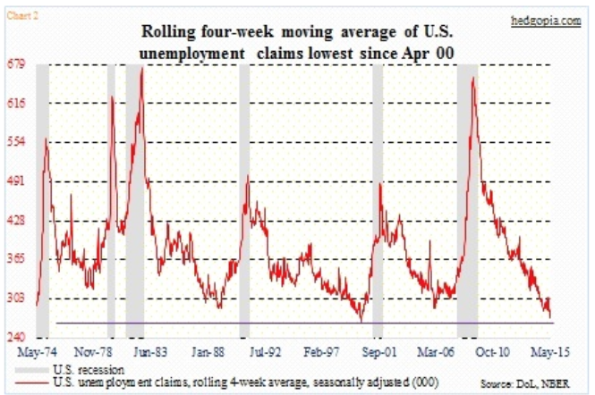
Weekly Jobless Claims – Another Run at the Lows
-1,000 to 260,000 near a new 42 year low! headed for Full Unemployment at 5%-Global Recovery a Driver

Slide 10

Bonds-Giving Up the Ghost
*Fed interest rate rise is now looking like sure thing in December, has already been discounted by the bond market with 6 point pullback
*10 year treasuries dead unchanged on the year, Now flirting wit with the 2.30% level
*Poor liquidity could exacerbate any move down in prices and up in yield
*Stock market rally brings
massive short squeeze in Junk
bonds as hedge funds cover shorts
*Large scale China selling has had
absolutely no impact on the market
*Buy (TBT) on this dip for more
strength in 2016

Slide 11
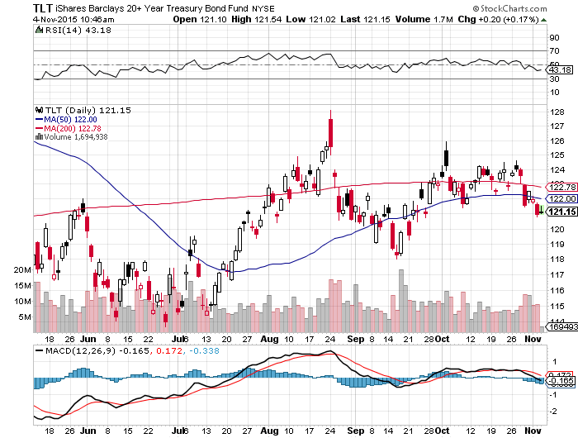
Ten Year Treasury Yield ($TNX) 2.20% took profits on 11/$128-$133 vertical bear put debit spread, rolled down to the $125-$128 vertical bear put debit spread

Slide 12
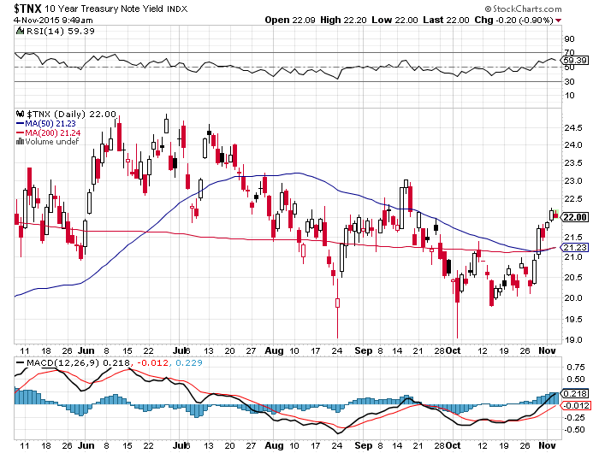
Ten Year Treasury Yield ($TNX) 2.20%
1.90% Support Holds

Slide 13
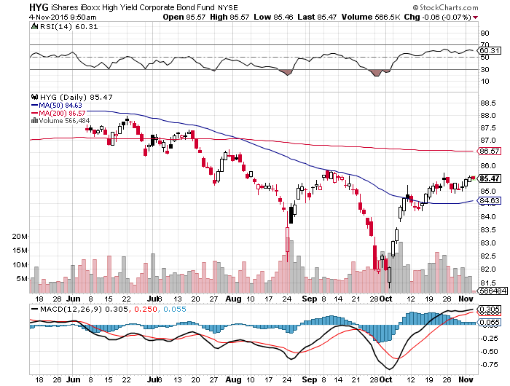
Junk Bonds (HYG) 6.69% Yield
Signaling Major “RISK ON”

Slide 14
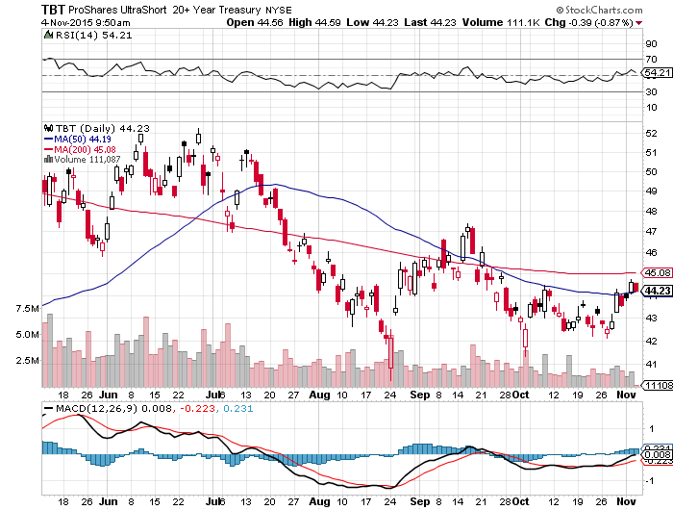
2X Short Treasuries (TBT)-Big Trade of 2016?
Buy at the Dip, $41 will hold

Slide 15
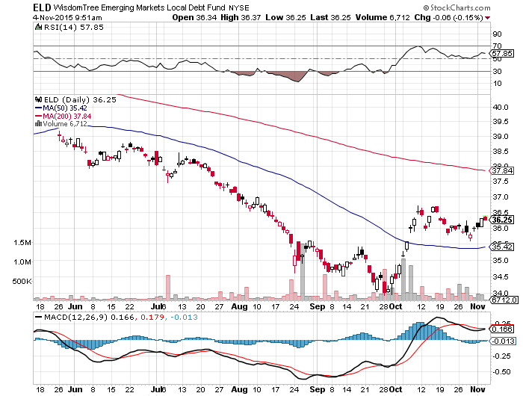
Emerging Market Debt (ELD) 5.81% Yield-
TELLING US “RISK ON”

Slide 16
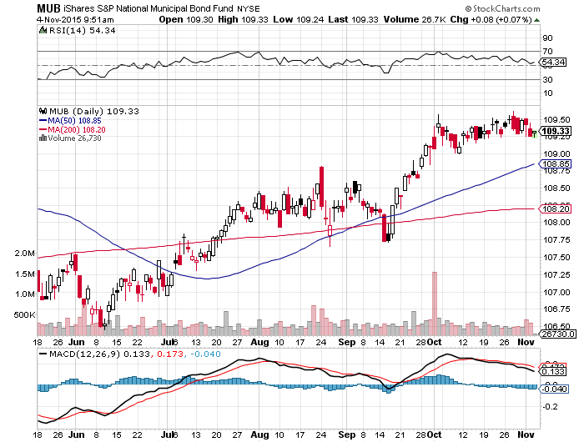
Municipal Bonds (MUB)-1.67% yield
Mix of AAA, AA, and A rated bonds-flight to safety

Slide 17
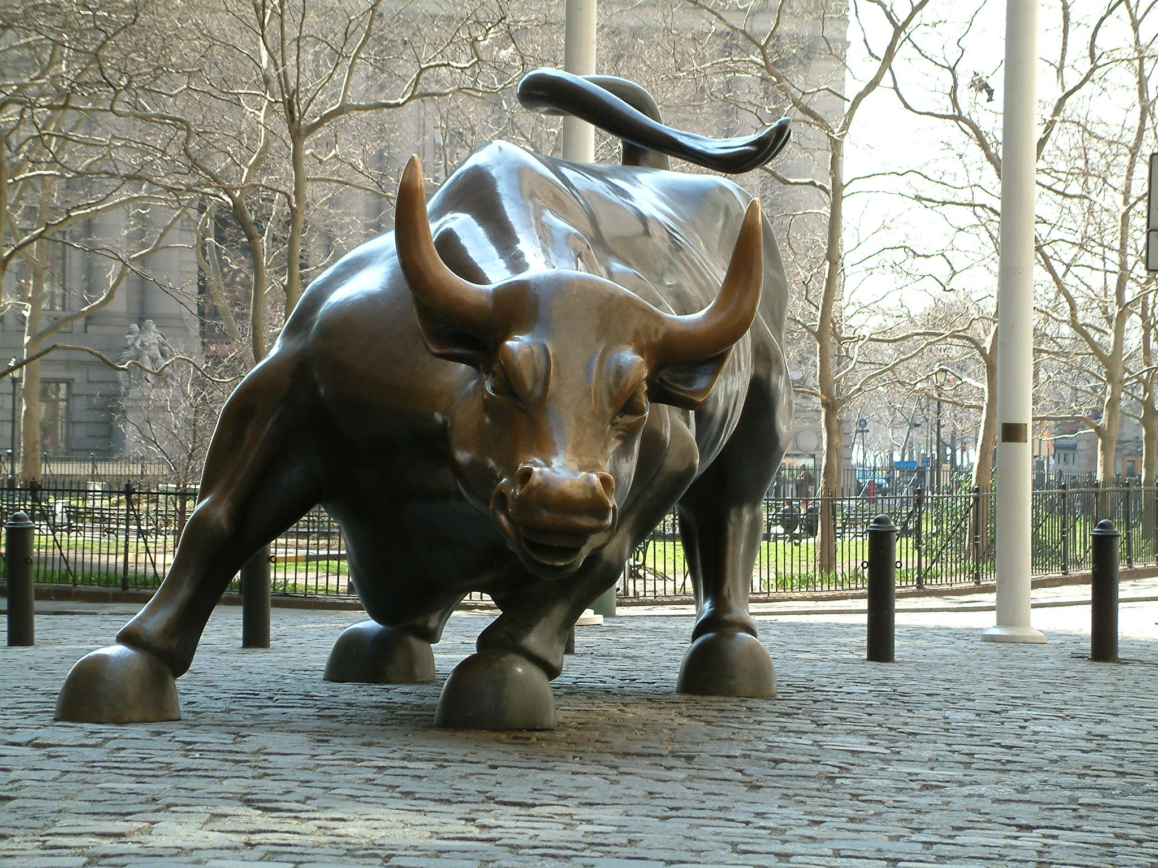
Stocks-Yearend Melt Up is On
*Investors are back in “Buy the Dip” mode, look for new all time high in stocks before yearend
*May get a small correction in December in Fed interest rate rise
*Portfolio managers chasing performance trying to get any kind of positive return for 2015
*There is nothing else to buy globally, US stocks offer the best risk/reward and yield
*Investors looking forward to a 2016
earnings recovery
*$100 billion in withdrawals from equity
funds over past 6 months will have to go back in,
taking us to new highs

Slide 18
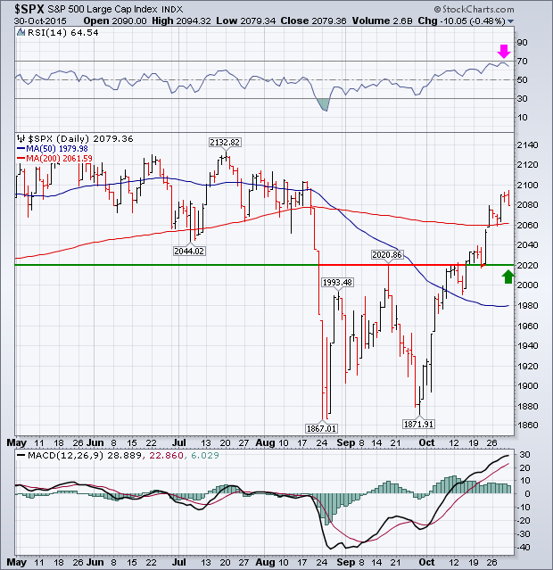
S&P 500-200 Day MA in Play at $204.29
Setting up the Range stopped out of 11/$213-$216 vertical bear put spread at cost

Slide 19
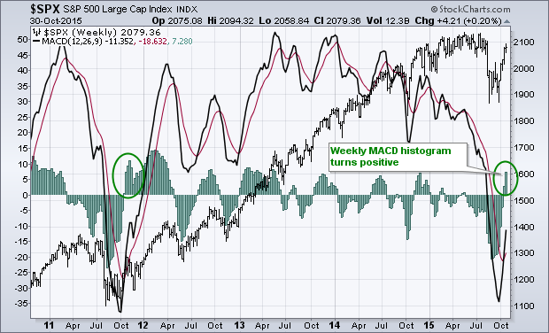
S&P 500-4 Year Chart

Slide 20
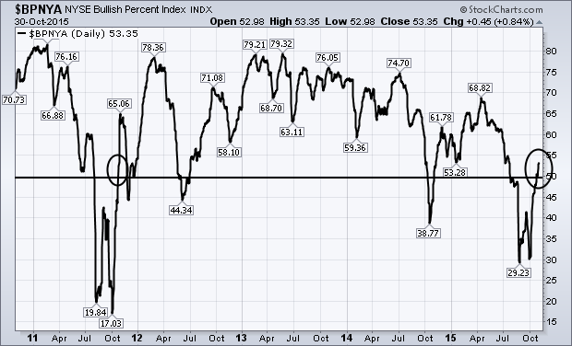
S&P 500

Slide 21
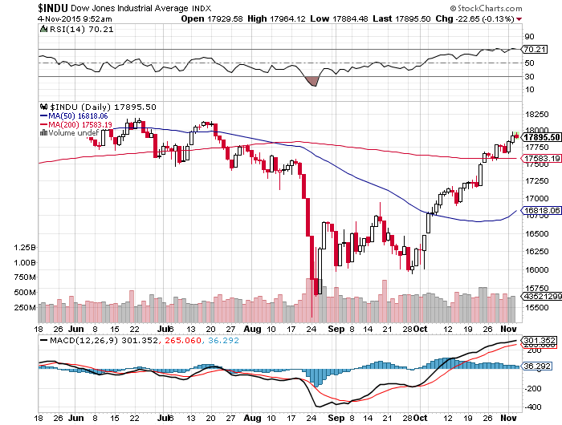
Dow Average- UP +0.5% on the year, 85 Points!

Slide 22
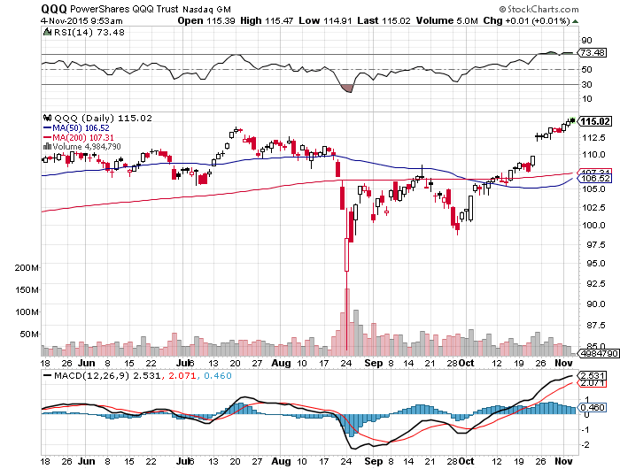
NASDAQ (QQQ)-

Slide 23
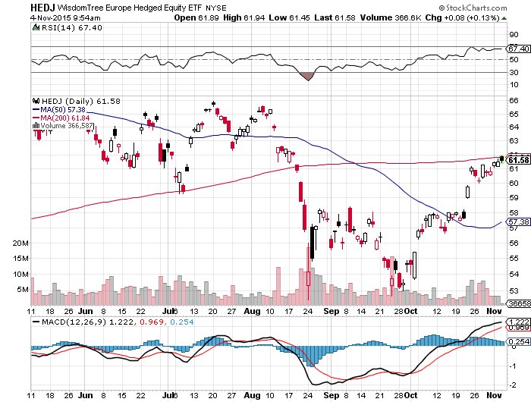
Europe Hedged Equity (HEDJ)-

Slide 24
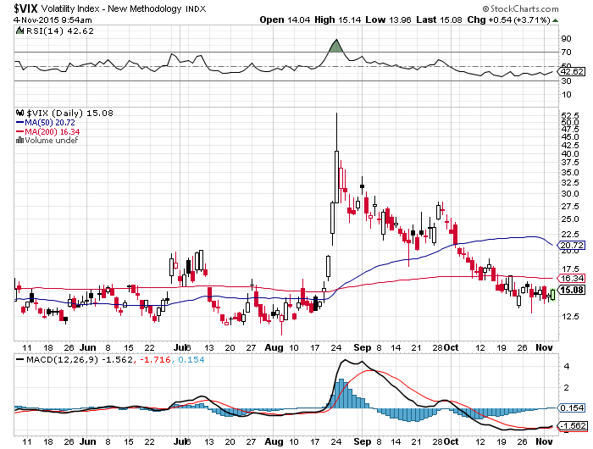
(VIX)-Bleeding Off From Four Year High!
Best Call of the Year!

Slide 25
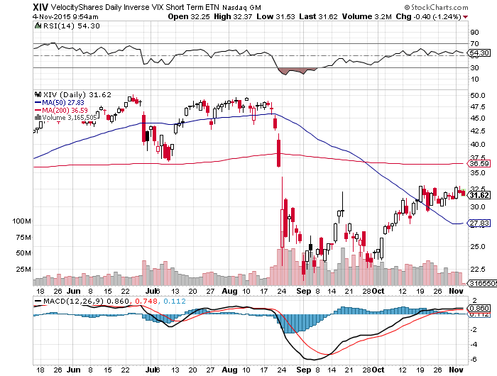
(XIV)-Velocity Shares Daily Inverse VIX Short Term ETN
4 Profitable Round Trips!

Slide 26
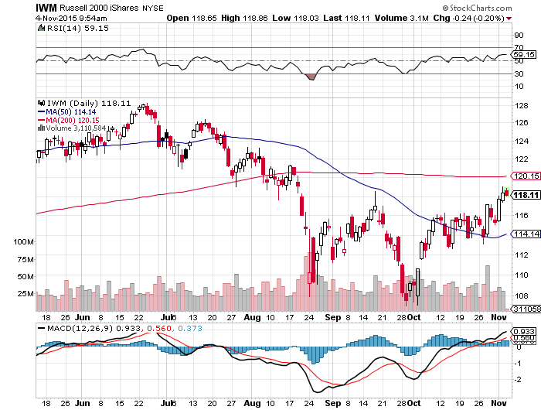
Russell 2000 (IWM)-The Weak Link
No place in a value world

Slide 27
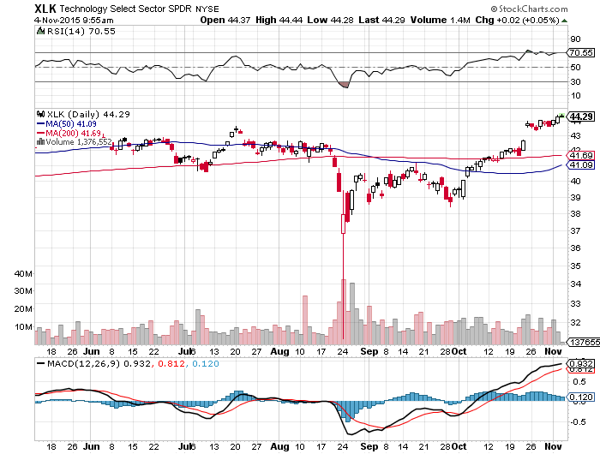
Technology Sector SPDR (XLK), (ROM)
(AAPL), (MSFT), (VZ), (T), (FB), (IBM)
First to Recover 200-Day Moving Average

Slide 28
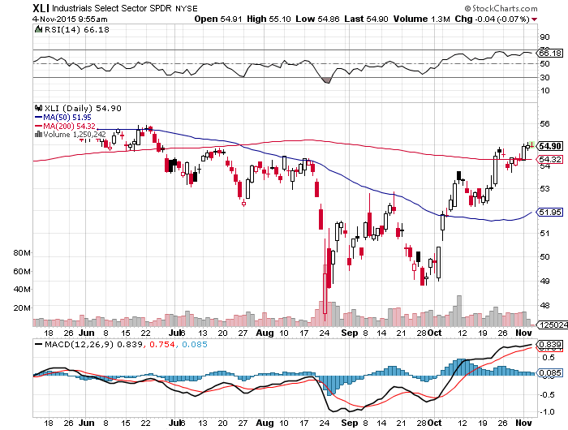
Industrials Sector SPDR (XLI)-Dow Mainstay
(GE), (MMM), (UNP), (UTX), (BA), (HON)

Slide 29
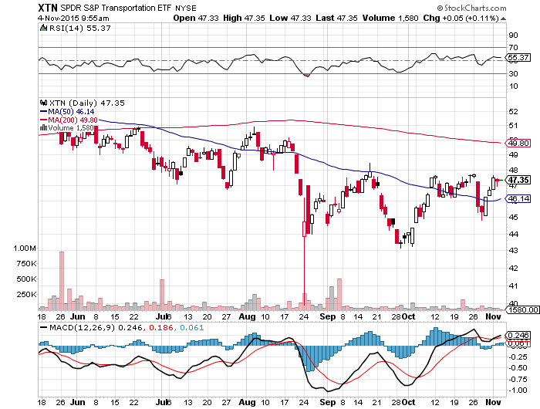
Transports Sector SPDR (XTN)-Another Dow Mainstay
(ALGT), (ALK), (JBLU), (LUV), (CHRW), (DAL),

Slide 30
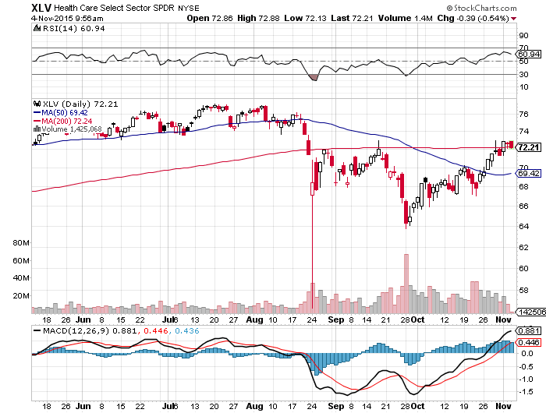
Health Care Sector SPDR (XLV), (RXL)
(JNJ), (PFE), (MRK), (GILD), (ACT), (AMGN)

Slide 31
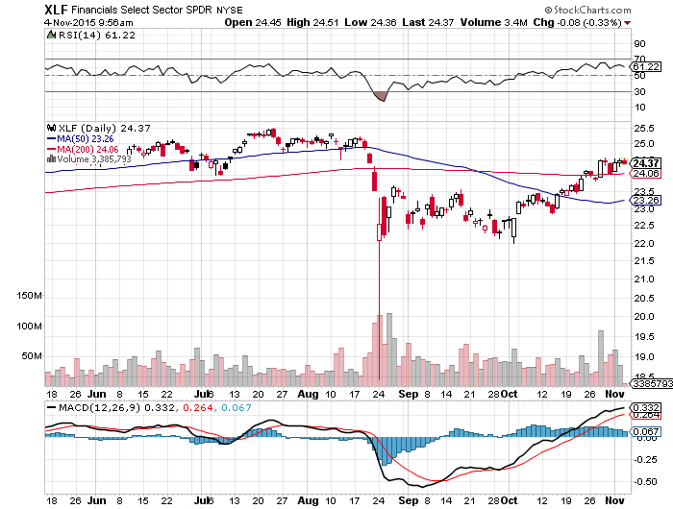
Financial Select SPDR (XLF)-Party Postponed
(BLK/B), (WFC), (JPM), (BAC), (C), (GS)

Slide 32
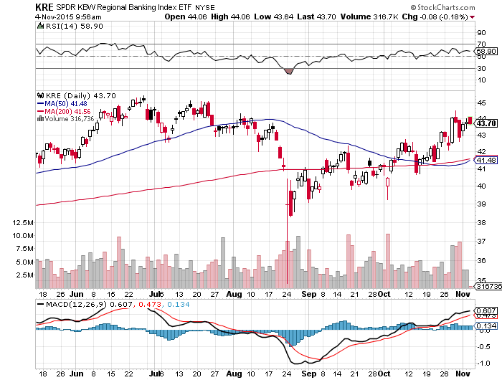
Regional Bank Basket (KRE)-The Fix Disappoints
(MTG), (RDN), (SIVB), (CFG), (CFR), (BXS)

Slide 33
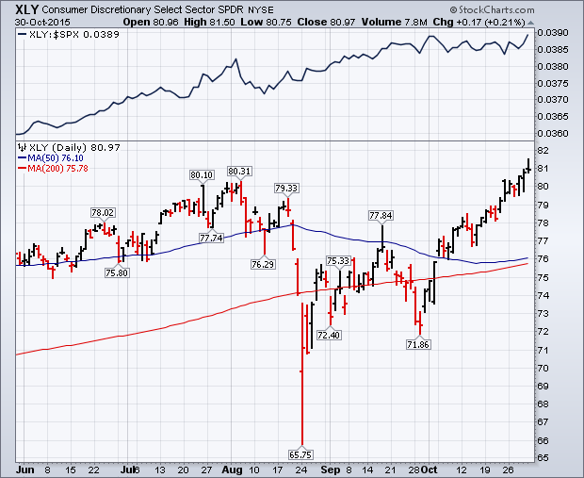
Consumer Discretionary SPDR (XLY)
(DIS), (AMZN), (HD), (CMCSA), (MCD), (SBUX)

Slide 34
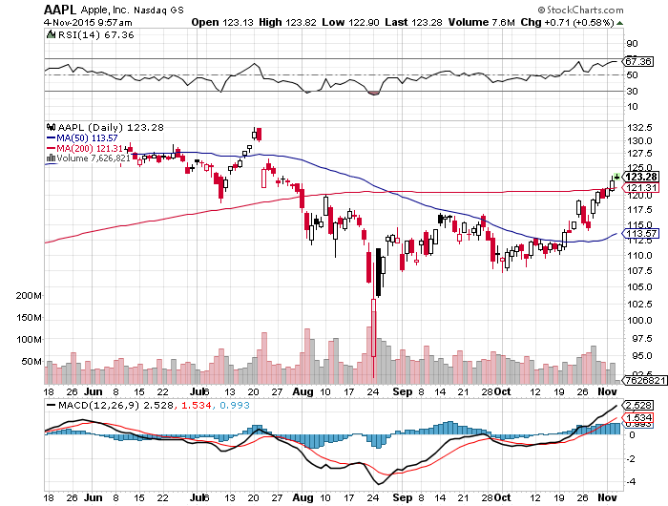
Apple (AAPL) –
NOT waiting for the next real catalyst-the iPhone 7

Slide 35
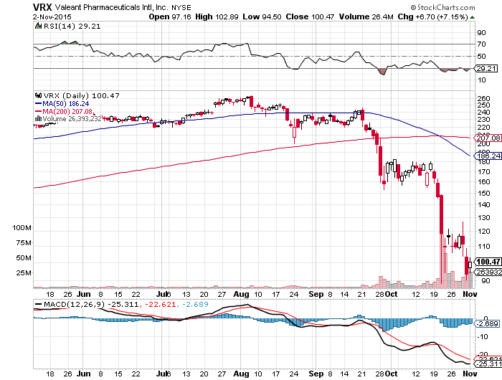
Stock of the Week- Valiant (VRX) –
Drug Pricing Scandal Brings a 50% Hit

Slide 36
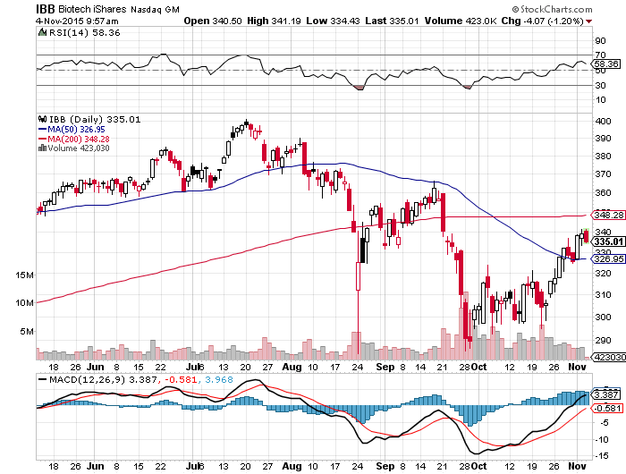
Biotech iShares (IBB)-

Slide 37
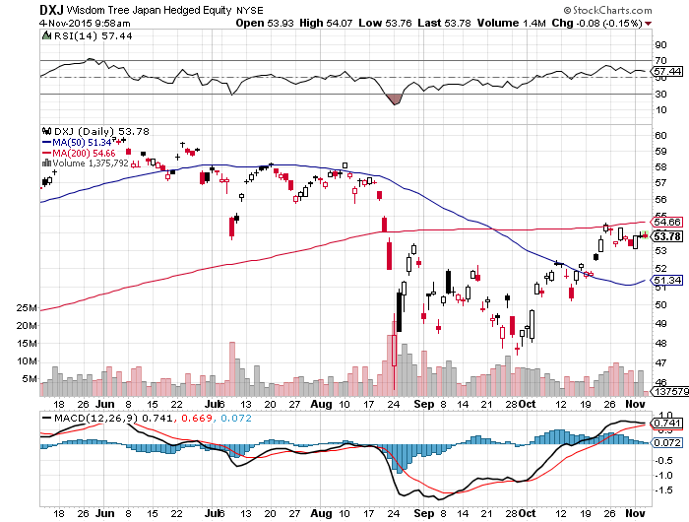
Japan (DXJ)-Hedged Japan Equity

Slide 38
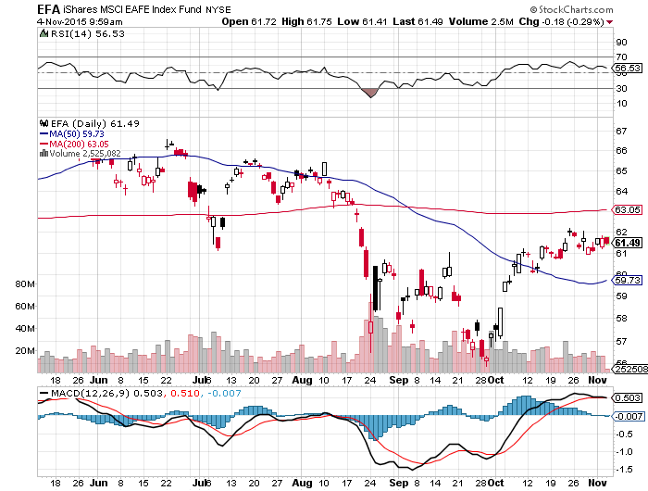
Emerging Markets (EFA)-Bounce on Commodities Rally

Slide 39
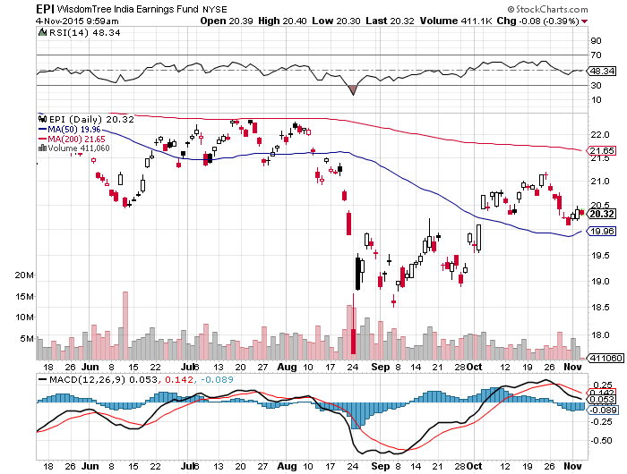
India (EPI)-

Slide 40

Foreign Currencies-Foreign QE = Dollar Strength
*The US will be simultaneously raising rate while Europe cuts rates for the first time since 1994, sets up a perfect long dollar trade
*Draghi says QE to be expanded, Euro deposit rates to be lowered, demolishing Euro (FXE), (EUO), QE to continue to at least September
*China sells portion of its E1.1 trillion Eurobond holdings to help QE there
*Bank of Japan lowers inflation forecast,
but fails to follow through with more
QE, delivering yen spike
*Commodity stall bring profit taking
in commodity currencies (FXC) and (FXA)

Slide 41
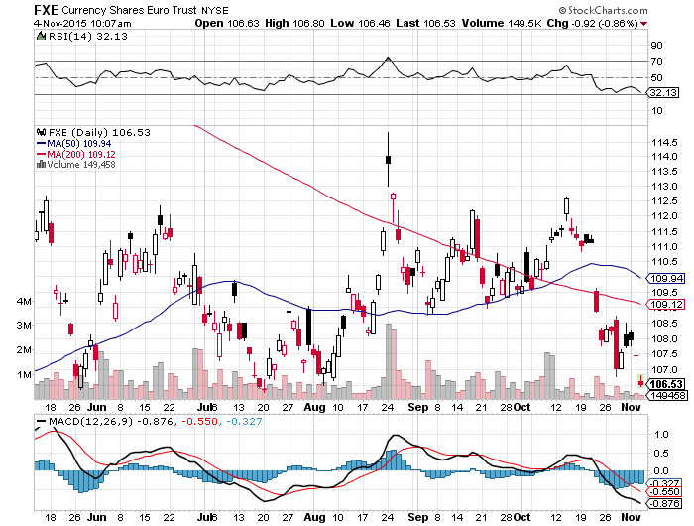
Euro ($XEU), (FXE), (EUO)

Slide 42
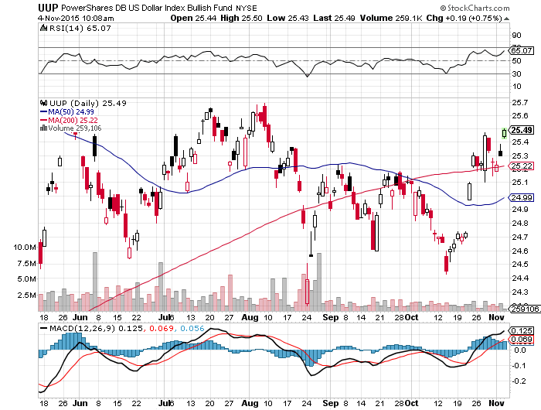
Long Dollar Index (UUP)-

Slide 43
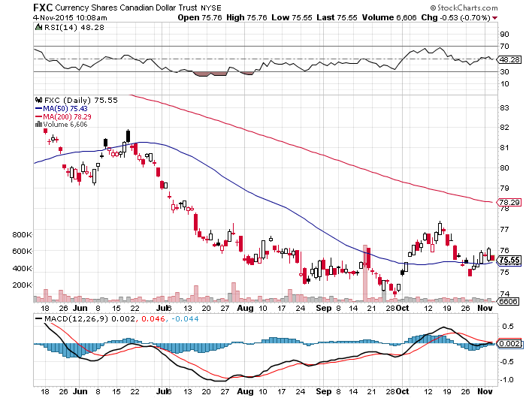
Canadian Dollar (FXC)-Commodity Bounce

Slide 44
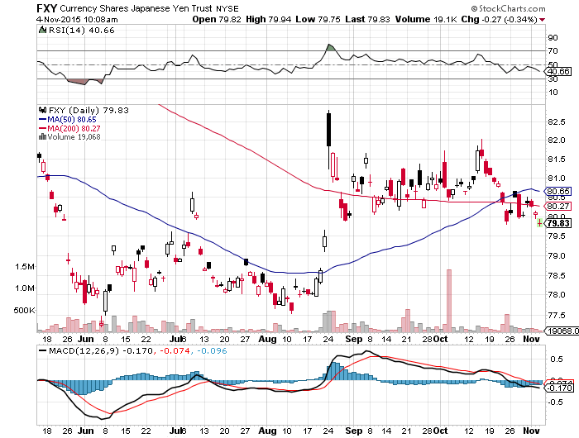
Japanese Yen (FXY)-

Slide 45
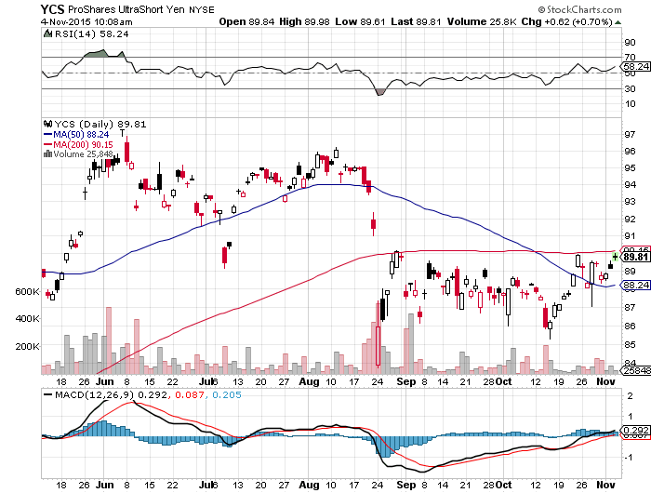
Short Japanese Yen ETF (YCS)

Slide 46
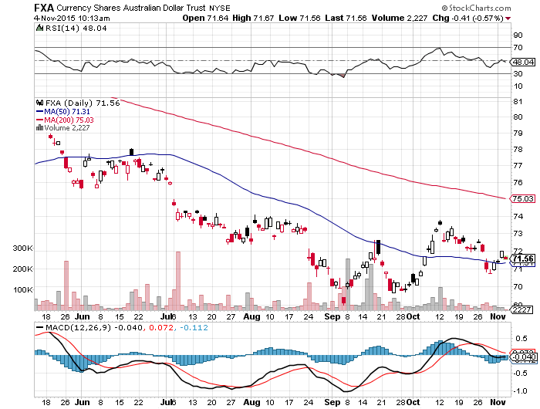
Australian Dollar (FXA) –Bounce

Slide 47
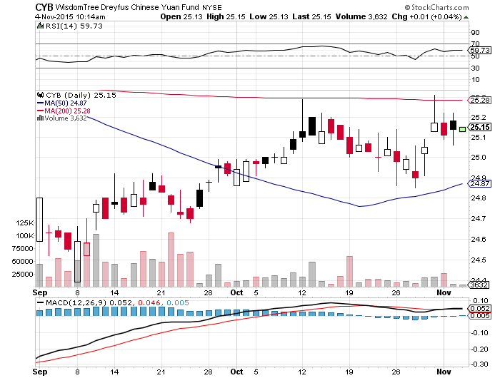
Chinese Yuan- (CYB)-Appreciating Again

Slide 48
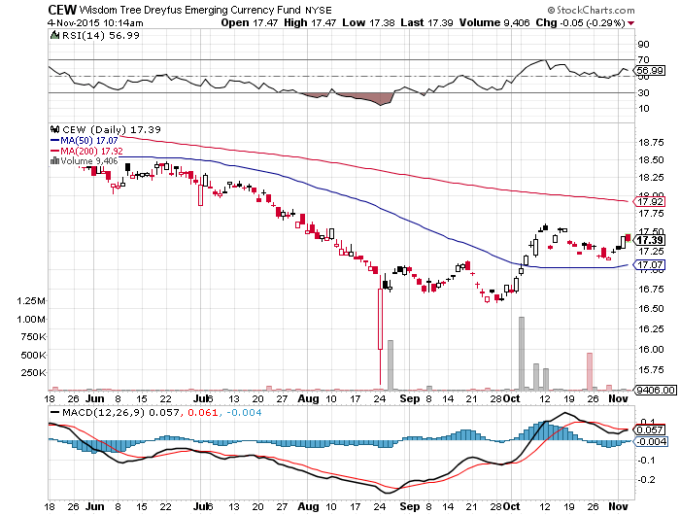
Emerging Market Currencies (CEW)
Another “RISK ON” Indicator

Slide 49

Energy-All About Inventories
*The oil markets are now moving from seasonal strength to weakness, should bring the final bottom, speculators now play from the long side
*US Oil Inventories rise a shocking 9.3 million barrels to 475 million barrels, approaching new all time high of 500 million barrels, Saudi inventories at all time high from lack of buyers
*Oxy pulls out of Bakken in North Dakota citing high costs and no chance of recovery to profitable levels
*Saudi Arabia running $100 billion
deficit this year, debt downgraded by S&P
*Short covering has started in
natural gas

Slide 50
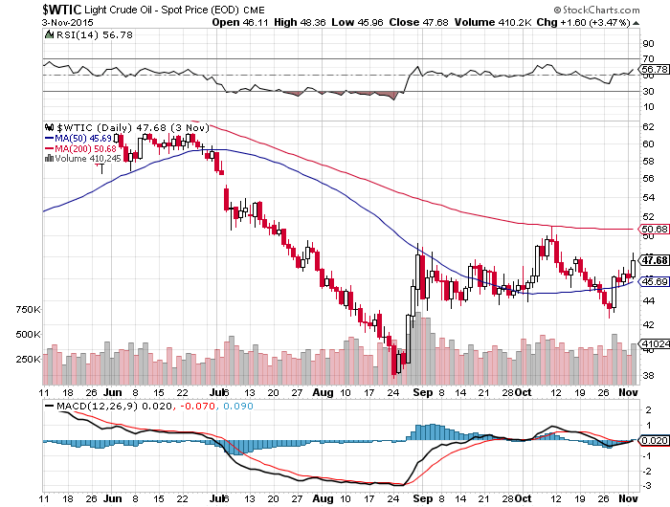
Oil-May Be a Q4 Story-A Buy at $44?
Building a Bottom

Slide 51
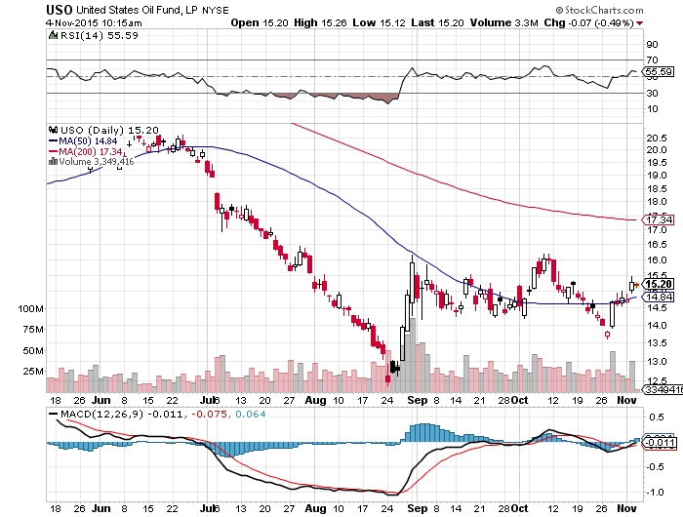
United States Oil Fund (USO)

Slide 52
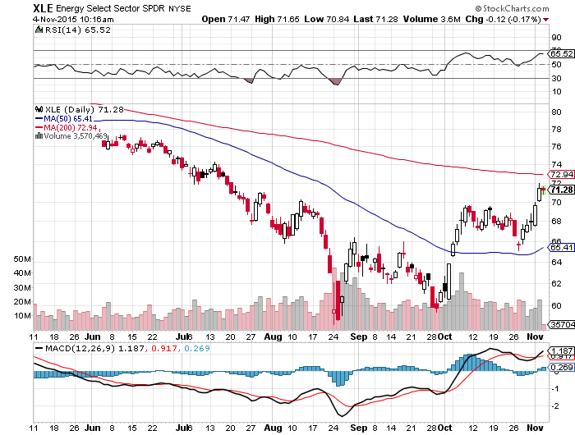
Energy Select Sector SPDR (XLE)
(XOM), (CVX), (SLB), (KMI), (EOG), (COP) stocks lead oil turnaround by 6 months

Slide 53
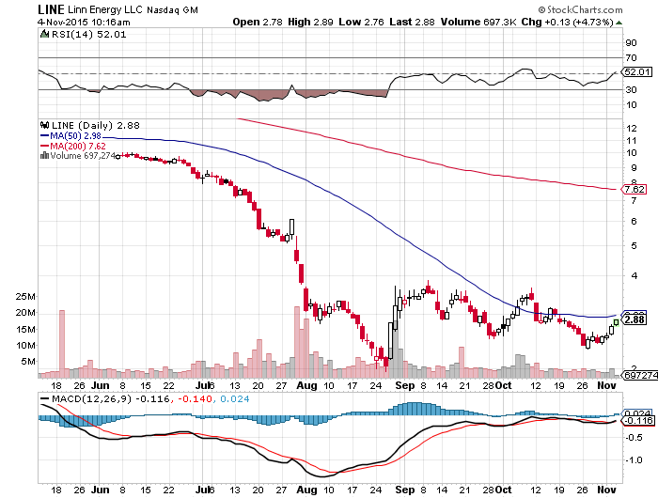
MLP’s (LINE)-Dividend Suspended!
Shares fall to option value

Slide 54
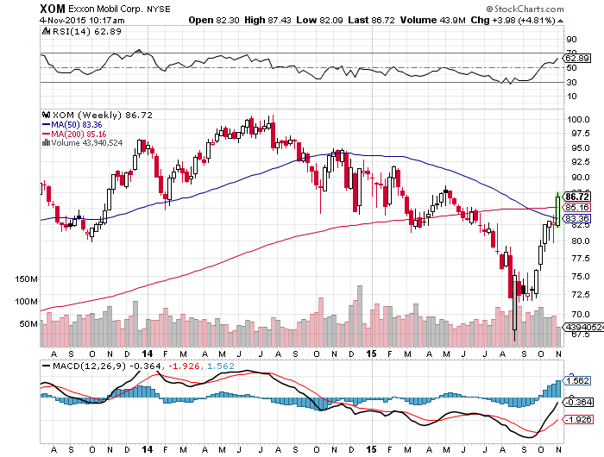
Exxon (XOM)-A Perfect Storm
A massive short covering, weak dollar, oil bottom story

Slide 55
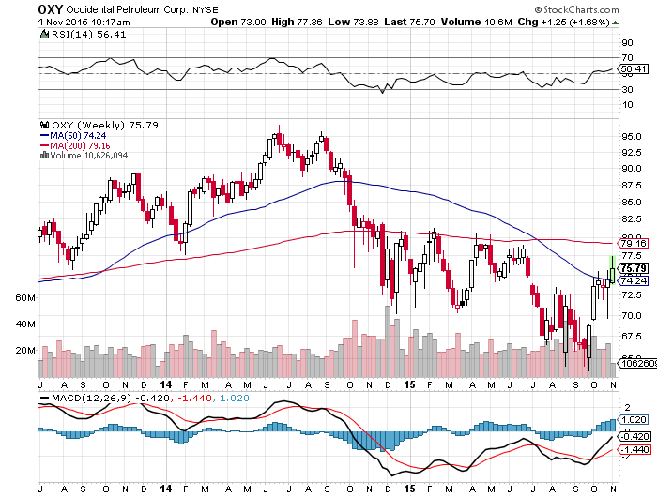
Occidental Petroleum (OXY)-
Back to Where Oil was $62

Slide 56
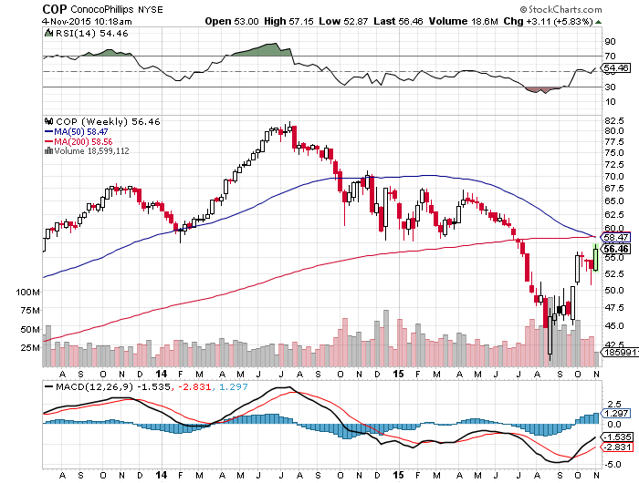
Conoco Phillips (COP)-

Slide 57
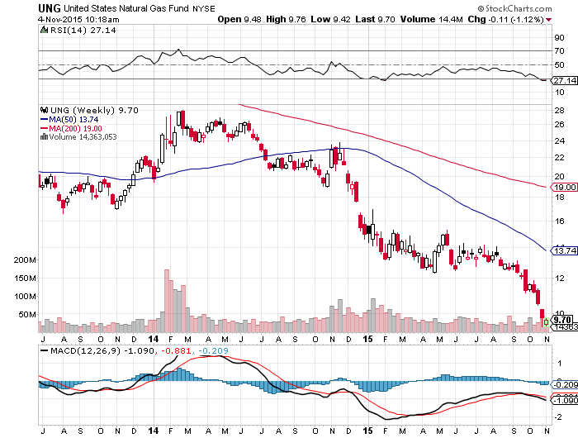
Natural Gas (UNG)-New Lows on Warm Winter

Slide 58
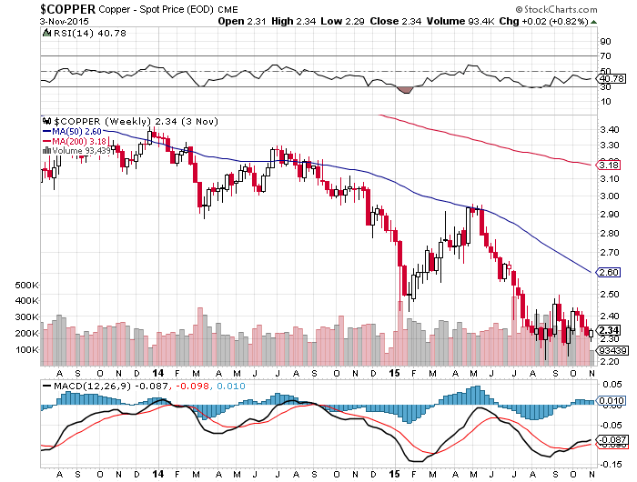
Copper-Commodity Collapse

Slide 59
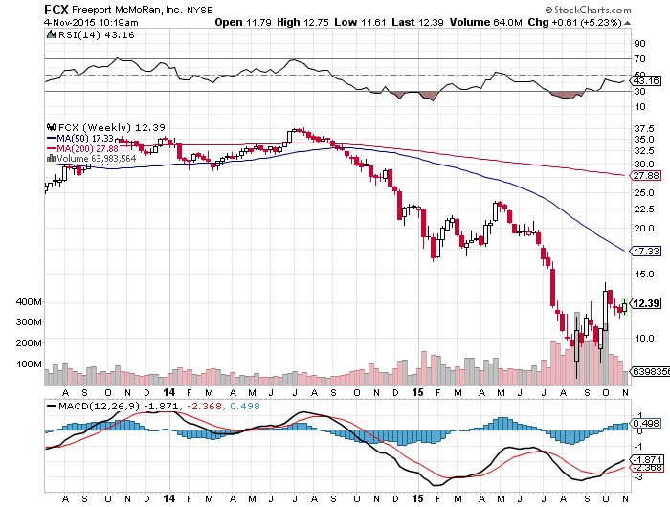
Freeport McMoRan (FCX)-Carl Icahn in Play

Slide 60

Precious Metals-Party is Over
*Gold tops out on charts, triggering big round of profit taking
*Huge increase in commercial shorts in futures market as miners rush to hedge production, 11.85 million to 16.33 million ounces
*Venezuela dumping its gold reserves to avert a financial crisis
*Stock market short squeeze bring huge
outperformance by mining stocks, don’t
chase rally
*Stay away, gold stocks are
a better play on a dip
with their earnings and dividend
support
*No room for gold in a paper
chasing world

Slide 61
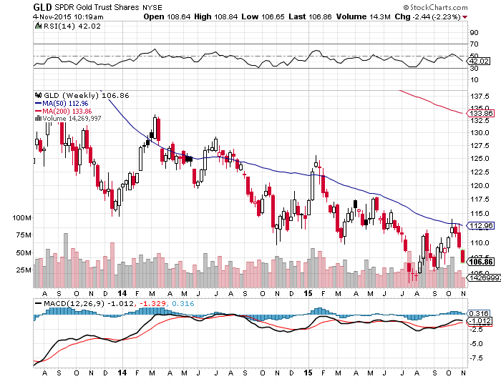
Gold (GLD)- Approaching New 4 Year Lows

Slide 62
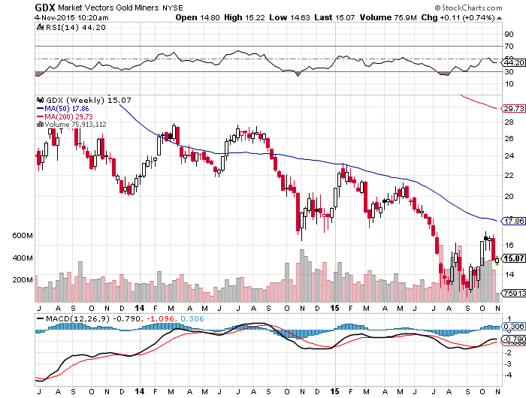
Market Vectors Gold Miners ETF- (GDX)

Slide 63

Silver (SLV)-

Slide 64

Silver Miners (SIL)

Slide 65

Platinum (PPLT)-The Volkswagen Effect new chapter of the “Clean Diesel” Scandal

Slide 66

Palladium (PALL)-The Non Diesel Play

Slide 67

Agriculture-Mostly Bullish
*Hurricane hit Texas, hurting crop yields
*Strong dollar still a problem, Wheat is $182/metric tonne in Russia vs. $220 from the US, but Russia is running out of wheat
*El Nino is strengthening, will hit farms harder this winter, second rain in 6 months hits California
*But price action is looking pretty feeble given these strongly positive findamentals

Slide 68

(CORN) –

Slide 69

(WEAT)-

Slide 70

Ag Commodities ETF (DBA)-

Slide 71

Real Estate-Shortage of Supply
*September Pending home sales down 2.3% due to shortage of inventory, northeast has biggest fall, -4.0%
*September new home sales down sharply, mortgage applications down 3.5%
*Home flipping returns with a vengeance, but profits are falling
*Traders loading up on these stocks
expecting a strong Spring 2016
*Predicted rush to buy homes to beat
the fed interest rate hike is unfolding
*Case Shiller S&P 500 National index
continues upward grind

Slide 72

July S&P/Case–Shiller Home Price Index
+4.7% YOY, Denver, San Francisco, Dallas
+4.7% YOY

Slide 73

US Home Construction Index (ITB)
(DHI), (LEN), (PHM), (TOL), (NVR)

Slide 74

Trade Sheet
So What Do We Do About All This?
*Stocks- buy the big dips in best value names only
*Bonds-the top is in, sell rallies, buy (TBT)
*Commodities-stand aside, buy the next oil down leg
*Currencies- Sell short the Yen and Euro on rallies
*Precious Metals –stand aside
*Volatility-sell short spikes through (XIV)
*The Ags –buy the big dips
*Real estate-buy the homebuilders LT

Slide 75

To buy strategy luncheon tickets
Please go to: www.madhedgefundtrader.com
Next Strategy Webinar
12:00 EST Wednesday,
November 18, 2015
San Francisco, CA
USA!
Good Luck and Good Trading!
Notes:
*

