Slide 1

The Mad Hedge Fund Trader “The Markets Don’t Care About Terrorists”
With John Thomas from San Francisco, CA, November 18, 2015 www.madhedgefundtrader.com
Notes:
*

Slide 2

Trade Alert Performance PEDDLING EXTRA HARD TO BRING YOU THESE NUMBERS
*January +0.53% Final *July +6.42% Final *February +7.73% Final *August +1.27% Final *March +3.00% Final *September +11.99% Final *April +6.62% Final *October Final -6.19% *May +5.15% Final *November MTD 4.20% *June +3.68% Final *2015 Year to Date +42.23% compared to -1.7% for the Dow Average *Trailing 1 year return +31.48%, +195.04% since inception, 1.59% short of NEW ALL TIME HIGH! *Average annualized return of 39.86%

Slide 3

Announcing the Executive Service
*A risk analysis of your own personal portfolio with the goal of focusing your investment in the highest return sectors for the long term. *A monthly phone call from John Thomas to update you on the current state of play in the global financial markets. *Personal meetings with John Thomas anywhere in the world once a year to continue our in depth discussions. The cost for this highly personalized, bespoke service is $10,000 a year. Limited to the first 10 clients, SOME PLACES WENT IN THE FIRST HOUR!

Slide 4
Portfolio Review Moderate Sized “RISK ON” Book
Mad Hedge Fund Trader
Model Trading Book
Asset Class Breakdown
Risk Adjusted Basis
current capital at risk
Risk On
World is Getting Better
(TLT) 12/$124-$127 put spread | 10.00%
(FXY) 12/$82-$84 put spread | 10.00%
(FXE) 12/$111-$112 put spread | 10.00%
(FXE) 12/$108-$111 put spread | 10.00%
(SPY) 12/$185-$190 call spread | 10.00%
Risk Off
World is Getting Worse
None
total net position | 50.00%
Expiration P&L 45.75% YTD

Slide 5
Paid Subscriber Trailing 12 Month Audited Return +31.48%

Slide 6
59 Months Since Inception Daily Audited Performance Averaged annualized return +39.86%

Slide 7

Strategy Outlook-The 3 Month Year
*Paris terrorist attacks triggers global “RISK ON” move” *Stocks too risky to chase here. Wait for bigger dip. The clearer trends and better quality trades have been in bonds and currencies. *Kiss bonds goodbye as they head towards 2015 lows, high in yields *Oil imminently breaking below $40, the final flush is at hand *New focus in December Fed rate hike breathes new life into the US dollar *Gold utterly fails to rally on terrorist attacks, breaks to new six year lows *Even el nino isn’t enough to support the ags in a huge oversupply situation

Slide 8
The Bill Davis View
Picks of the Week
Buys:
Amazon (AMZN) $640 Target to $672
Priceline (PCLN) $1,250 Target to $1,310
Transocean (RIG) $14.20 Target to $15.60
L-3 Communications (LLL) $122 Target to $131
Raytheon (RTN) $118 Target to $126
General Mills (GIS) $56 Target to $62
General Dynamics (GD) $143 Target to $153
Sells:
Celgene (CELG) $117 Target to $102
Cummins (CMI) $108 Target to $96
Alexion (ALXN) $178 Target to $165
Las Vegas Sands (LVS) $52 Target to $41

Slide 9

The Global Economy-Ramping Up
*Paris attacks slows Europe and accelerates Euro quantitative easing *Chinese October imports down 18.8%, demolishing commodities, President Xi says that annual growth won’t fall below 6.5% over next five years *US October industrial production down -0.2%, down 9 of 10 months *Japan enters recession with second quarter of no growth, GDP down -0.8% in Q3. *China appears to be stabilizing, now that selling stocks is illegal *Next to come is a “RISK ON” global synchronized growth in 2016

Slide 10
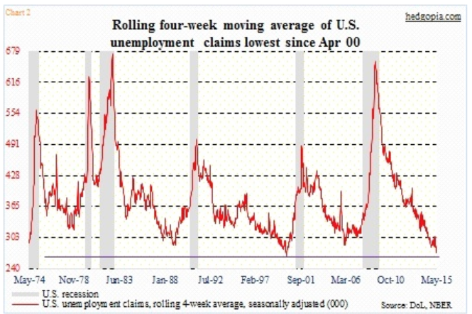
Weekly Jobless Claims – Another Run at the Lows unchanged 276,000, but ticking up last few weeks headed for Full Unemployment at 5%-Global Recovery a Driver

Slide 11

Bonds-Game Over
*The 30 year bull market is clearly over, with every major investor eyeing the exit *Fed interest rate rise is now looking like sure thing in December, has already been discounted by the bond market with 6 point pullback *The stampede to borrow while rates are low is on, US multinationals have borrowed $132 billion in jumbo loans in 2015, they think a December rate hike is real *Poor liquidity could exacerbate any move down in prices and up in yield *Stock market rally brings massive short squeeze in Junk bonds as hedge funds cover shorts *As liquidity disappears, the risk of a bond flash crash is rising, big guys can’t get out *Buy (TBT) on any dip for more strength in 2016

Slide 12
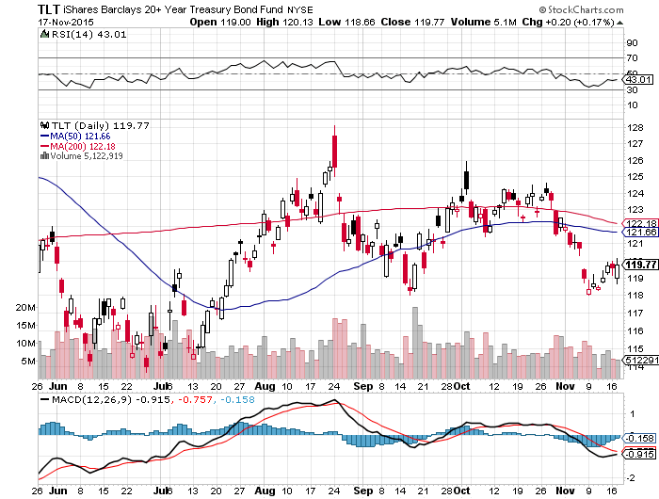
Ten Year Treasury Yield (TLT) 2.26% 4 (TLT) put spreads have been profitable in 5 weeks, rolled down to the 12/$124-$127 vertical bear put debit spread

Slide 13
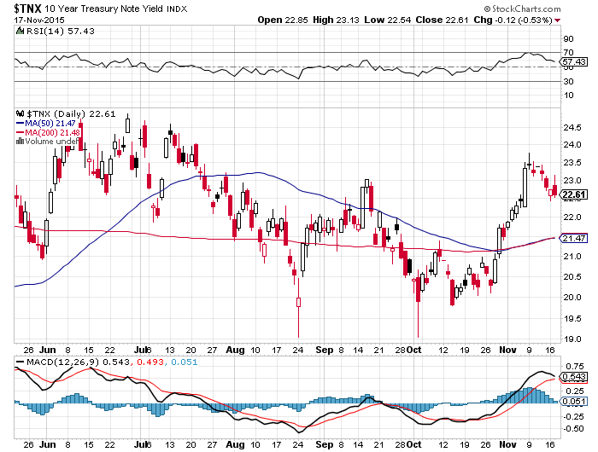
Ten Year Treasury Yield ($TNX) 2.26% 2.35% Ceiling Holds

Slide 14
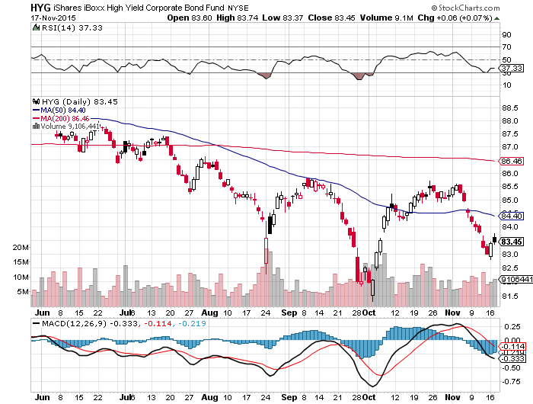
Junk Bonds (HYG) 6.62% Yield A Great Coincident Indicator

Slide 15
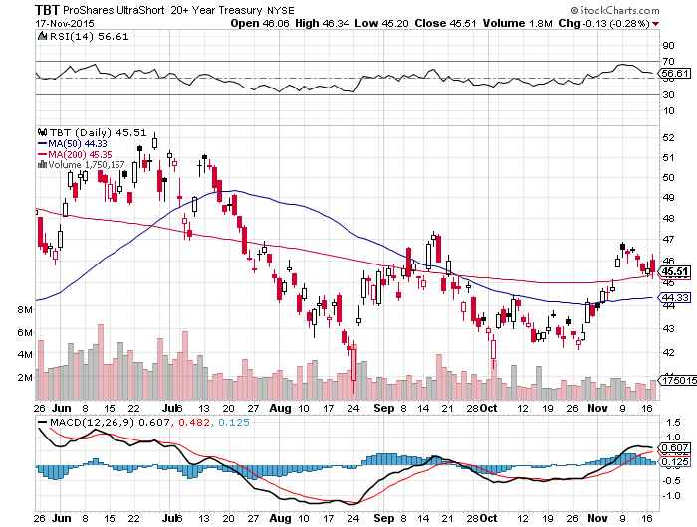
2X Short Treasuries (TBT)-Big Trade of 2016? Awaiting an Upside Breakout

Slide 16
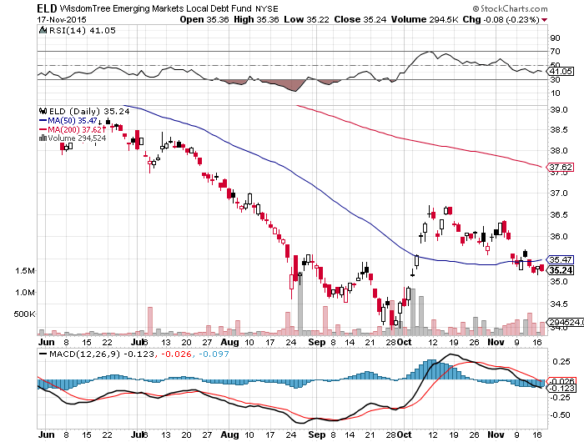
Emerging Market Debt (ELD) 7.73% Yield-

Slide 17
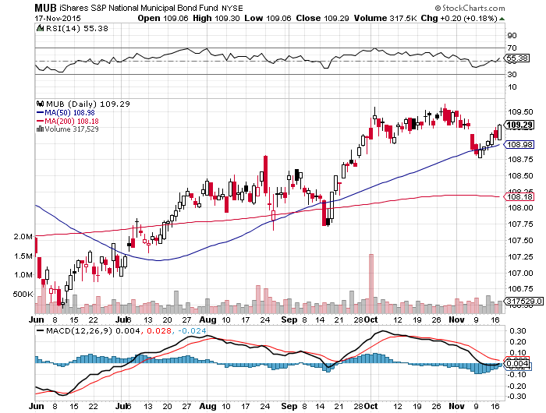
Municipal Bonds (MUB)-1.67% yield Mix of AAA, AA, and A rated bonds-flight to safety

Slide 18
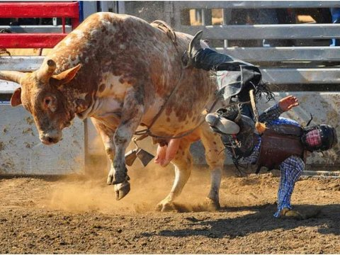
Stocks-Whipsaw is the Order of the Day
*Investors are back in “Buy the Dip” mode, look for new all time high in stocks before yearend, but have become too whippy to trade short term *Only a handful of stocks with good fundamentals have maintained uptrends, but all have become expensive, and hence risky. *Almost all managers, hedged, indexed, and conventional, are down this year *There is nothing else to buy globally, US stocks offer the best risk/reward and yield *Investors looking forward to a 2016 earnings recovery *Stock and bond return since the end of US QE a year ago has been zero

Slide 19
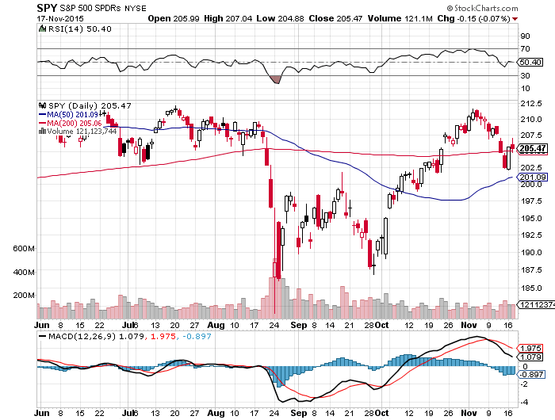
S&P 500-50 Day MA Holds long the 12/$185-$190 vertical bull debit spread Awaiting a “Golden Cross” at yearend

Slide 20
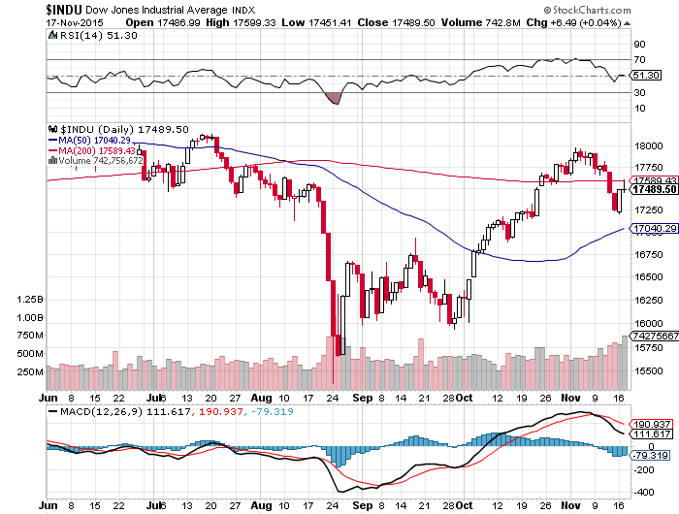
Dow Average-

Slide 21
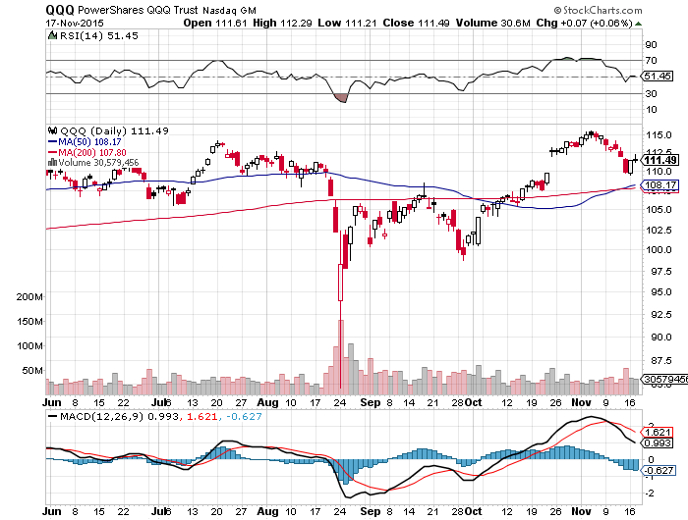
NASDAQ (QQQ)-The Strongest Chart

Slide 22
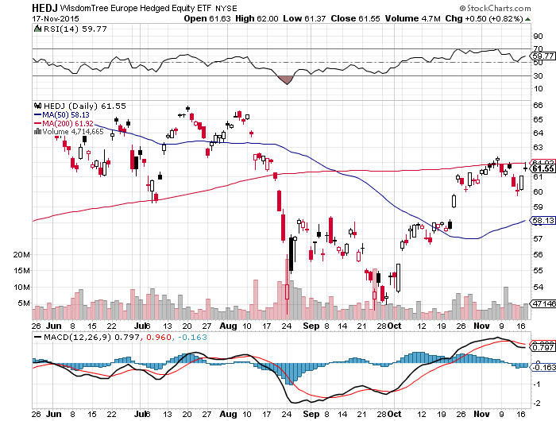
Europe Hedged Equity (HEDJ)-

Slide 23
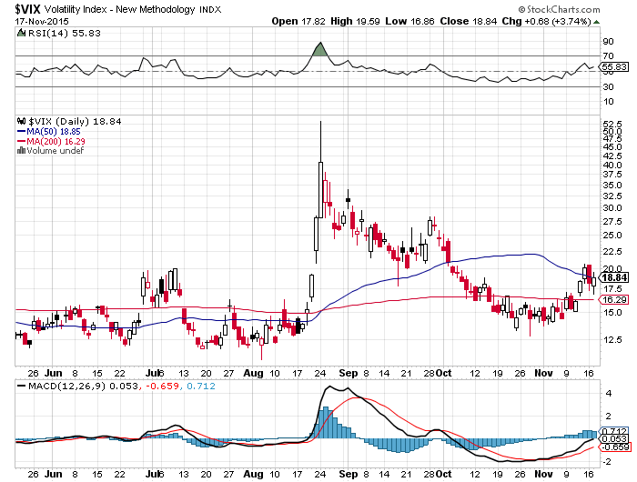
(VIX)-Another Selling opportunity

Slide 24
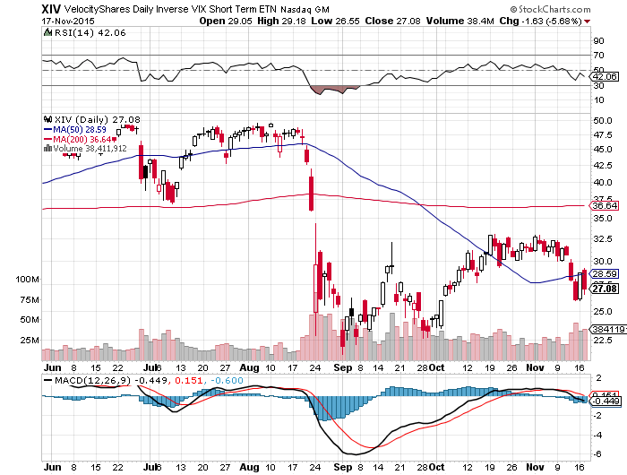
(XIV)-Velocity Shares Daily Inverse VIX Short Term ETN 4 Profitable Round Trips! But Missed No.5

Slide 25
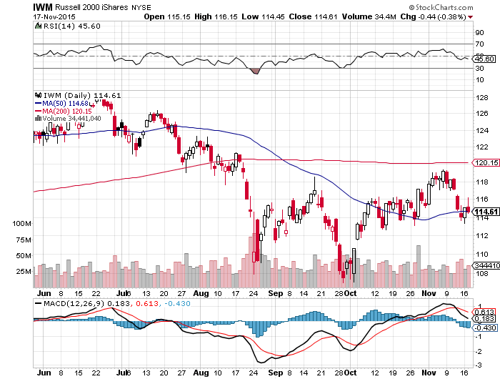
Russell 2000 (IWM)-The Weak Link No place in a value world

Slide 26
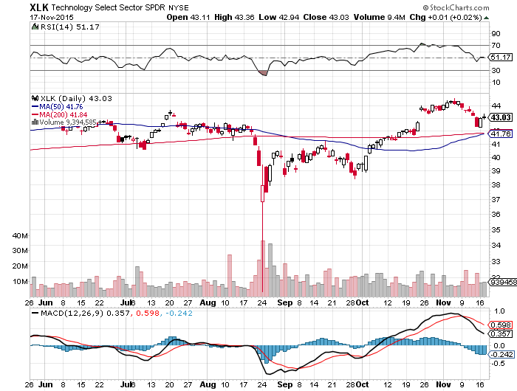
Technology Sector SPDR (XLK), (ROM) (AAPL), (MSFT), (VZ), (T), (FB), (IBM) First to Recover 200-Day Moving Average

Slide 27
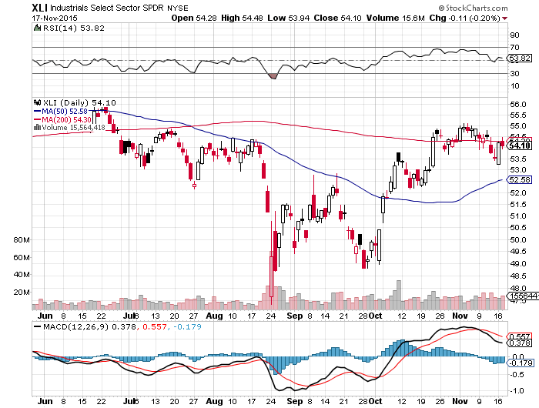
Industrials Sector SPDR (XLI)-Dow Mainstay (GE), (MMM), (UNP), (UTX), (BA), (HON)

Slide 28
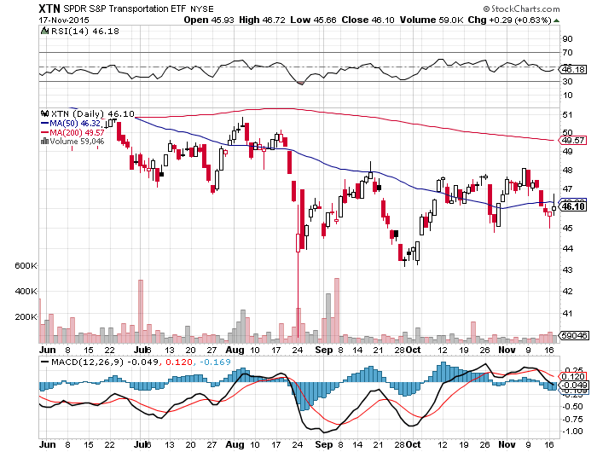
Transports Sector SPDR (XTN)-Another Dow Mainstay (ALGT), (ALK), (JBLU), (LUV), (CHRW), (DAL),

Slide 29
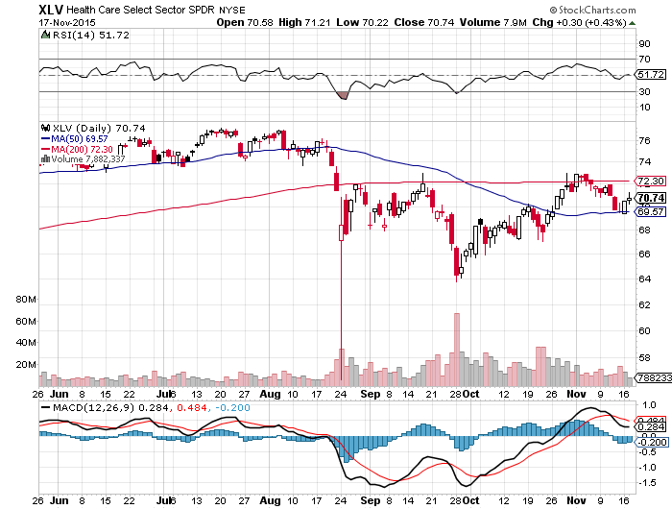
Health Care Sector SPDR (XLV), (RXL) (JNJ), (PFE), (MRK), (GILD), (ACT), (AMGN)

Slide 30
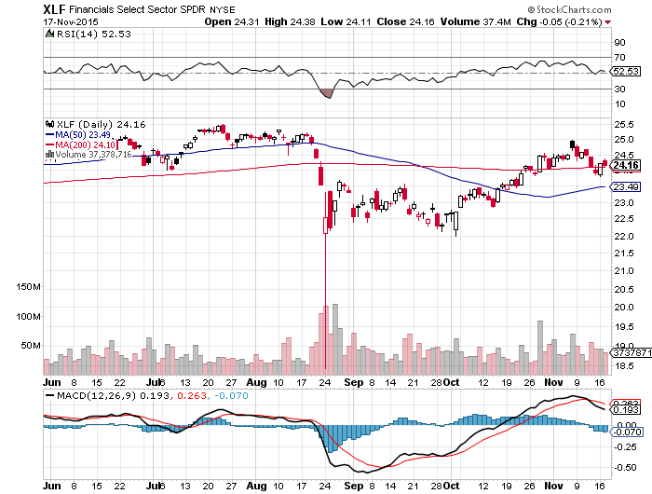
Financial Select SPDR (XLF)-Party Postponed (BLK/B), (WFC), (JPM), (BAC), (C), (GS)

Slide 31
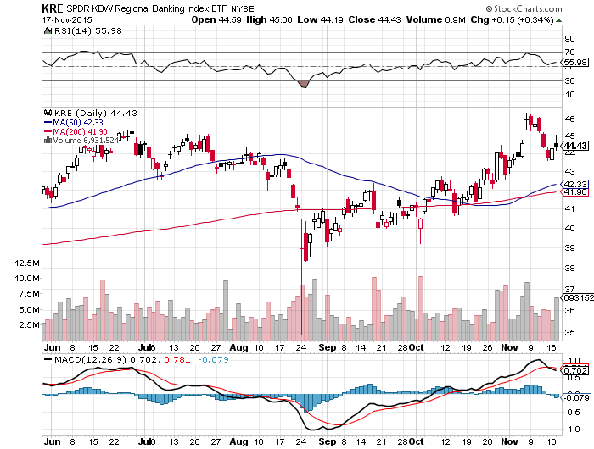
Regional Bank Basket (KRE)-Uptrend Intact (MTG), (RDN), (SIVB), (CFG), (CFR), (BXS)

Slide 32
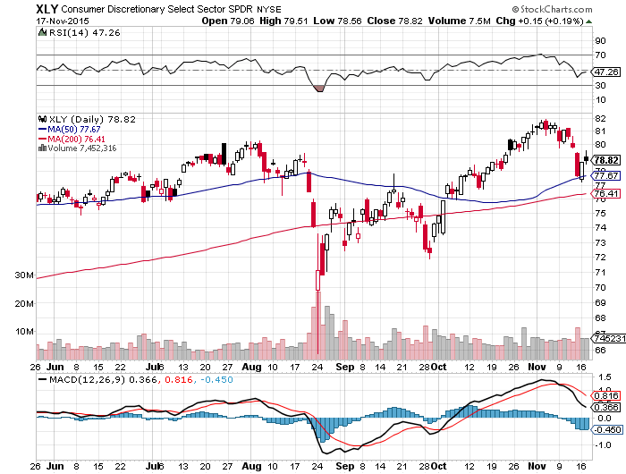
Consumer Discretionary SPDR (XLY) (DIS), (AMZN), (HD), (CMCSA), (MCD), (SBUX)

Slide 33
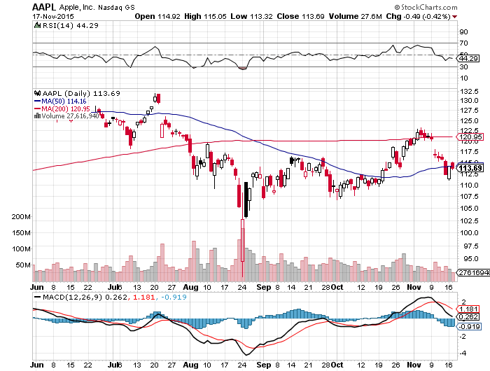
Apple (AAPL) – Back to waiting for the next real catalyst-the iPhone 7

Slide 34
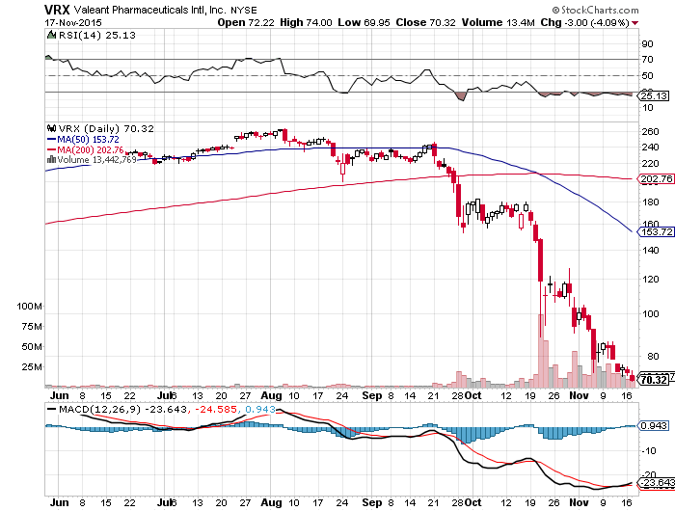
Stock of the Week- Valiant (VRX) – Drug Pricing Scandal Brings a 73% Hit-and Hedge Fund Hell

Slide 35
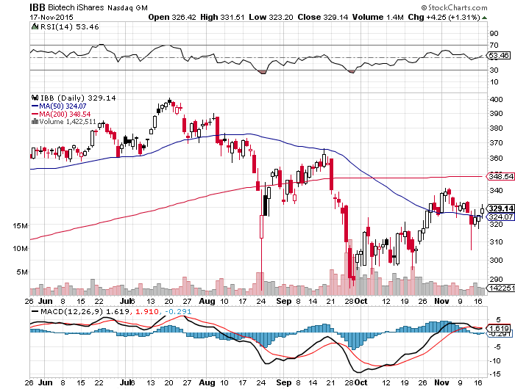
Biotech iShares (IBB)-

Slide 36
Europe Hedged Equity (HEDJ)-Hedged Japan Equity Weak Euro Boost-Beating the US

Slide 37
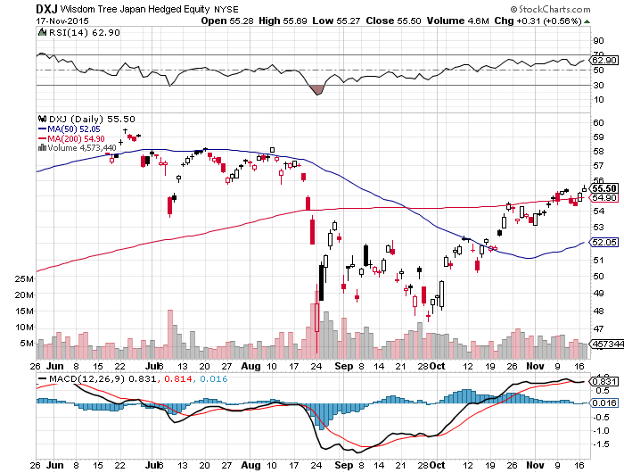
Japan (DXJ)-Hedged Japan Equity Weak Yen Boost

Slide 38
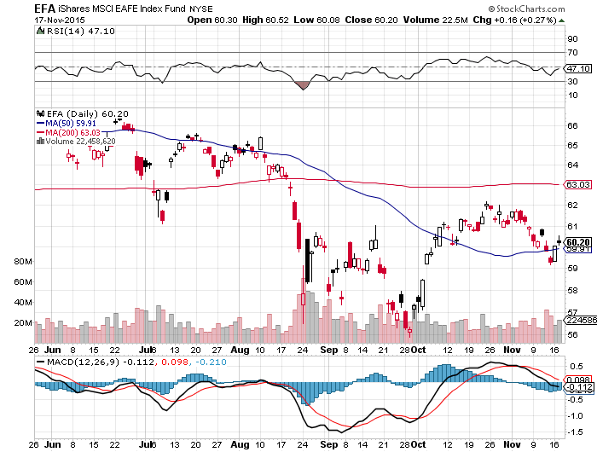
Emerging Markets (EFA)-Bounce on Commodities Rally

Slide 39
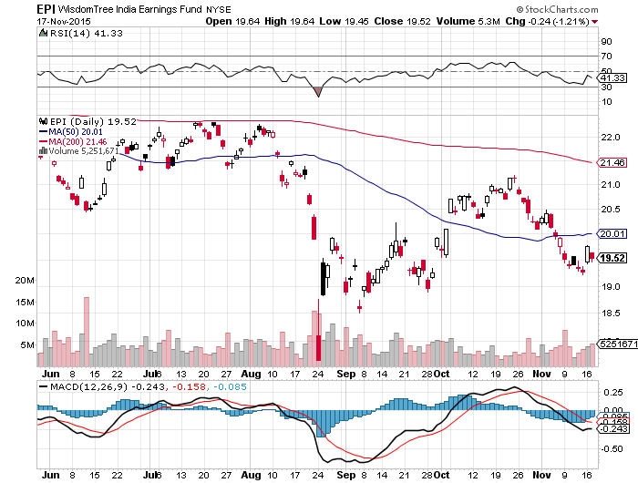
India (EPI)-

Slide 40

Foreign Currencies-The One-Way Trade
*The US will be simultaneously raising rate while Europe cuts rates for the first time since 1994, sets up a perfect long dollar trade *Draghi says QE to be expanded, Euro interest rates to be lowered 0.1% at December 3 meeting and maybe more, demolishing Euro (FXE), (EUO), *Strong dollar is looking like a sure thing for rest of 2015, buy every dip *Commodities hit new six year low, killing commodity currencies (FXC) and (FXA), will get worse before better

Slide 41
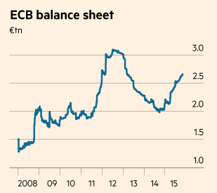
More QE Means Weaker Euro

Slide 42
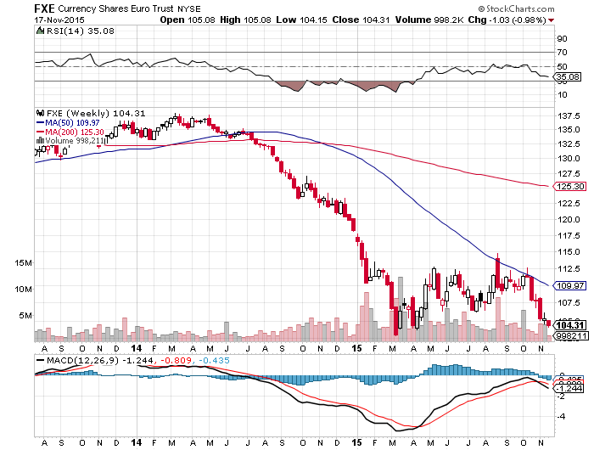
Euro ($XEU), (FXE), (EUO)-Short a Double Position long the 12/$111-$114 vertical bear put debit spread long the 12/$108-$111 vertical bear put debit spread

Slide 43
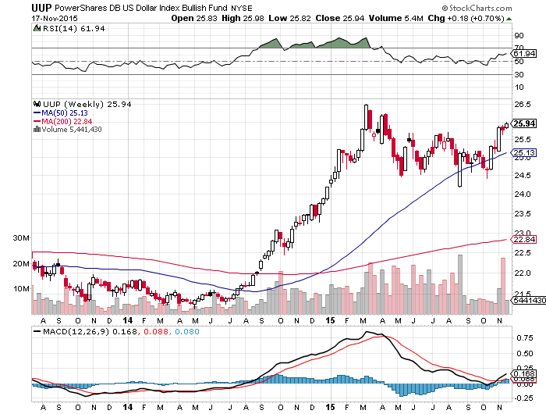
Long Dollar Index (UUP)-

Slide 44
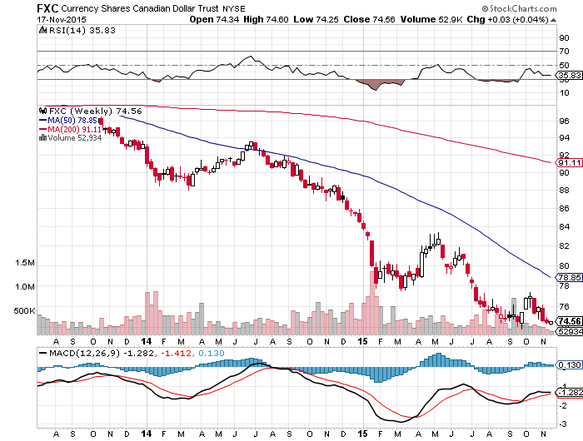
Canadian Dollar (FXC)-Commodity Disaster

Slide 45
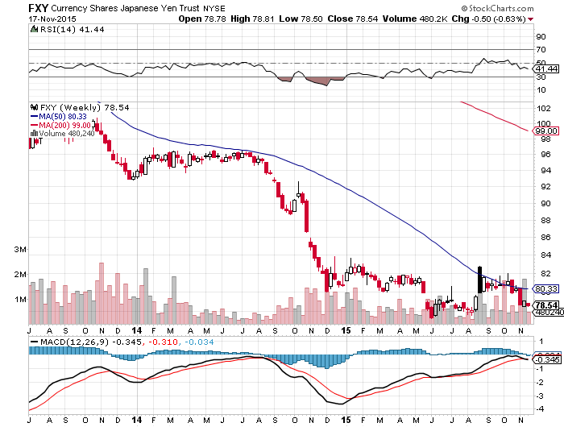
Japanese Yen (FXY)-More QE Coming long the 12/$82-$84 vertical bear put debit spread

Slide 46
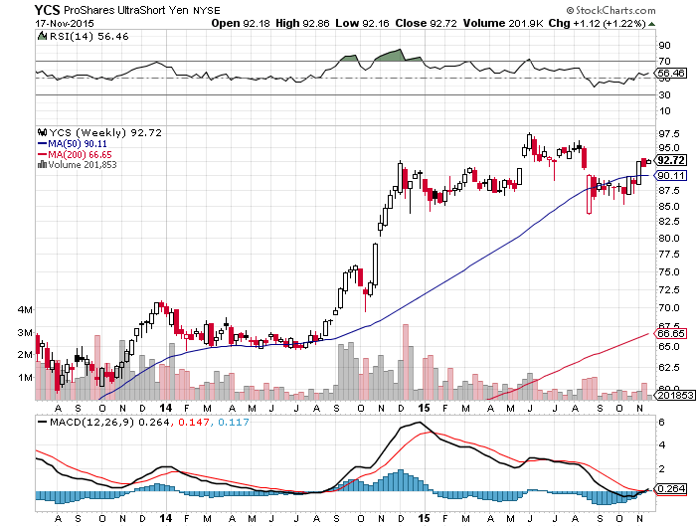
Short Japanese Yen ETF (YCS)

Slide 47
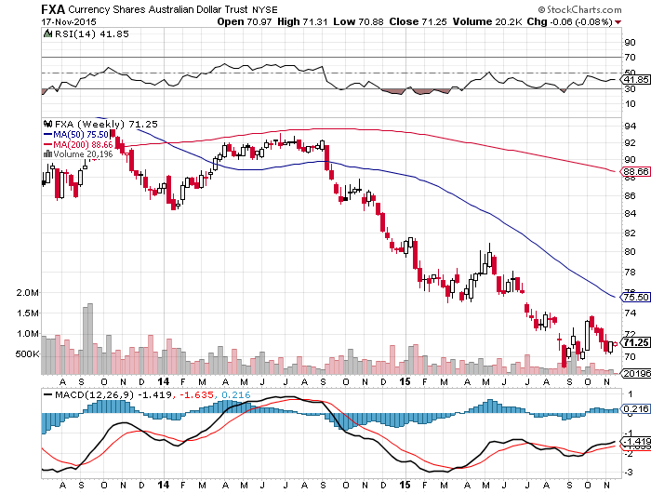
Australian Dollar (FXA) –Feeble Bounce Vaporizes

Slide 48
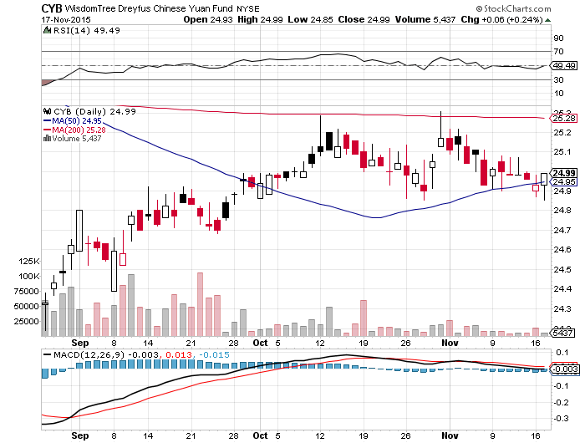
Chinese Yuan- (CYB)-China Stabilizes

Slide 49
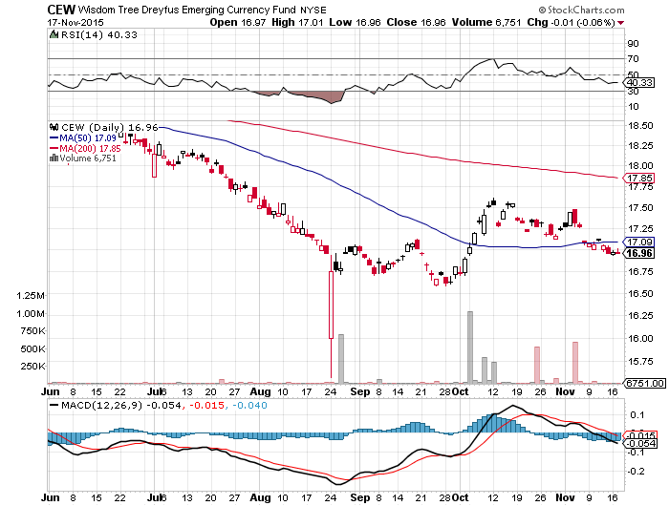
Emerging Market Currencies (CEW)

Slide 50
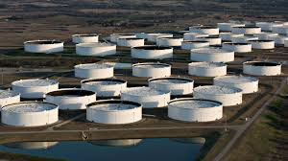
Energy-All About Inventories
*The oil markets are now moving from seasonal strength to weakness, should bring the final bottom, speculators now play from the long side *IEA says oil to remain in oversupply until 2020, price under $80 *A record 100 million barrels now at sea in storage in tankers *Both oil and gas inventories are at all time highs, while demand is still flaccid *OPEC increased production to 31.6 million barrels/day, 2.1 million more than demand *Natural gas storage hits new all time high at 4 trillion cubic feet *Disruption of ISIS supplies is having a minimal impact on prices *Iran promises 500,000 b/d in new production in 2016, once sanctions come off

Slide 51
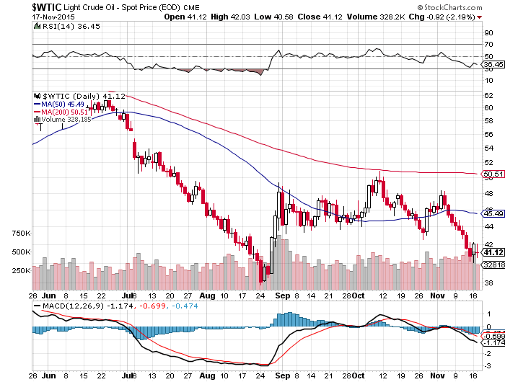
Oil-May Be a Q4 Story-A Buy at $44? A New Run at the Lows

Slide 52
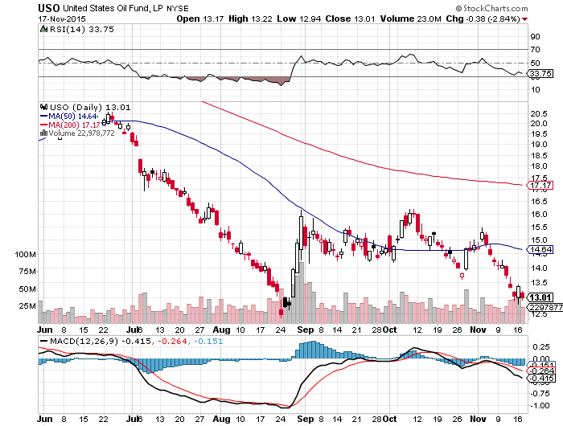
United States Oil Fund (USO)

Slide 53
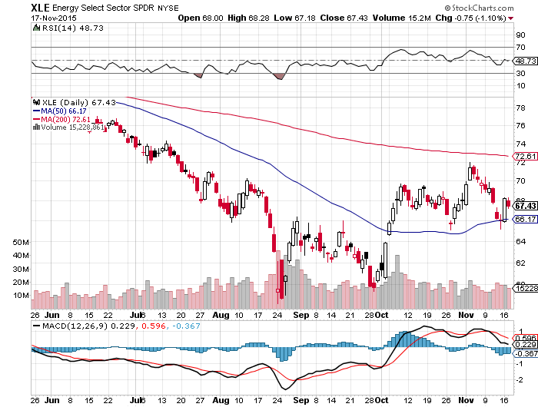
Energy Select Sector SPDR (XLE) (XOM), (CVX), (SLB), (KMI), (EOG), (COP) Way Out of Synch with Oil Prices

Slide 54
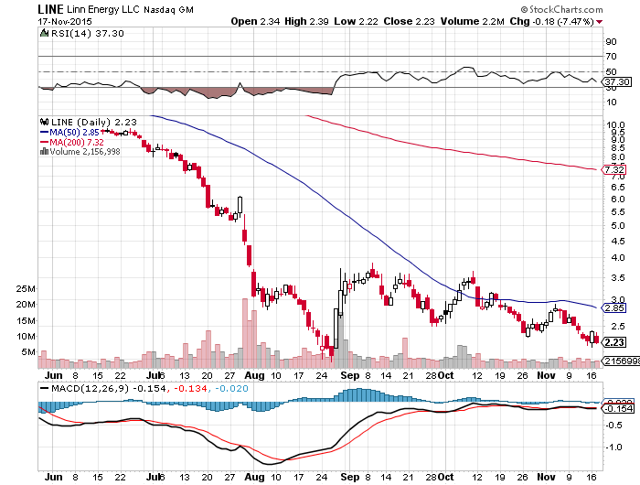
MLP’s (LINE)-Dividend Suspended! Shares fall to option value-Entire industry has become high risk how long can they maintain leverage in the face of non-recovering oil prices?

Slide 55
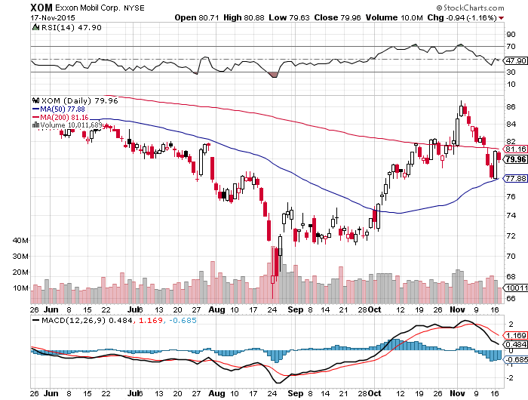
Exxon (XOM)-

Slide 56
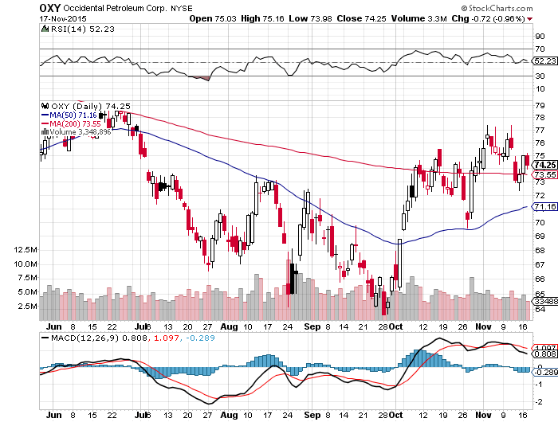
Occidental Petroleum (OXY)- Back to Where Oil was $62

Slide 57
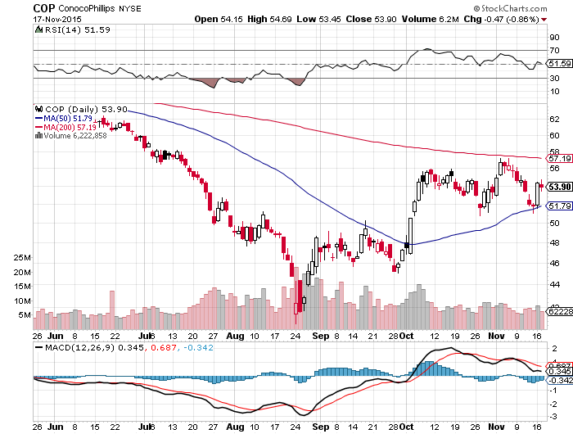
Conoco Phillips (COP)-

Slide 58
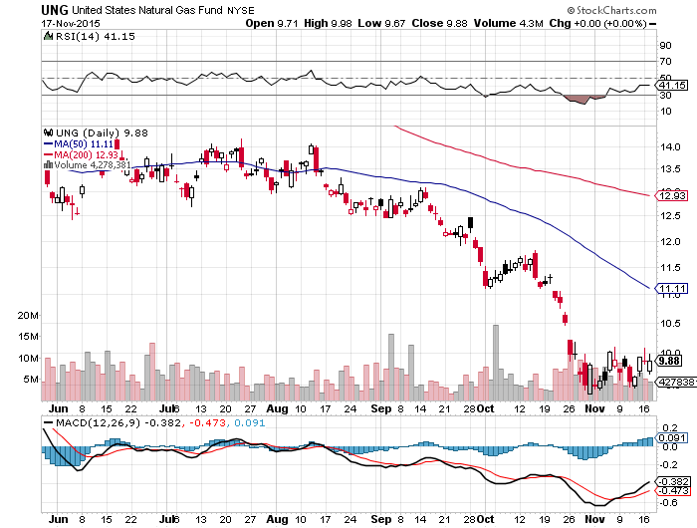
Natural Gas (UNG)-New Lows on Warm Winter

Slide 59
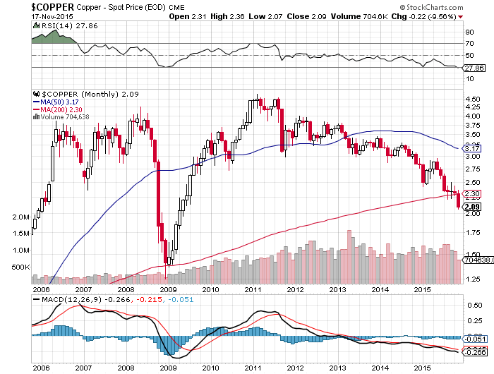
Copper-New 6 Year Low

Slide 60
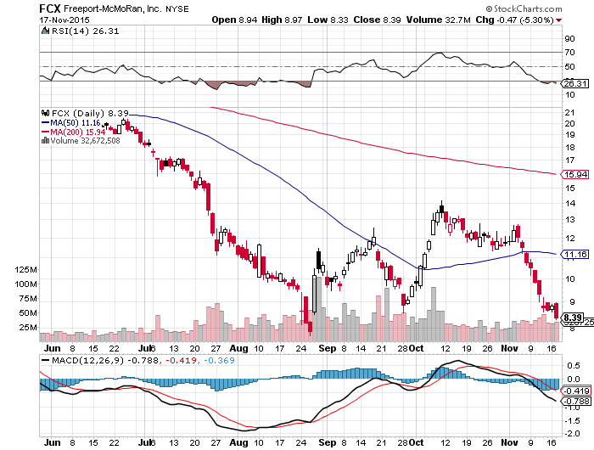
Freeport McMoRan (FCX)-Carl Icahn in Play

Slide 61
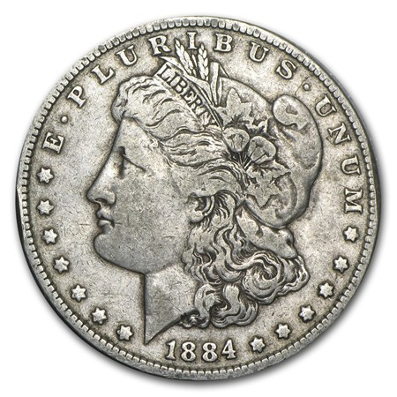
Precious Metals-Capitulation
*Perfect technical failure at 200-day MA brings new lows *Silver down an incredible 20 consecutive days *Utter failure to rally on Paris terrorist attacks means the safety aspect of gold holdings is long gone *December Fed rate hike is the final nail in gold’s coffin, look for a run down to $1,000 by yearend *Stay away, gold stocks are a better play on a dip with their earnings and dividend support *No room for gold in a paper chasing world

Slide 62
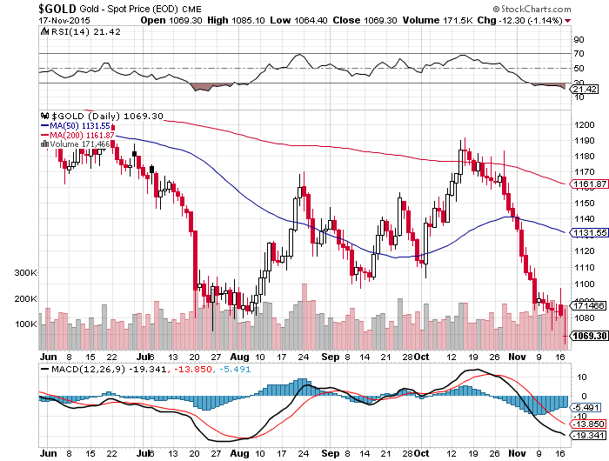
Gold (GLD)-Barf!

Slide 63

Market Vectors Gold Miners ETF- (GDX)

Slide 64

Silver (SLV)-

Slide 65

Silver Miners (SIL)

Slide 66

Platinum (PPLT)-The Volkswagen Effect new chapter of the “Clean Diesel” Scandal

Slide 67

Palladium (PALL)-The Non Diesel Play

Slide 68

Agriculture-Rally Dies
*Even el nino is not enough to support Ag prices in a hugely oversupplied market *Strong dollar crushing ags once again, Wheat is $182/metric tonne in Russia vs. $220 from the US, but Russia is running out of wheat *Saudi Arabia has flipped from a smaller grain exporter to a large importer *El Nino is strengthening, it’s now raining weekly in California 4 feet of snow already in the Sierras *New lows in global commodity collapse isn’t helping

Slide 69

(CORN) – New Lows!

Slide 70

(WEAT)-

Slide 71

Ag Commodities ETF (DBA)- New Lows

Slide 72

Real Estate-Shortage of Supply
*November homebuilder sentiment down 3 points, first drop in six months *Warm weather boosting fall sales, market has exploded in recent weeks *October housing starts -11%, second bad month this year, permits up 4.1% *Traders loading up on these stocks expecting a strong Spring 2016 *Predicted rush to buy homes to beat the fed interest rate hike is unfolding, 2 month wait to get appraisers in Bay area *Case Shiller S&P 500 National index continues upward grind

Slide 73

July S&P/Case–Shiller Home Price Index +4.7% YOY, Denver, San Francisco, Dallas
+4.7% YOY

Slide 74

US Home Construction Index (ITB) (DHI), (LEN), (PHM), (TOL), (NVR)

Slide 75

Trade Sheet So What Do We Do About All This?
*Stocks- buy the big dips in best value names only *Bonds-the top is in, sell rallies, buy (TBT) *Commodities-stand aside, buy the next oil down leg *Currencies- Sell short the Yen and Euro on rallies *Precious Metals –stand aside, wait for new low *Volatility-sell short spikes over $20 through (XIV) *The Ags –buy the big dips for a trade *Real estate-buy the homebuilders LT

Slide 76

To buy strategy luncheon tickets Please go to: www.madhedgefundtrader.com Next Strategy Webinar 12:00 EST Wednesday, December 2, 2015 San Francisco, CA USA!
Good Luck and Good Trading!
Notes:
*

