Slide 1
Mad Day Trader
Bill Davis
Webinar – December 9, 2015

Slide 2
Today I would like to look at a few short term charts and then scope out to the big picture. Then end with a few extreme patterns.

Slide 3
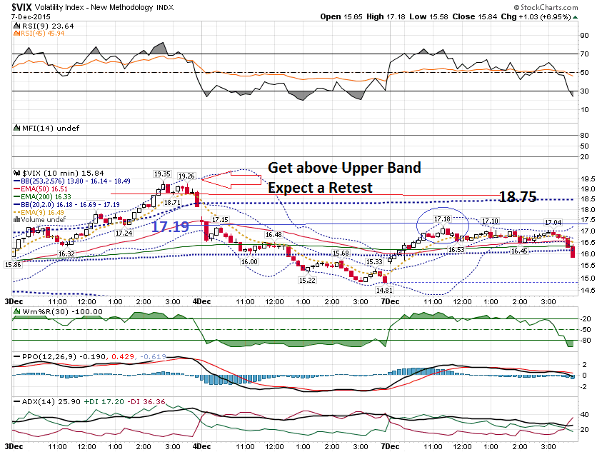

Slide 4
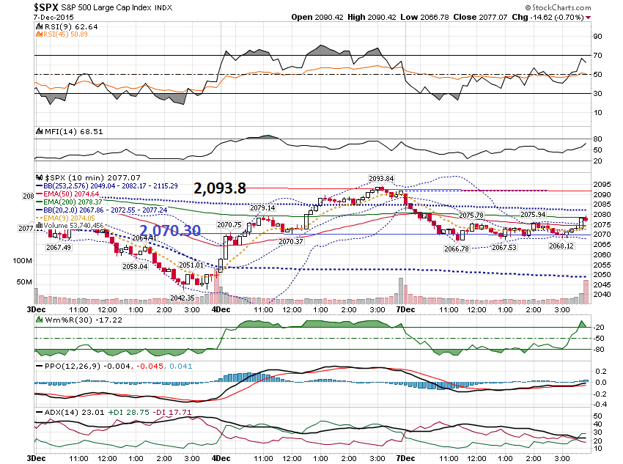

Slide 5
Let’s scope out and look at a few days

Slide 6
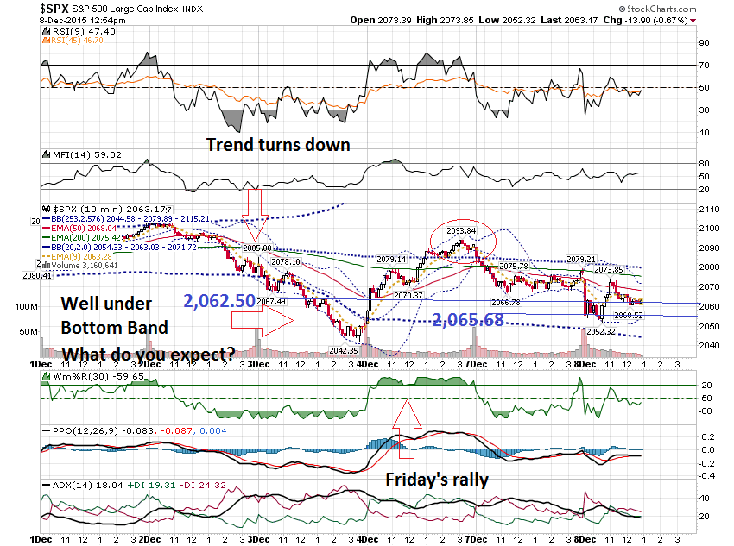

Slide 7
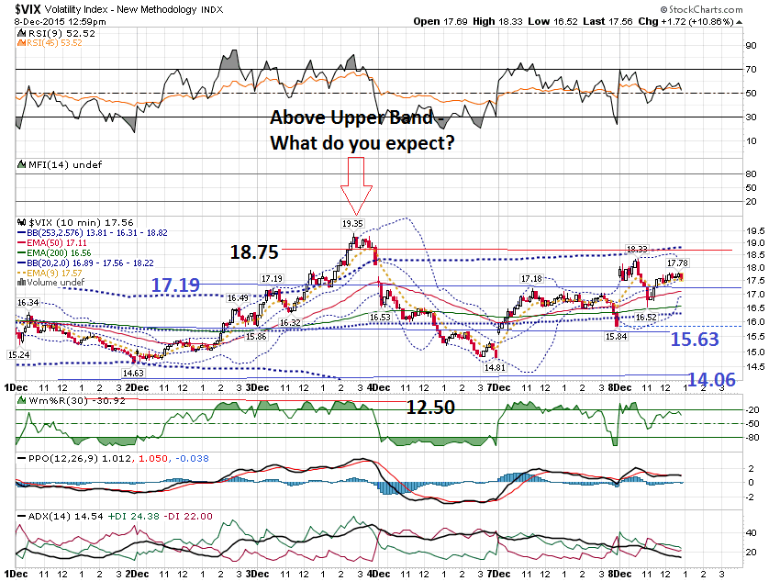

Slide 8
Next, I want to take a look at the long term charts of the Indexes, but before I do I want to show a chart of GMCR.

Slide 9
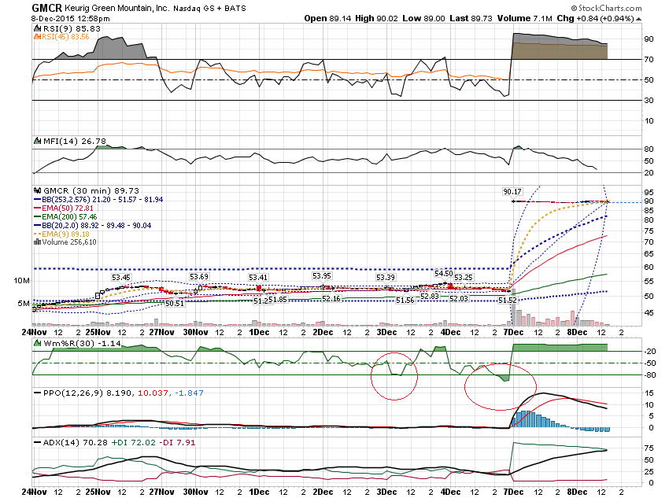

Slide 10
Monthly Charts of the Indexes

Slide 11
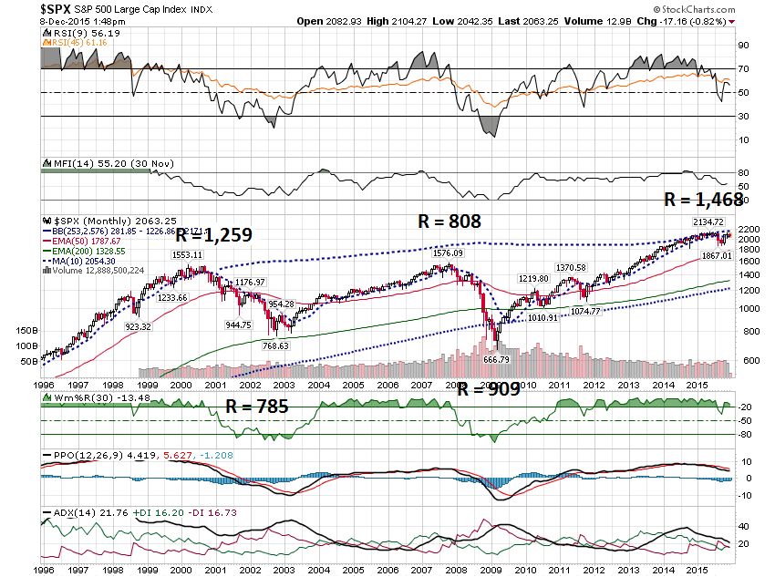

Slide 12
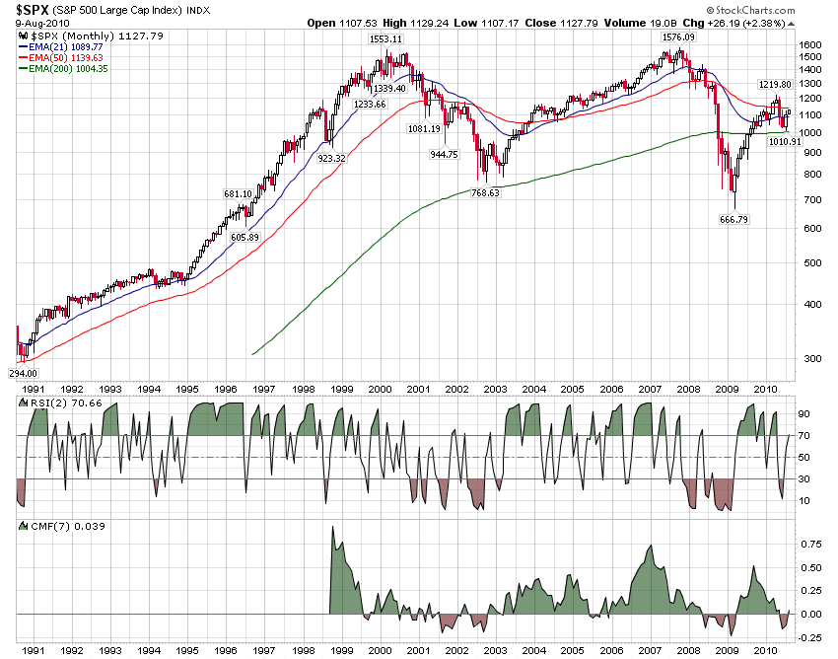

Slide 13
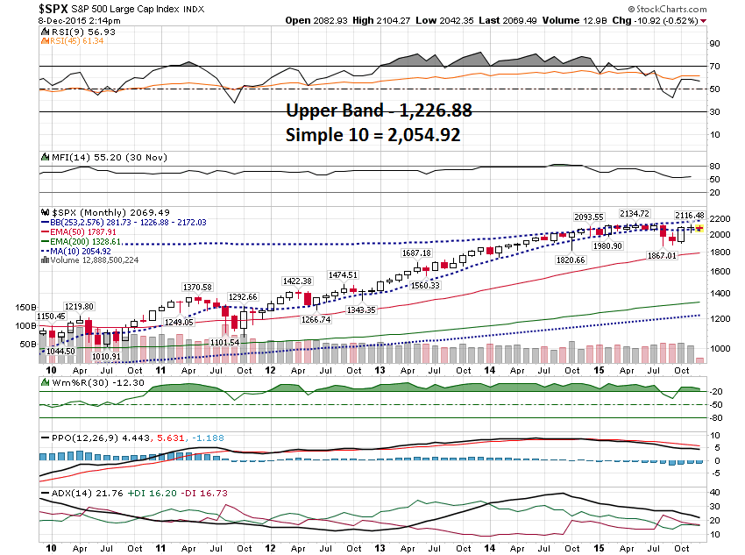

Slide 14
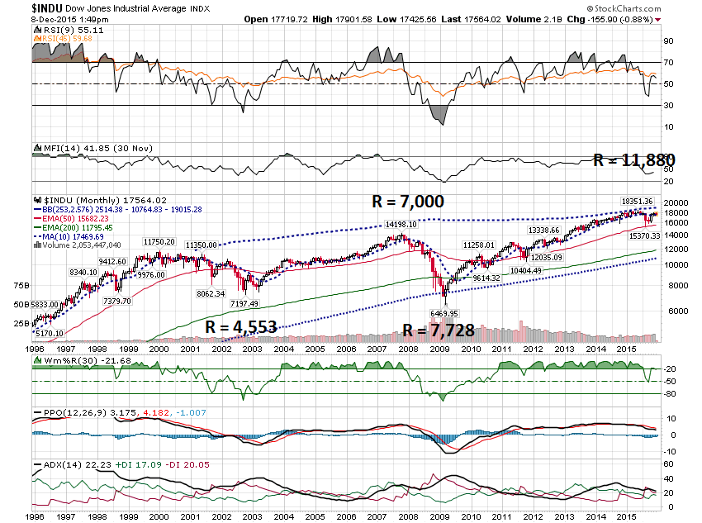

Slide 15
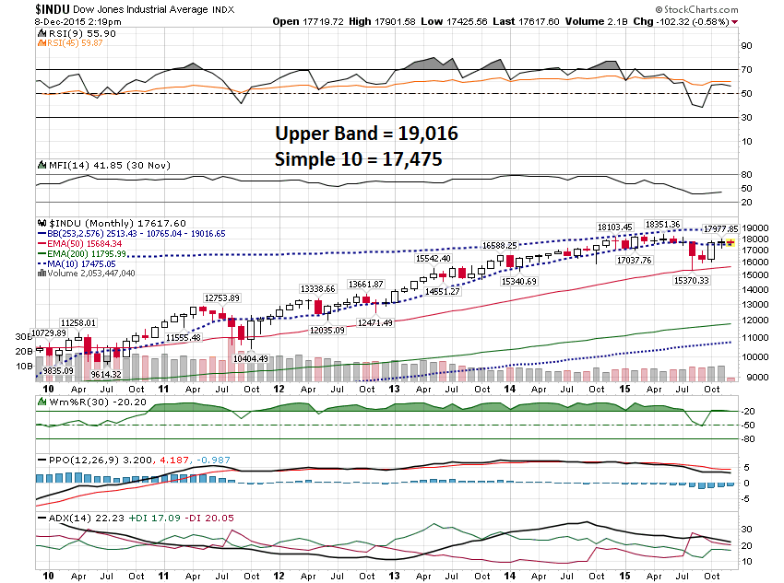

Slide 16
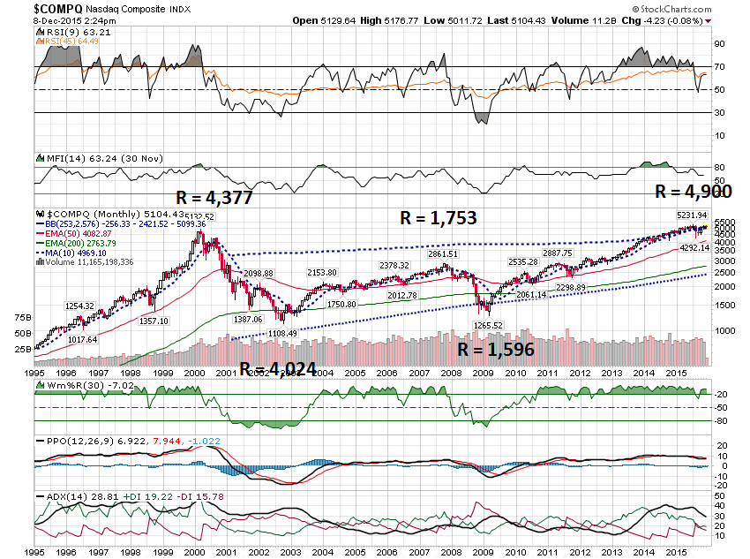

Slide 17
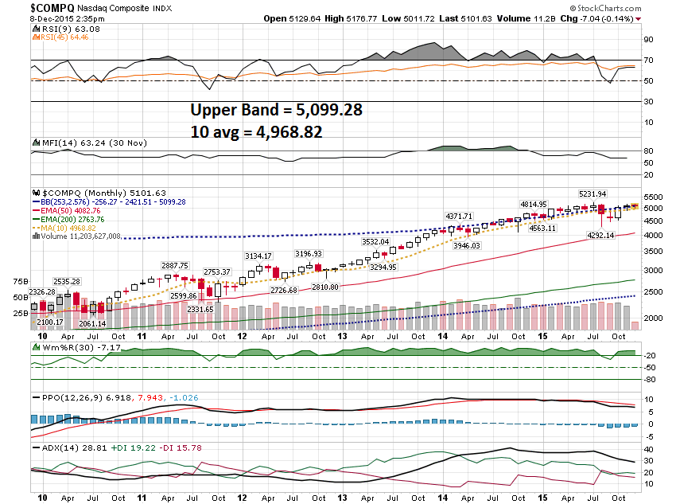

Slide 18
The “Dead Cat Bounce” & The Extreme Bands

Slide 19
Let’s look at Multiple Timeframes and a Stock I suggested a while back … ETE

Slide 20
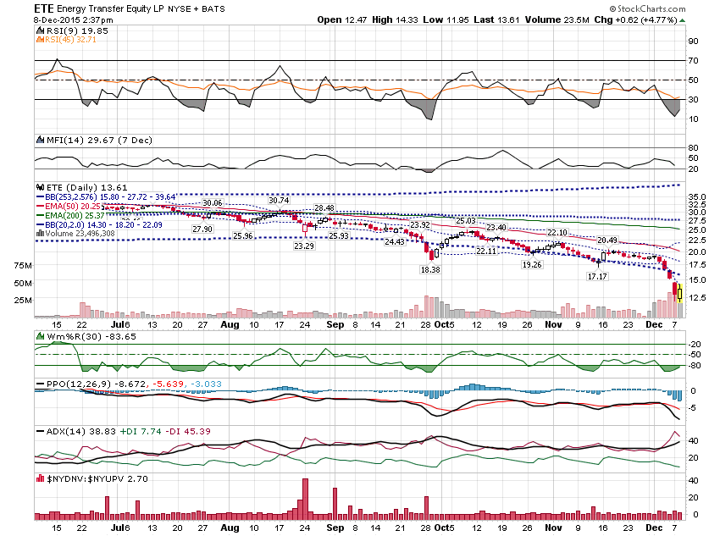

Slide 21
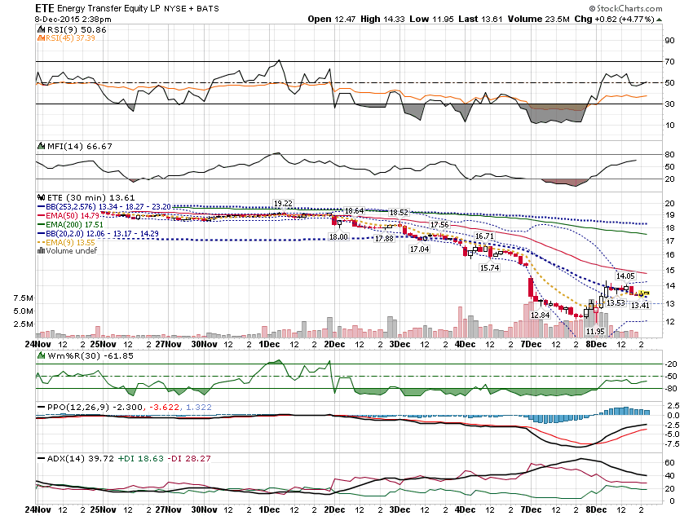

Slide 22
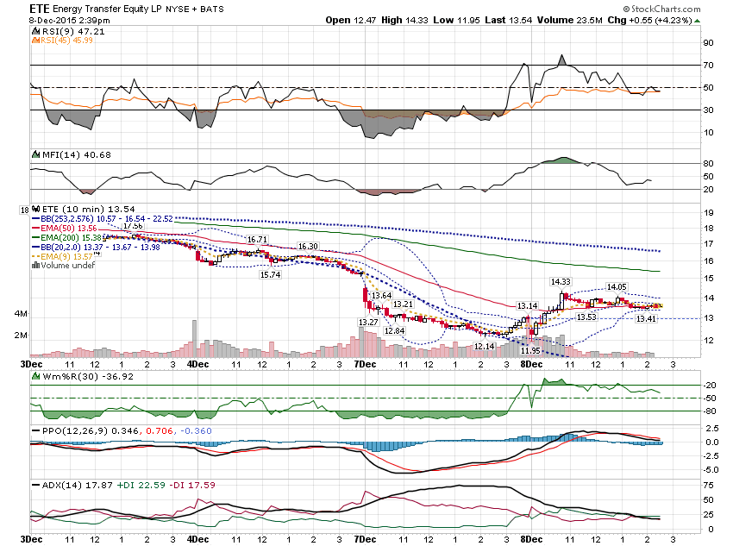

Slide 23
Here is one more …

Slide 24
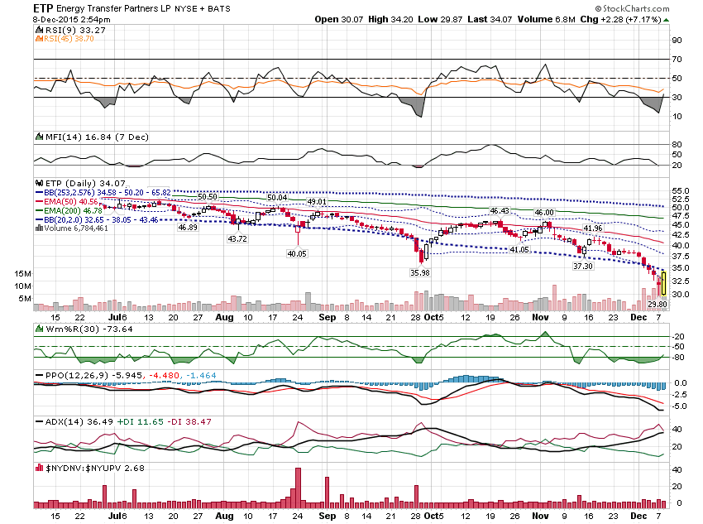

Slide 25
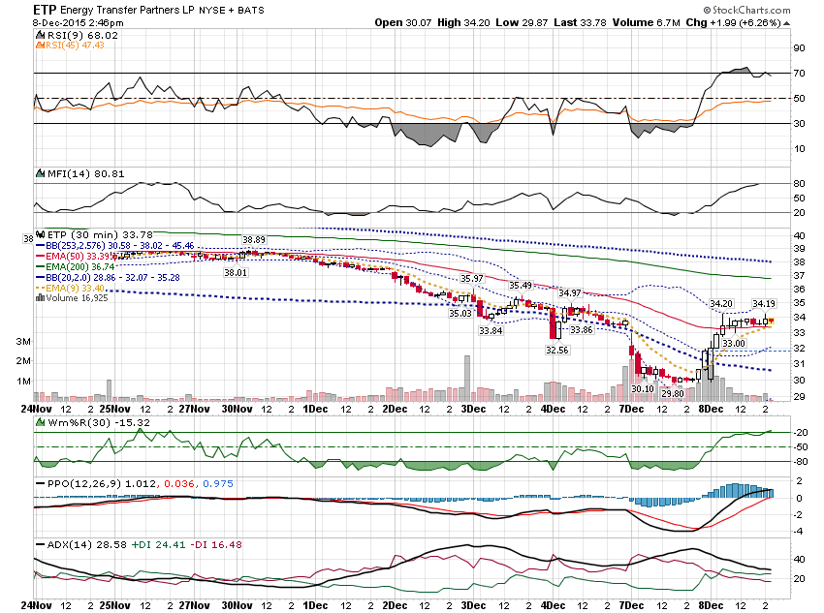

Slide 26
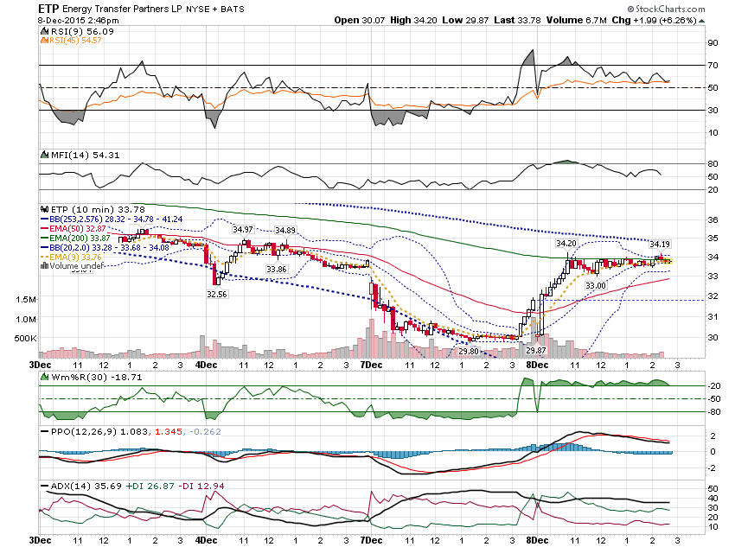

Slide 27
I want to show a few more lower band patterns

Slide 28
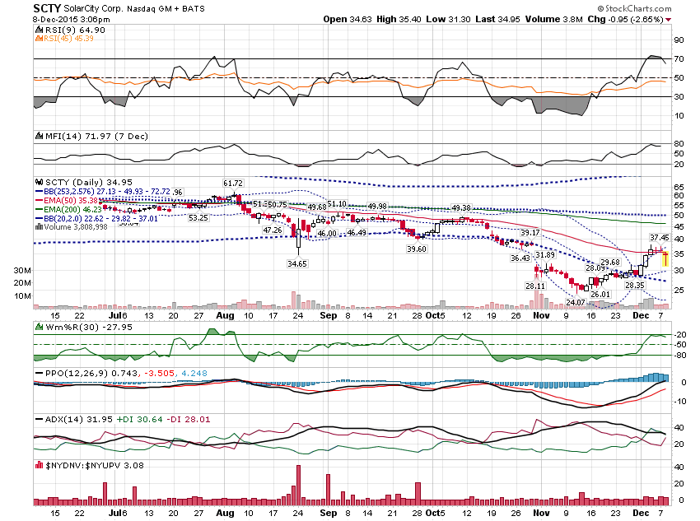

Slide 29
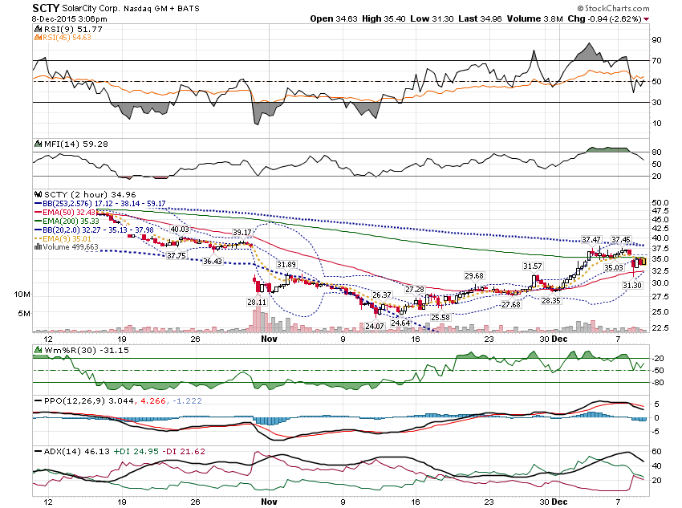

Slide 30
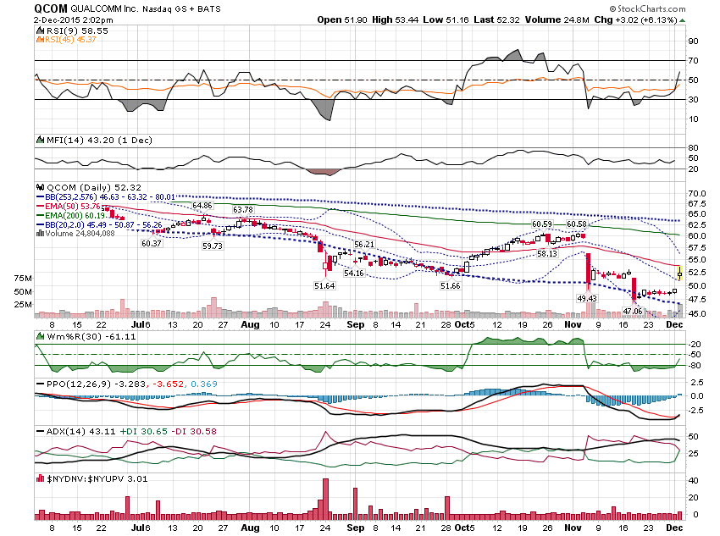

Slide 31
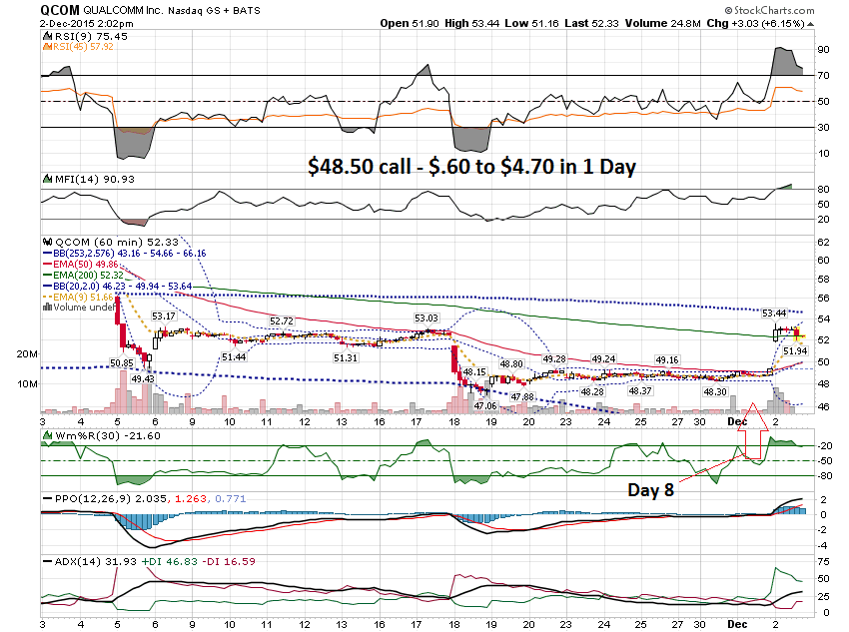

Slide 32
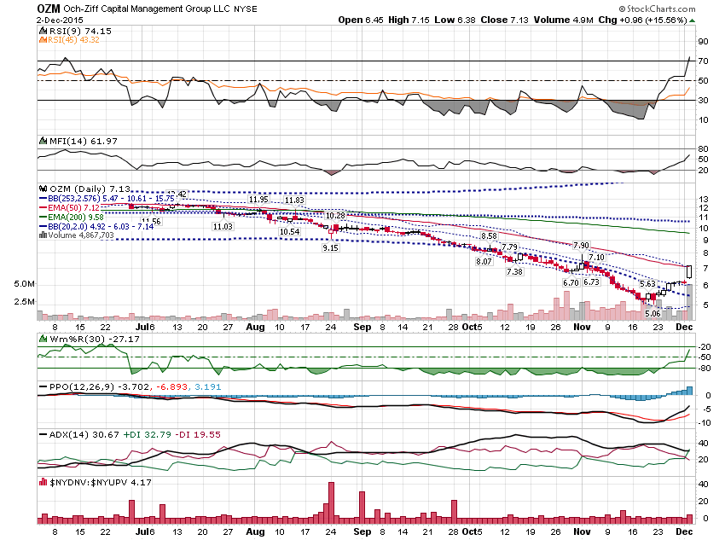

Slide 33
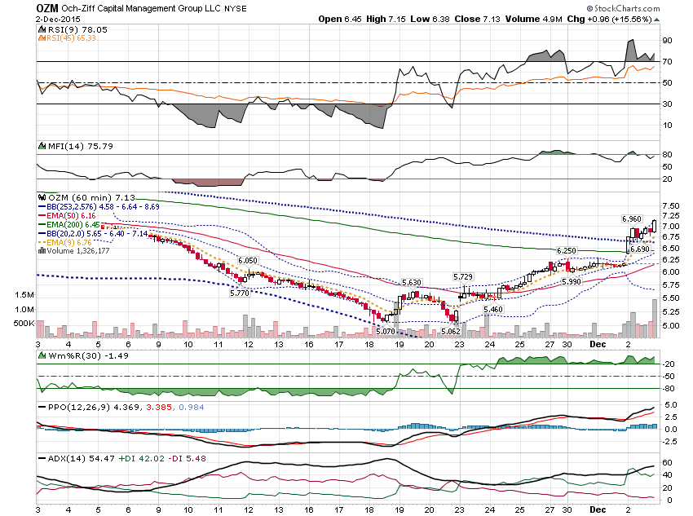

Slide 34
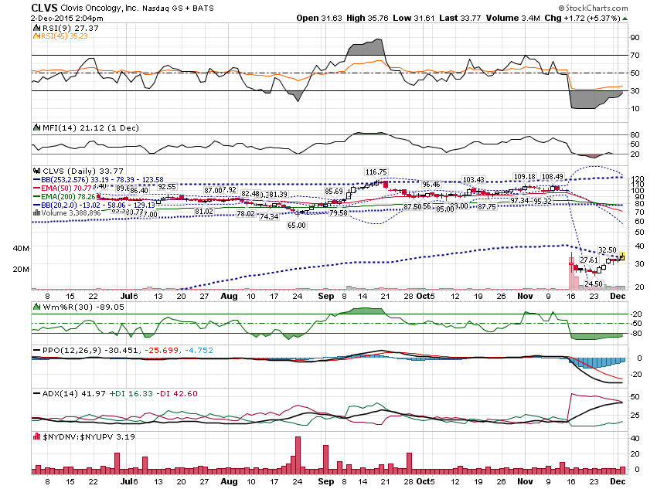

Slide 36
Thanks for watching! Bill Davis Mad Day Trader December 9, 2015 davismdt@gmail.com

