Slide 1
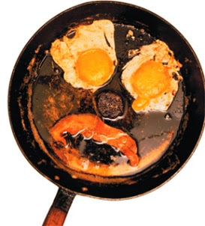
The Mad Hedge Fund Trader “The Teflon Market”
With John Thomas from San Francisco, CA, December 2, 2015 www.madhedgefundtrader.com
Notes:
*

Slide 2

Trade Alert Performance PEDDLING EXTRA HARD TO BRING YOU THESE NUMBERS
*January +0.53% Final *July +6.42% Final *February +7.73% Final *August +1.27% Final *March +3.00% Final *September +11.99% Final *April +6.62% Final *October Final -6.19% *May +5.15% Final *November MTD 5.78% *June +3.68% Final *December 0.20% *2015 Year to Date +44.61% compared to +0.5% for the Dow Average *Trailing 1 year return +35.93%, +197.42% since inception, 0.20% short of NEW ALL TIME HIGH! *Average annualized return of 39.32%

Slide 3
Portfolio Review From the Department of Everything That is Working Aggressive “RISK ON” With No Hedge
Mad Hedge Fund Trader
Model Trading Book
Asset Class Breakdown
Risk Adjusted Basis
current capital at risk
Risk On
World is Getting Better
(TLT) 12/$124-$127 put spread | 10.00%
(FXY) 12/$82-$84 put spread | 10.00%
(FXE) 12/$108-$111 put spread | 10.00%
(DIS) 1/$100-$105 call spread | 10.00%
Risk Off
World is Getting Worse
None
total net position | 40.00%
Expiration P&L 47.06% YTD

Slide 4
Paid Subscriber Trailing 12 Month Audited Return +35.93%

Slide 5
60 Months Since Inception Daily Audited Performance Averaged annualized return +39.32%

Slide 6

Strategy Outlook-The 3 Month Year
*Both bonds and stocks down together for the first time since 1969 *Fed removes any doubt of December rate hike by saying the necessary conditions “could be met by the time of the next meeting.” *Stocks too risky to chase here. Wait for bigger dip. The clearer trends and better quality trades have been in bonds and currencies. *German Bunds holding up US Treasuries, delaying yield spike *Oil imminently breaking below $40, the final flush is at hand *Gold is still despised, don’t try to catch the falling knife *Severe cold snap fails to get us a short covering rally in Ags

Slide 7
The Bill Davis View A $1,500 Upgrade for the Mad Day Trader Service
Buys:
Apple, Inc (AAPL) $117 Target to $125
Alphabet Inc. (GOOGL) $765 Target to $796
Keurig Green Mtn (GMCR) $50 Target to $59
Federal Express (FDX) $156 Target to $168
Martin Marietta (MLM) $156 Target to $175
3 M Co (MMM) $153 Target to $162
CF Industries (CF) $44 Target to $50
(CF is oversold. If it breaks under $41, look for a new low)
Sells:
Chipotle Mexican (CMG) $594 Target to $530
Fossil Group (FOSL) $44 Target to $25
Buffalo Wild Wings (BWLD) $168 Target to $150
Akamai (AKAM) $68 Target to $52
Franklin Resources (BEN) $44 Target to $37
Cummins (CMI) $103 Target to $95

Slide 8
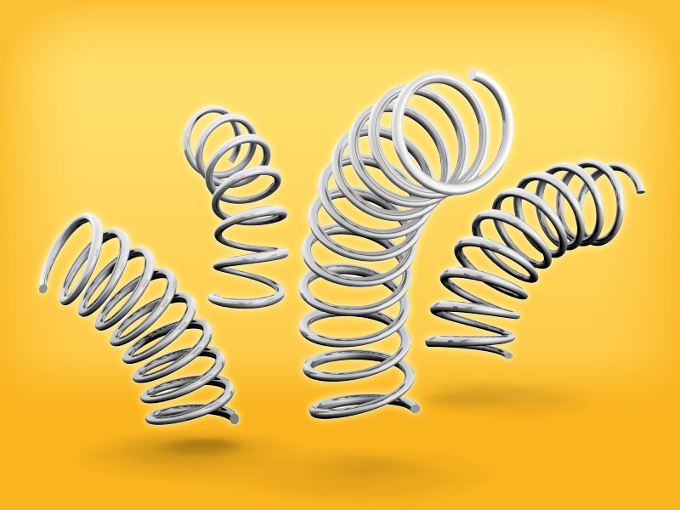
The Global Economy-2016 Bounce Back
*US Q3 GDP revised up from 1.5% to a moderate 2.1%, October Durable Goods up +3.0%, October Personal Income +0.40%, full employment creating high double digit YOY online sales *German Q4 GDP ramping up from 0.3% to 1.7% thanks to QE *Chinese profits down 4.6% YOY, off for the 5th month in a row, stocks take another dive, most of the weakness is in mining, metals, and steel, Yuan becomes IMF SDR reserve currency *Japanese jobless rate hits 3.1%, a 20 year low, but inflation still dead
in the water *Next to come is a “RISK ON” global synchronized growth in 2016

Slide 9
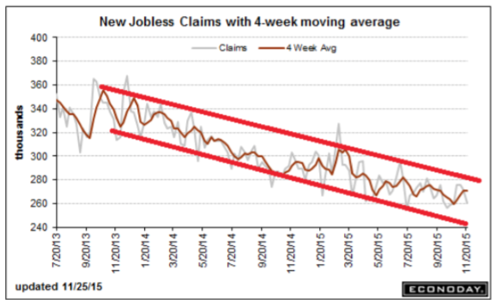
Weekly Jobless Claims – Another Run at the Lows -12,000 to 260,000 headed for Full Unemployment at 5%-Global Recovery a Driver

Slide 10

Bonds-Counter Trend Rally
*The 30 year bull market is clearly over, with every major investor eyeing the exit *Fed interest rate rise is now looking like sure thing in December, has already been discounted by the bond market *In the meantime, collapsing European interest rates are pulling down bond yields globally, with German bunds at 0.46% *Mass layoffs hitting Wall Street bond desks as lack of volatility cuts into profits, reducing liquidity further *Junk gives up all its gains *Buy (TBT) on any dip for more strength in 2016

Slide 11
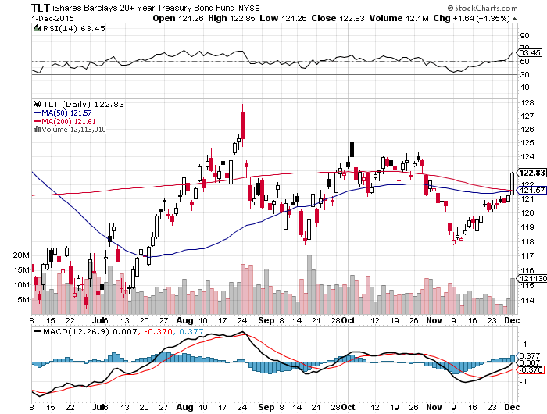
Ten Year Treasury Yield (TLT) 2.26% rolled down to the 12/$124-$127 vertical bear put debit spread

Slide 12
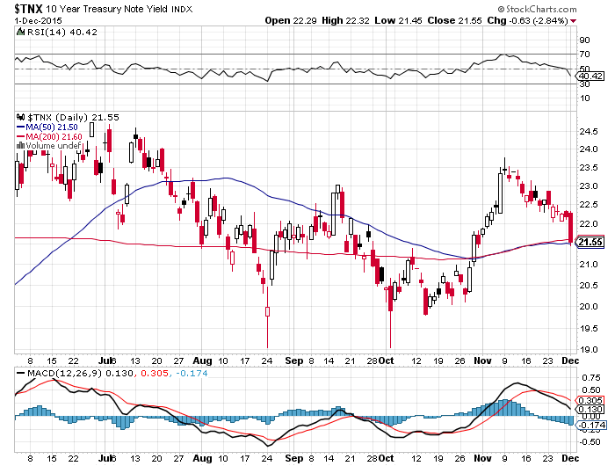
Ten Year Treasury Yield ($TNX) 2.19% 2.35% Ceiling Holds, so will the 2.0% floor

Slide 13
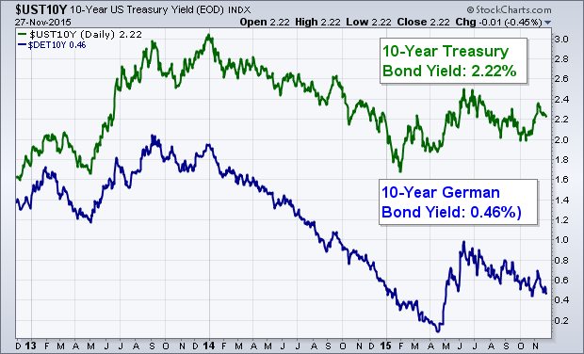
German Ten Year Bonds (0.46%) Are Dragging Down US Bonds Despite an Imminent US Rate Hike

Slide 14
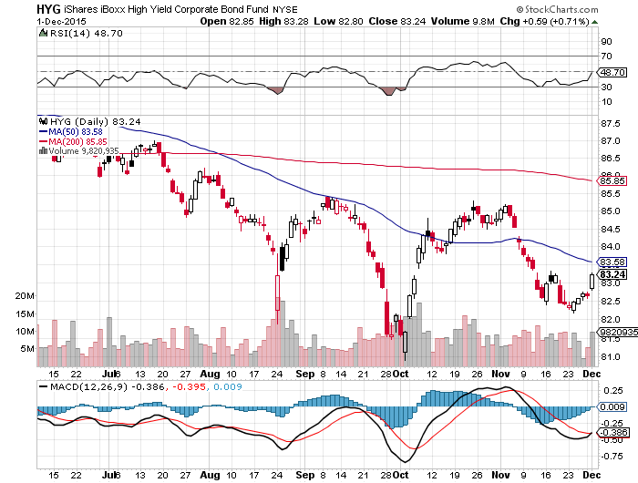
Junk Bonds (HYG) 6.62% Yield A Great Coincident Indicator

Slide 15
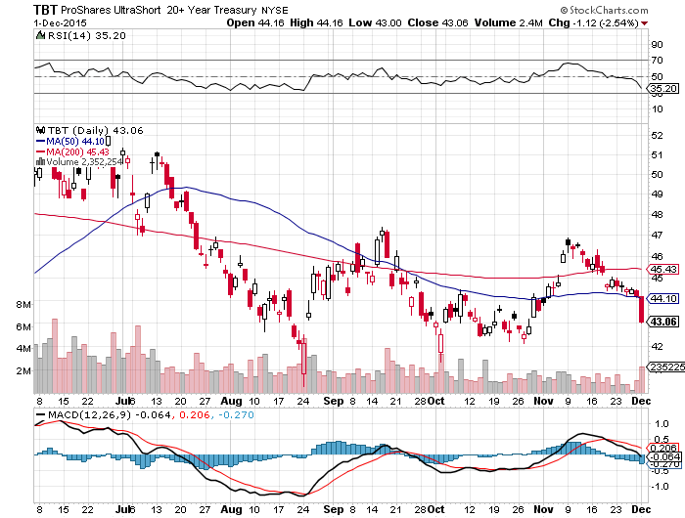
2X Short Treasuries (TBT)-Big Trade of 2016? Back in “BUY” Territory

Slide 16
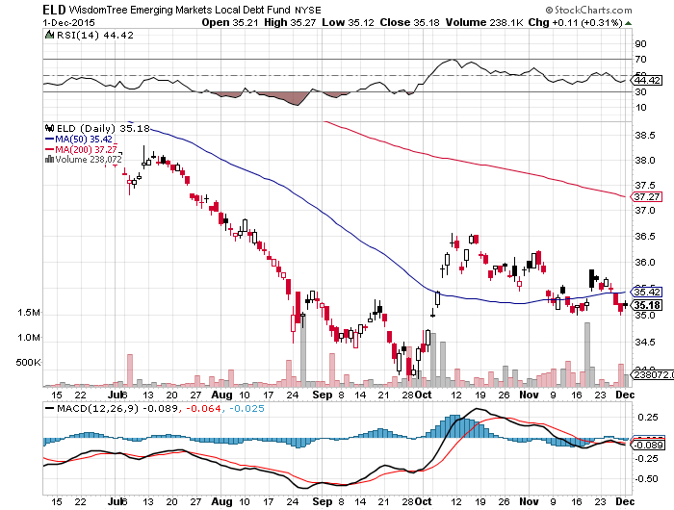
Emerging Market Debt (ELD) 7.73% Yield-

Slide 17
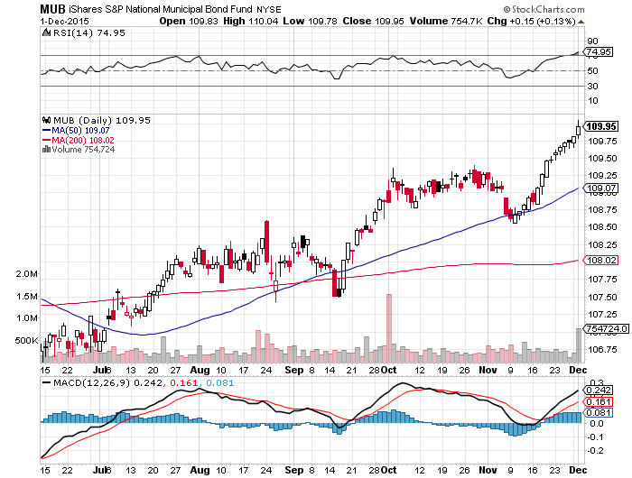
Municipal Bonds (MUB)-1.67% yield Mix of AAA, AA, and A rated bonds-flight to safety

Slide 18

Stocks-Grind Up to Yearend
*Investors are back in “Buy the Dip” mode, look for new all time high in stocks before yearend, sideways grind to lead to upside breakout *Half of all US stocks down more than 20% this year, only a handful of stocks with good fundamentals have maintained uptrends, but all have become expensive, and hence risky. *Look for single digit returns in the US next year, versus double digit in Europe and Japan, thanks to weak Euro and Yen *Increasing share of US growth is hidden in 144 unicorns with market cap of $500 billion mostly in San Francisco in order to avoid regulation. Public markets are more for low and ex-growth companies *Investors looking forward to a 2016 earnings recovery, but multiple shrinkage as rising rates eat into valuations

Slide 19
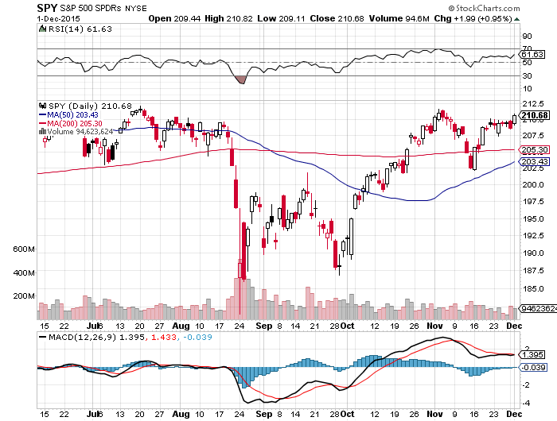
S&P 500-50 Day MA Holds long the 12/$185-$190 vertical bull debit spread Awaiting a “Golden Cross” at yearend

Slide 20
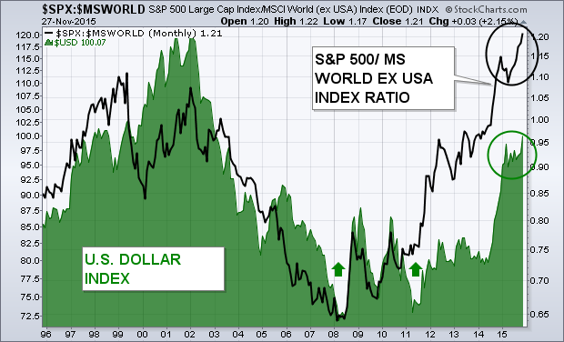
Foreign Stocks Love That Strong Dollar

Slide 21
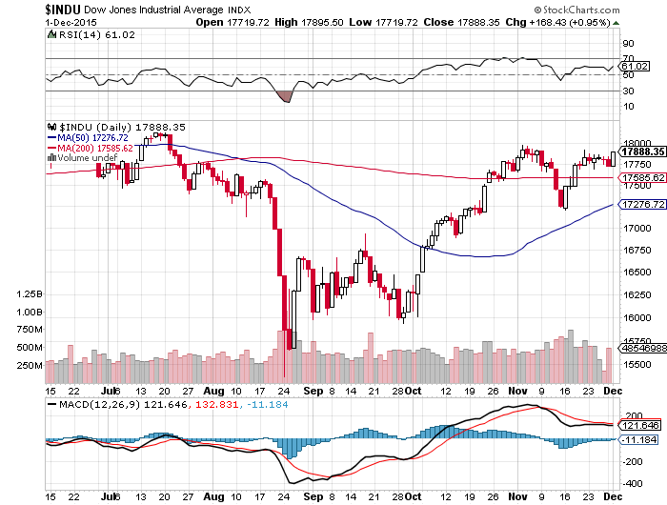
Dow Average-

Slide 22
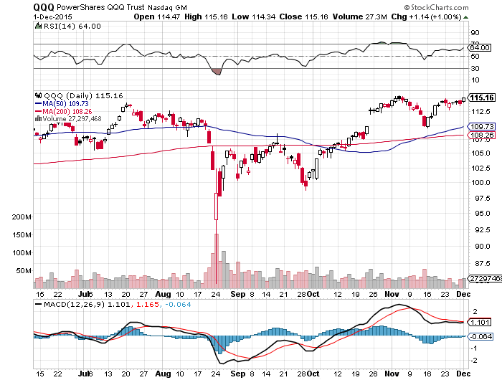
NASDAQ (QQQ)-The Strongest Chart

Slide 23
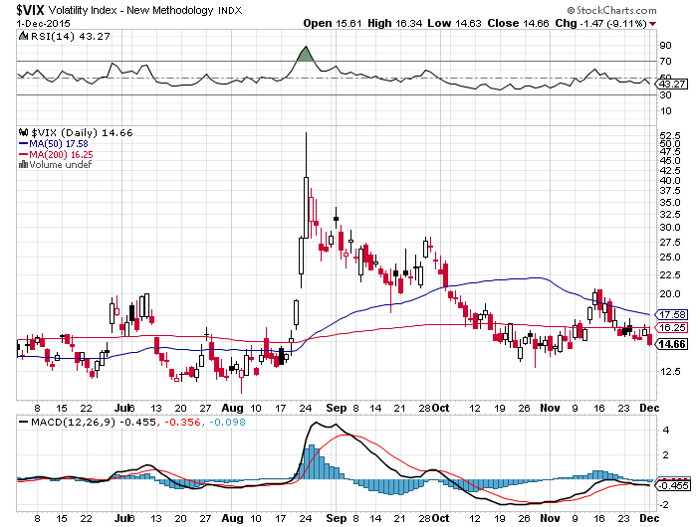
(VIX)-Wait for the next spike

Slide 24
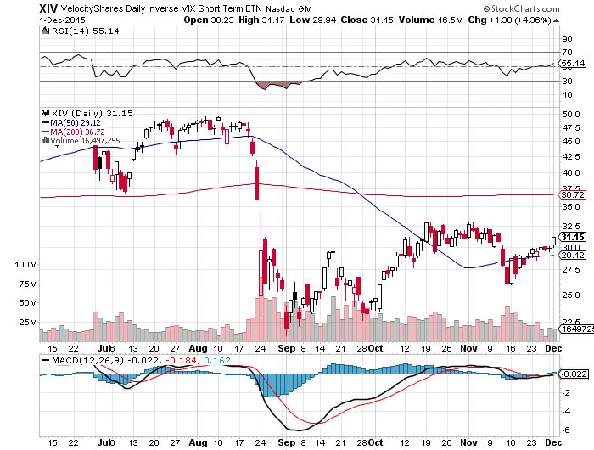
(XIV)-Velocity Shares Daily Inverse VIX Short Term ETN 4 Profitable Round Trips! But Missed No.5

Slide 25
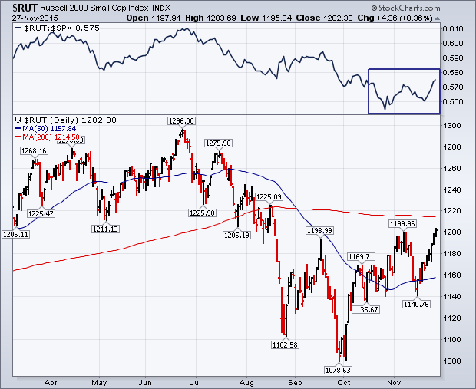
Russell 2000 (IWM)-Signs of Life

Slide 26
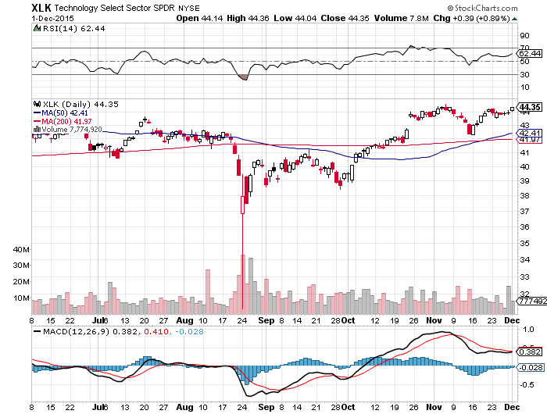
Technology Sector SPDR (XLK), (ROM) (AAPL), (MSFT), (VZ), (T), (FB), (IBM) First to Recover 200-Day Moving Average

Slide 27
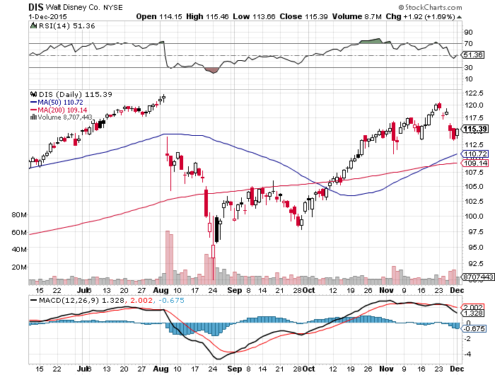
Walt Disney Co. (DIS) long the 1/$100-$105 vertical bull call debit spread

Slide 28
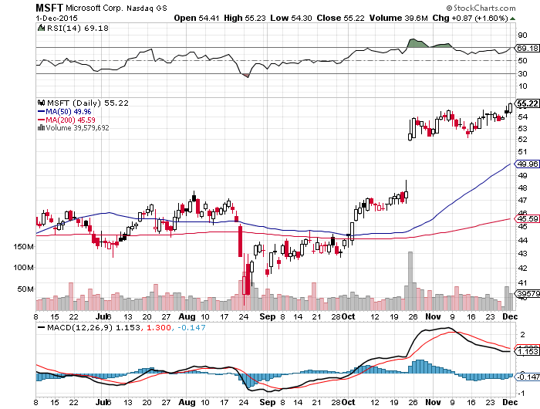
Microsoft (MSFT) long the 1/$50-$52.50 vertical bull call debit spread

Slide 29
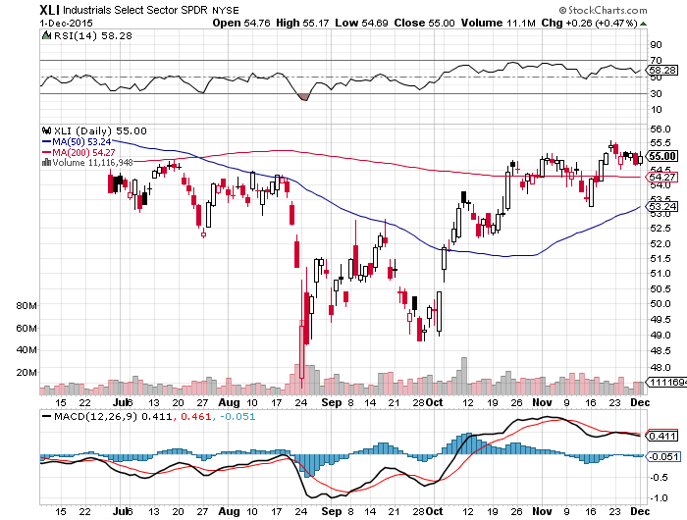
Industrials Sector SPDR (XLI)-Dow Mainstay (GE), (MMM), (UNP), (UTX), (BA), (HON)

Slide 30
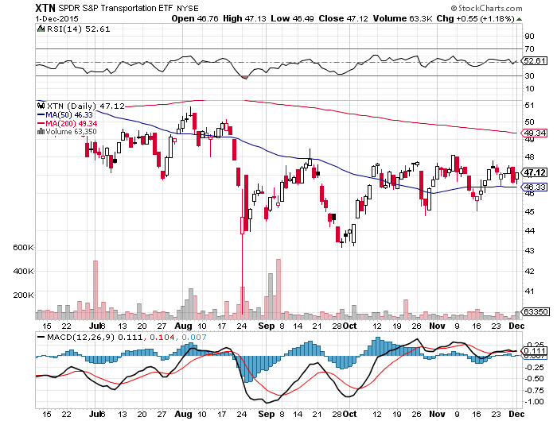
Transports Sector SPDR (XTN)-Another Dow Mainstay (ALGT), (ALK), (JBLU), (LUV), (CHRW), (DAL),

Slide 31
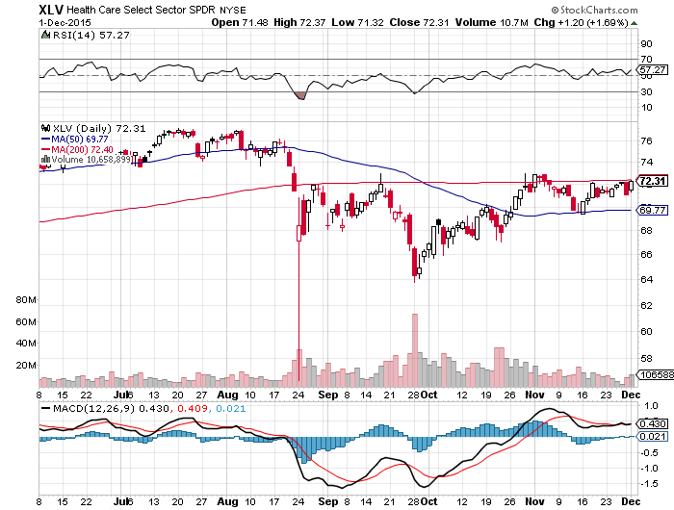
Health Care Sector SPDR (XLV), (RXL) (JNJ), (PFE), (MRK), (GILD), (ACT), (AMGN)

Slide 32
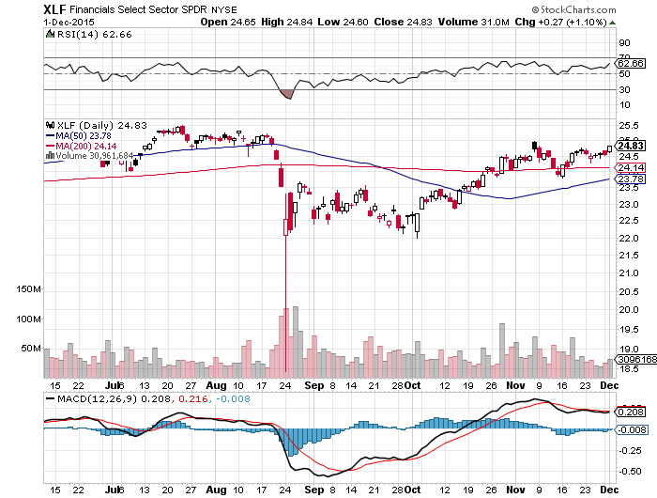
Financial Select SPDR (XLF)-Party Back (BLK/B), (WFC), (JPM), (BAC), (C), (GS)

Slide 33
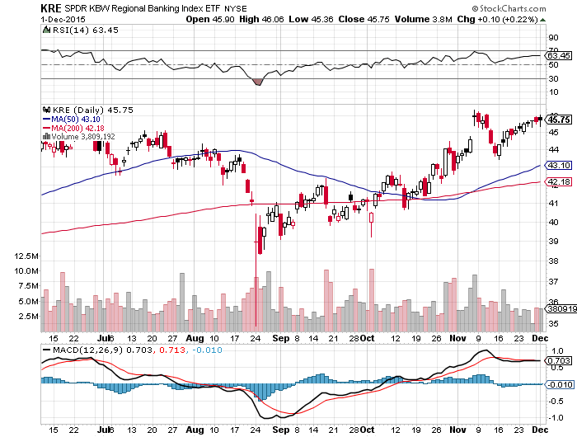
Regional Bank Basket (KRE)-Uptrend Intact (MTG), (RDN), (SIVB), (CFG), (CFR), (BXS)

Slide 34
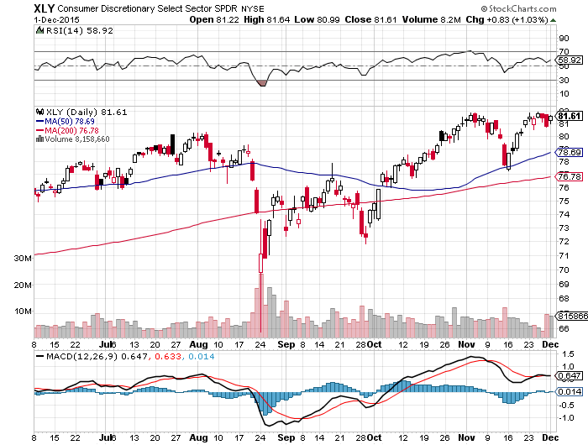
Consumer Discretionary SPDR (XLY) (DIS), (AMZN), (HD), (CMCSA), (MCD), (SBUX)

Slide 35
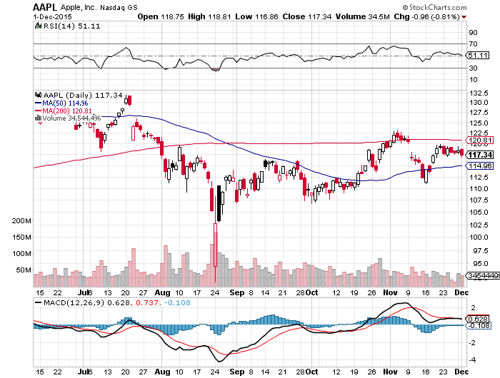
Apple (AAPL) – Back to waiting for the next real catalyst-the iPhone 7 Buy after Q1 earnings in April to avoid post Christmas dip

Slide 36
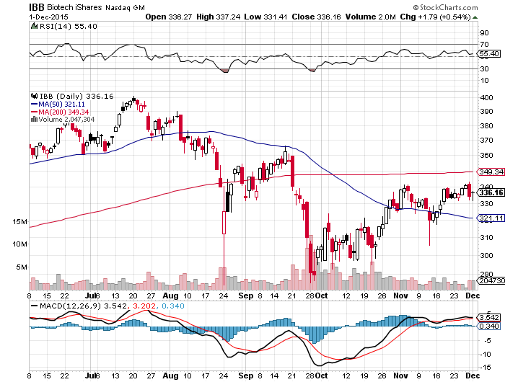
Biotech iShares (IBB)-

Slide 37
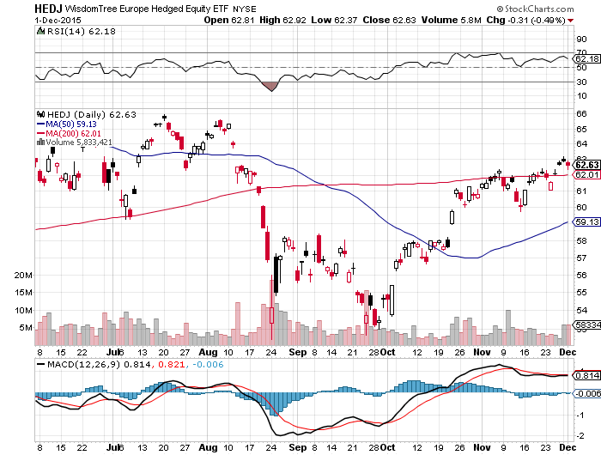
Europe Hedged Equity (HEDJ)-Hedged Japan Equity Weak Euro Boost-Beating the US

Slide 38
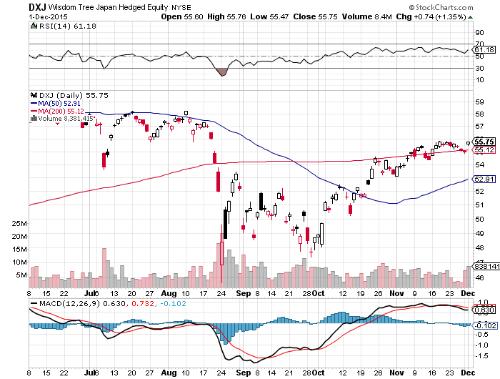
Japan (DXJ)-Hedged Japan Equity Weak Yen Boost

Slide 39
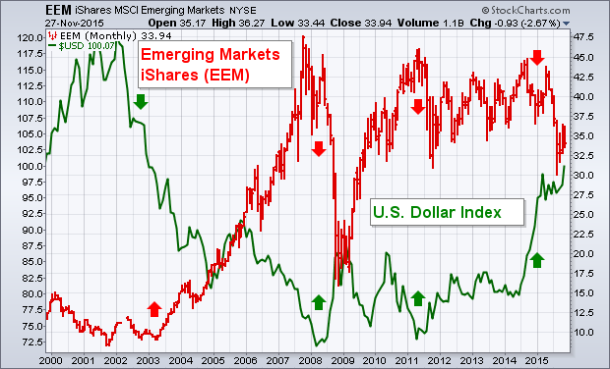
Emerging Markets (EEM)-Demo-ed by Dollar

Slide 40
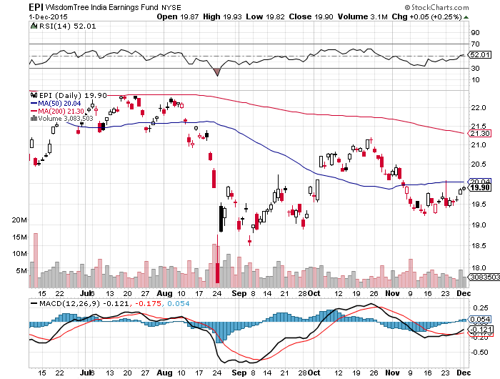
India (EPI)-

Slide 41
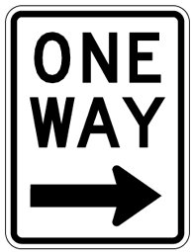
Foreign Currencies-The One-Way Trade
*All eyes on December 4 ECB meeting and extent of the Euro interest rate cut *Draghi says “We will do what we must to raise inflation”, crushing the Euro, cut expectations bumped up from 10 to 20 basis points, watch for profit taking on announcement to create another entry point *The US will be simultaneously raising rate while Europe cuts rates for the first time since 1994, sets up a perfect long dollar trade *Hedge fund dollar longs in triple in recent weeks to $45 billion. *Strong dollar is looking like a sure thing for rest of 2015, buy every dip *Swiss franc hits five year low

Slide 42
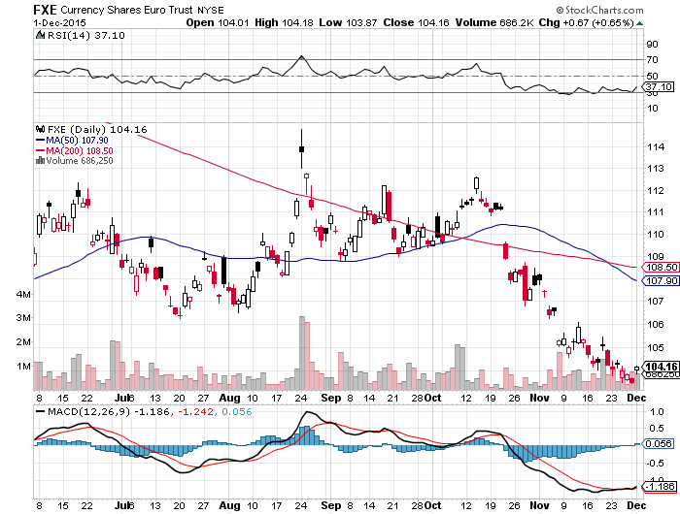
Euro ($XEU), (FXE), (EUO)-Short a Double Position took profits on long the 12/$111-$114 vertical bear put debit spread long the 12/$108-$111 vertical bear put debit spread

Slide 43
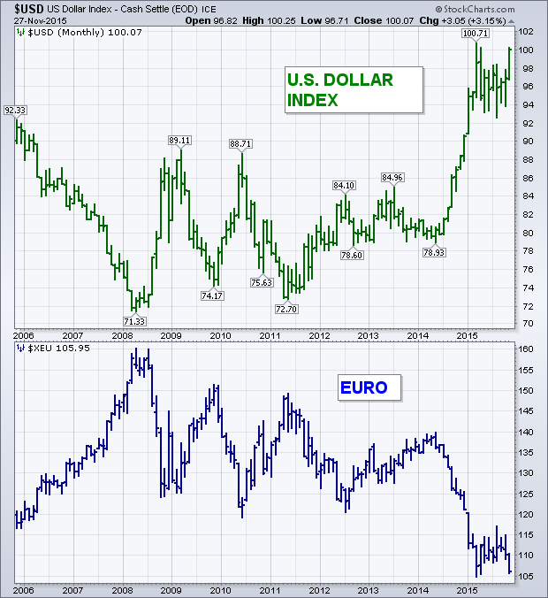
Long Dollar Index (UUP)-Up, Up and Away

Slide 44
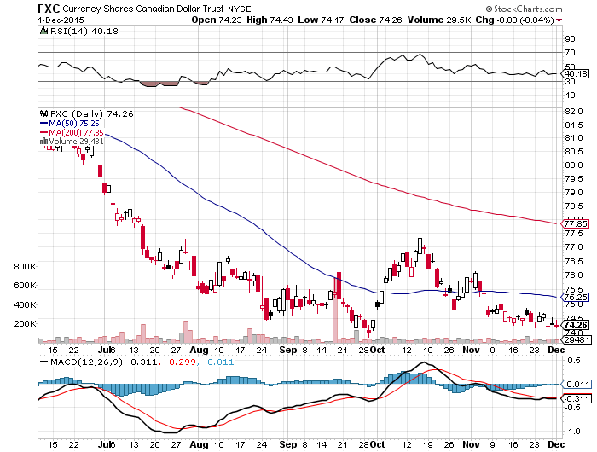
Canadian Dollar (FXC)-Commodity Disaster

Slide 45
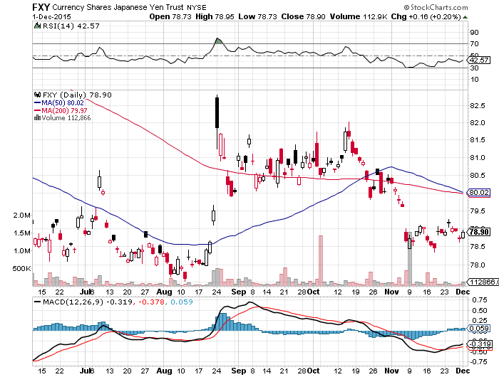
Japanese Yen (FXY)-More QE Coming took profits on long 12/$82-$84 vertical bear put debit spread

Slide 46
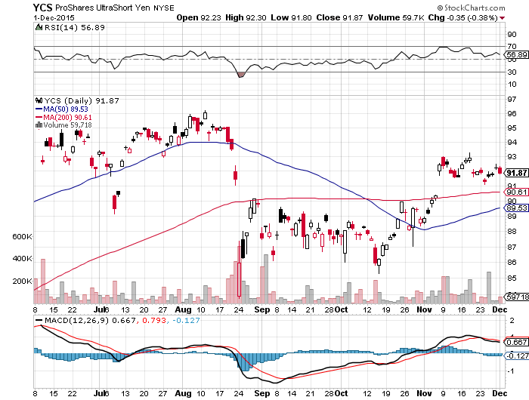
Short Japanese Yen ETF (YCS)

Slide 47
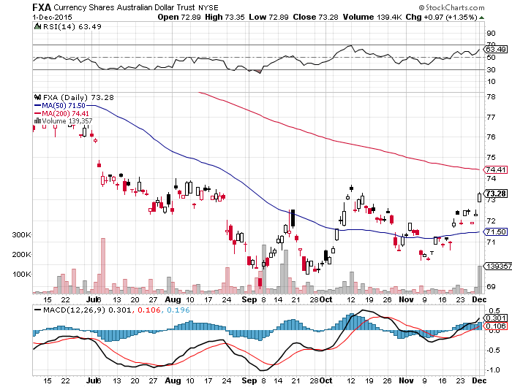
Australian Dollar (FXA)

Slide 48
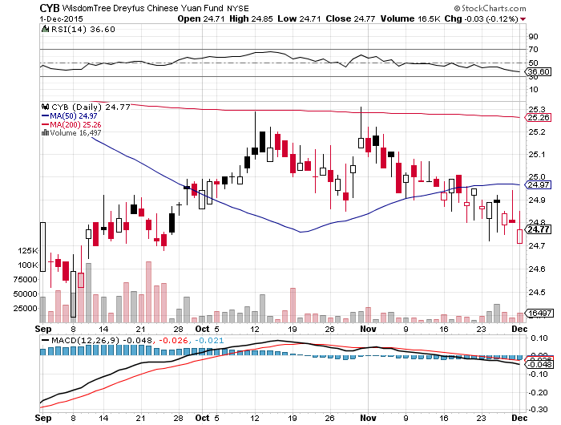
Chinese Yuan- (CYB)-China Stabilizes

Slide 49
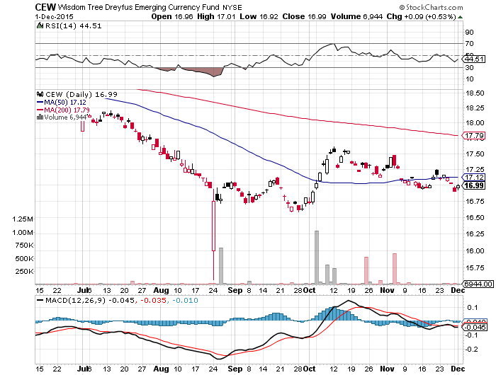
Emerging Market Currencies (CEW)

Slide 50

Energy-Drowning in Oil
*Widening contagos point to new lows in oil, expect to hear a long about storage shortages *Saudi oil minister Al-Naimi says they will maintain production even if oil falls to $20, new investment is collapsing globally *Attack on ISIS supplies temporarily boosts prices only $1 *Natural Gas Storage hits another new all time high at 4.04 trillion cubic feet. *National average gasoline price $2.07, down 75 cents YOY, lowest since 2008 *Both oil and gas inventories are at all time highs, while demand is still flaccid *Miles driven up 4.6% YOY as drivers cash in on sub $2 gallon gasoline, causing traffic jams everywhere *US rig count falls 45.5% YOY from 1017 to 555

Slide 51
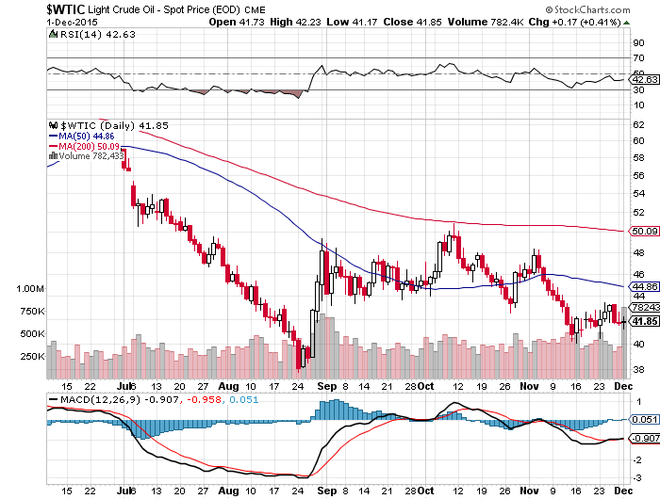
Oil-Won’t Bottom Until 2016 A New Run at the Lows

Slide 52
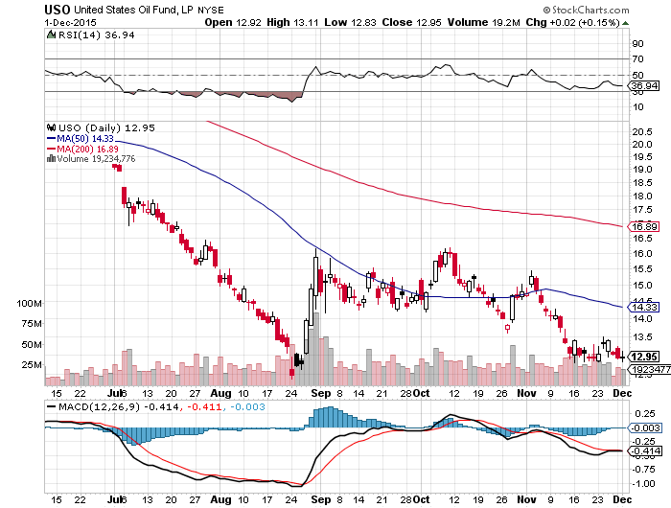
United States Oil Fund (USO)

Slide 53
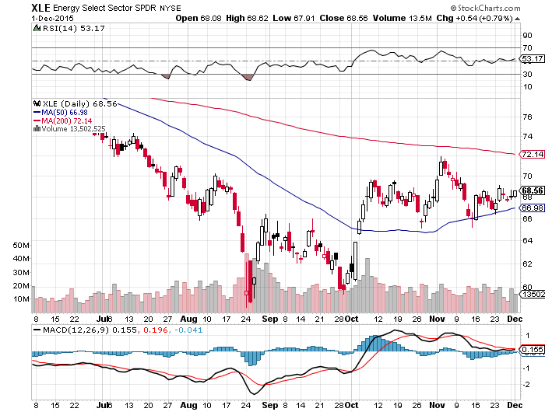
Energy Select Sector SPDR (XLE) (XOM), (CVX), (SLB), (KMI), (EOG), (COP) Way Out of Synch with Oil Prices

Slide 54
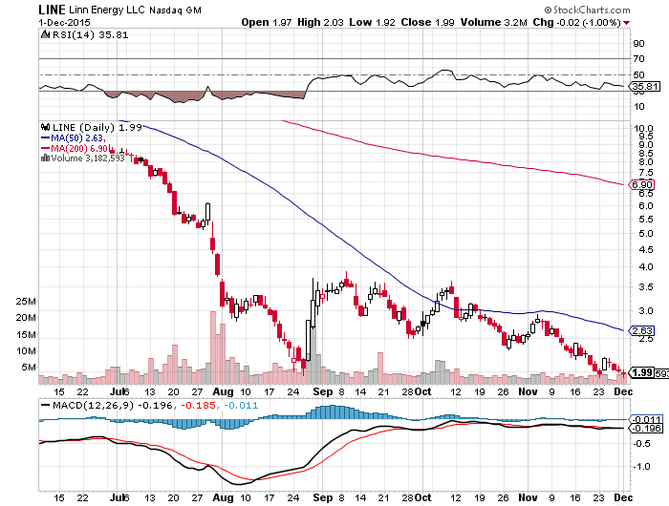
MLP’s (LINE)-Dividend Suspended! Shares fall to option value-Entire industry has become high risk how long can they maintain leverage in the face of non-recovering oil prices?

Slide 55
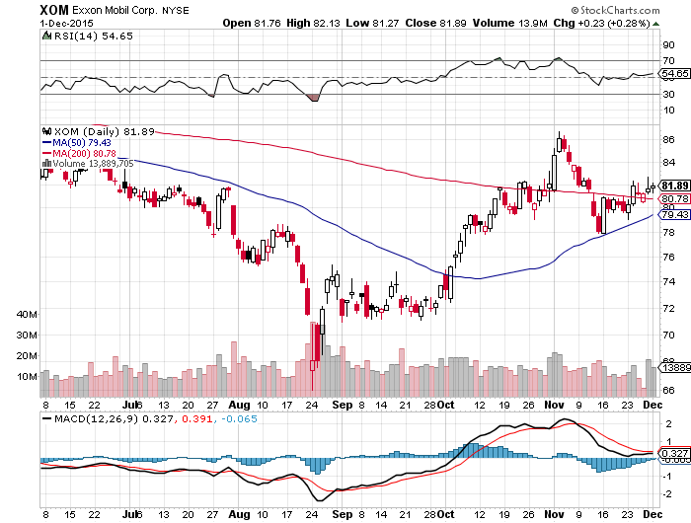
Exxon (XOM)-

Slide 56
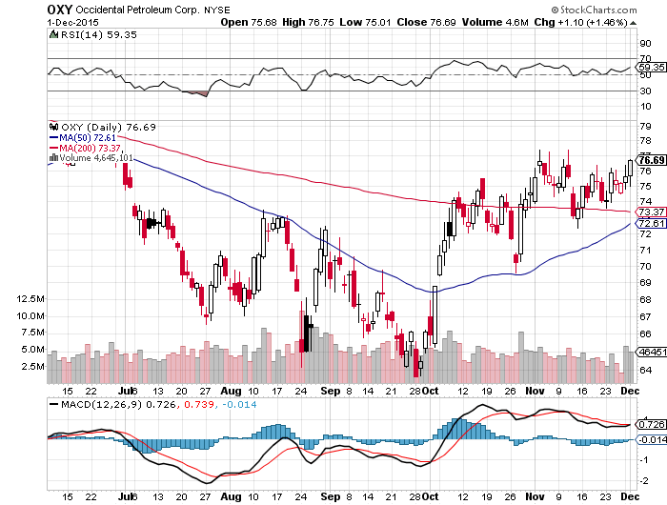
Occidental Petroleum (OXY)- Back to Where Oil was $62

Slide 57
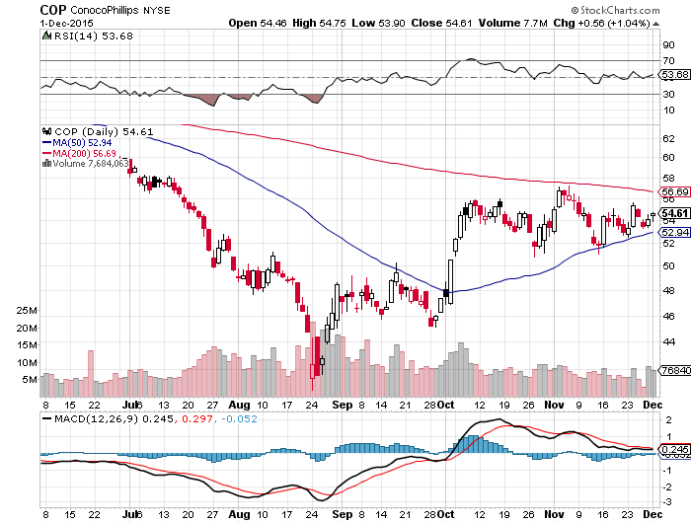
Conoco Phillips (COP)-

Slide 58
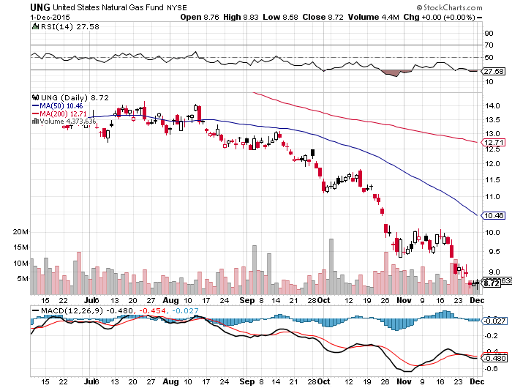
Natural Gas (UNG)-New Lows on Warm Winter

Slide 59
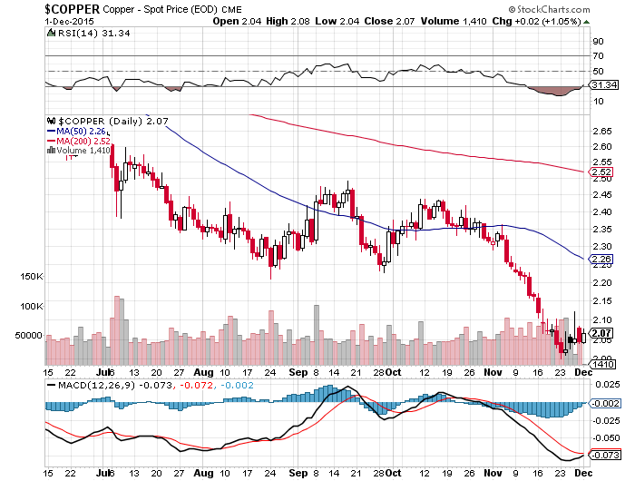
Copper-New 6 Year Low

Slide 60

Freeport McMoRan (FCX)-Carl Icahn in Play

Slide 61

Precious Metals-Capitulation
*Perfect technical failure at 200-day MA brings new lows, speculative longs in futures has gone to zero *Oil bottom will also call the bottom in the barbarous relic *Shoot down of Russian jet brings only a one day rally *December Fed rate hike is the final nail in gold’s coffin, look for a run down to $1,000 by yearend *Stay away, gold stocks are a better play on a dip with their earnings and dividend support *No room for gold in a paper chasing world

Slide 62

Gold (GLD)-Barf Again!

Slide 63

Market Vectors Gold Miners ETF- (GDX)

Slide 64

Silver (SLV)-

Slide 65

Silver Miners (SIL)

Slide 66

Platinum (PPLT)-The Volkswagen Effect new chapter of the “Clean Diesel” Scandal

Slide 67

Palladium (PALL)-The Non Diesel Play

Slide 68

Agriculture-Rally Dies
*Sudden cold snap hits the principal growing areas in the Midwest, but fails to help prices *Farm incomes down 40% YOY as low prices cut profits *Falling incomes means rising risk for Midwestern banks *Ethanol production hits new all time high at 1 million barrels a day thanks to driving boom, but still can’t break price falls, showing how weak the ag sector really is * The California draught is over with the return of a normal winter. It has raised every week for a month, and more is on the way *New lows in global commodity collapse isn’t helping

Slide 69

(CORN) – New Lows!

Slide 70

(WEAT)-New Lows!

Slide 71

Ag Commodities ETF (DBA)- New Lows

Slide 72

Real Estate-Slowing
*October existing home sales -3.4% to 5.36 million units, biggest drop in west (-8.4%) as supplies shrink, Pending Home Sales +0.2% * October new home sales +10.7% to 495,000, vs. -12.9% in September, +15.7% YOY *September Case-Shiller National Home Price Index accelerates to 5.5% YOY gains *Multiple offer bidding wars in hottest market still common, like San Francisco *Traders loading up on these stocks expecting a strong Spring 2016 *Predicted rush to buy homes to beat the fed interest rate hike is unfolding *Case Shiller S&P 500 National index continues upward grind

Slide 73

July S&P/Case–Shiller Home Price Index +4.7% YOY, Denver, San Francisco, Dallas
+5.5% YOY

Slide 74

US Home Construction Index (ITB) (DHI), (LEN), (PHM), (TOL), (NVR)

Slide 75

Trade Sheet So What Do We Do About All This?
*Stocks- buy the big dips in best value names only *Bonds-the top is in, sell rallies, buy (TBT) *Commodities-stand aside, buy the next oil down leg *Currencies- Sell short the Yen and Euro on rallies *Precious Metals –stand aside, wait for new low *Volatility-sell short spikes over $20 through (XIV) *The Ags –buy the big dips for a trade *Real estate-buy the homebuilders LT

Slide 76

To buy strategy luncheon tickets Please go to: www.madhedgefundtrader.com Next Strategy Webinar 12:00 EST Wednesday, December 16, 2015 San Francisco, CA USA! LAST WEBINAR OF THE YEAR!
Good Luck and Good Trading!
Notes:
*

